Slide 2
R&D on the Flux Concentrator for CLIC
H. Bajas, Y. Zhao

Slide 3
Outline
Flux Concentrator in linear accelerators
Modelling of the geometry and the electrical circuit
Validations of the model
A tool for FC design optimisation
Design optimization for the CLIC e+ source
Conclusion

Slide 4
Outline
Flux Concentrator in linear accelerators
Modelling of the geometry and the electrical circuit
Validations of the model
A tool for FC design optimisation
Design optimization for the CLIC e+ source
Conclusion

Slide 5
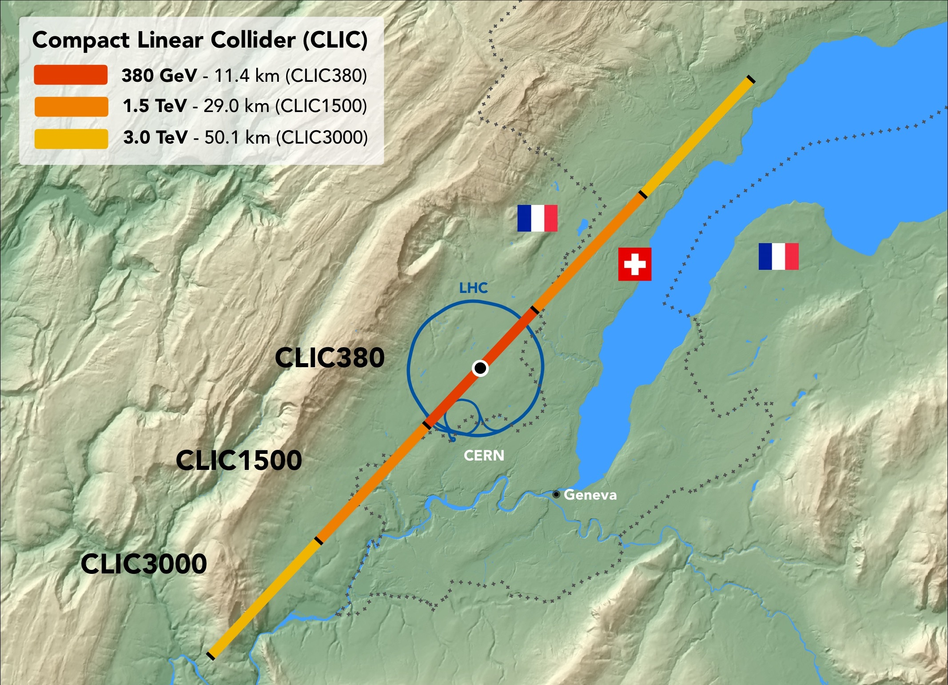
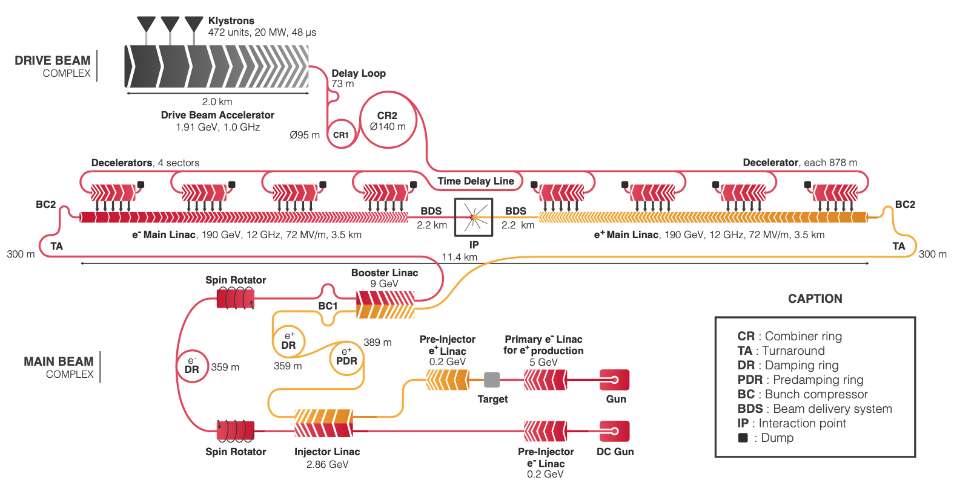

Flux Concentrator in linear accelerators
Future linear colliders, such as CLIC at CERN, would use both electrons and positrons.
The positron source produces positrons from the collision of electrons on fixed target then introduced in the pre-injector.
The quality of the source is of prior importance for the luminosity of the machine.
Positron source
Steinar Stapnes, October 2019, Sendai
International Workshop on Future Linear Colliders

Slide 6
Outline
Flux Concentrator in linear accelerators
Modelling of the geometry and the electrical circuit
Validations of the model
Design proposal for the SuperKEKB e+ source
Design optimization for the CLIC e+ source
Conclusion

Slide 7
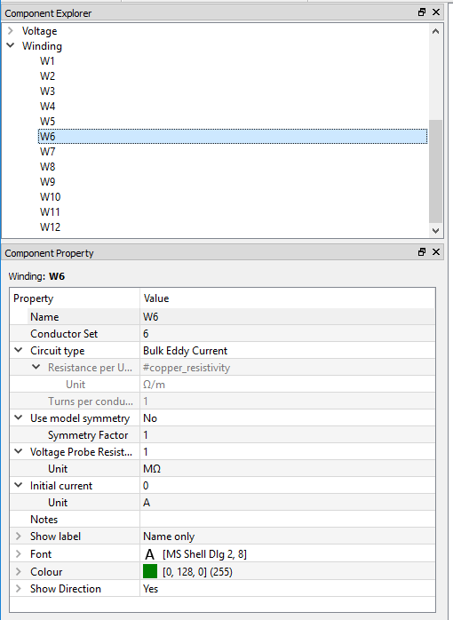
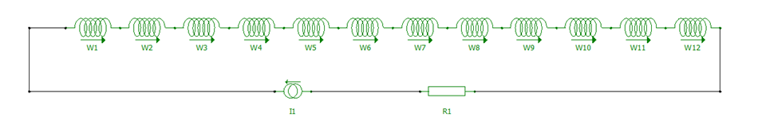
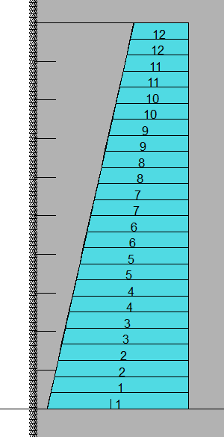
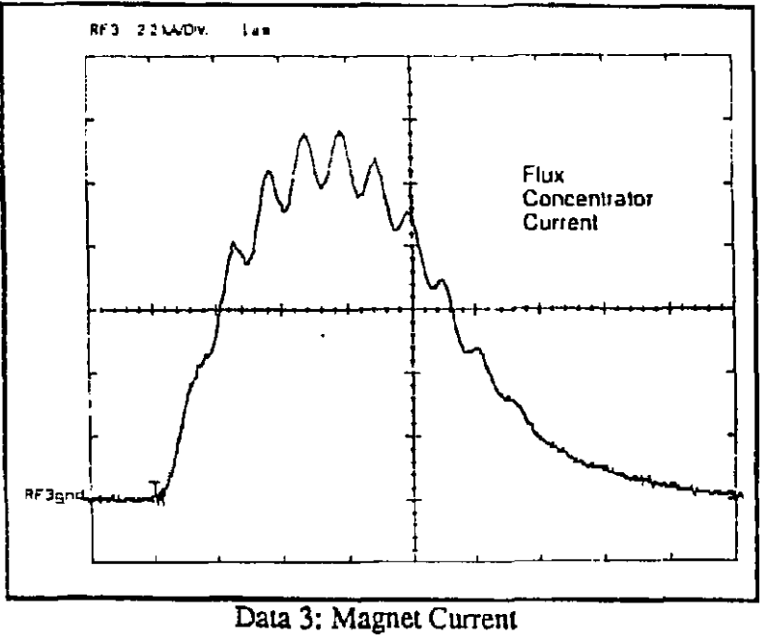
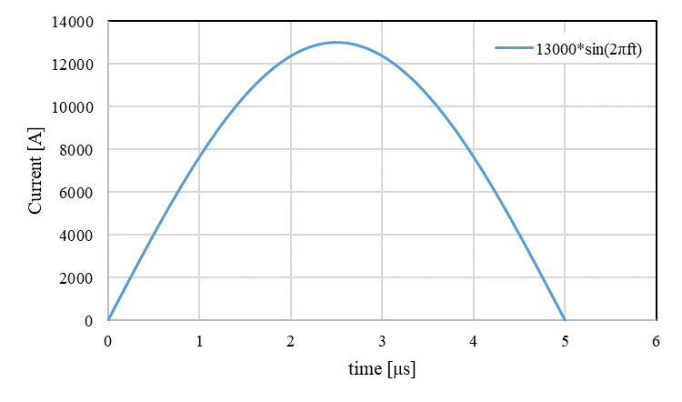
Modelling of the geometry and the electrical circuit
Opera® allows linking the FE model to the circuit elements to impose flow of current
(current supply, external resistor and winding elements)
The built-in circuit allows reproducing
the experimental pulse of current.
Axi-symmetric model
Time step
1.0E-08 s
J. De Lamare, et Al. , “SLC Positron Source Flux Concentrator Modulator,” SLAC-PUB-5472, May 1991.

Slide 8
Outline
Flux Concentrator in linear accelerators
Modelling of the geometry and the electrical circuit
Validations of the model
A tool for FC design optimisation
Design optimization for the CLIC e+ source
Conclusion§

Slide 9
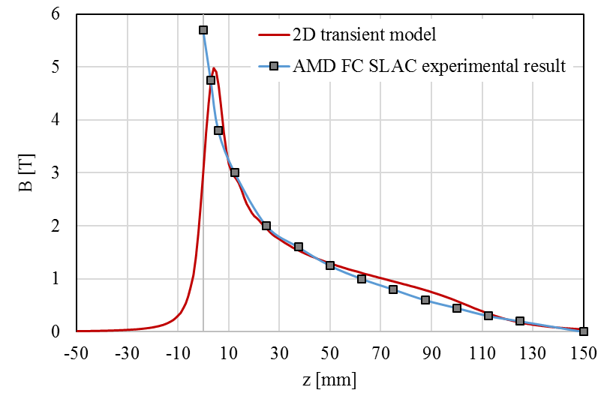
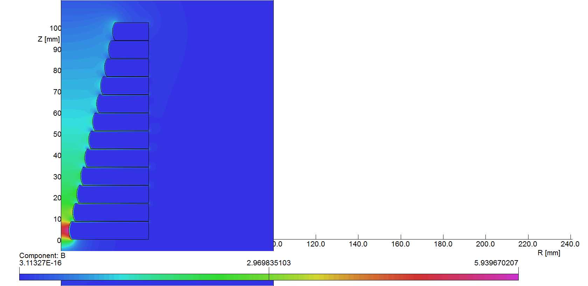
Comparison with experimental result: SLAC
Solenoidal field map
A.V. Kulikov, S.D. Ecklund, and E.M. Reute, “SLC Positron Source Pulsed Flux Concentrator,” Stanford Linear Accelerator Center, Stanford University, Stanford, CA 94309, SLAC-PUB-5473, June 1991.
https://agenda.linearcollider.org/event/8217/

Slide 10
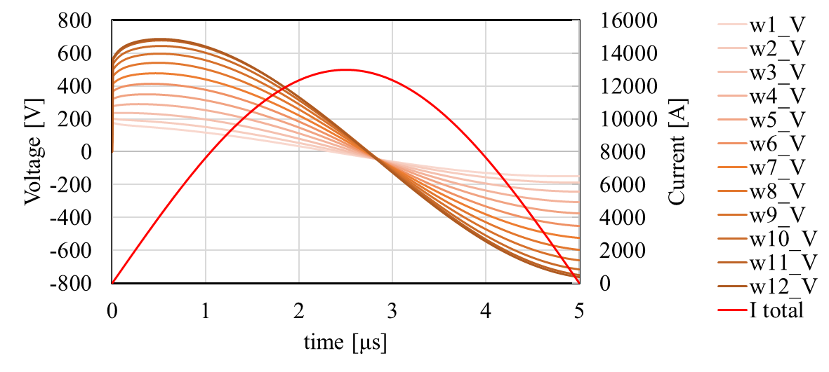
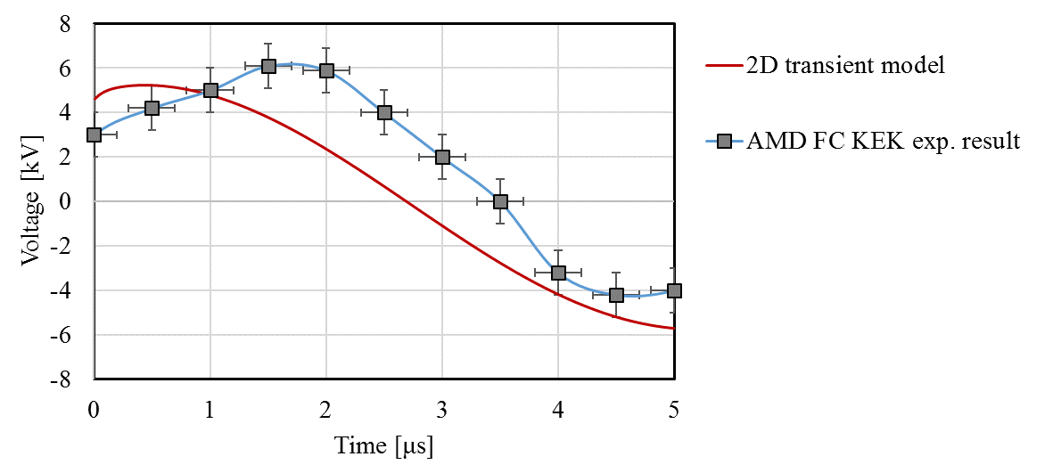
Comparison with experimental result : KEK
Voltage across each turn
Voltage across the solenoid
See presentation of Yoshinori Enomoto

Slide 11
Outline
Flux Concentrator in linear accelerators
Modelling of the geometry and the electrical circuit
Validations of the model
A tool for FC design optimisation
Design optimization for the CLIC e+ source
Conclusion

Slide 12
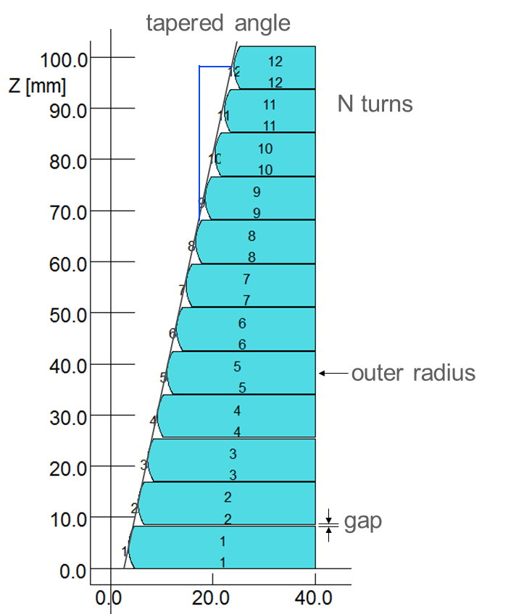
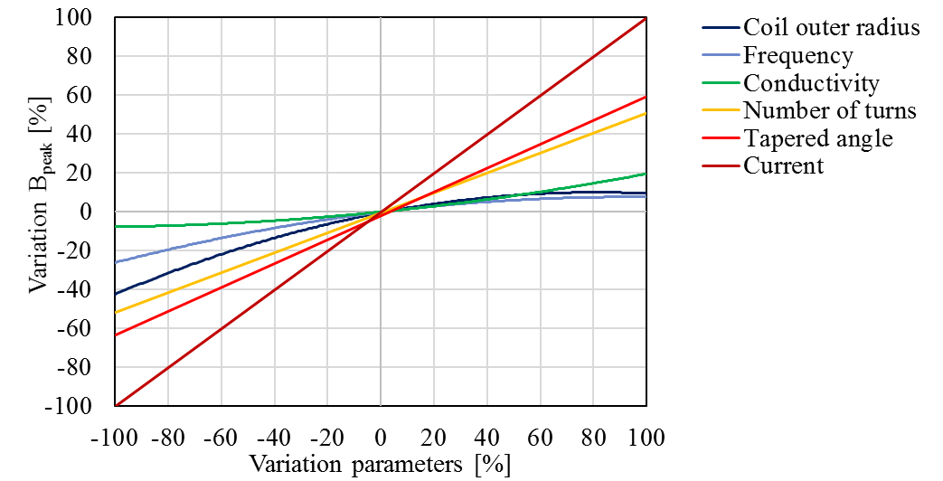
A tool for FC design optimisation
A tool to optimise FC’s design.
In particular it is possible to increase the gap between turns compensating the loss of field.
https://indico.cern.ch/event/879495/

Slide 13
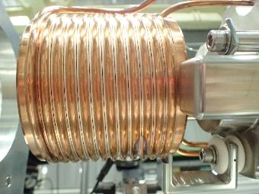
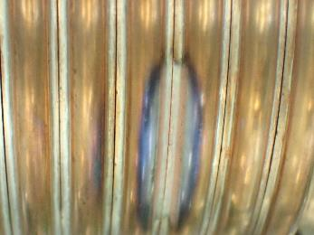
Dielectric breakdowns during the test of the KEKB FC
Issue of electrical arcing between turns at full current discharge during FC test.
Flux Concentrator design from KEK
Courtesy Yoshinori Enomoto, October 2019, Sendai
International Workshop on Future Linear Colliders

Slide 14
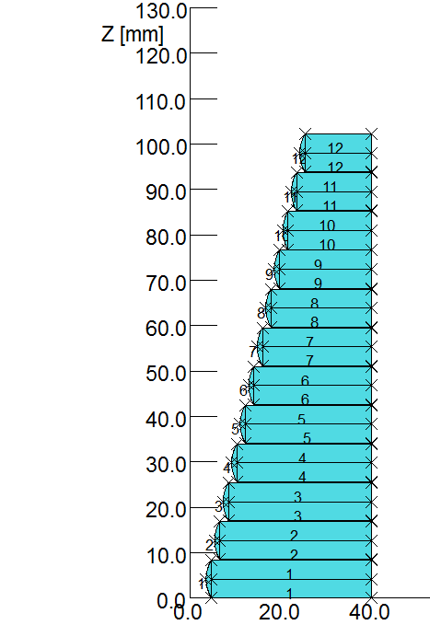
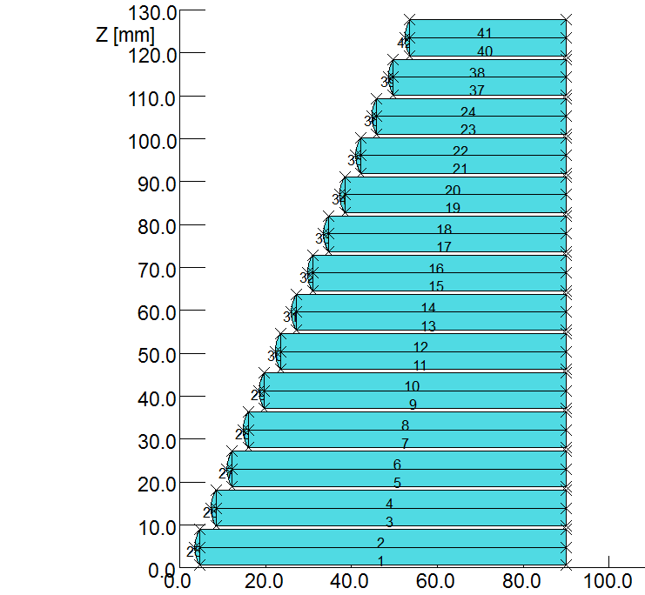
Modified design to cope with breakdown issue
SLAC design
gap=0.2 mm σ=5.67 10⁷ S/m
Rₒ=40 mm
N=12 turns
γ=0.255
f=100 kHz
Modified design
gap=0.8 mm
σ=5.67 10⁷ S/m Rₒ=90 mm
N=14 turns
γ=0.450
f=25 kHz
The gap between turns is increased and the loss of field compensated with
2 extra turns and larger tapered angle.
The voltage between turns is minimized using lower frequency and larger outer radius.
https://indico.cern.ch/event/879495/

Slide 15
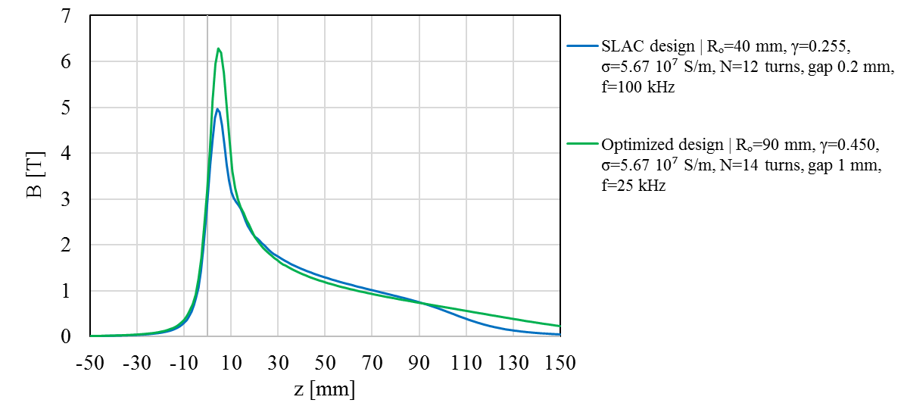
Expected results for the modified design

Slide 16
Outline
Flux Concentrator in linear accelerators
Modelling of the geometry and the electrical circuit
Validations of the model
A tool for FC design optimisation
Design optimization for the CLIC e+ source
Conclusion

Slide 17
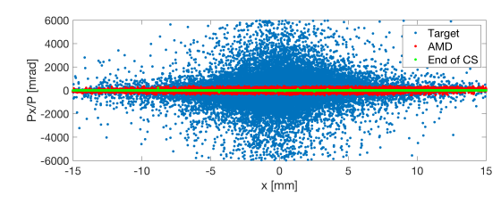
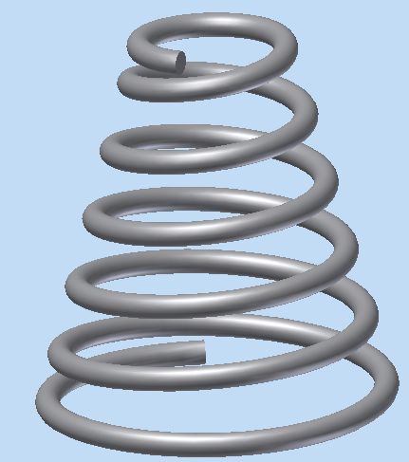
Design optimization for the CLIC e+ source
Parameters to optimize:
  To maximize:
    the positron yield (purpose of the device)
  To minimize:
    the total voltage & the inter-turn voltage
    (power supply limitation & electrical breakdown)
    the Lorentz forces (mechanical displacement, vibration)

Slide 18
Design optimization for the CLIC e+ source
OPERA computes: the field, the voltages and the Lorentz forces.
The positron yield is computed using RF-track and GEANT4 by Yongke Zhao (many thanks!).
https://indico.cern.ch/event/862915/
A. Latina, “RF-Track: Beam Tracking in Field Maps Including Space-Charge Effects, Features and Benchmarks”, 2017.
https://geant4.web.cern.ch/

Slide 19
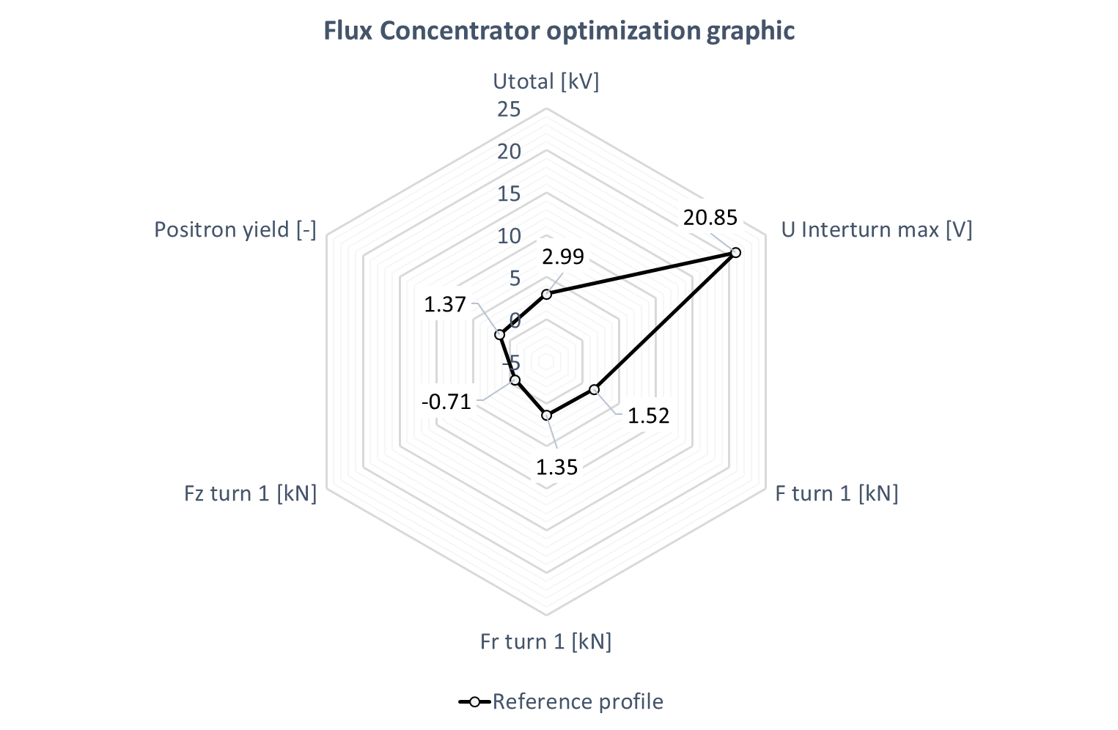
Design optimization for the CLIC e+ source
Graphics containing the parameters to optimize.
Use of the radar plot to compare different design of FC.
SLAC design
@ 25 kHz & 13 kA

Slide 20
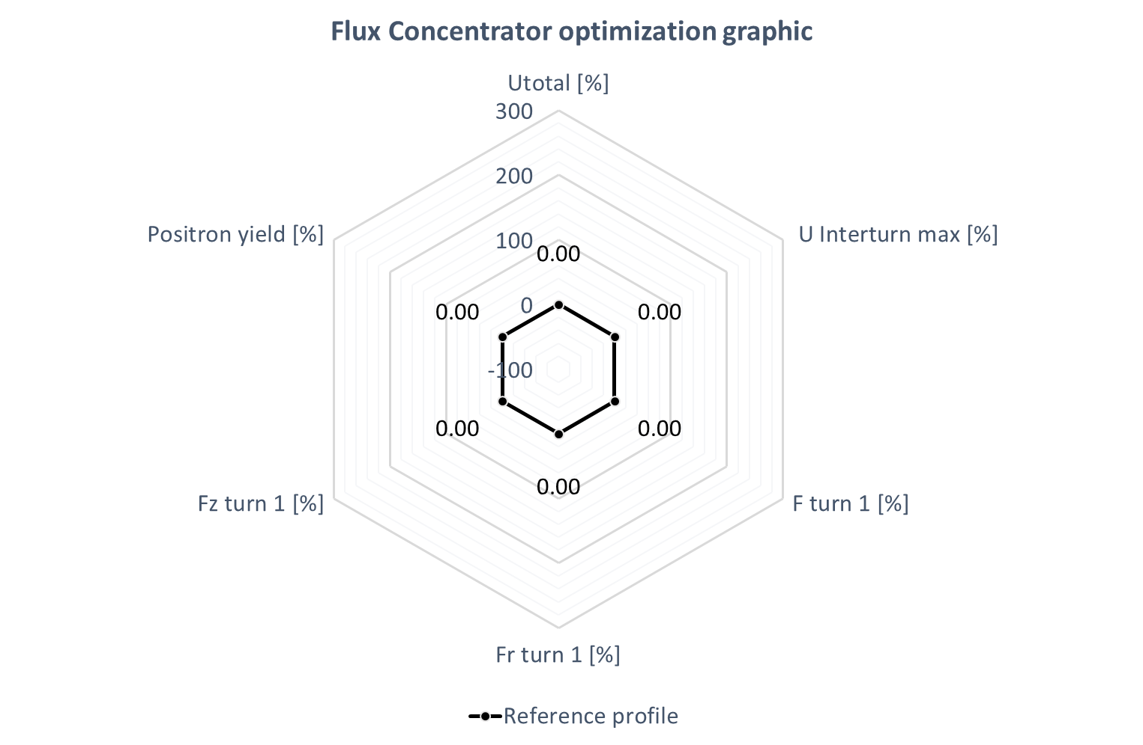

Design optimization for the CLIC e+ source
Normalization of each parameter to its reference value:
SLAC design
@ 25 kHz & 13 kA
Var [%] = 100 * $\frac{\left(V−V_{ref}\right)}{V_{ref}}$

Slide 21
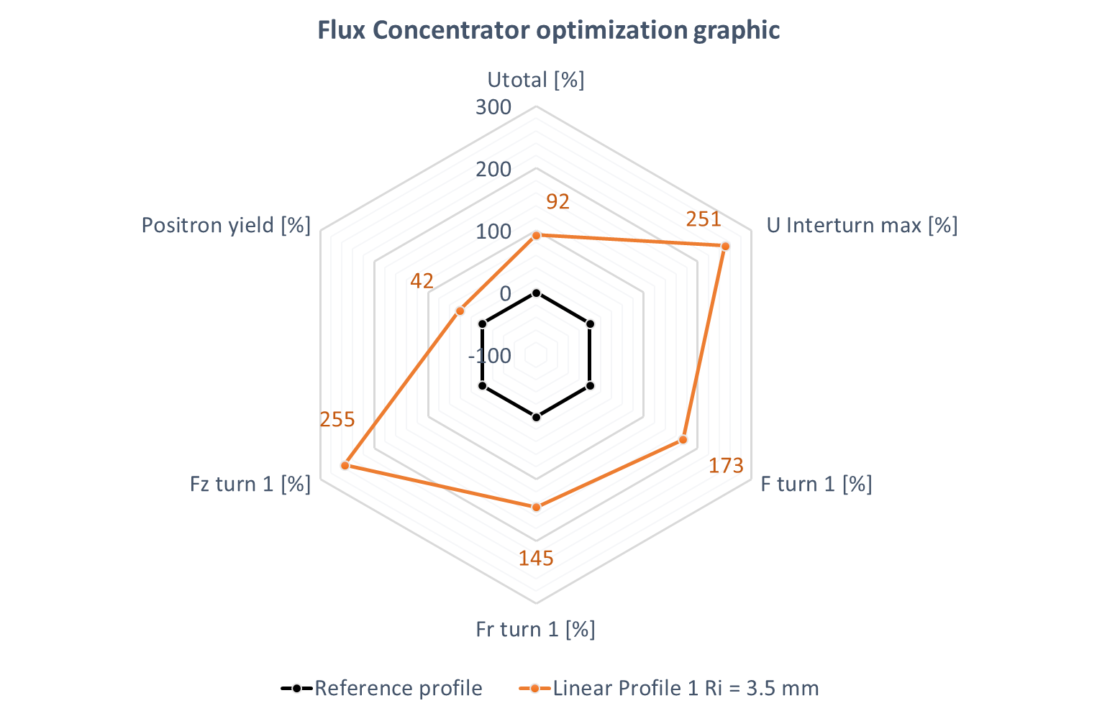
Design optimization for the CLIC e+ source
SLAC design (reference)
@ 25 kHz & 13 kA
Vs.
linear modified design
@ 25 kHz & 13.8 kA
The modified design induces a significant increase of each parameters’ value:
The yield increases by 42%
The voltage increases by 92%
(due to the gap increase
and current increase)
The forces get ~3 times higher

Slide 22
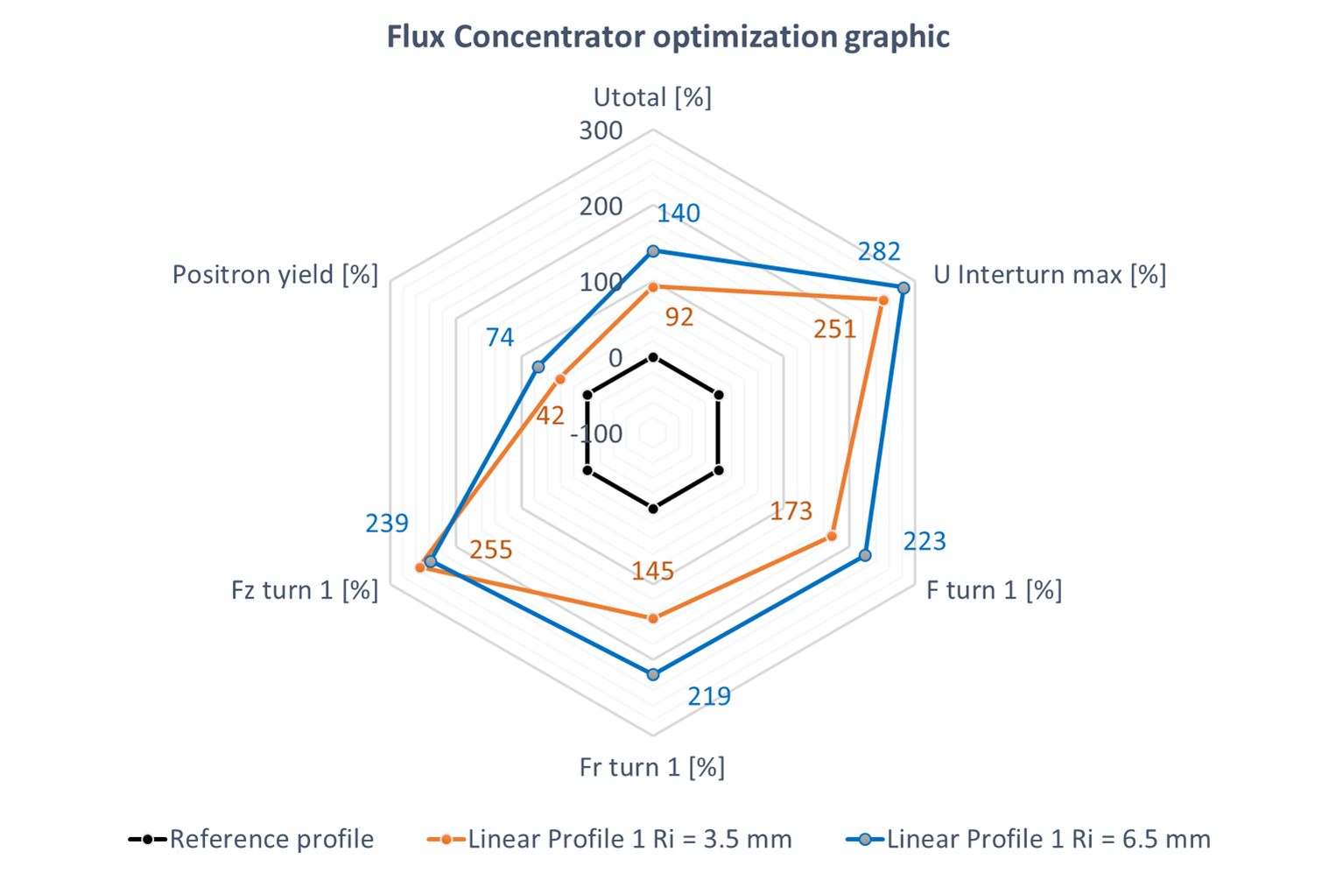
Design optimization for the CLIC e+ source
SLAC design
@ 25 kHz & 13 kA
Vs.
linear modified design
Vs.
linear modified design
with large aperture
Increasing the aperture
(from 3.5 to 6.5 mm)
increases the yield by 74%
(from 1.37 to 2.39).
But…
both voltages and Lorentz forces grow very fast!
How can one lower down the other parameters keeping high yield?

Slide 23
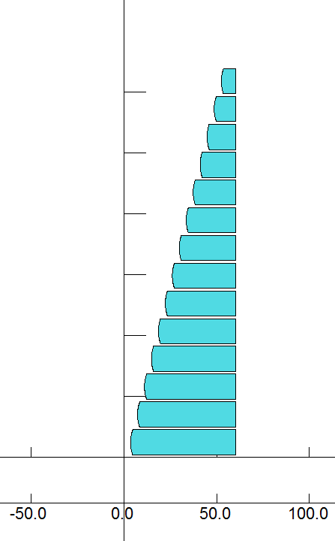
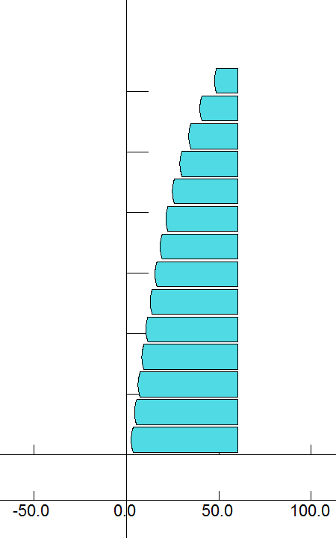
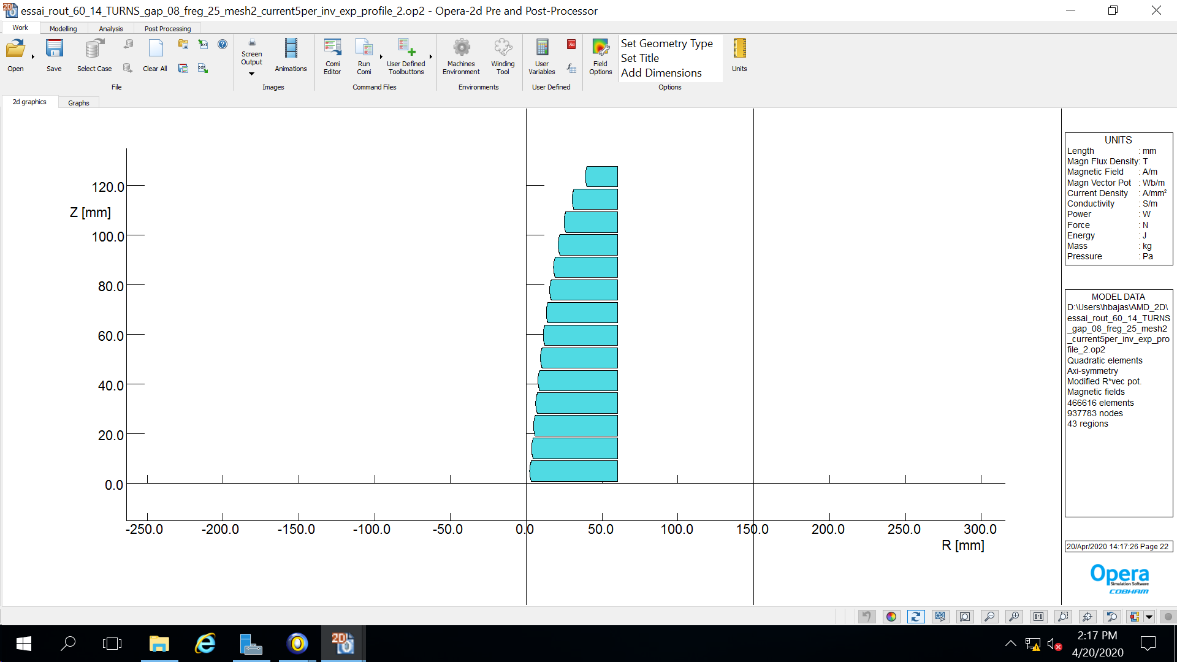

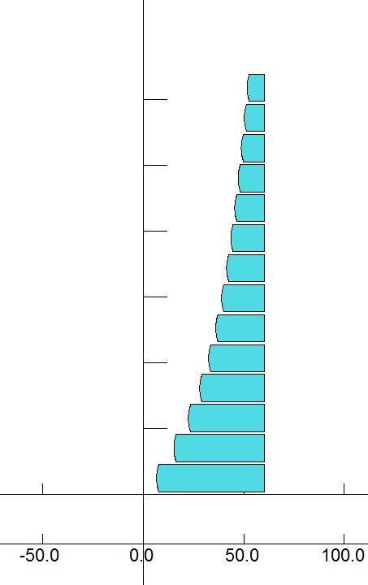
Design optimization for the CLIC e+ source
From linear to non-linear profile for the FC aperture:
Linear
Concave downward (1)
Concave downward (2)
Concave downward + linear (3)
Concave upward
How does the shape impact the parameters to optimize?

Slide 24
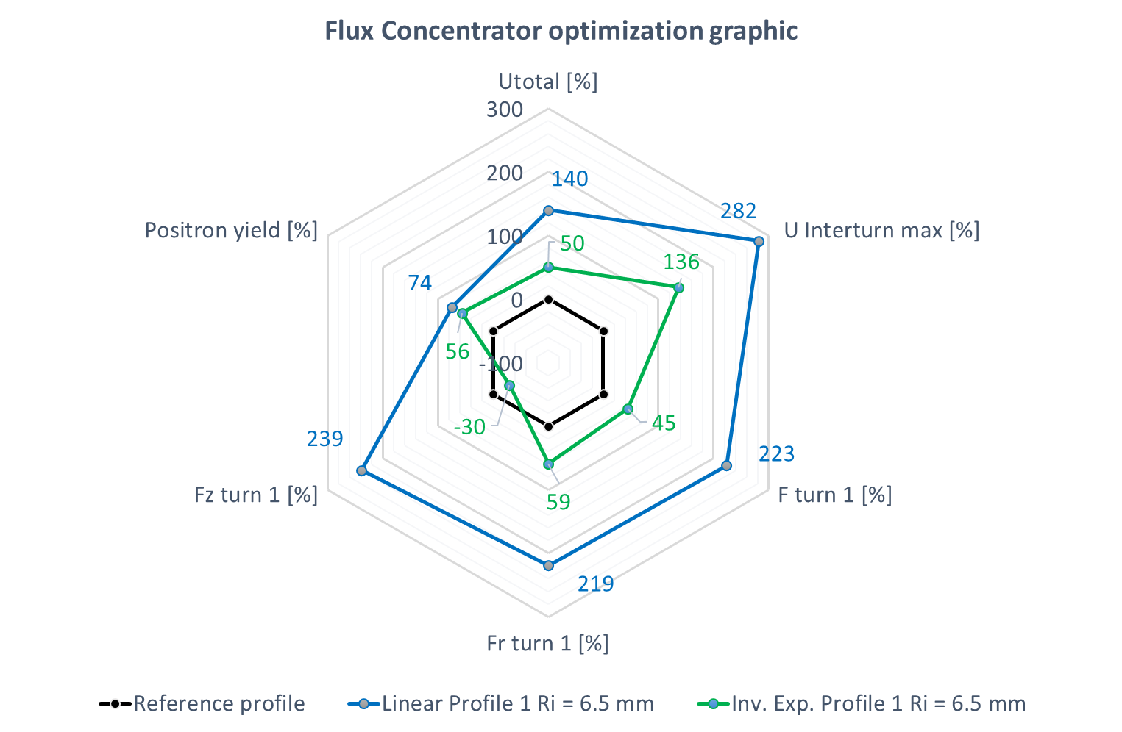
Design optimization for the CLIC e+ source
SLAC design
@ 25 kHz & 13 kA
Vs.
linear modified design
with large aperture
Vs.
Non-linear design (1)
Concave downward
The use of non-linear shape induces a dramatic drop of the voltages.
The Lorentz forces decrease significantly.
The yield get lower but is still 56% higher than the reference case.

Slide 25
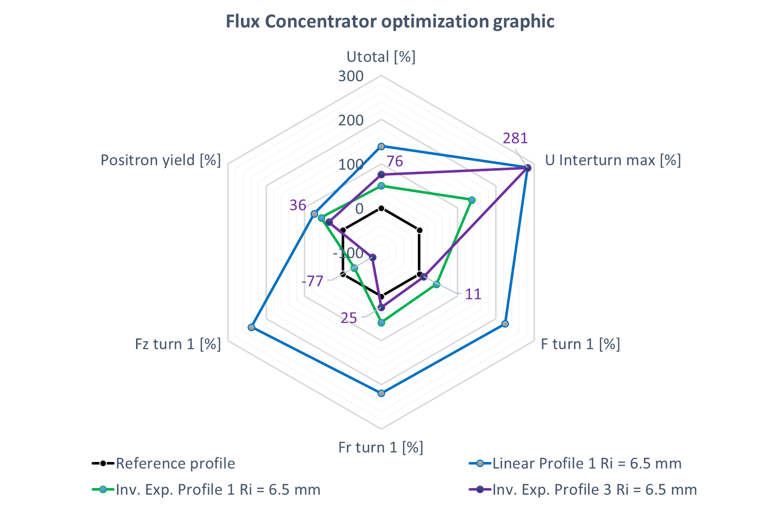
Design optimization for the CLIC e+ source
SLAC design
@ 25 kHz & 13 kA
Vs.
linear modified design
with large aperture
Vs.
Non-linear design (1)
Concave downward
Vs.
Non-linear design (3)
Concave downward + linear
Using more exotic shape allows to decrease the Lorentz forces.
The yield gets lower though.
The voltage gets higher.

Slide 26
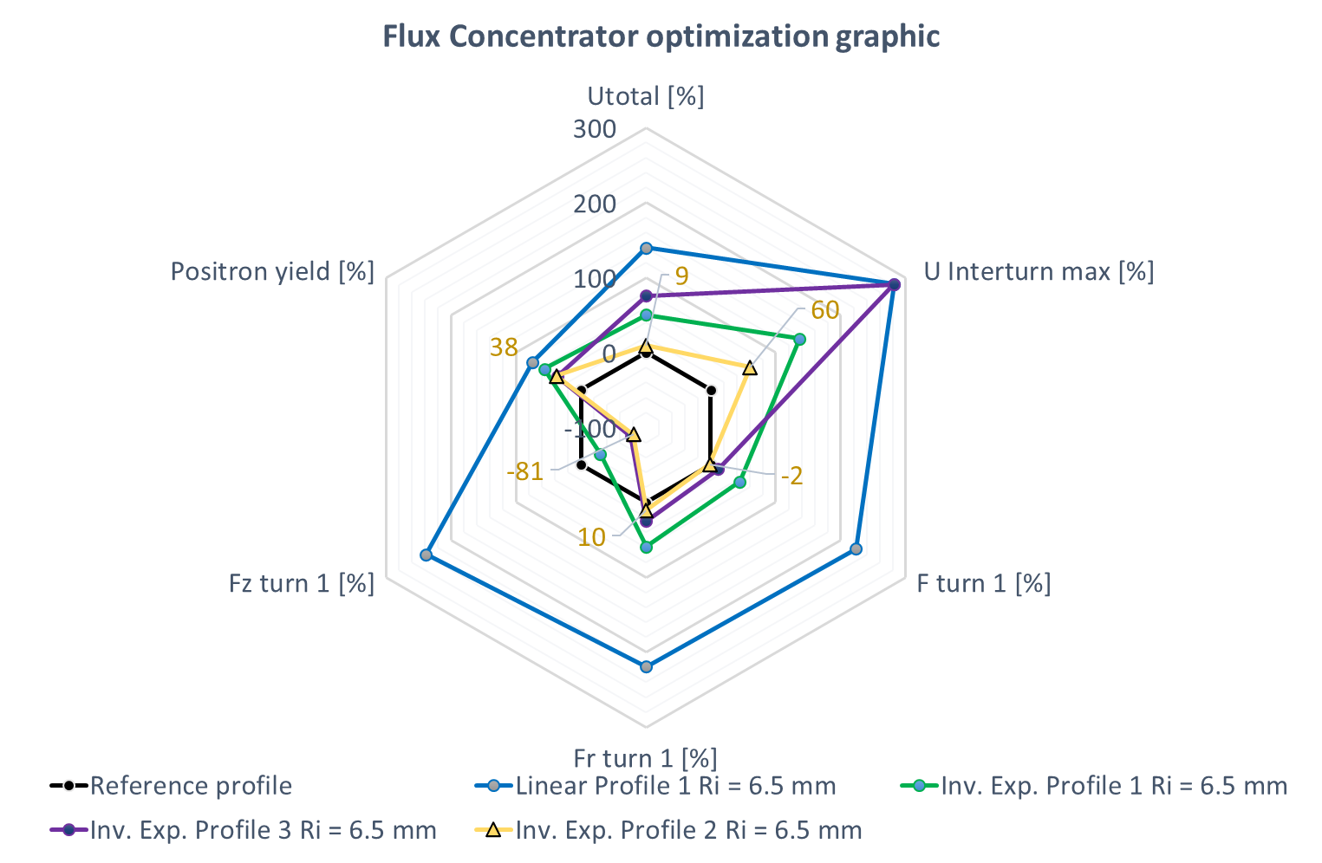
Design optimization for the CLIC e+ source
SLAC design
@ 25 kHz & 13 kA
Vs.
linear modified design
with large aperture
Vs.
Non-linear design (1)
Concave downward
Vs.
Non-linear design (3)
Concave downward + linear
Vs.
Non-linear design (2)
Concave downward
Adapting the non-linear shape (green vs. yellow) preserves the yield (38% higher).
The voltages get significantly lower.
The detrimental forces
directed along the coil axis Z lowers too.

Slide 27
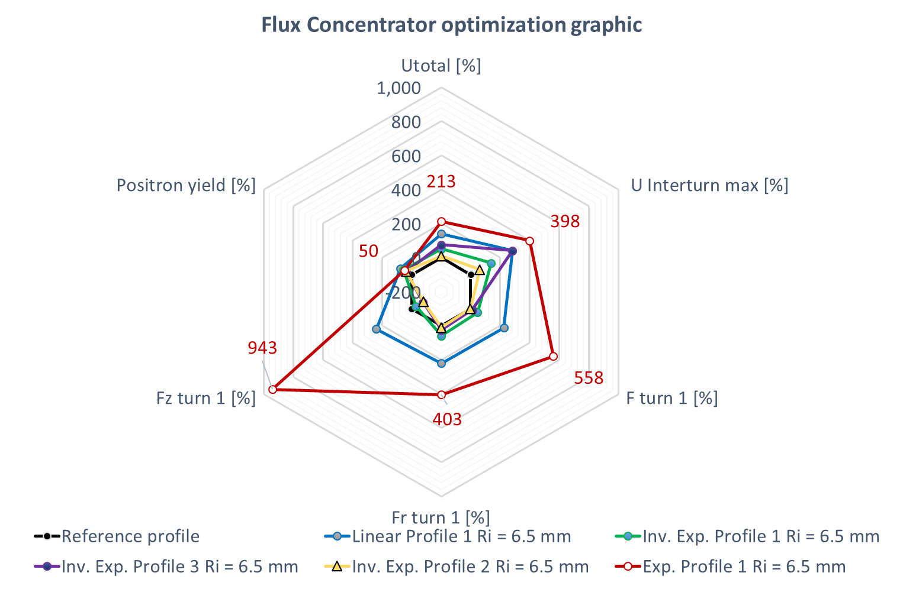
Design optimization for the CLIC e+ source
The upward concavity despite the highest peak field do not lead to the highest yield.
Voltages and forces get extremely high.
Adding the upward concavity case
Mind the change of scale !!

Slide 28
Conclusion
Construction of a transient electromagnetic model of Flux Concentrator using Opera® software.
Validation of the model by direct comparison with available experimental data (current, voltage and magnetic field).
Parametric study for optimization of the electromagnetic behavior (voltage and field) to cope with breakdown voltage issue.
Export of 2D field maps as input for particles tracking software packages (GEANT4, RF-track) and positron yield computations.
New design of the coil’s geometry using non-linear profiles for coupled optimization: electromagnetic, mechanical (Lorentz forces) and optical behavior (positron yield).
The optimization process lead to an interesting design that produces a better positron yield of 1.89 (38% gain) keeping low voltages (3kV, 10% extra) and lower forces (-81% F_{z}, -2% F_{total}).

Slide 30
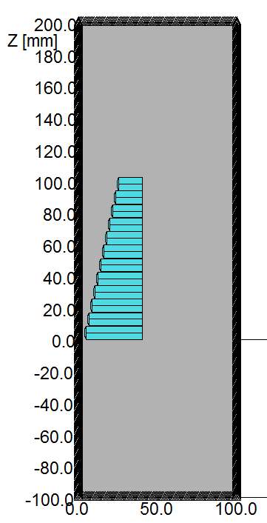
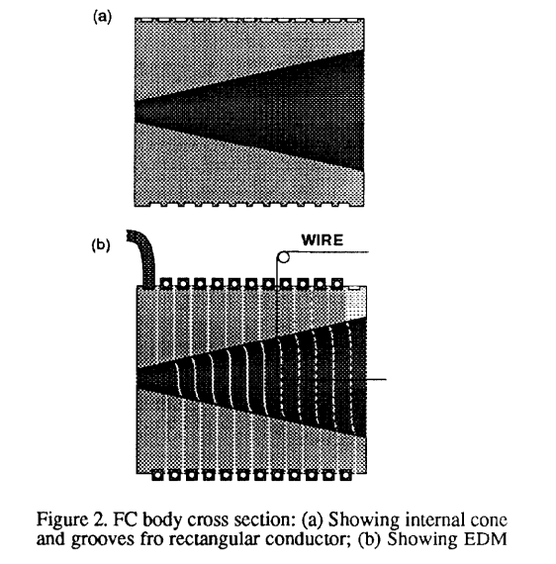
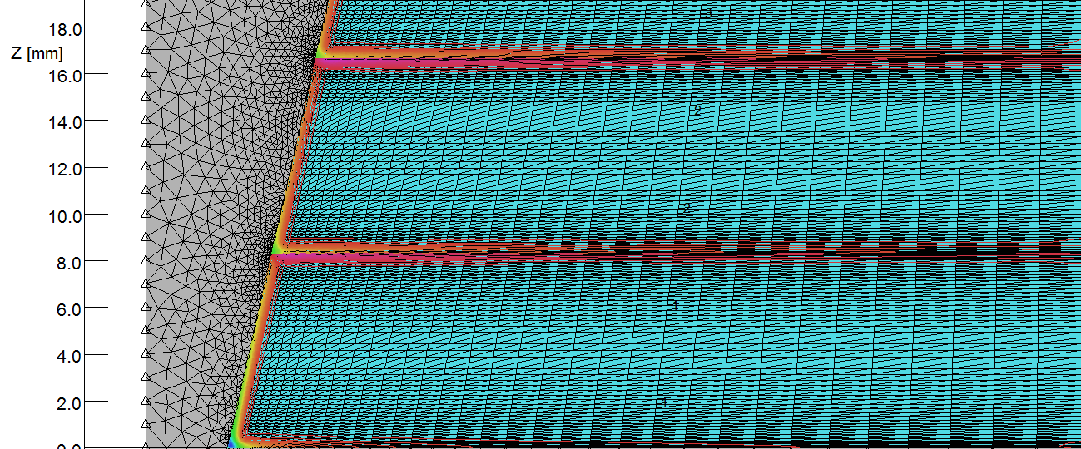
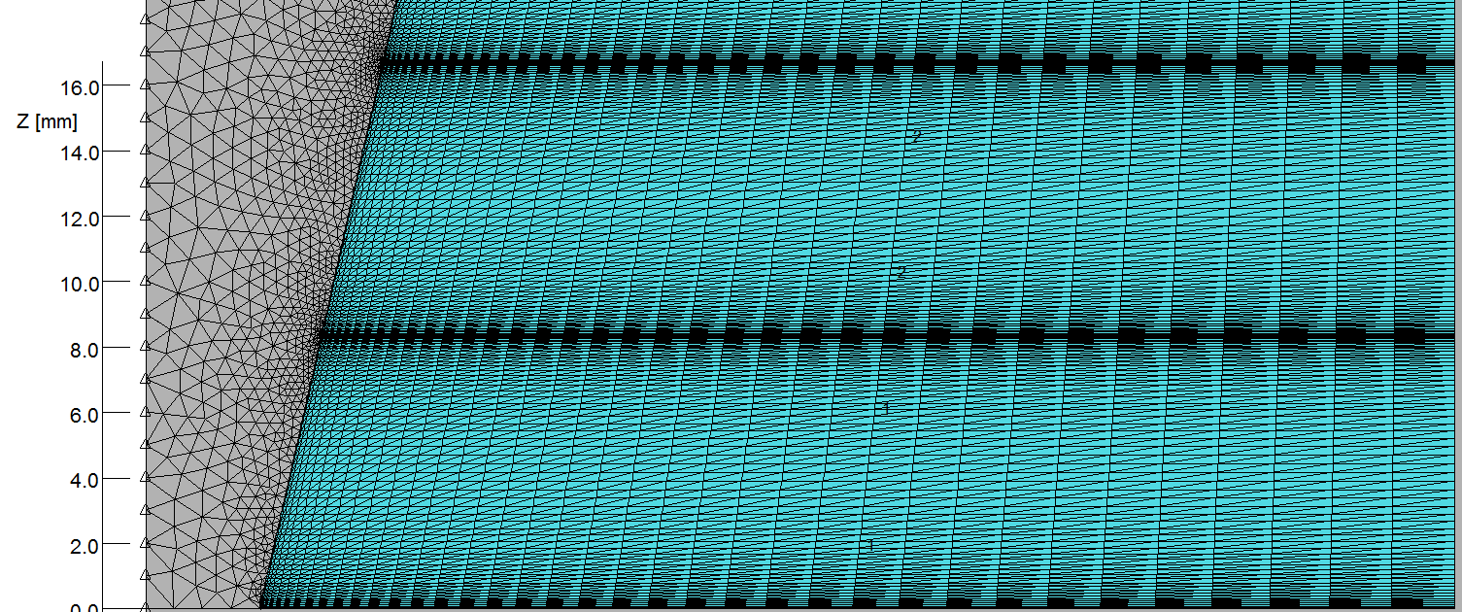
Modelling of the geometry
12-turnstapered solenoid (SLAC design)
2D model
Axi-symmetric system
Boundary conditions:
  Tangential field for symmetry and far field
Material properties
  Conductivity with linear behavior (OFHC Copper)
Regular mesh and mesh refinement:
  quadrilateral Finite Element in conductor and Bias method
Transient simulation:
  Eddy Current and Skin effect

Slide 31
Backup

Slide 32
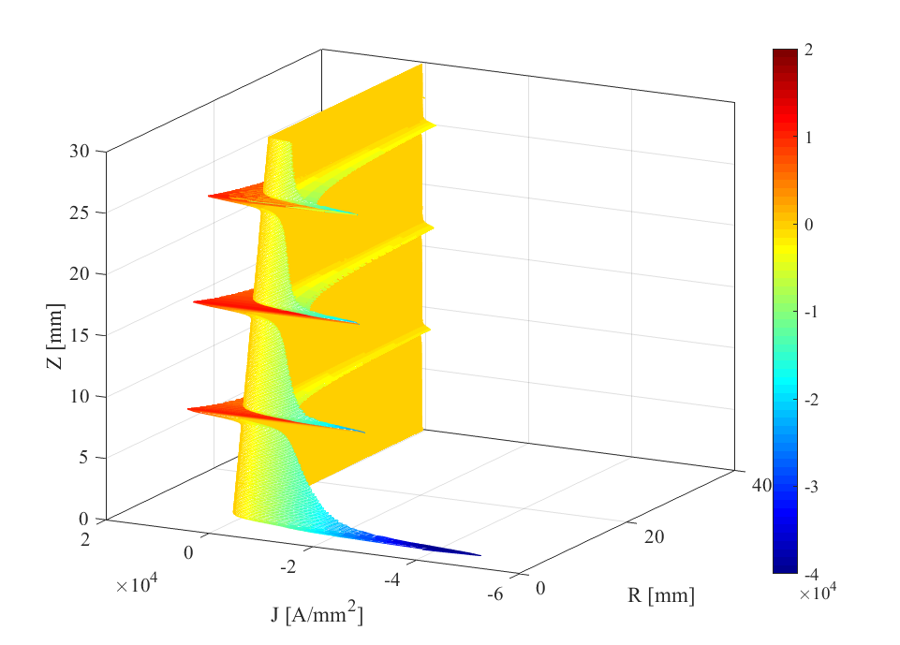
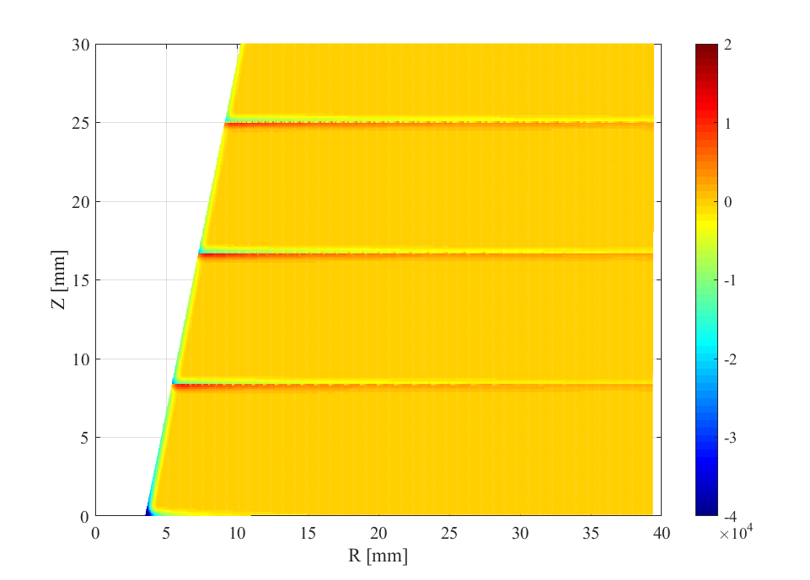
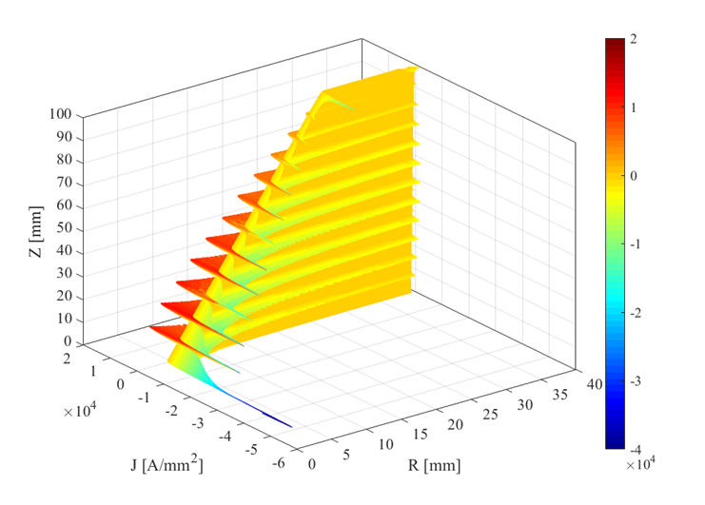
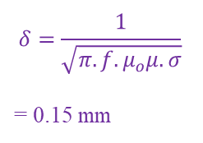
The origin of the field boost
Tapered solenoid in transient
$$δ=\frac{1}{\sqrt{π.f.μ_{o}μ.σ}}$$
= 0.15 mm
Zoom in first 3 turns`
Positive
Eddy Current loop
Negative
Eddy Current loop
Negative
Transport current
The pulse of current produces strong eddy current loops that circulate in opposite directions within each turn.
The current density concentrates at the skin of the conductor.
https://agenda.linearcollider.org/event/8217/

Slide 33
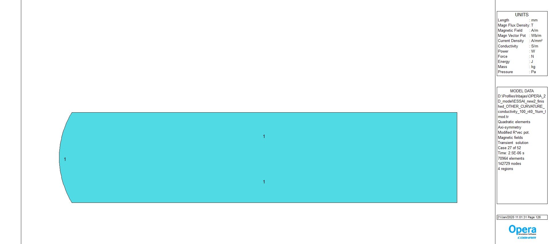
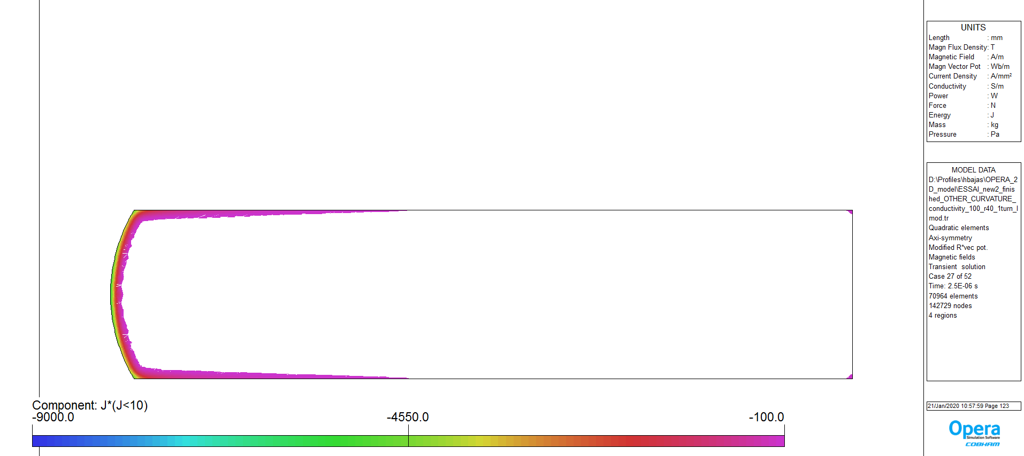
The eddy currents depend on the adjacent turns
Let’s model One-turn coil
The current density is only negative

Slide 34
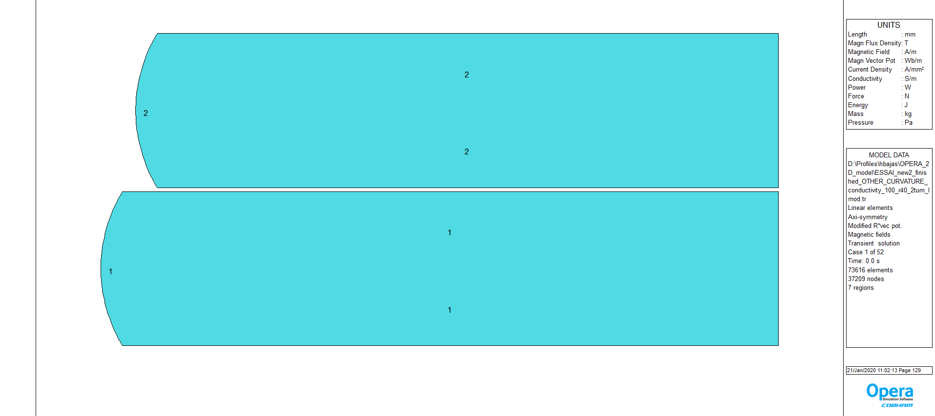
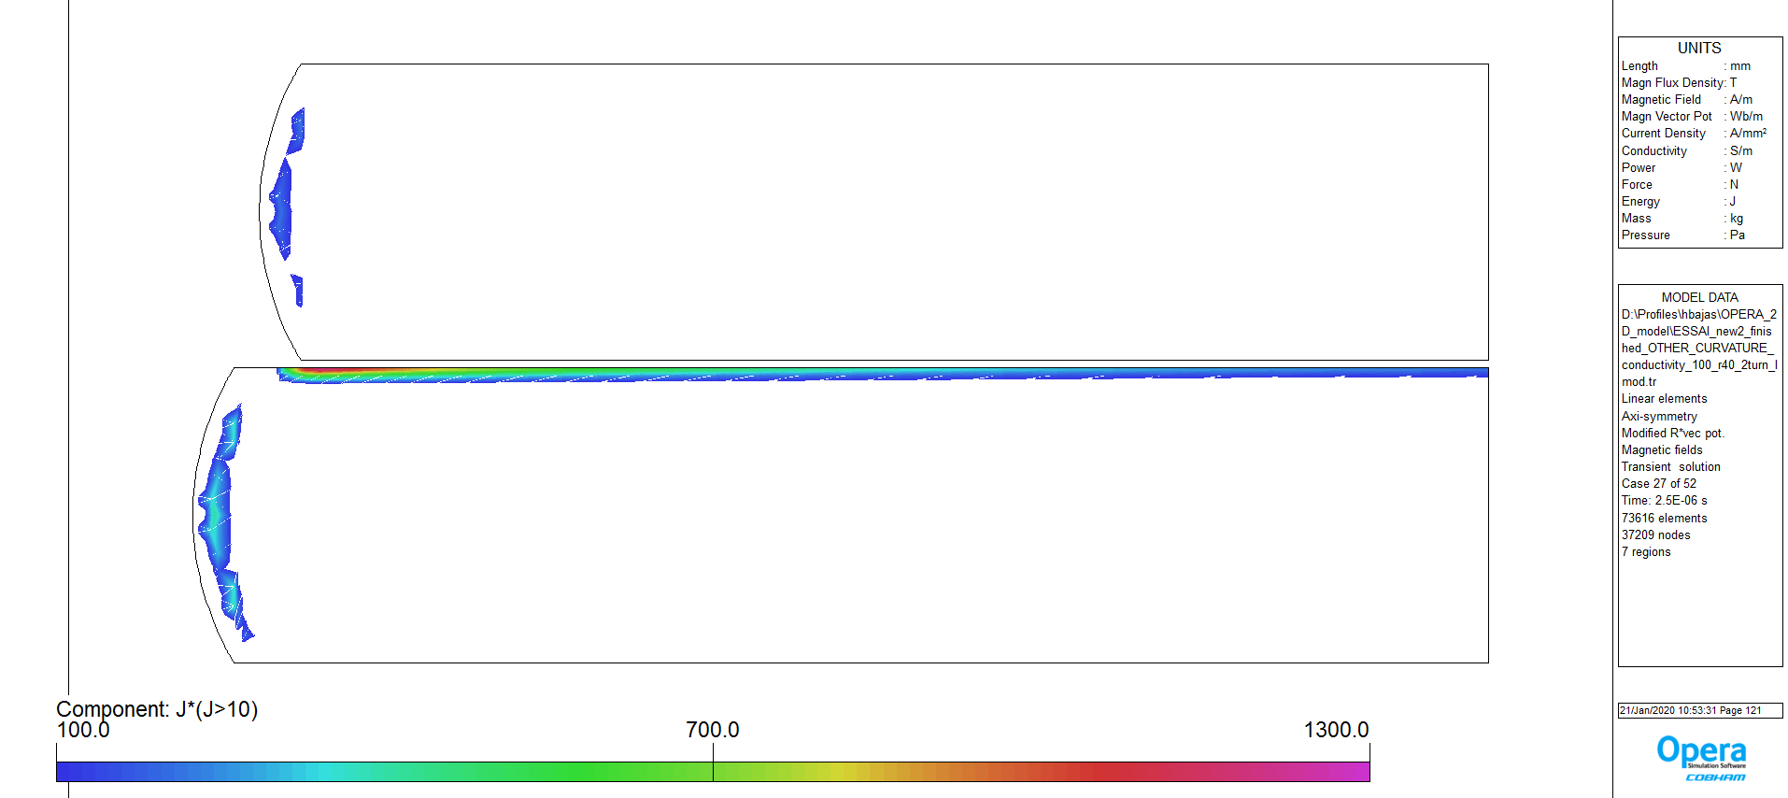
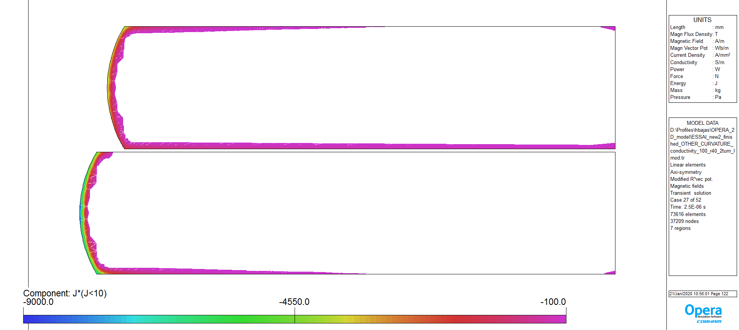
The eddy currents depend on the adjacent turns
Let’s model Two-turn coil
The current density is both positive & negative

Slide 35
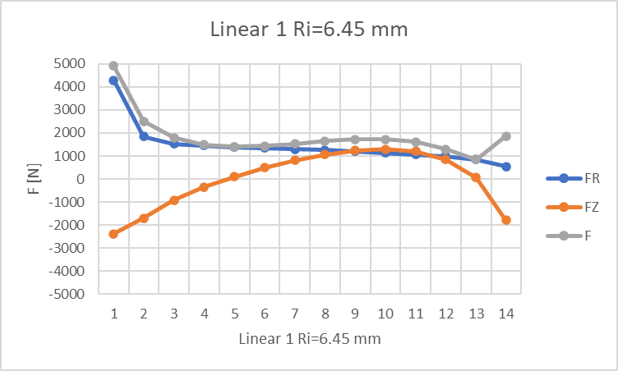
Third run of optimisation
The Lorentz force are now available as output data.
The forces are not only directed along the radius in the outward direction.
A significant compressive force applies to the FC along the solenoid axis.

Slide 36
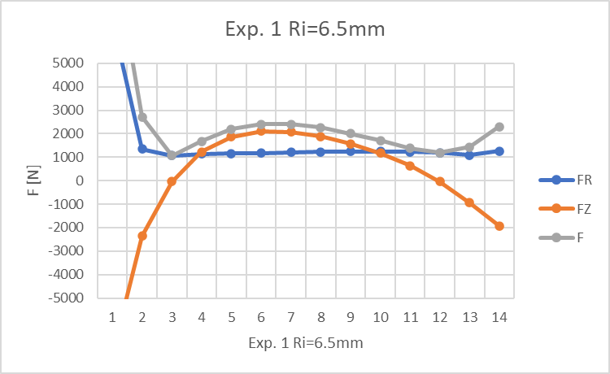
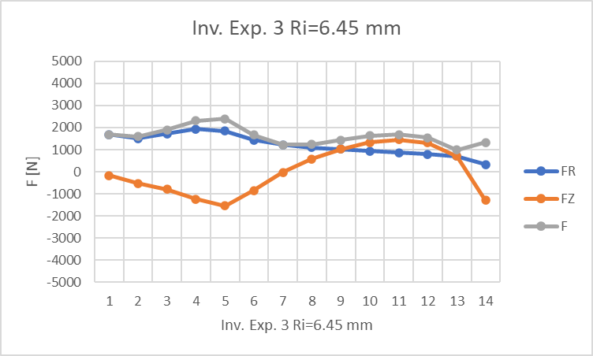
The distribution of the force along and accross the coil is complexe and need further investigation.
It changes a lot with the geometry.

Slide 37
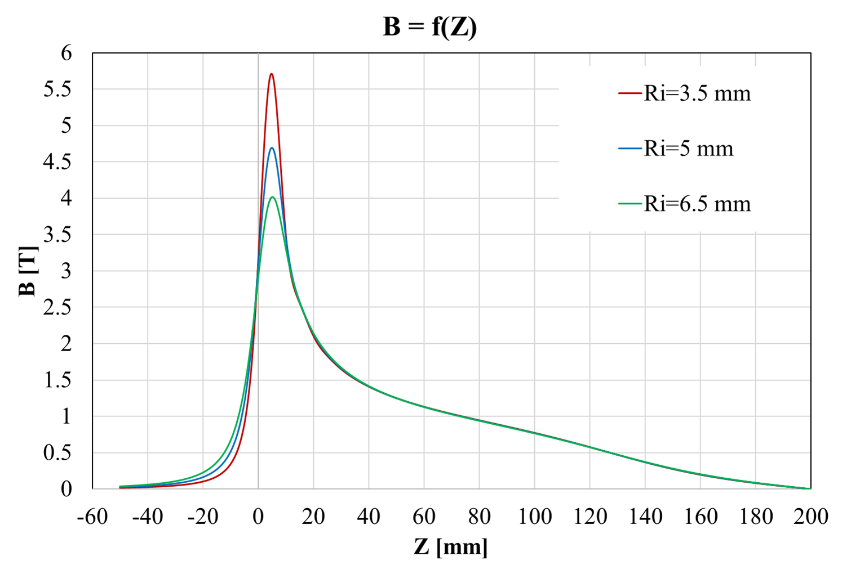
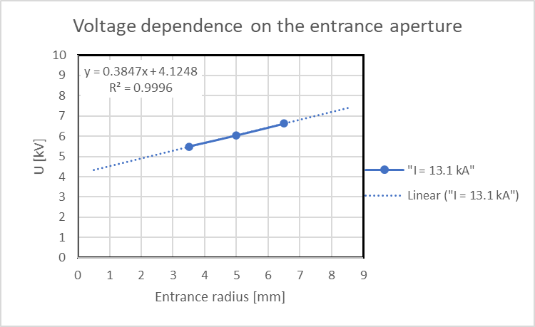
Design optimization for the CLIC e+ source
Increasing the entrance aperture yields to higher positron but:
    The field decreases with the aperture
    The voltage increases with the aperture
R. H. Helm, SLAC, Report No. 4, August 1962.

Slide 38


Design optimization for the CLIC e+ source
The shape of the FC profile significantly impacts the shape of the field distribution.
The downward concavity leads to:
  a broad distribution in the low field domain (< 3T) that extend to Z=50 mm
  Small fringe field Z < 0 mm
The upward concavity leads to:
  a “peaky” distribution in the high field domain (>4T)
  Larger fringe field
More complex shape:
  The field distribution can be more or less broad according to the design
What is a «GOOD FIELD DISTRIBUTION» in terms of positron yield?

Slide 39


Design optimization for the CLIC e+ source
The voltage accross the magnet is largely impacted by the coil design.
Still the tradeoff between Good Field Distribution and Voltage level should be done.

