Slide 1
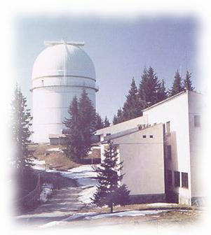
NCPP “Trends in Particle Physics”
20 - 26 June 2010, Primorsko
COSMOLOGY
Daniela P. Kirilova
Institute of Astronomy
Bulgarian Academy of Sciences

Slide 2
Cosmic Microwave Background

Slide 3
Observational Milestones of Hot Big Bang Cosmology
Homogeneity and isotropy and structures in the Universe
The expansion of the Universe
The abundance of the light elements
The cosmic microwave background radiation
The cosmic microwave background radiation is the remnant heat left over from the Big Bang. It is an evidence for a hot early Universe.
Points to a flat LambdaCDM dominated Universe now.

Slide 4
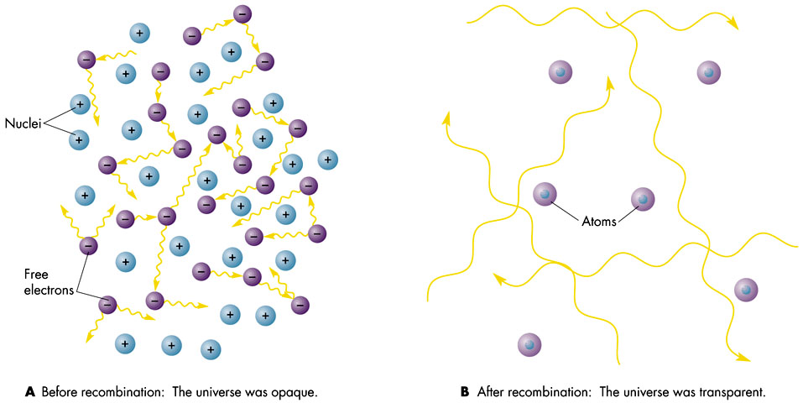
CMB Formation
The Big Bang theory predicts hot and dense early Universe and cooling as it expands. Thus it is filled with radiation that is the remnant heat left over from the Big Bang, called the “cosmic microwave background radiation”, or CMB.
CMB first predicted by G. Gamow and collaborators R. Alfer and R. Herman in 1948.
  T>3000 K : thermodynamical equilibrium
  Photons interact with electrons.
  The cosmic microwave background photons easily scatter off electrons (Thompson scattering) . This process of
  multiple scattering and the electromagnetic interactions produced a blackbody spectrum of photons.
  T=3000 K : Recombination 380,000 y, z=1100
  The expanding Universe cooles T~1/R(t) and
  nuclei capture electrons to form neutral atoms.
The radiation stops to intarct.
The energy of photons had decreased and was insufficient
to ionise H atoms, photons “decoupled” from the other
particles and could move through the Universe essentially
unimpeded. Universe becomes transparent to radiation.
CMB emitted detectable by radio telscopes.
H⁺ + e ⁻ = H
The cooling blackbody radiation in an expanding Universe retains its blackbody form (Tolman 1934) .
It was detected by radio telescopes. We observe it as a 2.7 K thermal blackbody radiation filling the entire Universe.

Slide 5
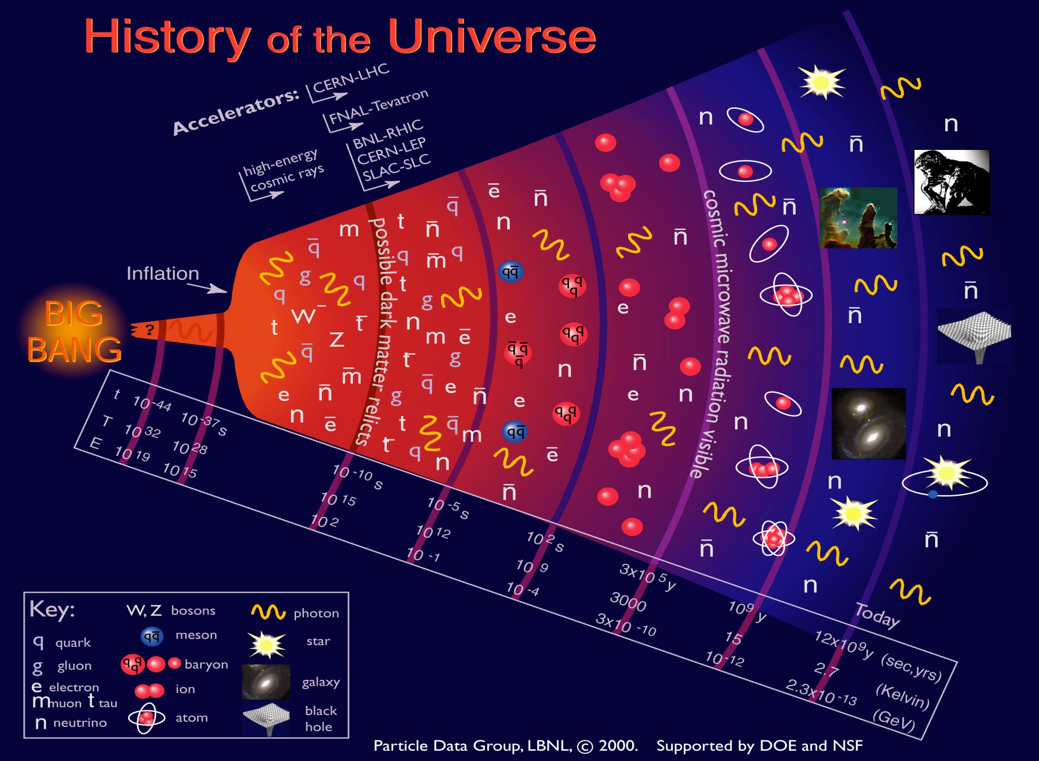
КМФ
T~3000 К
t~380 000 г

Slide 6
The Cosmic Background Radiation
History
The Big Bang theory predicts hot and dense early Universe and cooling as it expands. Thus it is filled with radiation that is the remnant heat left over from the Big Bang, called the “cosmic microwave background radiation”, or CMB.
Some measurements as early as 1940 had found that a radiation field was necessary to explain energy level transitions in interstellar molecules (McKellar 1941)
G. Gamov (1946) predicted CMB and calculated its temperature, more precise calculations provided by Ralph Alpher and Robert Herman in 1950
In 1964, Doroshkevich and Novikov explicitly suggested a search for the radiation focusing on its blackbody characteristics.
R. Dicke, P. Peebles, P. Roll, D. Wilkinson, (1964) Princeton University: were devising an experiment to find the CMB.
.

Slide 7
Following 1964 discovery, independent measurements were made by Wilkinson and others, using balloon-borne, rocket-borne or ground based instruments.
The intensity of the radiation has its maximum for a wavelength of about 1 mm where the absorption in the atmosphere is strong.
Although most results gave support to the blackbody form, few measurements were available on the high frequency. Measurements of the high frequency part of the CMB spectrum (wavelengths shorter than about 1 mm) possible from space.
1992, the Cosmic Background Explorer (COBE) satellite detected cosmological fluctuations in the microwave background temperature
(see however pioneer Relikt results)
WMAP – precision cosmology

Slide 8
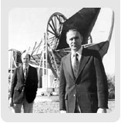
CMB discovery
A. Penzias, R. Wilson, (1964) Bell Labs, Murray Hill, NJ – first observed CBR (the radiation was acting as a source of excess noise in a radio receiver they were building).
Penzias and Wilson shared the 1978 Nobel prize in physics for their discovery.

Slide 9
Measured Plank’s curve
By A. Penzias, R. Wilson (left); by COBE (right)
The FIRAS experiment measured the spectrum at 34 equally spaced points along the blackbody curve. The error bars are so small that they can not be seen under the predicted curve in the figure!

Slide 10
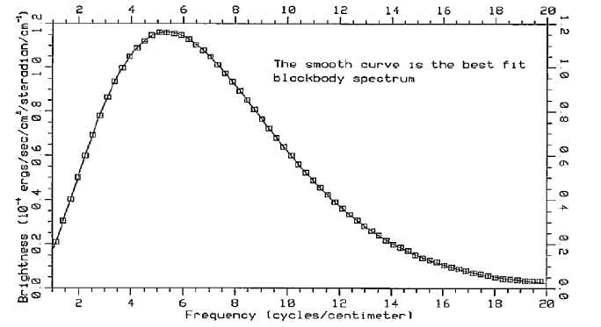
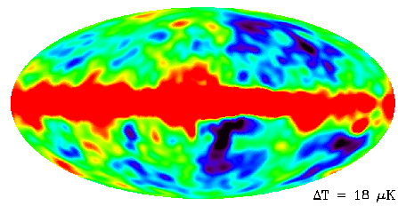
CMB Detection and Characteristics
1964 A. Penzias & R.Wilson
detect noise in the radio antena,
not dependent on the direction.
  2.7 K blackbody
  Isotropic (<1%)
  Relic of the early 380 000 y
  hot 3 000 K Universe
  1970’s and 1980’s
  3 mK dipole (local Doppler) due to
  the Earth movements towards
  Hydra Centaurus superclusters v=600 km/s.
  δT/T < 10⁻⁵
Мaximum at 1 mm where the absorption of the atmosphere is big, hence studied by cosmic missions
RELIKT (1983-84)
COBE (1989-93)
  Т fluctuations 13 ± 4 μK ℓ < 30 : δT/T ≈ 10⁻⁵
  2006 Nobel Prize in Physics (G. Smoot, J.Mather)
”for their discovery of the blackbody form and anisotropy of the Cosmic microwave background radiation”
1992: δT/T ≈ 5.10⁻⁶
Т= 2.728 K
T= 2.725 ± 0.001 К
411cm⁻³
Precise measurements of Universe characteristics:
density, age, geometry, reionization , ...

Slide 11
Relikt 1
http://lambda.gsfc.nasa.gov/product/relikt/
The Relikt Experiment Prognoz 9, launched on 1 July 1983 investigated
the anisotropy of the CMB at 37 GHz, using a Dicke-type modulation
radiometer. During 1983 and 1984 some 15 million individual
measurements were made (with 10% near the galactic plane providing
some 5000 measurements per point). The entire sky was observed in 6
months. The angular resolution was 5.5 degrees, with a temperature
resolution of 0.6 mK. The galactic microwave flux was measured and the
CMB dipole observed. A quadrupole moment was found between 17 and
95 microKelvin rms, with 90% confidence level. A map of most of
the sky at 37 GHz is available.
References: I.A. Strukov, A.A. Brukhanov, D.P. Skulachev and M.V. Sazhin. Pis’ma v
Astronomicheskii Zhurnal v.18 (1992), 387 (in Russian, English version: Soviet
Astronomy10 Letters 18 (1992), 153). I.A. Strukov, A.A. Brukhanov, D.P. Skulachev and
M.V. Sazhin. Mon. Not. R. Astron. Soc. 258 (1992), 37p. Letters 18 (1992), 153).
I.A. Strukov, A.A. Brukhanov, D.P. Skulachev and M.V. Sazhin. Mon. Not. R. Astron. Soc. 258 (1992), 37p.11

Slide 12
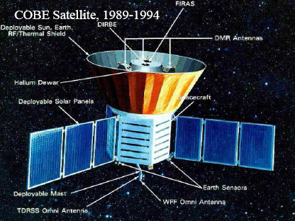
COBE
COsmic Background Explorer 1989-94
COBE was launched November 18, 1989 and carried three
instruments covering the wavelength range 1 μm to 1 cm to measure
the anisotropy and spectrum of the CMB as well as the diffuse
infrared background radiation
John Mather was the COBE Principal Investigator and the
project leader from the start.
Diffuse Infrared Background Experiment to search for
the cosmic infrared background radiation, Mike Hauser
Differential Microwave Radiometers (DMR) to map the cosmic radiation sensitively
principal investigator George Smoot
The objective was to search for anisotropies at three wavelengths, 3 mm, 6 mm, and 10 mm in the
CMB with an angular resolution of about 7°.
Far Infrared Absolute Spectrophotometer (FIRAS) to measure the spectral distribution of the CMB in the range 0.1 – 10 mm and compare it with the blackbody form expected in the Big Bang , John Mather

Slide 13
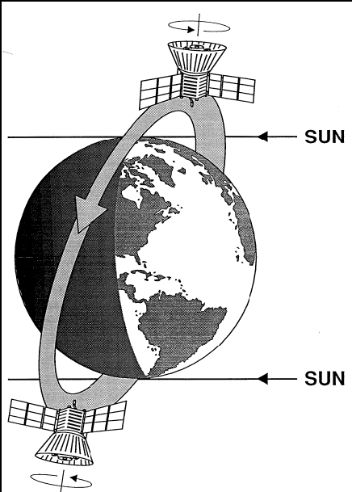
The COBE orbit and spin axis orientation chosen to measure the CMB over the entire sky. All previous measurements from ground were done with limited sky coverage.
The spin axis pointed almost perpendicular to the direction of the Sun and in an outward direction from the Earth. As the COBE orbited the Earth once every 103 minutes, it viewed a circle on the sky 94 degrees away from the Sun, and as the Earth moves around the Sun over the course of a year the COBE gradually scaned the entire sky.
Schematic view of COBE in orbit around the earth. The altitude at insertion was 900 km.

Slide 14
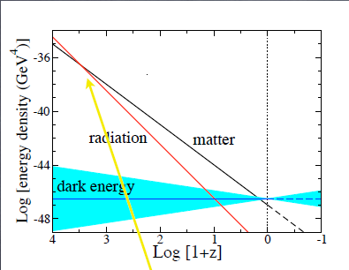
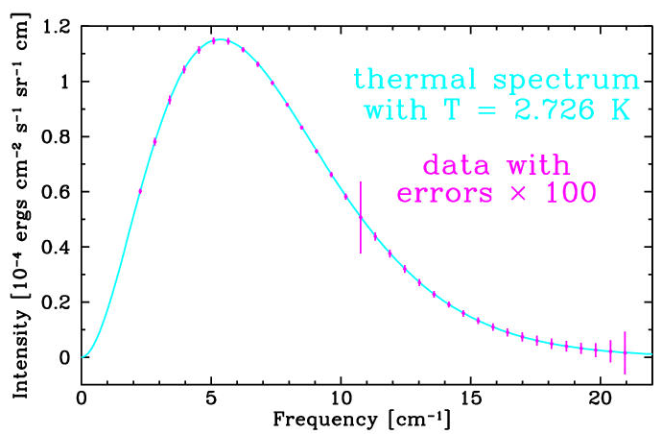
CMB is a direct evidence for an early hot stage of the Universe:

Slide 15
The results from COBE
Temperature fluctuations of the order of 10⁻⁵ were found and the background radiation with a temperature of 2.725 K followed very precisely a blackbody spectrum.
The spectrum of the radiation (measured in the wavelength range 0.1 – 10 mm) is extremely uniform, with less than 1 % deviation from that of a blackbody..
Final result for the temperature 2.725 ± 0.002 K Largest deviations were 0.03%
WMAP obtained better accuracy: T= 2.725 ± 0.001 K
corresponing to particle density of 411 per cubic cm
and energy density 4.64 10E-34 g/cm
There is no alternative theory yet proposed that predicts this energy spectrum. The accurate measurement of its shape was another important test of the Big Bang
CMB is probably the best recorded blackbody spectrum that exists.

Slide 16
The first FIRAS result (Mather et al. 1990). Data had been accumulated during nine minutes in the direction of the northern galactic pole. The small squares show measurements with an error estimate of 1%. T=2.735 ± 0.060 .

Slide 17
Properties of the CBR
Isotropic, except for the motion of the earth (together with the local cluster) towards Hydra and Centaurus super-cluster with velocity of v=600 km/s.
dipole temperature anisotropy dT/T = 10⁻³
(Conklin 1969, Henry 1971, Corey and Wilkinson 1976 and Smoot, Gorenstein and Muller 1977 )
Anisotropy
To explain the large scale structures in the form of galaxies and clusters of galaxies observed today, small anisotropies should exist.
Gravitation can make small density fluctuations that are present in the early Universe grow and make galaxy formation possible.
During 1970-ties the anisotropies expected 10⁻² – 10⁻⁴, but not observed experimentally.
Dark matter taken into account in the 1980-ties, the predicted level of the fluctuations was lowered to about 10⁻⁵, thereby posing a great experimental challenge.

Slide 18

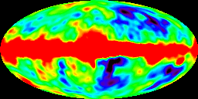
Anisotropy of CMB
In 1992, CMB Explorer satellite made the first detection of anisotropies fluctuations in CMB temperature for three frequencies, 90, 53 and 31.5 GHz (wavelengths 3.3, 5.7 and 9.5 mm), chosen near the CMB intensity maximum and where the galactic background was low (first indications by Relikt - 1990)
The bottom image shows the sky as seen at microwave frequencies, after the dipole anisotropy due to the Sun motion relative to the rest frame of the CMB has been subtracted from the map.
Main sources for the fluctuations:
The emission of the Milky Way dominates the equator of the map.
Fluctuating emission from the edge of the visible universe dominates the regions away from the equator.
There is also residual noise from the instruments themselves, but it is small compared to the signals in these maps.
The hot regions, are 4 Kelvin
hotter than the blue ones.
The hot regions, shown in red, are 0.0002 Kelvin
hotter than the blue ones.

Slide 19
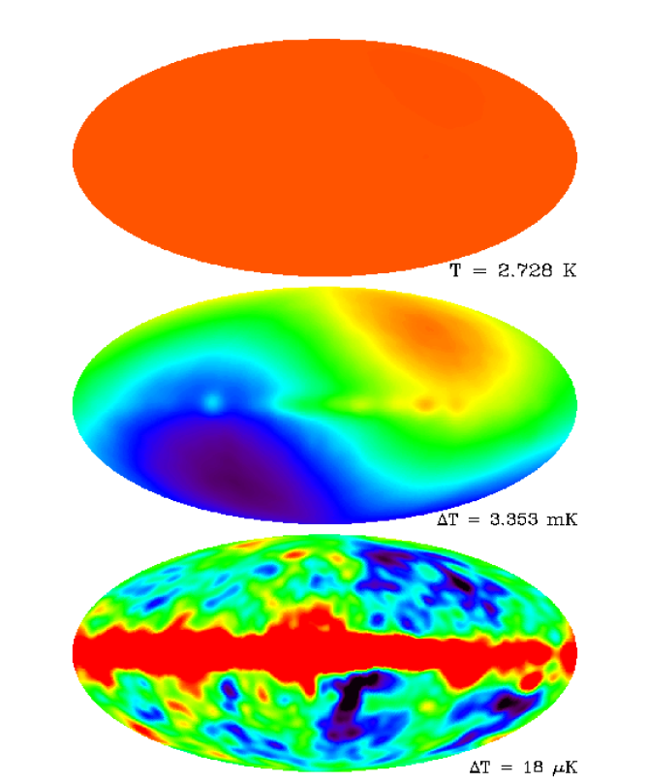
DMR results
DMR results (Smoot et al. 1992, http://lambda.gsfc.nasa.gov/product/cobe/ ) in galactic coordinates
The data from the 53 GHz band (6 mm wavelength) showing the near uniformity of the CMB (top), the dipole (middle) and the quadrupole and higher anisotropies with the dipole subtracted (bottom). The relative sensitivities from top to bottom are 1, 100 and 100,000. The background from the Milky Way, not following a blackbody spectrum (visible as a horizontal red band in the bottom panel), has not been subtracted.

Slide 20
The RMS cosmic quadrupole amplitude was estimated
at 13 ± 4 μK (ΔT/T = 5×10⁻⁶) with a systematic error of
at most 3 μK.
The DMR anisotropies were compared and found to agree
with models of structure formation by Wright et al. 1992.
Most models for structure formation predict that temperature
variations have Gaussian distribution for large angles (corresponding to the DMR measurements). In inflation models the Gaussian distribution originates from primordial quantum fluctuations. COBE’s DMR data showed Gaussian, near scale-invariant temperature fluctuations and in that sense provides support for inflation models (Kogut et al. 1996).
COBE’s results were soon confirmed by a number of balloon-borne experiments, and, more recently, by the 1° resolution WMAP (Wilkinson Microwave Anisotropy Probe) satellite, launched in 2001 (Bennett et al. 2003).
Mather and Smoot shared the 2006 Nobel prize in physics for their discovery.

Slide 21
2006 Nobel Prize in Physics
Info http://www.kva.se
Press Release 3 October 2006
The Nobel Prize in Physics 2006 The Royal Swedish Academy of
Sciences has decided to award the Nobel Prize in Physics for 2006 jointly
to John C. Mather (NASA Goddard Space Flight Center, Greenbelt, MD,
USA), and George F. Smoot (University of California, Berkeley, CA,
USA) ”for their discovery of the blackbody form and anisotropy of the
Cosmic microwave background radiation” .
They have made measurements looking back into the infancy of the Universe
and attempted to gain some understanding of the origin of galaxies and stars.

Slide 22
Some CMB results
Strong support to the Big Bang model in proving the cosmological origin of the CMB and finding the primordial seeds of the large structures observed today.
Estimâtes the ammount of total matter (support of inflationary hypothesis)
estimate the amount of dark matter in the Universe (link with particle physics, and in particular the Large Hadron Collider accelerator at CERN which may soon show evidence for new particles,such as susy particles that can account for the DM)
Estimate the ammount of baryon matter in accordance with BBN– the triumph of BBN paradigm!
Universe Age from CMB: 13.7 Blny
Give unique and detailed information about the early Universe, thereby promoting cosmology to a precision science.

Slide 23
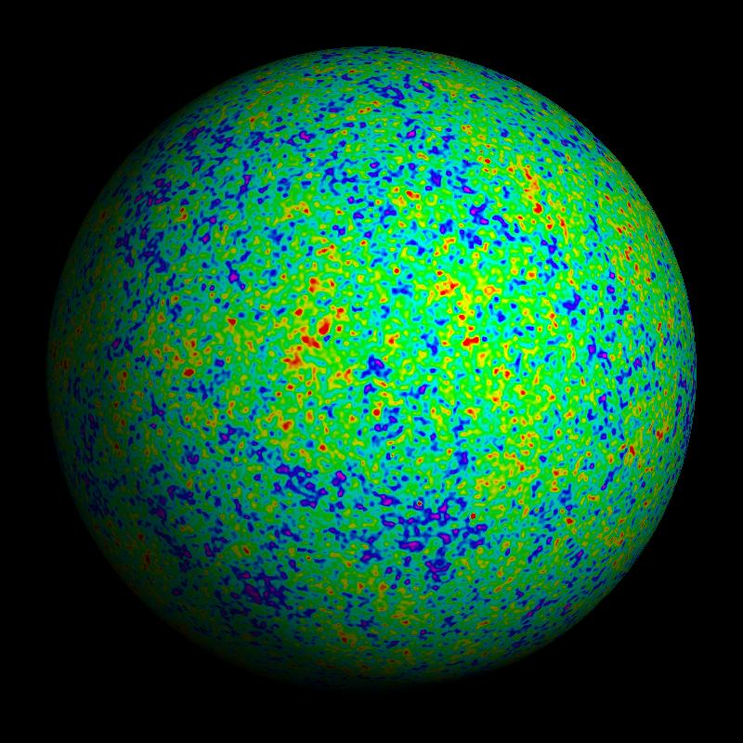
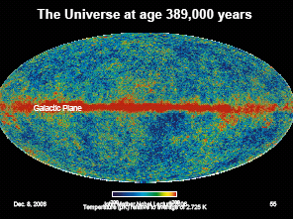
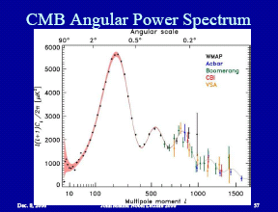
WMAP
COBE’s results were soon confirmed by a number of balloon-borne experiments, and, more recently, by the 1° resolution WMAP (Wilkinson Microwave Anisotropy Probe) satellite, launched in 2001 (Bennett et al. 2003).

Slide 24
Main CMB Results
WMAP measures the density of baryonic and non-baryonic matter to an accuracy of better than 5%. It is able to determine some of the properties of the non-baryonic matter: the interactions of the non-baryonic matter with itself, its mass and its interactions with ordinary matter all affect the details of the cosmic microwave background fluctuation spectrum.
WMAP determined that the universe is flat: the mean energy density is equal to the critical density (within a 2% margin of error), equivalent to a 9.9 x 10-30 g/cm3 (5.9 protons per cubic meter).
4% Atoms, 23% Cold Dark Matter, 73% Dark Energy. Thus 96% of the energy density in the universe is in a form that has never been directly detected in the laboratory. Fast moving neutrinos do not play any major role in the evolution of structure in the universe. They would have prevented the early clumping of gas in the universe, delaying the emergence of the first stars, in conflict with the new WMAP data.
The data places new constraints on the Dark Energy. It seems more like a "cosmological constant" than a negative-pressure energy field called "quintessence". But quintessence is not ruled out.

Slide 25
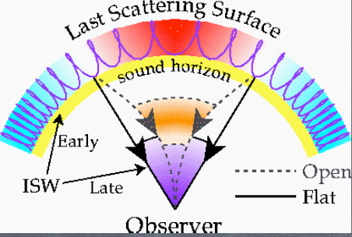
  Sound waves: Лъчистото налягане противодейства на
опитите на гравитацията да свие газа в потенциалните ями,
довеждащи до акустични осцилации, които водят до
пространствени вариации на КМФ температура с времето.
Фотон-барионната система флуид спира да осцилира при рекомбинацията. Осцилациите са замразени при рекомбинацията.
Модите хванати в максимум на осцилациите им представляват максимумите. Пространствените вариации на Т да се наблюдават като вариации по ъгли с увеличаване на ъгловия размер.

Slide 26
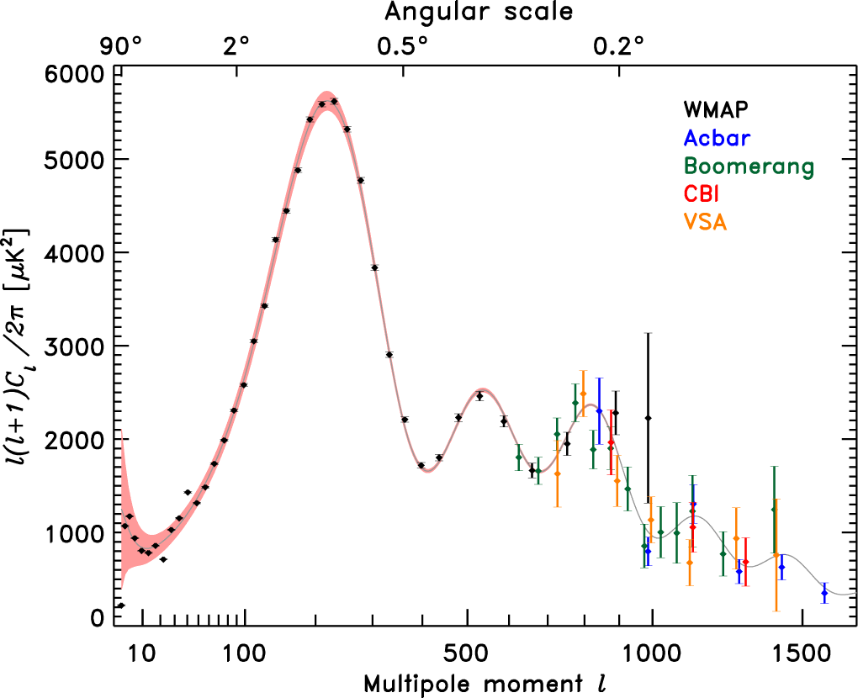
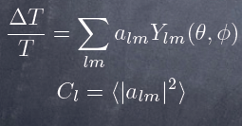
CMB Angular Power Spectrum
Location and height
of acoustic peaks
determine the values
of cosmological
parameters.
Relevant parameters curvature
(e.g. open, flat, closed) dark energy
(e.g. cosmological constant)
amount of baryons (e.g. electrons & nucleons)
amount of matter (e.g. dark matter)
WMAP+ 3yr TT power spectrum (Hinshaw et al. 2006)

Slide 27
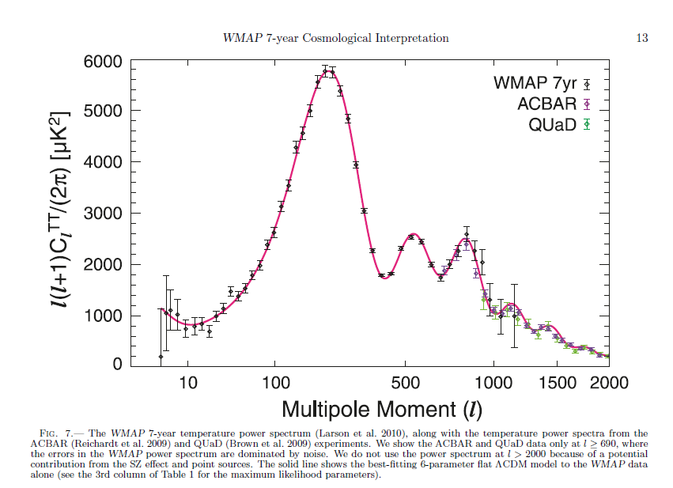

Slide 28
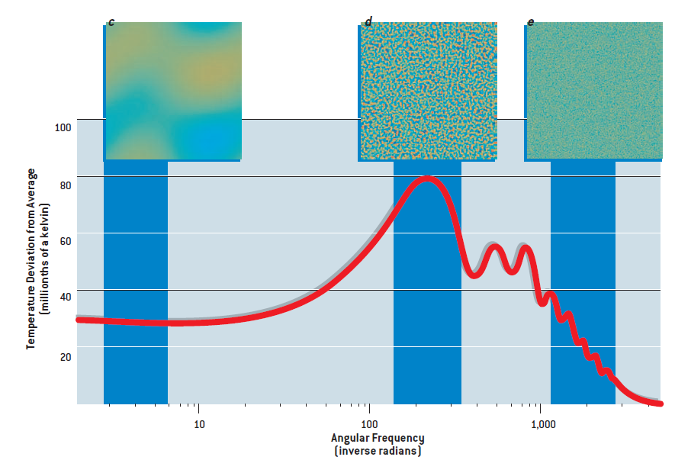
Температурните вариации са най-силно изразени за мащаби ~ 1° , за големи мащаби ~ 30 ° (с) и малки – 0.1 ° (е) не така значими.

Slide 29
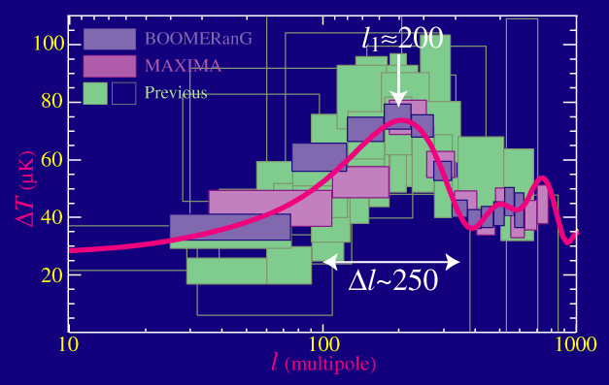
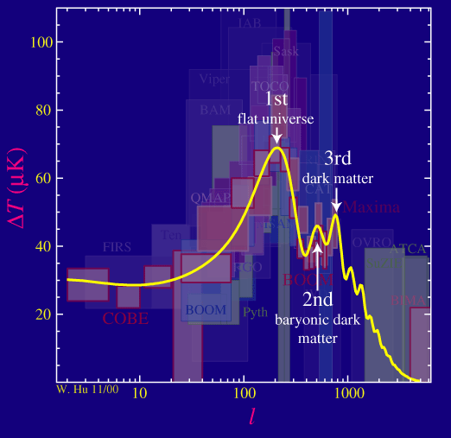
Boomerang и Maxima експерименти
измерват първия максимум.
Изключителното добро съгласие
между формата на измерения максимум и
предсказанията от теорията,
базирана на звукови вълни
от пертурбациите в инфлационния стадий,
е триумф на СКМ.
Положението на максимумите основно зависи от
кривината. С намаляване на кривината максимумите се
изместват към по-малки ъгли (по-големи мултиполи l)
докато формата им се запазва.
Формата зависи от физичната плътност на
материята и барионите. Отсъствието на тъмна
енергия играе малка роля в положението на
максимумите.
Резултати:
Измереното положение на първият максимум указва на плоска Вселена.

Slide 30
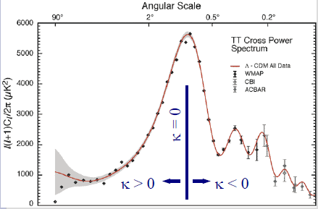



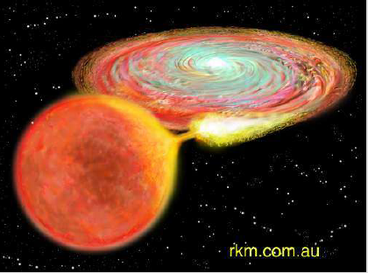

Можем до определим пълната енергия от измервания на
пространствената кривина: Ω = 1 + k / H²R²
КМФ има максимум на флуктуациите на определено разстояние от нас ~ 380 000 г. Измервайки съответния му ъглов размер можем да определим геометрията на пространството.
Позицията на максимума е мерило за кривината.
От наблюдения: ,
следователно:
Понеже то
съществува Тъмна Енергия
студена, еднородно разпределена !!
Наблюденията на SNIa
в далечни г-ки
указват на ускорено разширение - наличие на Λ
Наличие на тъмна енергия ТЕ
необходима за съгласие между наблюдателните данни . Необходимото количесво ТЕ съвпада с ТЕ необходима за обяснение на резултатите от SN звезди.

Slide 31
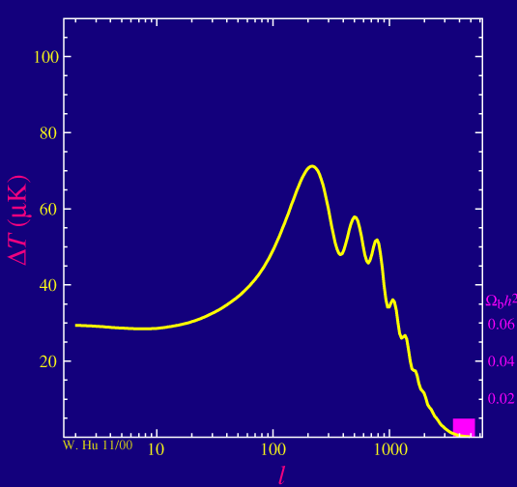
Изменение на барионната плътност изменя съотношението между четни и нечетни максимуми
Мястото и височината на
Courtesy Wayne Hu – http://background.uchicago.edu

Slide 32
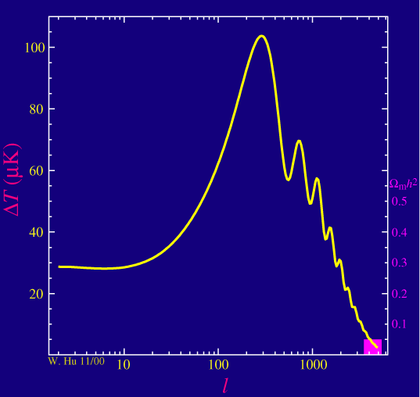
Peaks and Matter
Changing dark matter density
also changes peaks…
Location and height of acoustic peaks
  determine values of cosmological parameters
Relevant parameters
  curvature of Universe (e.g. open, flat, closed)
  dark energy (e.g. cosmological constant)
  amount of baryons (e.g. electrons & nucleons)
  amount of matter (e.g. dark matter)
Courtesy Wayne Hu – http://background.uchicago.edu

Slide 33
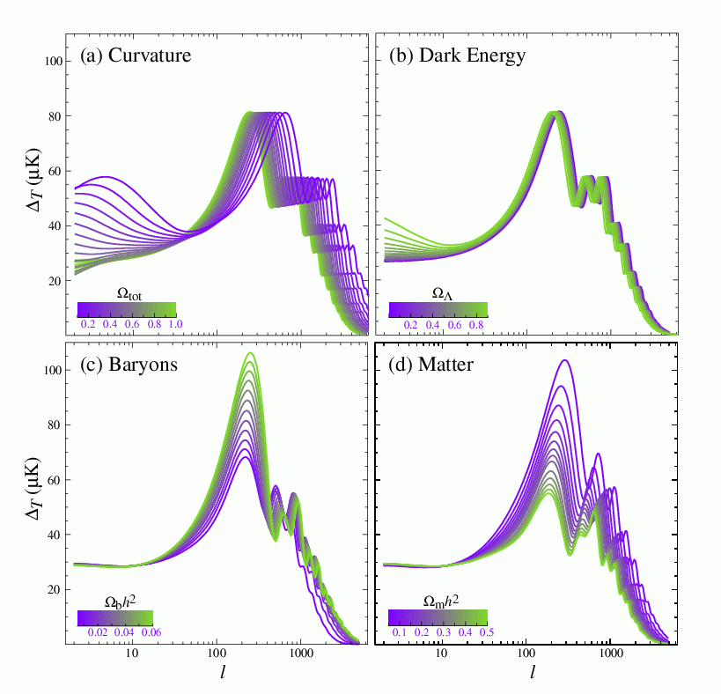
Изключителното добро съгласие
между формата на измерените максимуми и
предсказанията от теорията,
базирана на звукови вълни
от пертурбациите в инфлационния стадий,
е триумф на СКМ.

Slide 34
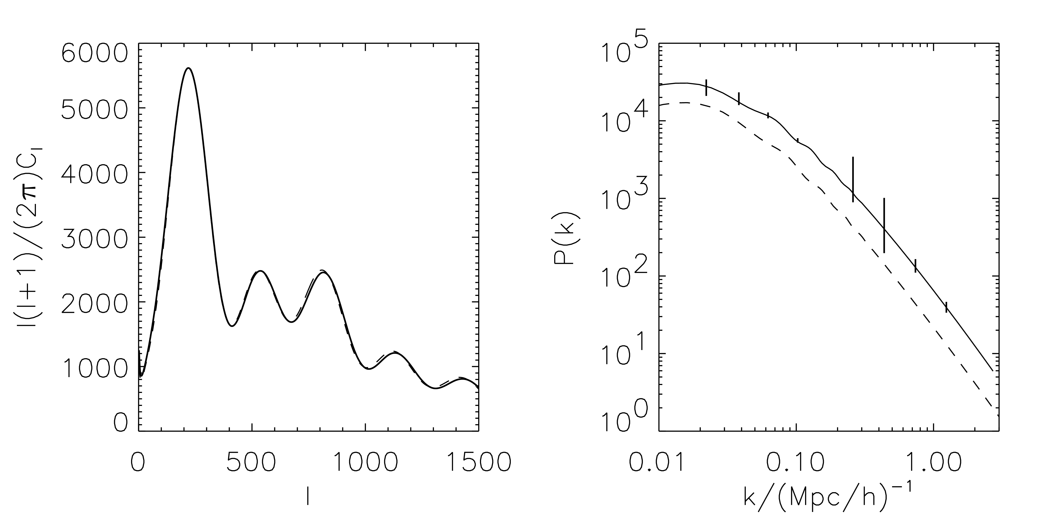
How comparing the CMB and galaxy surveys constrains the neutrino mass.
... but at low redshift they are no longer relativistic and have a big effect on galaxy clustering.
Massive neutrinos can hide in the CMB…
Solid: h=0.71 neutrino density=0
Dashed: h=0.60 neutrino density=0.02
2dF
Lyman Alpha

Slide 35
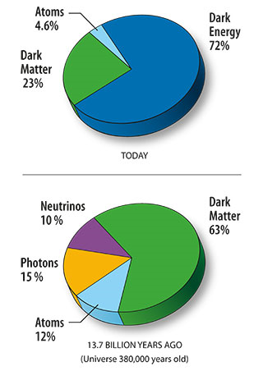
WMAP
96% от плътността на енергията на Вселената е във форма недетектирана в лабораторни условия....!?
  КМФ – бариометър на Вселената 4.6% светещи бариони (0.1%)
  ТВ 23.3% (1.3%)
  ТЕ 72.1% (1.5%)
WMAP данните дават указания за свойствата на небарионното вещество: самодействие, маса, взаимодействие с обичайното вещество.
Неутриното не играе важна роля в образуването на структурите (иначе би забавило появата на първите звезди и галактики), но наличието на реликтовия неутринен фон е установено.
  Кривина на пространството – плоско
  Евклидово с точност 1%
  Средната плътност е равна на критичната 9.9 x 10⁻³⁰ g/cm³ (5.9 p в m³ ) (2% точност)
  Пълна карта на небето в микровълни с
  резолюция 0.2 градуса
  Поляризация на микровълновото лъчение на цялото небе.
  По- ранна рейонизация от очакваната - информация за първите галактики
  Възраст на Вселената 13.73 милиарда
  години , 1% точност (0.12 млрд. г.)

Slide 36
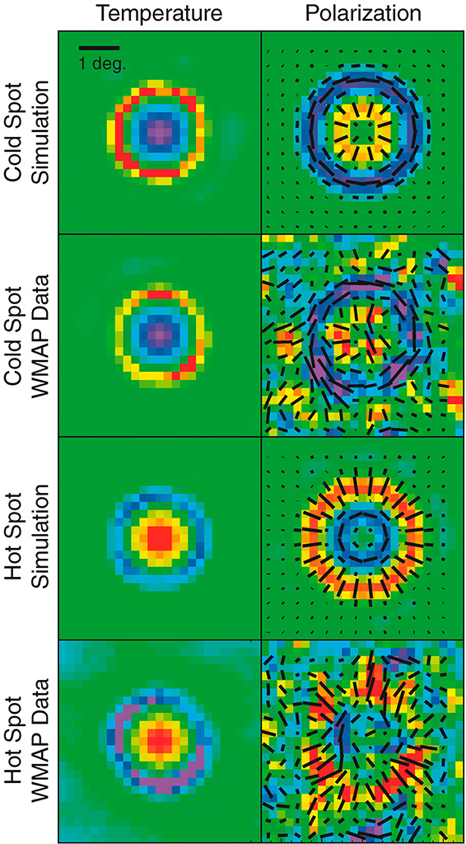
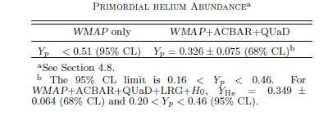

Slide 37
WMAP 7-year Results
WMAP 7-year Results Released - January 26, 2010
The WMAP team has reported the first direct detection of pre-stellar helium, providing an important test of the big bang prediction.
One of the key predictions of the hot big bang model is that most of the helium in the universe was synthesized in the hot early universe only a few minutes after the big bang. Previously, cosmologists studied old stars to infer the helium abundance before there were stars. WMAP data, in combination with smaller-scale data from the ACBAR and QUaD experiments, show the effects of helium in the microwave patterns on the sky indicating the presence of helium long before the first stars formed.
WMAP now places 50% tighter limits on the standard model of cosmology (Cold Dark Matter and a Cosmological Constant in a flat universe), and there is no compelling sign of deviations from this model.
WMAP has detected a key signature of inflation.
WMAP data place tight constraints on the hypothesized burst of growth in the first trillionth of a second of the universe, called “inflation”, when ripples in the very fabric of space may have been created. The 7-year data provide compelling evidence that the large-scale fluctuations are slightly more intense than the small-scale ones, a subtle prediction of many inflation models.
WMAP strongly constrains dark energy and geometry of the universe.
The newly-released WMAP data are now sufficiently sensitive to test dark energy, providing important new information with no reliance on previous supernovae results. The combination of WMAP and other data** limits the extent to which dark energy deviates from Einstein's cosmological constant. The simplest model (a flat universe with a cosmological constant) fits the data remarkably well. The new data constrain the dark energy to be within 14% of the expected value for a cosmological constant, while the geometry must be flat to better than 1%. The simplest model: a flat universe with a cosmological constant, fits the data remarkably well.
In more technical terms, for a flat universe, the dark energy "equation of state" parameter is -1.1 ± 0.14, consistent with the cosmological constant (value of -1). If the dark energy is a cosmological constant, then these data constrain the curvature parameter to be within -0.77% and +0.31%, consistent with a flat universe (value of 0).
** Includes: the current expansion rate of the universe (the Hubble constant) and the large-scale galaxy distribution (the baryon acoustic oscillations).
WMAP places new constraints on the number of neutrino-like species in the early universe.
Neutrinos are nearly massless elementary particles that move at or near the speed of light. They permeate the universe in large quantity but they interact very weakly with atomic matter. Nonetheless they leave an imprint on the microwave fluctuations and the new WMAP data together with other data** show that the effective number of neutrino-like species is 4.34 ± 0.87. The standard model of particle physics has 3.04 effective species of neutrinos.
** Includes: the current expansion rate of the universe (the Hubble constant) and the large-scale galaxy distribution (the baryon acoustic oscillations).
WMAP has detected, with very high significance, temperature shifts induced by hot gas in galaxy clusters.
The CMB temperature in the direction of known galaxy clusters is expected to be slightly cooler than the average CMB temperature, due to interactions between CMB photons and the gas in the clusters. This effect has been observed in aggregate by WMAP and is consistent with analogous observations by the South Pole Telescope. Both observations are in conflict with extrapolated X-ray observations of clusters (X-rays probe a smaller volume of cluster gas than the CMB observations) and with numerical simulations, which must be missing some of the complex gas physics in the outer regions of the clusters.
WMAP has produced a visual demonstration that the polarization pattern around hot and cold spots follows the pattern expected in the standard model.
Credit: NASA/WMAP Science Team
The standard model predicts a specific linked pattern of temperature and polarization around hot and cold spots in the map. WMAP now sees the predicted pattern in the map, as shown in the figure.

Slide 38
The Age of the Universe
Structure of CMB fluctuations depend on the current density, the composition and the expansion rate. WMAP data with complimentary observations from other CMB experiments (ACBAR and CBI), we are able to determine an age for the universe closer to an accuracy of 1%.
The results are in agreement with the results deduced from structure formation studies.
  WMAP +CMB experiments (ACBAR and CBI), determine the age of the Universe
  with precision 1%: 13.73 billion y (0.12 billion y)
The result is in agreement with the age determined by structure studies, by globular cluster studies, etc.
The universe is at least as old as the oldest globular clusters (11-13 billion y) that reside in it.
Universe age - 13.7 billion years

Slide 39
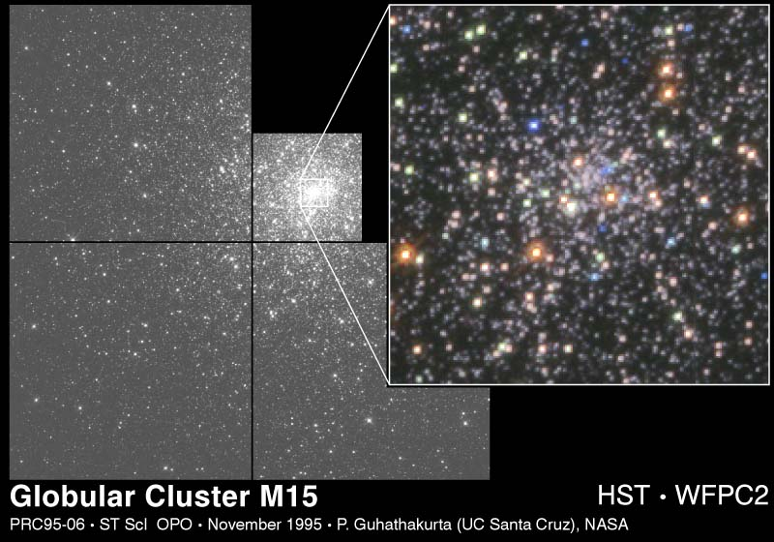
Oldest globular clusters age.
Life cycle of a star depends upon its mass
All of the stars in a globular cluster formed at roughly the same time: they can serve as cosmic clocks. The oldest globular clusters contain only stars less massive than 0.7 M. Observation suggests that the oldest globular clusters are between 11 and 13 billion years old.
Turn off points

Slide 40
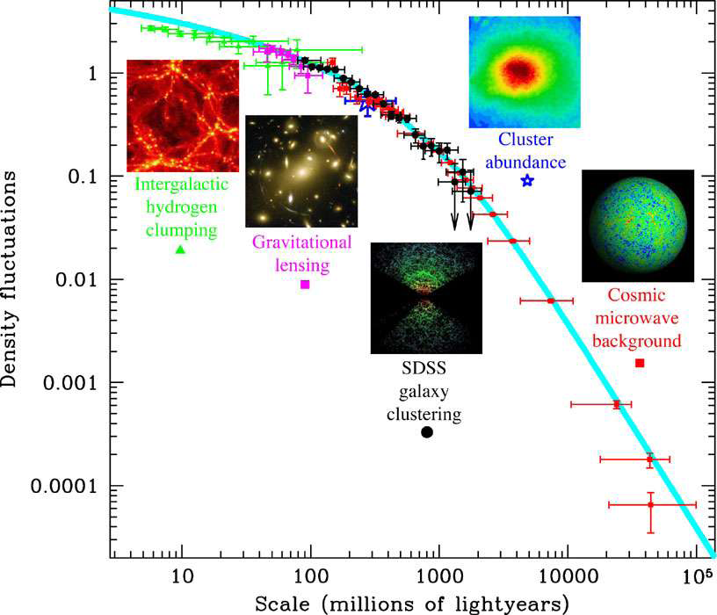
Наблюдение на структури на различни мащаби: междугалактични Н облаци, галактики, купове и свръхкупове, наред с КМФ – информация за Вселената.
Динамиката на тези структури предоставя директна оценка както на пълната плътност на веществото, така и информация за
спектъра на флуктуациите на различни машаби.
Малките пертурбации в CMB ΔT/T ~ 10 ⁻⁵
указват на флуктуациите на плътността в тази епоха, които впоследствие нарастват до наблюдаемите днес огромни галактики и купове от галактики.

Slide 41
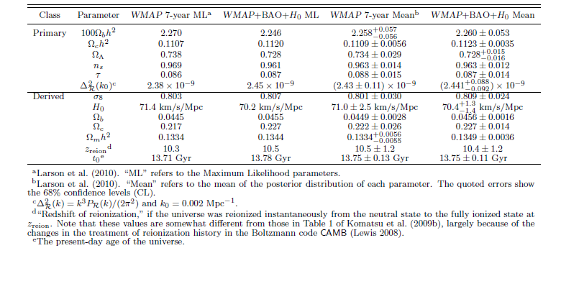

Slide 42
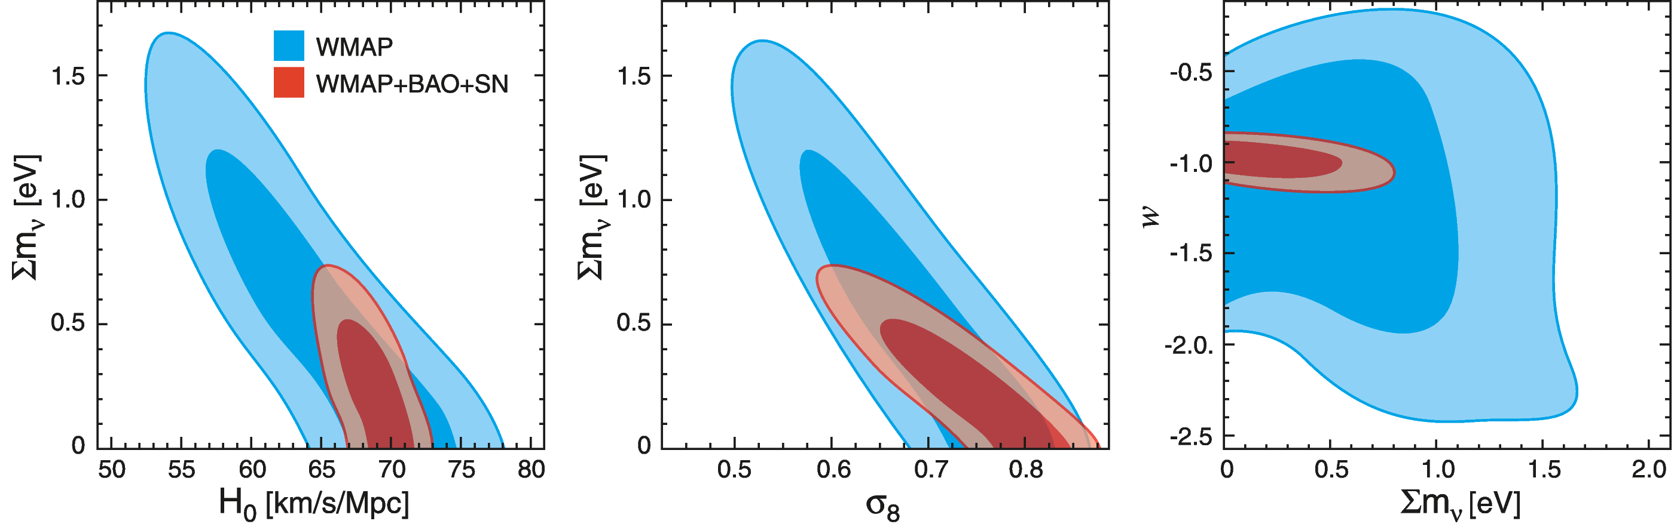
Cosmological parameters and neutrino
Fast moving neutrinos do not play any major role in the evolution of structure in the universe. They would have prevented the early clumping of gas in the universe, delaying the emergence of the first stars, in conflict with the new WMAP data.
Komatsu et al., 803.0547

Slide 43
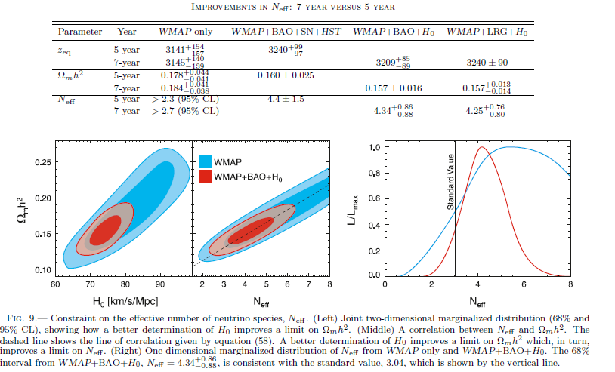

Slide 45
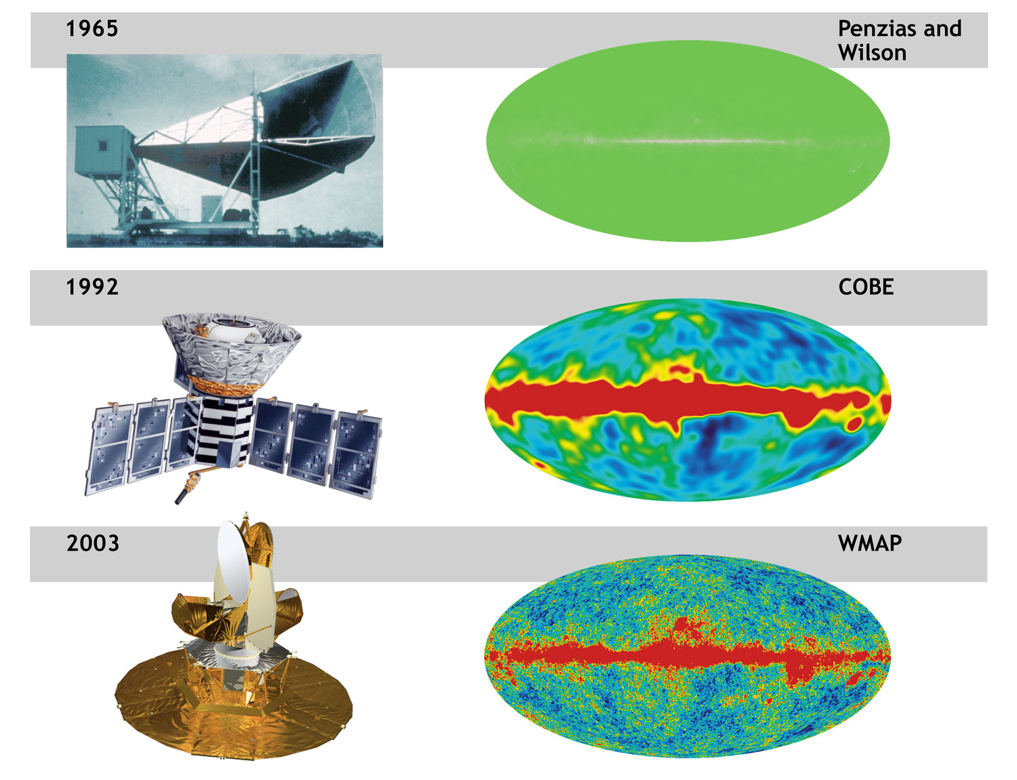
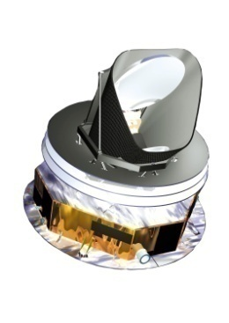
Cosmic Microwave Background Radiation Overview
The oldest light in universe
Discovered the remnant afterglow from the Big Bang. 2.7 K
Blackbody radiation, Discovered the patterns (anisotropy) in the afterglow. angular scale ~ 7° at a level ΔT/T of 10⁻⁵
(Wilkinson Microwave Anisotropy Probe): → angular scale ~ 15’
→ angular scale ~ 5’, ΔT/T ~ 2x10⁻⁶, 30~867 Hz
2009
Planck
Notes:
45

Slide 46
matter-antimatter asymmetry
inflation
The Universe Secrets
Dark Matter, Dark Energy

Slide 47
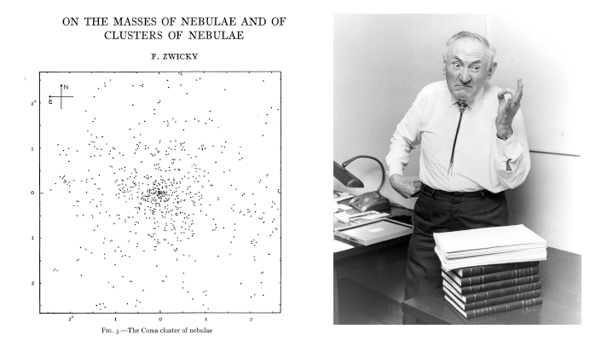
Скрита маса
Наблюдателни свидетелства и теоретични указания
Наблюдателни и теоретични указания, форми, представители
“Проблема за скритата маса”
1933, Fritz Zwicky
F. Zwicky открива указания за ТВ в купове от галактики, изучавайки скоростите на галактиките.
Notes:
47

Slide 48
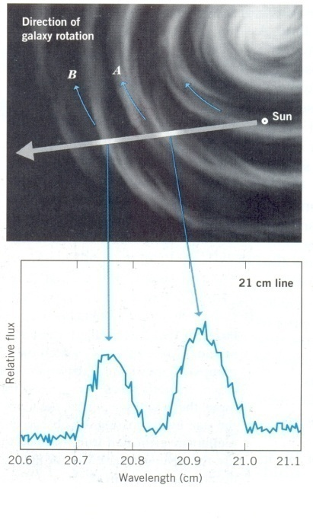
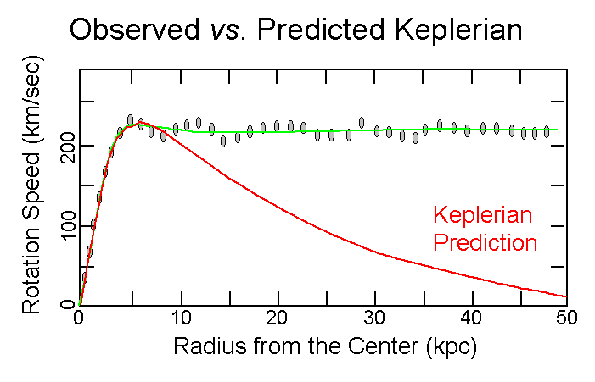
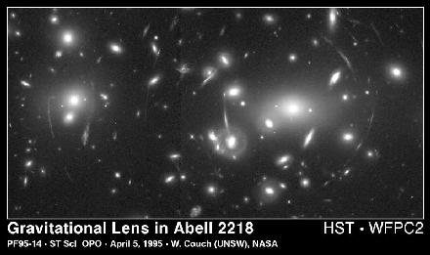
Dark Matter
Observational Indications
Rotation Curves: The dependence of the velocity of rotation of an object on its distance from the galactic center.
The mass inferred for galaxies is roughly ten times larger than
the mass that can be associated with stars, gas and dust in a Galaxy.
NGC3198
Radio and optical observations of gas and stars in galaxies enable us to determine the distribution of mass in these systems
DM at galactic and galaxy cluster scale
F. Zwicky discovered the presence of DM on a much larger scale
through his studies of large velocitieas in galactic clusters. Recent measurements:
galaxy clusters (and binary galaxies) have M/L ratios up to 300.
Gravitational Lensing
This mass discrepancy confirmed by gravitational lensing.
By measuring how the background galaxies are distorted by the foreground cluster the cluster mass is measured. It is more than ten times larger than the inferred mass in visible stars, gas and dust.

Slide 49
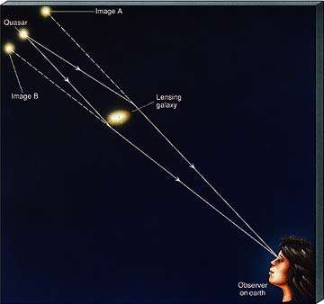
Gravitational lensing, predicted by GR, occurs when light
traveling toward us from a distant galaxy is magnified and
distorted as it encounters a massive object between the galaxy
and us.
The massive objects that create the lenses are usually huge clusters
of massive galaxies. Gravitational lensing allows to measure the mass
of the object creating the lense. The angle of deviation is
proportional to the mass of the lensing system and provides
information about DM distribution.
COSMOS project: to survey a single 1.6-square-degree field of sky (nine times the area of the full Moon)
with several space-based and Earth-based observatories, namely Hubble Space Telescope, Spitzer Space
Telescope, XMM-Newton spacecraft, Chandra X-ray Observatory, Very Large Telescope (VLT), Subaru
Telescope, Canada-France-Hawaii Telescope.
Astronomers using Hubble Space Telescope and ground-based telescopes have compiled a
large catalog of gravitational lenses in the distant universe. The catalog contains 67 new
gravitationally lensed galaxy images found around massive elliptical and lenticular-shaped
galaxies. If this sample is representative, there would be nearly half a million similar
gravitational lenses over the whole sky.
The study of the gravitational lenses gives an opportunity to probe DM distribution around
galactic lenses.

Slide 50
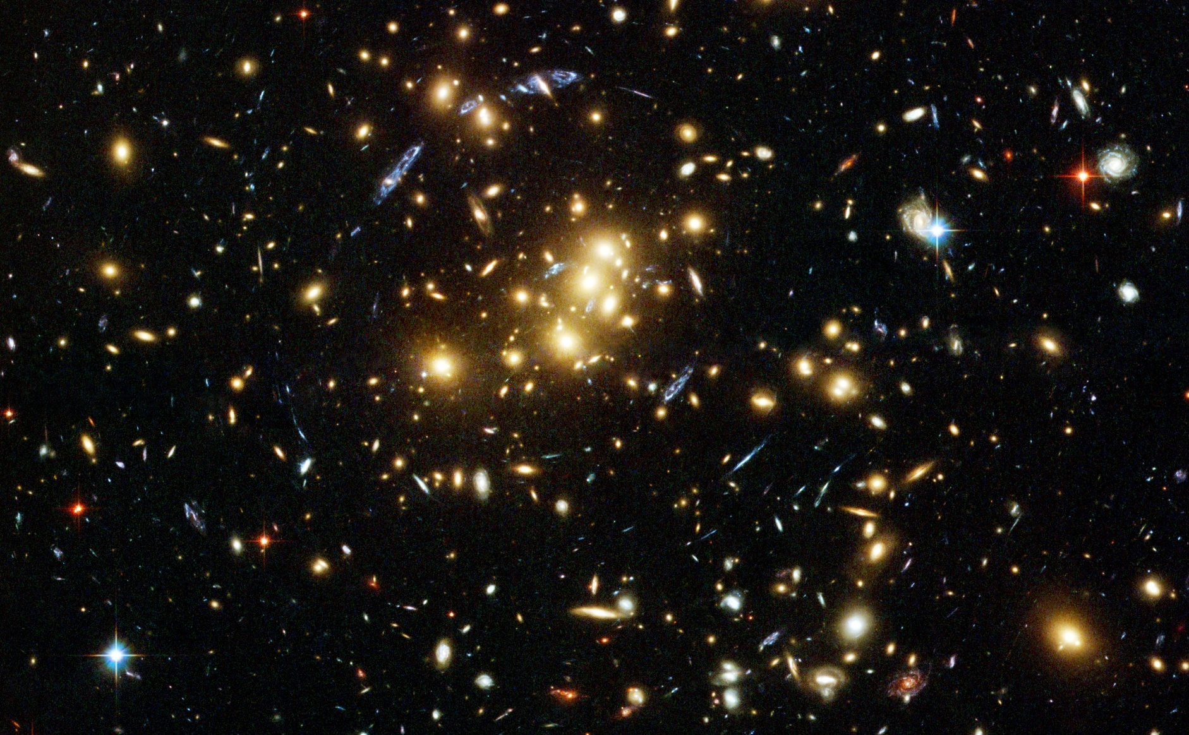
Gravitational Lenses
HST image presenting a rich cluster of galaxies (in yellow) , at 5 billions ly, distorting the light from far away galaxies situated behind it, seen as blue arcs.
The form and the distribution of arcs show that the shining matter in the cluster is not enough to explain the distortions, i.e. the cluster contains big quantity of DM.

Slide 51
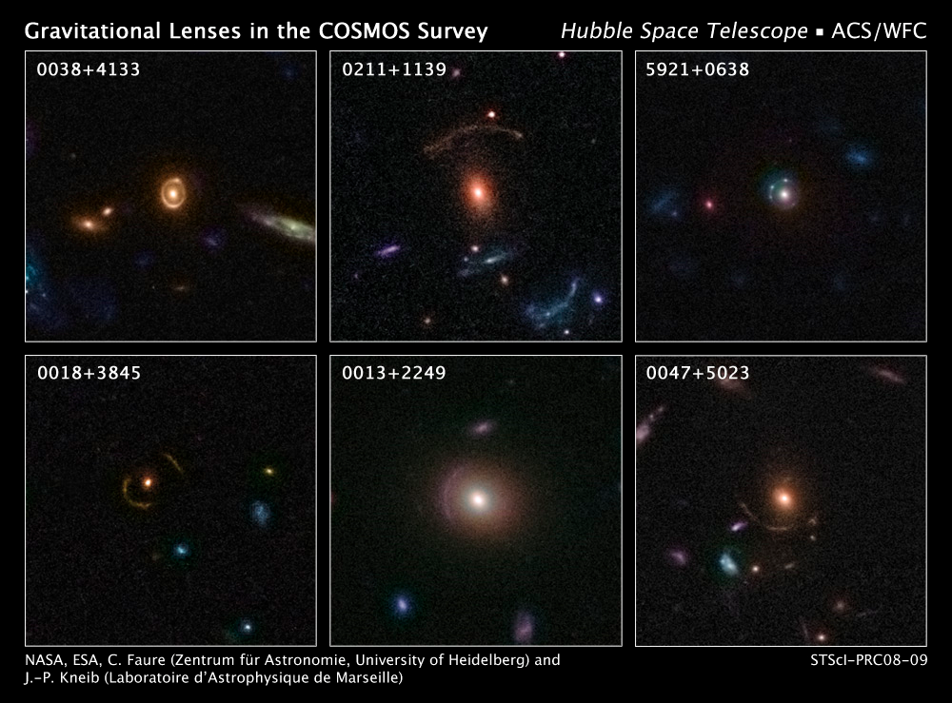

Slide 52
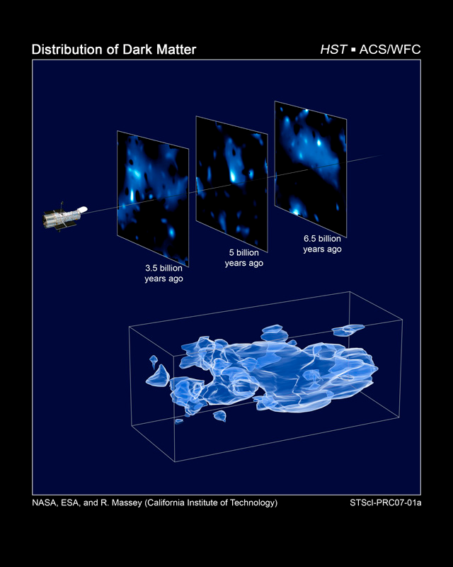
A 3D map of DM in the Universe
The map reveals a loose network of dark matter filaments, gradually collapsing under the relentless pull of gravity, and growing clumpier over time. This confirms theories of how structure formed in our evolving universe, which has transitioned from a comparatively smooth distribution of matter at the time of the big bang. The dark matter filaments began to form first and provided an underlying scaffolding for the subsequent construction of stars and galaxies from ordinary matter. Without dark matter, there would have been insufficient mass in the universe for structures to collapse and galaxies to form.
[Top] - Three slices through the evolving distribution of DM.
This is calibrated by measuring the cosmological redshift of the lensing galaxies used to map the dark matter distribution, and binning them into different time/distance "slices".
Each panel represents an area of sky nine times the angular diameter of the full Moon. Note that this fixed angle means that the survey volume is a really a cone, and that the physical area of the slices increases (from 19 Mpc on a side to 31 Mpc on a side) from left to right.
[Bottom] - When the slices across the universe and back into time are combined, they make a 3D map of DM in the universe. The three axes of the box correspond to sky position (in right ascension and declination), and distance from the Earth increasing from left to right (as measured by cosmological redshift). Note how the clumping of the DM becomes more pronounced, moving right to left across the volume map, from the early universe to the more recent universe.
The DM distribution was mapped with Hubble Space Telescope's survey of the universe, the Cosmic Evolution Survey ("COSMOS"). To compile the COSMOS survey, Hubble photographed 575 adjacent and slightly overlapping views of the universe using the Advanced Camera for Surveys' (ACS) Wide Field Camera onboard Hubble. It took nearly 1,000 hours of observations. The distances to the galaxies were determined from their spectral redshifts, using the Subaru telescope in Hawaii.

Slide 53

Galaxies’ Distribution vers Theoretical Simulations
DM is required in order to enable gravity to amplify the small fluctuations in CMB enough to form the large-scale structures that we see in the universe today.

Slide 54
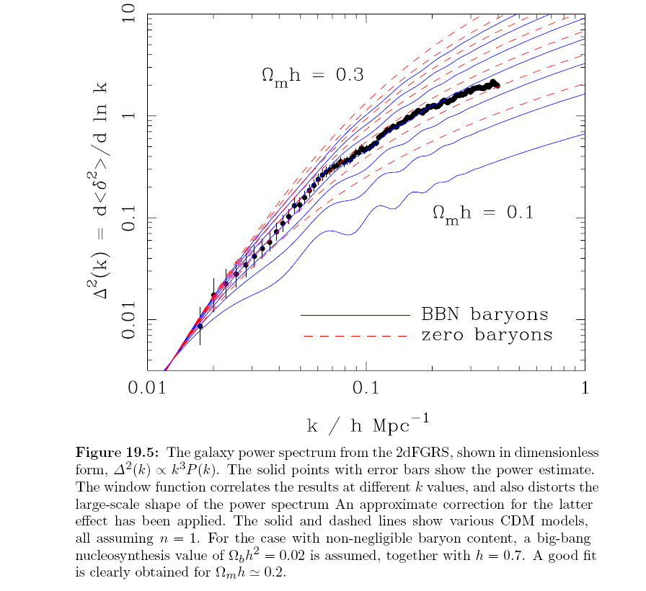

Slide 55
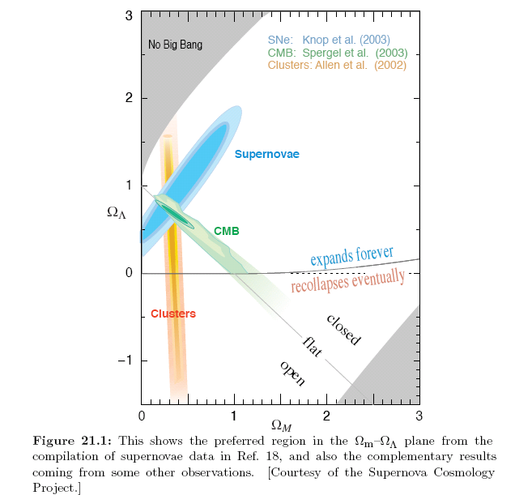
Combined Results
Hubble ST + WMAP + clusters
point to the existence of DM and DE:

Slide 56
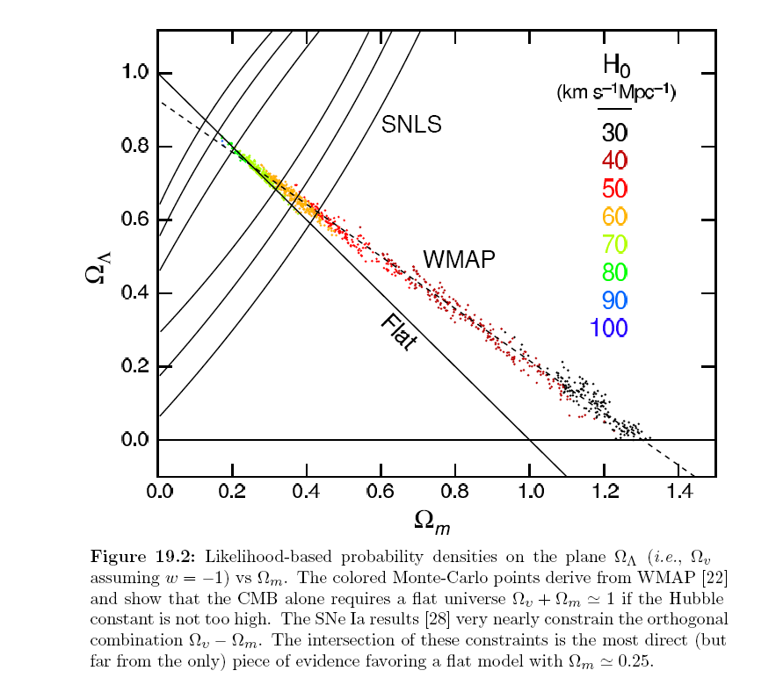

Slide 57
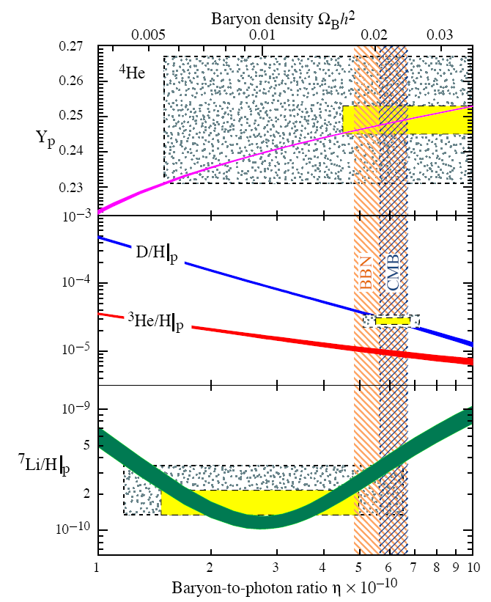



BBN constraints
BBN+CMB:

Slide 58
Dark Matter Candidates
Baryonic
MACHOS MAssive Compact Halo Objects
If a star's mass is less than one twentieth of our Sun, its core is not hot enough to burn either hydrogen or deuterium, so it shines only by virtue of its gravitational contraction, not luminous enough to be directly detectable by our telescopes. Brown Dwarfs and similar objects have been nicknamed MACHOs
Supermassive Black Holes, thought to power distant quasars.
detection by gravitational lensing
Non baryonic (CDM and HDM)
WIMPs (Weakly Interacting Massive Particles) or non-baryonic matter , produced shortly after the Big Bang
neutrino - HDM
sterile neutrino with KeV masses WDM
axion - CDM,
neutralino, gravitino, axino
Modified gravity models able to explain the dynamics of the LSS
without DM but have problems at Solar system scales.

Slide 59
The role of flavor neutrino
There exist robust experimental and observational evidence for the existence of neutrino oscillations, pointing to at least 2 non-zero neutrino masses.
Contribution of neutrinos to total energy density today (3 degenerate masses)
In case neutrino masses are in the eV range they can constitute several % of the DM, they can influence matter clustering (suppressing small-scale power of the matter power spectrum) providing better correspondence between models and observational data (from SDSS, cluster abundance, weak lensing, Lyman Alpha forest, CMB). Tegmark et al., 2004

Slide 60

Particle Dark Matter Candidates
ν
cold
thermal
relics
Other
Scales:
wimpzilla
log₁₀(σ/picobarns)
axion
gravitino

Slide 61
DARK ENERGY
Accelerated Expansion
  LSS Ω_{Μ} = 0.3
Flatness
  Ω ₀ = 1
  Ω_{Μ} = 0.3
  1 − 0.3 = 0.7
DE density
Е. Колб: The unbearable lightness of nothing!
Непоносимата лекота на нищото!

Slide 62
Dark Energy
SN I data about accelerated expansion.
The source of this acceleration is not understood yet. It is nicknamed dark energy.
Whatever it is, it appears to make up most of the mass of the universe – around 70%.
CMB prefers “cosmological constant“, not “quintessence ".
Most of the universe is made of some mysterious form of energy whose nature is completely unknown…..

Slide 63
Supernovas Classification

Slide 64

HST, SN and DE
HST, SN and DE
Hubble observations show for the first time that dark energy has been a present force for most of the universe's history.
Snapshots, taken by NASA's Hubble Space Telescope, reveal five supernovae and their host galaxies. The supernovae exploded between 3.5
and 10 billion years ago. Astronomers used the supernovae to measure the expansion rate of the universe and determine how the expansion rate
is affected by the repulsive push of dark energy. Supernovae provide reliable measurements because their intrinsic brightness is well
understood. They are therefore reliable distance markers.

Slide 65

Обичайното вещество гравитира.
Антигравитация изисква наличие на
необичайна среда с Р < 0 и
Каква е причината за ускорението?
космологична константа
ненулева енергия на вакуума
систематични ефекти
...........
p/ = ω < -1/3 разширение с ускорение

Slide 66

2dF data

Slide 68

Union 300 SN Ia
&
CMB
&
BAO
Combined results
of studies of the dynamics,
CMB and structures of the Universe
point to the existance of DE and DM:

Slide 69


Agreement between independent data

Slide 70

Nature of Dark Energy
cosmological constant
an energy of empty space
Why space should contain the observed amount of energy and not, say, much more or much less?
quintessence (time varying cosmological constant)
Unlike the energy of space envisioned by Einstein, quintessence would have the property that it could vary from place to place and moment to moment. Existing evidence tends to disfavor quintessence.
Accelerating universe signals a new aspect of the law of gravity.
An effect of extra dimensions of space
One of the extra dimensions (predicted by supersymmetry of space can mimic the effect of a dark energy by causing the expansion of our three-dimensional space to accelerate.

Slide 71


Slide 72





Енергия на вакуума
За енергията на вакума естественото очакване е
В действителност обаче
Newton's constant: G = (6.67 ± 0.01) x 10-8 cm3 g-1 sec-2
Cosmological constant: L = (1.2 ± 0.2) x 10-55 cm-2
Equivalently (ℏ = c = 1),
EPlanck = 1018 GeV , Evac = 10-12 GeV .
Причината за това силно отличие е неизвестна: мулти Вселени с различни
енергии на вакуума, вечната инфлация, нова симетрия, резултат от
допълнително пространствено измерение, проявяващо се при големи разстояния,
модифицирана гравитация (отхвърлена от тестове в слън с-мо)

Slide 73


ТЕ е бавно меняща се динамична компонента – скаларно поле квинтесценция
Невзаимодействащо и с прецизно фитирана маса

Slide 74
Енергия на вакуума
честота
водещ принос
ултравиолетов cut off

Slide 76


Slide 78



Baryonic Density
“Бариони”
5%
Тъмна енергия
73%
Тъмно вещество
22%
BBN
Standard Big Bang Nucleosynthesis provides a probe of the
baryonic density at the epoch when the Universe was few minutes.
D towards low Z QAS at high z
The recent deuterium observations in pristine enviroments towards
quasars at high z D/H=(3±0.4) 10⁻⁵ have provided a precise
determination of the baryonic density.
CMB
Precise determination, corresponding to the epoch,
when the Universe was several hundred thousands years
old z ~ 1000, from observations of the anisotropy of the
CMB by DASI, BOOMERANG, MAXIMA and WMAP experiments .
Baryonic density is ~ 0.045 of the total, i.e. much bigger than the visible matter (0.005),
considerably smaller than the density of clustered matter (0.3).
Why the baryonic component is negligible constituent of the total density ?

Slide 79

Antimatter in the Universe
Missions for search of cosmic/galactic antimatter: PAMELA, BESS, AMS, AMS 2 (2009), PEBS(2010), etc
The cosmic ray results from search of antiprotons, positrons and antinuclei indicate that there is not significant quantity of antimatter objects within a radius 1 Mpc.
BESS 98
AMS 01
PAMELA antiprotons secondary origin, positron excess ?
HESS positron excess
Gama ray flux measurements exclude significant amounts of antimatter
up to the distance of galaxy cluster scales ~ 10 -20 Mpc.
Steigman 79, Stecker 85, Dolgov 99
CR and gama ray data do not rule out antimatter domains > 10 -20 Mpc,
or small ratios of antimatter/matter objects on small scales (stars, globular clusters).
Subdominant domains of antimatter allowed within the Galaxy as well.
Both theory and observations allow astronomically significant antimatter .
Baryon Asymmetry generation?
Models of separation of matter from antimatter domains ?

Slide 81



Results from PAMELA -2
Emiliano Mocchiutti
Preliminary
Evidence for Dark Matter
Annihilation?

Slide 83




Matter Content in the Universe
To solve the Friedmann equations, one has to specify the Universe matter content
and the equation of state for each of the constituents. Current observations point to at least four components:
Radiation (relativistic degrees of freedom) ~0.002%
Today this component consists of the photons and neutrino and gives negligible contribution into total energy density. However, it was a major fraction at early times.
Baryonic matter
Dark matter
Was not directly detected yet, but should be there.
Constitutes major matter fraction today.
Dark energy
It provides the major fraction of the total energy density.
Was not anticipated and appears as the biggest surprise and
challenge for particle physics, though conceptually it can be
very simple, being just a `cosmological constant' or vacuum energy.
~4%
~20%
~76%
4% - Н+Не, 0.0025% heavy elements, 0.8% stars, 0.005% CMB
23% - DM, 73% DE, 0.17% neutrino

Slide 84


Radiation:
0.005%
Chemical Elements:
(other than H & He) 0.025%
Neutrinos:
0.1% - 0.5%
Stars:
0.5%
H & He:
gas 4%
Cold Dark Matter:
(CDM) 22%
Dark Energy (Λ):
73%

Slide 85


Cosmological Parameters

Slide 88


Slide 89
Наред с безпрецедентната точност при определяне на редица характеристики на Вселената, като например плътността на познатото ни барионно вещество, следваща от данните относно КН и КМФ, съвременната космология се сблъсква със сериозни загадки. Съгласно съвкупност от независими наблюдателни данни от свръхнови, КМФ, КН и др. 22% от пълната плътност на Вселената представлява тъмно вещество, а 73% е във вид на тъмна енергия. Каква е природата на 95% от материята на Вселената?
Дали съществува космологична константа или поле отговорни за тъмната енергия, дали нови екзотични физични теории, като суперсиметрията например, ще предложат кандидата за тъмното вещество или тъмното вещество и енергия са сигнатури за необходимост от алтернативна гравитационна теория ?
Очакваме бъдещите изследвания и в частност Големия адронен колайдер, да дадат отговори на част от космологичните загадки.

Slide 90
Summary
BBN is the most sensitive cosmological probe of number of neutrino species, of distortions in the energy distribution of neutrinos, lepton asymmetry, neutrino mass differences and mixings, etc. It provides constraints on many neutrino characteristics.
Active-sterile oscillations lead to additional species into equilibrium,
distort neutrino spectrum and neutrino-antineutrino asymmetry, thus
influencing Universe expantion, CMB and BBN.
BBN constraints on neutrino oscillations parameters depend nontrivially
on the population of sterile neutrino and the lepton asymmetry in the Universe.
CMB+LSS constraints (sensitive to the total energy density can be obtained 1<δN_{s}<5 ,
CMB +LSS constrains total neutrino mass < 0.6 eV
CMB+LSS sensitive to the total energy density , they put the most stringent constraints
to the sum of neutrino masses.
These constraints are much stronger than the existing laboratory mass constraints.
Future Planck mission will strengthen CMB constraints considerably.

Slide 91
Какво знаем за Вселената
еднородна и изотропна на големи мащаби
плоска, с пренебрежима кривина
разширява се с ускорение от 5 млрд години
доминирана от равномерно разпределена
тъмна енергия ~ 73% с характеристики на Λ
Веществото е предимно тъмно
и небарионно, плътността му е подкритична ~ 0.27 ,
барионната му компонента съставлява <5%!
Леките елементи деутерий, хелий-3,
хелий-4 и литий-7 са
синтезирани в ранната Вселена.
Днешната Вселена е изпълнена с реликтови фотони и неутрино.
Наблюдателни свидетелства от различни епохи на еволюцията на Вселената:
обилието на леките елементи от първите минути на Големия Взрив, КМФ от 300 000 г-ни от
началото, структурите от първите милиард години, предоставят информация за
характеристиките на Вселената и поставят ограничения върху физиката отвъд СМ.

Slide 92

Бъдещи космични мисии и наземни наблюдения и ескперименти на ускорители и колайдери да прецизират знанията за нашата Вселената и изяснят космологичните загадки - ТВ, ТЕ, бариогенезис, инфлация, плоскостност, изотропия, ..........
Колайдер
Произвежда частици & aнтичастици, съществували ~ 1 ps след Големия Взрив
LHC
(pp)
Една
сила
Четири
сили
Физиката на частиците изследва свойствата на частиците, произведени на ускорители
.
92
Notes:
92

