Slide 1

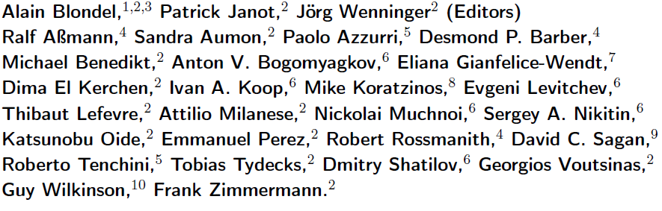
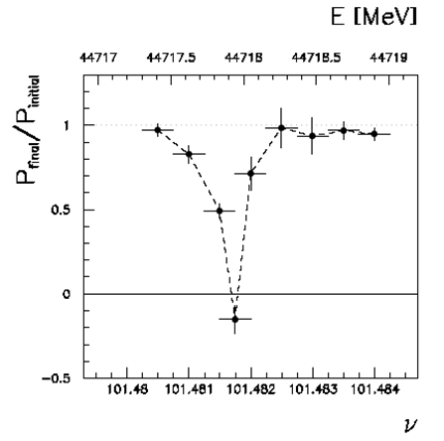
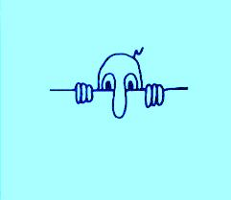
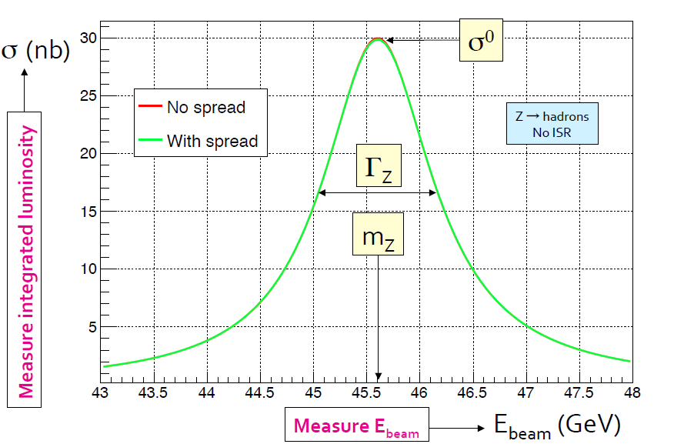

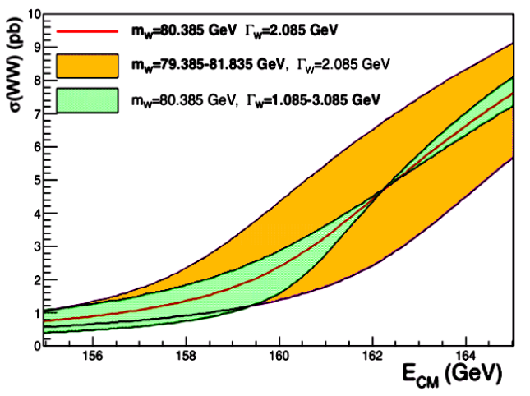
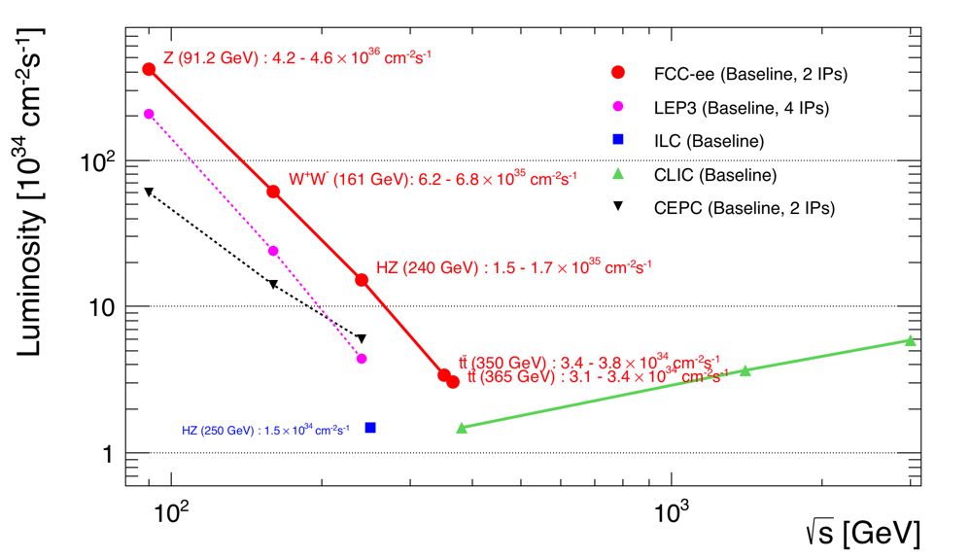
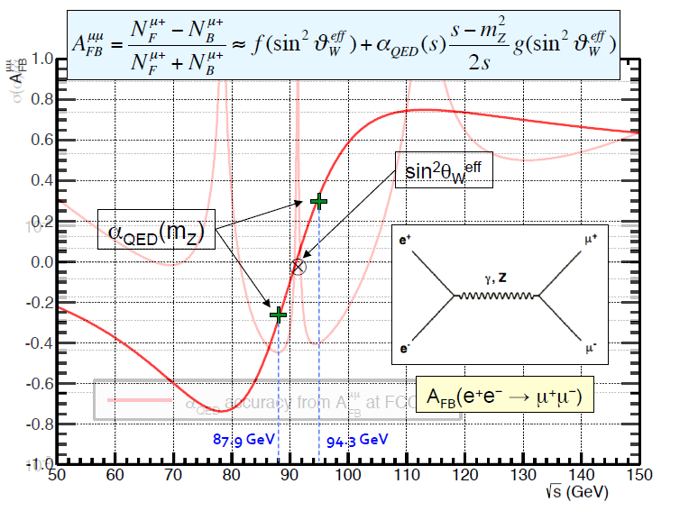
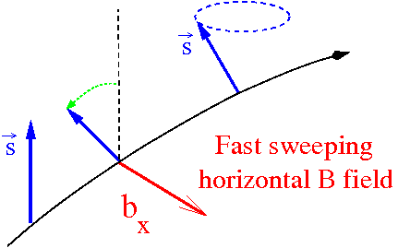

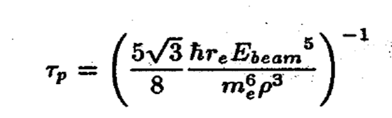
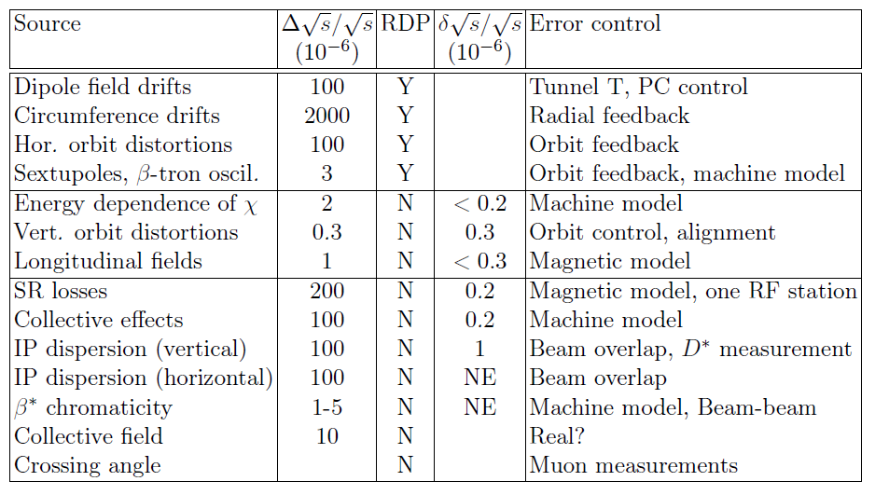
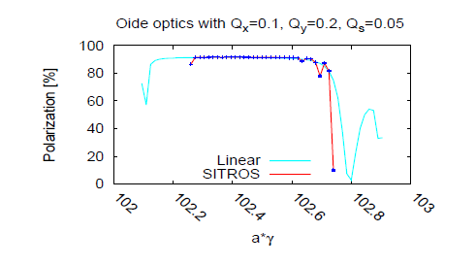
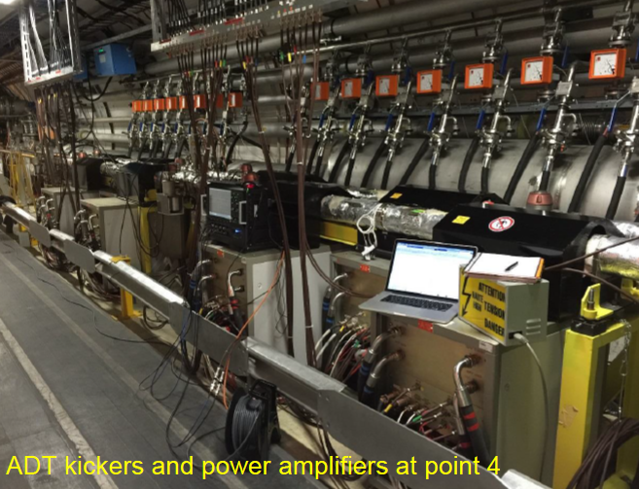
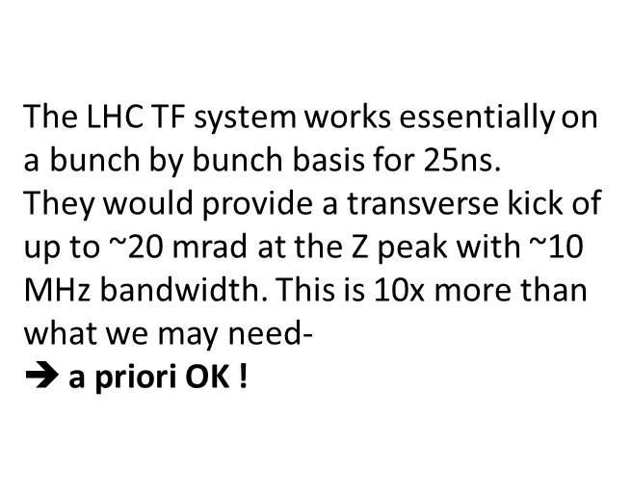
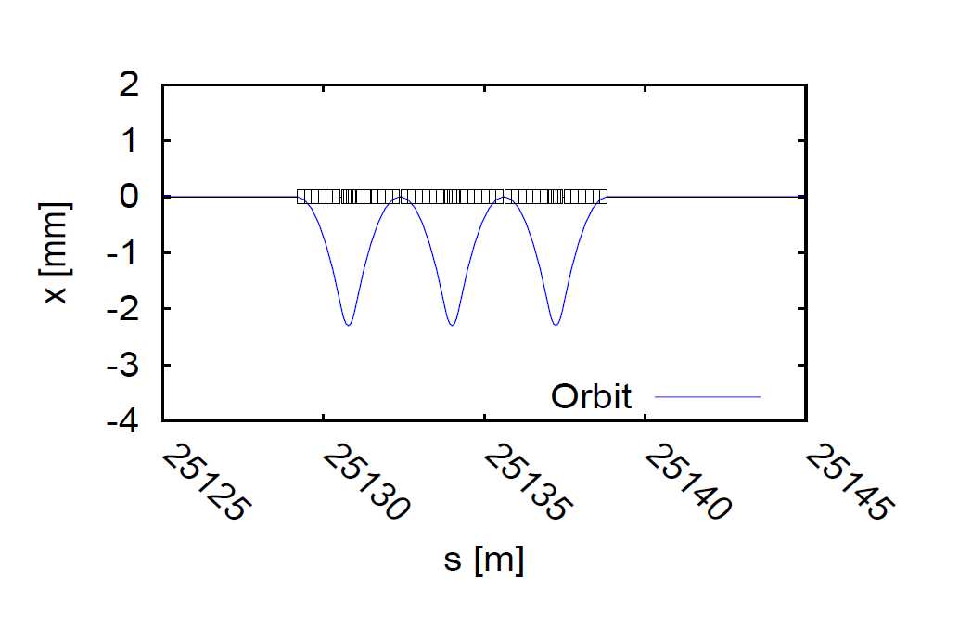
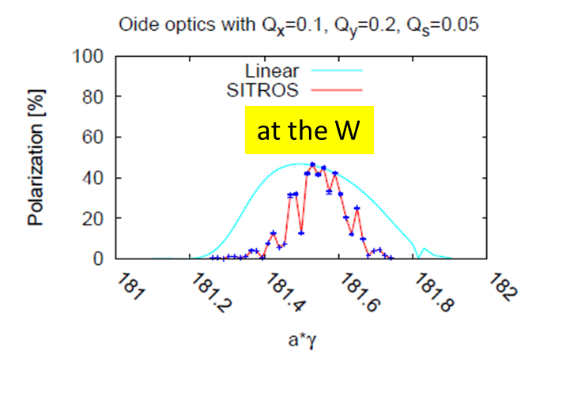
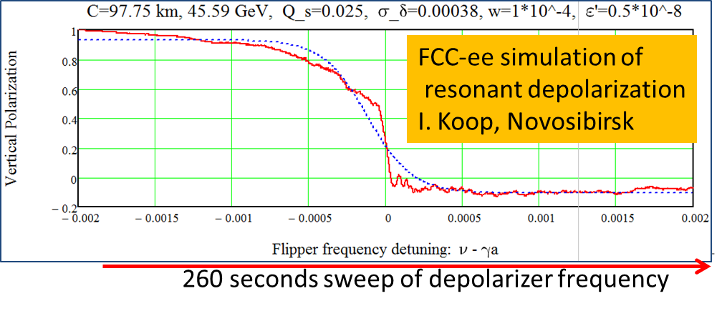


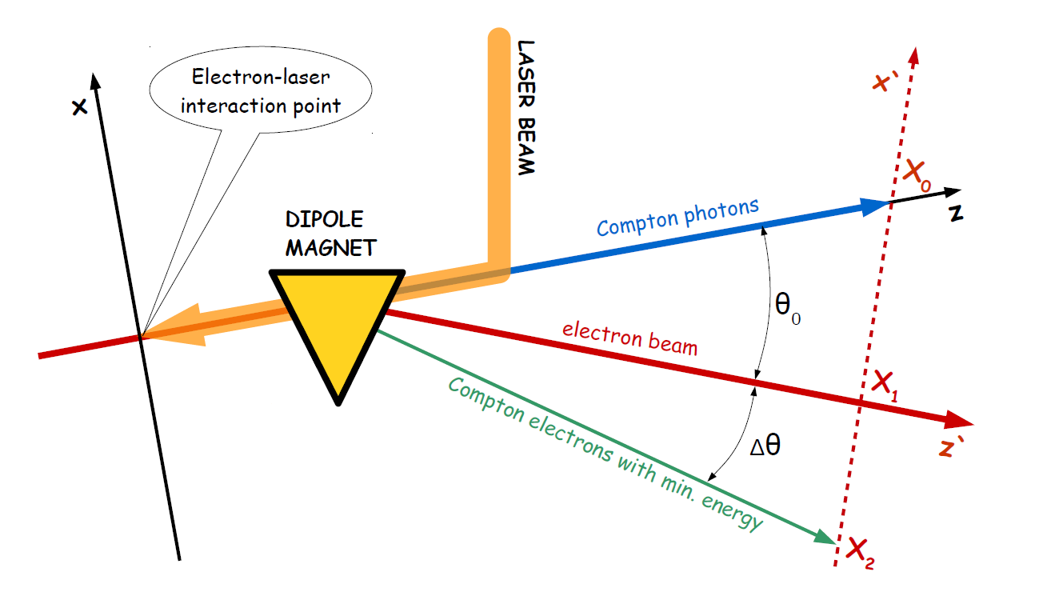

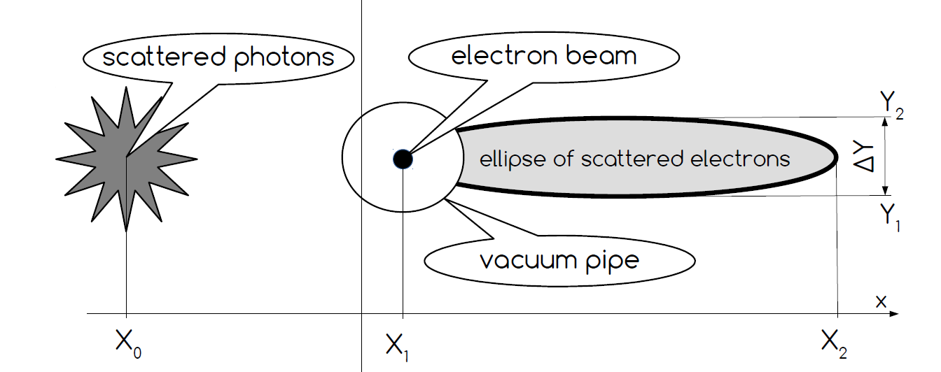
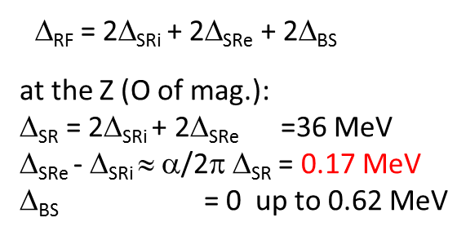
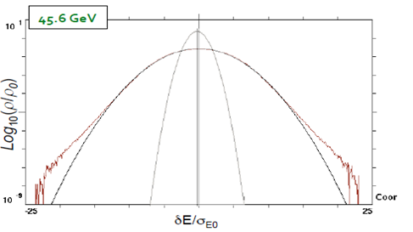
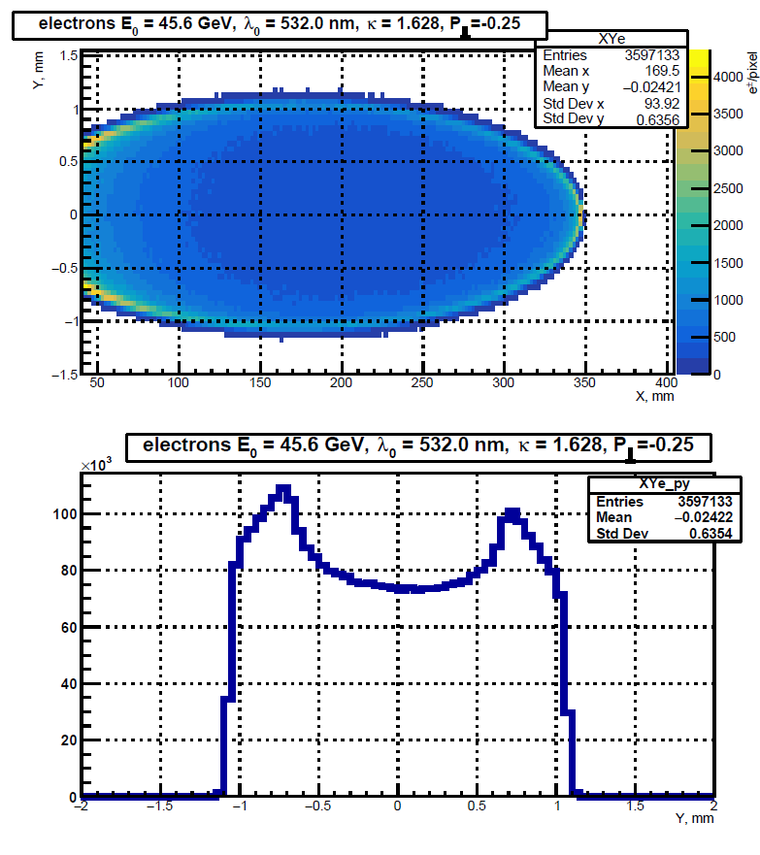
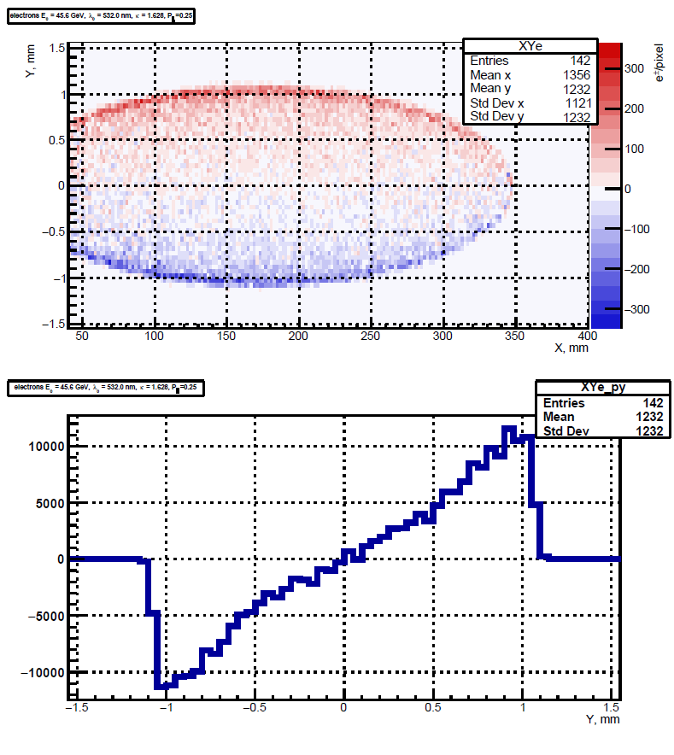
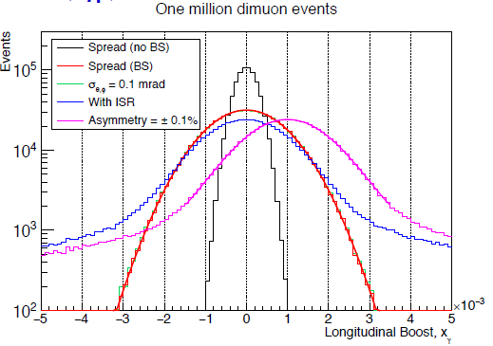
Beam Polarization and
E_{CM} Calibration at FCC-ee
The FCC-ee Energy and Polarization Working Group
Alain.Blondel@cern.ch arXiv:1909.12245v1
¹Uni Geneva, ²CERN, ³CNRS/IN2P3 LPNHE Paris, ⁴DESY, ⁵INFN Pisa,
⁶BINP Novosibirsk, ⁷Fermilab, ⁸MIT, ⁹Wilson Lab, Cornell, ¹⁰Uni Oxford
!
!
Electroweak Factory
Physics priorities scan points
LEPx10⁵!
5 10¹² Z
3 10⁸ WW
10⁶ ZH
10⁶ ‾t t
FCC-ee will produce huge statistics of Z and Ws and millions of Higgs and tops.
This is an opportunity to perform extremely precise measurements of many electroweak observables, such as mass and width of the Z, Z pole asymmetries, the W, & top quark masses, and Higgs mass and width. These quantities are sensitive to new physics up to 10-100 TeV (decoupling) or possibly much more (non decoupling).
This also enables to perform e+e- → H s-channel production measure the electron Yukawa couling.
This requires high luminosity and an extremely precise knowledge of the beam energy, UNIQUE TO THE MODERN CIRCULAR e+ e- and COLLIDERS
Scans using the half integer spin tunes can be used.
for Z line shape ν= 99.5, 103.5, 106.5/107.5
and W W threshold ν= 178.5, 184.5
In order to avoid extrapolation errors, a set of 200 ‘pilot’ bunches – having no colliding counterpart -- will be stored at the beginning of fills with polarization wigglers ON, for about 1.5 hour to develop about 5-10% transverse polarization, then, after a first energy calibration is performed, the full luminosity run will comprise regular calibrations (1/10 min) on the pilot bunches.
Goal precisions; uncertainties on
m_{Z} , Γ_{Z} : ±100 keV , m_{W} : ±300 keV – or better.
Beam Energy measurement by Resonant depolarization
Resonant depolarization
Beam energy uncertainties
This is a well known method, which has been used to measure particle masses such as the J/ψ à Novosibirsk, the
τ mass at IHEP Beijing, the ϒ mass at Doris (DESY), the Z mass at LEP. It requires transverse polarization of the beams
A visible depolarization can be realized with a transverse
kicker excited at a frequency in resoance with the
spin precession frequency a.k.a. spin tune ν
Absolute: The proportionality between spin tune and beam energy is rigourously true only if the ring is perfectly planar. A certain number of effects resulting from imperfections in the ring can affect this relation and bias the beam energy calibration.
Other effects such as opposite sign dispersion at the IRs also need to be considered.
Beam polarization
Polarization Wigglers
The polarization time at the Z is slow, (250 hrs)
In FCC-ee the e+ and e- beams polarize naturally
along the magnetic field by Sokolov-Ternov effect.
Excellent levels of asymptotic polarization are expected in FCC-ee at the Z, and sufficient at the W.
The spin tune is proportional to
the beam energy
It can reduced using asymmetric Polarization wigglers
placed in dispersion-free regions (H,F)
8 such units per beam with
B+=0.7 T L+ = 43cm L-/L+ = B+/B- = 6
at Eb= 45.6 GeV and B+= 0.67 T (E_{crit}=902 keV)
will provide a polarization level of P=10% in 1.8H
while increasing the energy spread within
a reasonable value of σ_{Eb} = 60 MeV
The bunch crossing rate at
the Z is 1/10ns.
at the Z
The well known plot shown in banner of this poster shows the location of the resonance at LEP (in that case ±100keV)
The process has been simulated by I. Koop for FCC-Z with
a precision of ±50 keV each time, 5 X worse at W.
A summary of possible uncertainties on E_{CM}.
Point-to-point (ptp) :The Z width, and the A_{FB} depend on relative uncertainties between the scan points. When considering only errors that can be different between scan points a relative error of ~±20keV at the Z is inferred. Experimental verification either with the polarimeter-spectrometer or using muon pairs can be made at ±40 keV on a daily basis.
Polarization measurement
From spin tune to E_{CM}
Opposite sign dispersion
The electron or positron beam polarization can be measured with a compton backscattering polarimeter. This technique was already used at LEP, where only the backscattered photons were detected. The FCC-ee polarimeter, designed by Muchnoy, proposes to make use also of the recoil electron to increase the sensitivity.
Δ_{SRe}
Δ_{SRi}
IP1
α=30 mrad
There will be two polarimeters, for e+ and e-, using the dispersion suppressor magnet, as the beam enters
points H and F on the locally outer ring.
E+ = E₀⁺ + 0.5Δ_{RF} -2Δ_{SRi} - Δ_{SRe} – 1.5Δ_{BS}
E⁻ = E₀⁻ - 0.5Δ_{RF} - Δ_{SRi} – 0.5Δ_{BS}
➔ E⁺ + E⁻ = E₀⁻+ E₀ (+ Δ_{SRe} - Δ_{SRi} )
Since the two beams circulate in two independent rings it is unavoidable that there will be a residual opposite sign dispersion in both x and y planes. This can bias the center-of-mass energy, by up to 4 MeV.
This requires beam collision scans every hour to reduce the total error to <40 keV. It is expected to be largely correlated between the scan points .
Δ_{RF}
←E₀ at half RF
single RF system ➔ E⁺ + E⁻ constant
if e+, e- energy losses are the same
(mod higher order corrections)
cross-checks: E⁺ - E⁻ (boost of CM),
+ measured Z masses!
IP2
RESULTS and CONCLUSIONS
The impact on the energy calibration systematics on the key line shape measurements are as follows.
We are well on track to achieve center-of-mass energy calibration systematics at the level of 100 keV (abs.) 40 keV (rel.) at the Z and 300 keV at the W – or better.
There remains much to do:
-- integration of spin code in optics codes
-- diagnostics to measure directly beam-beam offsets and local dispersion to control Opp. Sign Vert. Dispersion
-- improve precision at the W threshold to match 200keV stat.
-- Wiggler implementation
-- further reduction of point to point errors
-- energy model, logging and diagnostics
-- spectrometer stability
-- expt magnet and momentum scale stability
-- automatization and logging of all procedures!
JOIN US!
The polarimeter is sketched above. The e-γ IP is situated upstream of a ring magnet with suitable optics, so that the backscattered photon beam is centered on X_{o}, in the direction of the original beam, while the recoiling electrons are defelected by the magnet and measured between X₁ (the unscattered beam) and X₂ (for the slowest electrons). For a 45 GeV beam and a distance of the detection plane of 100m from the e-γ IP, X₂ - X_{o} = 638 mm. The end point moves by 2.4 microns for a variation of energy of 10⁻⁵. The polarimeter thus acts as a spectrometer, capable of constantly monitoring the beam energy with a sensitivity of a few 10⁻⁵ every second.
energy E₀ around ring is determined by magnetic fields
➔same for colliding or non-colliding beams
-- measured by resonant depolarization
-- can be different for e⁺ and e⁻
Beam energy spectrum without/with beamstrahlung
-- layout of accelerator with one RF station
➔ 0.5 (E_{CM}^{A} + E_{CM}^{G} ) = (E_{b}⁺ +E_{b}⁻ ) cos(α_{crossing} /2)
-- E_{b}⁺ vs E_{b}⁻ asymmetries and energy spread can be
measured/monitored in expt, using e+e- → μ+ μ- events
longitudinal momentum shift and spread (Janot)
In 5 min at the Z the energy spread and (E_{b}⁺ - E_{b}⁻ )
can be measured to ± 40 keV.
_{Quantity} _{(unit)} | stat. error | ΔE_{CM} (abs) 100 keV | ΔE_{CM} (ptp) 40 keV | Energy spread 50 keV
m_{Z} (keV) | 4 | 100 | 28 | --
Γ_{Z} (keV) | 4 | 2.5 | 22 | 10
sin² θ_{W}^{eff} from A_{FB}^{μμ} | 2 10⁻⁶ | -- | 2.4 10⁻⁶ | --
Δα_{QED}(mz) ________________________ α_{QED}(mz) | 3 10⁻⁵ | 0.1 10⁻⁵ | 0.9 10⁻⁵ | 0.05 10⁻⁵
The measurement of polarization will be made, as in LEP, by observing changes in the recoil electron and photons,
upon reversing the circular polarization of the incoming laser beam. The beam spot of the photon beam will move
by about ± P x1.4 mm at a distance of100 m. If the polarization is small this movement can be mistaken with a
movement of the beam. The change for the electron recoil is more distinctive: the change in the relative
population of the outer ring of the electron recoil spot is unmistakable.
The beam (transverse or longitudinal) polarization can be measured with a precision of ±1% every second.

