Slide 1
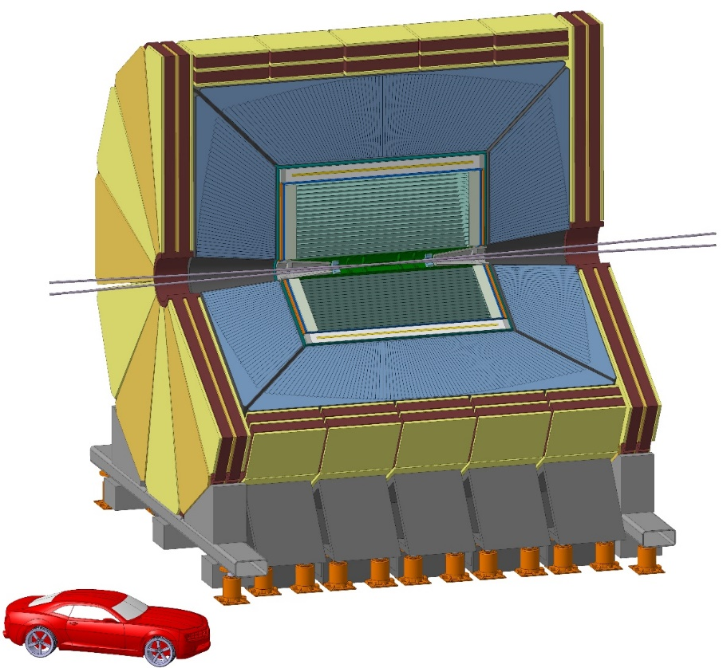
A proposal of a drift chamber for the IDEA detector concept for a future e⁺e⁻ collider
Innovative
Detector for Electron-positron Accelerators
More details in F. Bedeschi:
"A detector concept proposal for a circular e+e- collider",
Talk at this conference
Tassielli G.F. - INFN Lecce & Mathematics and Physics Dept., University of Salento
Notes:
1

Slide 2
Outline
FCC-ee
Tracking requirements
The IDEA tracking system
The IDEA drift chamber
  Novel approach at construction technique of high granularity and high transparency Drift Chambers
  Cluster Counting/Timing and P.Id. expected performance
Expected simulated performance
Ongoing R&D
Summary

Slide 3
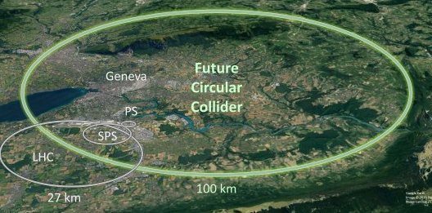
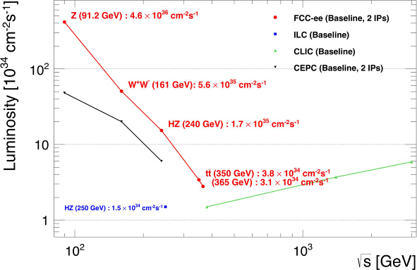
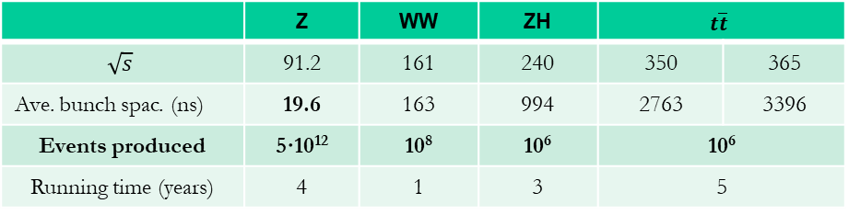
FCC-ee
FCC-ee: high-luminosity circular electron-positron collider allowing for high-precision measurements of the properties of the Z, the W, the top quark and the Higgs boson.
“FCC-ee: The Lepton Collider”
Eur. Phys. J. Special Topics 228, 261-623 (2019)
https://doi.org/10.1140/epjst/e2019-900045-4
 | Z | WW | ZH | $$t\overline{t}$$
$$\sqrt{s}$$ | 91.2 | 161 | 240 | 350 | 365
Ave. bunch spac. (ns) | 19.6 | 163 | 994 | 2763 | 3396
Events produced | 5·10¹² | 10⁸ | 10⁶ | 10⁶
Running time (years) | 4 | 1 | 3 | 5

Slide 4
Tracking requirements
Central tracker system:
state-of-the-art momentum and angular resolution for charged particles;
B field limited to ~ 2 T to contain the vertical emittance at Z pole. Large tracking radius needed to recover momentum resolution.
High transparency required given typical momenta in Z, H decays (far form the asymptotic limit where the Multiple Scattering contribution is negligible).
Particle ID is a valuable additional ability.
Vertexing:
excellent b- and c-tagging capabilities : few μm precision for charged particle origin;
small pitch, thin layers, limited cooling, first layer as close as possible to IP.
Challenges:
Physics event rates up to 100 kHz (at Z pole)
strong requirements on sub-detectors and DAQ systems

Slide 5
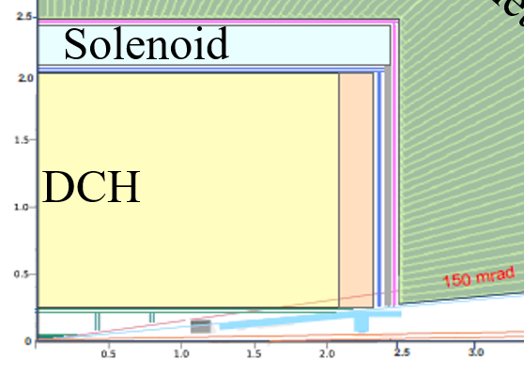
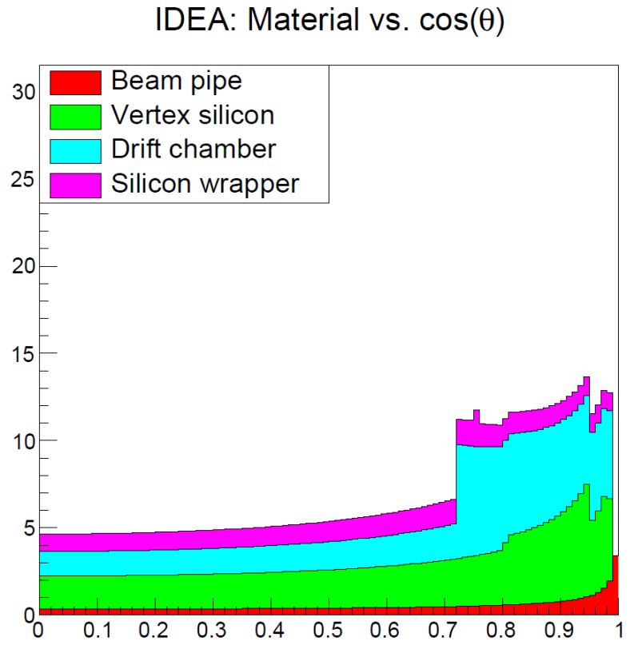
The IDEA tracking system
Solenoid: 2 T, length = 5 m,
r = 2.1-2.4 m, 0.74 X₀, 0.16 λ @ 90º
Si Wrapper:
2 layers of µ-strips (50 µm x 1 mm)
both barrel and forward regions
DCH: 56448 (~1.2 cm) cells
He based gas mixture
(90% He – 10% i-C₄H₁₀)
% X₀
100 mrad
Luminometer
~ 5% X₀ - barrel
< 15% X₀ - forward
  Vertex:
inner: 3 single Si pixel (20 µm x 20 µm) layers of 0.3% X₀
outer: 2 single Si pixel (50 µm x 50 µm) layers of 0.5% X₀
forward: 4 single Si pixel (50 µm x 50 µm) layers of 0.3% X₀

Slide 6
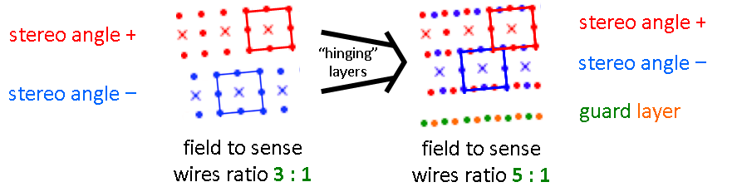
The IDEA drift chamber
(12÷14.5 mm at z=0)
The wire net created by the combination of + and – orientation generates a more uniform equipotential surface
sense wires: 20 mm diameter W(Au) => 56448 wires
field wires: 40 mm diameter Al(Ag) => 229056 wires
f. and g. wires: 50 mm diameter Al(Ag) => 58464 wires
343968 wires in total
High wire number requires a non standard wiring procedure and needs a feed-through-less wiring system. The novel wiring procedure developed and used for the construction of the ultra-light MEG-II drift chamber must be used.
MEG-II: muon to e-gamma search experiment at Paul Scherrer Institut - “The design of the MEG II experiment”, Eur. Phys. J. C (2018) 78:380 - https://doi.org/10.1140/epjc/s10052-018-5845-6

Slide 7
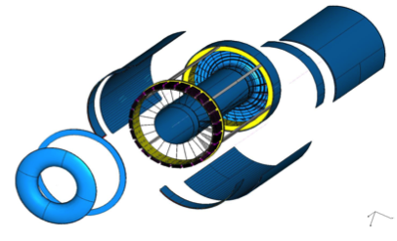
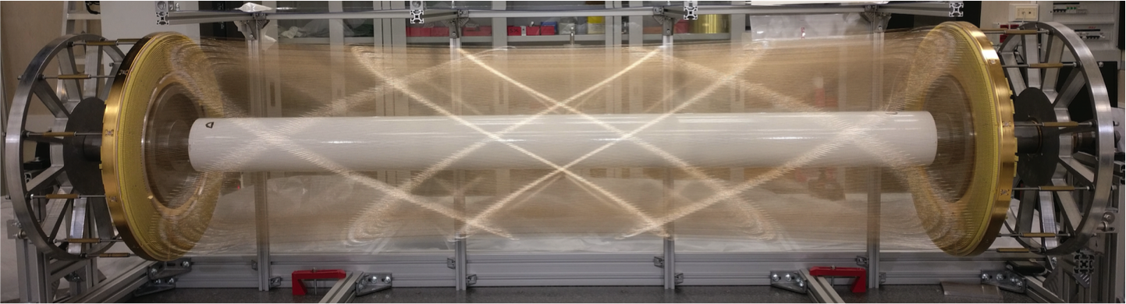
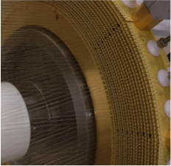
Novel approach at construction technique of high granularity and high transparency Drift Chambers
wire cage
Based on the MEG-II DCH new construction technique the IDEA DCH can meet these goals:
Gas containment – wire support functions separation:
  allows to reduce material to ≈ 10⁻³ X₀ for the inner
  cylinder and to a few x 10⁻² X₀ for the end-plates,
  including FEE, HV supply and signal cables
Feed-through-less wiring:
  allows to increase chamber granularity and field/sense wire ratio to reduce multiple scattering and total tension on end plates due to wires by using thinner wires
gas vessel

Slide 8
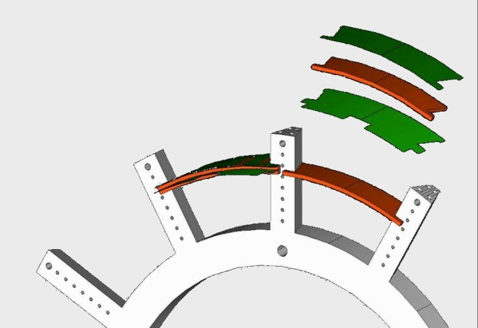
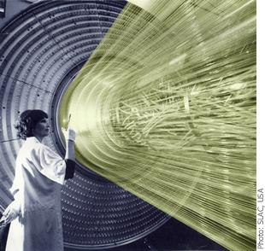
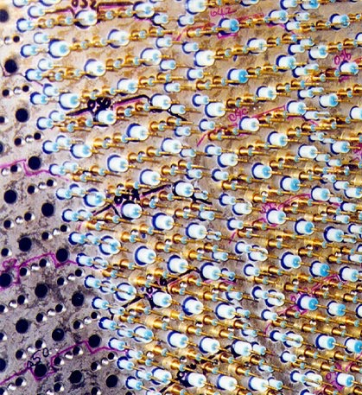
Novel approach at construction technique of high granularity and high transparency Drift Chambers
The solution adopted for MEG II:
wire PC board
peek spacer
end-plates numerically machined from solid Aluminum (mechanical support only);
Field, Sense and Guard wires placed azimuthally by a Wiring Robot with better than one wire diameter accuracy;
wire PC board layers (green) radially spaced by numerically machined peek spacers (red) (accuracy < 20 µm);
wire tension defined by homogeneous winding and
wire elongation (ΔL = 100μm corresponds to ≈ 0.5 g);
Drift Chamber assembly done on a 3D
digital measuring table;
build up of layers continuously checked
and corrected during assembly;
End-plate gas sealing done with glue.
wire PC board
spoke
(~ 12 wires/cm²) impossible to be built with a conventional technique based on feedthrough:

Slide 9
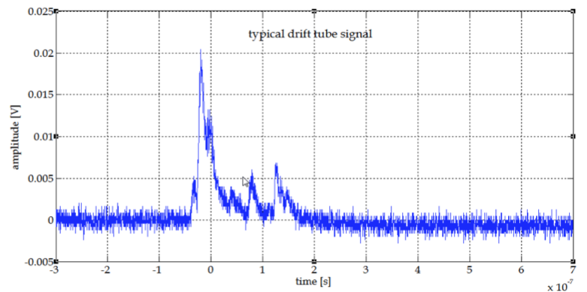
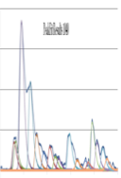
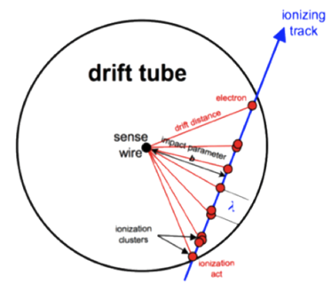
Cluster Counting/Timing and P.Id. expected performance
In He based gas mixtures the signals from each ionization act can be spread in time to few ns. With the help of a fast read-out electronics they can be efficiently identify.
Counting the number of ionization acts per unit length (dN/dx) is possible to identify the particles (P.Id.) with a better resolution than dE/dx method.
acquired signal
identified peaks
dE/dx dN_{cl}/dx
truncated mean cut (70-80%) reduces the amount of collected information. n = 112 and a 2m track at 1 atm give σ ≈ 4.3%
δ_{cl} = 12.5/cm for He/iC₄H₁₀=90/10 and a 2m track give
σ ≈ 2.0%
Moreover, C.C. may improve the spatial resolution < 100 μm for 8 mm drift cells in He based gas mixtures

Slide 10
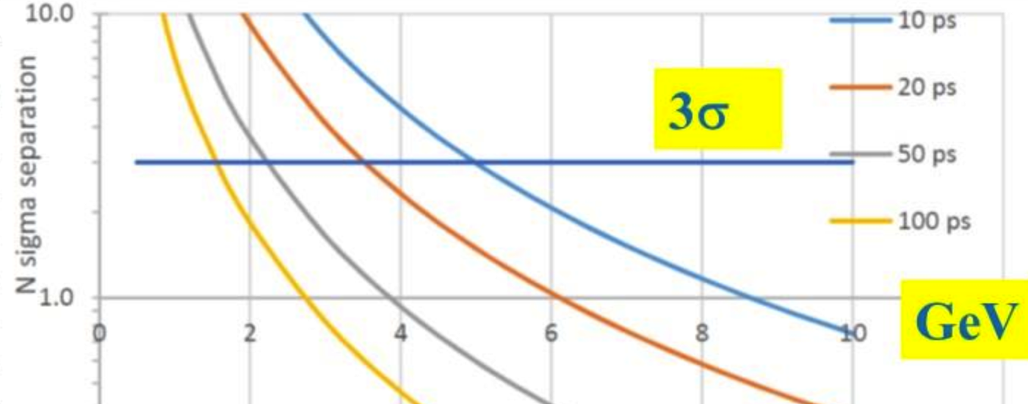
Cluster Counting/Timing and P.Id. expected performance
Expected excellent K/π separation over the entire range except 0.85<p<1.05 GeV (blue lines)
Could recover with timing layer
dN/dx
e/μ
μ/π
dE/dx
K/π
K/p
analytic evaluation, to be checked with detailed simulations and test beams
Nσ K/π separation with TOF over 2 m
3σ

Slide 11
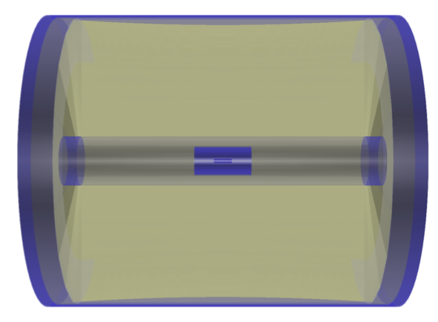
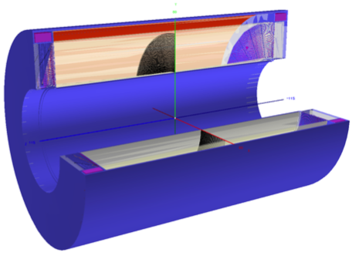
Expected simulated performance
A full geant4 simulation of the IDEA tracking system was developed to test the tracking performance
The DCH is simulated at a good level of geometry
details, including detailed description of the endcaps;
SVX and Si wrapper are simulated as simple
layer or overall equivalent material;
KF with simple track selection criteria was used: only a quality cut on Chi2/nDof < 25 was applied;
A preliminary SVX and DCH description inside the FCC-sw was implemented
More details in: G. Tassielli: "Tracking performance with the updated geometry of the IDEA detector ", 11th FCC-ee workshop, CERN, January 2019"
N. A. Tehrani: “Simulation and tracking studies for a drift chamber at the FCC-ee experiment”, CERN-ACC-2019-0043

Slide 12
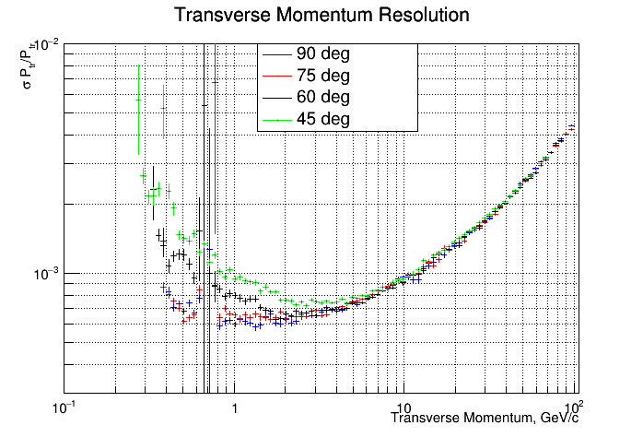
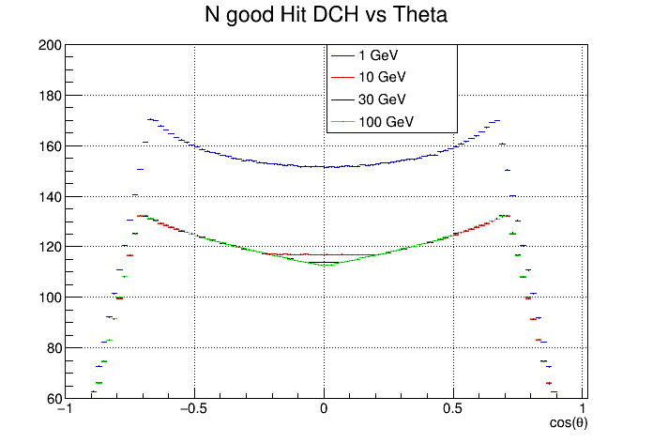
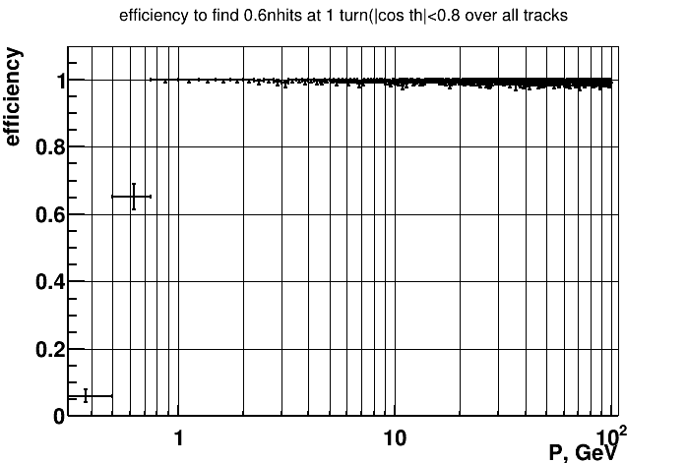
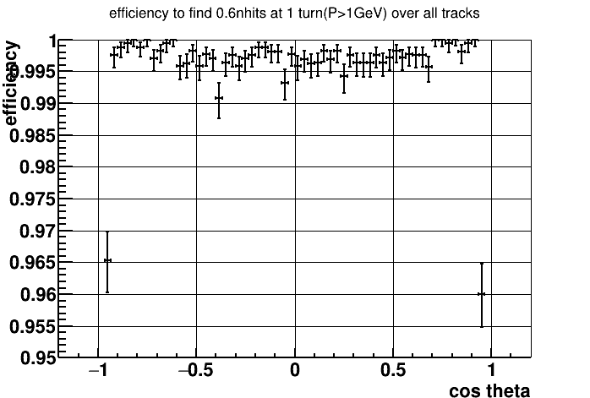
Expected simulated performance
assumed: σ_{d} = 100 µm and
(conservative for Si) σ_{Si} = pitch/√12 µm
σp_{t/}p_{t}
>100 Hits per tracks |ϑ|<45°
> 60 Hits per tracks |ϑ|<25°
Single track efficiency
> 99.5%
(defined as reconstructed track with >60% good hits)
Si-Wrapper not yet included in the PR algorithm

Slide 13
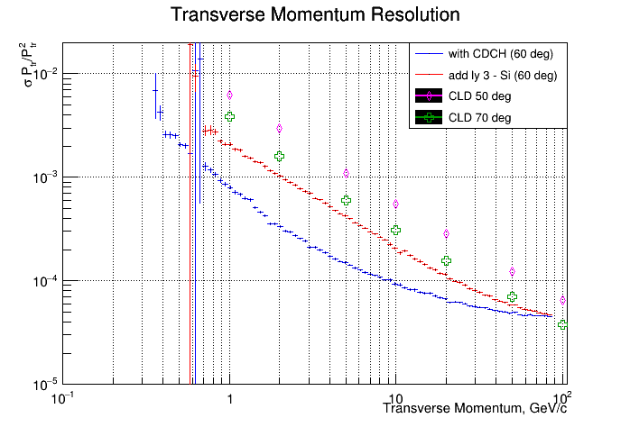
Expected simulated performance
Transparency more relevant than asymptotic resolution, the particle range is far from the asymptotic limit where MS is negligible.
CLD: a detector concept for FCC-ee with a full Si-tracker system, inspired by CLIC detector.

Slide 14
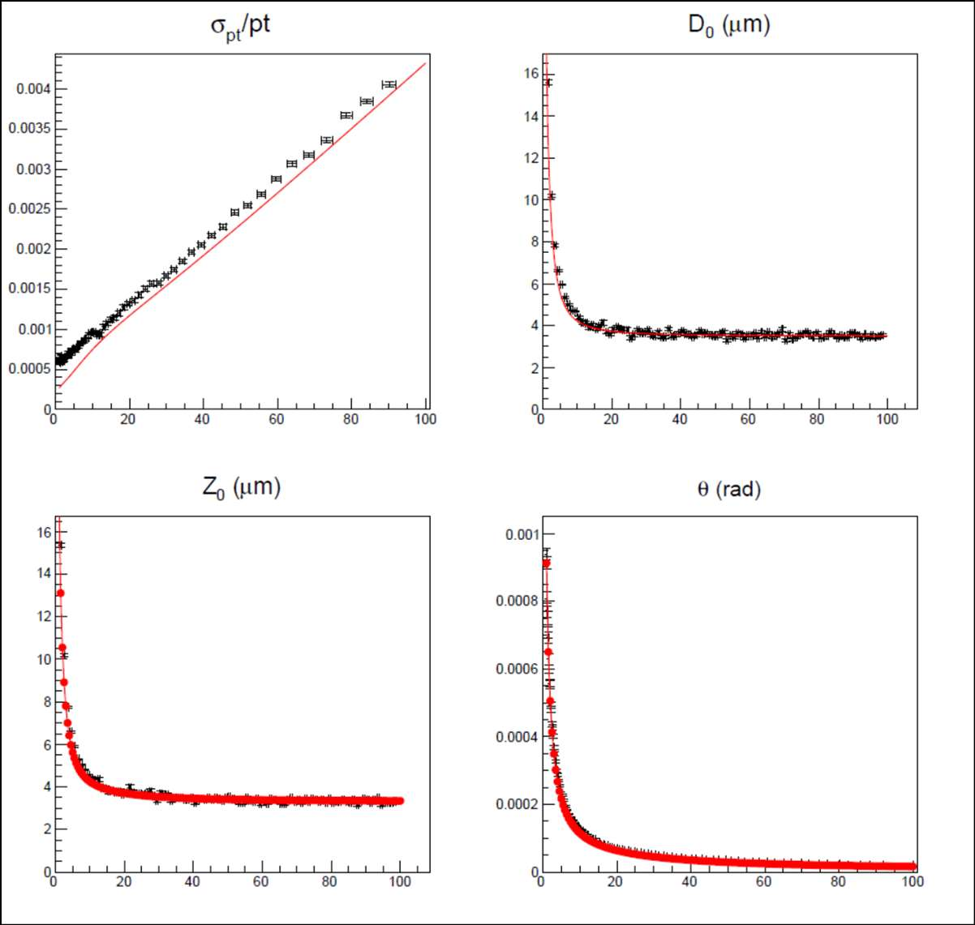
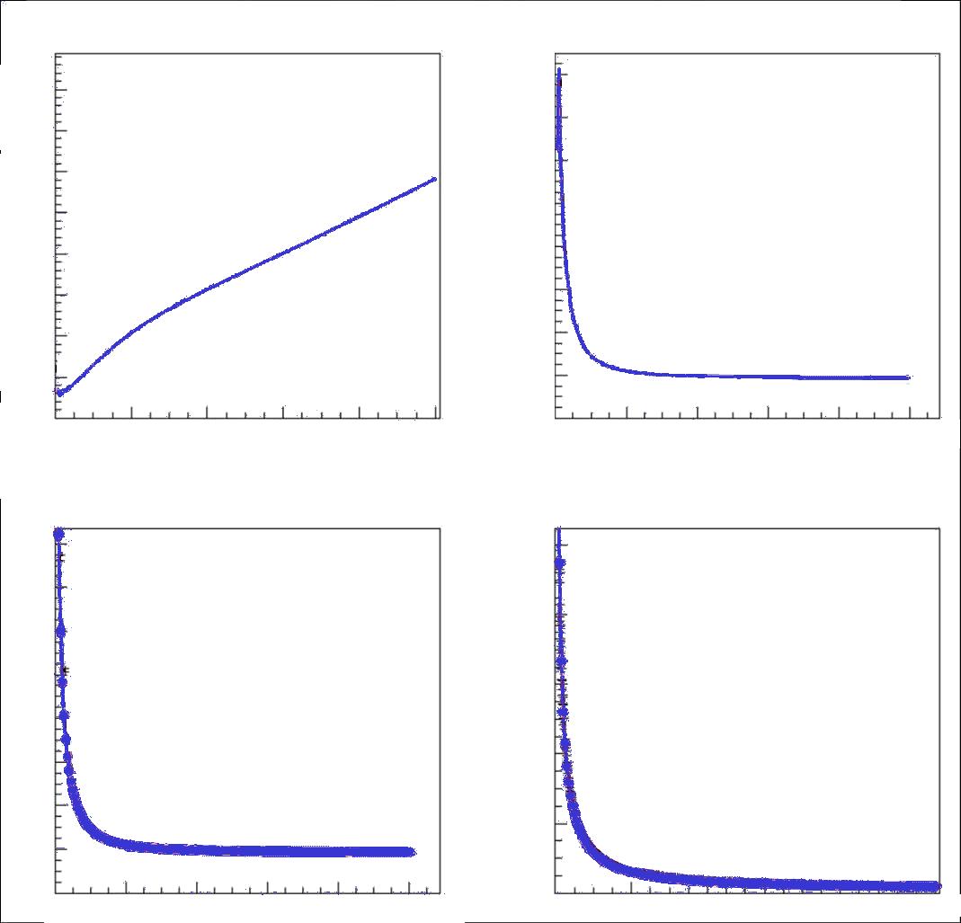
Expected simulated performance
Analytic model to evaluate full covariance matrix
black point: Full simulation
red line: analytic model with sale resolution as Full sim.
blue line: analytic model with improved Si resolutions*
p [Gev/c]
p [Gev/c]
* Vertex:
inner 3x3 µm
outer/forward 7x7 µm
Si wrapper: 7x90 µm
90º
p [Gev/c]
p [Gev/c]
More details in F. Bedeschi: "Fast Simulation Tracking",
Workshop on the Circular Electron-Positron Collider, Oxford, UK, April 2019"

Slide 15
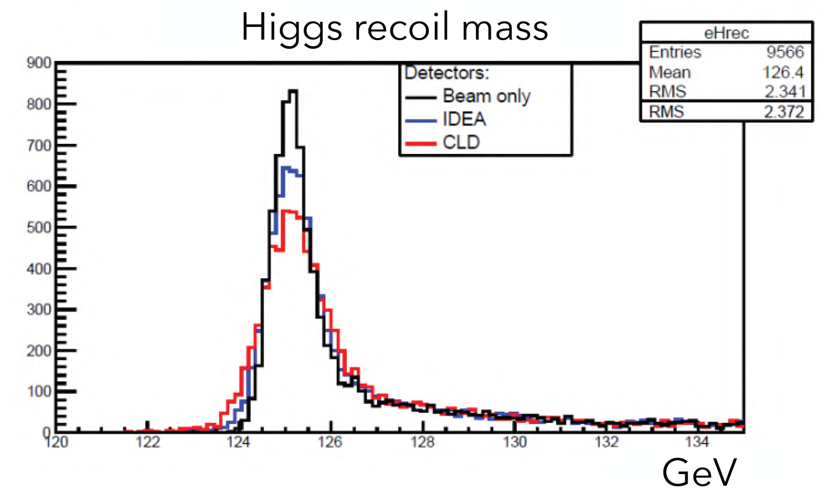
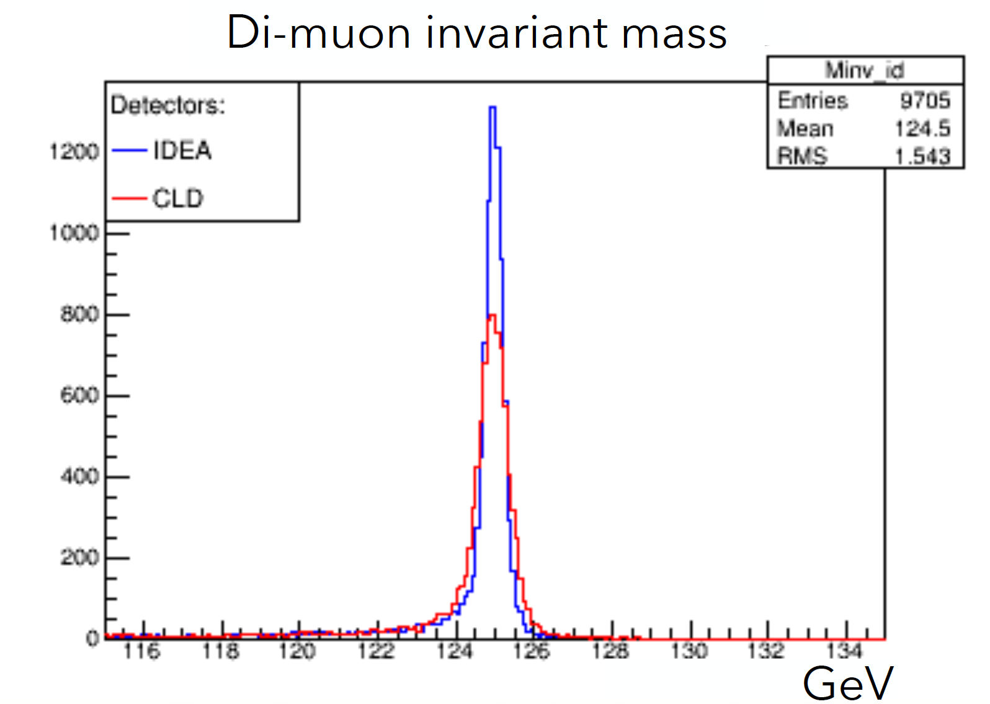
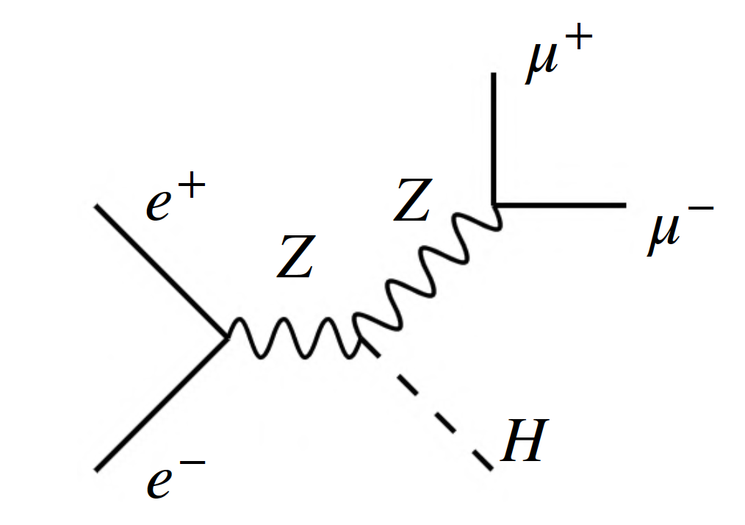
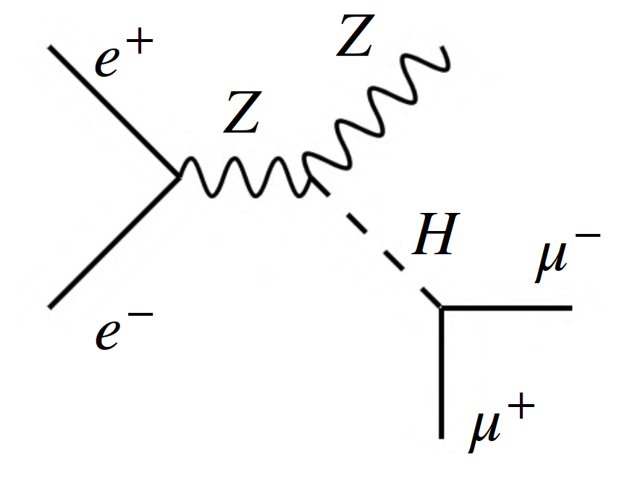
Expected simulated performance
Transparency more relevant than asymptotic resolution
Fast simulation studies
Beam only: assuming 0.136% beam spread and an ideal detector.
Event generate with Pythia8: e+e- → ZH.
First case Z decay forced to µ+µ-, second case H decay forced to µ+µ-.
DELPHES model prepared but under validation

Slide 16
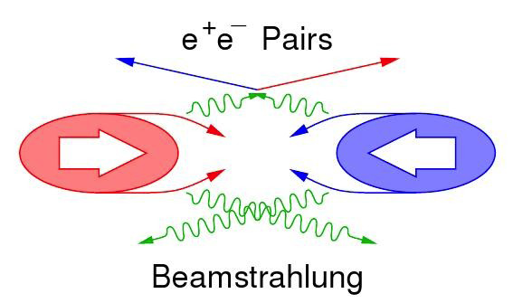
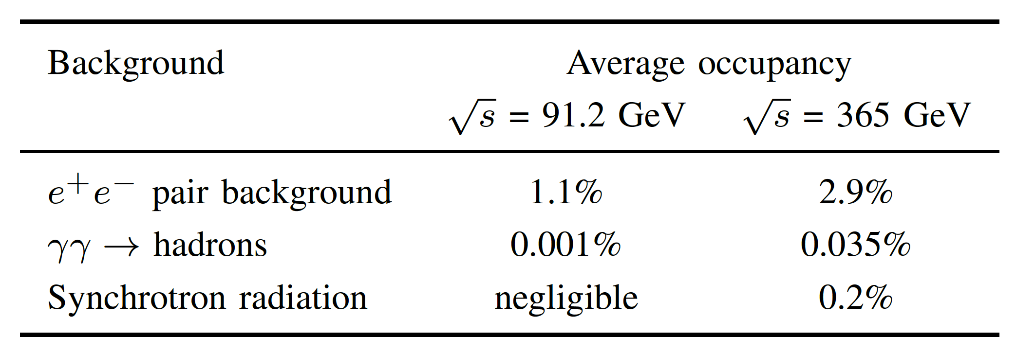
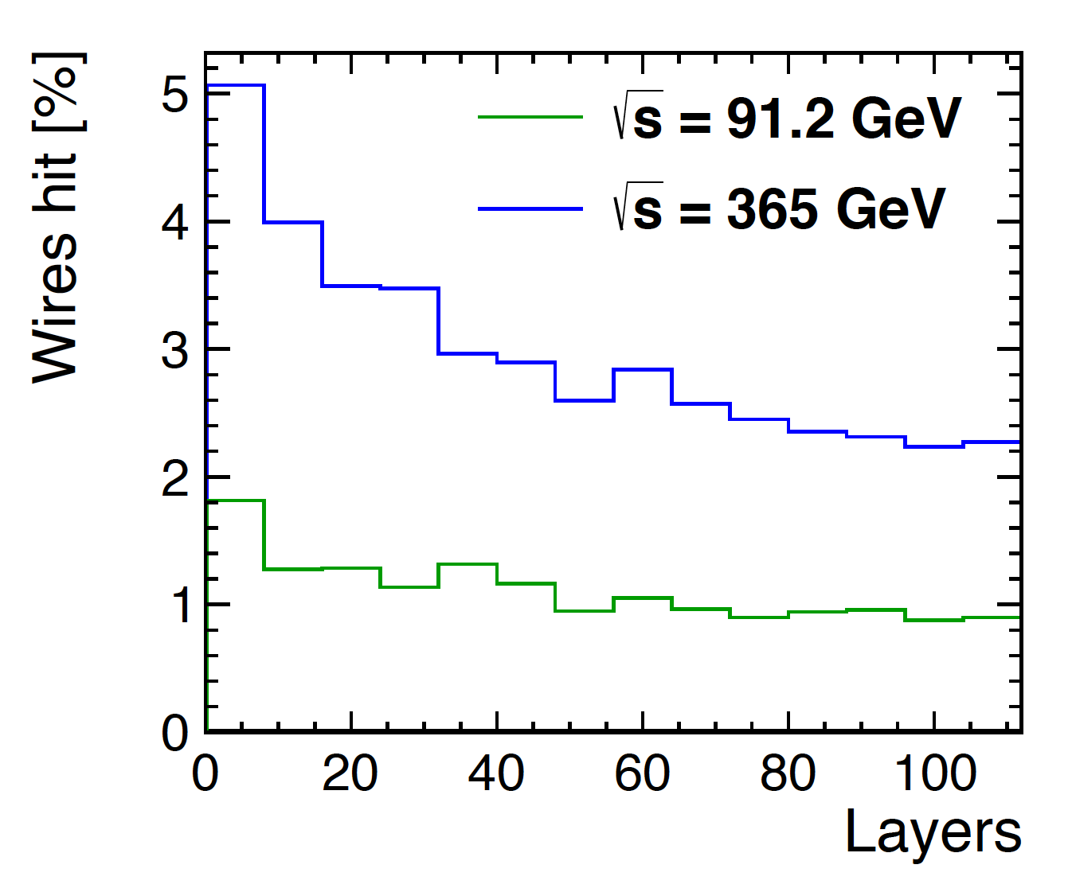
Expected simulated performance
Preliminary study of the machine background induced occupancy on the DCH, indicate that, it will be not an issue

Slide 17
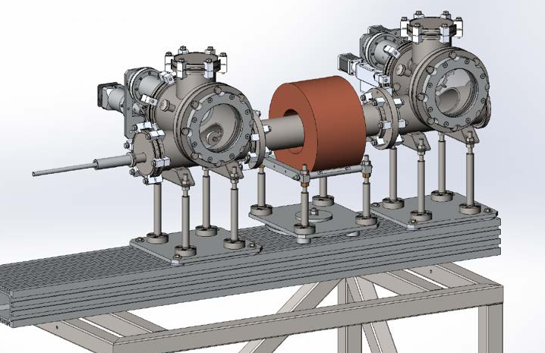
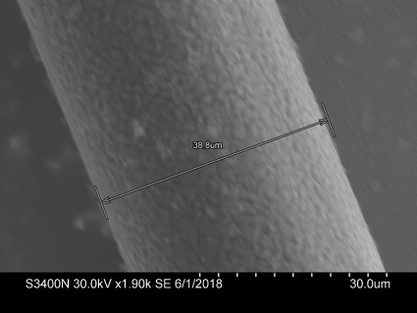
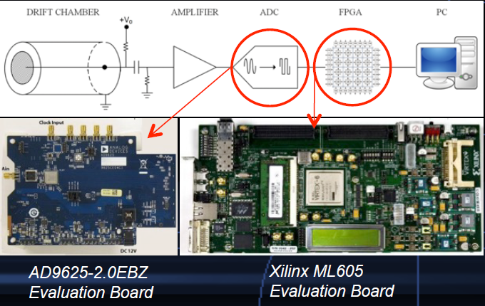
Ongoing R&D
35 µm C wire – Cu coated
Mechanics design
Light mechanics
new wires:
  new metallic alloys
  new technology
  (e.g. Carbon monofilaments)
Cluster Counting:
  simulations – tests
  electronics for online Cluster measurements
Cylindrical magnetron completed at BINP. The wire transport system in production
“Application of the Cluster Counting/Timing techniques to improve the …”
JINST Volume 12, July 2017
https://doi.org/10.1088/1748-0221/12/07/C07021

Slide 18
Summary
The central tracker of the IDEA concept is based on a full-stereo, high resolution, ultra-light Drift Chamber
The Drift Chamber construction is feasible by adopting the MEG-II Drift Chamber construction technique
The IDEA tracking system is completed by:
  MAPS Si detectors as inner vertex tracker;
  Si detectors wrapped around the Drift Chamber to improve the asymptotic resolution;
Full simulations and full covariance matrix analytic calculations show that the IDEA tracking can meet the FCC-ee goals
The Cluster Counting technique provides major improvements in PID performance over traditional dE/dx approaches, but more studies are on going.
The IDEA tracking system is very light, providing excellent resolution over the momentum range of interest.
Thanks for your attention

Slide 19
Backup

Slide 20
The Innovative Detector for Electron-positron Accelerators
Beam pipe:
  r ~ 1.5 cm, 0.47% X0 @ 90º
Si pixel vertex detector
  MAPS layers (ALICE ITS upgrade based),
  r=1.7 - 3.4 cm
Drift chamber (112 layers)
  4m long, r = 35 - 200 cm
Si wrapper: µ-strips
Superconducting solenoid:
  2 T, length = 5 m, r = 2.1-2.4
  0.74 X₀, 0.16 λ @ 90º
Pre-shower:
  2 layers of µ-Rwell each one behind an
  absorber layer of 1 X₀
Dual Readout fiber calorimeter
  2m deep/8 λ
Muon chambers
  µ-Rwell embedded in the magnet return yoke
IDEA concept

Slide 21
Challenges
Extremely high luminosities:
large statistics (high statistical precision) - control of systematics (@10⁻⁵ level)
Large beam crossing angle (30mrad)
very complex MDI
emittance blow-up with detector solenoid field (< 2T)
Physics event rates up to 100 kHz (at Z pole)
strong requirements on sub-detectors and DAQ systems
Bunch spacing down to 20 ns (at Z pole)
"continuous" beams (no power pulsing)
More physics challenges at Z pole:
  luminosity measurement at 10⁻⁵ - luminometer acceptance ≈1-2 μm
  detector acceptance definition at <10⁻⁵ - detector hermeticity (no cracks!)
  stability of momentum measurement - stability of magnetic field wrt E_{cm} (10⁻⁶)
  b/c/g jets separation - flavor and τ physics - vertex detector precision
  particle identification (preserving hermeticity) - flavor physics (and rare processes)

Slide 22
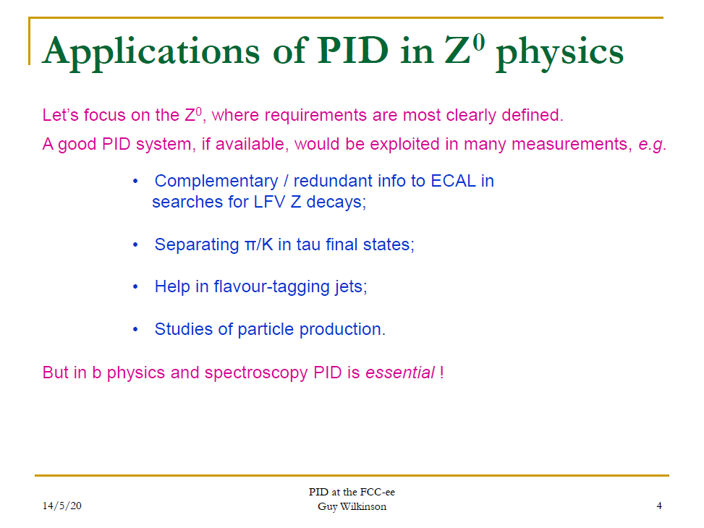
For more details, see G. Wilkinson talk at FCC France workshop on May 20:
https://indico.in2p3.fr/event/20792/contributions/81820/attachments/58703/78917/FCCee_PID_France.pdf

Slide 23
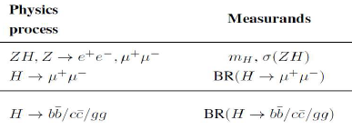
Tracking requirements
Central tracker system:
state-of-the-art momentum and angular
resolution for charged particles;
B field limited to ~ 2 T to boost luminosity at Z pole. Large tracking radius needed to recover momentum resolution.
High transparency required given typical momenta in Z, H decays.
Particle ID is a valuable additional ability.
Vertexing:
excellent b- and c-tagging capabilities : few μm precision for charged particle origin;
small pitch, thin layers, limited cooling, first layer as close as possible from IP.
in numbers:
σ(1/p_{T}) ≲ 3·10⁻⁵ GeV⁻¹ (p_{T} ≳ 100 GeV at 90∘) ≃ 2·10⁻⁵ ⊕ 1·10⁻³/(p sin θ) GeV⁻¹
σ(d₀) ≃ 2/5/20 μm (100/10/1 GeV at 90∘) ≃ 5 ⊕ 10/(p sin^{3/2} θ ) μm
σ(θ, φ) ~ 0.1 mrad (45 GeV muons)

Slide 24
Expected performance
Machine background will be not an issue
average machine background occupancy of the DCH is ~ 0.3% (3%) per bunch crossing at 91:2 (365) GeV, in the innermost layers.
The maximum drift time (400ns) will impose an overlap of some (20 at Z pole) bunch crossings bringing the hit occupancy to ~ 10% in the inner-most drift cells. Based on MEG-II experience, this occupancy, which allows over 100 hits to be recorded per track on average in the DCH, is deemed manageable.
However, signals from photons can therefore be effectively suppressed at the data acquisition level by requiring that at least three ionization clusters appear within a time window of 50 ns.
In addition, cluster signals separated by more than 100 ns are not from the same signals, this effectively bring the BXs pile-up from 20 to 4

Slide 25
The IDEA drift chamber
tracking efficiency ε ≈ 1
for ϑ > 14° (260 mrad)
97% solid angle
0.016 X₀ to barrel calorimeter
0.050 X₀ to end-cap calorimeter
He based gas mixture
(90% He – 10% i-C₄H₁₀)
Full stereo configuration with alternating sign stereo angles ranging from 50 to 250 mrad
12÷14.5 mm wide square cells 5 : 1 field to sense wires ratio
56,448 cells
14 co-axial super-layers, 8 layers each (112 total) in 24 equal azimuthal (15º) sectors
(N_{i} = 192 + (i − 1) × 48)
0.20 m
0.045 X₀
service area
(F.E.E. included)
0.016 X₀
active area
r = 2.00 m
0.050 X₀
112 layers
12-15 mm cell width
Front Plate
ϑ=14°
r = 0.35 m
inner wall 0.0008 X₀
z-axis
56,000 cells
340,000 wires
(0.0013+0.0007 X₀/m)
wires gas
outer wall 0.012 X₀
z = 2.00 m

Slide 26
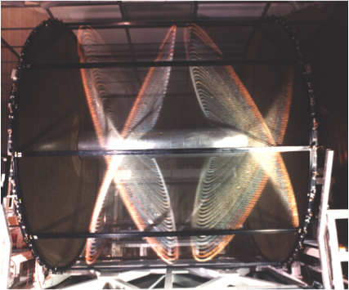
Novel approach at construction technique of high granularity and high transparency Drift Chambers (From KLOE DCH to IDEA DCH)
 | KLOE | MEG-II
stereo | Fully (~ 80 mrad) | Fully (~120 mrad)
diameter | 4 m | 0.6 m
length | 3.3 m | 2.0 m
structure | C-fiber | C-fiber
Gas (He-iC₄H₁₀) | 90% - 10% | 85% - 15%
Sense wires | 12000 | 2000
Total wires | 52000 | 12000
Weaker wire | 80 µm Al | 40 µm Al
cell size | 2x2 - 3x3 cm² | 0.7x0.7 - 1x1 cm²
Wire density | ~0.4 wires/cm² | ~12 wires/cm²
Ancestor chamber: KLOE at INFN LNF Daϕne φ factory (commissioned in 1998 and operated for over 20 years)
CluCou Chamber proposed for the 4th-Concept at ILC (2009)
I-tracker chamber proposed for the Mu2e experiment at Fermilab (2012)
DCH for the MEG-II upgrade at PSI (under commissioning)
MEG-II DCH
KLOE DCH
MEG-II: High wire densities prevent the use of feed-through, needing novel approaches to the wiring procedures

Slide 27
Novel approach at construction technique of high granularity and high transparency Drift Chambers
wire cage
Based on the MEG-II DCH new construction technique the IDEA DCH can meet these goals:
Gas containment – wire support functions separation:
  allows to reduce material to ≈ 10⁻³ X₀ for the inner
  cylinder and to a few x 10⁻² X₀ for the end-plates,
  including FEE, HV supply and signal cables
Feed-through-less wiring:
  allows to increase chamber granularity and field/sense wire ratio to reduce multiple scattering and total tension on end plates due to wires by using thinner wires
Cluster timing:
  allows to reach spatial resolution < 100 μm for 8 mm drift cells in He based gas mixtures (such a technique is going to be implemented in the MEG-II drift chamber under commissioning)
Cluster counting:
  allows to reach dN_{cl}/dx resolution < 3% for particle identification (a factor 2 better than dE/dx as measured in a beam test)
gas vessel

Slide 28
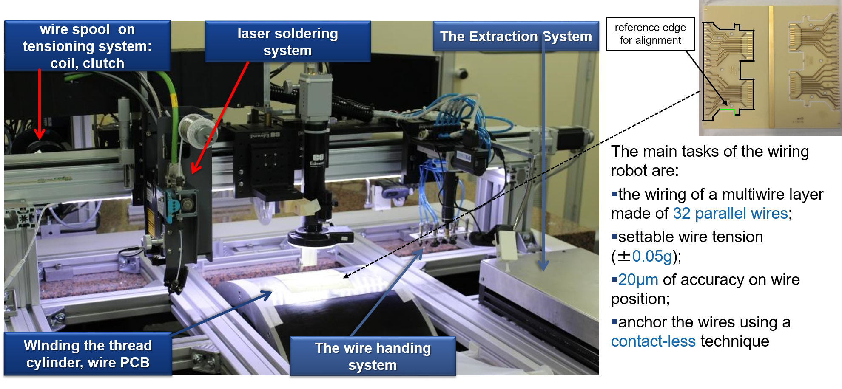
  The MEG-II Drift Chamber: Wiring procedure

Slide 29
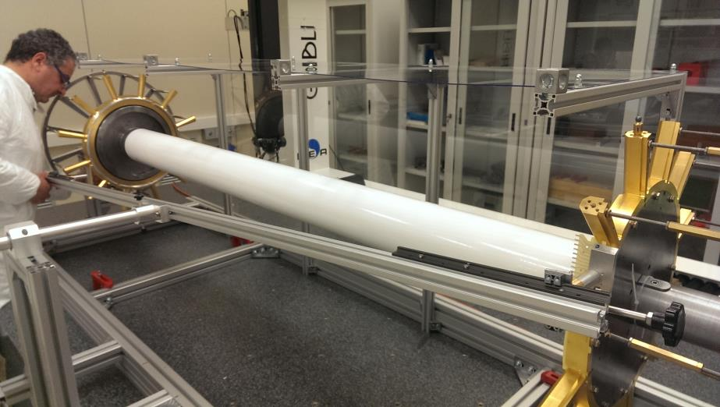
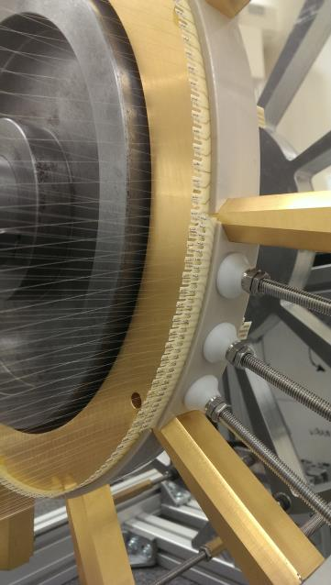
  The MEG-II Drift Chamber: Assembling
Procedure:
  The mounting arm (with the multi-wire layer) is then placed next to the end plates for the engagement procedure
  The mounting arm is fixed to a support structure to prevent damaging the wires
  This structure transfers the multi-layer wire on the end plates between two spokes
  Spacers, to separate the successive layer, are pressed and glued in position
Spacer
Spoke used as reference for the alignment of the pcb

Slide 30
Cluster Counting/Timing and P.Id. expected performance
From the ordered sequence of the electrons arrival times, considering the average time separation between clusters and their time spread due to diffusion, reconstruct the most probable sequence of clusters drift times:
acquired
signal
identified peaks
dE/dx dN_{cl}/dx
from Walenta parameterization (1980)
from Poisson distribution
truncated mean cut (70-80%) reduces the amount of collected information n = 112 and a 2m track at 1 atm give
σ ≈ 4.3%
Increasing P to 2 atm improves resolution by 20% (σ ≈3.4%) but at a considerable cost of multiple scattering contribution to momentum and angular resolutions.
δ_{cl} = 12.5/cm for He/iC₄H₁₀=90/10 and a 2m track give
σ ≈ 2.0%
A small increment of iC₄H₁₀ from 10% to 20% (δ_{cl} = 20/cm) improves resolution by 20% (σ ≈1.6%) at only a reasonable cost of multiple scattering contribution to momentum and angular resolutions.
Moreover, C.C. allows can improve the spatial resolution < 100 μm for 8 mm drift cells in He based gas mixtures

Slide 31
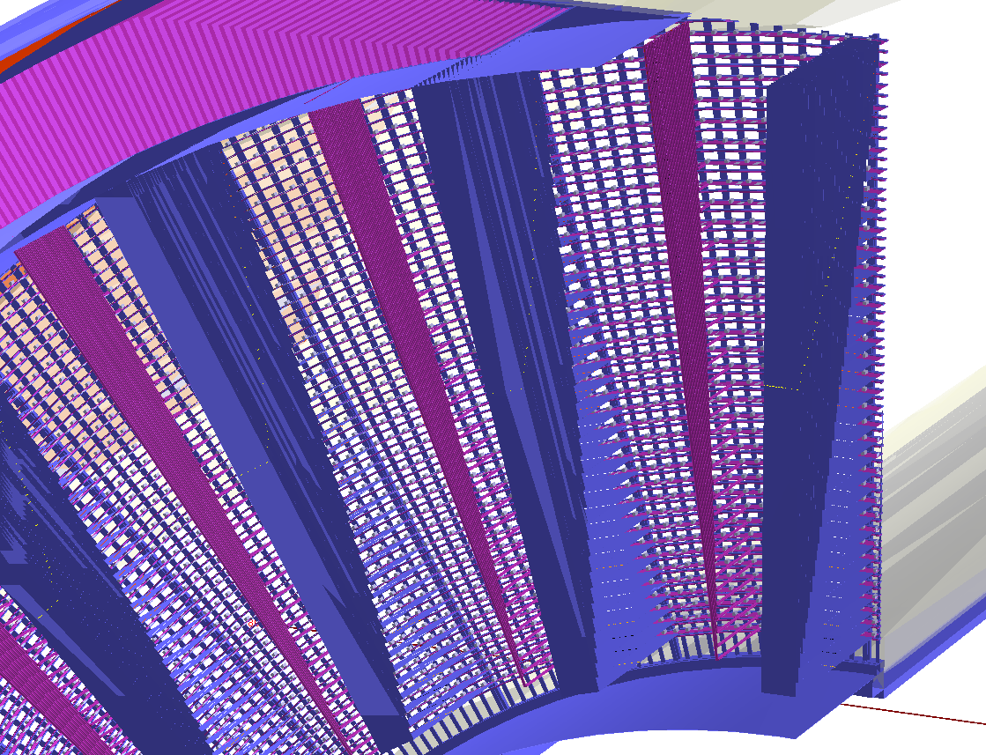
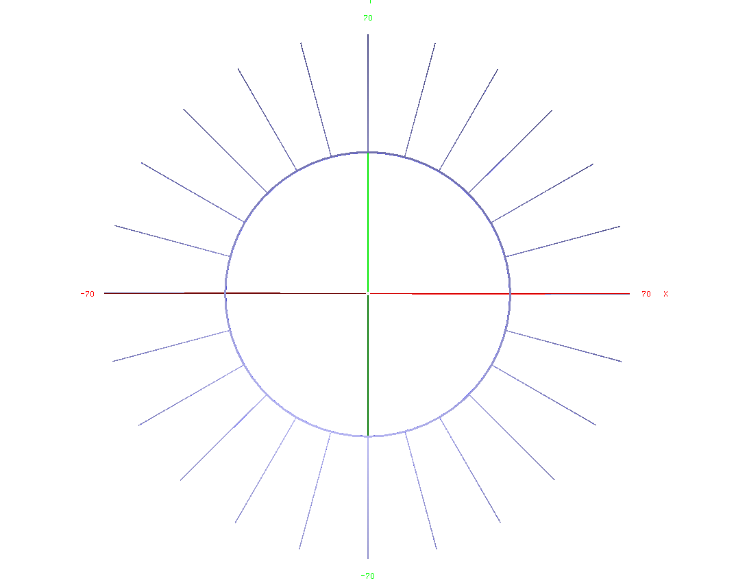
IDEA DCH geometry (simulation)
Electronics boards: 12 cm x 6 cm x 3mm G10 (FR4);
signal cables:
2.032 cm x 25 µm Kapton
+ 40 µm 16 pairs of Copper wires;
HV cables:
500 µm Copper wire
+ 500 µm Teflon insulation;
Wire anchoring (see next slide);
Carbon fiber wire support.
Connecting ring is described as a circular layer: 0.5 cm x 1.5 cm Carbon fiber

Slide 32
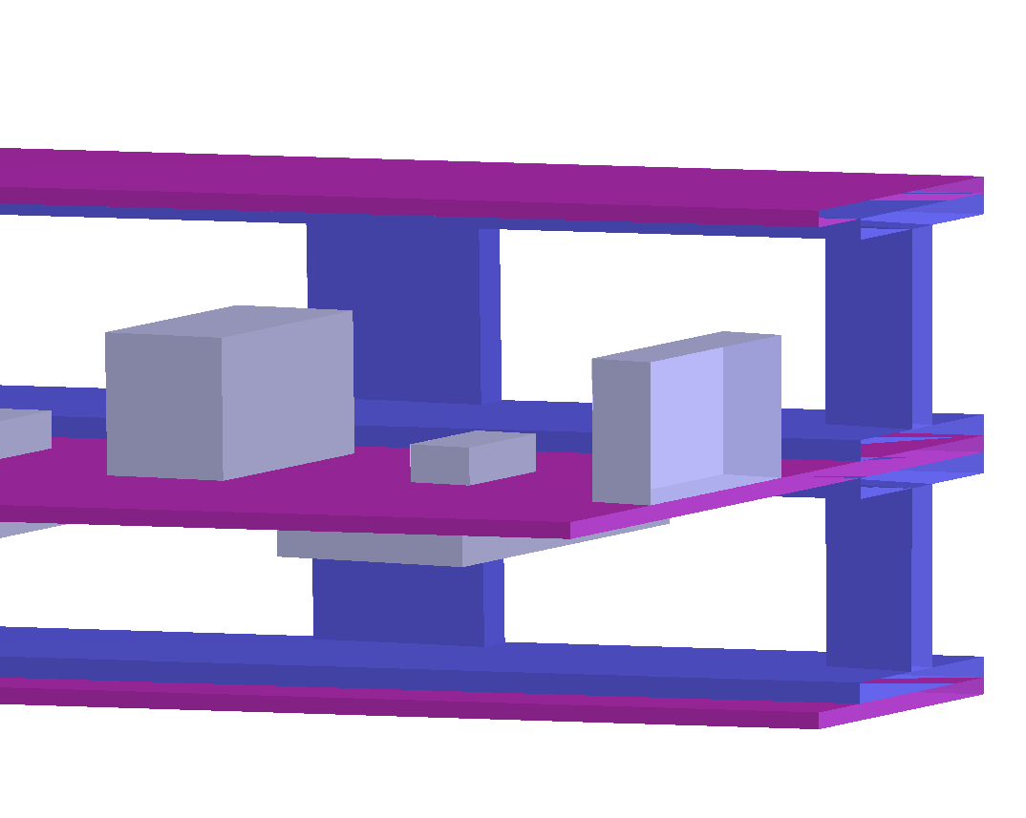
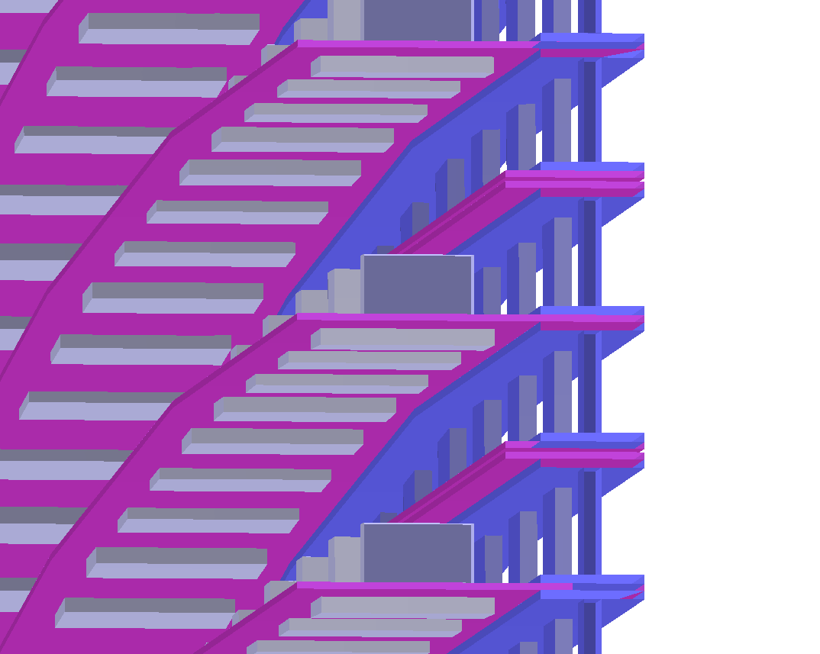
IDEA DCH geometry (simulation)
FWboard
The wire anchoring system:
Field wire board: 4 mm x 200 µm G10(FR4);
Spacer: made of polycarbonate,
instead of holes it is drawn with spokes but with the same area ratio.
Sense wire board: 1 cm x 200 µm G10(FR4) plus components:
1) termination resistance: 1.6 mm x 800 µm x 450 µm Aluminum;
2) HV Capacitance: 3.17 mm x 1.57 mm x 1.7 mm
Aluminum;
3) HV resistance (only downstream): 5 mm x 2.5 mm x 550 µm Aluminum.
Spacer
SWboard
Spacer
FWboard

Slide 33
IDEA tacking system – ly1 - SVX
Layer | R [mm] | L [mm] | Si eq. thick. [μm] | X₀ [%] | pixel size [mm²] | area [cm²] | # of channels
1 | 17 | ±110 | 300 | 0.3 | 0.02×0.02 | 235 | 60M
2 | 23 | ±150 | 300 | 0.3 | 0.02×0.02 | 434 | 110M
3 | 31 | ±200 | 300 | 0.3 | 0.02×0.02 | 780 | 200M
4 | 320 | ±2110 | 450 | 0.5 | 0.05×1.0 | 85K | 170M
5 | 340 | ±2245 | 450 | 0.5 | 0.05×1.0 | 96K | 190M
Disks | R_{in} [mm] | R_{out} [mm] | z [mm] | Si eq. thick. [μm] | X₀ [%] | pixel size [mm²] | area [cm²] | # of channels
1 | 62 | 300 | ±400 | 300 | 0.3 | 0.05×0.05 | 5.4K | 220M
2 | 65 | 300 | ±420 | 300 | 0.3 | 0.05×0.05 | 5.4K | 220M
3 | 138 | 300 | ±900 | 300 | 0.3 | 0.05×0.05 | 4.4K | 180M
4 | 141 | 300 | ±920 | 300 | 0.3 | 0.05×0.05 | 4.4K | 180M

Slide 34
IDEA tacking system – ly1 - DCH
 | R_{in} [mm] | R_{out} [mm] | z [mm]
drift chamber | 350 | 2000 | ±2000
service area | 350 | 2000 | ±(2000÷2250)
active volume | 50 m³
readout channels | 112,896 | r.o. from both ends
max drift time | 400 ns | 800 × 8 bit at 2 GHz
 | inner wall | gas | wires | outer wall | service area
thickness [mm] | 0.2 | 1000 | 1000 | 20 | 250
X₀ [%] | 0.08 | 0.07 | 0.13 | 1.2 | 4.5
# of layers | 112 | min 11.8 mm – max 14.9 mm
# of cells | 56448 | 192 at 1st – 816 at last layer
average cell size | 13.9 mm | min 11.8 mm – max 14.9 mm
average stereo angle | 134 mrad | min 43 mrad – max 223 mrad
transverse resolution | 100 μm | 80 μm with cluster timing
longitudinal resolution | 750 μm | 600 μm with cluster timing

Slide 35
IDEA tacking system – tentative layout
 | Base Line | Option 1 | Option 2
 | value | value | value | dim.
R_{in} | 345 | 200* | 250 | mm
R_{out} | 2000 | 2150 | 2000 | mm
active area length | 4000 | 4000 | 4000 | mm
total length | 4500 | 4500 | 4500 | mm
total cells | 56448 | 34560 | 52704 | n.
layers | 112 | 96 | 112 | n.
Superlayers | 14 | 12 | 14 | n.
Layers per Superlay. | 8 | 8 | 8 | n.
phi sector | 12 | 12 | 12 | n.
smaller cell | 11.85 | 14.2 | 11.65 | mm
larger cell | 14.7 | 22.5 | 15.25 | mm
min. stereo angle | 48 | 25 | 35 | mrad
max. stereo angle | 250 | 240 | 245 | mrad
* not over the entire length, to avoid overlap with beam pipe etc.
A possible construction strategy is available.
Geometry is not yet optimized:

Slide 36
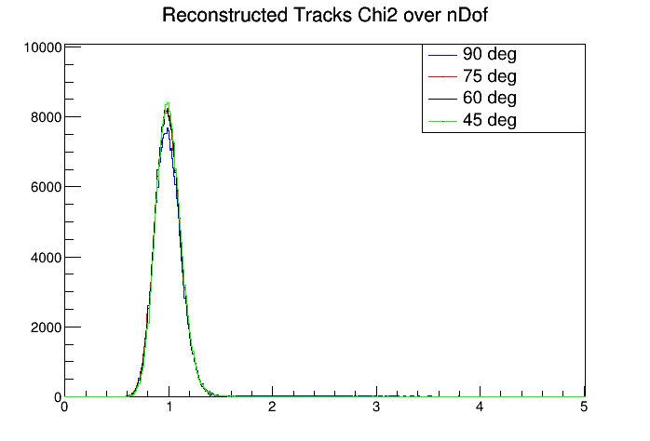
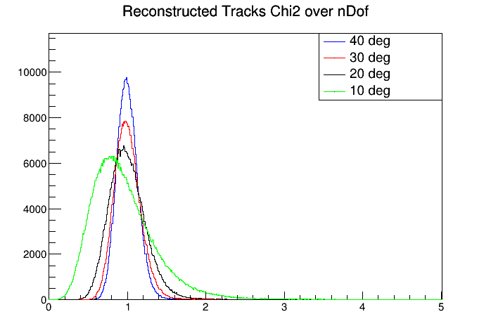
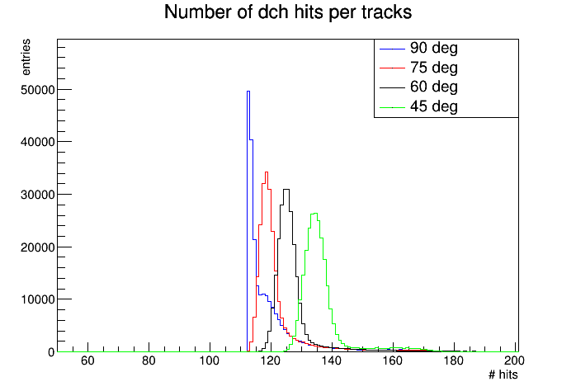
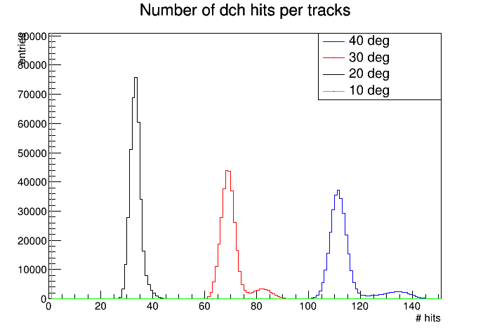
  IDEA – layout v1 – Expected tracking performance
BARREL:
FORWARD:
χ² /ndof
> 100 Hits per track
at 10 deg
no hits in DCH
N hits fitted
(DCH)

Slide 37



  IDEA – layout v1 – Expected tracking performance
BARREL:
FORWARD:
p
p_{t}

Slide 38




  IDEA – layout v1 – Expected tracking performance
BARREL:
FORWARD:
impact parameter
Z

Slide 39




  IDEA – layout v1 – Expected tracking performance
BARREL:
FORWARD:
theta
phi

Slide 40




  IDEA tracking system – Expected tracking performance
  (single muon as function of ϑ)
base line option
p
p_{t}
momentum resolution:
phi
theta
angular vertex resolution:

Slide 41

  IDEA tracking system – Expected tracking performance
  (single pi+ at fixed θ=65deg)
Note: DCH layout differs a bit from the final IDEA one,
only to compare the relative effects

Slide 42

Expected performance
Transparency more relevant than asymptotic resolution
low Si res

Slide 43








  The MEG-II Drift Chamber Performance
spatial resolution on 7 mm cell
hits in 250 ns window
both views
3D
track finding
and fit
σ = 106 μm
(He/iC₄H₁₀ = 85/15)
arXiv:1605.07970
segment fit + turn merging
discard short segments and isolated hits
full track fit
zoom
signal
track
michel
tracks

