Slide 1


Transverse structure of heavy baryons in momentum space:
A light-front Hamiltonian approach
Zhi-Min Zhu^{1,2}
^{zhuzhimin@impcas.ac.cn}
¹Institute of Modern Physics, Chinese Academy of Science
²School of Nuclear Physics, University of Chinese Academy of Sciences
Light Cone 2021,
December 2, 2021

Slide 2
Outline
Overview on transverse momentum distributions (TMDs)
The bound state of heavy baryons in BLFQ framework
Numerical results

Slide 3
Outline
Overview on transverse momentum distributions (TMDs)
The bound state of heavy baryons in BLFQ framework
Numerical results

Slide 4
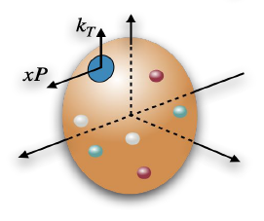
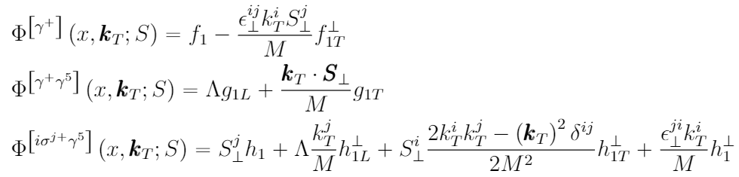
Overview on TMDs (spin 1/2)
Definition:
Parameterization:
8 terms leading-twist TMDs
Amsterdam notation:
f → unpolarized quarks
g → longitudinally polarized quarks
h → transversely polarized quarks
1 → the leading twist
L → longitudinally polarized hadron
T → transversely polarized hadron
Meißner, Metz, Schlegel. JHEP08 (2009) 056
[Zhi-Min Zhu, et al. in preparation]

Slide 5
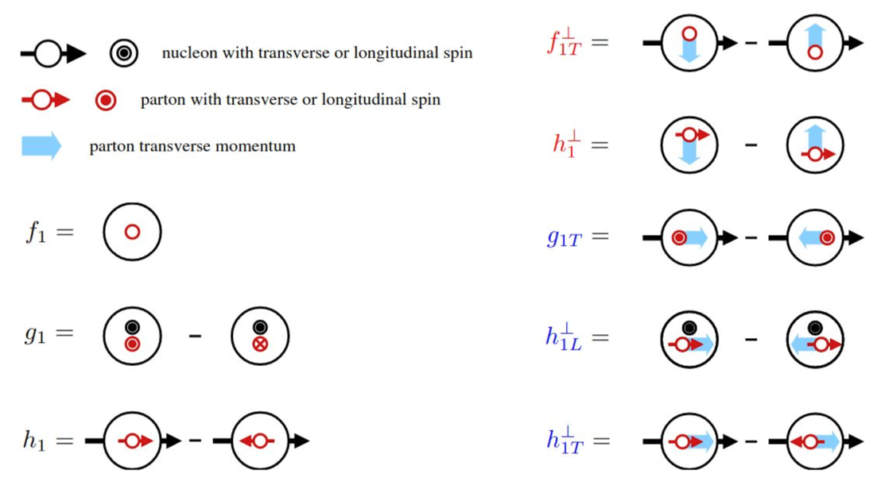
Overview on TMDs (spin 1/2)
f → unpolarized quarks
g → longitudinally polarized quarks
h → transversely polarized quarks
1 → the leading twist
L → longitudinally polarized hadron
T → transversely polarized hadron
From Bacchetta’s “Trento” Lecture notes
[Zhi-Min Zhu, et al. in preparation]

Slide 6

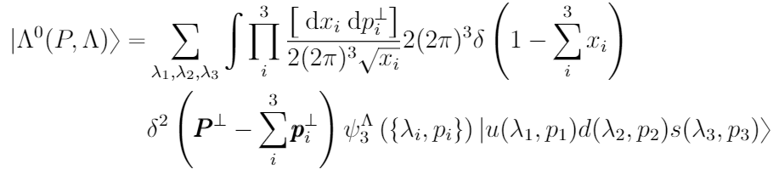

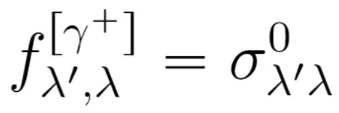
TMDs Evaluation using the overlaps LFWF
TMDs definition:
Baryonic bound state:
Λ⁰ baryon
Leading Fock Sector
Overlap form of TMDs:
Hadron spin
Light-front wave function (LFWF)
Struck quark spin
For example,
[Zhi-Min Zhu, et al. in preparation]

Slide 7
Outline
Overview on transverse momentum distributions (TMDs)
The bound state of heavy baryons in BLFQ framework
Numerical results

Slide 8
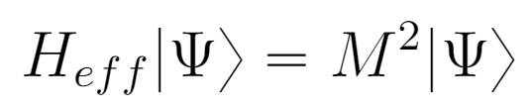
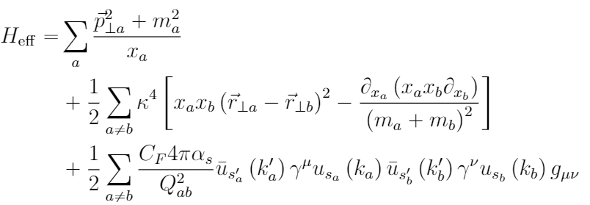
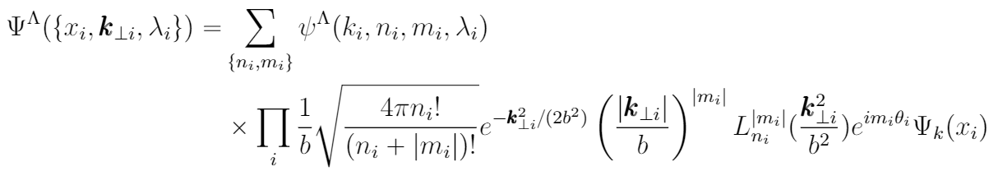
A light front Hamiltonion approach
Light front Schrödinger equation:
where
Kinetic energy
Confining potential
OGE
Wave function basis expansion:
Xu, Mondal, Lan, et al. Phys. Rev. D 104(9), 094036 (2021)
2D-HO basis
in transverse direction
plane-wave basis
in longitudinal direction
[Zhi-Min Zhu, et al. in preparation]

Slide 9
Outline
Overview on transverse momentum distributions (TMDs)
The bound state of heavy baryons in BLFQ framework
Numerical results

Slide 10

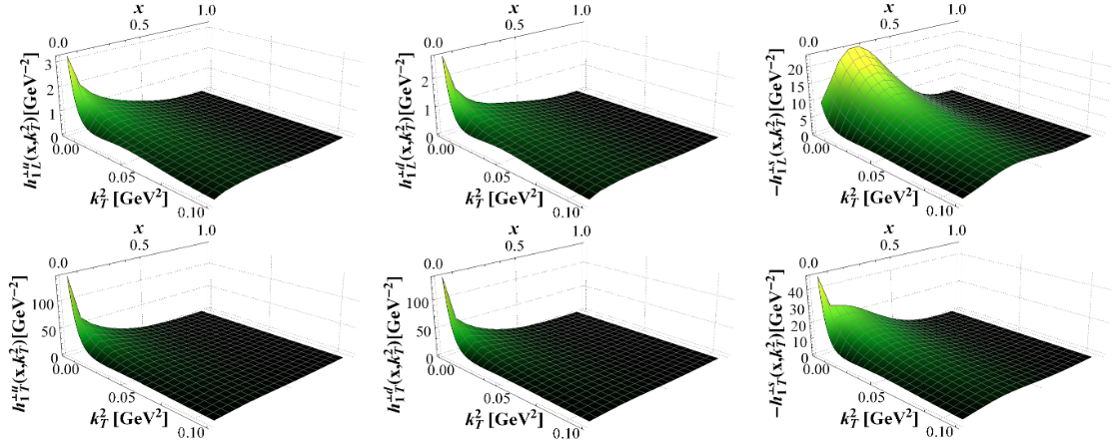
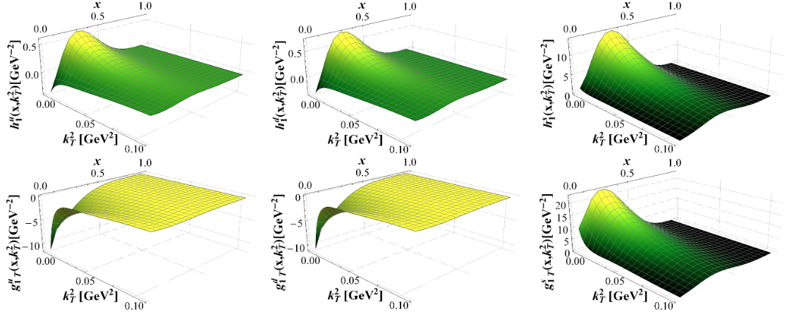
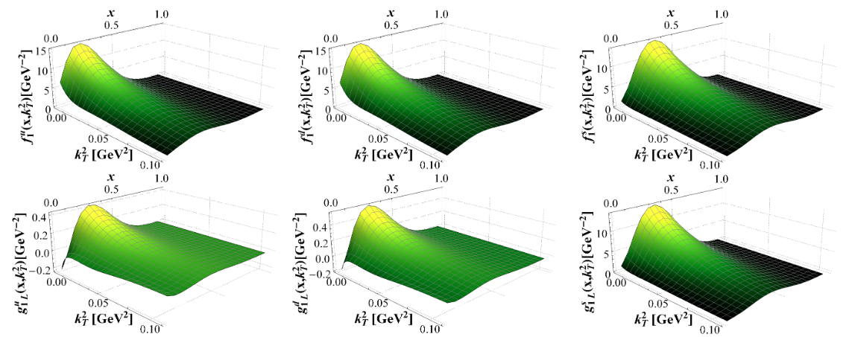
TMDs for the valance quarks of Λ⁰
u quark
d quark
s quark
TMDs of u and d quark have the same structure.
Heavy quarks concentrate in larger x range.
[Zhi-Min Zhu, et al. in preparation]

Slide 11

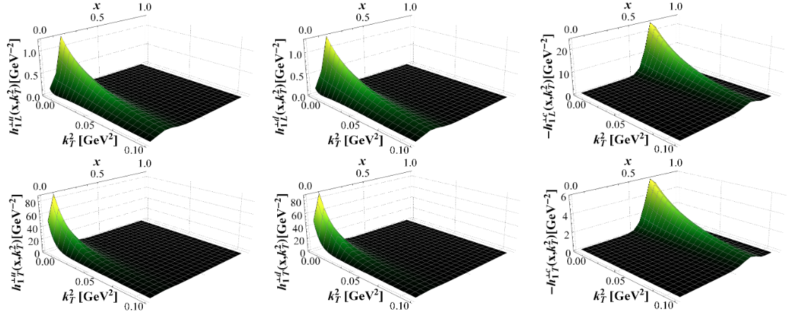
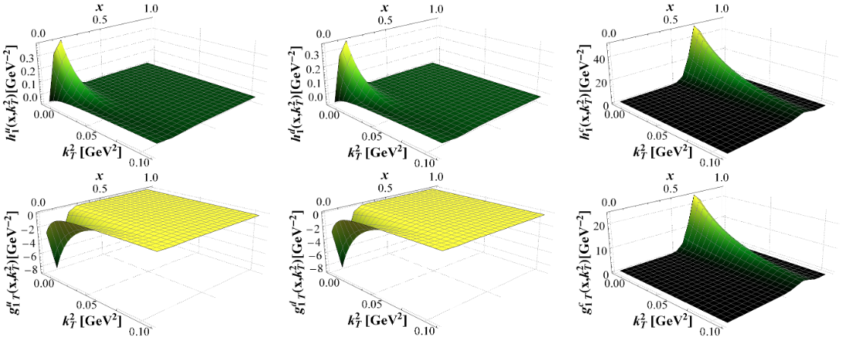
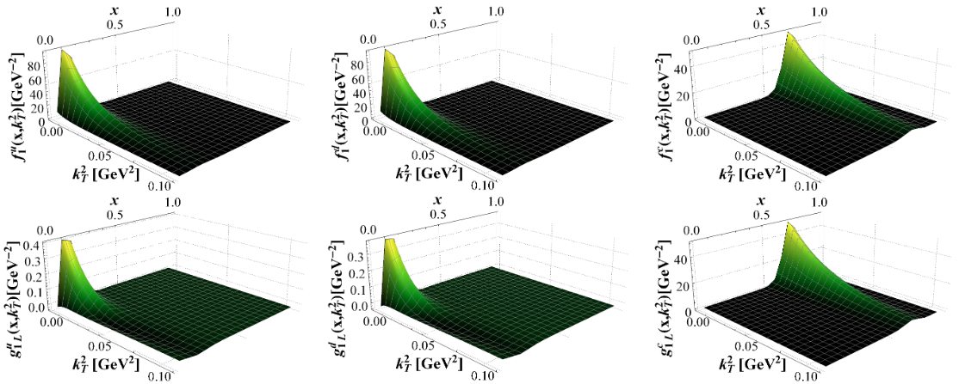
TMDs for the valance quarks of Λ_{c}
u quark
d quark
c quark
TMDs of u and d quark have the same structure.
Heavy quarks concentrate in larger x range.
Heavy quarks are dispersed in broader k_{T} range.
[Zhi-Min Zhu, et al. in preparation]

Slide 12


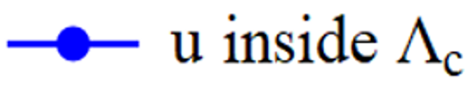
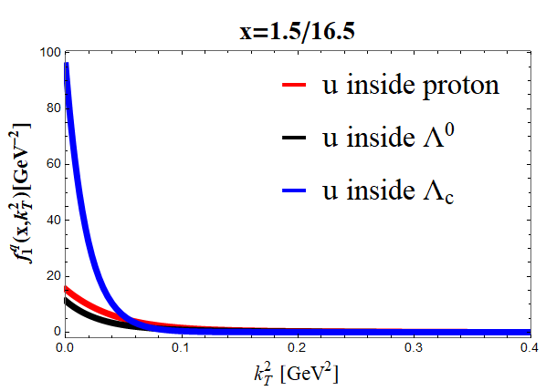
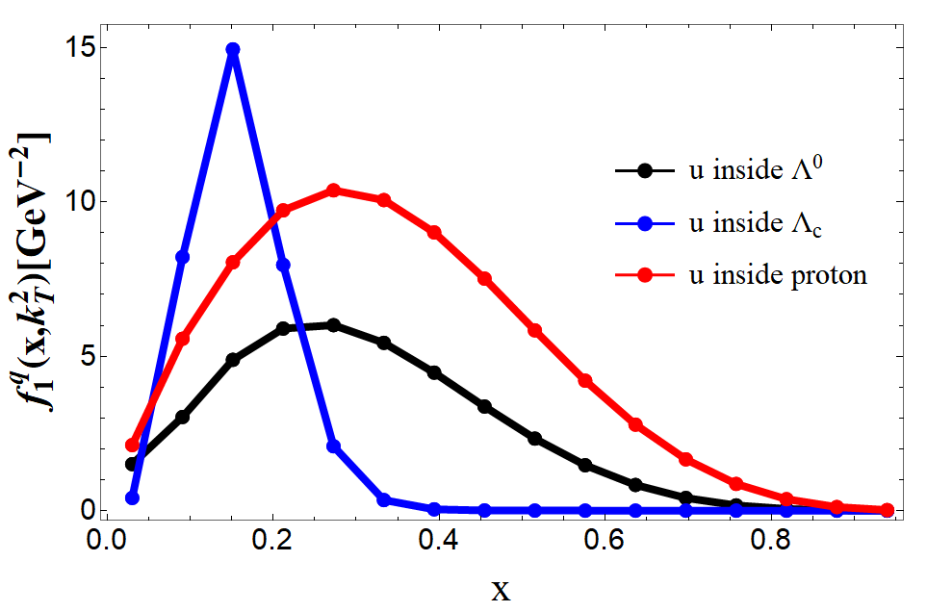
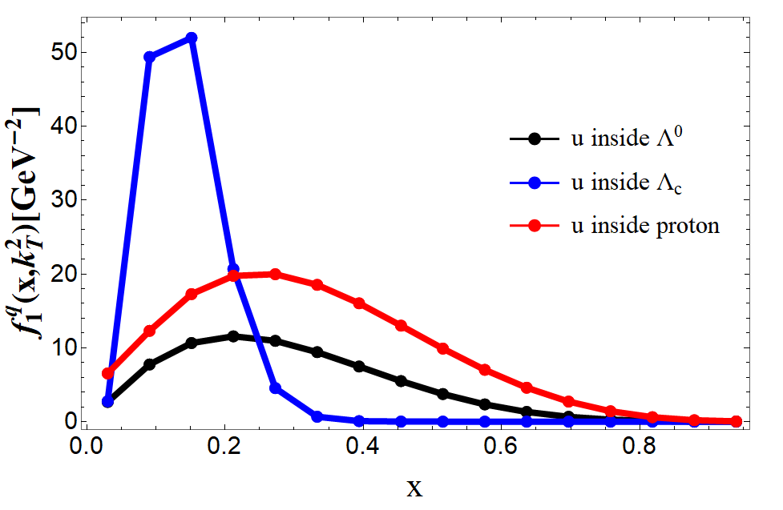
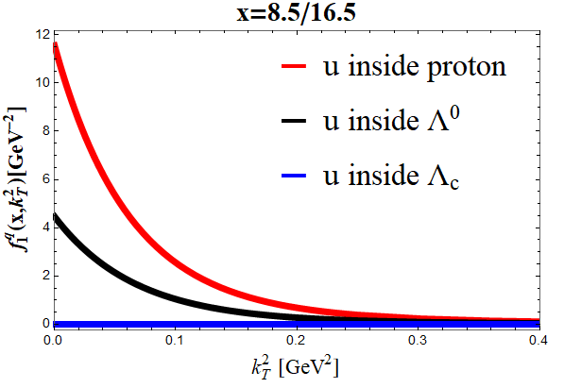
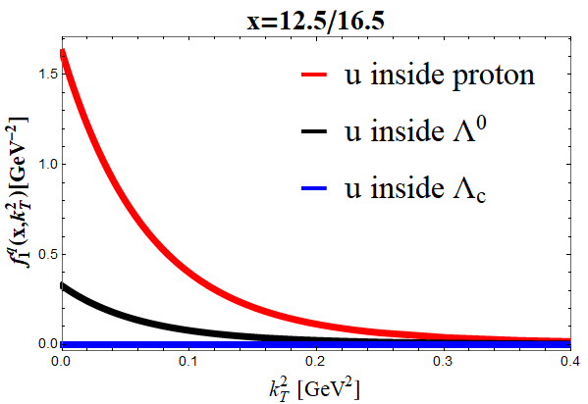
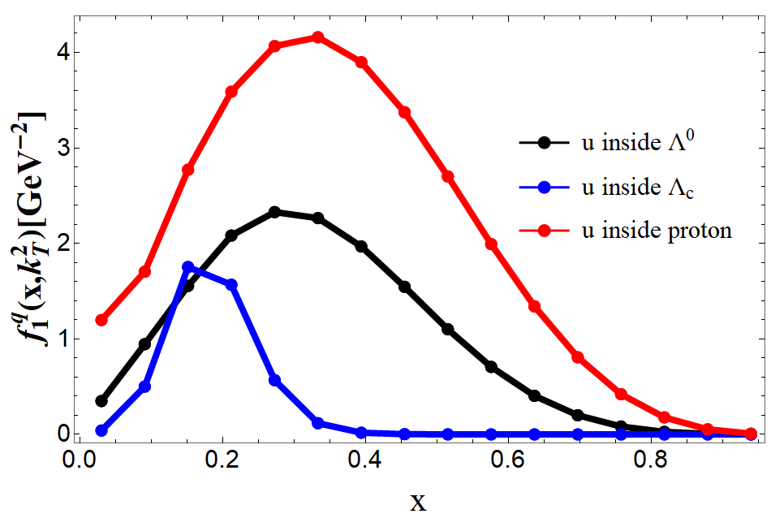
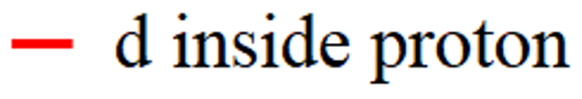


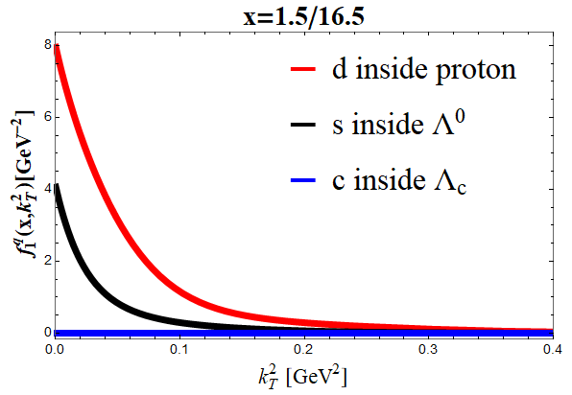
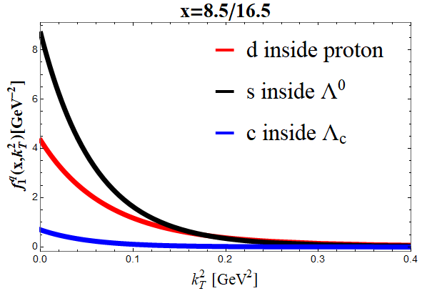
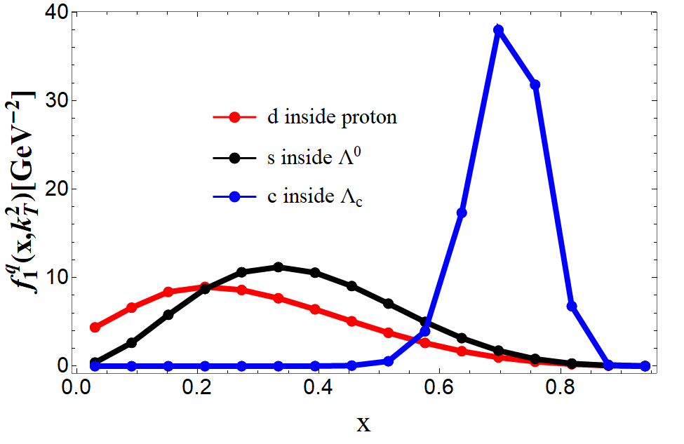
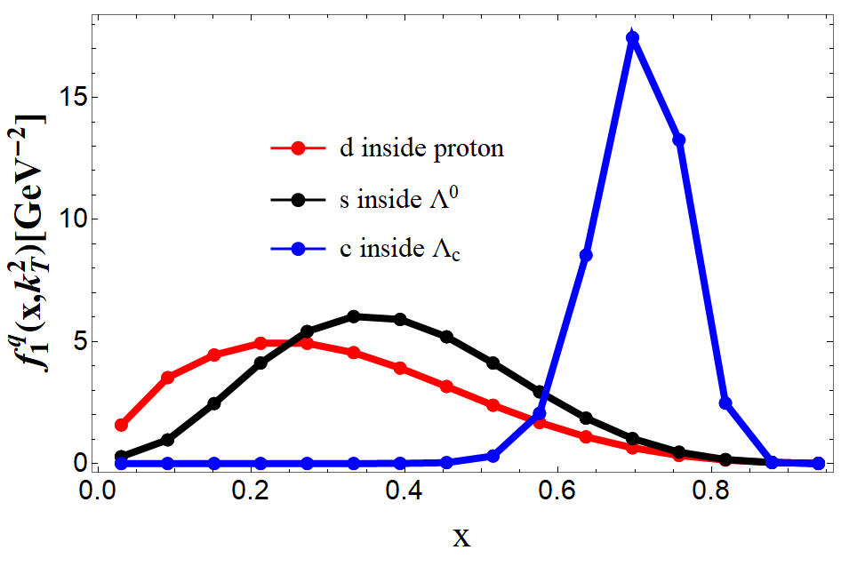
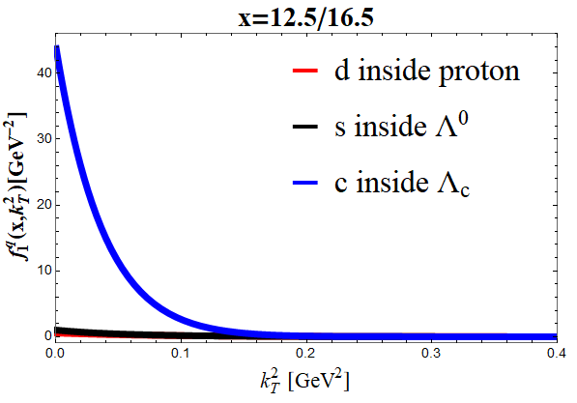
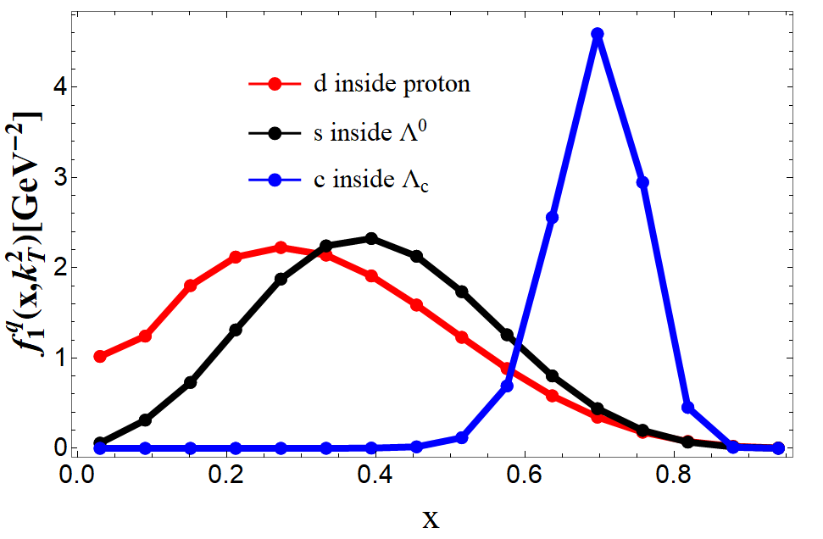
Proton 938MeV
Λ⁰ 1115MeV
Λ_{c} 2286MeV
TMDs for proton, Λ⁰ and Λ_{c}
light quark
k_{T}²=0.01GeV²
k_{T}²=0.04GeV²
k_{T}²=0.09GeV²
Almost twice
Narrow distribution
“heavy” quark
more x
k_{T}²=0.09GeV²
k_{T}²=0.01GeV²
k_{T}²=0.04GeV²
Narrow distribution
Heavier quark carrying more longitudinal momentum
[Zhi-Min Zhu, et al. in preparation]

Slide 13
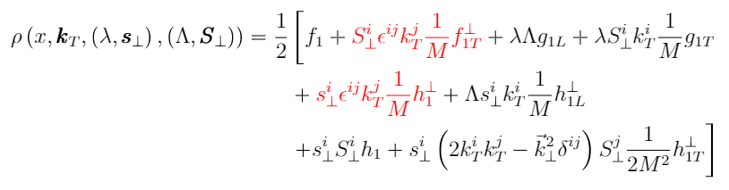
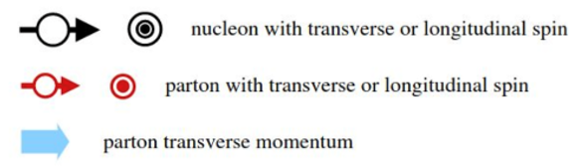
The spin-density
Definition：
Pasquini B, Lorcé C. arXiv:1203.5006, 2012.
Can’t calculate red terms in our initial work
[Zhi-Min Zhu, et al. in preparation]

Slide 14
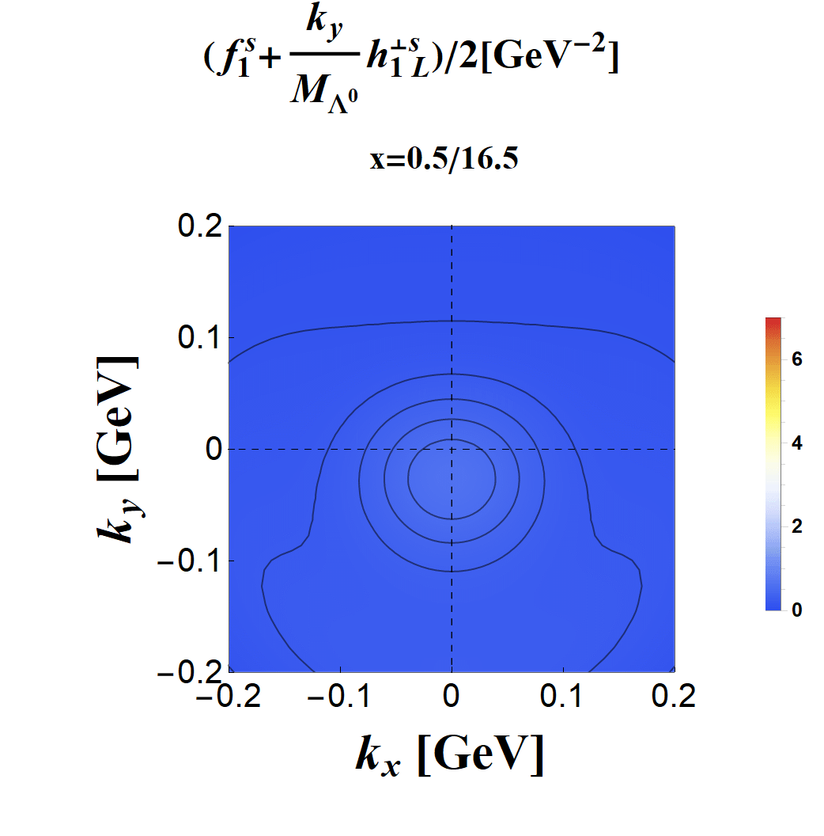
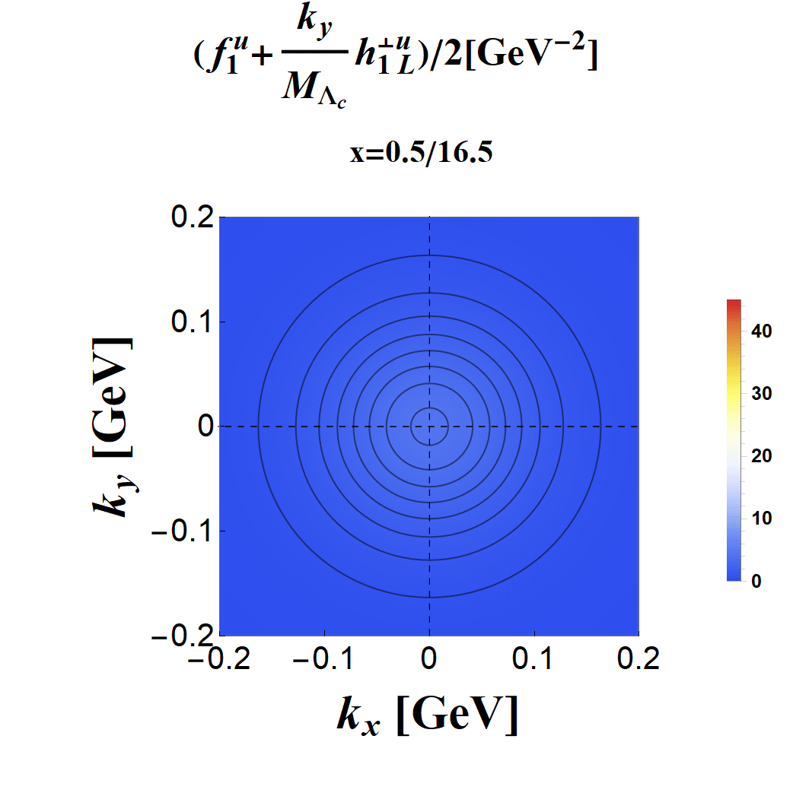
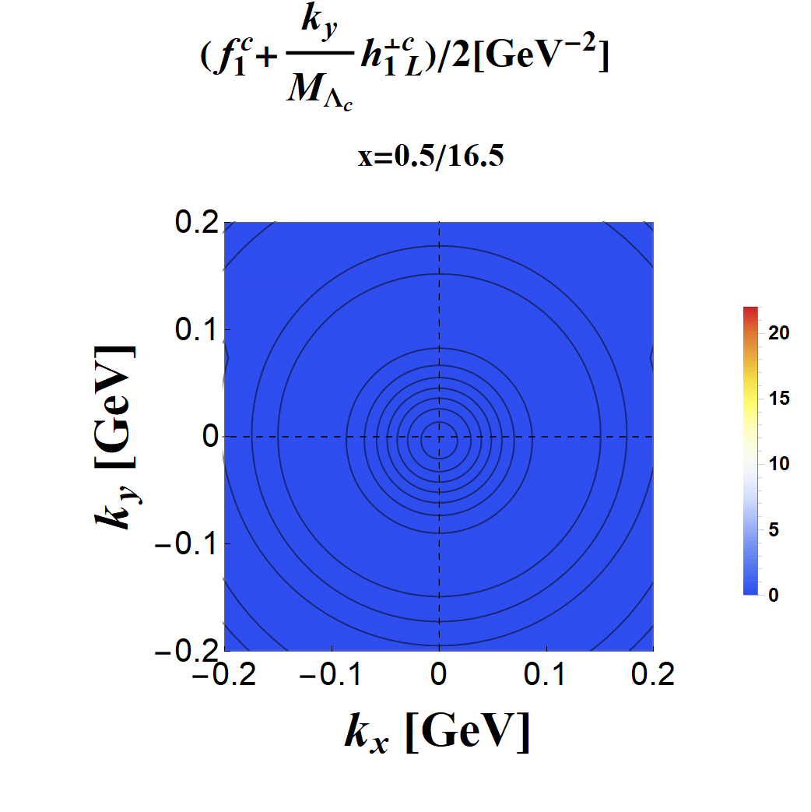
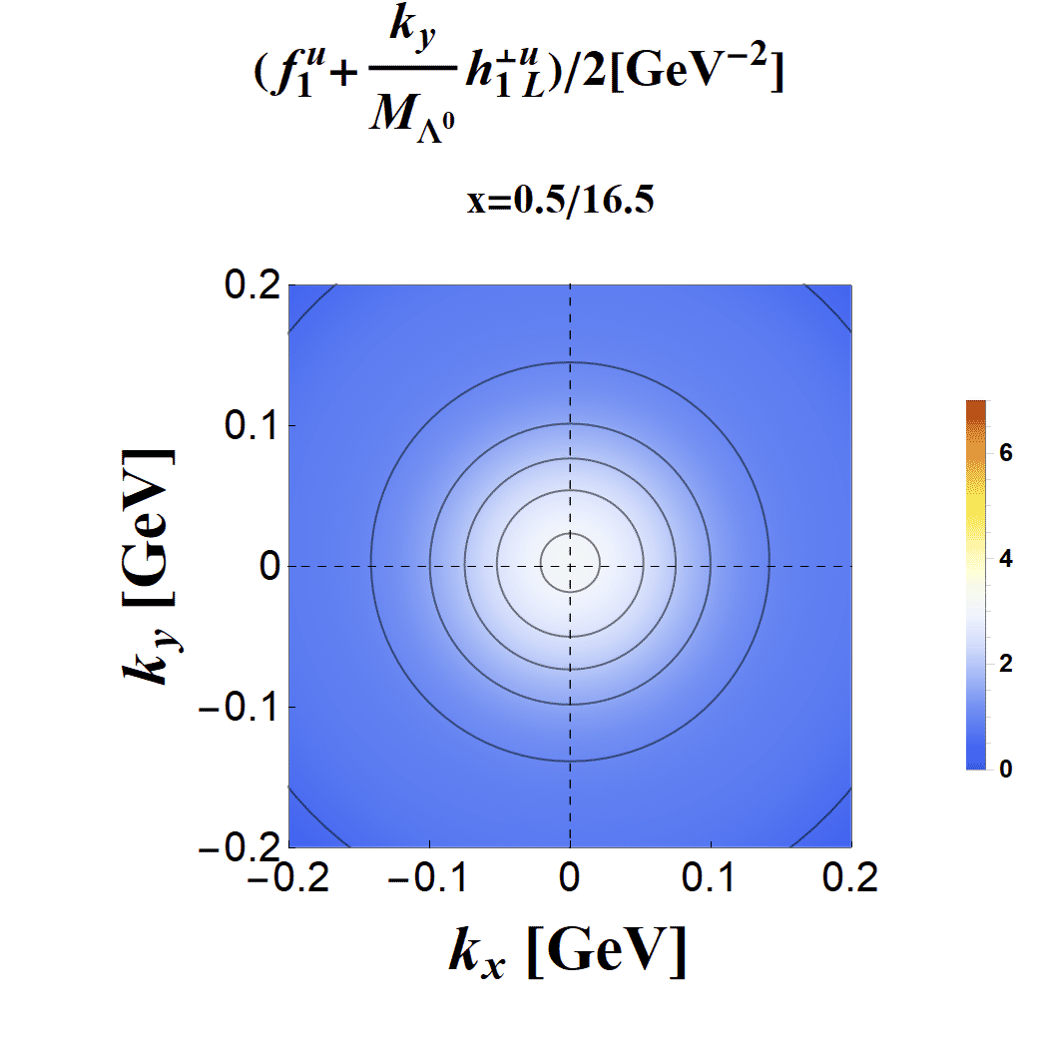

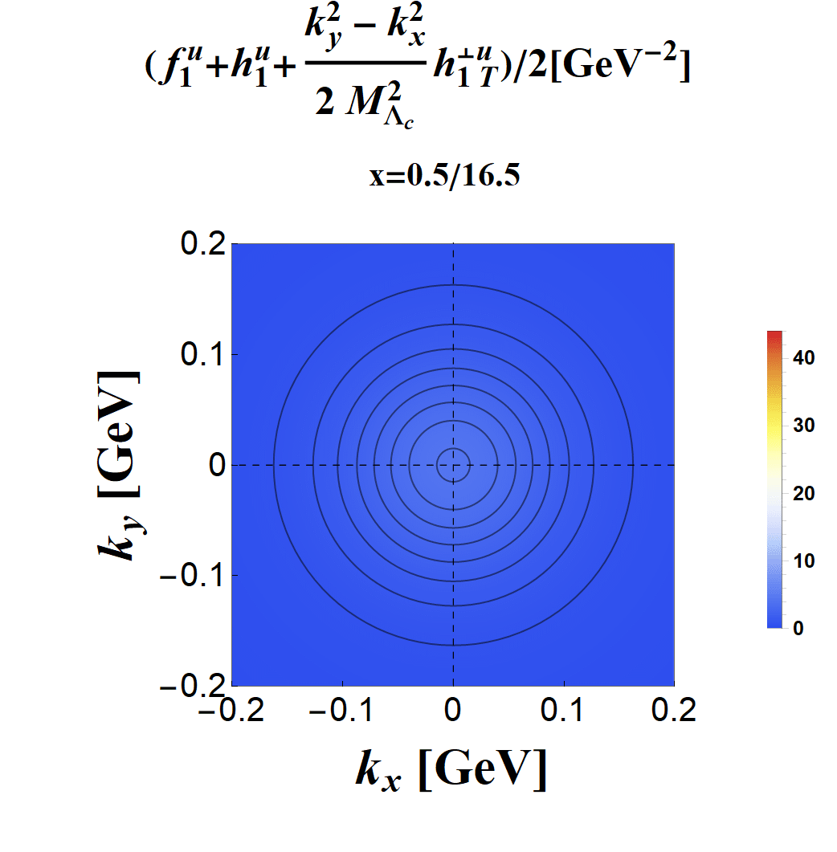
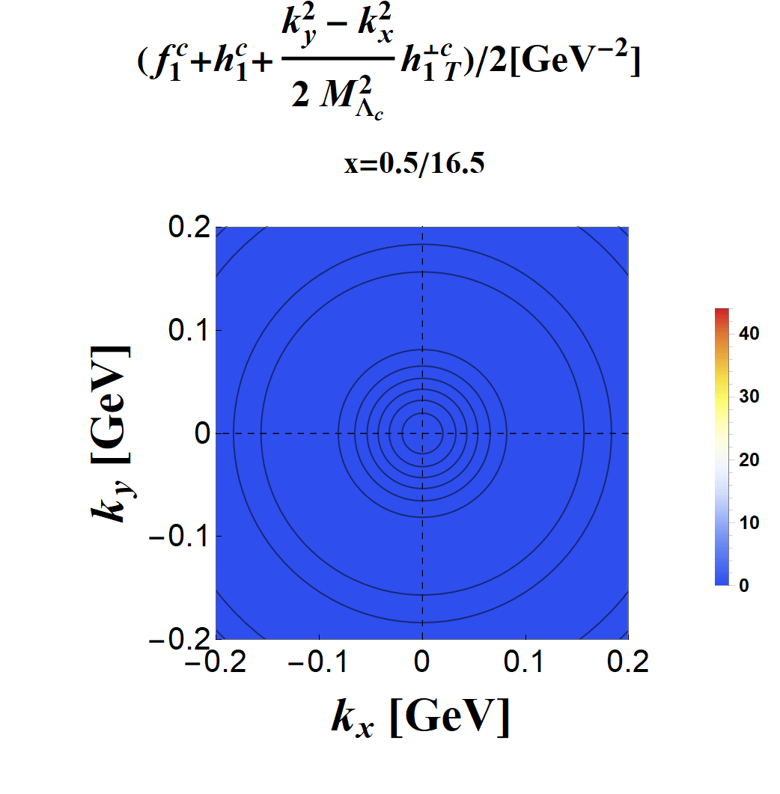

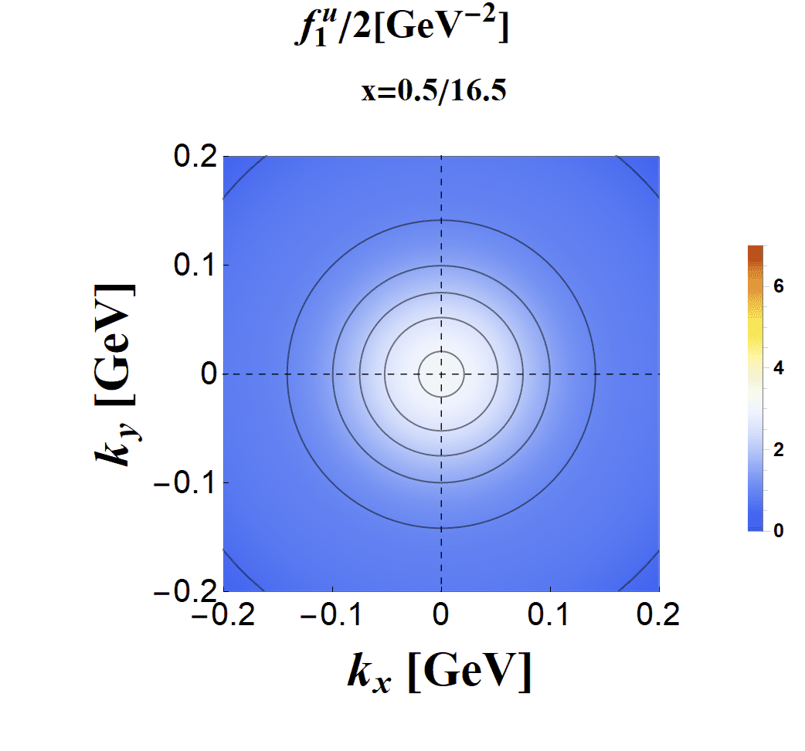
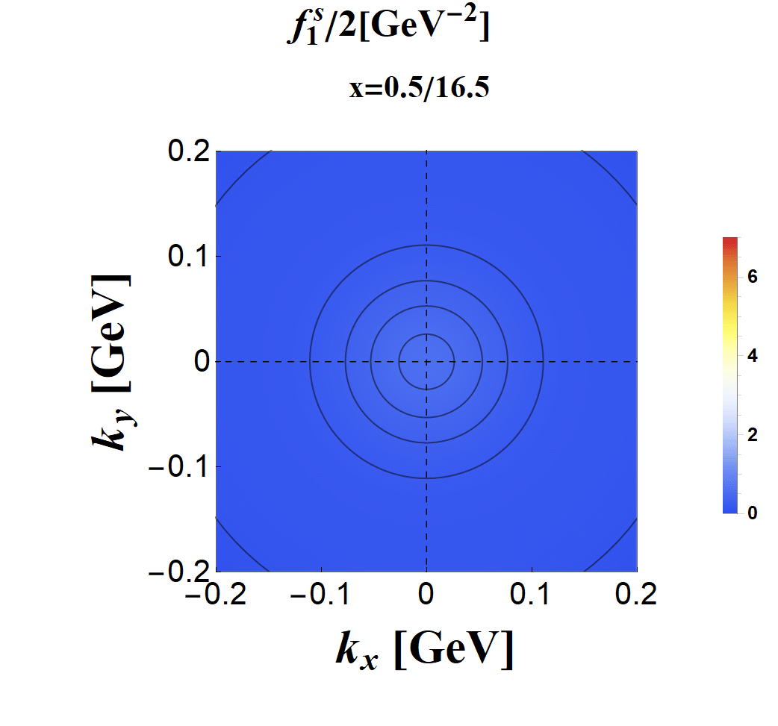




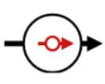


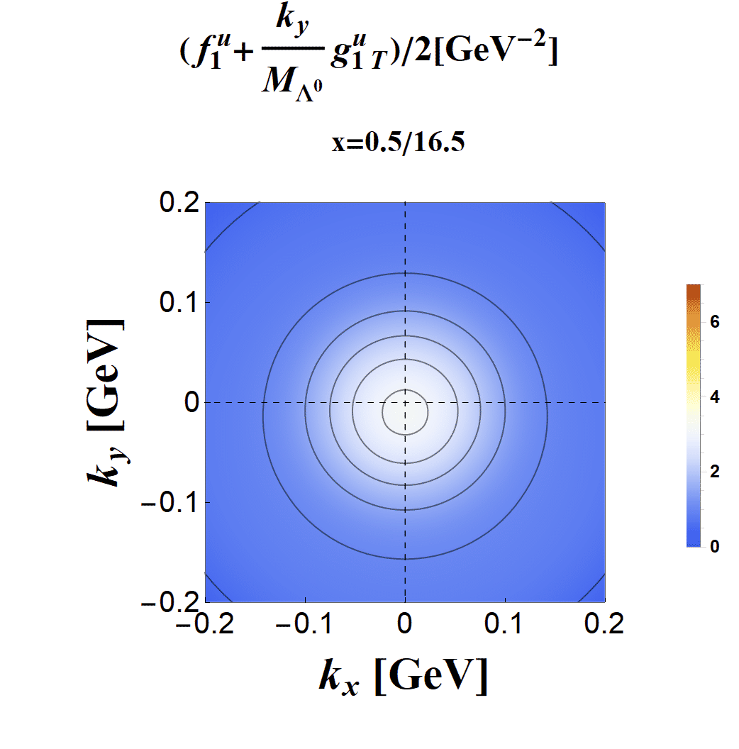
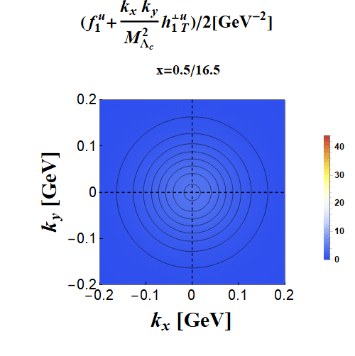

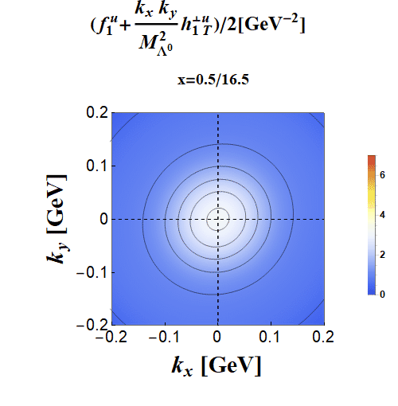
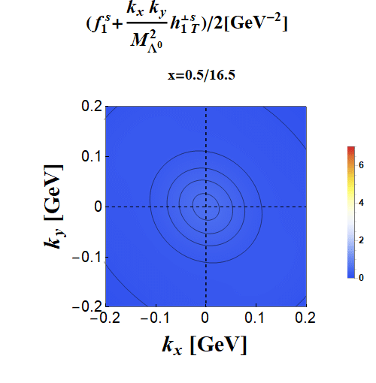

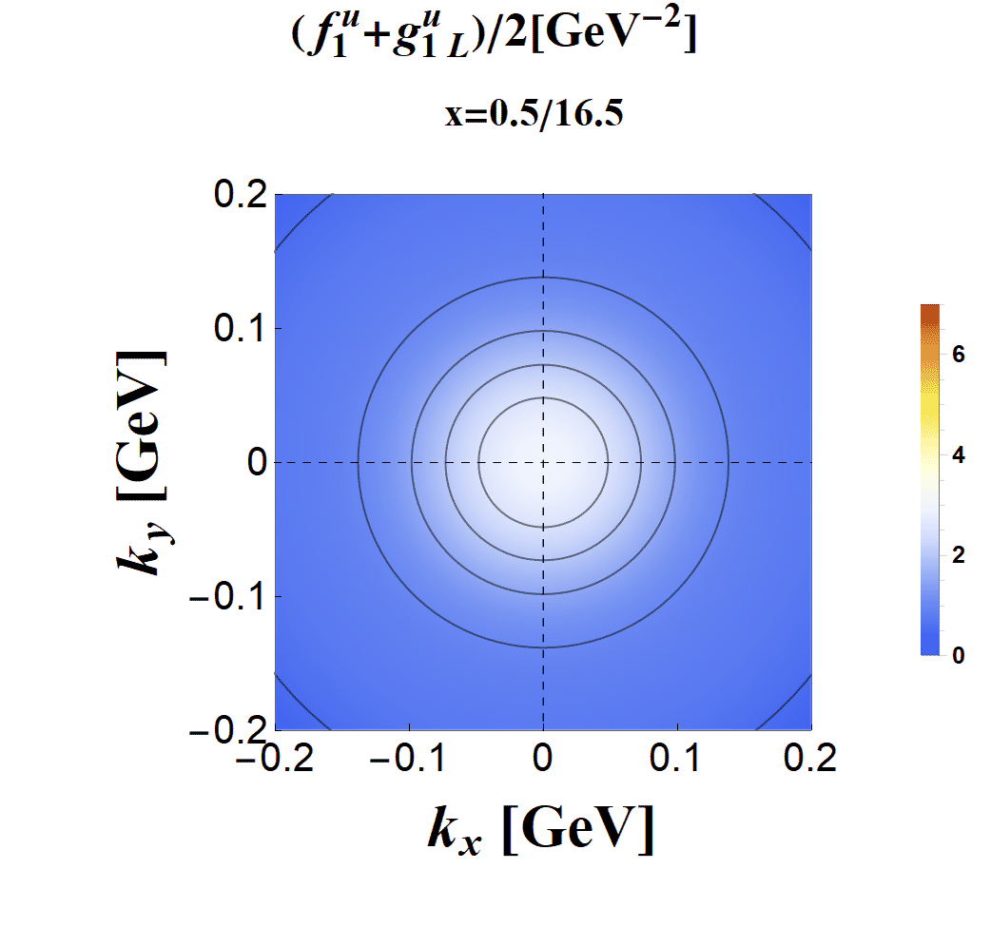
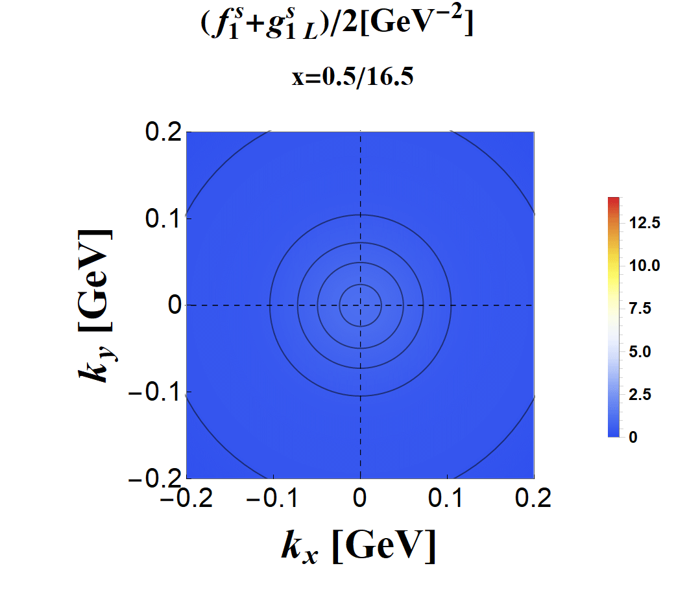
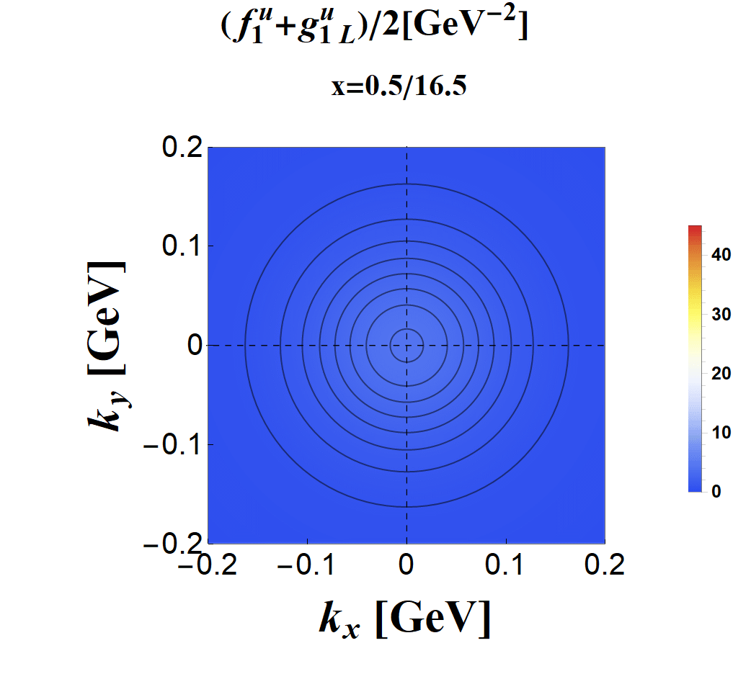
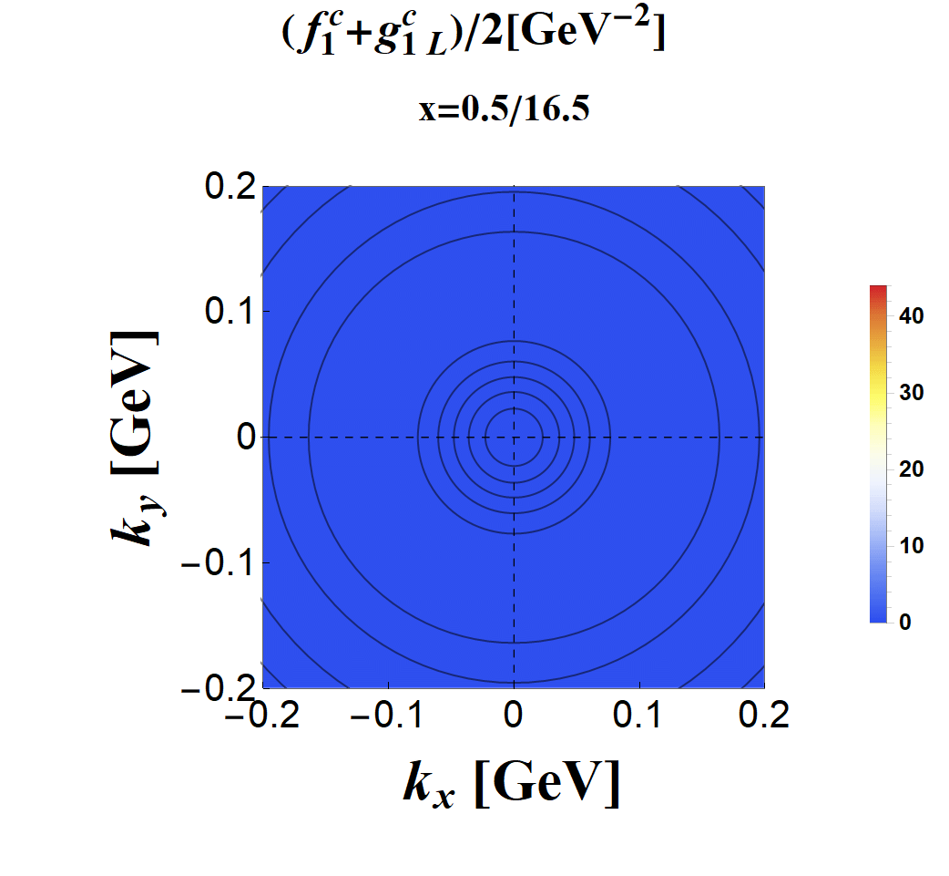

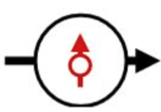
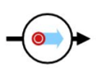
The spin-density for Λ⁰ and Λ_{c}
u/d quark
s quark
u/d quark
c quark
Transverse spin density
T(quark) L(baryon) spin density
Unpolarized spin density
Cylindrical symmetry
Cylindrical symmetry
Small shift in y-axis
Helicity spin density
L(quark) T(baryon) spin density
T-y(quark) T-x(baryon) spin density
Cylindrical symmetry
Small shift
Small shift in y-axis
Not circular but elliptical
[Zhi-Min Zhu, et al. in preparation]

Slide 15

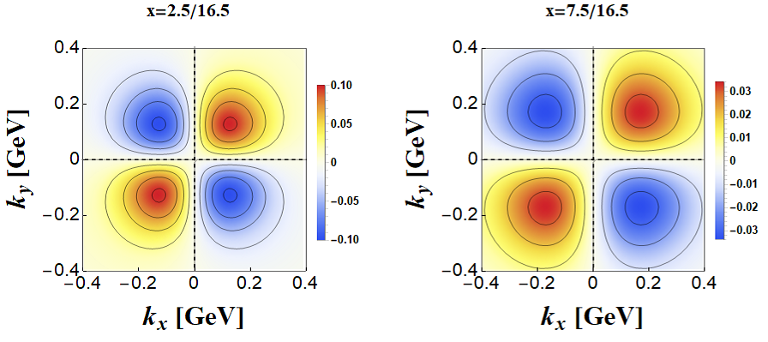












The spin-density for Λ⁰ and Λ_{c}
Total = unpolarized term + distortion term
u/d inside Λ⁰
=
+
s inside Λ⁰
=
+
The distortion term is small.
[Zhi-Min Zhu, et al. in preparation]

Slide 16
Conclusion
Heavy quarks concentrate in larger x range and carry more longitudinal momentum than light quark;
Heavy quarks are dispersed in broader k_{T} range compared with light quark;
There is a small shift in the spin-densities of quarks inside Λ⁰ and Λ_{c} with different polarization direction.
Thank You !
[Zhi-Min Zhu, et al. in preparation]

