Slide 1

Pair production in time-dependent light-front quantization (tBLFQ)
Bolun Hu
Institute of Modern Physics, Chinese Academy of Sciences
Advisor: Xingbo Zhao
2021.10.30

Slide 2
Outline
Overview of the vacuum pair production (Schwinger effect)
Introduction to tBLFQ
Results and conclusions

Slide 3
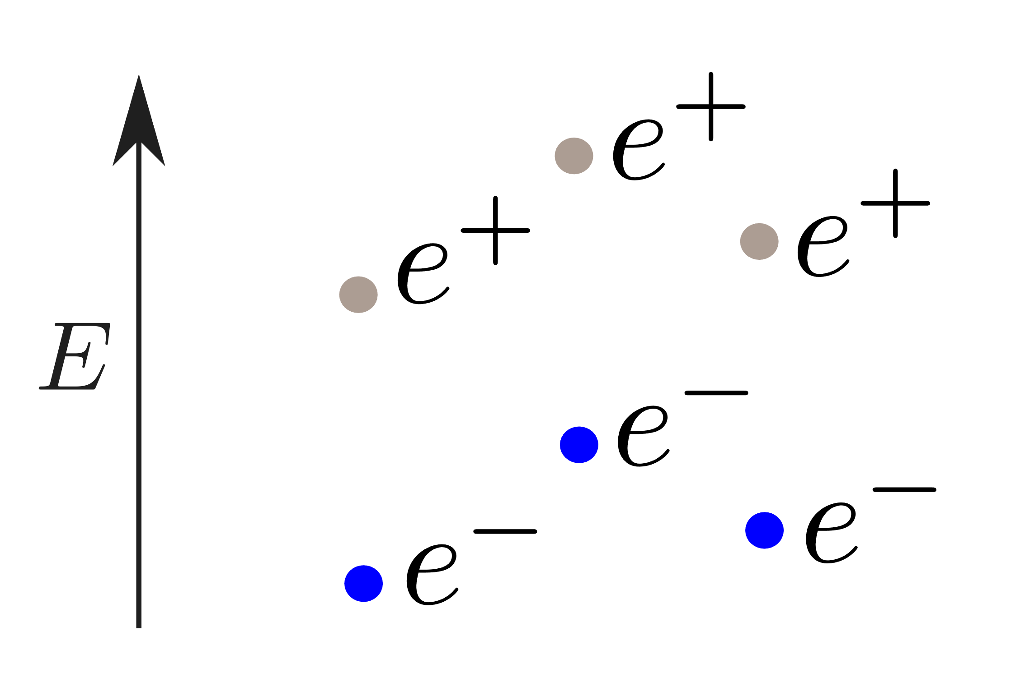
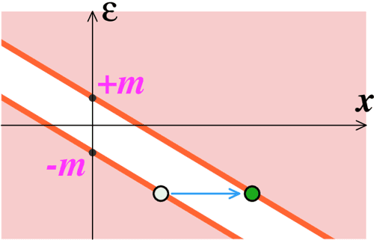
Pair production in strong electric field
In a constant field, the vacuum decay rate is
Typical scale
Each particle obtains energy of
electron mass in one Compton
wavelength

Slide 4
Pair production in tBLFQ
extension of BLFQ
interaction of the
background field
We truncate the Fock space up to 4 pairs of electrons and positrons.

Slide 5
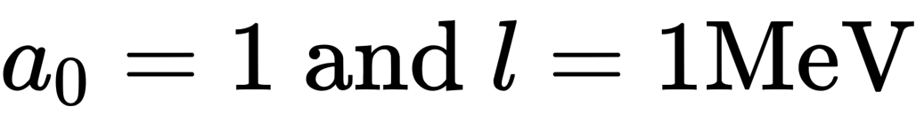
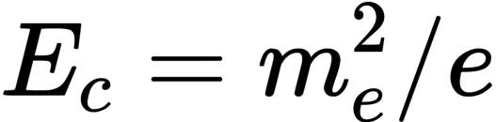
Background field and interactions
We adopt a background field with only the longitudinal component and a longitudinal non-homogeneity
For , the peak value of the electric field is approximately half of the Schwinger limit
consequently, only 2 terms in the light-front QED Hamiltonian contributes in our truncation

Slide 6
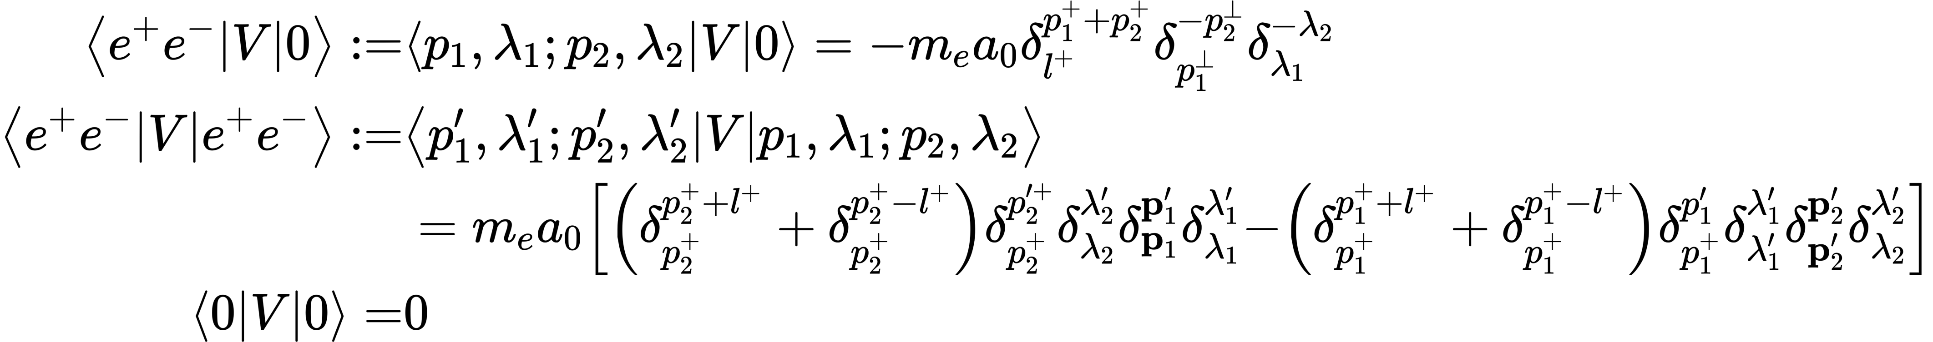
The interaction Hamiltonian in the leading 2 Fock sectors

Slide 7
Time evolution of the probability of finding pairs
As time passes, the probabilities of finding n pairs of electrons and positrons
increase and then decrease sequentially.
The interaction $V$ can excite one pair at one time
Larger $l$ corresponds to a more intense electric field
Zhiyu Lei, Bolun Hu, and Xingbo Zhao, in preparation

Slide 8
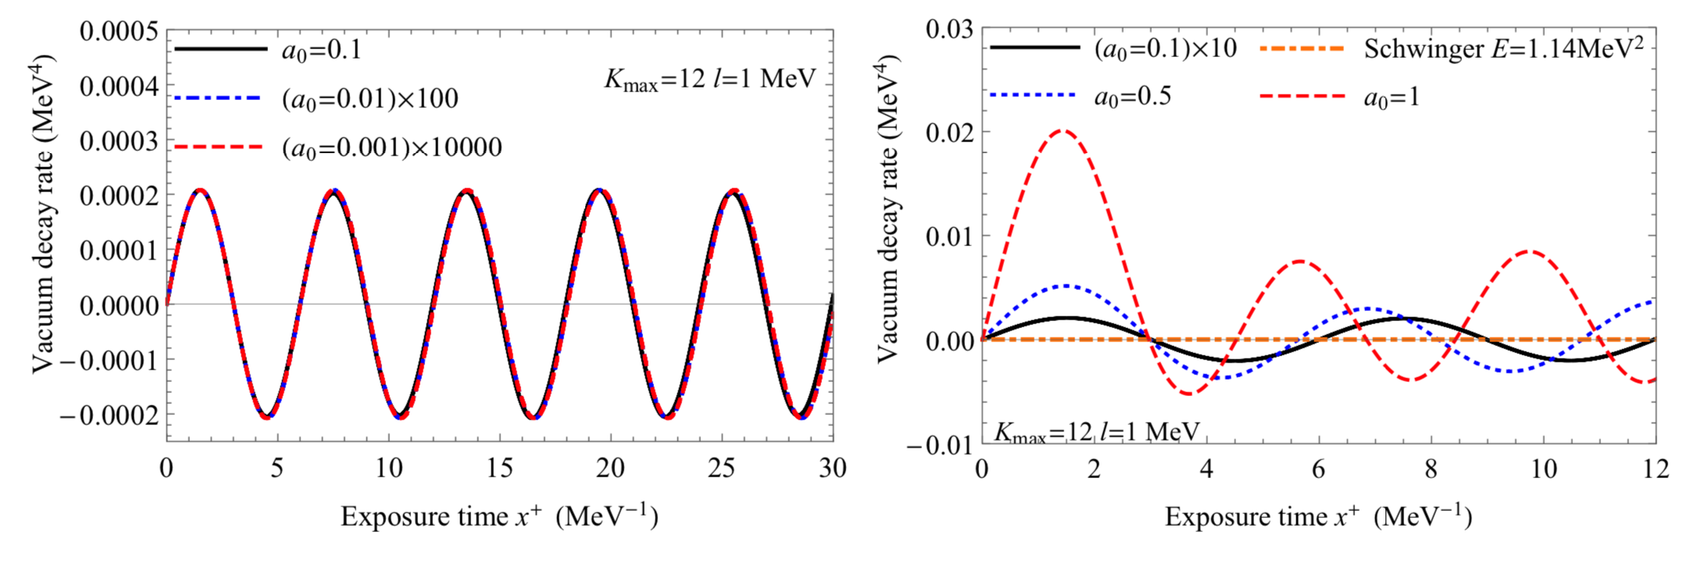
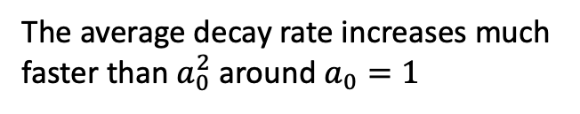

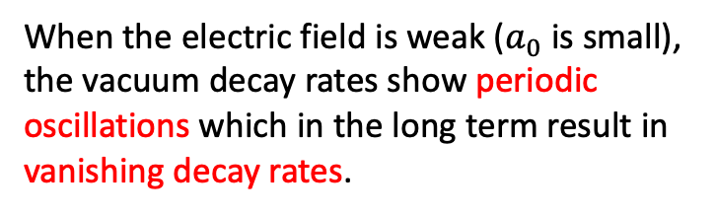
Dependence on the intensity
Vacuum decay rate is proportional to $a_{0}^{2}$
As we continue to increase the field intensity, the decay rates start to lose periodicity and will accumulate with time.
When the electric field is weak ($a_{0}$ is small),
the vacuum decay rates show periodic oscillations which in the long term result in vanishing decay rates.
The average decay rate increases much faster than $a_{0}^{2}$ around $a_{0}=1$

Slide 9
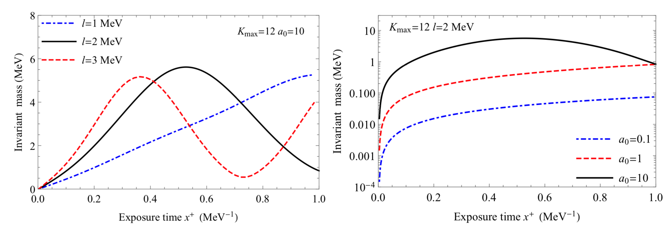




Invariant mass
dependence on $l$
dependence on $a_{0}$
larger $l$ corresponds to more
intensive electric fields
approximately proportional to $a_{0}^{2}$

Slide 10
Invariant mass

Slide 11
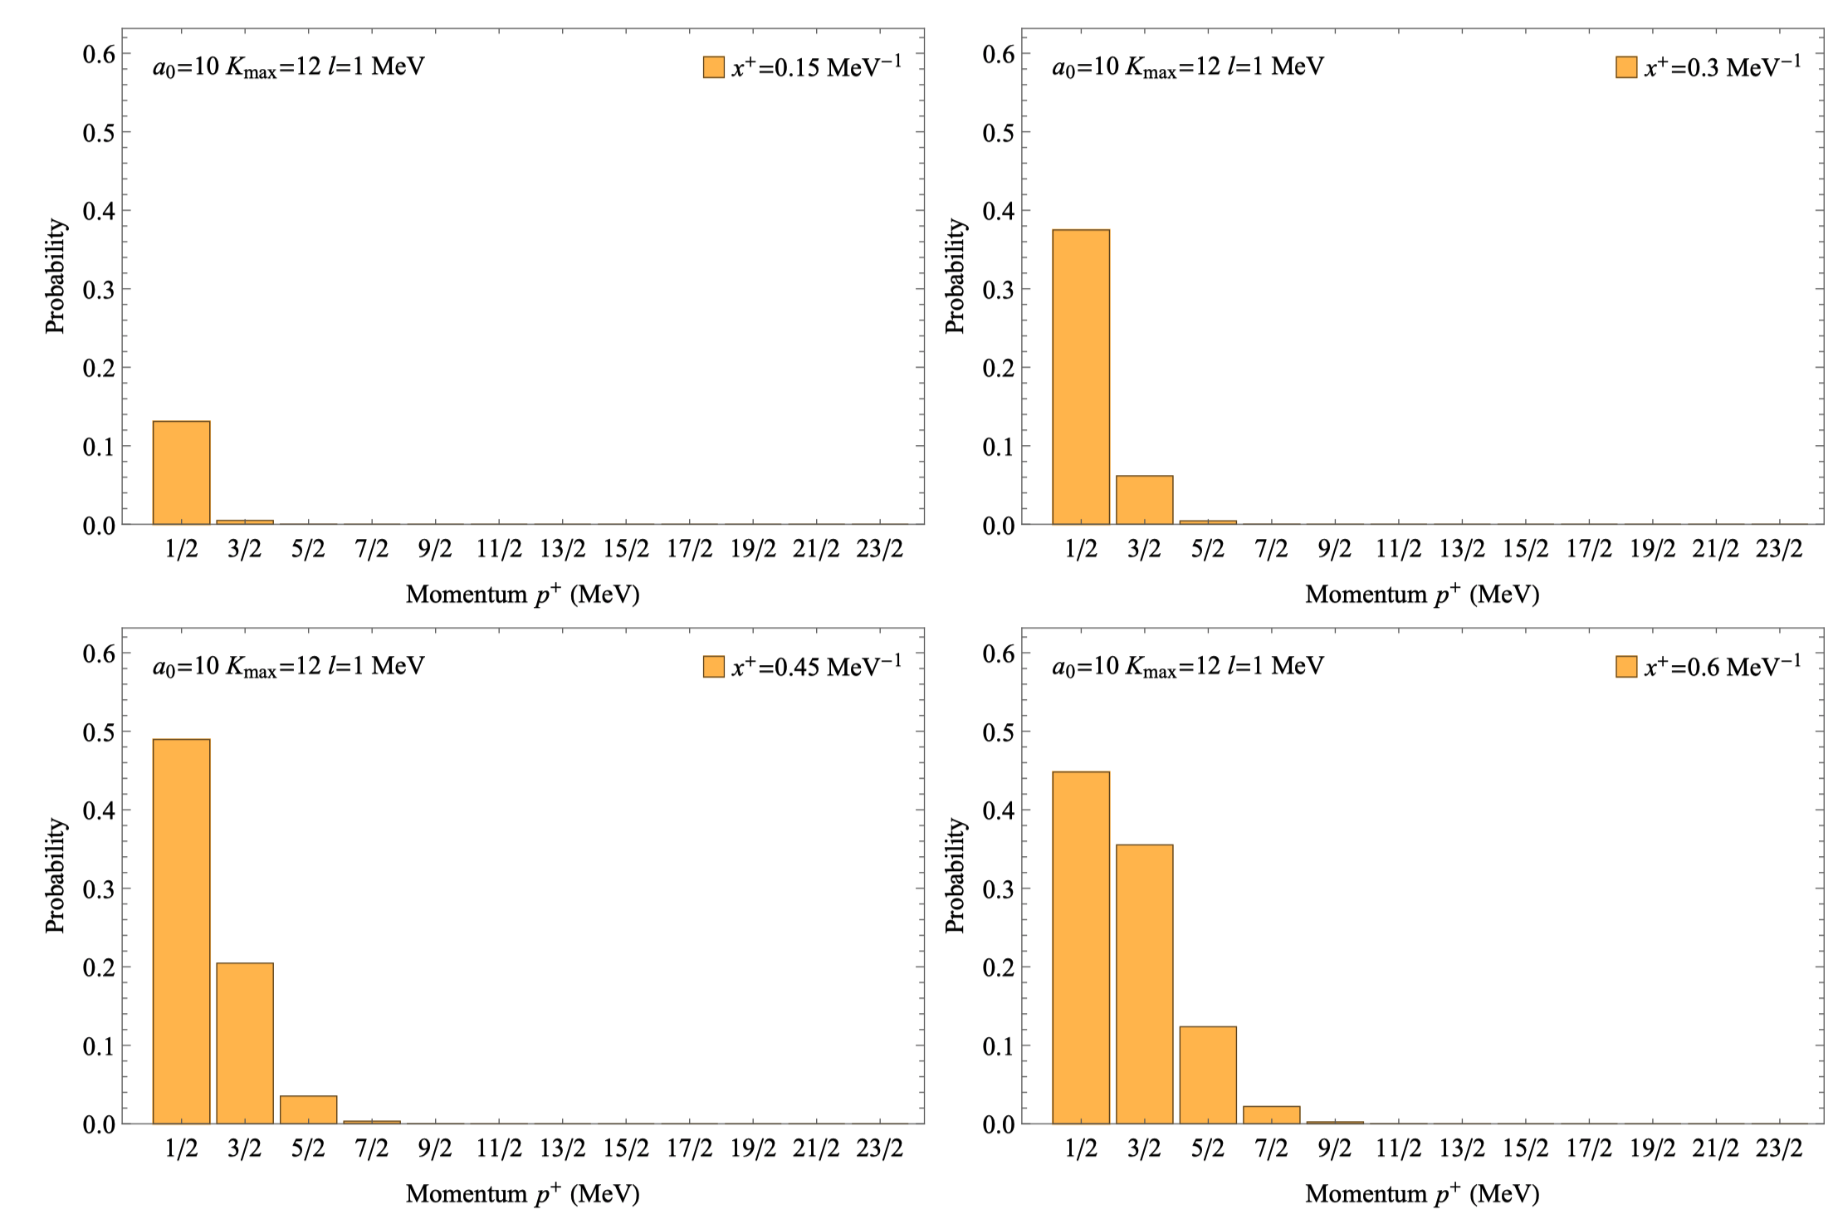
Longitudinal momentum distribution

Slide 12
Longitudinal momentum distribution

Slide 13
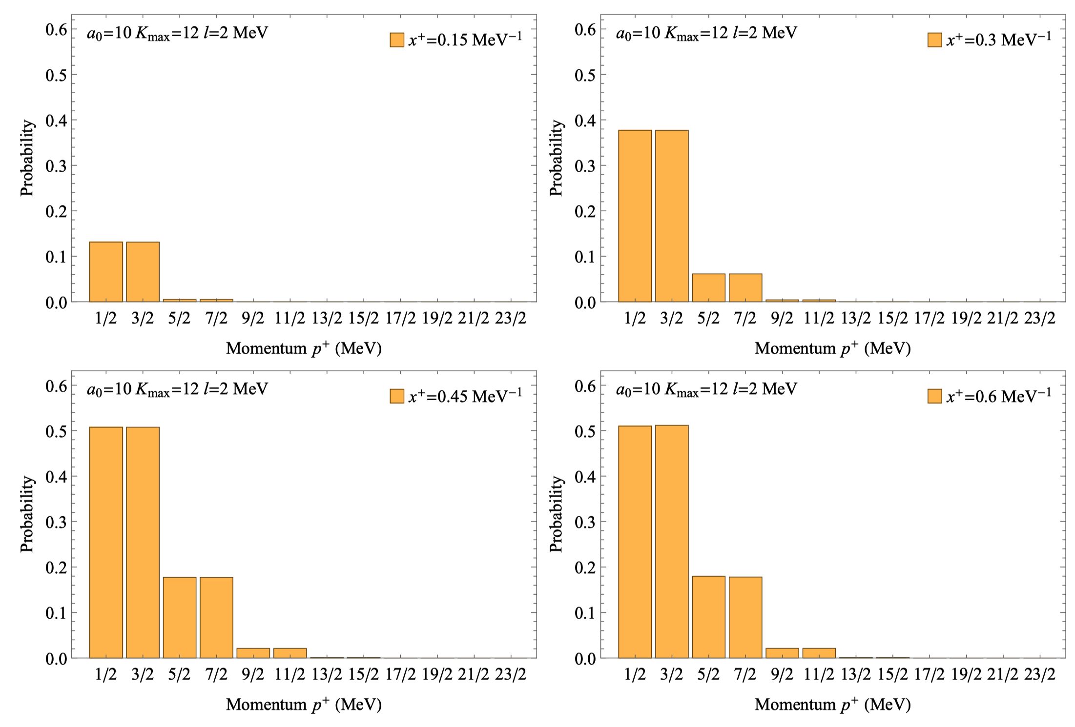

Momentum distribution ($l=2$MeV)

Slide 14
Future plans
Include the photon Fock sectors, so that we can study the interaction between the created fermions and the back reaction to the background fields.
Adopt more realistic background fields, for more faithful modeling of the lasers.

Slide 15
Conclusions
simulate the pair production in tBLFQ while tracking each fermion simultaneously.
find a critical electric field, above which the pairs can be created efficiently.

