Slide 1
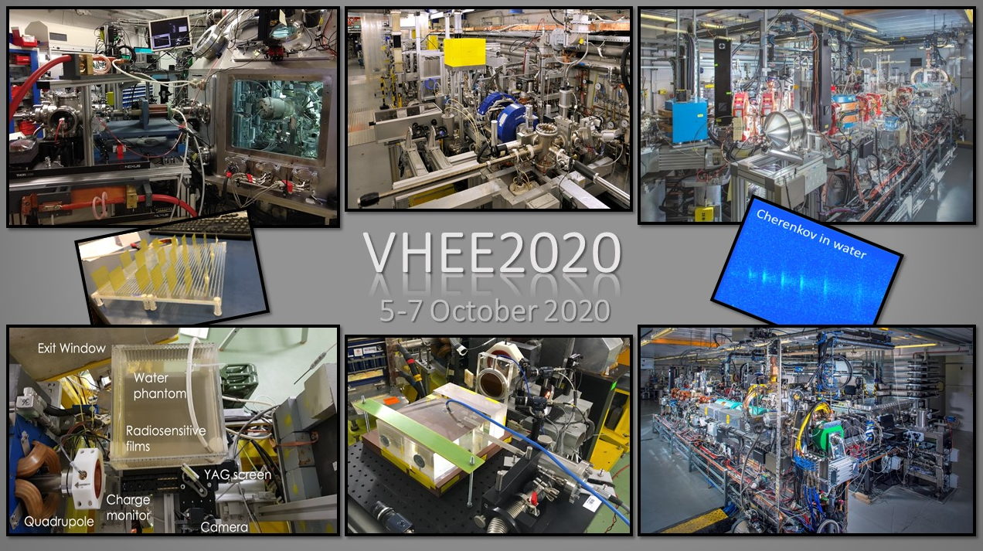
For a smooth video meeting…
Recommendations to all VHEE2020 participants :
Please keep your microphone muted and your camera turned off at all times except when giving your presentation (speakers only).
If you wish to comment or ask a question during a presentation, please use the Raise Hand button. In addition, you may also send your question via the Zoom chat. The Convener of the Session will tell you when to reactivate your microphone to intervene.
Speakers will be requested to «share screen» using the corresponding Zoom option.
Please upload your slides in advance on the VHEE Indico page or send your slides to Alexia (clic.project.office@cern.ch)

