Slide 1



Sources for high dose rate electron and proton
irradiation at the ELBE center Dresden
U. Schramm
Helmholtz-Zentrum Dresden-Rossendorf
Very High Energy Electron Radiotherapy Workshop (VHEE'2020)

Slide 2
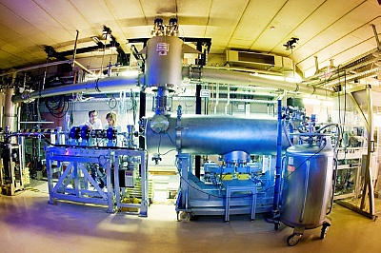
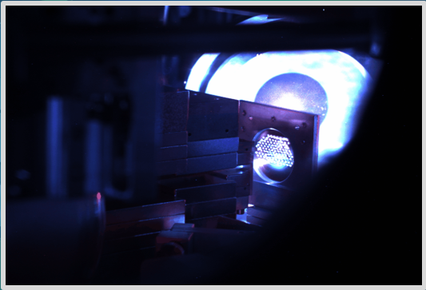
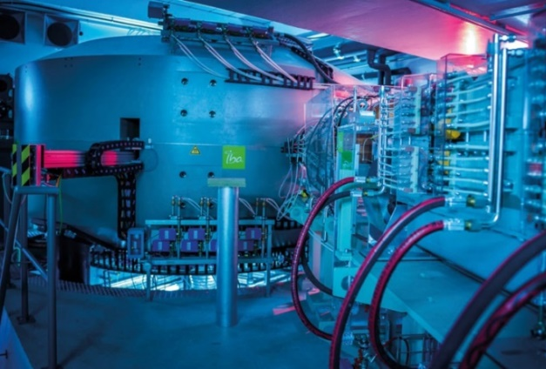
Sources for high dose rate electron and proton
irradiation at the ELBE center Dresden
SRF CW electron linac
PW laser driven plasma
accelerators
Clinical cyclotron and
other reference sources
(operated as open user facilities)

Slide 3
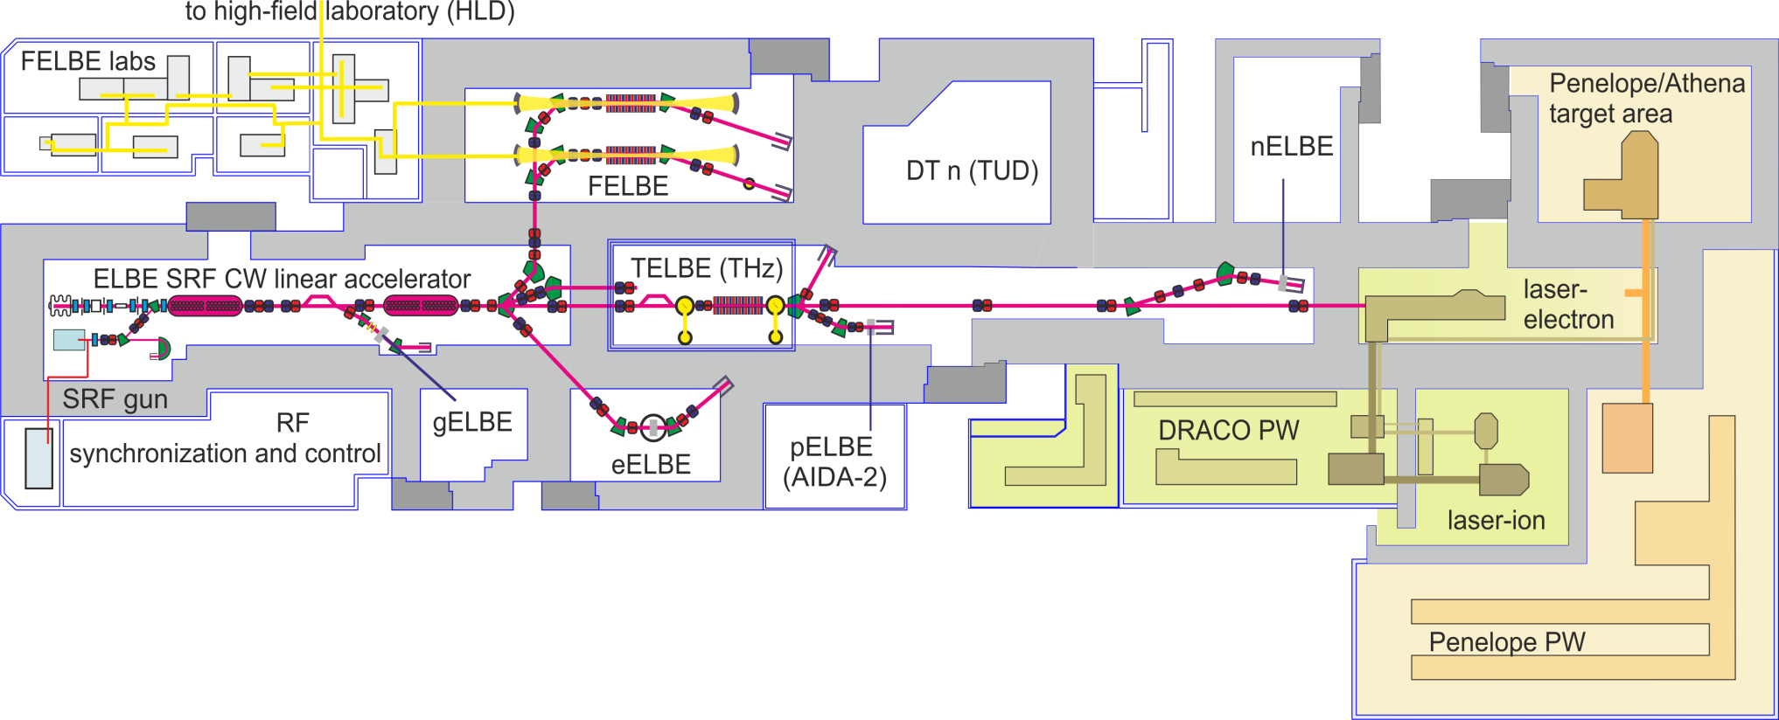
ELBE Center for high power radiation sources
Electron beam (few 10 MeV) in air at variable pulse
sequence and pulse dose
Advanced laser plasma accelerator development

Slide 4
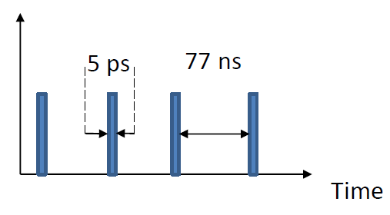
ELBE Center for high power radiation sources
Linear SRF accelerator with variable
pulse sequence (max. rate 13 MHz)
Short pulses (5ps) –> high dose rate
~10⁹ Gy/s
3x10⁵ Gy/s
pulse
mean dose rate
Total dose determined by:
- length of pulse train: e.g. 1400 pulses in 0.11ms -> 33 Gy
- bunch charge (between fC and ~100pC)

Slide 5
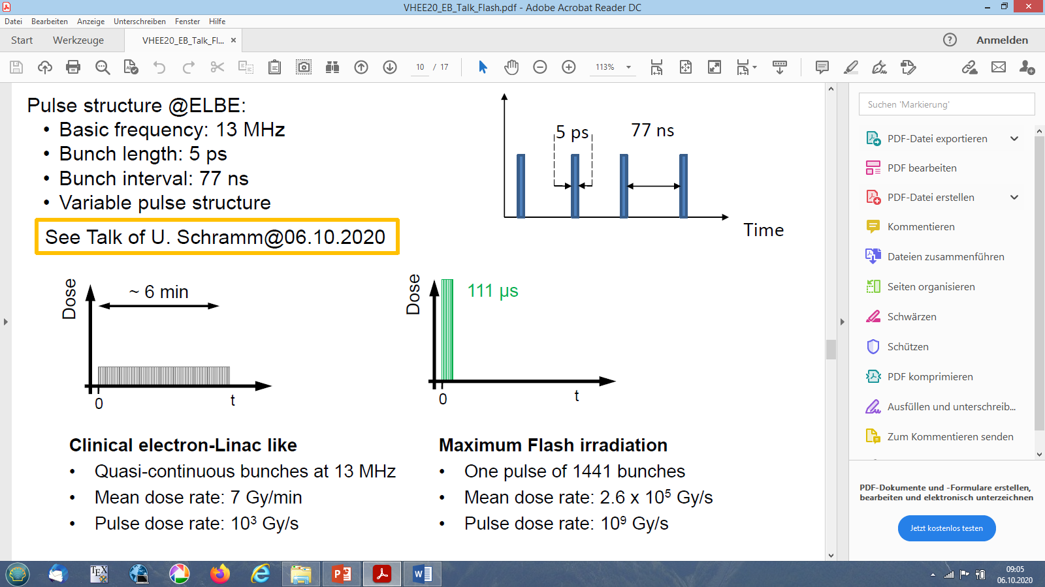
FLASH Experiments at ELBE (c.f. E. Beyreuther on Monday)
Linear SRF accelerator with variable
pulse sequence (max. rate 13 MHz)
Short pulses (5ps) –> high dose rate
7 Gy /min mean
10³ Gy/s
~10⁹ Gy/s
3x10⁵ Gy/s
pulse
mean dose rate
Length of zebra fish embryos (28 hpf) depends on dose rate (and oxygen conc.)

Slide 6
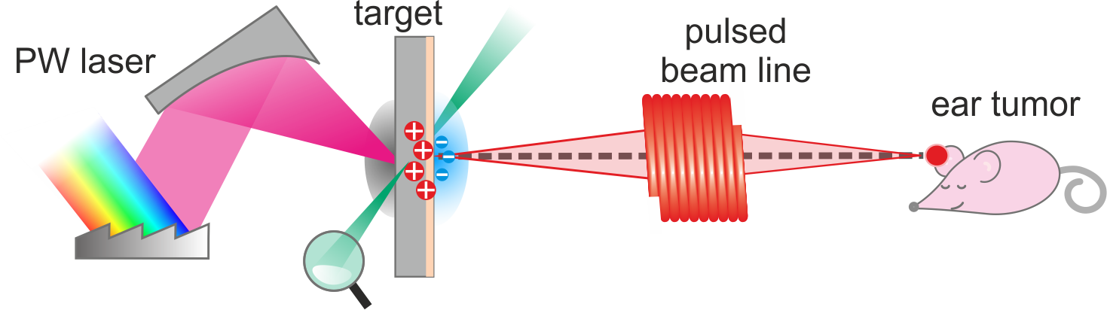
First in-vivo proton irradiation at a compact laser plasma accelerator
taking advantage of (and studying the role of) unique beam proporties
compact pulsed magnet beam transport
generation of flat dose distribution in single pulse
high power laser
non-standard dosimetry
dedicated tumor model
(mouse ear)
compact plasma accelerator
pulsed poly-chromatic beam
high single pulse dose (rate)

Slide 7
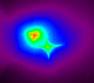
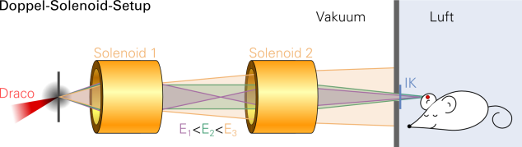
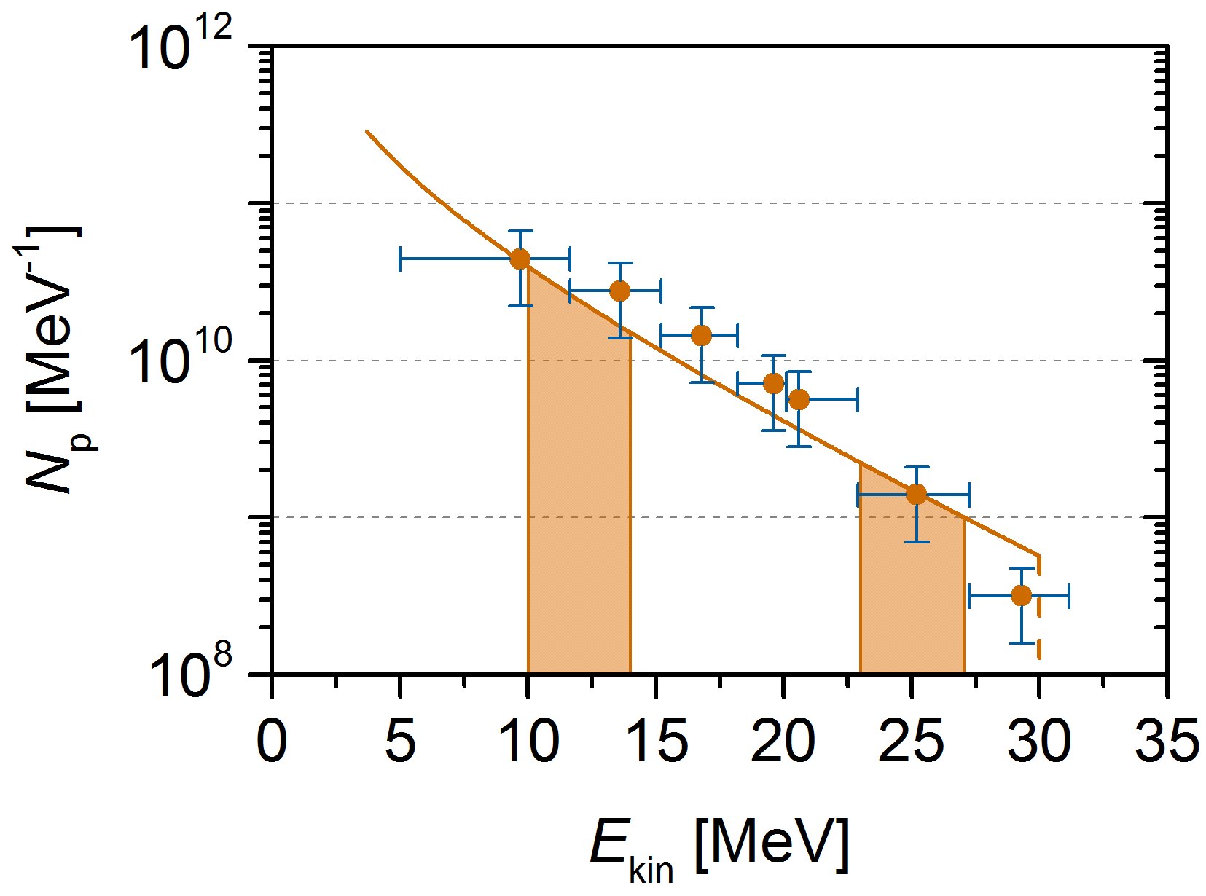
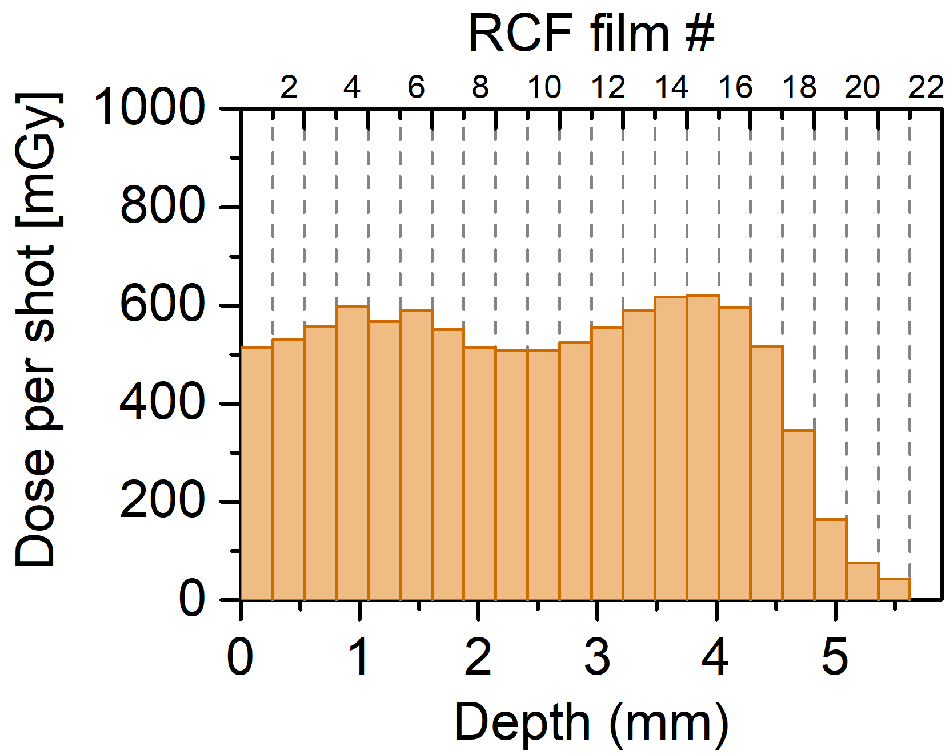
Proton beam characteristics
2-solenoid Setup
vacuum
air
1 cm
18,6 MeV
12,3 MeV
RCF #
D_{pulse} [mGy]
d [mm]

Slide 8
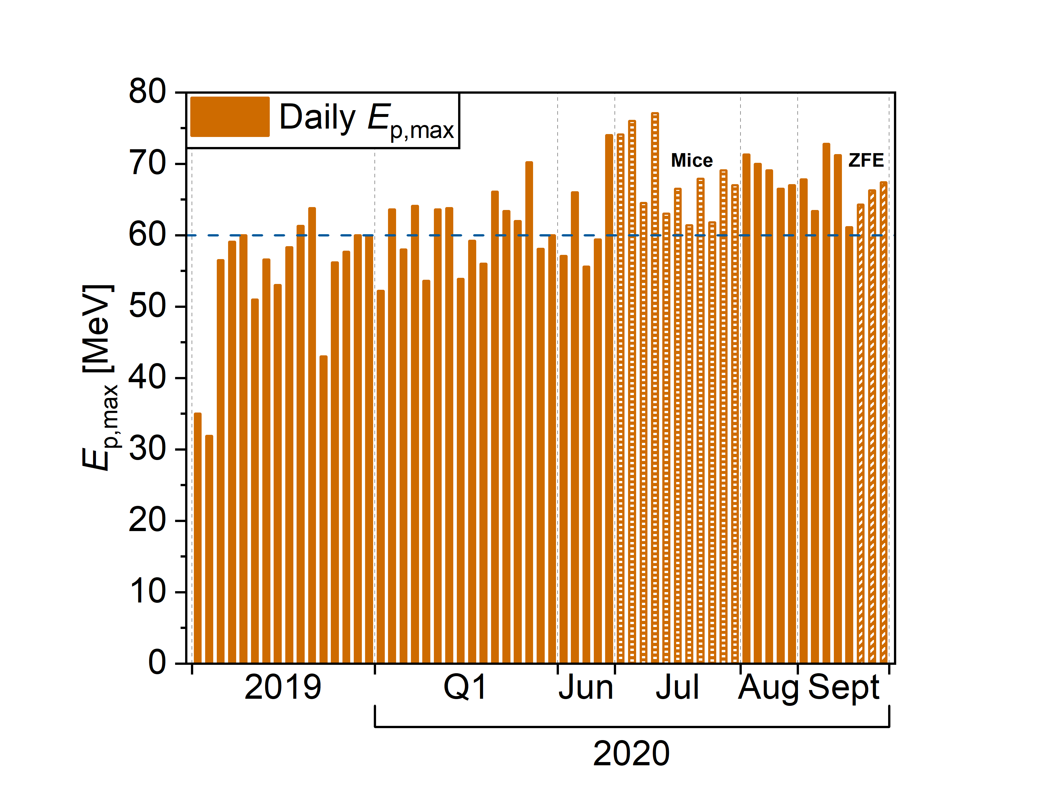
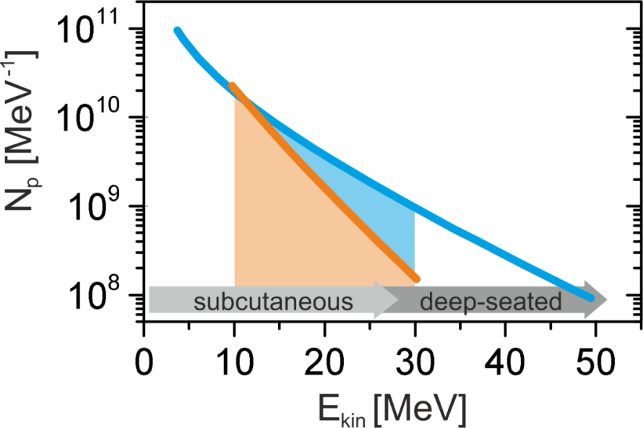
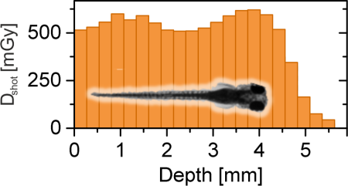
Recent progress in proton energies and operational stability
2019
2017
Tailoring the plasma for optimal efficiency
(either directly or via tailoring the laser pulse)
(based on ~15 J laser energy)
T. Ziegler, et al., arxiv:2007.11499 (2020)

Slide 9
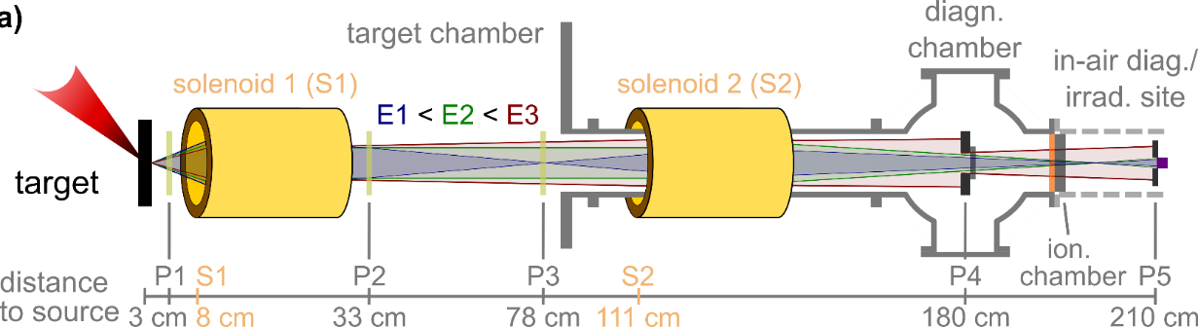
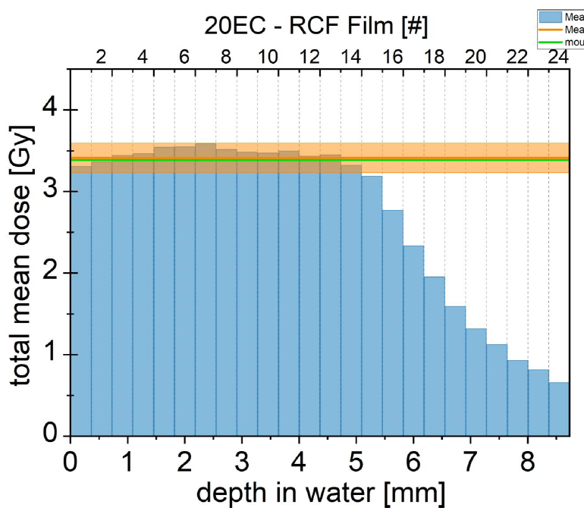
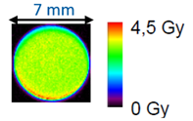
First in-vivo proton irradiation at a compact laser plasma accelerator
transfering intense
poly-chromatic proton pulse
into flat depth-dose
absolute and relative online dosimetry enables
monitoring of accumulated prescribed dose

Slide 10
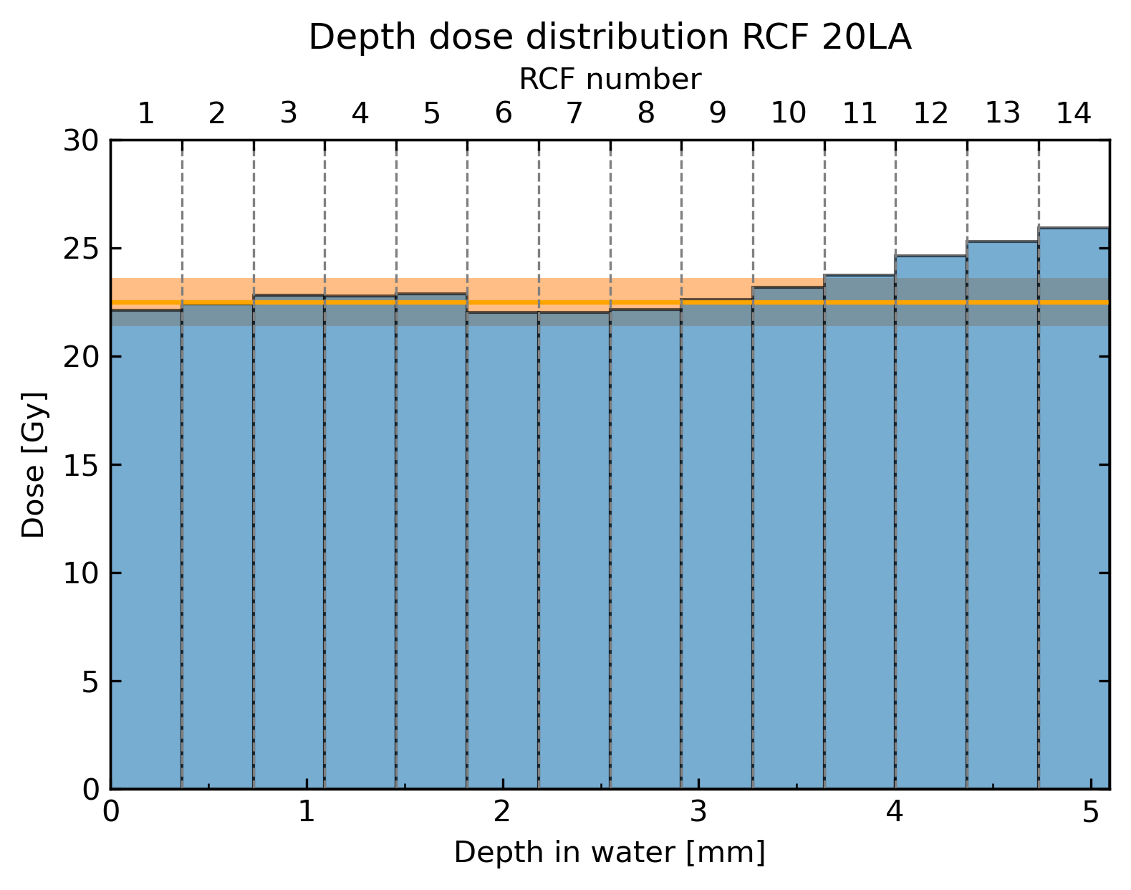
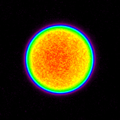
Maximum dose at single pulse for studying dose rate effects
Optimization of transport filter for maximum pulse dose rate of
up to 20 Gy in few ns
(reduction of stability and
prescribed dose control)

Slide 11
Laser plasma proton acceleration
Demonstration of system readiness
for systematic in-vivo radiobiology studies
(incl. full-scale reference irradiation protocols …)
for investigation of high dose rate effects
for providing a compact platform for reference data generation

Slide 12
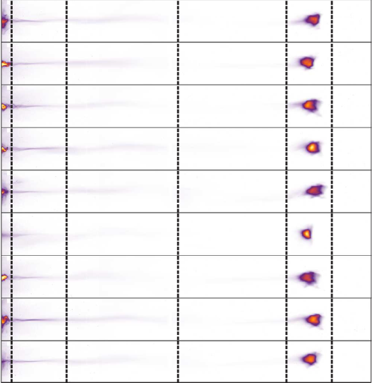

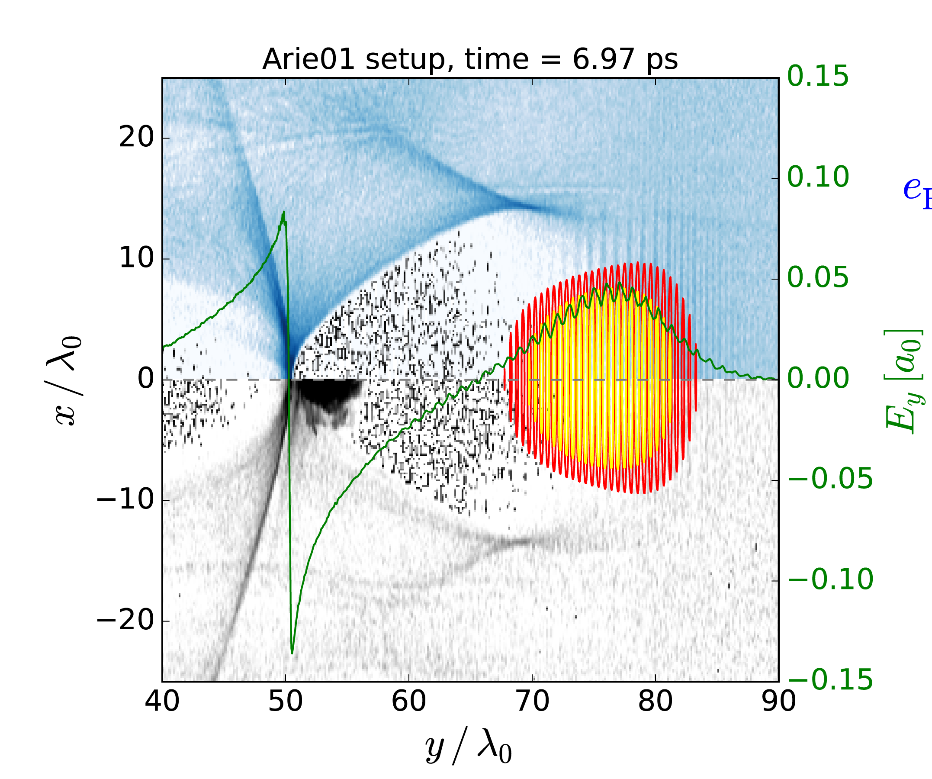
Laser wakefield electron acceleration (VHEE)
Orthogonal plane signal / divergence
5 25 100 180 350
focal plane signal [MeV]
J. Couperus, et al., Nat. Commun. 8, 487 (2017)

Slide 13
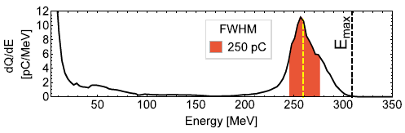
Laser wakefield electron acceleration (VHEE)
Stable beam generation in the multi 100 MeV range
Up to 500 pC charge at up to 10 (1) Hz repetition rate
Bunch duration only ~10 fs (compare ELBE 5 ps)
(thus increasing pulse dose rate by x1000)
Compact source for VHEE but (still) limits in average dose rate

Slide 14
K. Zeil, J. Metzkes-Ng, C. Bernert, F. Brack, S. Kraft, F. Kroll, L. Obst-Huebl,
M. Rehwald, M. Reimold, H.P. Schlenvoigt, T. Ziegler, et al.
A. Irman, J. Couperus, J. Krämer, A. Köhler, T. Kurz, S. Schöbel, O. Zarini, et al.,
M. Bussmann, A. Debus, R. Pausch, K. Steiniger, A. Hübl, T. Kluge, M. Garten, et al.
J. Pawelke, E. Beyreuther, et al.,
M. Siebold, D. Albach, S. Bock, R. Gebhardt, U. Helbig, M. Löser, T. Püschel, et al.
U. Schramm, T. Cowan, R. Sauerbrey

