Slide 1
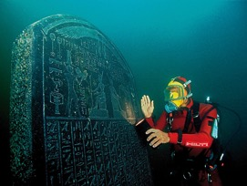

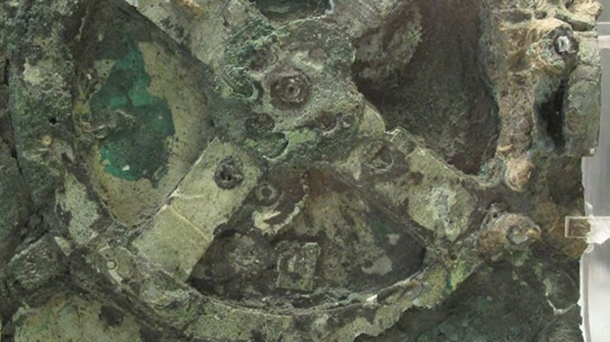
Muon Collider –
Archeology
Ronald Lipton

Slide 2
Some History
A focused accelerator R&D program, MAP, was launched in 2010 to study the feasibility of a muon-based collider program
  There were a number of earlier studies
  A small detector conceptual study was also launched to study the physics potential and associated detector issues
Snowmass studies were based on a simulation of a 1.5 TeV muon collider, with parametric studies of a Higgs factory.
As a result of the 2013/14 US P5 process the MAP program was terminated
  This also led to a termination of physics studies
  Most of this work was done by Vito Di Benedetto, Anna Mazzacane, Alex Conway, and Nikolai Terentiev with support from the MARS team and Hans Wentzel as well as Estia Eichten and Chris Hill

Slide 3
Study Thrusts
Much of the muon collider physics overlap with
CLIC AND ILC
We used CLIC and ILC studies as a starting
point
The detector environment is very different.
We tried to understand techniques for handling
the background and how the backgrounds
might affect the physics reach.
There are some areas where the muon collider has
unique advantages – we tried to understand those areas
  Narrow beam energy spread (lower brem) can enable precision physics
  Muon Collider has x 40,000 higher coupling for s-channel Higgs
  Other s-channel resonances (A’)
  Precise (~4 MeV) Higgs mass measurement
    Enabled by precise beam energy measurement by g-2 precession
    (Raja & Tollestrup)

Slide 4
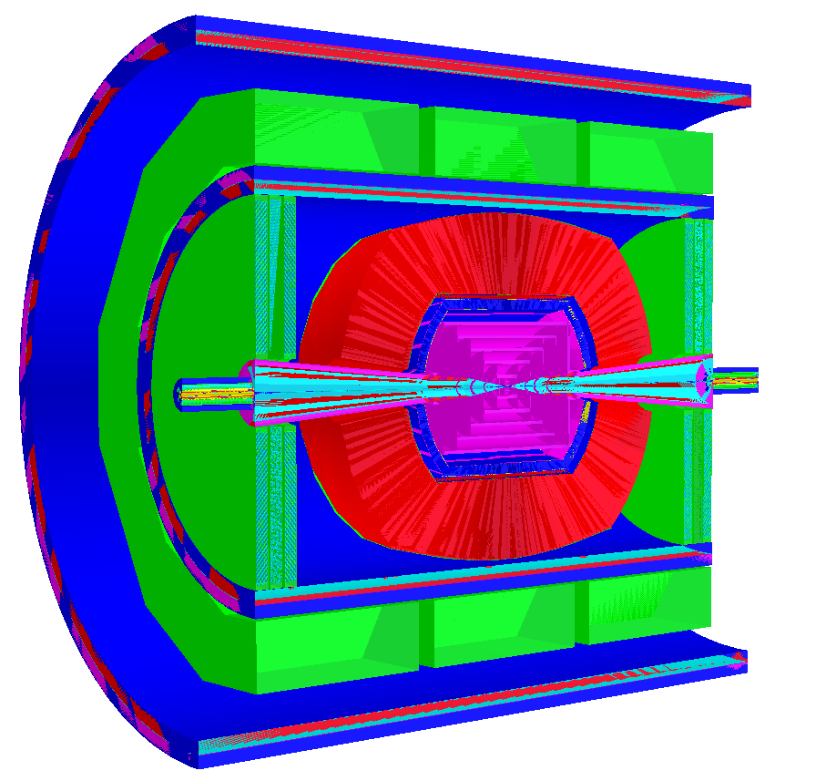
Detector Model
Detector was based on ILC concepts (SiD, ILD, 4th)
My own background was work on the SID vertex and tracker design
Fine pitch pixelated vertex and forward detectors (~20 μm) based on SiD
More coarsely (50 μm) pixelated tracker
  Both with sub-ns timing resolution
Dual readout (scintillator/Cerenkov) calorimeter to optimize hadronic shower resolution
  Based on existing “Adriano” design with realistic parameters – not optimized for timing
  Between 1 and 12 ns timing gates
ILCROOT Detector Model

Slide 5
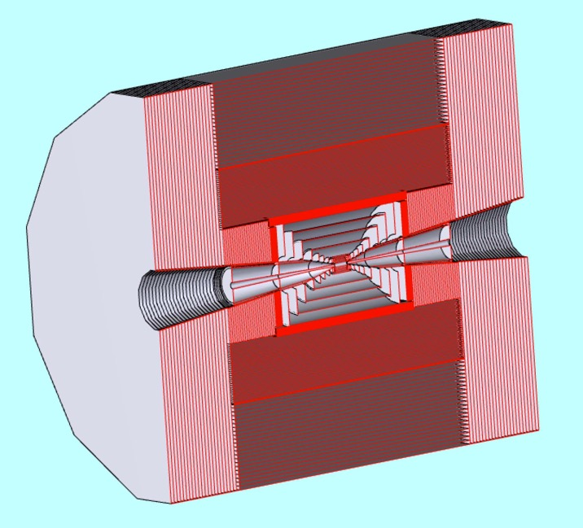
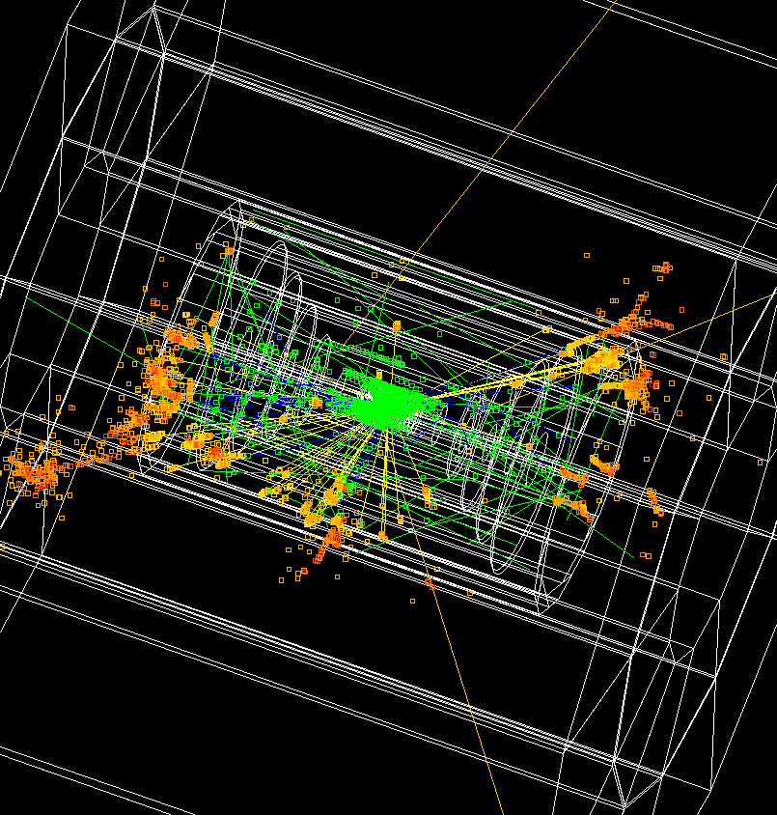
Detector Model based on ILC SiD concept
LCSIM Detector Model
Full Simulation
Absorber cone

Slide 6



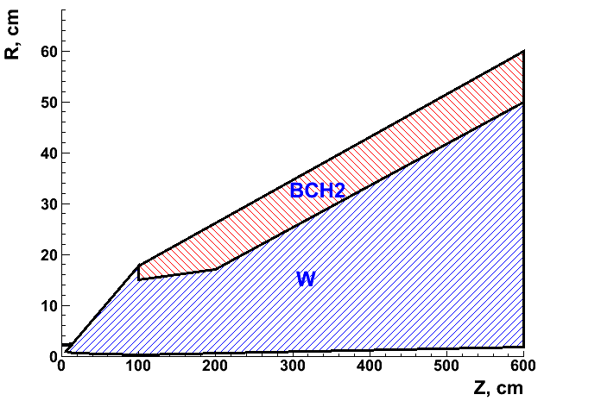
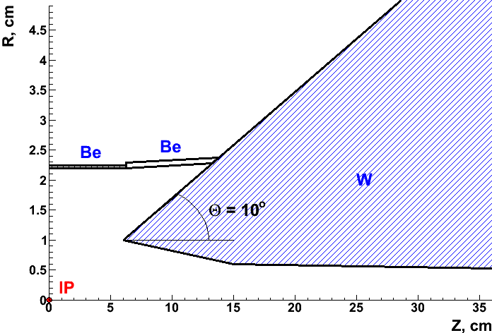
The Nose (google Gogol)
10⁰ shielding nozzle geometry for 1.5 TeV Muon Collider
General (1/2 RZ) view Zoom in beam pipe
W – tungsten
  Be – beryllium
  BCH2 – borated polyethylene

Slide 7
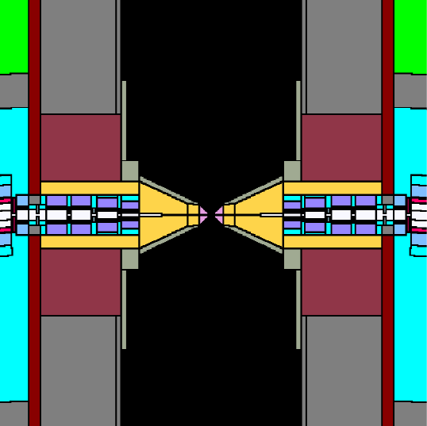
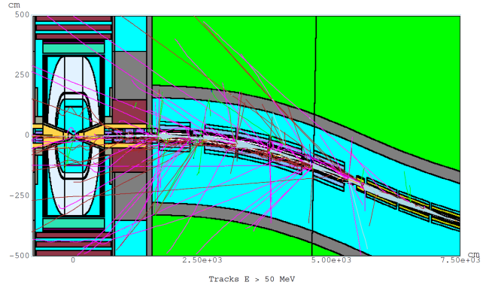
Backgrounds
MARS simulations
From the detector side the central issue in a muon collider are backgrounds due to muon beam decays.
For a 0.75-TeV muon beam of 2x10¹²/bunch
  4.28x10⁵ decays/m per bunch crossing
  0.5 kW/m.
Recalculated with a timing bug fixed in 2014
3.24x10⁸ particles into detector per crossing
  100 keV threshold for γ, e± ,μ±
  and charged hadrons
  0.001 eV for n
MARs-
ILCRoot
handoff
W-poly nose

Slide 8
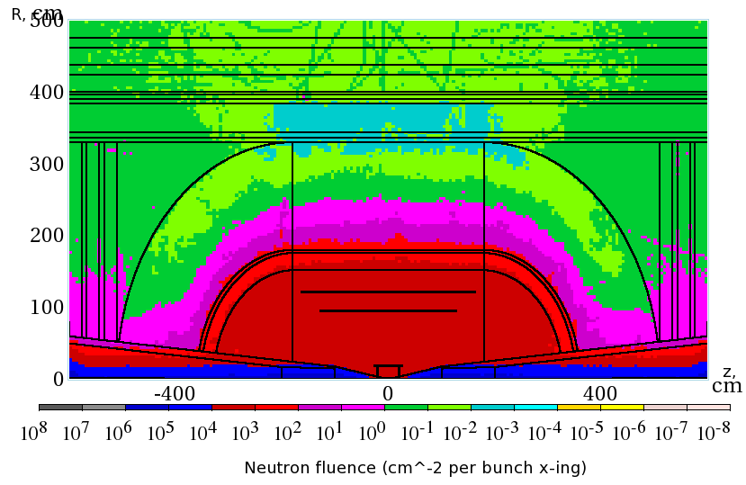
Overall Background – 1.5 TeV
Detectors must be rad hard
Dominated by neutrons –
smaller radial dependence
Non-ionizing background ~ .1 x LHC
But crossing interval 10μs/25 ns 400 x

Slide 9
Background Distributions
Mostly neutrons, photons and conversions

Slide 10
Background Energy Distributions
Generally soft
4
4
4

Slide 11
Attacking the Background
Timing and energy discrimination will be crucial in limiting the background in a Muon Collider
  Initial studies were conservative, assuming ns-level timing. ~30 ps timing now appears practical
  TOF corrections are crucial to ID vertex tracks
We concentrated on understanding the time resolution required and how it may affect the detector mass and resolution for physics objects
Overall, the R&D was synergistic with CLIC, which requires ns level resolutions, and LHC which is looking at fast timing for background reduction, and intensity frontier experiments, which may require 10’s of ps resolutions

Slide 12
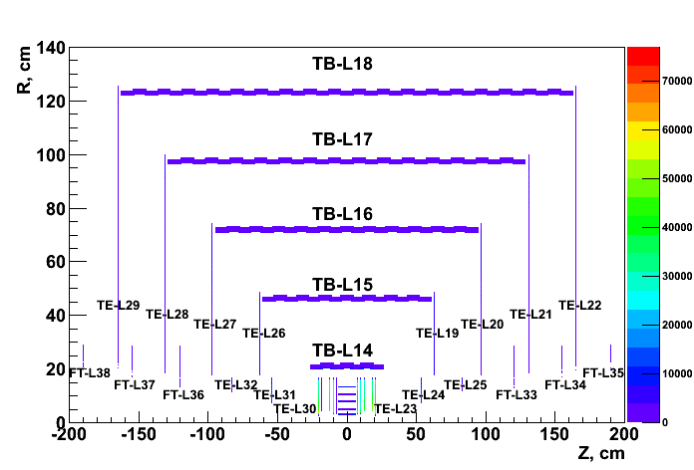
Tracker
Hit R vs. Z for ILCRoot VXD and Tracker detector layers
  Essentially a copy of the SiD tracker
  TB – Tracker Barrel, TE – Tracker Endcap, FT – Forward Tracker

Slide 13
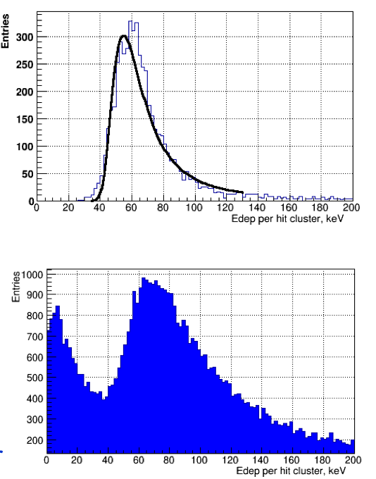
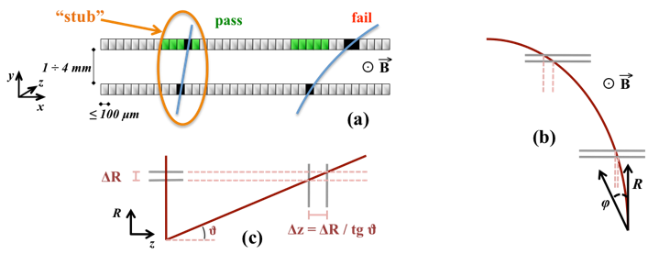
Background Cuts
(N. Terentiev)
We had relied heavily on timing for background rejection
A timing bug in MARS meant we had to revise physics analyses after Snowmass
  The peak level in the tracker at t=0 is about 4 orders of magnitude higher than before
  The effects in the calorimeter are less dramatic
Cuts
  Timing with respect to muon
  Energy deposition
  Angle offsets
Time cuts
Energy cuts
Angle cuts

Slide 14
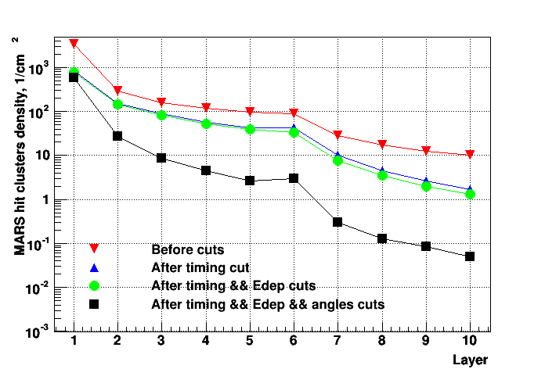
Tracker Cuts
(N. Terentiev)
VXD and Tracker cuts
  timing gate width 0.9 ns (VXD) and 0.9 ns – 1.05 ns (Tracker)
  energy deposition, Z, layer dependent
  Delta Phi
  Delta Theta, depends on Z and layer
At IP muon efficiency ~85%
  MARS background fraction is ~17% in the
  innermost VXD layer
  ~0.5% in the outermost Tracker layer
  The density of MARS surviving hit clusters is ~580 cm⁻² for innermost VXD barrel layer and ~0.05 cm⁻² for outmost Tracker barrel layer.
An additional calorimeter ROI cut had to be used for the physics analysis
I think we can do much better than this study indicates
Needed – small pixels, fast (50ps) timing, fast correlation of hits in φ and θ

Slide 15
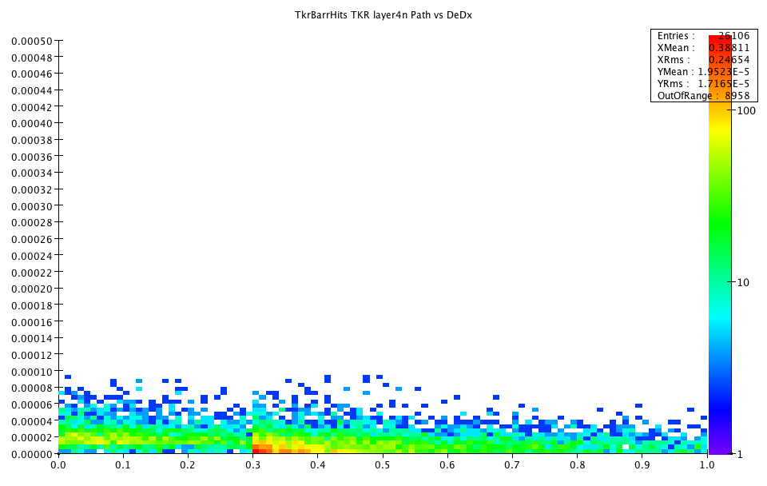
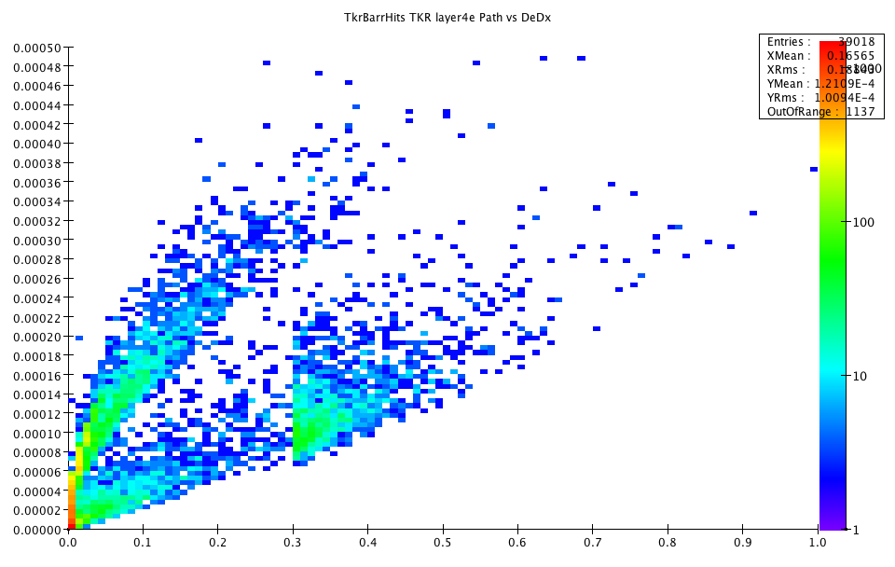
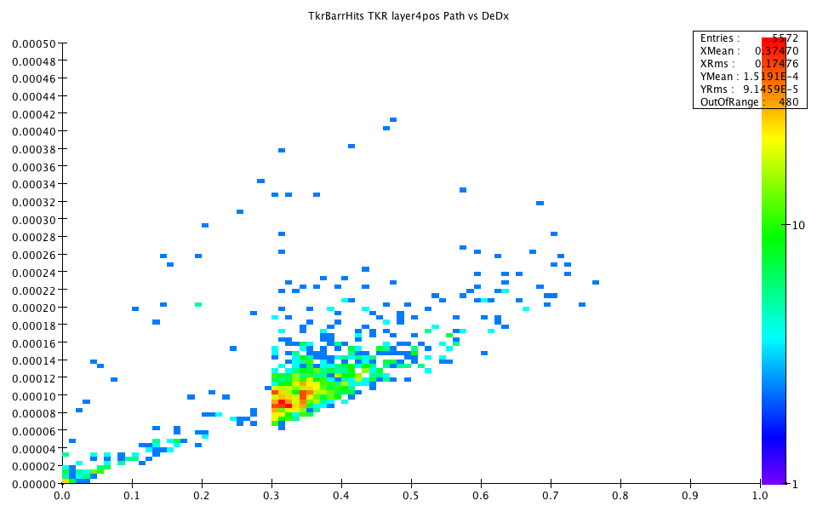
Energy deposits in
Silicon layers (RL)
Substantial background rejection by pulse shape is possible
Neutrons
Energy
deposit
Path length in silicon
electrons
positrons
Compton
High energy
conversions
soft
conversions

Slide 16
More sophisticated approaches to tracking
There have been substantial developments in tracking, 3D electronics fast timing and device engineering that should enable MUCH more sophisticated track pulse shape discrimination.
LGADs to provide internal amplification and fast timing
  AC LGADs add position resolution and fill factor
3D electronics to provide low capacitance small pixels with sophisticated processing
Substrate engineering to manipulate charge within a detector
  Much of the neutron background can be eliminated with pulse height and shape discrimination
  Compton electrons can be addressed by pulse shape cuts
MAPs for low cost, low mass fine pixel devices.
Background Track path

Slide 17
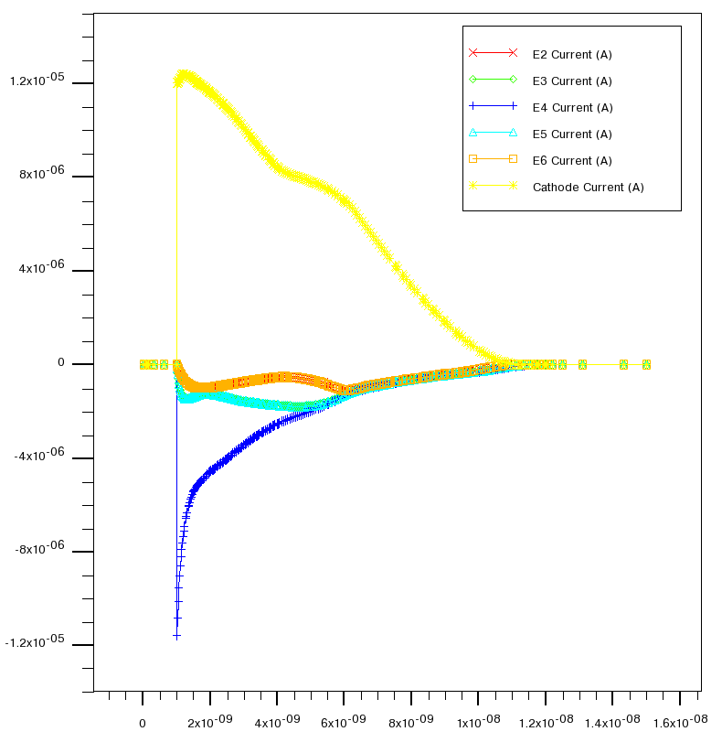
Example:Double Sided LGAD
anode
Use anode for timing, cathodes for pulse shape discrimination
15 degree
track
15 degree track detector internal current distributions
cathodes
15 ns
anode
0 degree
track

Slide 18
Calorimeter Backgrounds
Much of the calorimeter background is soft and electromagnetic
  High occupancy in the first few radiation lengths
  2014 study used a time cut and front/back segmentation
  Background pedestal was subtracted.

Slide 19
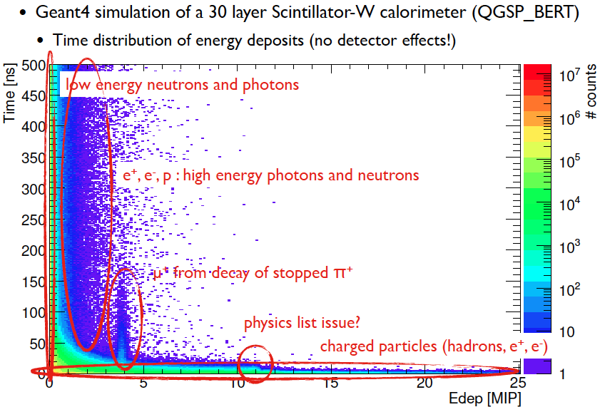
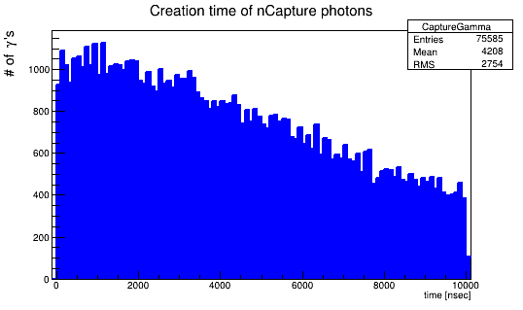
Time Development of Hadron Showers
(F. Simon CALICE)
The problem of hadron calorimetry at CLIC and a Muon Collider is interesting…
Hadron showers take time to develop – nuclear processes can take more than the ns time scale we would like for μC
(H. Wenzel)
n→ thermalize → neutron Capture
→ γ → visible Energy
(mean Time: 4.2 μ sec)

Slide 20
EM Calorimeter
I have not thought about this too much
Original studies used a dual-readout scheme - can this be improved?
A CMS HGC/Calice design for the EM section with finer sampling seems to make sense
Use deeper layers to define shower position
  Fit to shower longitudinal and transverse shapes to remove background pedestal
  Pointing of showers
Some energy in a hadronic shower is delayed – how do time cuts affect this?

Slide 21
Last Slide
Given the time I have not had time to describe the physics studies. There were parametric studies of a Higgs factory, self coupling, width measurement, and full simulation of H/A with background at 1.5 TeV (huge effort)
Some slides are attached
The Muon Collider has great potential
There is a great deal of work needed to understand how to most effectively cope with decay backgrounds and take full advantage of the proposed machines.
We barely scratched the surface.
The Muon Collider is an exciting experimental and accelerator problem that may ultimately provide the breakthrough we need to progress beyond the standard model.

Slide 22
Physics studies - Higgs Factory
S-channel Higgs production affords the most precise measurement of the muon Higgs-Yukawa coupling, g_{μ},
precision δg_{μ}/g_{μ} ~ (few)%.
The s-channel Higgs production affords the best mass measurement of the Higgs boson
precision of ~(few) x10⁻⁶ with a luminosity of 10³² cm⁻²s⁻¹.
It affords the best direct measurement of the Higgs boson width to a
precision of a few percent
(Analysis by Alex Conway with advice from Chris Hill, Estia Eitchen, RL)

Slide 23
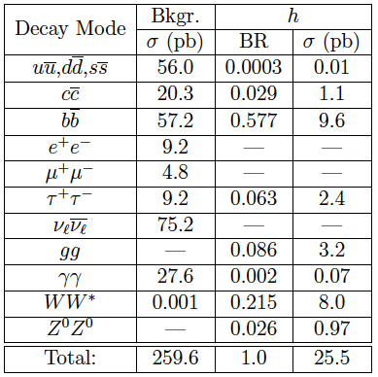
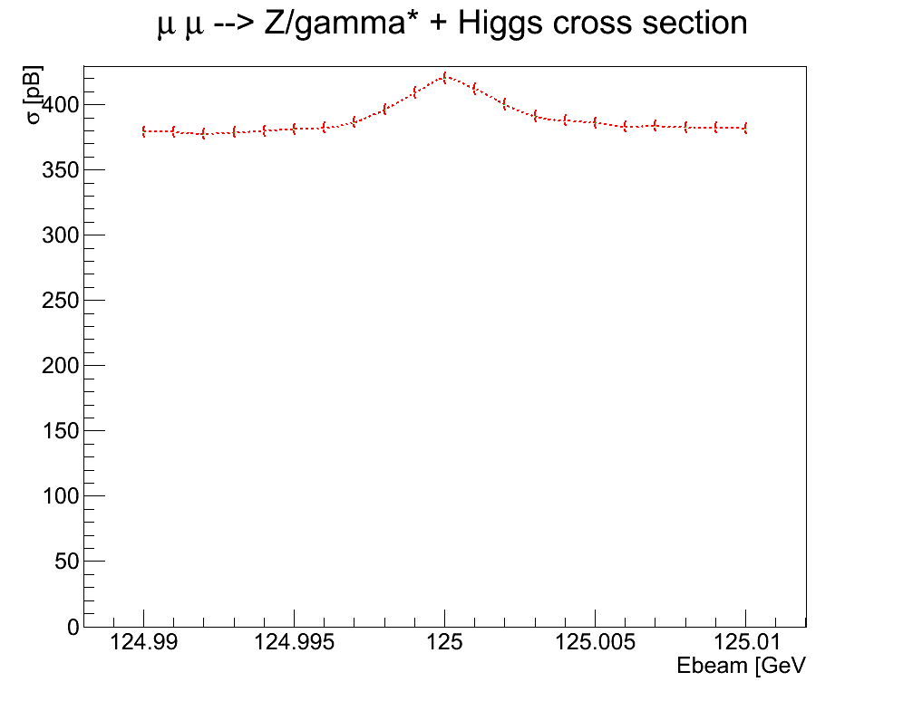
Higgs Factory S/B
Higgs production in an S-channel factory still has significant SM background.
cross sections are calculated as the peak value of the peak Breit-Wigner convoluted with a Gaussian of width 3.54 MeV to simulate the effect of beam smearing. The inclusion of initial state radiation effects and full one loop corrections further reduces the cross sections for Higgs production by a factor of 0.53; resulting in
a total Higgs cross section of 13.6 pb.

Slide 24
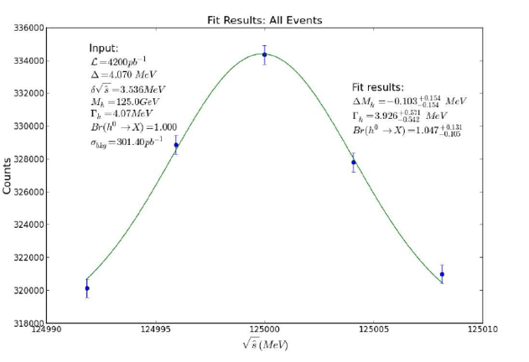
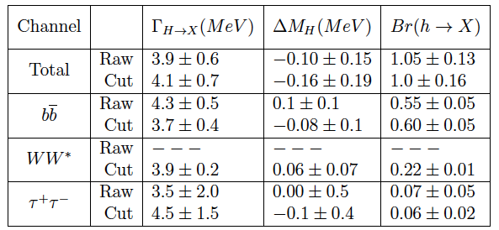
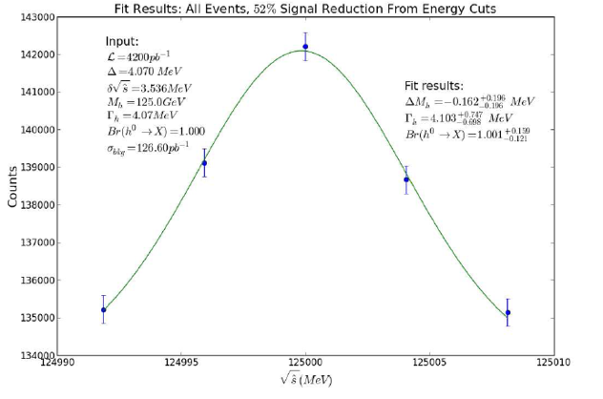
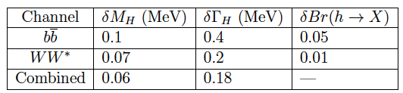
Higgs Mass and Width
Fitted values of Higgs decay width, mass and branching ratio from simulated data. Mass values are the difference between the measured mass and the true mass of 126 GeV. Total integrated luminosity was 4.2 fb⁻¹
336000
Scan-
All events
143000
Accuracy of fitted parameters
Scan- energy
cuts

Slide 25
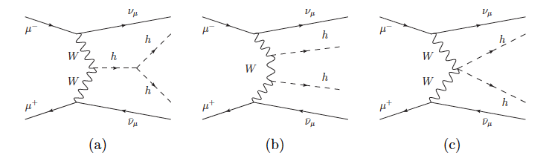
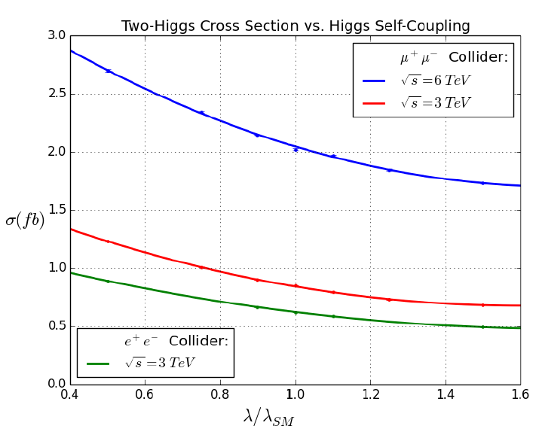
High Energy Collider Higgs Self-Coupling
Measurement of the Higgs trilinear self-coupling is a direct probe of the shape of the Higgs potential and a crucial test of the Standard Model.
All future high energy accelerators are likely to address this measurement.
A high energy (6 TeV) Muon collider would have the advantage of both higher luminosity and larger cross section
CLIC may have larger acceptance
Study the tradeoffs …
Variation of
σ with λ provides the sensitivity

Slide 26
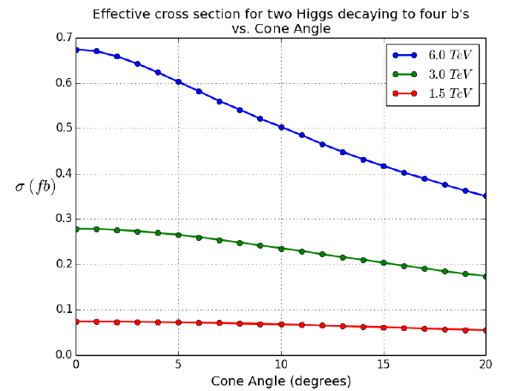
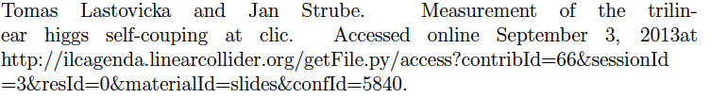
Self-coupling Analysis
For now we take the CLIC analysis and scale the results to the event yield correcting for events lost to the cone.
Losses due to the cone cut increase with E_{cm}, but the 6 TeV has about 2x the cross section for cone angles between 10 and 20 degrees
HH->4b, all 4 bs
accepted

Slide 27
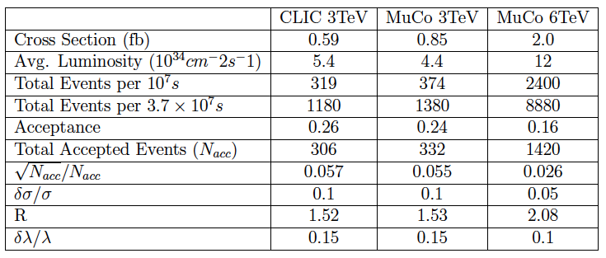
Self-coupling results
Results obtained by scaling CLIC results – note that the values can be improved by utilizing polarization
HL-LHC – evidence
ILC (20yr) – 13%
3 TeV CLIC (polarization) – 10%

Slide 28
Summary
The physics reach of a Muon collider has tantalizing promise, with many unknowns
It is challenging for both accelerator and detector technologies
  An opportunity to explore and expand limits
The utility of such a machine depends on the physics context
  Precision physics > 3 TeV
  Precision Higgs mass studies
  Z’
  ?
A clear understanding of the capability of such a machine would take a significant focused effort for several years (CLIC example)
Summaries MAP 2014 winter meeting: https://indico.fnal.gov/event/8959/other-view?view=standard
Talks by Di Benedetto, Terentiev, and Lipton

