Slide 1
IMC SG meeting
23.07.2020

Slide 2
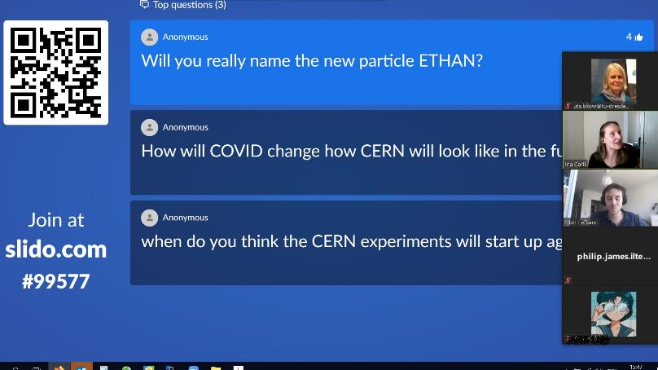
IMC Summer VCs
2 videoconference days offered in June with multiple slots
Circular on May 25
4 institutes expressed interest (Rome, Aachen, Bratislava, Birmingham)
group from Bratislava had their MC in March, but without VC. So the participation was offered to the students on a voluntary base
26.6., 15:00-16:00 CET
Moderators: Matt LeBlanc, Ina Carli
Slido.com for icebreaker, polls, collect questions
Aachen and Rome cancelled their participation on 17.6./23.6.
No students from Bratislava connected

Slide 3
IMC 21
regular period: 17.02. – 01.04.2021
regular start of registration: end of Oct

