Slide 1
Task 4.3 Klystron and Modulator technology
Recent information from discussion with the companies
WP4 Meeting 27/08/2020

Slide 2
Task 4.3 Klystron and Modulator technology
Recent information from discussion with the companies
CPI
no news with respect to last presentation in June
X-band klystrons
  Deliveries of 7 MW, 400 Hz tubes for DESY
  Tests of this tube up to 10MW to start
  Design of the 20 MW Klystron using GSB/Dakota code
  High efficiency 50MW tube with CERN
Preliminary studies of 15MW C-band high repetition rate klystron (5.996 GHz)

Slide 3
Task 4.3 Klystron and Modulator technology
Recent information from discussion with the companies
CANON
X-band klystrons
  8-10 MW high-efficiency (upgrade in collaboration with CERN of existing 6 MW tube)
    Simulations in CST-3D and FCI show output power of 8.2 MW, at 154 kV and 94A (~56% efficiency)
    The mechanical design has not been started
    Prototyping possible in 2021
  20 MW klystron, new design
    Mechanical design of 20 MW tube finished
    Prototyping to start after Summer with tests possible in 2020

Slide 4
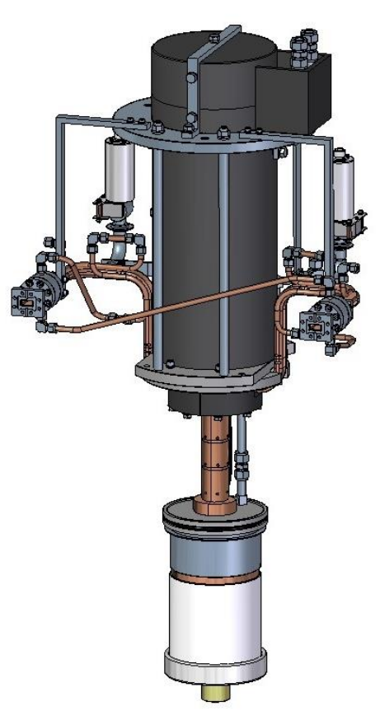
CANON - 20 MW klystron, specifications
Frequency | 11424 MHz (±1 MHz)
Peak Output Power | Target 20 MW (>16 MW for test specification of 1st prototype)
RF Pulse Width | 1.5 μs max.
Pulse Rep. Rate | 400 Hz max.
Beam Voltage | Design 265 kV (290 kV max.)
Beam Current | Design 170 A (195 A max.)
Drive Power | Design 120 W (400 W max.)
Efficiency | 44%
Max E field strength in cavity | < 60.4 kV/mm (for 1.5 μs RF)
Height | ~1.3 m
Weight | Klystron ~300 kg, Electromagnet ~800 kg
At 1kHz operation the average power of the RF and the beam will be 2.5 times higher
Modifications of the collector, windows and cooling circuits will be required for higher rep rate operation
Currently the frequency of this tube is American X-band, the interaction section design and RF windows has to be changed to match 12 GHz

Slide 5
Task 4.3 Klystron and Modulator technology
Modulator for dual-source operation – Scandinova, JEMA
3 alternatives in switching between the 10MW and 50 MW klystrons
(2 klystrons integrated in one modulator)
Alternative | Actions necessary for the switch | Approx switch time | Pricing/feasibility
Reconnection of HV-connector Scandinova, JEMA | Remove (part of) oil & open tank Disconnect one klystron and connect other Refill tank with oil Start heating filament Start pulsing | System completely OFF for the switch 3-5 hours | Cheapest option: One pulse transformer and minimal amount of power modules
Reconnection of primary connections Scandinova | Disconnect cables from one primary connections and move them to the other pulse transformer primaries related to klystron to be used | System in stand-by (filament heating of both klystrons ON) 1-3 hours | More expensive: two optimized pulse transformers will be used
Remote switching between 2 klystrons Scandinova | No need for any reconnections Most practical solution | Few msec | Most expensive: extra power Modules in the same system
System could be based on K500 platform, but klystron tank, control system, internal cooling distribution need to be modified

