Slide 1
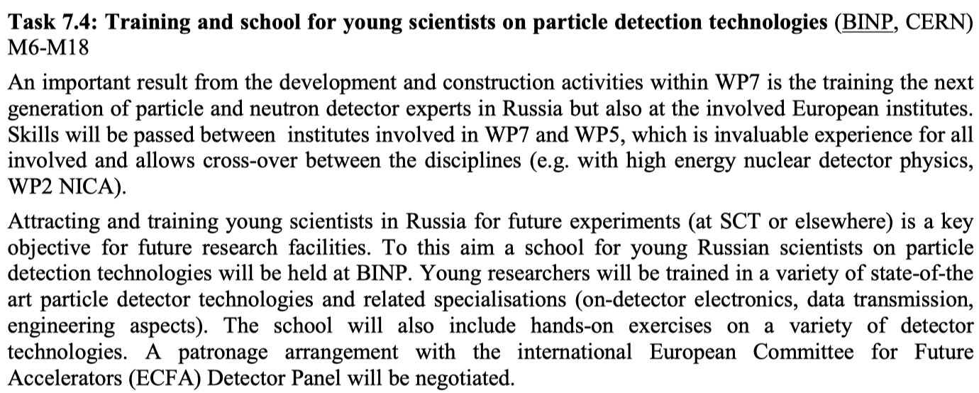



Task 7.4: School for young scientists on particle detection technologies

Slide 2
School for young scientists on particle detection technologies
Concept
  Duration: one week or two weeks ?
  Target audience: master and PhD students, young scientists
  Activities
    lectures on particle detection technologies
    hand-on exercises (personal project with supervisor)
    oral and/or poster student reports
    Laboratory visits
    social events
Following the CREMLINplus proposal Budker INP would be the 1st option for the hosting school
  Pros: local experience (two colliders with three particle detectors in operation)

Slide 3
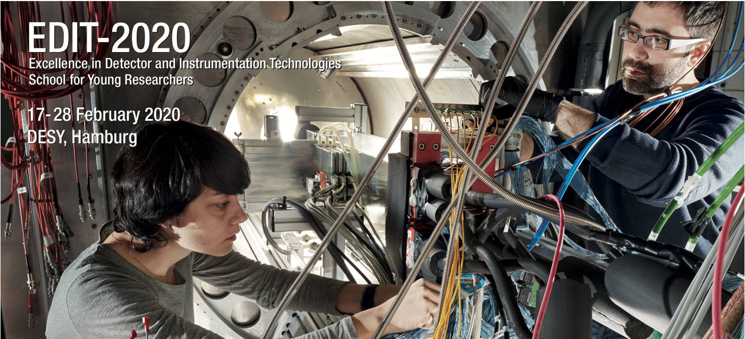
Example: the “EDIT” school, now ongoing at DESY
EDIT detector school, this week and next week at DESY, 60 students:
https://indico.desy.de/indico/event/22513/
It includes:
* Lectures on selected subjects by senior experts;
* Hands-on measurements and data analysis (in the lab);
* Hands-on measurements and data analysis (at the test beam, using the test beam telescope);
* DESY visits;
* Social events.

Slide 4
How to go from here?
We need to define the scope of the school
Detectors for:
Particle physics
Ion physics
Neutron physics?
Other?
Propose to start with nominating a scientific organising committee.
Detector experts from institutes participating in CREMLINplus and willing to engage in the school
  => e.g. sending teachers, and providing lab exercises with corresponding supervisors
The scientific committee does not need to be large, for example 5-8 persons.
Local organizing committee to be nominated once the location and scope of the school are clear

Slide 5
Additional material

Slide 6
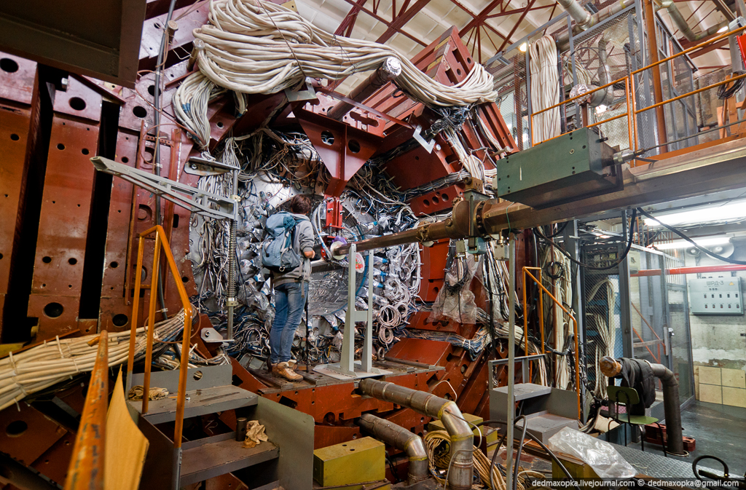
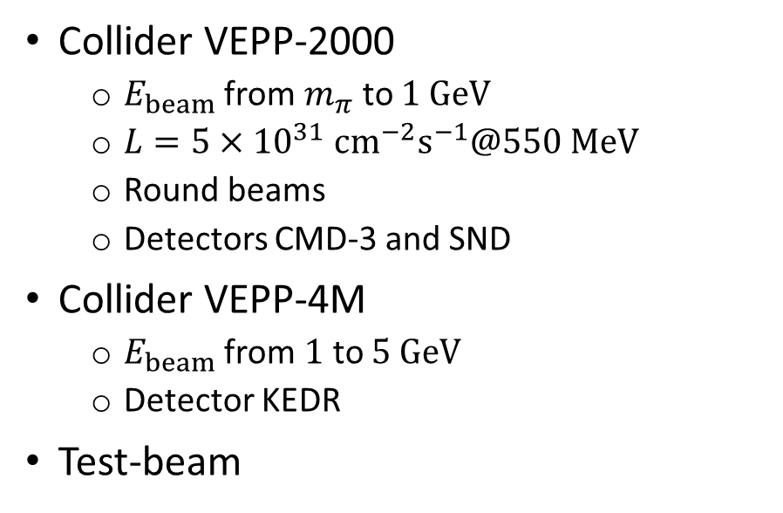
BINP HEP facilities
KEDR
Collider VEPP-2000
  $E_{beam}$ from $m_{π}$ to $1 GeV$
  $L=5×{10}^{31} {cm}^{−2}s^{−1}@550 MeV$
  Round beams
  Detectors CMD-3 and SND
Collider VEPP-4M
  $E_{beam}$ from $1$ to $5 GeV$
  Detector KEDR
Test-beam
SND
CMD-3
BINP experiments as a source of ‘real-world’ tasks for students

Slide 7
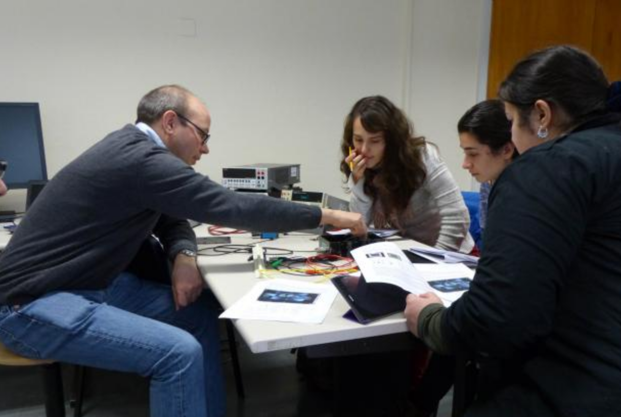
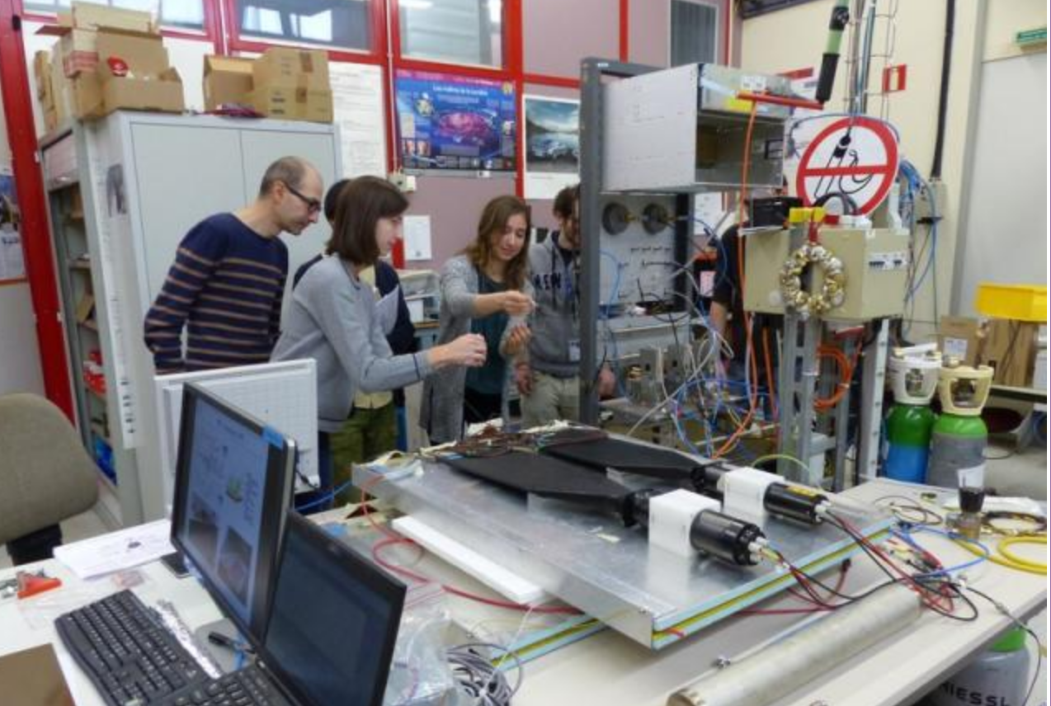
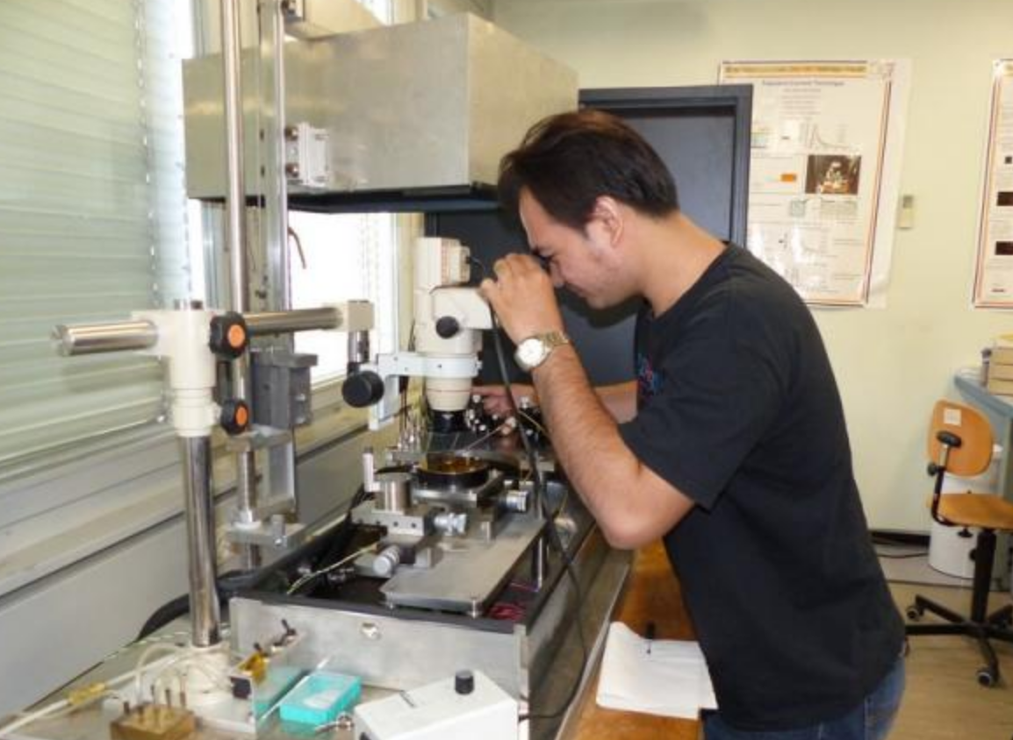
Example of what CERN can contribute
CERN can possibly offer:
Provide 1 or 2 members of the scientific organising committee;
Help with the organisation overall;
Send 1 to 3 experienced teachers;
Provide 1 or 2 hands-on exercises and send the corresponding material to BINP
  For example: SiPM exercise, or RPC exercise, or Solid State Detector exercise
Send a few young detector experts for supervising the laboratory exercises.

