Slide 1
Data Storage of JUNO and other IHEP experiments
Wang Lu
on behalf of IHEP-CC
wanglu@ihep.ac.cn

Slide 2
Outline
Experiments at IHEP
Distributed computing infrastructure
  Domestic infrastructure, foreign sites connected with LHCONE network
Our understandings of data lake
Answers of WLCG/HSF questionnaire
Summary

Slide 3
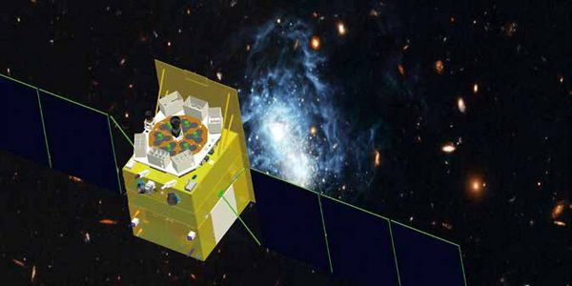
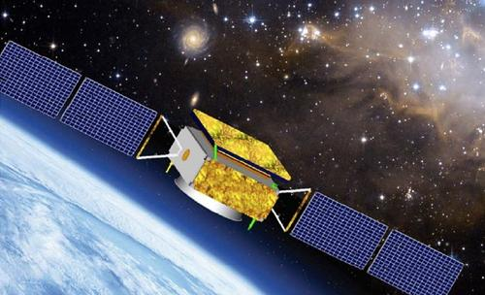
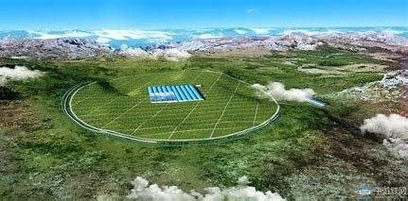
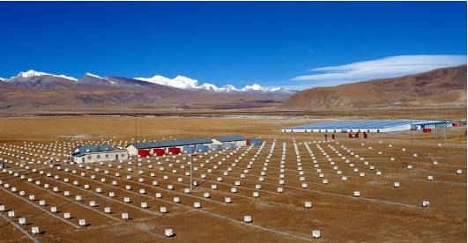


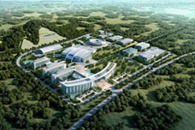
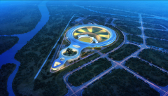
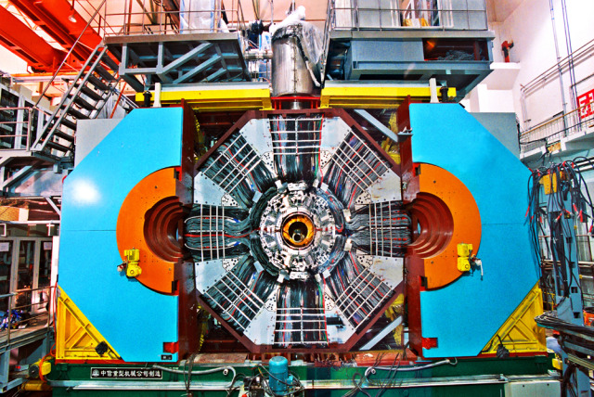


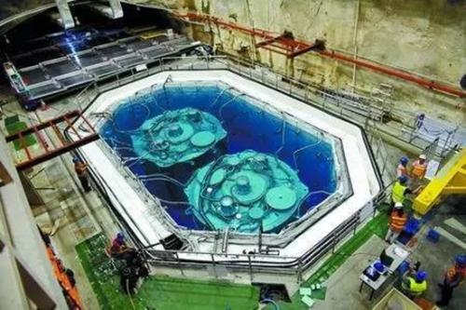


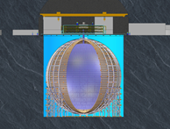
Experiments at IHEP,CAS
Astro Physics Experiments
HXMT: 0.2PB/year, 2000 CPU cores,2017-2023
GECAM:0.2PB/year, 2000 CPU cores,2021-2025
~550KM
High Latitude Cosmic Ray Observatory
LHAASO: 6 PB/year,10000 CPU cores 2020-
YBJ:0.1PB/year, 1990-
HEAD: 3PB/year, in plan
eXTP: 0.3PB/year, in plan
~4400M
Collider Experiments
BESIII: 0.7 PB/year, 10000 CPU cores,2010-2027
CEPC prototype: 0.3 PB/year, 2014-
~-5M
Neutron/Photon Sources
CSNS: 1PB/year 2000 CPU cores (current)
100 PB/year, 10000 CPU cores (future)
HEPS: 150 PB/year, 10000CPU cores, 2025-
~-300M
Neutrino Experiments
DayaBay：0.3 TB/year, 3000 CPU cores,2012-2020
JUNO：3 PB/year, 10000CPU cores 2022-2032

Slide 4
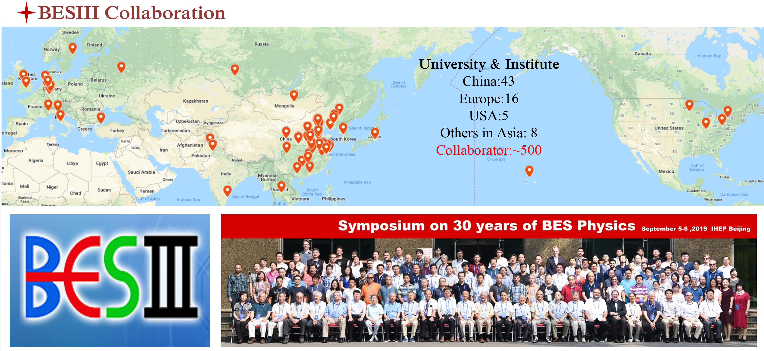
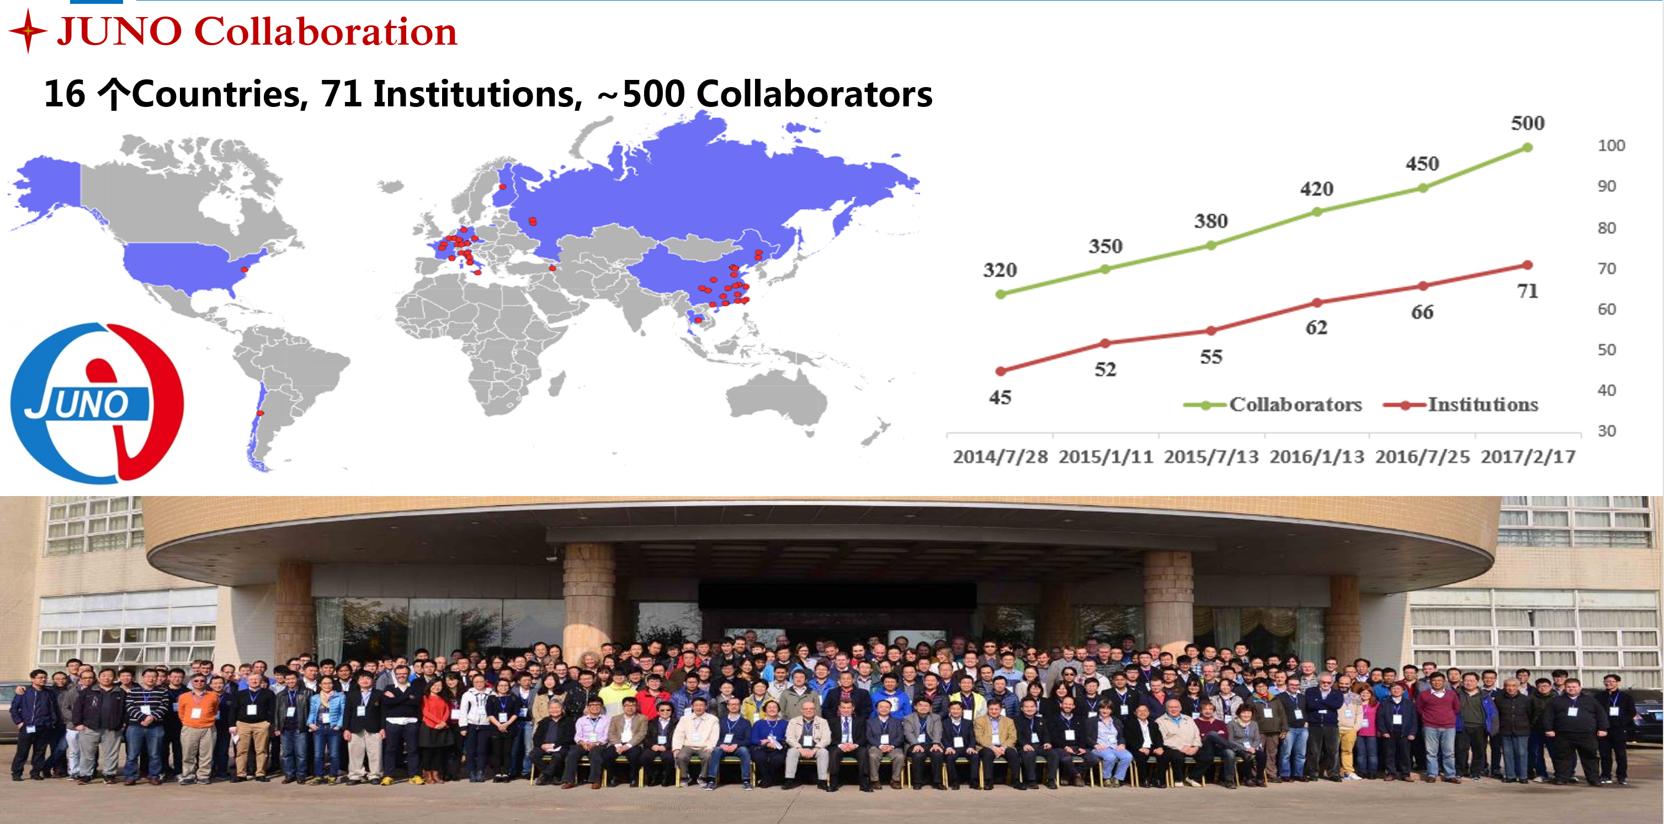
International Collaborations
BESIII
  72 institutions, ~500 collaborators
  7 countries and regions
LHAASO
  20 institutions, ~250 collaborators
  4 countries
DayaBay
  40 institutions, ~250 collaborators
  6 counties and regions
JUNO
  71 institutions, ~500 collaborators
  16 countries
HEPS & CSNS
  Public scientific research facilities
Tier-2 of ATLAS, CMS, LHCb, BELLE II

Slide 5
Domestic Resources
 | CPU Cores | Disk Storage | Tape Storage | Network | Experiments
IHEP-CC | 38000 | Lustre,20 PB EOS, 10 PB | 30 PB | 100G/10G/1G | All
IHEP-Dongguan Guangdong Province | ~4000 | Lustre 3 PB | 1 PB | 10G-100G to IHEP | CSNS
IATAMS Shandong Province | ~15000 | Lustre 2.5 PB |  | 1G-10G to IHEP | AMS
IHEP-Daocheng Sichuan Province | ~1800 | EOS 1.6 PB |  | 2G to IHEP | LHAASO
USTC, Anhui Province | 1920 | Lustre 4 PB |  | Internet | BESIII, ATLAS
LZU Gansu Province | 180 |  |  | Internet | BESIII
PKU Beijing | 288 |  |  | Internet | BESIII
Shandong Uni. Shandong Province | 472 |  |  | Internet | JUNO,LHAASO,BESIII,ATLAS
Huawei Cloud | ~20000 | 3 PB |  | 10G to IHEP Dongguan | CSNS
IHEP Huairou Branch (ready by 2025) | ~10000 | Lustre 30 PB |  | 100G to IHEP | HEPS
Remote sites have good network to IHEP
Remote sites is fully managed by IHEP-CC
Data transfers is managed by SPADE
CPUs can not be shared in a global pool
No unified user authentication and authorization
Notes:
The answer is adopt technologies from WLCG first. JUNO goes first in this direction

Slide 6
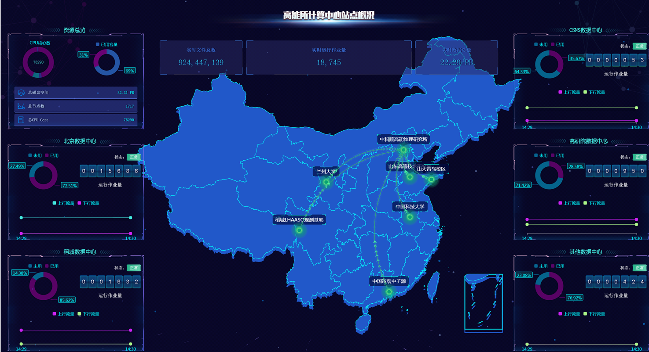
Domestic Resources
Q1: Is it possible to fully leverage distributed CPU resource by global scheduling and resource sharing between VOs?
Q2: The network is already fast, is it possible to run jobs at site without input data ? How?
Q3: Is it possible to run jobs at storage-less sites ?
Q4: How to control QoS of data by units of user, group and dataset?
Q5: How to manage such a large system with limited human resource ?
Adoption and reasonable tailoring of WLCG framework will be the first step !

Slide 7
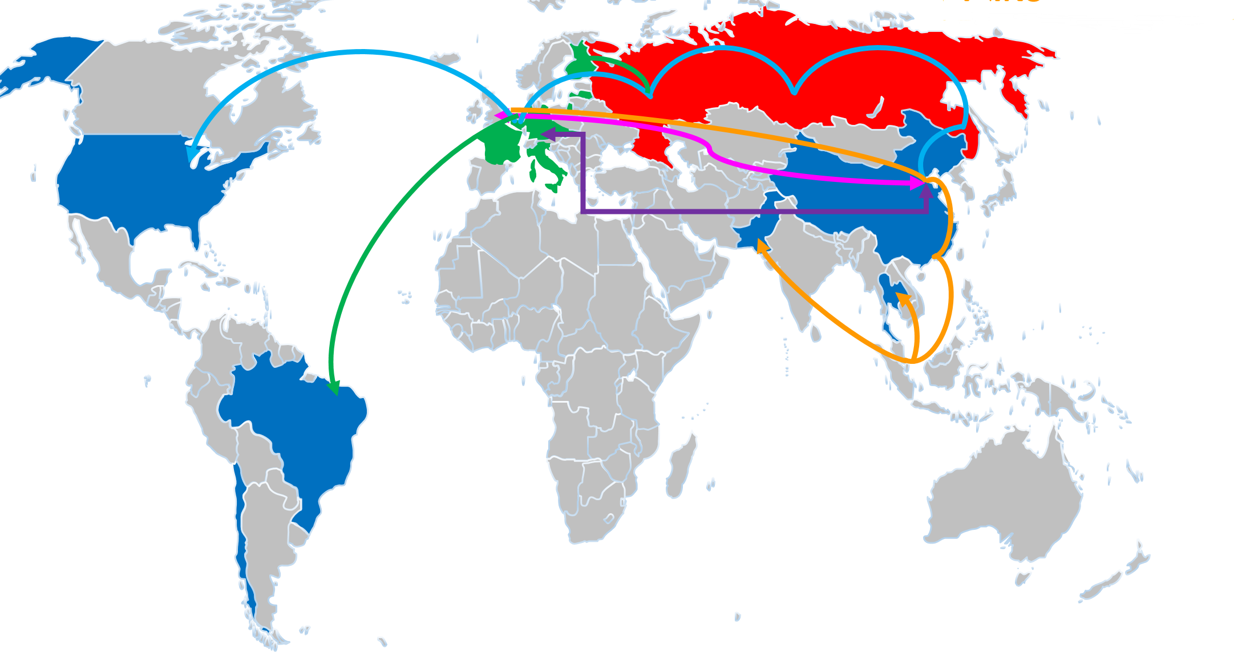
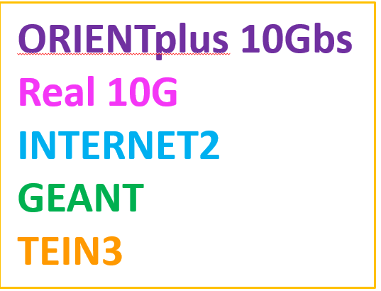
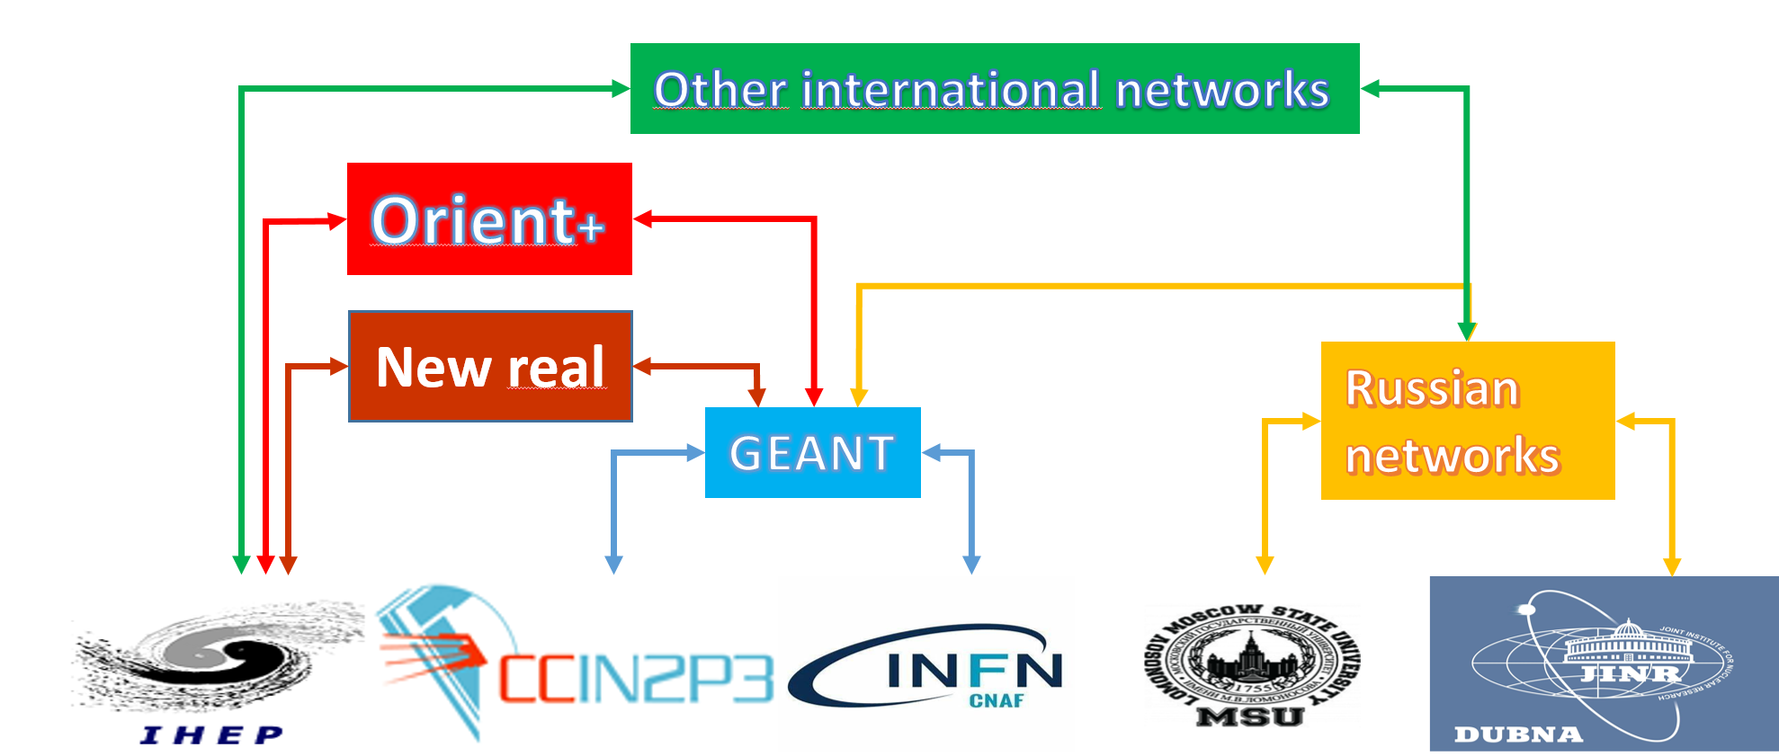
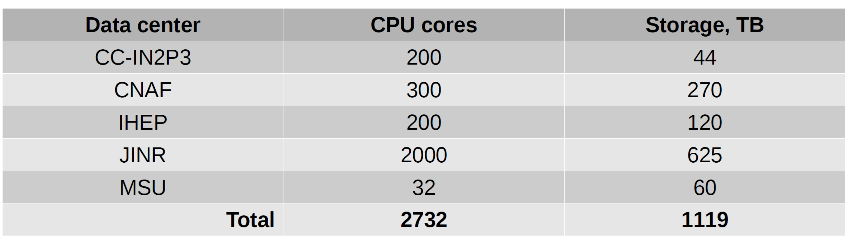
Foreign Resources for JUNO
Nikolay Kutovskiy,“Summary on JUNO data centers resources”, International collaboration meeting, July 2020
Giuseppe Andronico,“The JUNO distributed computing infrastructure”,CODATA2019

Slide 8
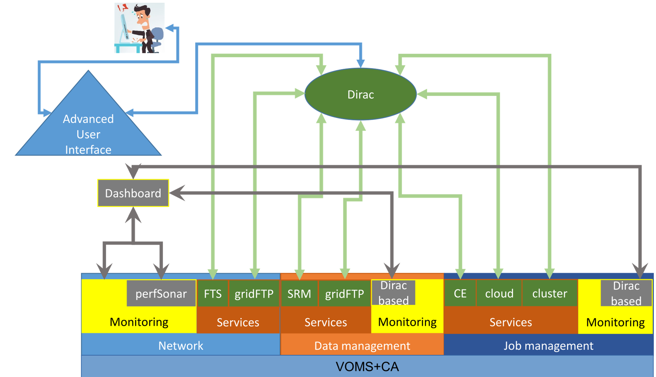
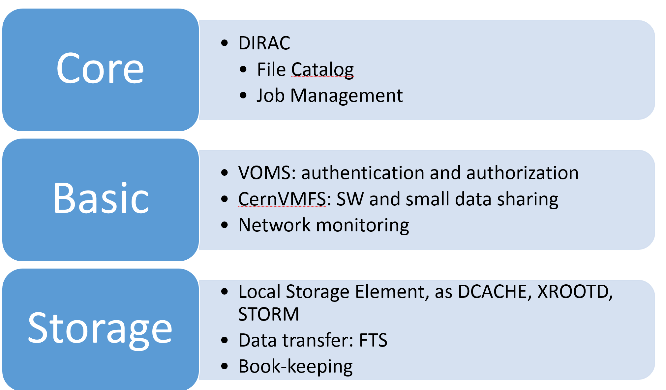
Distributed Computing Facility of JUNO
Giuseppe Andronico,“The JUNO distributed computing infrastructure”, CODATA2019
JUNO is also considering the possibility of using RUCIO as Data management system.
Experience of BELLE-2 will be useful.

Slide 9
Our Understanding of Data Lake(1)
Right direction of distributed data services when network is fast enough
  Raw data, output of simulation, reconstruction will be automatically transferred and replicated to sites with SEs
  Job will be scheduled to sites which have input data first
  When the expected waiting time is too high, jobs will be scheduled to site without data and opens data through data federation
  Instead of copy input data to local disk, job will access data remotely through an efficient data protocol (XrootD/POSIX)
  Job will write data to local file system, output data can be transfer back by sandbox/copy to SE and registered to DMS

Slide 10
Our Understanding of Data Lake(2)
Answers questions about our domestic distributed platform
  WLCG components such as security, data transfer, network can be reused
  VO specific endeavors on data management system, workflow control and job submission are still needed
  Collaboration with users and software developers is necessary
  Keep close contact with WLCG is necessary
    Operation and maintenance of WLCG Tier-2
    Actively taking part in WLCG/HSF Tech groups and discussions

Slide 11
Answers of WLCG/HSF questionnaire

Slide 12
Interface and Protocol
Do you foresee to use tokens (exclusively?). Is work in this direction ongoing? What is the timeline?
  Yes, follow steps of WLCG, depends on when XRootD and HTTP support is ready.
Is there any integration work (in your data/workflow management systems) required in order to use Third Party Copy? If yes, what is the status?
  Yes, it is essential for large scale data flow. We will reuse technologies of FTS, Rucio, and XRootD-TPC, HTTP-TPC, therefore, we will follow the lead of WLCG.

Slide 13
I/O patterns
What are the main workflows that will require access to storage and what are the access patterns?
  Very similar with other HEP experiments
  Production jobs: Large, sequential I/O
  Analysis jobs: large sequential I/O, random and small reads of partial file content
  Heat of data will change during its life cycle
Site Cache is useful
  Latency hiding and reuse of hot data
  Protocol translation if necessary, XrootD ->POSIX
Disk caches on computing node ?
  When local network is fast enough, disk cache on computing node is not necessary.
  However, site cache can be built as a federation of SSD disks on computing nodes.

Slide 14
Storage-less sites
What is the direction with respect to storage-less sites and how will that progressively evolve toward HL-LHC?
  Use Case 1: universities do not have manpower to maintain a SE
  Use Case 2: public cloud where storage and bandwidth is expensive
  a site can be easily set up/reconfigure as a cluster of containers
Closest SE
(VO specific)
Remote SEs
CE
DMS
(VO spefific)
Closest SE
(VO specific)
DMS
(VO spefific)
Closest SE
(VO specific)
Remote SEs
DMS
(VO spefific)
Remote SEs
Disk Cache
Read Only Cache Federation
Local file system
Local file system on work node for job output
Work nodes

Slide 15
Sites with SE(1)
Large sites with dedicated manpower for large distributed storage system
  When data is not located at site SE, jobs will read data through Proxy nodes and cache data in read only caches, upload data to site SE
  When data is located at Site SE, jobs will read data directly from SE, write data to local disk, upload data to site SE
Proxy Nodes
Local scheduler
DMS
(VO spefific)
Proxy Nodes
DMS
(VO spefific)
My SE
(VO specific)
DMS
(VO spefific)
Proxy Nodes
Work nodes
Disk Cache
Read Only Cache Federation
Lustre
EOS
Clients of EOS/Lustre
Lustre
EOS
Lustre
EOS
Lustre
EOS
Clients of distributed file system for write
Lustre
EOS
EOSCTA

Slide 16
Sites with SE(2)
Powerful proxy cluster and good network link(LHCone) to outsiders
Supports QoS control for both performance and reliability
  Ready with Lustre and EOS
Exports rich storage management interface for distributed data management system
  QoS of reliability by dataset
  Qos of performance by uid, gid, domain name
Under layer storage system support authentication and authorization for both local computing and distributed computing

Slide 17


Central Storage at IHEP
Proxy, SE, Data Transfer, DM client…
Proxy Layer
Policy Engine
+
Migration
Clients
Astro-Physics
Photon/Neutron
Source
Home
Dir.
Distributed Computing
&IHEPBox
HEP
Application Layer
HDF5
POSIX
XRootD
Disk Layer
30 PB, Disk Arrays/JBOD
Lustre
CVMFS/AFS
EOS/DPM
Upgrade
Achieve Layer
30 PB,LTO 4/7
Open Maintenance and Analysis Toolbox
Fine grained monitoring data in ELK
Anomaly Detection Framework
Temporal and Spatial Anomaly
Storage R&D
Computational Storage
AI based data compression
Notes:
The contents under yellow box will be our contribution, while the rest are technologies adopted from open source community.

Slide 18
Summary
Distributed computing technologies such as WLCG is a necessity for resource integration and sharing in large IHEP experiments
Through the maintenance of WLCG Tier2, we have learned many experience on distributed data management
To fully exploit distributed resources with limited manpower
  Reuse common tools and technologies from WLCG
  Use data federation to enable jobs running on sites without data
  Make storage is as “QoSable” as possible
  AIOPS, data compression and computational storage may help in the long run

Slide 19
Thank you!

