Slide 1
A study of covid-19 data from African countries
Dr. Kétévi A. Assamagan (BNL, USA), Dr. Somiéalo Azote (Université de Lomé, Togo), Cyrille E. Haliya (University of Abomey-Calavi, Benin), Toivo S. Mabote (Universidate Eduardo Mondlane, Mozambique), Kondwani C. C. Mwale (University of Rwanda, Rwanda), Ebode F. Onyie (University of Yaoundé 1, Cameroon), George Zimba (University of Jyväskylä, Finland)

Slide 2
Outline
Introduction
Global COVID-19 Situation
Situation in Africa
Impact on The African School of Physics (ASP)
ASP COVID-19 Exercise
Conclusions

Slide 3
Introduction
The WHO predicts that 29 to 44 million Africans could be infected with SARS-CoV-2 during the first year of the pandemic and 83 to 190 thousand Africans could die if they don't uphold containment measures
This grim prediction suggests that most African countries have a lower transmission rate than the other regions of the world such as Europe, the United States of America, and China
However, the low transmission rate may prolong the outbreak over several years, putting pressure on economic resources
The containment measures such as frequent hand washing, isolation, contact tracing, and social distance are a challenge in Africa—around 60% of the African population lives below the poverty line and cannot afford the basic hygienic amenities
In Africa, the outbreak of COVID-19 has already claimed thousands of lives, rendered millions jobless, increased in-security and poverty level
A number of studies have been performed on the evolution and impact of COVID-19 in Africa, and on the African responses to the pandemic
We hope that our study contributes to the understanding and containment of COVID-19
  https://arxiv.org/pdf/2007.10927.pdf

Slide 4
Global COVID-19 Situation
https://coronavirus.jhu.edu/map.html
https://www.nytimes.com/interactive/2020/world/coronavirus-maps.html

Slide 5
Situation in Africa
https://africacdc.org/covid-19/

Slide 6
Impact on the African School of Physics
ASP2020, planned for July 2020 in Morocco, was postponed
  ASP2020 students were already selected
  Preparation was at an advanced stage
We are studying options for a new date in 2021
  Depending on the evolution of COVID-19
  We will announce the new date in due course
In the meantime, we’ve set up an online lecture series, since May 2020
  Twice a week on Tuesdays and Thursdays
  The calendar is accessible here https://www.africanschoolofphysics.org/online-lecture-series/

Slide 7
ASP COVID-19 Exercise
In March 2020, Dr. Kétévi A. Assamagan made a call to all the ASP alumni for this exercise
Study and understand COVID-19 data from their country (of citizenship or residence)
  With the permission of their academic advisor
A number of ASP alumni responded to the call
  That’s how this exercise got started
Ultimately, the countries that we studied are
  The countries of the alumni that have stayed the course
  Togo (Dr. Somiéalo Azote)
  Benin (Cyrille E. Haliya)
  Mozambique (Toivo S. Mabote)
  Rwanda (Kondwani C. C. Mwale)
  Zambia (George Zimba)
  Analysis in ROOT (Ebode F. Onyie)
In the next few slides, we will introduce the analysis team

Slide 8
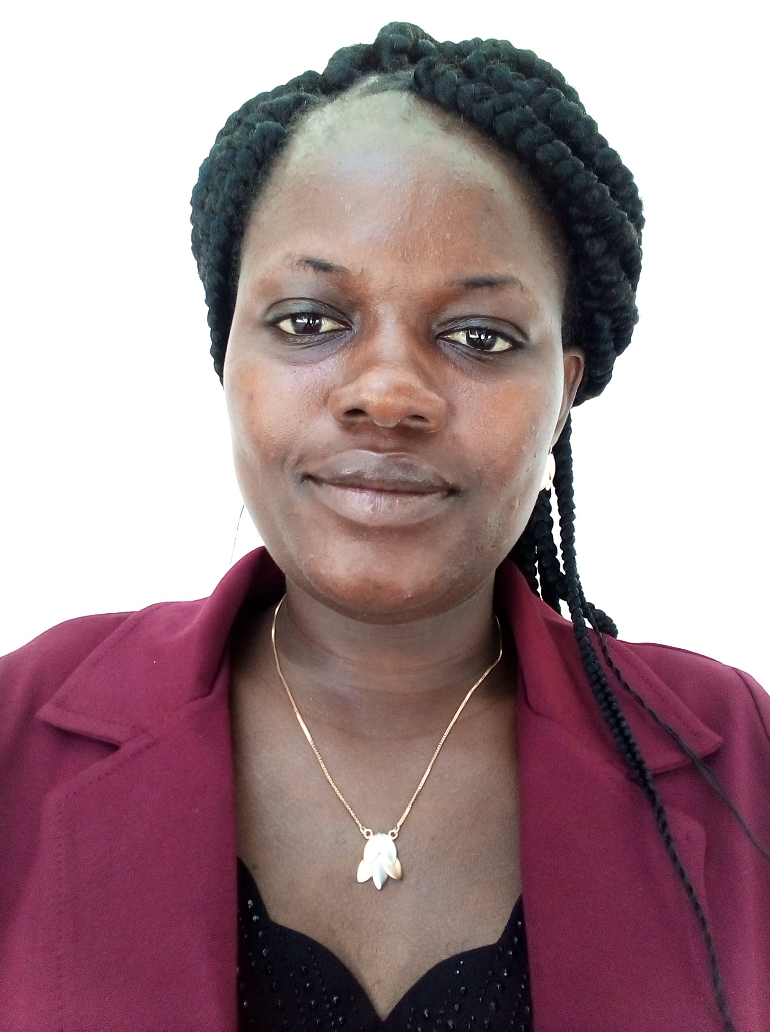
Dr. Somiéalo Azote is a 33 years female physicist from Togo, currently working at the department of physics at the Université de Lomé in Togo, as part time researcher and lecturer assistant. She attended the ASP 2016.
From April to June 2019, she worked as a part time lecturer at the Institut Nationale Supérieur de Technologies Industrielles (INSTI) of the Université Abomey Calavi in Benin.
From July to October 2019 she worked at the physics department at Brookhaven National Laboratory (BNL) in New York (USA) as short-term postdoctoral researcher under the ASP Alumni program
On December 2018, she has obtained her PhD in Physics (Biophysics specialty) from Stellenbosch University in South Africa.
In 2015, she did a Master II internship for five months at Laboratoire Interdisciplinaire de Physique (LIPhy) of Grenoble in France.
She has completed her Bachelor degree in Physics at Université de Lomé in 2011 followed by a Master II degree in Physics-Mathematics in 2014 from African Institute for Mathematical Sciences of Senegal

Slide 9
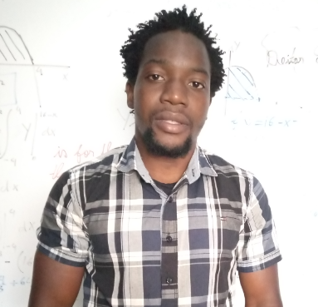
Toivo Samuel Mabote is a young physicist (BSc finalist student in physics) at the Eduardo Modlane University (UEM), 24 years old and is doing his BSc project in Medical Physics
Currently he is Tutoring the Introduction of Astronomy and Astrophysics Course at UEM.
He belongs to ASP2020, which was postponed due to COVID-19, but now he is one of the students in the ASP2020 online lecture series.
Since early 2019, he his coordinating many outreach actvities in the Astrophysics and Space Science Group at UEM, where specifically promotes STEM through Astronomy.
In 2019, he was part of a committee in which participated as a questioner and member of the jury, culminating in the choice of a Mozambican Bantu language to name an Exoplanet, as part of the celebration of the International Astronomical Union's 100th anniversary

Slide 10
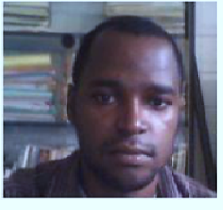
EBODE ONYIE Fabien is Ph.D Student in a co-supervision between the University of Yaounde I at Cameroon and the in a project #Measuring the Charged Pion Polarizability in the γγ → π + π − Reaction# which is A proposal to the 40th Jefferson Lab Program Advisory Committee at Jefferson Lab. This project plan to make a precision measurement of the charged pion polarizability by measurement of γγ → π + π − cross sections using the GlueX detector in Hall D. His contribution in the project is to model the muon chamber which is a great part of the GlueX detector in HALL D to do measurements of pions and muons polarizability. For that, he uses Geant4 in order to model the detector, run some events in order to get the production of the optical photons beyond the secondary particles from muons and pions like primary particles.
He was one of the selected students for the participation at the School on the Fundamental Physics and Applications which has been held at the University of Rwanda, Kigali, from 31july to 19 august 2016.

Slide 11
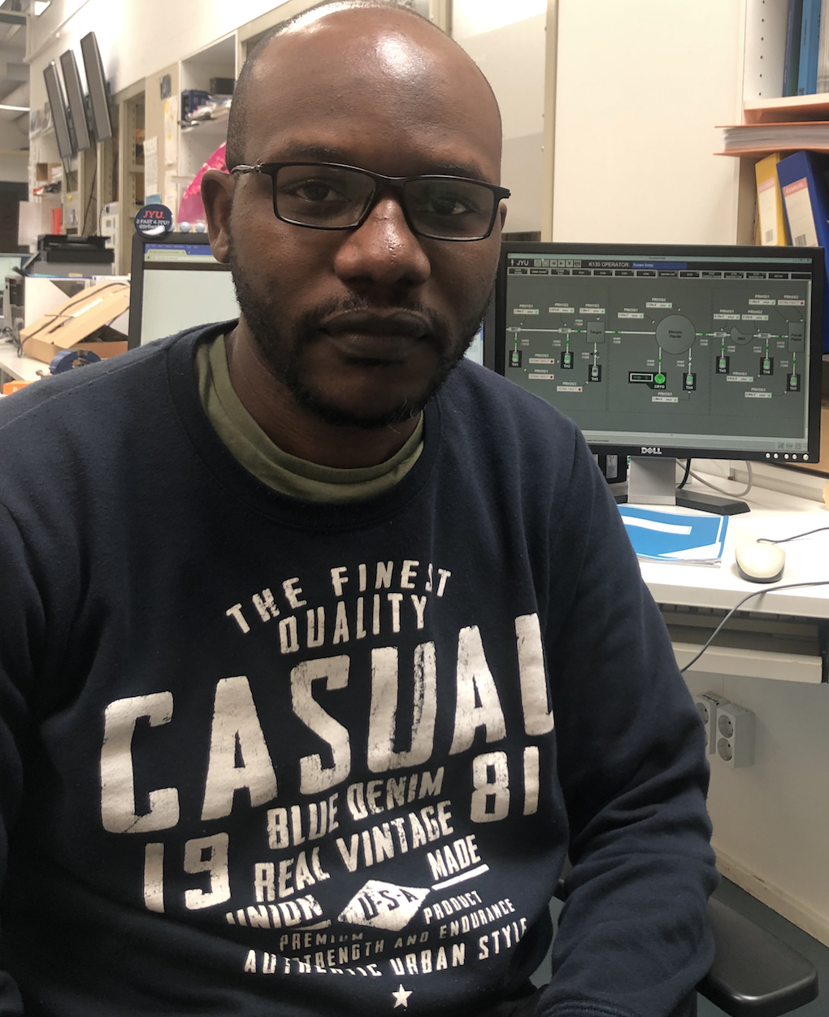
George Zimba is currently a PhD student in nuclear physics at the University of Jyväskylä. He earned his Bachelor of Science from the University of Zambia, in Zambia and a Masters from the University of Johannesburg in South Africa. George attended the African School of Fundamental Physics in 2016 in Kigali, Rwanda. George’s current area of research are nuclei around the proton = neutron line. These nuclei have interesting physics properties, i.e. interchange of proton and neutron, the so-called mirror nuclei. These studies contribute to the knowledge of the fundamental features of the strong interaction.

Slide 12
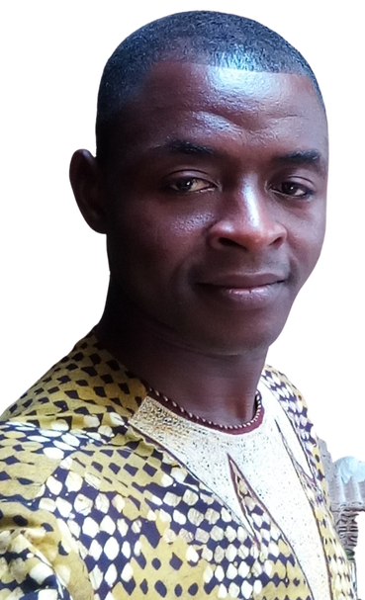
Cyrille Essossolim Haliya is born in March 1991 in Lome (Togo). He completed his master degree in Mathematical Physics in the year 2018 at the International Chair in Mathematical Physics and Applications UNESCO ICMPA-CHAIR of the University of Abomey-calavi in Benin republic. In 2019, He started a PhD program in the same institution but stopped few months latter due to financial issues. He is currently teaching at Arc-en-ciel International High school of Lome (Togo). The main scope of research interest of Cyrille are nonassociative algebras, difference equations and numerical analysis; he has three submitted preprint for publication in algebra:
On a pre-Jacobi-Jordan algebra: relevant properties and double construction (arXiv:2007.06736)
Double constructions of quadratic and sympletic antiassociative algebras (arXiv:2007.11991)
Analog of Drinfeld’s double construction for anticenter-symmetric Jacobi-Jordan algebras (to be appear)

Slide 13
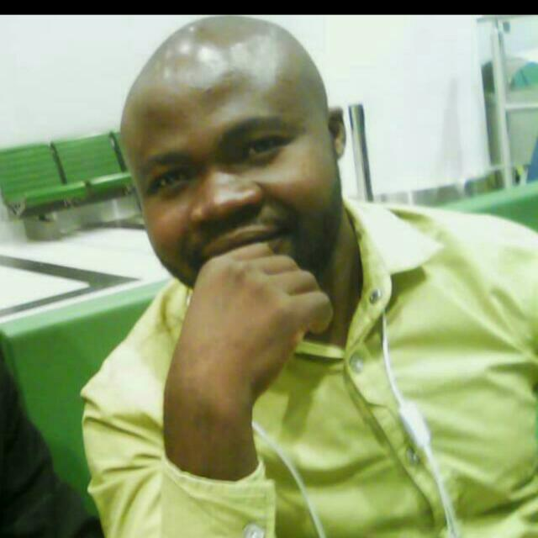
My name is Kondwani C.C Mwale, a Physicists and Educationist, currently in the Final Year of a Master of Physics education at the African Center of Excellence in Innovative Teaching and Learning of Mathematics and Science (ACEITLMS) University of Rwanda- College of education Rukara Campus-(UR-CE).
I’m a Bachelor of Education Science (Physics and Electronics) graduate from the University of Malawi Chancellor College. Am also a student at the African school of fundamental Physics and Applications (ASP 2020), In 2018 I was employed as a tutor in Physics at Lilongwe University of Agriculture and Natural Resources (LUANAR) where I worked for one year before winning a scholarship with the University of Rwanda under World Bank. I possess skills and expertise in programming like Python and Jupyter notebook which has made it possible for me to join the ASP alumni to study COVID-19 data from African countries

Slide 14
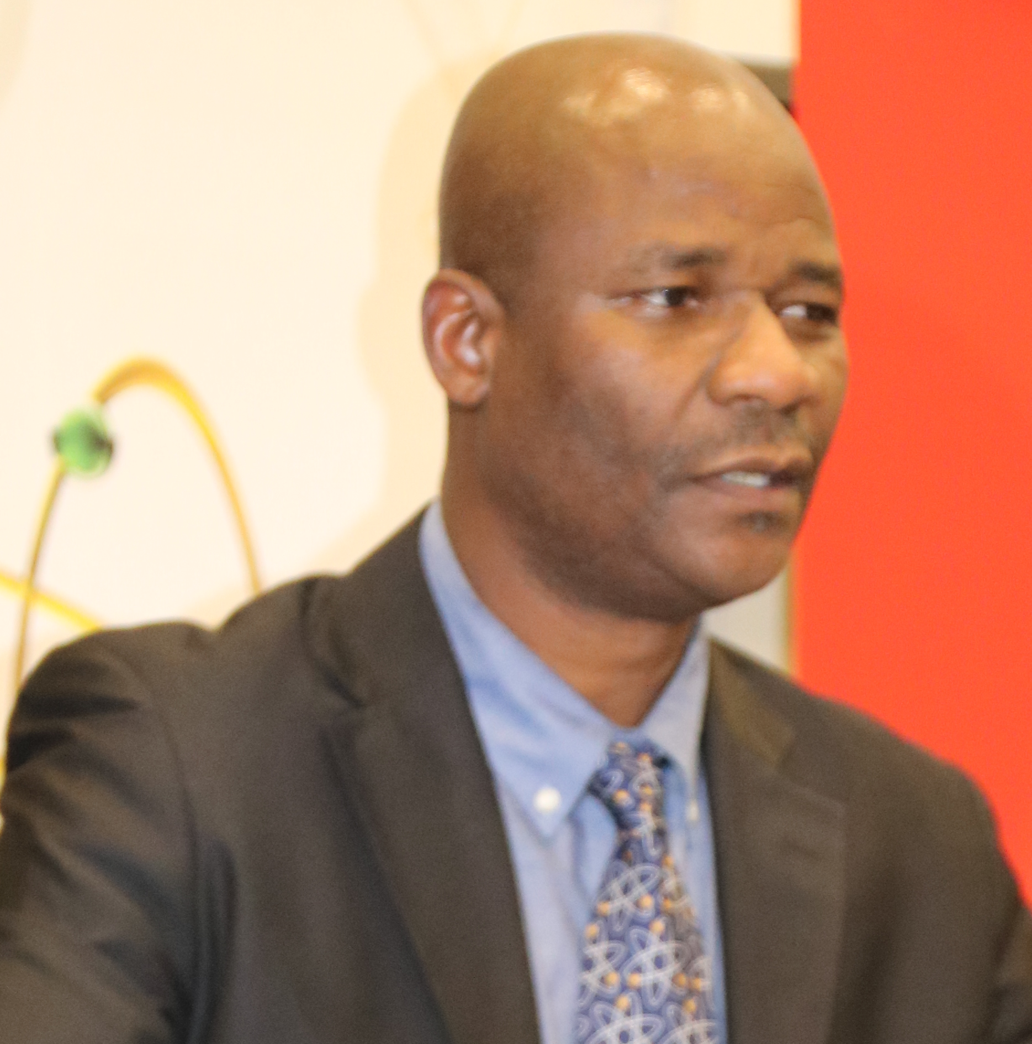
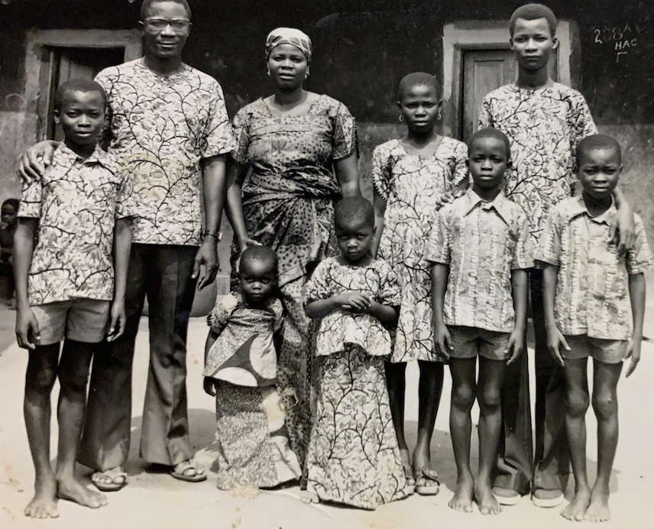
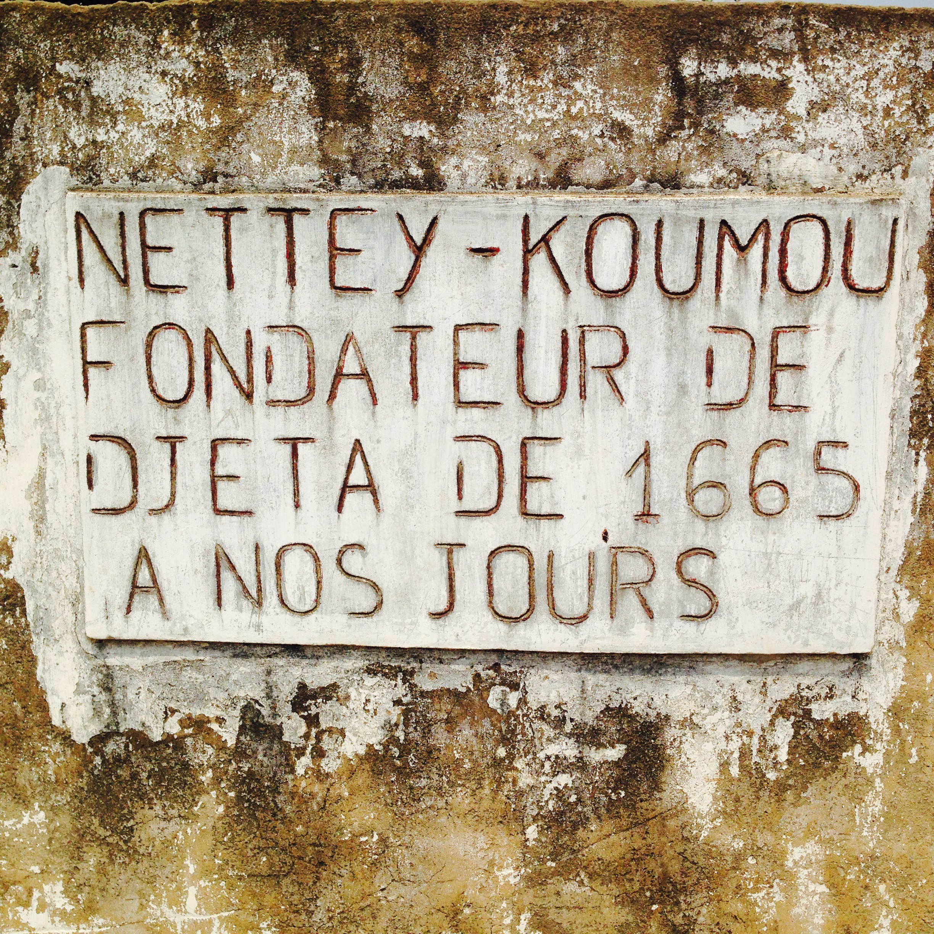
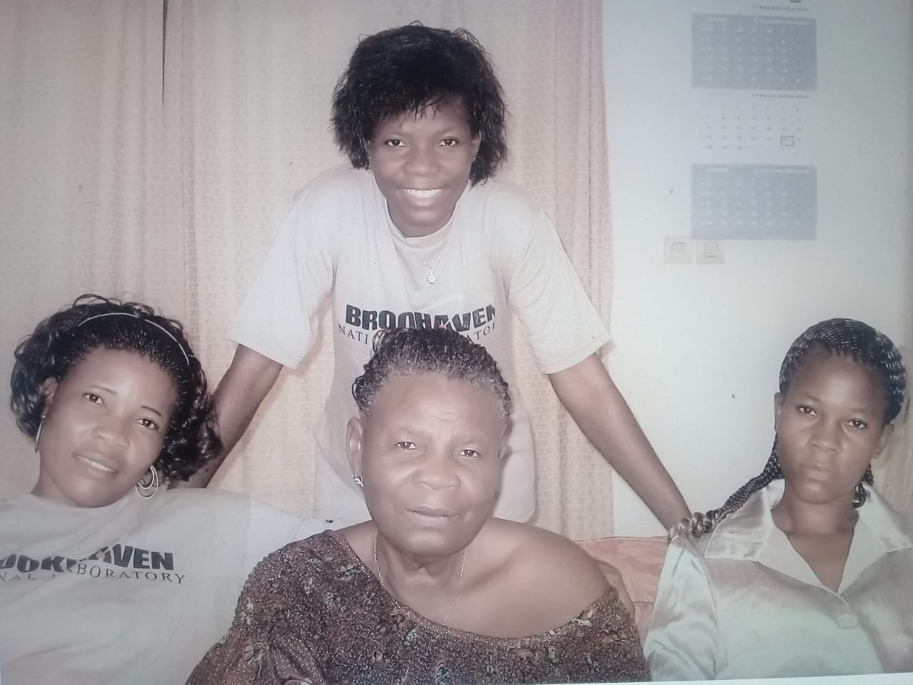
Dr. Kétévi Adiklè Assamagan
  I am originally from Togo (father) & Benin (mother)
  Born in Gabon
  My wife is from South Africa
  Paternal ancestry from Ghana, Accra-Gbese, (migrated to Togo in 1665, in an attempt to avoid to be captured and solved in to slavery)
  I have family in West Africa, South Africa, Madagascar (until recently), soon Egypt, USA and Europe
  I came to the USA for graduate studies; spent post-doc time in Europe; Visiting Scientist in South Africa
  I’ve been at Brookhaven National Laboratory since 2001
  I am one of the organizers of the Africa School of Physics
  I wrote a book, “Citizen and Traveler”, ISBN: 978-0-692-97479-7. I have a 2nd one in preparation
  I do research in experimental particle physics, searching for new physics beyond the Standard Model

Slide 15
The simplest model — SIR
t S = S(t) | is time, to be measured in days is the number of susceptible individuals,
I = I(t) | is the number of infected individuals, and
R = R(t) | is the number of recovered individuals.
N | is the total population
s(t) = S(t)/N, | the susceptible fraction of the population,
i(t) = I(t)/N, | the infected fraction of the population, and
r(t) = R(t)/N, | the recovered fraction of the population.
At each time t, s(t) + i(t) + r(t) = 1

Slide 16

More complicated models (1)
The SIS Model with vital dynamics and constant population
  Introduce birth and death rates
The MSIR model
  For some infections such as measles, consider passive immunity (for a few months after births, babies are immune to the disease)
Carrier State
  Some people who have had an infectious disease such as tuberculosis never completely recover and continue to carry the infection, whilst not suffering from the disease themselves.
The SEIR model
  For many important infections there is a significant incubation period during which individuals have been infected but are not yet infectious themselves. During this period the individual is in compartment E (for exposed).

Slide 17
More Complicated Models (2)
The SEIS model
  The SEIS model is like the SEIR model (above) except that no immunity is acquired at the end
The MSEIR model
  For the case of a disease, with the factors of passive immunity, and a latency period there is the MSEIR model.
The MSEIRS model
  An MSEIRS model is similar to the MSEIR, but the immunity in the R class would be temporary, so that individuals would regain their susceptibility when the temporary immunity ended.
Variable contact rates and pluriannual or chaotic epidemics
  It is well known that the probability of getting a disease is not constant in time. Some diseases are seasonal, such as the common cold viruses, which are more prevalent during winter. With childhood diseases, such as measles, mumps, and rubella, there is a strong correlation with the school calendar, so that during the school holidays the probability of getting such a disease dramatically decreases.
Which model is best suited for COVID-19?

Slide 18
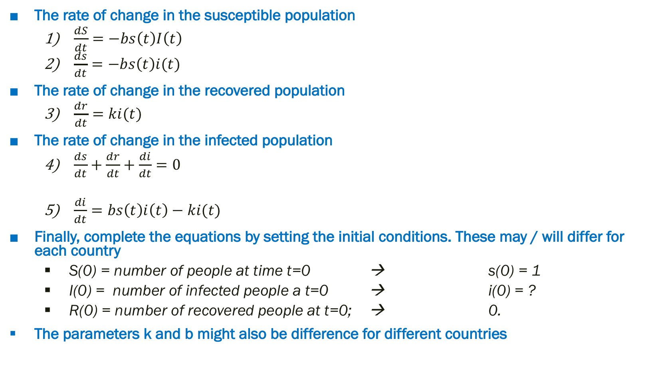
The SIR …
The rate of change in the susceptible population
  $\frac{dS}{dt}=−bs\left(t\right)I\left(t\right)$
  $\frac{ds}{dt}=−bs\left(t\right)i(t)$
The rate of change in the recovered population
  $\frac{dr}{dt}=ki(t)$
The rate of change in the infected population
  $\frac{ds}{dt}+\frac{dr}{dt}+\frac{di}{dt}=0$
  $\frac{di}{dt}=bs\left(t\right)i\left(t\right)−ki(t)$
Finally, complete the equations by setting the initial conditions. These may / will differ for each country
  S(0) = number of people at time t=0 → s(0) = 1
  I(0) = number of infected people a t=0 → i(0) = ?
  R(0) = number of recovered people at t=0; → 0.
The parameters k and b might also be difference for different countries

Slide 19
The SIR in a specific example
Assume that the population is 8 million. Further, hardly anyone was immune at the beginning of the epidemic, so almost everyone was susceptible. We will assume that there was a trace level of infection in the population, say, 1 person. Thus, our initial values for the population variables are:
  S(0) = 8.0 e⁶
  I(0) = 1
  R(0) = 0
  s(0) = 1
  i(0) = 0.125 e⁻⁶
  r(0) = 0

Slide 20
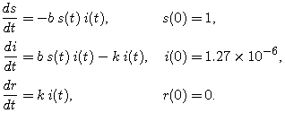
The complete set of equations specific example
0.125
We do not know what b and k are but they can be estimated / guessed for this particular example
Assume each infected would make a possibly infectious contact every day, then b would be 1.0
Assume the average period of infectiousness at 2 days, so that would suggest k = 1/2

Slide 21
The Basic Reproduction Number R₀
The basic reproduction number, R₀, is deﬁned as the expected number of secondary cases produced by a single (typical) infection in a completely susceptible population. It is important to note that R₀ is a dimensionless number and not a rate, which would have units of time⁻¹. In the SIR Model:
  In an epidemic, we require di/dt > 0
  bsi-ki > 0
  At the outset of the epidemic, everyone is susceptible, so set s=1
  So b/k = R₀ > 1
  R₀ = probability of infection (given contacts) x average rate of contacts x duration of infectiousness
R₀ is model dependent. In the SEIR Model with vital dynamics
R₀ > 1: epidemic continues; R₀<1: outbreak ends. R₀ can used to estimate the fraction of people to vaccinate. R₀ must be applied with caution due to model dependency

Slide 22
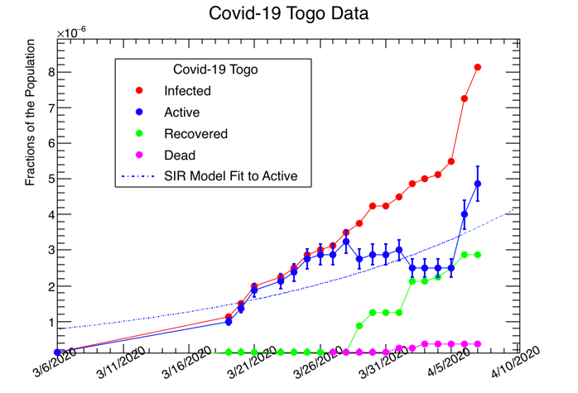
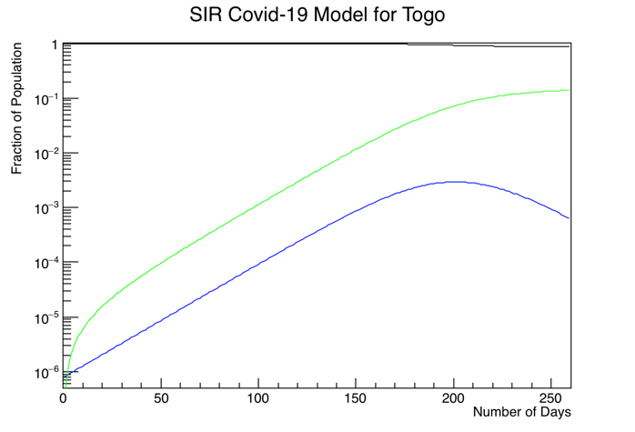
Early April in Togo

Slide 23
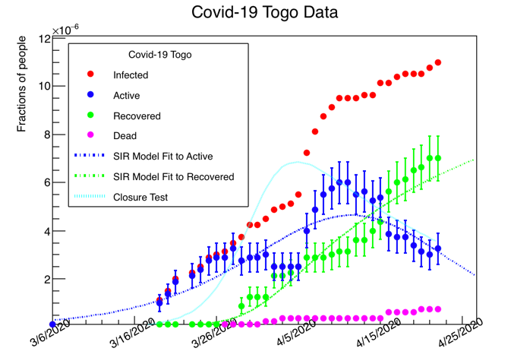
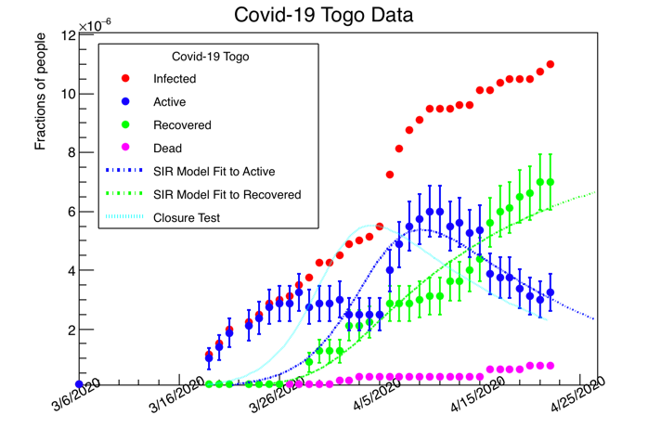
The SIR /SEIR Models do not fit the data
Features in the data (Active)
are not well modeled by the SIR / SEIR
We then moved to the SEIR Model
But the mis-modelling did not improve
A successful model should fit
the 3 curves simultaneously

Slide 24
We looked at this paper
Title: Why differential equation based models fail to describe the dynamics of epidemics
Preprint arXiv:2004.07208
https://arxiv.org/pdf/2004.07208.pdf

Slide 25
The COVID-19 Pandemic in Africa: Predictions using the SIR Model Indicate the Cases are Falling doi:10: 1101/2020: 06: 01: 20118893
They used the SIR Model which we just
showed does not model well the dynamical
evolution in containment measures

Slide 26
The countries that we studied
Benin
  https://covid19.who.int/region/afro/country/bj
Mozambique
  https://covid19.who.int/region/afro/country/mz
Rwanda
  https://covid19.who.int/region/afro/country/rw
Togo
  https://covid19.gouv.tg/
Zambia
  https://www.moh.gov.zm/

Slide 27
SIDARTHE

Slide 28
https://www.nature.com/articles/s41591-020-0883-7.pdf

Slide 29
SIDARTHE – R₀ for Italy

Slide 30
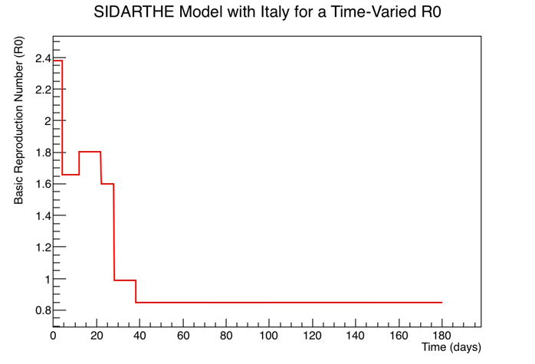
R₀ for Italy
Time-Dependent R0 in the case of
Covid-19 in Italy

Slide 31
Modeling data from African countries

Slide 32
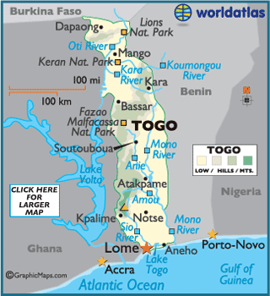
Togo — measures taken by the government
On 6 March, Togolese government’s officials announced the first COVID-19 case, a 42-year-old Togolese woman who travelled between Germany, France, Turkey, and Benin before returning to Togo. She was being treated in isolation and her condition was stable.
Start contact tracing, monitoring of persons under quarantine and testing of symptomatic cases.
Surveillance at point of entry, at the borders and airports

Slide 33
Togo continues
After an extraordinary council of ministers on 16 March, the government established the following measures: suspending flights from Italy, France, Germany, and Spain; canceling all international events for three weeks; requiring people who were recently in a high-risk country to self-isolate; closing their borders; and prohibiting events with more than 100 people effective 19 March
On 20 March, nine more cases were confirmed in Togo. On this day, the first case has recovered, as indicated by the Ministry of Health
On 21 March, seven more cases were confirmed . In an attempt to control the spread of the virus in Togo, all borders to the country were closed. The cities of Lomé, Tsévié, Kpalimé, and Sokodé have been quarantined starting on 20 March. They advised social distancing, wear of masks
For at least two and half months schools, universities, churches, saloons, bars,… were closed. Curfew established from 9pm to 6am.

Slide 34
Togo continues
Truck drivers entering the borders carrying essential commodities are tested and then proceed to their destination under surveillance. The drivers are placed under quarantine if suspect to have been in contact with a confirmed case.
On 27 March, the first death occurred.
On 07 April, start of massive tests of both symptomatic and asymptomatic cases in cities with more than 10 cases.
Between 5 and 20 May, the number of new cases sharply increased. This is because, neighboring countries have re-opened their borders leading to an influx of Togolese nationals returning to Togo with infections.
From 09 June, the curfew is lifted. The government made the wear of mask compulsory for the whole population, and washing hand before accessing to any public, private services or market.

Slide 35
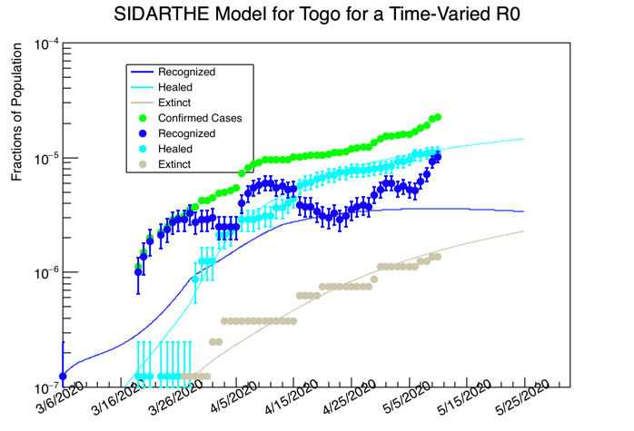
Togo data with “modified” R0 and Modified initial conditions
The green is the sum of the Healed,
Dead and Recognized
Need to better define R0
according to this structure
in the data of Togo. Need
to understand what the
structure corresponds to!
The Healed and Extinct seem
to be somewhat well modeled.

Slide 36
Understanding the Covid-19 data of Togo
https://covid19.gouv.tg/situation-au-togo/
Extinct ≡ Dead
Healed ≡ Recovered
Before 7 April Active cases =
Recognized +
Threatened
After 7 April Active cases =
Recognized +
Threatened+
Ailing (or Diagnosed)

Slide 37
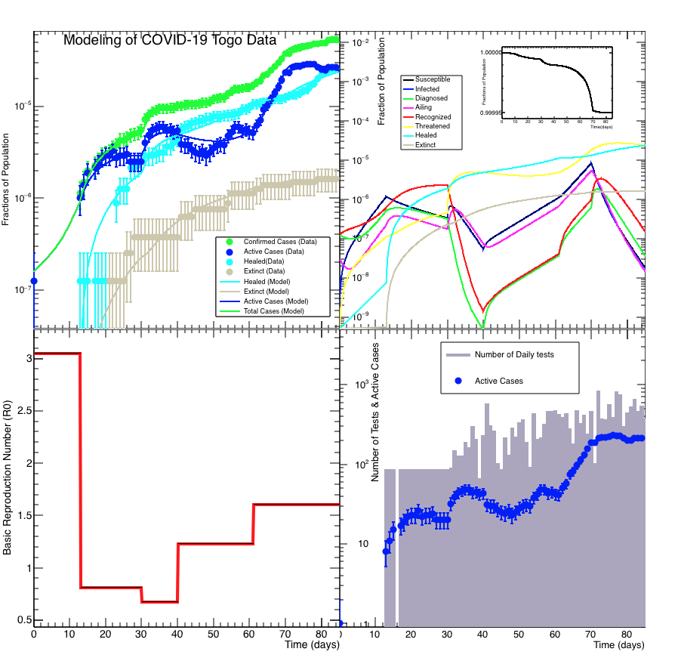
Togo
Number of daily tests
Not correlated with active
cases except around April 6
when the tests started to
include asymptomatic

Slide 38
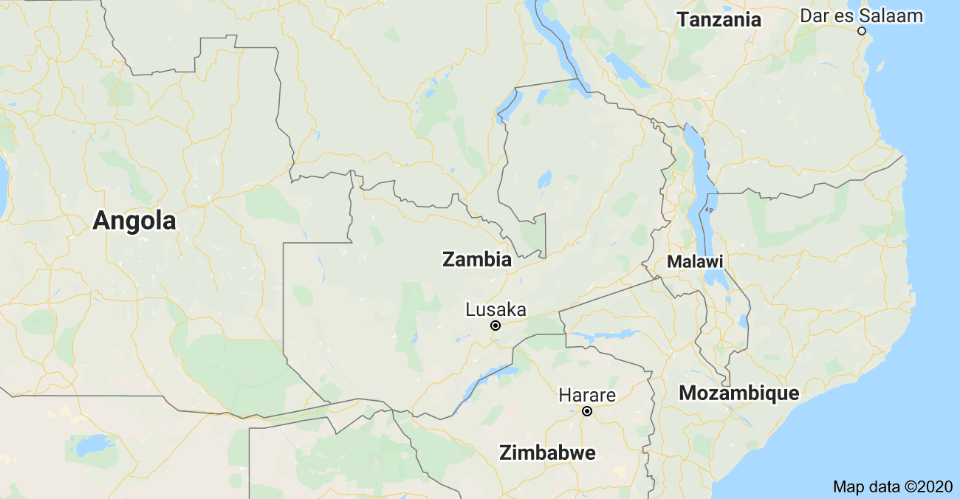
Zambia
Implemented closure of schools/Universities continued screening of travelers (suspension of non-essential travel to countries with confirmed Covid-19 cases).
“locked down” churches, saloons and sports activities are still open however bars are closed :-(
Encouraged social distancing?

Slide 39
Zambia continue…
Surveillance at community level, health facilities, point of entry (Trucks entering the borders carrying essential commodities proceed to their destination under secure escort, at which point the drivers are placed under quarantine pending test results. Other activities).
Contact tracing and monitoring of persons under quarantine.
Criteria for testing: individuals who meet the case definition or individuals who have had contact/been exposed to a confirmed positive case and/or are symptomatic. Testing has also been extended to all communities with confirmed cases. Testing of community alerts, suspects under quarantine, contacts of confirmed cases as well as re-testing of confirmed cases is ongoing

Slide 40
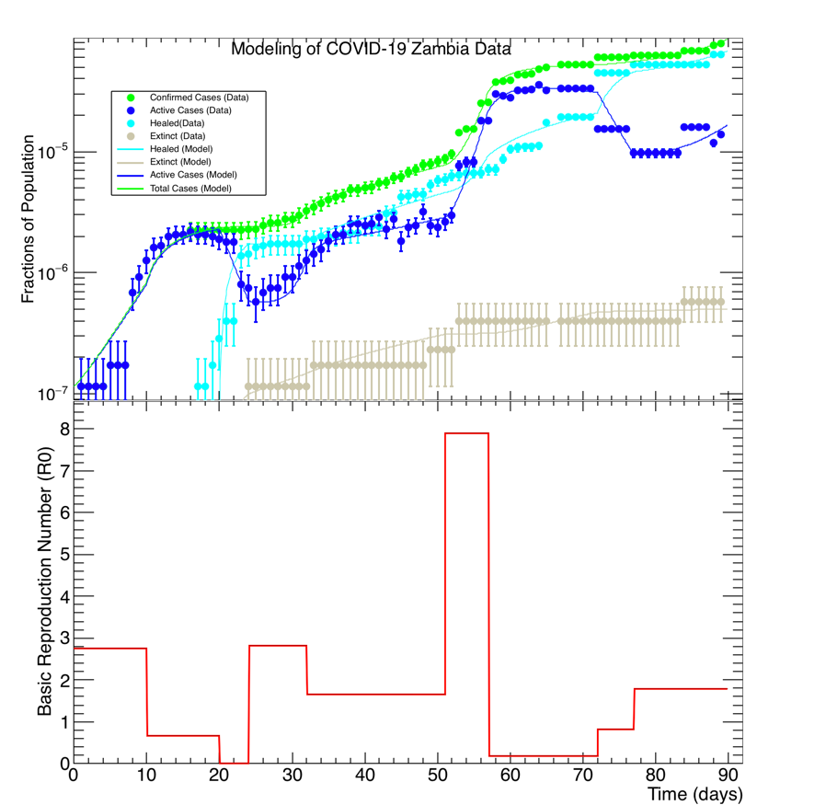
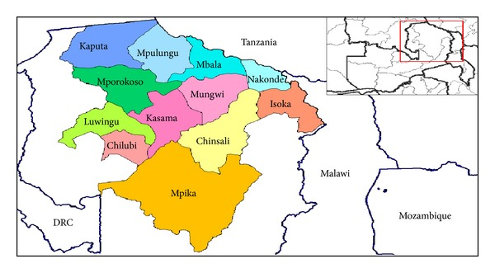
Zambia
On May 19, 50% increase in cases,
mostly from Nakonde
Between May 9-16, high daily increases
Mostly from Nakonde

Slide 41
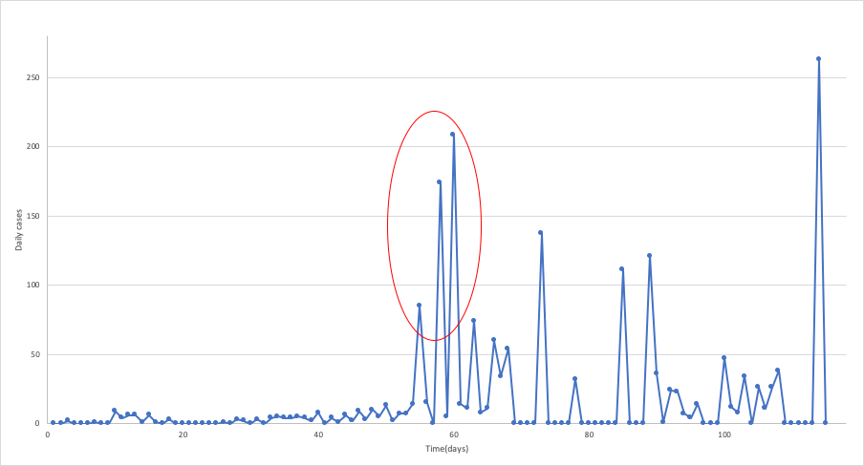
Zambia
On May 19, 50% increase in cases,
mostly from Nakonde
Between May 9-16, high daily increases
Mostly from Nakonde

Slide 42
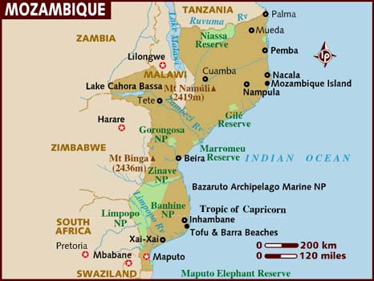
Mozambique
The first case was detected on March 22, 2020 The individual was a Mozambican national who had traveled to the United Kingdom
On March 23, The government closed all schools and Universities, suspended the issuance of entry visas and cancelled the ones already issued. They imposed travelers to self-quarantine. They also suspended social events with over 50 people
The state of emergency started on April 1 and has been extended monthly until all this month
On May 12, they suspended international ﬂights until May 30, except for humanitarian, cargo or state ﬂights

Slide 43
Mozambique
The government has not imposed a lockdown yet
The government and local authorities are studying schools re-opening strategies
Until July 22, 1557 infected cases, 1021 active cases, 523 recovered cases and 11 dead
Oficial website of Mozambican government “Covid-19 fica atento”
  https://covid19.ins.gov.mz/

Slide 44
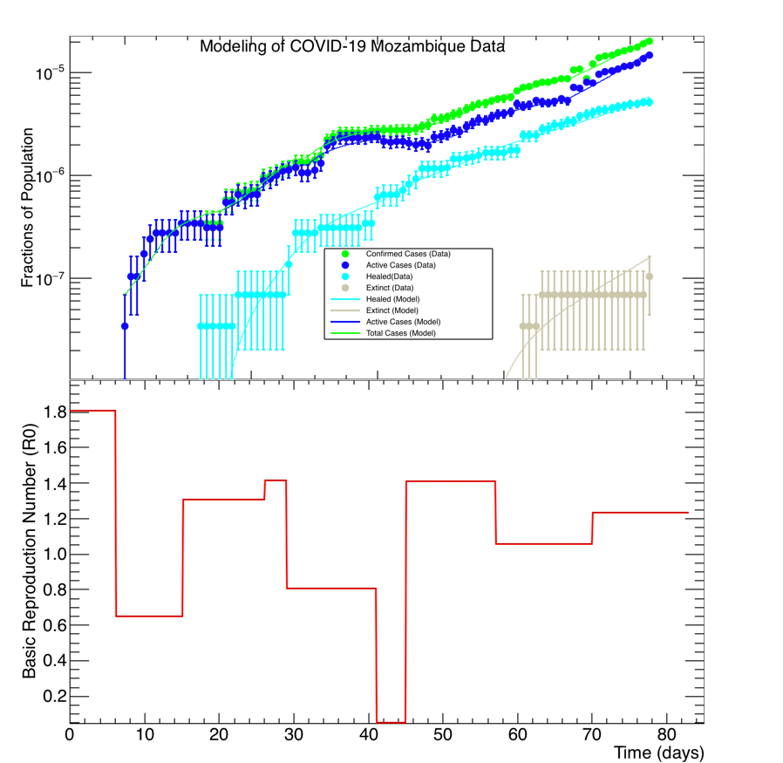
Mozambique

Slide 45
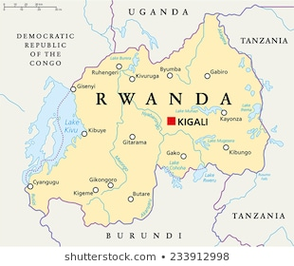
Understanding Covid-19 — Rwanda
On 14th March 2020 Rwanda confirmed first case of covid-19,
It was a foreign national who in the country on 8th March 2020,
He showed no symptoms upon arrival in Rwanda and he reported himself to a health facility on 13th March where he was tested immediately.
By 15th March schools, places of worships, weddings were all postponed till further notice
Testing of symptomatic cases started right away before the first case was identified just after world health declared covid-19 as a pandemic.
Testing of asymptomatic cases and contact tracing started on the date same after identification of the first case on March 14th 2020.

Slide 46
Rwanda continue …
Due to increase in number of cases additional safety measures were taken, on 21st March 2020, Lockdown was implemented, by closing of markets, bars, boarders, airports etc. except those selling essentials such as food and hygienic products
Additional information
Contact tracing is one of the best measures used by Rwandan Government to test asymptomatic individuals who came in contact with the infected persons
Masks are required in all public places, markets and shops are provided with sanitizers to prevent further spread of the virus
NB: Total Population of Rwanda is not less than 12 Million.

Slide 47
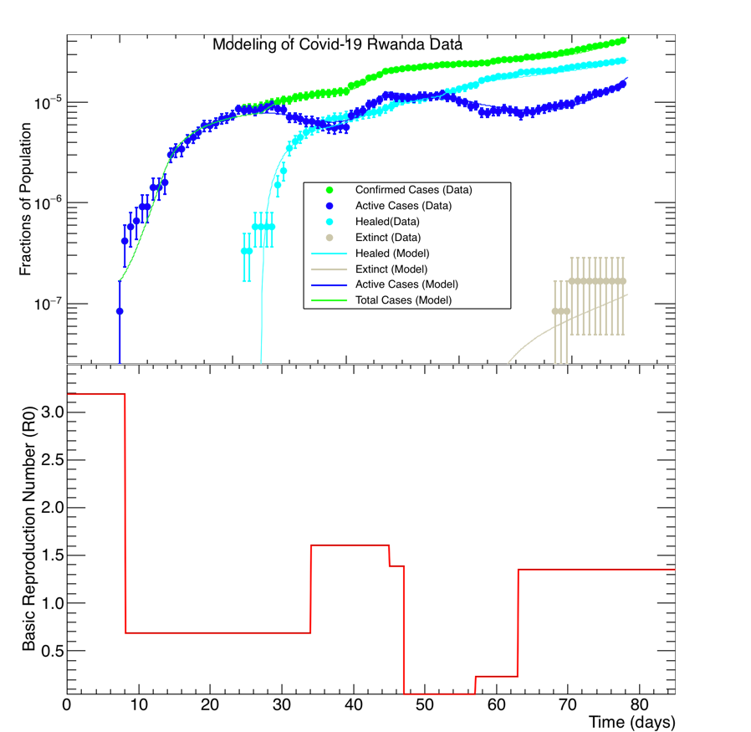
Rwanda

Slide 48
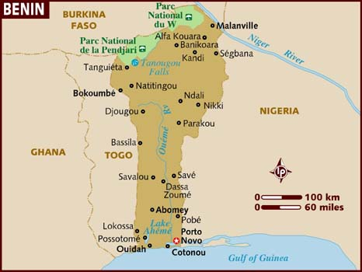
Benin
The first case of COVID-19 was discovered on the 16th March 2020. The government officials took these measures in response:
Limitation to the extreme necessity of entry and exit at the land borders . Only essential crossings are authorized in conjunction with the authorities of neighboring countries. Reinforcement of control measures will be applied for the systematic quarantine of any suspect or who would try to circumvent the device.
Restriction on issuing entry visas to Benin
Systematic and compulsory quarantine of anyone coming to Benin by air. As a result, the Government has decided to requisition a thousand hotel rooms for this purpose.

Slide 49
Benin
Suspension of all missions outside the country for members of the Government and for executives of the public administration, except in case of absolute emergency. Private sector structures and individuals are urged to observe the same caution.
Suspension of all demonstrations and all other non-essential sporting, cultural, religious, political and festive events; closing of churches and mosques.
Obligation for public transporters to equip their employees as well as passengers in appropriate masks, and to respect the social distance of 1 meter between occupants
Obligation for banks, supermarkets, restaurants, businesses and other establishments open to the public, to provide protection and hygiene measures, and to make customers and users aware of the social distance of 1 meter between them.
Provision by the government, for the benefit of pharmacies, supermarkets and other structures, of stocks of protective masks whose prices will be controlled to remain accessible to all of our fellow citizens
From Monday March 30 to Monday April 13 (note that this date was extended until 11th May), complete closing of schools and Universities

Slide 50
Benin
From the 30th March a total lockdown for the most exposed to the pandemic that are Cotonou, Abomey-Calavi, Allada, Ouidah, Sèmè-Podji, Porto-Novo, Akpro-Missérété and Adjarra to isolate them from the rest of the country.
From 30th April up to now financial donations and thousands of medical materials and equipment have been received.
The government has requested the involvement of the medias in raising awareness in national languages
The Republican police are intensifying awareness-raising and checks on the ground to make sure that restrictions are being observed .
Anyone who knows of the return to Benin of people who have not self-isolated is invited to call the numbers 136 to inform the authorities.
Note that from 11th May the lockdown on the above mentioned cities was raised and by 2nd June lot of activities restarted while respecting measures: wearing masks and social distancing between people.

Slide 51
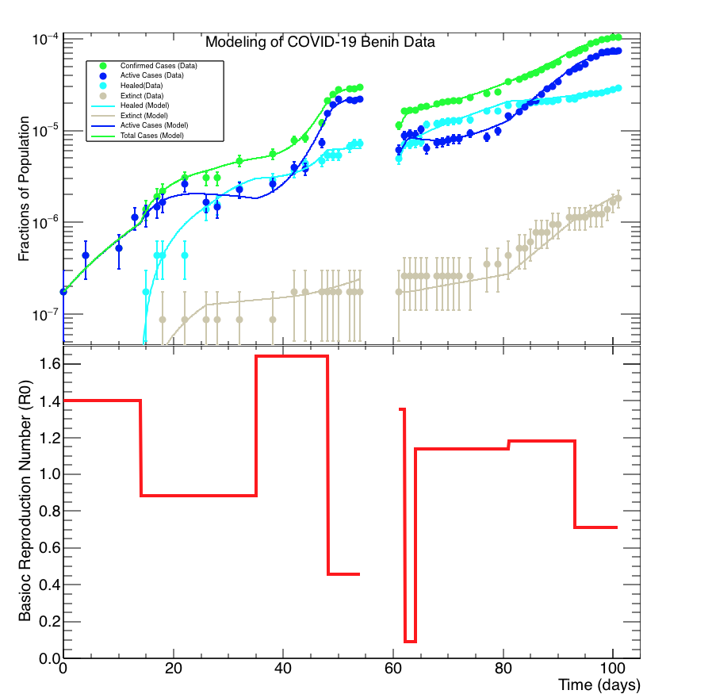
Benin

Slide 52
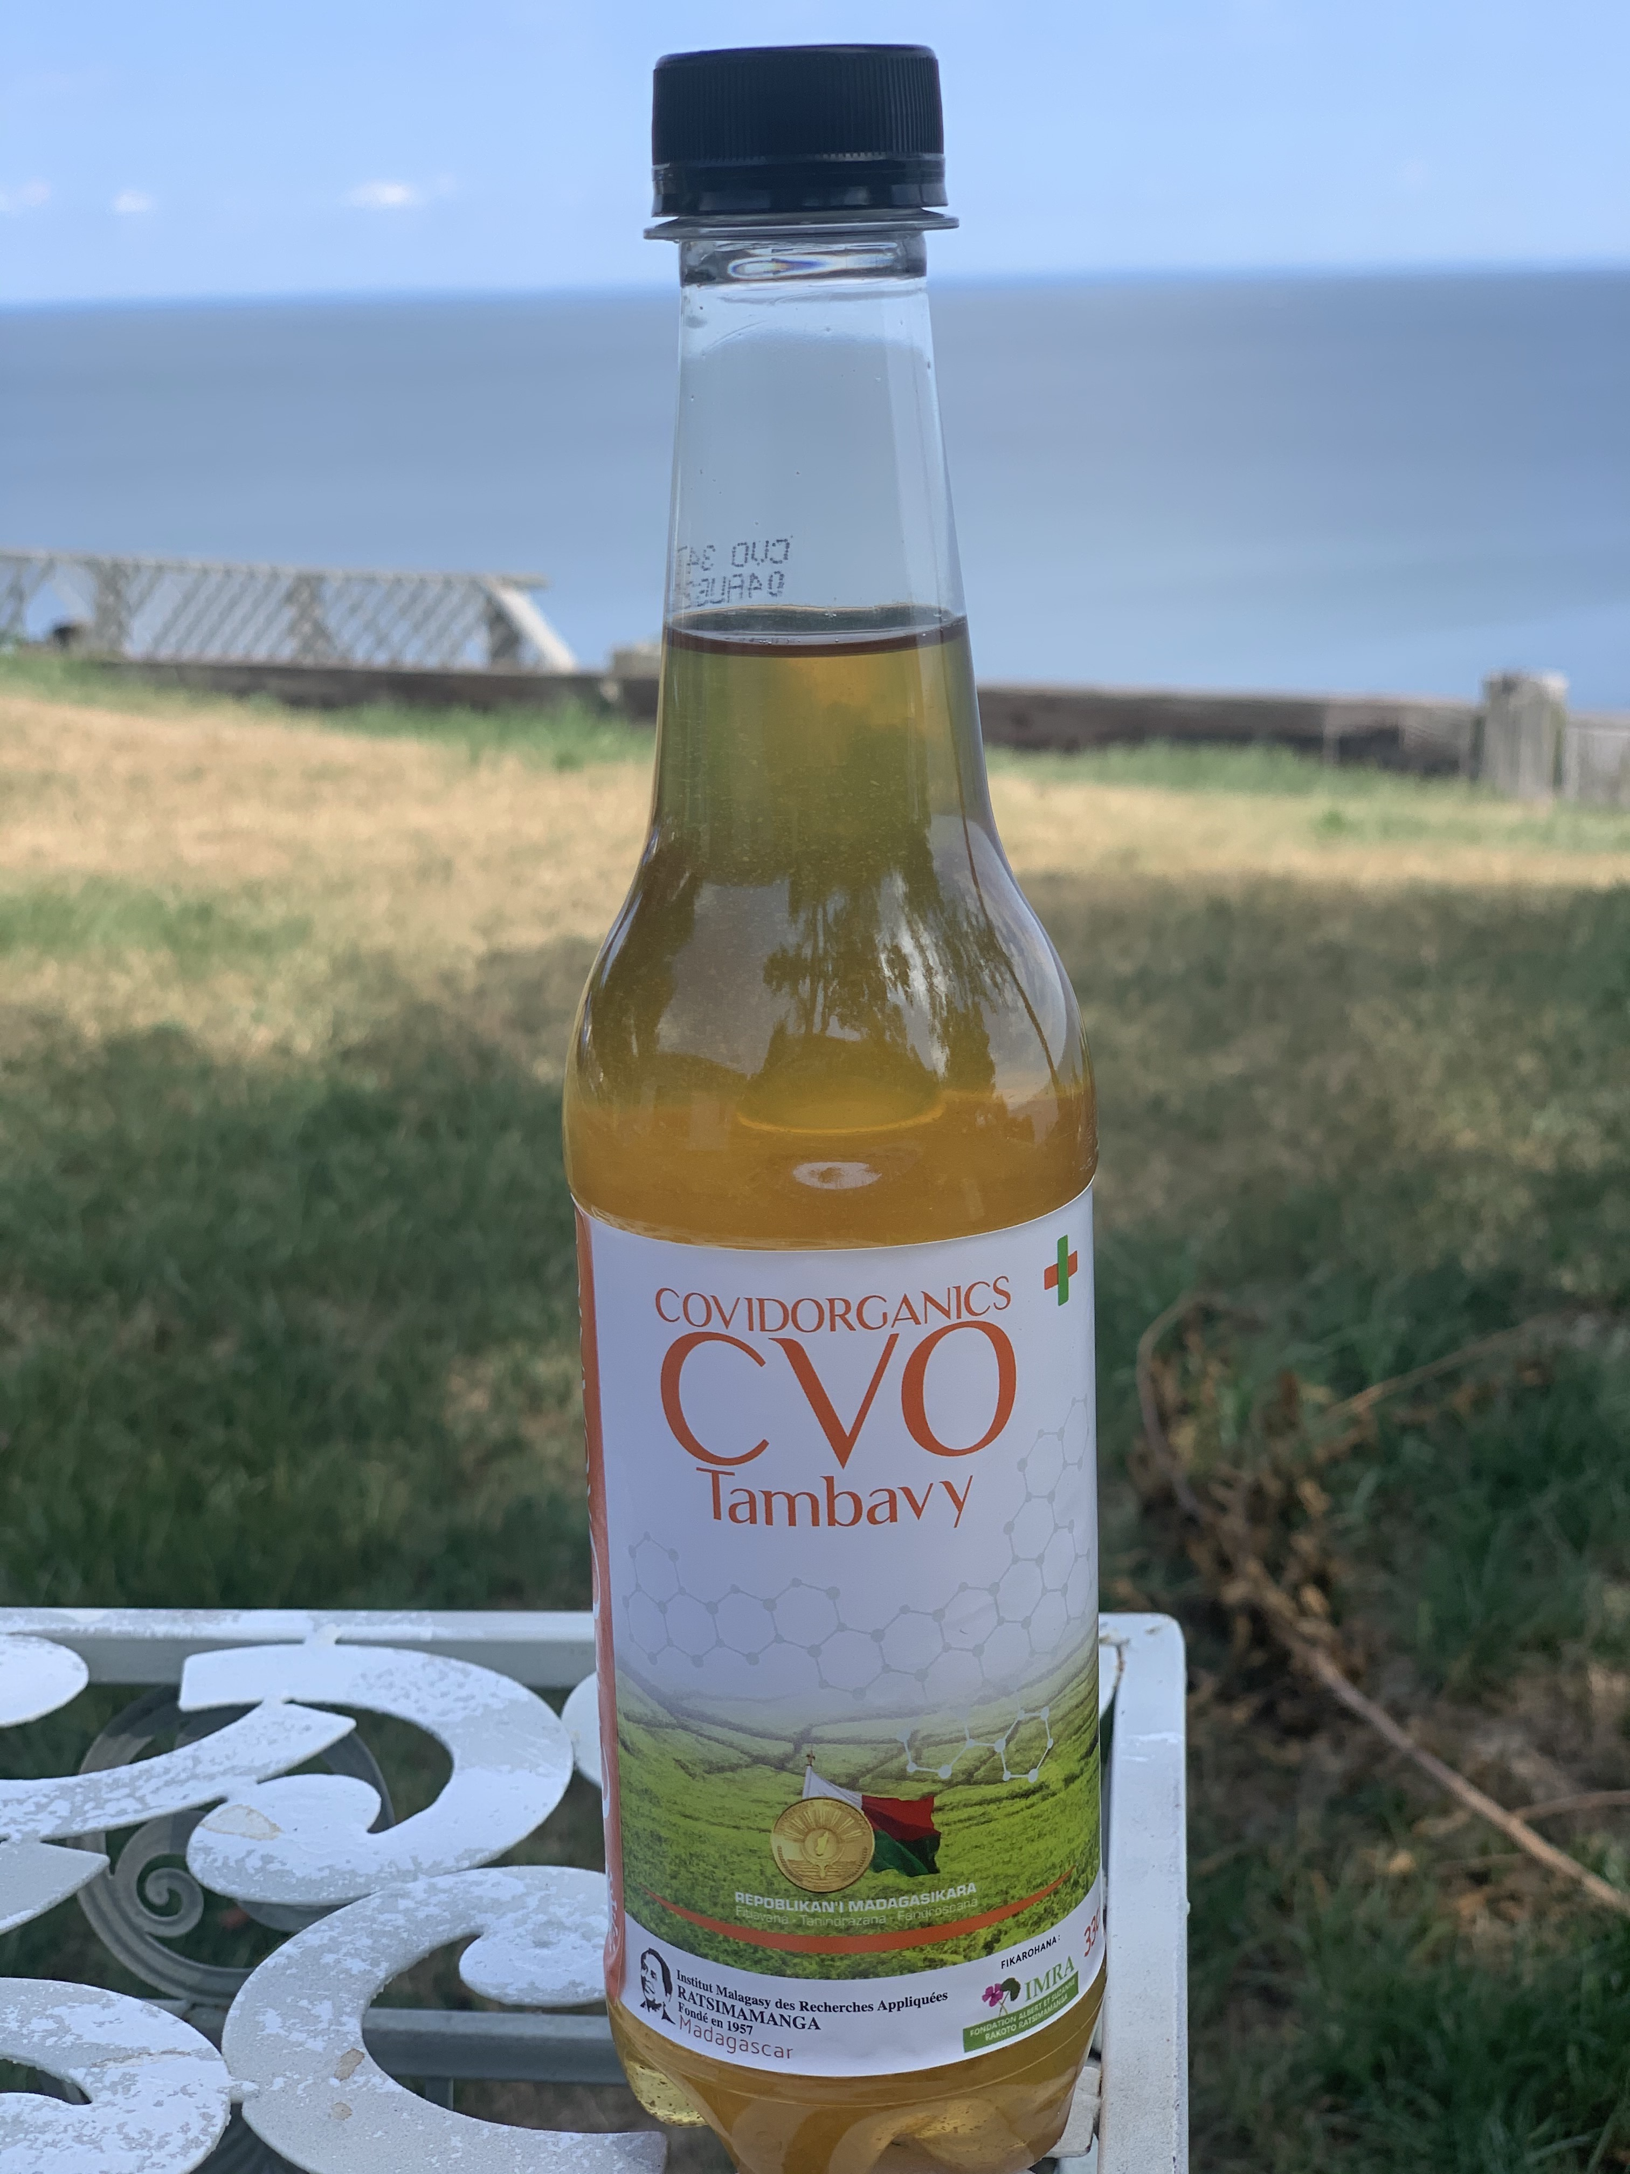
The Malagasy Proposal — Covidorganics
The World Health Organization (WHO) welcomes innovations around the world including repurposing drugs, traditional medicines and developing new therapies in the search for potential treatments for COVID-19
The WHO recognizes that traditional, complementary and alternative medicine has many benefits and Africa has a long history of traditional medicine and practitioners that play an important role in providing care to populations. Medicinal plants such as Artemisia annua are being considered as possible treatments for COVID-19 and should be tested for efficacy and adverse side effects. Africans deserve to use medicines tested to the same standards as people in the rest of the world. Even if therapies are derived from traditional practice, establishing their efficacy and safety through rigorous clinical trials is critical.
https://www.afro.who.int/news/who-supports-scientifically-proven-traditional-medicine?gclid=Cj0KCQjwvIT5BRCqARIsAAwwD-RwTgav0Sw_-hE3YYU3BcZNWgN70fEhlNq2rEBwvHin5DfkMOh31SAaAjiLEALw_wcB
04 May 2020

Slide 53
Hydroxychloroquine
Hydroxychloroquine has long been used as a treatment for malaria
Fact check: Hydroxychloroquine has not worked in treating COVID-19, studies show
  https://www.usatoday.com/story/news/factcheck/2020/07/21/fact-check-hydroxychloroquine-hasnt-helped-covid-19-studies-show/5407547002/
Dr. Stella Immanuel was born in Cameroon and received her medical degree in Nigeria. In her speech, Dr. Immanuel alleges that she has successfully treated hundreds of patients with hydroxychloroquine. Studies have failed to find proof that the drug has any benefit in treating COVID-19, and the Food and Drug Administration in June revoked its emergency authorization to use it to treat the deadly virus, saying it hadn’t demonstrated any effect on patients’ mortality prospects.
  https://www.thedailybeast.com/stella-immanuel-trumps-new-covid-doctor-believes-in-alien-dna-demon-sperm-and-hydroxychloroquine

Slide 54
Vaccines
Exclusive: Russia claims it's on track to approve COVID-19 vaccine by mid-August. But speed of process raises questions
  https://www.cnn.com/2020/07/28/europe/russia-coronavirus-vaccine-approval-intl/index.html
“Dozens of vaccine trials are underway around the world and a small number are in large-scale efficacy trials, but most developers have cautioned that much work remains before their vaccines can be approved. “

Slide 55
Fake news and mis-information
Some believe that COVID-19 is a scam, Africans are immune, and/or the disease has no impact in tropical climates
Many weird video clips about COVID-19 have been shared on social media
A continuous campaign of community engagement with regular briefings is important; so are an active combat against fake news and misinformation

Slide 56
Conclusions
We have studied COVID-19 data from Benin, Mozambique, Rwanda, Togo and Zambia
We modeled the data from these countries with the SIDARTHE, and extracted a time-dependent basic reproduction number for each country studied
Our studies show that the initial reactions of African governments and populations were eﬀective to bring the basic reproduction number below one
However, relaxation and diﬃculties to maintain the measures over time drive the basic reproduction number in a time-dependent cyclic pattern of rises and falls
We suggest that African countries ﬁnd satisfactory economic supports for their most disadvantaged populations. This will encourage adherence to the containment plans

