Slide 1
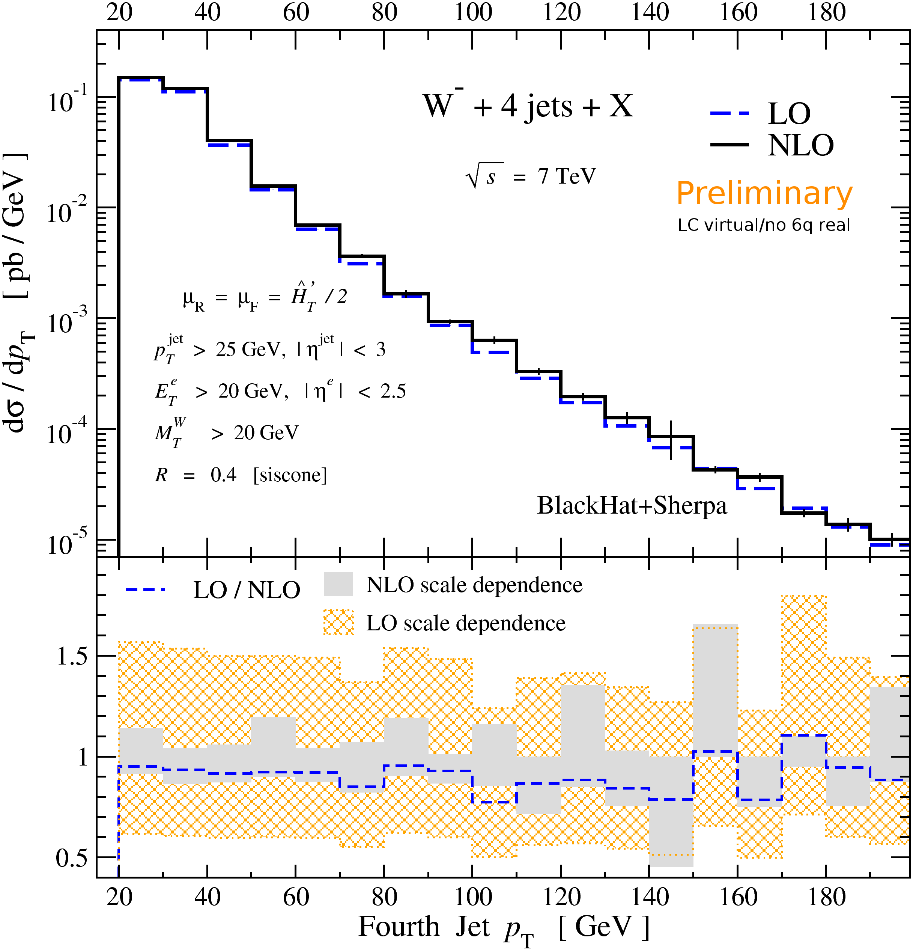
Recent Advances in NLO QCD
(V-boson+jets)
In collaboration with BlackHat: C.F.Berger, Z.Bern, L.J.Dixon, F.Febres Cordero, D.Forde, D.A.Kosower, D.Maitre;
+Sherpa: T.Gleisberg
Harald Ita, (UCLA+NSF TI-fellow)
US ATLAS Hadronic Final State Forum
SLAC, Aug 23rd 2010
Notes:
Theoretical predictions can play an important role in experimentally-driven determination of backgrounds, improving extrapolations to signal regions.

Slide 2
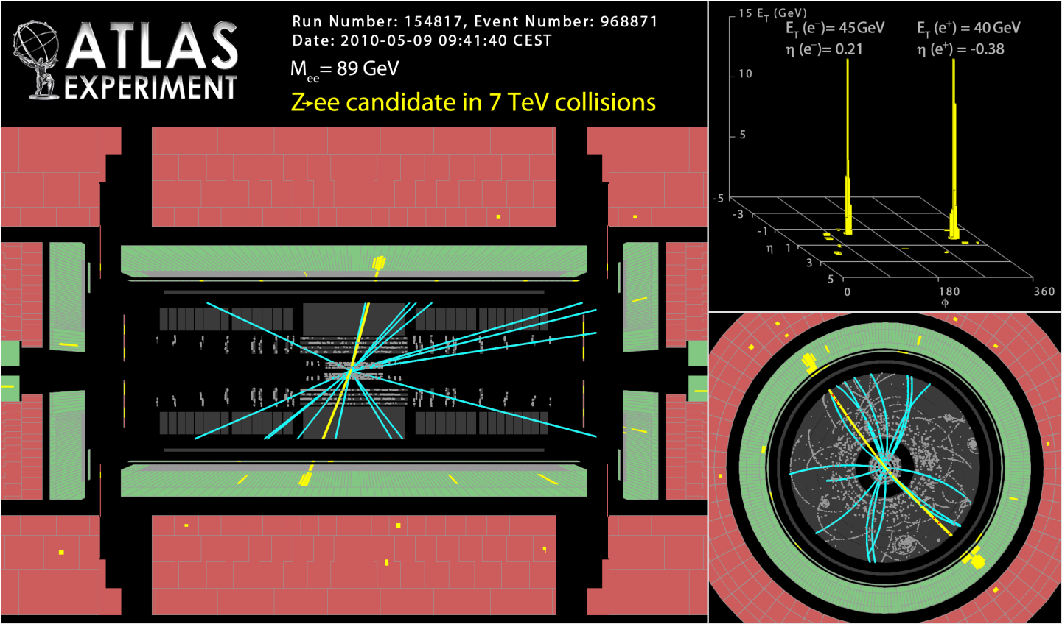
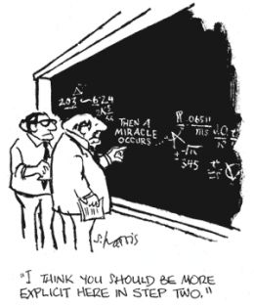
QCD omnipresent @ the LHC
QCD
Fundamental stuff:
masses, couplings, fields, strategies, theories ...

Slide 3
Signals in multi-jet final states
Example: SUSY gluino cascade
New particles, e.g. supersymmetry , Higgs
boson(s) typically decay through cascades into
multi-jet final states
Kinematic signatures not always clean
(e.g. mass bumps) if dark matter, neutrinos, or other escaping particles present
ν
ν
χ
χ
Need precise Standard Model backgrounds for a variety of processes with multiple jets, to maximize potential for new physics discoveries.

Slide 4
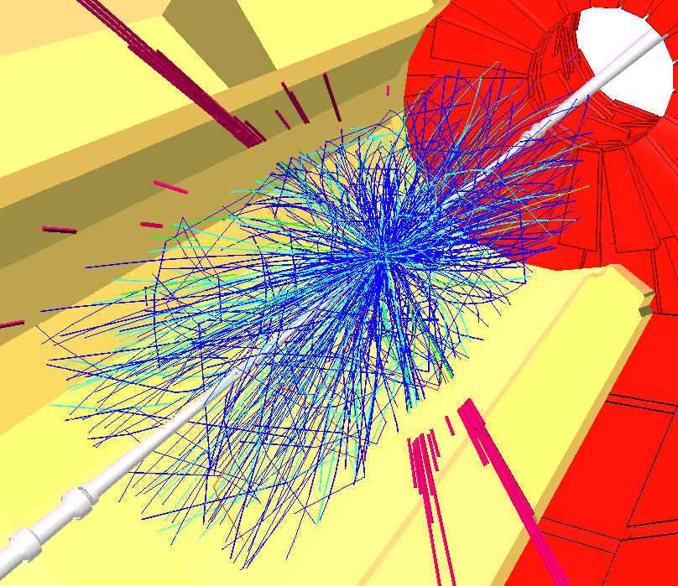
QCD factorization & parton model
Heavy fundamental particles produced in high energy interactions → Factorization:
Protons appear as clouds of point-like partons (quarks + gluons).
Asymptotic freedom guarantees that hard interactions between partons well described by perturbative QCD.
Quantitative first principle predictions.

Slide 5
How best to control
SM backgrounds?
Get the best theoretical prediction you can, whether
  Basic Monte Carlo [PYTHIA, HERWIG, Sherpa, …]
  LO QCD parton level
  LO QCD matched to parton showers [MadGraph/MadEvent, ALPGEN/PYTHIA, Sherpa, …]
  NLO QCD at parton level
  NLO matched to parton showers [MC@NLO, POWHEG,…]
  NNLO inclusive at parton level
  NNLO with flexible cuts at parton level
Increasing availability →
Increasing accuracy →
Take ratios whenever possible
- QCD effects cancel when event kinematics are similar
- Closely related to “data driven” strategies
L. Dixon

Slide 6
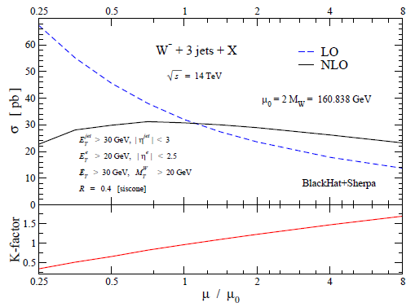
Want NLO for multi-jets
[BlackHat,0907.1984]
Reduced dependence on
unphysical renormalization
and factorization scales.
NLO importance for scale dependence grows with increasing number of jets.
NLO captures more physics:
- multiple partons merged to jets
- initial state radiation
- more types of initial state
partons included
Shape changes
Typical scale variation W+n jets
Number of Jets | LO | NLO
1 | 16 % | 7 %
2 | 30 % | 10 %
3 | 42 % | 12 %
NLO required for quantitative
control of multi-jet final states

Slide 7
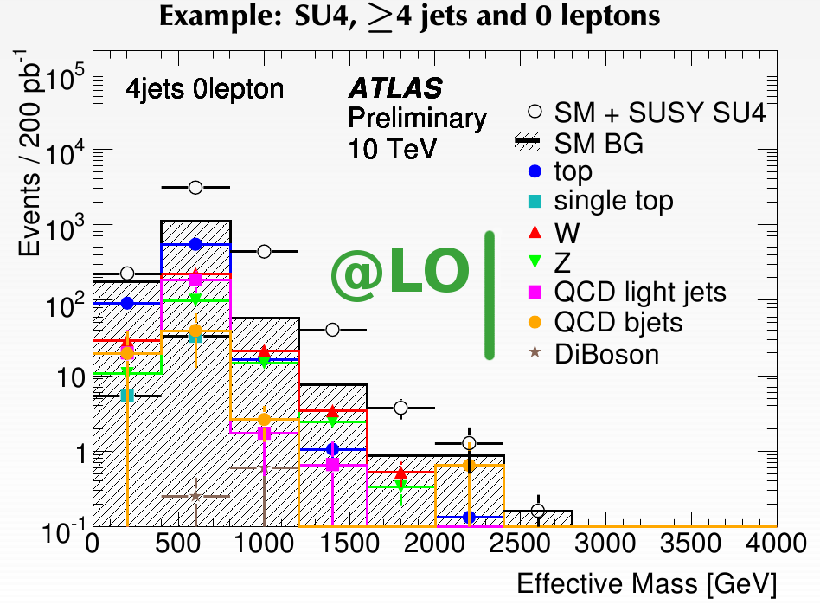
NLO motivation from SUSY search
Signature: multijet + Missing E_{T} + X
Irreducible background:
Z (→ neutrinos) + 4 jets
Signal excess over LO background with normalization still quite uncertain
ν
ν
χ
χ
Aim for NLO background:
Z (→ neutrinos) + 4 jets
ν
ν

Slide 8
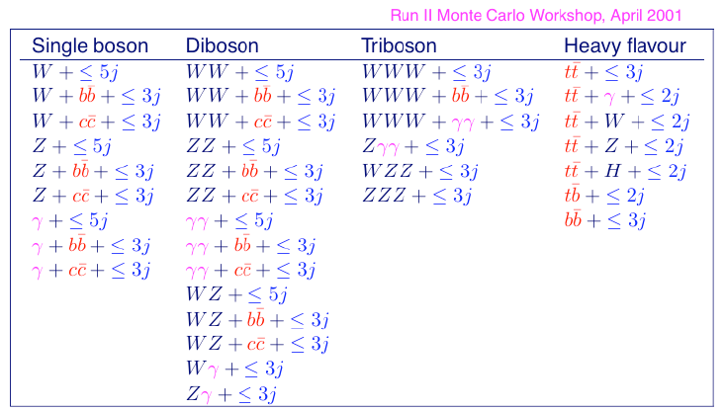
The Les Houches Wish List (2001)
Five-particle processes under good control with Feynman diagram based approaches.
Problem posed for over 10 years. Solution clear only recently!

Slide 9
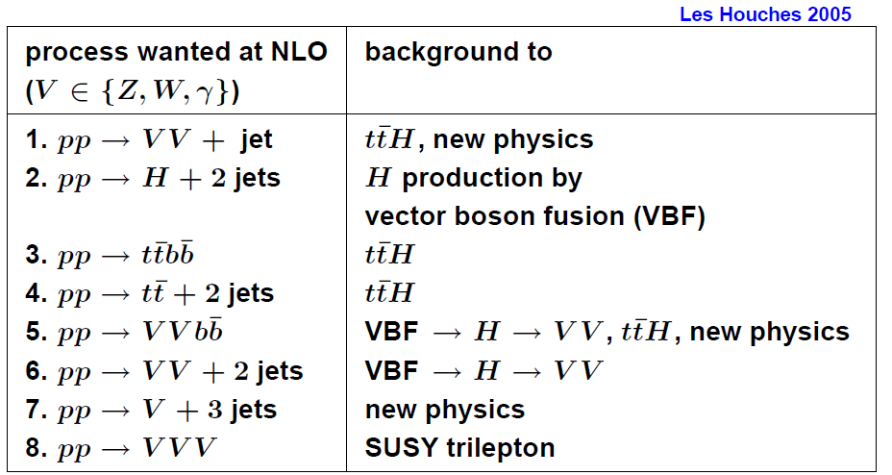
Les Houches Wish List (2005)
Descope!

Slide 10

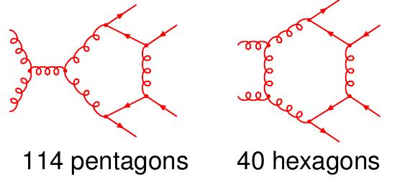
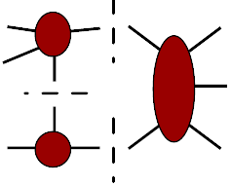
NLO bottleneck: loops
state of the art:
(Bredenstein, Denner, Dittmaier, Pozzorini; …)
Traditional methods:
Simplify loop-level Feynman
diagrams analytically.
Reduce tensor integrals.
Factorial growth of number of diagrams with multiplicity.
Intricate tensor reductions.
Bern, Dixon & Kosower
Britto, Cachazo & Feng
Ossola, Pittau & Papadopoulos
Giele, Kunszt & Melnikov
Recursive & on-shell/unitarity methods:
Use unitarity and factorization
properties to assemble amplitudes from
(on-shell) tree amplitudes numerically.
Efficiently drops unphysical parts (ghosts,…). Automatable for many processes.

Slide 11

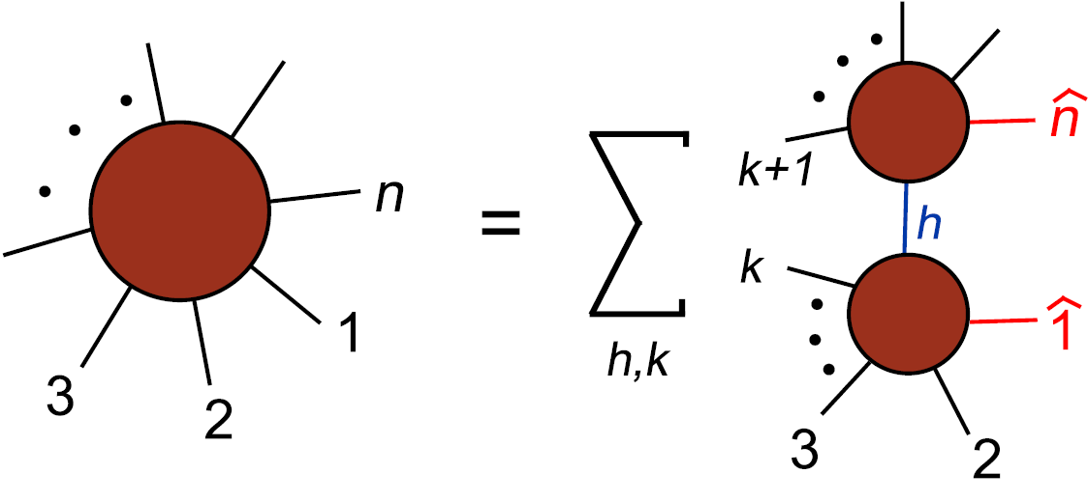
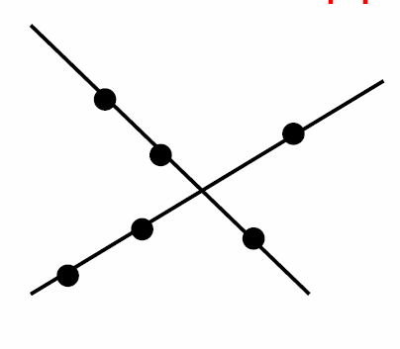

Example: new insights
Twistor-space:
twistor string [Witten 03’]:
Remarkable simplicity: Tree amplitudes
supported on lines in twistor space.
Obscure from Feynman diagrams!
Tree recursions: [Britto, Cachazo,
Feng, Witten 05’]
Fast QCD tree amplitudes from
lower point on-shell amplitudes.
Loop recursions: [Bern, Dixon, Kosower 05’]
Most efficient for parts of loop amplitudes (rational terms).
Leads to rewriting of and rethinking about
perturbative QFT.
Connected picture
=
Tree-amplitude
Disconnected picture
New textbook QFT
4 new chapters in 2nd edition!

Slide 12
05’ Wishlist 2→4 processes
pp → t¯tb¯b:
– 09’ Bredenstein, Denner, Dittmaier and Possorini [traditional]
– 09’ Bevilacqua, Czakon, Papadopoulos, Pittau and Worek [unitarity]
pp → W+3 jets:
– 09’ Ellis, Melnikov and Zanderighi (leading color approx) [unitarity]
– 09’ BlackHat [unitarity]
pp → Z+3 jets:
– 10’ BlackHat [unitarity]
pp → b¯bb¯b (q¯q-channel):
– 09’ Binoth, Greiner, Guffanti, Reuter, Guillet and Reiter [traditional]
pp → t¯tjj:
– 10’ Bevilacqua, Czakon, Papadopoulos and Worek [unitarity]
pp → W⁺W⁺+2 jets:
– 10’ Melia, Melnikov, Rontsch, Zanderighi [unitarity]

Slide 13
Selected recent NLO
pp → WWW, WWZ, … ZZZ:
– 08’ Binotha, Ossola, Papadopoulos, Pittau [unitarity]
pp → H+2 jets:
– 09’+10’ Campbell, Ellis, Zanderighi, Badger, Williams; Dixon, Sofianatos [unitarity]
pp → tt⁻+1 jet:
– 07’ Dittmaier, Uwer, Weinzierl [traditional]
– 10’ Melnikov, Schulze [unitarity]

Slide 14
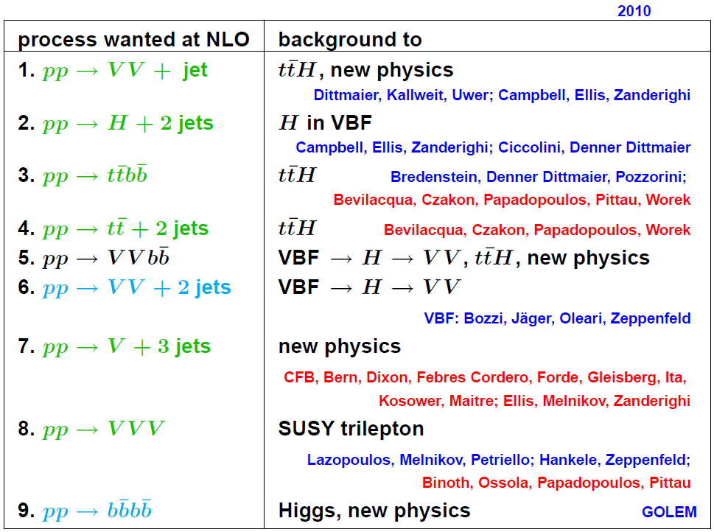
The Les Houches Wish List (2010)
Feynman
diagram
methods
now joined
by
unitarity
based
methods
Melia, Melnikov, Rontsch, Zanderighi
Berger,

Slide 15
First 2→5 process
pp → W+4 jets:
– 10’ BlackHat (leading color, preliminary) [unitarity]
First 2→5 NLO computation as needed for SUSY background
Background to top quark studies
LO uncertainty
NLO uncertainty
Back on the earlier 2001 wishlist!

Slide 16
The Les Houches Wish List (2001)

Slide 17
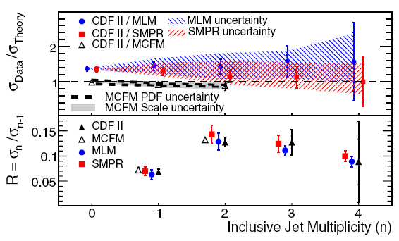
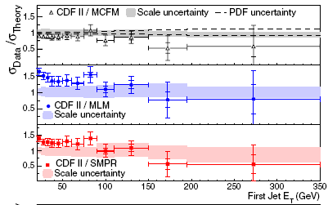
Comparing tools
T. Aaltonenet al. [CDF Collaboration], data: 320 pb⁻¹
arXiv:0711.4044
LO+shower:
SMPR-model: Madgraph+Pythia
MLM-model: Alpgen+Herwig
NLO-parton level (MCFM)
CDF: JETCLU R=0.4, f=0.75 (IR unsafe)
NLO: SISCone: R=0.4, f=0.5
NLO has smallest uncertainties on distributions.
NLO deviation of Data/Theory smaller than other calculations.
Second jet in W+2 jets

Slide 18
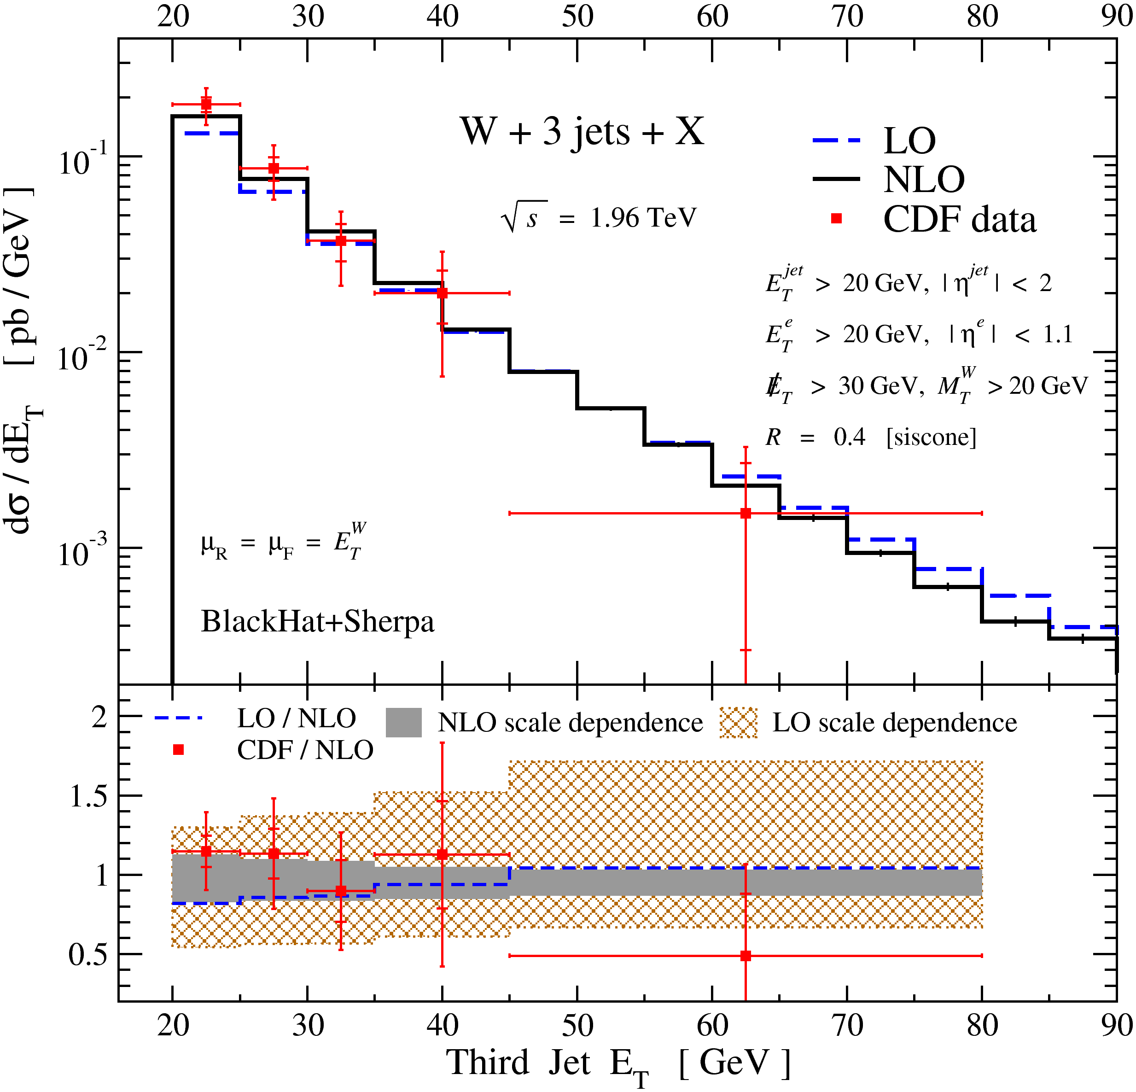
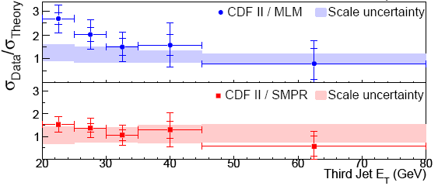
Comparing tools
Third jet in W+3 jets
[BlackHat,0907.1984]
Reduced scale dependence at NLO
Shape change small compared to LO scale variation

Slide 19
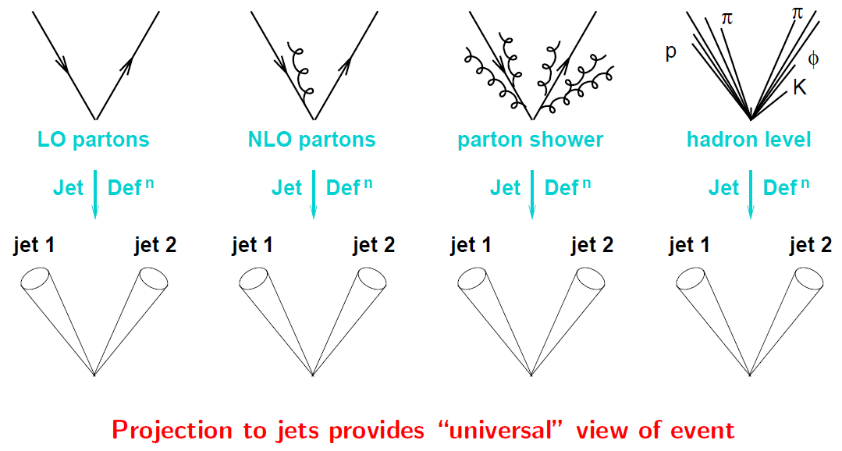
NLO + Shower MCs
Recent NLO progress (2→4,5) at parton level:
no parton shower, no hadronization, no underlying event.
Methods for matching NLO parton-level results to parton showers:
  MC@NLO [Frixione, Webber 02’, …]
  POWHEG [Nason 04’; Frixione, Nason, Oleari 07’;... ]
  GenEvA [Bauer, Tackmann, Thaler 08’]
  ME NLO PS [Gehrmann, Höche, Krauss, Schönherr;
  Hamilton, Nason; Alioli, Nason, Oleari, Re 10’]
Technical status:
  no complex multi-jet NLO included yet
  E.g.: NLO: Z, LO: Z+1/2/3/. . .+ parton shower
  Hamilton & Nason '10; SHERPA, prelim;
  NLO: Z & Z+j + parton shower, Alioli et al, prelim
Meanwhile:
NLO parton-level gives best normalizations away from shower-dominated regions.
Ratios will be considerably less sensitive to shower + nonperturbative effects.
Salam ICHEP 2010

Slide 20
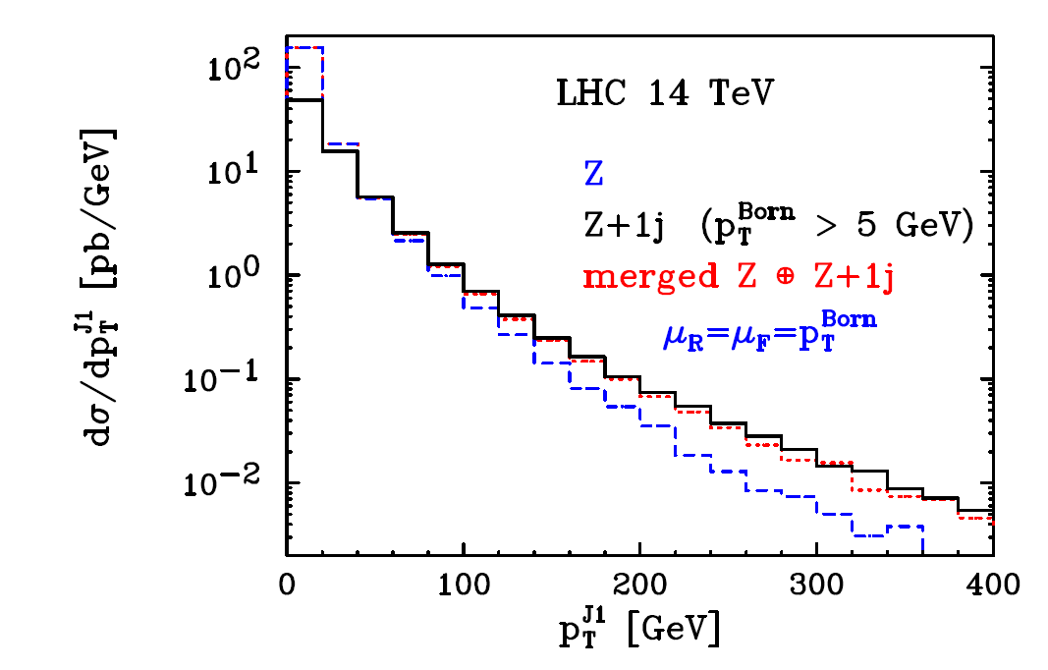
NLO + Shower MCs: samples
MC@NLO [Frixione,Webber 02’]
Some LHC processes available,
but see above references more
complete account.
W/Z production
Higgs production
Z + 1 jet
vector boson pairs
heavy quark pairs
single top
lepton pairs
Higgs bosons in association with a W or Z
Merged Z and Z +1 jet events [Alioli, Nason, Oleari, Re 10’]

Slide 21
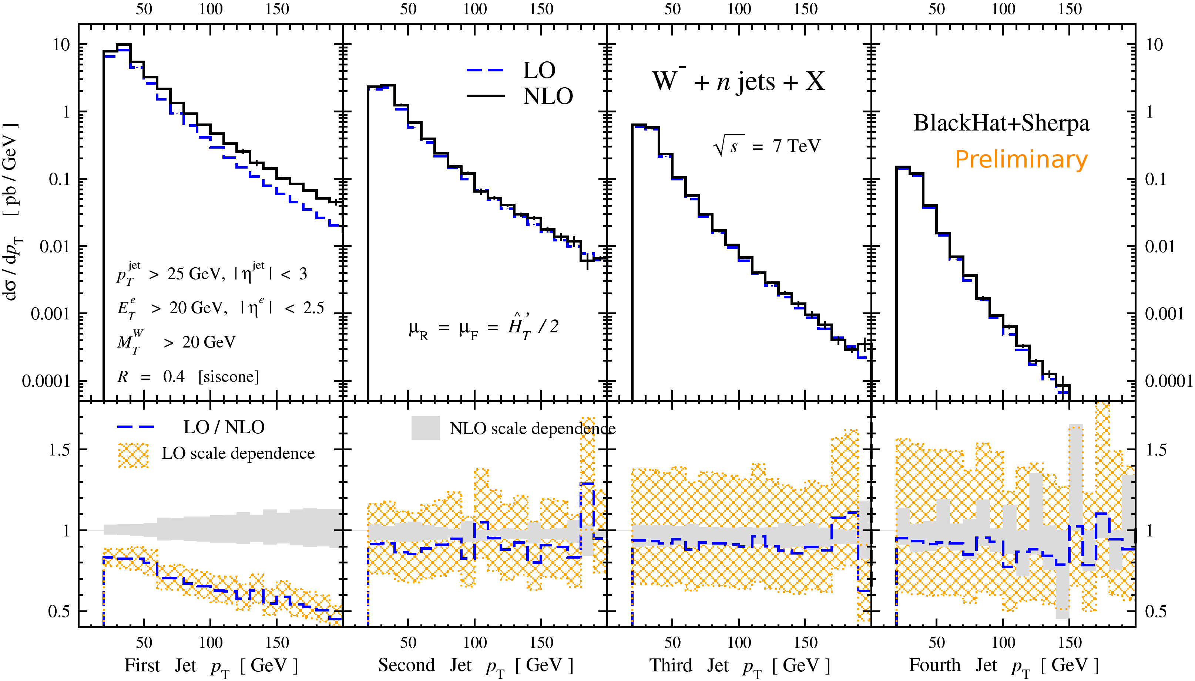
Multi-jet systematics: W+n jets.
W⁻+n jet+X softest jet p_{T} spectrum
[BlackHat, preliminary]
Reduction of cross-section by power of strong coupling for each added jet.
Jets prefer lowerst p_{T}.
Growth of LO scale variation and NLO reduction.
Complete input for MC@NLO approaches for W+4 jets

Slide 22
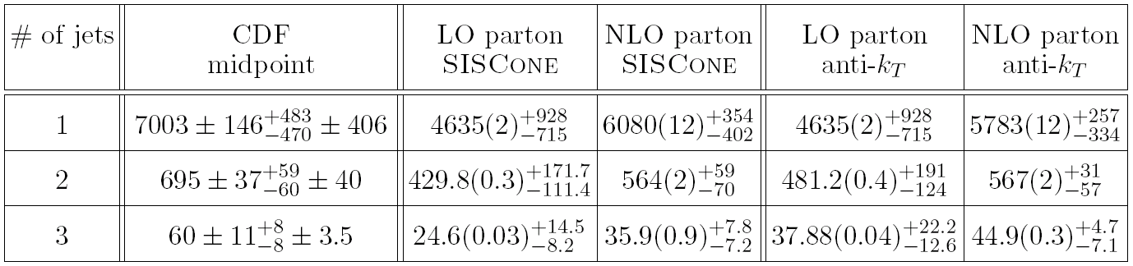
Multi-jet systematics: jet-algorithms Z+n jets.
CDF: Phys. Rev. Lett. 100, 102001 (2008)
[BlackHat: 0912.4927, 1004.1659]
See also talk by J. Huston
σ in [fb]
Non-pert correction
~1.1
~1.2
~1.4
σ (stat) ± scale var
Need non-perturbative corrections to compare to CDF data.
Is there a best value for R?
study | Jet alg R | Non-pert corr
CDF: W+n jets | R=0.4 | <10%
CDF: Z+n jets | R=0.7 | 10-40%
hadron-level
σ ± stat ± sys ± lum

Slide 23
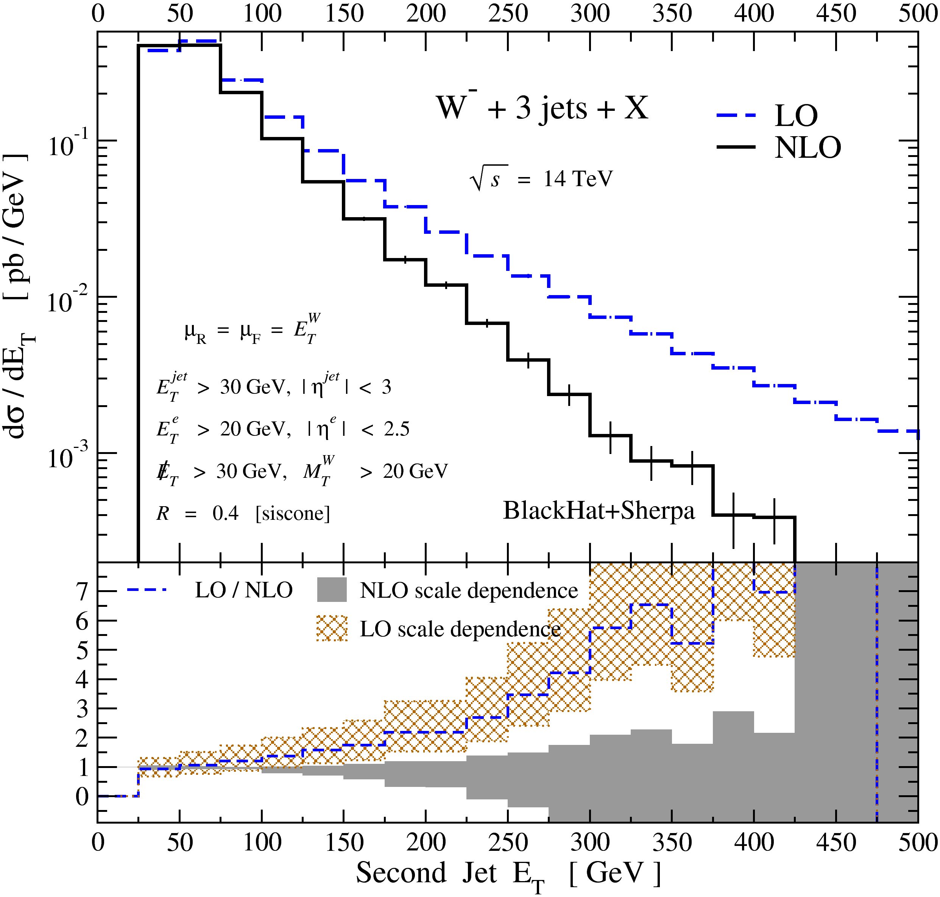
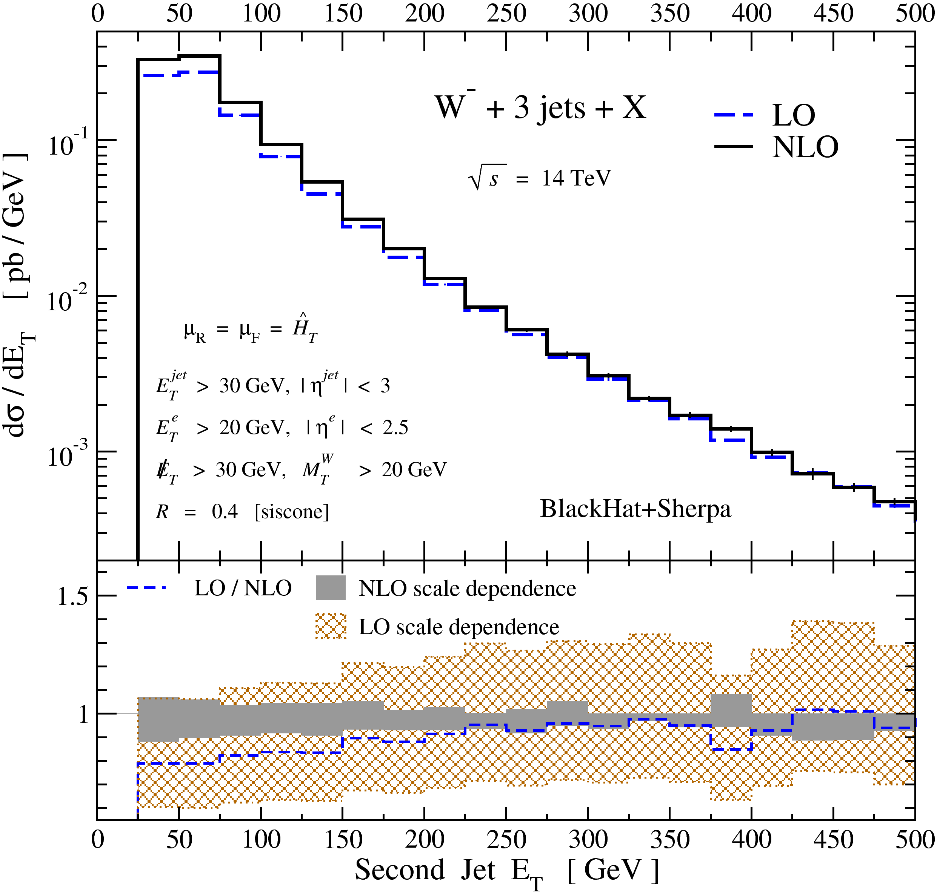
Scale Choices
Need to choose scales event-by-event
Functional form of scale choice is also important
E_{T}^{W} is not suitable; Ĥ_{T} is
Bauer, Lange 09’;
BlackHat 09’
Notes:
Need to choose scales event-by-event
Functional form of scale choice is also important
ETW is not suitable; HT is
NLO calculation is self-daignosing, LO isn’t
In the absence of an NLO calculation, should use a scale like HTScale

Slide 24
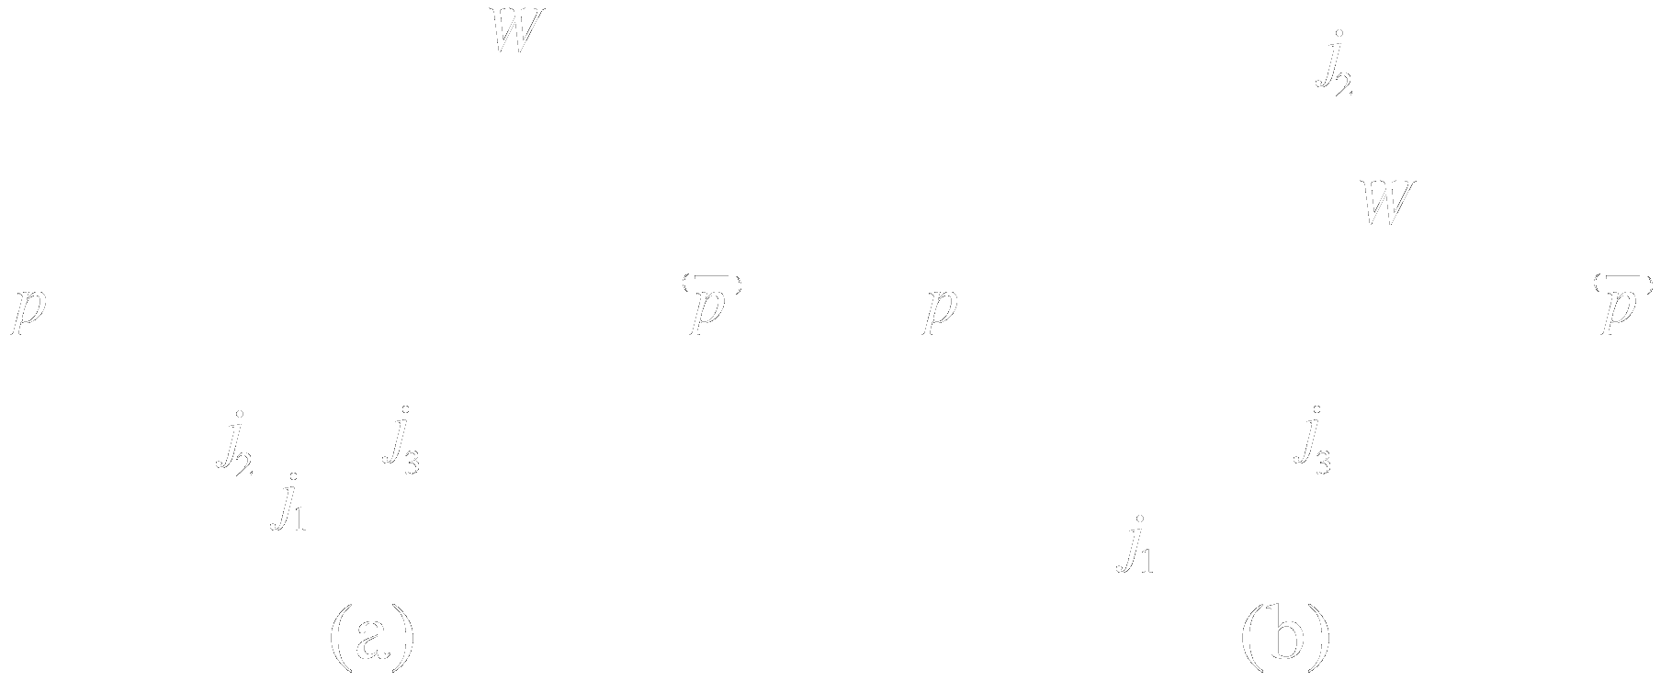
Scale Choices
E_{T}^{W} is not suitable; Ĥ_{T} is
NLO calculation is self-diagnosing, LO isn’t
In the absence of an NLO calculation, should use a scale like Ĥ_{T}
Notes:
Need to choose scales event-by-event
Functional form of scale choice is also important
ETW is not suitable; HT is
NLO calculation is self-daignosing, LO isn’t
In the absence of an NLO calculation, should use a scale like HTScale

Slide 25
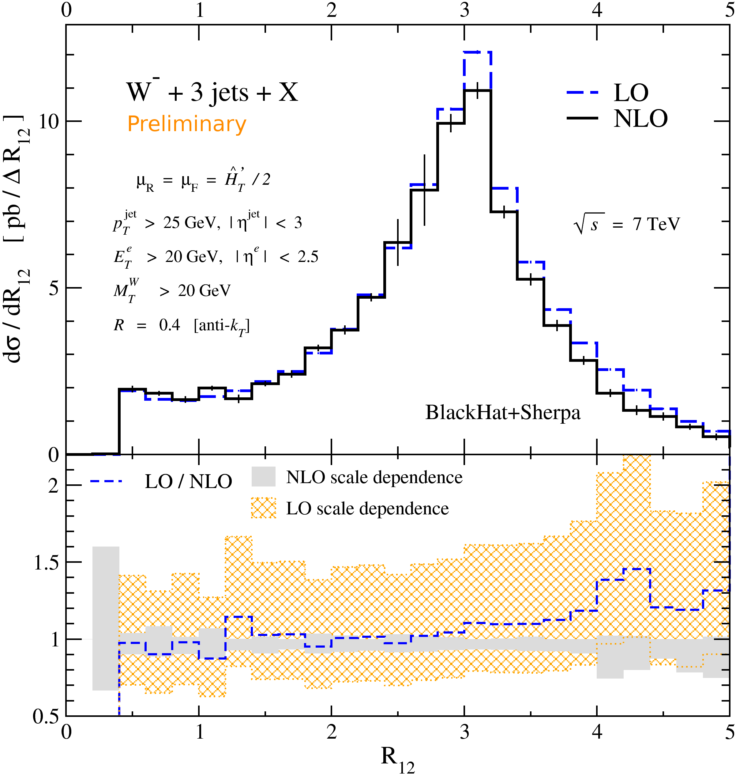
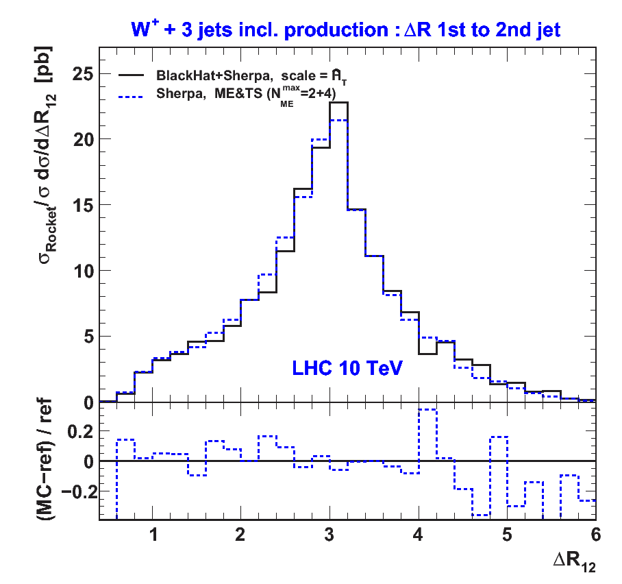
Shape change: W+3jets.
ΔR(1st,2nd) jet
Physics of leading jets not modeled
well at LO: additional radiation allows jets
to move closer
⇒ Shapes can change!
compare: Les Houches study [Hoche, Huston, Maitre, Winter, Zanderighi , 10’] comparing to SHERPA with ME matching & showering

Slide 26
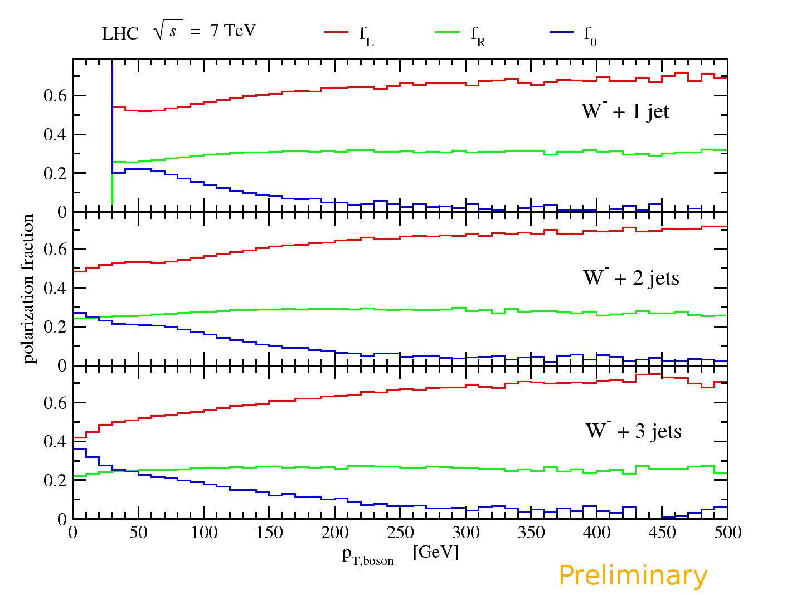
High-E_{T} W Polarization
Polarization of low-p_{T},
longitudinal, Ws is textbook material
[Ellis, Stirling & Webber] ⇒ dilution
in charged-lepton rapidity
distribution asymmetry at Tevatron
This is a different effect! Ws are also polarized at high p_{T}
Universal:
  Present at LO
  Present for fewer jets too
[BlackHat 09’,10’]
new
W^{+/-}
known
W⁺
p
p/p̄

Slide 27
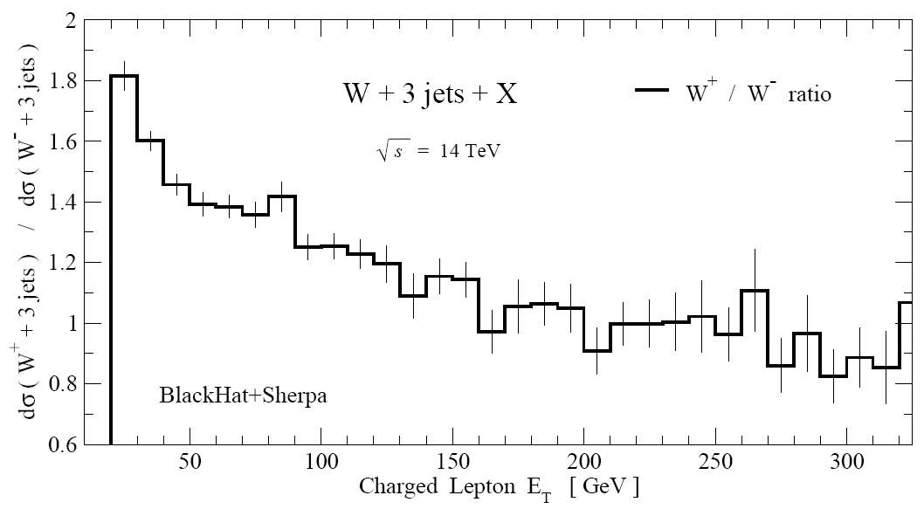
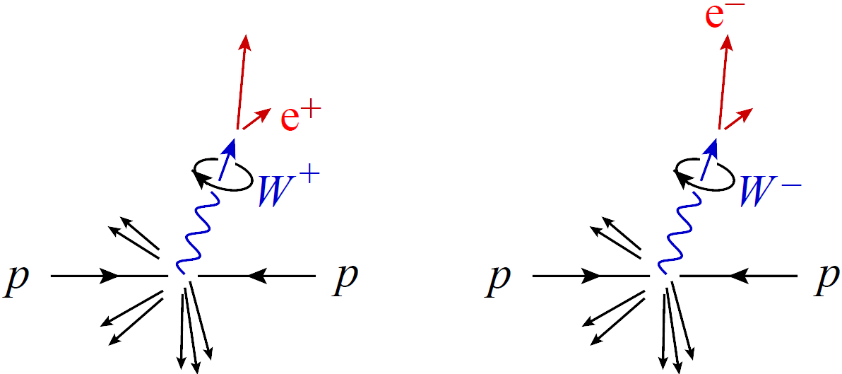
High-E_{T} W Polarization: analyzed by leptons
Ratio: E_{T} of e⁺ over E_{T} of e⁻ [BlackHat 09’]
W Polarization analyzed by
leptons:
⇒ E_{T} dependence of e⁺/e⁻ ratio
and missing E_{T} in W⁺/W⁻ at LHC.
Useful for distinguishing “prompt”
Ws from daughter Ws in top decay (or
new heavy-particle decays)!
ν_{L}
_{R}

Slide 28
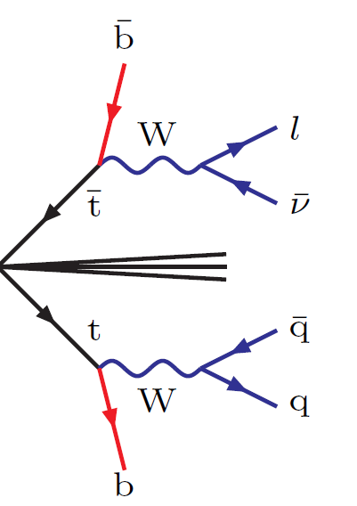
High-E_{T} W Polarization
Semi-leptonic ttˉ-decay
Semi-leptonic top decay involves left-handed W⁺
But charge conjugate top decay involves right-handed W⁻
⇒ Electron and positron have almost identical p_{T} distributions.
W_{L}⁺
p
p
+ charge conjugate
decay
Nice handle on separating W + jets from semi-leptonic top pairs.

Slide 29
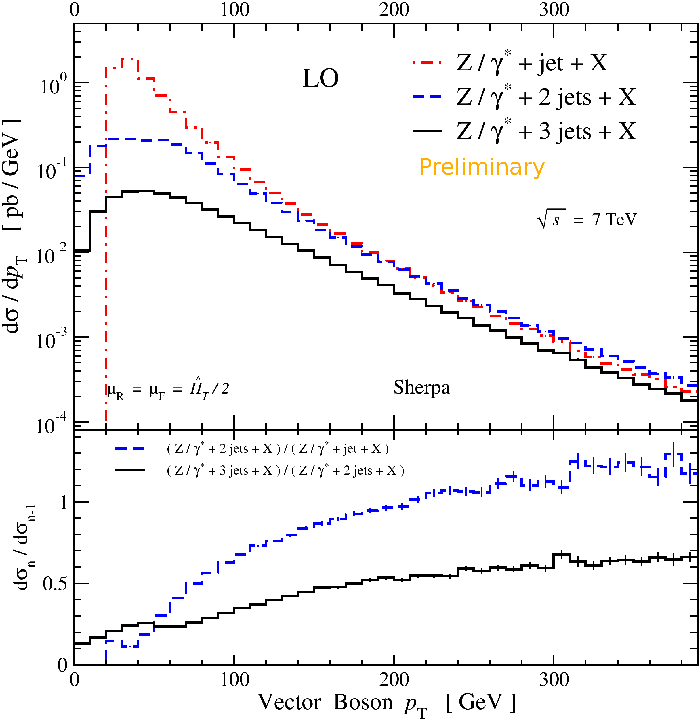
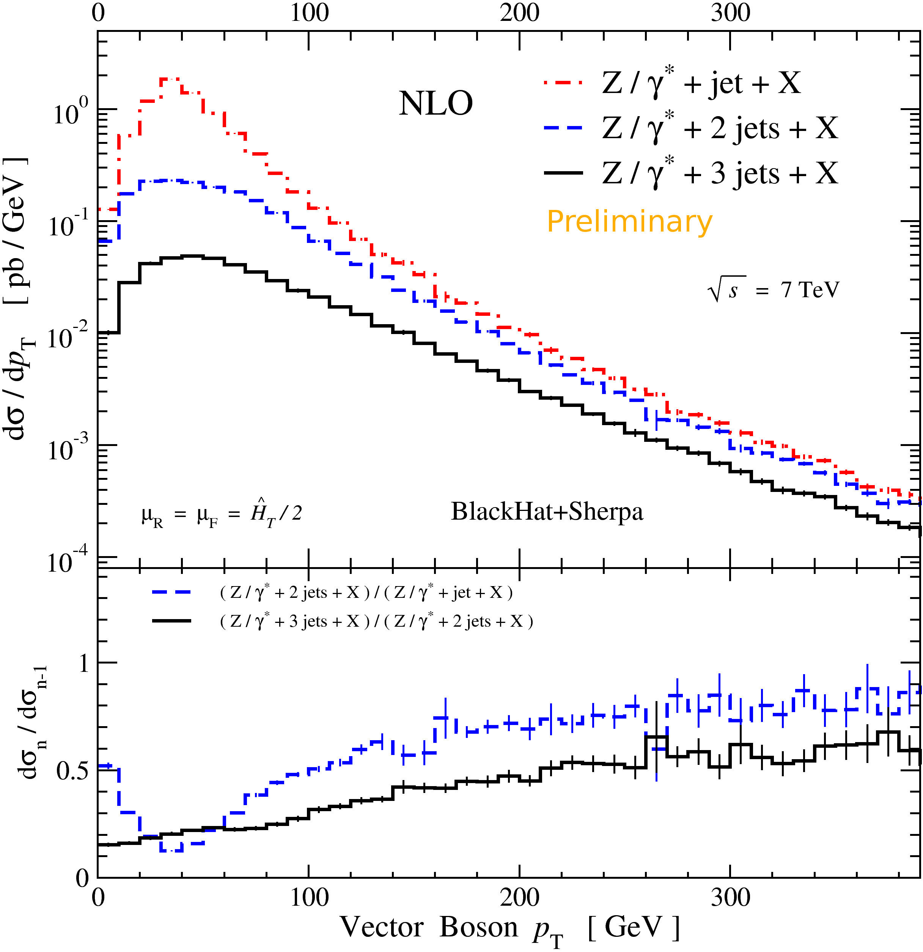
Jet-Production Ratios: Z+jets.
Ratios of jet cross sections
should be less sensitive jet
energy scale and non-pert corrections
Ratios are stable LO→NLO
But hide a lot of structure in
differential distributions:
  Kinematic constraints at low p_{T} in 2/1
  Factorization & IR ln(p_{T} / p_{T min})s at intermediate p_{T}
  Phase-space & pdf suppression at higher p_{T}.

Slide 30
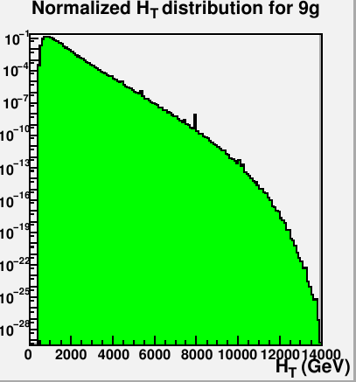
Interesting developments
J. Winter and W. Giele 09’;
Here LO; total NLO in progress
Multi-jet computation time-consuming:
need to integrate over multi particle phase space
amplitudes themselves take longer to evaluate
Or get efficiency gain from graphics cards?
[Hagiwara et al '09, Giele, Stavenga & Winter '09-10]
Generation of ROOT tuples: [Huston,…; BlackHat in progress]
Re-analysis possible
Distribute distributions
Flexibility for studying scale variations
Flexibility for computing error estimates
associated with PDFs

Slide 31
Conclusions
NLO calculations required for reliable QCD predictions at the Tevatron and
LHC
New efficient computational approaches to one-loop QCD amplitudes,
exploiting unitarity & factorization properties, are now method of choice for
important LHC backgrounds.
Many new processes: W/Z + 1,2,3,4 jets, tt + 1,2 jets, VV+1,2 jets,… now known at
NLO!
Most complex NLO results are still at parton level and not embedded in a full
Monte Carlo. Best use of these results may sometimes be via ratios – as aids
to data-driven analysis of backgrounds. Interesting recent progress from NLO
parton-shower approaches.
Discussed some new understanding from multi-jet NLO for V+n jets: scale
choices, jet-algorithms,…
Left-handed W polarization large and universal and allows to, leading to
further charge-asymmetric effects in W + n jets.
Thanks.

