Slide 1
News from CERN
Manfred Krammer
Head of the Experimental Physics Department

Slide 2
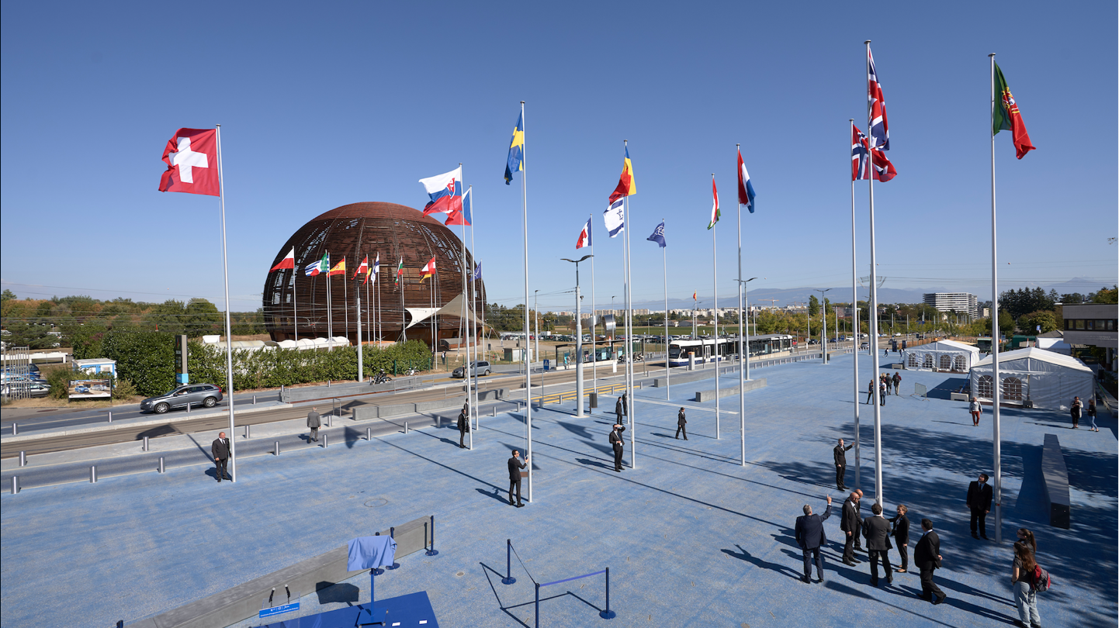
CERN was founded 1954: 12 European States
“Science for Peace”
Today: 23 Member States
9 Associate Member States
NEW Estonia (since Feb. 1st) Associate Member in the prestage to Membership
Member States: Austria, Belgium, Bulgaria, the Czech Republic, Denmark, Finland, France, Germany, Greece, Hungary, Israel, Italy, the Netherlands, Norway, Poland, Portugal, Romania, Serbia, Slovakia, Spain, Sweden, Switzerland and the United Kingdom
Associate Member: Croatia, Cyprus, Estonia, India, Lithuania, Pakistan, Slovenia, Turkey, Ukraine
Observers to Council: Japan, Russia, United States of America; JINR, European Commission and UNESCO
~ 2600 staff
~ 1800 other paid personnel
~ 12500 scientific users

Slide 3
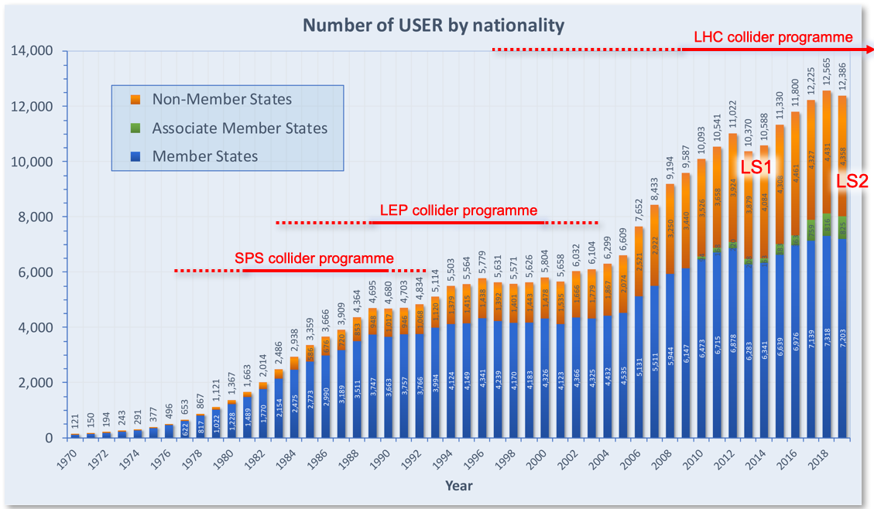
CERN attracts scientists from all over the world

Slide 4
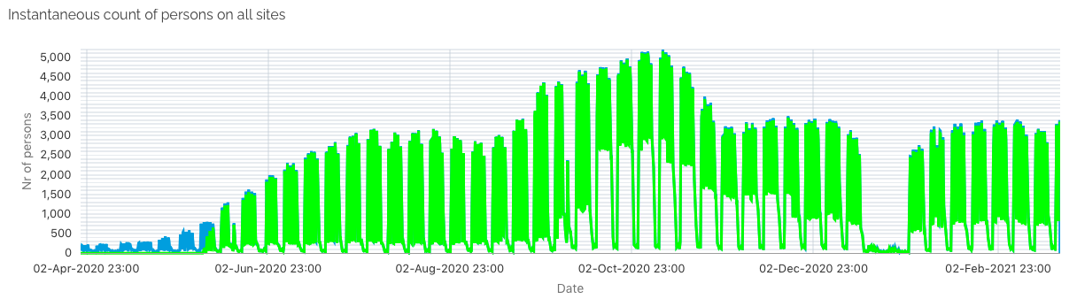
CERN and Covid-19
Mid March 2020: CERN put in safe mode. Within a few days personnel at CERN reduced from ~6500 people to few hundreds
End of April 2020: resume selected activities with small teams, priority given to time critical activities (e.g. warm up of CMS magnet, NSW construction ATLAS)
Mid May 2020: controlled ramp up, bring back people activity based, increase people on-site by 1000 every two weeks
September 2020: lift access restrictions
Mid October 2020 since today: mandatory telework for all who can, on site presence for others

Slide 5
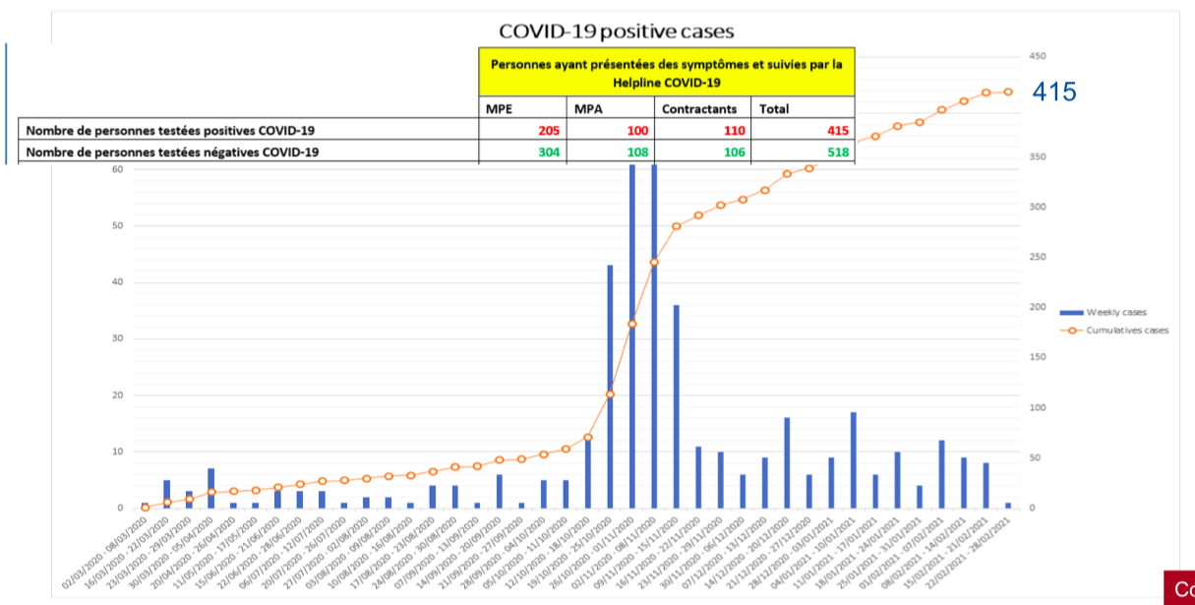

CERN Covid-19 Health and Safety Measures
Strict rules introduced with the first colleagues resuming work at CERN:
Distance of >2 m
Mask in all buildings, except when alone in an office
Disinfection gels distributed and hand dispensers everywhere
Additional measures for special activities and vulnerable people
Access restriction for colleagues aged 65 and above
Contact tracing of all cases and close contacts
No spread of infection on-site
CERN remained a very safe place!

Slide 6
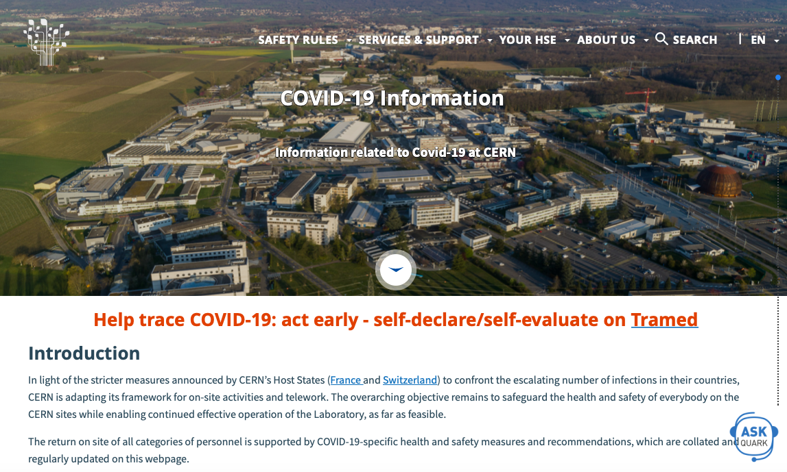
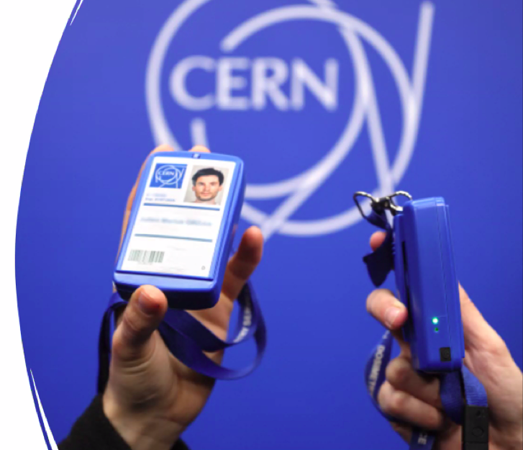
CERN Covid-19 Health and Safety Measures
Now Covid-19 testing on-site (Antigen and RT-PCR tests):
- personnel on duty travel (staff and users)
- vulnerable people
- stratified testing, e.g. shift personnel
Proximeter:
Device records close contacts, <2 m for >30 sec, Vibration alarm, data stored for 2 weeks, already >3500 devices distributed,
mandatory as of March 1st
Telework mandatory until end of March
- Hostel open for Users (if required on-site)
- Mandatory on-line course (Covid Health and Safety)
Regular updated information at:
https://hse.cern/covid-19-information

Slide 7
Status of LS2 works and baseline schedule for accelerator operation and experiments

Slide 8
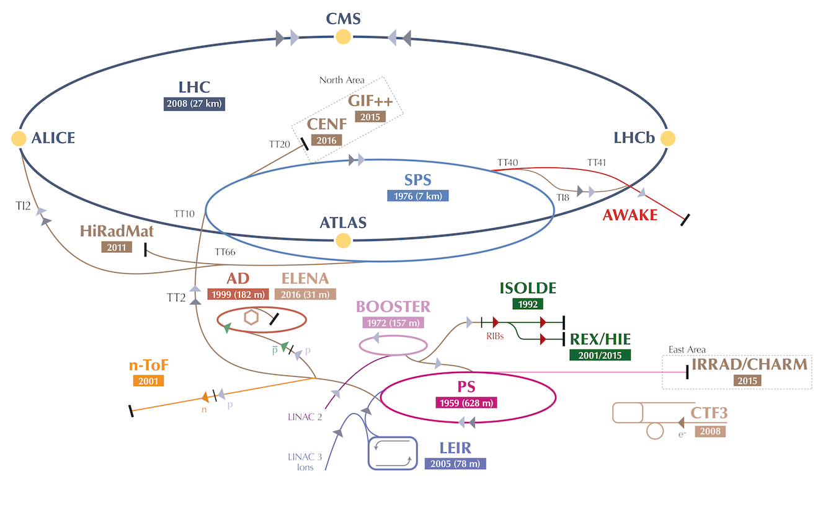
CERN Accelerators

Slide 9
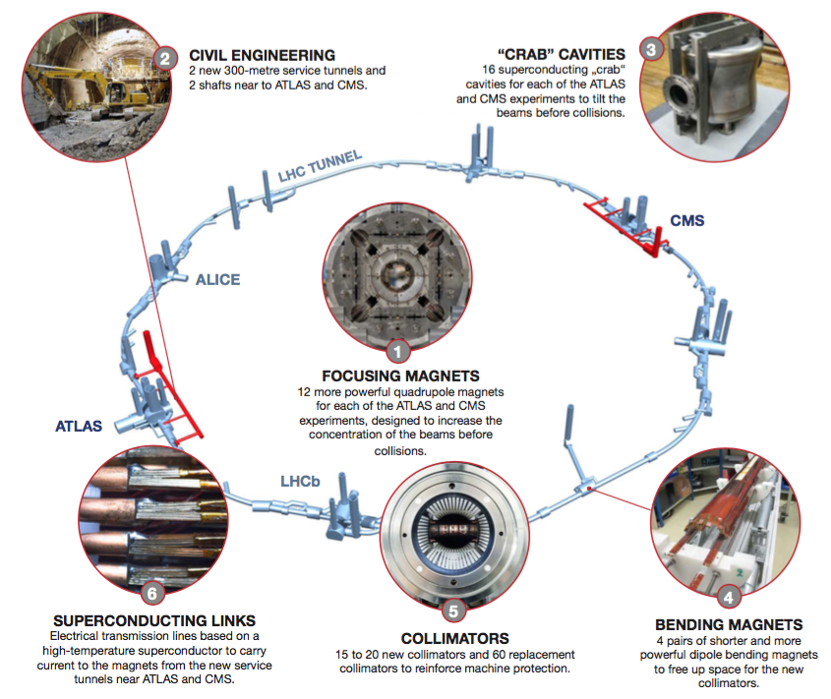
Finishing LS2 – Accelerator Complex
LHC Run 2 ended end of 2018, LS2 activities for the accelerators started in 2015, activities cover all injectors
LHC Injector Upgrade (LIU) project completed, all consolidations and maintenances on time
LINAC4: ready to inject beam into the booster, excellent source stability
Booster-PSB: almost rebuilt during LS2, commissioning started Dec. 7
PS: Final hardware tests in February, first beam injection March
SPS: All six reconfigured RF cavities connected to new solid state amplifiers, new beam dump system installed, fire doors and new sprinkler system, beam commissioning will start in April
LHC: Diode box consolidation completed (1232 dipoles)
  19 dipoles exchanged
HL-LHC activities followed the expected milestones
  Civil engineering (2 shafts, 2 x 300 m service tunnel)
  Issue with 11T short dipoles under investigation
ISOLDE: New front end installed, beam instrumentation
consolidation, repair of cryomodule CM4 for HIE-ISOLDE
AD/ELENA: All AD users connected to ELENA,
transfer lines commissioning ongoing

Slide 10
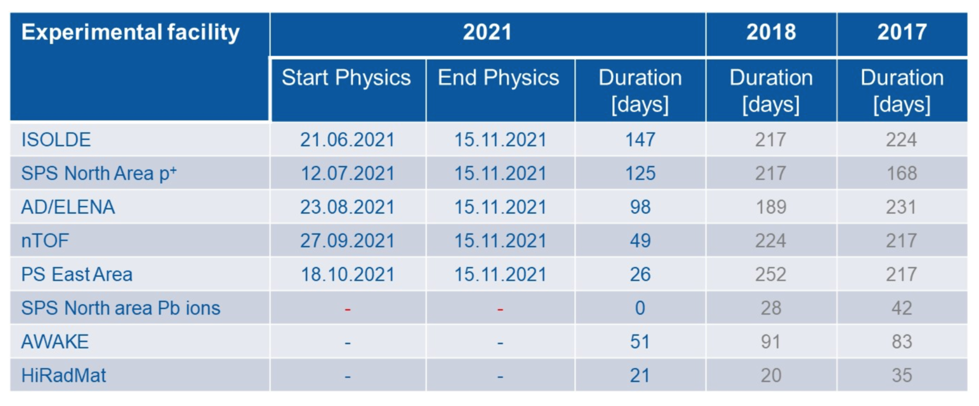



2021 Schedule for Injectors and non-LHC Experiments

Slide 11
Finishing LS2 – LHC Experiments
Major upgrades of ALICE and LHCb during LS2 (Phase 1 upgrades)
ALICE
New TPC readout, new Silicon Tracker, new readout for almost all detectors, continous readout, new datacenter
3 month contingency wrt. cavern closure
LHCb
Almost completely new detector (except calorimeter, muon detector), new electronics for all detectors, new data center
Schedule critical, necessary personnel cannot come to CERN due to Covid crisis
CMS
Maintenance of all detectors and magnet, new Barrel Pixel layer 1, new GE1/1 GEM chambers, hadron calorimeter upgrade with SiPMs, additional shielding as preparation for HL-LHC
ATLAS
New Small Wheel: NSW-A completion April/May 2021, NSW-C completion mid-September, very little contingency
Major upgrades of ATLAS and CMS for HL-LHC in LS3 (Phase 2 upgrades)

Slide 12
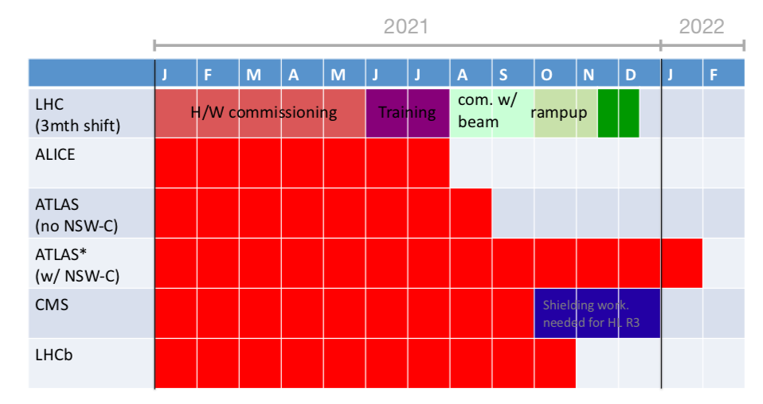
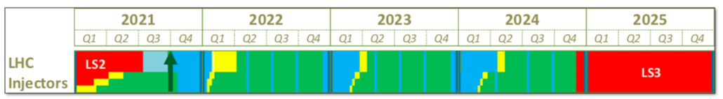

LHC Schedule for Run 3
Discussion June 8/ October 23, machines and experiments, assess delays due to Covid crisis
Baseline schedule:
Next meeting to assess the situation March 15, 2021

Slide 13
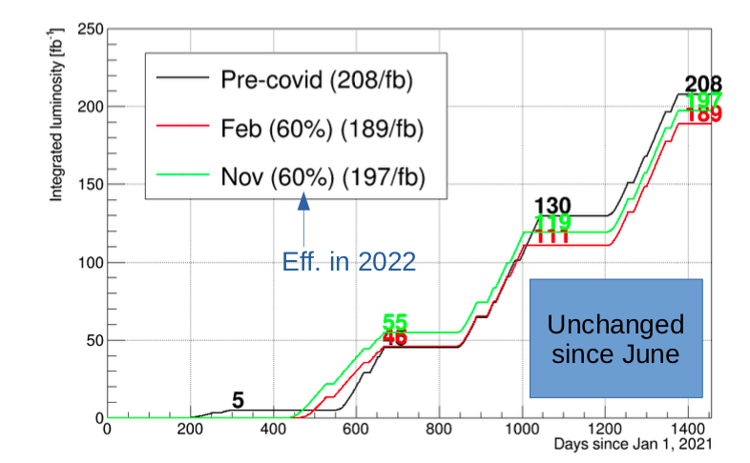
LHC New Baseline Schedule Run 3
ATLAS installs both sides of NSW
CMS installs new shielding on both sides
ALICE and LHCb complete their phase 1 upgrades
Close experimental caverns February 1st, 2022
Beam test in weeks 39-40 (Sept. 27 – Oct. 10)
11T magnets will not be installed
Injectors will have YETS starting in week 46 No ion beams for fixed target in 2021
Assumption for integrated luminosity:
Depends crucially on assumption of efficiency in 2022
Beam energy for run 3: Decide energy after magnet training. If collision energy exceeding 13.5 TeV will be achievable with high availability than that energy will be chosen, otherwise Run 3 will be operated at 13 TeV.
Magnet training with prudence. Avoid too many quenches.

Slide 14
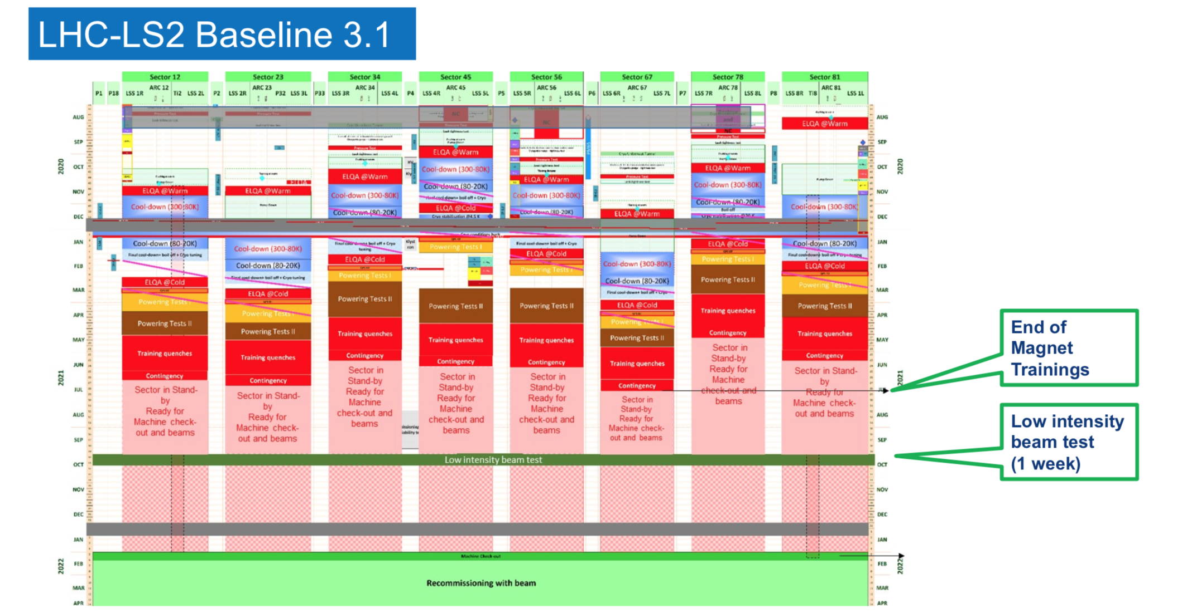

Slide 15
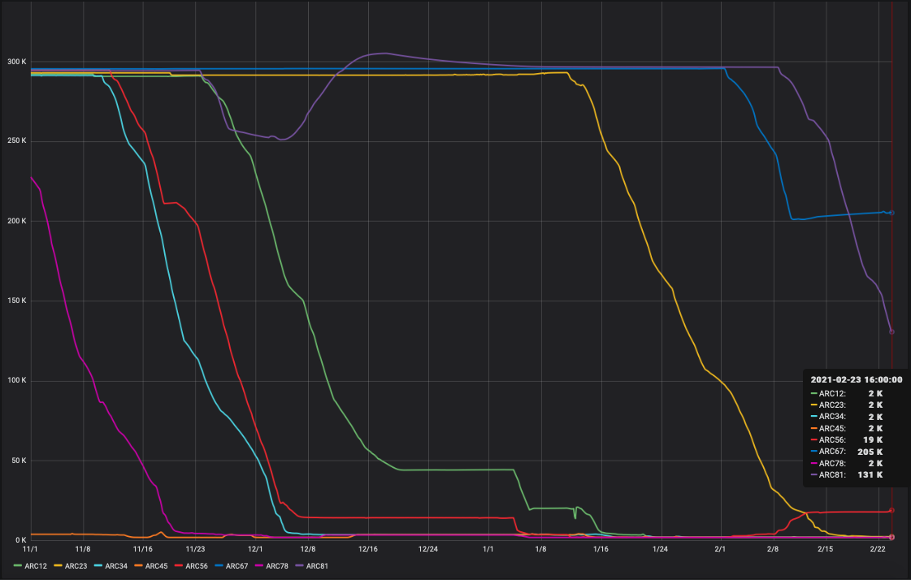
LHC cool down status – all sectors

Slide 16
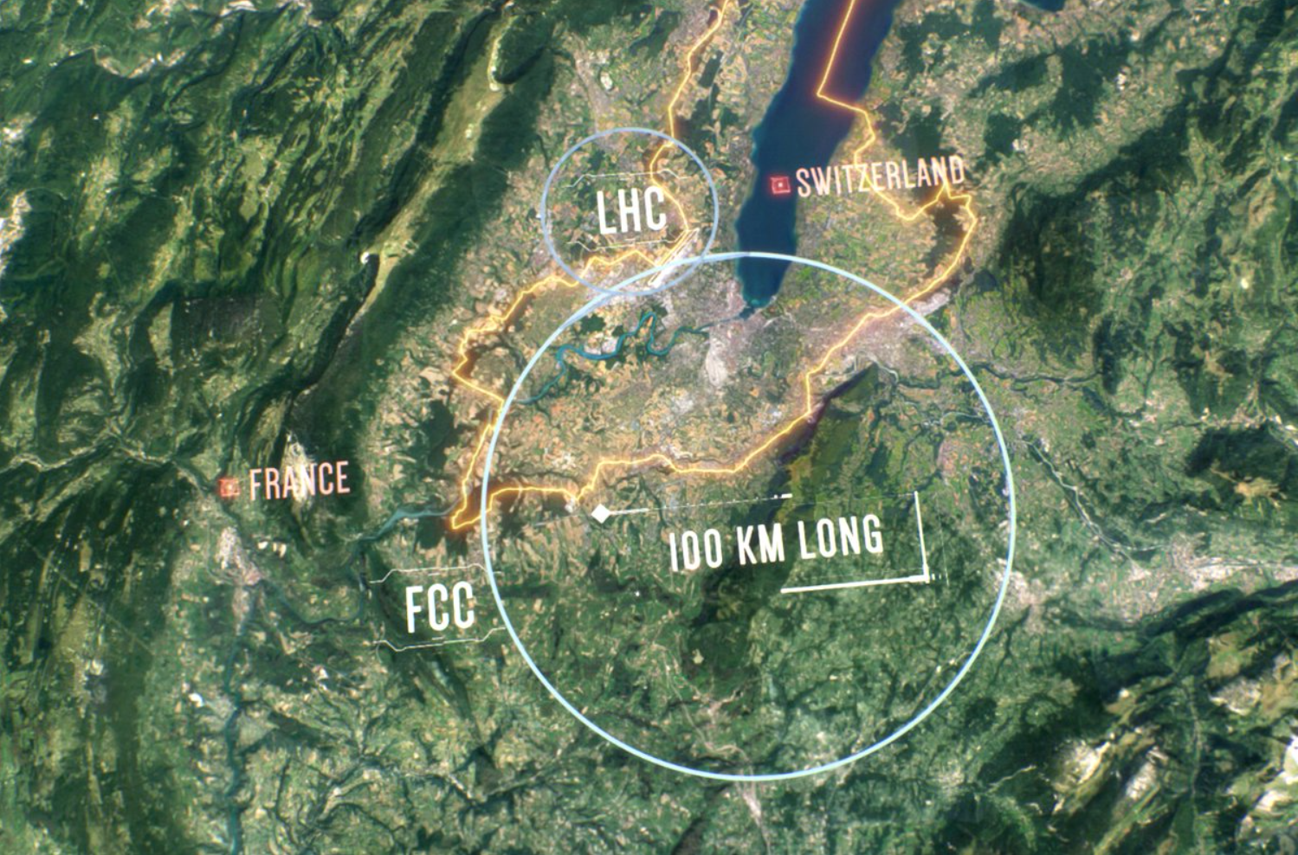
Implementation of the Update of the European Strategy
European Strategy for Particle Physics (ESPPU) updated at the CERN Council June 2020
2 year process, involvement of PP community worldwide, 20 recommendations
First implementation in the Medium Term Plan (MTP) of CERN
Rolling budget plan for next 5 years (2021-2025)
Main points in respect to the ESPPU:
Feasibility study for a Future Circular Collider (FCC)
  100 km tunnel, technical and financial study
Reinforced magnet R&D programme
  Low- and high temperature superconducting materials
Continue R&D on key technologies for the Compact Linear Collider (CLIC)
and establishment of an international design study for a muon collider
Accelerator studies
Detector R&D and new quantum technology initiative
Increased resources for the CERN hosted Physics Beyond Collider study (PBC)
Study to explore possibilities using the non-collider part of the CERN accelerator complex
Continue investment in long-baseline neutrino experiments in the US and Japan

Slide 17


Thank you for your attention !

