Slide 1

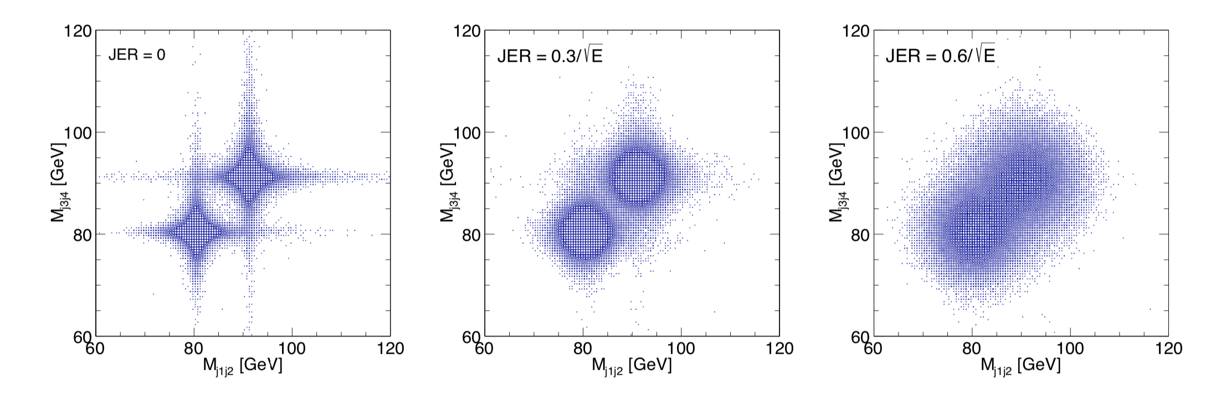
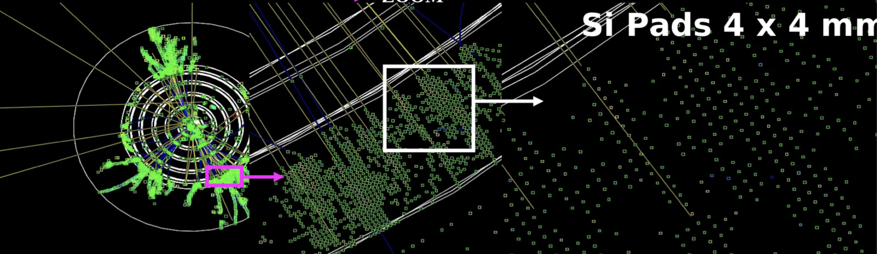
Calorimetry
Nigel Watson (University of Birmingham)
Fabrizio Salvatore (University of Sussex)

Slide 2

ECAL Design Principles
Measure 100% EM energy
  shower containment in ECAL, so X₀ large
Resolve energy deposited by individual particles
  small R_{moliere} and X₀ – compact and narrow showers
Separation of hadronic/EM showers
  λ_{int}/X₀ large, so EM showers early, hadronic showers late
Minimal material in front of calorimeters
Strong magnetic field
  lateral separation of neutral/charged particles
  Keep beam-related background inside beampipe
Active medium: Silicon (or scintillator)
    Pixel readout, minimal interlayer gaps, stability
ECAL, HCAL
inside coil (cost)

Slide 3

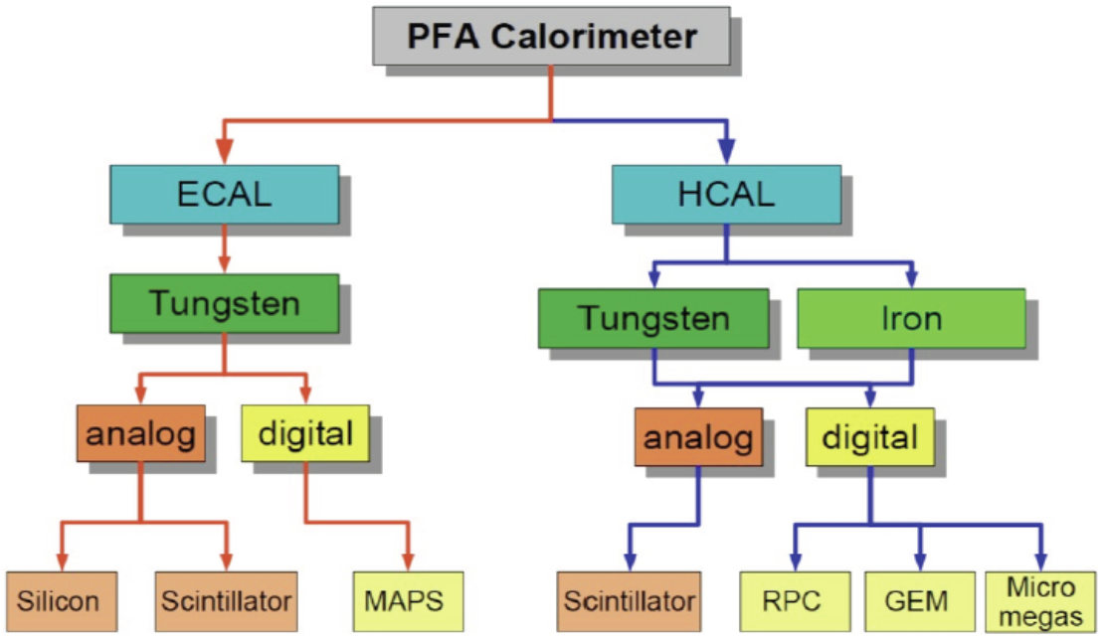
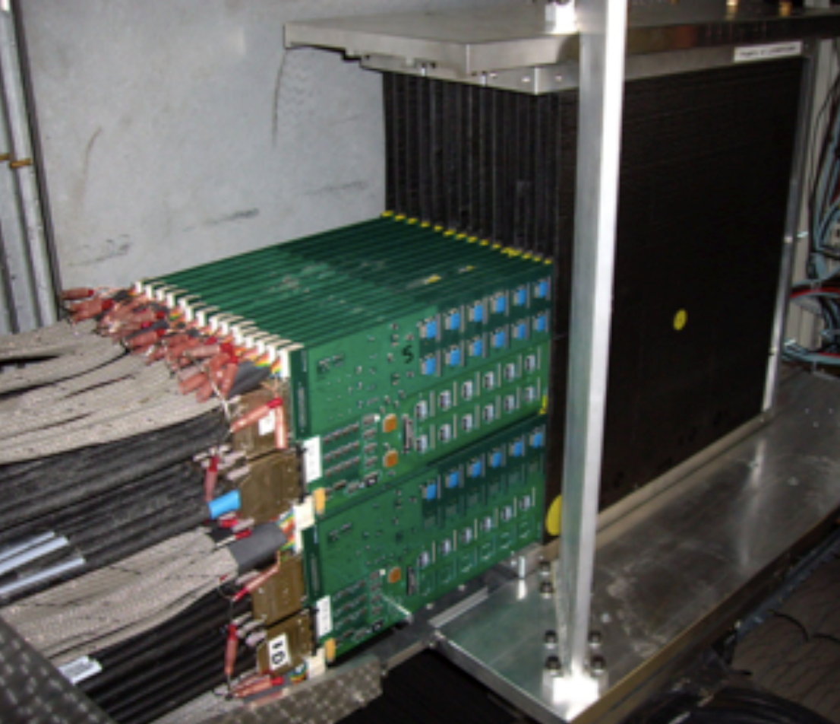
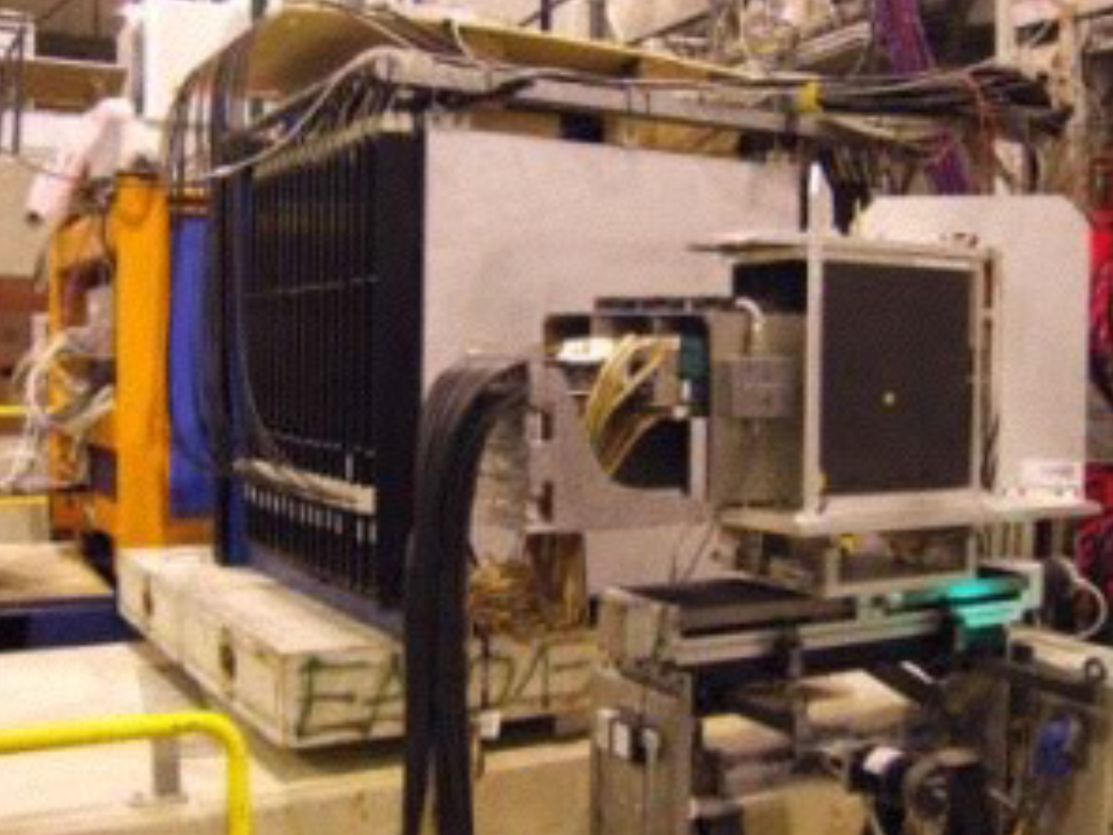
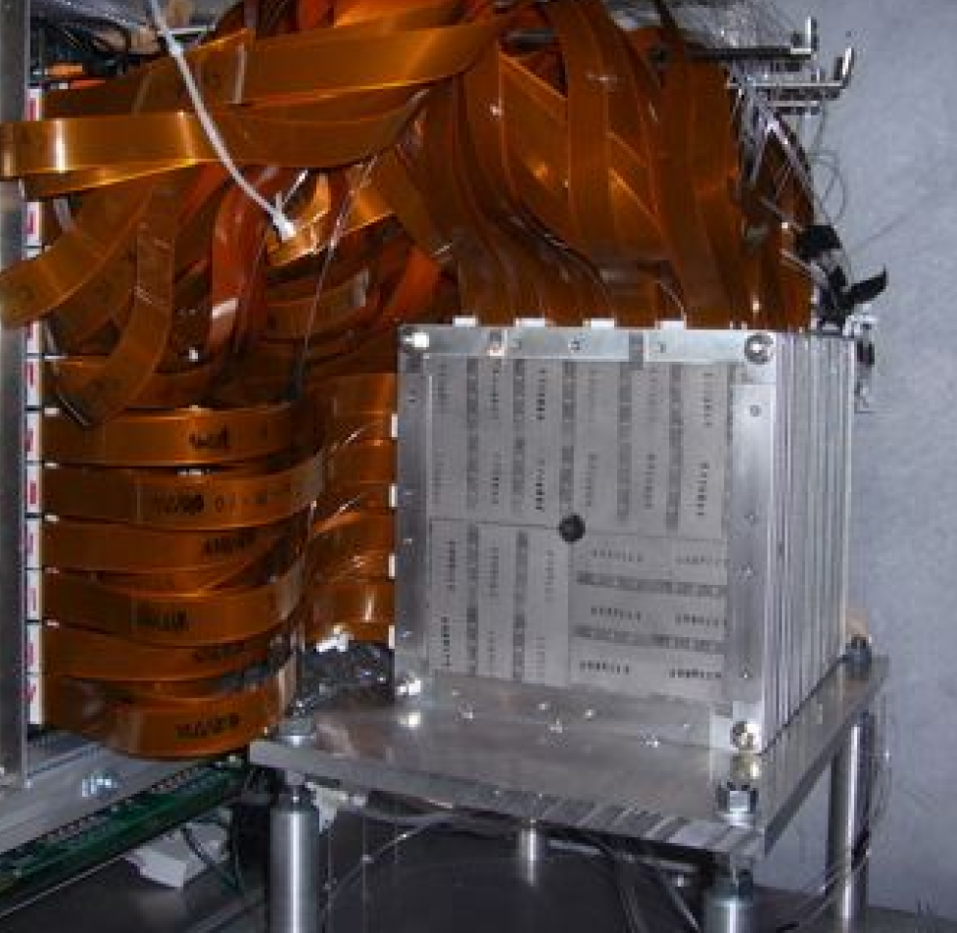
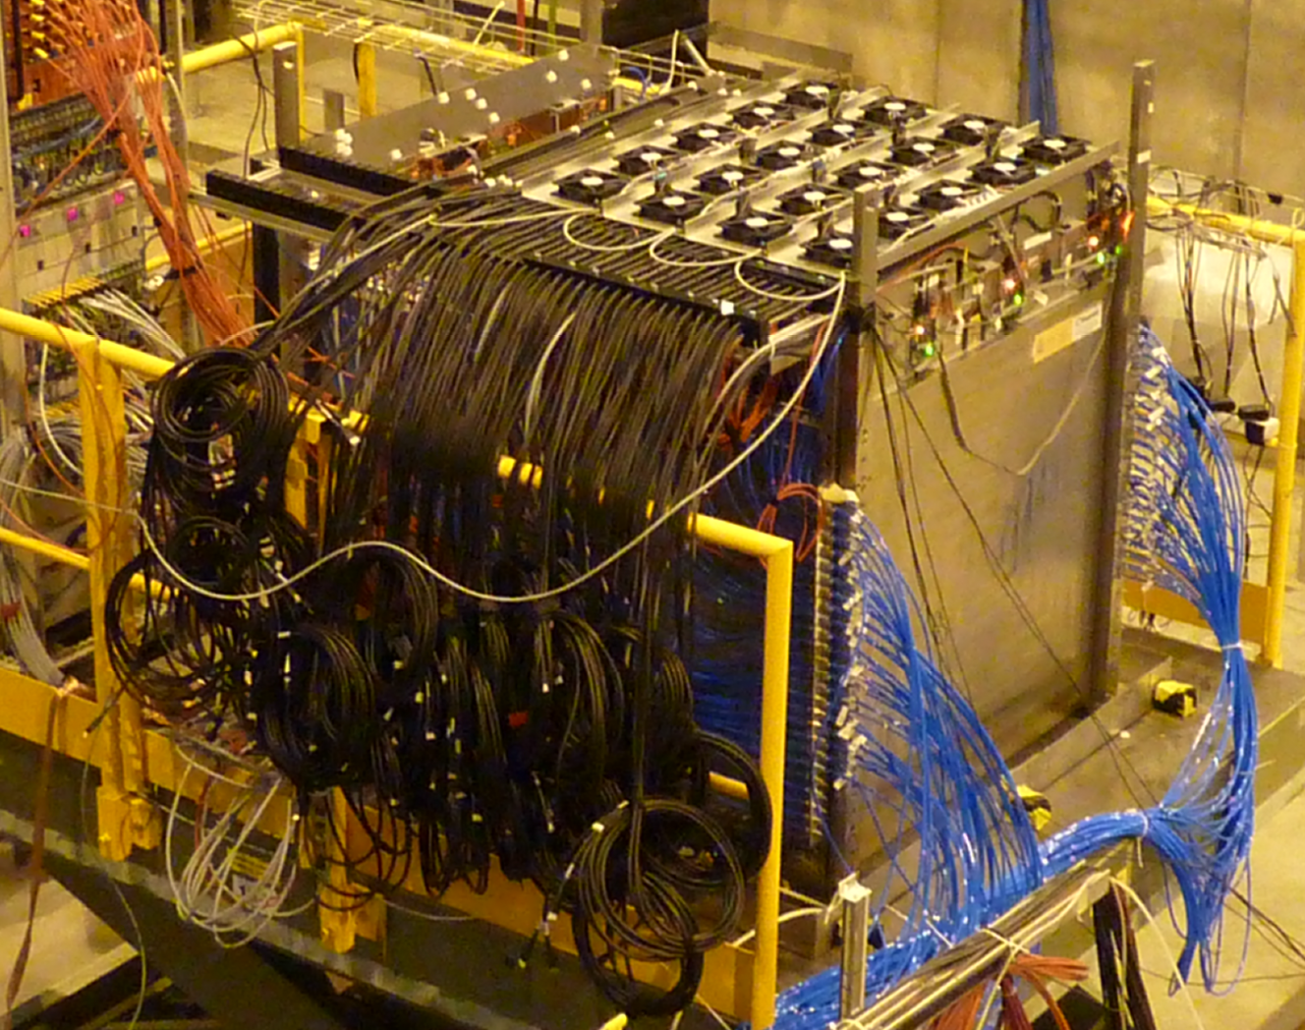
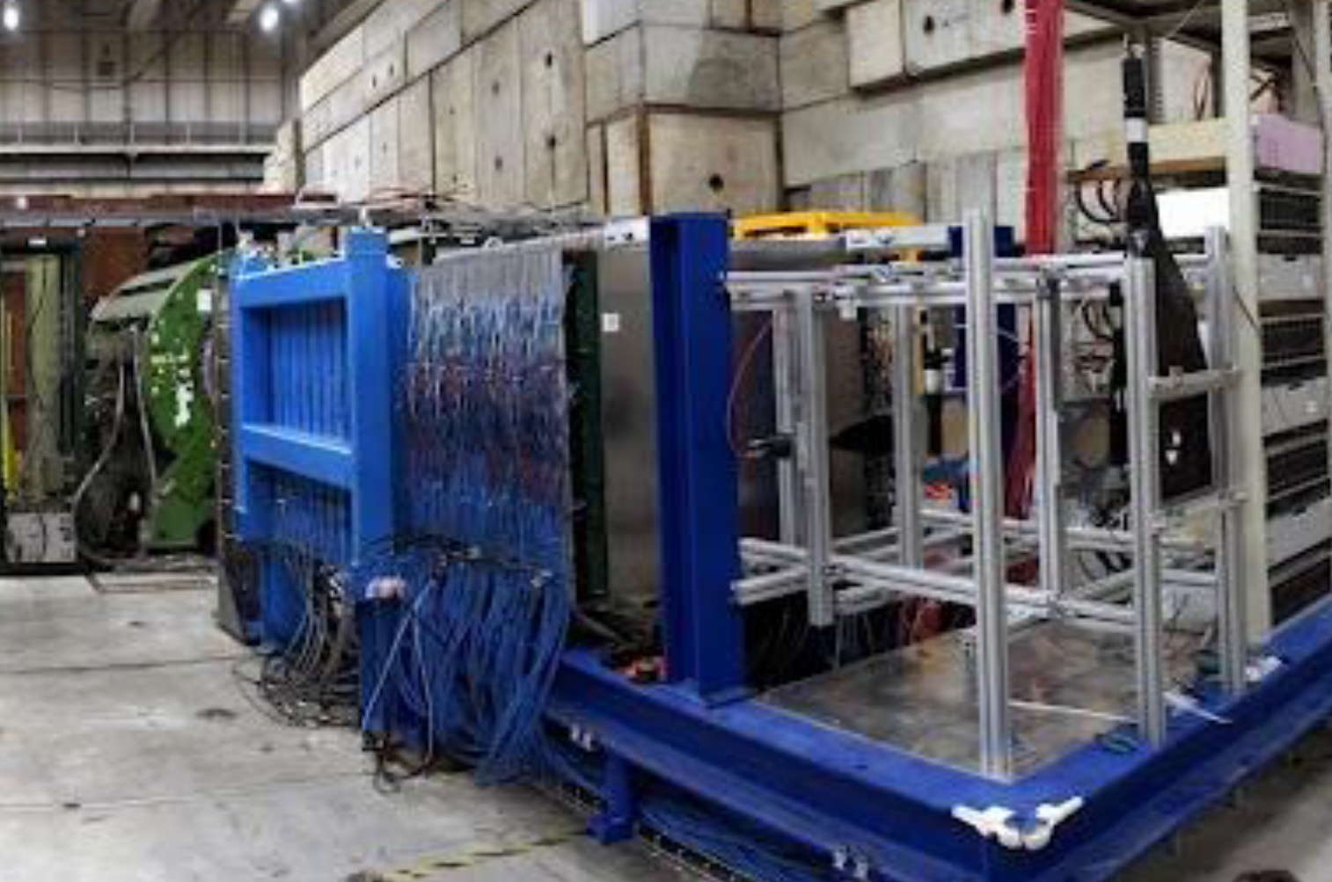
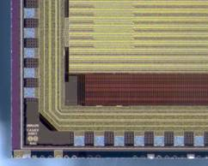
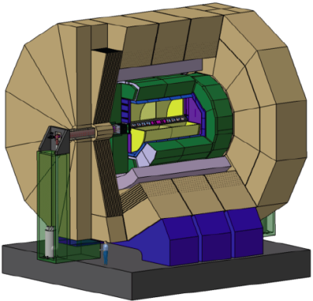
CALICE-like solution(s)
SiW ECAL
AHCAL
ScW ECAL
SDHCAL
DECAL
DHCAL

Slide 4
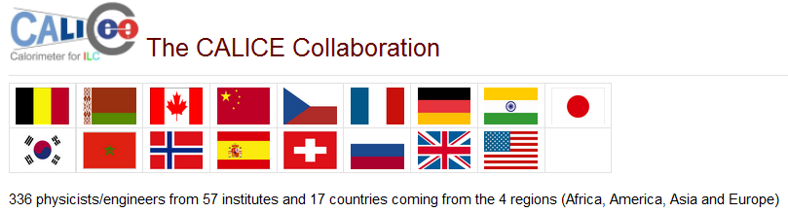
CALICE Collaboration
Collaborating since 2001
All papers available from https://twiki.cern.ch/twiki/bin/view/CALICE/
  (or google “calice cern” – top hit)
Cost-effective approach of testing both h/w and s/w
  in common framework
“Friendly competition” to ensure best technology chosen objectively
UK activity - primarily ECAL (DAQ and MAPS)

Slide 5
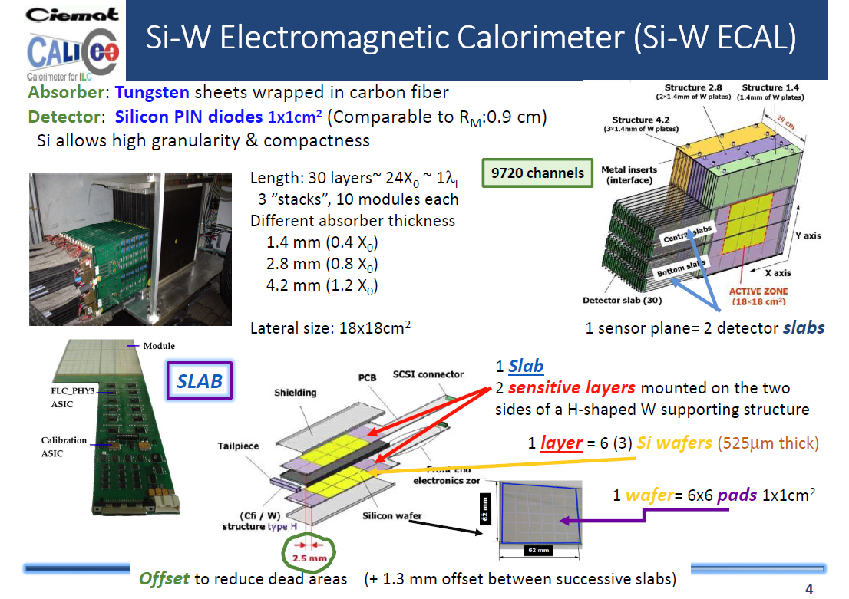
2005 - ECAL Physics prototype
Notes:
Examples of original physics prototype ECAL, from 2005, see https://inspirehep.net/literature/802597
Note time between first idea and prototype to being used in CMS HGCal

Slide 6
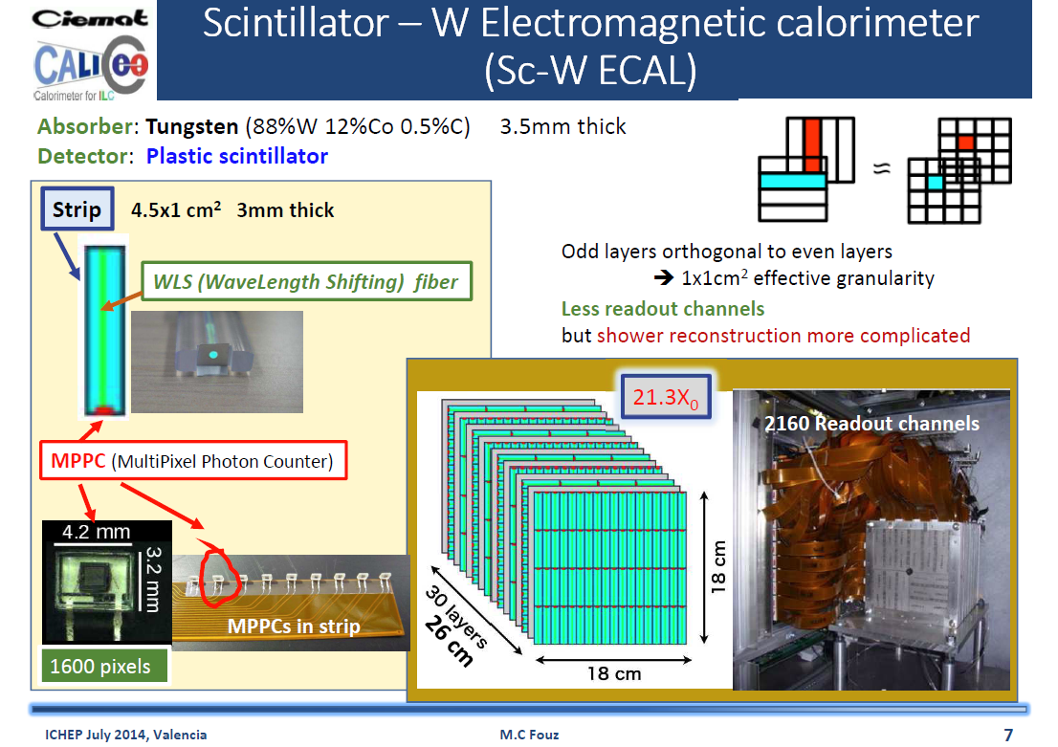
Notes:
Scintillator ECAL a lower-cos alternative investigated, primarily by Japanese colleagues

Slide 7
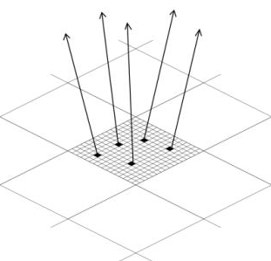
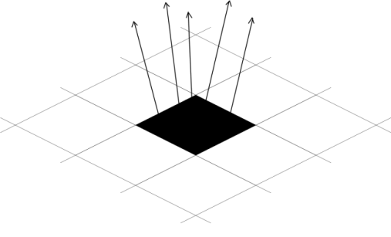
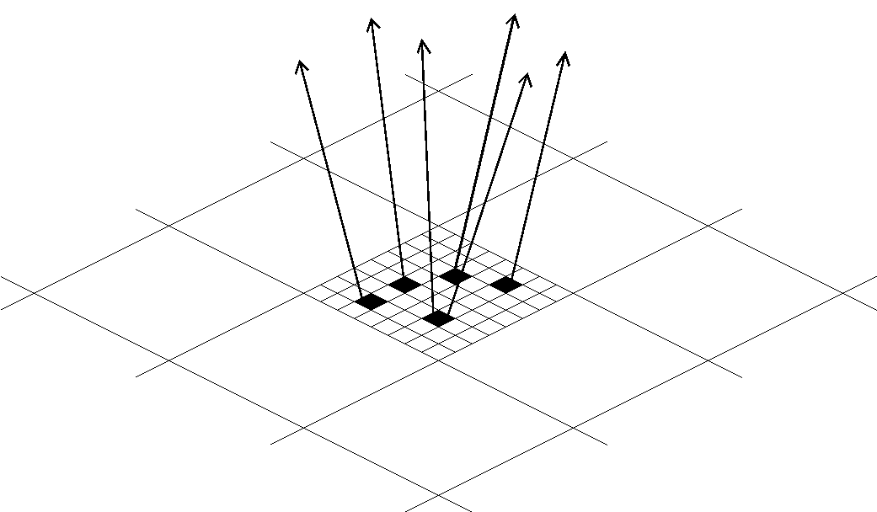
DECAL Concept – cost reduction for ECAL
Swap ~0.5x0.5 cm² Si pads with small pixels
  at most one particle/pixel,1-bit ADC/pixel - digital
How small to avoid saturation/non-linearity?
  EM shower core density at 500GeV ~100/mm²
  Pixels must be <100x100μm²
    Used baseline 50x50μm²
    Gives ~10¹² pixels for ECAL
Simpler construction (no bump bonding)
DECAL prototypes to date 180 nm process → 65nm
Performance gains? Tracking highly boosted decays, e.g. 𝜏
AECAL
DECAL N_{pixels}<N_{particles}
DECAL N_{pixels}=N_{particles}
Notes:
A UK initiated project from c. 2005, first fully sensitive deep p-well devices developed by RAL CMOS group

Slide 8
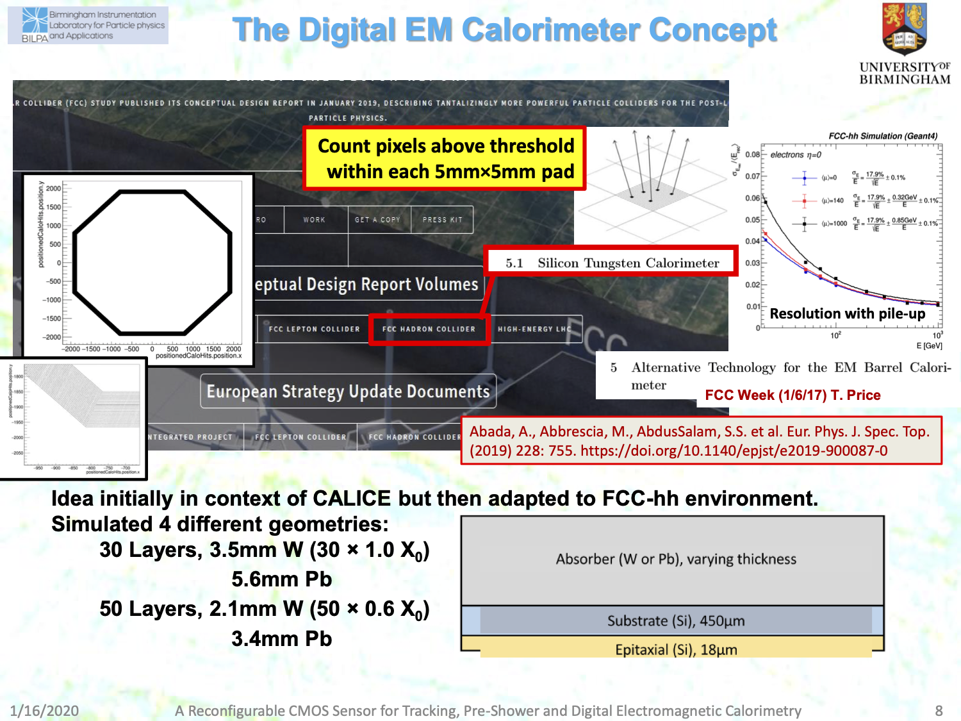
DECAL concept
in FCC-hh CDR
[c/o Phil Allport]
Notes:
Birmingham introduced SiW calorimeter concept to FCC-hh (analogue and DECAL versions)
a lot of detailed studies had been carried out for the CDR including with different pileup scenarious
the DECAL/SiW had the most detailed implementation in the FCC software framework (full description of the geometry, as shown by hitmaps – see picture on the left)

Slide 9
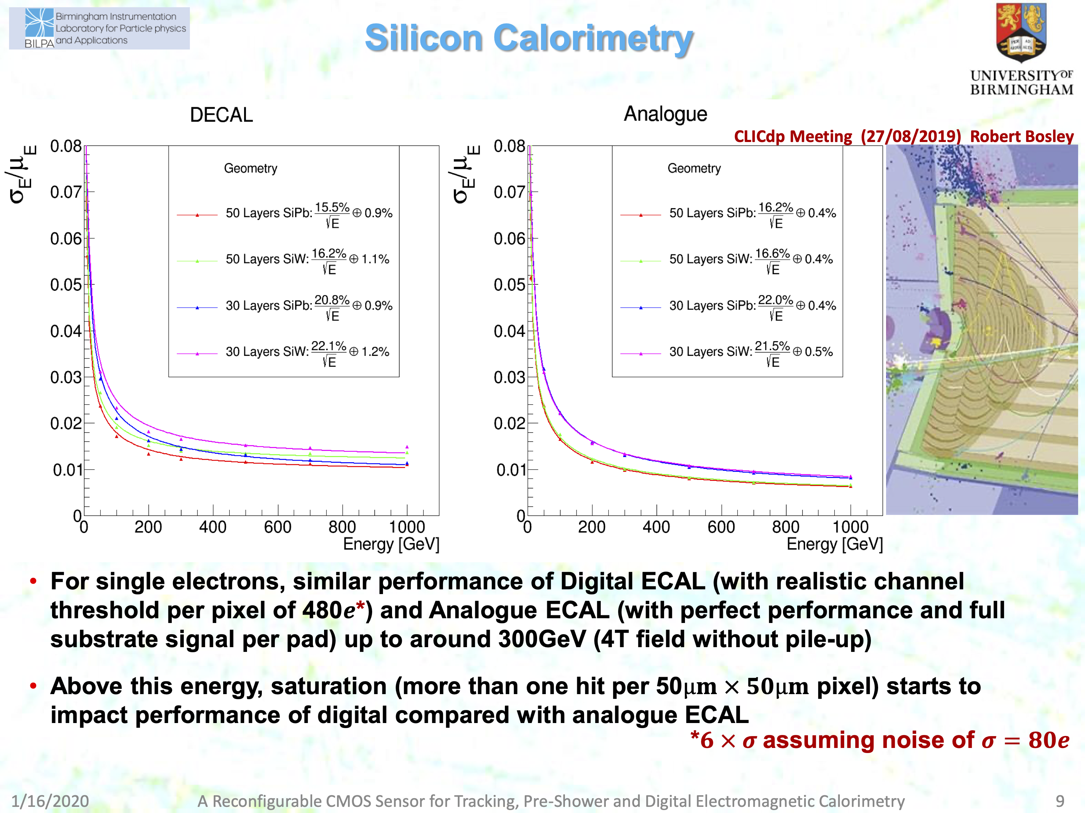
DECAL in full G4 CLIC
Comparable performance to analogue SiW
[c/o Phil Allport]
Notes:
Implemented in full geant4 models of CLIC detector, resolution comparable up to 300 GeV. At higher than ~300 GeV single particle energy, the DECAL has a risk of of saturating: too high a particle density in the core of an EM shower and you are not sensitive to higher energies as each pixel only registers a single hit. If you put in more than one bit per pixel, this problem would be reduced but that needs more memory per pixel and would generate more data volume to read out. In all scenarios, you would have zero suppressing at the front end and having a low noise level per pixel is critical: If you have 10^{11} or more pixels, you want to keep noise level at the 10^{-5} level or lower.

Slide 10
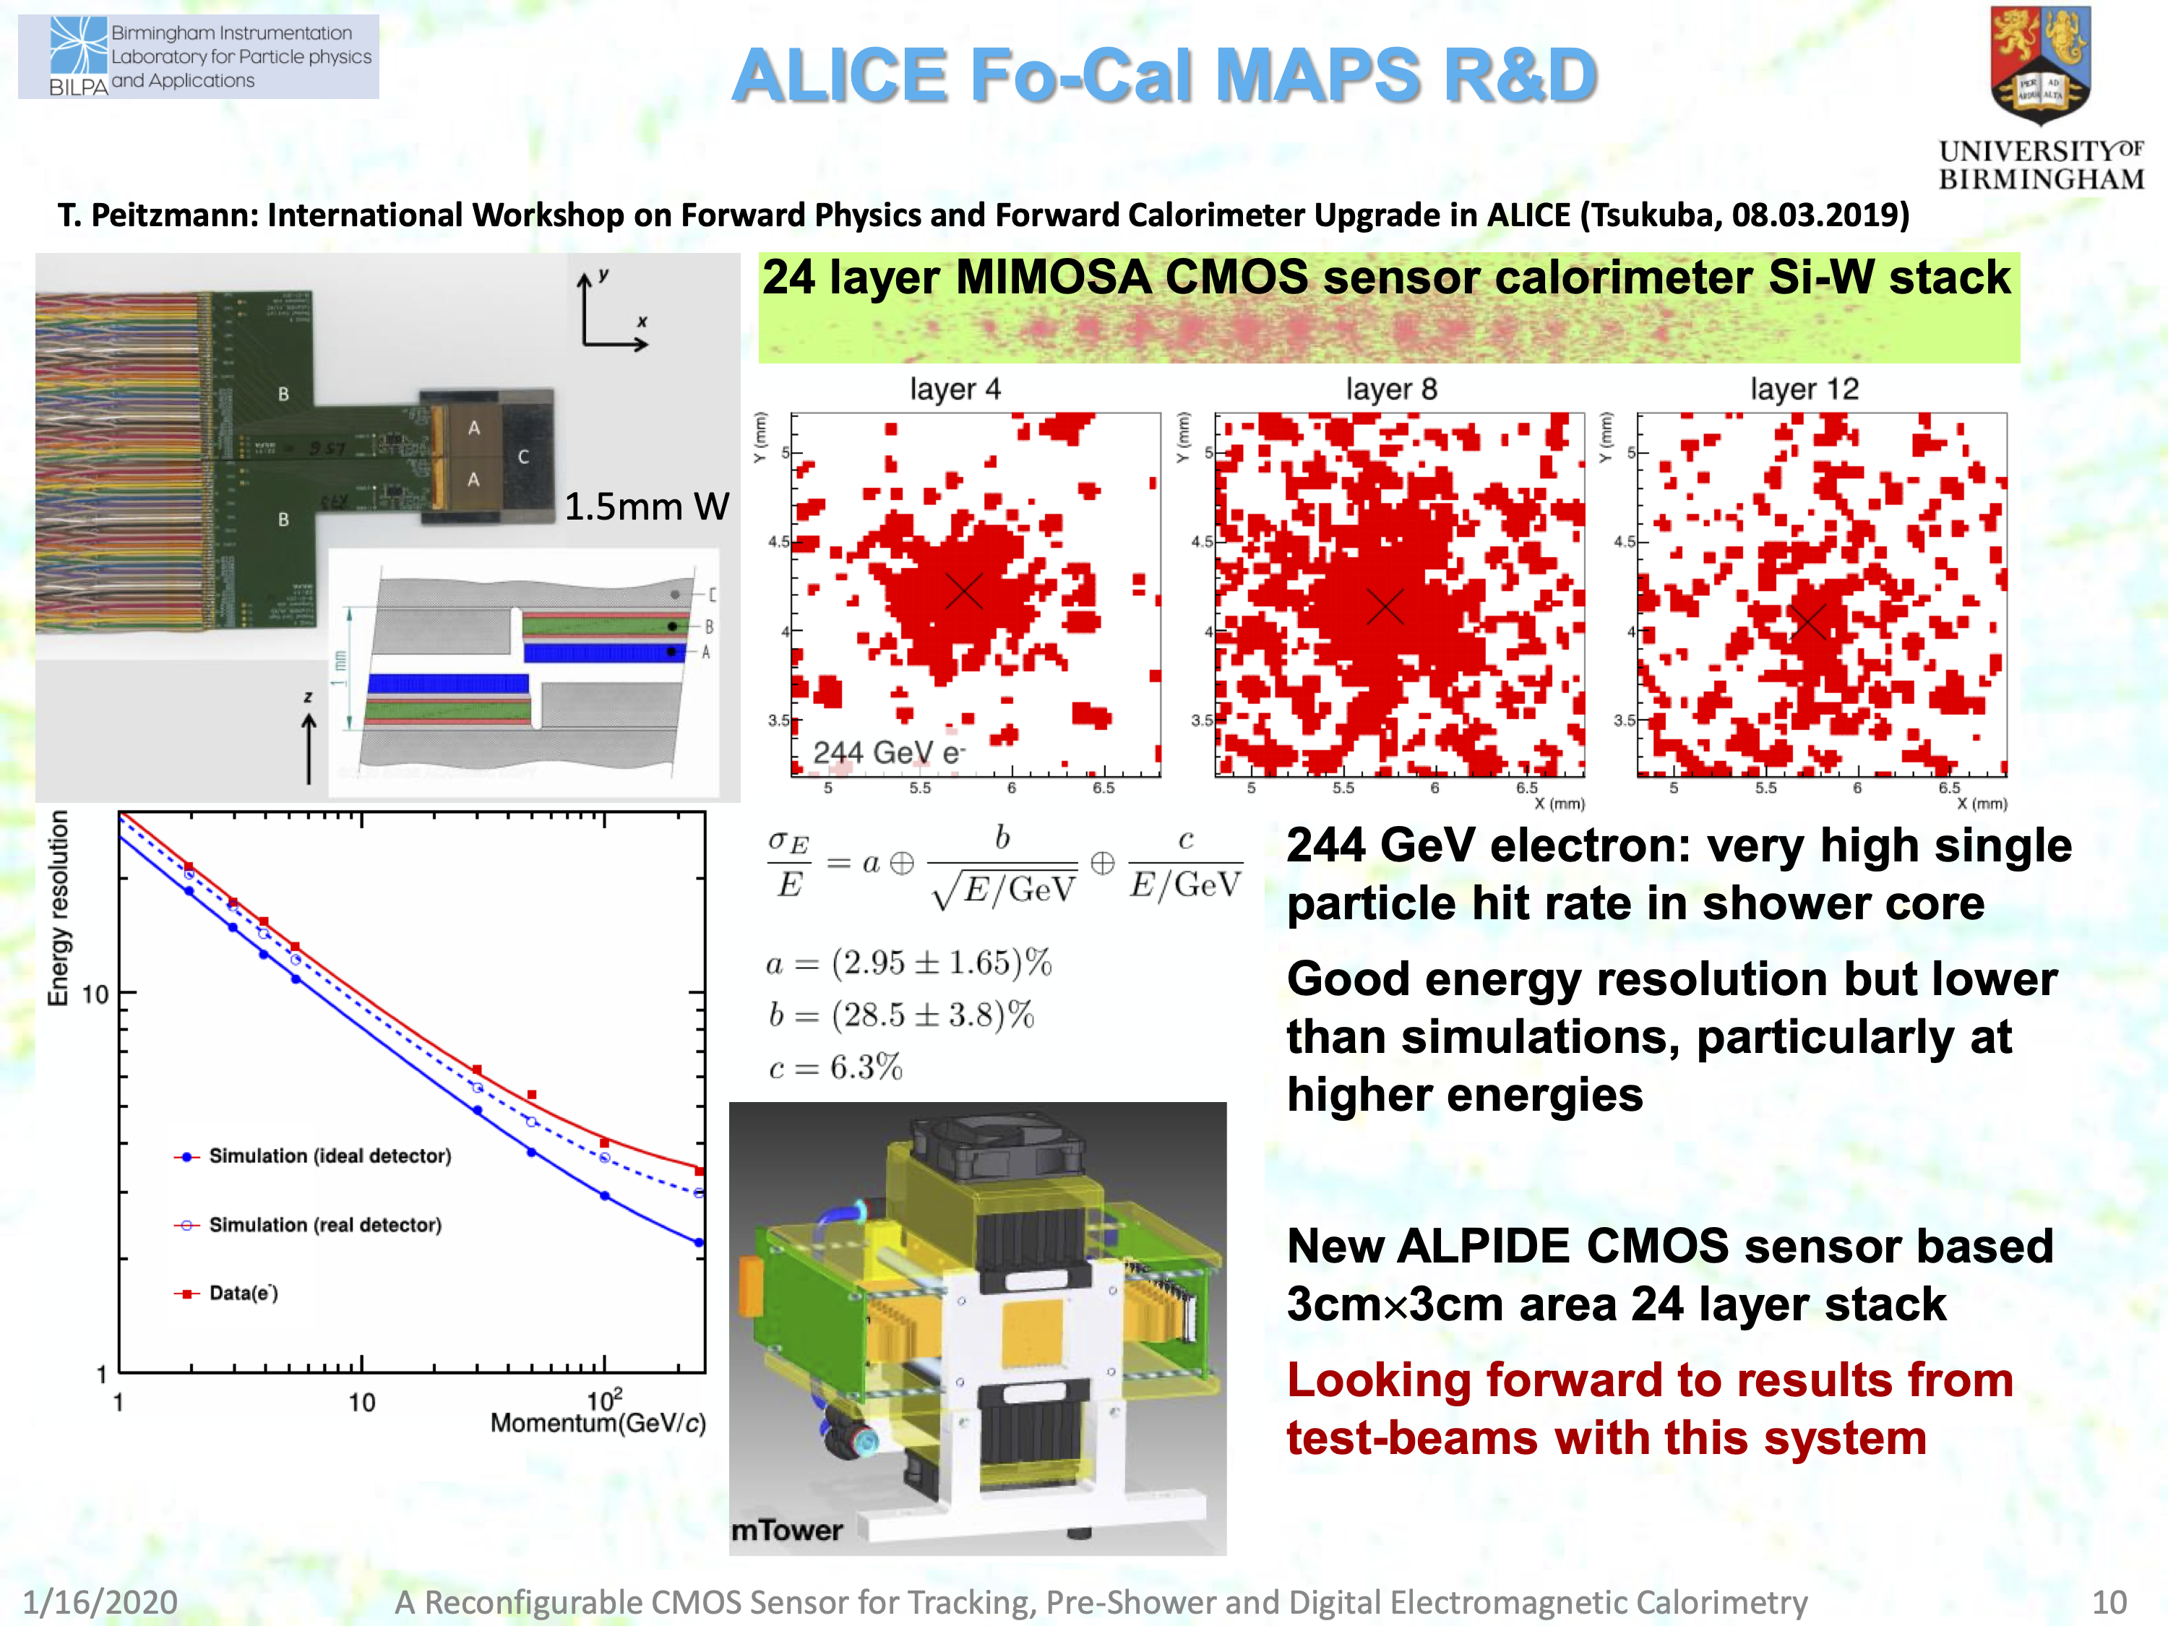
Successor to original UK R&D on DECAL, now using 48 ALPIDE sensors. Birmingham group involved
Testbeam @DESY, Feb. 2020
Performance paper in preparation
[c/o Phil Allport]
Notes:
Nigel is now coordinating the analysis of testbeam data from Feb. 2020 at DESY. Fully functioning mini calorimeter, very similar to what the UK groups proposed and were approved to build in 2009 (funding not delivered when STFC CEO pulled out of ILC). Small number of institutes involved, Uk would be very welcome indeed to work with this group and take this project further.

Slide 11
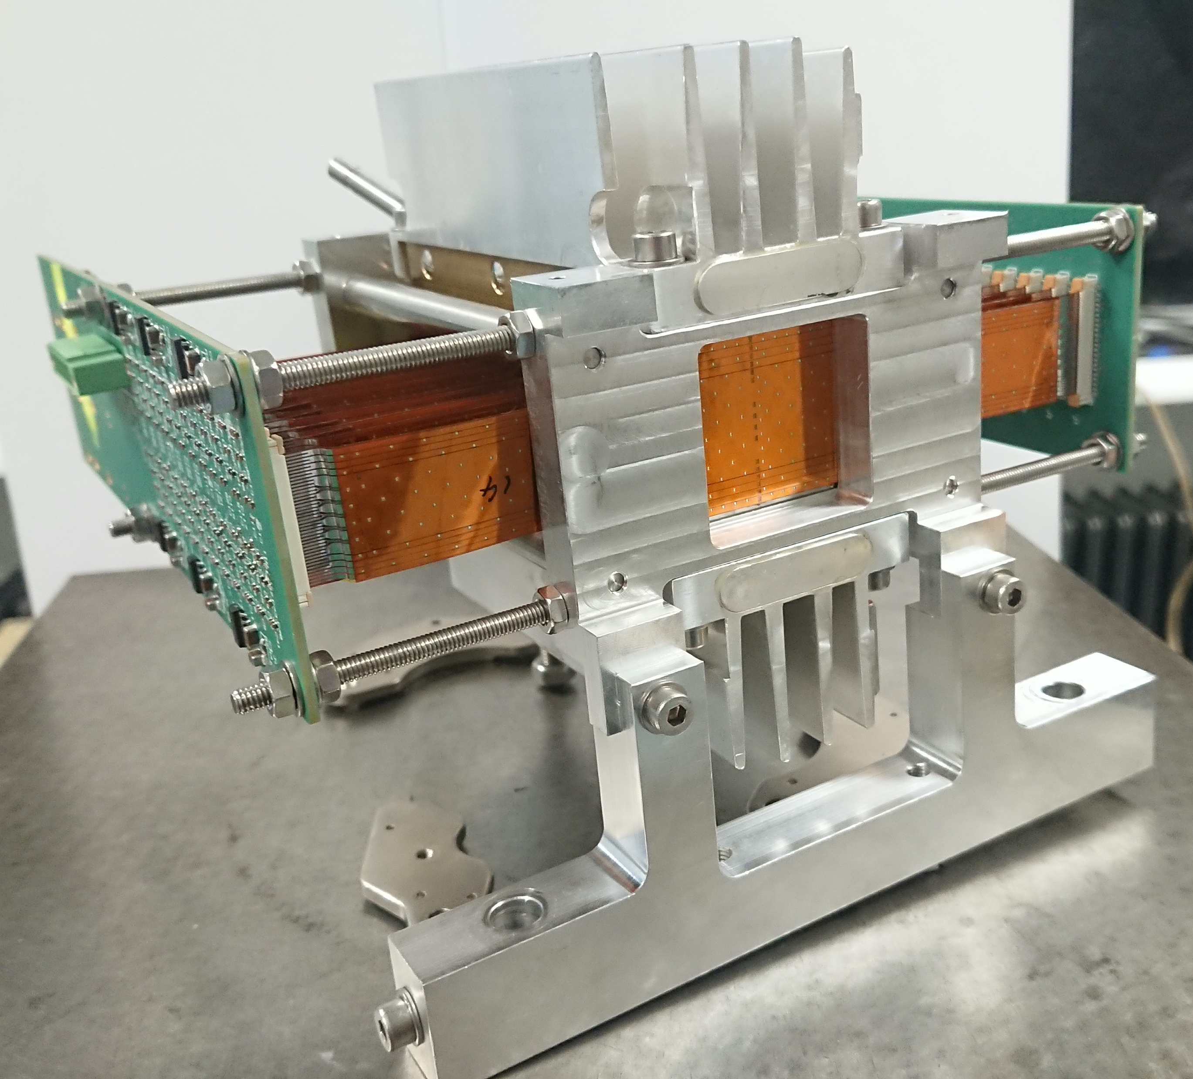
Successor to original UK R&D on DECAL, now using 48 ALPIDE sensors. Birmingham group involved
Testbeam @DESY, Feb. 2020
Performance paper in preparation
[c/o Phil Allport]
Notes:
Nigel is now coordinating the analysis of testbeam data from Feb. 2020 at DESY. Fully functioning mini calorimeter, very similar to what the UK groups proposed and were approved to build in 2009 (funding not delivered when STFC CEO pulled out of ILC). Small number of institutes involved, Uk would be very welcome indeed to work with this group and take this project further.

Slide 12
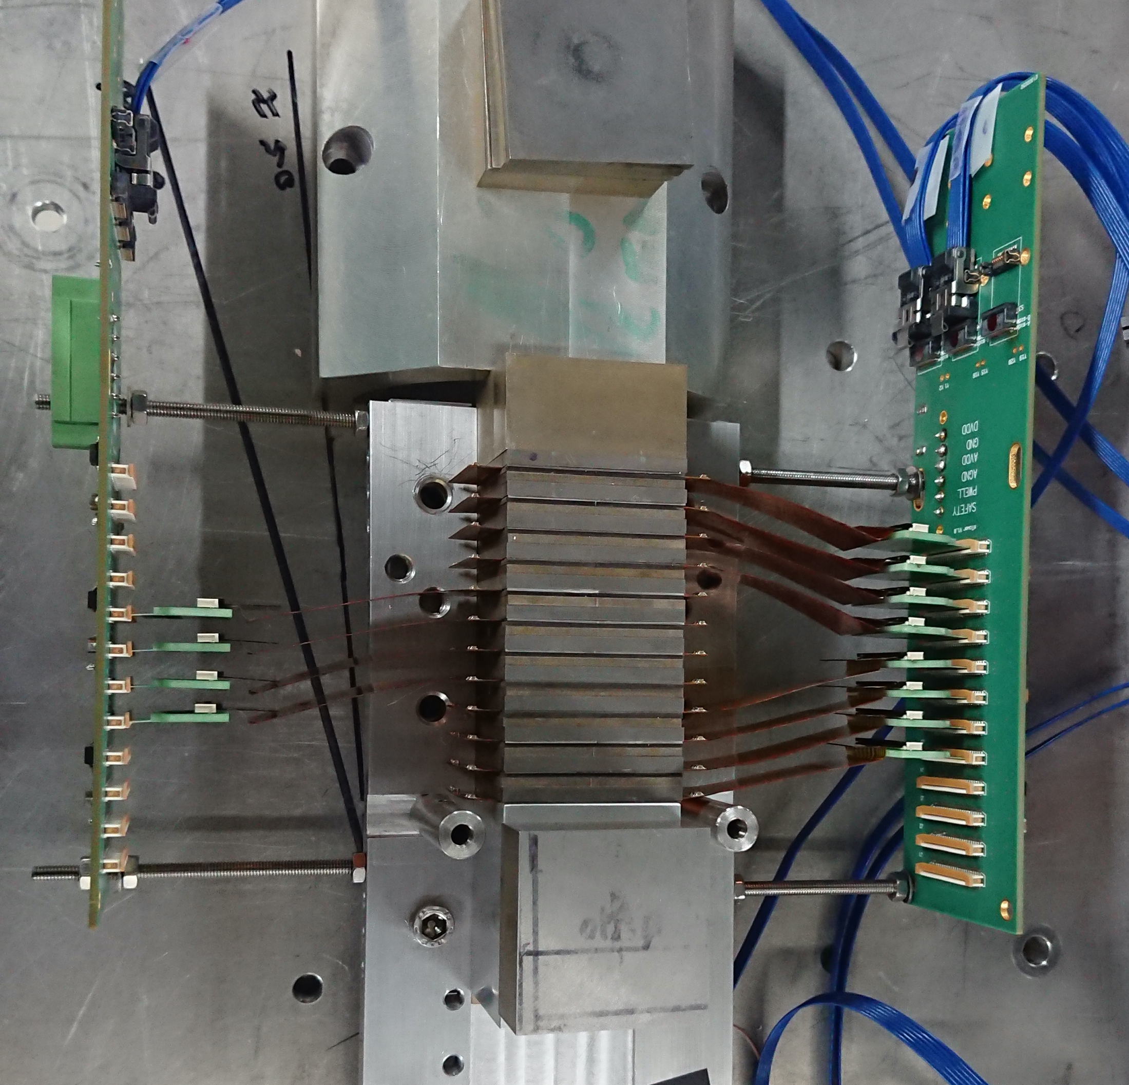
Future Opportunities (DECAL)
mTower prototype
Demonstrates high level integration possible
Using ‘off the shelf’ tracking sensor
Further optimise with new processes and sensor designed with calorimetry in mind
See e.g. Snowmass submission
SNOWMASS21-IF6_IF0-067

Slide 13
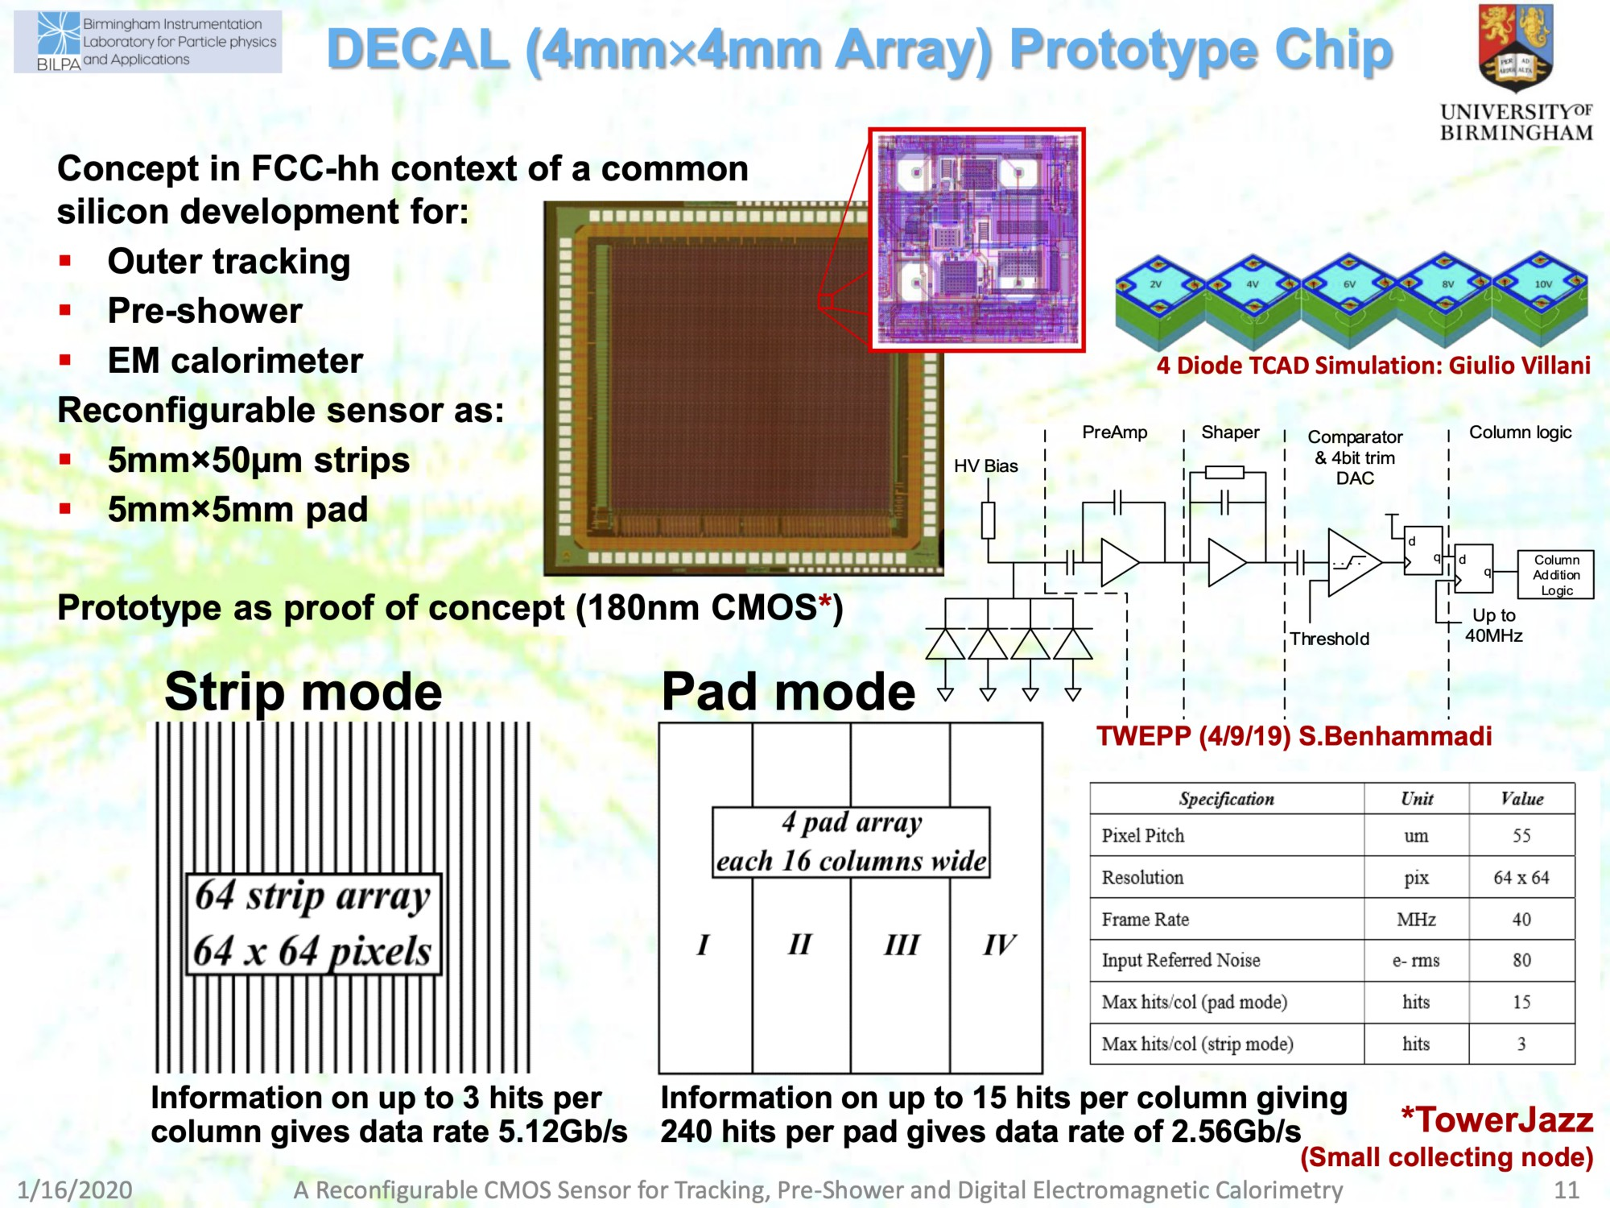
[c/o Phil Allport]
Notes:
Birmingham and RAL developing Rad Had, reconfigurable CMOS MAPS sensors, evolving into 65nm processes

Slide 14
Future Opportunities for UK
There is always room for new ideas!
e.g. Fabrizio Salvatore’s summary for FCC, significant effort on Dual Readout
Si-W calorimetry can give excellent PFA performance
  Potential to use same technology for outer tracker/preshower/ECAL
Affordable Si-W calorimeters, need sensor costs ~ CHF/cm² (active areas > 10⁷cm²)
  Plausible with CMOS MAPS: large commercial market
Power needs study, CMOS estimates range ~50-100mW/cm² (without pulsing)
DECAL, in same CMOS line as CERN et al, radiation hardness to > 10¹⁵neq/cm²
Digital EM calorimetry, high potential for future e⁺e⁻ facilities
  Very fast charge collection, potential for triggering
  Ultra-high granularity can benefit physics as well as cost (boosted decays)
  Currently, UK (Birmingham) working with ALICE FoCAL groups on mTower
  Perfect time to take ownership/lead this novel concept for future projects

Slide 15
Backup

Slide 17
Future Opportunities (IDEA – Dual Calorimeter) – some examples
Hardware activities:
  Development of full-EM containment prototype (2021 - , tbeam at DESY in Jan/Feb 2021)
  Development of a full-HAD containment prototype (2022 - )
  R&D on readout architecture
    Development of the readout for a ‘full scale’ detector using currently available SiPM technology
    Development of a readout using D-SiPMs. (2022 - )
Detector Simulation:
  Simulation and digitisation of SiPM signals
    Simulation of various beam configurations (also for general FCC-SW) – in collaboration with Uinsubria (Como) & UPavia
  Optical photon transport in Geant4
    Need to speed up the current optical transport for photons (very slow atm) - or study an alternative one - to allow full simulation of all readout channels
Software:
  Analysis of tbeam data: electron response, hadronic energy resolution, etc
  Jet response in environment with 4/6 jets
  Particle ID - in particular tau identification using ML/DL techniques
  Calorimeter + tracking reconstruction for full simulation of detector prototype
  Algorithms for energy/particle flow using the SiPMs’ timing information

Slide 18
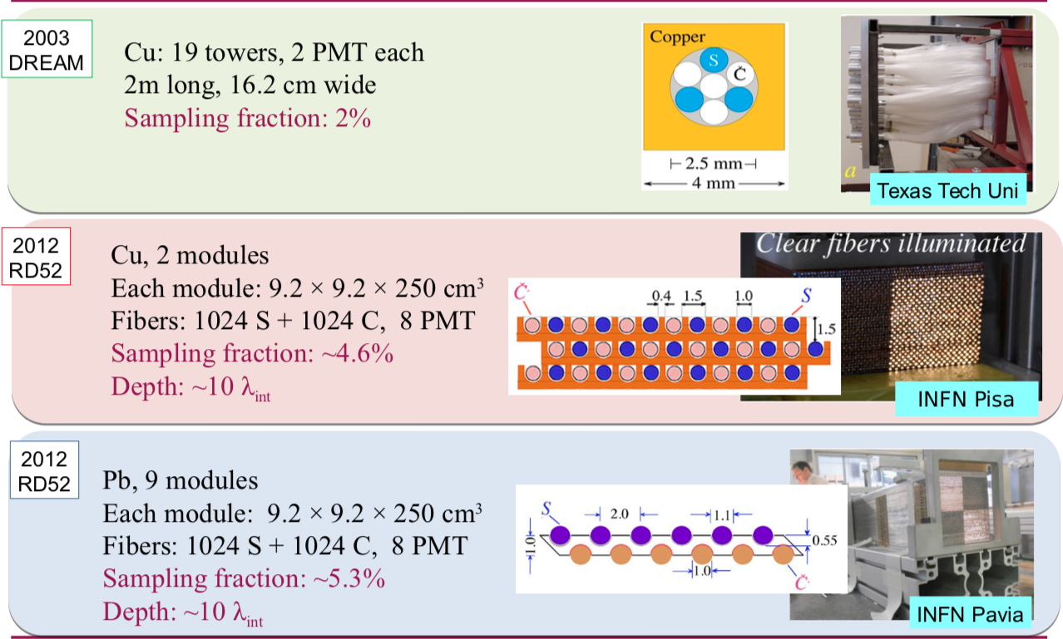
Dual readout calorimeters (PMT readouts)

Slide 19
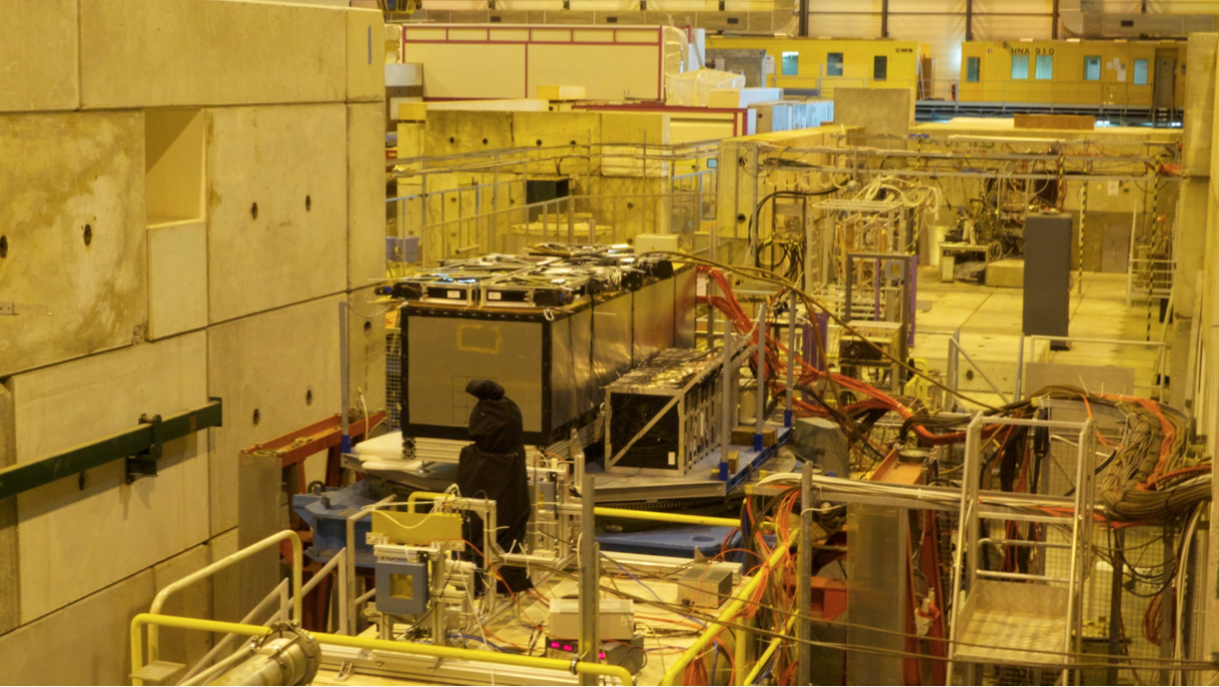

Dual readout calorimeter at work
Leakage counters
RD52 (Pb)
Ancillary detectors

Slide 20
Significant UK participation in all ongoing activities
TB activities:
  Active Sussex participation in 2017 and 2018 test beams at CERN
    Installation and data quality monitoring
    Data analysis and related publications
  Preparation for test of 10x10x100 cm³ module @DESY (dates tbc)
    Procuring and testing scintillating fibers for reading out SiPM signals
Software/Simulation:
  Simulation of the detector and integration in Geant4
  Detector characterisation and physics studies
  DAQ & Monitoring

Slide 21
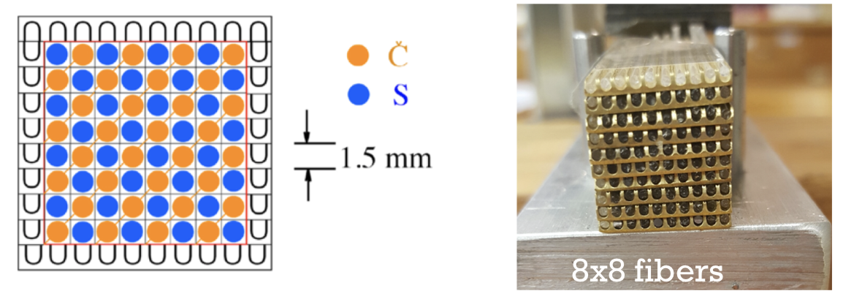
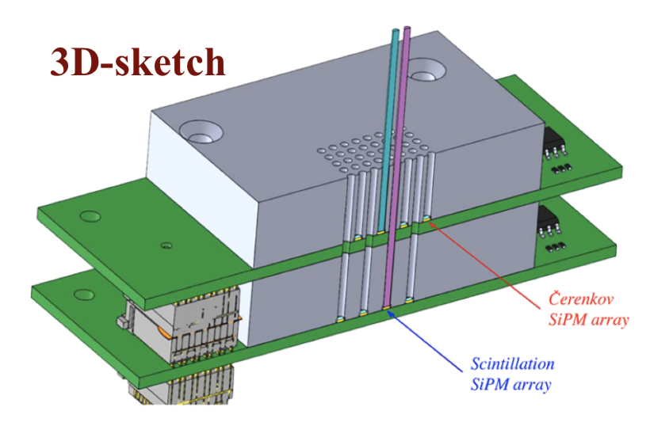
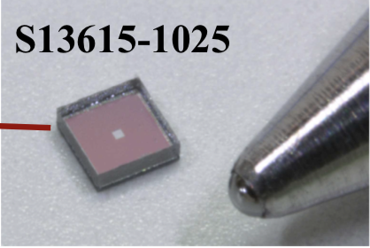
SiPM dual readout
Single fibre readout with HAMAMATSU SiPM.
Readout for Cherenkov and Scintillation light separated to minimise cross talk (the latter expected to be ~ 50 times larger if not attenuated).

