Slide 1


Test Platform for Automated Scan of Multiple Sensors

Slide 2
Test Platform for Automated Scan of Multiple Sensors
The CMS MTD: MIP Timing Detector for HL-LHC
UFSDs for the MTD End Caps
Characterization of a Timing Detector
Development of an automated scanning platform:
  Magnetic spectrometer for Sr⁹⁰
  Trigger and time reference
  Hardware: designed using easily available and accessible components
  Software: custom control and measurement software/firmware
Generic problem!

Slide 3
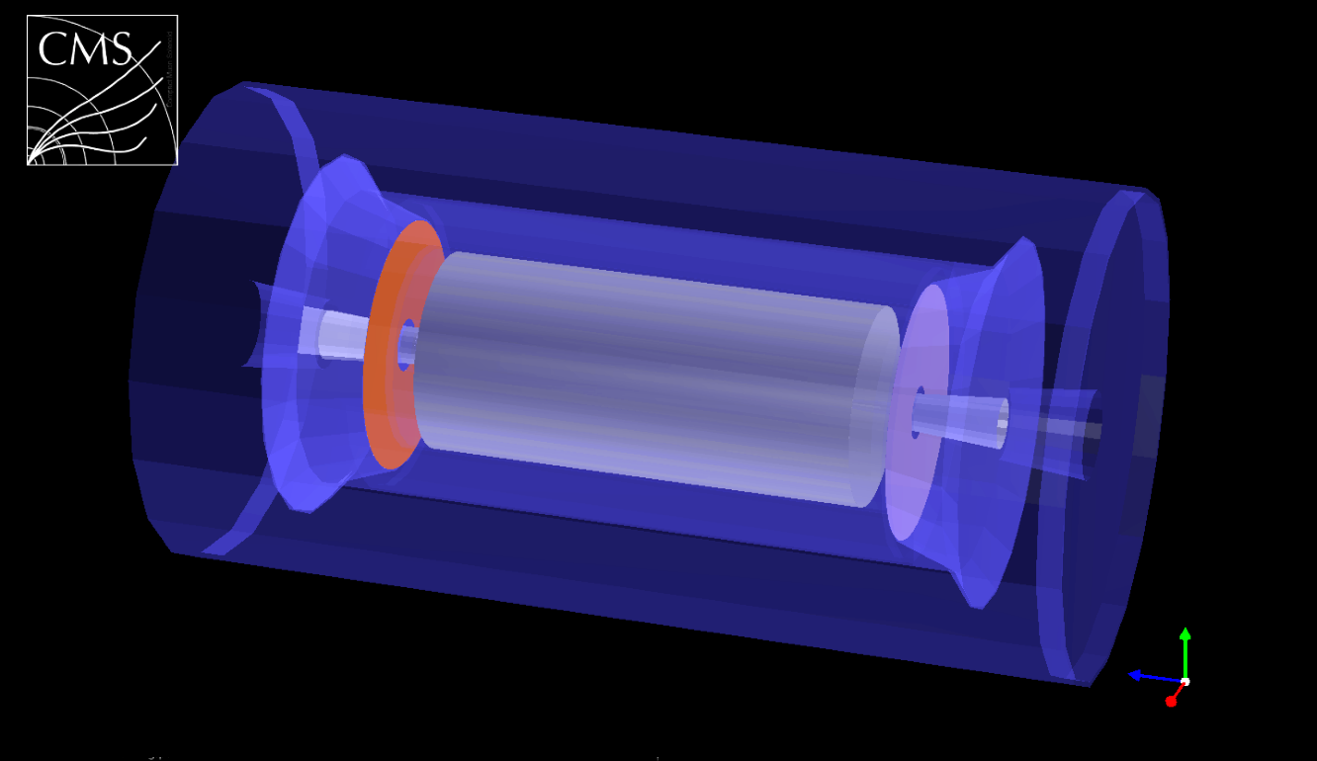
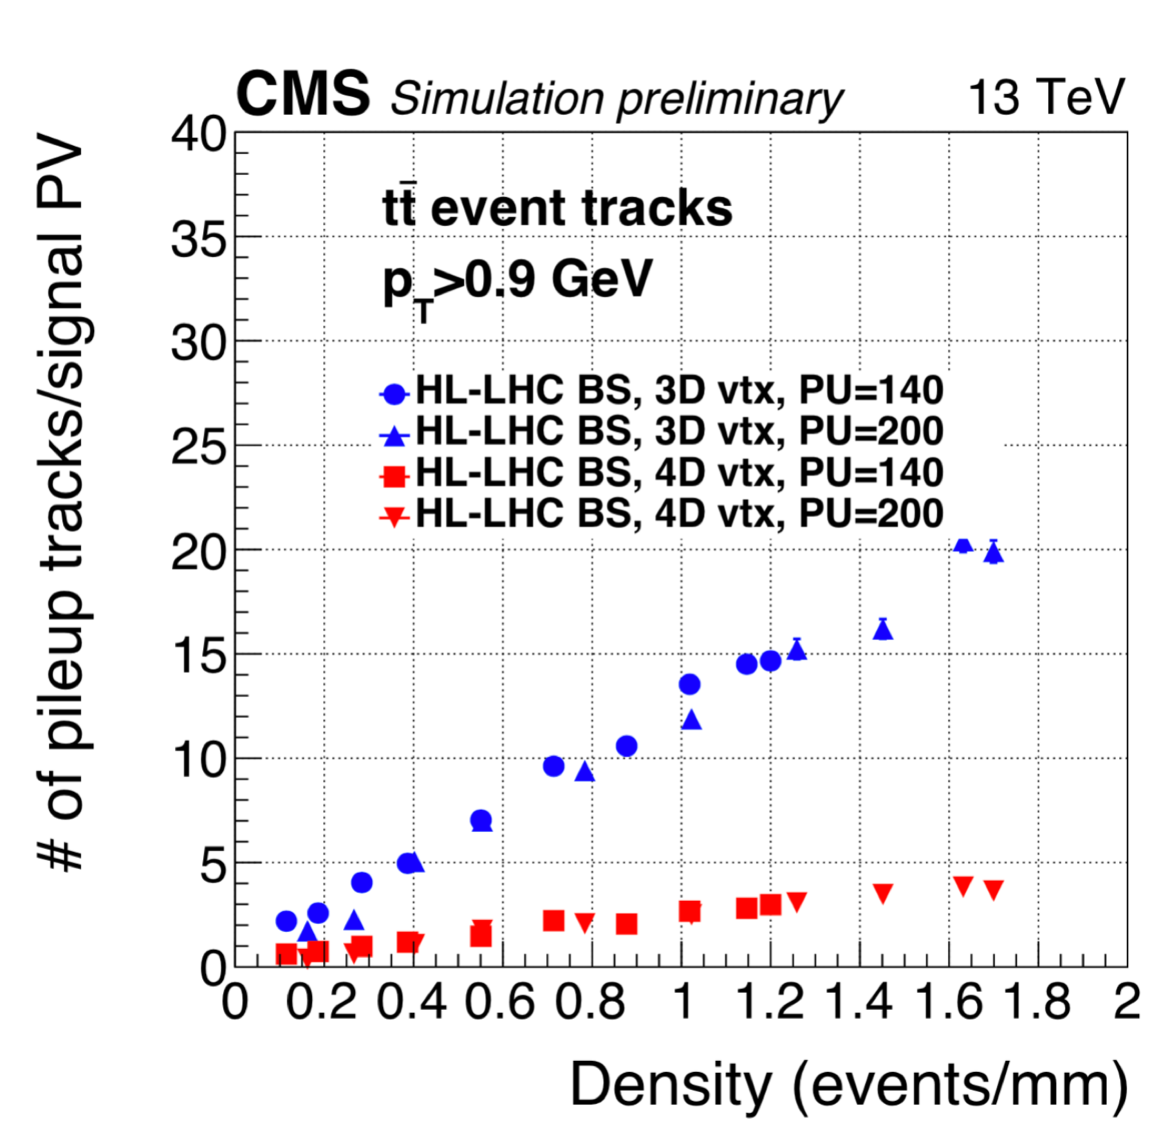
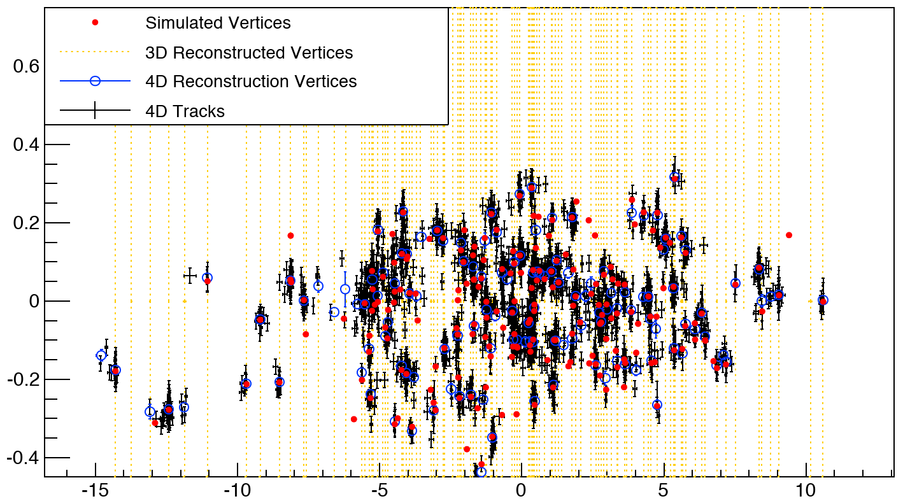
CMS MIP Timing Detector
A precise timing detector can be used for Particle Identification or for pile-up suppression
y
y
CMS MIP Timing Detector:
30-40 ps timestamp for every track
t
Barrel Timing Layer LYSO + SiPM
x
x
200 pileup interactions in 4D space
t (ns)
Endcap Timing Layers (ETL) LGADs
Spurious track-to-PV association suppressed by factor of ~3
z (cm)

Slide 4
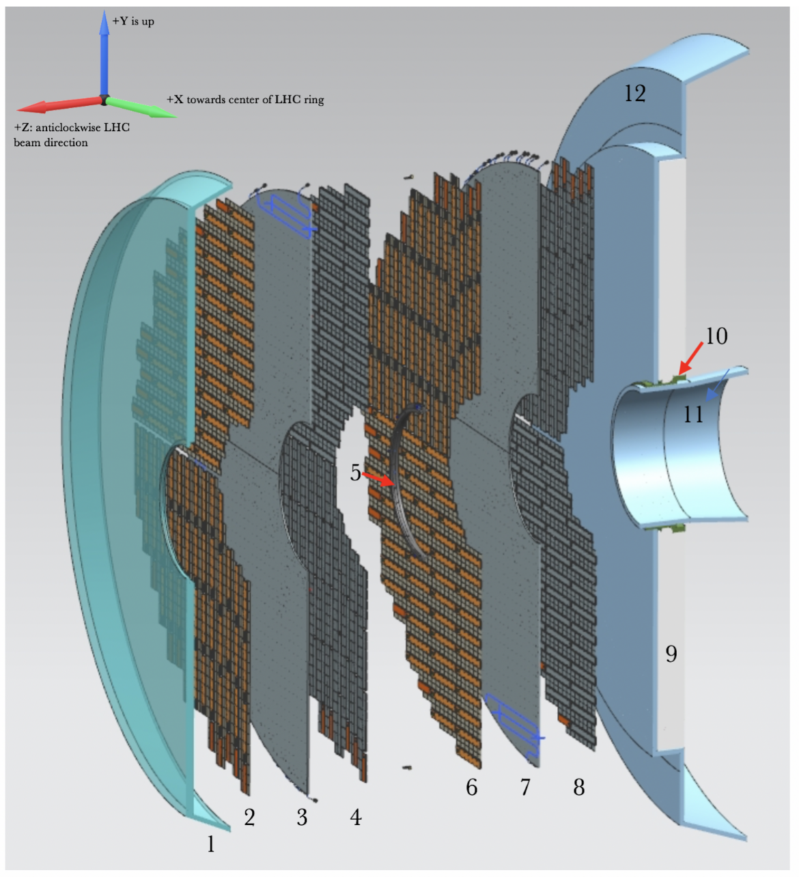

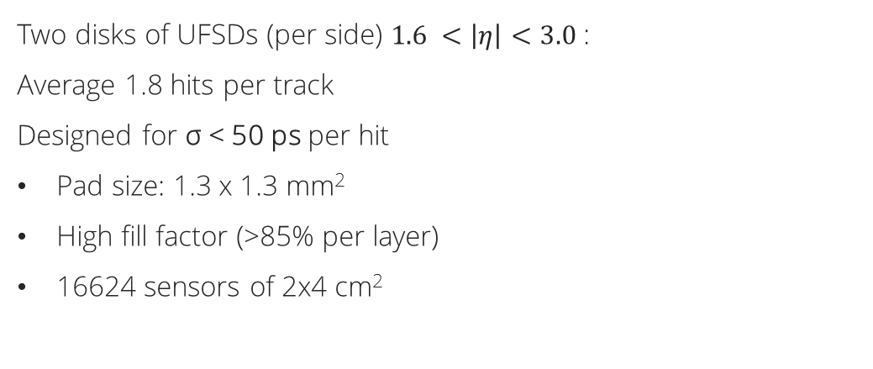
UFSDs for the MTD End Caps
Using UFSDs for a “CMS size” detector poses many challenging
Two disks of UFSDs (per side) $1.6 <\left|η\right|<3.0$:
Average 1.8 hits per track
Designed for σ < 50 ps per hit
Pad size: 1.3 x 1.3 mm²
High fill factor (>85% per layer)
16624 sensors of 2x4 cm²
  Less than 4x10¹⁴ n_{eq}/cm² for 50% of sensors
  Up to 2x10¹⁵ n_{eq}/cm² for 15% of sensors

Slide 5
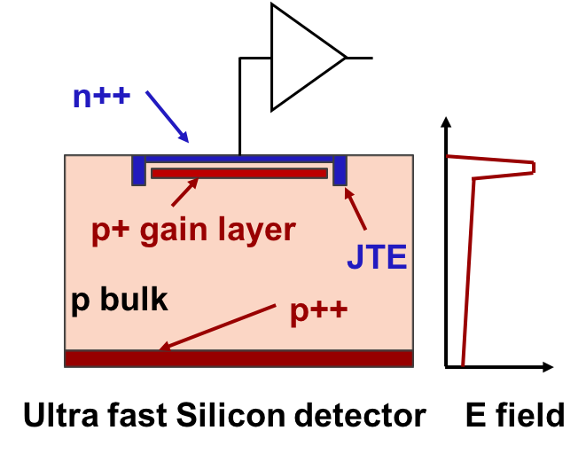
LGAD read out by the ETROC
Ultra Fast Silicon Detectors (UFSDs) are Low Gain Avalanche Diodes (LGADs) optimized for timing measurements employing a thin multiplication layer to increase the output signal at the passage of a particle of a factor ~20
65 nm
Waveform sampling
Charge Injection
Digital
Buffer and Read-out
TOA
PreAmp
Bump pad
Discriminator
TOT
DAC
Pulse Injection
PLL
Phase Shifter
I2C
Fast Control
16 x 16
channels
The low-gain mechanism, obtained with a moderately doped p-implant, is the defining feature of the design.
The low gain allows segmenting and keeping the shot noise below the electronic noise, since the leakage current is low.
  Main requirements:
  ASIC contribution to time precision <40 ps
  Power consumption: <4 mW/ch (80 kW total)
  Trigger rate: Up to 1 MHz
Time precision: 25~30 ps

Slide 6
Characterization of a Timing Detector
To characterize a timing detector it is mandatory to have a precise time reference
Common approach (with radioactive source):
Not Extensible! Not Flexible!
i.e., complete modules, with cooling plates…
~50 μm LGAD
Silicon substrate
Silicon substrate
~50 μm LGAD
PCB with hole under the sensor
ETROC
Time reference
SiPM or MCP-PMT
PCB
If a particle hits the scintillator, for sure it crossed the LGAD as MIP
Time reference
SiPM or MCP-PMT

Slide 7
Characterization of a Timing Detector
To characterize a timing detector it is mandatory to have a precise time reference
it should still be MIP after passing through the time reference
Time reference
SiPM or MCP-PMT
Precise timing and low material budget (no MCP-PMT…)
silicon
~50 μm LGAD
Possibilities:
Thin plastic scintillator
Thin plastic Cherenkov radiator
Ultrathin silicon sensor
ETROC
PCB

Slide 8
MIP portable source
The design goal is to have a compact source with a trigger and a time reference before the sensors
1 MeV electron in Silicon
Spectrum of Sr⁹⁰ and Ru¹⁰⁶
~0.5 MeV/mm
Both radioactive sources emit >20% (25% for Sr90) of the electrons with >0.9 MeV
Ruthenium-106 Half-Life ~ 370 days
Strontium-90 Half-Life ~ 29 years
Selecting electrons with >1 MeV, after 1 mm of Si, they’ll still be MIPs
https://nucleonica.com/

Slide 9
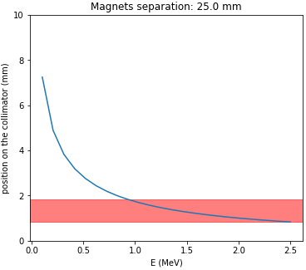
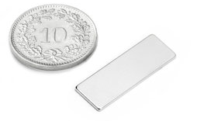
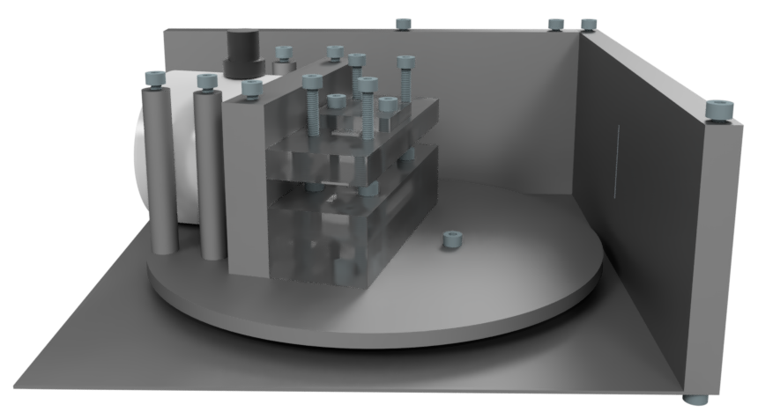
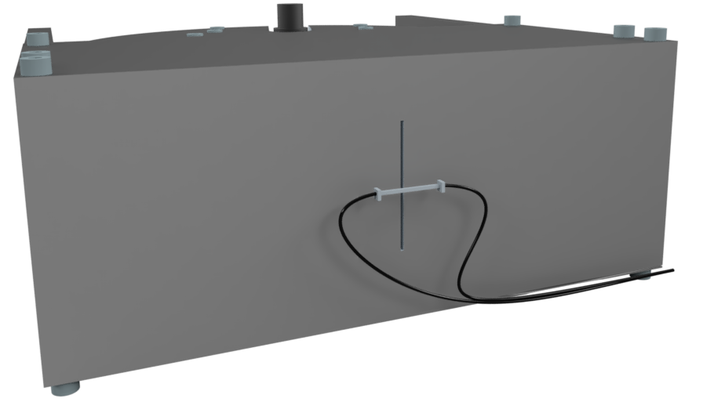
Source spectrometer
The design goal is to have a compact source with a trigger and a time reference before the sensors
Source: Sr⁹⁰
Collimator
Simulations show that it is possible to select >1MeV using small permanent magnets
Magnets with fine tunable support
Selection Slot
Trigger and time reference
Rotating support

Slide 10
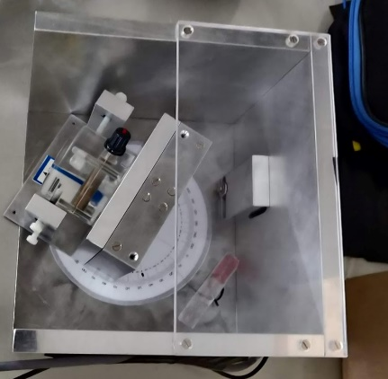
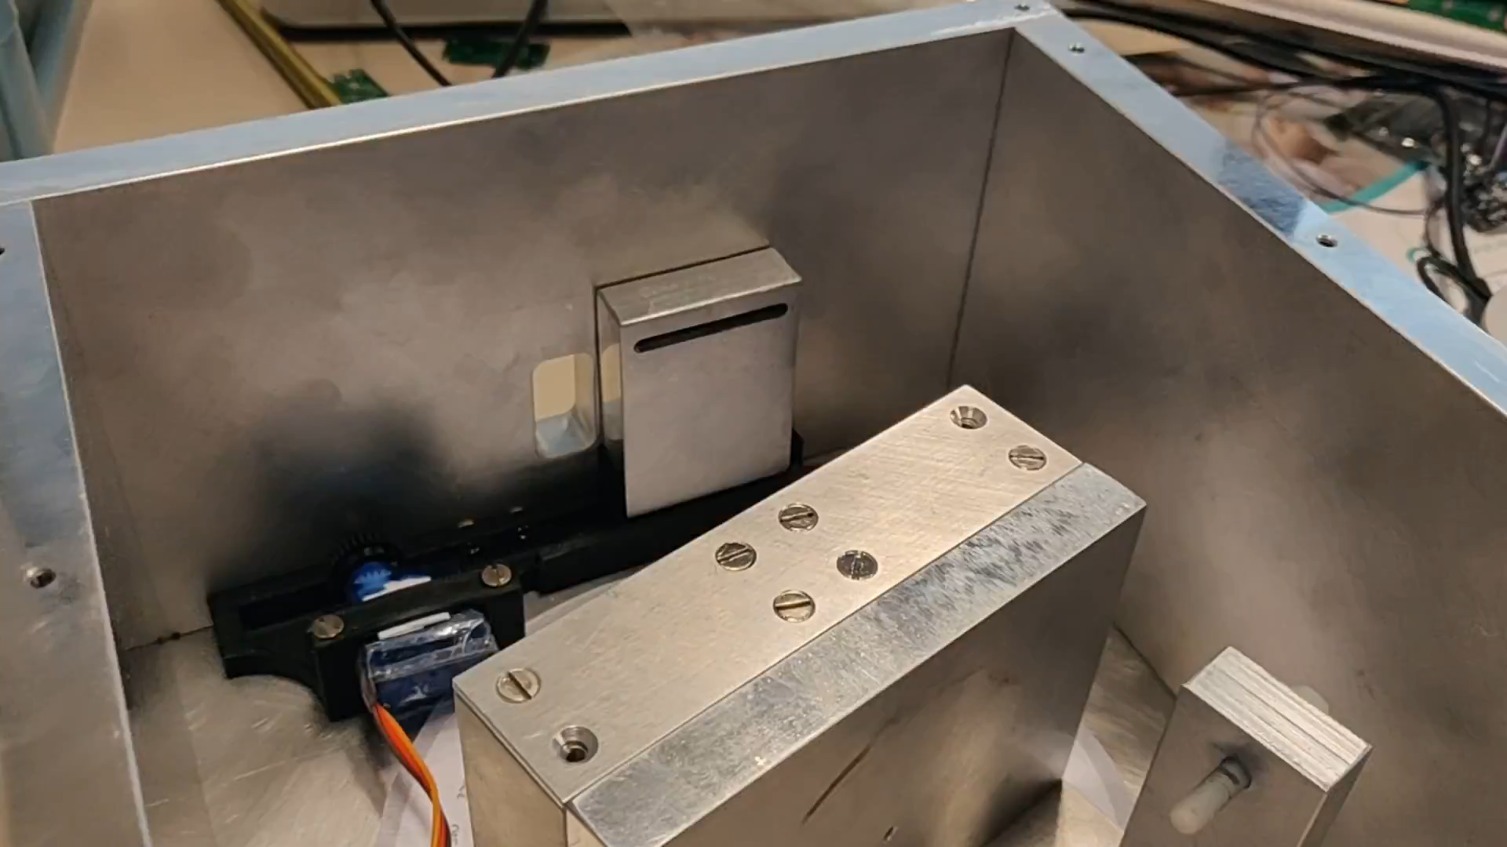
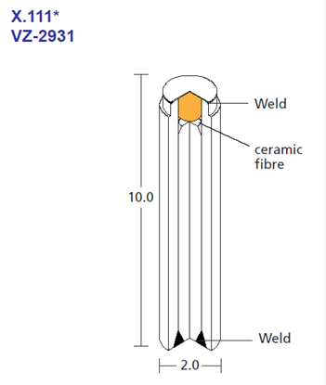
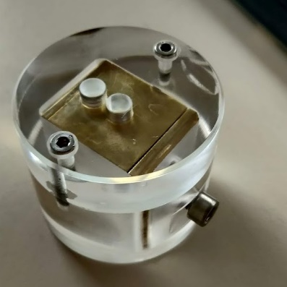
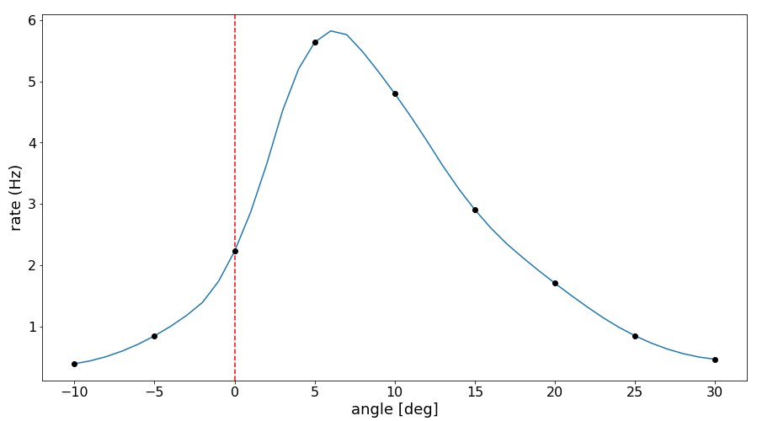
Radioactive Source Spectrometer
First prototype built and tested; a second prototype is in production.
Permanent magnet spectrometer
Remotely controlled shutter
Commercially available Sr⁹⁰
Holder with collimator
37 MBq (1 mCi)
Momentum selector tested
Open/close
~2 mm opening

Slide 11
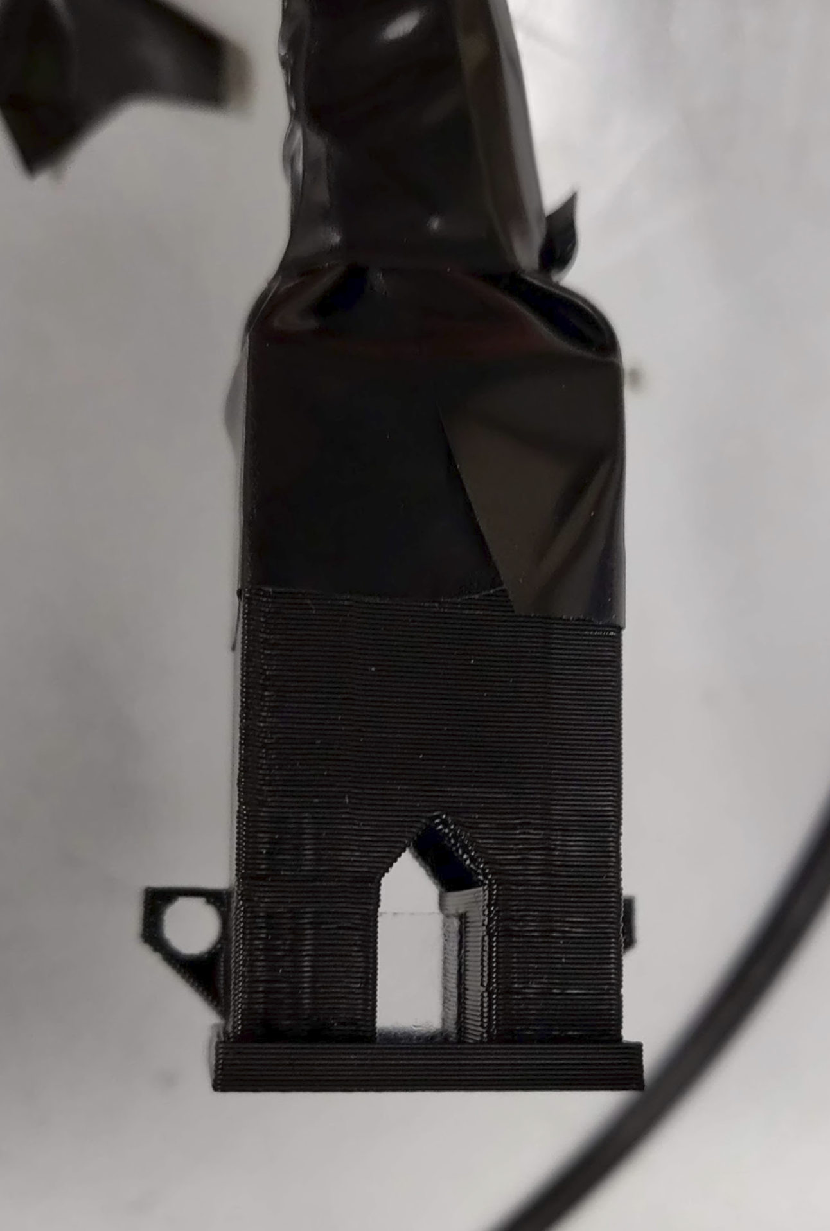
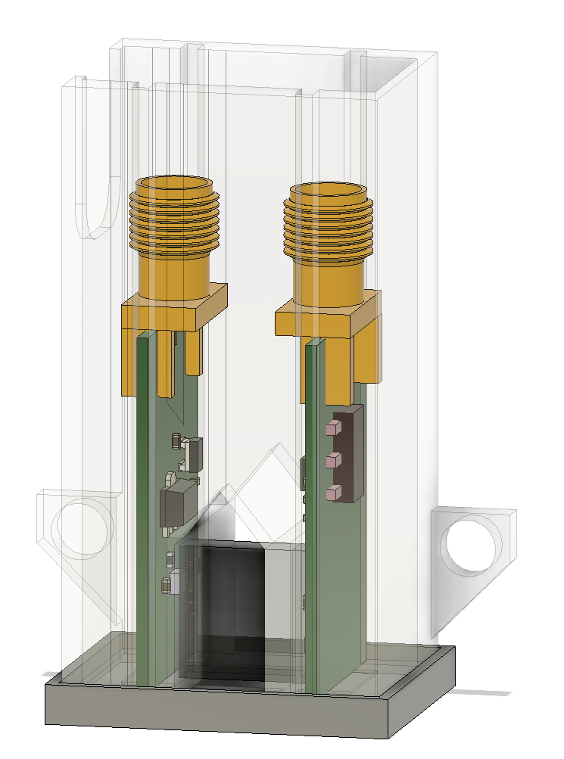
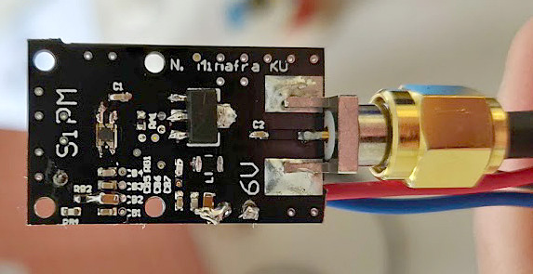
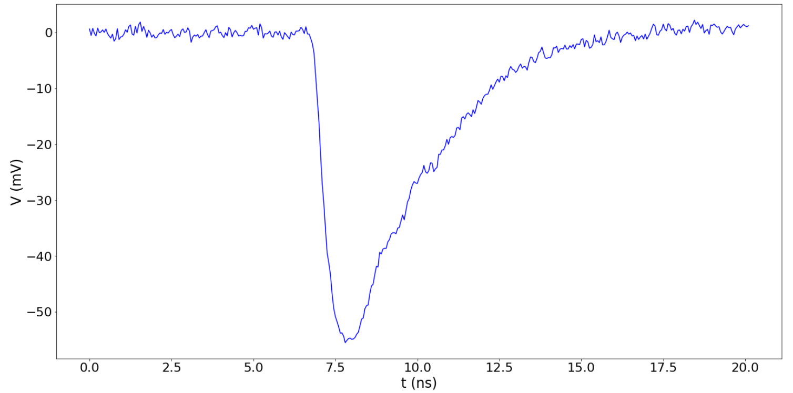
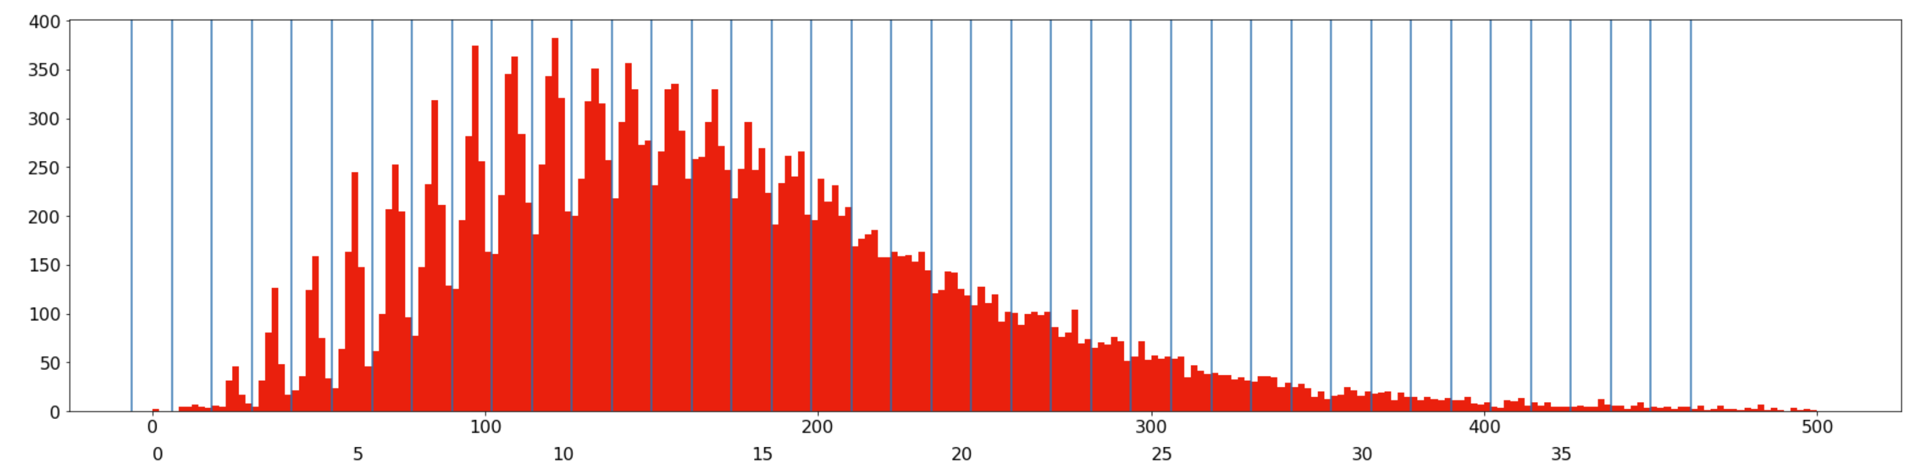
Trigger System: thin plastic scintillator
Trigger generated by plastic scintillators read out by SiPM
Small “all-in-one” boards with SiPM and amplifier, available for 1x1 mm2 and 3x3 mm2 (compatible with different brands of SiPM)
SMA output
MICROFC-30050-SMT-TR1
Amplifier
SiPM 3x3 mm² or 1x1 mm²
Plastic scintillator read out on both sides
(for coincidences)
2 photoelectrons
MICROFC-30050-SMT-TR1
Charge (A.U.)
# of photoelectrons

Slide 12
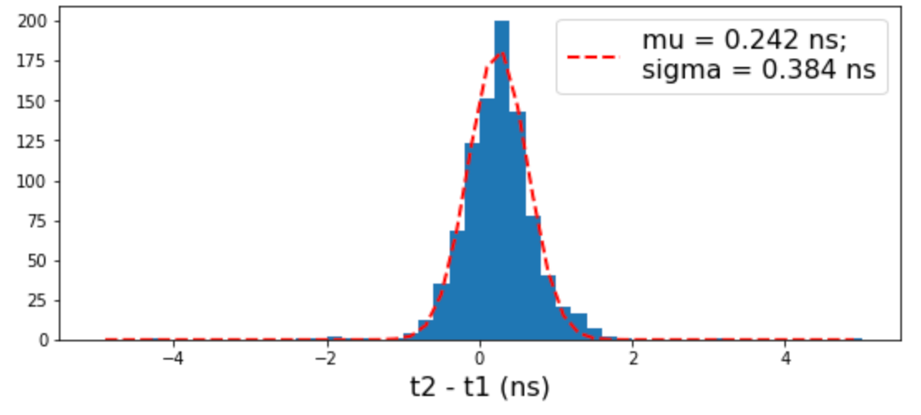


Trigger System: thin plastic scintillator
Trigger generated by plastic scintillators read out by SiPM
t₁
t₂
Time reference
SiPM or MCP-PMT
Time precision of single measurement:
Time precision of combined measurement:
$$σ_{1} \sim σ_{2} \sim \frac{{ σ}_{2−1}}{\sqrt{2}}\sim 270 ps$$
$$σ_{(1+2)/2} \sim \frac{{ σ}_{1}}{\sqrt{2}}\sim 190 ps$$
Still work to do…

Slide 13
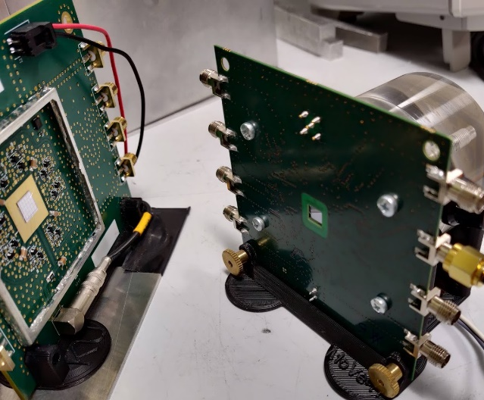
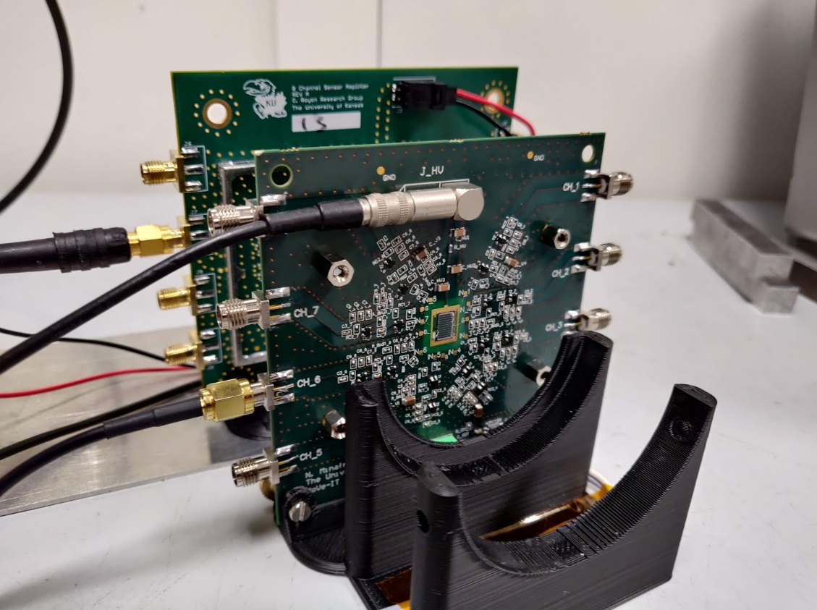
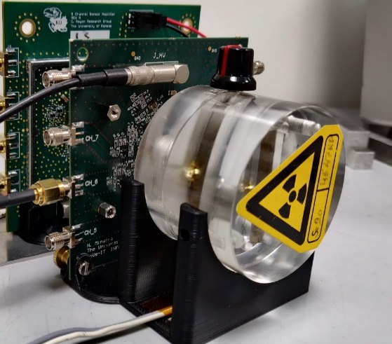
Time reference system: “ultra-thin” LGAD
Trigger generated using an ultra-thin silicon sensor that can provide also a time reference
KU MoVe-IT 8ch board
8 ch board designed for linearity up to 10 MIPs and for very high rates (>200 MHz)
Not optimized for MIP time measurements
MoVe-IT LGAD sensor
ETL 5x5 LGAD
KU 8ch board
Prototype of thin LGAD designed for Hadrotherapy
Thickness ~150 um
The first prototypes were affected by “pop-corn noise”, therefore the sensor was not operated in ideal conditions
To measure the time precision of the thin LGAD, a reference sensor (CMS MTD) was installed on a KU board designed for precise timing with MIP.
The expected time precision of this setup is <30 ps
Thanks to
R. Sacchi, S. Giordanengo, V. Monaco, et al.
(INFN Torino)
www.tifpa.infn.it/projects/move-it/
MoVe-IT - Modeling and Verification for Ion beam Treatment

Slide 14
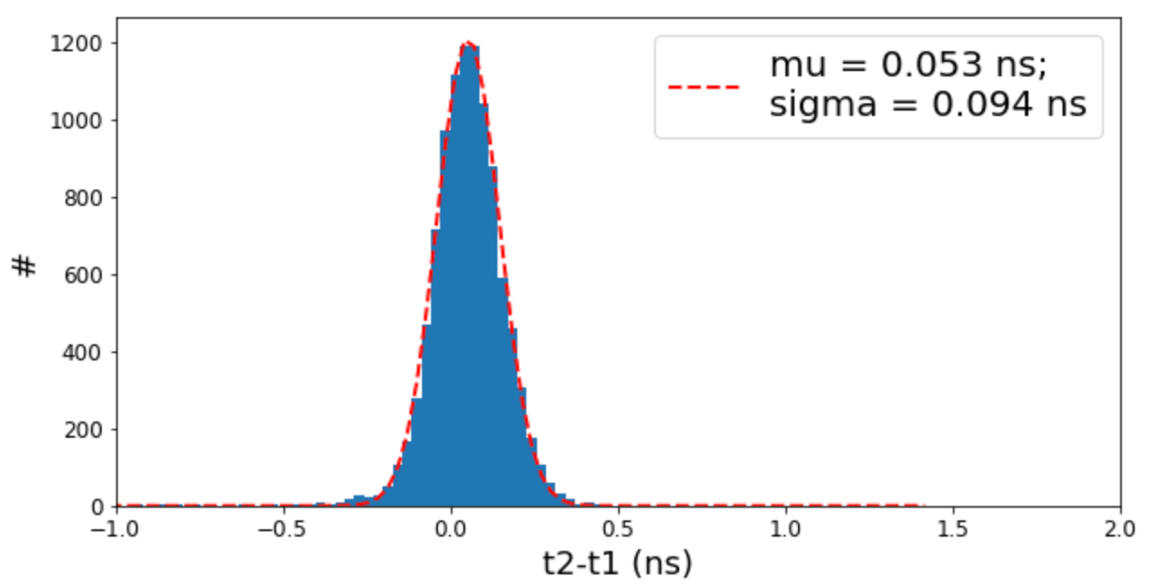
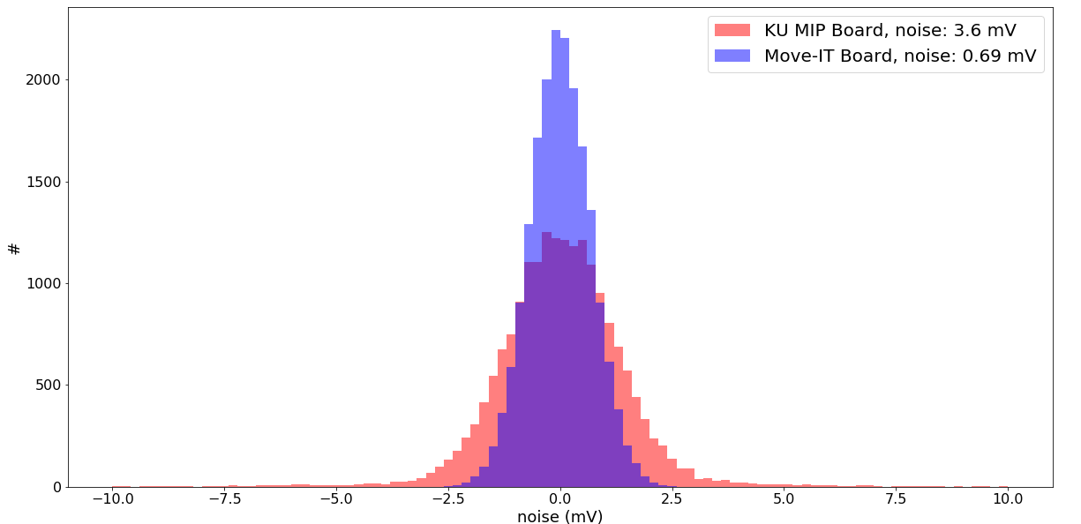
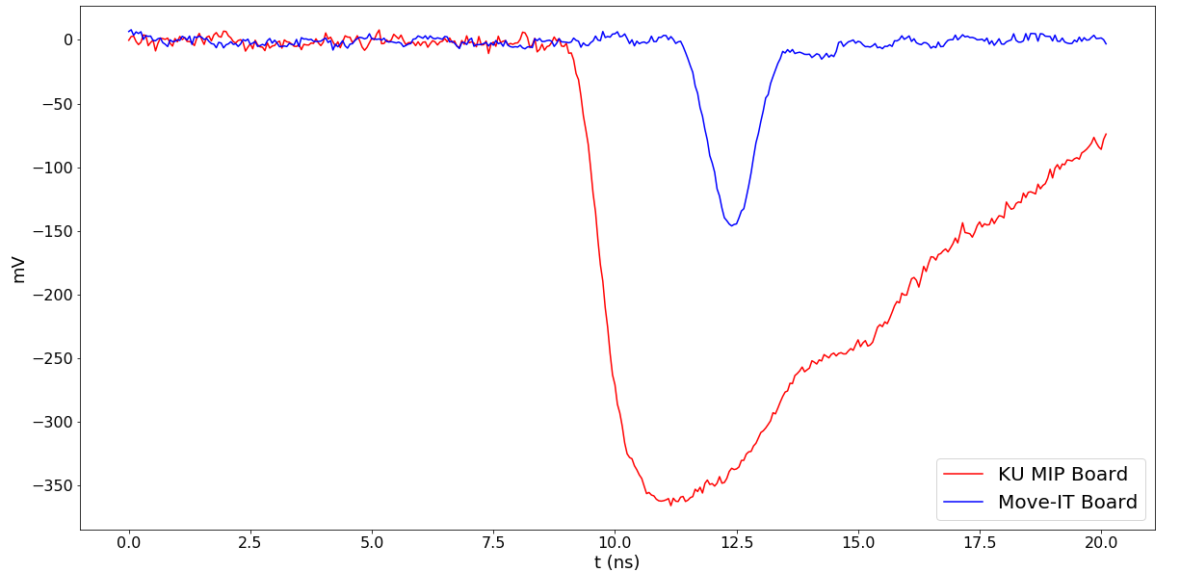
Time reference system: “ultra-thin” LGAD
Trigger generated using an ultra-thin silicon sensor that can provide also a time reference
PRELIMINARY
Assuming that the MIP sensor/board has a negligible contribution (~30 ps):
The time precision measured for the thin sensor is ~90 ps.
KU MoVe-IT board is designed with a lower gain (hence lower noise) to avoid saturation with ~10 MIPs charge deposit.
The output signal is quite smaller and faster wrt the board optimized for MIP detection
Still work to do…

Slide 15






Fully automated test of devices
All DUTs can be identified by a SN using a QR code
SN | Sensor Type | Sensor SN | Max Bias | Tested | …
ETLTEST1 | S10938-6130 | EXX33760-WNo42 | 250V | OK
…
The SN is linked to a database with all relevant information, then the module is tested and results are stored in the database

Slide 16
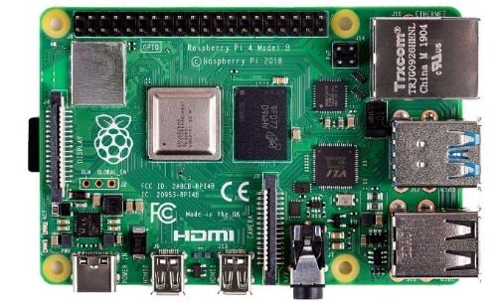
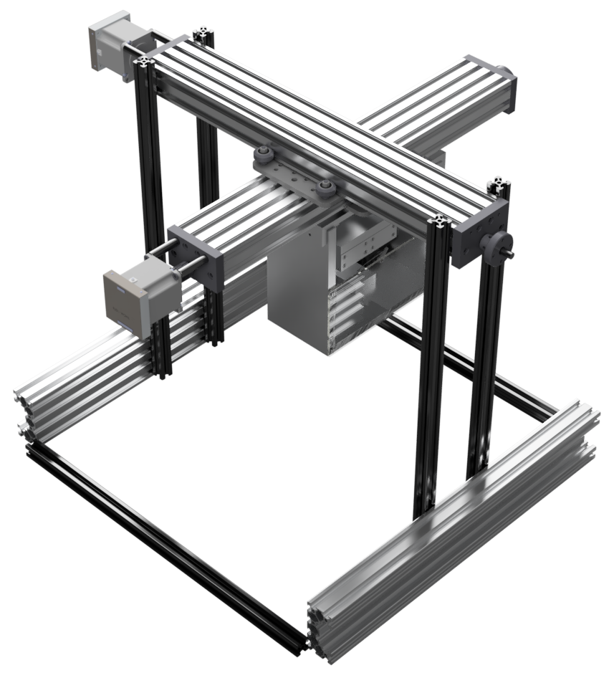

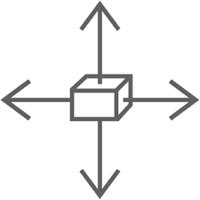
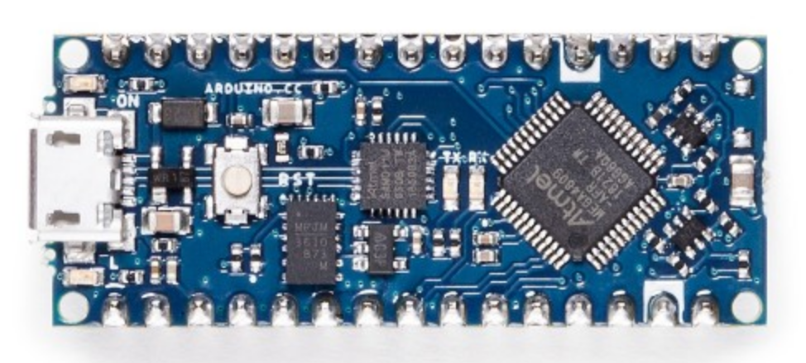
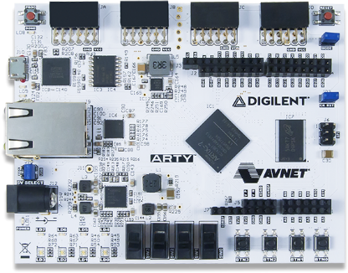
Scanning Platform
Precise XY positioning of the spectrometer
Raspberry PI 4 for “smart” processing
Camera acquisition, object recognition, data base, etc...
Arduino for “easy” processing
Motor control, shutter control, laser control, etc..
FPGA for
“fast” processing
Trigger control, coincidences, counters, etc..
Precision ~10 um
Accuracy ~100um over 20 cm
25 x 25 cm² available
Easy encapsulation for light and dry air

Slide 17
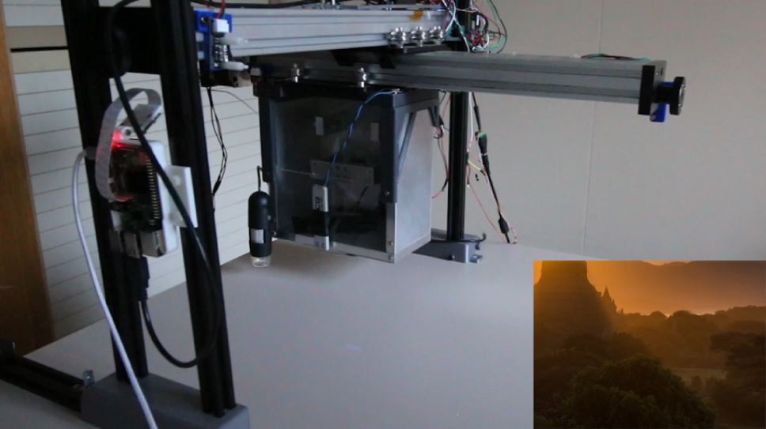
Scanning Platform: automated object location
XY movement with automatic object recognition
RPi Camera
RPi Camera
(corrected) perspective
Microscope
(not used in this demo)
Laser Pointer
Full video: https://youtu.be/R01_67eKrPA

Slide 18
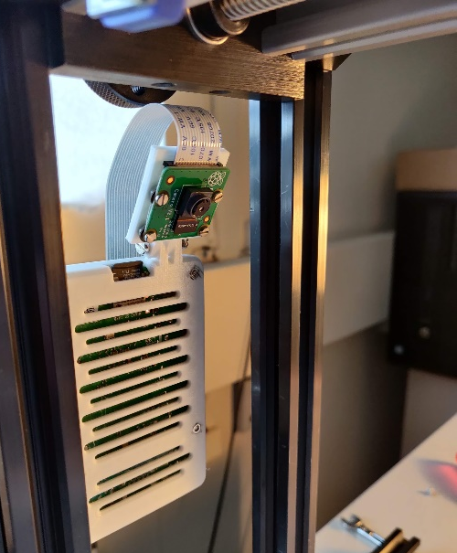


Scanning Platform: a technical slide!
Motor control
Object recognition
Coordinate transform
The motors need two signals: DIR and STEP
(open loop)
Low jitter and fast: timers
Acceleration: very demanding
2 independent axis: even more demanding
Pi Camera or WebCam (bird-eye)
USB microscope (detail)
Acquired and processed using OpenCV framework
Camera: Perspective correction
Point the laser at 3 (or more) known positions and use those as reference point in the camera reference system
XY platform:
Rotation and scaling
Z might not be perfectly perpendicular
X and Y could be rotated
Arduino Nano Every
Compatible with our probe station…

Slide 19
Conclusions
Within the upgrade program of the CMS MIP Timing Detector an automated test platform has been designed
The platform has 2 axis precise motion (XY) and fully custom control hardware/firmware
  The platform can be also modified to be used with particle beams (YZ movement)
The platform has cameras for object recognition and precise positioning
The platform is equipped with a Sr90 radioactive element and with a magnetic spectrometer to select electrons > 1MeV
A “thin” trigger/time reference system is under development: further research and tests are needed, but promising results.

