Slide 1

Dependence of field quality of main magnet on HL LHC energy
Ezio Todesco
Susana Izquiredo Bermudez
Kento Suzuki, Tatsu Nakamoto
Stefania Farinon, Pasquale Fabbricatore
1 September 2020 - Geneve

Slide 2
THE ISSUE
The main magnets of HL-LHC have a peak field in the range of 5 to 12 T
  At these levels of field, saturation is not negligible
  For the transfer function, saturation is compensated via the power converter and the field model
  For the allowed multipoles, some actions to reduce the dependence of multipoles on the energy can be done via iron shaping, but one is left with a variation of some units
The range of operational energy of HL-LHC is from 6.5 TeV (present value of RunII) to 7.0 TeV (possible target of RunIII) and, in principle but with lower probablity, up to 7.5 TeV (the ultimate energy)

Slide 3
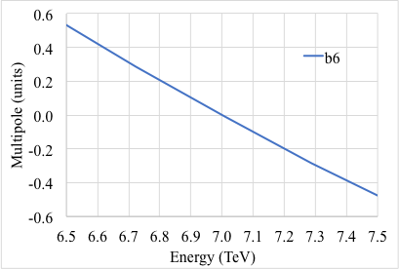
SITUATION FOR MQXF
For MQXF, the first (and only relevant allowed multipole) is b₆
  The variation of of the order of ±0.4 units, about 1/8 of the window of ±3 units
  A fine tuning of b₆ has been carried out
  I would not consider this as a major issue, and review the situation once we have data from prototypes, and beam screen measurements
Variation of b₆ versus energy (S. Izquierdo Bermudez)

Slide 4
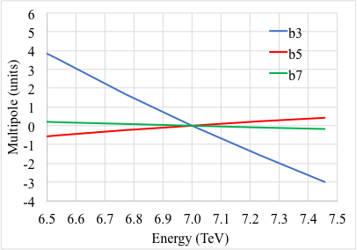
SITUATION FOR D1
For D1, the multipole concerned is b₃ (b₅ and b₇ are also given)
  Variation is far from being negligible, since it is the same size of the acceptance window – we should select an energy (presently is 7 TeV) for the optimization since we cannot guarantee the full range 6.5 to 7.5 TeV
  A fine tuning of the cross-section has been done for the prototype, with a strong corrective action on b₃
Variation of b₃ versus energy in D1 (K. Suzuki)

Slide 5
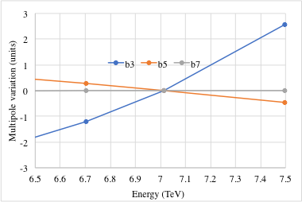
SITUATION FOR D2
For D2, the multipole concerned is b₃ (b₅ and b₇ are also given)
  Variation is smaller than in D1, but still far from being negligible ±2 units, with respect to an acceptance range of ±3 units
  We should select an energy (presently is 7 TeV) for the optimization since we cannot guarantee the full range
  A fine tuning of the cross-section has been done for the prototype
Variation of b₃ versus energy in D2 (S. Farinon)

Slide 6
CONCLUSIONS
For both D1 and D2 the dependence of b₃ on the energy is non negligible
  Moving the energy from 7 to 6.5 TeV would « eat » half of the acceptance range for D1, and 1/3 for D2
  The choice of the energy for the optimization is relevant
  Today for D1 and D2 we are aiming at best field quality at 7 TeV
From a manufacturing point of view
  Some flexibility can be guaranteed by shimming in the midplane/pole for D2
  For D1, wedges can be modified during production, having a good aniticipation
I would suggest reviwing the situation after the field quality measurements of prototype D1 and D2, and after the retraining of the LHC

