Slide 1
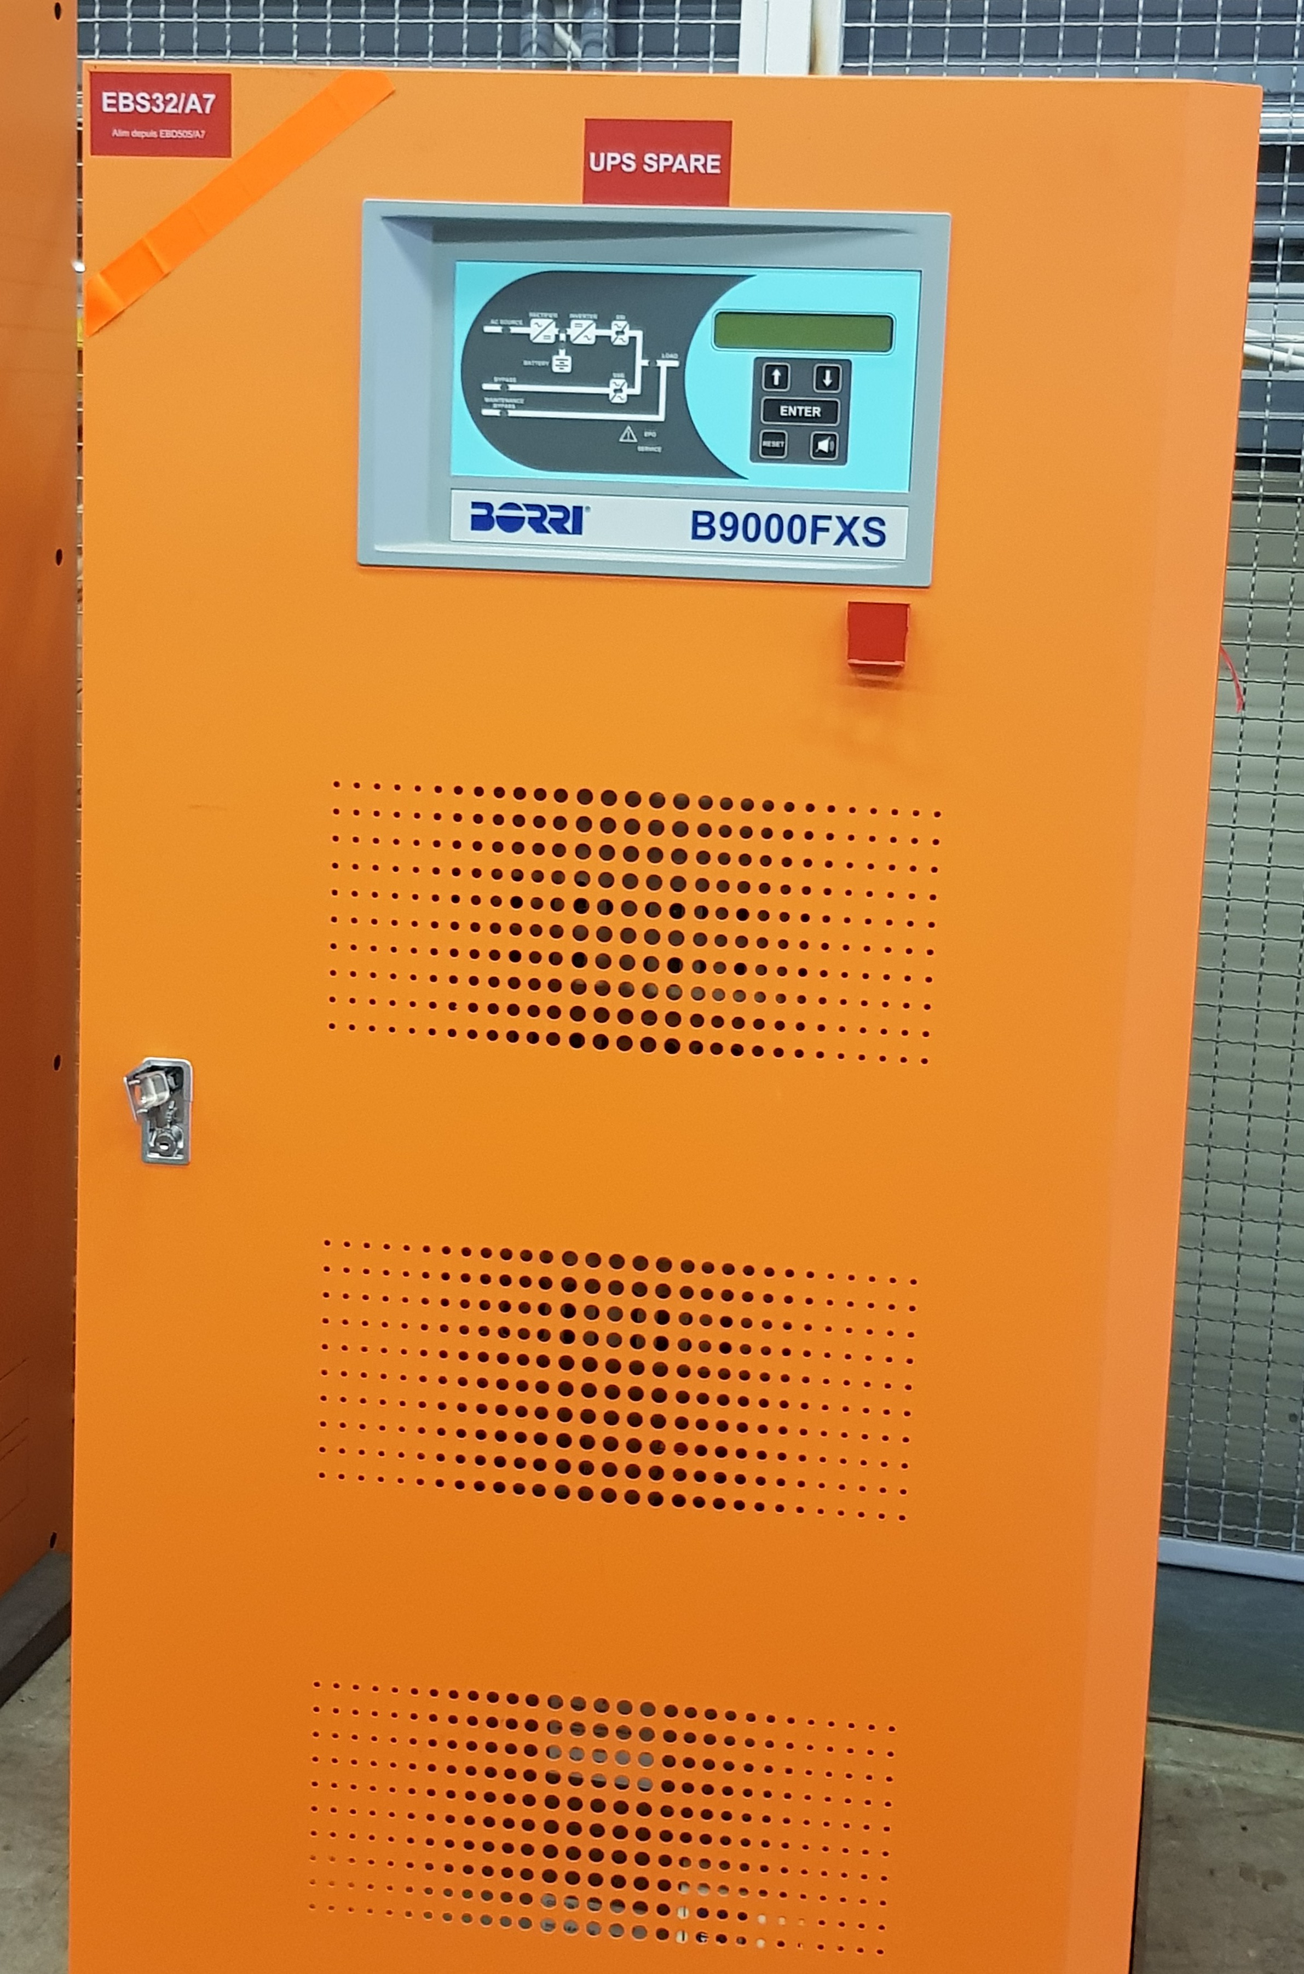
Measurements of the LHC (spare) UPS voltage spectra
G. Arduini, S. Kostoglou, Y. Papaphilippou, G. Sterbini
Measurements from EN-EL: J. Emonds-Alt, V. Chareyre,
P. Dominguez Chans, B. Saint Sulpice
Equipment: N. Biancacci, B. Salvant
Borri experts: F. Berti, F. Laponi
Valuable discussions & help: M. C. Bastos, M. Martino,
A. Lombardi, L. Timeo, D. Valuch
“Updates on noise studies” LMC 24/06/2020
WP2, 15.09.2020

Slide 2
Motivation
To determine if the UPS is a potential candidate for the high-f cluster (7-8 kHz) observed on the LHC transverse beam spectrum:

Slide 3
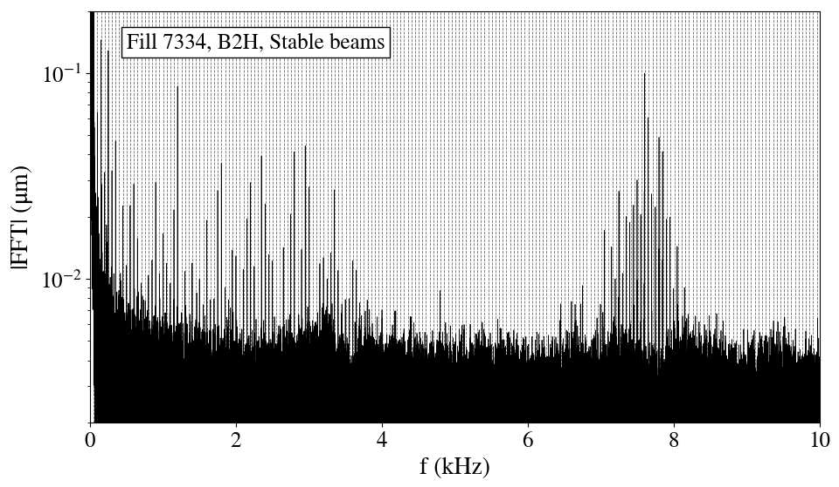
Motivation
To determine if the UPS is a potential candidate for the high-f cluster (7-8 kHz) observed on the LHC transverse beam spectrum:
  If UPS voltage spectrum contains 50 Hz harmonics.
Transverse beam spectrum
“High-f cluster”
50 Hz harmonics

Slide 4
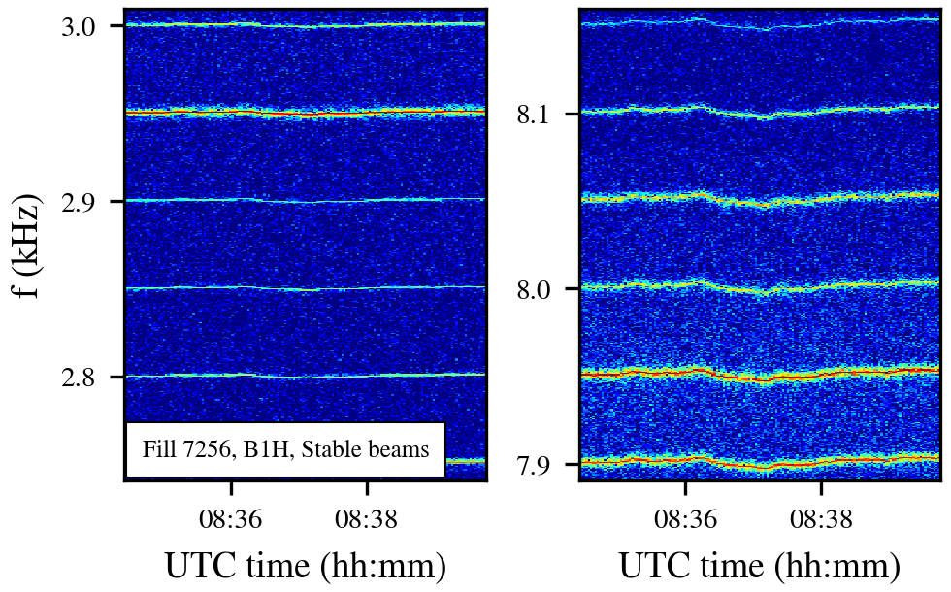
Motivation
To determine if the UPS is a potential candidate for the high-f cluster (7-8 kHz) observed on the LHC transverse beam spectrum:
  If UPS voltage spectrum contains 50 Hz harmonics.
  If spectral components are synchronized to the mains.
Transverse beam spectrum
“Low-f cluster”
“High-f cluster”

Slide 5
Motivation
To determine if the UPS is a potential candidate for the high-f cluster (7-8 kHz) observed on the LHC transverse beam spectrum:
  If UPS voltage spectrum contains 50 Hz harmonics.
  If spectral components are synchronized to the mains.
First measurements of the LHC UPS voltage spectra complete. Based on the results & experience gained → propose tests with beam for Run 3.

Slide 6
Outline
Introduction
Results: UPS voltage spectrograms
Conclusions & proposed tests for Run 3

Slide 7
Outline
Introduction
Results: UPS voltage spectrograms
Conclusions & proposed tests for Run 3

Slide 8
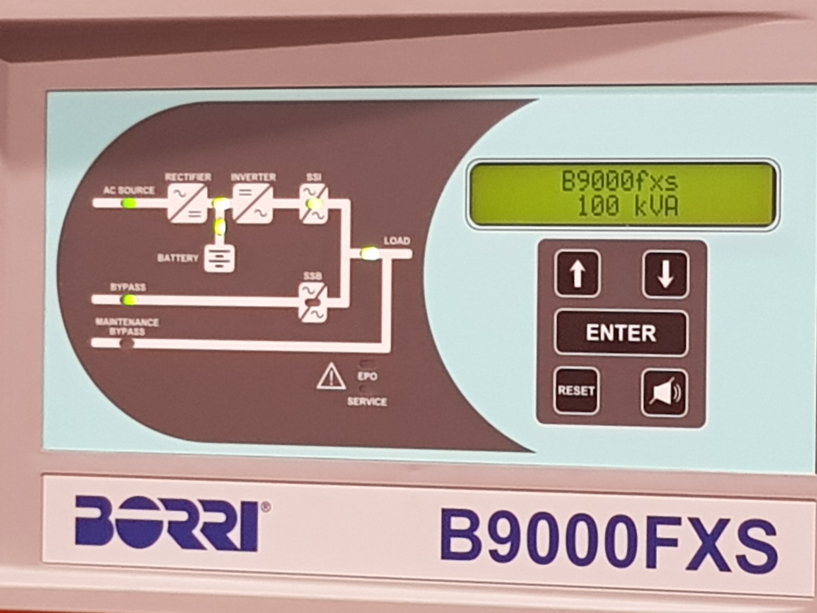
Introduction
Spare LHC UPS Borri B9000 100 kVA in BA7*.
ACin1
ACin2
* see appendix

Slide 9
Introduction
Spare LHC UPS Borri B9000 100 kVA in BA7*.
Main UPS components: rectifier, battery & inverter. Expected UPS voltage spectrum: SF of inverter (and harmonics) & 50 Hz sidebands.
ACin1
ACin2
* see appendix

Slide 10
Introduction
Spare LHC UPS Borri B9000 100 kVA in BA7*.
Main UPS components: rectifier, battery & inverter. Expected UPS voltage spectrum: SF of inverter (and harmonics) & 50 Hz sidebands.
Inverter’s switching frequency (SF) at 4 kHz.
ACin1
ACin2
* see appendix

Slide 11
Introduction
Spare LHC UPS Borri B9000 100 kVA in BA7*.
Main UPS components: rectifier, battery & inverter. Expected UPS voltage spectrum: SF of inverter (and harmonics) & 50 Hz sidebands.
Inverter’s switching frequency (SF) at 4 kHz.
Important UPS operation modes*: normal mode, on battery, bypass
ACin1
ACin2
* see appendix

Slide 12
Outline
Introduction
Results: UPS voltage spectrograms
Conclusions & proposed tests for Run 3

Slide 13
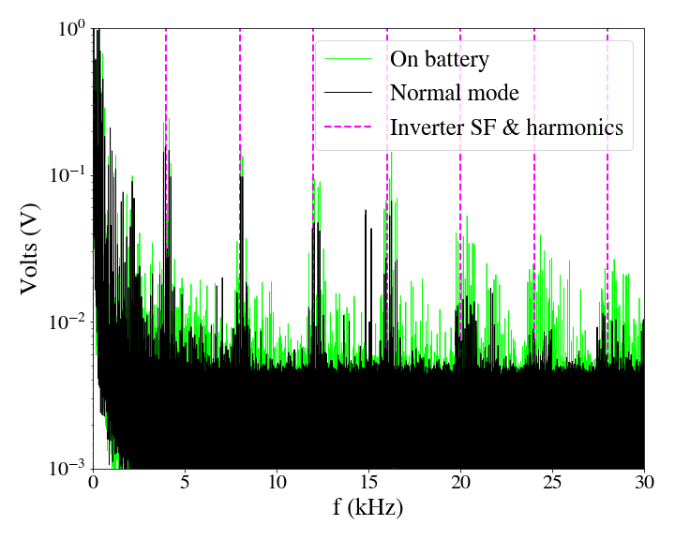
Results: UPS spectra
Inverter’s SF & harmonics

Slide 14
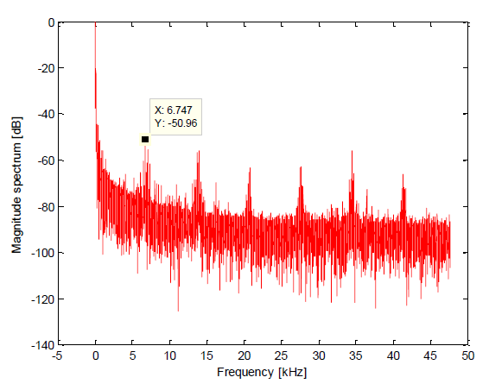
Results: UPS spectra
Present measurements
Inverter’s SF is clearly at 4 kHz.
Prior to LS1, the SF was at 8 kHz.
New UPS system was installed with SF at ~6.74 kHz* (not consistent with our observations).
Past measurements*
* V. Chareyre. Assessment of the High Frequency Noise Produced by the UPS Systems in the LHC Machine.

Slide 15
Results: UPS spectra
Present measurements
Inverter’s SF is clearly at 4 kHz.
Prior to LS1, the SF was at 8 kHz.
New UPS system was installed with SF at ~6.74 kHz* (not consistent with our observations).
→ The revolution and betatron frequency should always be considered when selecting SF.
Past measurements*
* V. Chareyre. Assessment of the High Frequency Noise Produced by the UPS Systems in the LHC Machine.

Slide 16
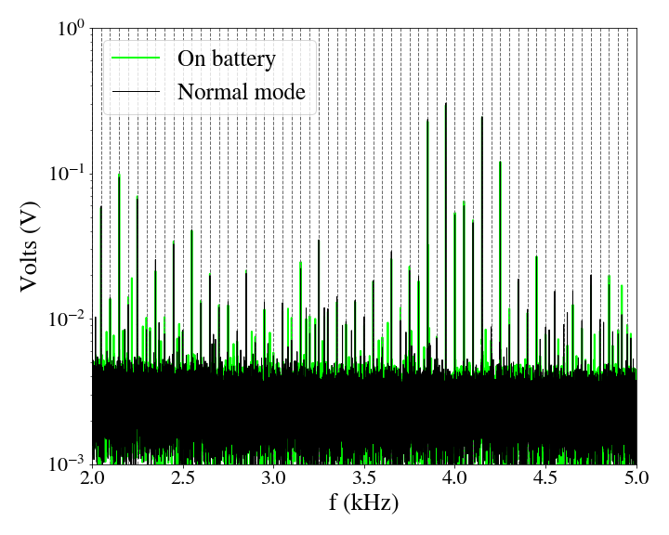
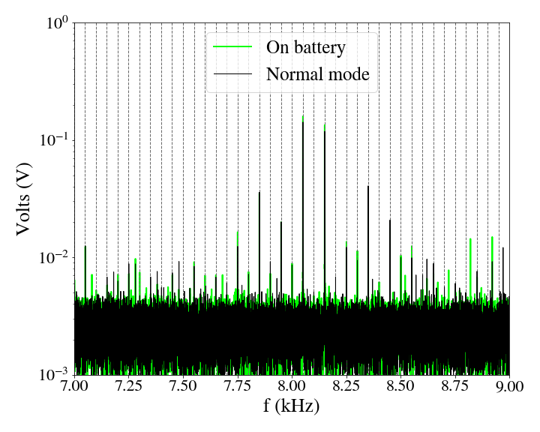
Results: UPS spectra
Spectral components around SF and its harmonics are 50 Hz harmonics.

Slide 17
Results: UPS spectra
Spectral components around SF and its harmonics are 50 Hz harmonics.
50 Hz sidebands are an expected feature as inverter relies on pulse-width modulation.
Slightly changing SF→ 50 Hz sidebands’ position would also change.

Slide 18
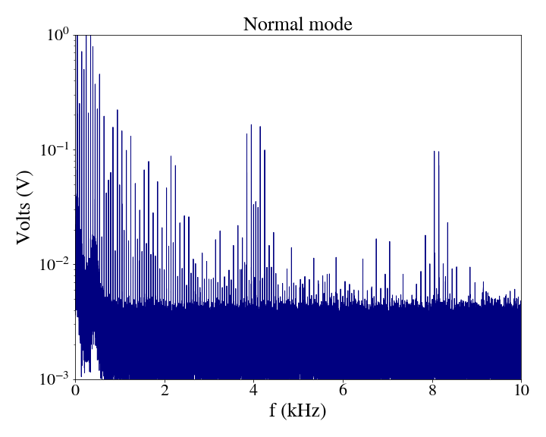
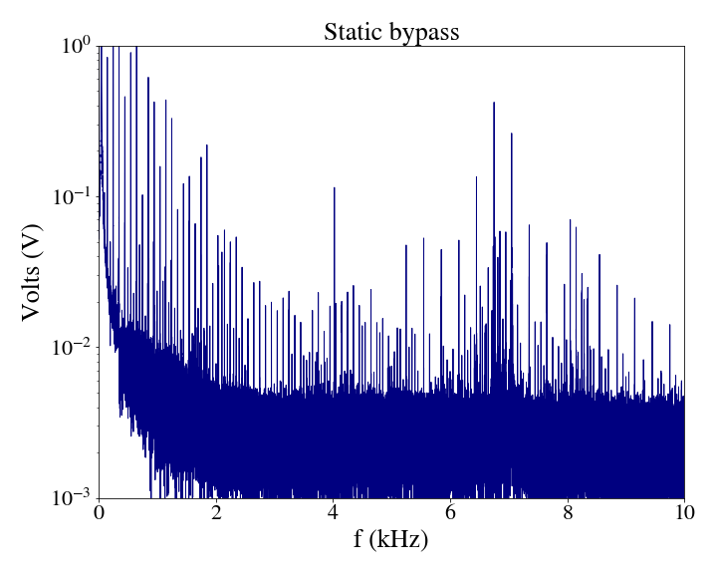
Results: UPS spectra
Switching UPS mode from normal to static bypass → UPS voltage spectrum changes.
Normal mode
Static bypass
Noise from the inverter
Noise from the mains

Slide 19
Results: UPS spectra
Switching UPS mode from normal to static bypass → UPS voltage spectrum changes.
If source of high-f cluster is UPS, this modification should be detected on the beam’s spectrum.
Normal mode
Static bypass
Noise from the inverter
Noise from the mains

Slide 20
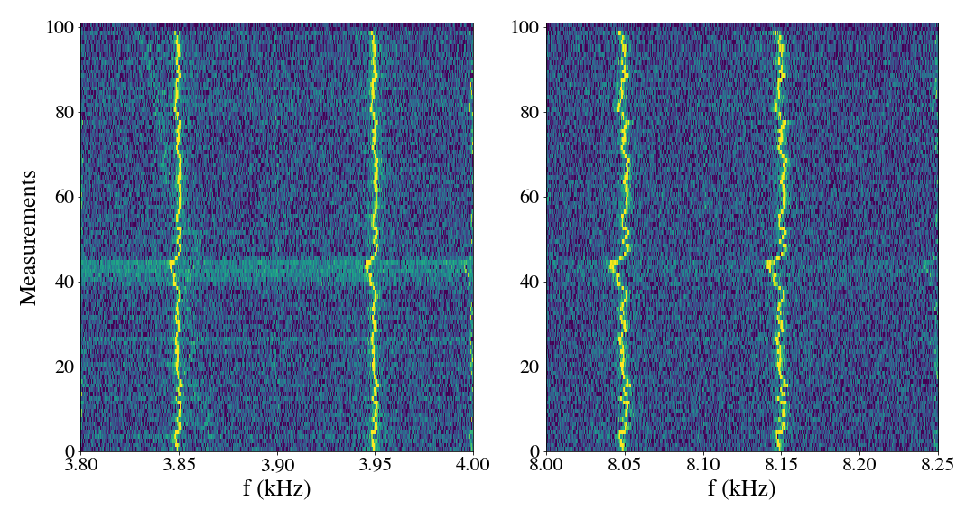
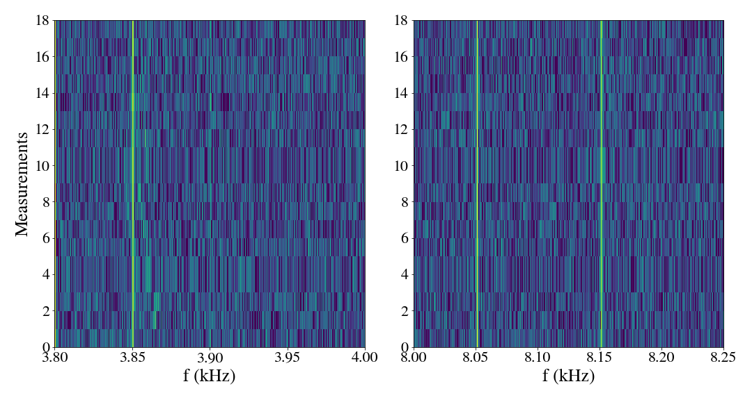
Results: UPS spectrograms
Normal mode
Clear synchronization with mains in normal mode.
Jittering not present when switching to battery mode and inhibiting synchronization.
On battery
Without synchronization with ACin1 & 2

Slide 21
Outline
Introduction
Results: UPS voltage spectrograms
Conclusions & proposed tests for Run 3

Slide 22
Conclusions
Goal of the study:
  To determine if UPS noise spectrum contains 50 Hz harmonics as observed on the LHC beam spectrum. Yes, 50 Hz harmonics around 4 kHz & 8 kHz (very close to betatron tune and alias).
  To determine if spectral components are synchronized to the mains as observed on the LHC beam spectrum. Yes, clear synchronization with mains in normal mode.

Slide 23
Conclusions
Goal of the study:
  To determine if UPS noise spectrum contains 50 Hz harmonics as observed on the LHC beam spectrum. Yes, 50 Hz harmonics around 4 kHz & 8 kHz (very close to betatron tune and alias).
  To determine if spectral components are synchronized to the mains as observed on the LHC beam spectrum. Yes, clear synchronization with mains in normal mode.
Based on this signature, the UPS is a potential candidate for the high-f cluster.

Slide 24

Conclusions
Goal of the study:
  To determine if UPS noise spectrum contains 50 Hz harmonics as observed on the LHC beam spectrum. Yes, 50 Hz harmonics around 4 kHz & 8 kHz (very close to betatron tune and alias).
  To determine if spectral components are synchronized to the mains as observed on the LHC beam spectrum. Yes, clear synchronization with mains in normal mode.
Based on this signature, the UPS is a potential candidate for the high-f cluster.
Tests with beam and different UPS configurations are needed to identify a correlation with the harmonics on the beam.

Slide 25
Proposed tests with beam for Run 3
Perturb UPS noise spectrum and observe if reproducible effect on transverse beam spectrum.

Slide 26
Proposed tests with beam for Run 3
Perturb UPS noise spectrum and observe if reproducible effect on transverse beam spectrum.
  Switch UPSs connected to ADT (2 in UX45 and 1 in SR4) from normal mode to static bypass with low intensity beam at injection.
  Similar test performed in the past without beam*. Important impact mainly from SR4.
  Remote operation not possible at the moment, new firmware required.
* see appendix

Slide 27
Proposed tests with beam for Run 3
Perturb UPS noise spectrum and observe if reproducible effect on transverse beam spectrum.
  Switch UPSs connected to ADT (2 in UX45 and 1 in SR4) from normal mode to static bypass with low intensity beam at injection.
  Similar test performed in the past without beam*. Important impact mainly from SR4.
  Remote operation not possible at the moment, new firmware required.
Next steps
SM18 warm measurements of LHC dipole transfer function up to 10 kHz.
* see appendix

Slide 28
Thank you for you attention

Slide 29
Backup

Slide 30
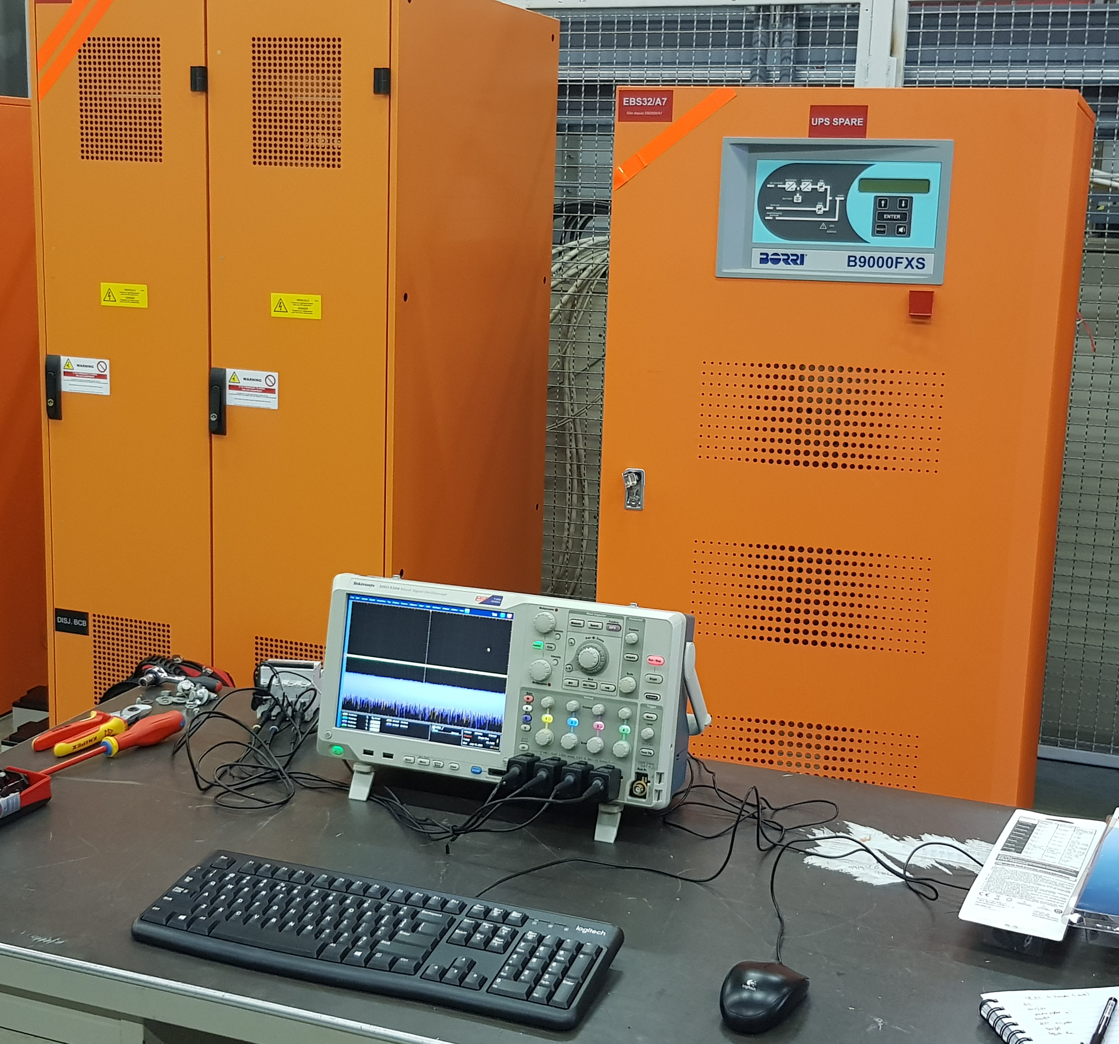
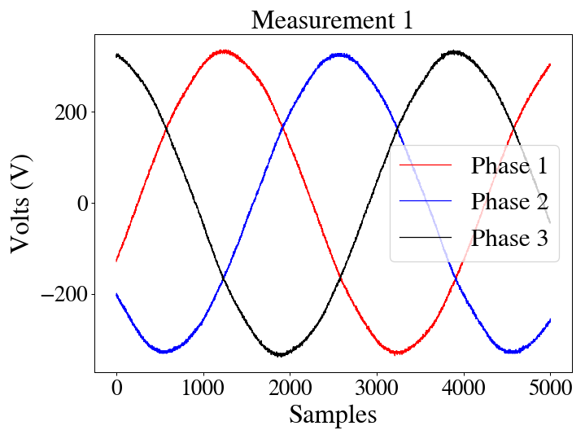
Measurement setup
Measurements in spare LHC UPS Borri B9000 100 kVA in BA7. Inverter’s SF at 4 kHz.
Sampling rate of 200 kHz, 10 s/acquisition & signals of 3 phases.
UPS
Oscilloscope
4P breaker

Slide 31
UPS operation modes
Normal mode: ACin1 → Rectifier→ Inverter→ Load
Synchronized to bypass (ACin2) through internal inverter PLL.
ACin1
ACin2

Slide 32
UPS operation modes
Normal mode: ACin1 → Rectifier→ Inverter→ Load
Synchronized to bypass (ACin2) through internal inverter PLL.
On battery: Battery→ Inverter→ Load
In case of power failure.
ACin1
ACin2

Slide 33
UPS operation modes
Normal mode: ACin1 → Rectifier→ Inverter→ Load
Synchronized to bypass (ACin2) through internal inverter PLL.
On battery: Battery→ Inverter→ Load
In case of power failure.
Static bypass: ACin2 → Switch → Load
Switches automatically to maintain power continuity in case of inverter failure.
ACin1
ACin2

Slide 34
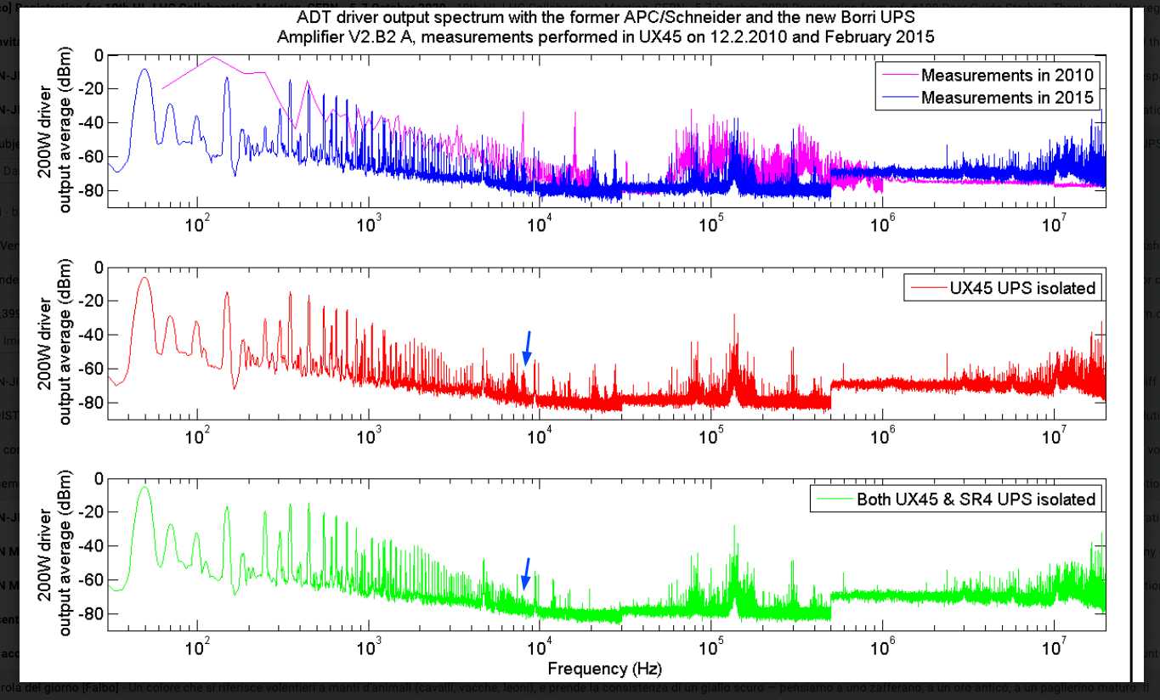
Past measurements with UX45 & SR4 UPSs to bypass
D. Valuch

