Slide 1


Optics commissioning with 250urad ??
WP2 meeting
15/09/2020
Crossing-angle in the first years of HL-LHC operation

Slide 2
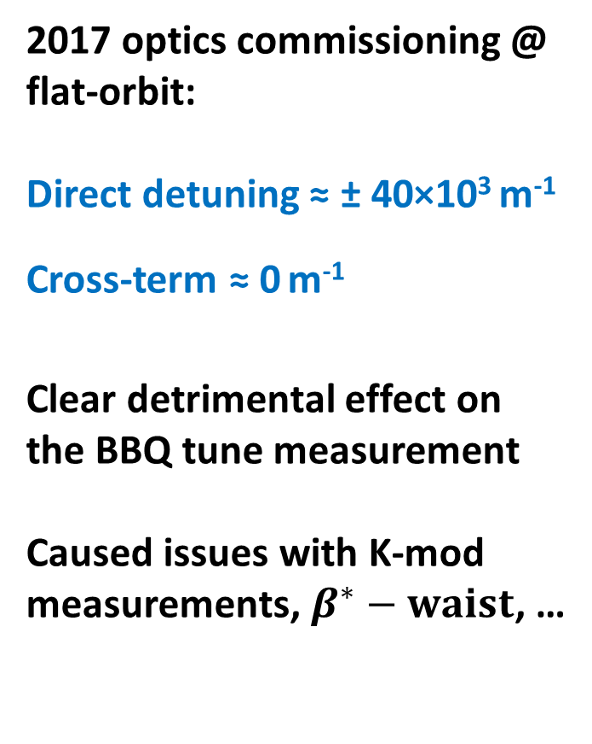
Success of linear optics commissioning is dependent on the uncorrected nonlinear errors present in the machine
2017 optics commissioning @ flat-orbit:
Direct detuning ≈ ± 40×10³ m⁻¹
Cross-term ≈ 0 m⁻¹
Clear detrimental effect on the BBQ tune measurement
Caused issues with K-mod measurements, $β^{∗}−waist$, …

Slide 3
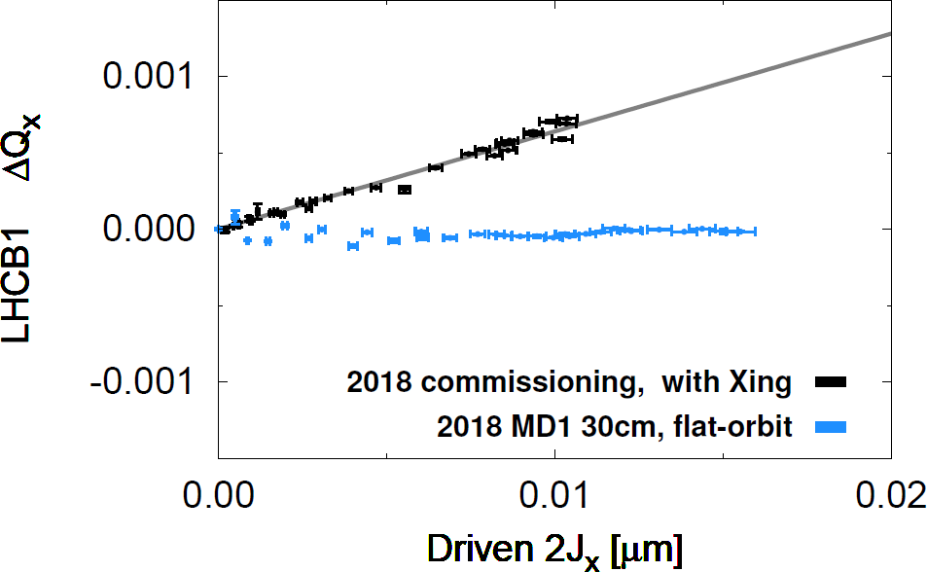
Since 2017 don’t just correct optics at flat-orbit, also perform linear optics corrections with operational crossing-scheme
Extra optics errors from sextupole feed-down (FD)
Also expect FD from a5,b5,
b6… to generate detuning
Already observed in LHC
But challenging and very time consuming to measure
Expect it will take some years to have dodecapole corrections fully validated/implemented in HL-LHC
Potential issue for HL-LHC optics commissioning in case of large b6 feed-down, also dependent on the crossing-scheme
Feed-down from decapole or dodecapole

Slide 4
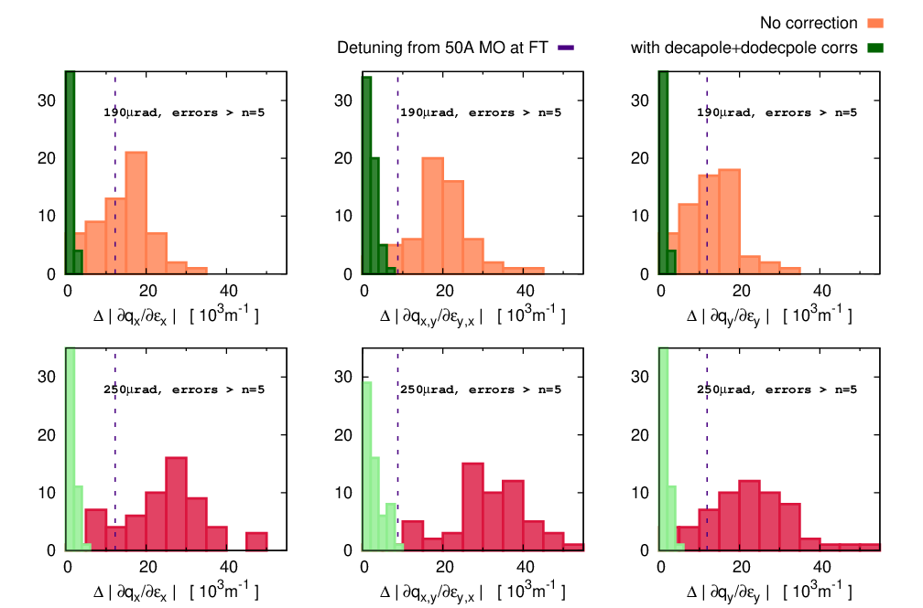
Predicted shifts to detuning coefficients due to feed-down at 40cm.
HL-LHC V1.4, systematic b6=-4[units] random 1[units]

Slide 5
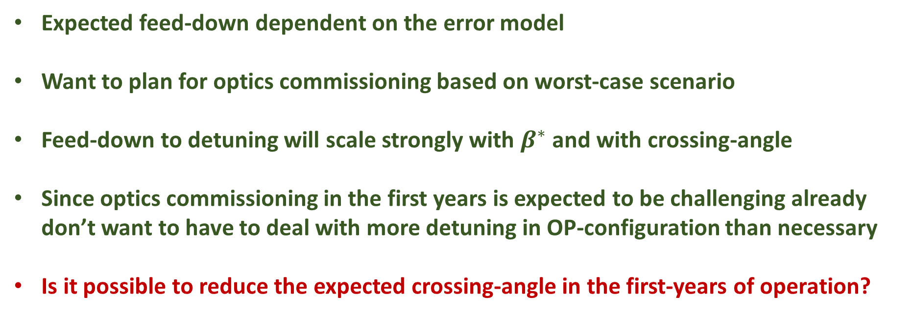
Expected feed-down dependent on the error model
Want to plan for optics commissioning based on worst-case scenario
Feed-down to detuning will scale strongly with $β^{∗}$ and with crossing-angle
Since optics commissioning in the first years is expected to be challenging already don’t want to have to deal with more detuning in OP-configuration than necessary
Is it possible to reduce the expected crossing-angle in the first-years of operation?

