Slide 1
Filimon Roukoutakis
some past background…
Marie Curie EST@CERN (FP6 RTN “MITELCO”, 2006-2009)
  PhD (University of Athens, 2010)
  “Phi and K* resonance analysis with/out pid and with
  kink kinematic pid in ALICE-LHC”
  Greek nationality
present status:
  Marie Curie ER@INFN-LNF, Frascati (RM), Italy since April 2010
  Working on: P12 (Optimization of Monte Carlo Tools and
  Comparison with Benchmark Data)
  Under the supervision of Stefano Miscetti

Slide 2
The job:
(as defined in P12 description)
Detailed simulation of lead/scintillating fibre (Scifi) calorimeters of different structures using Monte
Carlo tools (Fluka, Geant4) is relevant to evaluate and improve their energy response and sensitivity to
neutrons.
Two simulation programs with Fluka/Geant4 to describe neutron interaction on calorimeters
Geant4 version in close collaboration with the CERN group
Fluka version in collaboration with INFN Milan
Qualification of the programs with dedicated data-MC comparisons
Extensive use of benchmark data of neutron interaction on calorimeters taken with the KLOE detectors

Slide 3
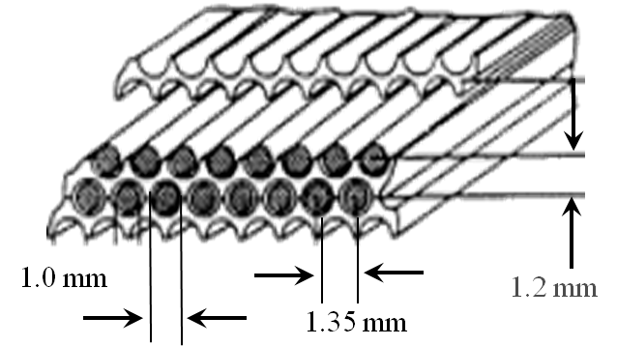
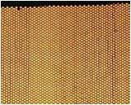
The problem:
Consistent detector description for several MC particle transport codes
GEANT3: The de-facto standard for many years
  Excellent handling of EM physics
  Hadronic physics not really including newer models
Geant4: mature enough to replace GEANT3 in most applications from the point of view of physics simulation and detector description
  Modern, modular C++ design and newer physics models
  Many interfaces for I/O and visualization
FLUKA: Quite advanced physics models quoted
  Rather unique I/O structure makes interaction with other packages challenging
  FLUGG interface quoted as unstable for ALICE detector and has not been recently maintained
  Flair seems convenient for standalone FLUKA usage though…
Each framework has its own way of defining geometries, materials
boundaries and interaction limits!
Describe this geometry and variants in a simulation-independent way if possible!

Slide 4
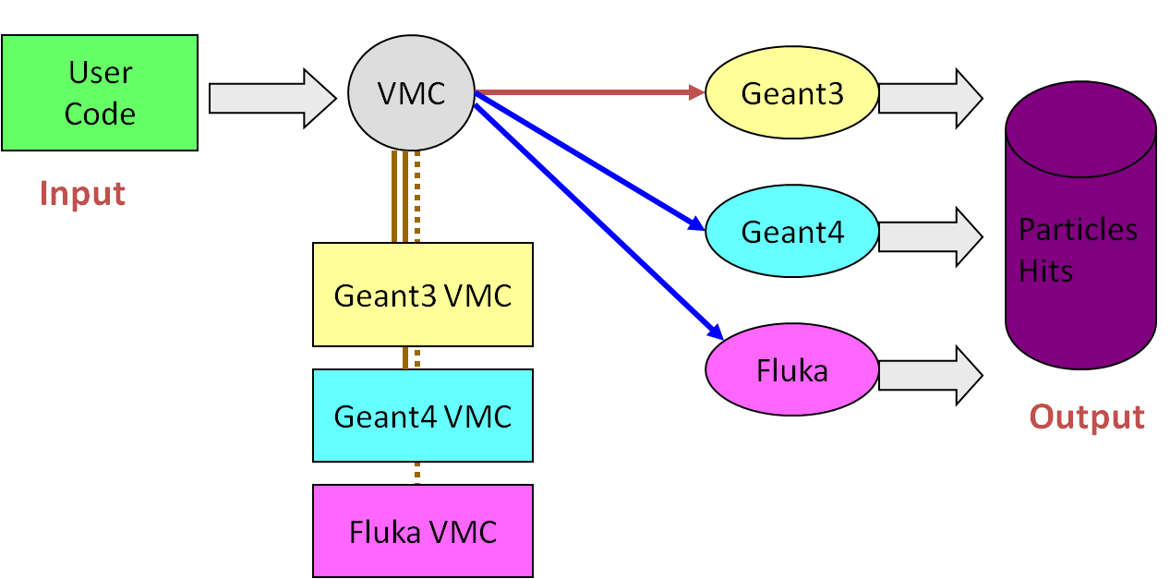
A possible solution:
Virtual Monte Carlo
Developed and tested by ALICE-LHC collaboration
Based on ROOT, the de-facto framework for physics analysis in HEP
Front-end is ROOT C++ code. User creates geometry in ROOT Geometric Modeller. Can be saved as .root file, .xml file, visualized within ROOT
Change of all parameters (materials, geometry, active physics processes) from within a unique set of C++ macros
Except the Geant4 and Fluka simulation requirement, GEANT3 simulation comes “as a bonus”
Notes:
The Virtual Monte Carlo (VMC) is a C++ API, part of ROOT, that defines an abstract interface for detector description and simulation. User code uses this interface to define geometry, interactions and run characteristics. The VMC loads on the fly the concrete Monte-Carlo (Geant3, Geant4, Fluka etc through their respective VMCs and executes the simulation. Results are persistent through VMC as ROOT objects.

Slide 5
My contribution:
Develop a software suite based on VMC but as generic as possible to be used outside KLOE too
The idea is to use ROOT interpreter-reflection capabilities to configure the application on-the-fly with detector geometry, material and physics configuration
A ROOT-loadable library allows the description of the detector and the physics configuration with standard C++ code, just like FORTRAN-like cards in FLUKA
Different primary particle generators can be plugged in (for the moment we have a simple particle gun with fixed momentum and direction and a source that simulates the test-beam setup done in TSL, Uppsala in 2008
The geometry was extracted from existing GEANT3 code, checked also against FLUKA and reference documentation

Slide 6
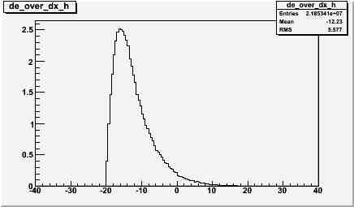
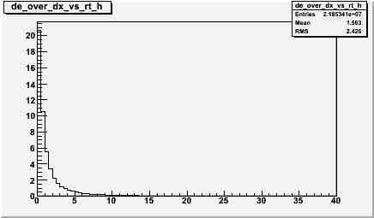
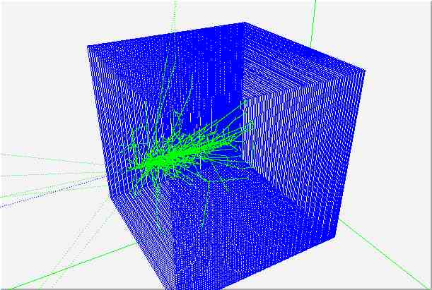
E/M shower preliminary analysis (1)
Longitudinal shower profile
GEANT3, 1000 events of 500 MeV e-
Lateral shower profile,
GEANT3, 1000 events of 500 MeV e-
Shower visualization,
GEANT3, 500 MeV e-

Slide 7
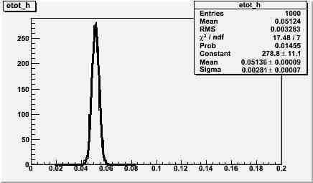
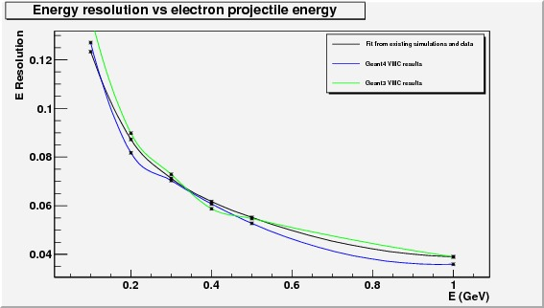
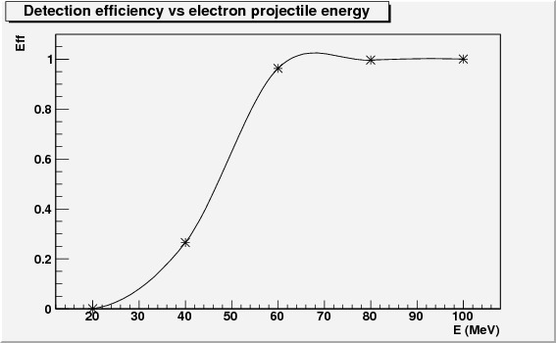
E/M shower preliminary analysis (2)
Various
energies
of
incident
electron
Example of resolution calculation for an energy slot
(Energy deposition of 1000 incident 500MeV electrons in
the sensitive volume (scintillator) and Gaussian fit)
Preliminary comparison of resolution obtained with GEANT3 (green), Geant4 (blue) versus test beam data fitted result (black)
Detection efficiency vs electron projectile energy
G4, 1000 events per energy bin

Slide 8
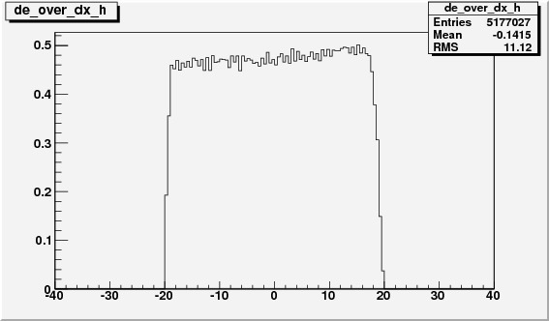
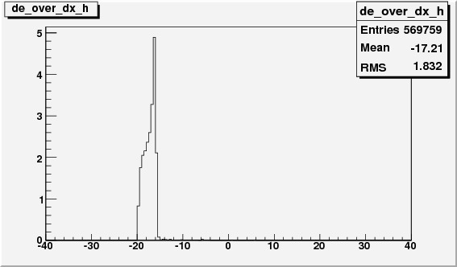
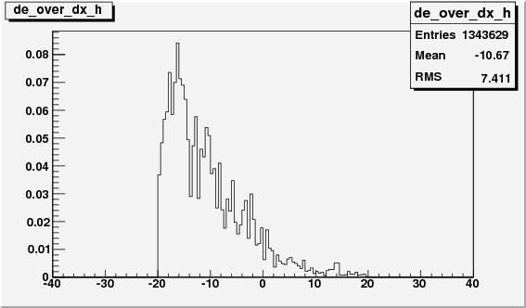
Longitudinal E/M shower profile
Other particles
Longitudinal shower profile
GEANT4, 1000 events of 500 MeV mu-
Longitudinal shower profile
GEANT4, 1000 events of 500 MeV p
Longitudinal shower profile
GEANT4, 1000 events of 100 MeV n

Slide 9
Overview - Training
30/1-2/2/2010: 2nd MC-PAD Network Training Event (before start of contract)
10-14/5/2010: The XV LNF Spring School "Bruno Touschek" in Nuclear, Subnuclear and Astroparticle Physics, in INFN-LNF, Italy
30/6-5/7/2010: ESOF 2010 and Marie Curie Satellite Event, Turin Lingotto, Italy
Several lectures on LNF site
Travel arrangements already made to attend “International Conference on Computing in High Energy and Nuclear Physics (CHEP), Taipei, Taiwan (18-22/10/2010)
1-14/9/2010: I was assigned as a reviewer for a paper submitted in Nuclear Instruments and Methods in Physics Research A (editor-in-chief Fabio Sauli, the inventor of GEM)

Slide 10
Overview - Results
Poster presented at the Marie Curie Satellite Event
Abstract accepted for a poster to be presented in IEEE NPSS Nuclear Science Symposium 2010, Knoxville, USA (30/10-6/11/2010)
The developed software suite will be available when finished from a webpage, providing a « turn-key » solution for generic detector simulation using ROOT geometry
Aiming at a peer-reviewed publication once some physics results are available

Slide 11
Conclusions and plans
A generic VMC application has been developed that allows the simulation of an arbitrary detector geometry without need to rebuild the code. An elegant solution that seems to solve the problem of a consistent detector description and parameterized analysis
Preliminary results for electromagnetic showers show agreement between GEANT3, Geant4 and test beam data
The “hits” part of the simulation is complete. Need to implement the digitization of the signal, from the scintillation to the PMT readout
After validation of the electromagnetic calorimeter, move to proton/neutron projectiles to simulate hadronic calorimetry
VMC allows the straightforward change of the geometric/material parameters thus enabling us to find the optimum cell size (minimum scintillator material for maximum efficiency)
P12-D1, P12-D3 in progress for Geant4/3, tbd for Fluka
Contacts and work with CERN experts

