Slide 1



Towards a HEP-workload
GEN GPU benchmark:
MadGraph5_aMC@NLO
Andrea Valassi (CERN IT-SC-RD)
HEPiX Benchmarking WG meeting, 5th November 2020 - https://indico.cern.ch/event/946409

Slide 2
Foreword: GEN workloads and GPUs in WLCG
MC event generators are essential for HEP physics analyses
  First step in the GEN-SIM-DIGI-RECO chain for simulated data
  MadGraph5_aMC@NLO (MGaMC) is one of the main generators at the LHC
Growing interest (and concerns) about the software aspects of generators
  GEN workloads are a sizeable (and growing) fraction of WLCG CPU budgets
    Currently ~12% for ATLAS (mainly Sherpa) and ~5% for CMS (mainly MGaMC)
  Paper for the HL-LHC LHCC review: https://arxiv.org/abs/2004.13687
    See also the recent LHCC talk: https://doi.org/10.5281/zenodo.4028834
  Code modernization and speedup, faster algorithms, port to new architectures…
WLCG does not provide/account GPUs yet, but it will one day
  Example: HPCs (and the experiments already have access to these resources)
  Only few workloads could make sizable use of GPUs today (e.g. CMS patatrack)
  Porting generators to GPUs would open up new ways of using GPUs in WLCG
    And generators are natural candidates for exploiting parallelism on GPUs (see later…)
⇒ Generators are a natural fit for preparing a HEP-workload GPU benchmark
  Bonus: in principle one can run exactly the same algorithm on CPUs and GPUs

Slide 3
MGaMC on GPU – overview
Why choose MadGraph and not another MC generator for a GPU port?
  Earlier efforts at KEK in 2010-2013, which were never released for production
    Touched both matrix element (ME) and MC integration – see summary at HOW2019
    We are ~not leveraging on this work (based on old version of MadGraph’s ME library)
  Main reason: active involvement of core MadGraph developer (Olivier Mattelaer)
Project is maintained on https://github.com/madgraph5/madgraph4gpu
  Overall coordination: Stefan Roiser
  Composite effort: physicists & engineers (CERN, Louvain, Argonne, Bangalore)
    Core CUDA development: AV, OM, SR, Taran Singhania
    Abstraction layers, profiling, MC integration: David Smith, Laurence Field, Smita Darmora, Taylor Childers, Tyler Burch, Walter Hopkins
    Just joined: Josh McFayden, Stephan Hageboek
  Meetings every two weeks
    Plus more frequent discussions of core CUDA developers
  The collaboration is largely a spin-off of the activities in the HSF generator WG
    https://hepsoftwarefoundation.org/workinggroups/generators.html

Slide 4
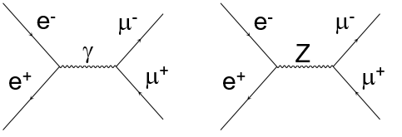
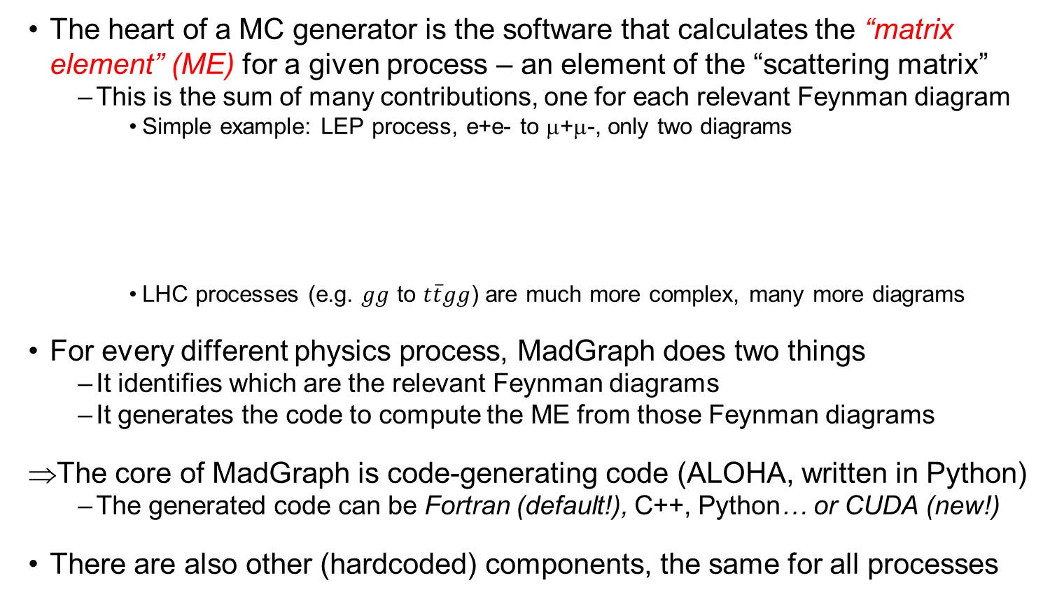
The core of MGaMC is a code-generating code
The heart of a MC generator is the software that calculates the “matrix element” (ME) for a given process – an element of the “scattering matrix”
  This is the sum of many contributions, one for each relevant Feynman diagram
    Simple example: LEP process, e+e- to μ+μ-, only two diagrams
    LHC processes (e.g. $gg$ to $t\overline{t}gg$) are much more complex, many more diagrams
For every different physics process, MadGraph does two things
  It identifies which are the relevant Feynman diagrams
  It generates the code to compute the ME from those Feynman diagrams
⇒The core of MadGraph is code-generating code (ALOHA, written in Python)
  The generated code can be Fortran (default!), C++, Python… or CUDA (new!)
There are also other (hardcoded) components, the same for all processes
⊕

Slide 5
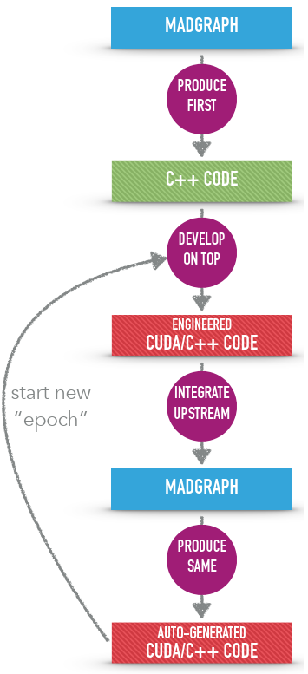
MGaMC on GPU – development process
MadGraph being a code-generating code complicates the development process
  We eventually must deliver CUDA-generating code
  We start from the C++-generating code
We start from a simple process, e+e- to μ+μ-
  Few diagrams = Few lines of code to manually port to CUDA, and manually optimize…
  Then the code-generating code must be adapted
  And we start another iteration
    Potentially on a complex process with more diagrams
Eventually: not only CUDA/Nvidia, also Intel, AMD?
  Either natively or using abstraction layers: oneAPI, SYCL, HIP/ROCm, Alpaka, Kokkos, OpenCL…
  Code-generating code would be needed for these too
S. Roiser, madgraph4gpu meeting, Oct 2020

Slide 6
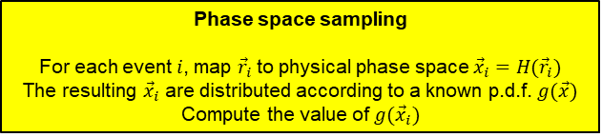
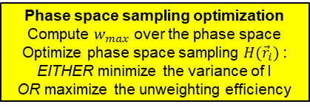
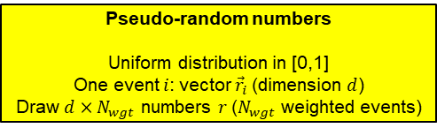
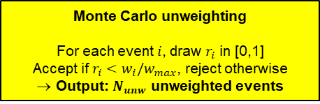
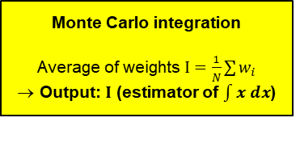
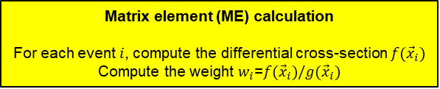
MC generators: simplified computational anatomy
Pseudo-random numbers
Uniform distribution in [0,1]
One event $i$: vector ${\vec{r}}_{i}$(dimension $d$)
Draw $d×N_{wgt}$ numbers $r$($N_{wgt}$ weighted events)
Phase space sampling
For each event $i$, map ${\vec{r}}_{i}$ to physical phase space ${\vec{x}}_{i}{=H(\vec{r}}_{i})$
The resulting ${\vec{x}}_{i}$ are distributed according to a known p.d.f. $g(\vec{x})$
Compute the value of ${g(\vec{x}}_{i})$
Phase space sampling optimization
Compute $w_{max}$ over the phase space
Optimize phase space sampling ${H(\vec{r}}_{i})$ :
EITHER minimize the variance of I
OR maximize the unweighting efficiency
Not shown explicitly here:
parton distribution functions (initial state parton flavors
and momenta are not fixed)
Matrix element (ME) calculation
For each event $i$, compute the differential cross-section ${f(\vec{x}}_{i})$
Compute the weight ${{w_{i}\text{=}f(\vec{x}}_{i})/g(\vec{x}}_{i})$
Monte Carlo integration
Average of weights $I=\frac{1}{N}\sum{w_{i}}$
Output: $I$ (estimator of $\int{x dx}$)
Monte Carlo unweighting
For each event $i$, draw $r_{i}$ in [0,1]
Accept if $r_{i}<w_{i}/w_{max}$, reject otherwise
Output: $N_{unw}$ unweighted events
Parton showers (PS)
Hadronisation and decay
For LHC processes, the ME calculation is the most computationally-intensive part
of the whole application workflow
(but this is not true in a simpler e+e- to μ+μ-)
Particle-level filtering
Detector simulation

Slide 7
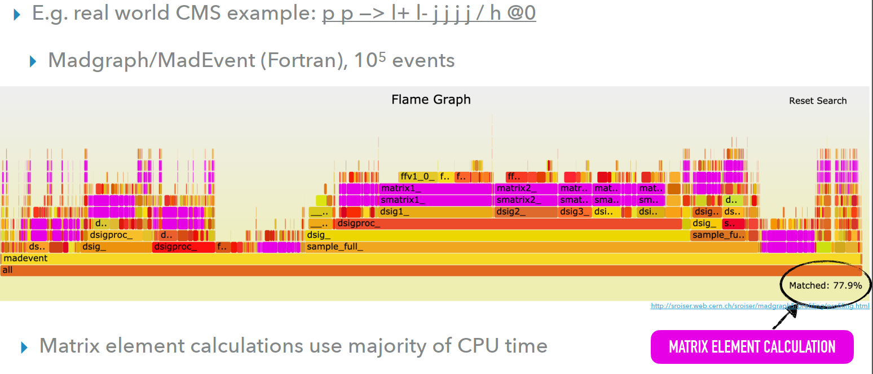
The ME calculation is where CPU is spent at LHC
Phase space sampling optimization (“integration”)
Unweighted event generation
S. Roiser, madgraph4gpu meeting, Oct 2020

Slide 8
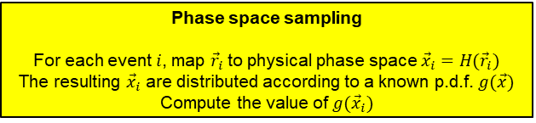
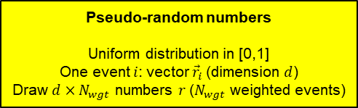

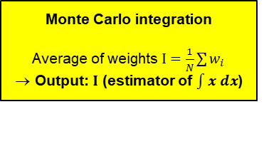
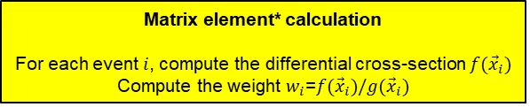
MGaMC on GPU: event-level data-parallel approach
One main reason why generators are excellent candidates for a GPU port:
  The compute-intensive ME calculation is exactly the same function for all events
  This reduces the risk of “thread divergence” on GPUs (unlike detector simulation)
We use an event-level data-parallel approach
  Execute the same operations on multiple data in parallel
  On GPUs: SPMD (Single Program Multiple Data)
  On CPUs: SIMD (Single Instruction Multiple Data)?
    Aka vectorization: eventually, we will also try to speed up the C++ code this way
(no input data)
Pseudo-random numbers
Uniform distribution in [0,1]
One event $i$: vector ${\vec{r}}_{i}$(dimension $d$)
Draw $d×N_{wgt}$ numbers $r$($N_{wgt}$ weighted events)
Phase space sampling
For each event $i$, map ${\vec{r}}_{i}$ to physical phase space ${\vec{x}}_{i}{=H(\vec{r}}_{i})$
The resulting ${\vec{x}}_{i}$ are distributed according to a known p.d.f. $g(\vec{x})$
Compute the value of ${g(\vec{x}}_{i})$
Matrix element* calculation
For each event $i$, compute the differential cross-section ${f(\vec{x}}_{i})$
Compute the weight ${{w_{i}\text{=}f(\vec{x}}_{i})/g(\vec{x}}_{i})$
Monte Carlo integration
Average of weights $I=\frac{1}{N}\sum{w_{i}}$
Output: $I$ (estimator of $\int{x dx}$)
Monte Carlo unweighting
For each event $i$, draw $r_{i}$ in [0,1]
Accept if $r_{i}<w_{i}/w_{max}$, reject otherwise
Output: $N_{unw}$ unweighted events

Slide 9
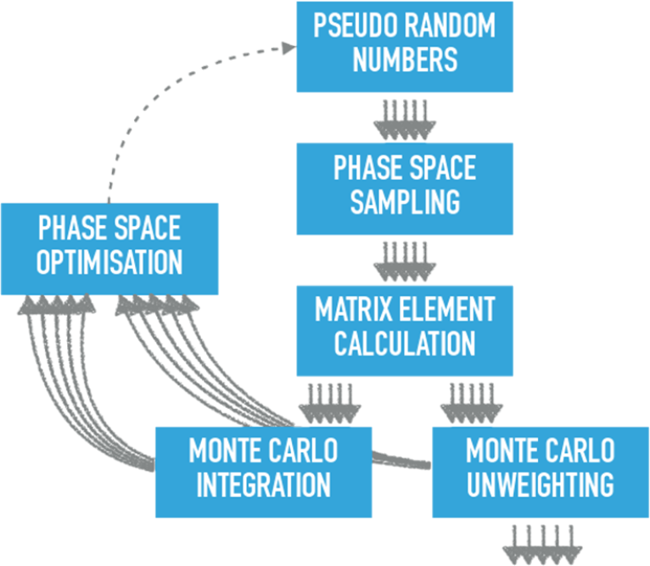
Status: where are we now?
On GPU:
cuRAND
On GPU:
RAMBO kernel
Basic (uniform) “democratic” sampler,
no optimization
PARTON DISTRIBUTION FUNCTIONS
On GPU:
SIGMAKIN kernel
ME for simple (LEP)
e+e- to μ+μ- process
CUDA implementation
Not yet fully ported upstream
to code-generating code
Single source code for C++ and CUDA (using #ifdef’s): same algorithms

Slide 10
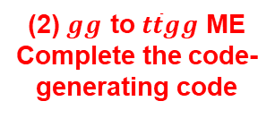
Status: which are we the (main) ingredients that we are missing for LHC processes?
On GPU:
cuRAND
(3) More efficient
sampler/integrator
on GPU: MadEvent
On GPU:
RAMBO kernel
Basic (uniform) “democratic” sampler,
no optimization
(4) PDFs on GPU
PARTON DISTRIBUTION FUNCTIONS
On GPU:
SIGMAKIN kernel
ME for simple (LEP)
e+e- to μ+μ- process
(2) $gg$ to $t\overline{t}gg$ ME
Complete the code-generating code
CUDA implementation
Not yet fully ported upstream
to code-generating code
Single source code for C++ and CUDA (using #ifdef’s): same algorithms
(1) More complete workflow
NB: this is needed also to extract more realistic benchmark results for a possible BMK container based on e+e- to μ+μ-

Slide 11
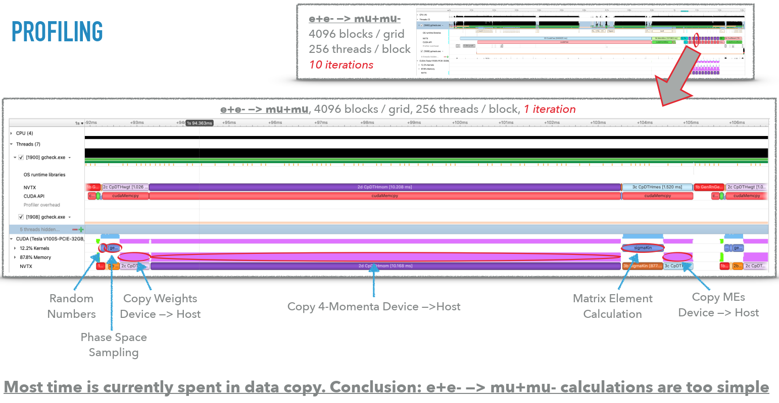
Benchmarking based on (our current) e+e- to μ+μ-?
S. Roiser, madgraph4gpu meeting, Oct 2020
Benchmarking GPUs today based on MG is possible, but VERY preliminary!
  1. Even for eeμμ, we need at least a realistic integration/unweighting workflow
  2. In any case, it would not be representative of more complex LHC processes

Slide 12
Hardware benchmarking, Software benchmarking
In the HEPiX BMK WG we mainly deal with hardware benchmarking
  Run the same frozen software on different CPUs/GPUs and compare them
    Goals: accounting/pledging and procurement of compute resources (à la HS06)
  Reproducible applications, pre-built and containerized as docker images
In the madgraph4gpu effort we do a whole lot of software benchmarking
  Change the software (or change build options) and compare old/new versions
  We do more, but we also compare software performance on different GPUs
    Software optimizations depend on hardware (professional/FP64 vs consumer/FP32)
    Software languages and abstraction layers depend on hardware (Nvidia, AMD, Intel)
There is a lot in common, but also some important differences
  Main similarity: we both need reproducible application workloads
  Main difference: prebuilt library/executables vs source code to rebuild
  It makes sense to keep these two efforts well synchronized

Slide 13
How do we benchmark our own code today? WIP!!!
./gcheck.exe -p 16384 32 12
***************************************
NumIterations = 12
NumThreadsPerBlock = 32
NumBlocksPerGrid = 16384
---------------------------------------
TotalEventsComputed = 6291456
RamboEventsPerSec = 8.130406e+07 sec^-1
MatrixElemEventsPerSec = 6.703134e+08 sec^-1
***************************************
MeanMatrixElemValue = 1.372152e-02 GeV^0
***************************************
00 CudaFree : 0.928572 sec
0a ProcInit : 0.000625 sec
0b MemAlloc : 0.062333 sec
0c GenCreat : 0.010851 sec
1a GenSeed : 0.000015 sec
1b GenRnGen : 0.007457 sec
2a RamboIni : 0.000108 sec
2b RamboFin : 0.000049 sec
2c CpDTHwgt : 0.006603 sec
2d CpDTHmom : 0.070621 sec
3a SGoodHel : 0.001733 sec
3b SigmaKin : 0.000081 sec
3c CpDTHmes : 0.009305 sec
4a DumpLoop : 0.022506 sec
8a CompStat : 0.031386 sec
9a GenDestr : 0.000064 sec
9b MemFree : 0.013876 sec
9c CudReset : 0.027250 sec
9d DumpScrn : 0.000217 sec
9e DumpJson : 0.000003 sec
TOTAL : 1.193654 sec
TOTAL(123) : 0.095971 sec
TOTAL(23) : 0.088500 sec
TOTAL(3) : 0.011118 sec
***************************************
./check.exe -p 16384 32 12
***************************************
NumIterations = 12
NumThreadsPerBlock = 32
NumBlocksPerGrid = 16384
---------------------------------------
TotalEventsComputed = 6291456
RamboEventsPerSec = 3.243099e+06 sec^-1
MatrixElemEventsPerSec = 3.962151e+05 sec^-1
***************************************
MeanMatrixElemValue = 1.372152e-02 GeV^0
***************************************
0a ProcInit : 0.000467 sec
0b MemAlloc : 0.055191 sec
0c GenCreat : 0.000923 sec
1a GenSeed : 0.000032 sec
1b GenRnGen : 0.321630 sec
2a RamboIni : 0.082014 sec
2b RamboFin : 1.857938 sec
3b SigmaKin : 15.878891 sec
4a DumpLoop : 0.019507 sec
8a CompStat : 0.028952 sec
9a GenDestr : 0.000104 sec
9b MemFree : 0.001440 sec
9d DumpScrn : 0.000248 sec
9e DumpJson : 0.000002 sec
TOTAL : 18.247335 sec
TOTAL(123) : 18.140505 sec
TOTAL(23) : 17.818844 sec
TOTAL(3) : 15.878891 sec
***************************************
CUDA/GPU
Full V100
C++/CPU
Single thread
RamboPerSec
No longer sure this makes sense… bug?
Exactly the same calculation, exactly the same result
Throughput adding Rambo – i.e. ME, plus:
- add random-to-momenta mapping
- (CUDA only) add copy momenta to host
- (CUDA only) add copy weight to host
GPU: 6M in 0.09 sec ~ 7E7/sec
CPU: 6M in 18 sec ~ 3E5/sec
GPU is ~x200 a single CPU thread
MEPerSec throughput:
- ME calculation
- (CUDA only) copy MEs to host
GPU: 6M in 0.011 sec ~ 7E8/sec
CPU: 6M in 16 sec ~ 4E5/sec
GPU is ~x1500 a single CPU thread
This is WIP!!! https://github.com/madgraph5/madgraph4gpu/issues/22
Device-to-host copies dominate because e+e- to μ+μ- MEs are too simple!

Slide 14
Nvidia GPUs – hackathons and profiling tools
Some of us attended the http://gpuhackathons.org Sheffield event in July
  Extremely beneficial for us, I highly recommend it for any CUDA developer!
  Many thanks to our mentors at this specific event! https://gpuhack.shef.ac.uk
This was useful also to understand performance in a benchmarking context
  Which features of the GPU hardware are relevant (e.g. registers, FP32/64…)
  Application profiling using two Nvidia tools, Nsight Systems and Nsight Compute
Most plots in these slides are from tools/concepts learnt at the hackathon
  Some detailed studies in https://github.com/madgraph5/madgraph4gpu/issues

Slide 15
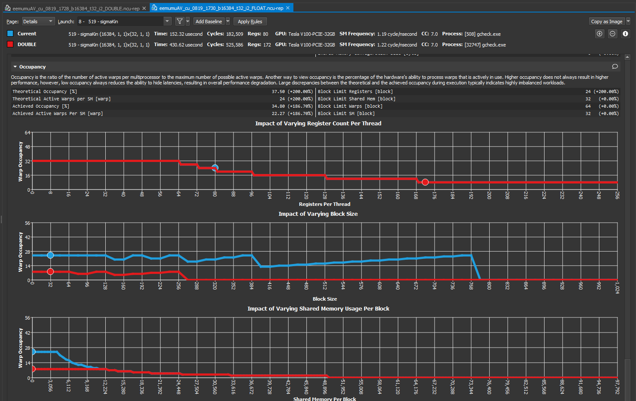
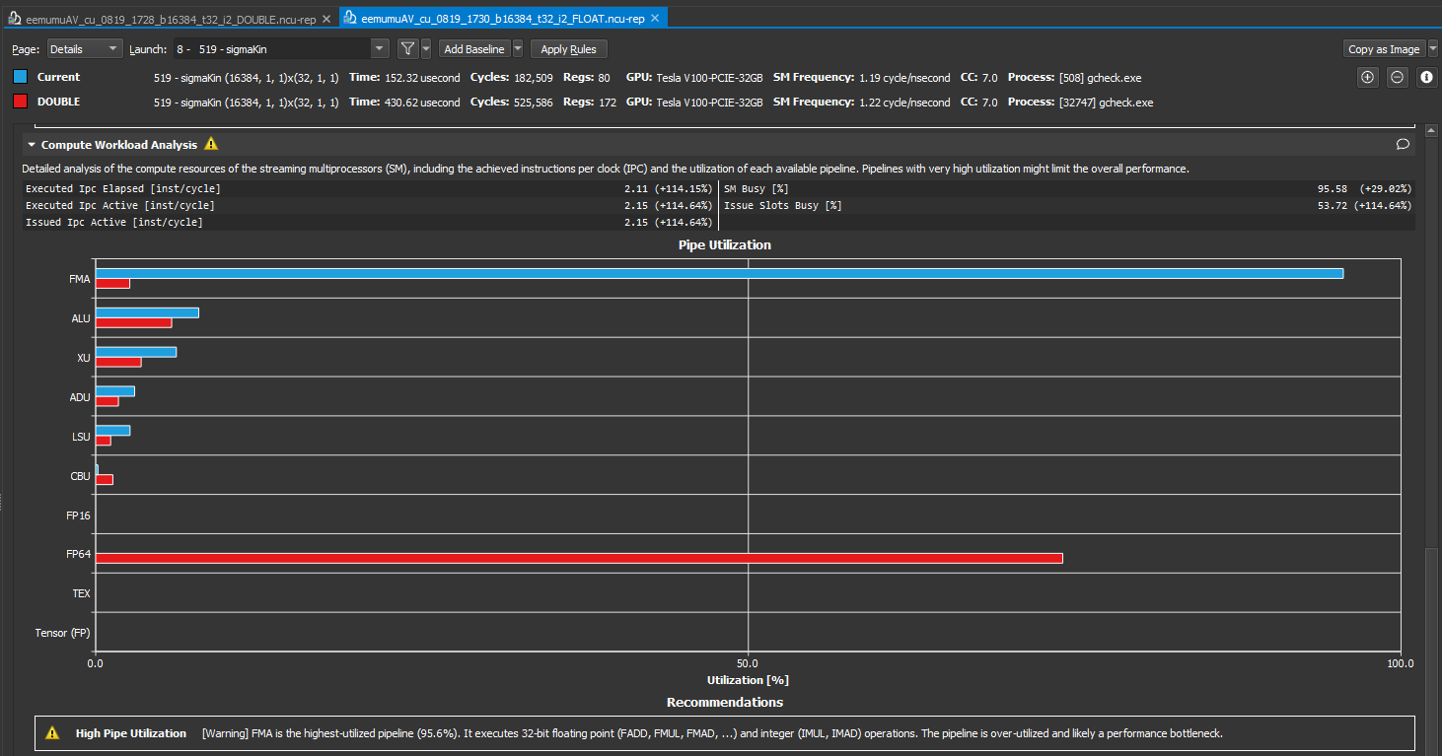
One example relevant to GPU benchmarking: float vs. double (consumer vs. professional cards)
By default MGaMC uses double-precision complex number arithmetic
  This is required for physics precision… but it is worth checking this again!
Moving from double to single precision (V100): gain a factor 2.4! (issue #5)
  Intuitively, being able to use FP32 cores and not only FP64 cores gains a factor 2
  In addition, single-precision reduces register pressure and increases occupancy
single is 2.4 faster than double (sigmakin = ME kernel)
Single Occupancy – Registers: 80
Active Warps per SM: ~22
FMA pipe (single)
FP64 pipe (double)
Double Occupancy – Registers: 172
Active Warps per SM: ~8

Slide 16
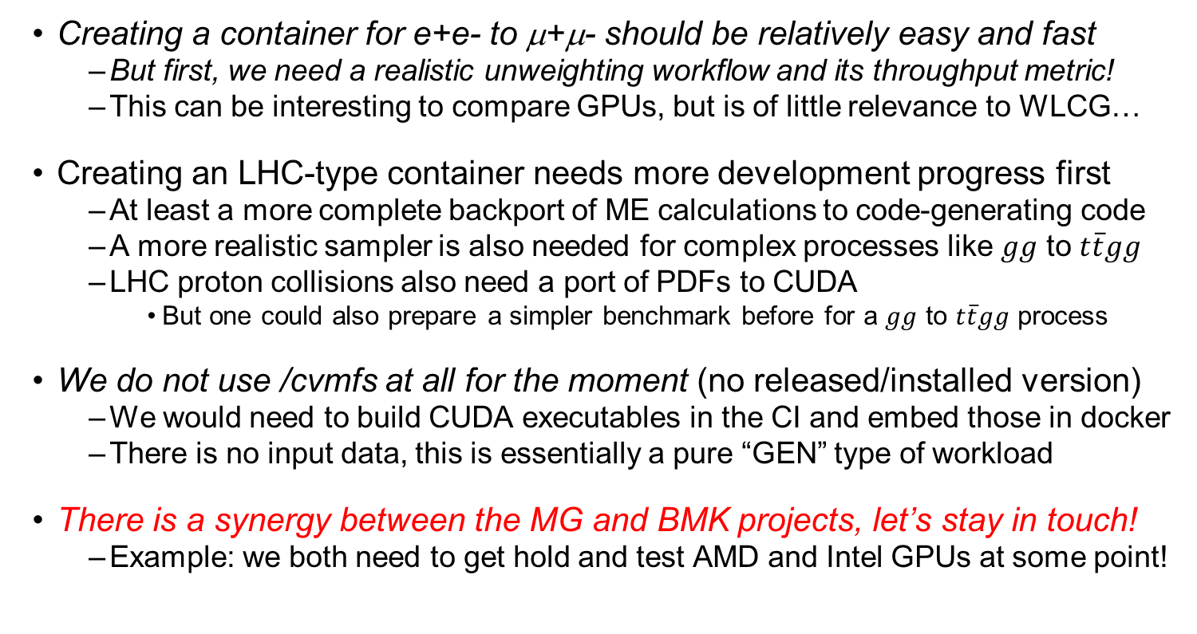
Outlook: a BMK container for MGaMC on GPU?
Creating a container for e+e- to μ+μ- should be relatively easy and fast
  But first, we need a realistic unweighting workflow and its throughput metric!
  This can be interesting to compare GPUs, but is of little relevance to WLCG…
Creating an LHC-type container needs more development progress first
  At least a more complete backport of ME calculations to code-generating code
  A more realistic sampler is also needed for complex processes like $gg$ to $t\overline{t}gg$
  LHC proton collisions also need a port of PDFs to CUDA
    But one could also prepare a simpler benchmark before for a $gg$ to $t\overline{t}gg$ process
We do not use /cvmfs at all for the moment (no released/installed version)
  We would need to build CUDA executables in the CI and embed those in docker
  There is no input data, this is essentially a pure “GEN” type of workload
There is a synergy between the MG and BMK projects, let’s stay in touch!
  Example: we both need to get hold and test AMD and Intel GPUs at some point!

Slide 17
Backup slides

Slide 18
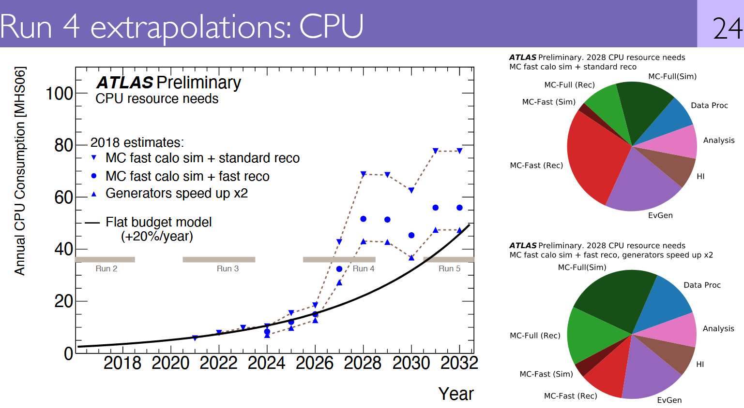

MC generators and HL-LHC software and computing
One of the main issues (not the only one!): HL-LHC computing resource gap
  Generator performance must also keep up with higher physics precision
Many other challenges, including:
  WLCG software workloads on non-traditional resources (HPCs, GPUs…)
  Funding and careers (especially at the theory/experiment/computing interface)
CPU cost of generators as a fraction of WLCG CPU resources:
for ATLAS, ballpark of 10%-20%
(for CMS, this is lower)
ATLAS considers an overall generator speedup by a factor x2 as an R&D goal for HL-LHC
Side note: the higher the fraction of negative-weight events from MC generators, the higher the CPU cost of MC simulation, MC reconstruction and analysis
(need more MC events)
WLCG meeting with LHCC referees, Feb. 2020

Slide 19
A few performance comparisons
A few studies from August 2020 (essentially the same code as today)
  Measurements on lxbatch: sensitive to external load, reproducible within ~10%
  Extensive discussion of numbers and Nsight Compute profiler plots on https://github.com/madgraph5/madgraph4gpu/issues
  General approach: change a #define switch to a non-default value in the code
    Now kept cuComplex and float switches, but hardcoded AOSOA and “local” memory
From double precision to single precision: gain a factor 2.4! (issue #5)
  FMA (FP32) used instead of FP64 pipe; fewer registers hence higher occupancy
Memory layout for 4-momenta (issue #16): study “requests” vs “sectors”
  Default: AOSOA with 4 events per array (four 8-byte doubles: 32-byte cache line)
    AOS ~7% slower: memory not coalesced, #sectors (transactions) factor 4 higher
    SOA ~2% slower: slightly higher number of registers
  Side result of this study: improve helicity filtering to reduce #requests (issue #24)
Memory for wavefunctions in ixxx/oxxx/FV_xx (issue #7): default is “local”
  Lose 70% with “global” (become memory-bound!), also lose 35% with “shared”
From thrust::complex to cuComplex: lose ~5% (issue #6)
  Require execution of higher number of instructions (something to fix?)

Slide 20
FP: double vs single precision (issue #5)
Two main effects
  Exploit the FP32 units (unused otherwise!)
  Fewer registers hence higher warp occupancy
FMA pipe (single)
FP64 pipe (double)
single is 2.4 faster than double
(sigmakin = ME kernel)
Single Occupancy
Registers: 80
Active Warps per SM: ~22
Double Occupancy
Registers: 172
Active Warps per SM: ~8

Slide 21
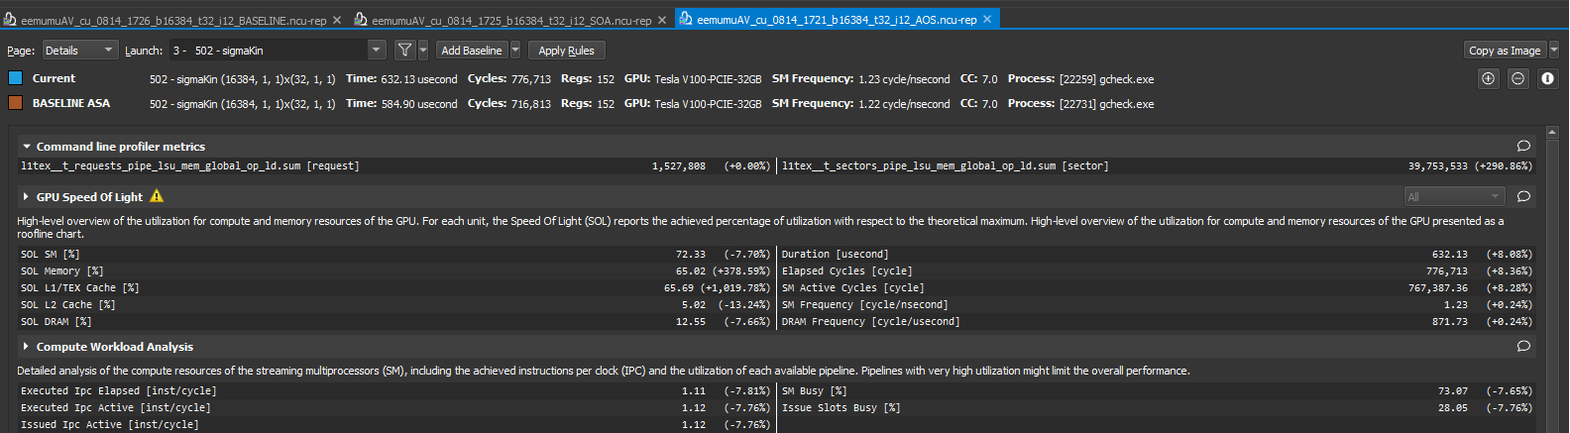
4-momenta memory: AOSOA vs AOS (issue #16)
Number of “requests”:
- It is the same for AOSOA or AOS (the same information needs to be retrieved…)
- Later on, the number show here was dramatically decreased by improving helicity filtering (issue #24)
Number of “sectors” (transactions):
- It is a factor 4 higher for AOS than for AOSOA
- One roundtrip (AOSOA, coalesced) vs four roundtrips (AOS, not coalesced) to retrieve four 8-byte doubles from a 32-byte cache line
A few useful links:
https://developer.nvidia.com/blog/using-nsight-compute-to-inspect-your-kernels/
https://docs.nvidia.com/nsight-compute/2019.5/NsightComputeCli/index.html#nvprof-metric-comparison
https://stackoverflow.com/questions/60535867/what-is-a-transaction-and-a-request-in-the-gld-transactions-per-request-metric

Slide 22
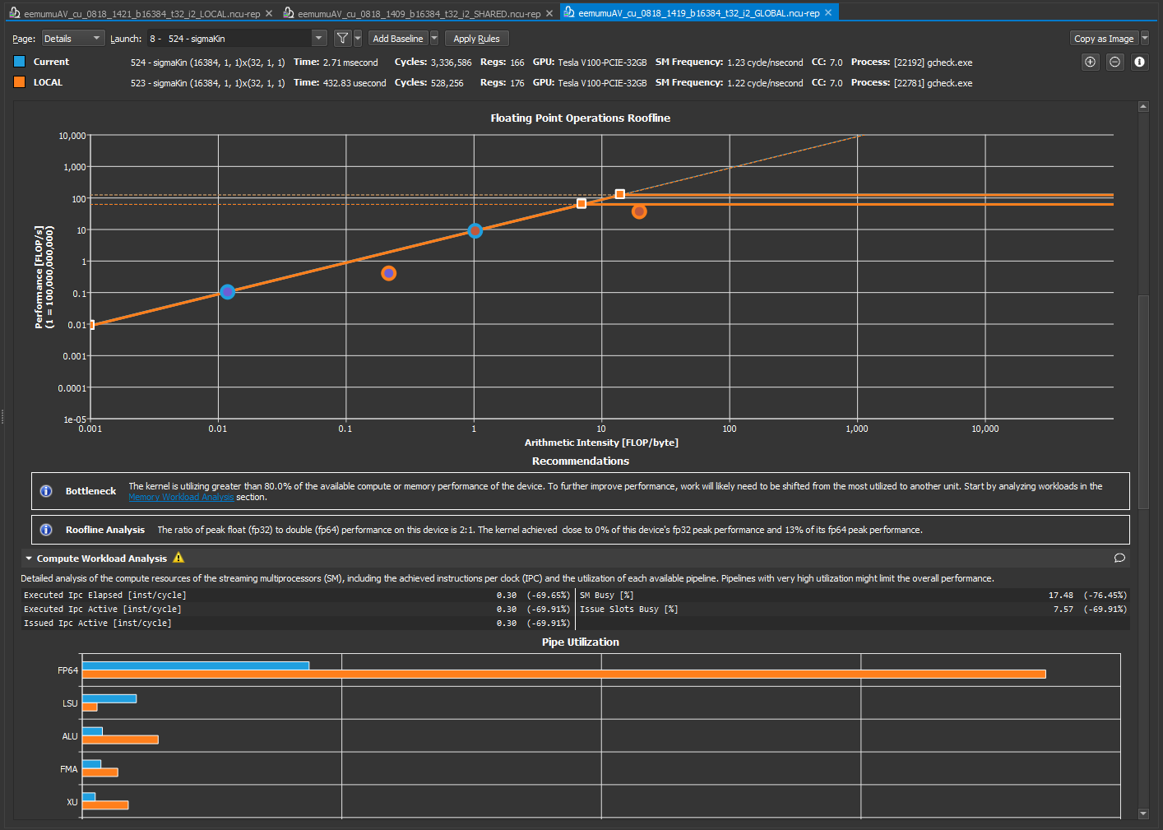
Wavefunction memory: “local” vs “global” (issue #7)
Roofline: “local”
is compute-bound
FP64
FP32
Roofline: “global” is memory-bound

Slide 23
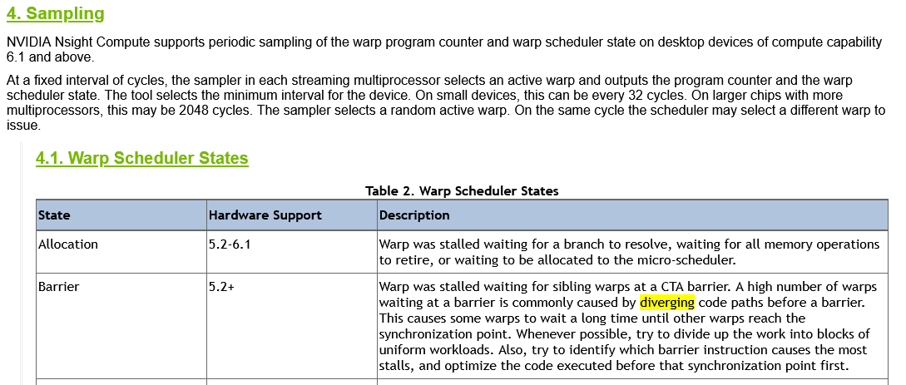
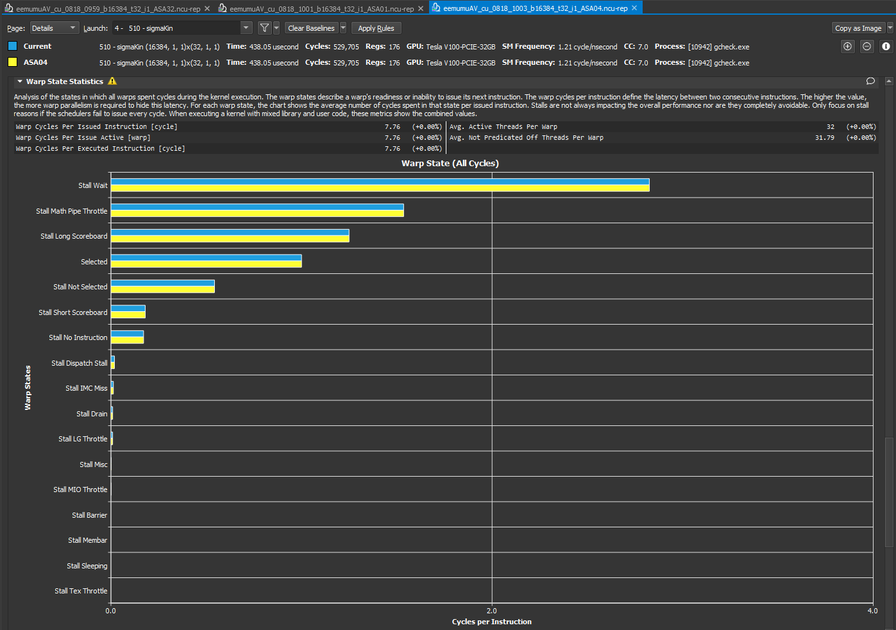
No evidence for
“thread divergence”
(issue #25)
https://docs.nvidia.com/nsight-compute/ProfilingGuide/index.html#statistical-sampler
Nsight Compute:
  Stall Barrier = 0
Similarly, no indication for thread divergence from Nsight System

