Slide 1
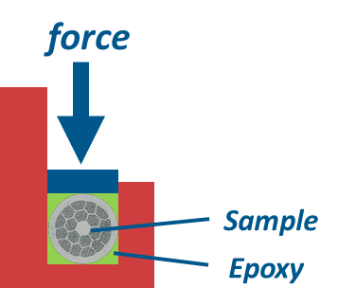



A flavour of HTS: transverse stress sensitivity of Bi2212 wires
PIT 192
I_{c0}(B=19T) = 135 A
Irreversible stress limit at ~ 70 MPa
No recover of I_{c} after unload
RRP 108/127

