Slide 1


Connecting fluctuation measurements and grand canonical susceptibilities: global conservation effects
Roman Poberezhnyuk (BITP, FIAS)
NA61/SHINE Open Seminar (virtual)
August 20, 2020
with Volodymyr Vovchenko, Oleh Savchuk, Volker Koch, Mark Gorenstein, Kirill Taradiy, Viktor Begun,
Leonid Satarov, Jan Steinheimer, Horst Stoecker

Slide 2
Fluctuations in strongly interacting matter
Fluctuations probe finer details of the (QCD) equation of state
Fluctuation measures --- Cumulants (susceptibilities) of distributions --- are sensitive to fine details of interactions, e.g., phase structure
in GCE:
2

Slide 3
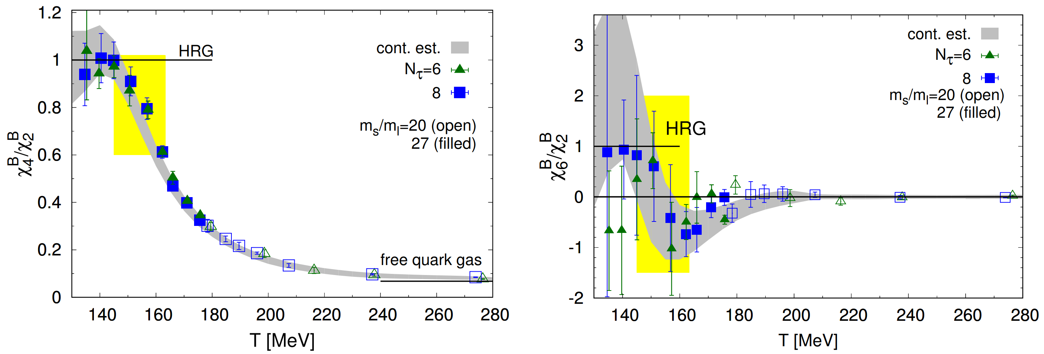
Lattice QCD (fluctuations of conserved charges)
Bazavov et al. (HotQCD), 1701.04325
3

Slide 4
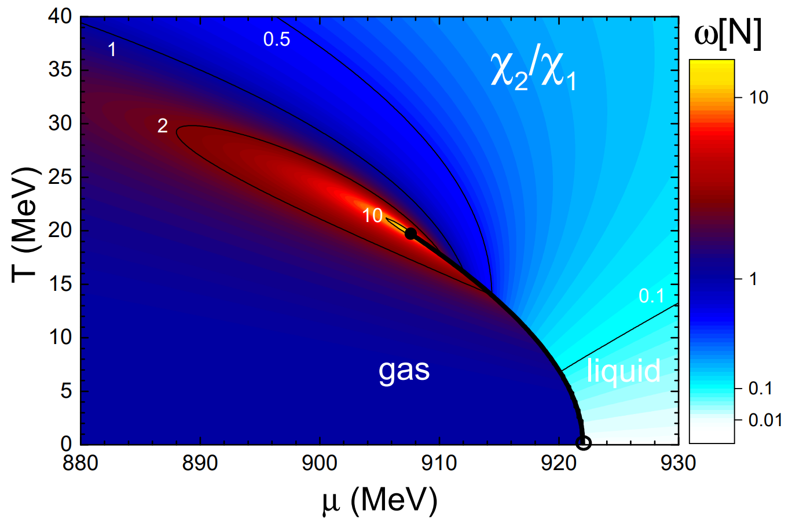
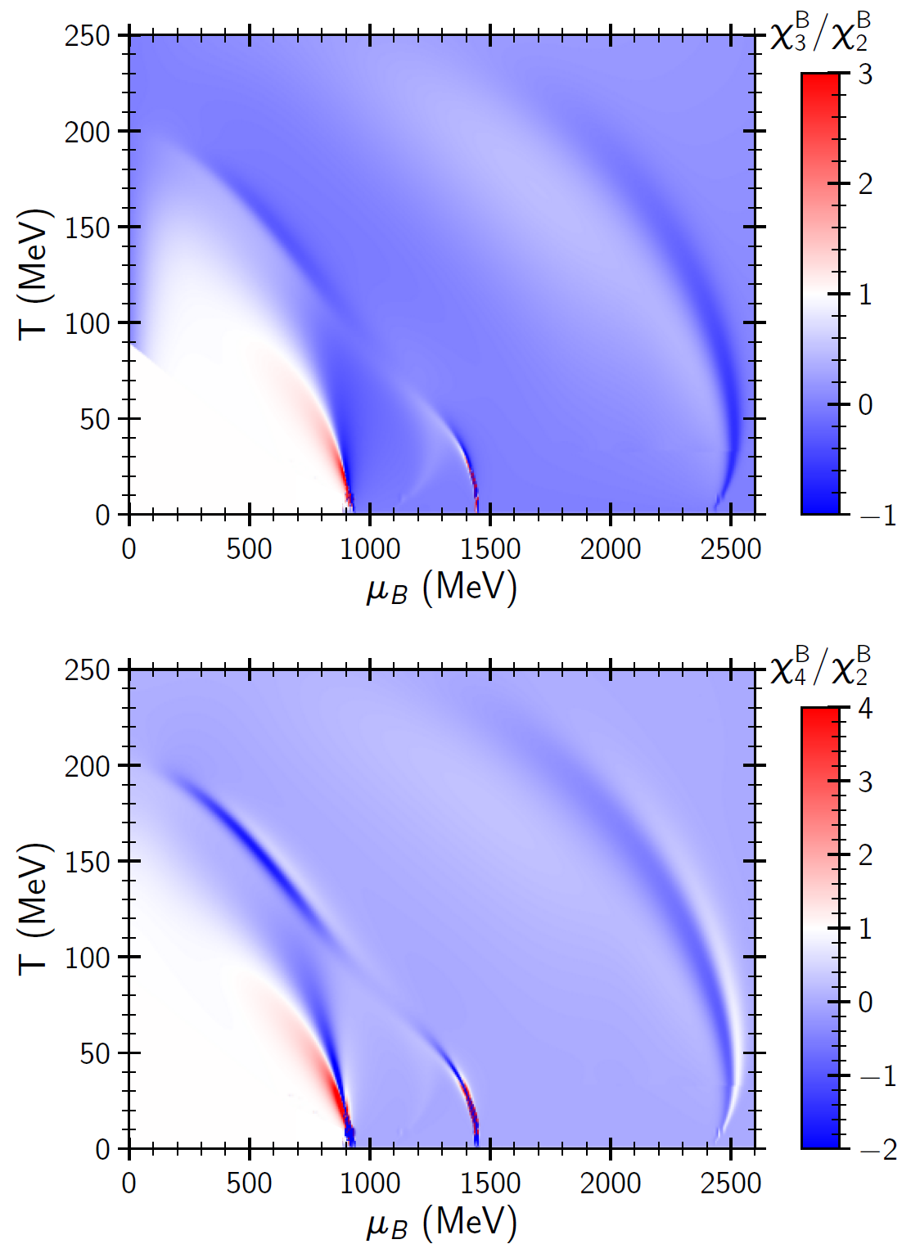
Statistical models (HRG, effective QCD,...)
V.Vovchenko et al, PRC 2015
A.Motornenko. et al, PRC 2020
R.P. et al, PRC 2019
4

Slide 5
Grand canonical ensemble
Total system, V=V₁+V₂, is in the canonical ensemble (CE)
Subsystem (observed), V₁ = αV
Reservoir (thermostat), V₂
coordinate space
α = V₁/V
5

Slide 6
Grand canonical ensemble
Total system, V=V₁+V₂, is in the canonical ensemble (CE)
Subsystem (observed), V₁ = αV
Reservoir (thermostat), V₂
coordinate space
α = V₁/V
Requirements for GCE:
1) V₁ ≫ ξ --- (Thermodynamic limit) --- ratios of extensive quantities become V-independent
2) V ≫V₁ --- (Subsystem is a small part of the system<=>α<<1)
V ≫ V₁ ≫ ξ
5

Slide 7
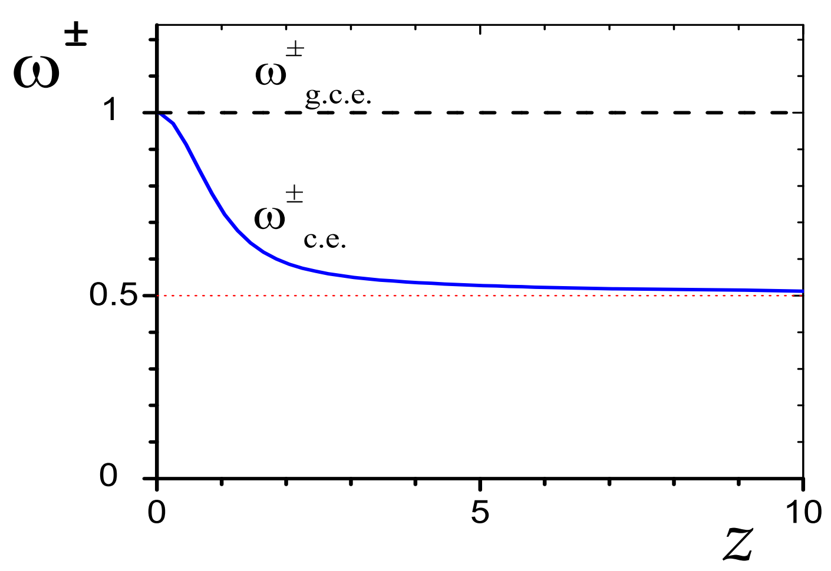
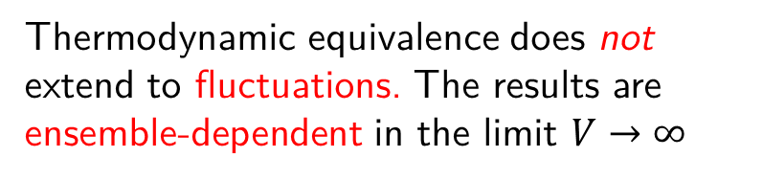
Equivalence of ensembles
Begun, Gorenstein, Gazdzicki, Zozulya, PRC 2004
6

Slide 8
Subensemble
V ≫ V₁ ≫ ξ
Global conservation effects
Finite size effects
Finite sybsystem in finite reservoir corresponds to Subensemble ---
the generalization of grand canonical and canonical statistical ensembles
V.Vovchenko, O.Savchuk, R.P., M.Gorenstein, V.Koch, 2003.13905 [hep-ph], 2020
R.P., O.Savchuk,, M.Gorenstein, V.Vovchenko, K.Taradiy, V.Begun, L.Satarov, J.Steinheimer, H.Stoecker PRC, 2020
Relevant for heavy-ion collision experiments
7

Slide 9
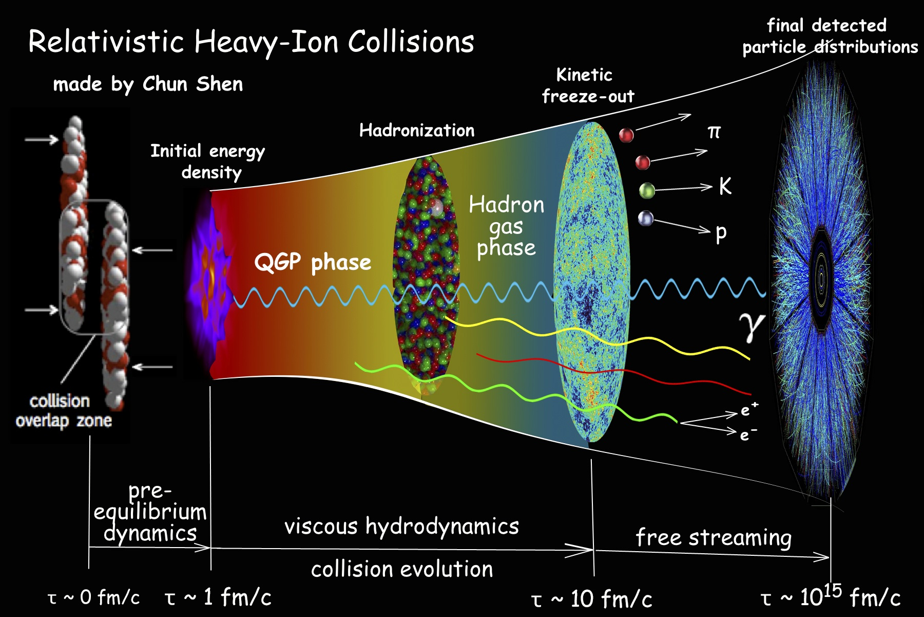

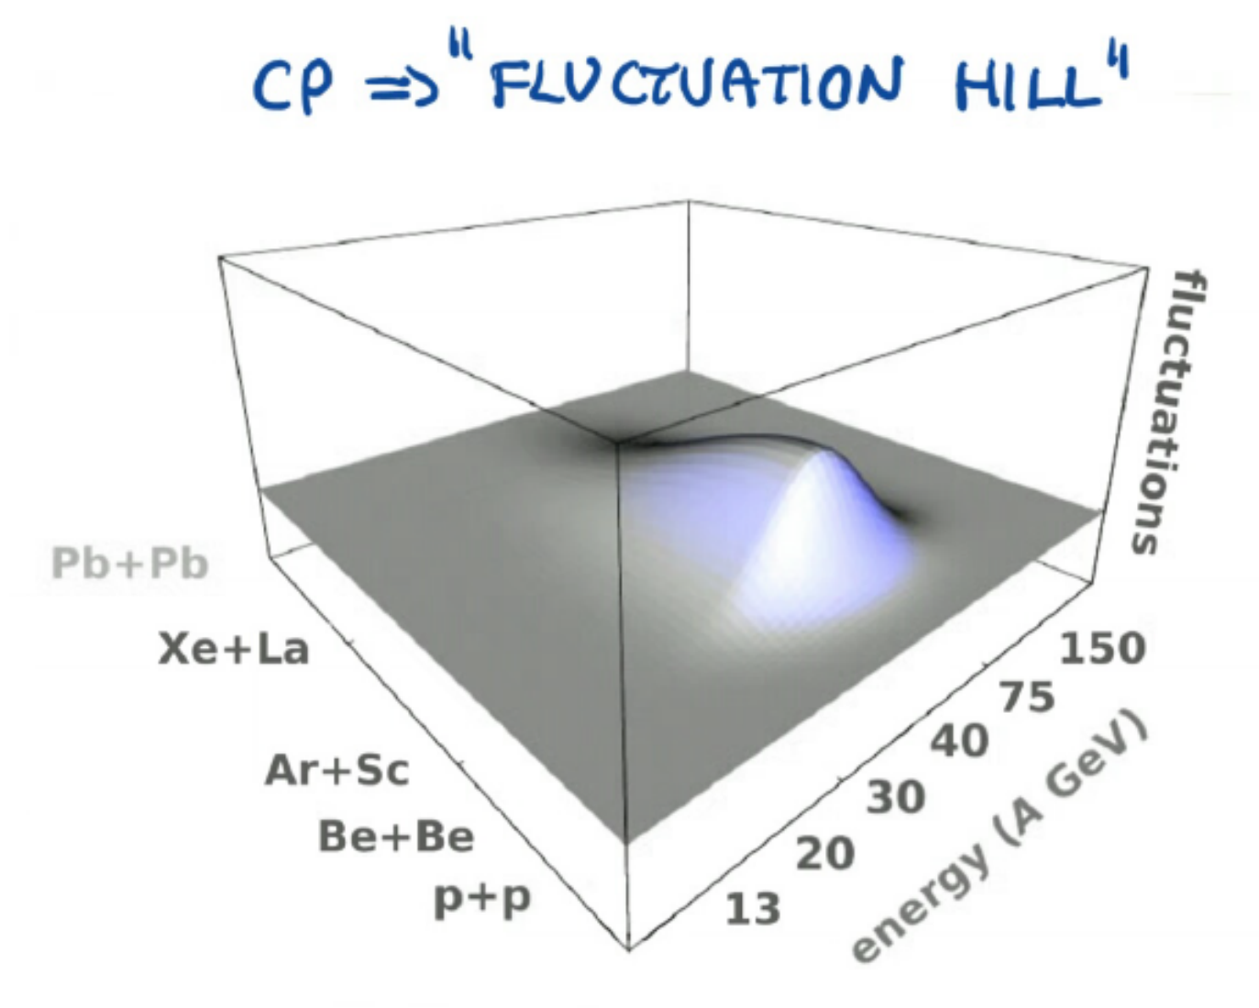
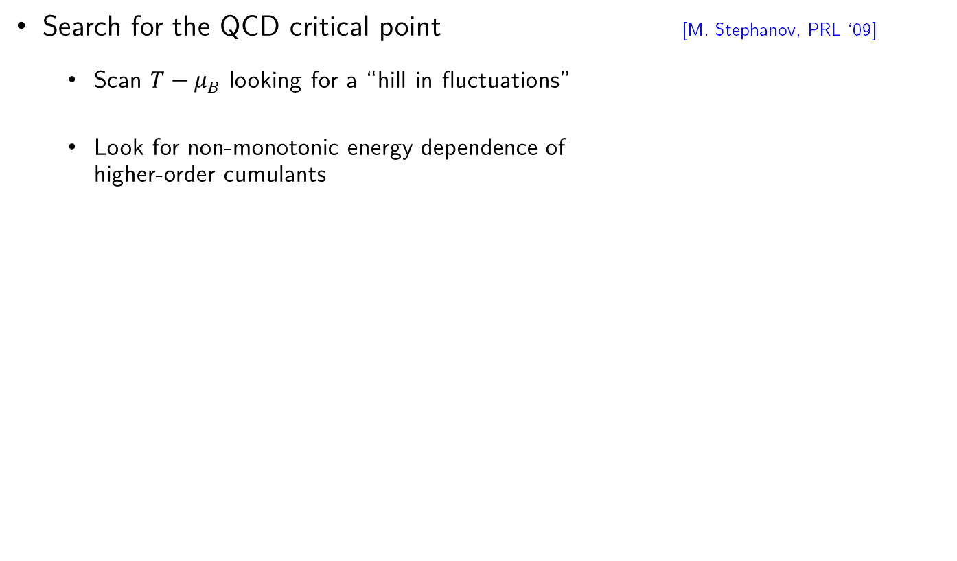
Relativistic heavy-ion collisions (Event-by-event fluctuations)
Facilities: CERN-LHC, BNL-RHIC, CERN-SPS, FAIR-GSI, …
NA61/SHINE program
STAR-BES program
M. Gazdzicki, CPOD2016
8

Slide 10
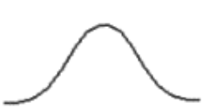
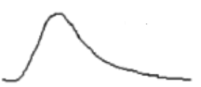

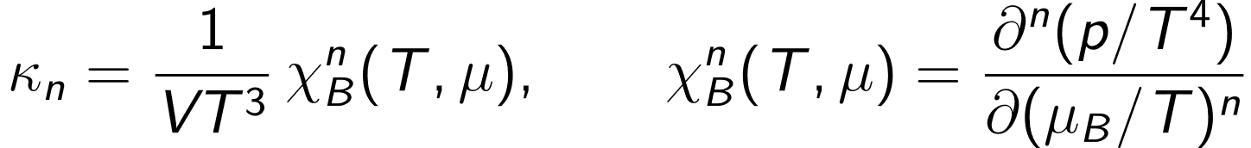
Event-by-event fluctuations
Cumulants are connected with moments of particle multiplicity/conserved charge distribution:
Intensive (volume independent in GCE) ratios of cumulants:
also strongly intensive quantities - expressed through cumulant ratios
Grand-canonical ensemble:
9

Slide 11
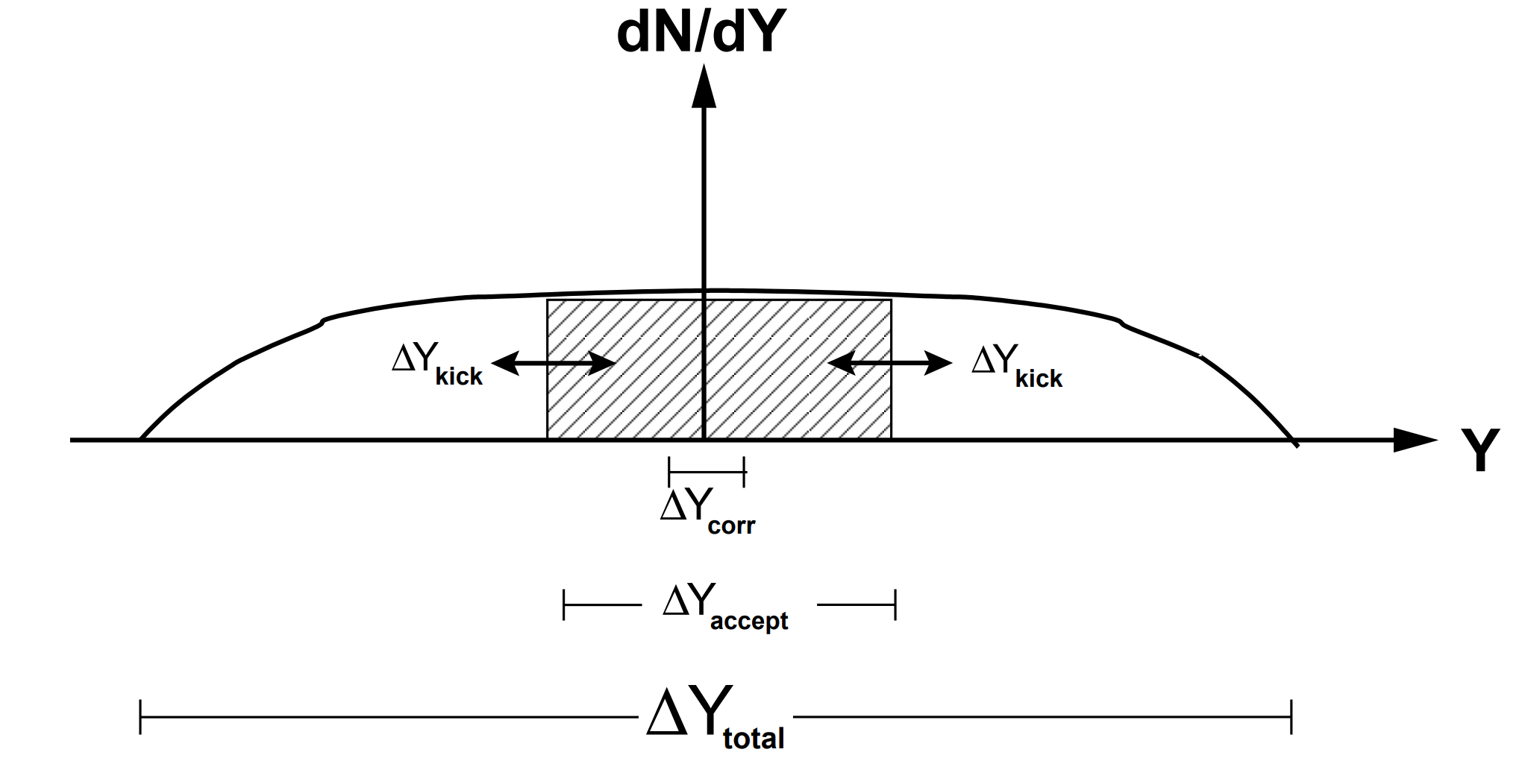
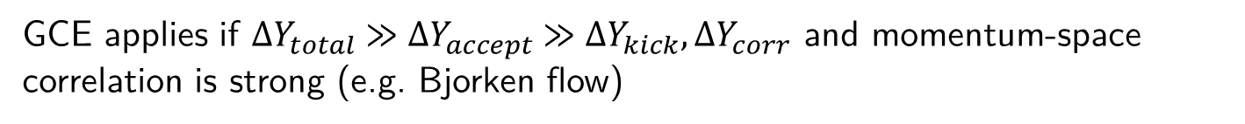
Applicability of the GCE in heavy-ion collisions
Experiments measure fluctuations in a finite momentum acceptance
V. Koch, 0810.2520
GCE applies if ${∆Y}_{total} ≫{∆Y}_{accept} ≫{∆Y}_{kick},{∆Y}_{corr}$ and momentum-space correlation is strong (e.g. Bjorken flow)
In practice, difficult to satisfy all conditions simultaneously…
If ${∆Y}_{total} ≫{∆Y}_{accept}$ does not hold, corrections from global conservation appear
10

Slide 12
Applicability of the GCE in heavy-ion collisions
Experiments measure fluctuations in a finite momentum acceptance
V. Koch, 0810.2520
GCE applies if ${∆Y}_{total} ≫{∆Y}_{accept} ≫{∆Y}_{kick},{∆Y}_{corr}$ and momentum-space correlation is strong (e.g. Bjorken flow)
In practice, difficult to satisfy all conditions simultaneously…
Subensemble acceptance method allows to account for global conservation effects and provides fluctuation measures insensible to global conservation!
If ${∆Y}_{total} ≫{∆Y}_{accept}$ does not hold, corrections from global conservation appear
10

Slide 13
Theory vs experiment: Caveats
proxy observables in experiment (net-proton, net-kaon) vs actual conserved charges in QCD (net-baryon, net-strangeness)
volume fluctuations
non-equilibrium (memory) effects
final-state interactions in the hadronic phase
accuracy of the grand-canonical ensemble (global conservation laws)
Asakawa, Kitazawa, PRC ’12; V.V., Jiang, Gorenstein, Stoecker, PRC ‘18
Gorenstein, Gazdzicki, PRC ’11; Skokov, Friman, Redlich, PRC ’13;
Braun-Munzinger, Rustamov, Stachel, NPA ‘17
Mukherjee, Venugopalan, Yin, PRC ‘15
Steinheimer, V.V., Aichelin, Bleicher, Stoecker, PLB ‘18
Jeon, Koch, PRL ’00; Bzdak, Skokov, Koch, PRC ’13;
Braun-Munzinger, Rustamov, Stachel, NPA ‘17
11

Slide 14
Theory vs experiment: Caveats
proxy observables in experiment (net-proton, net-kaon) vs actual conserved charges in QCD (net-baryon, net-strangeness)
volume fluctuations
non-equilibrium (memory) effects
final-state interactions in the hadronic phase
accuracy of the grand-canonical ensemble (global conservation laws)
Asakawa, Kitazawa, PRC ’12; V.V., Jiang, Gorenstein, Stoecker, PRC ‘18
Gorenstein, Gazdzicki, PRC ’11; Skokov, Friman, Redlich, PRC ’13;
Braun-Munzinger, Rustamov, Stachel, NPA ‘17
Mukherjee, Venugopalan, Yin, PRC ‘15
Steinheimer, V.V., Aichelin, Bleicher, Stoecker, PLB ‘18
Jeon, Koch, PRL ’00; Bzdak, Skokov, Koch, PRC ’13;
Braun-Munzinger, Rustamov, Stachel, NPA ‘17
11

Slide 15
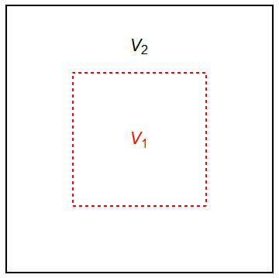
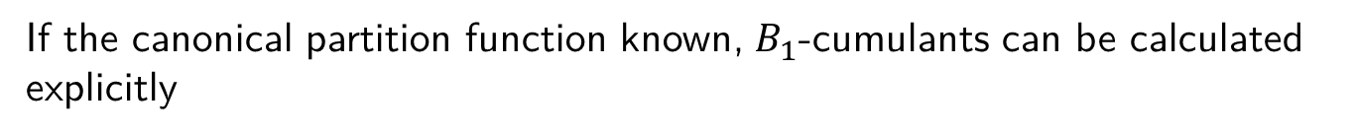


Subensemble acceptance method
Partition a thermal system with a globally conserved charge B (canonical ensemble) into two subsystems which can exchange the charge
Neglect surface effects:
$$\hat{H}={\hat{H}}_{1}+{\hat{H}}_{2}+{\hat{V}}_{1,2}≈{\hat{H}}_{1}+{\hat{H}}_{2}$$
The canonical partition function then reads:
$$V_{1}+V_{2}=V$$
The probability to have charge $B_{1}$ is:
If the canonical partition function known, $B_{1}$-cumulants can be calculated explicitly
V.Vovchenko., Savchuk, R.P., Gorenstein, Koch, 2003.13905
12

Slide 16
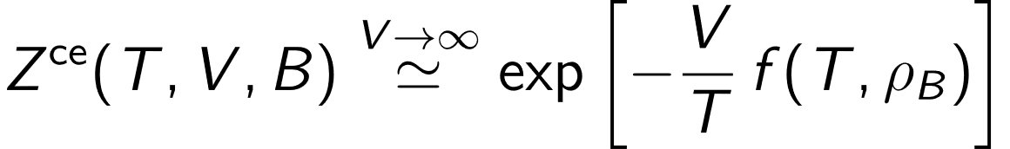
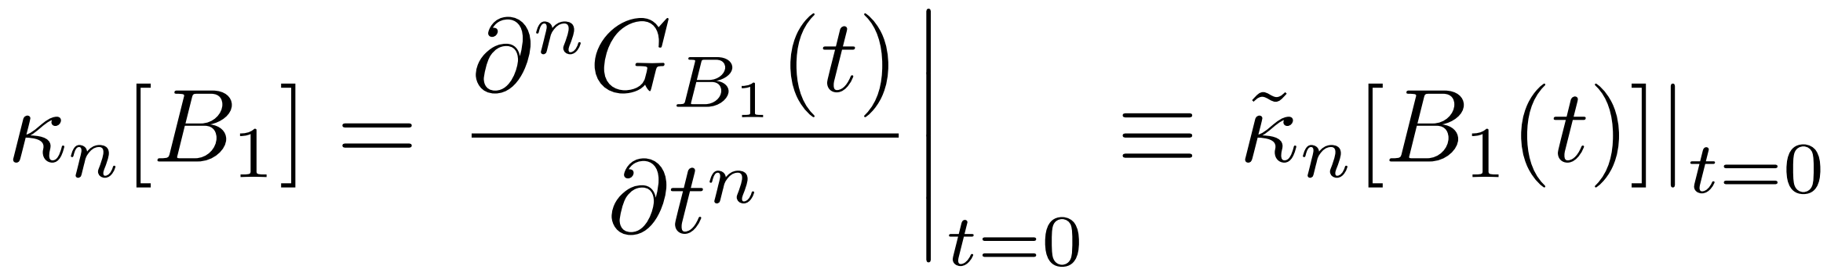
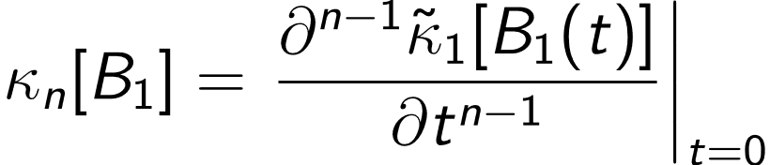
Subensemble acceptance: Thermodynamic limit
In the thermodynamic limit, $V→∞$, $Z^{ce}$ expressed through free energy density
$B_{1}$ cumulant generating function:
$B_{1}$ cumulants:
or
All $κ_{n}$ can be calculated by determining the t-dependent first cumulant ${\tilde{κ}}_{1}[B_{1}\left(t\right)]$
V.Vovchenko., Savchuk, R.P., Gorenstein, Koch, 2003.13905
13

Slide 17
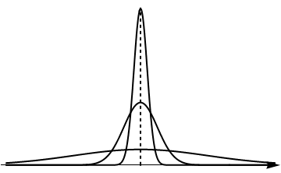


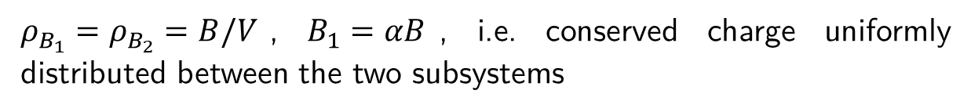
Subensemble acceptance: Thermodynamic limit
Thermodynamic limit: $\tilde{P}(B_{1};t)$ highly peaked at $\left\langle B_{1}(t)\right\rangle$
$$B_{1}/V$$
$$\left\langle B_{1}(t)\right\rangle$$
$\left\langle B_{1}(t)\right\rangle$ is a solution to equation $d\tilde{P}$/d$B_{1}$ = 0:
where
t = 0:
$ρ_{B_{1}}=ρ_{B_{2}}=B/V$, $B_{1}=αB$, i.e. conserved charge uniformly distributed between the two subsystems
V.Vovchenko., Savchuk, R.P., Gorenstein, Koch, 2003.13905
14

Slide 18
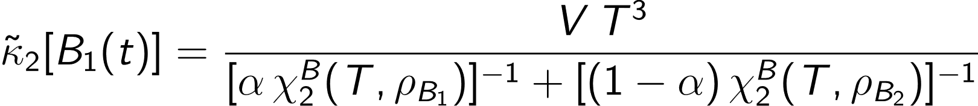


Subensemble acceptance:$κ_{2}[B_{1}]$
(*)
GCE susceptibilities:
Solve the equation for ${\tilde{κ}}_{2}$:
t = 0:
Connection between cumulant measured in the subsystem and GCE susceptibility
Higher-order cumulants: iteratively differentiate ${\tilde{κ}}_{2}$ w.r.t. t
V.Vovchenko., Savchuk, R.P., Gorenstein, Koch, 2003.13905
15

Slide 19


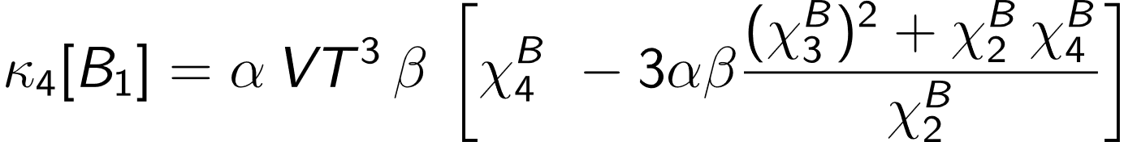
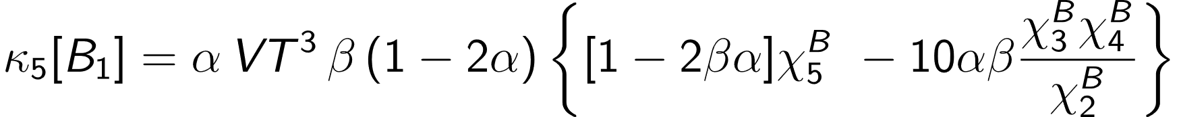
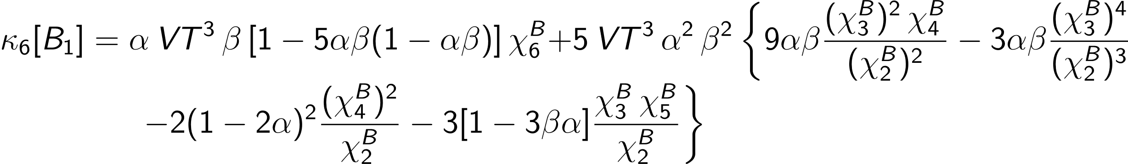
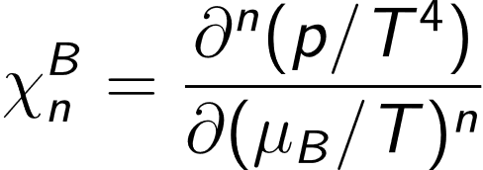

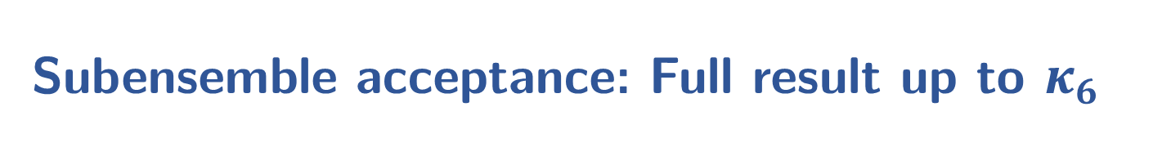
Subensemble acceptance: Full result up to $κ_{6}$
Model-independent!
$$β=1−α$$
– grand-canonical susceptibilities
V.Vovchenko., Savchuk, R.P., Gorenstein, Koch, 2003.13905
16

Slide 20
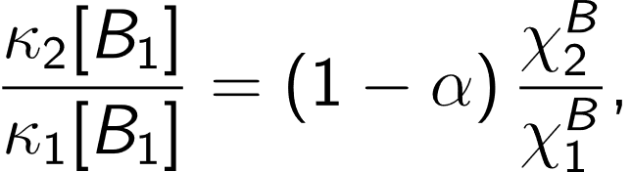
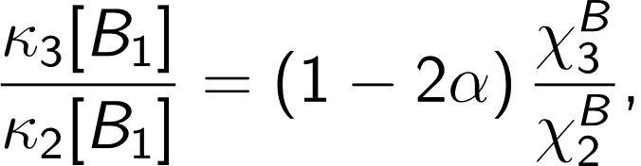
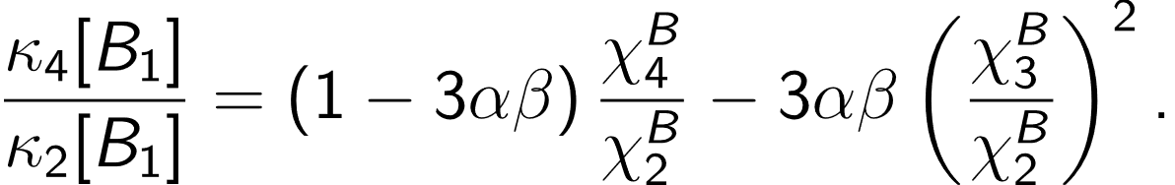
Subensemble acceptance: Cumulant ratios
Some common cumulant ratios:
scaled variance
skewness
kurtosis
V.Vovchenko., Savchuk, R.P., Gorenstein, Koch, 2003.13905
17

Slide 21
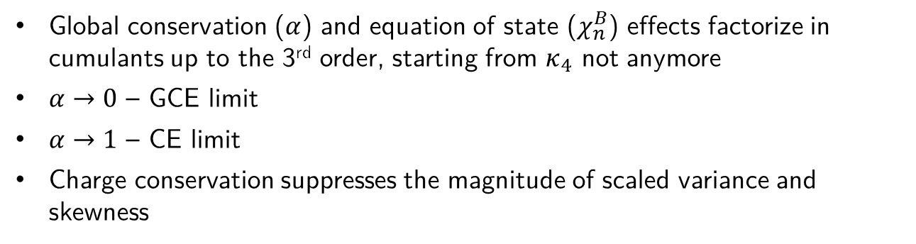
Subensemble acceptance: Cumulant ratios
Some common cumulant ratios:
scaled variance
skewness
kurtosis
Global conservation ($α$) and equation of state ($χ_{n}^{B}$) effects factorize in cumulants up to the 3rd order, starting from $κ_{4}$ not anymore
$α→0$ – GCE limit
$α→1$ – CE limit
Charge conservation suppresses the magnitude of scaled variance and skewness
For ideal uncorrelated gas all cumulant ratios equal to 1 and subensemble acceptance is reduced to binomial acceptance
V.Vovchenko., Savchuk, R.P., Gorenstein, Koch, 2003.13905
18

Slide 22
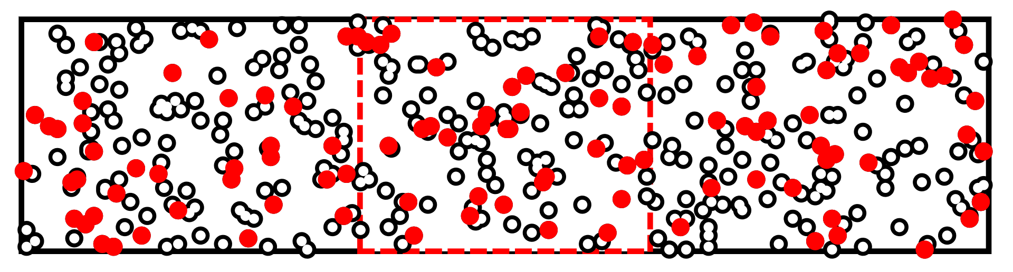
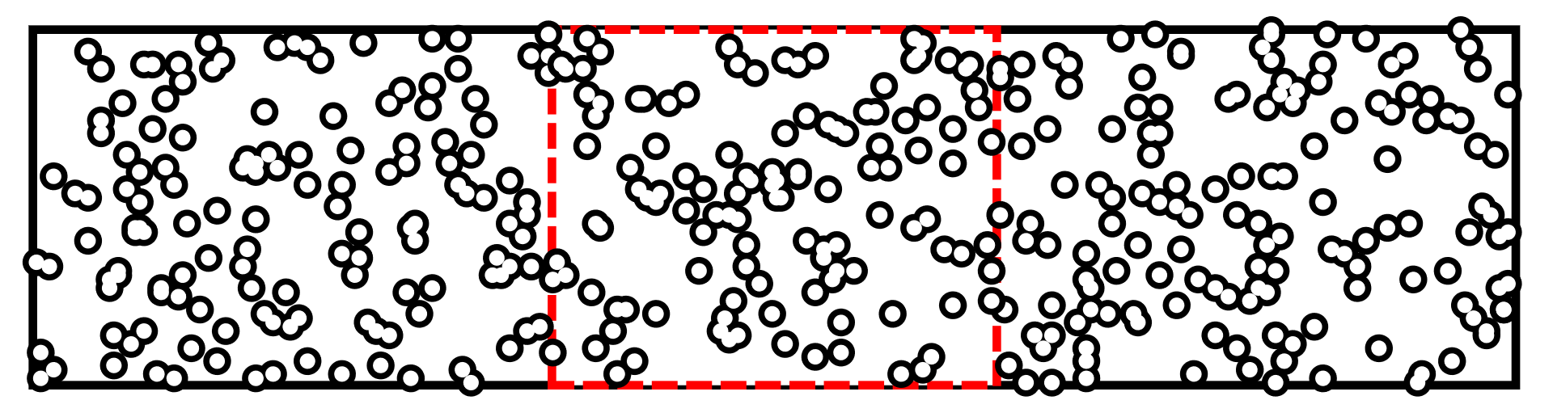
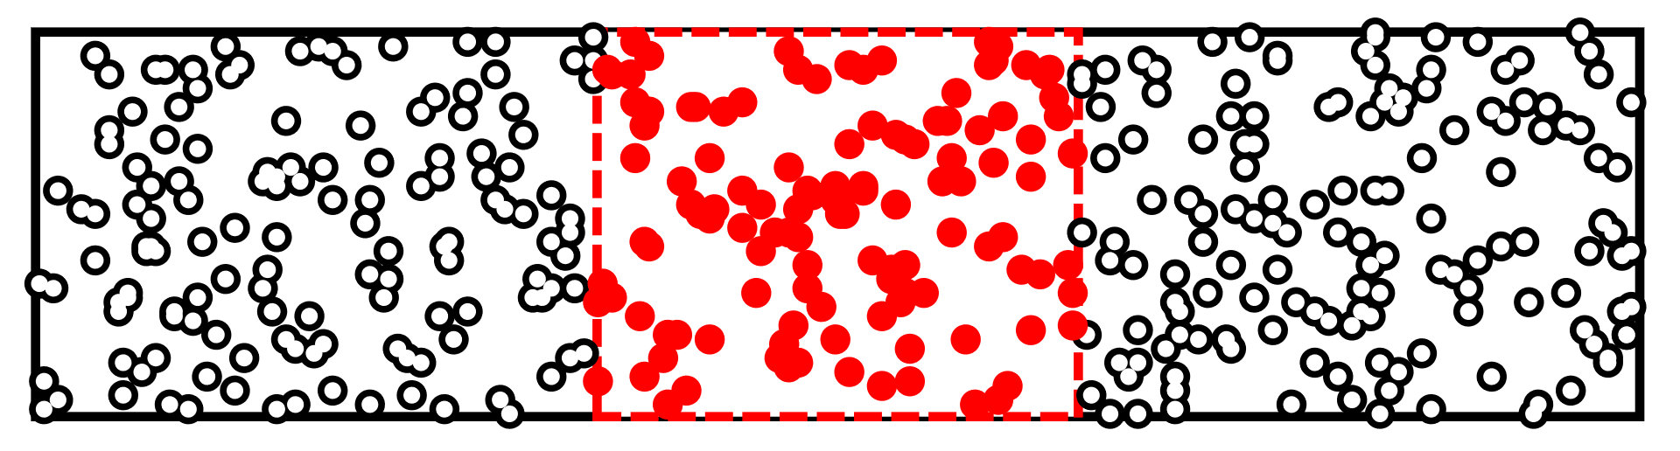
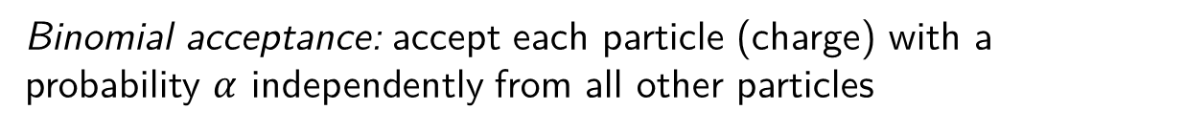
Binomial acceptance vs actual acceptance
Binomial acceptance: accept each particle (charge) with a probability $α$ independently from all other particles
The binomial acceptance does not account for correlations between particles
Subensemble:
Accounts for correlations, connects measurements with GCE susceptibilities
19

Slide 23
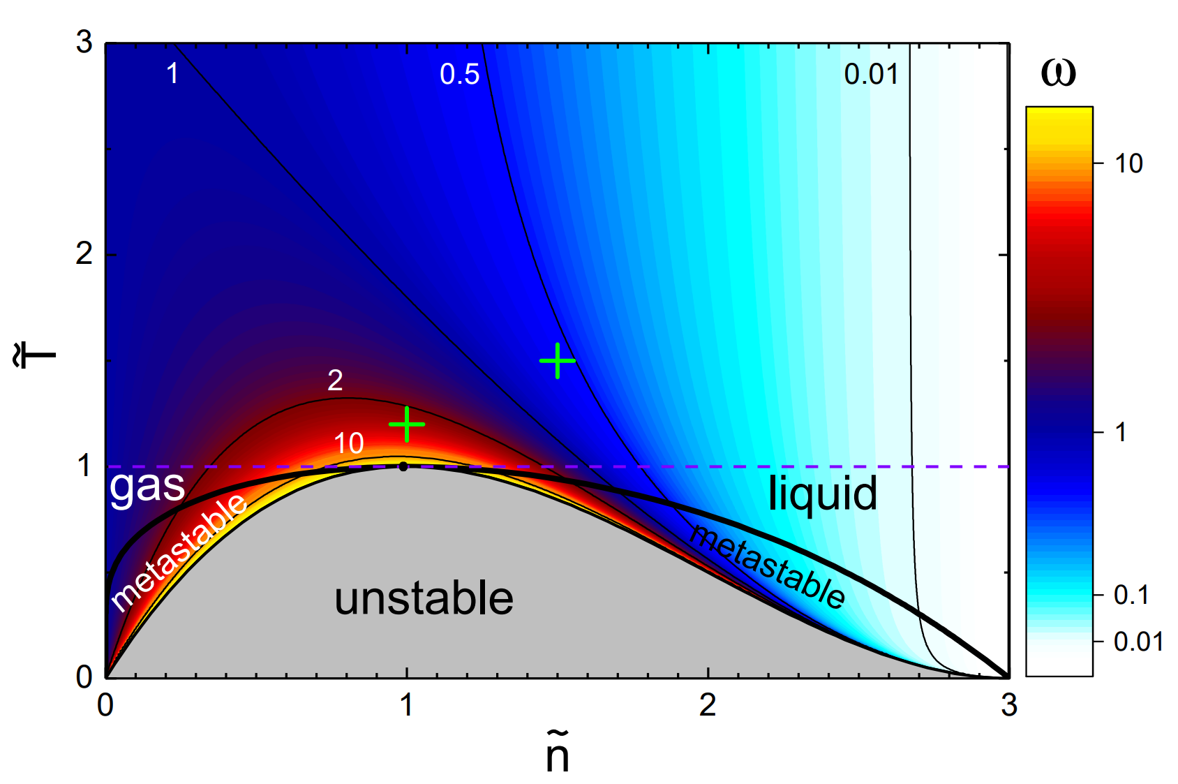
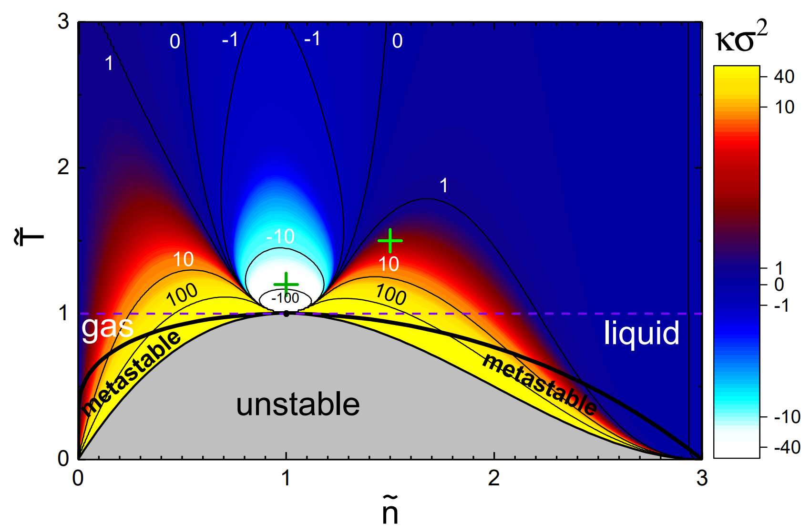
Subensemble acceptance: van der Waals fluid
van der Waals equation of state: first-order phase transition and a critical point
Rich structures in cumulant ratios close to the CP
Vovchenko, R.P., Anchishkin, Gorenstein, 1507.06537
20

Slide 24
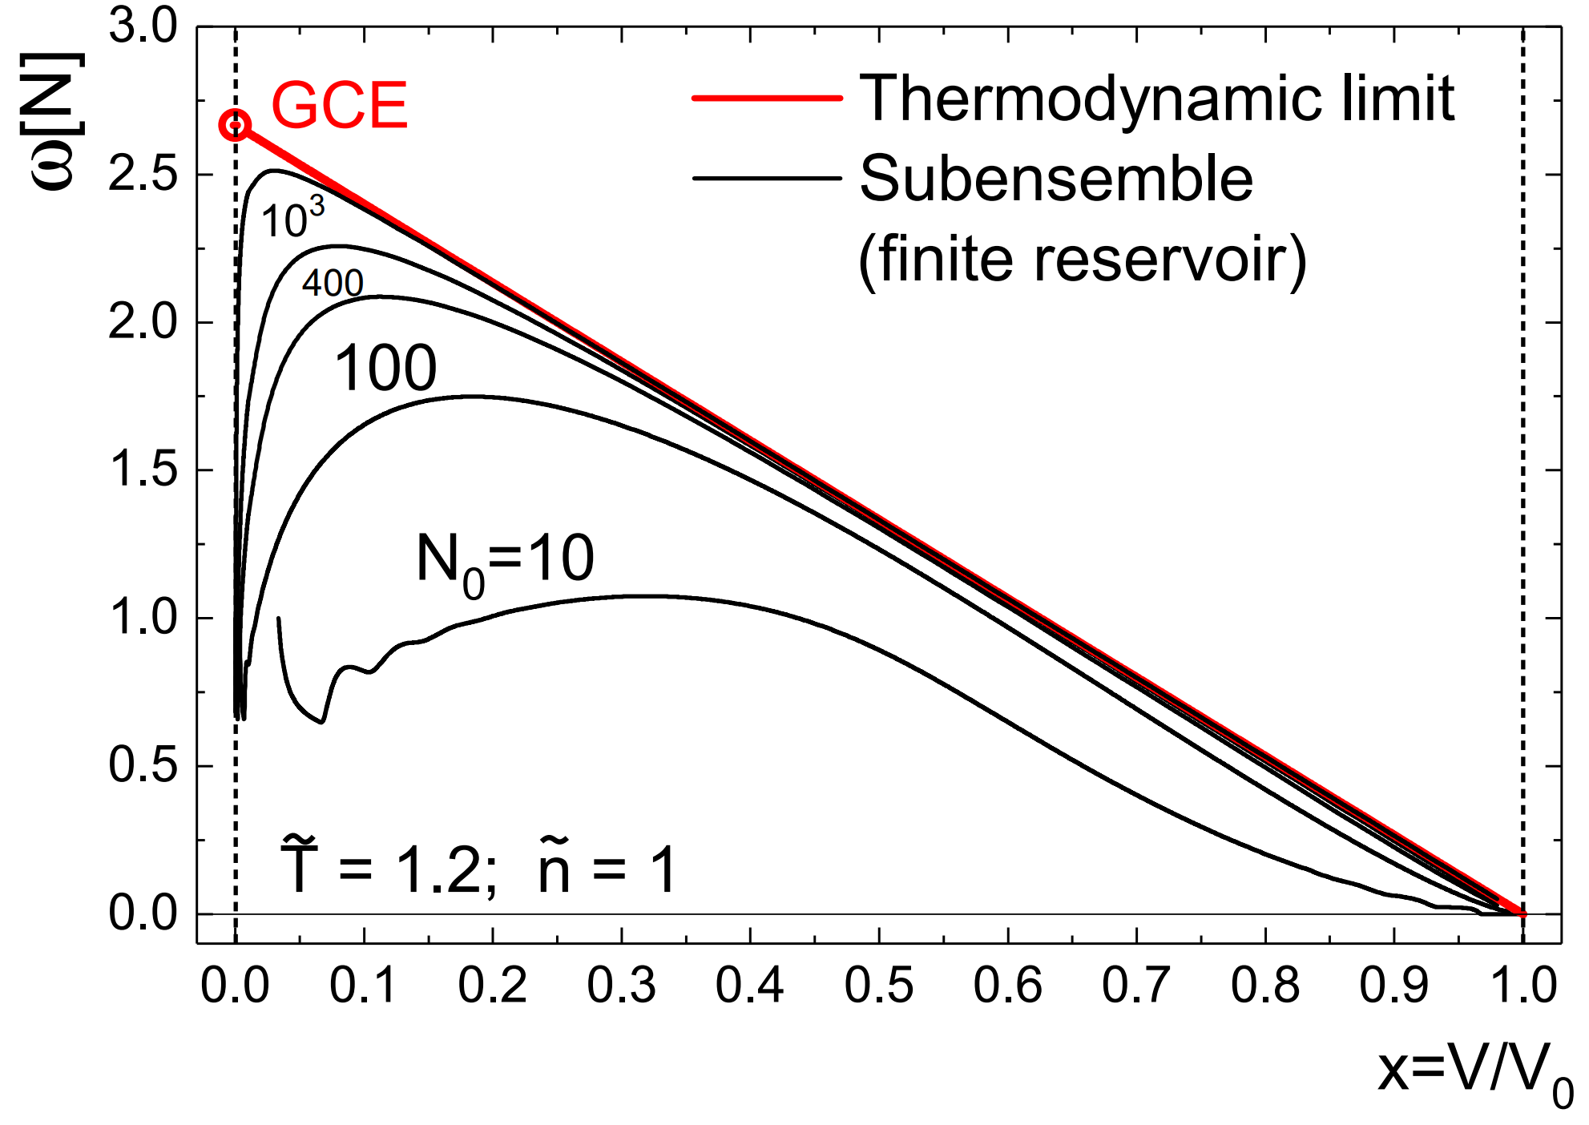
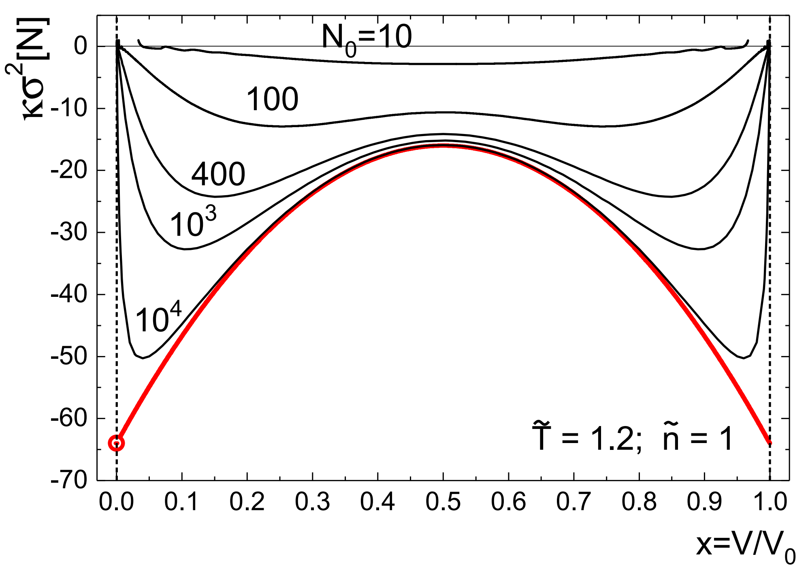
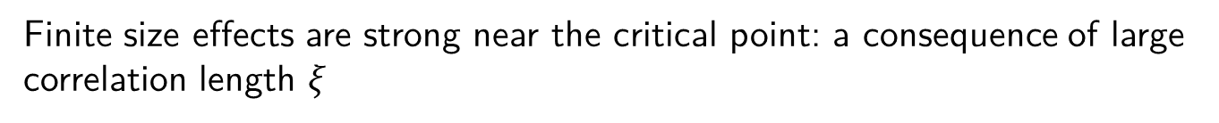
Subensemble acceptance: van der Waals fluid
Calculate cumulants $κ_{n}[N]$ in a subvolume directly from the partition function
and compare with the subensemble acceptance results
Finite system
Results agree with subsensemble acceptance in thermodynamic limit ($N_{0}→∞$)
Finite size effects are strong near the critical point: a consequence of large correlation length $ξ$
21
R.P., Savchuk, Gorenstein, Taradiy, Begun, Satarov, Steinheimer, Stoecker, PRC, 2020

Slide 25
Global conservation effects at α = 0.4
GCE (α 0)
α = 0.4
20

Slide 26
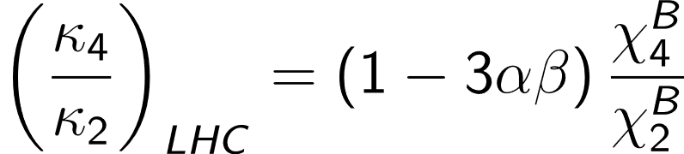
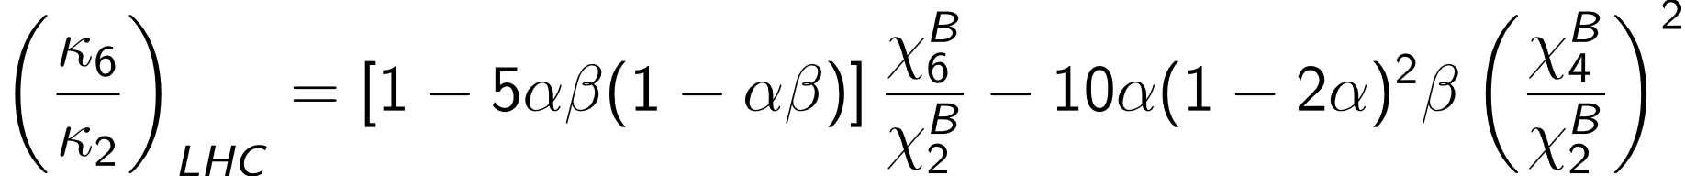
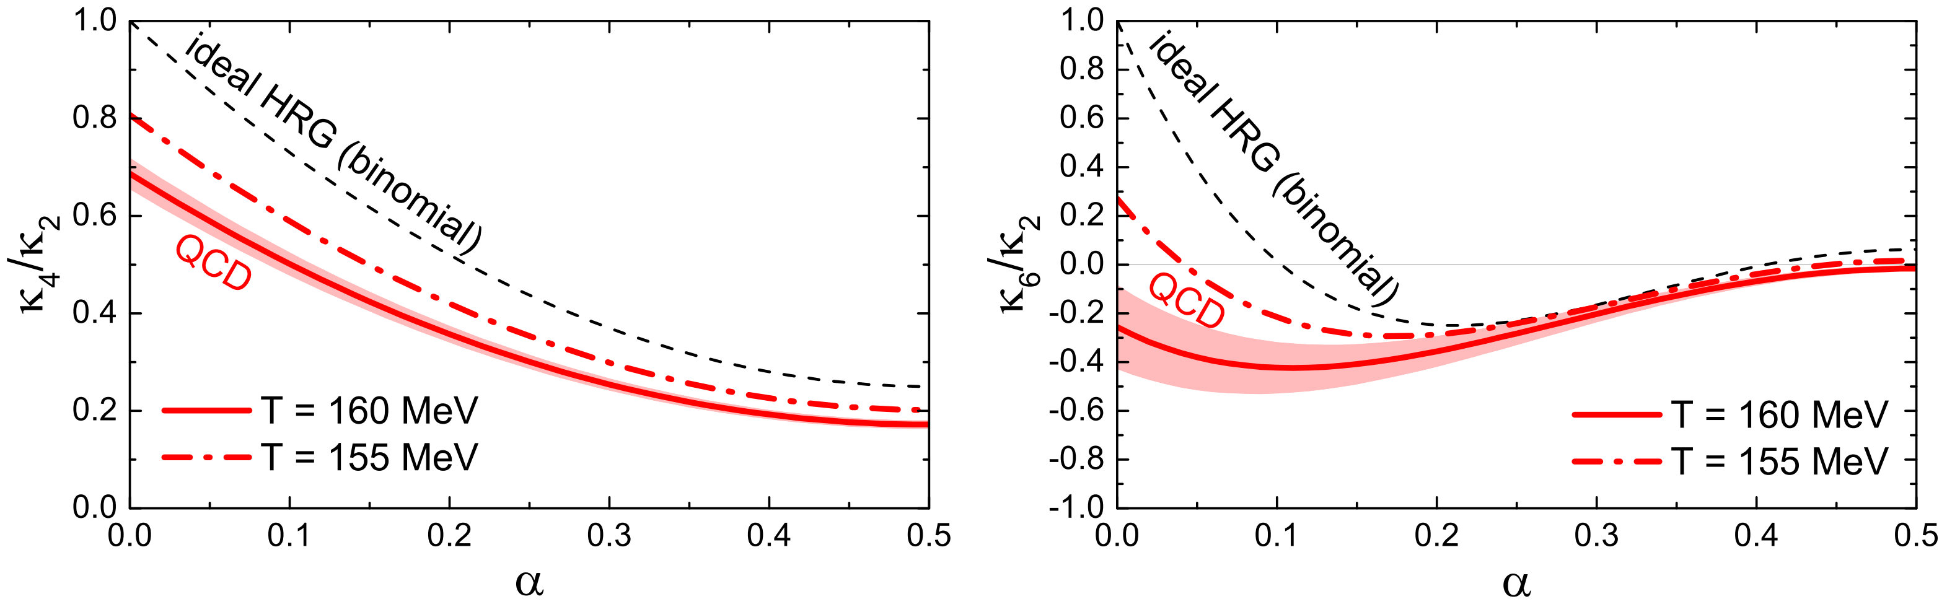
Net baryon fluctuations at LHC and top RHIC
Lattice data for $χ_{4}^{B}/χ_{2}^{B}$ and $χ_{6}^{B}/χ_{2}^{B}$ from Borsanyi et al., 1805.04445
For $α>0.2$ difficult to distinguish effects of the EoS and baryon conservation in $χ_{6}^{B}/χ_{2}^{B}$, $α≤0.1$ is a sweet spot where measurements are mainly sensitive to the EoS
Estimates: $α≈0.1$ corresponds to ${ΔY}_{acc}≈2(1)$ at LHC (RHIC)
Vovchenko, Savchuk, R.P., Gorenstein, Koch, 2003.13905
22

Slide 27
Multiple conserved charges
NOTATIONS
Diagonal and off-diagonal GCE susceptibilities:
Other notation:
https://github.com/vlvovch/SAM
Vovchenko, R.P., Koch, 2007.03850
23

Slide 28
Special cases
Two conserved charges: B,Q
Three conserved charges: B,Q,S
The fact that electric (strange) charge is fixed has an effect on
observables which do not involve explicitly the electric charge.
But only for fluctuations of non-conserved quantities and for higher order fluctuations of conserved charges
Vovchenko, R.P., Koch, 2007.03850
24

Slide 29
General formulas
For results up to the 6-th order see arXiv:2007.03850
Vovchenko, R.P., Koch, 2007.03850
25

Slide 30
General formulas
Cumulants up to 3-d order have the same simple
α-dependence as in the case of single conserved charge
For results up to the 6-th order see arXiv:2007.03850
Vovchenko, R.P., Koch, 2007.03850
25

Slide 31
General formulas
Cumulants up to third order have the same simple
α-dependence as in the case of single conserved charge
For results up to the 6-th order see arXiv:2007.03850
The global conservation effects cancel out in any ratio of second order cumulants and in any ratio of third order cumulants
Ensemble-independent fluctuatio measures, not sensitive to global conservation
non-conserved quantities come later...
Vovchenko, R.P., Koch, 2007.03850
25

Slide 32
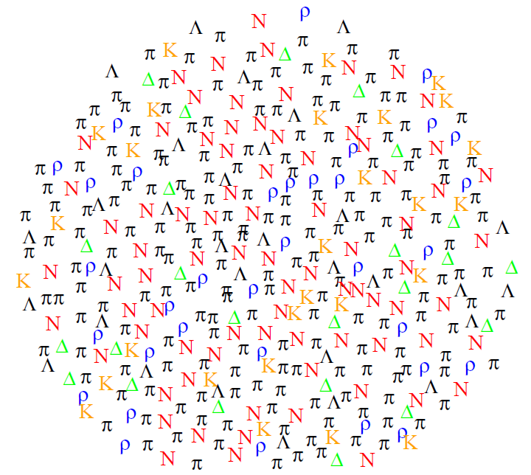
Check in Hadron Resonance Gas
Two sources of correlations:
1) Global conservation:different hadron species do carry different values of B,Q,S charges
2) Resonance decays
Vovchenko, R.P., Koch, 2007.03850
26

Slide 33
Check in Hadron Resonance Gas (third order)
Two sources of correlations:
1) Global conservation:different hadron species do carry different values of B,Q,S charges
2) Resonance decays
Vovchenko, R.P., Koch, 2007.03850
27

Slide 34
Check in Hadron Resonance Gas (higher order)
B and S charge conservation do influence the higher order fluctuations of electric charge.
The effect is stronger for non-conserved quantities, even higher cumulants of conserved charges
Vovchenko, R.P., Koch, 2007.03850
28

Slide 35
LHC energies
All odd-order GCE susceptibilities vanish
Now cumulants up to fifth order have the same simple α-dependence as for single conserved charge.
Vovchenko, R.P., Koch, 2007.03850
29

Slide 36
Strongly intensive fluctuation measures
M.Gorenstein, M.Gazdzicki, PRC, 2011
Both strongly intensive and ensemble independent (insensitive to global conservation)
Vovchenko, R.P., Koch, 2007.03850
30

Slide 37
Non-conserved quantities (net-proton, pion, kaon,...)
Example: net proton number
Variance of non-conserved quantity:
GCE susceptibility
CE susceptibility
Vovchenko, R.P., Koch, 2007.03850
31

Slide 38
Off-diagonal cumulants involving non-conserved quantity
Vovchenko, R.P., Koch, 2007.03850
32

Slide 39
Net-proton and net-Λ fluctuations
Vovchenko, R.P., Koch, 2007.03850
33

Slide 40
Summary
Subensemble acceptance method (SAM) provides general formulas to correct cumulants of distributions in heavy-ion collisions for global conservation of all QCD charges
Formulas connect cumulants measured in the subsystem of the thermal system with grand canonical susceptibilities. The method works for an arbitrary equation of state and sufficiently large systems, such as created in central collisions of heavy ions.
Some fluctuation measures are insensitive to global conservation and, thus, can be especially convenient for experimental measurement:
34

Slide 41
Summary
Subensemble acceptance method (SAM) provides general formulas to correct cumulants of distributions in heavy-ion collisions for global conservation of all QCD charges
Formulas connect cumulants measured in the subsystem of the thermal system with grand canonical susceptibilities. The method works for an arbitrary equation of state and sufficiently large systems, such as created in central collisions of heavy ions.
Some fluctuation measures are insensitive to global conservation and, thus, are can be especially convenient for experimental measurement:
Outlook: Application of method to intermediate collision energies
(NA61/SHINE, RHIC-BES,...). Effects of thermal smearing and “imperfect” space-momentum correlations, net proton higher order fluctuations.
34

Slide 42
Summary
Subensemble acceptance method (SAM) provides general formulas to correct cumulants of distributions in heavy-ion collisions for global conservation of all QCD charges
Formulas connect cumulants measured in the subsystem of the thermal system with grand canonical susceptibilities. The method works for an arbitrary equation of state and sufficiently large systems, such as created in central collisions of heavy ions.
Some fluctuation measures are insensitive to global conservation and, thus, are can be especially convenient for experimental measurement:
Outlook: Application of method to intermediate collision energies
(NA61/SHINE, RHIC-BES,...). Effects of thermal smearing and “imperfect” space-momentum correlations, net proton higher order fluctuations.
Thank you for attention!
34

