Slide 2
Simulation Studies on E-Cloud Single-Bunch Instabilities at the LHC
31st August 2020 HSC Section Meeting 237
L. Sabato, G. Iadarola
luca.sabato@cern.ch
Acknowledgements: L. Mether, K. Paraschou

Slide 3
Outline
Introduction
Quadrupoles at Injection Energy
Quadrupoles at Collision Energy
Dipoles at Injection Energy
Conclusions

Slide 4
Outline
Introduction
  Motivation
  Simulation Parameters
Quadrupoles at Injection Energy
Quadrupoles at Collision Energy
Dipoles at Injection Energy
Conclusions

Slide 5
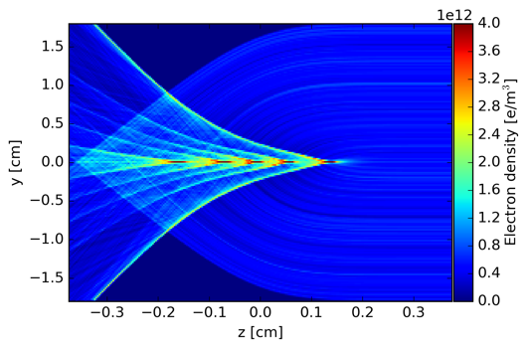
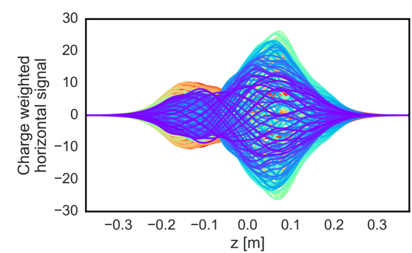
Introduction: Motivation
During Run2 (2015-2018) the Large Hadron Collider (LHC) has been operated with the nominal bunch spacing of 25 ns
  e-cloud develops in the beam chambers (heat loads measured on the beam screens of the superconducting magnets [1])
The interaction of the circulating bunches with the e-cloud can trigger transverse head-tail instabilities (observed during LHC operation, especially at injection energy [2])
Electron dynamics
Electron dynamics
Proton bunch
oscillations
Tail
Head
[1] G. Iadarola et al., “Analysis of the beam induced heat loads on the LHC arc beam screens during Run 2,” CERN-ACC-NOTE-2017-0066, Dec 2017.
[2] X. Buffat et al., “Transverse instabilities,” in Proc. 2019 Evian Workshop on LHC beam operation, Evian Les Bains, France, Jan 2019.

Slide 6
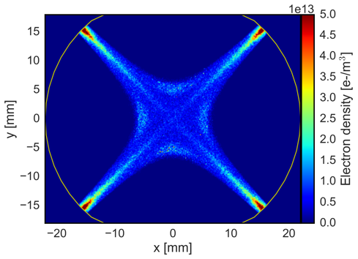
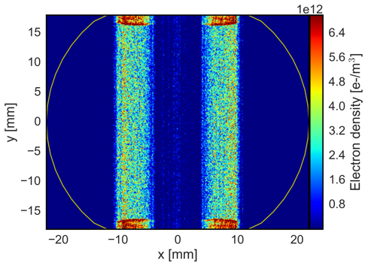
Introduction: Motivation
For nominal bunch intensity electrons in the arc quadrupoles are expected to be the strongest contributor (quadrupolar field concentrates a large electron density at the beam location [3])
For these reasons, particular attention is given to the study of instabilities driven by e-cloud in quadrupole magnets at injection energy
Simulations for the dipoles were performed to check that they are not critical
[3] R. J. Macek et al., “Electron cloud generation and trapping in a quadrupole magnet at the Los Alamos proton storage ring,” Phys. Rev. Accel. Beams, vol. 11, no. 1, p. 010101, 2008.

Slide 7
Introduction: Motivation
We carried out a systematic study on these transverse instabilities and on their dependence on beam and machine configuration
  based on macroparticle (MP) simulations performed with the PyECLOUD-PyHEADTAIL suite
The simulations have significant requirements in terms of computing resources and time
  performed on the High Performance Computing (HPC) cluster at INFN-CNAF (Bologna, Italy)
The simulation results have also been used to benchmark a recently developed linearized approach for the study of e-cloud instability using the Vlasov method [4]
Electron dynamics
[4] G. Iadarola, L. Mether, N. Mounet, and L. Sabato, “Linearized method for the study of transverse instabilities driven by electron clouds,” Phys. Rev. Accel. Beams, vol. 23, p. 081002, Jul 2020.

Slide 8
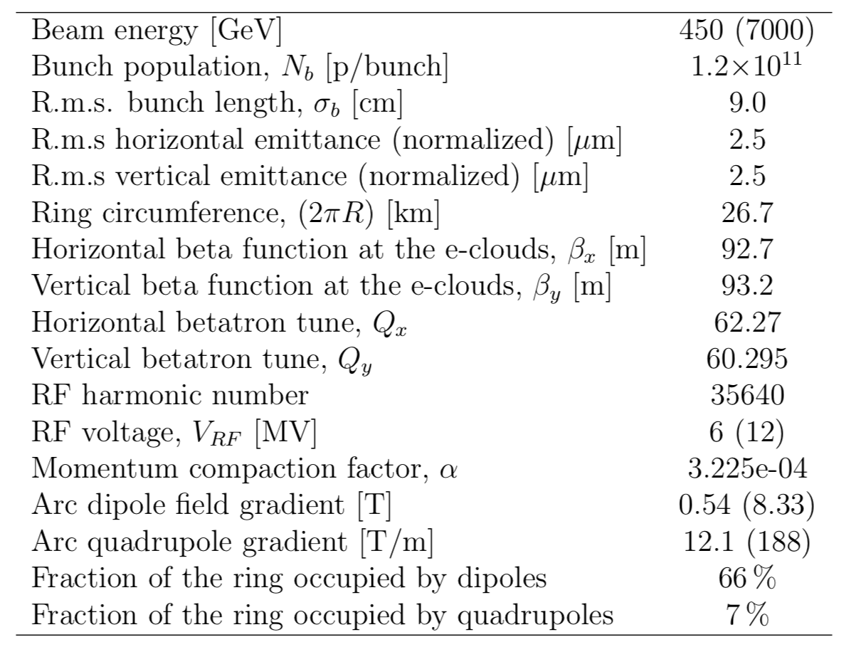
Introduction: Simulation Parameters
For the parameters that differ between injection energy and collision energy the latter are indicated in parenthesis

Slide 9
Outline
Introduction
Quadrupoles at injection energy
  Convergence Studies
  Bunch Length and RF voltage
  Bunch Intensity
  Transverse Emittance
  Chromaticity and Damper
  Octupoles
  Frequency Analysis
Quadrupoles at collision energy
Dipoles at injection energy
Conclusions

Slide 10
Outline
Introduction
Quadrupoles at injection energy
  Convergence Studies
  Bunch Length and RF voltage
  Bunch Intensity
  Transverse Emittance
  Chromaticity and Damper
  Octupoles
  Frequency Analysis
Quadrupoles at collision energy
Dipoles at injection energy
Conclusions

Slide 11
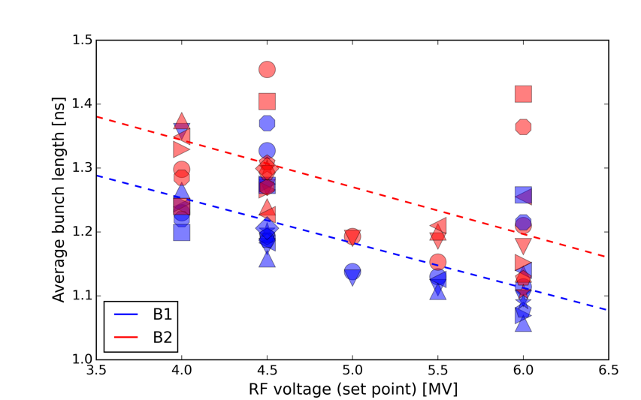
Quad at 450 GeV: Convergence Studies
The possibility of lowering the RF voltage at injection is being considered to cope with RF power limitations
  An extensive simulation study has been conducted to address the impact on e-cloud driven instabilities
In the simulations the bunch length has been adapted to the RF voltage following the dependence measured at the LHC
  In all simulations the longitudinal distribution is matched to the bucket
LHC measurements
H. Timko, presentation at LMC meeting, 5 Sep 2018
Simulated

Slide 12
Quad at 450 GeV: Convergence Studies
Finding the numerical convergence for these simulations is not trivial
We performed an extensive study to find the correct numerical parameters:
  the number of longitudinal slices along the bunch
  the average number of MPs/slice used to model the proton bunch
  the number of e-cloud interactions (kicks) along the ring
  the number of MPs used to model the e-cloud at each interaction
  the configuration of the transverse grids used to compute the fields generated by the beam and by the electrons through the PIC method [5])
[5] E. Belli, “PyPIC: the multigrid solver”, EC Meeting #32 – September 2, 2016

Slide 13
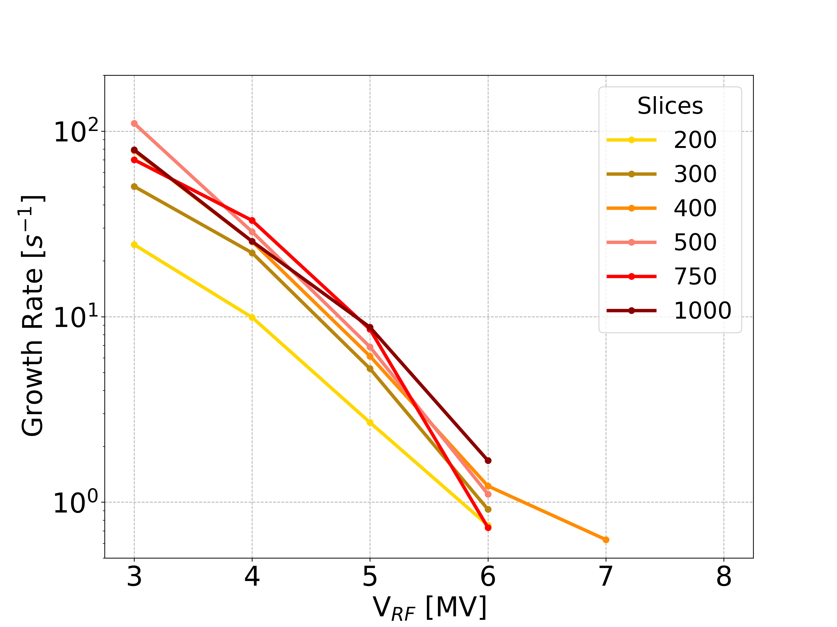
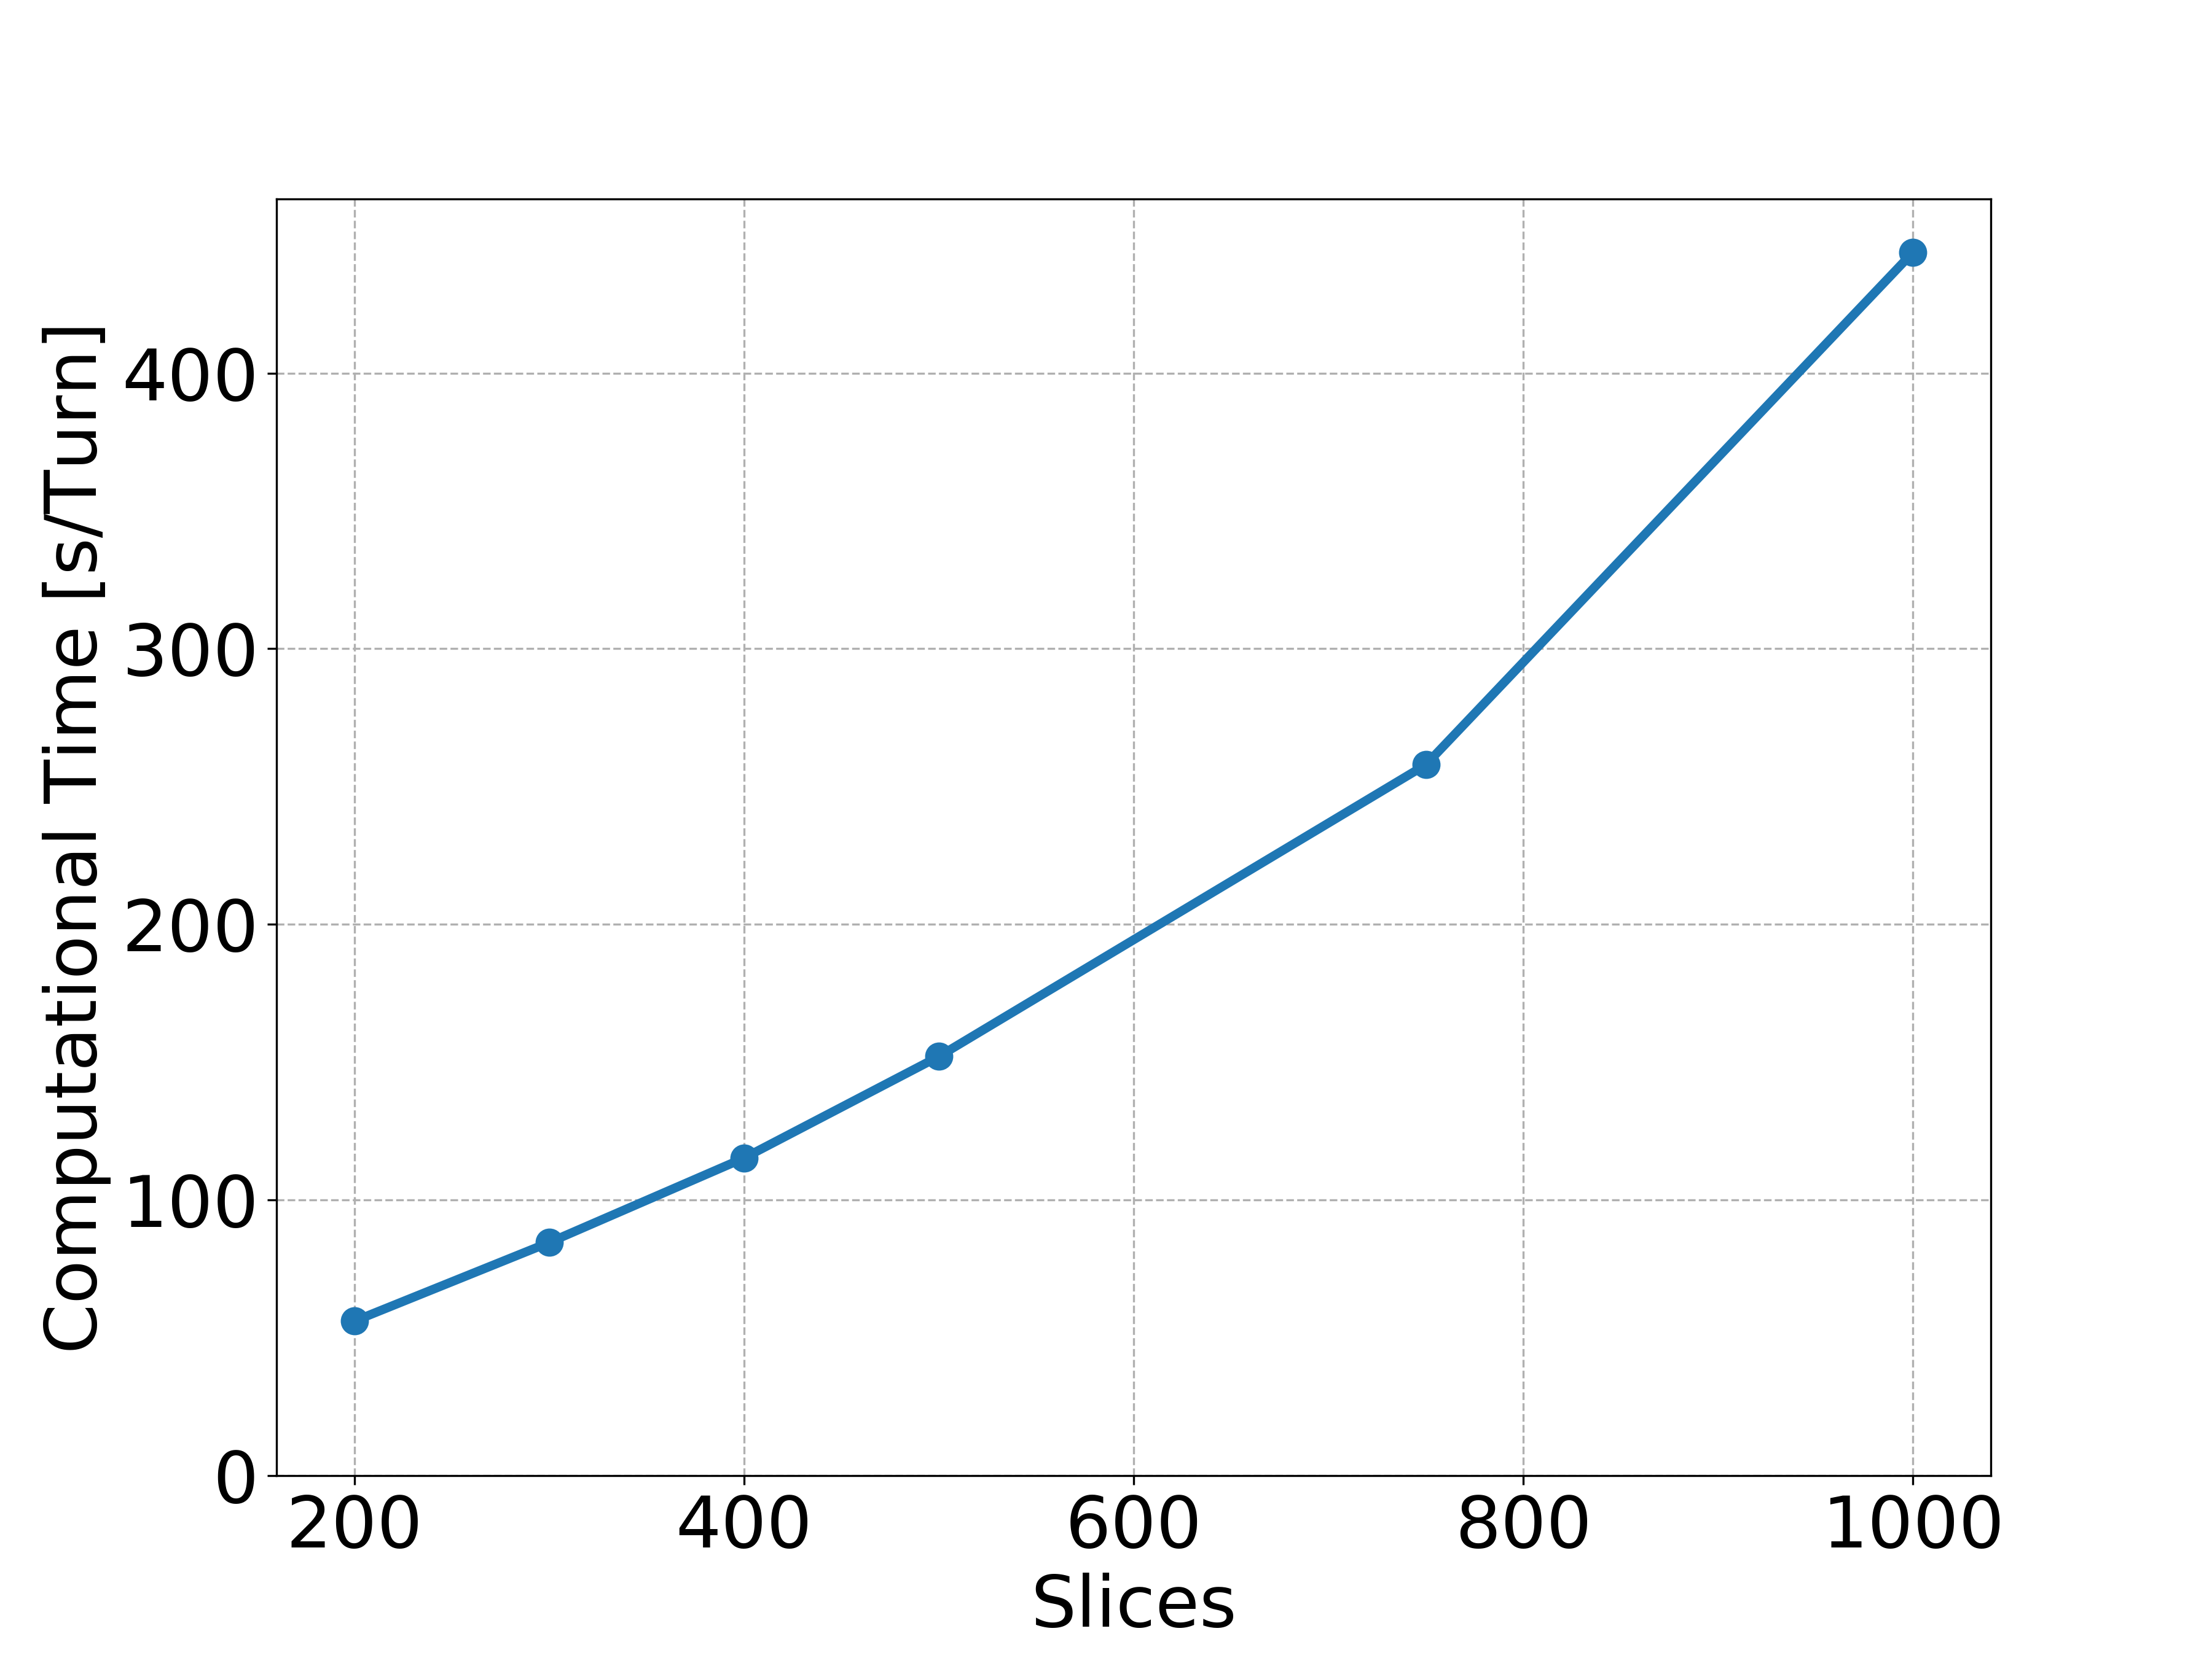
Quad at 450 GeV: Convergence Studies
Slices
numerical convergence is observed when the number of slices is larger than 300
old setting 150 slices is not adequate
the number of longitudinal slices has a strong impact on the required computational time

Slide 14
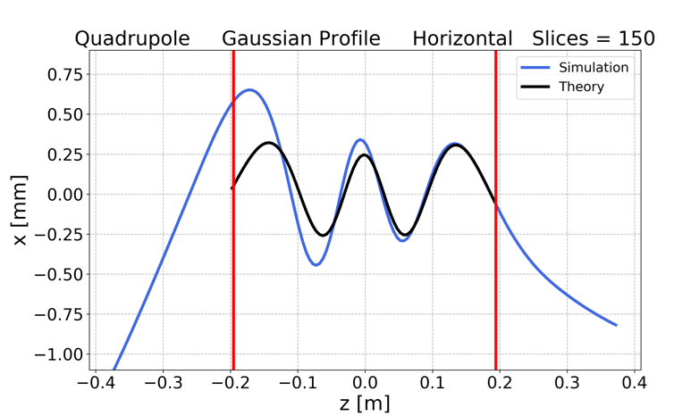
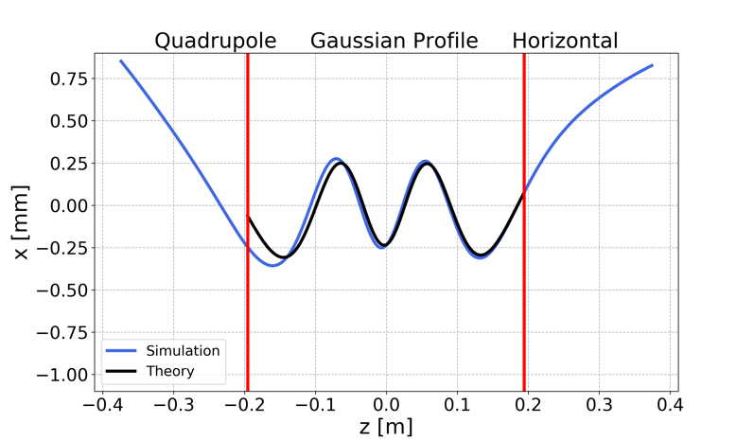
Quad at 450 GeV: Convergence Studies
To understand the origin of such requirements in terms of longitudinal slicing
we analyzed the motion of individual electrons at small transverse amplitude [6]
using a too small number of slices, the amplitude of the electron oscillation artificially increases along the bunch
this effect is instead suppressed for a sufficiently large number of slices
[6] L. Sabato, “Analysis of the electron motion within the Beam,” Presentation at the Electron Cloud Meeting, CERN, 22 February 2019.

Slide 15
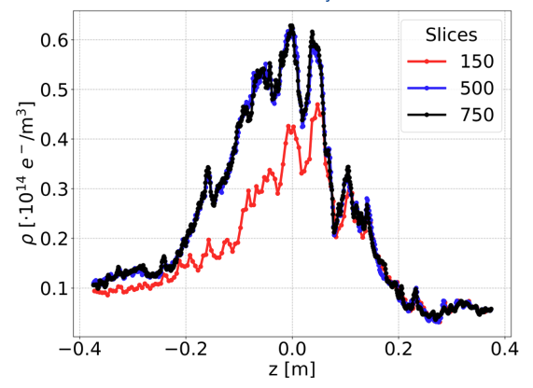
Quad at 450 GeV: Convergence Studies
To understand the origin of such requirements in terms of longitudinal slicing
when the number of slices is too small, the inaccurate modeling of the electron motion results in a reduced electron density at the beam location
this effect tends to artificially stabilize the bunch

Slide 16
Quad at 450 GeV: Convergence Studies
Selected Numerical Parameters
Convergence scans performed on all numerical parameters allowed to identify the following configuration, useful for the future studies
Numerical Parameter | Chosen Value
Slices/bucket | 500
MPs/Slice | 2,500
Segments | 8
e⁻ MPs | 5x10⁵
Transverse Grid | T₀ Internal grid coverage: 6.95 mm (10𝜎) Internal grid cell size: 0.139 mm (0.2𝜎) External grid cell size: 0.8 mm
More details in:
[7] L. Sabato, G. Iadarola, and L. Mether, “Numerical simulation studies on single-bunch instabilities driven by electron clouds at the LHC”, CERN-ACC-NOTE, to be published

Slide 17
Quad at 450 GeV: Convergence Studies
Summary
378 multi-core simulations
Total computational time: ~ 32672 CPUcores*days
It took months using the full CNAF cluster
~127 GB stored

Slide 18
Outline
Introduction
Quadrupoles at injection energy
  Convergence Studies
  Bunch Length and RF voltage
  Bunch Intensity
  Transverse Emittance
  Chromaticity and Damper
  Octupoles
  Frequency Analysis
Quadrupoles at collision energy
Dipoles at injection energy
Conclusions

Slide 19
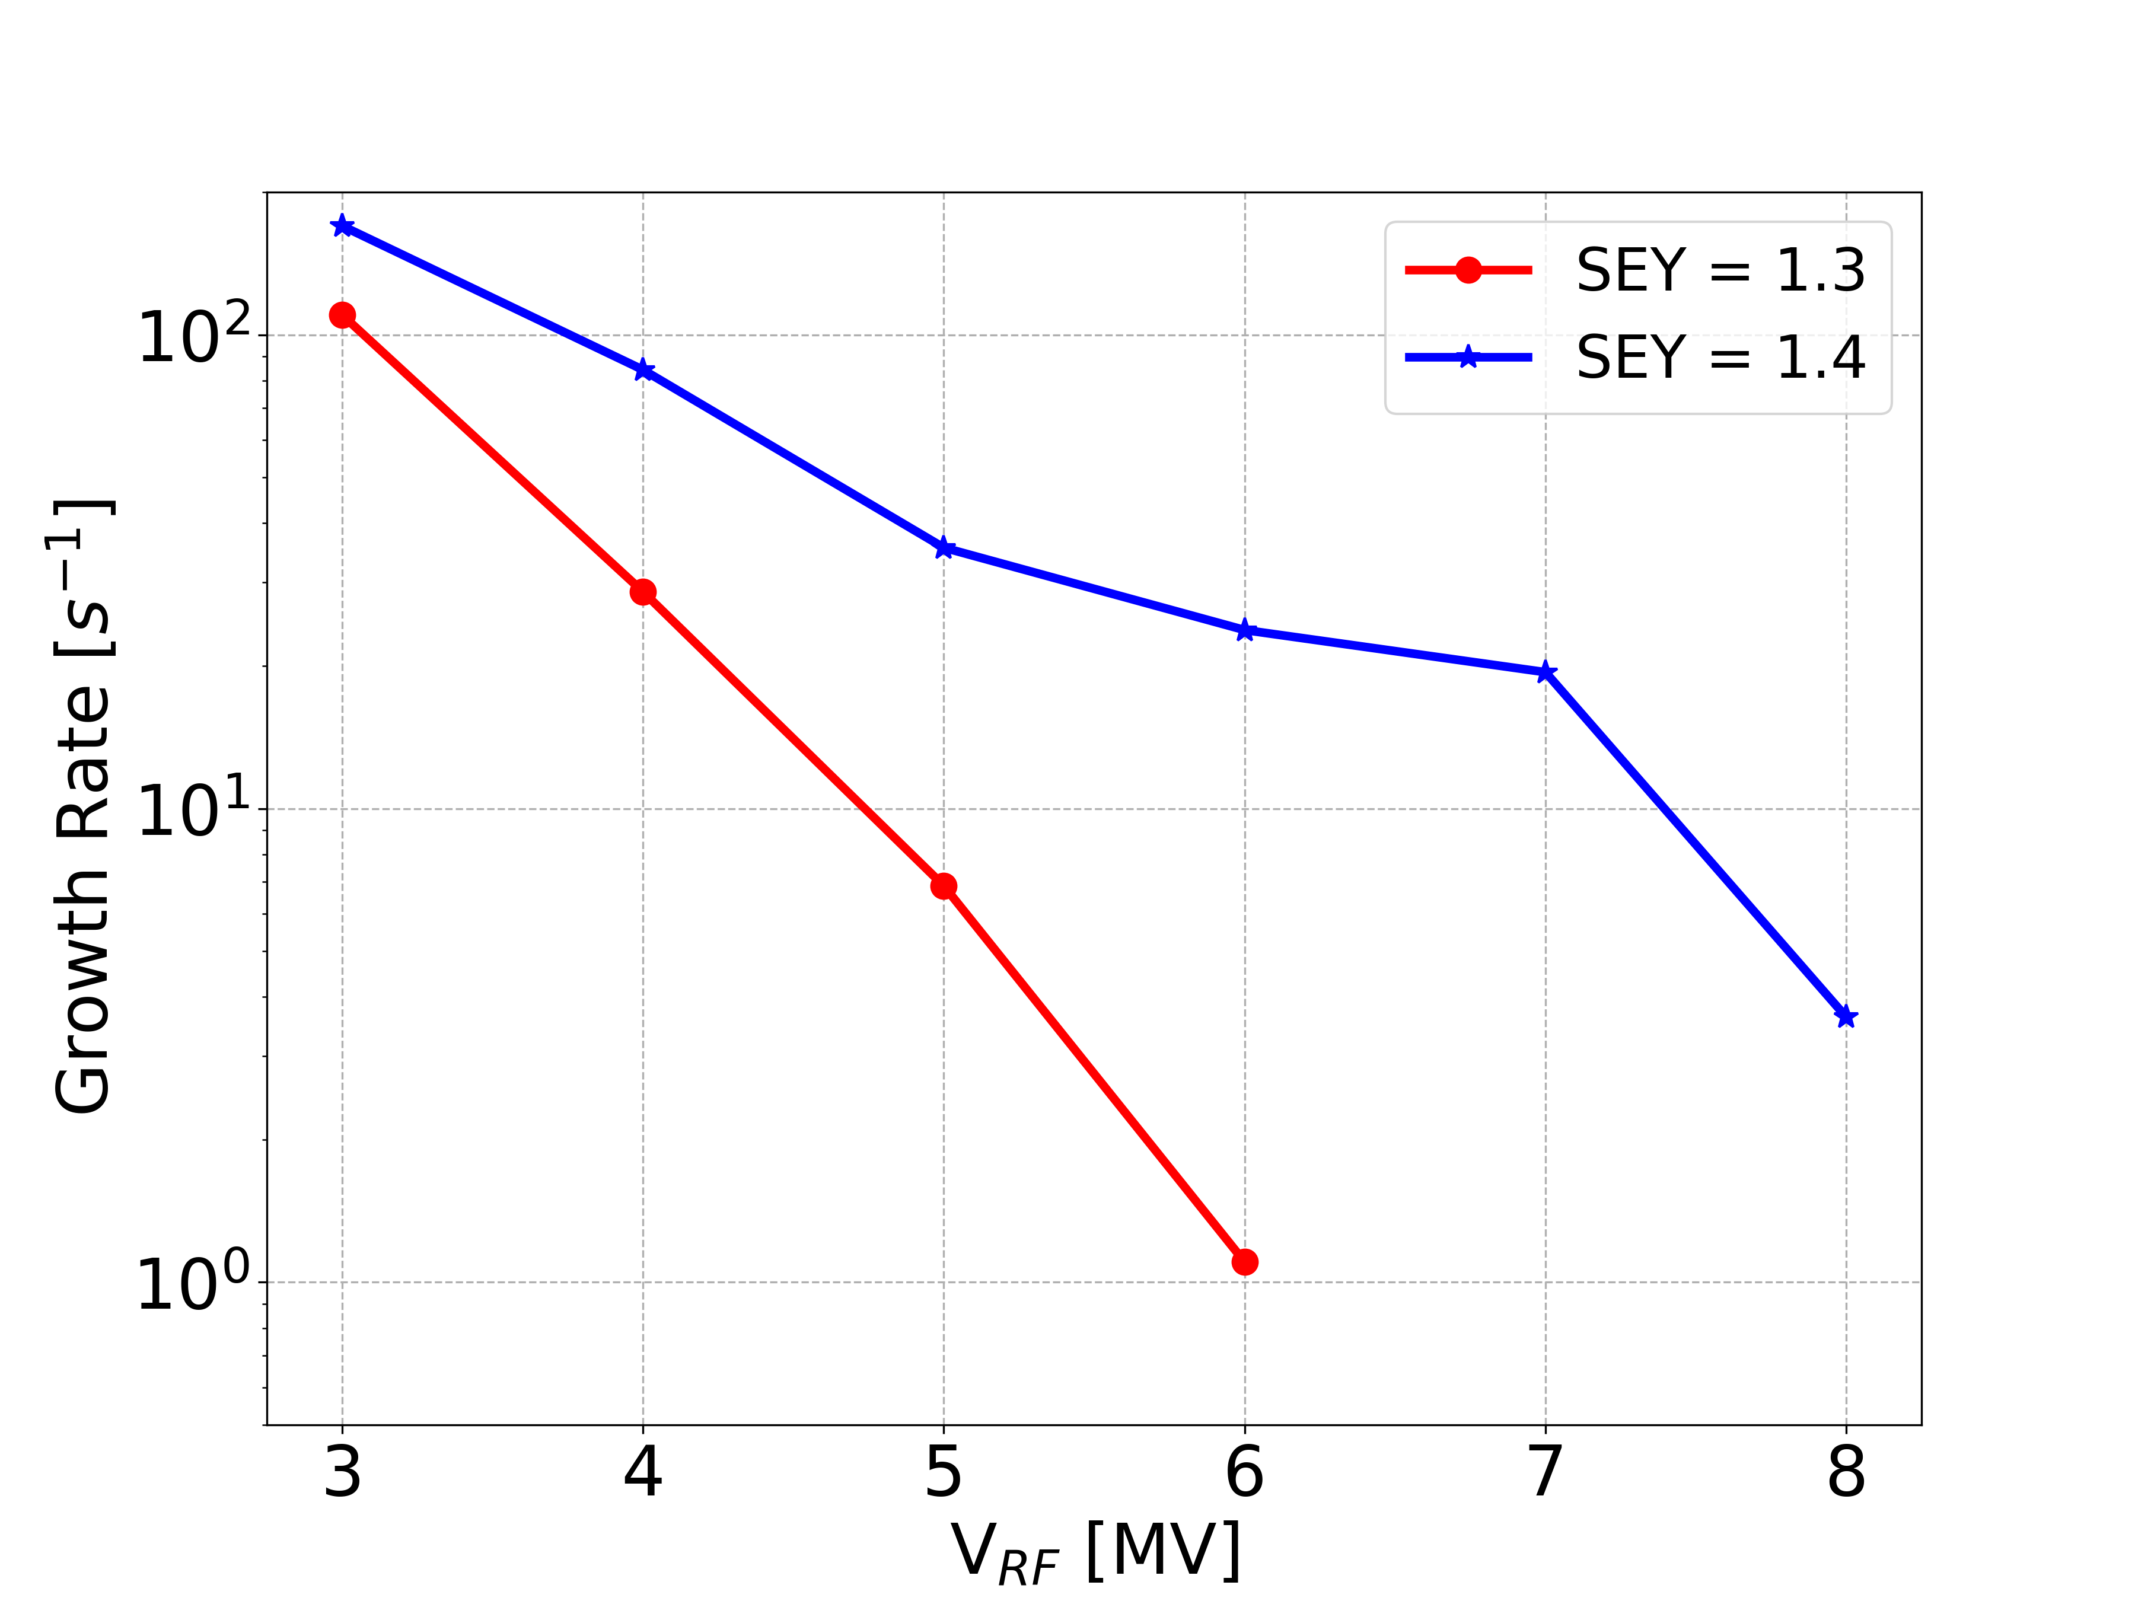
Quad at 450 GeV: Bunch Length and RF Voltage
1.2 x 10¹¹ p/bunch
Increasing the SEY, the bunch is more unstable
Increasing V_{RF} and decreasing the bunch length, the bunch is more stable
  → Which is dominant?

Slide 20
Quad at 450 GeV: Bunch Length and RF Voltage
Increasing V_{RF}, we change
Faster synchrotron tune Q_{s} Bunch length
Stabilising mechanism EC dynamics
Longer bunches → more e⁻
Shorter bunches → less e⁻
We study the two effects separately

Slide 21
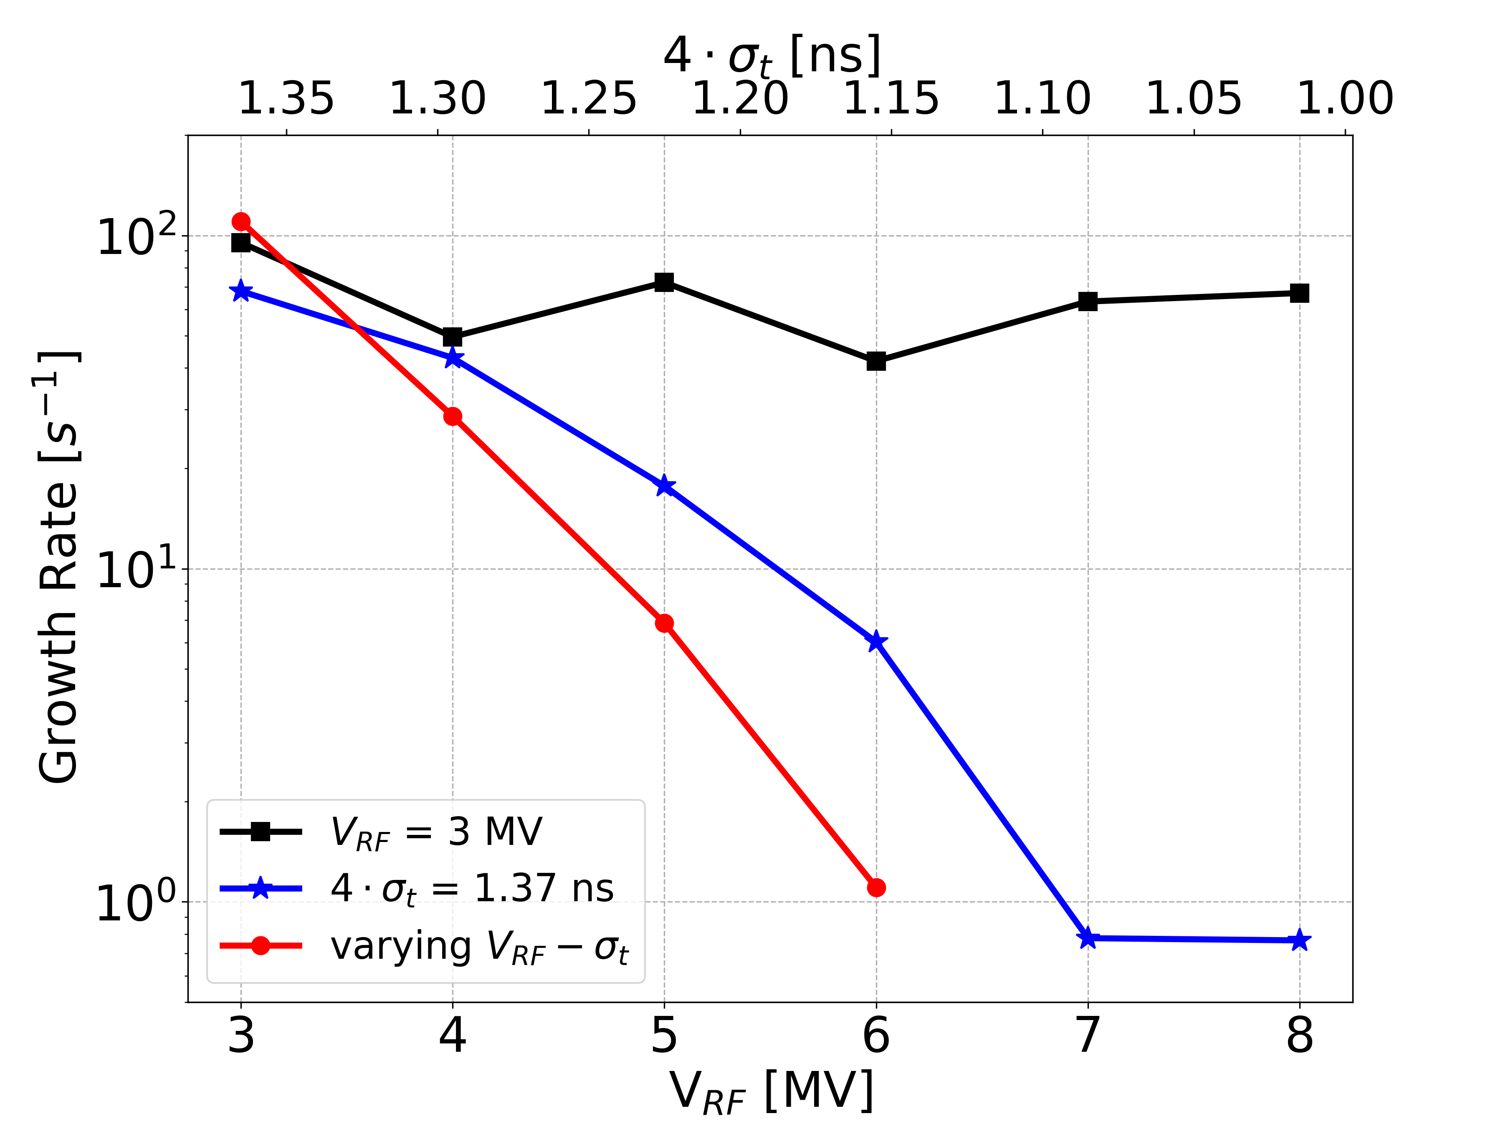
Quad at 450 GeV: Bunch Length and RF Voltage
Changing bunch length
Changing V_{RF} (Q_{s})
1.2 x 10¹¹ p/bunch, SEY = 1.3
Fixed V_{RF} (Q_{s})
Changing bunch length
Fixed bunch length (same e⁻ pinch)
Changing V_{RF} (Q_{s})
→ the dominant stabilizing factor is the change of Q_{s}

Slide 22
Outline
Introduction
Quadrupoles at injection energy
  Convergence Studies
  Bunch Length and RF voltage
  Bunch Intensity
  Transverse Emittance
  Chromaticity and Damper
  Octupoles
  Frequency Analysis
Quadrupoles at collision energy
Dipoles at injection energy
Conclusions

Slide 23
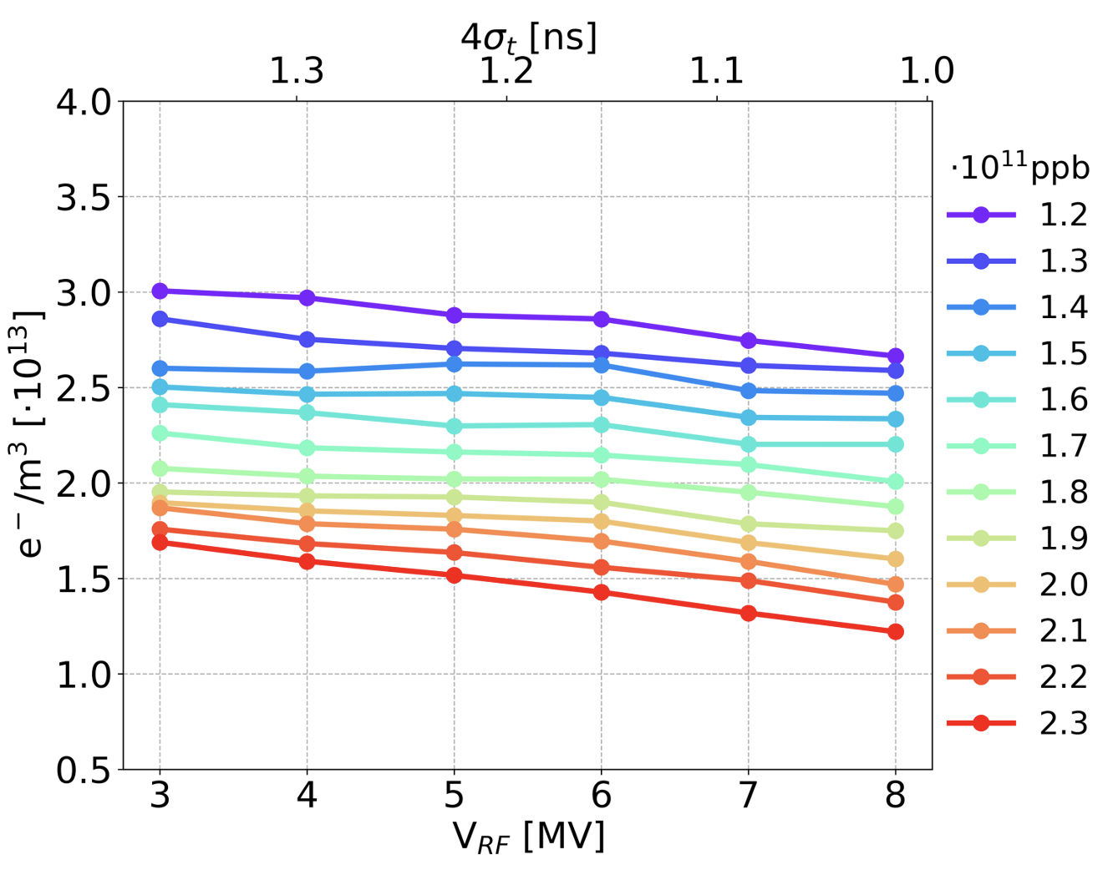
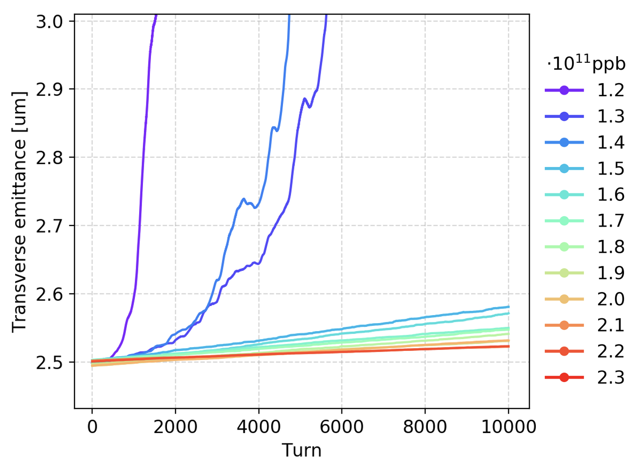
Quad at 450 GeV: Bunch Intensity
The electron density close to the bunch, during the pinch, is significantly smaller for high intensity
Over the simulated 10⁴ turns, an instability could be observed only for the lowers values of the bunch intensity

Slide 24
Outline
Introduction
Quadrupoles at injection energy
  Convergence Studies
  Bunch Length and RF voltage
  Bunch Intensity
  Transverse Emittance
  Chromaticity and Damper
  Octupoles
  Frequency Analysis
Quadrupoles at collision energy
Dipoles at injection energy
Conclusions

Slide 25
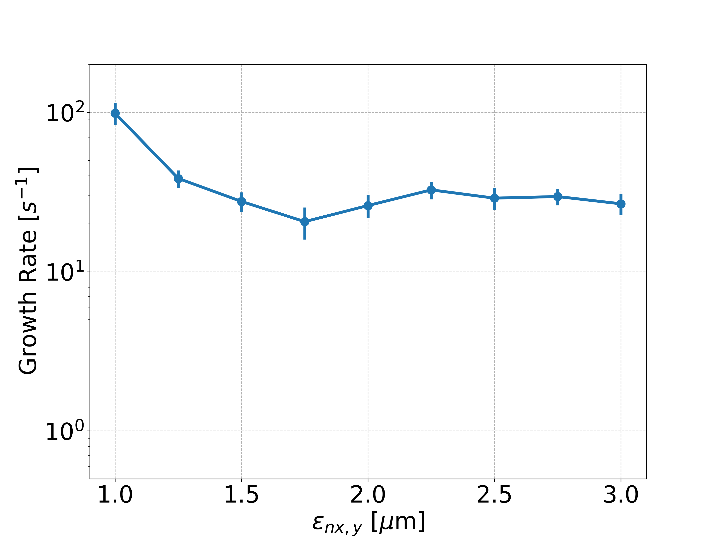
Quad at 450 GeV: Transverse Emittance
1.2 x 10¹¹ p/bunch, SEY = 1.3, V_{RF} =6 MV
The observed dependence is rather weak
to distinguish the effect from statistical fluctuations due to the generation of the bunch distribution, we needed to simulate each case twenty times

Slide 26
Outline
Introduction
Quadrupoles at injection energy
  Convergence Studies
  Bunch Length and RF voltage
  Bunch Intensity
  Transverse Emittance
  Chromaticity and Damper
  Octupoles
  Frequency Analysis
Quadrupoles at collision energy
Dipoles at injection energy
Conclusions

Slide 27
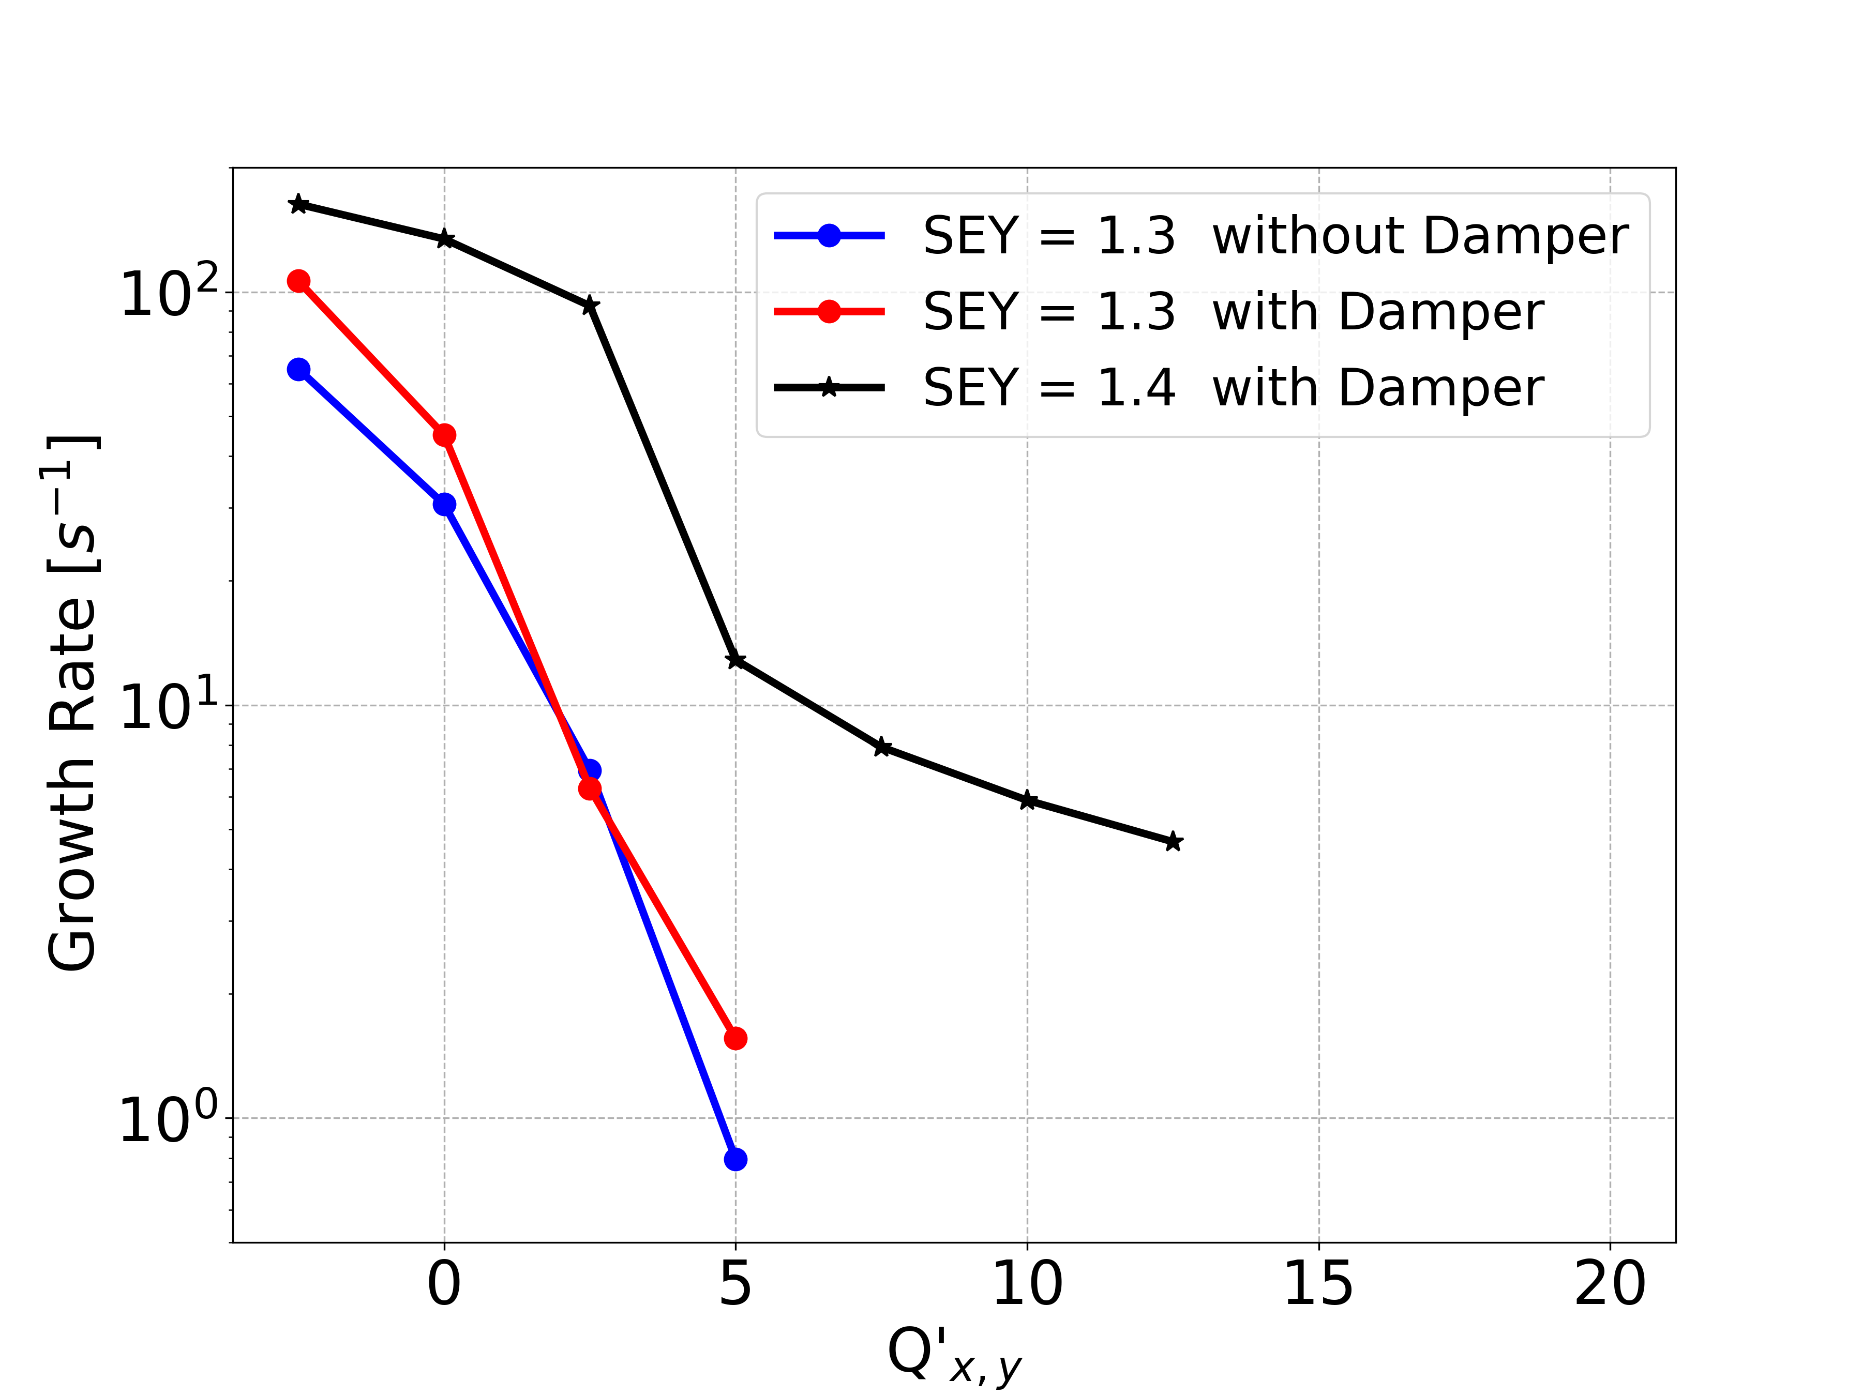
Quad at 450 GeV: Chromaticity and Damper
1.2 x 10¹¹ p/bunch
V_{RF} = 4 MV
SEY = 1.3 – 1.4
Feedback damping time is 10 turns
The instability is strongly mitigated by increasing the chromaticity settings
The transverse feedback is mostly ineffective → cannot damp intra-bunch motion

Slide 28
Outline
Introduction
Quadrupoles at injection energy
  Convergence Studies
  Bunch Length and RF voltage
  Bunch Intensity
  Transverse Emittance
  Chromaticity and Damper
  Octupoles
  Frequency Analysis
Quadrupoles at collision energy
Dipoles at injection energy
Conclusions

Slide 29
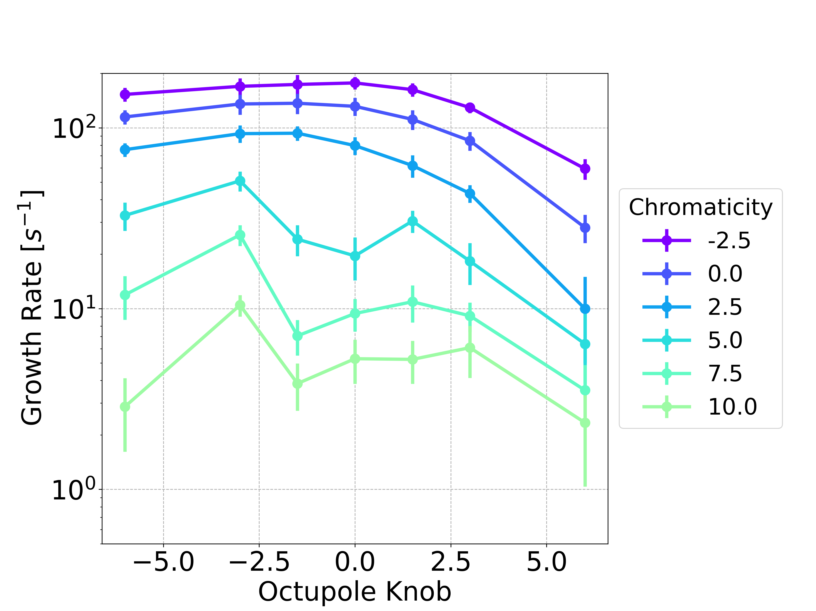
Quad at 450 GeV: Octupoles
1.2 x 10¹¹ p/bunch
V_{RF} = 4 MV
SEY = 1.4
Damper = 10 turns
I = 78 A
I = -78 A
For the case of LHC intensity the octupole current has also been scanned
  → less effective compared to chromaticity
To mitigate dependence on initial random seed (bunch MP coordinates) we repeat each simulation 20 times
Reveals non-trivial dependence on octupole current for high chromaticity
  The dependence on the knob value is non monotonic
  Large values of the octupole knob tend to reduce the instability growth rate
29

Slide 30
Outline
Introduction
Quadrupoles at injection energy
  Convergence Studies
  Bunch Length and RF voltage
  Bunch Intensity
  Transverse Emittance
  Chromaticity and Damper
  Octupoles
  Frequency Analysis
Quadrupoles at collision energy
Dipoles at injection energy
Conclusions

Slide 31
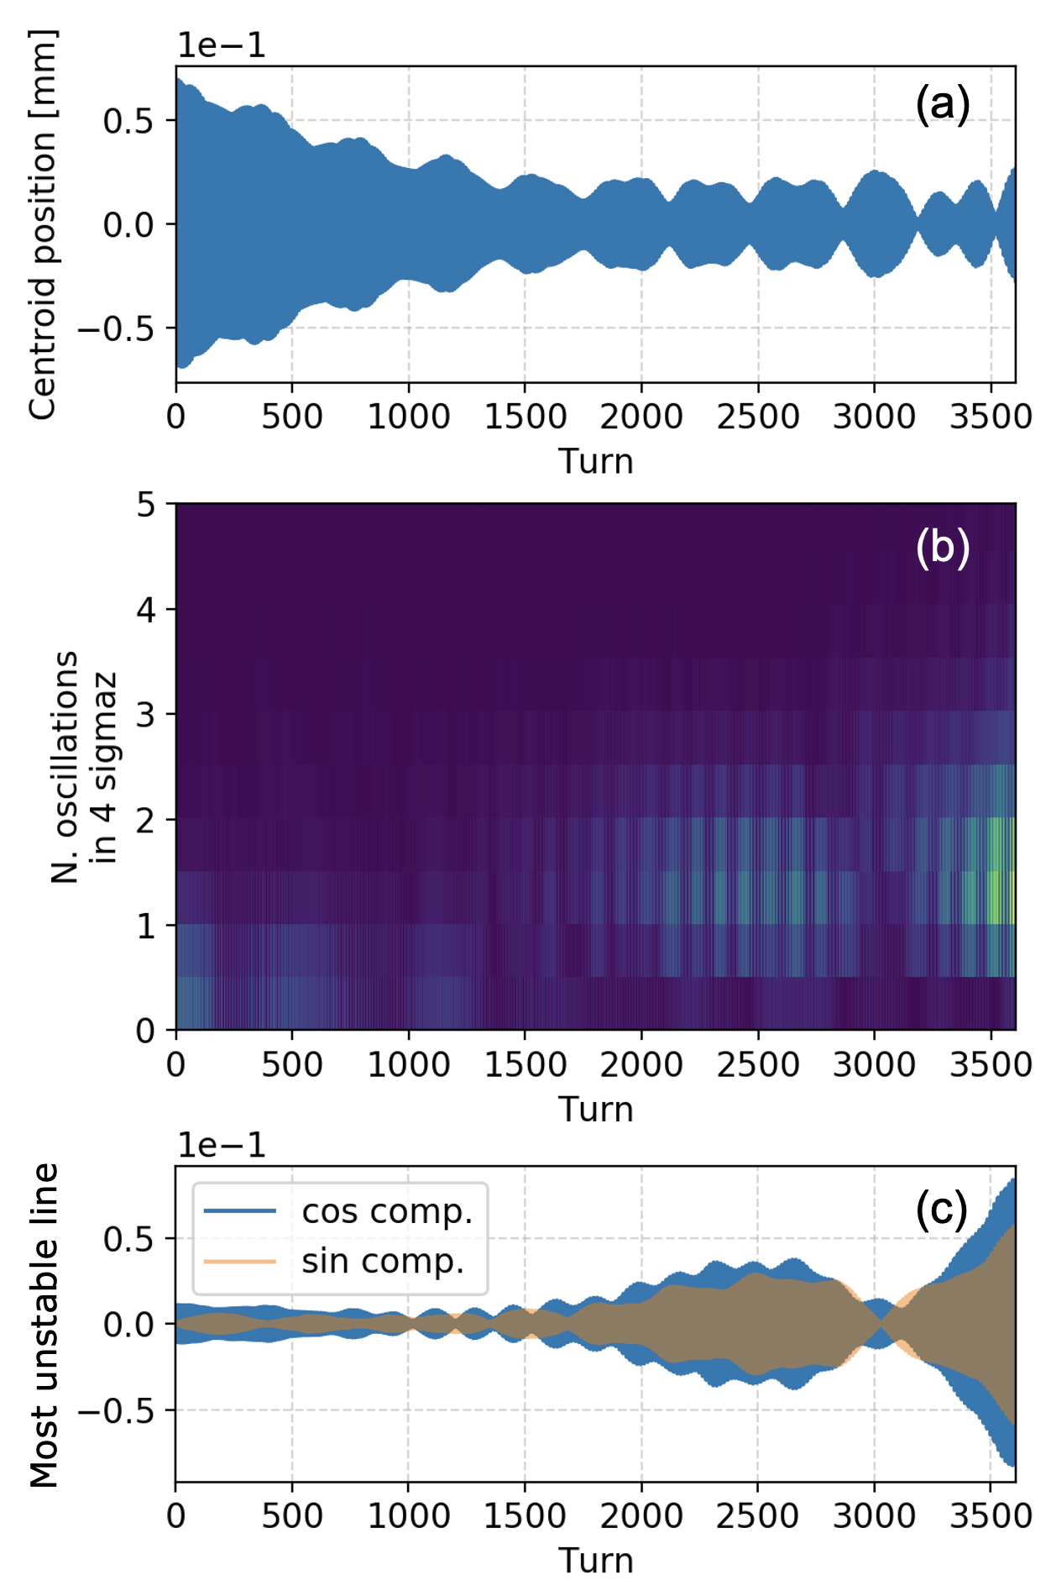
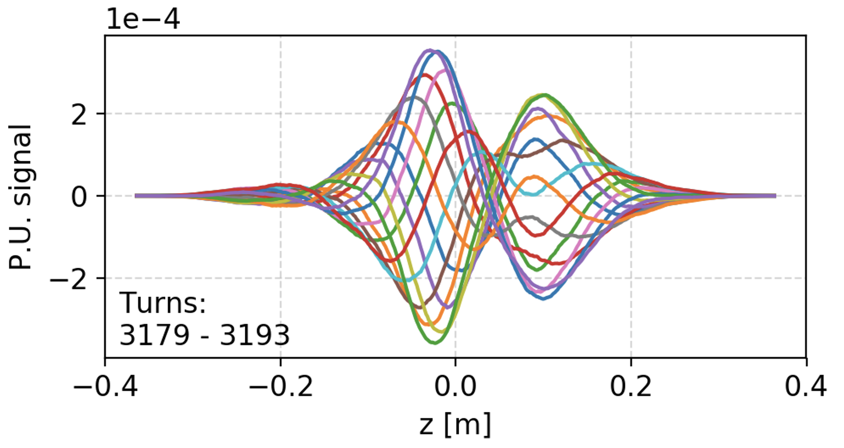
Quad at 450 GeV: Frequency Analysis
1.2 x 10¹¹ p/bunch, SEY = 1.3, V_{RF} = 5 MV
The instabilities are often characterized by the absence of a clear growth in the motion of the bunch centroid
The instabilities are instead revealed by the development of a strong intrabunch motion and by fast transverse emittance blow-up
31

Slide 32
Quad at 450 GeV: Frequency Analysis
Applying a Fourier transform to the position along the bunch at each turn:
  the spectral line corresponding to a rigid oscillation of the bunch (N_{osc} = 0) shows indeed a decreasing amplitude
  instead, an increase in amplitude is observed on other spectral lines (0.5 < N_{osc} < 2.5)
In the time evolution of the sine and cosine components of the strongest spectral line, the development of the instability is clearly visible
32

Slide 33
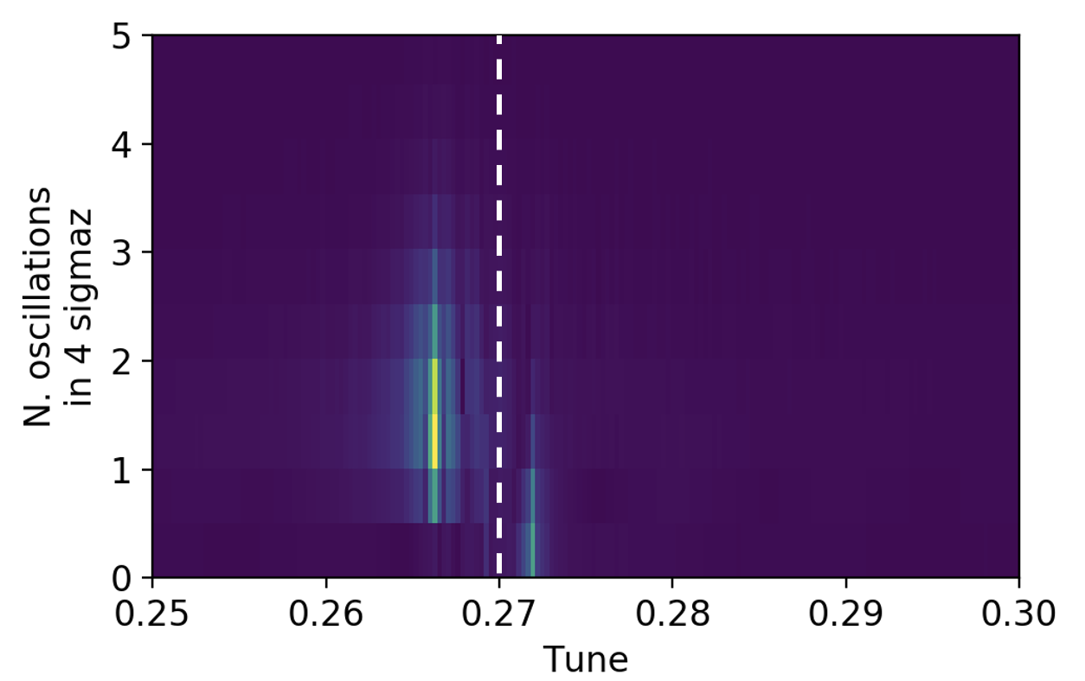
Quad at 450 GeV: Frequency Analysis
By performing a double Fourier transform with respect to the intrabunch position and with respect to time, we obtain the 2D spectrum:
The vertical dashed line indicates the unperturbed betatron tune
A positive tune shift is observed on the rigid bunch line (N_{osc} = 0)
The unstable lines (0.5 < N_{osc} < 2.5) show a negative tune shift
Recent work based on a linearized model of the e-cloud has shown that the instability is generated by a Transverse Mode Coupling mechanism [4]
[4] G. Iadarola, L. Mether, N. Mounet, and L. Sabato, “Linearized method for the study of transverse instabilities driven by electron clouds,” Phys. Rev. Accel. Beams, vol. 23, p. 081002, Jul 2020.
33

Slide 34
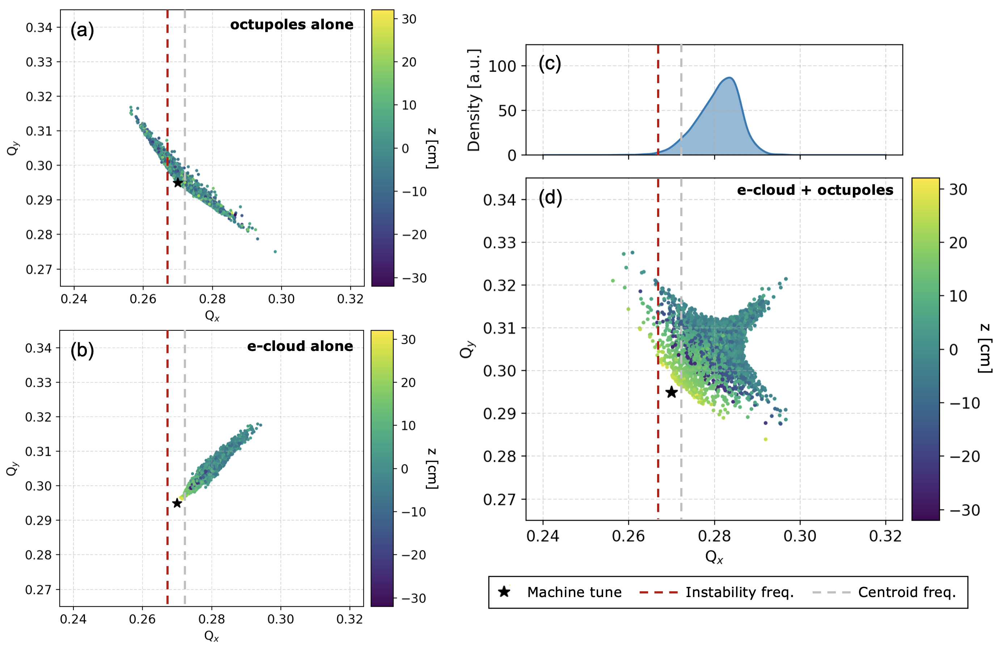
Quad at 450 GeV: Frequency Analysis
Having identified the frequency of the unstable line is useful to explain why the octupoles are ineffective for suppressing the instability
Octupoles alone: the tune spread overlaps with the unstable line
e-cloud alone: positive detuning both in the horizontal and in the vertical plane
Octupoles + e-cloud: due to the positive detuning introduced by the e-cloud, the particle density in the tune space at frequencies close to the unstable line is very low, rendering Landau damping ineffective
34

Slide 35
Outline
Introduction
Quadrupoles at Injection Energy
Quadrupoles at Collision Energy
Dipoles at Injection Energy
Conclusions and Future Developments

Slide 36
Quadrupoles at Collision Energy
From previous simulation studies, instabilities driven by e-cloud in the LHC are expected to be less critical at collision energy compared to injection energy [8]
We have performed a set of convergence scans for this simulation scenario, studying in particular the dependence of the instability growth rate on the beta function at the e-cloud interactions (for simplicity the beam is assumed to be round at those locations)
Electron dynamics
[8] A. Romano, “Electron cloud formation in CERN particle accelerators and its impact on the beam dynamics,” Darmstadt, Tech. U. : 2018-04-30, 2018.

Slide 37
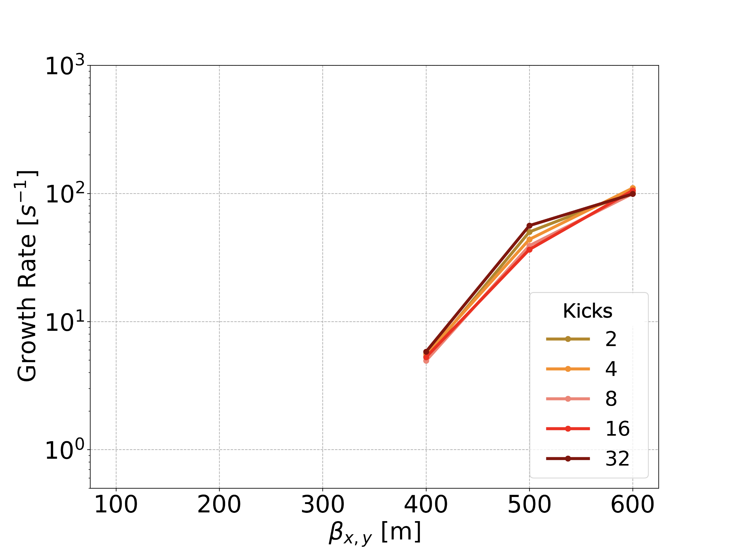
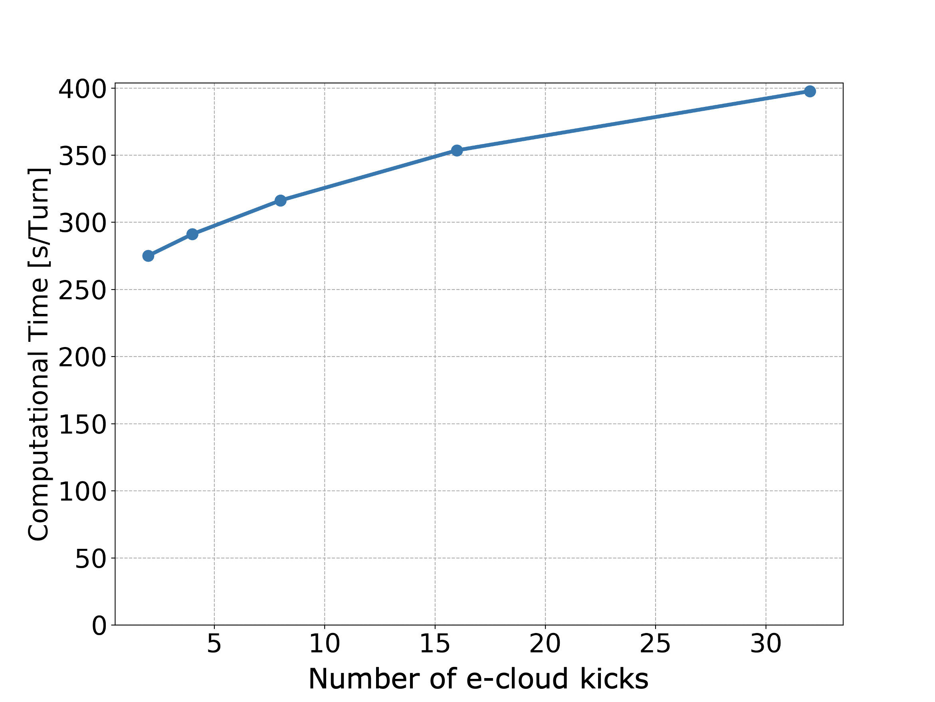
Quadrupoles at Collision Energy
No instabilities are observed over the simulated 2×10⁴ turns for values of the beta function below 400 m
For all scenarios considered for LHC operations and for the HL-LHC upgrade the average beta function in the arcs is well below such a value

Slide 38
Quadrupoles at Collision Energy
Selected Numerical Parameters
Numerical Parameter | Chosen Value
Slices/bucket | 750
MPs/Slice | 2,500
Segments | 4
e⁻ MPs | 5x10⁵
Transverse Grid | T₀ Internal grid coverage: 10𝜎 Internal grid cell size: 0.2𝜎 External grid cell size: 0.8 mm
Electron dynamics
More details in:
[7] L. Sabato, G. Iadarola, and L. Mether, “Numerical simulation studies on single-bunch instabilities driven by electron clouds at the LHC”, CERN-ACC-NOTE, to be published

Slide 39
Outline
Introduction
Quadrupoles at Injection Energy
Quadrupoles at Collision Energy
Dipoles at Injection Energy
Conclusions

Slide 40
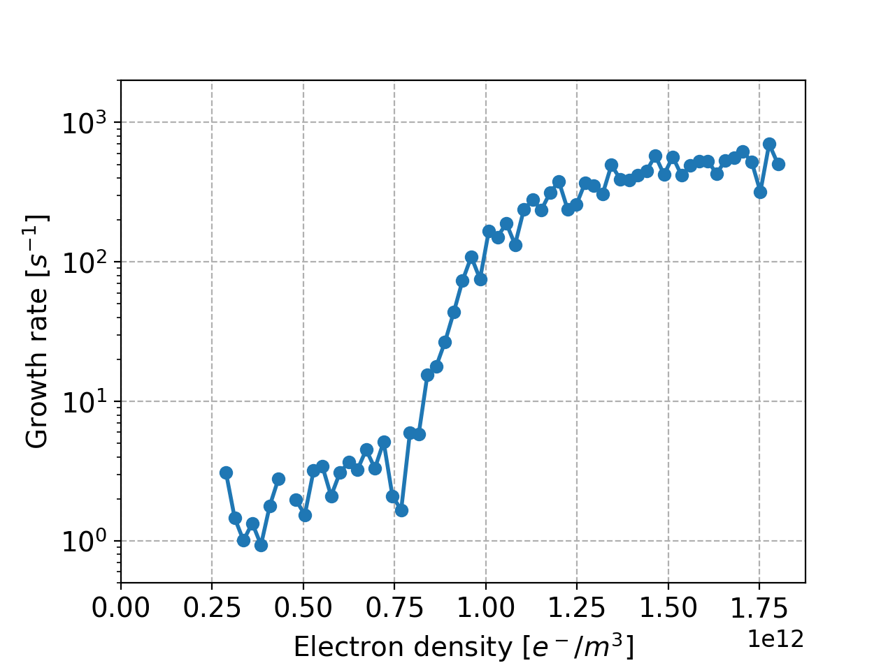
Dipoles at Injection Energy
No instability is observed for electron densities below 2.5×10¹² e⁻/m³
For densities 0.25×10¹² e⁻/m³ - 0.75×10¹² e⁻/m³: slow instability is observed
For densities above 0.75×10¹² e⁻/m³: a much stronger instability appears
Electron dynamics
The electron densities predicted in the dipoles from buildup simulations are below 0.1×10¹² e⁻/m³ (SEY < 1.4 and bunch intensity > 10¹¹ p/bunch)
  “dipole instabilities” are expected less critical compared to “quadrupole instabilities”
  For bunch intensity < 10¹¹ p/bunch, the electron density at the beam location can be higher and “dipole instabilities” are possible, as observed experimentally at LHC [9]
[9] A. Romano et al, “Electron cloud buildup driving spontaneous vertical instabilities of stored beams in the Large Hadron Collider,” Phys. Rev. Accel. Beams, vol. 21, p. 061002, Jun 2018.

Slide 41
Outline
Introduction
Quadrupoles at Injection Energy
Quadrupoles at Collision Energy
Dipoles at Injection Energy
Conclusions

Slide 42
Conclusions
  Instabilities driven by e-cloud at the LHC have been studied by means of numerical simulations
  Particular care has been given to the study of instabilities due to the e-cloud in the quadrupole magnets at injection energy
    The numerical parameters of the simulations have been defined through extensive convergence studies (useful guidelines for future simulation campaigns)
    The stability properties have been studied in particular with respect to the RF voltage settings: the beam is more stable for higher voltage as a result of the faster synchrotron motion
    Higher bunch intensity mitigates the instability: the electron density is lower
    A bunch-by-bunch damper is unable to suppress the instability due to the presence of a strong intrabunch motion
    Octupole magnets are ineffective: the detuning forces due to the e-cloud tend to move the tune spread away from the frequency of the observed unstable mode
    The instability can be suppressed using large chromaticity settings

Slide 43
Conclusions
  Simulations have also been performed for instabilities driven by e-cloud in the quadrupoles at collision energy
    confirm no instability is expected at collision energy in the operational conditions foreseen for LHC and HL-LHC
  Instabilities driven by e-cloud in dipole magnets at injection energy were also simulated
    confirm that they are not expected to be critical for realistic values of the bunch intensity and of the SEY

Slide 44
Thanks for your attention

Slide 46
Spares

Slide 47
Introduction: Description of the Simulation Setup
The bunch is modelled by a set of MPs
Longitudinal and transverse beam dynamics are simulated using modules from the PyHEADTAIL code
Smooth approximation (constant beta functions) is used for the transverse dynamics
Longitudinal dynamics is lumped at a single location of the ring
e-cloud is modelled by a set of thin interactions installed along the ring
  at each interaction the electron dynamics is simulated using the PyECLOUD code, based on the bunch distribution provided by PyHEADTAIL
The bunch is longitudinally sliced, each slice defining a time step for the simulation of the electron dynamics
For each slice, the forces generated by the bunch and by the electrons are computed using the Particle In Cell (PIC) method to solve a 2D Poisson problem
Electron dynamics

Slide 48
Introduction: Description of the Simulation Setup
The electric field generated by the beam and by the electron themselves is taken into account for the simulation of the electron motion, while the electric field generated by the electron distribution alone defines the transverse kicks applied on the bunch MPs at each e-cloud interaction
e-cloud MPs at each interaction are initialized using the charge, position and momenta of MPs saved from PyECLOUD buildup simulations, performed with a rigid beam for the same scenario
electron distribution from a single snapshot of the buildup simulation shows a significant numerical noise, due to the limited number of MPs.
  it would introduce numerical artifacts in the corresponding instability simulation
  the MP set used in the instability simulation is obtained by merging MP sets from several snapshots of the e-cloud at saturation, as obtained from the buildup simulation
  left-right and top-bottom symmetry of the distribution is also enforced by mirroring the MP distribution
Electron dynamics

Slide 49
Introduction: Description of the Simulation Setup
Parallel computing is regularly exploited by simulating different e-cloud interactions on different computing cores, using the PyPARIS parallelization layer
  typically a number of cores equal to the number of e-cloud interactions is utilized
Positions and statistical momenta of the bunch and of the slices are recorded by PyHEADTAIL at each revolution
To characterize the instability, a Fourier transform is applied to the position along the bunch at each turn and the instability growth rate is measured by applying an exponential fit on the most unstable spectral line
Based on the computational time, we had to limit the simulation time window to 20,000 turns, which allows detecting instabilities with growth rates in the order of 0.5 s⁻¹ (corresponding to a risetime of two seconds) or faster.
Electron dynamics

Slide 50
Quad at Inj: Convergence Studies
Force interpolation
In PyECLOUD each time-step is divided in a certain number of substeps in which the electric fields are kept constant
  this is convenient to handle the very fast cyclotron motion of the electrons in the presence of strong magnetic fields
  in instability simulations this is done based on the input parameter Dt_{REF} which defines the target size of these substeps
Recently the possibility of updating also the electric fields at each substep has been introduced in PyECLOUD (as of version 8.3.0)
This is done without performing the full PIC recalculation, but simply re-interpolating the field map at the new MP location at each substep

Slide 51
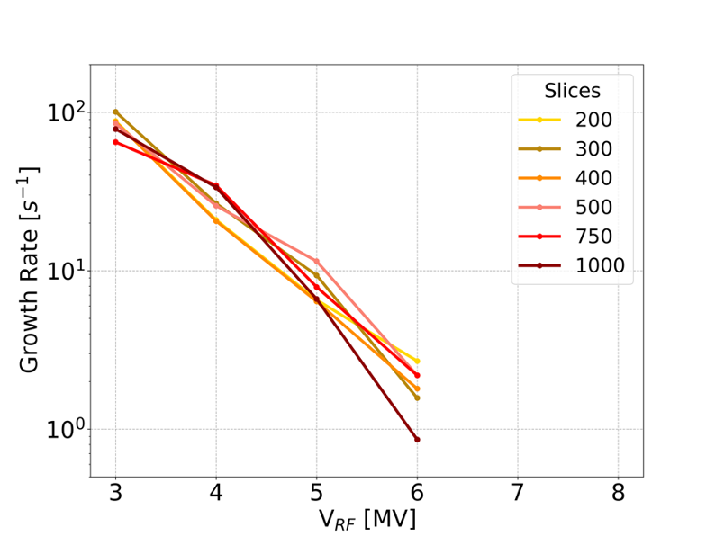
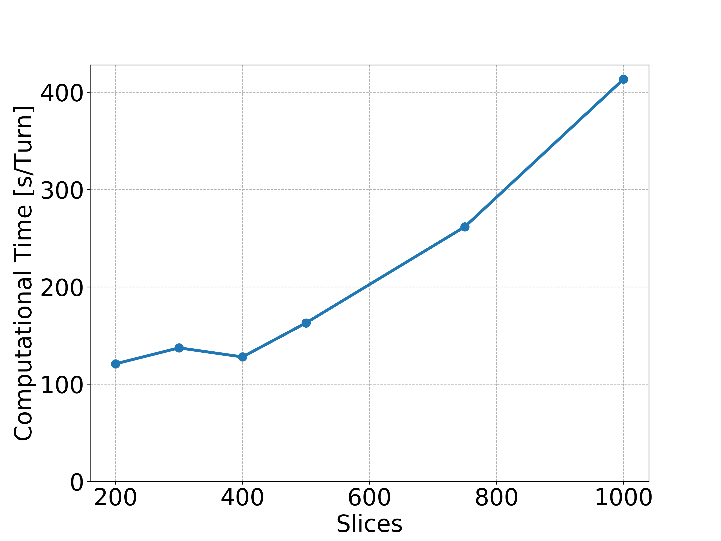
Quad at Inj: Convergence Studies
Force interpolation
This is found to significantly improve the convergence properties, but implies some cost in terms of computing time, especially for small numbers of slices

Slide 52
Quad at Inj: Convergence Studies
Strategy
Scan every numerical parameter, using conservative values for the other parameters:
    Slices = 750
    MPs/slice = 5,000
    Segments = 8
    e⁻ MPs = 500,000
    Transverse Grid: T₀

Slide 53
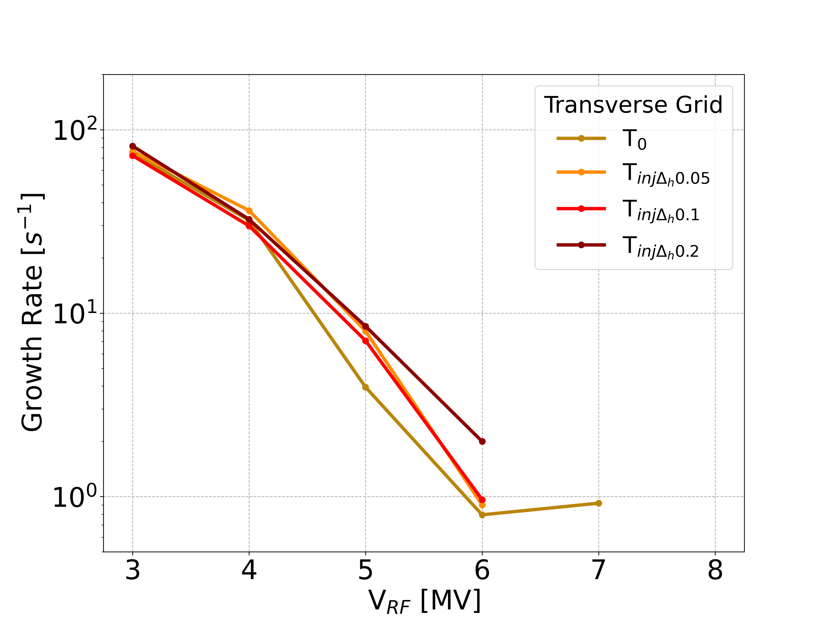
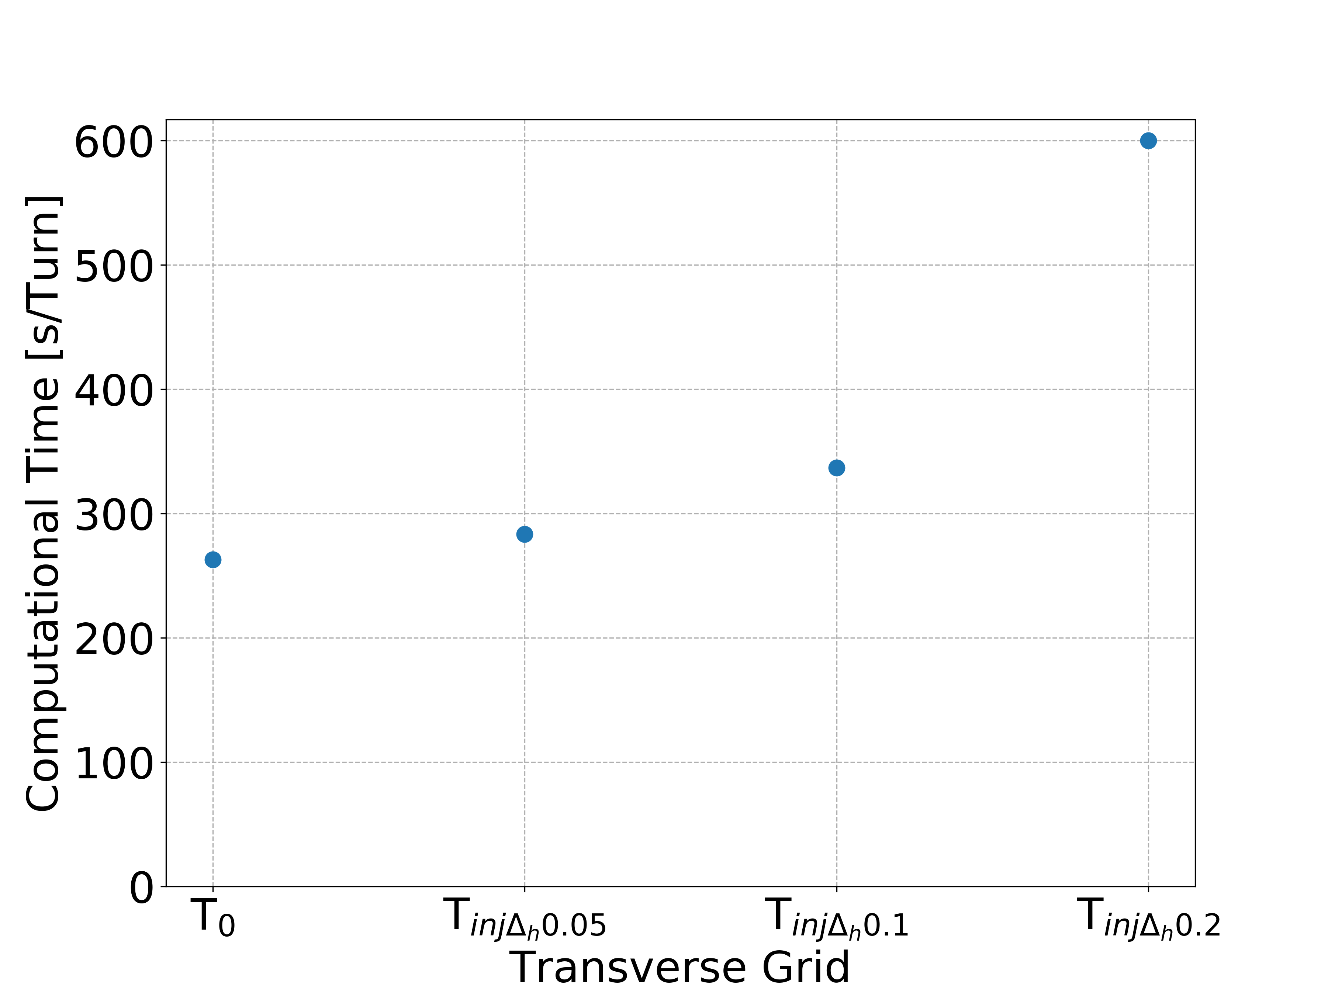
Quad at Inj: Convergence Studies
Transverse Grids
The grid T₀, used in the past studies, is adequate
Parameter | T₀
Internal grid coverage [mm] | 6.95 (10𝜎)
Internal grid cell size [mm] | 0.139 (0.2𝜎)
External grid cell size [mm] | 0.8
T_{inj} Δh=0.2σ | T_{inj} Δh=0.1σ | T_{inj} Δh=0.05σ
10.5 (15𝜎) | 10.5 (15𝜎) | 10.5 (15𝜎)
0.139 (0.2𝜎) | 0.0697 (0.1𝜎) | 0.0349 (0.05𝜎)
0.4 | 0.4 | 0.4

Slide 54
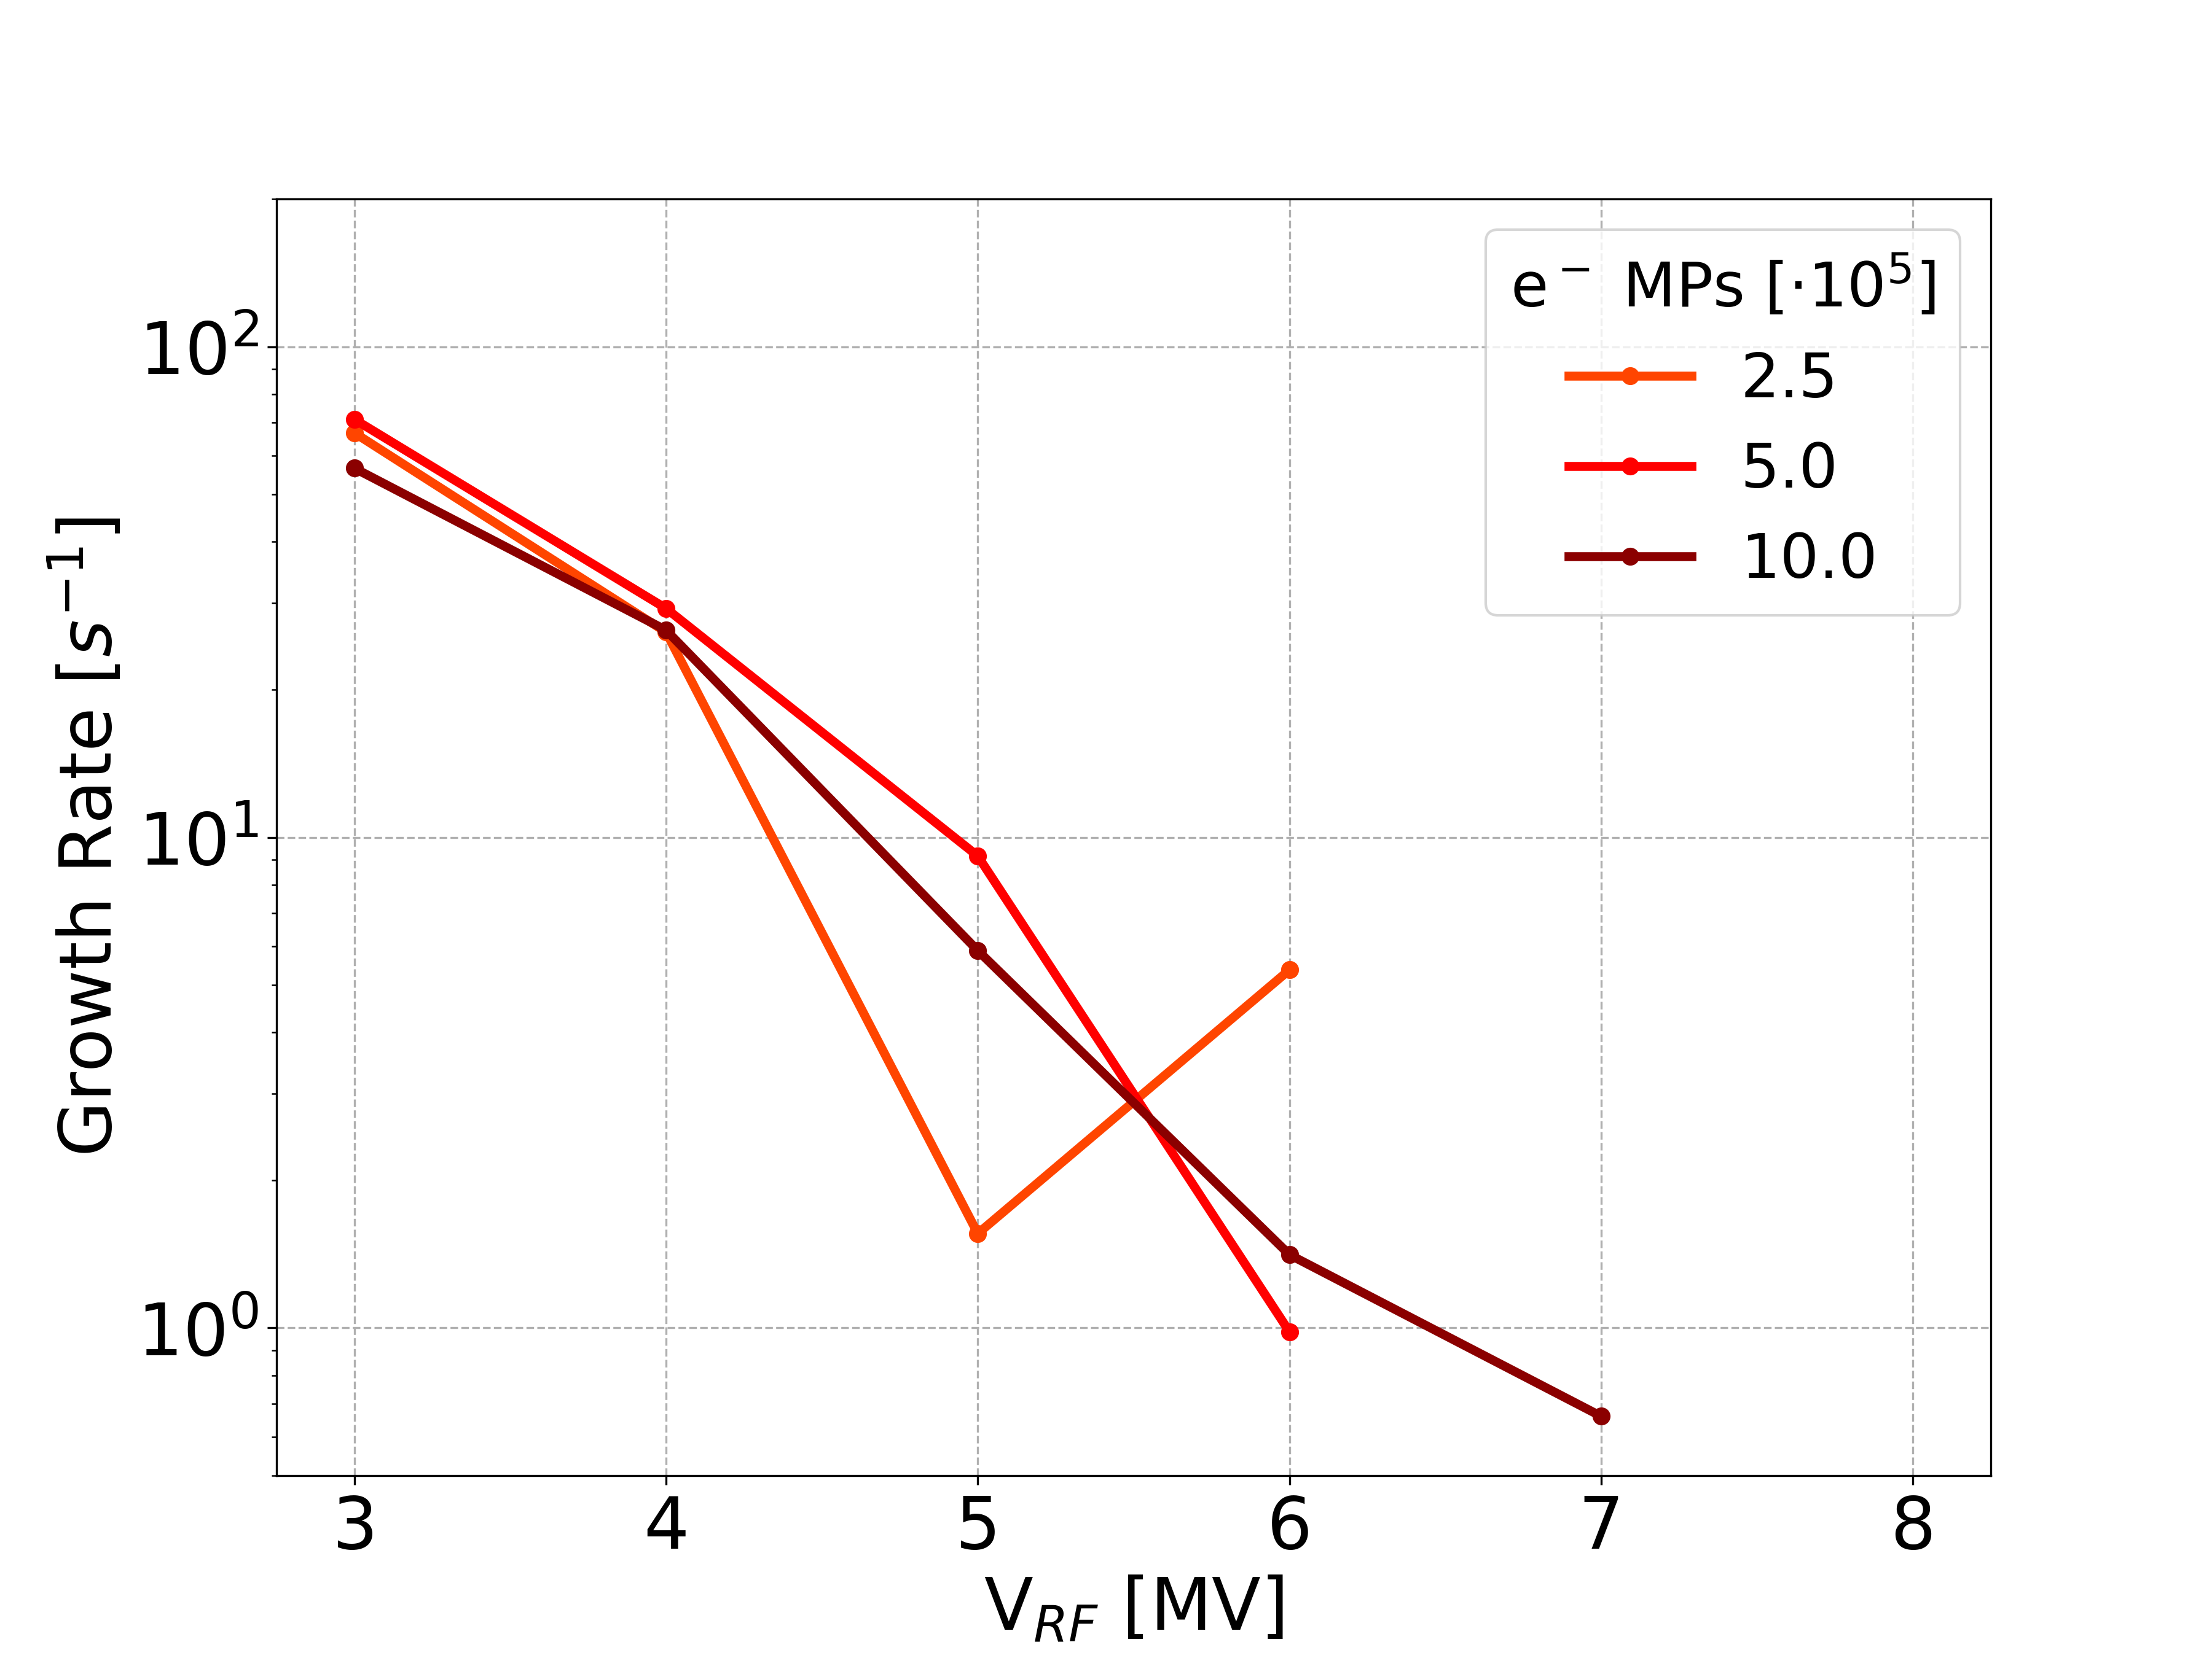
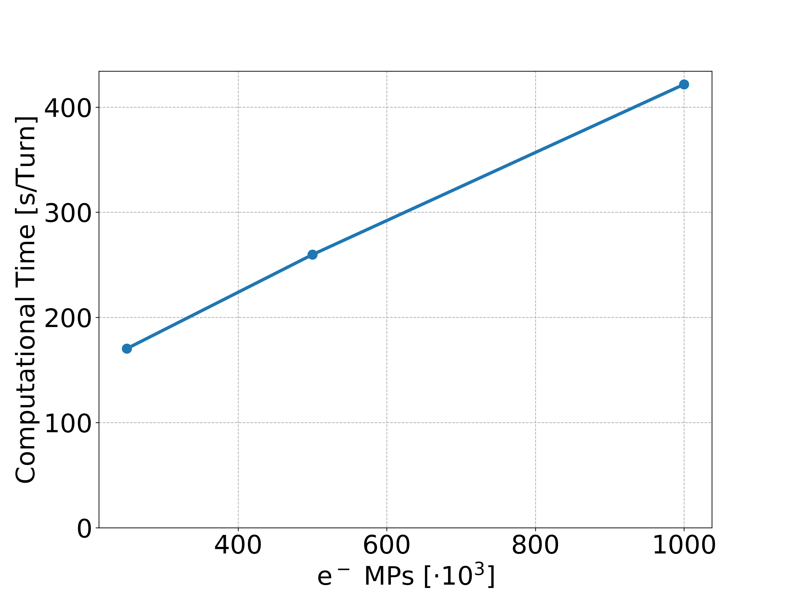
Quad at Inj: Convergence Studies
Electron MPs
At least 5×10⁵ MPs are required to achieve convergence

Slide 55
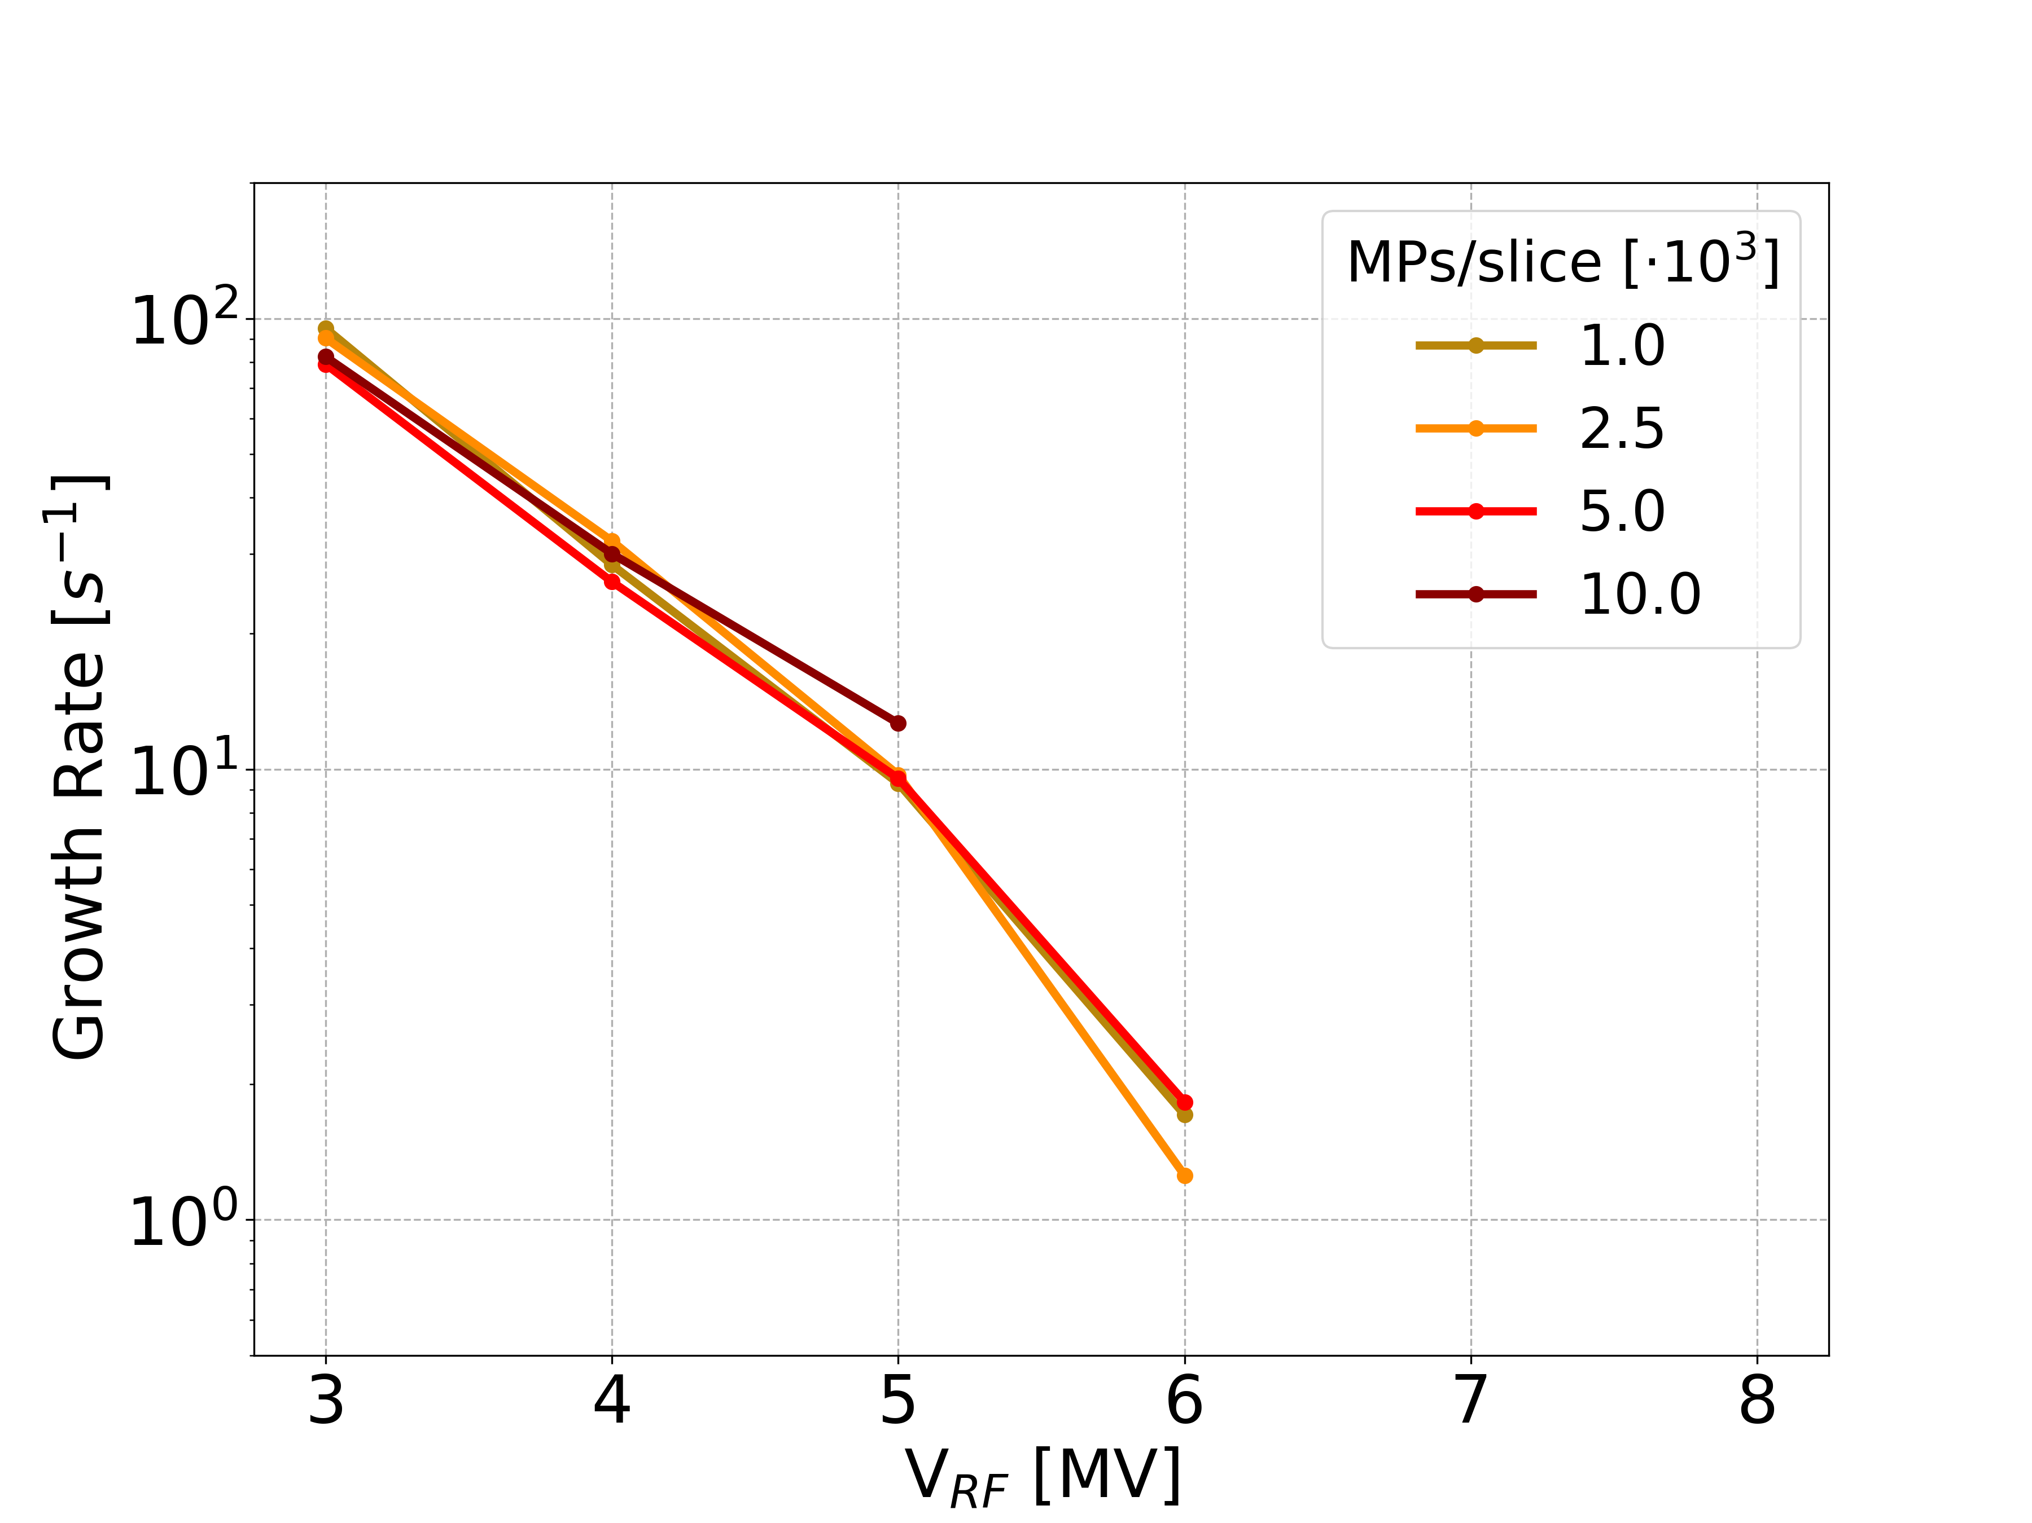
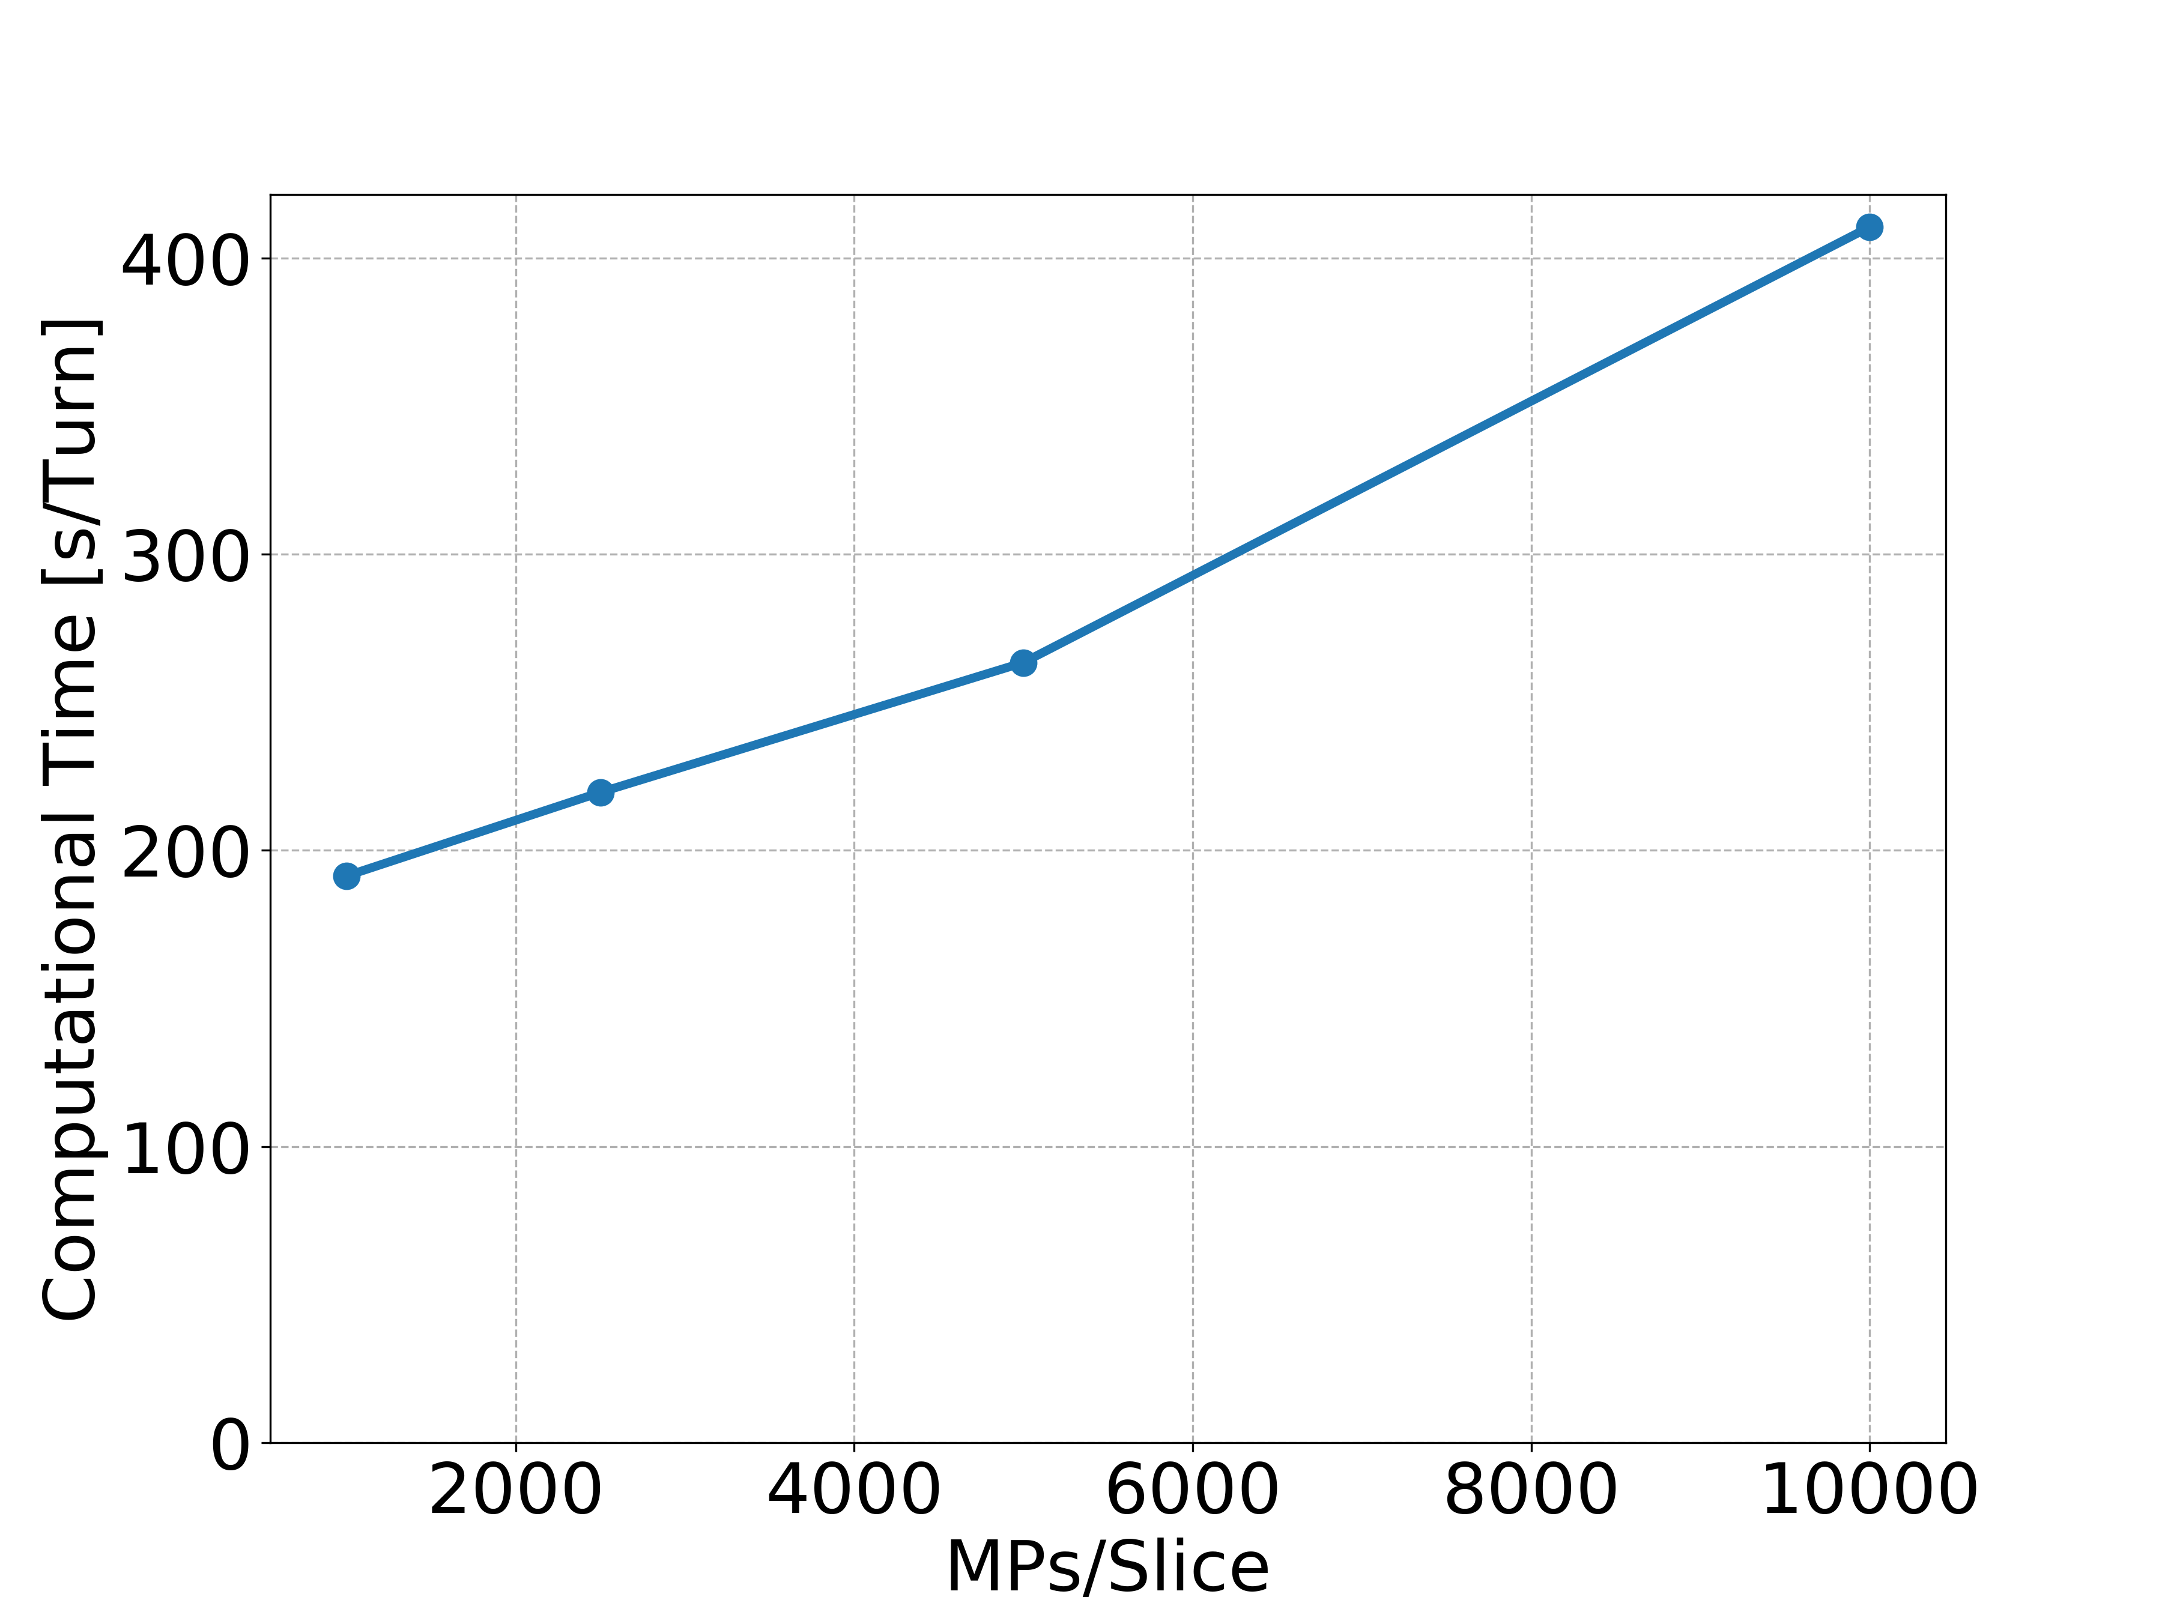
Quad at Inj: Convergence Studies
MPs per Slice
Numerical convergence is achieved already for 10³ MPs per slice

Slide 56
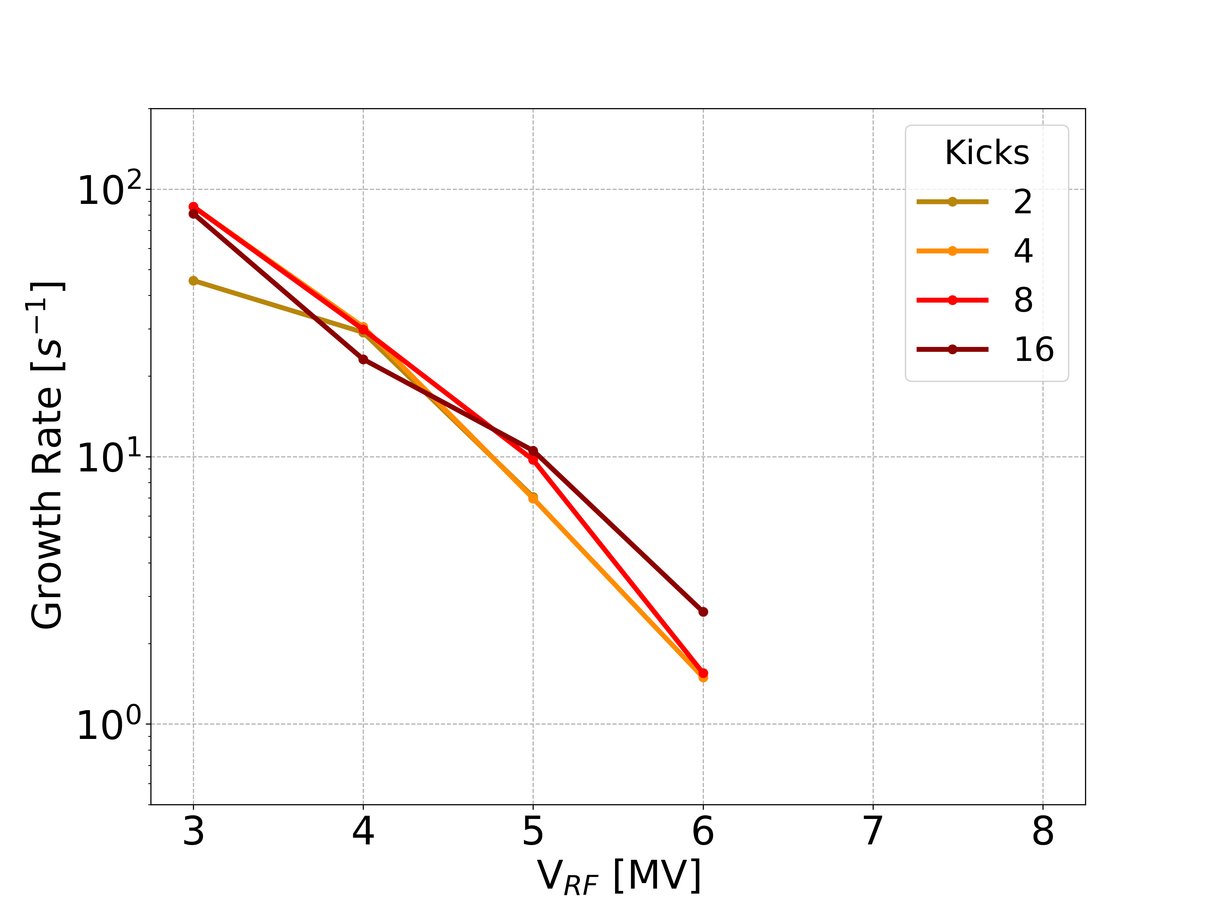
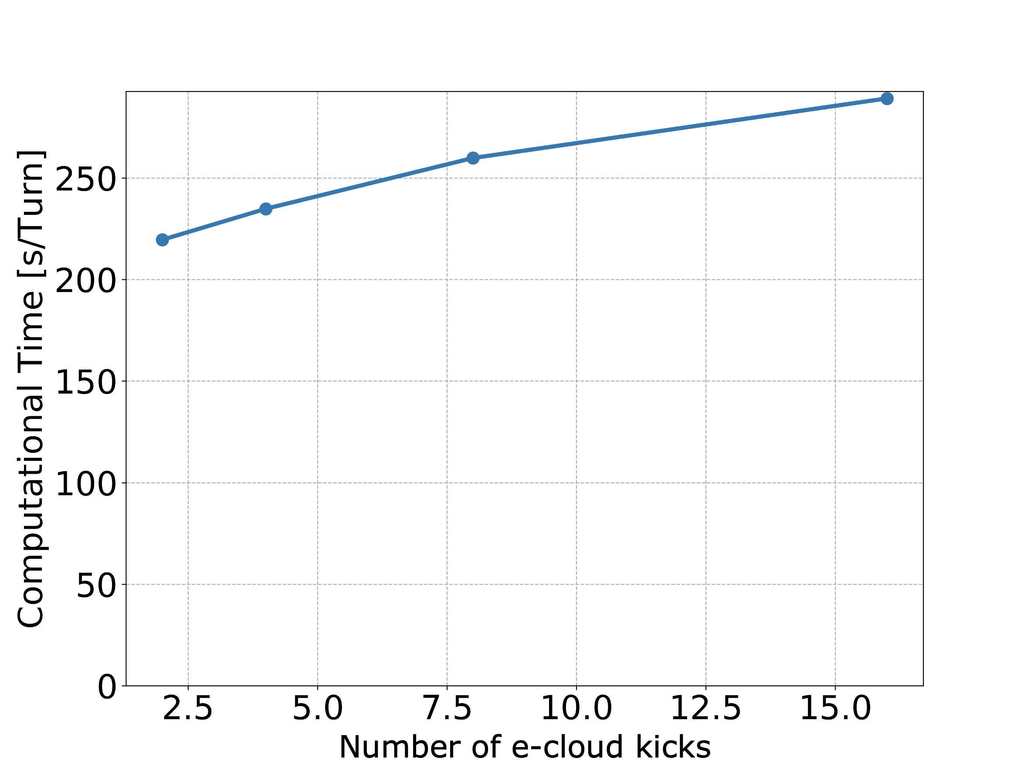
Quad at Inj: Convergence Studies
Numerical convergence is obtained already with a small number of e-cloud interactions
The number of CPU-cores used for the simulation is chosen equal to the number of e-cloud interactions
  For this reason the corresponding increase in the computational time is relatively small and is in line with the expectation from the employed parallelization strategy [6]
[6] G. Iadarola, E. Belli, K. Li, L. Mether, A. Romano, and G. Rumolo, “Evolution of python tools for the simulation of electron cloud effects,” in Proc. 8th International Particle Accelerator Conference, Copenhagen, Denmark, May 2017. pp.THPAB043.

Slide 58
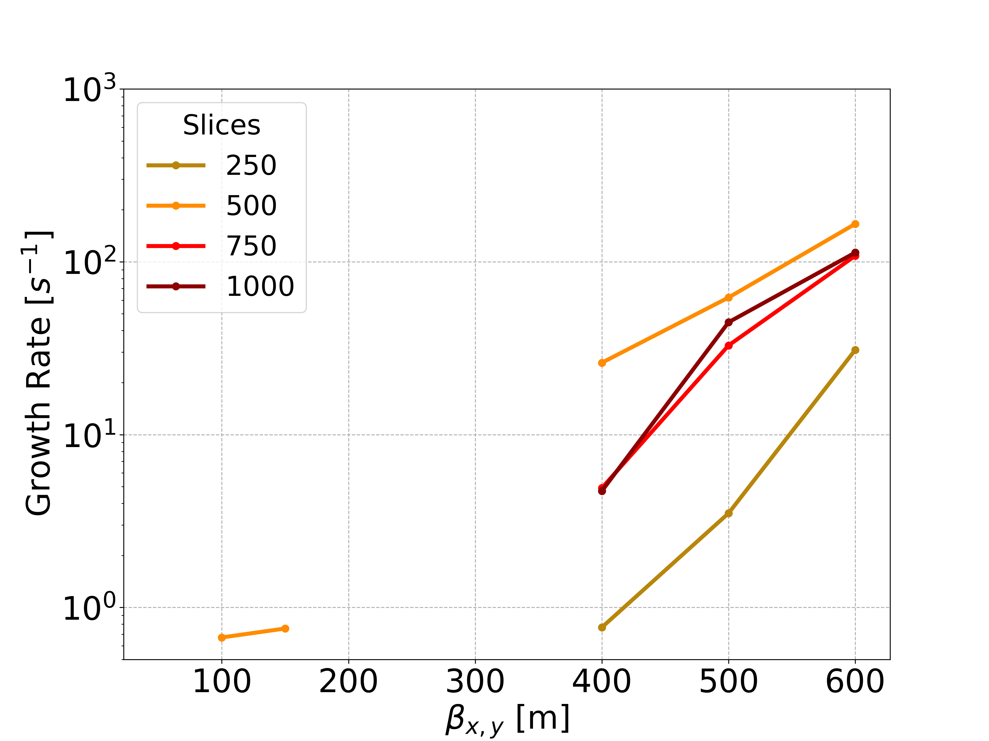
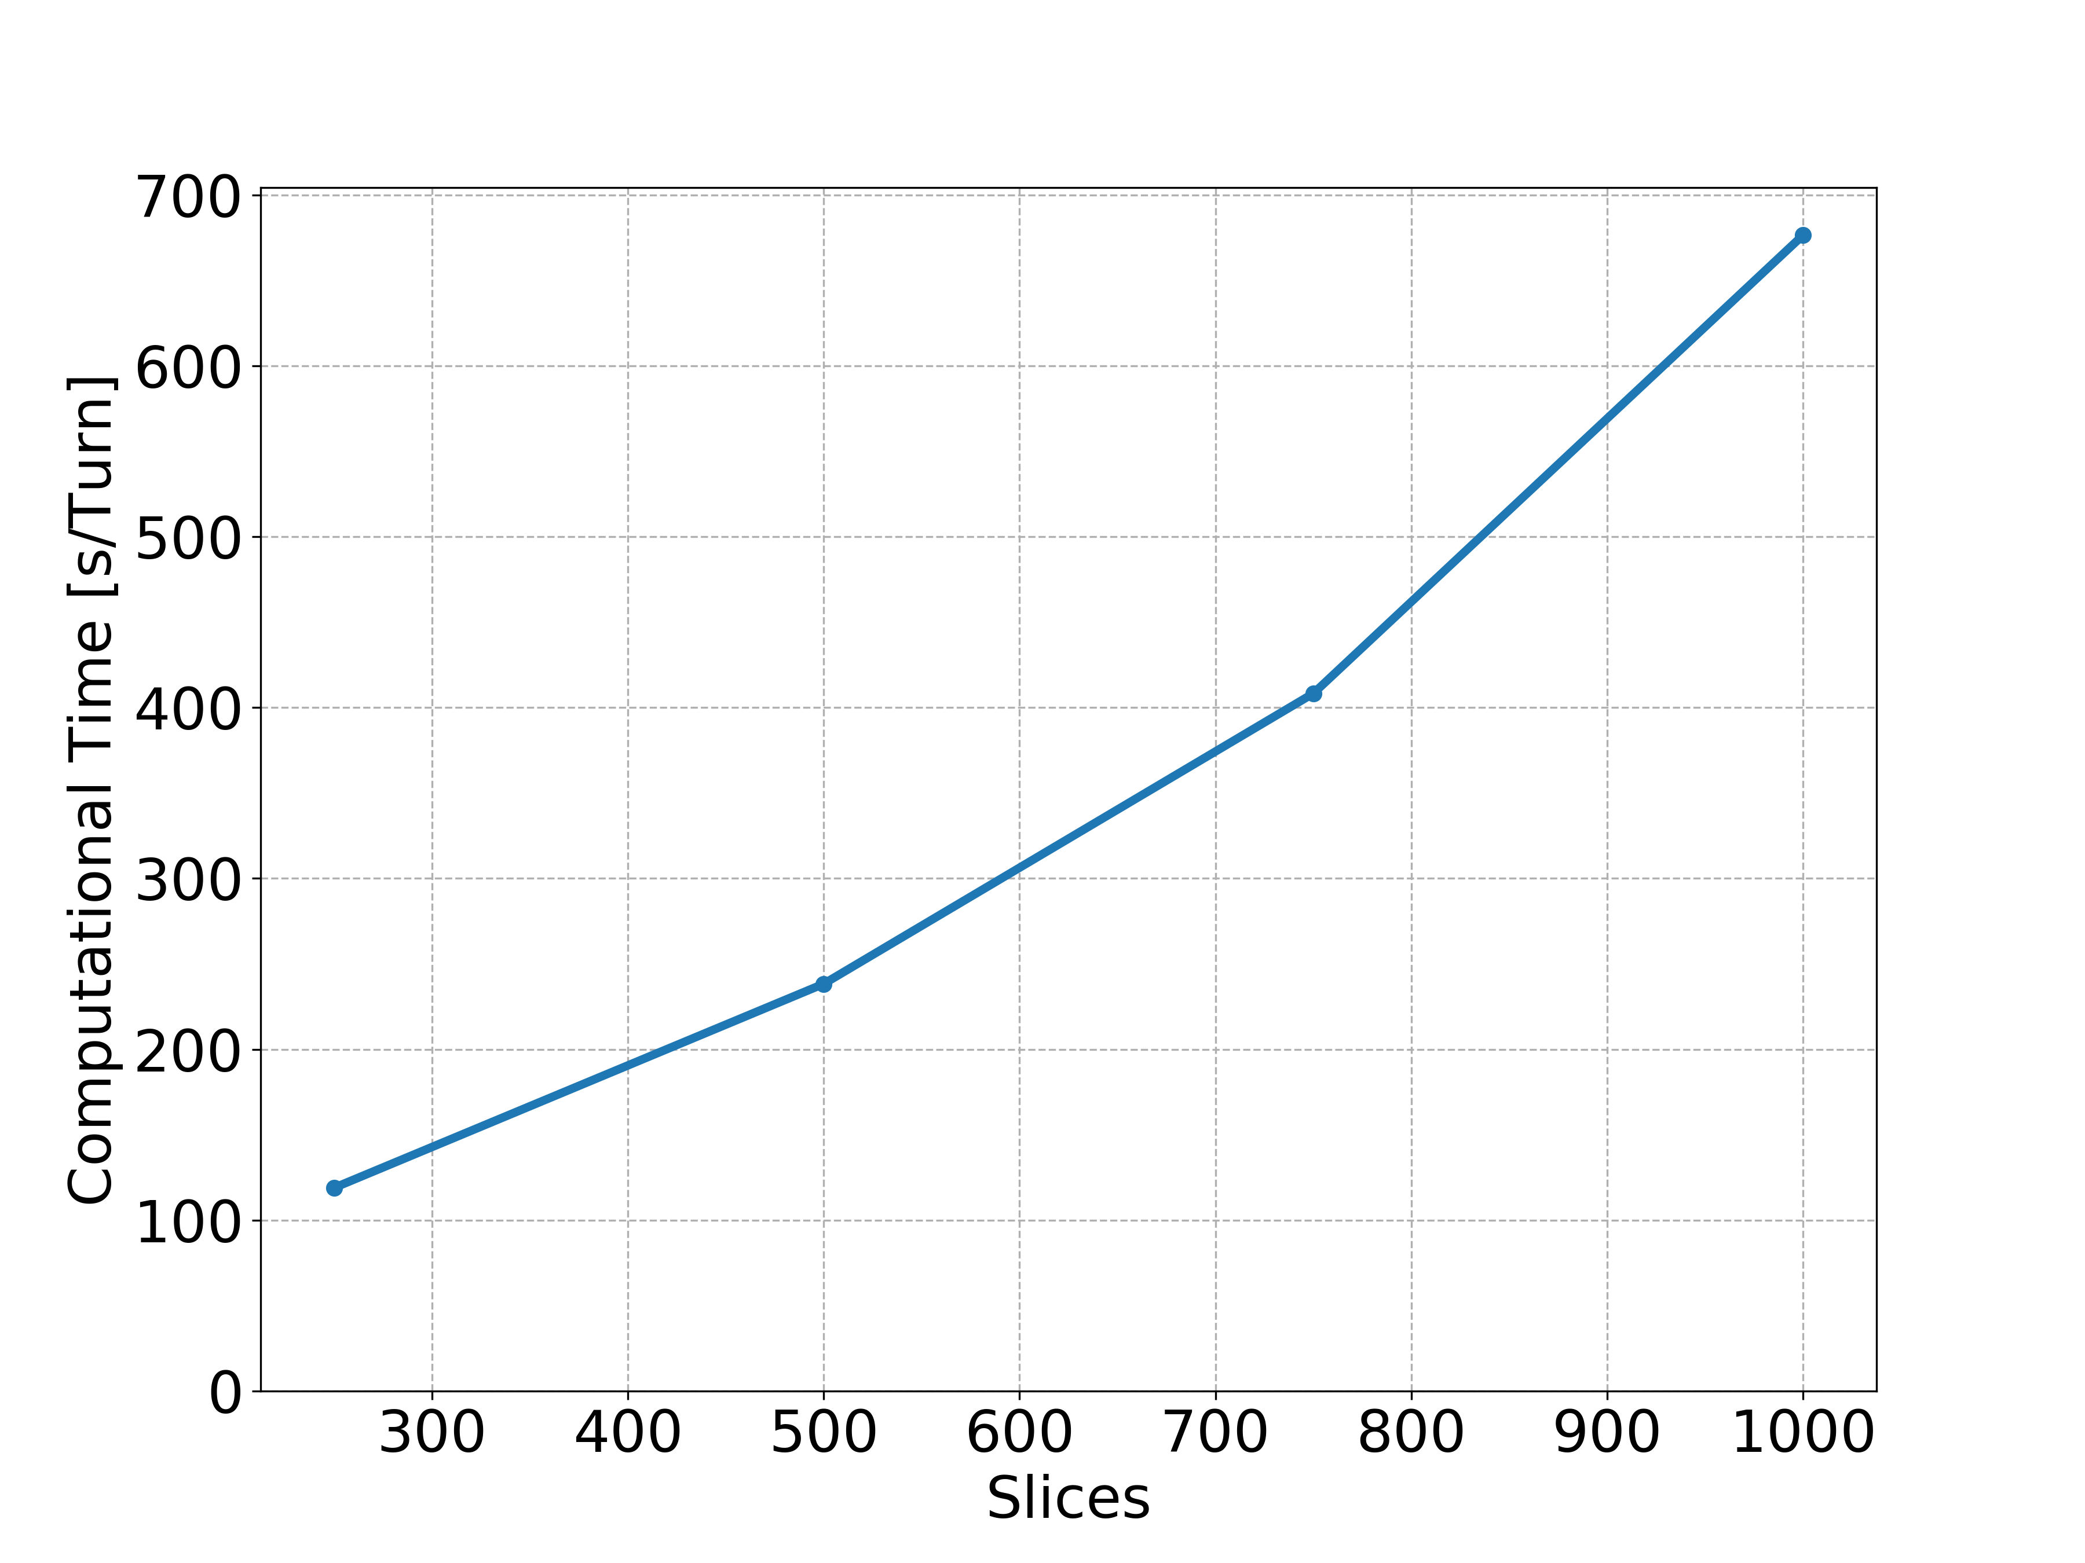
Quad at Col: Slices
…

Slide 59
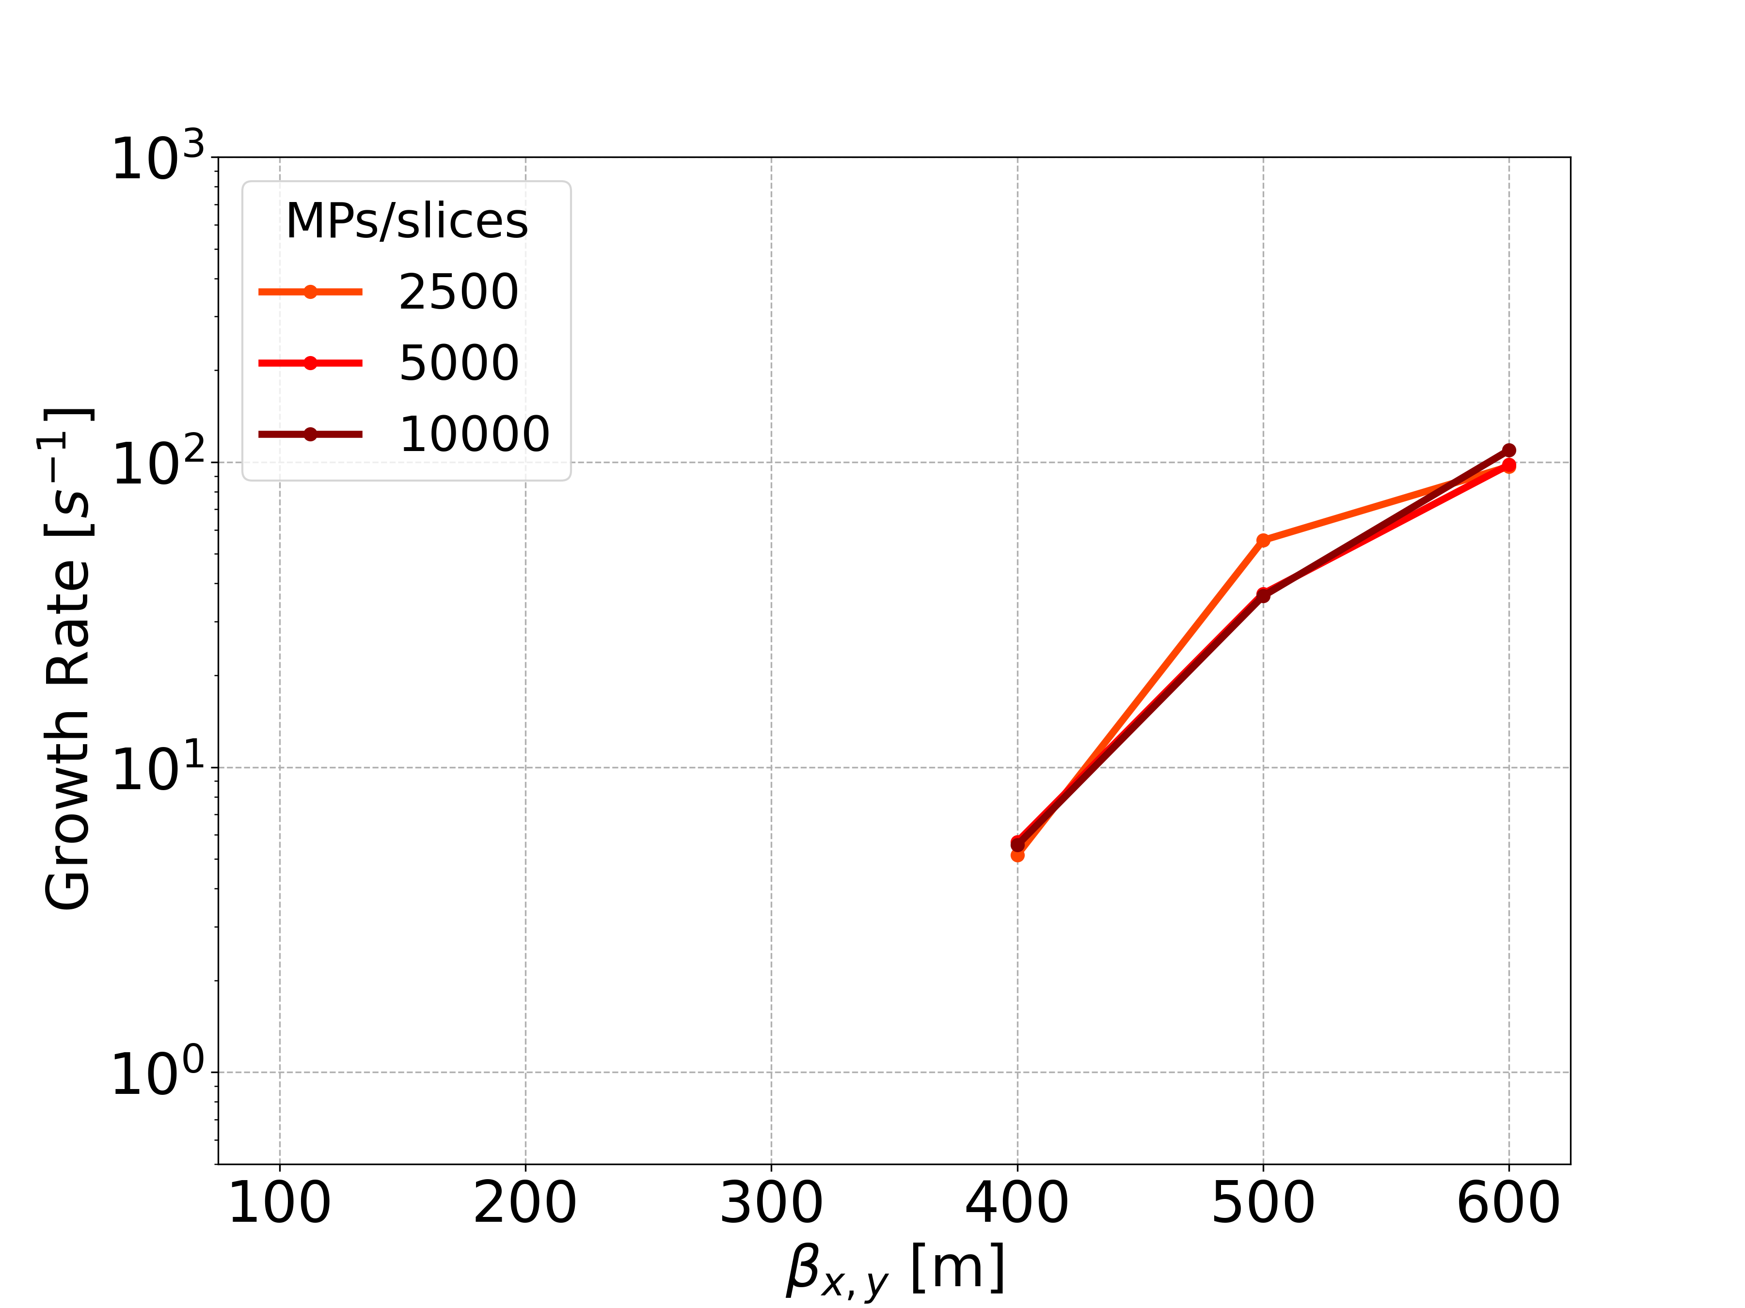
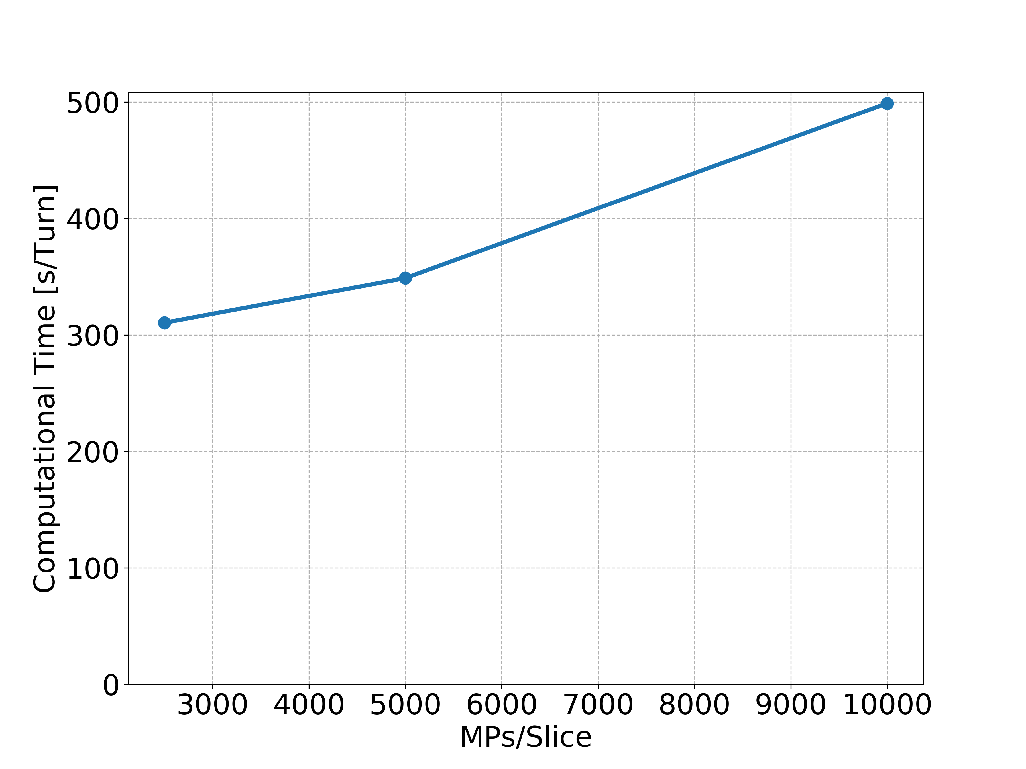
Quad at Col: MPs per Slices
…

Slide 60
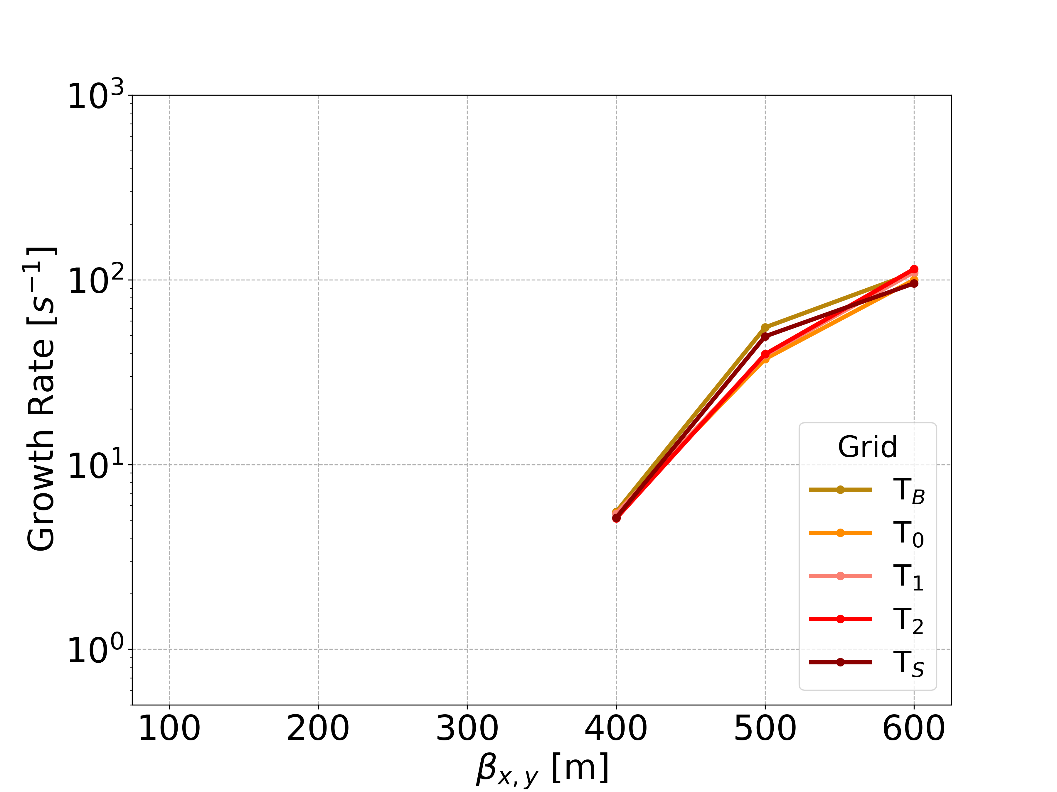
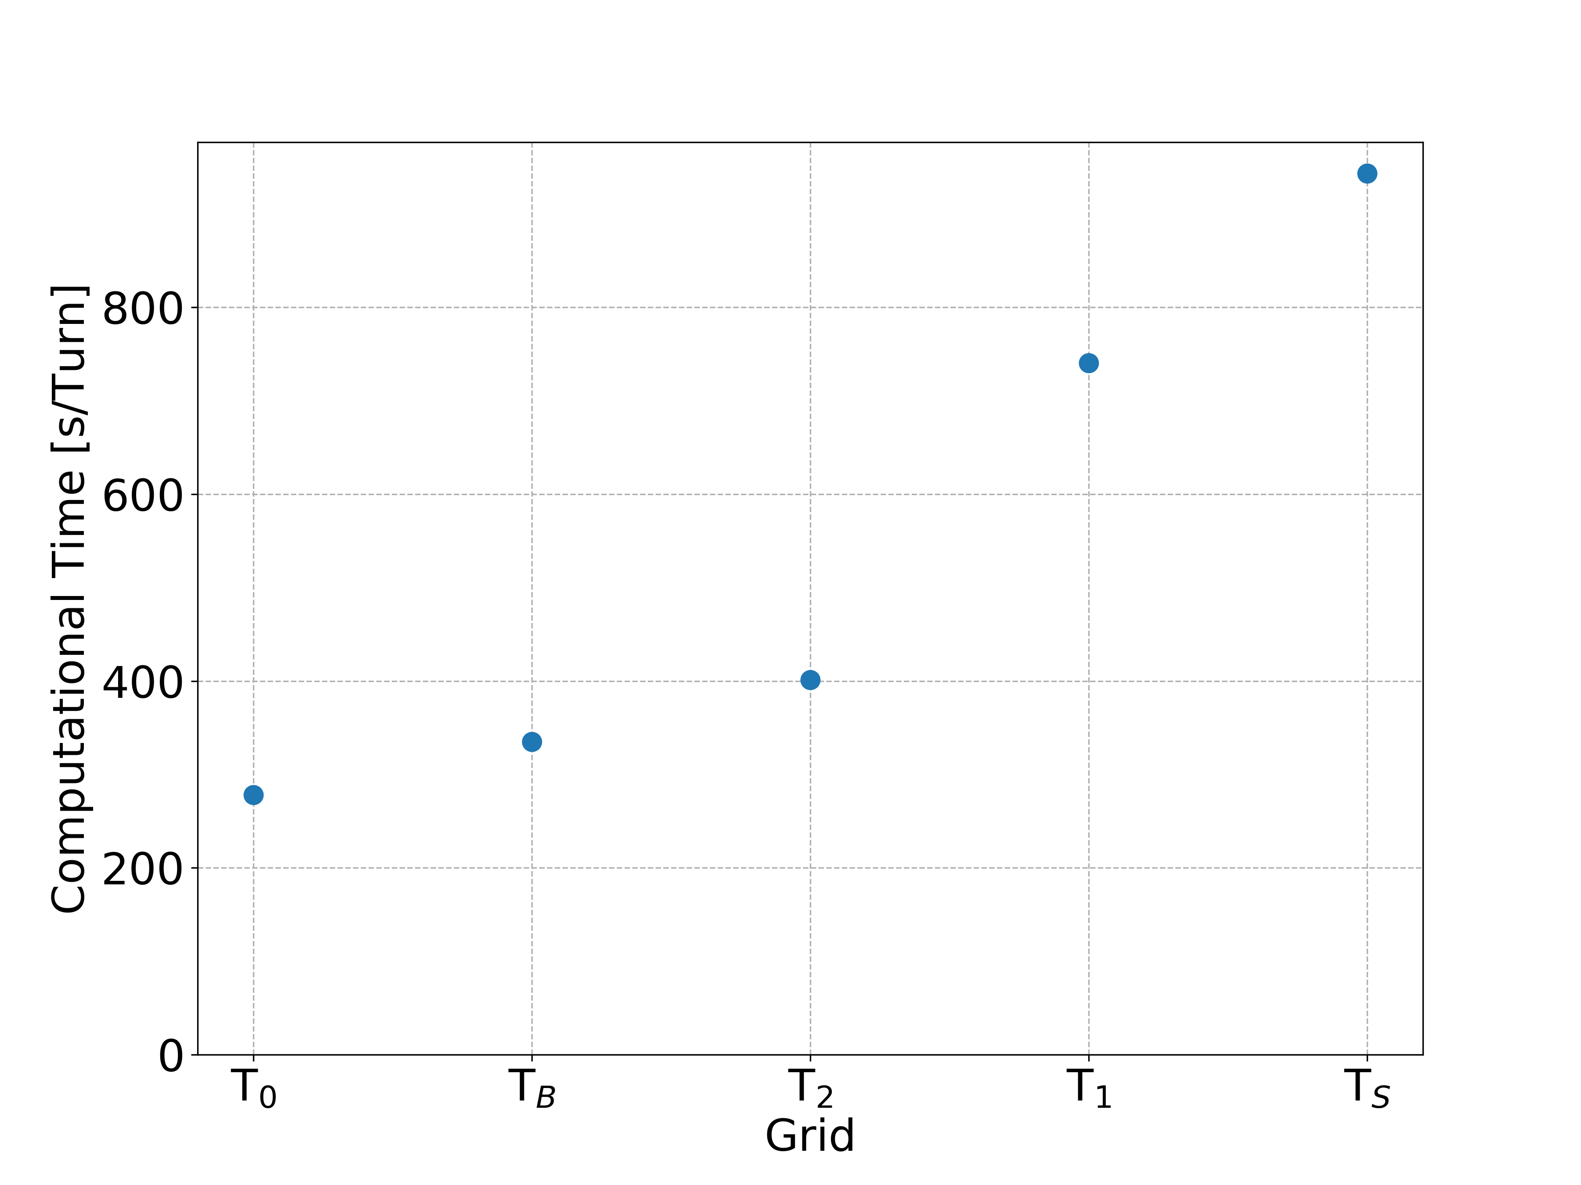
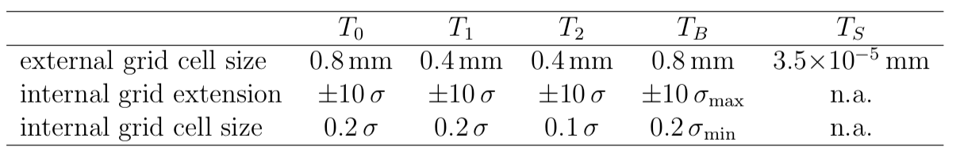
Quad at Col: Transverse Grids

Slide 61
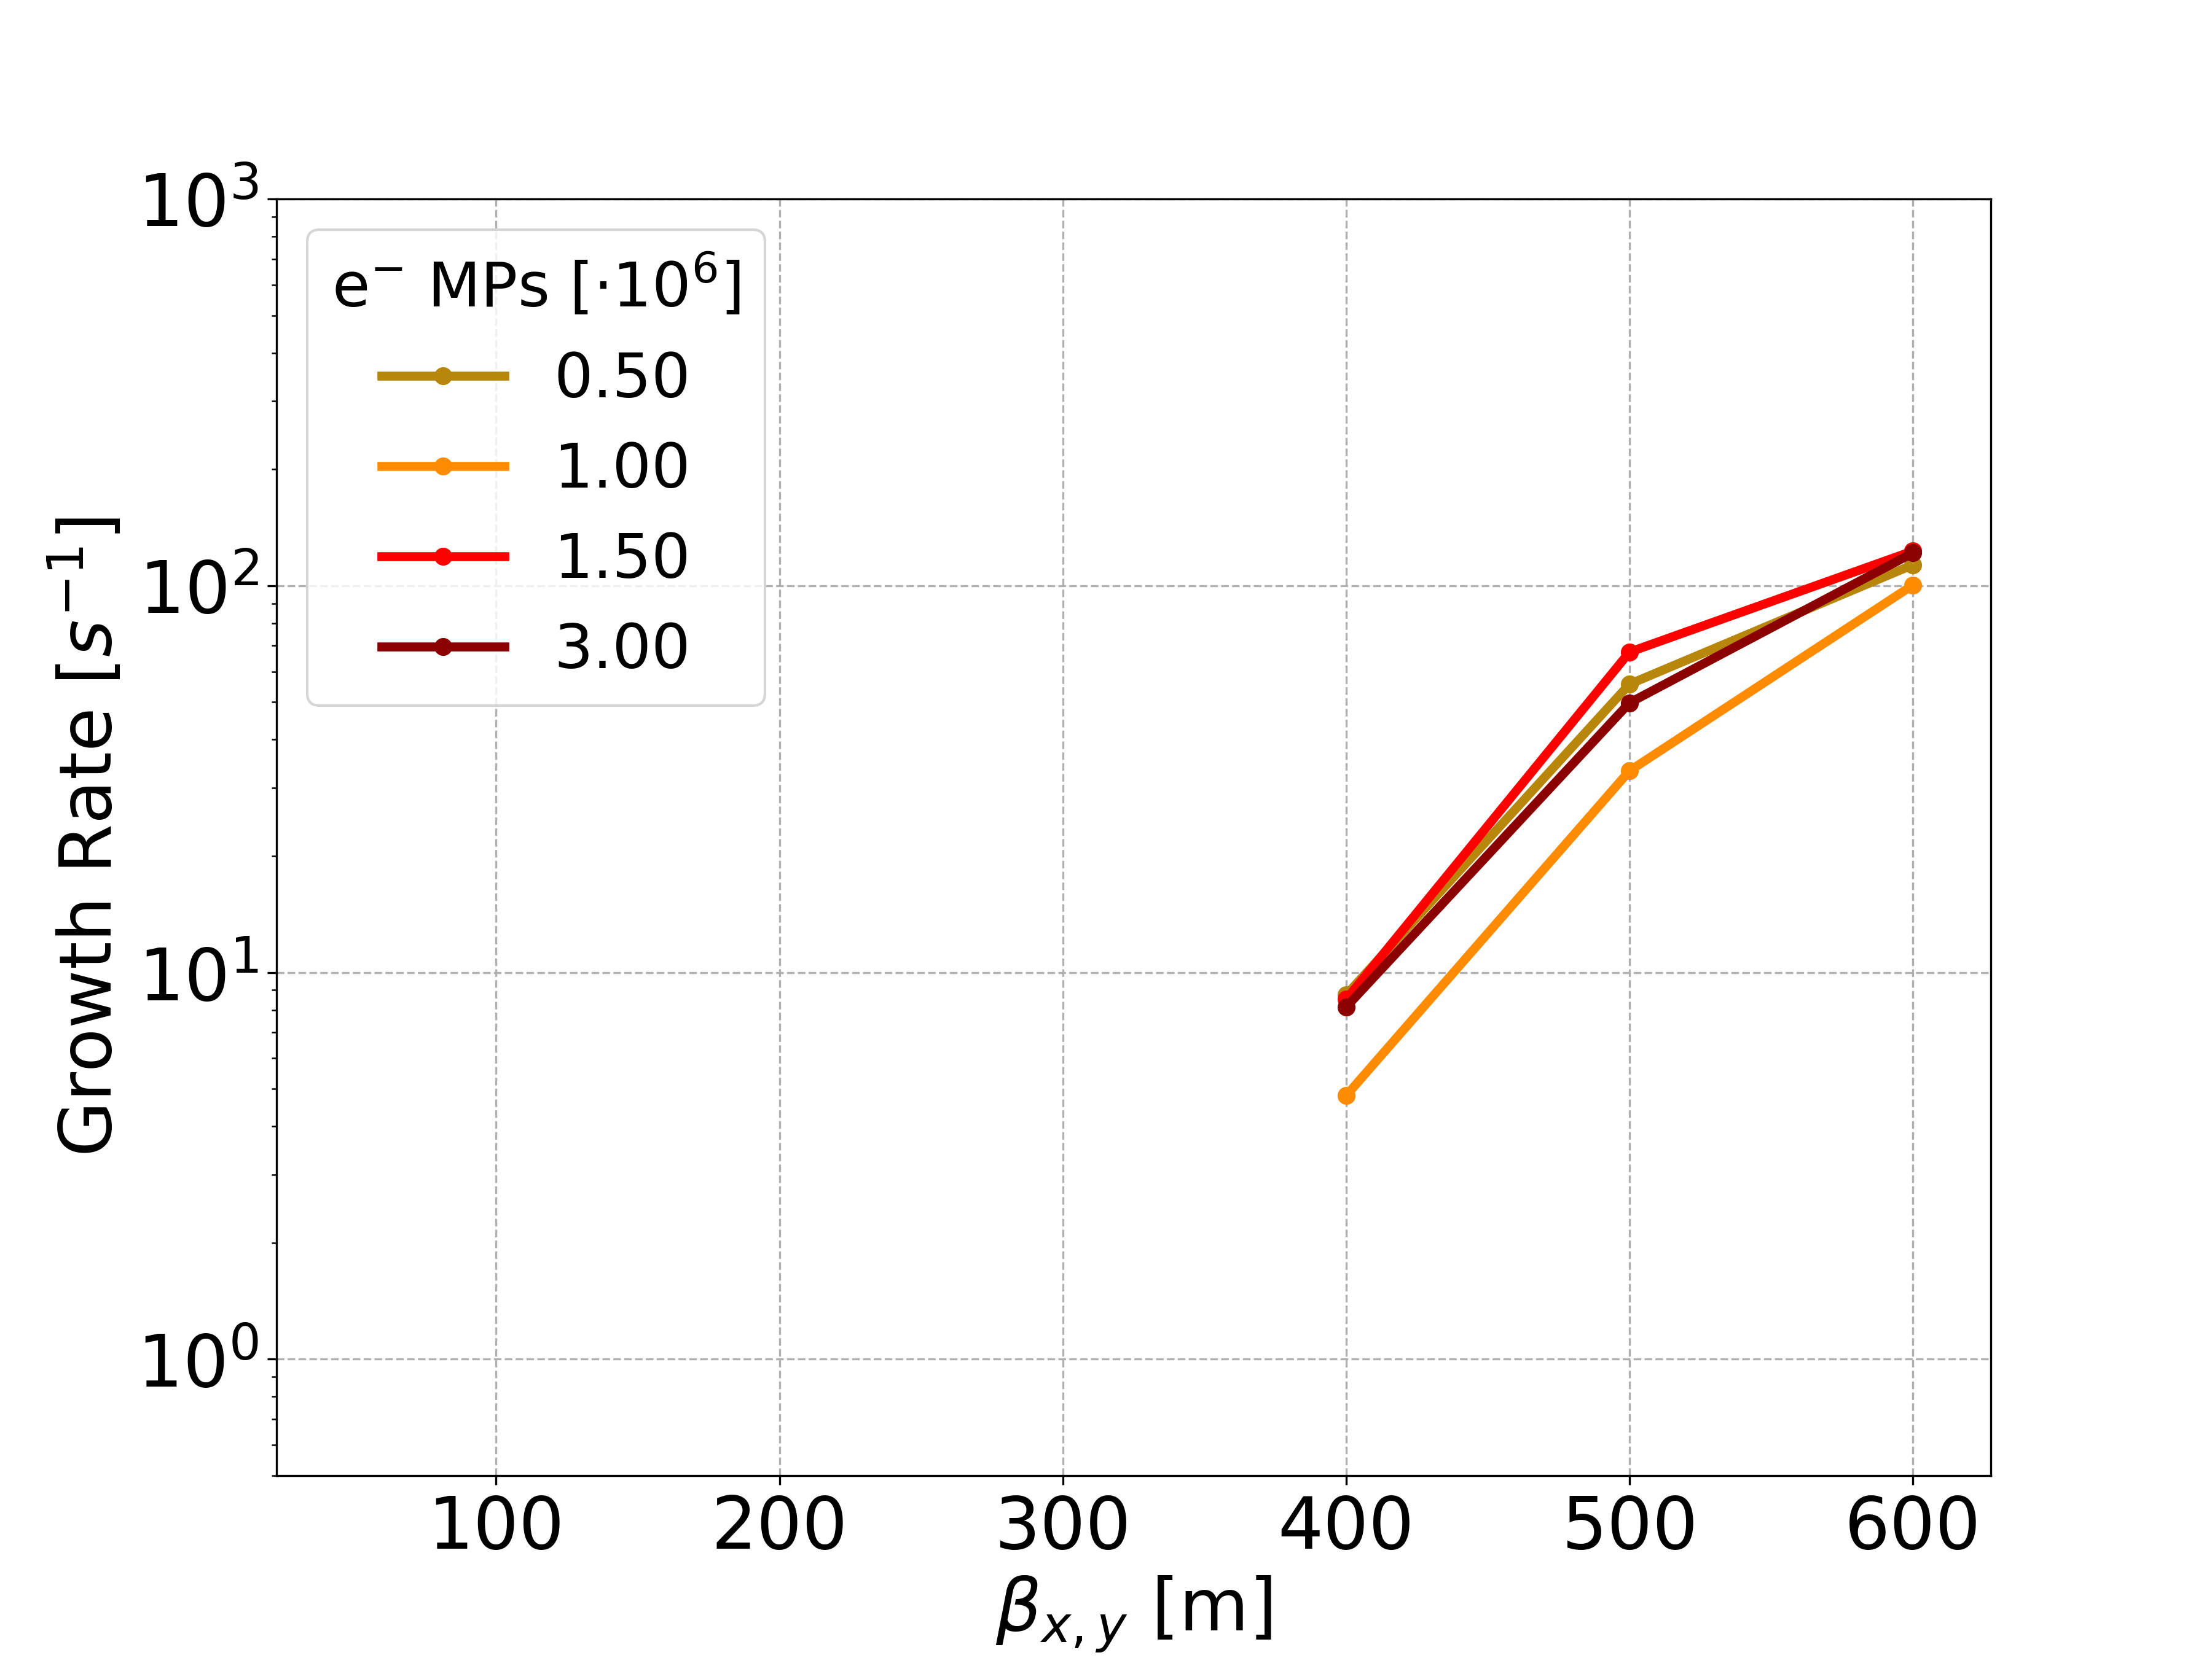
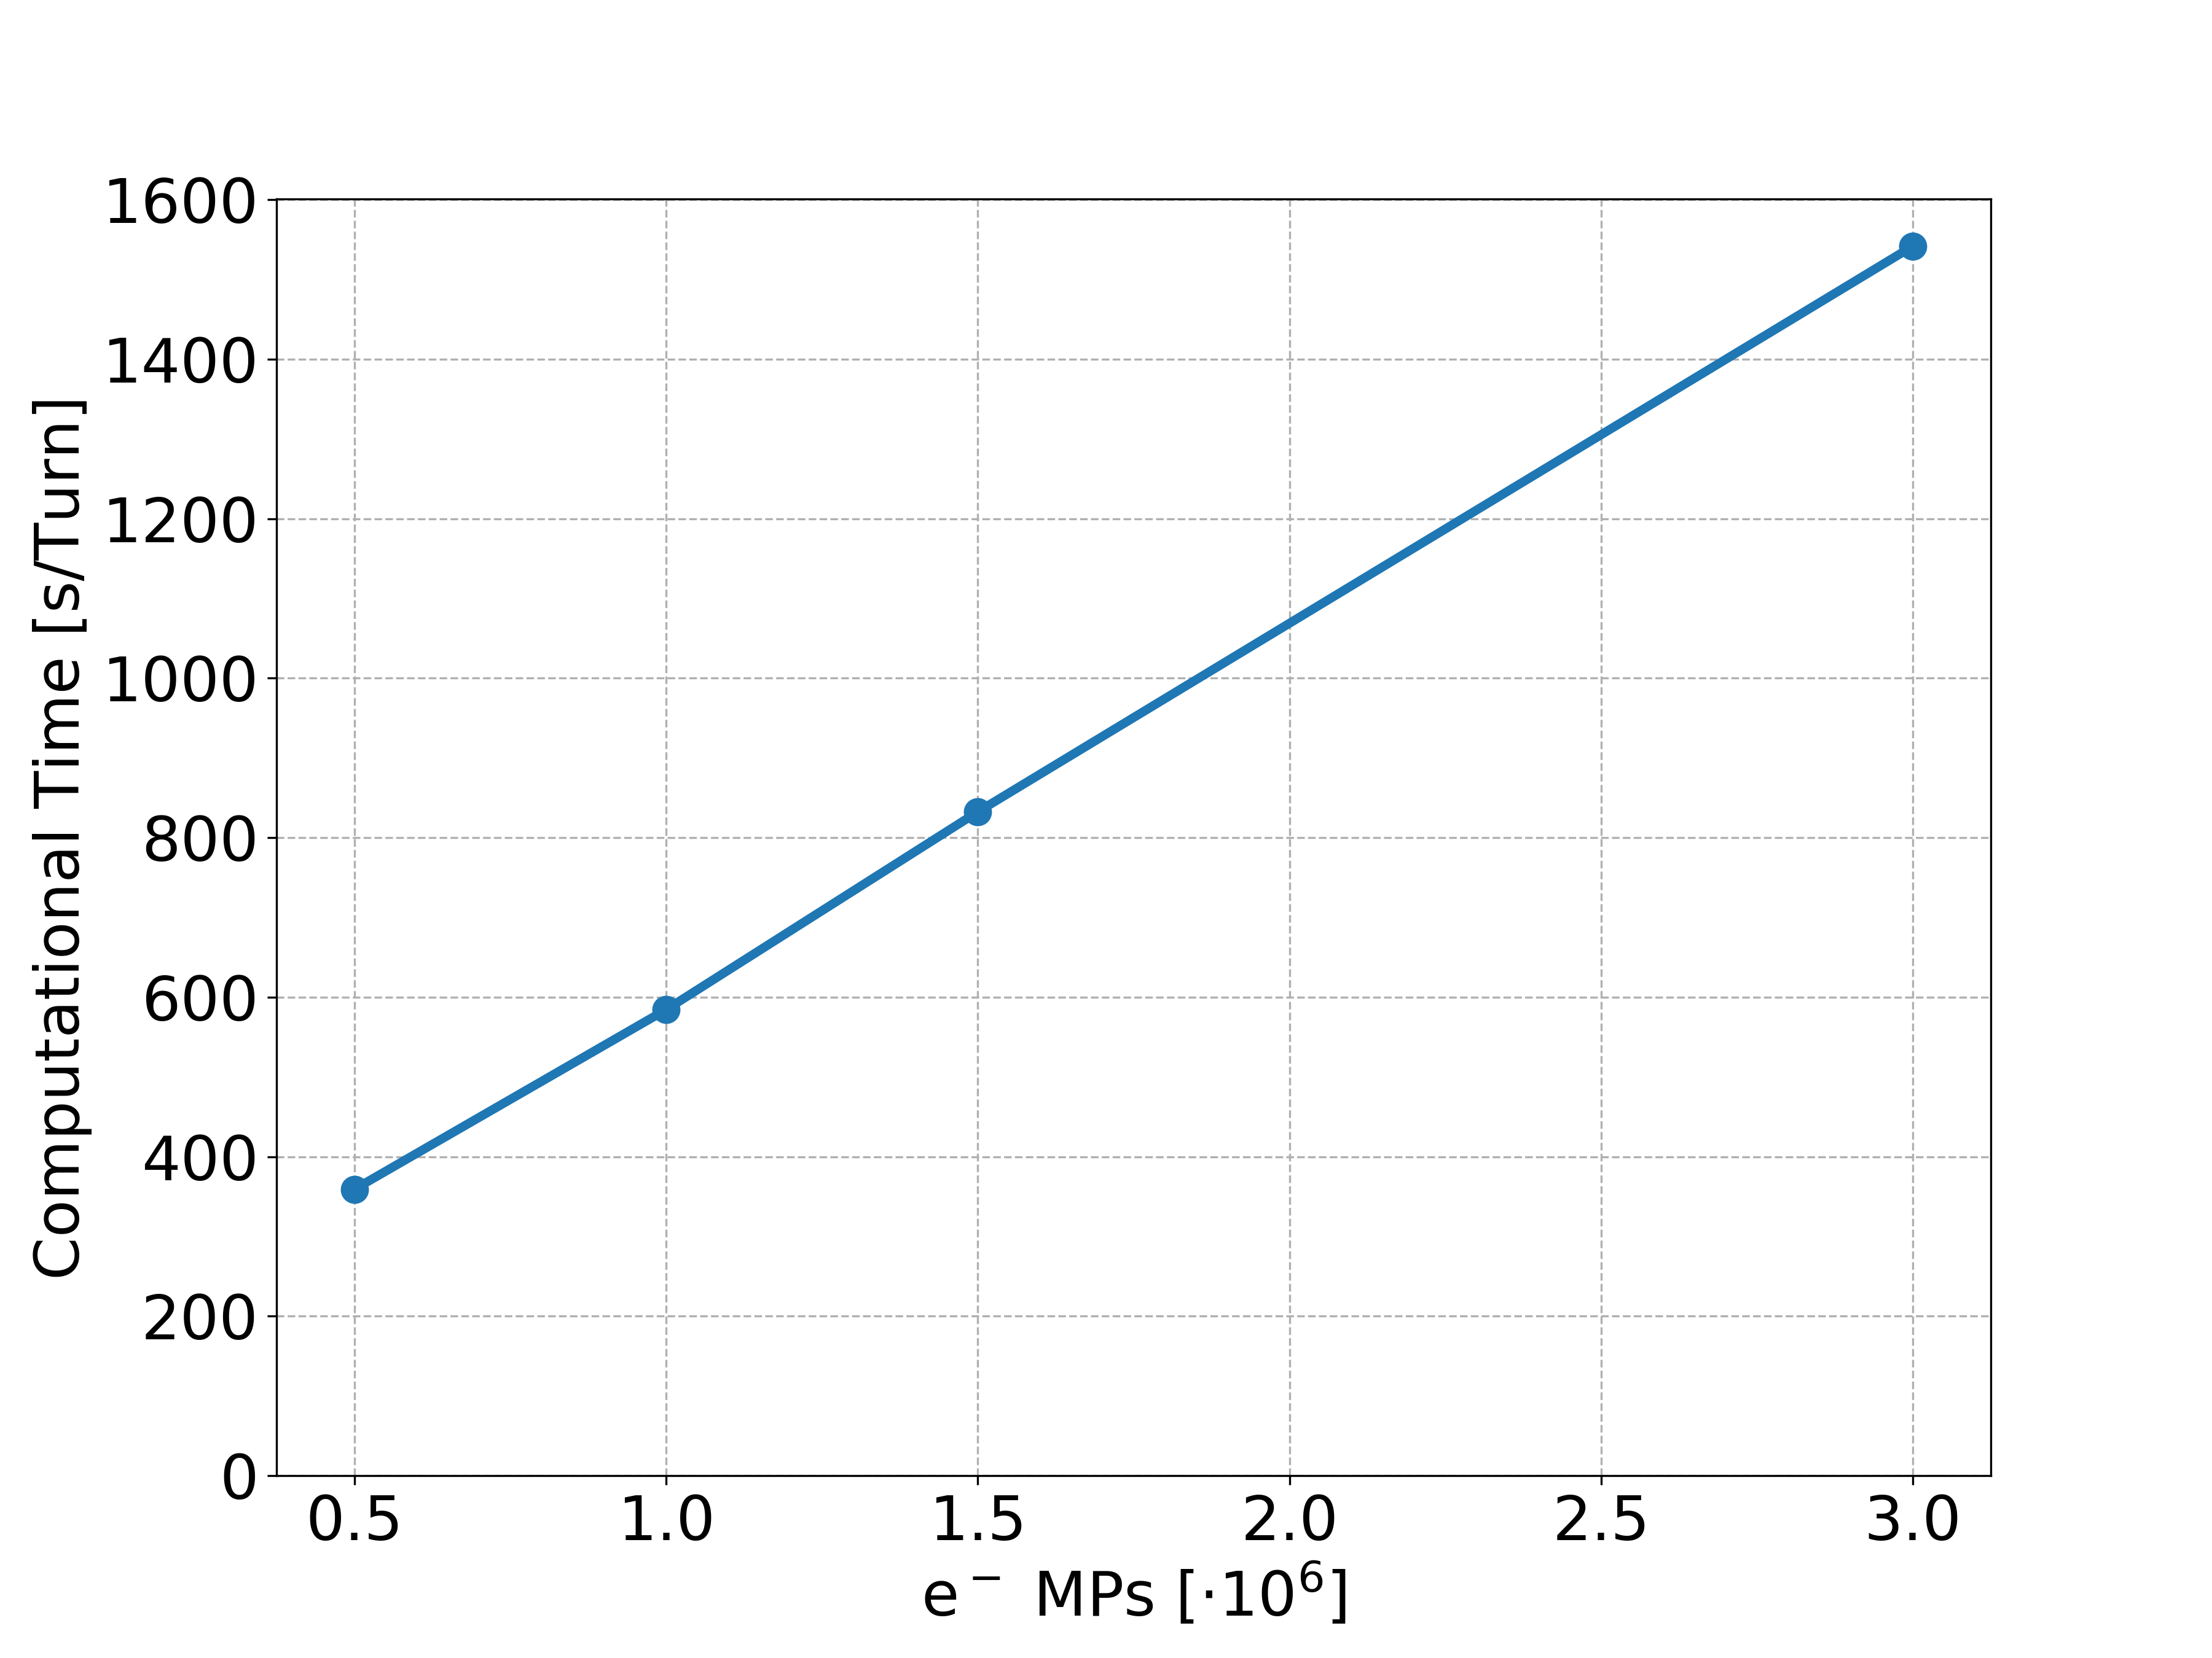
Quad at Col: Electron MPs
…

