Slide 1
Effect of a high frequency BBR on the SPS TMCI from a BBR with PyHEADTAIL
Acknowledgments: N. Mounet, B. Salvant, C. Zannini
Sébastien Joly, Elias Métral
31/08/2020

Slide 2
Introduction
Within the framework of the study of the effects of space charge on the SPS TMCI, we looked at the effect of a high frequency broad-band resonator impedance on the TMCI from a broad-band resonator.
A high frequency broad-band resonator impedance has some similarities with space charge and introduces negative tune shifts without any growth rate (for a high enough frequency).
Investigating the impact of such an impedance could help us to understand better the different aspects of space charge on instabilities.

Slide 3
SPS parameters
SPS Q26 optics at injection, single bunch PyHEADTAIL simulations
Parameters | E_{kinetic} = 25.1 GeV
τ_{b} (full bunch length) [ns] | 2.8
Q_{s} | 3.24*10⁻³
Q_{x} | 26.13
Q_{y} | 26.18
α_{p} | 1.92*10⁻³
γ_{tr} | 22.8
n_{turns} | 8192
n_{macroparticles} | 500000
n_{slices} | 5000

Slide 4
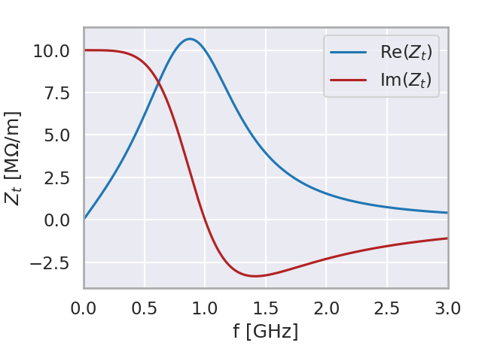
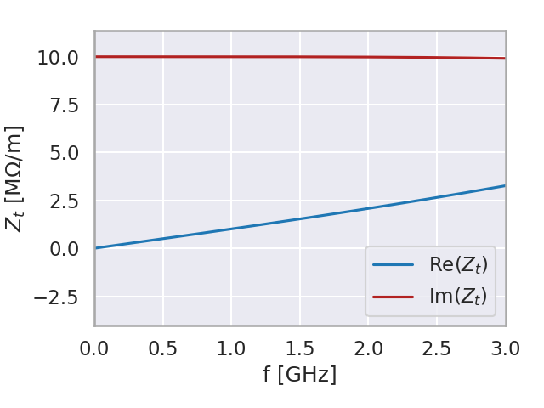
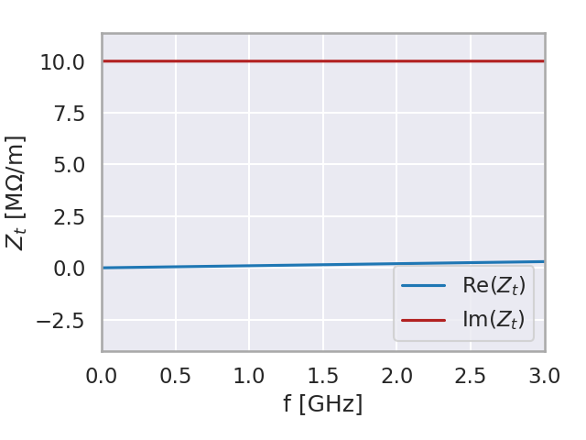
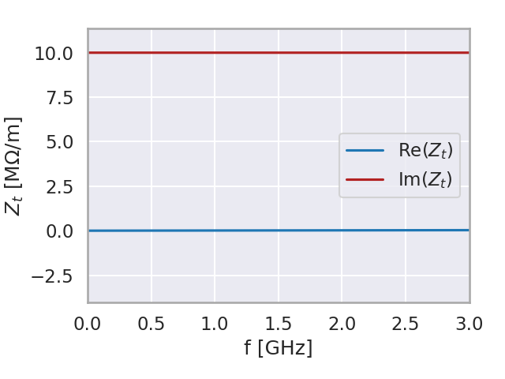
Resonators parameters
 | Broad band resonator (BBR) | High frequency broad band resonator (hfBBR)
R_{t} [MΩ/m] | 10 | 0 → 100 | 0 → 100 | 0 → 100
Q | 1 | 1 | 1 | 1
f_{res} [GHz] | 1 | 10 | 100 | 1000
Impedance plot
R_{t} = 10 MΩ/m
R_{t} = 10 MΩ/m
R_{t} = 10 MΩ/m
R_{t} = 10 MΩ/m

Slide 5
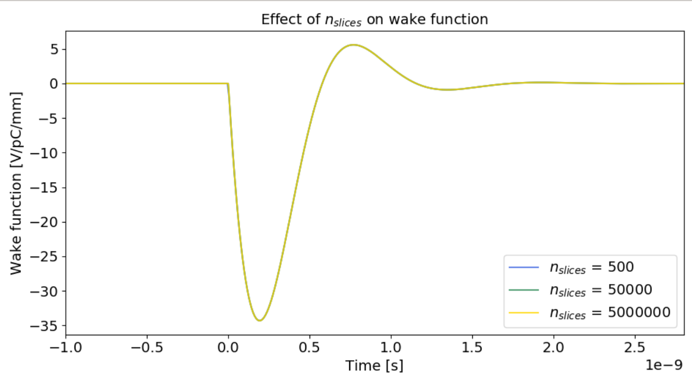
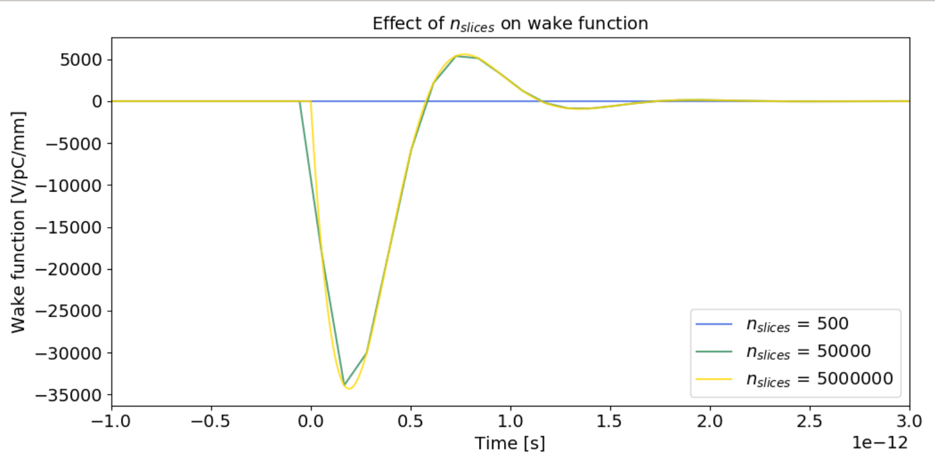
Effect of n_{slices} on wake function (BBR and hfBBR cases)
BBR wake function
R_{t} = 10 [MΩ/m]
Q = 1
f_{res} = 1 GHz
hfBBR wake function
R_{t} = 10 [MΩ/m]
Q = 1
f_{res} = 1000 GHz
Wake function much shorter !

Slide 6
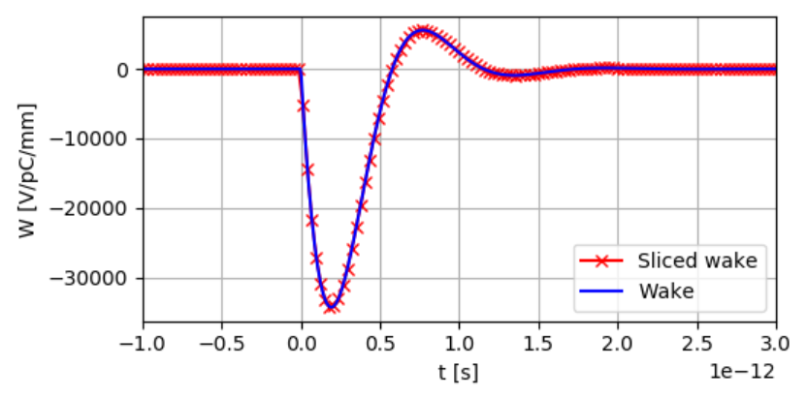
Effect of n_{slices} on wake function (BBR and hfBBR cases)
Setting a number of slices up to 500000 allows accurate wake slicing to the cost of time consuming simulations
Another option is to take advantage of the length of the wake. Rather than uniformly slice the wake from –σ_{z} to σ_{z} we can slice from –σ_{z}/100 to σ_{z}/100
We can use a limited number of slices (5000) and still accurately interpolate the wake
We will use this way of slicing wakes for the rest of the study
hfBBR wake function
R_{t} = 10 [MΩ/m]
Q = 1
f_{res} = 1000 GHz

Slide 7
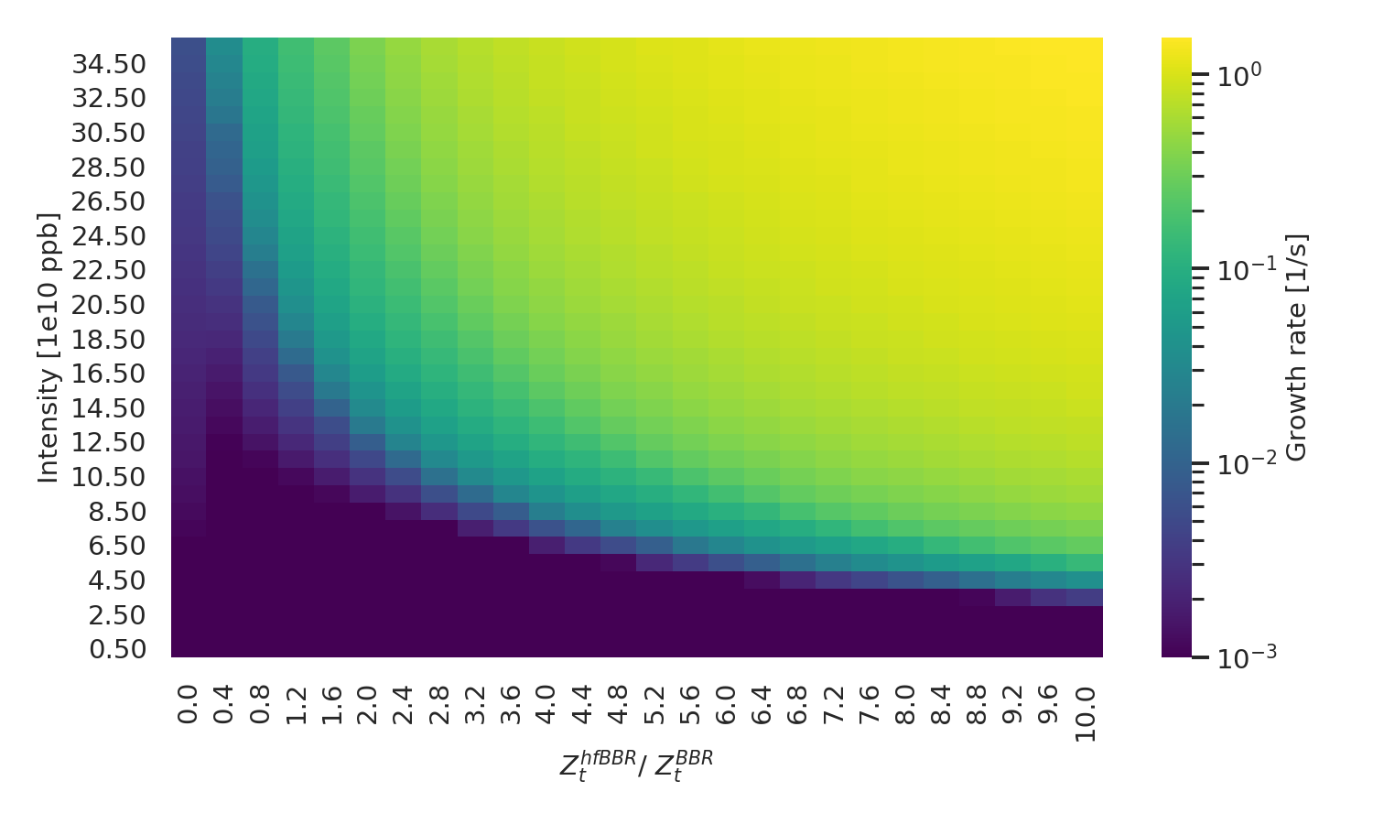
Growth rate of a hfBBR (10 GHz) + BBR
Region more stable
than BBR only
SPS TMCI from a BBR
threshold
Beam becomes the most unstable at larger intensities and inductive impedances
The area of the stable region becomes smaller as the frequency of the inductive impedance increases

Slide 8
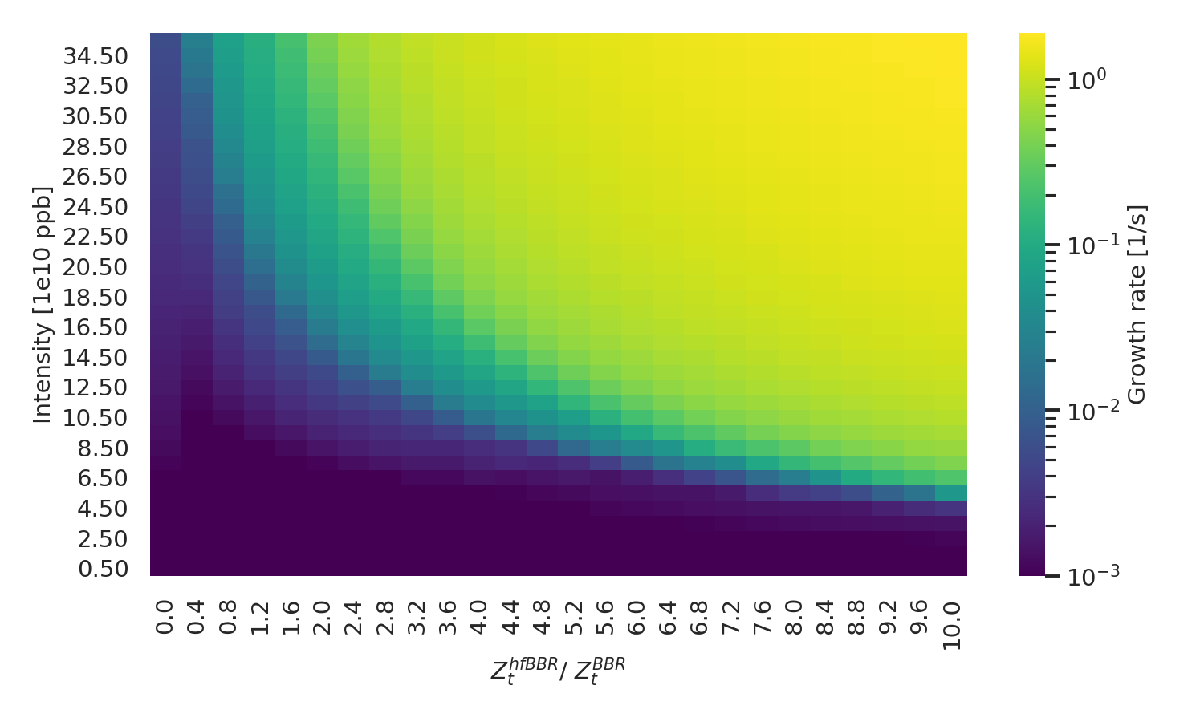
Growth rate of a hfBBR (100 GHz) + BBR
Region more stable
than BBR only
SPS TMCI from a BBR
threshold
We observe a region where the effect of inductive impedance is beneficial leading to a beam more stable than the case BBR only
We observe another region where the effect of inductive impedance is detrimental

Slide 9
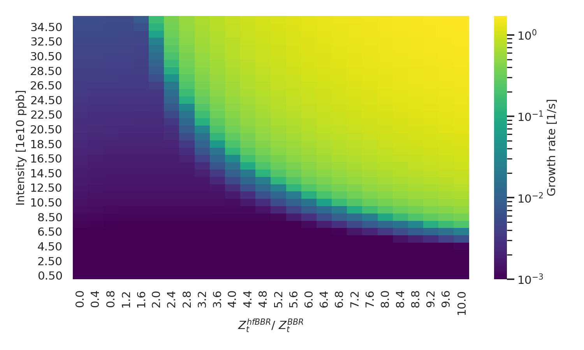
Growth rate of a hfBBR (1000 GHz) + BBR
SPS TMCI from a BBR
threshold
Beam becomes the most unstable at larger intensities and inductive impedances
The stable region disappears after a certain frequency of the inductive impedance

Slide 10
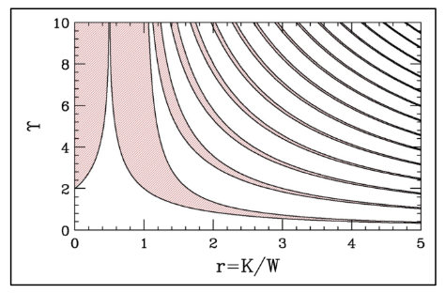
Similarities between the effect of a hfBBR and space charge
E. Métral, HSC section meeting, CERN, 18/05/2020
The effect of a hfBBR on the SPS TMCI from a BBR shares some similarities with the effect of space charge from 2-particle model from Chao-Chin-Blaskiewicz

Slide 11
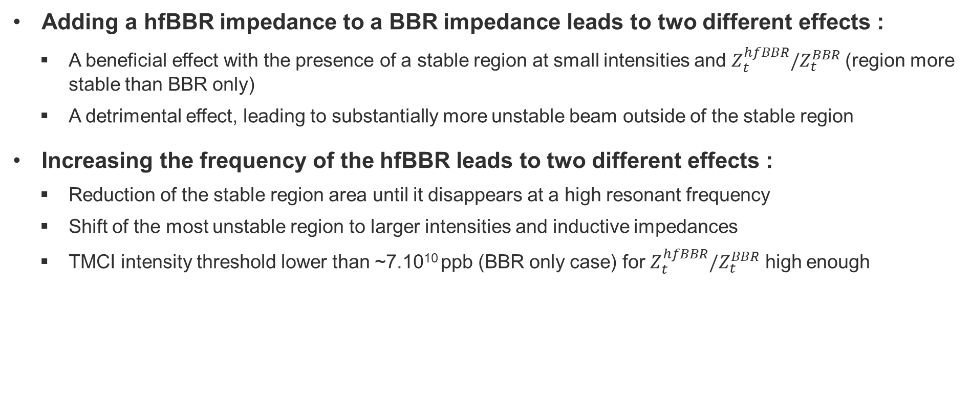
Conclusion
Adding a hfBBR impedance to a BBR impedance leads to two different effects :
  A beneficial effect with the presence of a stable region at small intensities and $Z_{t}^{hfBBR}/Z_{t}^{BBR}$(region more stable than BBR only)
  A detrimental effect, leading to substantially more unstable beam outside of the stable region
Increasing the frequency of the hfBBR leads to two different effects :
  Reduction of the stable region area until it disappears at a high resonant frequency
  Shift of the most unstable region to larger intensities and inductive impedances
  TMCI intensity threshold lower than ~7.10¹⁰ ppb (BBR only case) for $Z_{t}^{hfBBR}/Z_{t}^{BBR}$ high enough

Slide 12
Outlook
Check the results
  Check the convergence with the number of turns, slices and macroparticles
Look at intra-bunch motion
How to introduce a hfBBR impedance in the SPS ?
  Investigate potential adverse effects from such an impedance
  Use DELPHI again
  Highlight most critical mode coupling with DELPHI

Slide 13
Backup slides

Slide 14
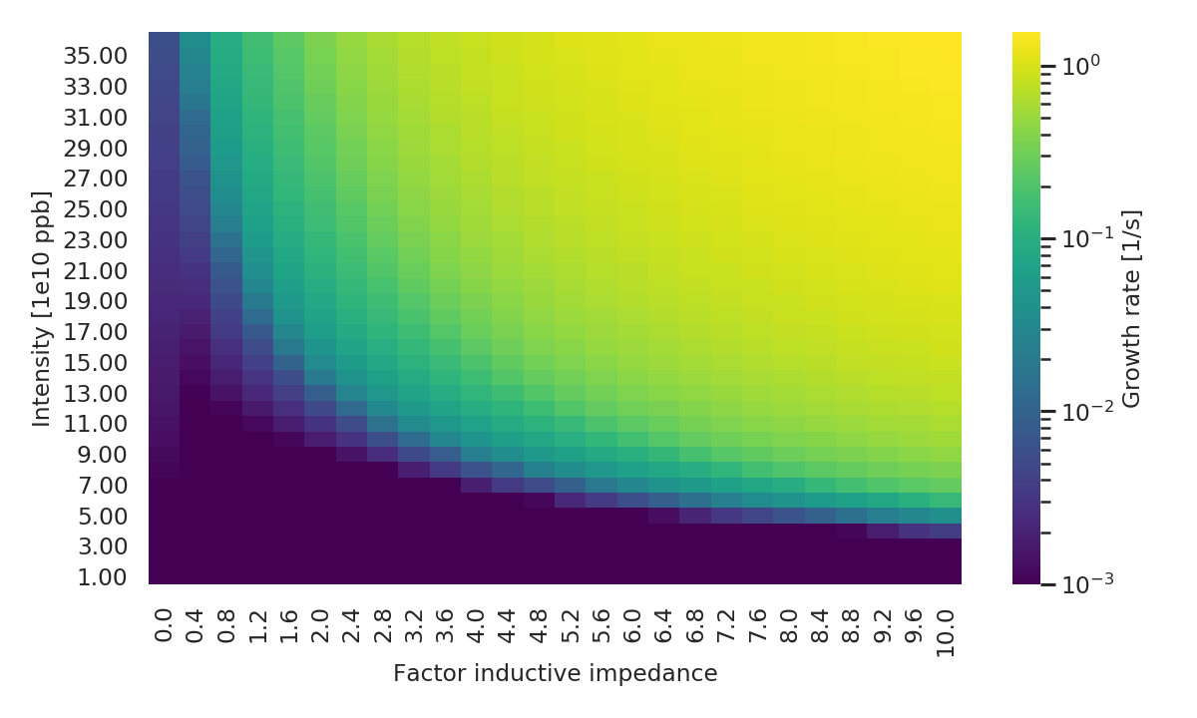
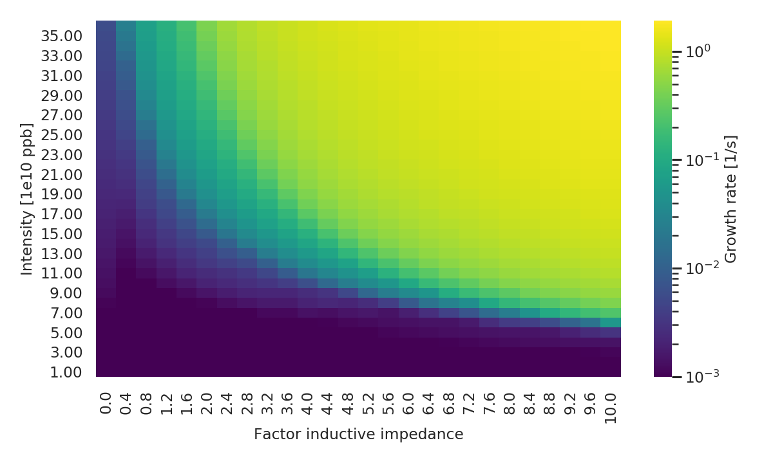
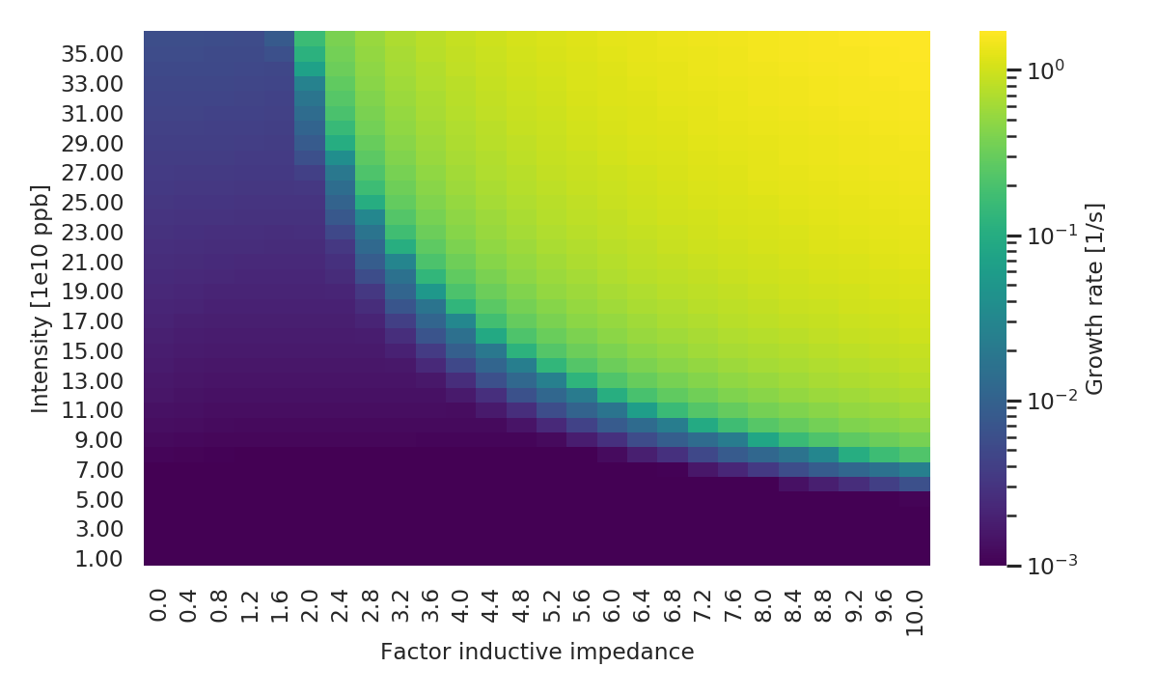

Slide 15
