Slide 1
Education and Training Programs with Greece
Evangelos Gazis / NTUA
Emmanuel Tsesmelis / CERN
23rd CERN-Greece Working Group Meeting
16 September 2020

Slide 2
THE YEAR 2019, 12 YEARS OF GREEK HSTs TRAINING @ CERN!
36 Greek High School Teachers Training on 28-31 August 2019 from all over Greece
TOTAL NUMBER OF GREEK HSTs TRAINED 2008-2019:
1233 (from Greece) + 20 (from Cyprus)
Greek High School Teacher Program
Important points to be taken into account:
The Ioannis S. Latsis Foundation supported the accommodation and meals of the HSTs for 2016-2018.
A great thanks for their generous support to the CERN International Relations Sector (IR) and Education, Communications & Outreach (ECO), but mainly to the Teacher & Student Programs (TSP) Section : Sascha Schmeling, Jeff Wiener

Slide 3
Greek High School Teacher Program
New Lectures since 2017 by Andromachi Tsirou:
          What does it take to "run" a detector in lab?
          What does it take to "run" a detector in class?
          Electronic boards controlling sensors for the class
Dr. A. Tsirou provides to many HSTs “Arduino” electronics elements and S/W to build in their school with their students prototype control systems
New Collaboration since 2016: Perimeter Institute for Theoretical Physics (CA)
Perimeter Institute Staff: Olga Michalopoulos, Laura Pankratz
offered a 2h workshop with physics experiments to the Greek HSTs, providing them with educative material for their class
Visits: ATLAS, ALICE, SC, Data Center, SC, Microcosm
FEEDBACK from Greek High Schools: There have been organised more than 1000 events, about CERN and its activities, during the last 10 years, from the HSTs been trained here at CERN

Slide 4
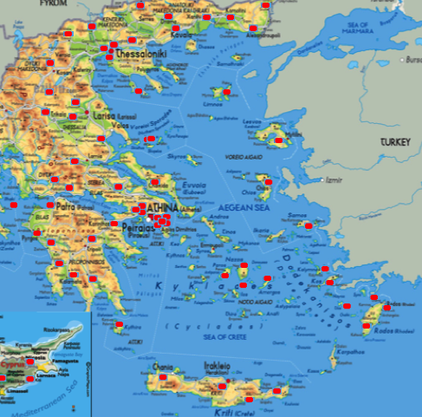
Greek HSTs Trained at CERN 2008-2019 from High Schools all over Greece

Slide 5
Primary School Teachers
Playing with Protons
New and innovative training course started within CMS and ATLAS in 2016.
Aims to inspire, educate, and empower primary school teachers towards modern physics, scientific discovery and innovation.
Joint Greece and United Kingdom course.
Up to September 2019 has trained 60 primary school teachers from Greece and the UK.
Course participants implement activities in their own schools and also activate networks to engage colleagues from other schools in their region.
  Large multiplication factor - for each participating teacher, reach out to 173 students, 6 teachers and 3 schools.

Slide 6
Primary School Teachers
Playing with Protons

Slide 7
Primary School Teachers
Playing with Protons
Supporting bodies
  CMS and ATLAS
  IdeaSquare at CERN
  Ogden Trust
  Stavros Niarchos Foundation
  Perimeter Institute
  University of Birmingham
  Science and Technology Facilities Council (STFC)
  European Commission CREATIONS project

Slide 8
CERN-Greek Educational Activities II
CERN Summer Schools in Greece:
1. Hellenic Physics Society – EEF & NTUA, CERN: Jun 2018, Lavrion, Attica
20 students from lyceum 2nd and 3rd class for 1 week
2. Filekpedeftiki Eteria – Arsakia Schools & NTUA, CERN: June 2019, Ekali, Attica
40 students from lyceum 2nd and 3rd class for 1 week
3. Filekpedeftiki Eteria – Arsakia Schools & NTUA, CERN: June 2020, Ekali, Attica
40 students from lyceum 2nd and 3rd class for 1 week CANCELLED
4. CERN-HSPP 30 Aug - 13 Sep 2020, 24 Greek Lyceum students for 2 weeks, CANCELLED

Slide 9
CERN-Greek Educational Activities III
20 MSc Students from the East Macedonia & Thrace Institute of Technology (Kavala) (*),
have been successfully trained at CERN the periods:
16-21 Mar 2015
27-29 May 2016
28-29 May 2017
28-30 Nov 2018
26-28 Mar 2020 CANCELLED COVID-19
Attended
Lectures: Int. Particle Physics, Detector Technology, Accelerator Technology, HL-LHC project, FCC-project, Computing for Experiments, Medical applications, Transfer Technology, HEP socio-economic impact
Visits: ATLAS, ALICE, Data Center, SC, CCC, SM-18, Microcosm
Note: This training is part of their education curriculum. This the 4th year of this kind of education.
(*) The East Macedonia & Thrace Institute of Technology has renamed as Hellenic International University, Physics Department

Slide 10
CERN-Greek Educational Activities IV
NTUA Participation to the
Science Communication Hackathon at CERN
13-15 November 2020 at IdeaSquare, CERN
Hackathon Mentors:
                Dr. Eleni Adamidi,
                Prof. Evangelos Gazis

Slide 11
CERN-Greek Educational Activities V
NTUA Participation to the LHC Integration, LS1 and LS2
The NTUA Engineering Team with 12 members(*). An NTUA PhD Physicist as coordinator has participated to the LHC works:
2006-2008: LHC Integration & Completion, VME & other electronic control cards, for the LHC cryogenics instrumentation, installation and Commissioning. Project Manager R. Saban/EN
2012-2014, LS1-SMACC Project: Consolidation of the LHC splices, to be achieved the 13TeV of the LHC beams. Project Manager J-P. Tock/TE
(*) Members of the NTUA Engineering Team: Students from NTUA Engineering Schools, TEI-Athens/Piraeus, Sivitanidios vocational school

Slide 12
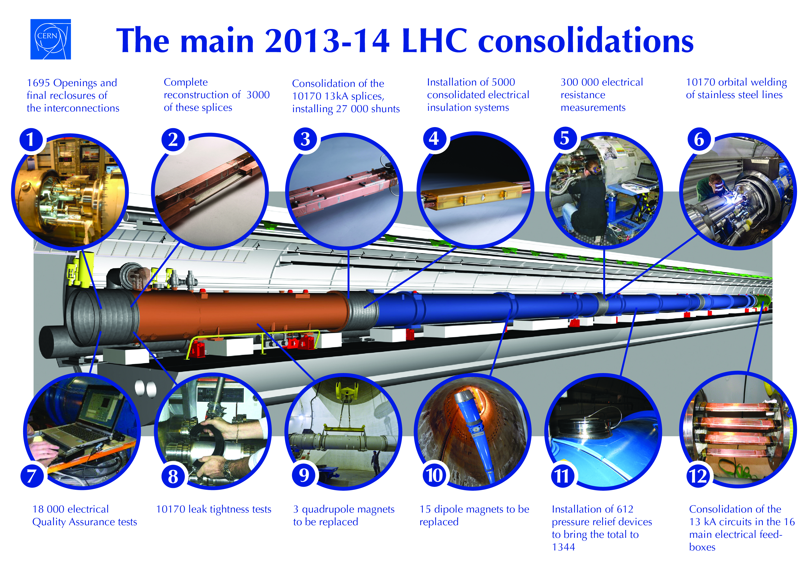
SMACC PROJECT

Slide 13
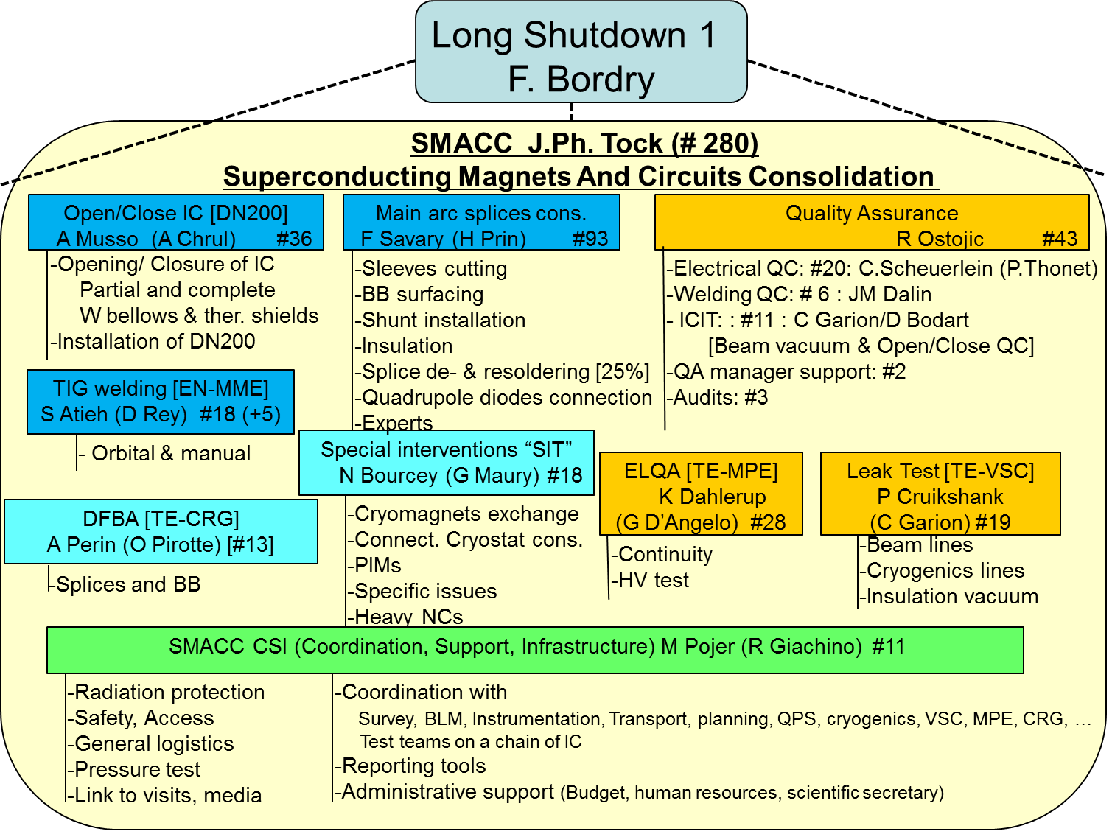
SMACC Organisation chart
NTUA Contribution

Slide 14
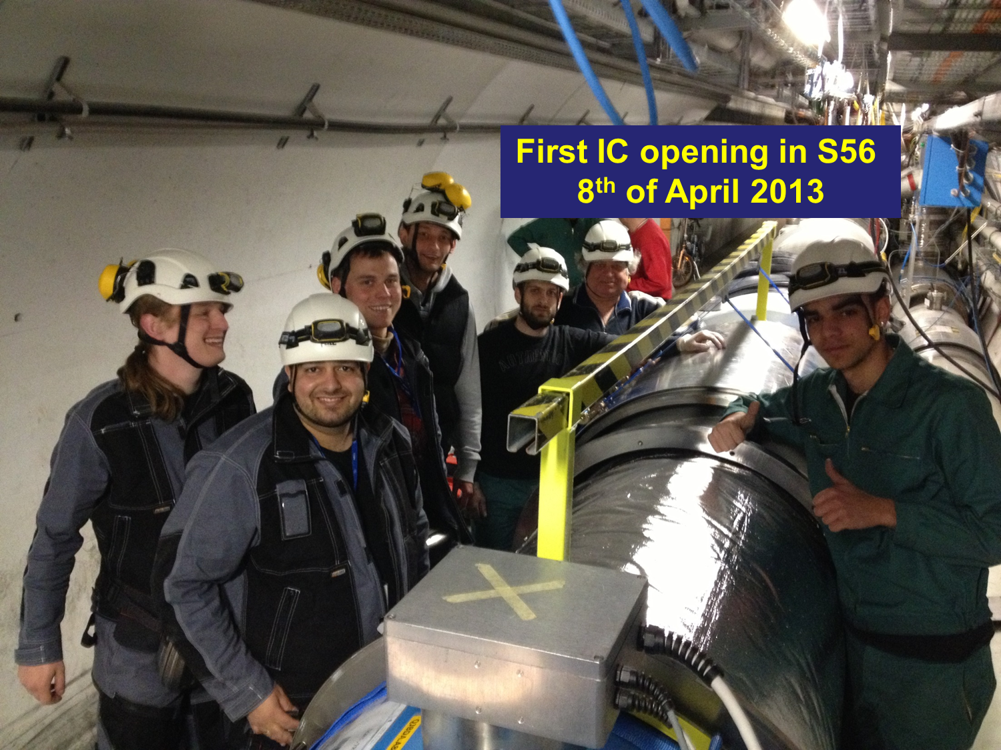

Slide 15
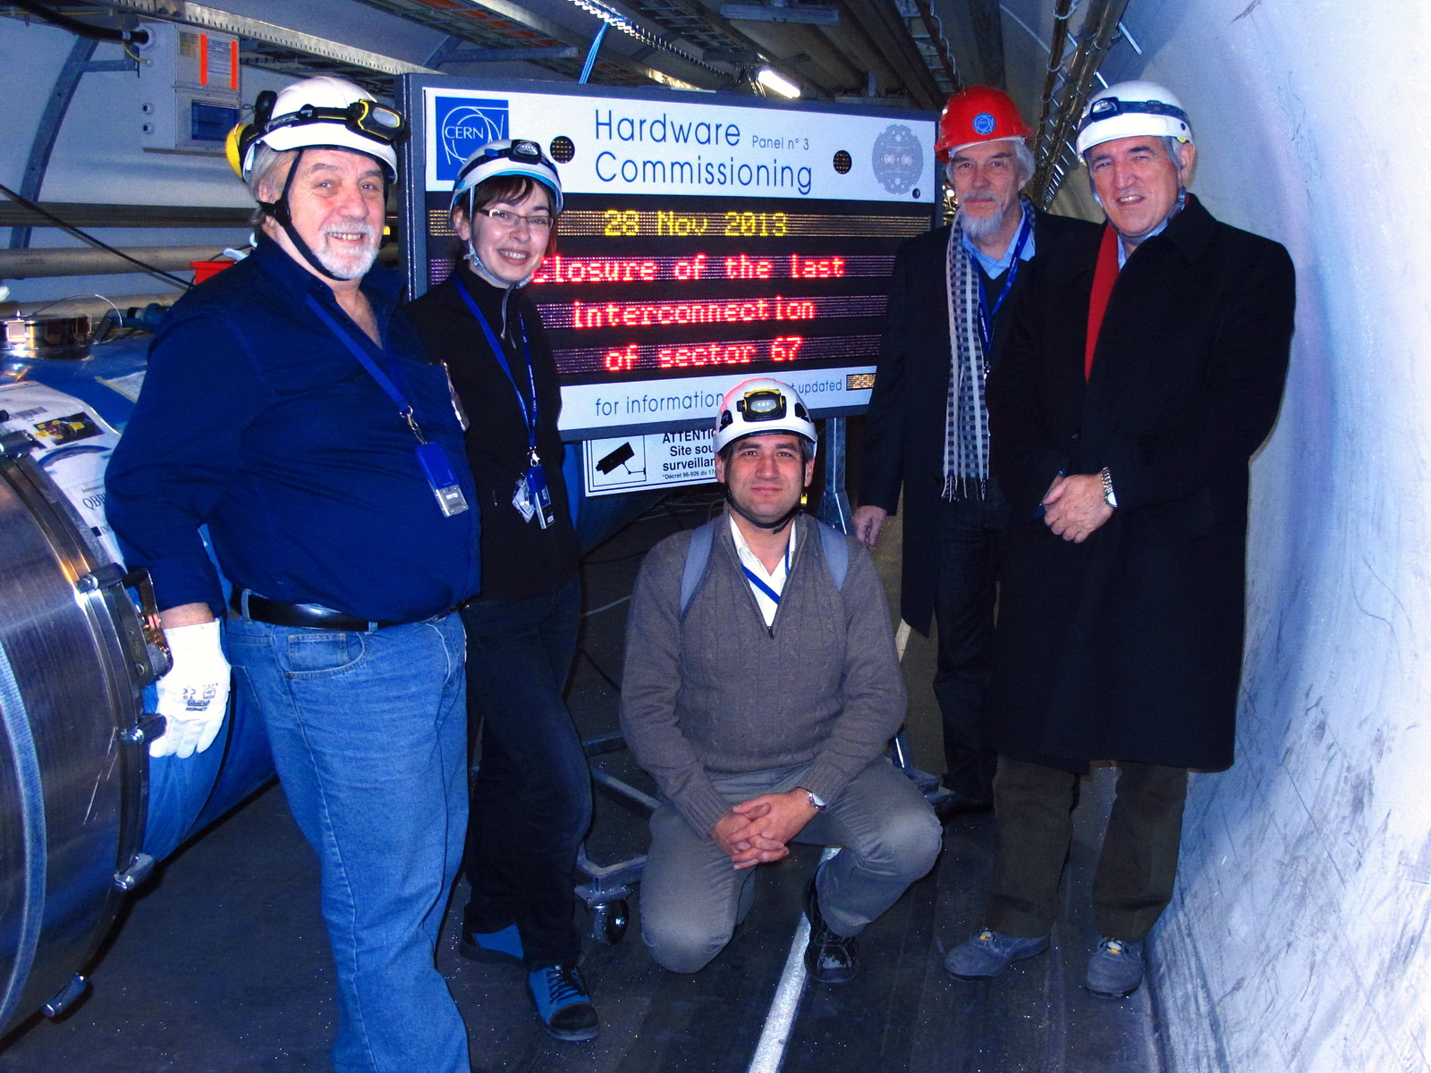

Slide 16
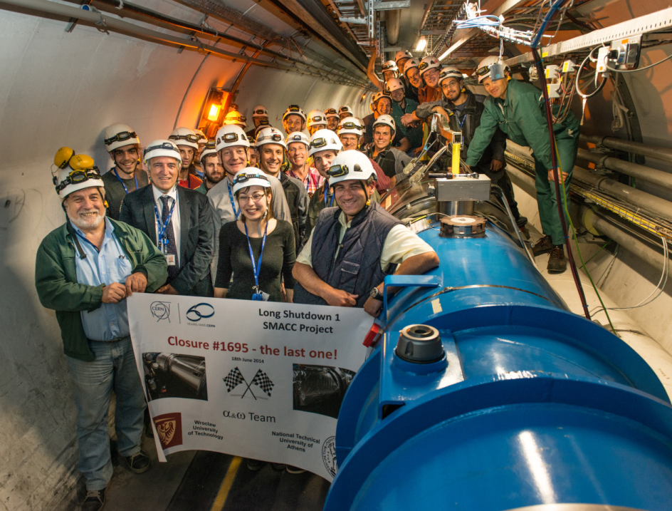

Slide 17
CERN-Greek Educational Activities V
NTUA Participation to the LHC Integration, LS2
2019-2020, LS2-DISMAC Project: Consolidation of the LHC power diodes. Project Manager J-P. Tock/TE
On 23 August 2019 the NTUA Greek Team with the Teams from Poland, Russia and Pakistan achieved to open at the LS2 operation:
1000 Dipole Interconnections in less than 3 months work

Slide 18
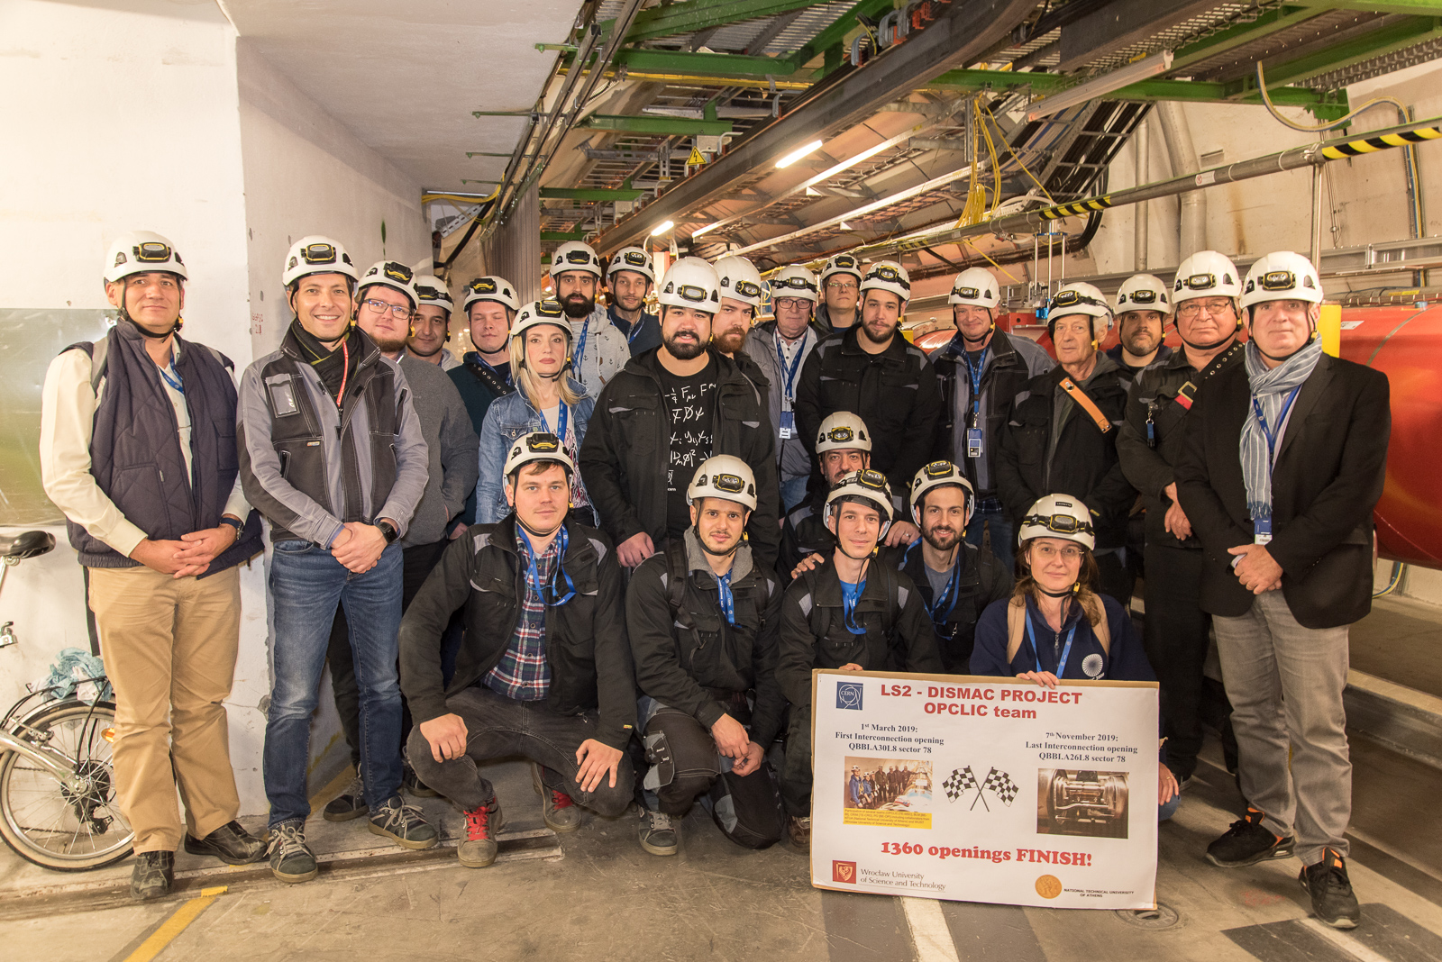
1360th Last Interconnection Opening - 07 Nov 2019
In presence of the LS2 coordinator, JM Jimenez, the last interconnection was opened in the sector 78, thanks are going to the collaborating institutes: NTUA Athens and WUST Wroclaw and to the CERN team: L Ponce, A Jacquemod, A Bastard

