Slide 1
Cryo-Assembly and Cryostat Tooling outstanding issues
R. Rabehl
Teleconference with CERN
August 20, 2020

Slide 2
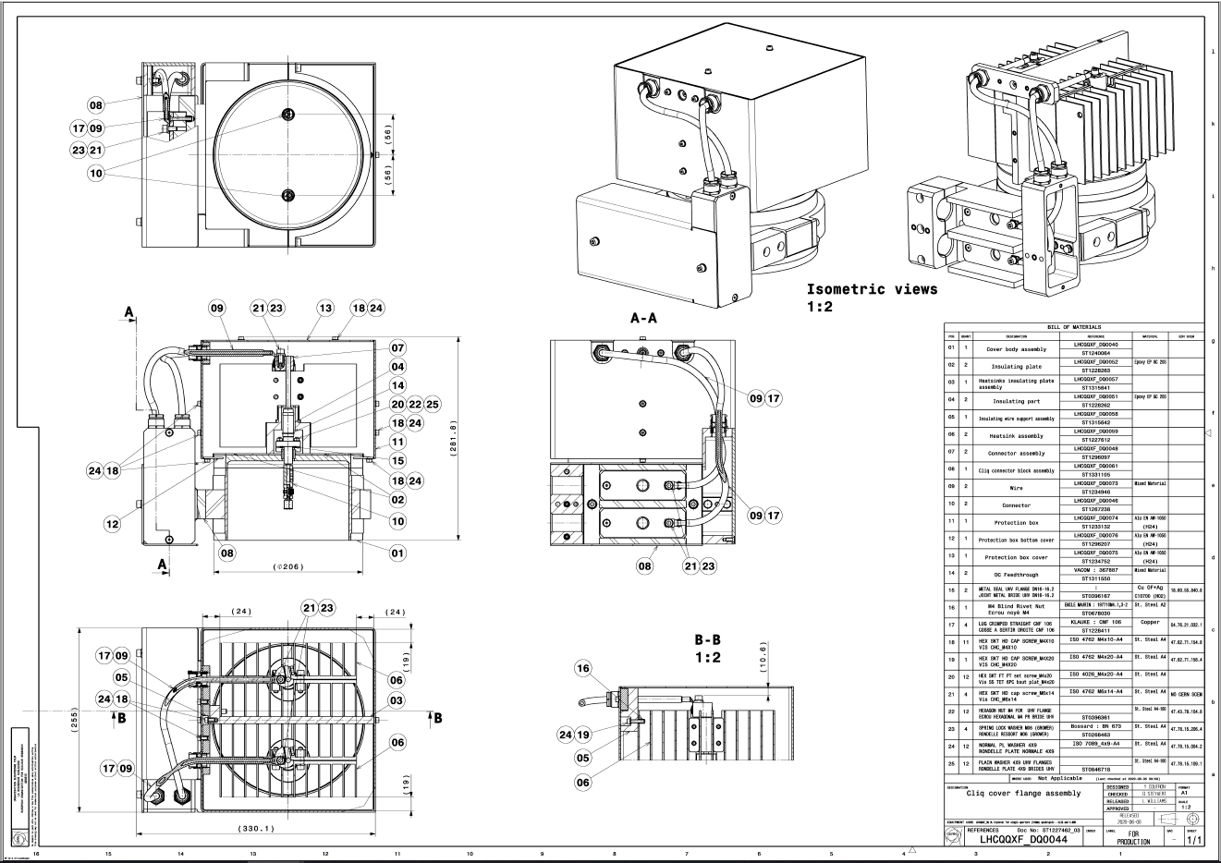
Released copies of Cryo-Assembly Drawings
  Cover flange assemblies for CLIQ and k-mod have been released; 2 detail drawings are under revision
  Cover flange assembly for IFS

Slide 3
Released Cryo-Assembly fabrication documentation
  Assembly procedure
  MIP
  Installation and positioning of FSI monitoring system components
  Needed by September 7 for upload to the review website

Slide 4
Applus+ tooling
  Documentation
    Design report for Fermilab tooling
    Assembly procedure from vendor
    UL certification for the electrical system
    Operating procedure/controls description
    Wiring diagrams, equipment cutsheets
  Travel plans?
  No updates received

Slide 5
Cryostat pipes
  The pipes shown in the 3-D model are the minimum length to be received by CERN.
  Based on these minimum lengths and the horizontal test stand interconnect design, we have proposed piping lengths provided by CERN and returned to CERN by Fermilab

Slide 6
Beam screen E_{H}E’_{H} (commercial pipe)
  Only 1 of 2 used on the test stand
  10640 mm minimum length
  Propose 10716 mm length provided by CERN and returned by Fermilab (extra 38 mm (1.5 in) at each end)

Slide 7
Quench LD (commercial pipe)
  10640 mm minimum length
  Propose 10716 mm length provided by CERN and returned by Fermilab (extra 38 mm (1.5 in) at each end)

Slide 8
1.9 K return XB (commercial pipe)
  Not used on the test stand
  10640 mm minimum length
  Propose 10716 mm length provided by CERN and returned by Fermilab (extra 38 mm (1.5 in) at each end)

Slide 9
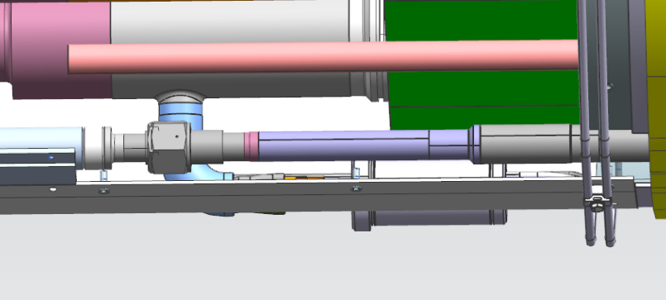
Shield E’_{H}
  10145 mm provided by CERN as per LHCQQXFA0038
  10145 minimum length
  Present design allows 10155 mm returned by Fermilab (extra 5 mm (0.2 in) at each end)

Slide 10
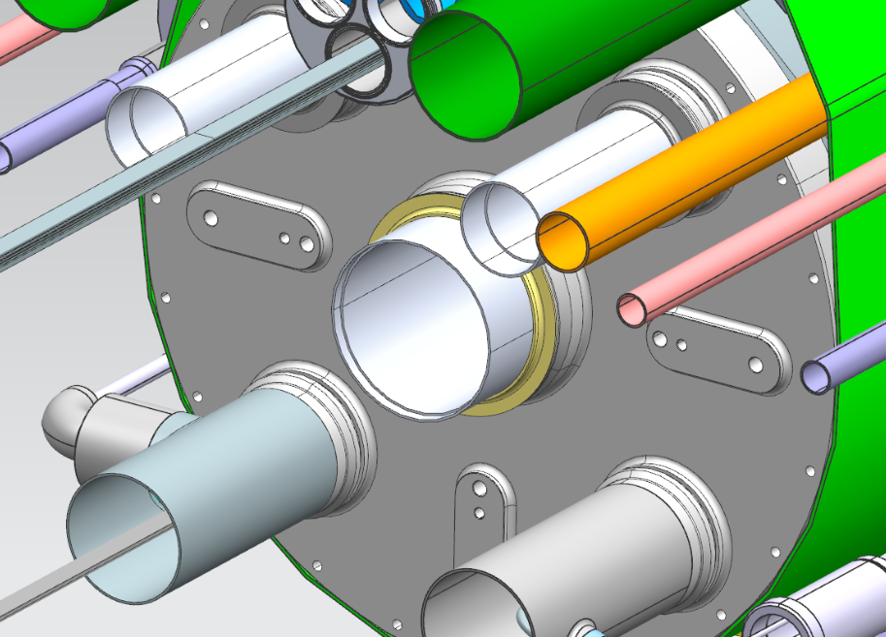
Beam pipe V
  10640 mm provided by CERN as per LHCLMQXF_S0025
  10294 mm minimum length
  10370 mm returned by Fermilab (extra 38 mm (1.5 in) at each end)
  Counterbore machined by CERN

Slide 11
Heat exchanger X
  10434 mm provided by CERN as per LHCLMQXF_S0022
  10434 mm minimum length
  10510 mm returned by Fermilab (extra 38 mm (1.5 in) at each end)
  Counterbore machined by CERN

Slide 12
IFS/He-II conduction L1 (non-IP end/test stand feed end)
  240 mm minimum length, measured from cold mass end cover reference plane
  Propose 278 mm length provided by Fermilab (extra 38 mm (1.5 in))

Slide 13
CLIQ/k-mod/He-II conduction L2 (non-IP end/test stand feed end)
  240 mm minimum length, measured from cold mass end cover reference plane
  Propose 278 mm length provided by Fermilab (extra 38 mm (1.5 in))

Slide 14
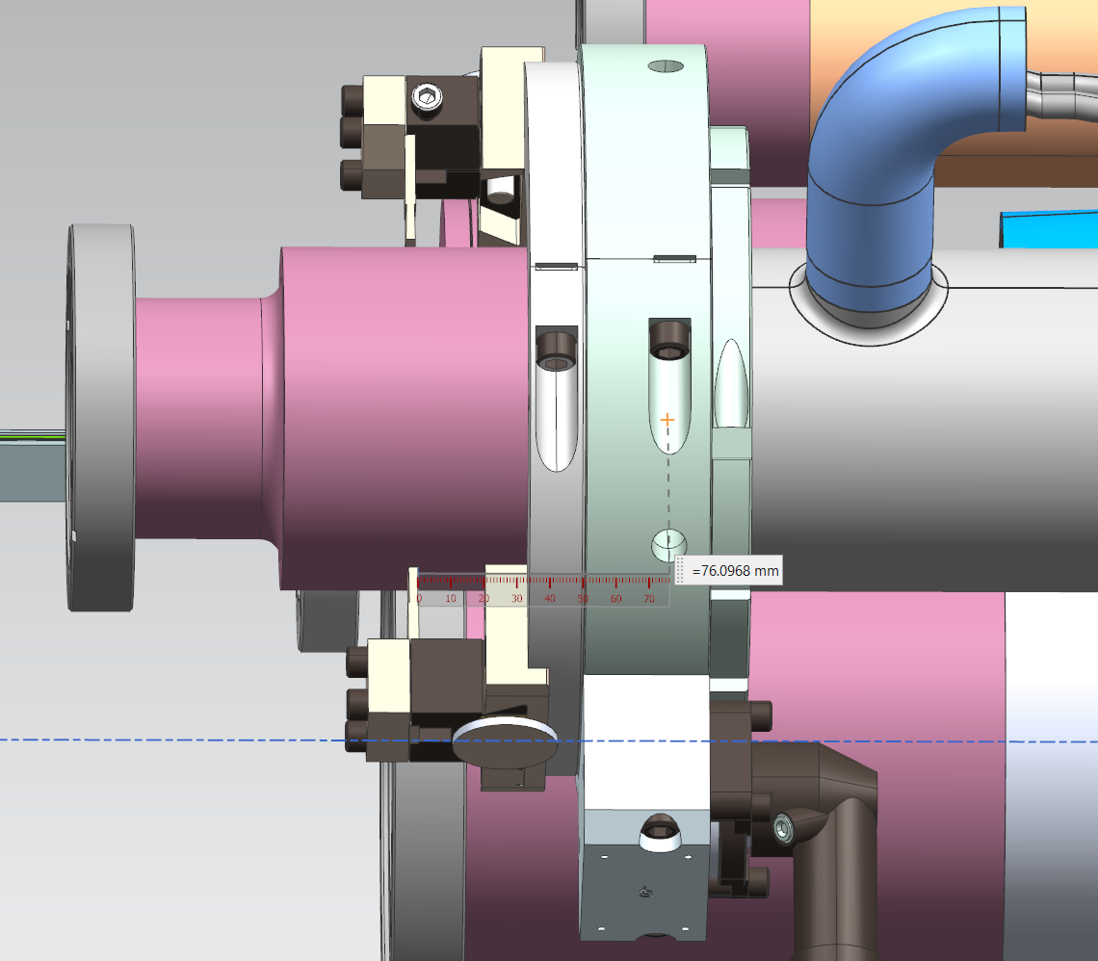
IFS/He-II conduction L1 (IP end/test stand return end)
  240 mm minimum length, measured from cold mass end cover reference plane
  Propose 316 mm length provided by Fermilab (extra 76 mm (3 in))

Slide 15
CLIQ/k-mod/He-II conduction L2 (IP end/test stand return end)
  240 mm minimum length, measured from cold mass end cover reference plane
  Propose 316 mm length provided by Fermilab (extra 76 mm (3 in))

Slide 16
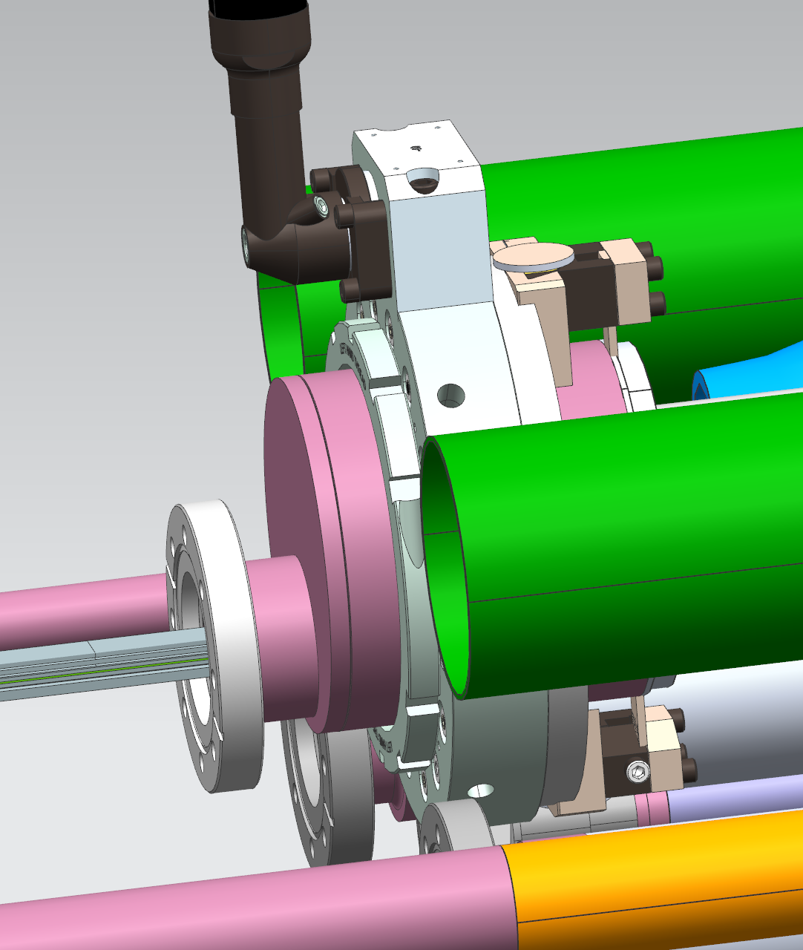
Bus aperture M
  Fermilab will leave its piping transition in place, to be removed by CERN.

