Slide 1




hep_tables
G. Watts (UW/Seattle)
vCHEP – 2021

Slide 2


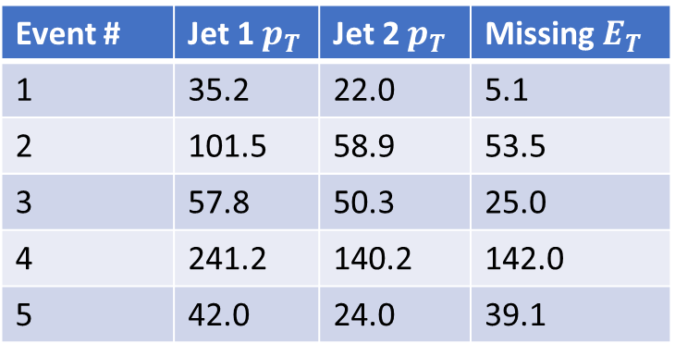
HEP Data in the Python Ecosystem
Expressive, Readable, and Concise
Not Fast
Replace loops over arrays with compiled code
Event # | Jet 1 $p_{T}$ | Jet 2 $p_{T}$ | Missing $E_{T}$
1 | 35.2 | 22.0 | 5.1
2 | 101.5 | 58.9 | 53.5
3 | 57.8 | 50.3 | 25.0
4 | 241.2 | 140.2 | 142.0
5 | 42.0 | 24.0 | 39.1
r = [2*x for x in array]
r = 2*array
Array

Slide 3
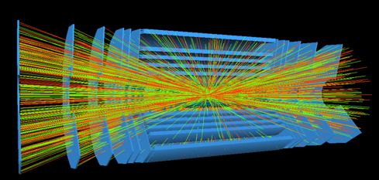













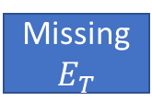







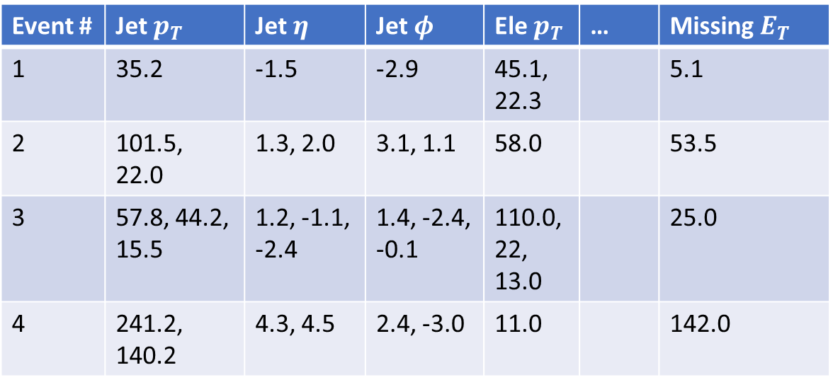
HEP Data
Electron 1
Electron 2
$$p_{T}$$
$$η$$
$$φ$$
$$p_{T}$$
$$η$$
$$φ$$
Event # | Jet $p_{T}$ | Jet $η$ | Jet $φ$ | Ele $p_{T}$ | … | Missing $E_{T}$
1 | 35.2 | -1.5 | -2.9 | 45.1, 22.3 |  | 5.1
2 | 101.5, 22.0 | 1.3, 2.0 | 3.1, 1.1 | 58.0 |  | 53.5
3 | 57.8, 44.2, 15.5 | 1.2, -1.1, -2.4 | 1.4, -2.4, -0.1 | 110.0, 22, 13.0 |  | 25.0
4 | 241.2, 140.2 | 4.3, 4.5 | 2.4, -3.0 | 11.0 |  | 142.0
Jet 1
Event 1
$$p_{T}$$
$$η$$
$$φ$$
Missing$E_{T}$
Electron 1
$$p_{T}$$
$$η$$
$$φ$$
Jet 1
Jet 2
Array of Arrays
Event 2
Built on numpy
Efficient handling of non-uniform arrays
$$p_{T}$$
$$η$$
$$φ$$
$$p_{T}$$
$$η$$
$$φ$$
Missing$E_{T}$

Slide 4
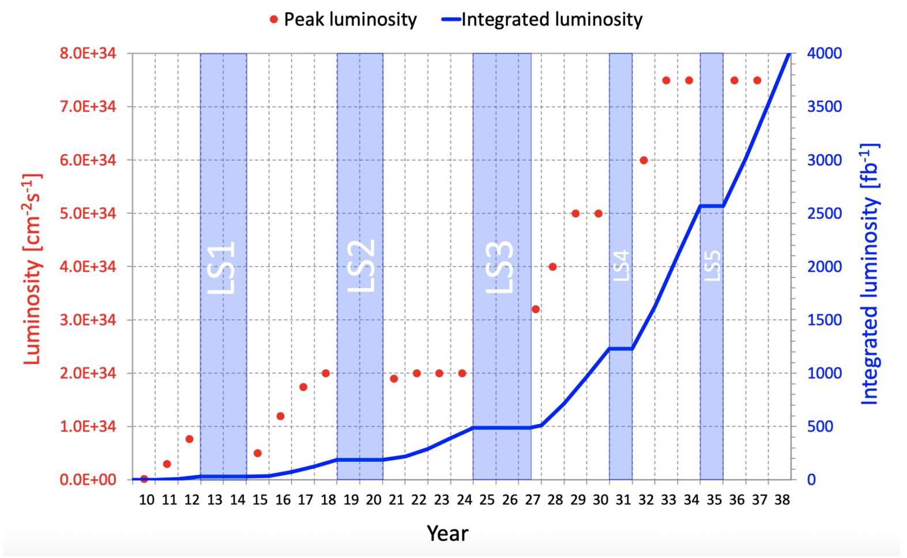
Limitations and the HL-LHC
Analysis will need to be distributed
Analysis span types of data access systems
Optimization

Slide 5




Spanning Systems
GRID
Experiment Data
ServiceX
Columnar Data
Awkward & DASK
Histogram
Data

Slide 6


DASK
chunks
r = 2*array
r_proxy = 2*array
r_proxy
*
A Compute Graph
2
array
r = r_proxy.compute()
Causes the array to be rendered locally
1
Record the Operations
2
Translate the operations to the target system
3
Execute the operations and aggregate the results

Slide 7
Recording the Compute Graph
dataframe_expressions
A token that represents the source data (dataframe_expressions.DataFrame)
array = <data source>
r_proxy = 2*array
ast.Num(2)
ast - DataFrame
array
ast.BinOp(*)
r_proxy
DataFrame
DataFrame supports:
Standard mathematical operations
numpy operations (NEP 18)
Method calls and property calls
Arbitrary slicing
Awkward (experimental)
It only records these operations in a Compute Graph

Slide 8
Executing The Compute Graph
hep_tables
2
List of Backends
ast.Num(2)
ast - DataFrame
Backend ServiceX
3
ast.BinOp(*)
4
DataFrame
Backend Awkward
1
make_local(r_proxy)
awkward array is returned in local memory
5
Complete Graph is executed by the ServiceX Backend
Case where a single backend can execute every operation

Slide 9
Executing The Compute Graph
hep_tables
2
List of Backends
ast.Num(2)
ast - DataFrame
Backend ServiceX
4
Sub-Graph is executed by the ServiceX Backend
3
ast.BinOp(*)
DataFrame
Backend Awkward
1
make_local(r_proxy)
awkward array is returned in local memory
5
Sub-Graph is executed by Awkward backend
When an operation can’t be handled by a single backend

Slide 10
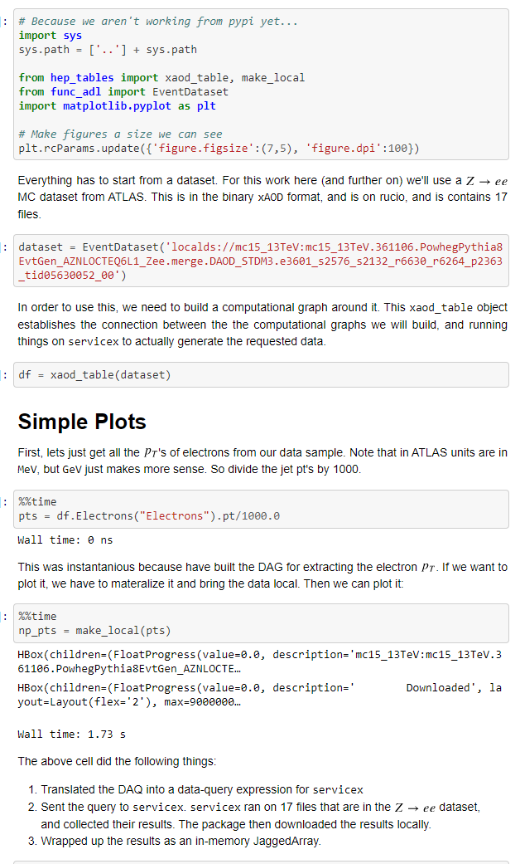
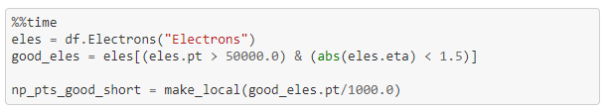
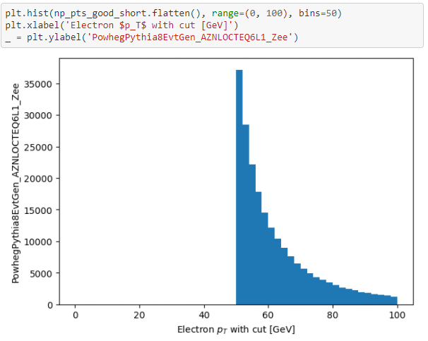
Current Status
From example notebook (see docs)
Prototype Finished
  ServiceX and in-process awkward backend
  Simplistic expressions routed to ServiceX
  Histograms, etc., done locally
  Used in some simple ATLAS MC analysis
Limitations
  awkward integration is insufficient
  Complex multi-object operations are not readable
  ServiceX translation is simplistic
Next Steps
  Rewrite the ServiceX backend to support better complex queries
  Rewrite awkward backend to support DASK clusters
  Better support awkward stand-alone functions
  Play better with other packages

