Slide 1
vCHEP2021 close-out
Graeme Stewart and Simone Campana
25th International Conference on Computing in High-Energy and Nuclear Physics, 17-21 May 2021

Slide 2
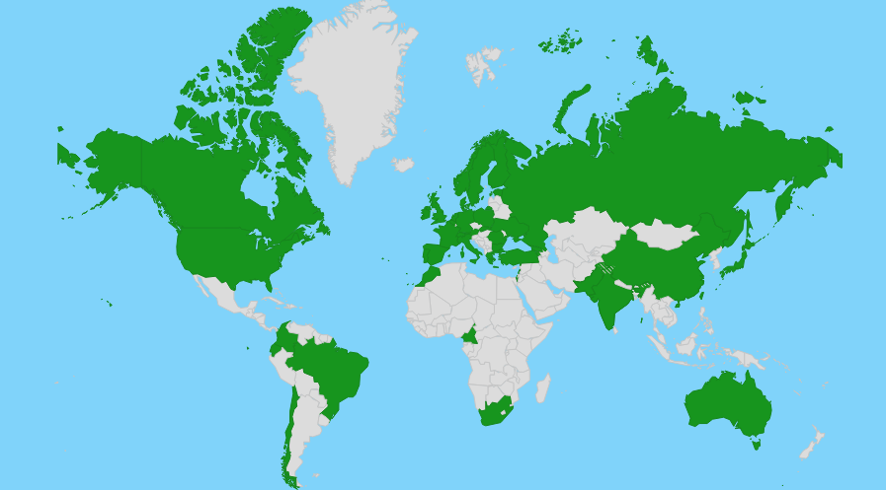

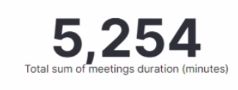
Thanks for your participation
We will send a survey soon, please spend 5’ to provide this valuable feedback
507 people interacting in Mattermost
vCHEP is…
47 Countries over 6 continents
> 950 people
Time zones from Brisbane, UTC+10, to Honolulu, UTC-10
25% are students

Slide 3
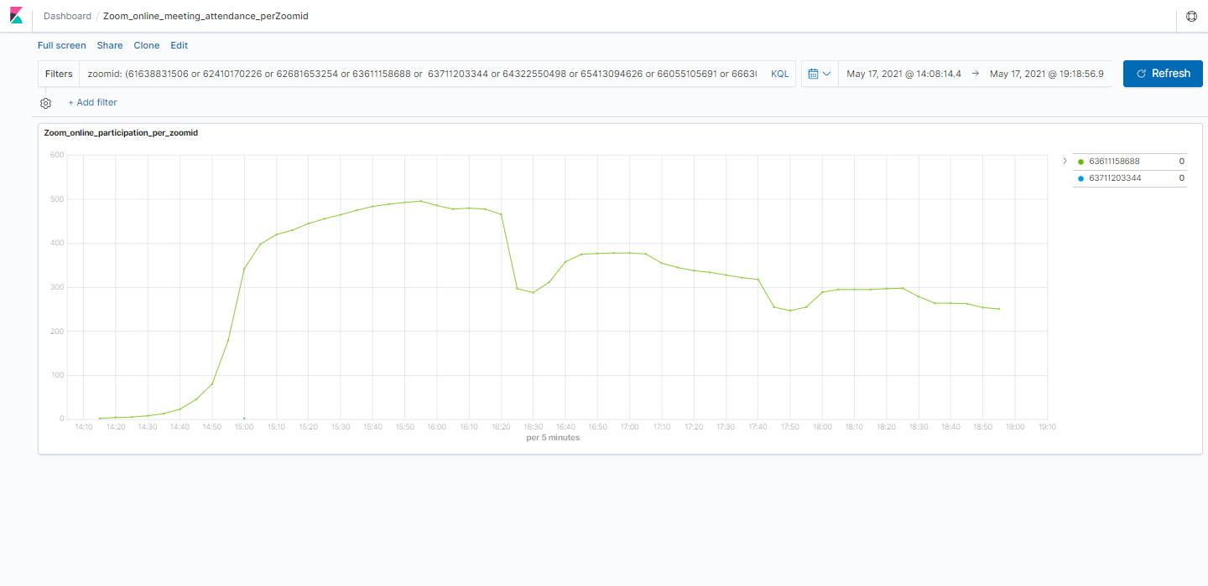
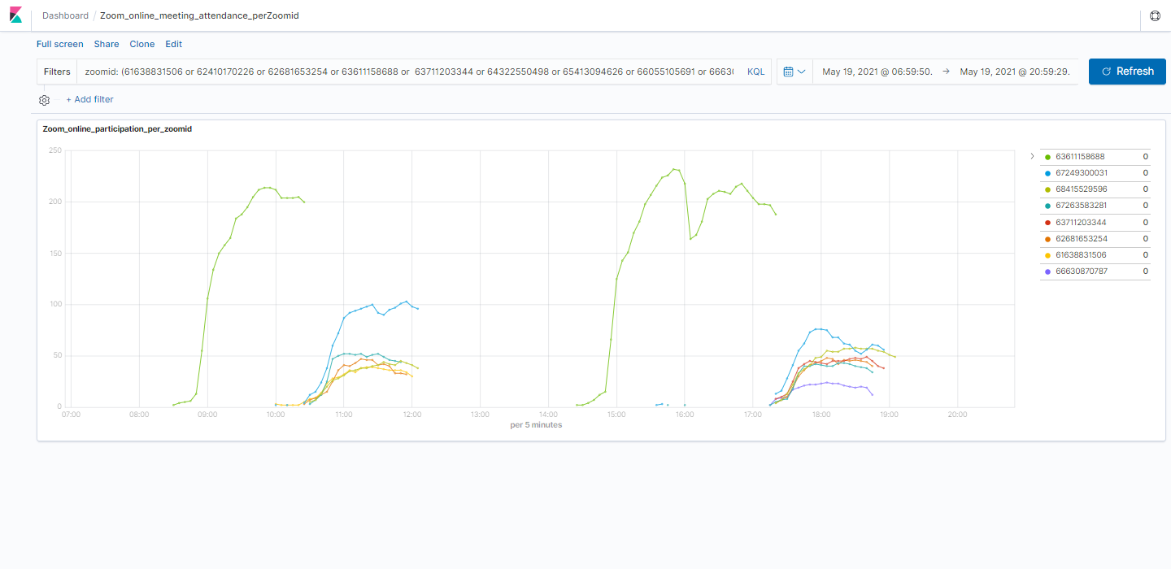
Thanks for your participation
Conference peak of attendance:
Monday at 15:55 CEST
Number of attendees on Mon
500
300
Number of attendees on Wed
200
Parallel sessions as well attended as plenary sessions
100

Slide 4
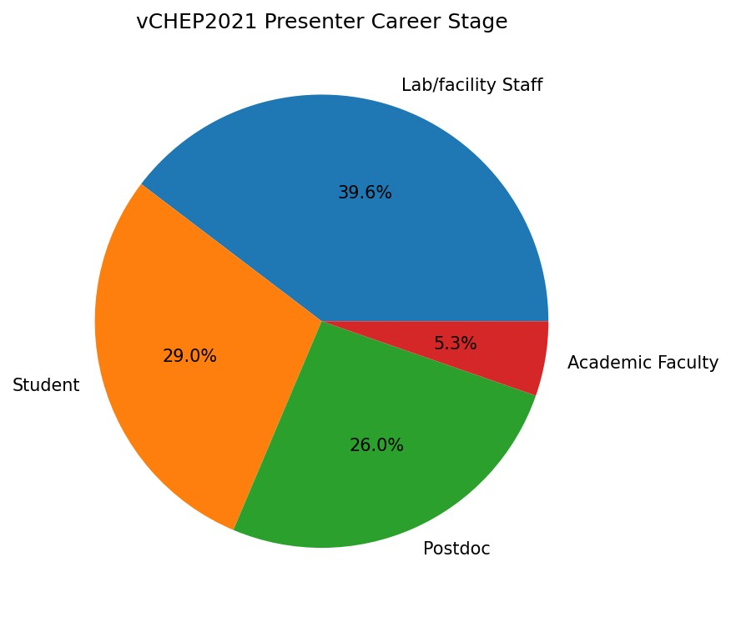
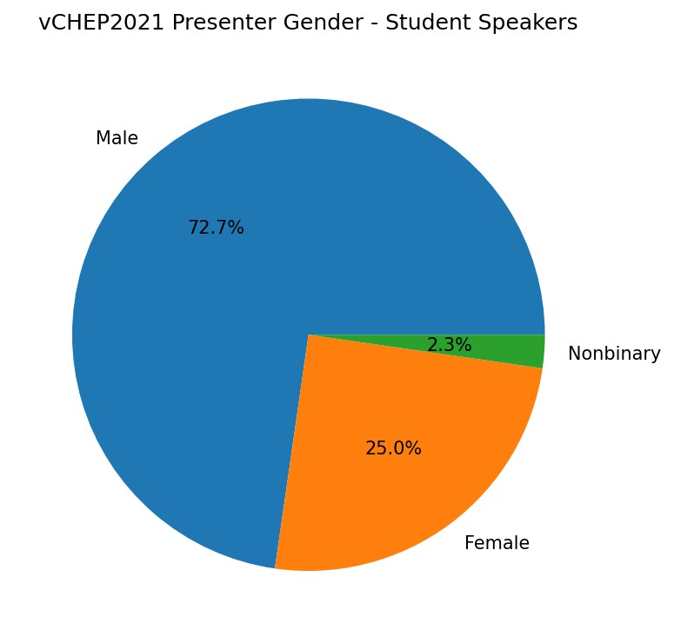
Thanks to all the scientific contributors
Thanks for submitting your contribution to vCHEP2021
  A different model, asking a full paper to be submitted (rather than an abstract)
  This helped build a solid and diverse scientific program, thought it created challenges for many (contributors, program committee, organisers, ..) it paid off
We accepted 205 contributions (30 plenary,175 parallel)
  It was a pleasure to see many excellent presentations from early career colleagues
We want to finalise the process and get the proceedings published ASAP
  All papers received a 1st review by the referees
  The deadline to submit a second draft is June 4th. We want to finalise by June 25th
  11 contributions were selected for publication in CSBS (Springer)

Slide 5
Thanks to the CHEP committees
Thanks to the International Advisory Committee for helping us making many of the difficult choices for this peculiar vCHEP. And thanks for the Jobs@vCHEP initiative
Thanks to the CERN Local Organizing Committee, for the work in preparing and running the conference
Thanks to the Program Committee for managing and curating the scientific aspects of the conference.
  A special thanks to the Program Committee Chairs (Benedikt, Catherine, Chiara, Stefan) for the help in the overall organisation
Thanks to the CERN management, supporting the organisation of the conference (including the financial part)

Slide 6
Finally...
We hope you had a really great vCHEP!
On behalf of Team vCHEP: IAC, LOC and Full PC
We think the event has been a great success, even if we missed the usual opportunities to interact in person.
And for that, see you at CHEP2022 in Norfolk!

Slide 7


