Slide 1
Ka-band Specifications
(from a beam dynamics viewpoint)
Andrea Latina (CERN)
CompactLight@elettra.eu
XLS
www.CompactLight.eu

Slide 2
Contents
Part I: Ka-band
Impact of Ka-band aperture radius and cavity length:
  Jitter amplification
  Transverse emittance growth
Part II: Ka-band as XLS linearizer
Sensitivities with 2 or 3 Ka band
  Phase / Voltage / Charge stability on
  Intensity / arrival time /

Slide 3
Part I: Action amplification due to
position jitter in the Ka band
The head-to-tail amplification of the ‘action’ can lead to beam breakup.
The amplification factor, A, is a function of the position along the bunch, z
a = 1 - 3 mm, iris aperture of the Ka band (whenever not specified is 2 mm)
L_{cav} = 20 - 40 cm, length of Ka band (whenever not specified is 30 cm)
J_{i} = initial action; J_{f} = final action (bunch tail)
β = beta function at the Ka band
Q = 75 pC, bunch charge
E_{beam} = 300 MeV, beam energy at Ka band
g gap length = l_{cell} - 0.0006 m, of the Ka band
In the following slides, it is shown the amplification factor in a two-particle beam model
with z = 1.5 σ_{z} (σ_{z} = 300 μm)
The amplification factor A should be ~1 to avoid beam breakup.
This implies: A-1 must be small ( << 1 )

Slide 4
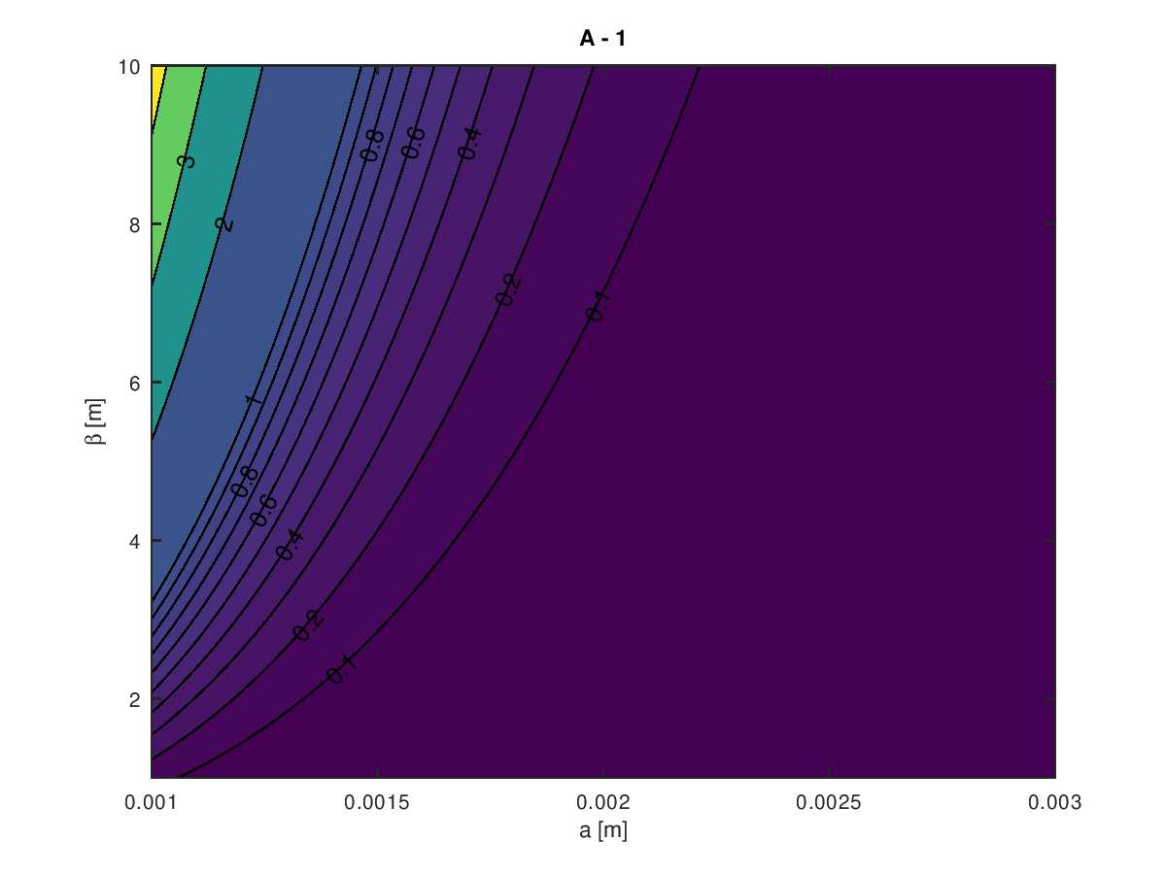
Jitter amplification
Assuming a Ka-band length = 30 cm
We want it to be < 10%
a=2 mm seems like a good choice. β, beta function at Ka band, should be smaller than 6 meters

Slide 5
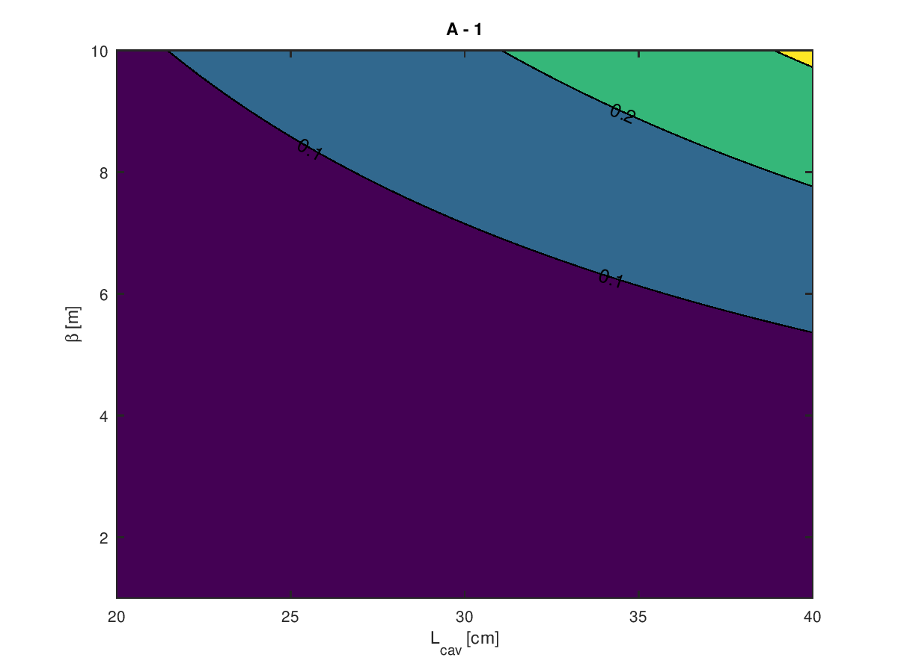
Jitter amplification
Assuming a β function = 5 m
We want it to be < 10%
L_{cav} = 30 cm seems like a good choice. β, beta function at Ka band, should be smaller than 6 meters

Slide 6
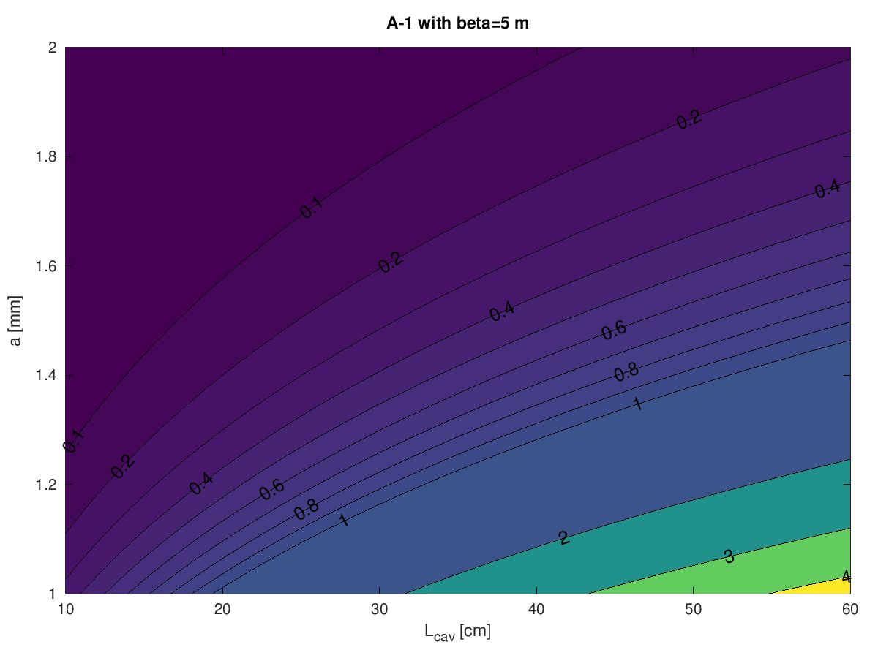
Jitter amplification
Assuming that the beta function at Ka band is, β = 5 m
We want it to be < 10%
Let’s take a=2 mm, L_{cav} = 30 cm as upper limit.

Slide 7
Emittace growth at BC1 entrance due to
Ka-band structure misalignment
Under the effect of the short-range tranverse wakefields
10%
We want it to be << 10%
Δx = 100 μm is the standard RMS misalignment from pre-alignment
Δx = 20 μm could be considered as the equivalent misalignment after BBA correction
We do not have a defined budget, but being < 10% seems definitely a requirement

Slide 8
Prescriptions
Beam dynamics show good working point with:
a >= 2 mm iris aperture radius
L_{cav} <= 30 cm
β function at Ka-band <= 6 m

Slide 9
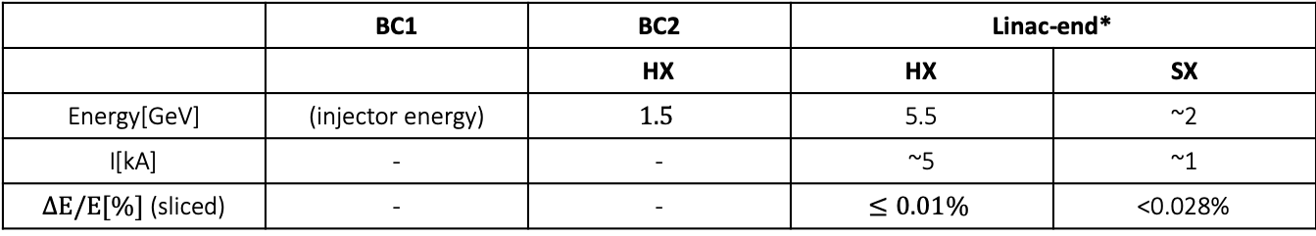


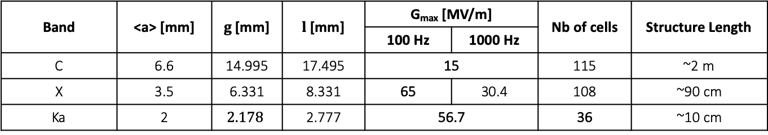


Part II: Ka-band sensitivities
C-band
injector
$$K$$
BC1
Linac-1
Linac-1
BC2
Linac-2
FEL
Linac RF Structures
Band | <a> [mm] | $g$ [mm] | $l$ [mm] | G_{max} [MV/m] |  | Nb of cells | Structure Length
 |  |  |  | 100 Hz | 1000 Hz
C | 6.6 | 14.995 | 17.495 | 15 |  | 115 | ~2 m
X | 3.5 | 6.331 | 8.331 | 65 | 30.4 | 108 | ~90 cm
Ka | 2 | $$2.178$$ | 2.777 | 56.7 |  | 36 | ~10 cm
Bunch Compressor: $R_{56}, T_{566}=−\frac{3}{2}{ R}_{56}$
Design Objectives
 | BC1 | BC2 | Linac-end*
 |  | HX | HX | SX
Energy[GeV] | (injector energy) | $$1.5$$ | 5.5 | ~2
I[kA] | - | - | ~5 | ~1
$ΔE/E[\%]$ (sliced) | - | - | $$≤0.01\%$$ | <0.028%
Design/Simulation Tools: Track1D (by A. Latina) and Octave

Slide 10
Key beam parameters and layout
Beam parameters:
Bunch charge = 75 pC
C-band injector gun
Initial beam energy is 100 MeV (distribution from Michele Croia)
Follows: Linac 0 to reach 300 MeV off-crest
with G_{max} = 15 MV/m, we need 8 C-band structures before the Ka-band
Follows: BC1, 4-bend chicane
Follows: Linac 1
consists of 12 X-band structures, with G_{max} = 65 MV/m
Follows: BC2, 4-bend chicane
Follow: Linac 2 and Linac 3, consisting respectively of
8 X-band structures, with G_{max} = 65 MV/m
72 X-band structures, with G_{max} = 65 MV/m

Slide 11
Stability criteria
From [Beutner, Bolko & Reiche, Sven & Scherrer, Paul. (2011). “Operation modes and longitudinal layout for the SwissFEL hard X-ray facility”. ]
«The stability goals of the machine are difficult to define from a user point of view since the community is heterogeneous. We decide to use a beam dynamics definition of these limits.
The arrival time stability should not exceed the bunch length,
The energy fluctuations should be within the bandwidth of the undulator,
From the intrinsic fluctuations of the SASE we obtain a fluctuation limit on the peak current, in the sense that a peak current more stable than the FEL power fluctuations would not stabilize the system any further. This is the tightest goal which makes sense from the beam dynamics point of view – user requirements are in general more relaxed.»
That means:
Arrival time: same as bunch length = sigma_z
Peak current (compression factor) = 5%
Average beam energy = 0.05%

Slide 12
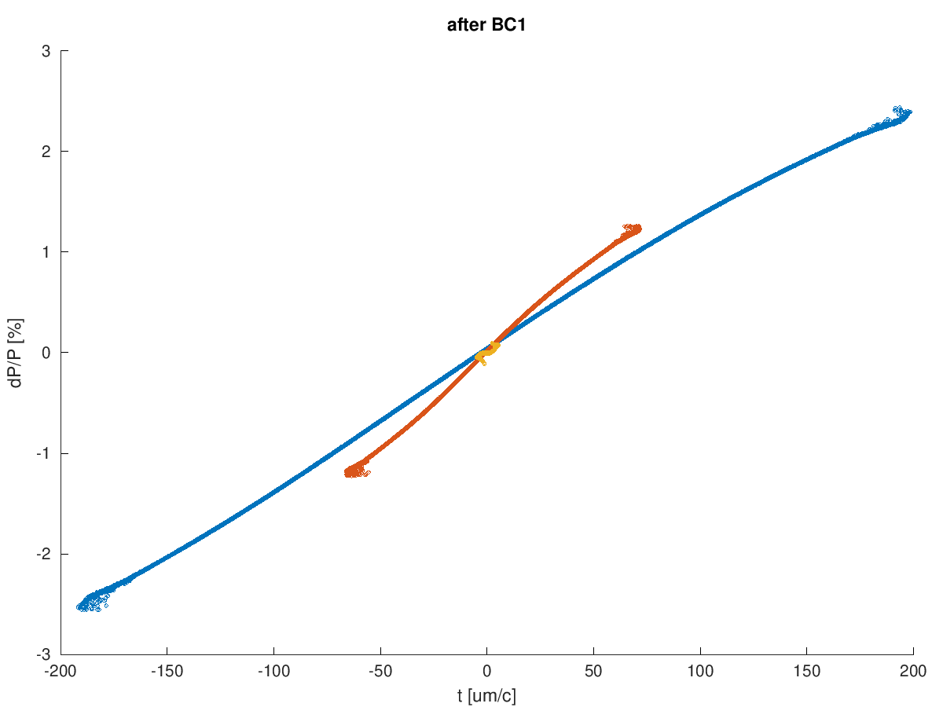
2 Ka band structures
L0_PhiD = 16 deg
L0_Voltage = 20 MV
Ka_PhiD = 180 deg
Ka_Voltage = 11.338 MV
BC1_R56 = -0.009 m
BC1_T566 = 0.01377 m
L1_PhiD = 40 deg
L1_Voltage = 3.970 MV
BC2_R56 = -0.0048 m
BC2_T566 = 0.007239 m
L2_PhiD = -1.0102
L2_Voltage = 0.98182
L3_PhiD = -1.0102
L3_Voltage = 8.8363
Final rms bunch length = 2 um/c = 6.6 fs
blue is the injected beam,
orange is the beam after BC1
yellow is the beam at the end of linac3

Slide 13
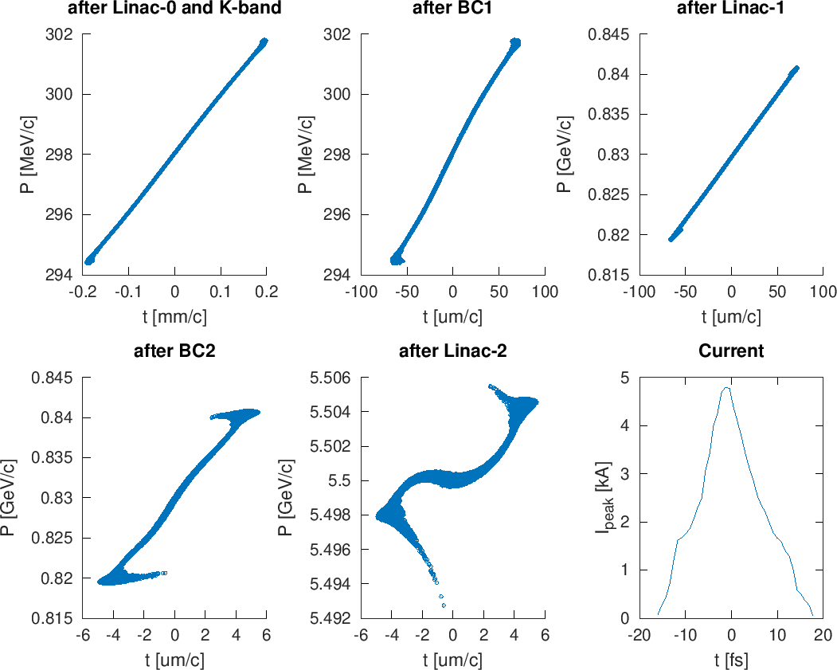
2 Ka band structures

Slide 14
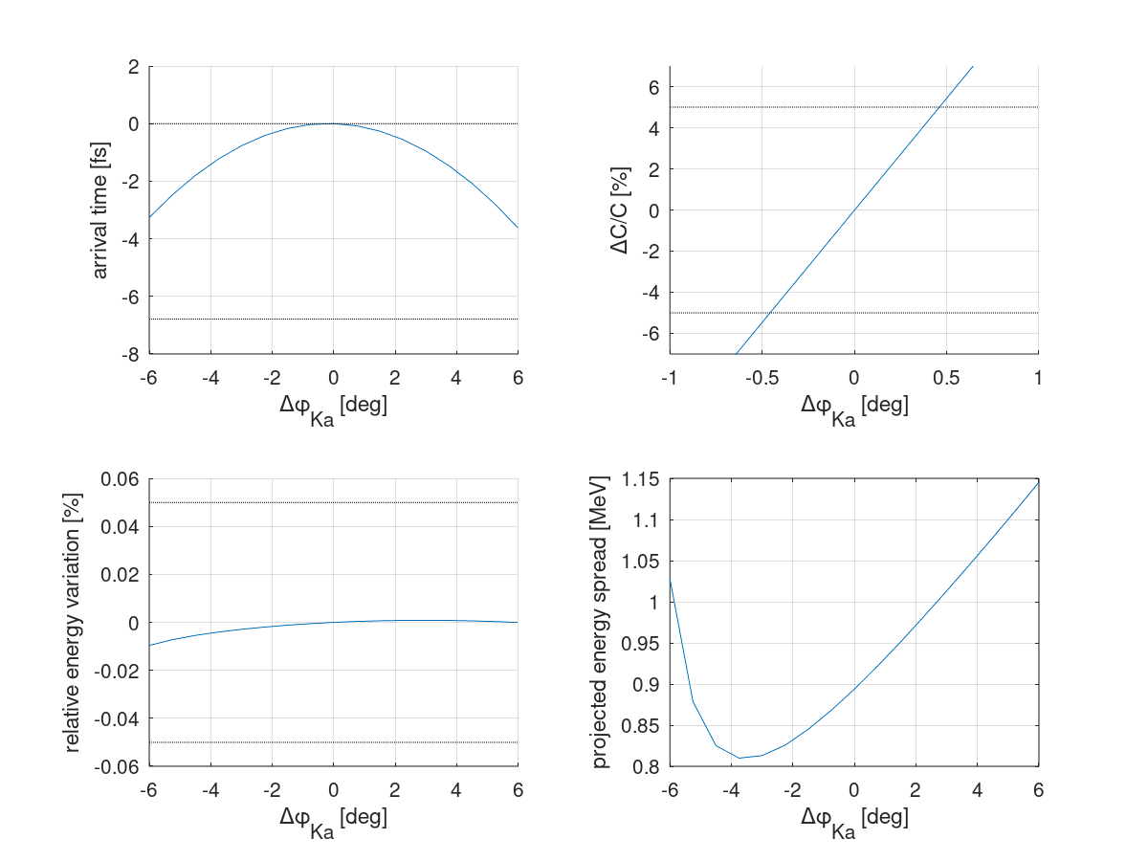
2 Ka band structures
Ka band phase stability

Slide 15
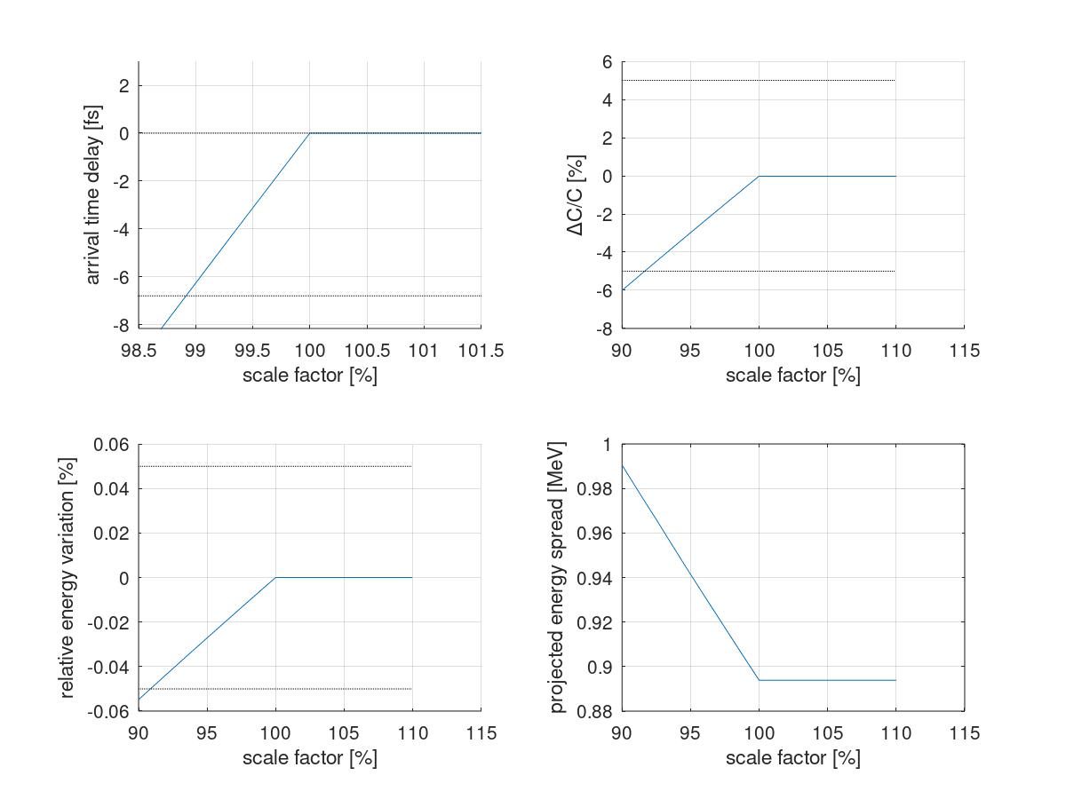
2 Ka band structures
Ka band voltage stability
Saturation

Slide 16
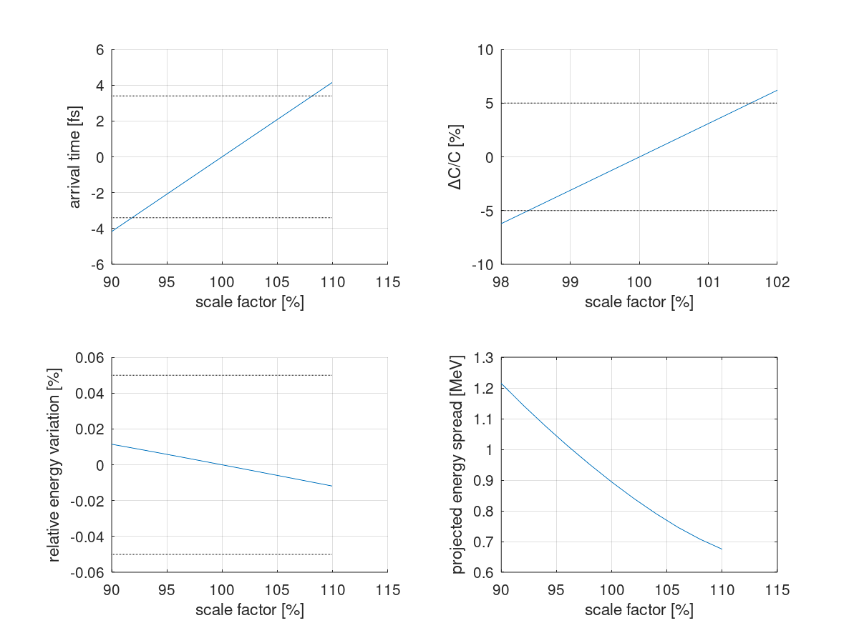
2 Ka band structures
Charge stability (due to the effect of the wakefields generated in all structures: C-, Ka-, and X-band)

Slide 17
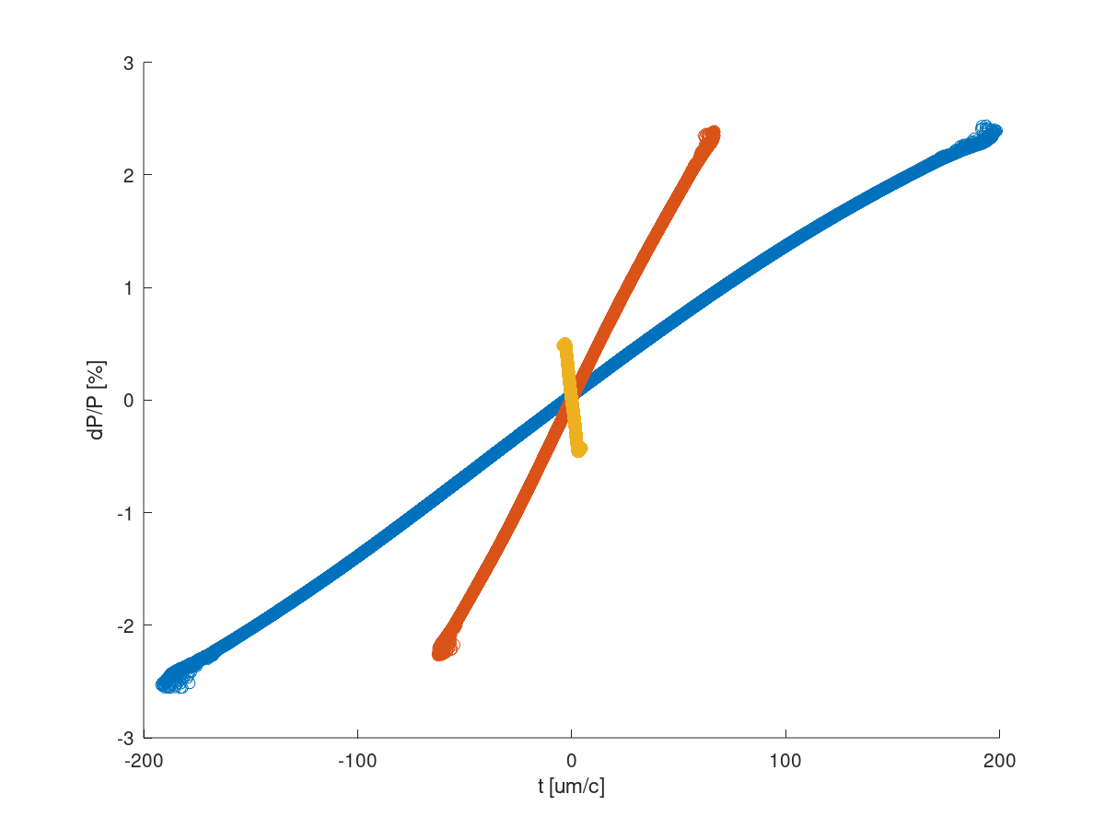
3 Ka band structures
L0_PhiD = 20.761 deg
L0_Voltage = 203.27 MV
Ka_PhiD = 180 deg
Ka_Voltage = 10.669 MV
BC1_R56 = -0.0091825 m
BC1_T566 = 0.013774 m
L1_PhiD = 40.642 deg
L1_Voltage = 3.9708 GV
BC2_R56 = -0.0048265 m
BC2_T566 = 0.0072398 m
L2_PhiD = 16.175 deg
L2_Voltage = 1.9297 GV
L3_Voltage = 4.2111 deg
L3_PhiD = 2.6442 GV
Final rms bunch length = 2 um/c = 6.6 fs
blue is the injected beam,
orange is the beam after BC1
yellow is the beam at the end of linac3

Slide 18
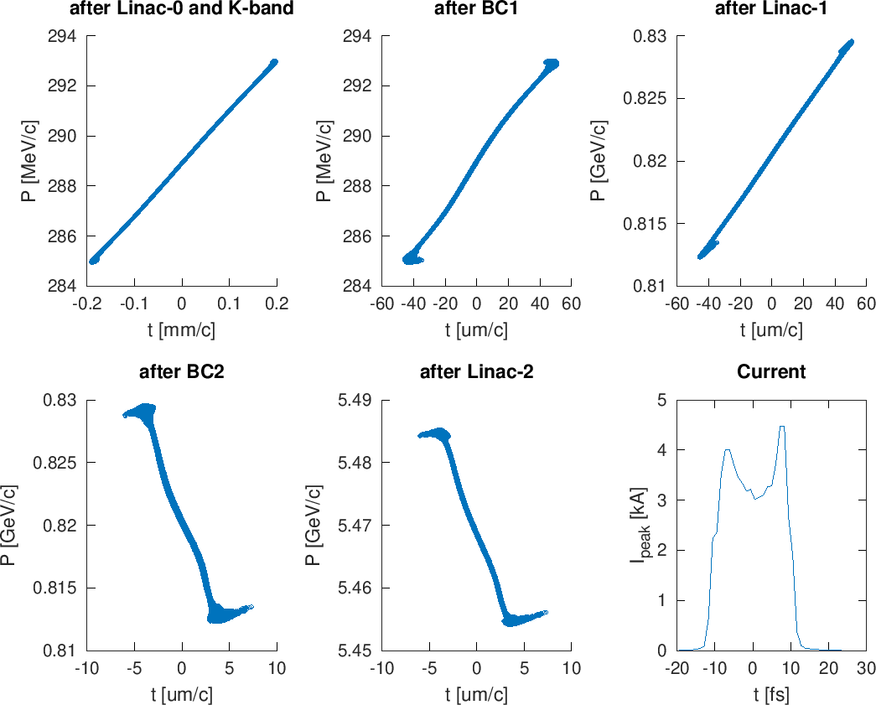
3 Ka band structures

Slide 19
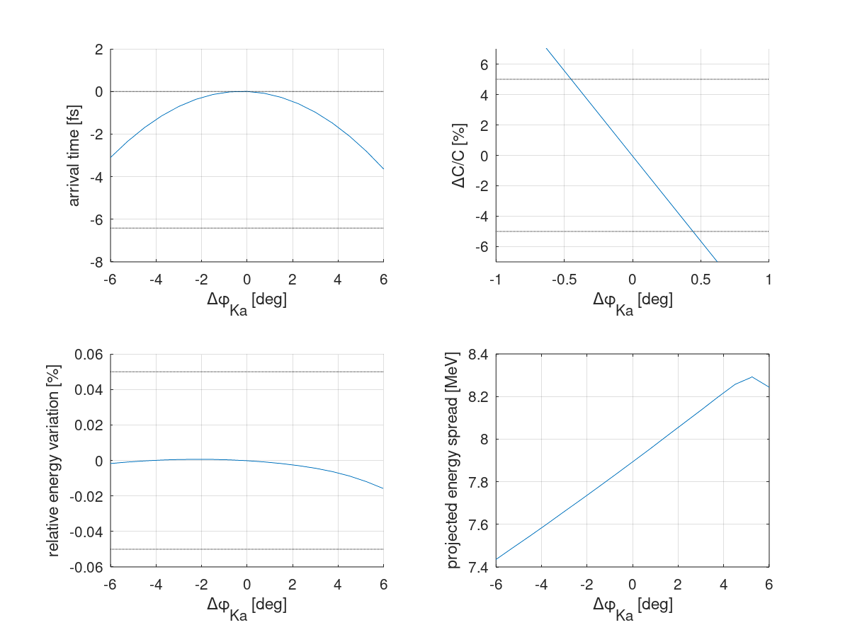
3 Ka band structures
Ka band phase stability

Slide 20
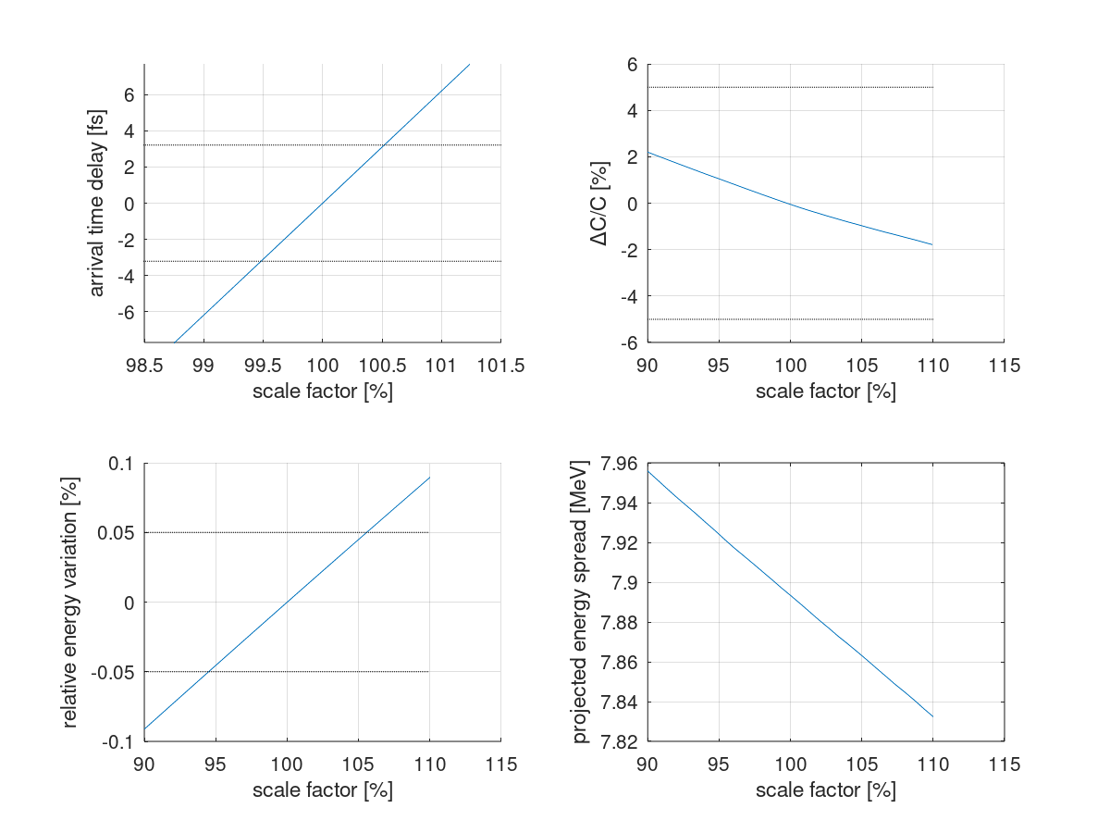
3 Ka band structures
Ka band voltage stability

Slide 21
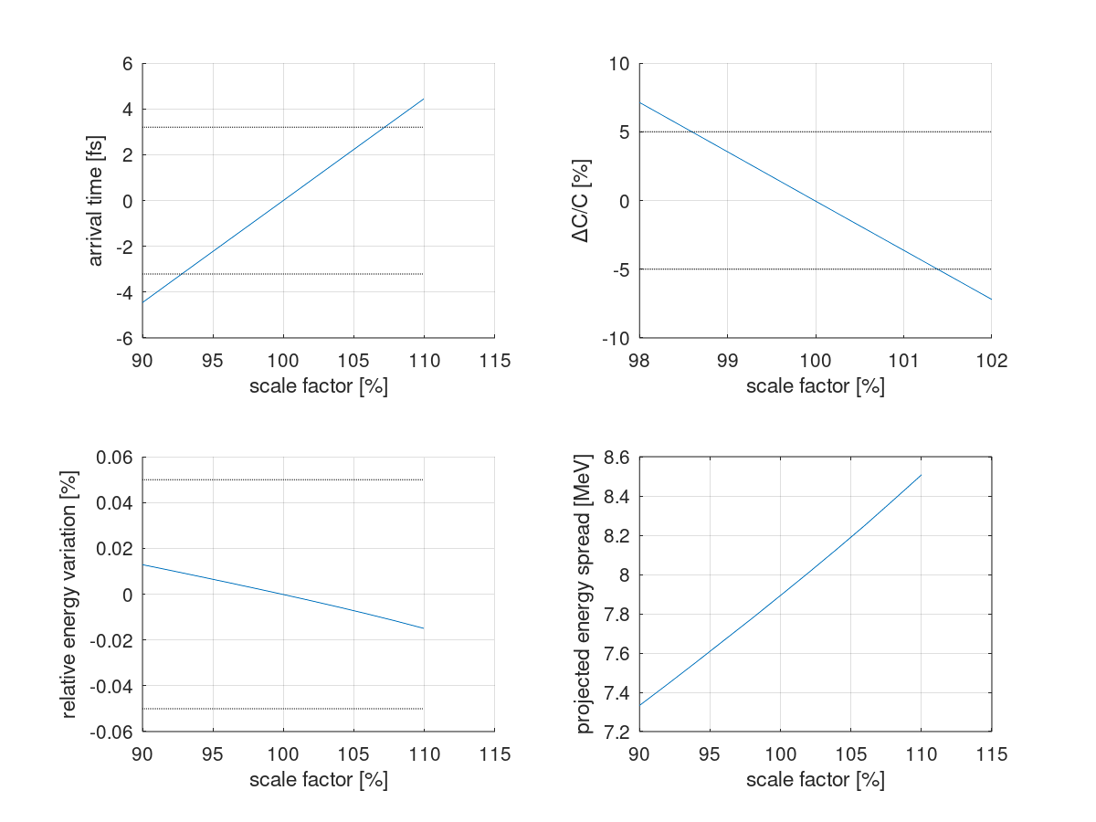
3 Ka band structures
Charge stability (due to the effect of the wakefields generated in all structures: C-, Ka-, and X-band)

Slide 22
Conclusions
Prescriptions have been given for the Ka-band due to beam dynamics requirements:
  a >= 2 mm iris aperture radius
  L_{cav} <= 30 cm
  β function at Ka-band <= 6 m
The required integrated voltage depends on various effects non-linearly. It was found that integrated voltages I ≤ 12 MV produce good distributions.
Applying a safety margin, the Ka band should be capable of providing a integrated voltage I_{max} = 15 MV.
Some stability requirements have been computed using 1D tracking with full longitudinal wakefield effects:
 | 2x10cm Ka band | 3x10cm Ka band | Most critical sensitivity
Phase stability | ± 0.5 deg | ± 0.5 deg | ΔC/C
Voltage stability | ± 1 % | ± 0.5 % | arrival time
Bunch charge stability | ± 1.5 % | ± 1.5 % | ΔC/C

Slide 23
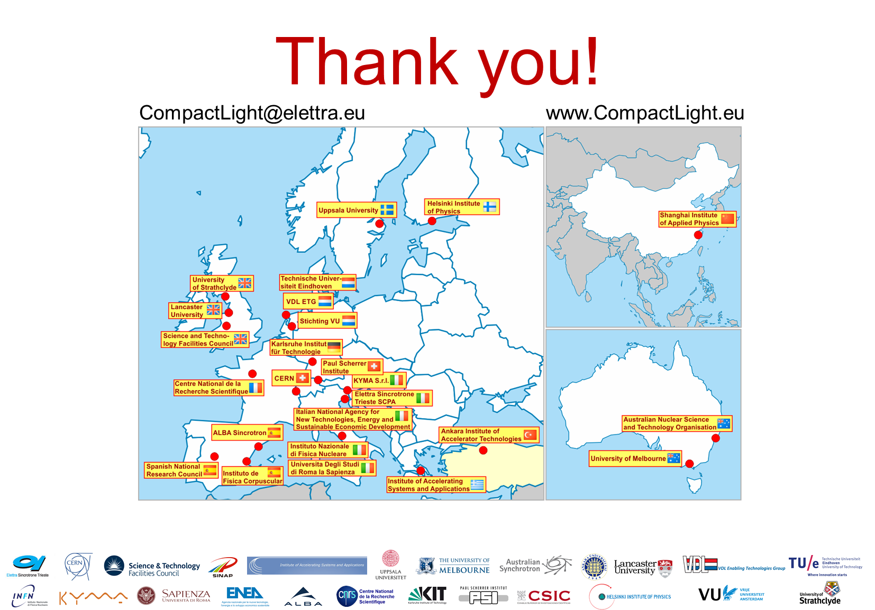

Slide 24
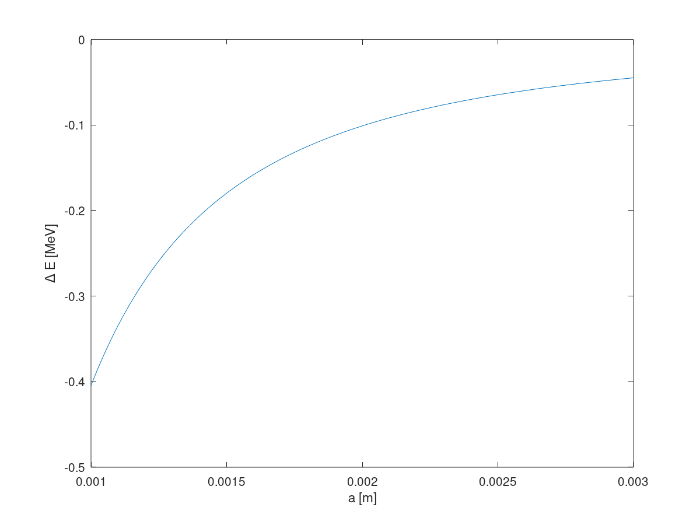
Energy loss in the Ka band
as a function of a
Average energy loss due to the Ka band. This is a static effect, so not particularly worrisome.

