Slide 1
ORNL/SNS Capabilities with Synergies to EIC
Sarah Cousineau, on behalf of the SNS project
EIC Workshop
October 7, 2020

Slide 2
OUTLINE
Intro to SNS
Non interceptive diagnostics for proton rings
  IPM
  Electron scanner
PIC simulation capability
Pulse power capability

Slide 3
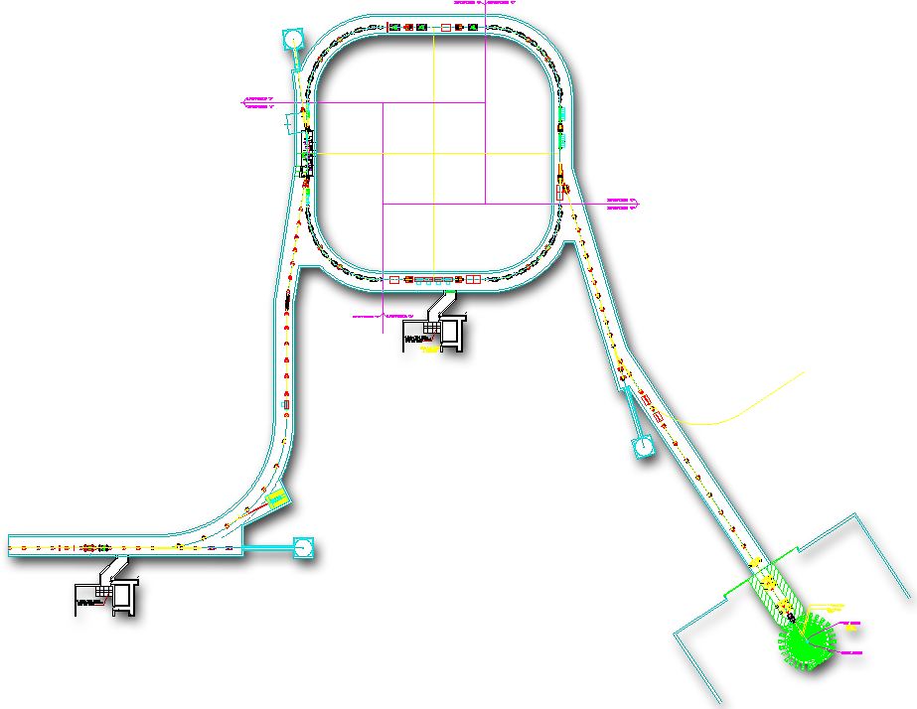
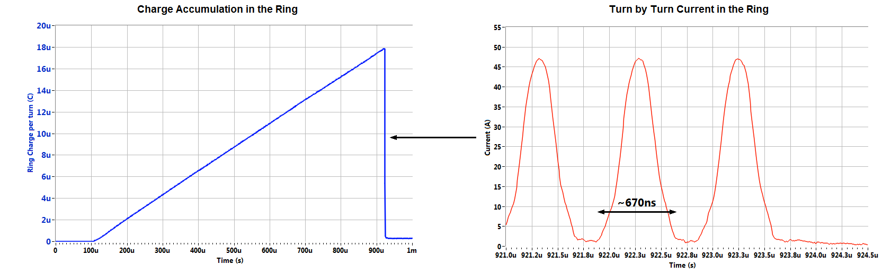
Spallation Neutron Source Accelerator
Accumulated in the Ring
Current
670 ns
945 ns
1ms
Current
Current
1 ms macro-pulse
16.6ms
The bunches in the SNS Accumulator are ~670 ns long!

Slide 4
Beam Instrumentation at SNS
SNS is a high intensity facility specializing in high dynamic range, high dimensionality, and non-interceptive diagnostics devices.
For the SNS 1.4 MW ring, evaluated two profile monitor candidates:
  Ionization Profile Monitor
  Electron Beam Scanner

Slide 5
SNS accumulator ring IPM system requirements for fully accumulated 1.5x10¹⁴ ppp beam
IPM CONCEPT DEVELOP9MENT AT SNS
.
Requirement | Value or Range
Measured Profile Plane | Transverse Horizontal and Vertical
Longitudinal Resolution | 1µs (Single Turn)
Time Resolution | 20 ns
System Bandwidth | 17.5 MHz
Beam Size Measurement Accuracy | ±10% of RMS Beam Size
Dynamic Range | 100
Maximum Beam Trajectory Deflection | 0.5 mrad
Maximum Allowed Magnet Multipole Component | < 1% at 12.78 cm Radius
Pressure | 10⁻⁹-10⁻⁸ mbar
~ 2-3mm

Slide 6
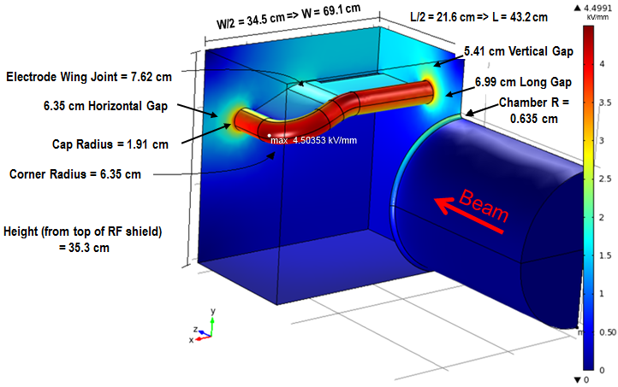
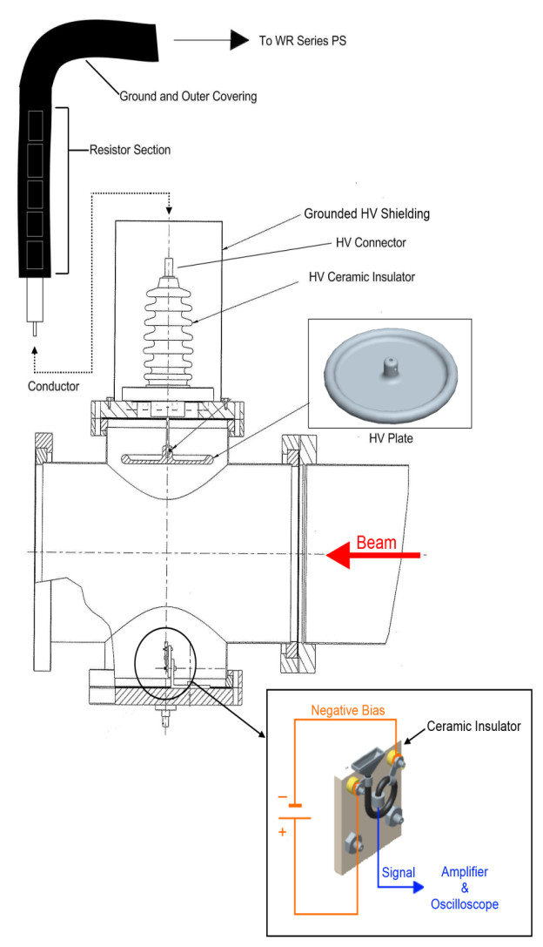
High Voltage Electrode Design
Detector test with beam set up
Quarter model of IPM chamber and electrode with electrostatic surface electric field simulation results for detailed optimized dimensions.

Slide 7
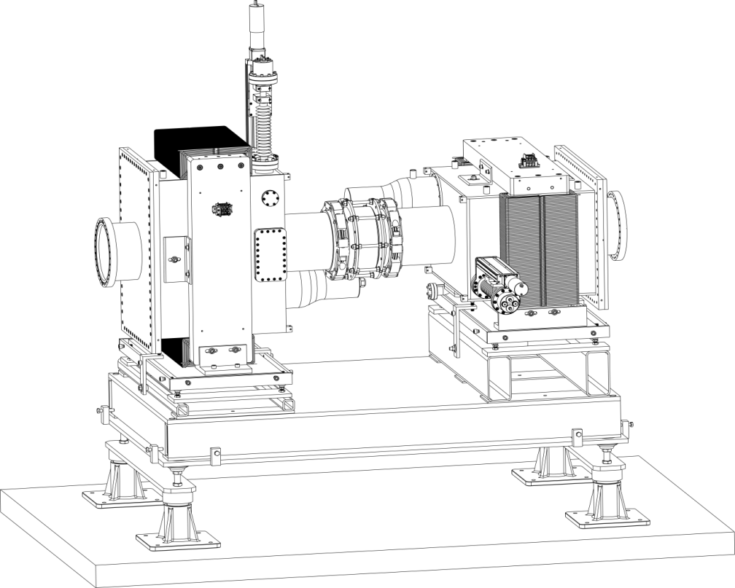
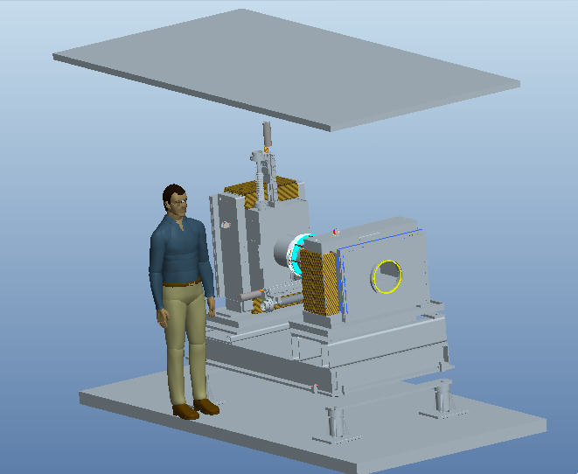
SNS IPM Mechanical Design
Large size => Large cost
For SNS requirements:
High Cost
No confidence in understanding of IPM operation in electron collection regime
Ion collection regime does not satisfy temporal resolution requirement
But could be reconsidered for EIC parameters

Slide 8
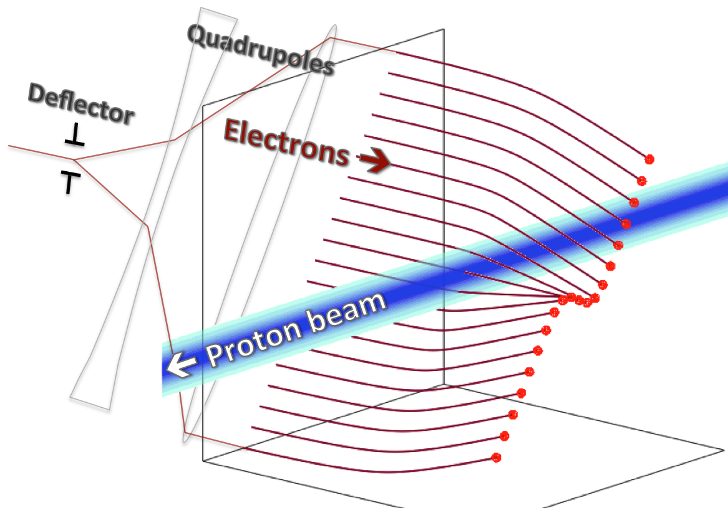
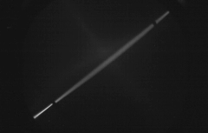
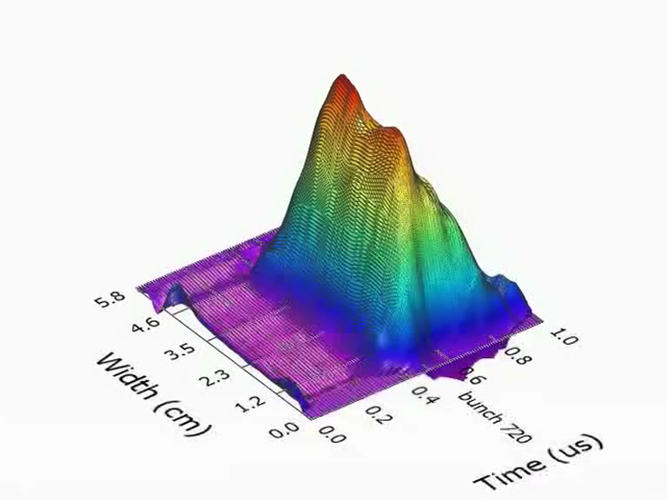
Electron Beam Scanner Concept
dy
dx
3D plot of Turn 720 at ~11uC
Non-intercepting transverse profile measurements at high intensity
20 ns scan during ~640 ns long proton bunch (scan << bunch)

Slide 9
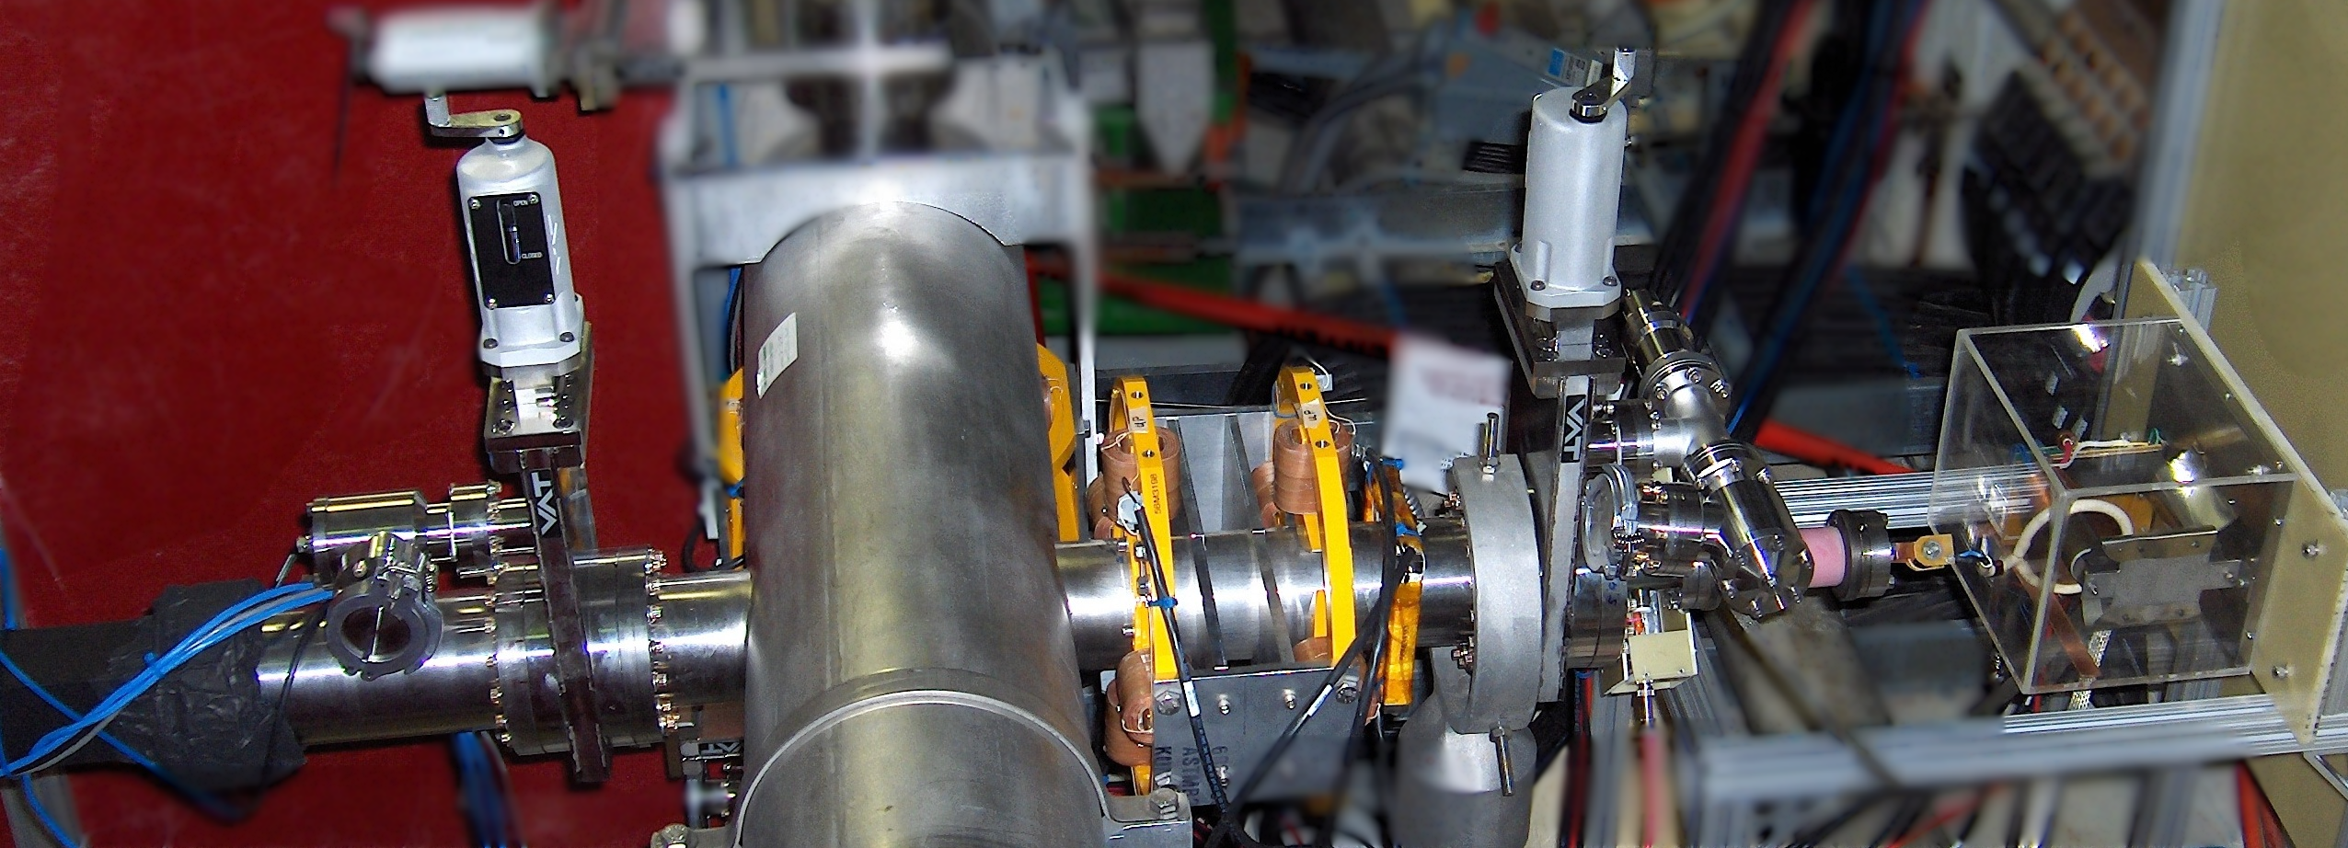
Electron Beam Scanner Configuration
Vacuum Valve
Vacuum Valve
Quadrupoles
HV Transformer
Electron Gun
Screen
Ring Pipe
Dipoles
Deflector

Slide 10
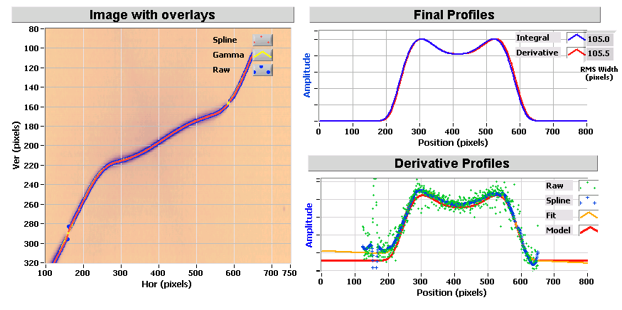
Electron Beam Scanner Data Reconstruction
Single 650 ns turn of low intensity beam.
Full accumulation cycle showing turns 50,100, 200, 300, 400, 500, 600

Slide 11
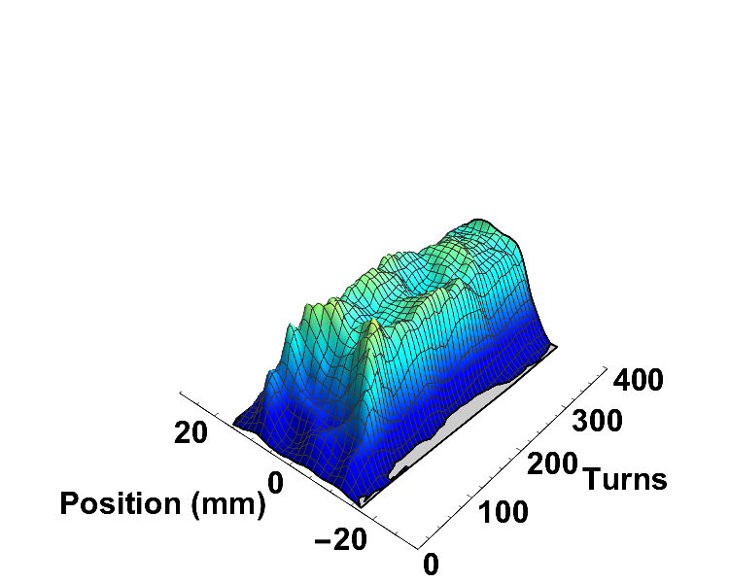
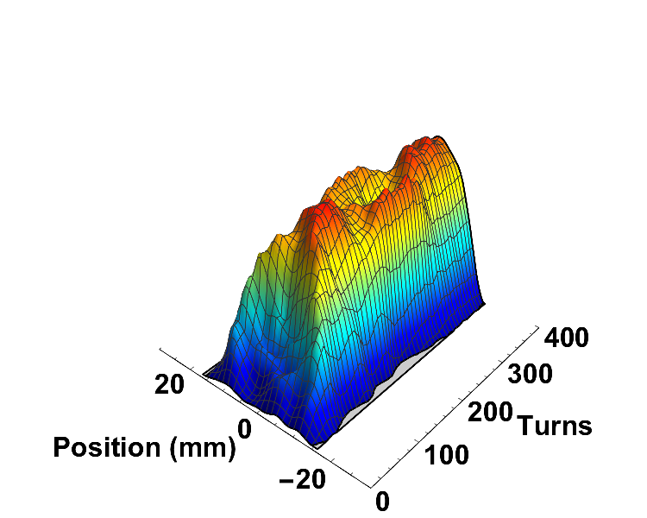
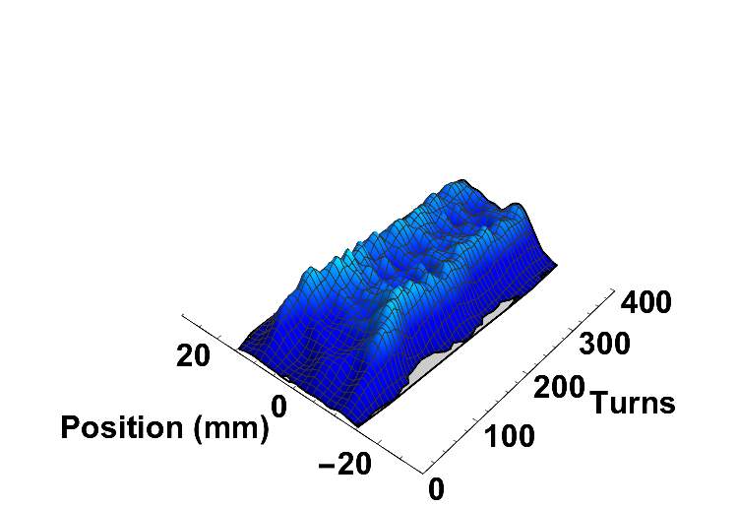
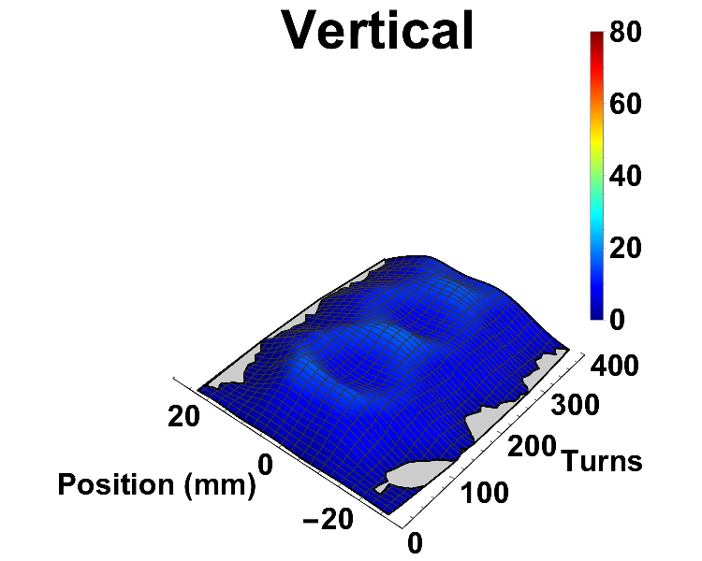
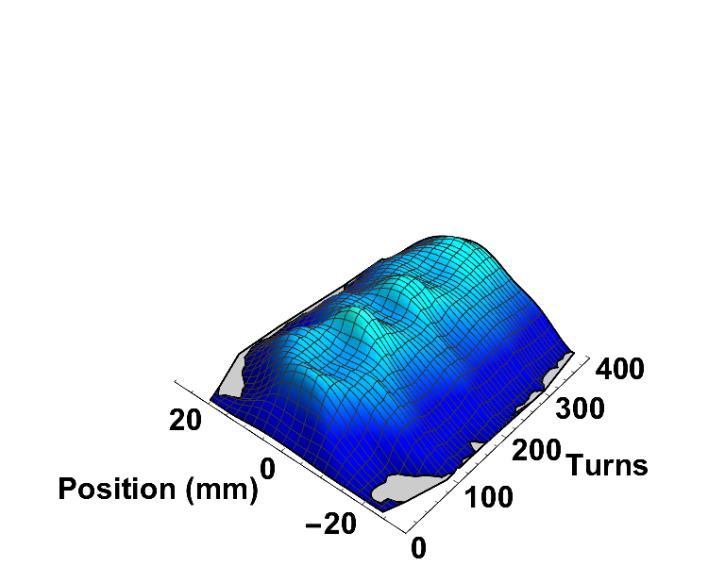
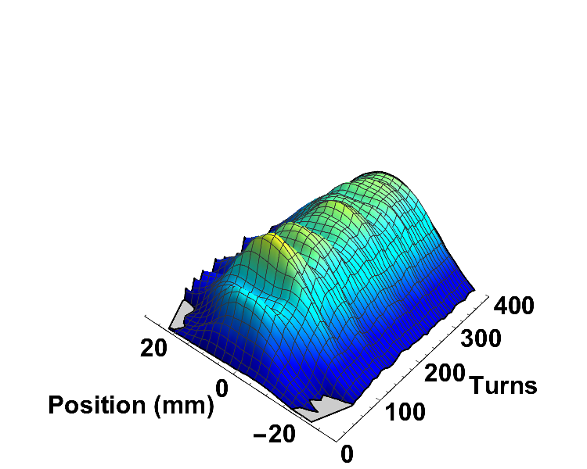
Example of Electron Scanner Beam Accumulation Studies
Full Intensity
(7.5e12ppp)
Low Intensity
(2.5e12ppp)
Mid Intensity
(4.4e12ppp)
Horizontal
Vertical

Slide 12
Code Development and Simulation for Rings: pyORBIT

Slide 13
The pyORBIT Code
PyORBIT is descendant of ORBIT code, originally a ring and transport line PIC Code
PyORBIT & ORBIT have the two-language structure: driving scripting shell and C++ underneath
ORBIT’s Super Code shell was replaced by Python
Recent flavor of PyORBIT was started in 2006. Now includes linac capability
Open source: means everybody can do anything, and it is open for future collaborators
Modifiable user script run by custom
built Python2 interpreter with MPI support
Dynamic Loading
Module 1
Module 2
Module 3
Optional
Module 4
Input File With
Structure
.
.
.
Output File With Results

Slide 14
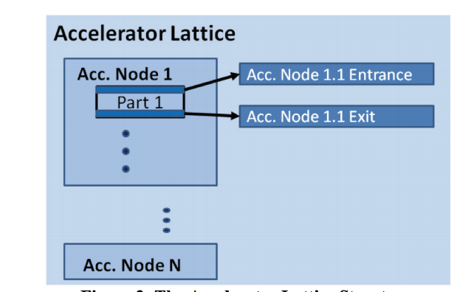
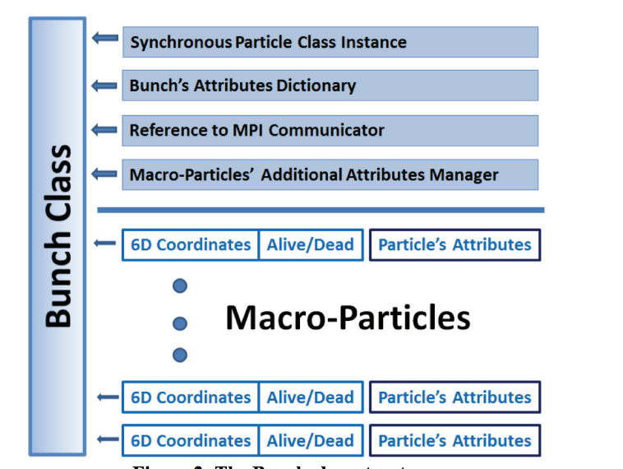
PyORBIT Simulation Code Used for Ring and Linac
Open access parallel PIC simulator
  Variable mass and charge
  C++ core, python scripting wrapper
  Library of modules for building custom simulation scripts
  Written by physicist for physicists
  Capabilities:
    Parses lattices from MAD, Trace
    Acceleration in linac or rings
    Space charge: 1D, 2D, 2.5D, 3D
    Symplectic tracking
    Injection and painting
    Scattering and collimation
    Apertures
    Impedances
    …
https://doi.org/10.1016/j.procs.2015.05.312

Slide 15
Open Source Code has Global User Community
ORNL
GSI
CERN
KEK
JPARC
LANL
CSNS
ISIS
ESS
Fermilab
Different levels of developers
We provide bug support
We provide support to get users started
Users develop their own new tools
We have many unknown users… Git doesn’t track.

Slide 16
Pulsed Magnet Capability

Slide 17





SNS Pulsed Power Expertise >140 Years Combined Experience
David Anderson – Designed PFNs, Modulators , High voltage/High Speed Switching, Solid State Switches, Linear Induction accelerators, Marx generators, pulse-forming lines, kicker systems
Chris Pappas – Kicker system design from conception through installation and operations using PFL/thyratron or solid-state switching technologies for the power modulators, and picture frame, multipole, transmission line and strip line magnets.
Vladimir Peplov – Developed High voltage/High Speed MOSFET Switching, modulators, PFNs
Yugang Tan – PFNs, Modulators, kicker systems, Power Supplies
Robert Saethre - PFNs, Modulators, Power Supplies, High voltage/High Speed Switching, Solid State Switches, Kicker Systems, Full/Half-sine Wave capacitor discharge pulse generators, Inductive adder pulse generators, Resonant Charging, Magnetic Switches
5 electronics technicians with extensive experience with kickers, choppers, modulators, power supplies, radar systems

Slide 18
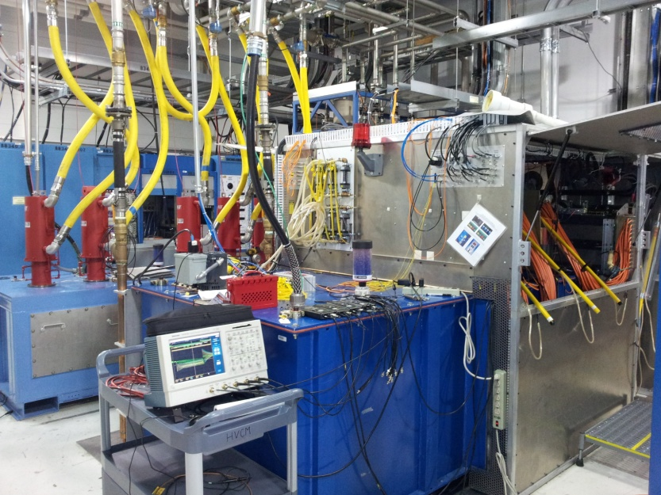
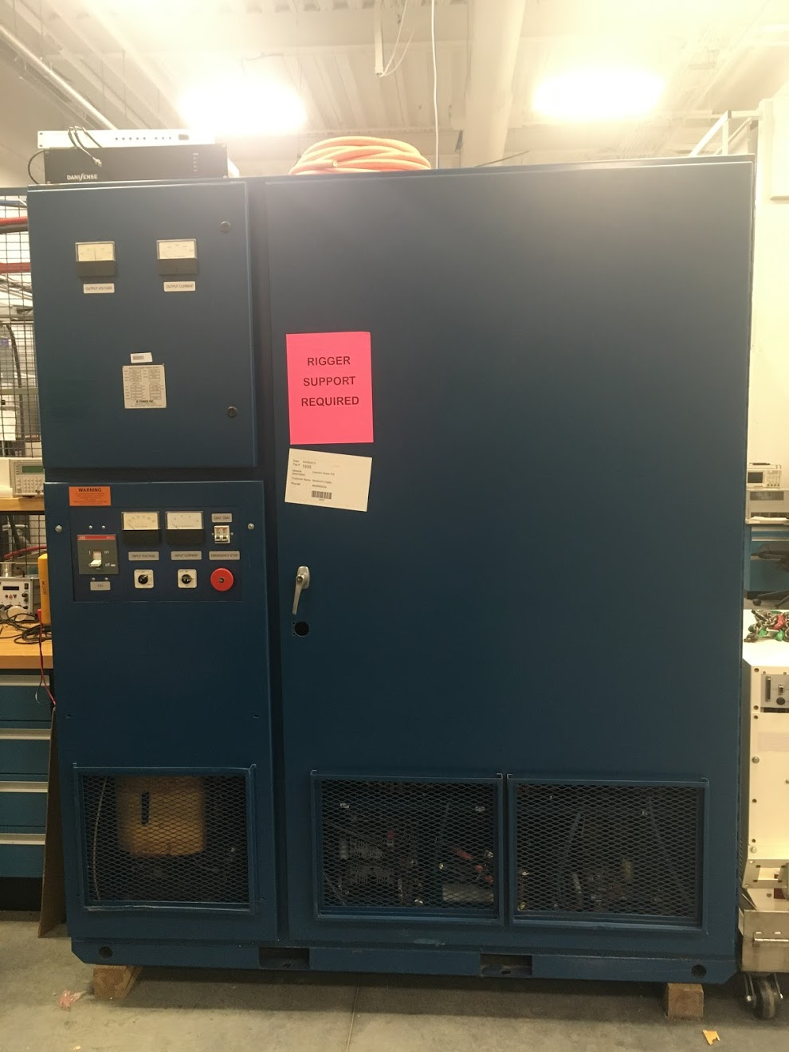
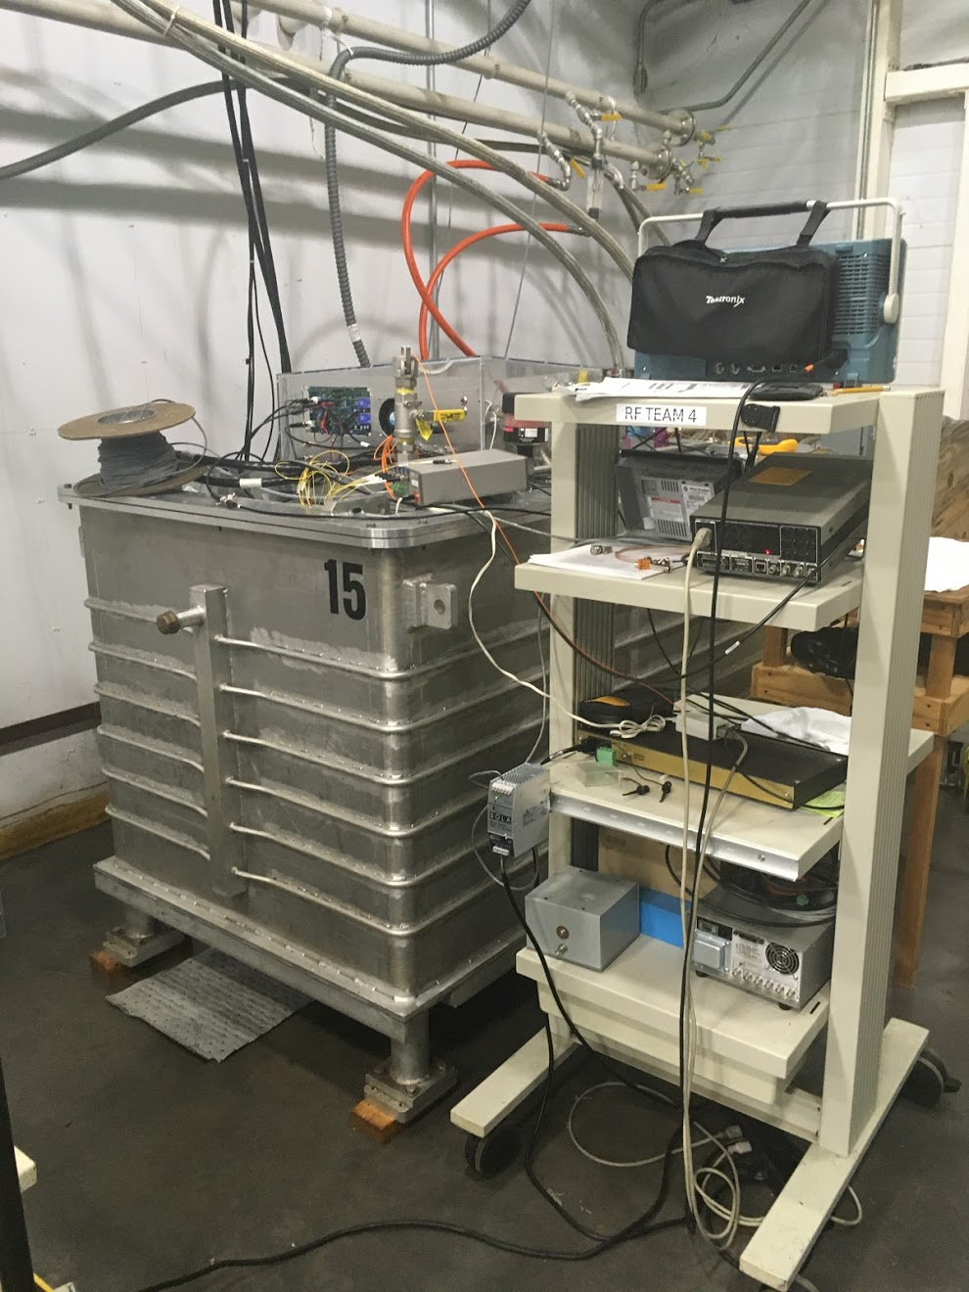
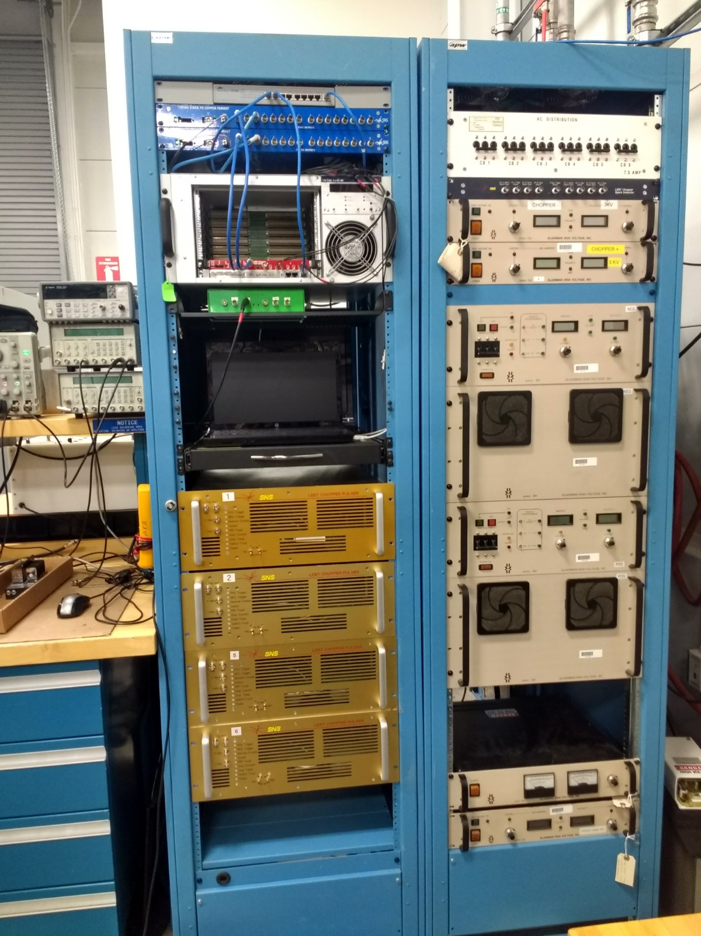
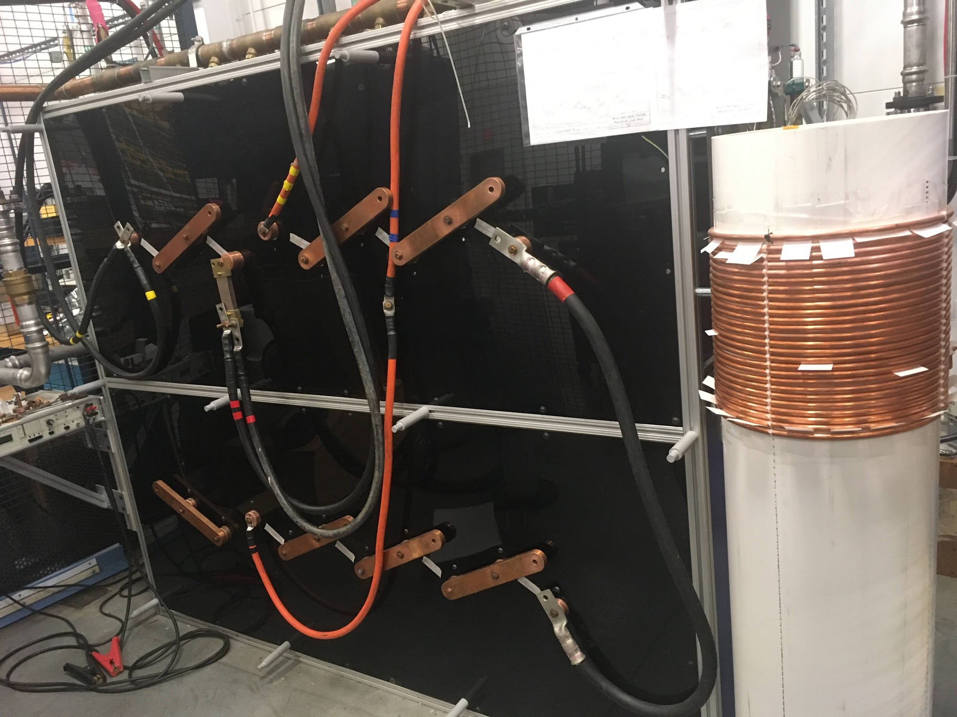
Current Test Stand Capabilities
3 full long-pulse modulator test stands
  Up to 135 kV, 120 A, 1.5 ms, 60 Hz
  Up to 1 MW
  DC power supply up to 2600 V, 450 A
  AC 2100 V RMS to 1.5 MVA
High Speed Beam Chopper test stand
  +/- 5 kV DC PS
  Timing and control system
  Test loads
DC and Inductive load Power supply test stand
  480V three-phase power available
  Water-cooled load (19-50 mΩ, up to 30 kW)

Slide 19
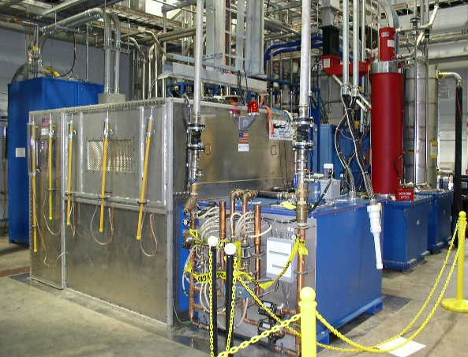
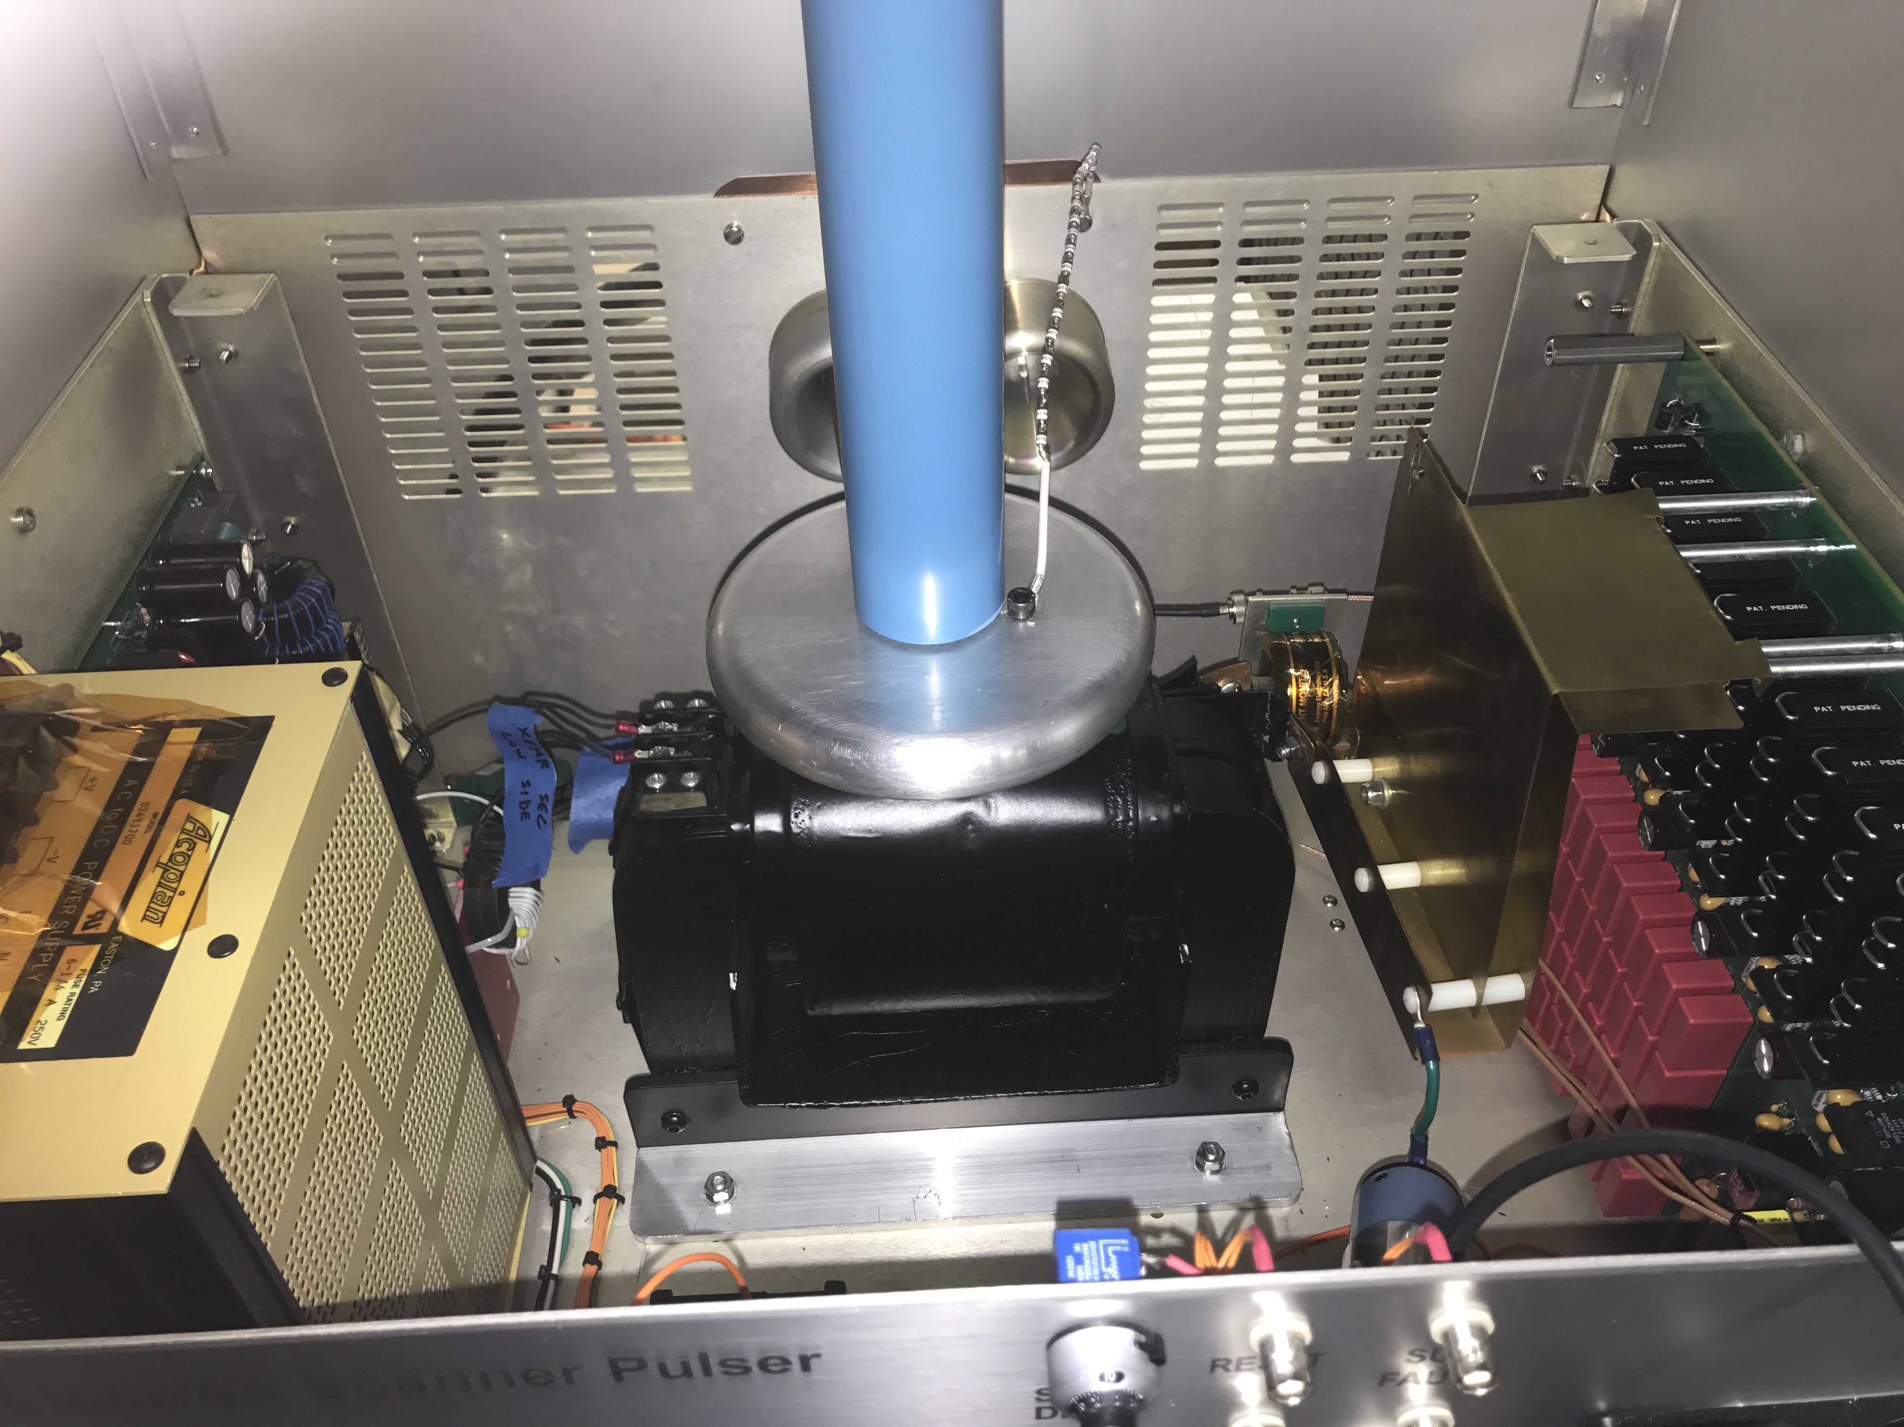
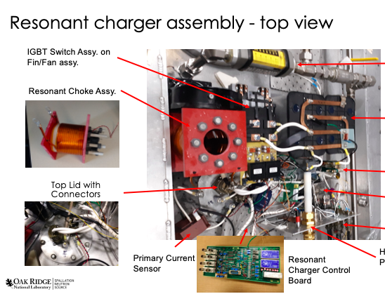
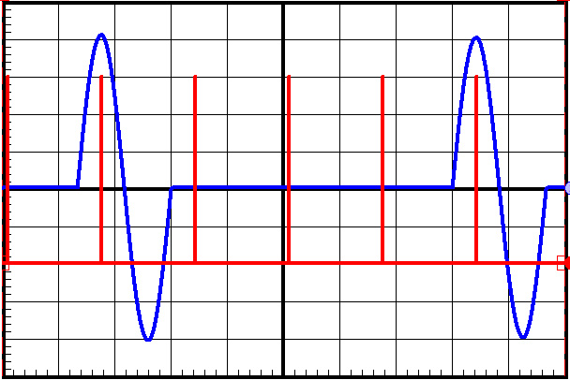
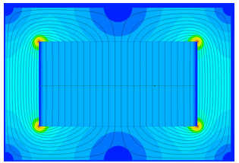
Examples of Pulsed Power Design by Team Members
HVCM – ≤135 kV, 1 MW average, 11 MW peak power, >1 ms pulse width
Extraction Kicker – PFN to 45 kV, high voltage SS Switches, Magnetic Switching, 1 μs pulse width
Injection Kicker – High current 1600A, High Average power 10s-100s kW, High Precision 0.1%, Arbitrary waveform
E-Gun Pulser for Beam profile scanner – High Voltage 100 kV, Fast Risetime 200 ns,
E-Scanner ramp generator – High Voltage 2 kV, Fast Linear Ramp time 20 ns
RTST Kicker – Full-sine wave generator, 15 Hz, 500-600A peak current, 0.1% repeatability

Slide 20
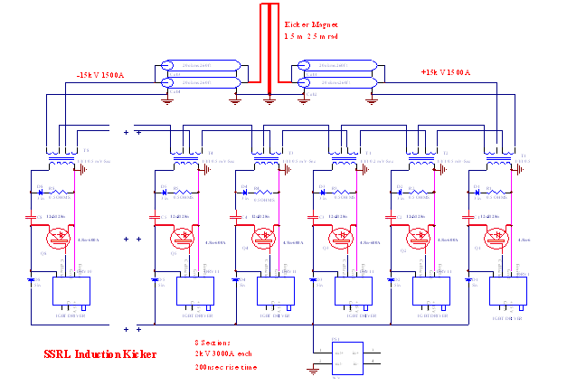
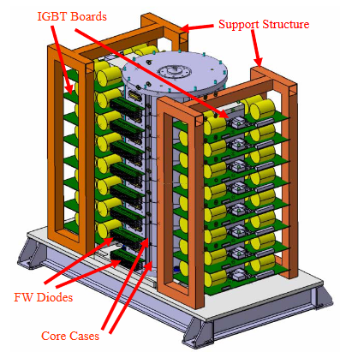
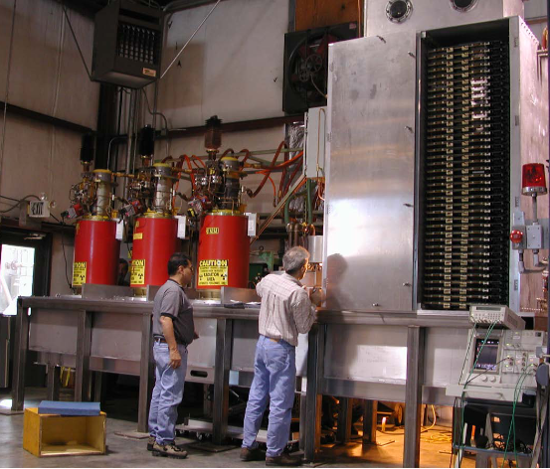
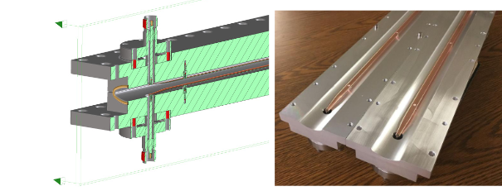
Examples of Pulsed Power Design by Team Members cont.
LEBT/MEBT Beam Choppers – 3 kV, 8-50 ns risetime, < 1μs pulse width, bipolar, 1MHz burst-mode operation, 5 ns timing accuracy
LEB extraction, MEB injection, and collider ring abort kickers at SSCL.
g-2, AGS extraction, RHIC injection and RHIC abort kickers at BNL.
PEPII and SPEARIII injection, PEPII abort, and damping ring kickers for SLAC and NLC.
Booster ring extraction and storage ring injection kickers for ALS, beam spreaders for NGLS and swap-out and accumulator ring kickers for ALS-U at LBNL.

Slide 21
What are the EIC system requirements for the Rapid Cycling Synchrotron (RCS) and Storage Ring Bumps and Kickers?
Pulse Generators for RCS Injection/Extraction and SR Injection Pulsed Systems
  Half-sine wave capacitor discharge pulse generators
  Pulse forming network pulse generators
  Marx generators
  Inductive adder pulse generators
  Stability and regulation
    Kicker 1% to 2%
    Bumps and septa 0.25%
  Voltage 100s of volt to a few kilovolts
Nanosecond Fast Kicker Systems
  fast kicker 8.9 ns bunch spacing, ns rise/fall times
  Single bunch nanosecond extraction at 1-2 Hz
  Sub-ns jitter
  parallel-plate strip-line push-pull structure
  500A into a 50Ω load
  Higher current version of SNS MEBT Chopper
From: “PULSED SYSTEMS FOR eRHIC BEAM INJECTION AND EXTRACTION*”
W. Zhang, IPAC18
Vancouver, British Columbia, Canada
April 29 - May 4, 2018
BNL-203262-2018-COPA

Slide 22
Path forward for SNS Collaboration on Fast Kicker R&D
SNS has the expertise to assist in DC and Pulsed Power system design
The fast kicker systems are pushing the state-of-art technology but theoretically feasible with R&D
A development program could take a year or two and require multiple iterations
Need to gather the requirements for EIC

Slide 23
Summary
We have a strong program in diagnostics, pulsed magnets, and code development.
We are interested in collaborating with the EIC in any area where we can be helpful.

