Slide 1



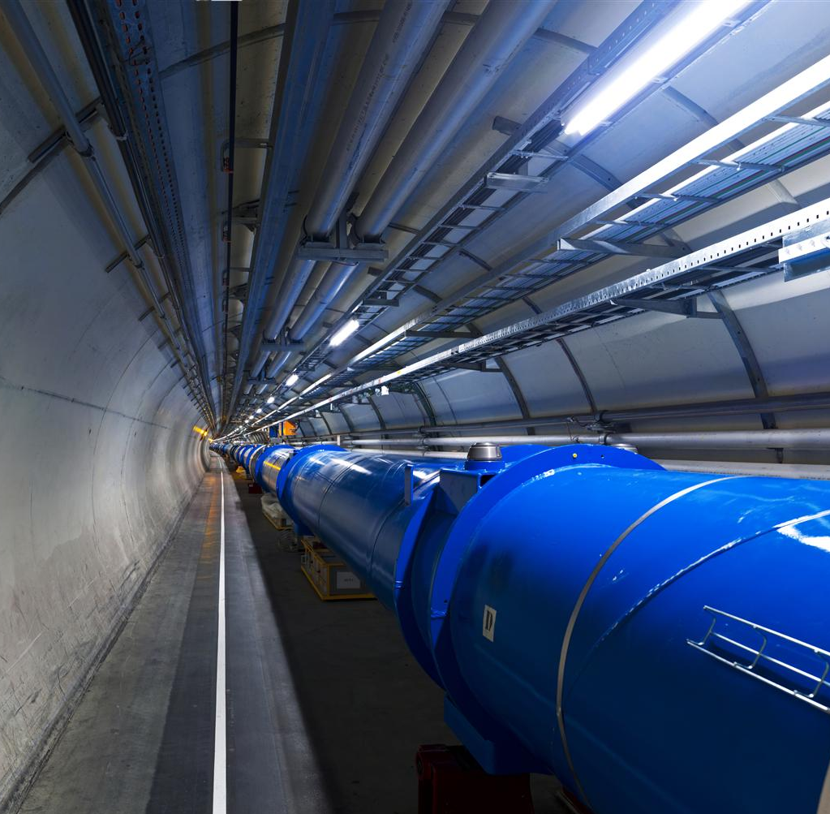

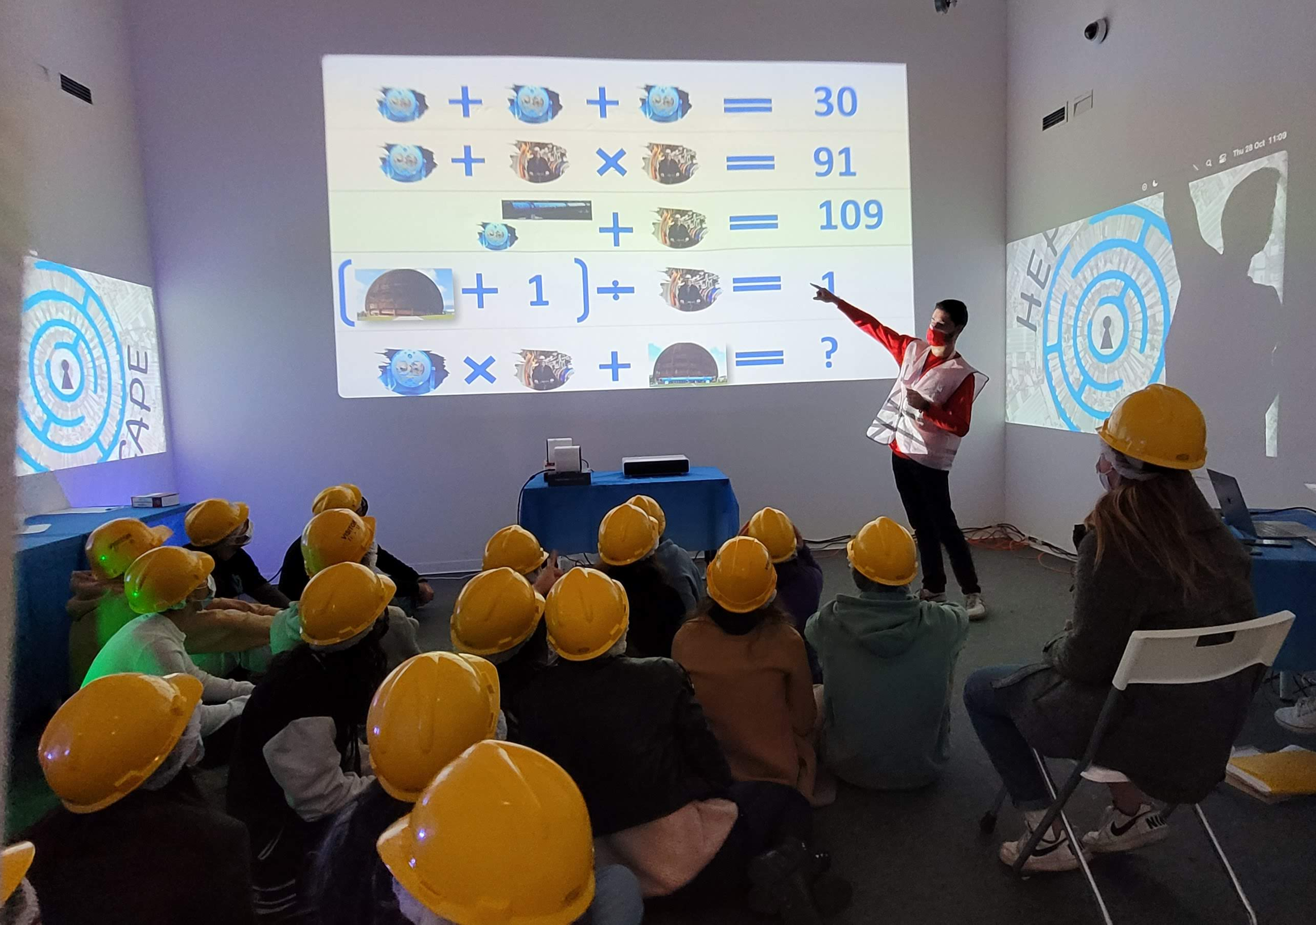
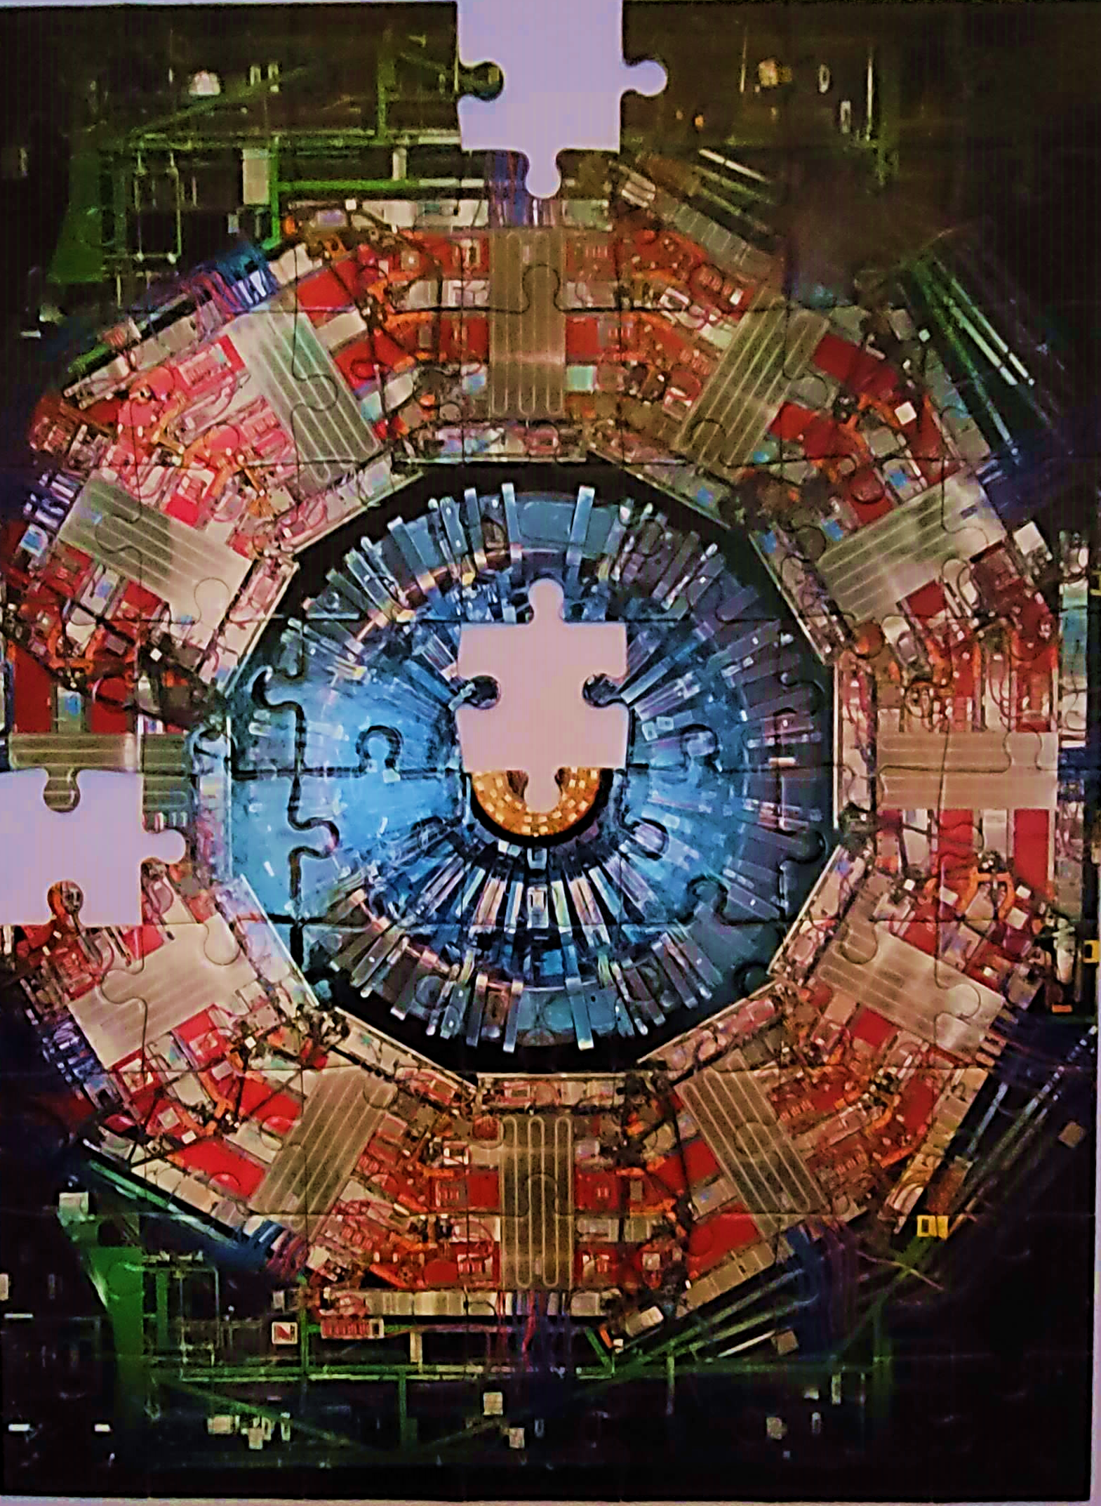
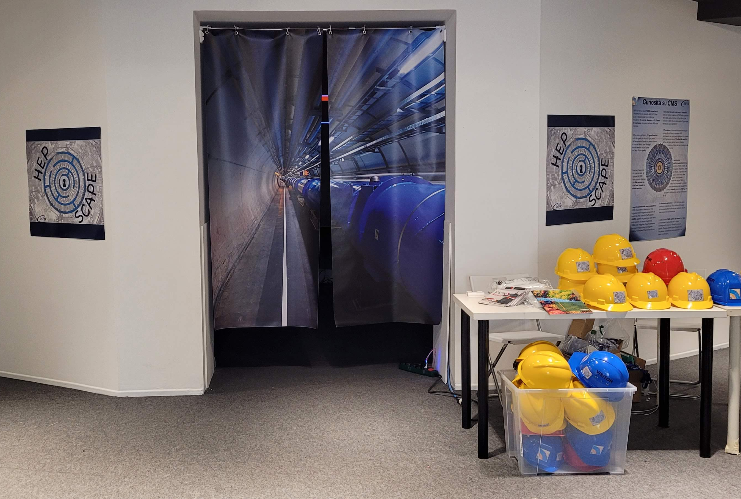
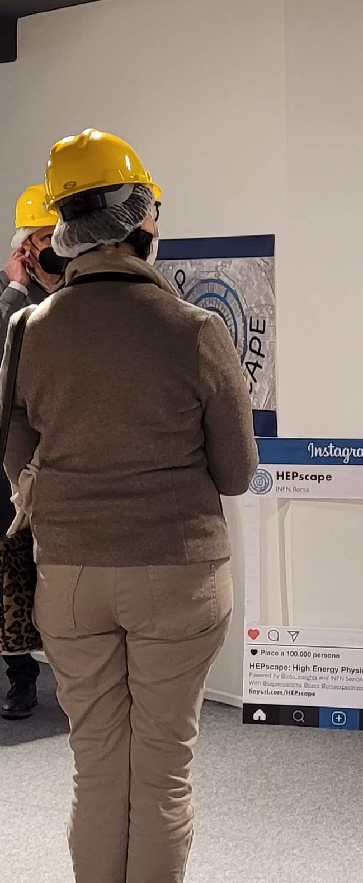
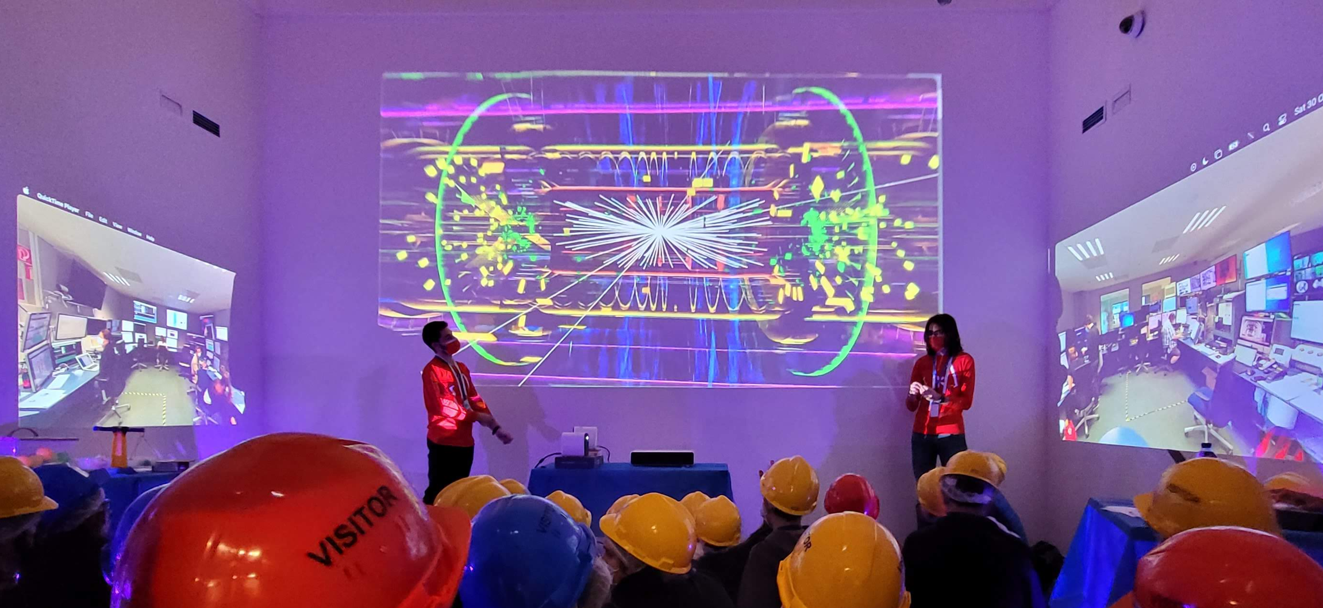

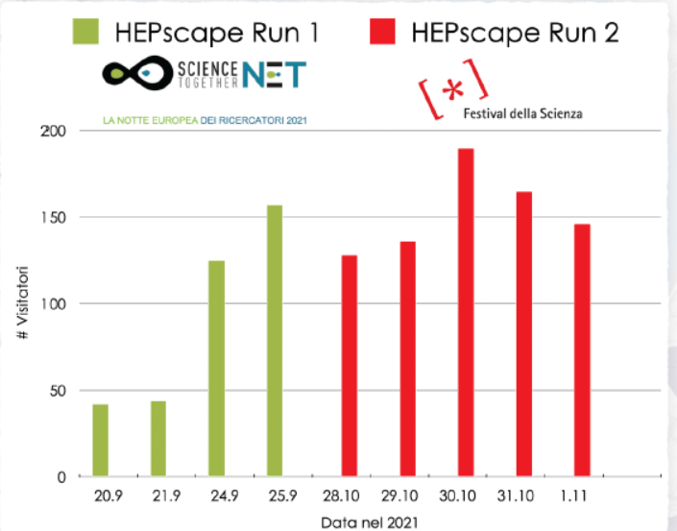
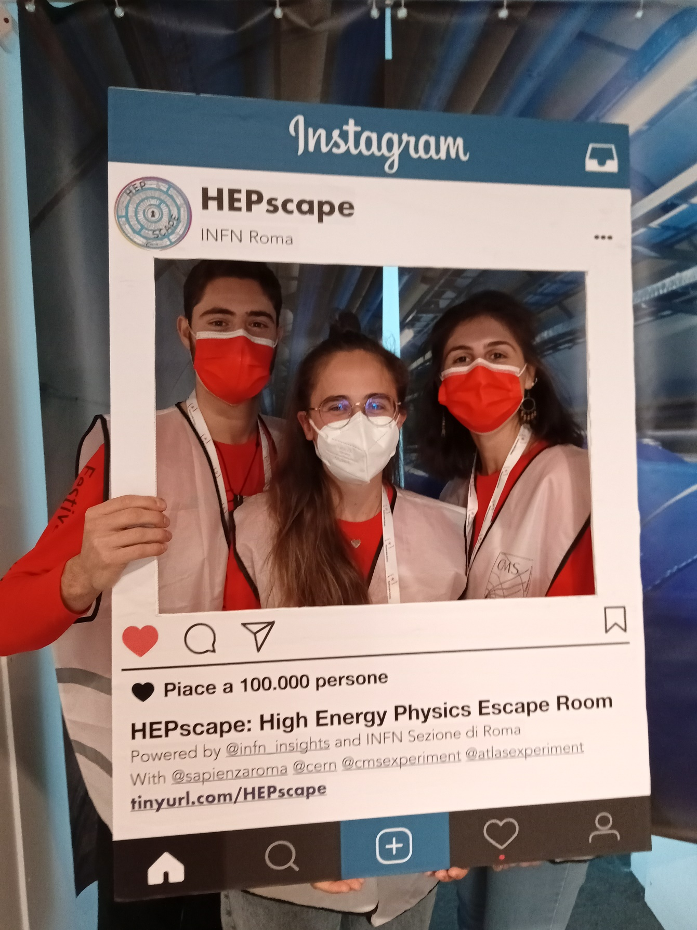



HEPscape: an escape room about high energy physics
Francesca Cavallari
(Istituto Nazionale di Fisica Nucleare, Rome, Italy)
(on behalf of the CMS Collaboration)
Escape rooms
Escape rooms are more and more popular nowadays. They have the challenges of a treasure hunt and represent a pleasant way to encourage team building. In addition they can be fun way to discover a new subject, a key point that can be exploited for science outreach.
HEPscape
In 2021 a team from INFN has built an escape room about high energy physics, called HEPscape.
It was presented as an attraction at the researchers’ night in Rome and at the Science festival in Genova.
https://sites.google.com/view/hepscape/home
Entrance
The visitors are given a helmet and they have the impression of visiting the Large Hadron Collider at CERN and of being in one of the experimental control rooms.
The games
Through some clues, that are hidden in the room, the visitors discover the working principles of particle accelerators and high energy physics experiments.
The games can be tuned to the age group, resulting in a fun experience for all.
Number of visitors
Researchers’ night Rome
Science festival Genova
Instagram photo booth
@hepscape
Implementation
>1000 visitors !!!
HEPscape is made of portable equipment that can be transported and assembled in less than two hours. This allows to use it in science fairs and exhibitions. It can also be installed in a gazebo. It can be brought on demand to high schools in remote provinces.
It makes heavy use of projectors and colourful lighting.
The game is guided by a moderator.
The material and the format of the games are simple and it is possible to adapt it to the age group and translate the games in other languages.
Satisfaction test
4,4
school groups
mixed groups
total
age
age
age
view the poster and the video here
Lepton Photon 2022, Manchester, UK

