Slide 2
Descriptive part: layout, machine specificities, LIU changes, different beams
LIU-SPS operational readiness Analysis (ORA) 26+27 October 2020
B. Goddard for LIU-SPS project team, with input from
R. Alemany, H. Bartosik, V. Kain, K. Li, G. Papotti, E. Shaposhnikova

Slide 3
What does the SPS have to provide?
Beam to LHC (protons, ions)
FT beam to NA (protons, ions)
Beam to HiRadMat (protons, theoretical ions)
Beam to AWAKE (protons, possibly ions)
Beams for in-ring “test facilities” with or without COAST
  UA9
  Crab Cavities
  COLDEX
Beams for MD studies
  Protons, ions, partially stripped ions
Huge range of particle types, bunches, cycles, ….

Slide 4
Baseline proton beam parameters
LIU target (protons) | N (x 10¹¹p/b) | ε (μm) | Bunch length (ns) | Number of bunches
SPS injection | 2.6 | 1.9 | 3 | 72
SPS extraction | 2.3 | 2.1 | 1.65 | 4 x 72
(*) Beam parameters at injection are given after RF capture
Achieved (protons) | N (x 10¹¹p/b) | ε (μm) | Bunch length (ns) | Number of bunches
SPS injection | 2.1 | 4 | 3 | 72
SPS extraction | 1.3 | 2.5 | 1.6 | 4 x 72
(**) Beam parameters at injection and extraction not simultaneously achieved
LHC Injectors Upgrade (LIU) Project Description, LIU-PM-RPT-0015
LIU PROTON BEAM PARAMETERS, LIU-PM-NOT-0011

Slide 5
SPS proton beam parameters before LS2
Beam performance achieved at the SPS flat top (double RF system) for PS batches with different number of bunches
number of bunches per injection | bunch intensity at 450 GeV/c [10¹¹] | transverse emittance [μm] | bunch length [ns] | total number of bunches at SPS extraction | main limitation
1 | 3.7 | 2.5 | 2.7 | 1 | space charge + instabilities
12 | 2.0 | 4.0 | 1.6 | 4 x 12 | long. instability
48 | 1.4 | 2.2 | 1.5 | 4 x 48 | beam loading
72 | 1.3 | 2.5 | 1.6 | 4 x 72 | beam loading
The LIU intensity (72 x 2.6x10¹¹) achieved in the PS in 2018 (Ꜫ_{t} ~ 5.0 μm) → available for SPS

Slide 6
Baseline Pb ion beam parameters
LIU target (Pb ions) | N (x 10⁸ ions/b) | ε (μm) | Bunch spacing (ns) | Number of bunches
SPS injection | 3.5 | 1.0 | 3x 100 + 150 | 56
SPS extraction | 2.0 | 1.5 | 7x 50 + 100 | 56
(*) Assuming 14 injections from PS and slip stacking in the SPS
Achieved (Pb ions 2016) | N (x 10⁸ ions/b) | ε (μm) | Bunch spacing (ns) | Number of bunches
SPS injection | 3.5 | 1.0 | 3x 100 + 150 | 28
SPS extraction | 2.2 | 1.5 | 3x 100 + 150 | 28
(**) In 2016 there were only 7 injections from the PS
LHC Injectors Upgrade (LIU) Project Description, LIU-PM-RPT-0015
LIU ION BEAM PARAMETERS, EDMS 1581381

Slide 7
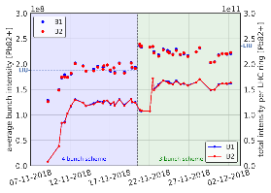
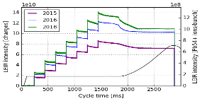
SPS ion beam parameters before LS2
SPS extracted beam parameters from LHC luminosity production fills in 2018
Pre-LS2 performance needs to be maintained with addition of Slip-Stacking to reduce bunch spacing in the SPS and double number of bunches in the LHC
Beam (2018) | N (10⁸ ions/b) | ε (μm) | # of bunches
4b–100 ns | 2.0 | 1.5 | 648
3b–75 ns | 2.3 | 1.5 | 733
LIU target
2018
LEIR
2016
2015
4b-100 ns
3b-75 ns

Slide 8
Direct LHC proton performance limitations
200 MHz RF power for beam acceleration
800 MHz RF power for beam stabilisation
Beam Losses at injection (transfer, capture, acceleration)
Longitudinal beam stability
Transverse beam stability (TMCI and horizontal coupled-bunch)
Beam dump robustness and power
Transfer line collimator performance
Electron cloud
Kicker heating
ZS sparking

Slide 9
Special challenges for SPS
Many key system upgrades not tested with beam before LS2, and there are no fall back solutions:
    BPMs needs to work from day 1
    Beam dump system needed from day 1
    Full RF system needs to work very early in commissioning
    New LLRF without keeping old one (as done in PS) (major risk)
SPS beams are all very different:
  Making things work for one type is no guarantee for the others (ions versus protons, LHC protons versus FT protons, COAST,…)
  Many commissioning steps need to be done again
Interlocking is even more complex:
  Few experts and intricate validation needed
In 2021 same number of SPS operators on shift will have to operate one additional machine (LHC) besides SPS and LEIR

Slide 10
Upgrade scope (i/iii)
WP / Equipment / Systems | Scope | Motivation
RF power (25.1 MCHF) | Rearrangement into 4x3+2x4 cavities, two new 2 MW power plants, new couplers, new TX, HOM reduction | Raise acceleration limit from 1.3e11 to 2.4e11 Keep beam longitudinally stable
RF 800 MHz (0.1 MCHF) | Double 800 MHz power, make 2nd 800 MHz Landau cavity operational, upgrade 800MHz LL | Up to 0.2 V ratio with 800MHz Improve longitudinal stability
200 MHz LL (1.9 MCHF) | New digital LL control for existing and new amplifiers | Improve longitudinal impedance Improve RF control
Beam dump (13.4 MCHF) | New system in LSS5 (kickers, dump, shielding, BI), removal of LSS1 system | Allow dumping of full LIU intensity Improve dumped power limit
Transfer line collimators (6.9 MCHF) | New 2 m long TCDIL, new locations in TLs, modified optics and MQ powering | Keep protection level with LIU beam
Beam instrumentation (7.2 MCHF) | New Orbit system, new wirescanners, upgraded BSRT, BLM, BGI, BCT | Improve orbit measurement Improve emittance measurement Improve intensity measurement

Slide 11
Upgrade scope (ii/iii)
WP / Equipment / Systems | Scope | Motivation
vac impedance reduction, aC coating, (5.5 MCHF) | Impedance reduction and aC coating of 100 QF SSS, aC coating of 1 sextant of MBB dipoles | Improve longitudinal stability Reduce beam losses/emittance growth
Vacuum system (2.6 MCHF) | Improve LSS and arc sectorisation | Reduce intervention time Reduce recovery time after venting Protect aC coated sections
QD-MBB aperture (+0.2 MCHF) | Fix “design flaw” in QD-MBB transition in 25 key locations (~90 total) | Improve aperture with Q20 optics for off-momentum particles
Beam transfer systems (3.2 MCHF) | Kicker impedance reduction, new TPSG4 & 6 protection devices, upgraded extraction septa | Improve transverse stability Improve longitudinal stability Protect with LIU beam Reduce ZS sparking with LIU beam Prototype low-impedance MKP
Extraction kickers (0.3 MCHF) | Impedance reduction (serigraphy, reduce from 8 to 7 MKE) | Improve longitudinal stability Reduce kicker heating
Extraction septa (0.1 MCHF) | Improve power converter stability | Reduce LHC setting-up time
Injection kicker (0.1 MCHF) | Reduce rise time to 125 ns for ions | Improve #bunches for ions

Slide 12
Upgrade scope (iii/iii)
WP / Equipment / Systems | Scope | Motivation
Scraper (0.3 MCHF) | Construct spare | Reduce risk of long down time Improve design
Transverse damper (0.9 MCHF) | New pickups, LL and digital control | Improve damper performance Standardise sub-systems
Wideband feedback (0.8 MCHF) | Prototype vertical kicker plus electronics, proof of principle | If needed to stability vertical ECI
Optics (0 MCHF) | Low-gamma-transition Q20 optics | Stabilise TMCI at LIU intensity
Magnet Interlocks (0.5 MCHF) | Replace relays with standard safety PLC based solution | Improve availability, standardise

Slide 13
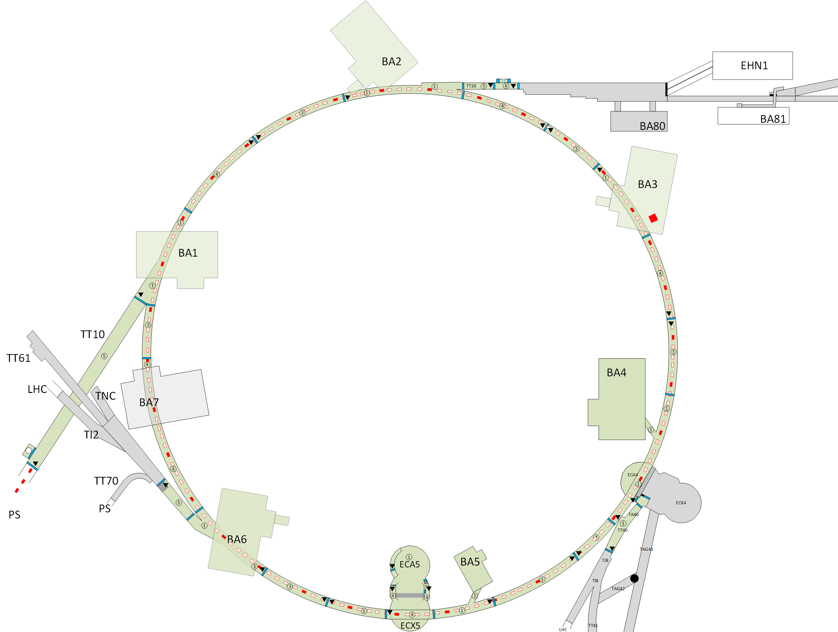
LIU-SPS upgrades: chronological
LS1/EYETS 2016-2017
New Vacuum sectorization
Optical fibres for the orbit systems
800 MHz
2 New fast BLMs (Diamond)
New Fast BCT
(LSS5)
Renovation of the over head crane (ECX5)
Civil engineering for new beam dump
aC coating (9 QFs, 2 cells MBB,10% drifts)
and impedance reduction

Slide 14
LIU-SPS activities
YETS 2017-2018
New RF power feeder line
New 1 GHz slotline kicker
Installation kicker platform
Installation of kicker transmission lines
Dump platform reinforcement
aC coating (8 QFs, 1 cell MBB, drifts)
and impedance reduction

Slide 15
LIU-SPS activities
LS2
ZS improvement
(LSS2)
200 MHz RF power upgrade
(LSS3, BA3, BAF3)
Reconfiguration of LSS1 (LSS1, BA1)
New Fast BCT
(LSS3)
aC coating (QF, drifts), QD-MBB aperture, and impedance reduction
Extraction protection devices:
Replacement of TPSC4 (LSS4)
Replacement of TPSG6 (LSS6)
New collimators TCDI (TI2, TI8)
Replacement MOPOS electronics
(Sextants 1,2,3,4,5,6)
New Beam Dump
Reconfiguration of LSS5
New Wire Scanners
(LSS4, LSS5)
New BGI (LSS5)

Slide 16
Mandatory CONSolidation activities for LIU-SPS
Equipment / Systems | Description | Risks if not done | Due date
Electrical cables | Decabling of obsolete cables | No space in cable trays for new cables | EYETS, LS2
Electrical distribution | 18 kV / 3.5 kV / 400 V distribution consolidation | Essential for RF 200 MHz, LSS5 dump. | LS2
Water cooling | SPS cooling loop upgrade linked to SM18 | Essential for RF 200 MHz system | LS2
BLM upgrade | BLM electronics | Increased losses, down-time, performance | LS3

Slide 17
Specific risks (many others…)
Equipment / System | Risks | Risk Level class | Mitigation
Key system upgrades not tested with beam, no fall back | Unexpected problems | High (performance, schedule, availability) | Integration into the control system by the operations team and dry runs as early as possible
PS to SPS transfer | High beam loss compromises performance reach | Medium (performance) | -use lower long emittance from PS -improved PS bunch rotation -80 MHz capture system in SPS -additional RF voltage in PS for bunch shortening -collimation system in SPS
RF 200 MHz | New SSPA system to operate (e.g. new RF power interlocks) | Low (availability) | -early testing, spares, expert availability
Ring impedance | Limited performance due to longitudinal instabilities | Medium (performance) | -replace VV with shielded/damped versions -further impedance studies and reduction (LSS, MKP)
Slip stacking (ions) | Beam stability, complex and new RF manipulations, LLRF functionality | High (ion performance) | -75 ns scheme
Injection kicker MKP | Excessive impedance heating | Medium (performance) | -new kicker design to replace existing kickers (EYETS 2021/22 installation)

Slide 18
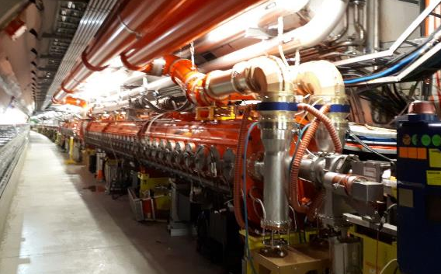
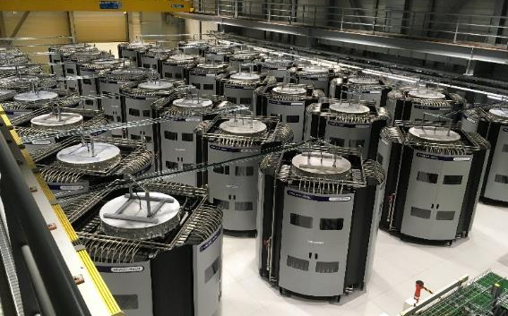
RF systems: 200 MHz power
Validated BAF3 SSPA
Cavities in LSS3

Slide 19
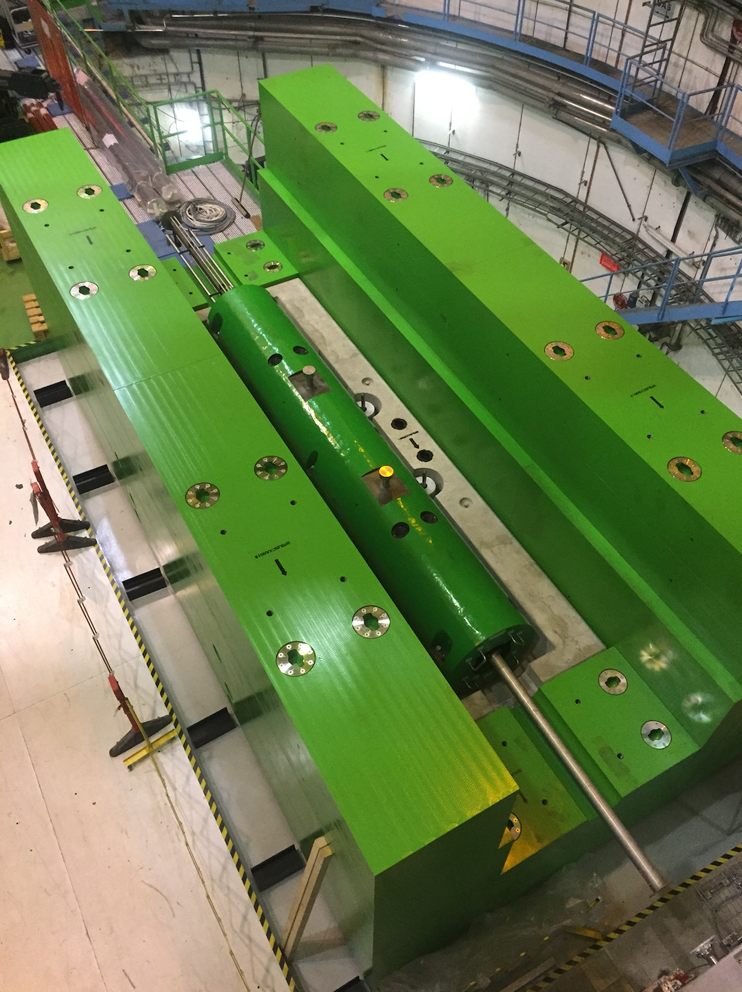
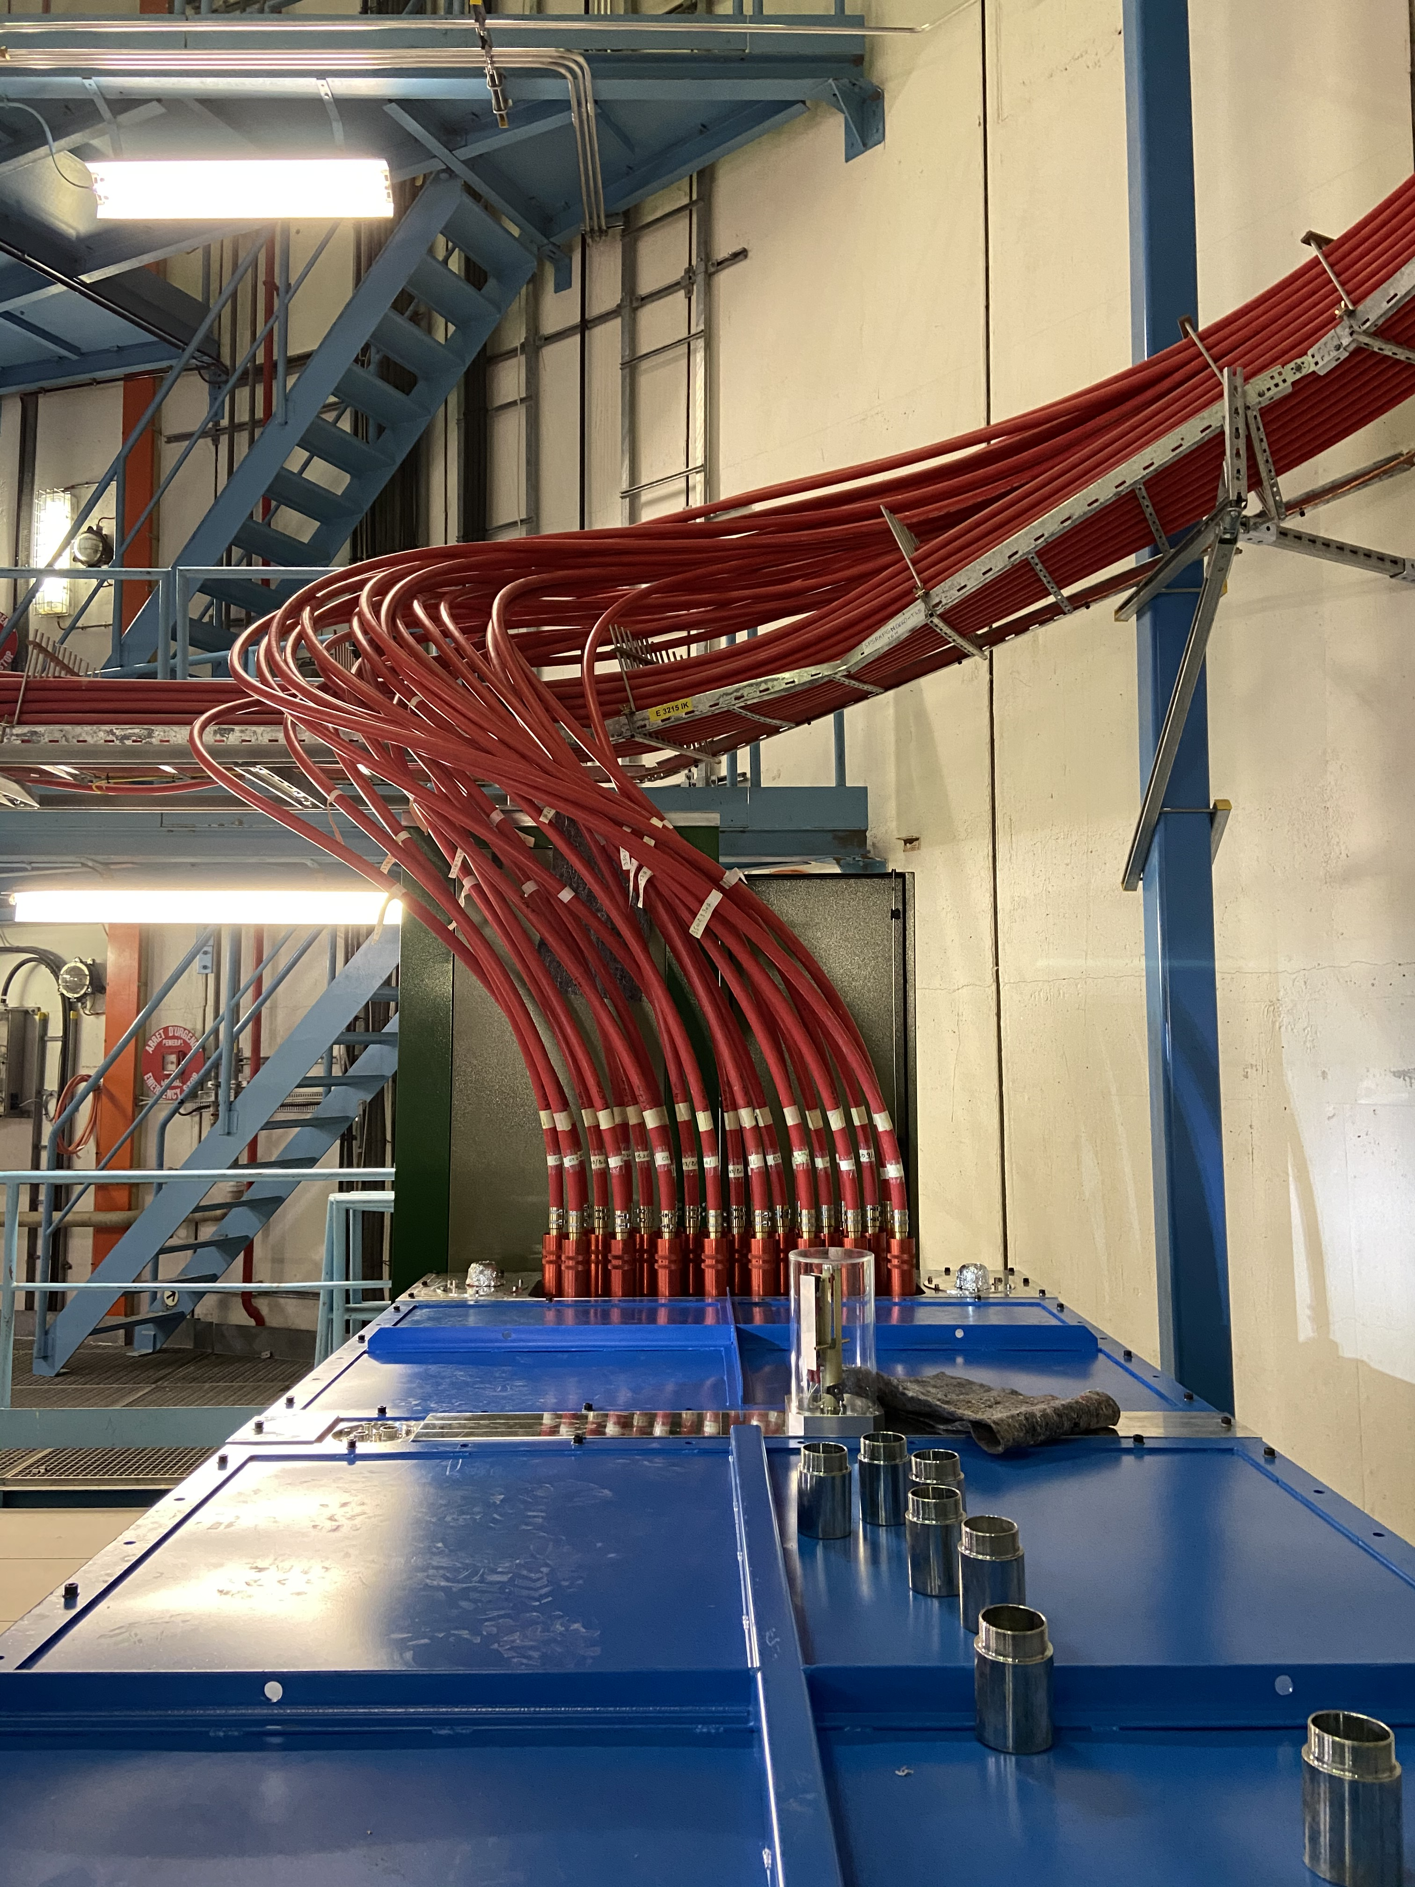
Internal beam dump
Dump block TIDVG5 in LSS5
MKDV PFN and cables

Slide 20
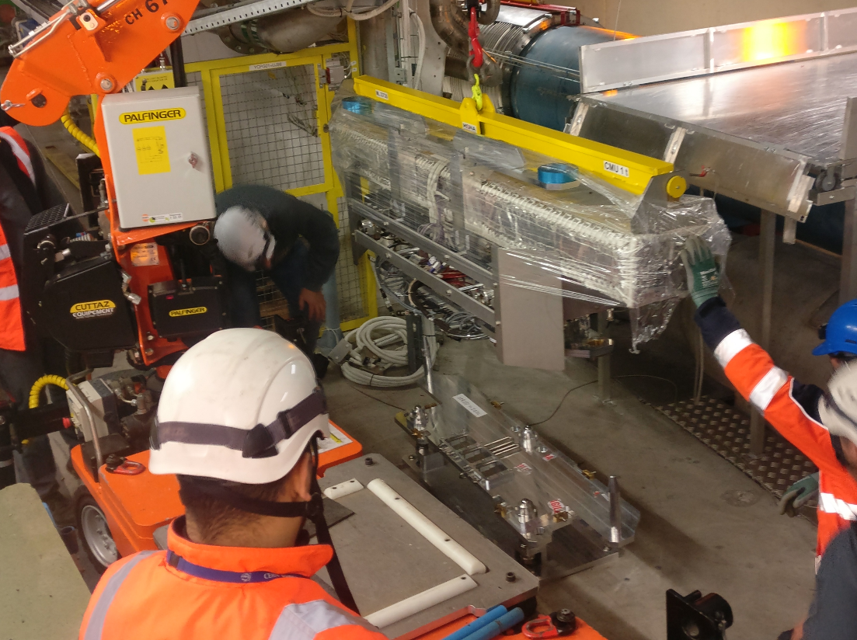
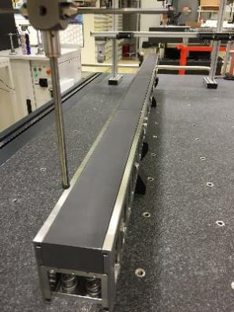
Beam loss control: TCDIL
Installation in TI8
Graphite/CC jaw

Slide 21
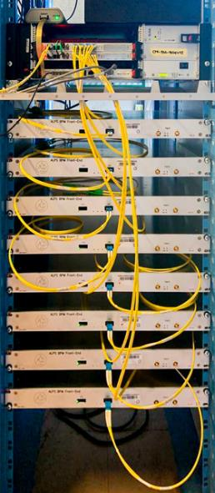
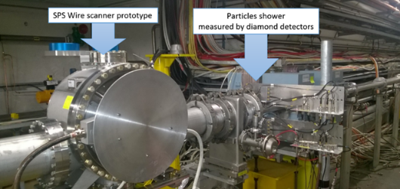
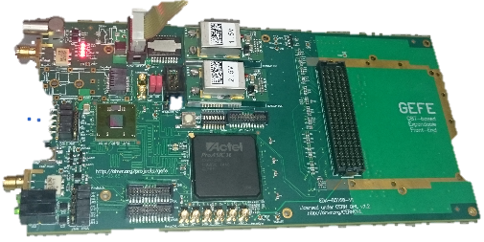
Beam instrumentation
ALPS BPM interlock
SPS wire-scanner in LSS5
ALPS radiation hard digital front-end

Slide 22
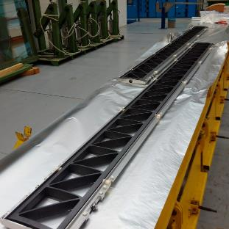
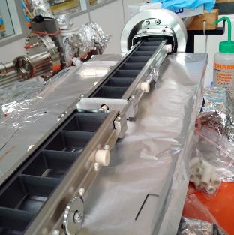
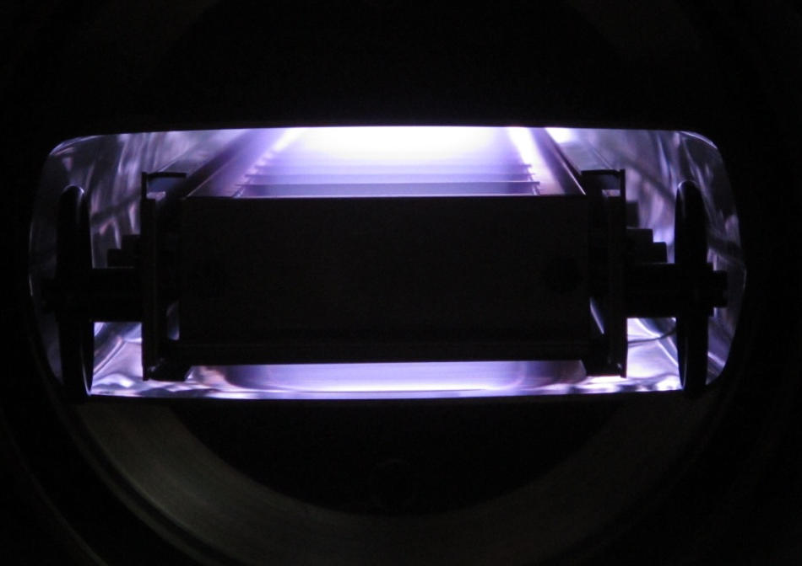
ecloud mitigation: aC coating
QF hollow-cathode electrode
MBB hollow-cathode electrode
MBB HC discharge

Slide 23
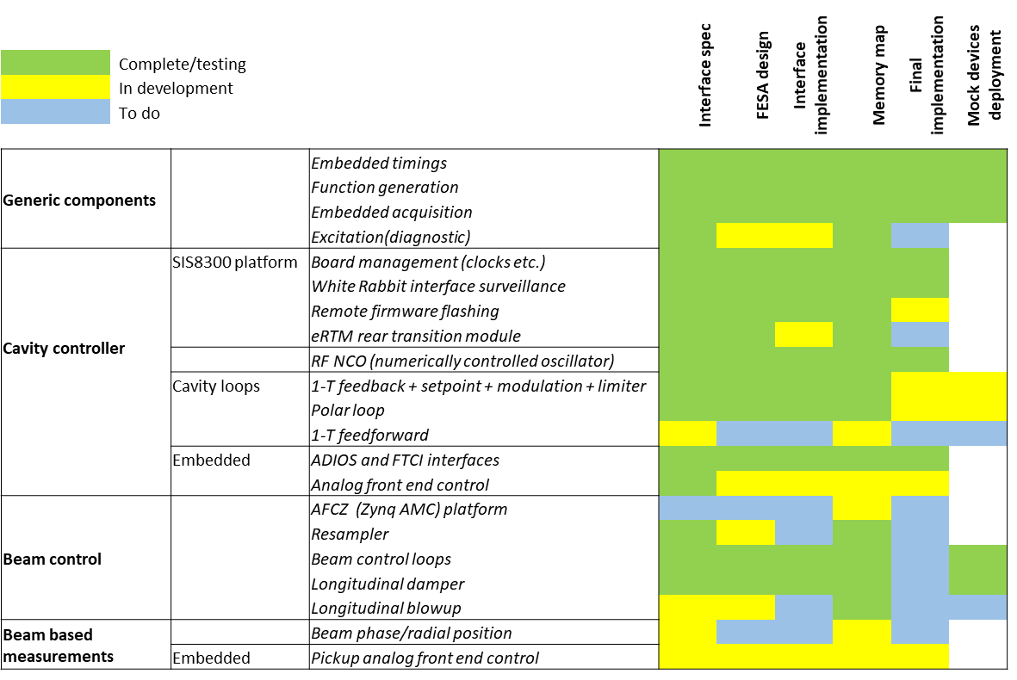
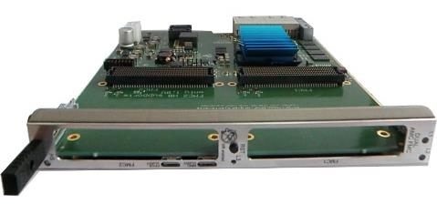
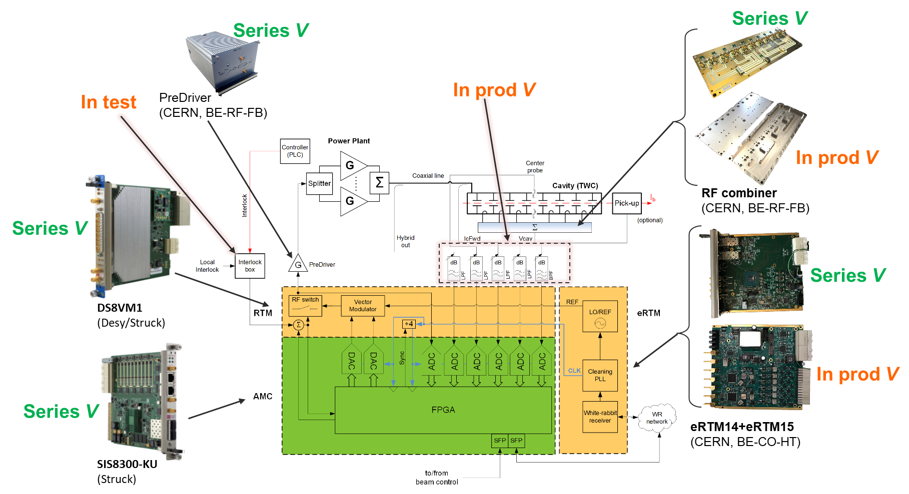
RF systems: 200 MHz LL
AFCZ
4 boards available
Series 10 ordered…but late
Cavity control
FE SW

