Slide 2
LIU-SPS Operations Readiness Analysis
HWC plan and checklist status
SPS Joint Leaders Team

Slide 3
Contents
SPS complex layout
Post-LS2 changes
Overview of HWC planning
Keys points scheduled in the HWC planning
Key points status for the HWC
Overview of HWC checklist
What we still need to do with checklist
Summary

Slide 4
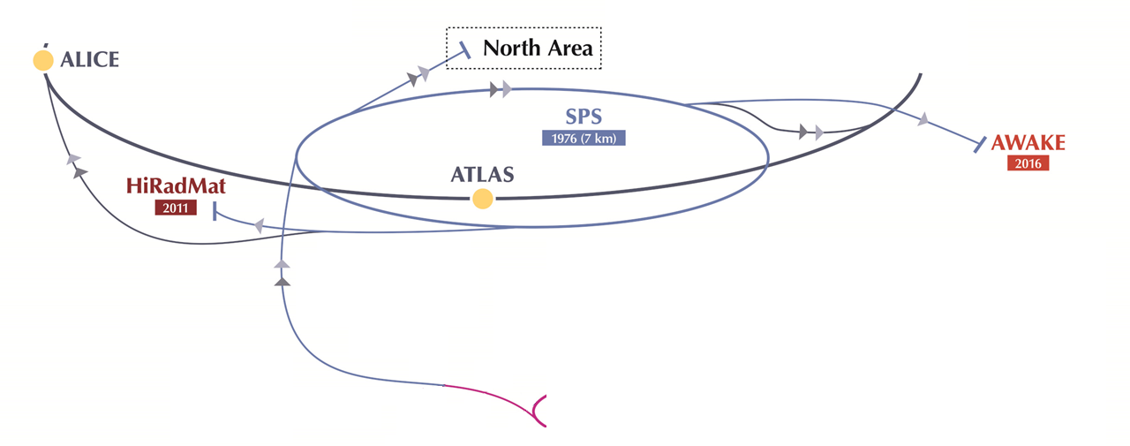
SPS complex layout
TT20, 21, 22, 23, 24, 25
TT40
TT41
LHC
TI8
TT66
TI2
TT10
TT60
SPS complex composed by:
SPS Ring
Transfer lines
TT2, TT10 → Injection line
North Extr, TT20, 21, 22, 23, 24, 25 → FT North Area
East Extr, TT40, TI8 → LHC B2
West Extr, TT60, TI2 → LHC B1
East Extr, TT40, TT41 → AWAKE
West Extr, TT60, TT66 → HIRADMAT
TT2
PS

Slide 5
Post-LS2 changes (Ring)
New access system
New fire safety system
Upgrade Main Quadrupole power converters
Upgrade PLCs to control Main Power Supply (MPS)
RF power upgrade with new configuration of 200 MHz cavities
New low-level RF
New B train (based on white rabbit network)
New SPS Beam Dump System (SBDS) and displaced from BA1 to BA5
Reconfiguration of LSS1, LSS3, LSS5
Upgrade Beam Position Monitor: MOPOS → ALPS
  Many other upgrade on beam instrumentation
    BBQ, BGI, BSM, BOSTEP, Diamond BLM

Slide 6
Post-LS2 changes (Ring)
New wire scanners
Upgrade Function Generator Controller from FGC_91 to FGC_63
New power converters
Upgrade Beam Loss Monitor (BLM) Fesa class
New compensator (BEQ1)
Update BIS Ring
Update optics sequence
New hierarchy of parameters RF in LSA for beam control, cavities control, synchro partially rewriting, Atim..
Renaming EPC devices
New DI/DT interlock

Slide 7
Post-LS2 changes (Transfer lines)
New Beam Interlock System (BIS) for injection
New Beam Loss Monitors (BLM) in TT10
Upgrade TI8 optic add 2 matching quadrupoles and new collimators
New transfer line optic with all extraction region
New power converters in TI2 and collimators
Upgrade Function Generator Controller from FGC_91 to FGC_63
  Part of TT10, TT40, TT41, TI2, TI8
New interlock intensity on TED TT40, TT60, TI8, TI2 managed by SMP flag…..

Slide 8
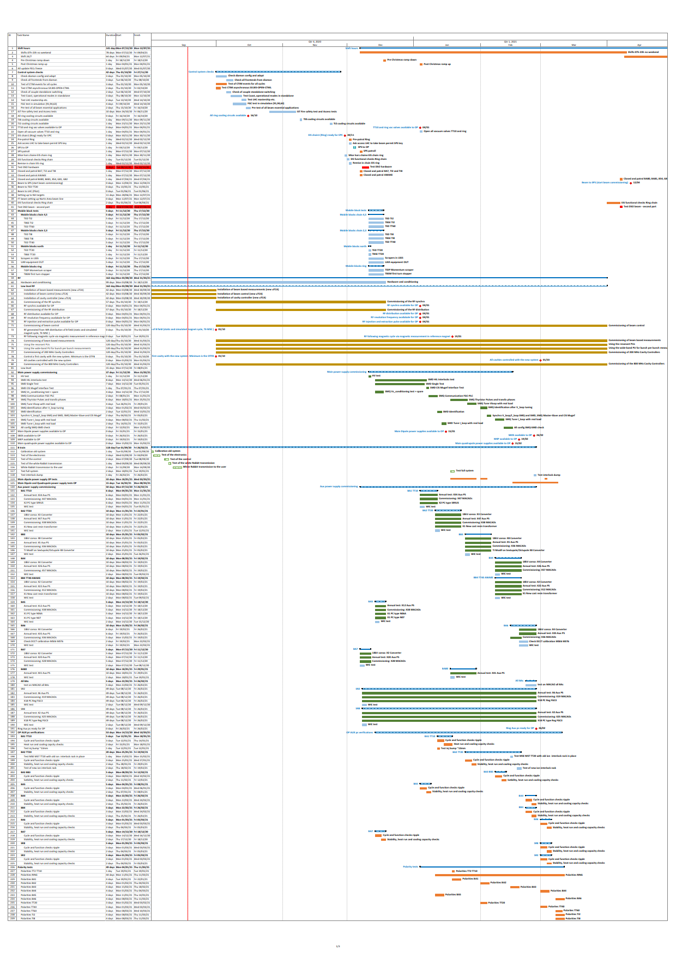
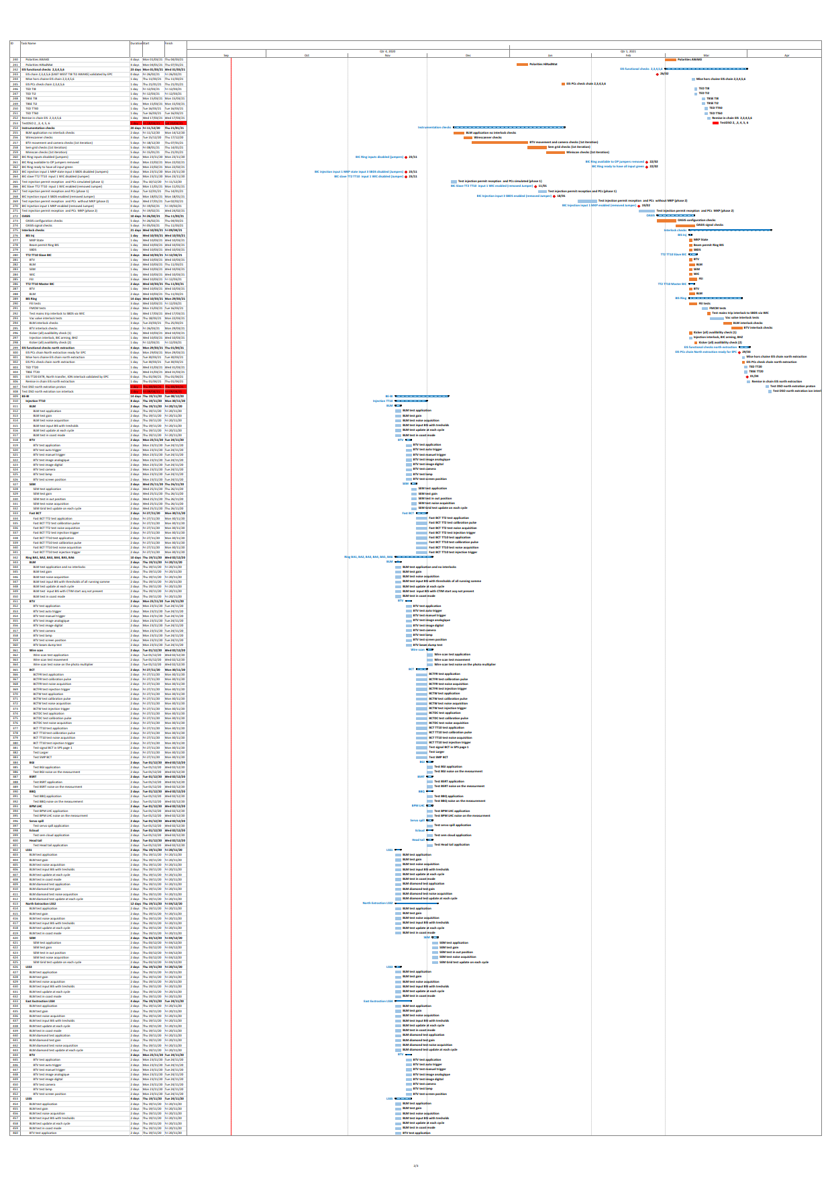
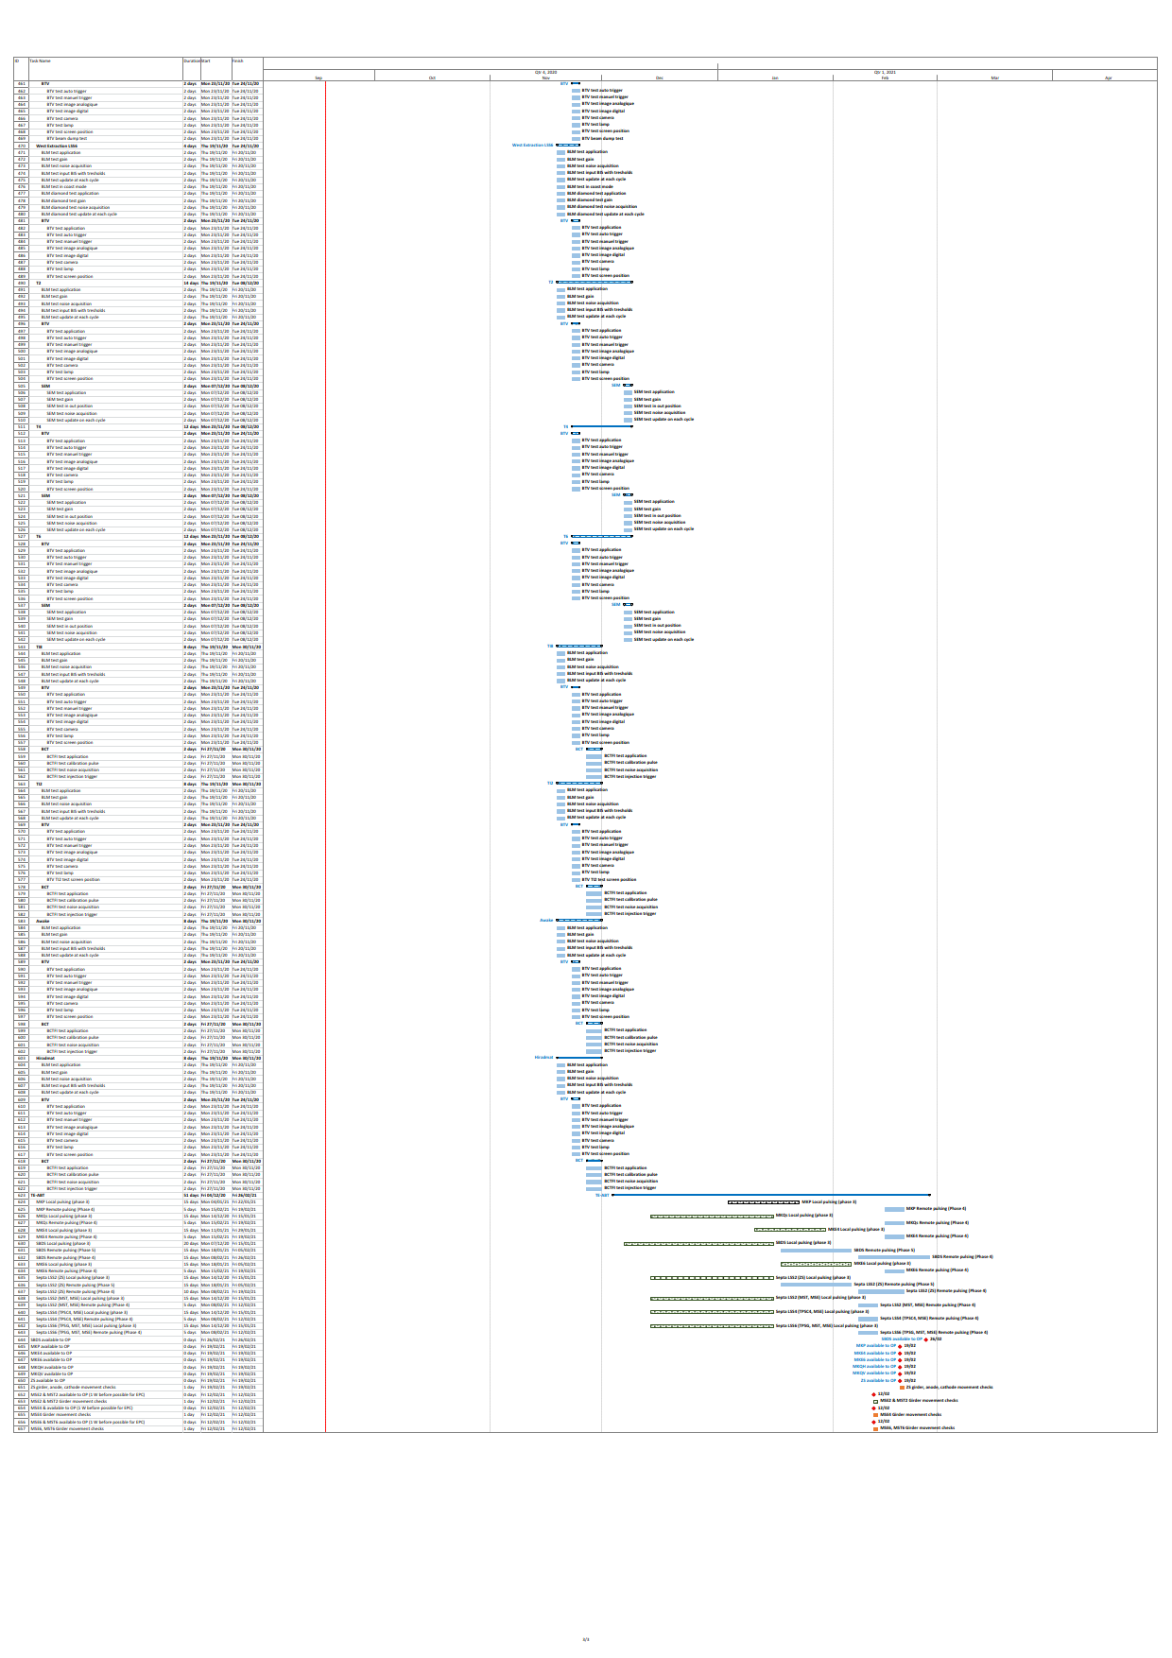
Overview of HWC planning
All this planning has been rechecked with the expert groups after COVID19

Slide 9
Where to find planning Project or Gant viewer
Link to project (with license)
  https://cern.sharepoint.com/sites/Projects-Accelerator-Complex-Schedules/Projects.aspx
  Project name node: Intervention_Period: LS2-restart
  Project name: SPS_LS2-restart_HC
Link to Gantt view (without license)
  https://oss-coordination.web.cern.ch/gantt/latest?facilities=SPS&intervention=LS2-restart&scale=week&worktypeproject=
  Task name: SPS_LS2-restart_HC

Slide 10
Keys points scheduled in the HWC planning
Prerequisite
  BAs cooling
  Cooling TI2 and TI8
  Timing check
  All Fesa classes should have been ready from the end of July
    not the case, see Verena’s presentation
Hardware commissioning
  DSO tests Ring, North extraction, LHC and AWAKE extraction
  Vacuum ready and all valves opened
  Commissioning of MPS, AUX PS, SBDS, BI items, RF Power, Btrain
  Commissioning of RF low level was usually not done fully by OP in the past
    New system, new routines and experience to be established
  Magnets heat run
  Polarity check
  Commissioning injection BIS
  Check main applications to operate the SPS and main analysis tools

Slide 11
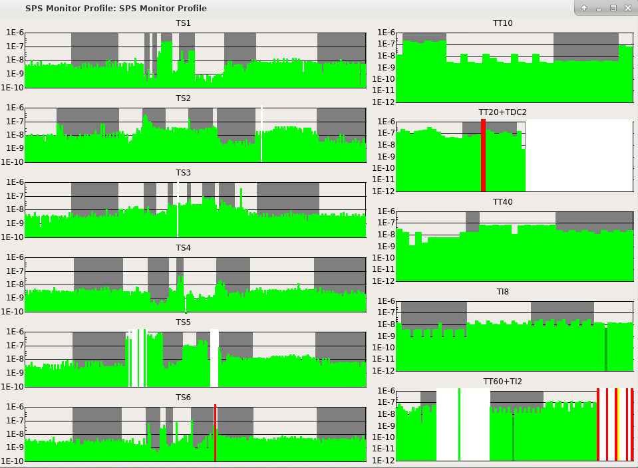
Keys point status for the HWC
The equipment below are in the critical path for the HWC
  Access system (Global IST on W45, from 02-11-2020 to 08-11-2020)
  Cooling water (BA1,2, 5 completed, BA3, 4, 6 functional test to be done
  in BA3 minus one cooling cable not yet tested)
  Vacuum (on track, it stay dump sector, TT22, 23, 24, 25 and two sectors in TI2)
  Compensator BEQ1 (commissioning by ABB should be completed by end of W44)
  BIS Ring (on track)
  MPS (on track)
  AUX PS (on track)
  RF power (on track 7 cavities with RF power….)
  RF low level (on track, final system will only arrive during HWC)
  SBDS (on track)
  Cycles generated (on track)
  Timing (on track)
One of critical paths is to have on the 15-01-2021 the equipment below ready:
  The main dipole operational
  Cycle generated
  Btrain operational
  Frev operational
  BIS Ring operational
  To start the remote pulsing of SBDS on 18-01-2021 and to keep on the control the hardware commissioning

Slide 12
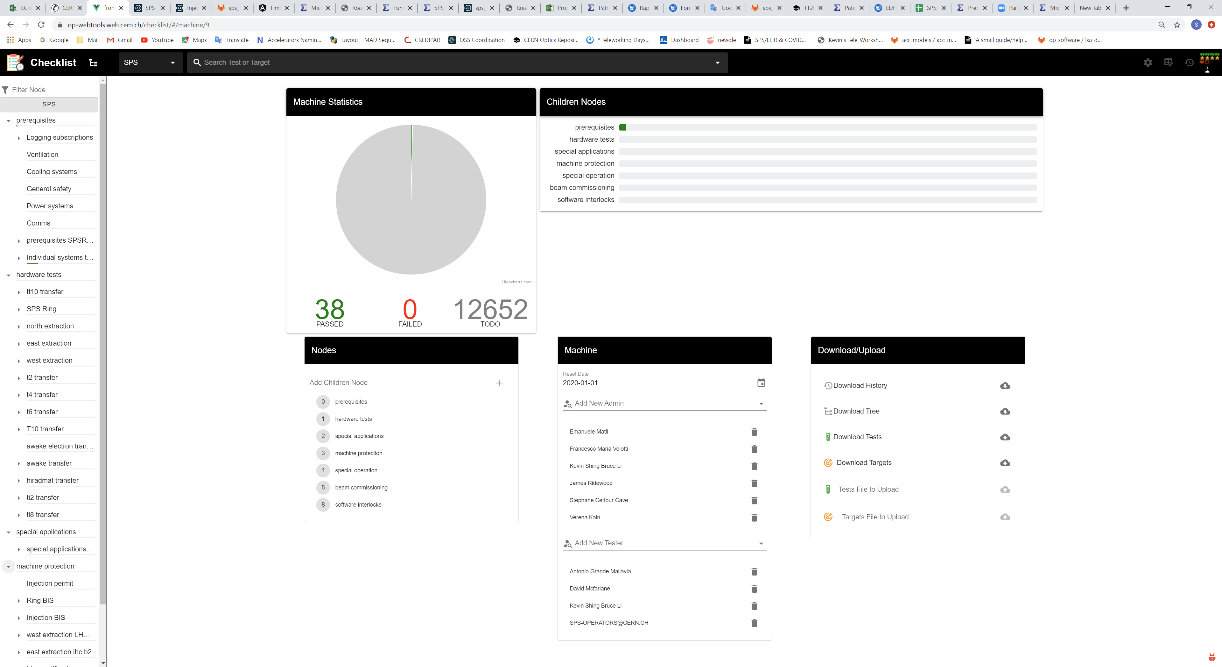
Overview of HWC checklist
We splited the checklist in different family
  Prerequisite
  Hardware test
  Special applications
  Machine protection
  Special operation
  Software interlocks
  Beam commissioning
IST passed today
Number of test to do

Slide 13
What we need to do yet with checklist
We had already a checklist relatively complete but:
  We added a checklist for the IST followed by EN/ACE , BE/OP
  We updated the PREREQUISITE checklist with new tests
  We are updating HWC checklist with the tests of new equipment, injection BIS, new SIS tree, logging etc..
We planned the main checklist tests in the HWC planning
  We try to improve the planning of these tests more and more

Slide 14
Summary
All the require equipment should be ready for the HWC start →
  Reminder:
    The SPS will be closed from 07/12/2020, the accesses will be permit only outside of working hours before 8H30 or after 18H30 and should be confirmed in the 8h30 morning meeting by zoom which will begin alsaw on 07/12/2020
  Link: https://cern.zoom.us/j/94490736883?pwd=M2svVVhmWWpxdi9PZmV3cjhTY3JOUT09
The planning of HWC is well established with minor updates ongoing
The checklist is being updated for the new systems
04-12-2020

Slide 15
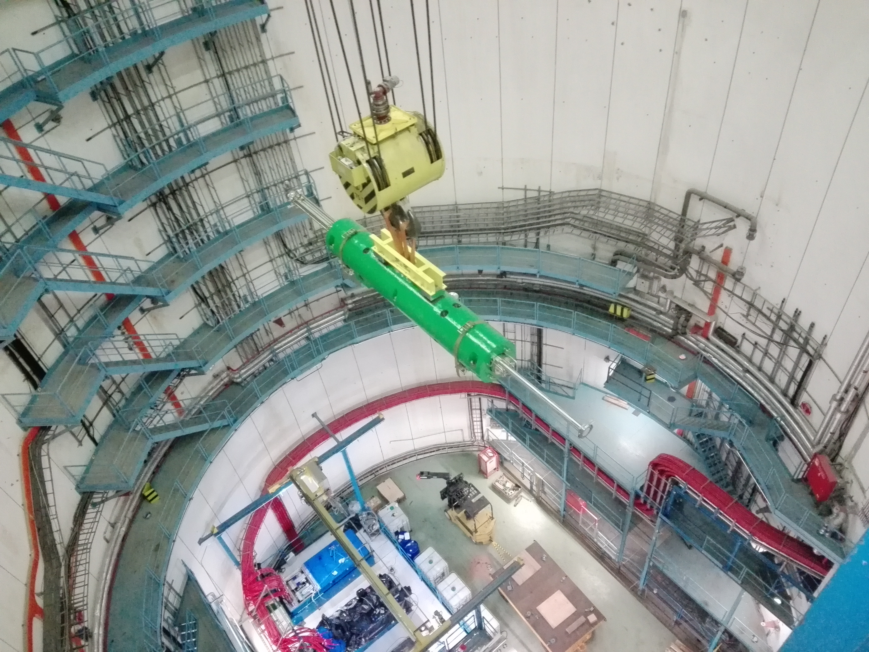
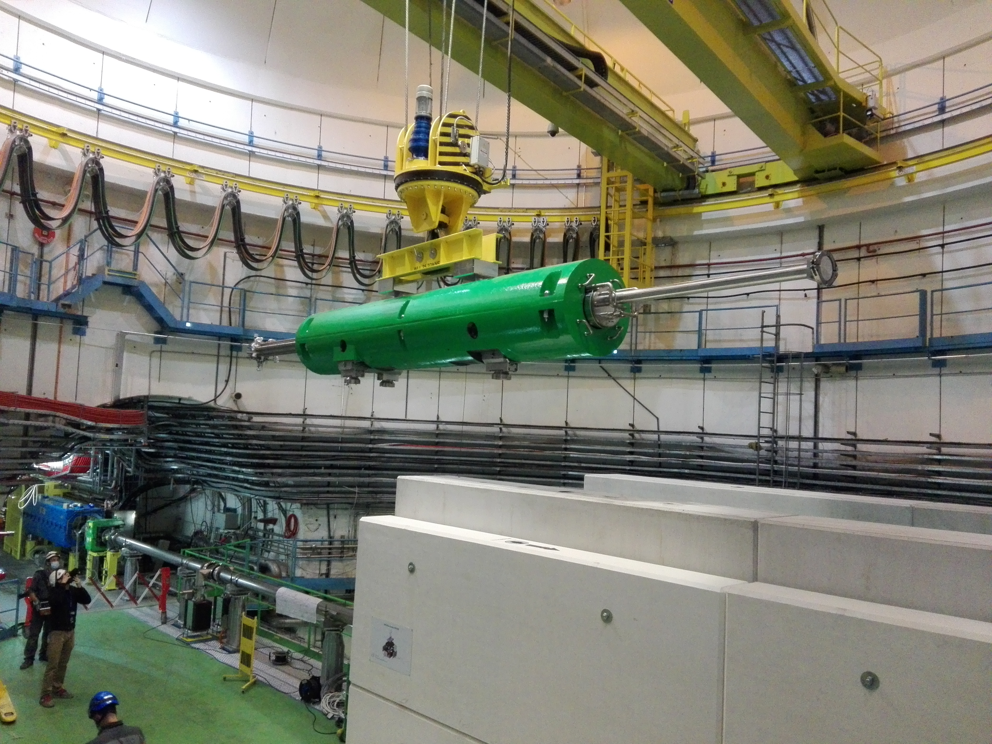
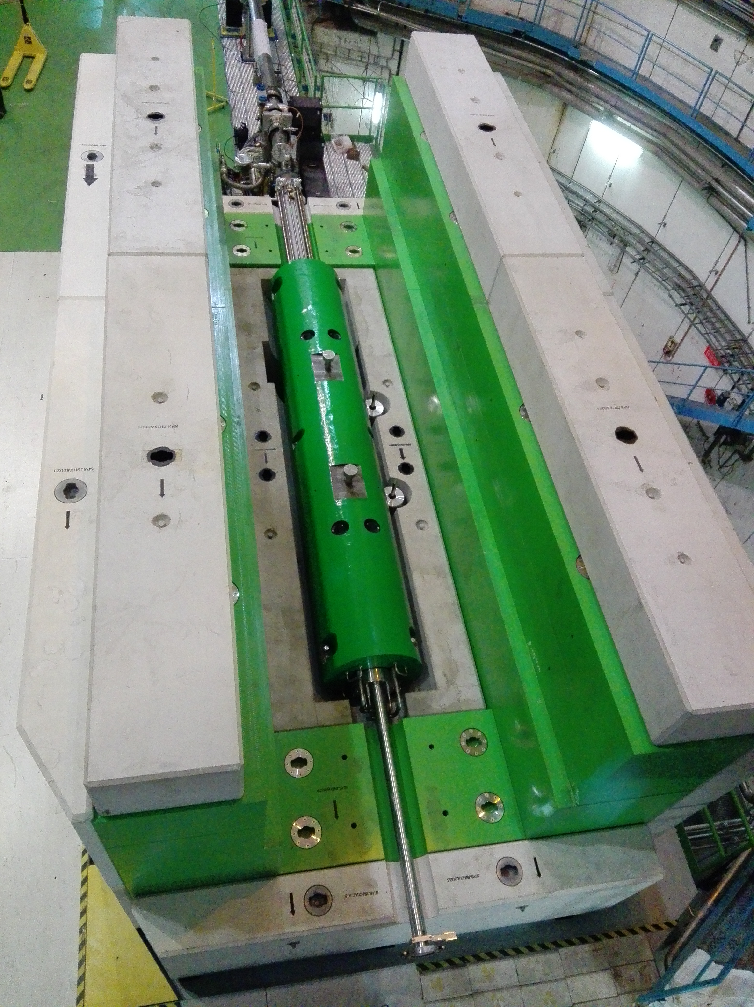
THANKS FOR YOUR ATTENTION

