Slide 2
Beam commissioning (incl. ions) and scrubbing plan
Kevin Li with help an input from Reyes Alemany Fernandez, Philippe Baudrenghien, Andy Butterworth, Stephane Cettour Cave, Verena Kain, Giulia Papotti and the entire OP-SPS team
SPS Operational Readiness Analysis
27. October 2020

Slide 3
Overview
Dry Runs:
A work on systems integration
Key systems to dry run – where are we? What remains? Any items forgotten?
Beam commissioning:
Key systems
Planning overview with co-activities
Detailed break-down and planning with activities, beams, requirements & deliverables, risks
Scrubbing:
Overall schedule
Scrubbing weeks with detailed planning, milestones, co-activities, risks
Ion commissioning:
Schedule, strategy

Slide 4
A work on systems integration
Systems integration is a key component of a successful systems deployment to make it accessible for OP and thus truly operational;
A few of the new key systems need to be well integrated since they are part of “routine operation”:
  Orbit measurement system: ALPS
  RF system: new LLRF control
  BI systems: e.g., new Wire Scanners, new BLM classes
  Beam dump system: new SBDS
  …
Integration activities include:
  Establishment and review of parameter models and settings (i.e., RF system)
  Identification of monitoring and control capabilities (i.e., ALPS with new interlocks)
  Definition of FESA interfaces (all systems)
  Development of applications (all systems)
  Definition of operational scenarios and procedures (i.e., injection interlocking)
  Planning of system tests and dry runs

Slide 5
List and status of dry runs
Key systems:
  ALPS – beam position
    2 BAs tested with YASP
    Interlocking in the way for next week
    Full ring tests in coming weeks
    Logging underway
  RF – power and LL control
    ATIMs, and RFFGs mostly tested as fundamental building blocks – still missing COAST trims
    LSA parameter models buils
    Beam control, cavity control and acquisition FESA devices coming in – tests being identified and scheduled accordingly
    Application development taking place in parallel with incoming FESA devices
  FGCs – new PCs and FEI system
    Large set of tests done and completed in simulation mode
    Final set of tests planned soon
    FEI tests well underway
  SBDS – mostly done during HWC
    List ready and integrated in HWC planning
  BI devices – mostly tested during HWC
    Specific tests after BLM upgrades
    List ready and integrated in HWC planning
  SPSQC – PM dependent
    Quite some work here – not yet tested
Notes:
BLMs -

Slide 6
List and status of dry runs
ALPS – beam position
2 BAs tested with YASP
Interlocking in the way for next week
Full ring tests in coming weeks
Logging underway
RF – power and LL control
ATIMs, and RFFGs mostly tested as fundamental building blocks – still missing COAST trims
LSA parameter models buils
Beam control, cavity control and acquisition FESA devices coming in – tests being identified and scheduled accordingly
Application development taking place in parallel with incoming FESA devices
FGCs – new PCs and FEI system
Large set of tests done and completed in simulation mode
Final set of tests planned soon
FEI tests well underway
SBDS – mostly done during HWC
List ready and integrated in HWC planning
BI devices – mostly tested during HWC
List ready and integrated in HWC planning
SPSQC – PM dependent
Quite some work here – not yet tested
Specific tests after BLM upgrade

Slide 7
List and status of dry runs
ALPS – beam position
2 BAs tested with YASP
Interlocking in the way for next week
Full ring tests in coming weeks
Logging underway
RF – power and LL control
ATIMs, and RFFGs mostly tested as fundamental building blocks – still missing COAST trims
LSA parameter models buils
Beam control, cavity control and acquisition FESA devices coming in – tests being identified and scheduled accordingly
Application development taking place in parallel with incoming FESA devices
FGCs – new PCs and FEI system
Large set of tests done and completed in simulation mode
Final set of tests planned soon
FEI tests well underway
SBDS – mostly done during HWC
List ready and integrated in HWC planning
BI devices – mostly tested during HWC
List ready and integrated in HWC planning
SPSQC – PM dependent
Quite some work here – not yet tested
Specific tests after BLM upgrade
Identify key systems and systems that underwent significant changes during LS2
Define dry run program to best possible ensure good integration and smooth start-up of the system
Keep “routine”-systems tests close to past procedures; many tests anyway already integrated into HWC
Systems are now coming in for completion of dry run program

Slide 8
Beam commissioning planning
Establish breakdown view highlighting milestones, timelines and co-activities of key systems
Define beams needed along beam commissioning
Establish day-to-day planning, identify requirements and highlight critical path items
Many of the checklists and established procedures can be re-used; a few procedures need to be revised or still created → still to be done!
Still need to fold in the new systems – ALPS, RF, SBDS
Integrate planning into ASM – link with checklists

Slide 9
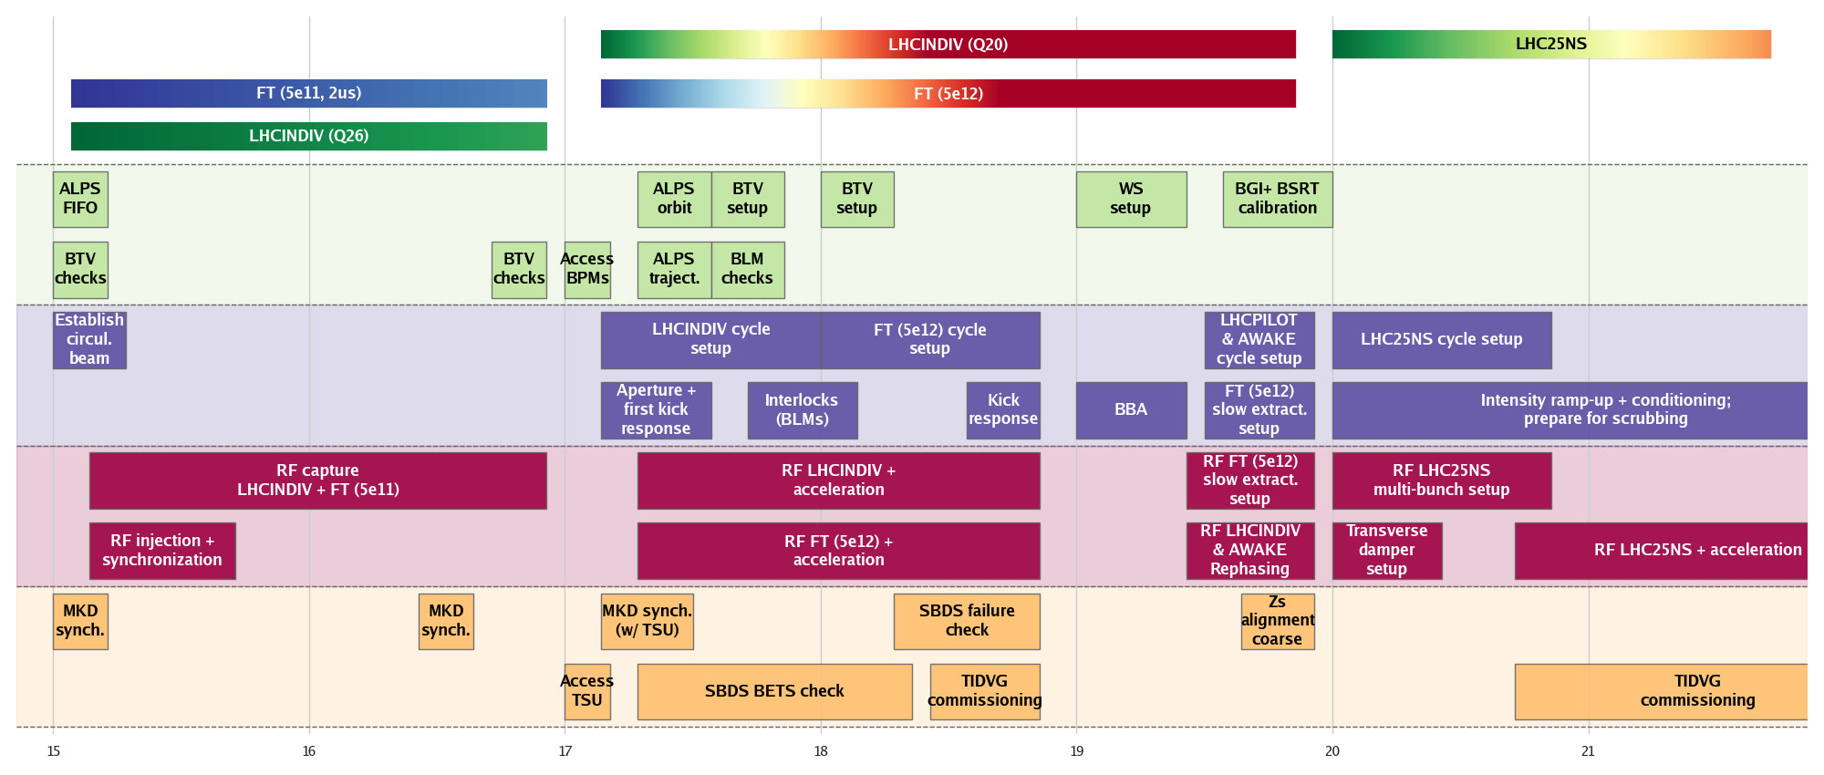
Beam commissioning overall breakdown by system
26 GeV
450 GeV
26 GeV
450 GeV
Beams
14 GeV
400 GeV
26 GeV
Moving into the intensity ramp up
BI
OP
RF
ABT
15
16
17
18
19
20
21
LHC and FT beams captured
Beam-based alignment
LHC25NS
setup

Slide 10
Beam commissioning timeline – overview
Week | 15 (1) | 16 (2) | 17 (3) | 18 (4) | 19 (5) | 20 (6) | 21 (7)
Milestones | Circulating beam and RF capture | Circulating beam and RF capture | LHCINDIV @450 GeV | Beam based alignment | LHCPILOT and AWAKE close to ready | LHC25NS ready for scrubbing | LHC25NS intensity ramp up (conditioning, scrubbing RF setting up)
Beams | MD26_Q26 FT (5e11, 2us) LHCINDIV (1.2e11) | MD26_Q26 FT (5e11, 2us) LHCINDIV (1.2e11) | FT (5e12) LHCINDIV (1.2e11) | FT (5e12) LHCINDIV (1.2e11) | FT (5e12) LHCINDIV (1.2e11) AWAKE | LHC25NS intensity ramp-up (12b +) | LHC25NS intensity ramp-up (12b +)
Key tasks | Establish circulating beam Phase in cavities Establish RF capture All beams at flat-bottom | Establish circulating beam Phase in cavities Establish RF capture OP support and BC of BI devices etc | OP and RF setup for LHCINDIV Acceleration of LHCINDIV Orbit system setup (first turn with BST, kick response) Aperture checks: capture FT aperture | Kick response Acceleration of FT (transition crossing) Beam based alignment + accesses | Establish golden orbits OP set up LHCPILOT, AWAKE, slow extraction RF rephasing and slow extraction | Zs alignment coarse OP and RF setup of LHC25NS multi-bunch beams Transverse damper setup | OP and RF setup of LHC25NS multi-bunch beams OP support and execution of CCAs according to scrubbing planning Mode to scrubbing
Stage 1
(RF capture)
Stage 2
(BBA)
Stage 3
(multi-bunch LHC beams)

Slide 11
Summary beam commissioning
Reviewed beam commissioning plan (from 2019 LIU-Days) taking into account latest knowledge and post Covid-19 changes
Requirements, beams and key system co-activities identified and planned
Overall beam commissioning timeline and milestones defined; weekly programme exists, beam commissioning checklists are available but still need to be reviewed
Essential milestones accommodated in first two weeks:
  Establish circulating beam
  Establish RF capture
The start of the SPS post-LS2 beam commissioning should be early in week 15 (12.04.2021)
Deliverables:
  LHC INDVI beam up to extraction
  SFTPRO extractable to TT40 TEDs
  AWAKE beam up to extraction

Slide 12
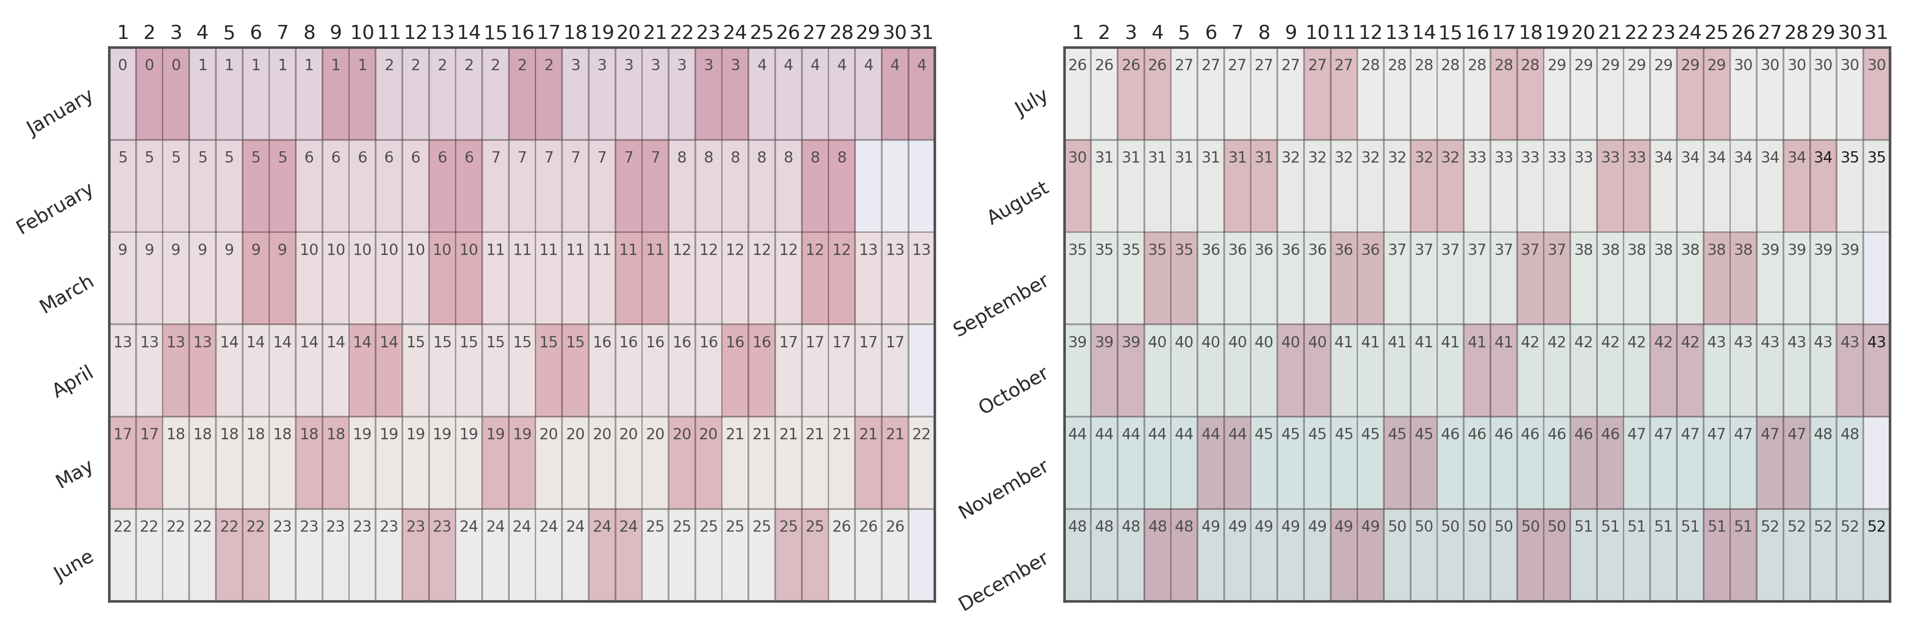
SPS commissioning and physics programme – status July 2020
HWC
MD
MD
AWAKE 1
MD
MD
MD
HRM 1
LIU Prot.
MD
MD
TS
AWAKE 2
HRM 2
Ions 1
MD
MD
HRM 3
MD
Ions 2
MD
DSO tests
MD
MD
MD
MD
Ions 3
AWAKE 4
MD
HRM 4
LIU Prot.
Beam commissioning – new machine with LIU upgrades; very little margin
Intensity ramp-up: conditioning, scrubbing run, setup and tuning of LHC beams
NA Beamline setting up
Delivery of LHC PILOT
Delivery of FT physics
Start of MDs
FT ions (tbc)
Dedicated and long FB MDs
Commissioning of ions
Commissioning of ions & slip stacking (dedicated slots!)
MD

Slide 13
Scrubbing planning overview
Advanced automation:
ZS alignment
50 Hz spill correction
Main quads hysteresis corrections
Auto-Q chromaticity correction given the ramp shape: SFTPRO and LHC-type ramp chromaticity fit
Operational beams setting up:
Set up operations with ZS and high intensity scrubbing beam
Extraction LHC (extraction bumps, rephrasing, interlocks tests)
Beams to TT40 and TT60 TEDs
RF gymnastics:
FFA checks for ions
Slip stacking with protons
RF gymnastics optimization
Longitudinal blow-up development and tests
Stocking fillers:
Cool-down compatible activities (CCAs); RF setting up multi-batch
beams using “very low duty cycle”
Daytime (14 h)
NA setting up
Priority NA setting up
Priority scrubbing
Scrubbing
Nighttime (10 h)
Scrubbing; RF setting up multi-batch
beams partly in parallel and interleaved

Slide 14
Scrubbing planning overview
Advanced automation:
ZS alignment
50 Hz spill correction
Main quads hysteresis corrections
Auto-Q chromaticity correction given the ramp shape: SFTPRO and LHC-type ramp chromaticity fit
Operational beams setting up:
Set up operations with ZS and high intensity scrubbing beam
Extraction LHC (extraction bumps, rephrasing, interlocks tests)
Beams to TT40 and TT60 TEDs
RF gymnastics:
FFA checks for ions
Slip stacking with protons
RF gymnastics optimization
Longitudinal blow-up development and tests
Stocking fillers:
Day time activities compatible with cool-down
Daytime (14 h)
NA setting up
Priority NA setting up
Priority scrubbing
Scrubbing
Nighttime (10 h)
HDCy Scrubbing
1 batch done 4 batches done Ramp done
TIDVG commissioning
COLDEX

Slide 15
Detailed planning
Cool-down compatible activities (CCAs); RF setting up multi-batch
beams using “very low duty cycle”
NA setting up
10 hours per day
Priority NA setting up
Priority scrubbing
Scrubbing
Scrubbing; RF setting up multi-batch
beams partly in parallel and interleaved
Week 25 (4th scrubbing week) → beams, cycles
  Goal: excellent beam quality at 450 GeV and HiradMat 440 GeV set up with high intensity
Prerequisites:
  NA experiments ready for taking beams on targets
Beams:
  LHC single bunch
  LHC n x 72 bunches
  MTE 5e12
  AWAKE
Cycles:
  Long flat bottom scrubbing cycle
  SFTPRO cycle
  LHC 25 ns nominal (with flat top)
  AWAKE
Mon | Steer beam to NA targets; NA setting up
Tue | 50 Hz correction final testing with beam for QF; NA setting up
Wed | Final AWAKE cycle optimization, RF gymnastics; NA setting up
Thu | NA setting up
Fri | NA setting up
After going through a detailed day-by-day planning with all activities:
The list of times to be carried out is long and the planning is rather aggressive
There are many RF items that would be valuable or even necessary to tackle during this phase:
  Necessary: AWAKE final bunch setting up, e.g., RF gymnastics, NA setting up with high intensity beams > 5e12 ppb
  Valuable: ions preparation without / with beam for FFA, slip stacking etc.
We think that we can accept having 10 hours daytime NA beamline setting-up during week 25
We would like to keep some “mini”-shifts of 4 hours during daytime for additional CCAs

Slide 16
Summary scrubbing
2 weeks (BC) of multi-bunch beam setting up + 3 weeks of multi-bunch beam setting up and exploitation (scrubbing);
CCAs allocated – teams need to be informed about their slots;
RF activities will depend on availability of RF teams – some activities can be carried out in parallel and independently by the different teams; sequence of activities prepared by RF;
COLDEX will run in parallel with scrubbing – exact window and conditions were clarified with COLDEX;
NA setting up will start during daytime in week 25 – scrubbing can continue during night time; keep mini-shifts of 4 hours for CCAs.

Slide 17
Ions commissioning
Ion commissioning will take place in dedicated blocks where we will focus exclusively on ion commissioning together with the new LLRF system:
  3 weeks of dedicated ions commissioning
  4 days of dedicated ion beam studies (with long ion cycle)
Some critical items to be commissioned:
  FFA
  Slip stacking
  SFT ions
Organization and planning:
  The idea is to identify ion commissioning subtasks with exact procedures and times required
  Based on the current programme and available time, the subtasks can be assembled and reshuffled as needed to establish a full ion commissioning plan → in preparation
MD
MD
AWAKE 1
MD
MD
MD
HRM 1
LIU Prot.
MD
MD
TS
AWAKE 2
HRM 2
Ions 1
MD
MD
HRM 3
MD
Ions 2
MD
DSO tests
MD
MD
MD
MD
Ions 3
AWAKE 4
MD
HRM 4
LIU Prot.

Slide 18
Ions commissioning
Ion commissioning will take place in dedicated blocks where we will focus exclusively on ion commissioning together with the new LLRF system:
  3 weeks of dedicated ions commissioning
  4 days of dedicated ion beam studies (with long ion cycle)
Some critical items to be commissioned:
  FFA
  Slip stacking
  SFT ions
Organization and planning:
  The idea is to identify ion commissioning subtasks with exact procedures and times required
  Based on the current programme and available time, the subtasks can be assembled and reshuffled as needed to establish a full ion commissioning plan → in preparation
MD
MD
AWAKE 1
MD
MD
MD
Risk mitigation measures:
Certain tasks will be tried out already before having first ion beams in week 39 (i.e., using a dedicated cycle for preparing FFA)
Certain tasks have been identified as possible CCA during the scrubbing run; if time allows, these could advance some activities and free up time during the dedicated ions weeks
HRM 1
LIU Prot.
MD
MD
TS
AWAKE 2
HRM 2
Ions 1
MD
MD
HRM 3
MD
Ions 2
MD
DSO tests
MD
MD
MD
MD
Ions 3
AWAKE 4
MD
HRM 4
LIU Prot.

Slide 19
Conclusions
Integration & dry runs
Integration activities ongoing for the various new subsystems
Dry runs planned and being carried out – final tests ramping upas systems are coming in
Beam commissioning
Sequences and co-activities established
Requirements and preparations identified
Critical path items → preparation & tests are essential to minimize impact
Scrubbing
Times allocated
Key tasks identified, sequence established, CCAs identified and scheduled
RF development slots allocated and communicated to RF – RF sequence of CCAs established
Detailed planning available, COLDEX and NA co-existence clarified; last scrubbing week used also for NA beamlines setting up
Ions commissioning
Ions commissioning mode established, dedicated ion commissioning blocks allocated
Ion commissioning subtasks modules in preparation for quick and adaptable planning with timelines and milestones

Slide 21
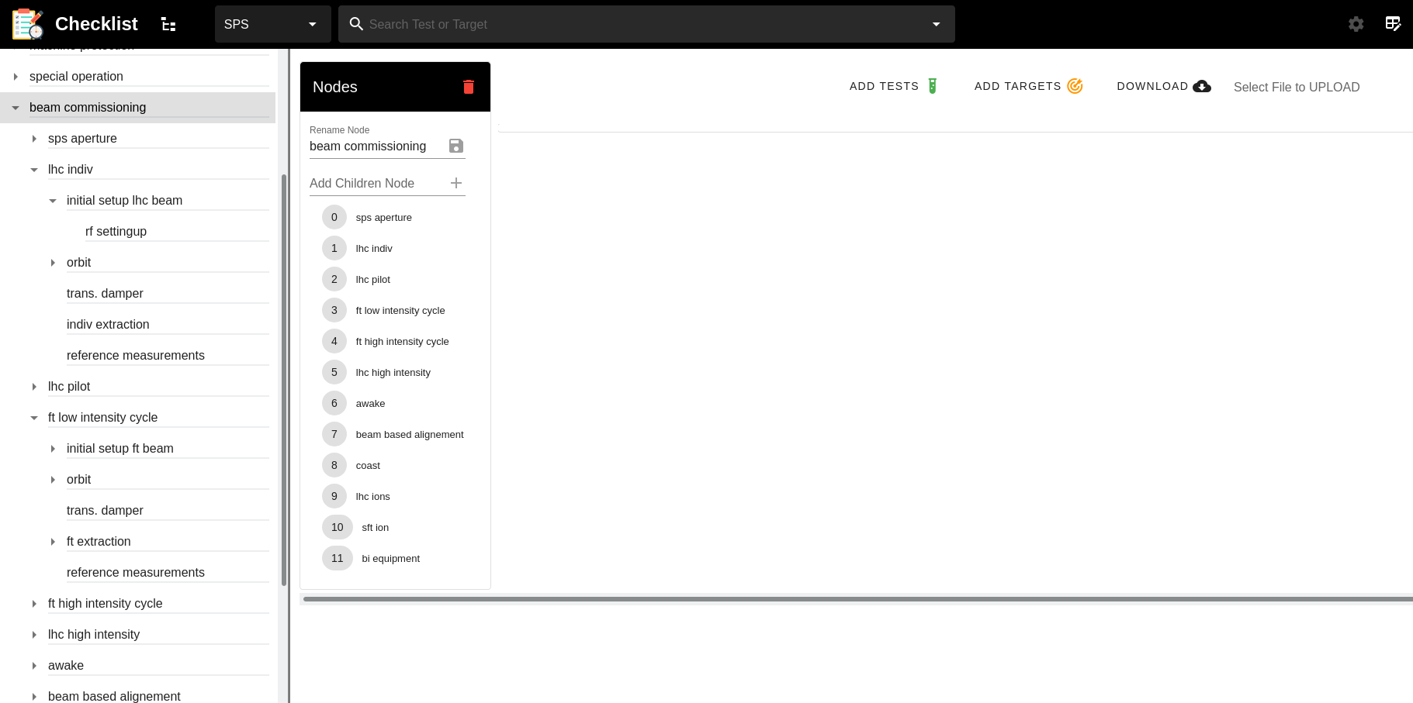
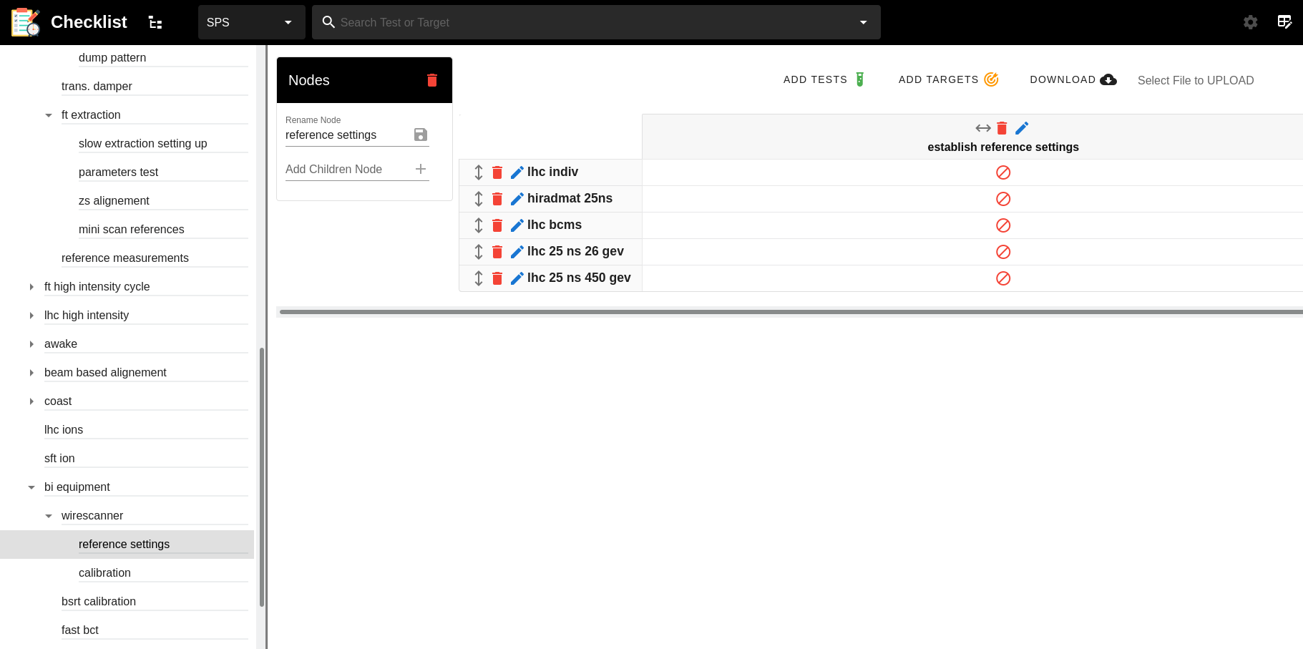
Status of checklists
Checklists from beam commissioning are prepared
Adaptations still needed for new systems and procedures
Some procedures need to be reviewed or still be added
Schedule will be established in ASM – links to tests

Slide 22
RF HWC ideas
Power sequence – powering lines from CCC
  Power interlocking
Acquisition buffers:
  Check clock synchroneous buffers (voltage, power, frequency)
  Check SPSQC buffers (synchro and phase loop errors)
  Check bunch synchroneous buffers
Beam control
  Frequency program, from B-train & LSA, radial steering on different pickups
  Injection bucket selection, injection masks, injection phase corrections
  Loop toggling checks
  Rephasing tests LHC
Cavity control
  Check voltage setpoints + total voltage read back
  Check phase setpoints
RF HWC special:
First time commissioning of RF HW – routines to be established
System still under development and certain part may not be entirely ready
Compiled an HWC menu of possible tests

Slide 23
Beam commissioning timeline – week 1
Week 1
Week 2
Week 3
Week 4
Week 5
Week 6
Activity | Related tasks | Tool requirements | Risks | Remarks | Estimated duration
Establish circulating beam | Setup ALPS in FIFO | YASP with ALPS integration | Critical: but, vertical slice tests in 2018 | LHCINDIV | 1 day
Establish RF capture Setup RF injection | Setup LHCINDIV cycle Setup FT aperture cycle | Experts + RF tools old & new | Critical: entirely new system – first test with beam | LHCINDIV FT (5e11, 2us) | 10 days
Test BLM HW / SW interlock |  | New BLM software integration | Non-critical: BI intervention | LHCINDIV | 1 shift
Synchronize MKD Check BTVs | RF capture + settings (i.e., injection bucket) | Experts (ABT, BI, RF) + SBDS app + RF tools | Critical: new systems – first test with beam | LHCINDIV | 1 day

Slide 24
Beam commissioning timeline – week 2
Circulate & capture
Week 1
Week 2
Week 3
Week 4
Week 5
Week 6
Activity | Related tasks | Tool requirements | Risks | Remarks | Estimated duration
Establish circulating beam | Setup ALPS in FIFO | YASP with ALPS integration | Critical: but, vertical slice tests in 2018 | LHCINDIV | 1 day
Establish RF capture Setup RF injection | Setup LHCINDIV cycle Setup FT aperture cycle | Experts + RF tools old & new | Critical: entirely new system – first test with beam | LHCINDIV FT (5e11, 2us) | 10 days
Test BLM HW / SW interlock |  | New BLM software integration | Non-critical: BI intervention | LHCINDIV | 1 shift
Synchronize MKD Check BTVs | RF capture + settings (i.e., injection bucket) | Experts (ABT, BI, RF) + SBDS app + RF tools | Critical: new systems – first test with beam | LHCINDIV | 1 day
Kick response | RF capture ready | ALOHA | Medium: inconsistencies | LHCINDIV FT (5e11, 2us) | 1 shift

Slide 25
Beam commissioning timeline – week 3
ALPS ready, aperture checks
Week 1
Week 2
Week 3
Week 4
Week 5
Week 6
Activity | Related tasks | Tool requirements | Risks | Remarks | Estimated duration
Access: fix BPMs, synchronization of TSUs |  | Experts | Medium: broken links or BPMs |  | 1 shift
Aperture checks | RF for FT (5ns structure) | Aperture measurement | Medium: aperture bottleneck | FT (5e11, 2us) | 2 days
Setup ALPS orbit system | RF BST ready | YASP with ALPS integration | Low: BI intervention | LHCINDIV | 1 shift
Setup and acceleration of LHCINDIV to 450 GeV | Setup RF acceleration for LHCINDIV cycle | Experts + RF tools old & new | Medium: acceleration first time with new RF system | LHCINDIV | 5 days
Synchronization of MKD with TSU | Setup BT, MKD WF | Experts + SBDS app + RF tools | Low: tested w/o beam | LHCINDIV FT | 2 days
Check SBDS energy tracking and waveform | TSU commissioned with beam | Experts + SBDS | Medium: tested w/o beam; could block acceleration | LHCINDIV | 1 day

Slide 26
Beam commissioning timeline – week 4
Beam-based alignment
Week 1
Week 2
Week 3
Week 4
Week 5
Week 6
Activity | Related tasks | Tool requirements | Risks | Remarks | Estimated duration
Setup and acceleration of MTE (5e12) to 400 GeV | Setup RF acceleration for MTE (5e12) to 400 GeV | Experts + RF tools old & new | Medium: FT beam with additional requirements and functionalities | FT (5e12) | 3 days (+ some days from previous week)
Check SBDS for MTE (5e12) | Setup BT, and synchronisation | Experts + SBDS app + RF tools | Non-critical: step in intensity for BTV | FT (5e12)
Commissioning of TIDVG for MTE (5e12) | Commissioning of the full SBDS functionalities | Experts + SBDS app | Medium: initial conformity evaluation of TIDVG (low intensity) | FT (5e12)
Beam-based alignment |  | YASP with ALPS integration | Non-critical: access for alignment | LHCINDIV FT (5e12) | 1 shift
Access for beam-based alignment |  | Experts (survey) | Non-critical: might need second access, provisioned | Ideally by Thursday the latest | 1 shift

Slide 27
Beam commissioning timeline – week 5
LHCPILOT & AWAKE coarse
Week 1
Week 2
Week 3
Week 4
Week 5
Week 6
Activity | Related tasks | Tool requirements | Risks | Remarks | Estimated duration
Access for beam-based alignment |  | Experts (survey) | Non-critical: might need second access, provisioned | Likely need 2 iterations | 1 shift
Establish goldens (trajectory & orbit) |  | YASP with ALPS integration | Non-critical | LHCINDIV | 1 shift
Setup LHCINDIV extraction | RF re-phasing; extraction interlock tests (FEI, BPMs) | YASP with ALPS integration, FEIs | Medium: several new subsystems | LHCINDIV | 5 days
Setup AWAKE up to extraction | RF re-phasing | YASP with ALPS integration | Non-critical: LHCINDIV already done | LHCPILOT | 5 day
Setup slow extraction on TED | RF slow extraction gymnastics coarse | Servospill | Non-critical: time for optimization | FT (5e12) | 3 days

Slide 28
Beam commissioning timeline – week 6
LHC25NS ready
Week 1
Week 2
Week 3
Week 4
Week 5
Week 6
Activity | Related tasks | Tool requirements | Risks | Remarks | Estimated duration
Zs alignment |  | Further develop optimization tools | Non-critical | FT (5e12) | 1 shift at least
OP setup LHC25NS cycle | RF setup LHC25NS multi-bunch beams | Experts + RF tools old & new, Laslett tune correction | Medium: first experience with multi-bunch LHC beams | LHC25NS (12 b) | 5 days
OP intensity ramp-up; conditioning (kickers, vacuum) |  |  | Medium: many vacuum sectors opened; new elements | LHC25NS (12 b) | 5 days
Transverse damper setup |  | Experts + damper application | Non-critical | LHC25NS (12 b) | 2 days

Slide 29
Detailed planning
NA setting up
Priority NA setting up
Priority scrubbing
Scrubbing
Week 22 (1st scrubbing week) → 72 bunches flat bottom
  Goal: 72 bunches stable and emittance preserved by the end of the week
Prerequisites:
  Inform groups about start of scrubbing
  BE-ABP: ensure scripts are ready
  BE-BI: diagnostics set up and ready
  TE-VSC: ensure vacuum logging is enabled
  EN-STI: TED tests
Beams
  LHC single bunch
  LHC 72 bunches
Cycles:
  Long flat bottom scrubbing cycle
  LHC short cycle for extraction
  HiRadMat cycle for extraction
Mon | scrubbing cycle setting up, diagnostics checks (WS, e-cloud monitors, vacuum levels), analysis scripts, communicate start of scrubbing (TE-VSC, EN-STI, TE-ABT,…)
Tue | RF activities according to RF planning
Wed | set up extraction to TEDs in TT40 and TT60 for LHC INDIV, extraction channel aperture scan, test extraction interlocks with beam, kicker delay adjustment and scan, test new TED interlock with beam (modify threshold)
Thu | Finish day program from last two days → RF / OP
Fri | if quality good and extraction setting up finished, allow for access during day for COLDEX; run COLDEX in parallel until middle of 3rd scrubbing week

Slide 30
Detailed planning
NA setting up
Priority NA setting up
Priority scrubbing
Scrubbing
Week 23 (2nd scrubbing week) → multiple batches flat bottom
  Goal: multiple batches stable and emittance preserved by the end of the week
Prerequisites:
  ML deployable models ready
  Laslett tune correction ready for all optics
  RF teams available during day time
Beams:
  LHC single bunch
  LHC n x 72 bunches
Cycles:
  Long flat bottom scrubbing cycle
  SFTPRO cycle
  LHC single bunch
  Slip stacking cycle (intermediate flat top at 300 GeV)
Mon | deploy hysteresis prediction for tune and test mechanism → FT cycle without beam + 450 GeV cycle in super cycle with single bunch or no beam, check damper for tune measurement as function of injection, set up Laslett tune correction (parasitically during scrubbing)
Tue | RF activities according to RF planning
Wed | RF activities according to RF planning
Thu | RF activities according to RF planning
Fri | RF activities according to RF planning

Slide 31
Detailed planning
NA setting up
Priority NA setting up
Priority scrubbing
Scrubbing
Week 24 (3rd scrubbing week) → acceleration of high intensity beams
  Goal: multiple batches accelerated to 450 GeV by the end of the week
Prerequisites:
  TE-ABT teams ready for Zs monitoring
  TE-ABT teams ready for auto-alignment of Zs
  EN-STI teams ready for TIDVG monitoring
Beams:
  LHC single bunch
  LHC n x 72 bunches
  MTE 5e12
Cycles:
  Long flat bottom scrubbing cycle
  SFTPRO cycle
  LHC 25 ns nominal (with flat top)
Night time – day time
boundaries getting softer
Mon | Remove COLDEX; accelerate 25 ns high intensity, start switching on ZS (if necessary, FT cycle without beam with voltage modulation as buffer)
Tue | RF activities according to RF planning
Wed | RF activities according to RF planning; low intensity beam on TED with “final" version of ZS alignment algorithm tests
Thu | RF activities according to RF planning; run 25 ns to 450 GeV with FT beam in parallel; TIDVG commissioning with TIDVG specific tests through ramp and high intensity
Fri | RF activities according to RF planning; TIDIVG commissioning with TIDVG specific tests through ramp and high intensity
Auto-Q chromaticity correction given the ramp shape: SFTPRO and LHC-type ramp chromaticity fit

Slide 32
Detailed planning
NA setting up
Priority NA setting up
Priority scrubbing
Scrubbing
Week 25 (4th scrubbing week) → beams, cycles
  Goal: excellent beam quality at 450 GeV and HiradMat 440 GeV set up with high intensity
Prerequisites:
  NA experiments ready for taking beams on targets
Beams:
  LHC single bunch
  LHC n x 72 bunches
  MTE 5e12
  AWAKE
Cycles:
  Long flat bottom scrubbing cycle
  SFTPRO cycle
  LHC 25 ns nominal (with flat top)
  AWAKE
Mon | Steer beam to NA targets; NA setting up
Tue | 50 Hz correction final testing with beam for QF; NA setting up
Wed | Final AWAKE cycle optimization, RF gymnastics; NA setting up
Thu | NA setting up
Fri | NA setting up

Slide 33
Detailed planning
Cool-down compatible activities (CCAs); RF setting up multi-batch
beams using “very low duty cycle”
NA setting up
10 hours per day
Priority NA setting up
Priority scrubbing
Scrubbing
Scrubbing; RF setting up multi-batch
beams partly in parallel and interleaved
Week 25 (4th scrubbing week) → beams, cycles
  Goal: excellent beam quality at 450 GeV and HiradMat 440 GeV set up with high intensity
Prerequisites:
  NA experiments ready for taking beams on targets
Beams:
  LHC single bunch
  LHC n x 72 bunches
  MTE 5e12
  AWAKE
Cycles:
  Long flat bottom scrubbing cycle
  SFTPRO cycle
  LHC 25 ns nominal (with flat top)
  AWAKE
Mon | Steer beam to NA targets; NA setting up
Tue | 50 Hz correction final testing with beam for QF; NA setting up
Wed | Final AWAKE cycle optimization, RF gymnastics; NA setting up
Thu | NA setting up
Fri | NA setting up
The list is long and the planning aggressive
There are many RF items that would be valuable or even necessary to tackle during this phase:
  Necessary: AWAKE final bunch setting up, e.g., RF gymnastics, NA setting up with high intensity beams > 5e12 ppb
  Valuable: ions preparation without / with beam for FFA, slip stacking etc.
We think that we can accept having 10 hours daytime NA beamline setting-up during week 25
We would like to keep some “mini”-shifts of 4 hours during daytime for additional CCAs

Slide 34
Conclusions
Integration & dry runs
  Integration activities ongoing for the various new subsystems
  Dry runs planned and being carried out – final tests ramping upas systems are coming in
Beam commissioning
  Sequences and co-activities established
  Requirements and preparations identified
  Critical path items → preparation & tests are essential to minimize impact
Scrubbing
  Times allocated
  Key tasks identified, sequence established, CCAs identified and scheduled
  RF development slots allocated and communicated to RF – RF sequence of CCAs established
  Detailed planning available, COLDEX and NA co-existence clarified; last scrubbing week used also for NA beamlines setting up
Ions commissioning
  Ions commissioning mode established, dedicated ion commissioning blocks allocated
  Ion commissioning subtasks modules in preparation for quick and adaptable planning with timelines and milestones

