Slide 1
Xboxes Update
02/09/2020

Slide 2
Summary
XBOX1: LLRF & Software Testing
XBOX2:
33.6MW and stable.
Measurable dark current signal.
XBOX3AB: T42 Structures
Has been offline due to a modulator problem.
XBOX1: LLRF & Software Testing
XBOX2:
Didn’t run during weekend (chiller alarm).
Now at 35.5 peak input power and stable.
If we run without interruptions we might reach 100MV/m this month.
Difficulty with transmitted power measurement.
XBOX3AB: T42 Structures
Restarted last Wednesday after being OFF for 10 days
Bad restart – Line 1 dropped back to 12MW (previously at 22MW)
Line 2 is fine, low BDR and flat running at 23MW
This morning I found the K6 chiller has stopped running

Slide 3
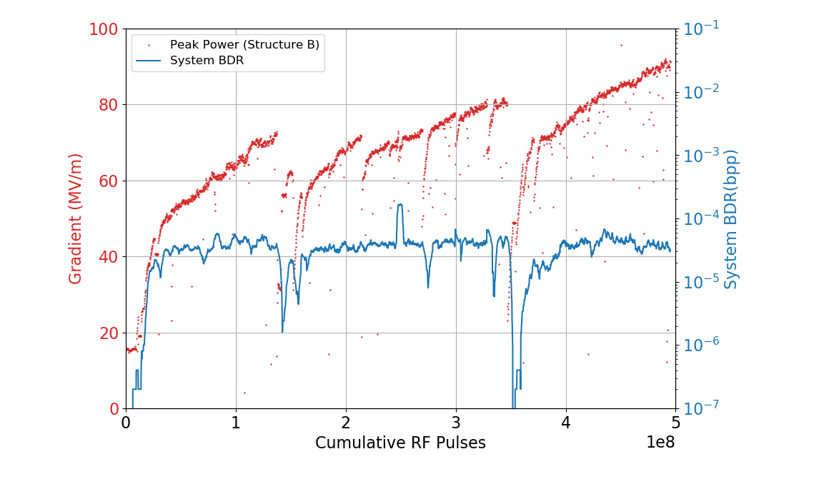
XBOX2
Chiller alarm on Friday evening, didn’t run during the weekend. Also had a software crash on Monday evening, so not much runtime.
Now at 35/31 MW (highest we have ever been!).
Parameters:
0.7us klystron pulse
50ns pulse
50Hz rep rate
Target Power: 40MW Peak in structure B
BDR Setpoint: 3E-5

Slide 4
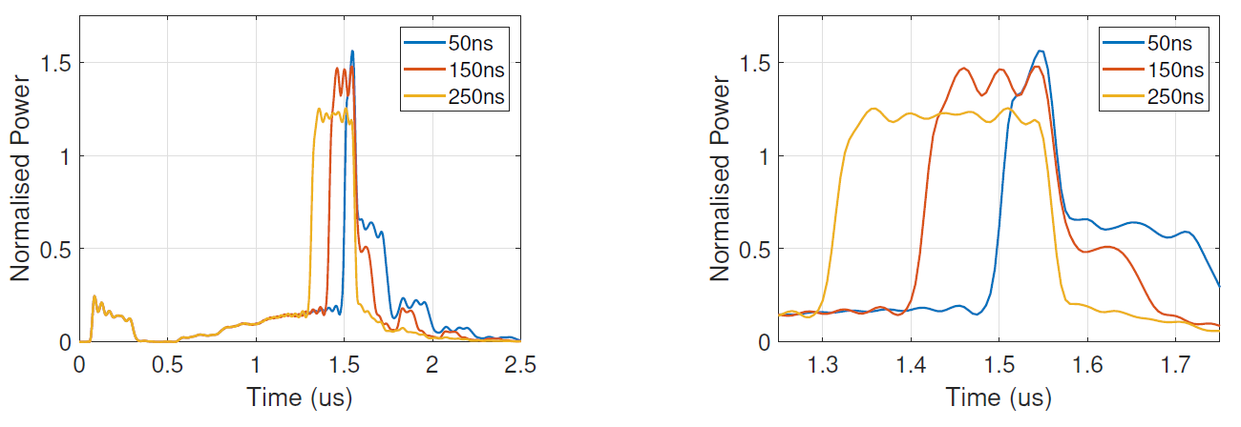
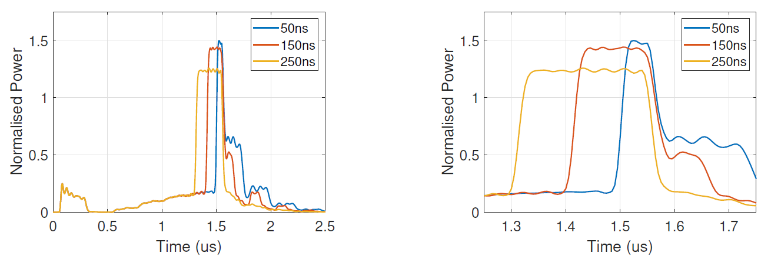
XBOX2 – Pulse Shape study.
Occasionally it is mentioned that the structures receive different pulse shapes.
Following last week I ran a quick study for different pulse lengths.
Shown are the pulses seen at Port 2 and Port 3.
As expected the dispersive effect more prominent at shorter pulse lengths.
Port 2
Port 3

Slide 5
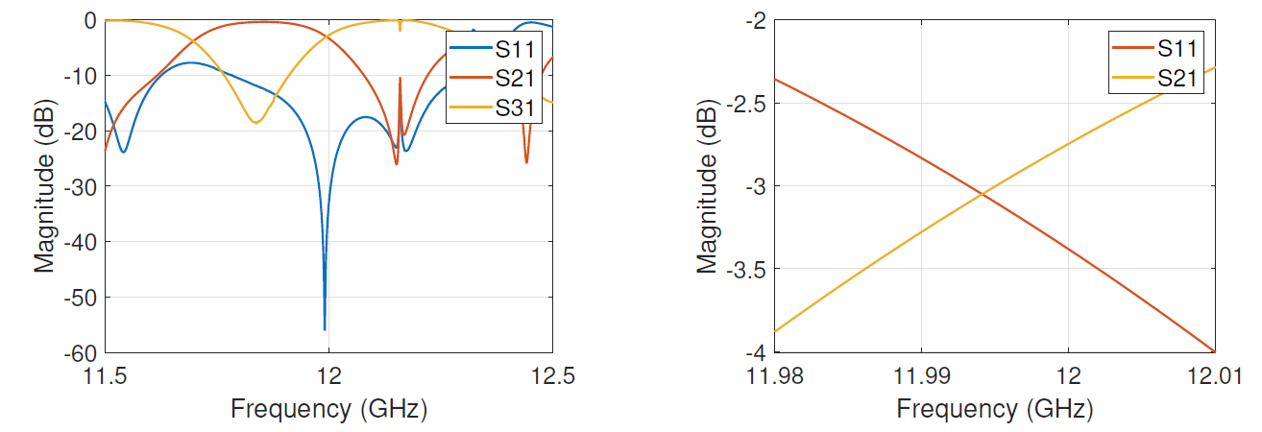
XBOX2 – Pulse Shape study.
Cause: Appears to be due to the difference between the S21 and S31 values of the power splitter. One filters high frequency components, the other filters lower frequency components.

Slide 6
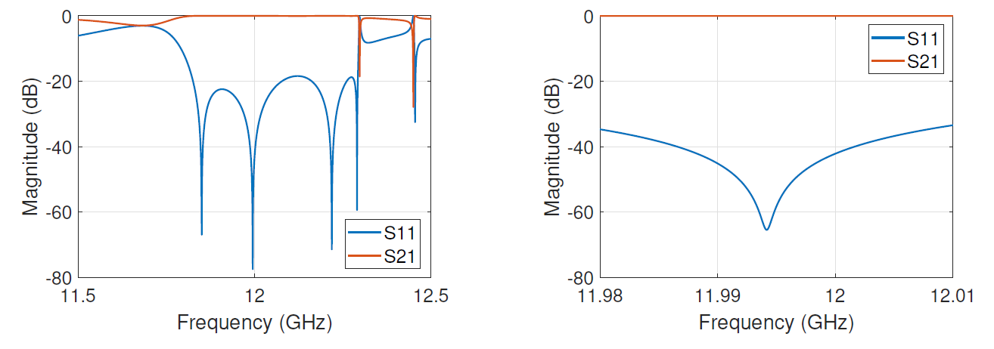
XBOX2 – Phase Shifter.
Phase Shifter has a negligible effect.

Slide 7
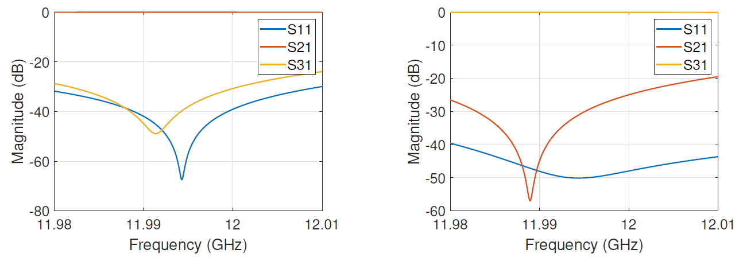
XBOX2 – Pulse Shape study.
If we deliver all power to port 2 or all power to port 3, the pulses are the same.
Piston Inserted
Piston Retracted

Slide 8
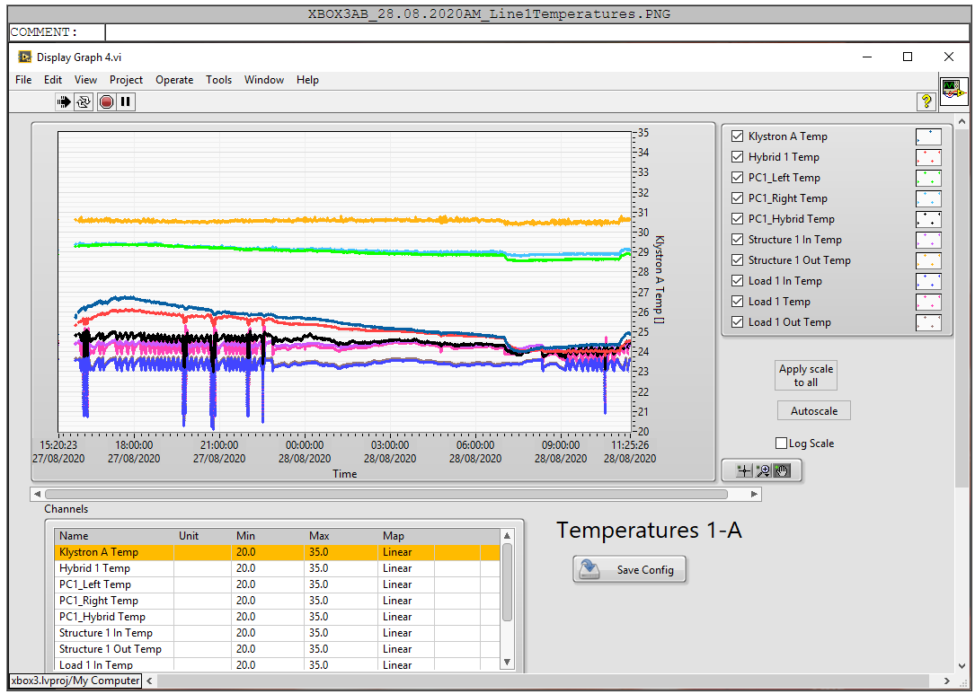
XBOX3 AB –Line 1 Structure Temp
Parameters:
1.3us klystron pulse
50ns pulse
50Hz rep rate
Current Power: 15.7MW

Slide 9
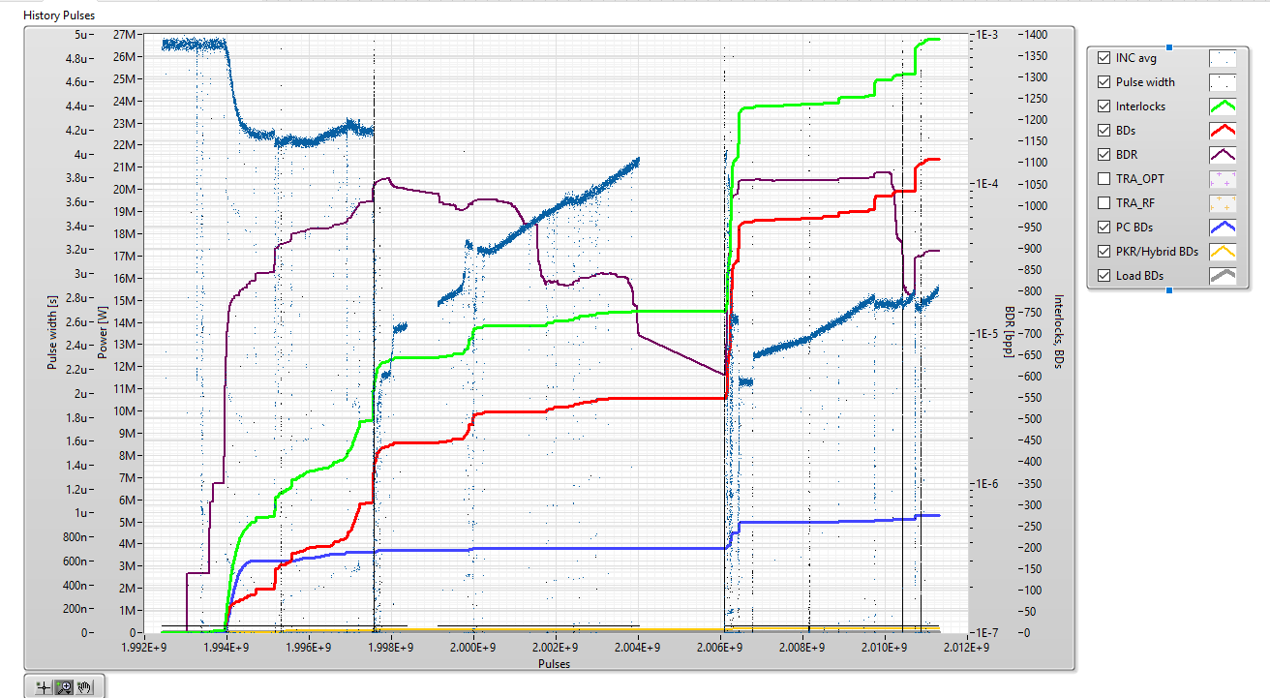
XBOX3 AB –Line 1 Pulses
Parameters:
1.3us klystron pulse
50ns pulse
50Hz rep rate
Current Power: 15.7MW
Bad Restart 1
Bad Restart 2

Slide 10
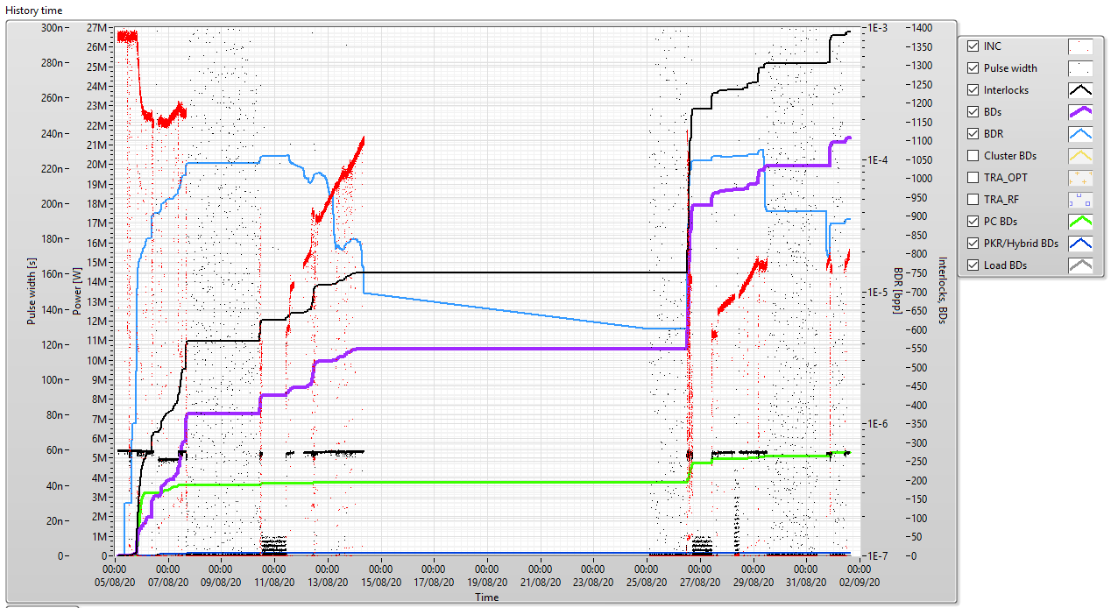
XBOX3 AB –Line 1 Time
Parameters:
1.3us klystron pulse
50ns pulse
50Hz rep rate
Current Power: 15.7MW

Slide 11
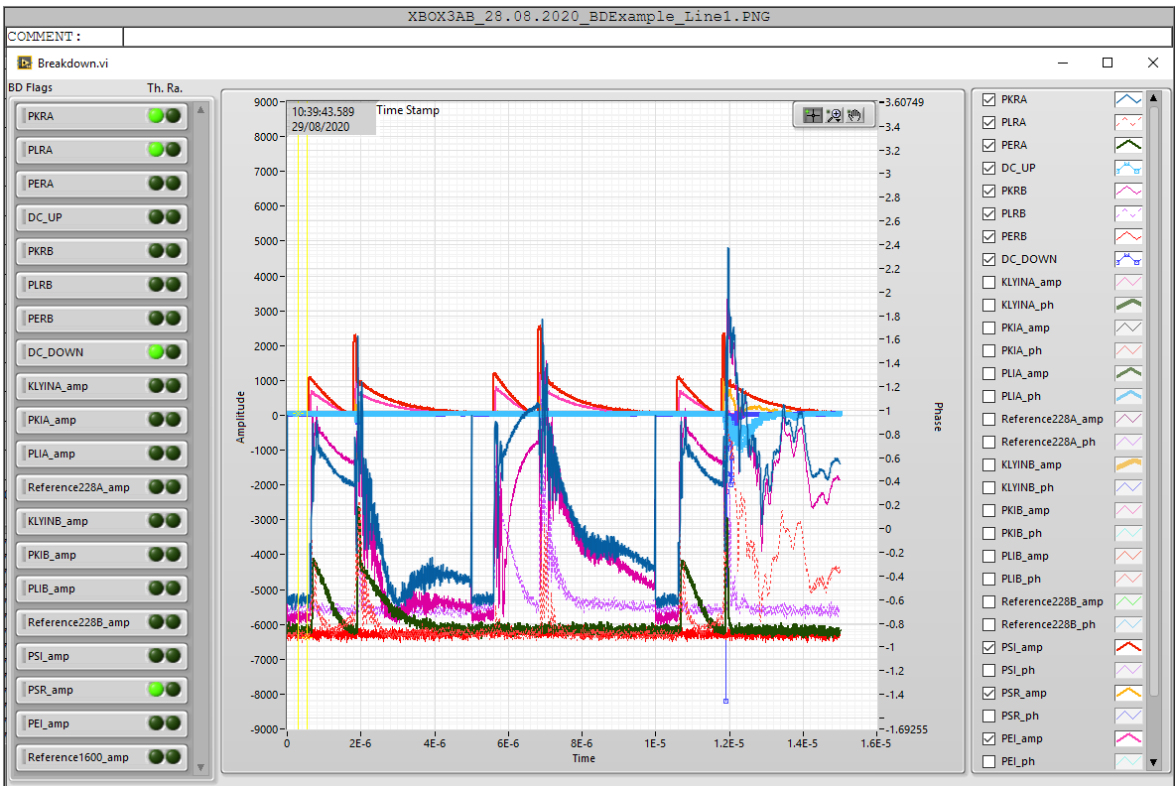
XBOX3 AB –Line 1 BD Example
Parameters:
1.3us klystron pulse
50ns pulse
50Hz rep rate
Current Power: 15.7MW

Slide 12
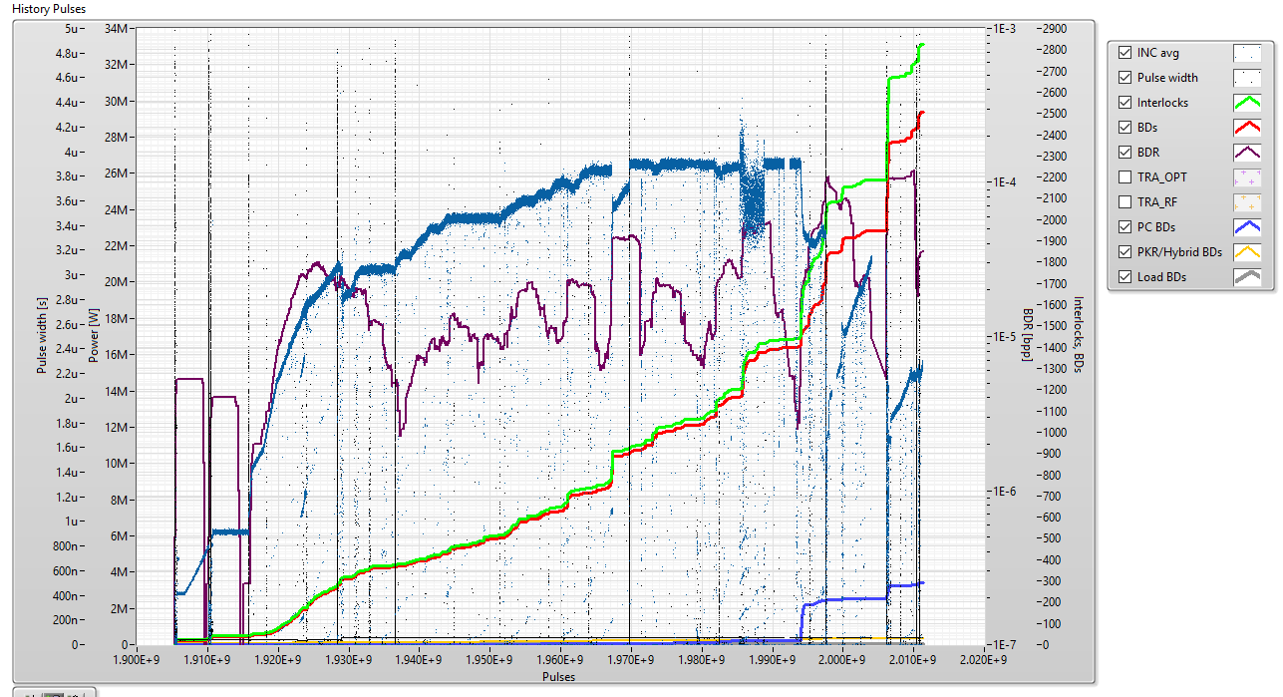
XBOX3 AB –Line 1 Full Reversed History
Parameters:
1.3us klystron pulse
50ns pulse
50Hz rep rate
Current Power: 23MW

Slide 13
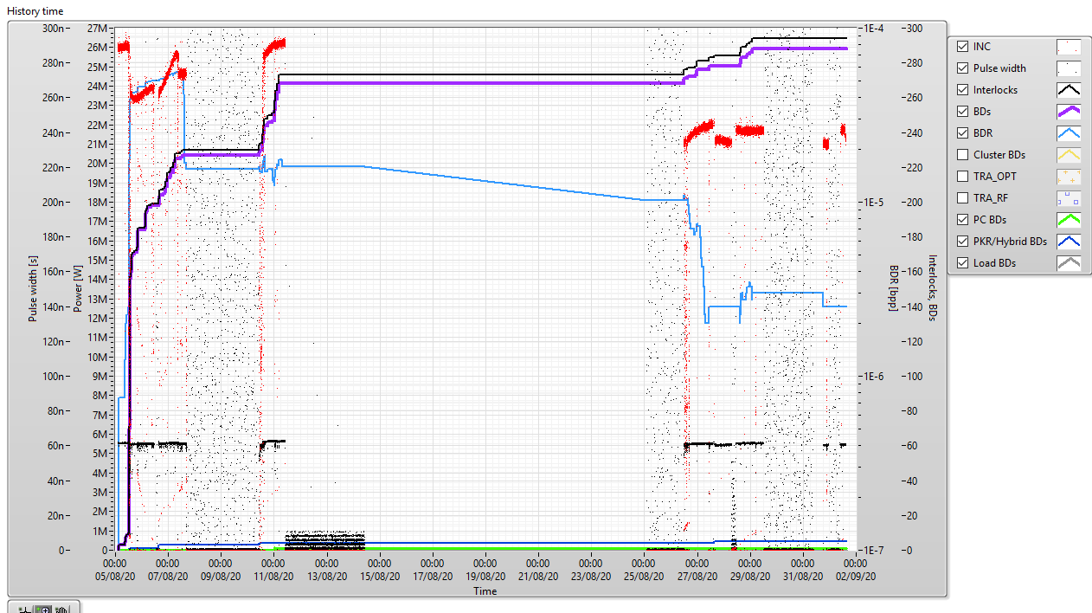
XBOX3 AB –Line 2 Time
Parameters:
1.3us klystron pulse
50ns pulse
50Hz rep rate
Current Power: 23MW

Slide 14
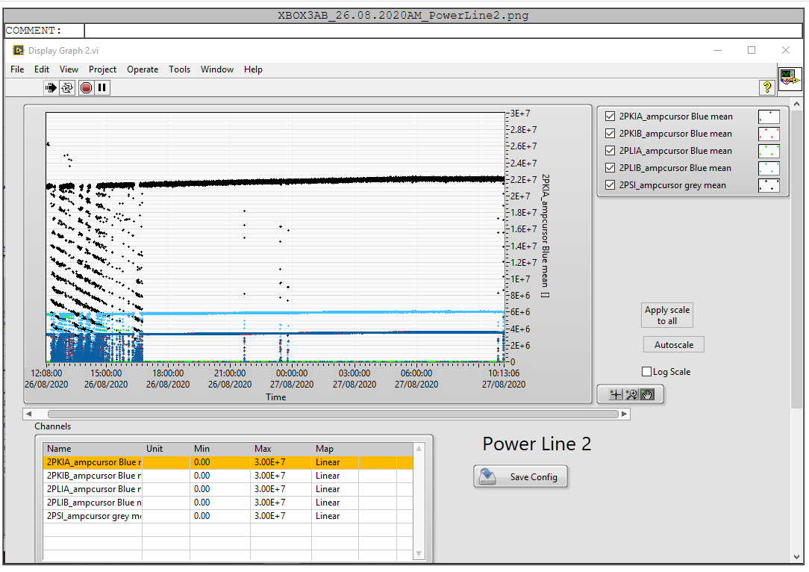
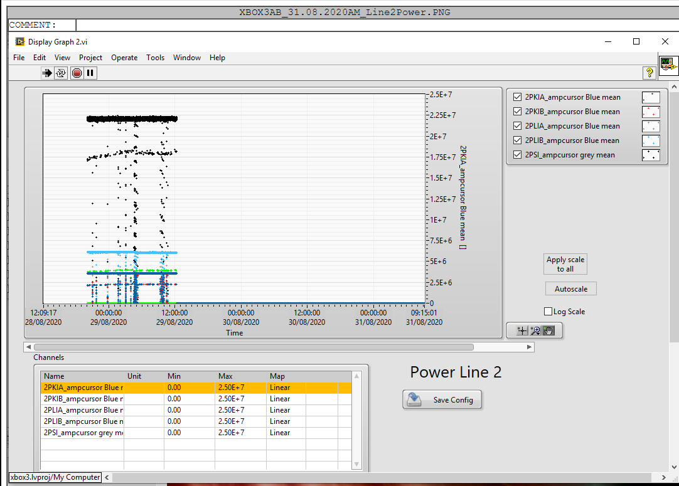
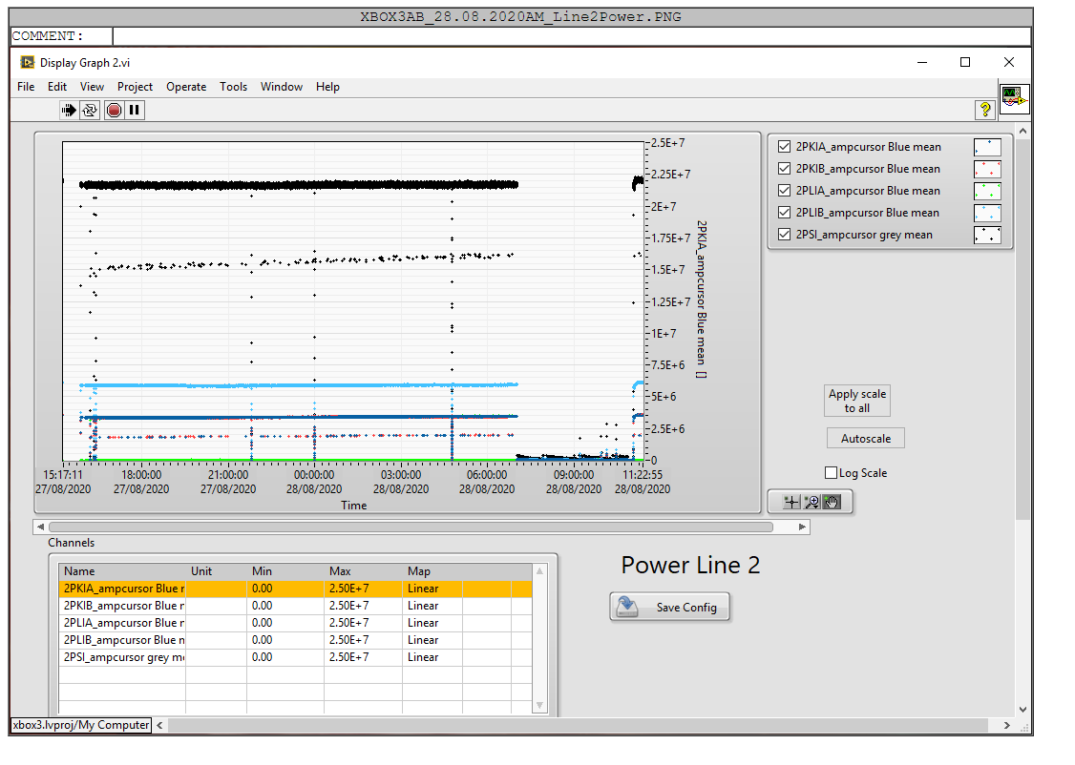
XBOX3 AB –Line 2 Time
Parameters:
1.3us klystron pulse
50ns pulse
50Hz rep rate
Current Power: 23MW

Slide 15
XBOX3 AB –Line 2 Time
Parameters:
1.3us klystron pulse
50ns pulse
50Hz rep rate
Current Power: 23MW

Slide 16
XBOX3 AB –Line 2 Time
Parameters:
1.3us klystron pulse
50ns pulse
50Hz rep rate
Current Power: 23MW

Slide 17
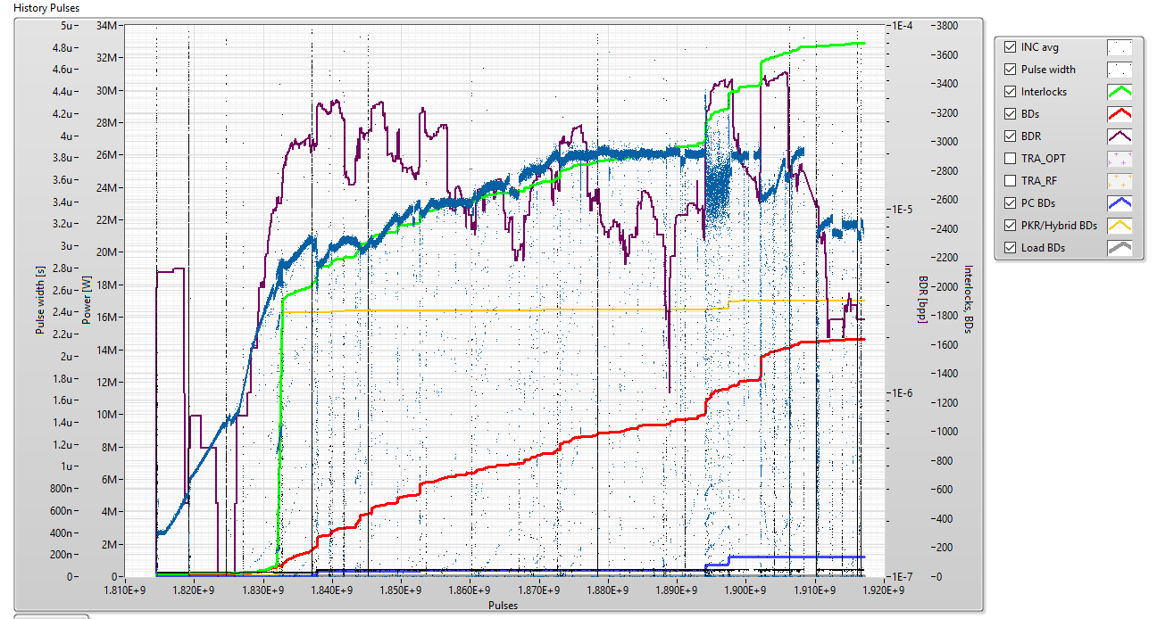
XBOX3 AB –Line 2 Full Reversed History
Parameters:
1.3us klystron pulse
50ns pulse
50Hz rep rate
Current Power: 15.7MW

