Slide 1
Content Management System for
HR
Catharina Hoch
18.5.2010

Slide 2
HR’s sites concerned
HR general
  http://cern.ch/hr
Recruitment
  http://cern.ch/jobs
Admin e-guide
  http://cern.ch/admin-eguide

Slide 3
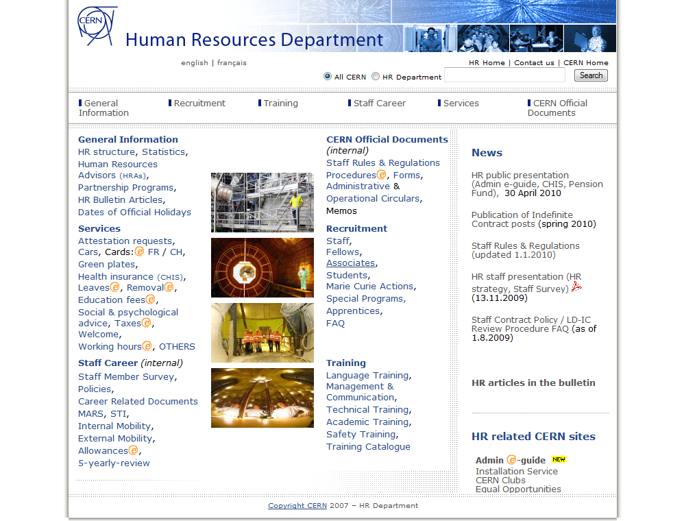
Notes:
Current HR web site (bilingual, content orientated)

Slide 4
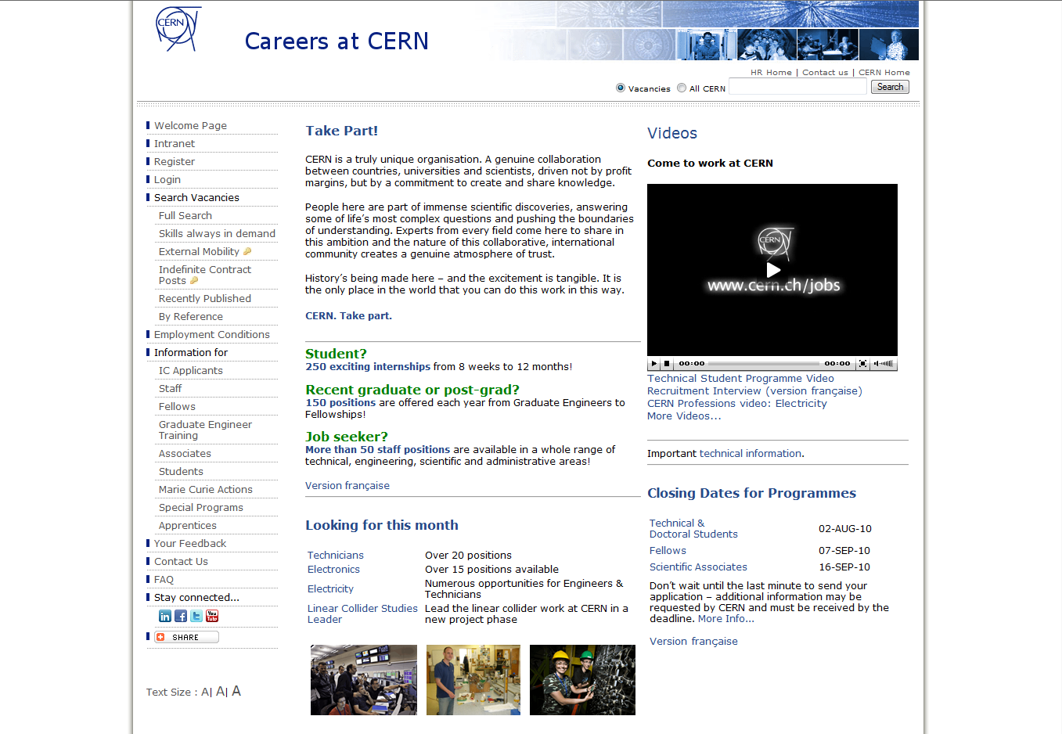
Notes:
current Recruitment site do be redone

Slide 5
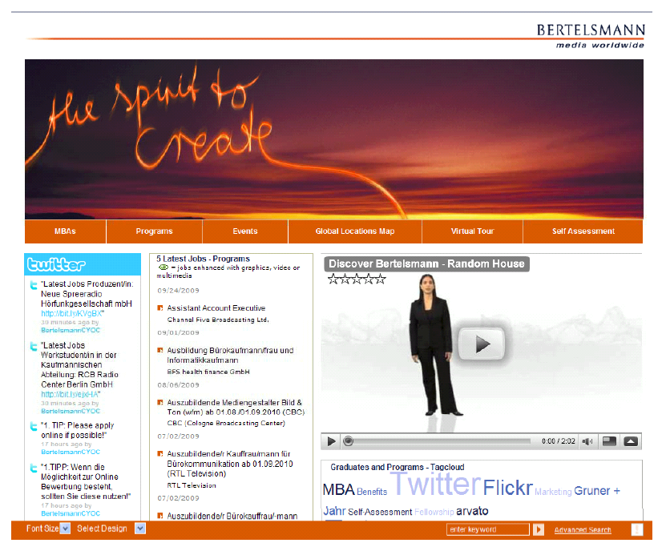
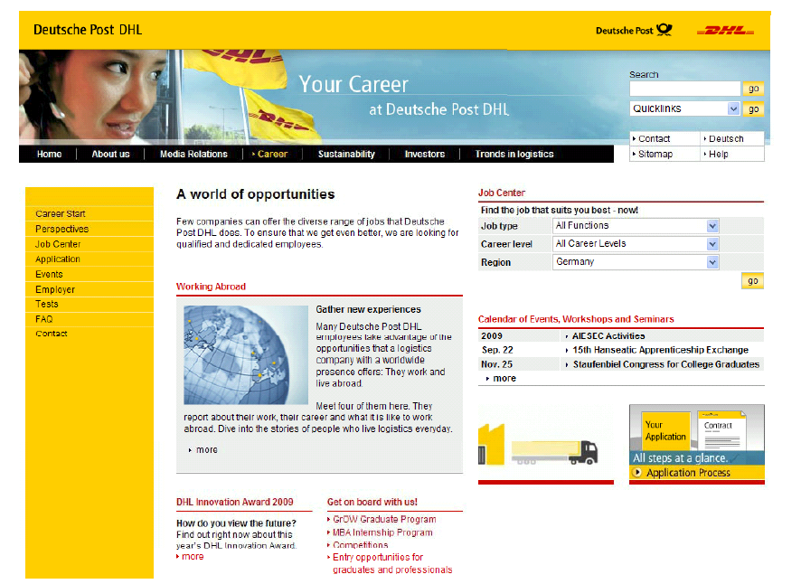
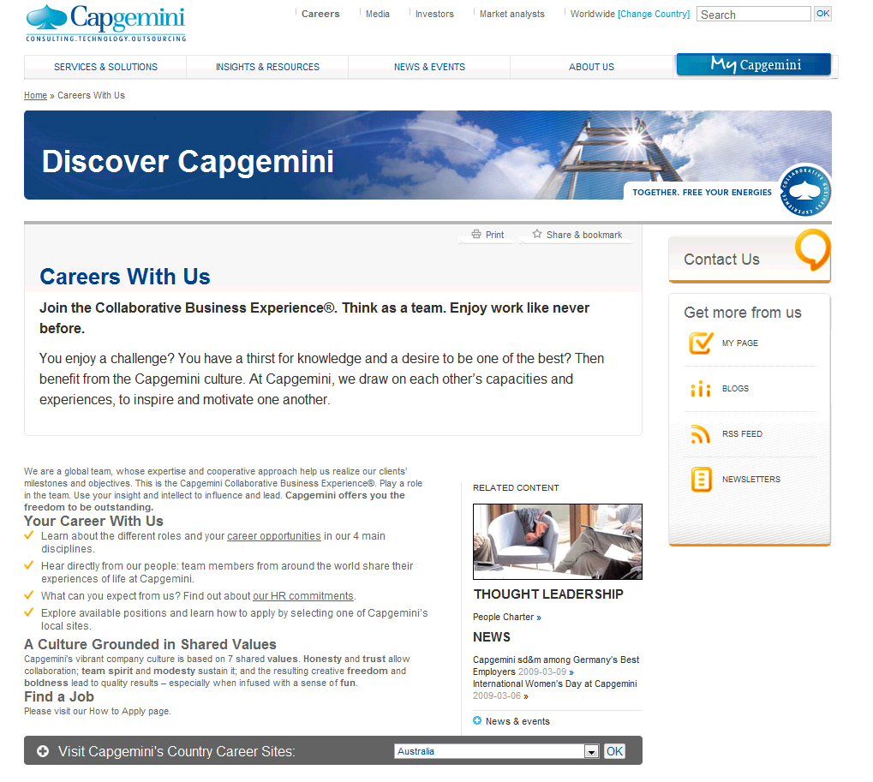
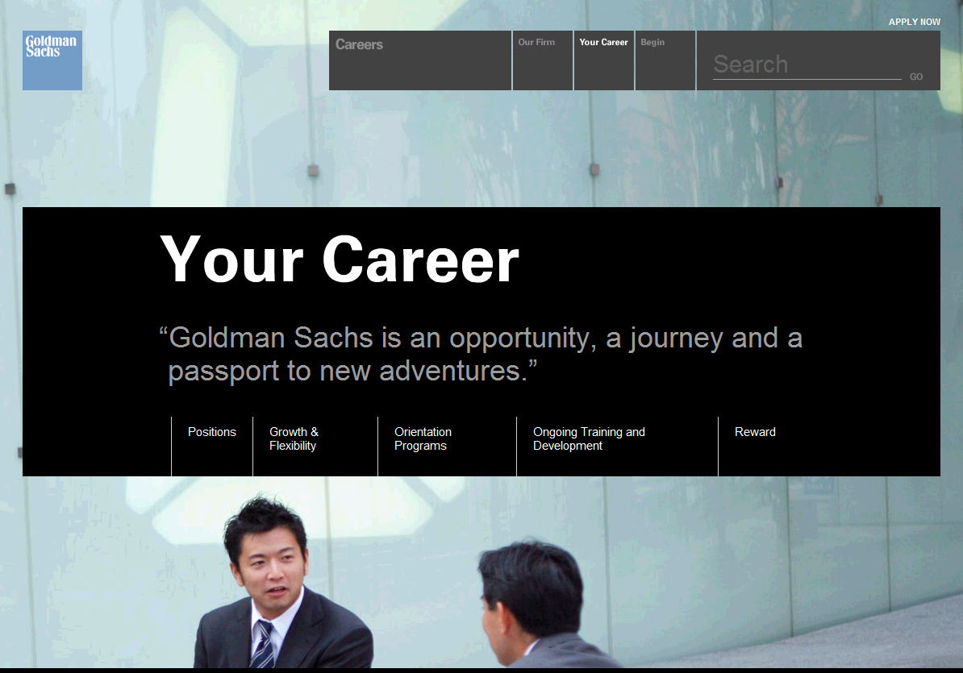
More attractive
Notes:
more attractive

Slide 6
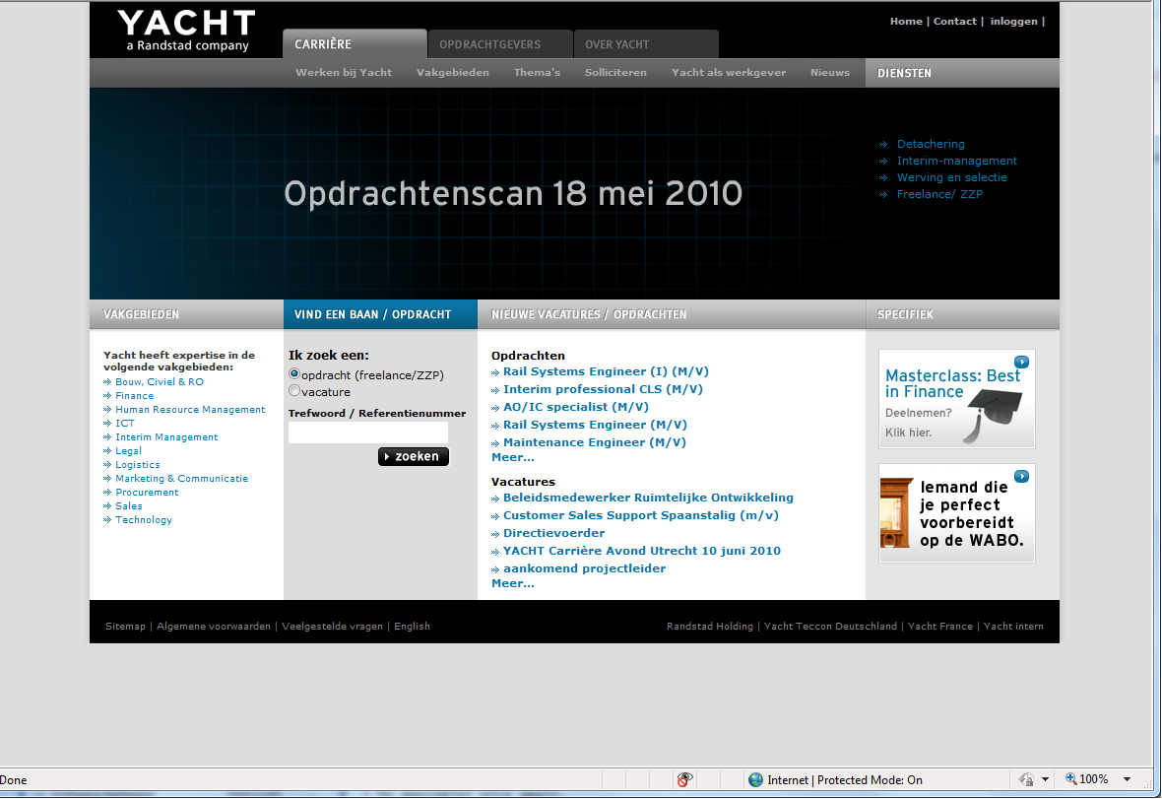
Including dynamic content
Notes:
http://www.yacht.nl/content/carriere/home/index.xml
Including dynamic content: e.g. XML feed from ICAMS (ert) into Flash component on CMS

Slide 7
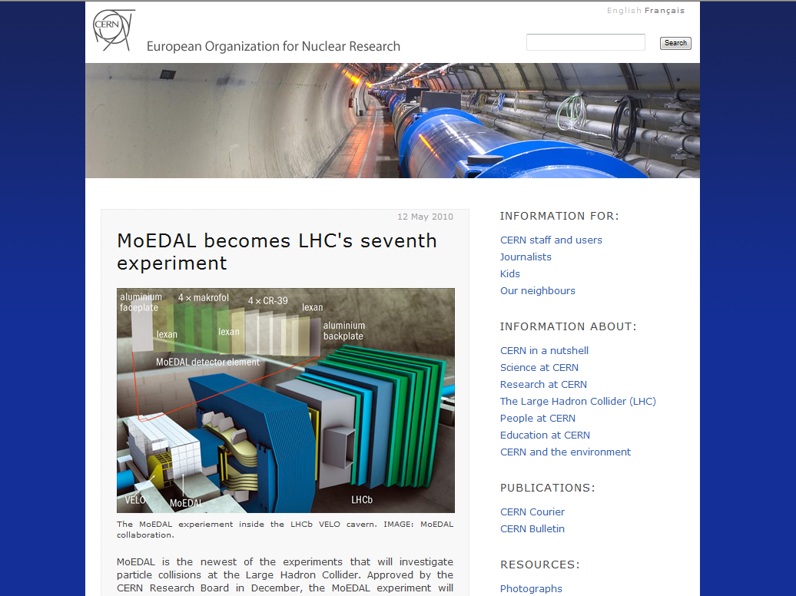
Integration with CERN home pages
Notes:
-> same visual branding as CERN’s public pages

Slide 8
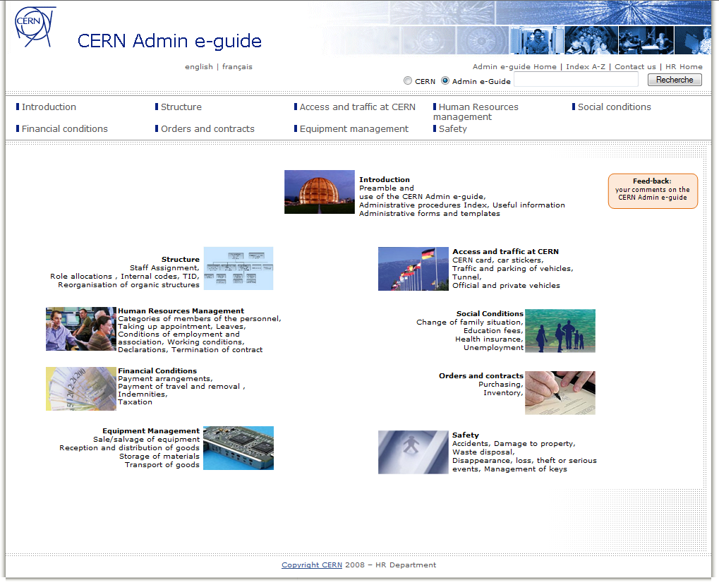
Notes:
Administrative e-guide
- bilingual
- powerful search
- content + managers all over CERN

Slide 9
HR’s needs - 1
Nice URLs
Common visual branding (CERN graphics templates)
Multilingual
Easy and independent content update by end-users
Dynamic content (integration of eRT)
Powerful search (meta data, content categorisation)
Notes:
easy to do basic formatting (such as bold, italic, tables, lists) without knowledge of HTML or CSS. Integrated spell-checker would be nice

Slide 10
HR’s needs - 2
Option for light/heavy pages (e.g. with/without videos)
Protected areas (single sign-on)
RSS
Accessibility
Bread crumbs
Tag clouds

Slide 11
Who does what
What we do
  Webmaster: Template design, information/site architecture
  End user: Edit , create & maintain content
What we expect IT to do
  Provide infrastructure
  Provide tool where training providers exist
  Demonstrate the tool works with real use case

