Slide 1



AAI technology and services in GEANT
Christos Kanellopoulos, GÉANT
email: christos.kanellopoulos@geant.org
twitter: @skanct
Senior Trust & Identity Manager
© GÉANT Association
As part of the GÉANT 2020 Framework Partnership Agreement (FPA), the project receives funding from the European Union's Horizon 2020 research and innovation programme under Grant Agreement No. 856728 (GN4-3).

Slide 2




2003
2010
2018
2020
Notes:
Innovation is at the core GEANT.
We are driving the future of networking technology and services to meet
the needs of our users - now and into the future.

Slide 3

2003
2010
2018
2020
Notes:
Innovation is at the core GEANT.
We are driving the future of networking technology and services to meet
the needs of our users - now and into the future.

Slide 4

2003
2010
2018
2020
Notes:
Innovation is at the core GEANT.
We are driving the future of networking technology and services to meet
the needs of our users - now and into the future.

Slide 5







GÉANT
AAIaaS
Implements the AARC Blueprint Architecture and expands eduGAIN to support virtual teams to manage their membership and to connect and manage access to native and web services.
Manages groups
Connects services
Manages access
Research
Infrastructures
or
NRENs
Users
Federated access to research resources
Notes:
r-infras/nres = should we add can connect to EOSC? Or should that be above ?
Need to add for all services privacy aspect ?

Slide 6
eduTEAMS Offerings
eduTEAMS Service
Provided by GÉANT to small and medium sized communities who want to get started with their virtual collaborations and take full advantage of the federated access without having to deal with the complexity of operating and supporting their own AAI. Supports multiple communities on the same platform. Provides everything required in order to securely collaborate and use services available to the GÉANT community and European Open Science Cloud.
eduTEAMS Dedicated
For communities requiring full control of their AAI, GÉANT can host and operate their own, dedicated AAI Service powered by the eduTEAMS technology. Communities can rely on the operational capabilities and expertise of GÉANT, while they are in full control of the policies, configuration and branding of their AAI.
eduTEAMS Bespoke
For those communities who require tailor-made functionality, such as integration with custom back-office and front-office systems, new features or enhancing their existing AAIs with new functionality available in eduTEAMS, GÉANT can provide bespoke solutions based on the eduTEAMS technology, which can include a combination of consultancy, development and hosting of the service.

Slide 7

Feature matrix
Feature | eduTEAMS Service | eduTEAMS Dedicated
User management
User Profile Management | ● | ●
R&S compatible user attribute set | ● | ●
Extensible User Attribute set |  | ●
User managed attributes | ● | ●
Account linking | ● | ●
Provisioning of accounts |  | ●
Step-up Authentication Service | Coming Soon

Slide 8
Feature matrix
Feature | eduTEAMS Service | eduTEAMS Dedicated
Community Organization & Management
Create new Communities | ●
Flexible Community structure | ● | ●
User onboarding to Community | ● | ●
Community managed Acceptable Usage Policy |  | ●
Community managed Privacy Policy |  | ●

Slide 9
Feature matrix
Feature | eduTEAMS Service | eduTEAMS Dedicated
Identity Sources
eduGAIN Identity Providers | ● | ○
Social Media Identity Providers (Google, Facebook, LinkedIn, Github, Bitbucket) | ● | ○
ORCID | ● | ○
Addition of other Identity Providers (SAML2, OIDC, OAuth2) |  | ●

Slide 10
Feature matrix
Feature | eduTEAMS Service | eduTEAMS Dedicated
Service Providers
REFEDS Research and Scholarship Services in eduGAIN | ● | ○
Services in eduGAIN supporting GÉANT Code of Conduct | ● | ○
GÉANT Community Services | ● | ○
EOSC Services | ● | ○
Add new Services (SAML or OIDC) | ● | ●

Slide 11
Feature matrix
Feature | eduTEAMS Service | eduTEAMS Dedicated
Protocol support
SAML2.0 | ● | ●
OpenID Connect 1.0 (Core, Discovery, Dynamic Registration) | ● | ●
OIDC Remote Introspection |  | ●
RFC 8693 – OAuth 2.0 Token Exchange | Coming Soon
RFC 7636 - Proof Key for Code Exchange by OAuth Public Clients | Coming Soon
RFC 8628 – OAuth 2.0 Device Authorization Grant | Coming Soon
OpenID Connect Federation 1.0 | 2021

Slide 12
Feature matrix
Feature | eduTEAMS Service | eduTEAMS Dedicated
Platform
Service Level Agreement |  | ●
REFEDS Research & Scholarship | ● | ○
REFEDS Sirtfi | ● | ○
GÉANT Code of Conduct | ● | ○
High Availability Configuration | ● | ●
Dedicated Installation |  | ●

Slide 13
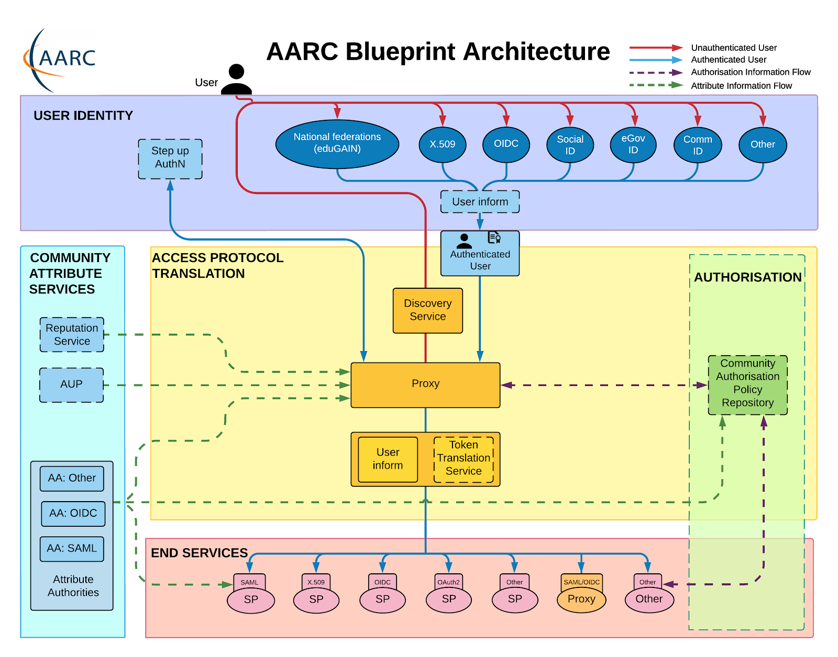






Interoperability

Slide 14
Interoperability
AARC Guidelines | AARC Identifier
Guidelines on expressing group membership and role information | AARC-G002
Exchange of specific assurance information between Infrastructure | AARC-G021
Guidelines for evaluating the combined assurance of linked identities | AARC-G031
Specification for expressing resource capabilities | AARC-G027
Implementing scalable and consistent authorisation across multi-SP environments | AARC-I047
A specification for IdP hinting | AARC-G049
Guidelines for expressing affiliation information | AARC-G025

Slide 15
Interoperability
AARC Guidelines | AARC Identifier
Guidelines for expressing community user identifiers | AARC-G026
AARC profile for expressing community identity attributes | AARC-G056
A specification for IdP hinting v2.0 | AARC-G049

Slide 16
Powered by eduTEAMS
FENIX Research Infrastructure AAI | Production (Transitioning)
LUMI - EuroHPC | Design
PRACE | Design
PaNOSC (UmbrellaID) – Photon and Neutron Sources - ESFRI Cluster Project | Production
EOSC Life – Life Science RIs - ESFRI Cluster Project | Production (Transitioning)
SSHOC – Social Sciences & Humanities Open Cloud - ESFRI Cluster Project | Production
VESPA - Virtual European Solar and Planetary Access - EuroPlanet | Production
LAGO – Latin American Giant Observatory | Production
NextGEOSS - European Earth observation data hub and platform | Production
EUROFusion – Realising Fusion Electricity in Europe | Pilot
SURF Research Access Management | Production (Transitioning)
GEANT | Implementation

Slide 17

Powered by eduTEAMS
FENIX Research Infrastructure AAI | Production (Transitioning)
LUMI - EuroHPC | Design
PRACE | Design
PaNOSC (UmbrellaID) – Photon and Neutron Sources - ESFRI Cluster Project | Production
EOSC Life – Life Science RIs - ESFRI Cluster Project | Production (Transitioning)
SSHOC – Social Sciences & Humanities Open Cloud - ESFRI Cluster Project | Production
VESPA - Virtual European Solar and Planetary Access - EuroPlanet | Production
LAGO – Latin American Giant Observatory | Production
NextGEOSS - European Earth observation data hub and platform | Production
EUROFusion – Realising Fusion Electricity in Europe | Pilot
SURF Research Access Management | Production (Transitioning)
GEANT | Implementation
    eduTEAMS one of the components of EOSC AAI
    eduTEAMS technology underpins AAI for the Erasmus Student mobility

Slide 18

Thank you

