Slide 1
Current status of IST Procedures
System Name | Link to document | Status/Validity | References
13kA EE | https://edms.cern.ch/ui/file/2278630/1.0/LHC-DQEE-TP-0002-1-0.pdf | RELEASED | EDMS N0. 2278630 Rev. 1.0, 02-06-2020 Ref. LHC-DQEE-TP-0002
600A EE | https://edms.cern.ch/file/1380150/0.4/LHC-DQEMC-TP-0001_v0.4.docx | Under Approval DRAFT | EDMS N0. 1380150 Rev. 0.4, xx-xx-2020 Ref. LHC-DQEMC-TP-0001
QDS | https://wikis.cern.ch/display/MPEEP/QDS-IST+Specifications?preview=/152208254/153714760/QDS_IST_2020_v02.pdf | In Preparation DRAFT | EDMS N0. xxxx Rev. 5.0, xx-xx-2020 Ref. LHC-DQ-TP-0002
PIC | https://edms.cern.ch/file/531823/1.2/LHC-CI-TP-0001-10-13.docx | RELEASED DRAFT(?) | EDMS N0. 531823 Rev: 1.3, 19-08-2020 Ref. LHC-CI-TP-0001
CL Heating System | https://edms.cern.ch/document/2406291/1 | Engineering Check DRAFT | EDMS N0. 2406291 Rev: 0.2, 14-08-2020 Ref. LHC-DQCLHS-TP-000?
WIC | https://edms.cern.ch/ui/file/896395/3.0/LHC-OP-MPS-0010-3-0.pdf | RELEASED | EDMS N0. 896395 Rev. 3.0, 24-06-2016 Ref. LHC-OP-MPS-0010

Slide 2
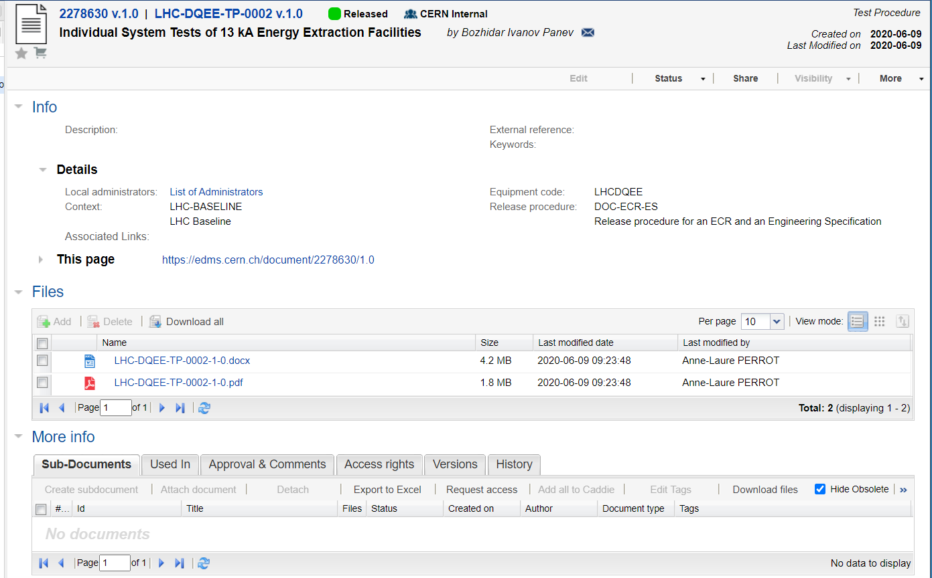
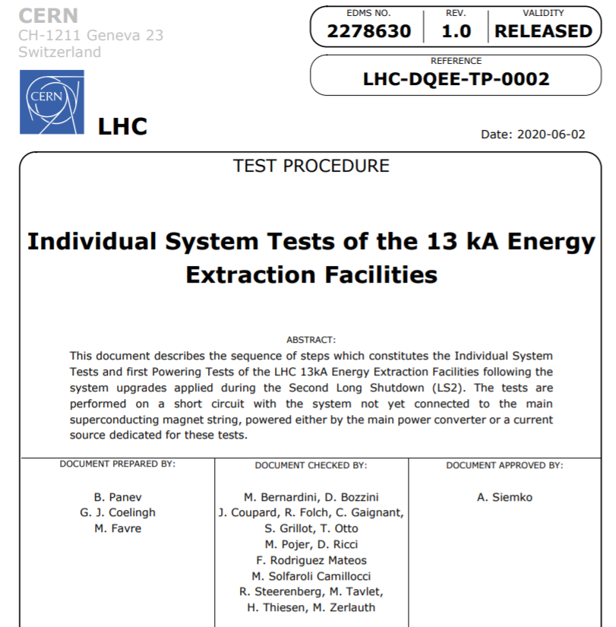
13kA EE
Back to Table

Slide 3
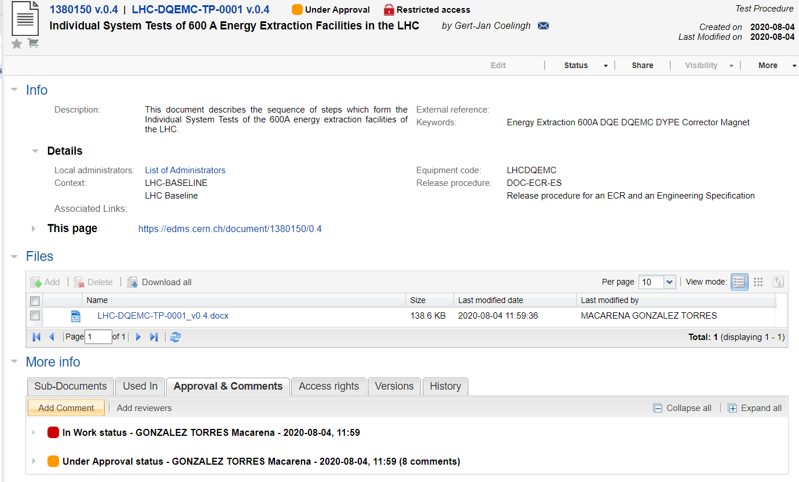
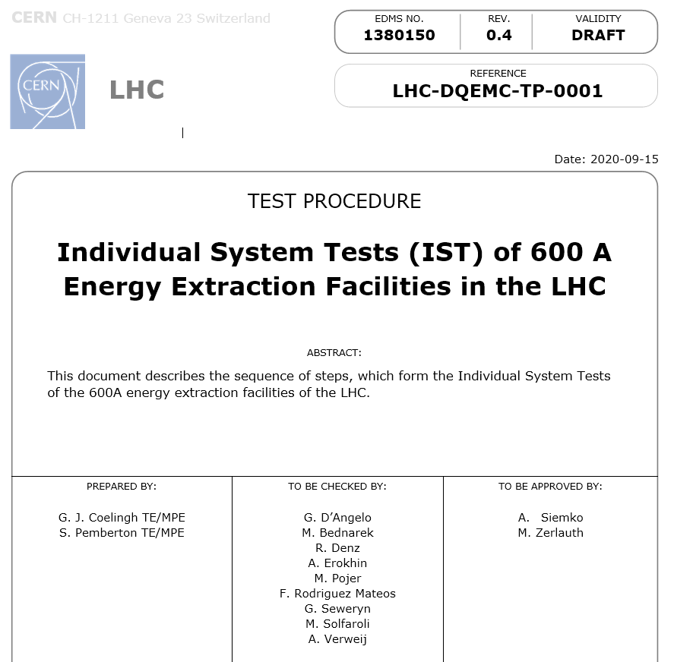
600A EE
Back to Table

Slide 4
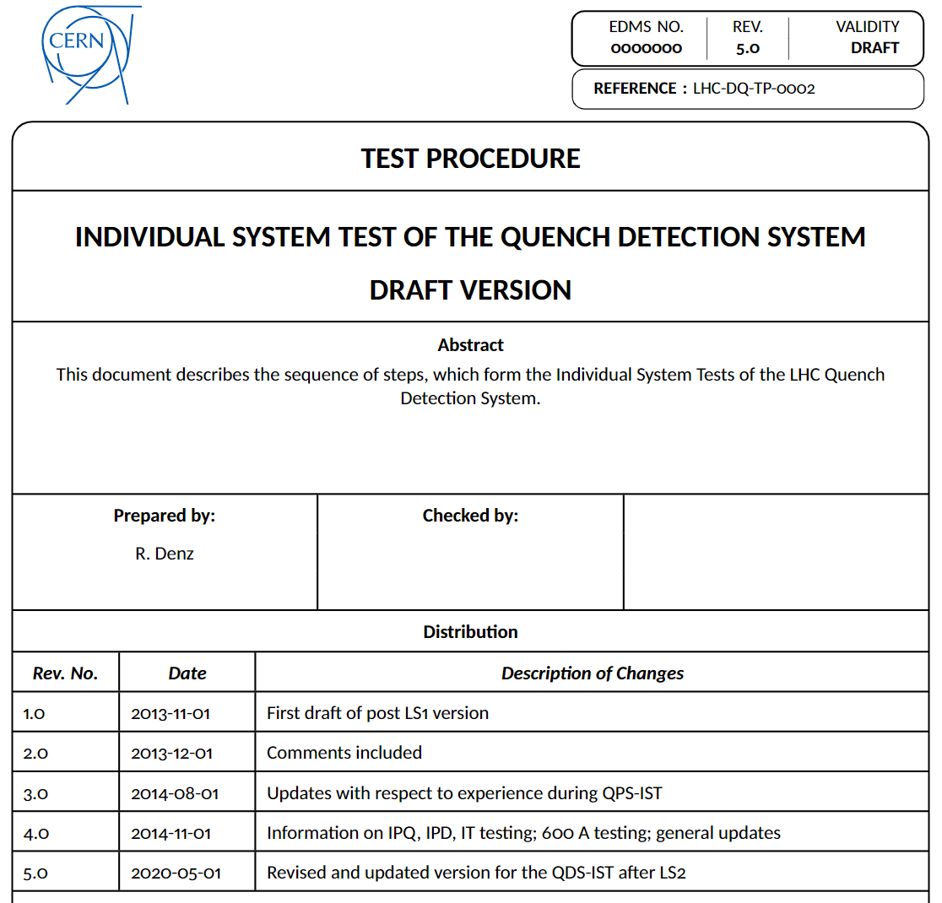
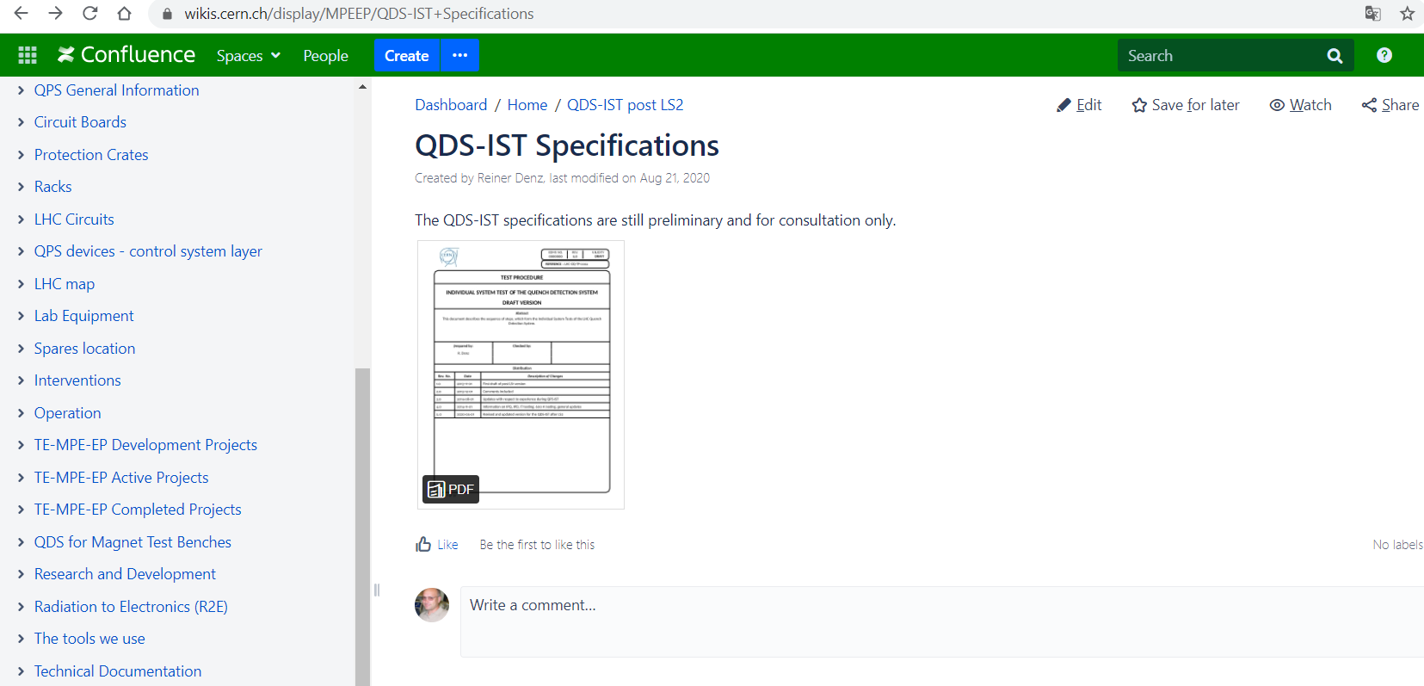
QDS
Back to Table

Slide 5
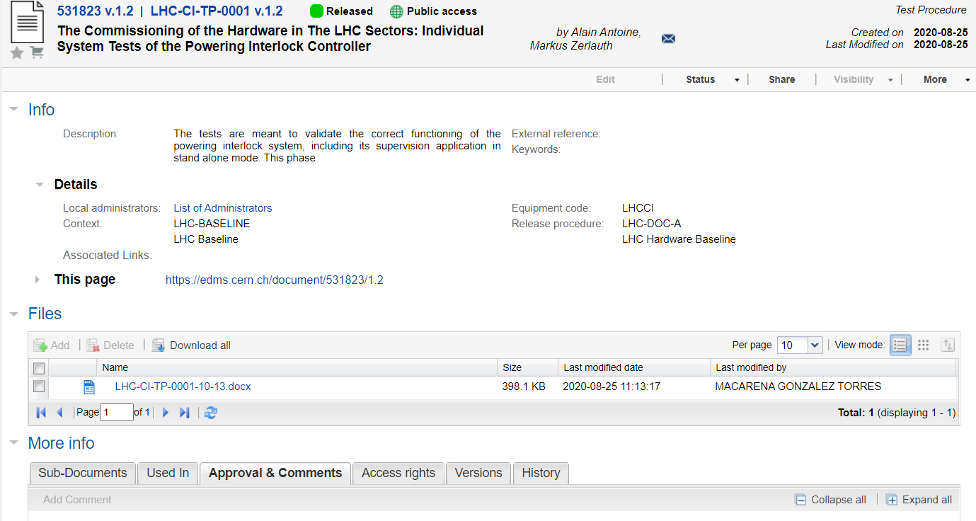
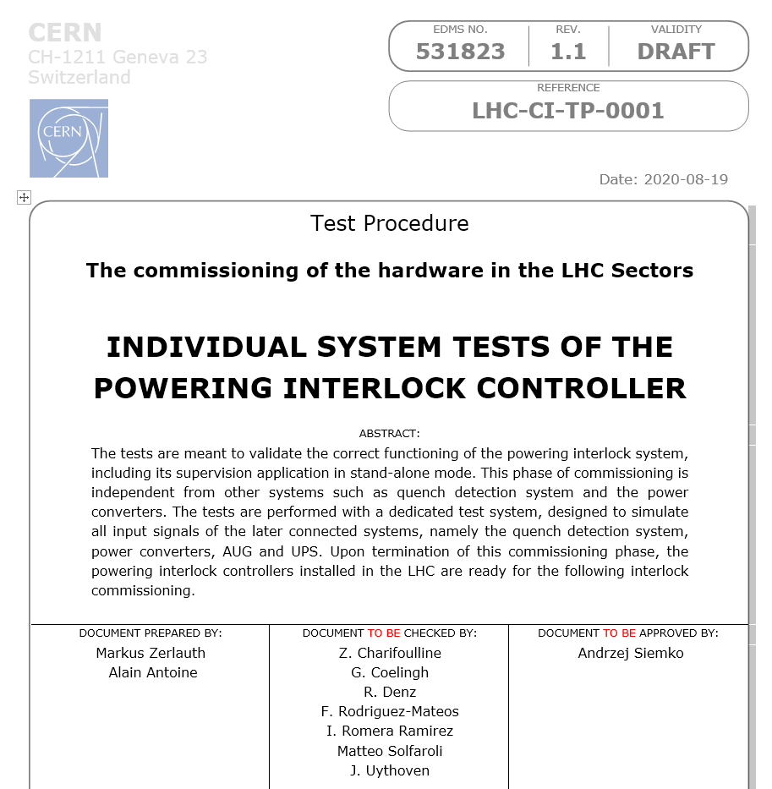
PIC
Back to Table

Slide 6
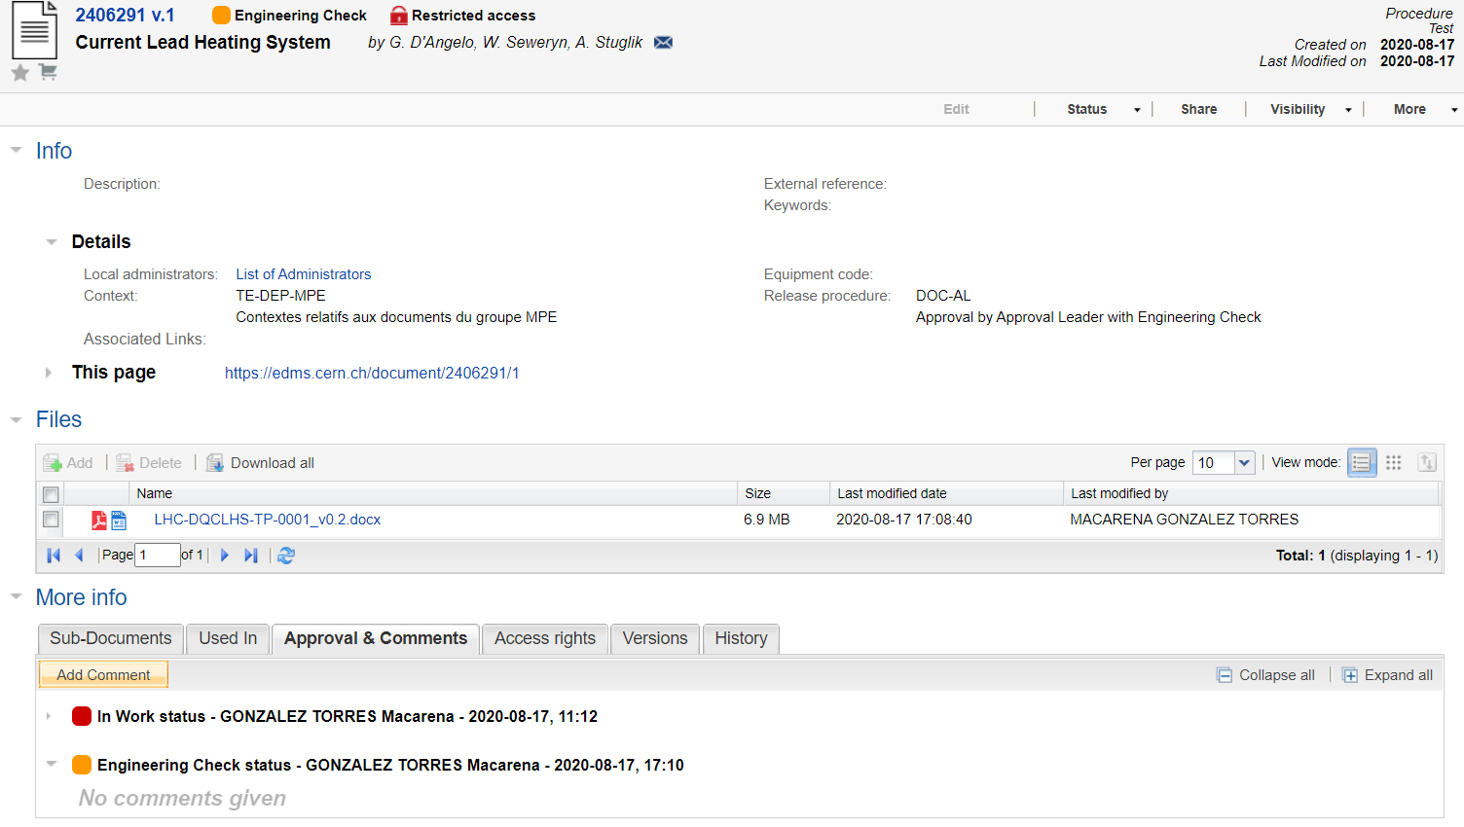
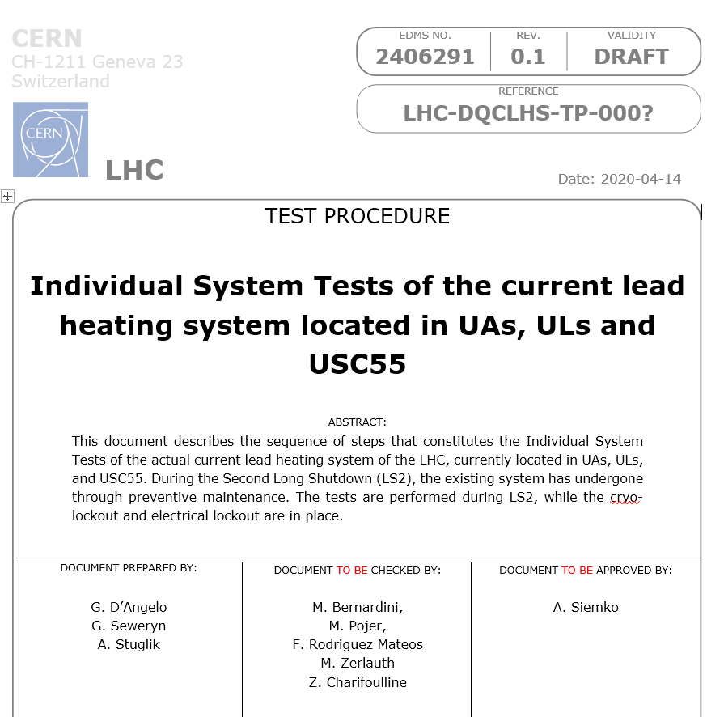
Current Lead Heating System
Back to Table

Slide 7
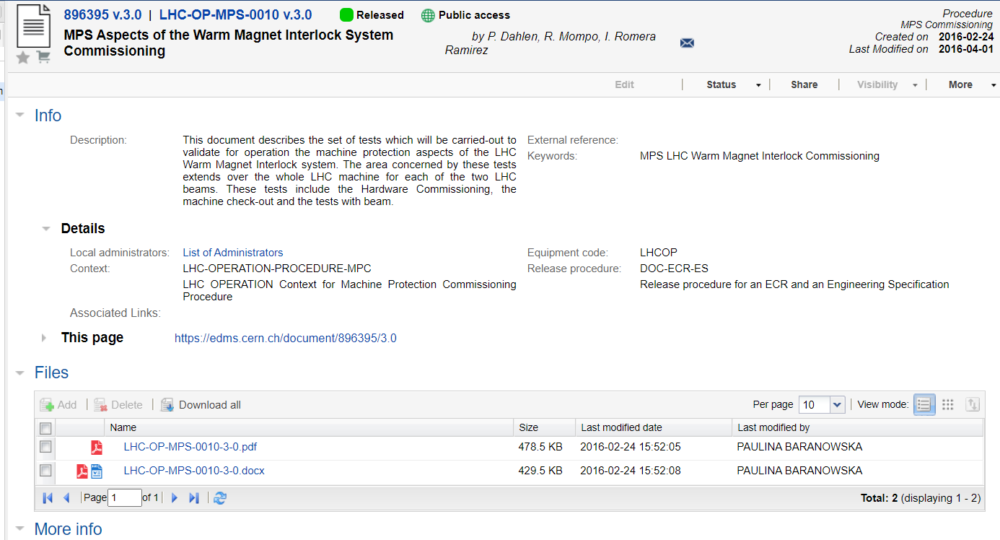
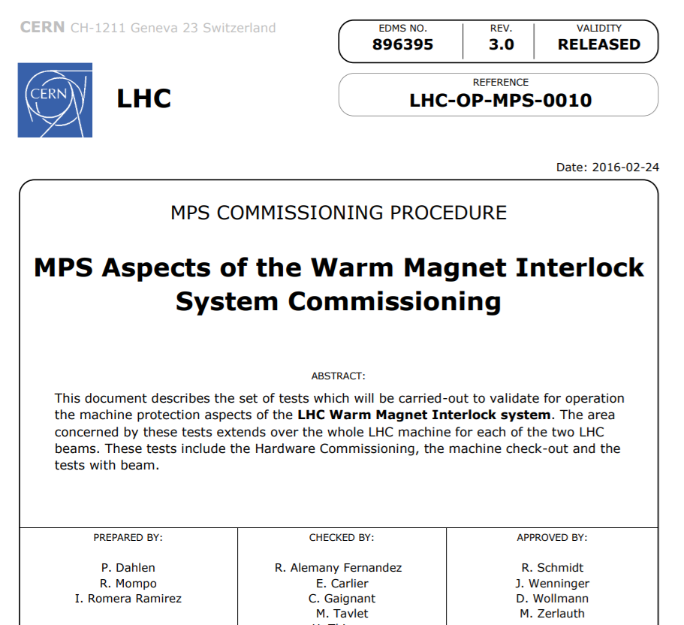
WIC
Back to Table

Slide 8
Thanks!

