Slide 1
Deep Learning for Disaster Relief: Generating Synthetic High Resolution Images
Openlab Lightning Talk
Surendrabikram Thapa
09/24/2020

Slide 2
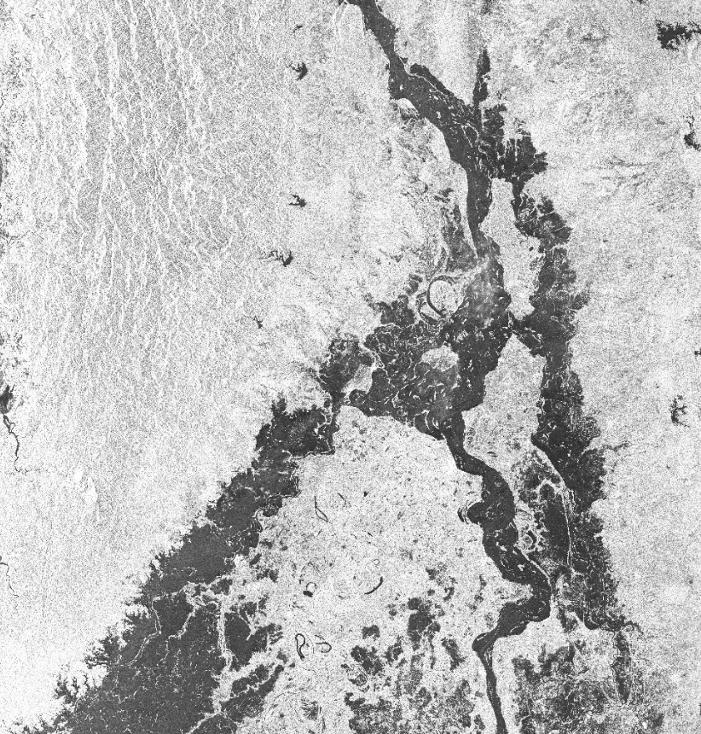
Satellite Images: Importance
Use of Satellite images:
Relief Works
Risk Assessment due to disasters like Flood
Phenomenal in making strategies for some of the critical problems like refugee management
Planning and high level overview of the status of different crisis
Applications in Deep Learning
Building models to make relief works easier
Ensure efficiency and timeliness of the rescue and rehabilitation operations
Make systems for sharing information sharing to response teams as early as possible
Fig. Flood Image of Myanmar provided by UNOSAT

Slide 3
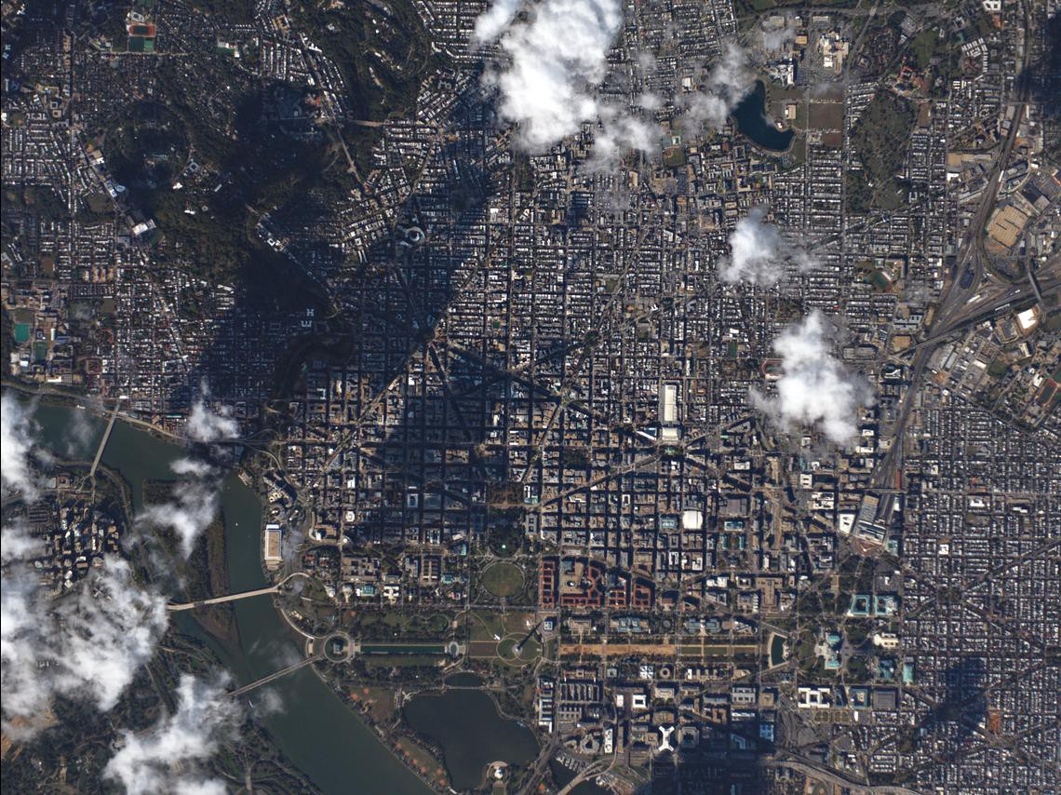
Synthetic Images for Satellite Images
This work was done in collaboration with UNOSAT
Image imputation for distorted images, for examples the images taken by a satellite in cloudy environment.
Data Augmentation
Synthetic Images can be shared with a lot of stake holders outside the imaging organization. This is the objective of UNOSAT in particular.
Similarly, for open-source projects, synthetic images are useful.

Slide 4
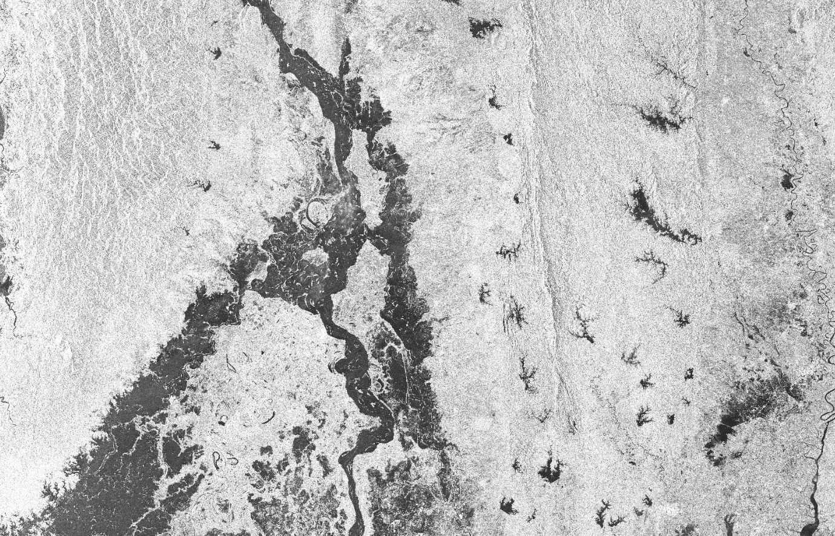
OBJECTIVE OF THE PROJECT: IMAGE COMPLETION WHERE THE GENERATION OF EACH TILES ARE CONDITIONED ON PREVIOUSLY GENERATED TILES

Slide 5
FIRST STEP: CONDITIONING THE GENERATION OF SECOND TILE WITH INFORMATION FROM FIRST

Slide 6
SECOND STEP: COMPLETING THIRD TILE WITH INFORMATION FROM FIRST AND SECOND (GENERATED) TILE

Slide 7
FINAL STEP: THE COMPLETE IMAGE WHICH IS COMPLETED BY CONDITIONING THE GENERATION OF EACH TILES

Slide 8


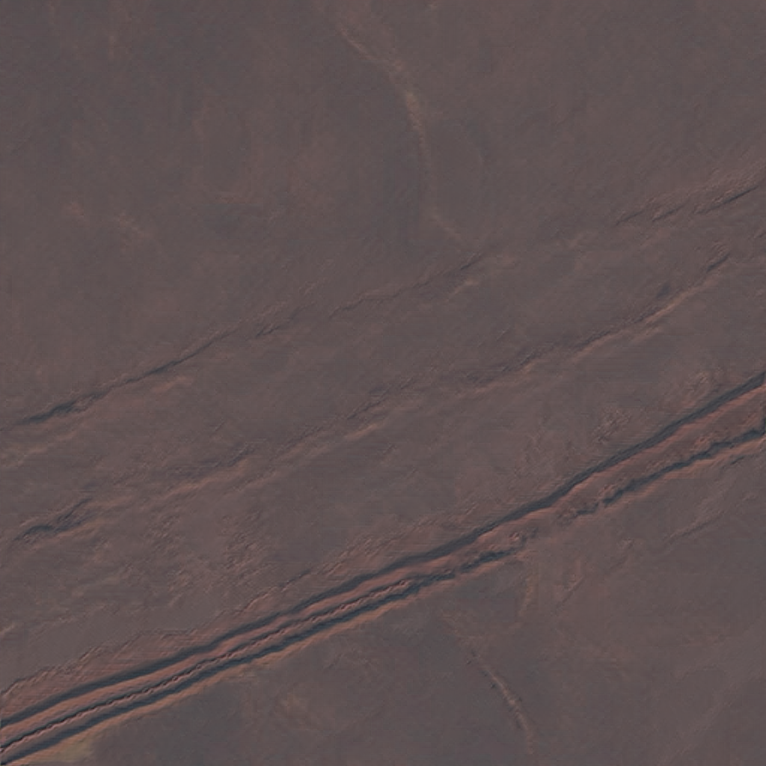
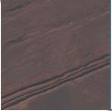
Progressive Conditional GAN
Encoder
Dataset
Discriminator
Critic
Encoder
Loss
Encoder
Generator
Noise
̴̴N(0, I)

Slide 9
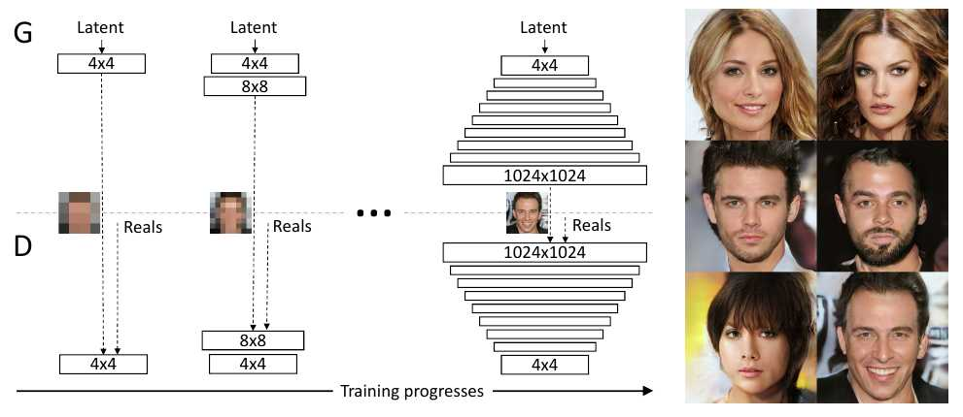
Progressive GANs
Karras, Tero, et al. "Progressive growing of gans for improved quality, stability, and variation."

Slide 10
A slightly different approach…
Conditional Progressive GANs with Multiple Encoders
Nature of Conditional GAN
Unlike most of the previous works using a combination of reconstruction, contextual or/and adversarial losses, our method is strictly conditional and only (Conditional) GAN-based so that it preserves the key-feature of CGAN.
Why Encoders?
The major issue having a strict GAN architecture lies in the fact that the conditional part is too large to be directly injected as input into the Generator. It should be encoded creating a bottle neck limiting the quantity of information transmitted to the Generator.
To tackle this issue, we introduced secondary encoders re-injecting information at each stage of the Progressive Generator.

Slide 11
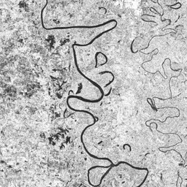
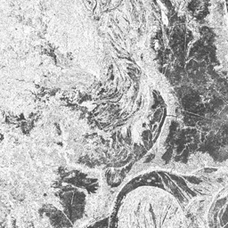
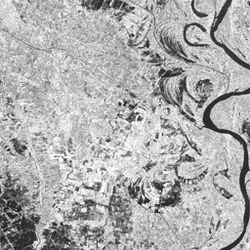
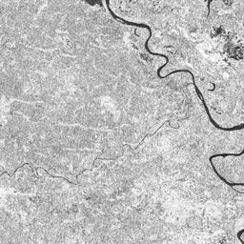
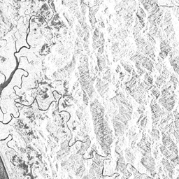
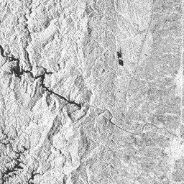
THE DATASET
UNOSAT Flood Dataset

Slide 12
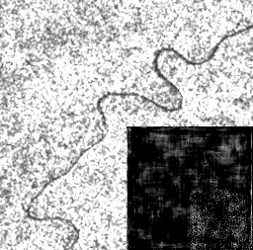
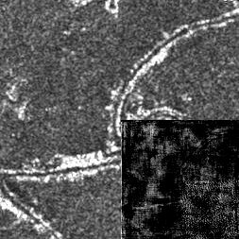
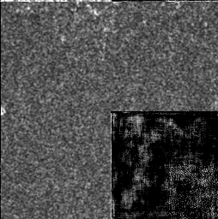
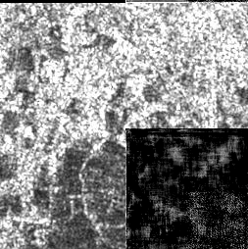
THE FIRST STEP
Correctly guessing the fourth tile!

Slide 13
THE APPROACH
Initializing the training
Nature of the dataset
256 X 256
Single Channel

Slide 14
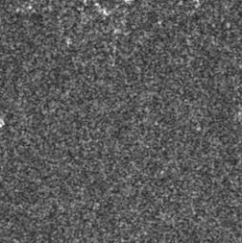
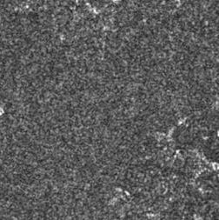
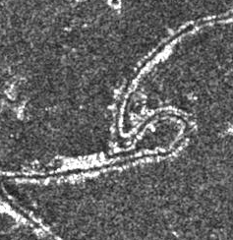
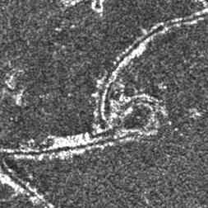
RESULTS
REAL IMAGES
FAKE IMAGES

Slide 15
FURTHER WORKS
Completing a bigger image tile by tile rather than filling the fourth tile only.
Assessing the quality of the GAN by testing on various datasets.
Evaluating the performance with standard evaluation metrics.

Slide 16
QUESTIONS?
surenthapa5803@gmail.com

