Slide 1
Intel oneAPI Integration Tests With the ATLAS Offline Software
CERN Openlab online summer intern project presentations
Speaker: Angéla Czirkos, supervisor: Attila Krasznahorkay
24 / 09 / 2020

Slide 2
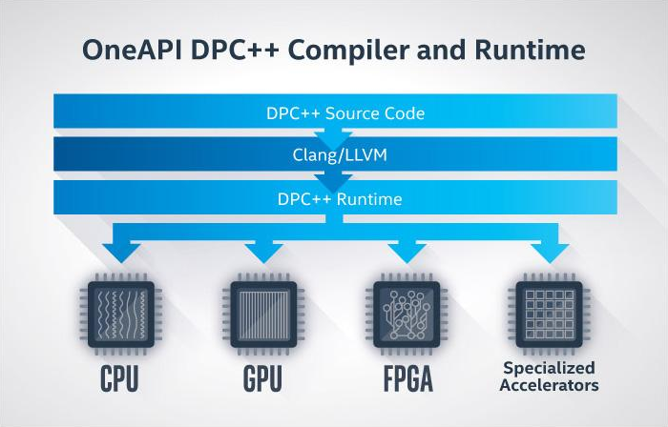
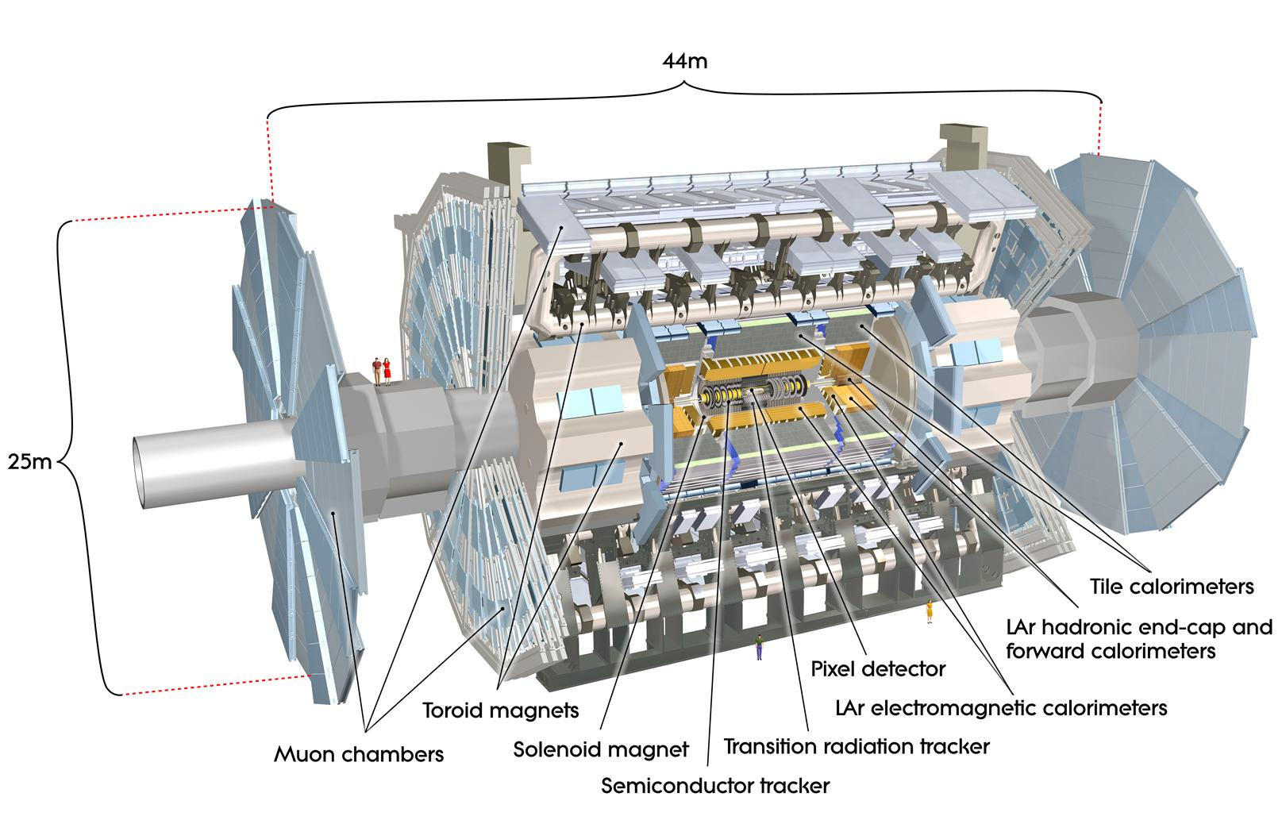

SYCL/DPC++
Use Intel oneAPI, SYCL and DPC++ to utilize heterogeneous backends
Investigate how GPUs could be used with the ATLAS Offline Software → implement SYCL/DPC++ algorithm for the tracking software.

Slide 3
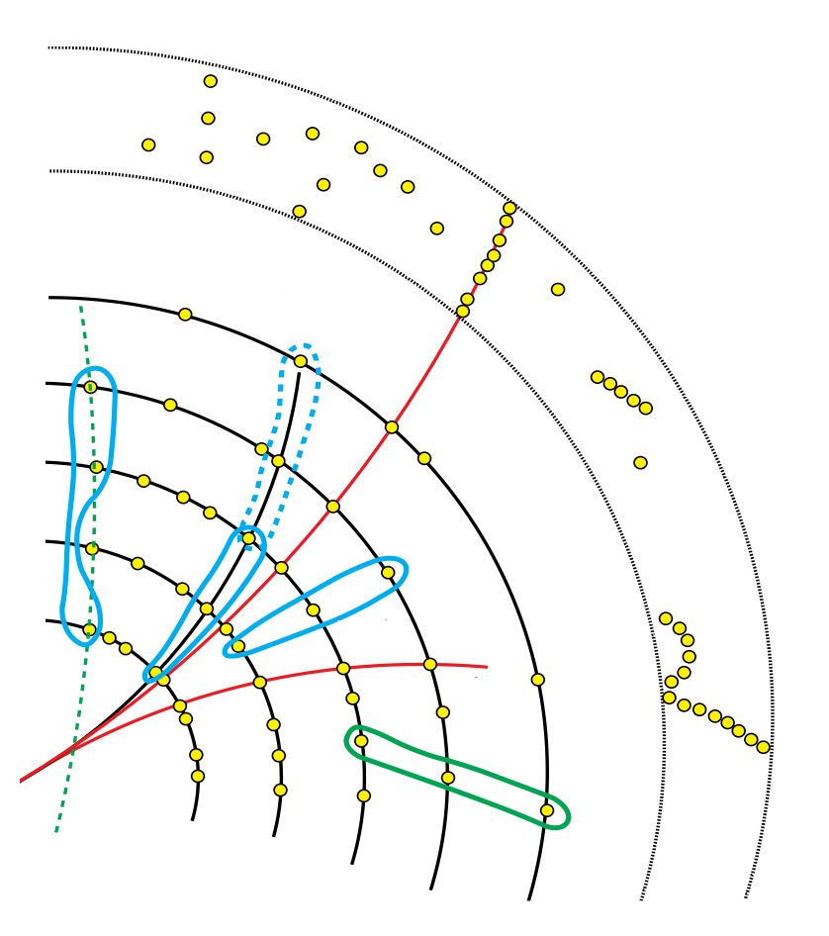
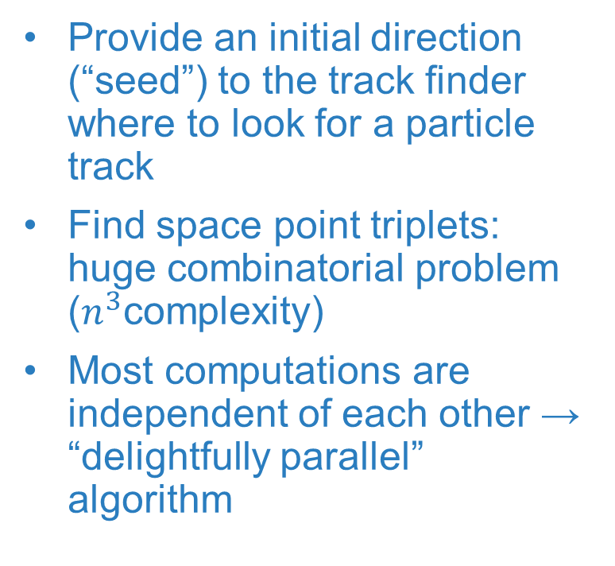
Track seeding
Provide an initial direction (“seed”) to the track finder where to look for a particle track
Find space point triplets: huge combinatorial problem ($n^{3}$complexity)
Most computations are independent of each other → “delightfully parallel” algorithm

Slide 4
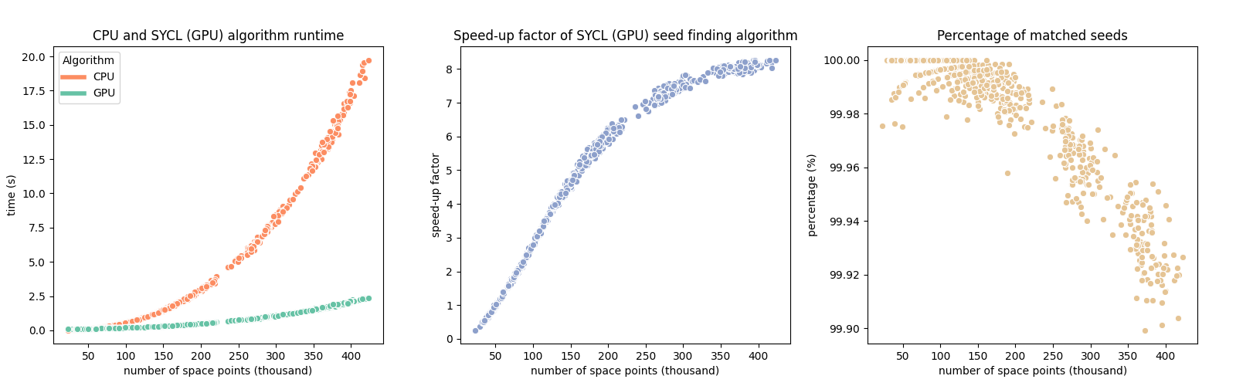
Evaluation
Note: part of the seed finding algorithm (the last step of filtering) is still carried out on CPUs, which limits performance, especially for higher intensity events. There’s another sub-optimal solution, namely frequent memory allocation and deallocation.
Experimental setup:
CPU: Intel® Core™ i9-9900K Processor (16M Cache, up to 5.00 GHz)
GPU: Nvidia GeForce RTX 2060 6GB GDDR6
Code, data and graphs are available at: https://github.com/czangela/openlab2020
“Software is never finished, only released.” (unknown)

Slide 5
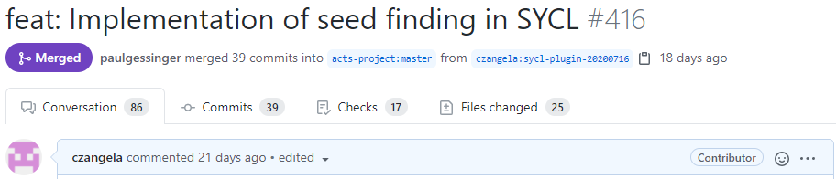

Acts Common Tracking Software
Availability, reproducibility
The code was successfully merged into Acts master branch
It wasn’t that easy, but we did it.
A follow-up pull request included some updates and documentation for the code and a how-to build and run guide
Code is available at: https://github.com/acts-project/acts/tree/master/Plugins/Sycl

Slide 6
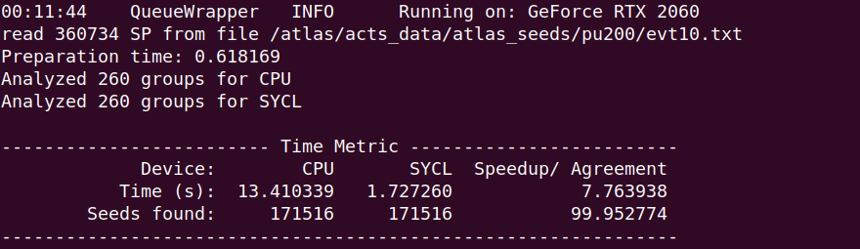
Heterogeneous computing
The code ran successfully on the following architectures:
OpenCL backends:
Intel Gen9 Integrated Graphics
Intel Gen12 Discrete Graphics
(DG-1 card, accessed through Intel’s devcloud)
CUDA backends:
Turing and Pascal architectures (3 different devices)
Compiler: dpc++ (custom built clang based compiler from https://github.com/intel/llvm/)
Clang version: 12.0.0.
Date: 24/08/2020
CUDA version: 10.1.

Slide 7
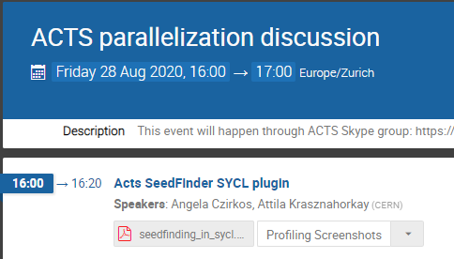
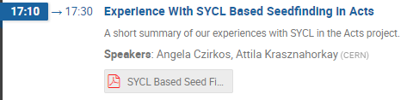
Contribution
Introductory speech about SYCL and the seed finding algorithm to the Acts group as part of their parallelization discussion.
Contributed to the development of DPC++ compiler by providing feedback in form of issues.
https://github.com/intel/llvm/issues/2328
https://github.com/intel/llvm/issues/2353
https://github.com/intel/llvm/issues/2376
Discussed further development directions and technical difficulties with Codeplay Software.
https://indico.cern.ch/event/955809/
Discussion with Codeplay:

Slide 8
QUESTIONS?
angela.czirkos@cern.ch

