Slide 1
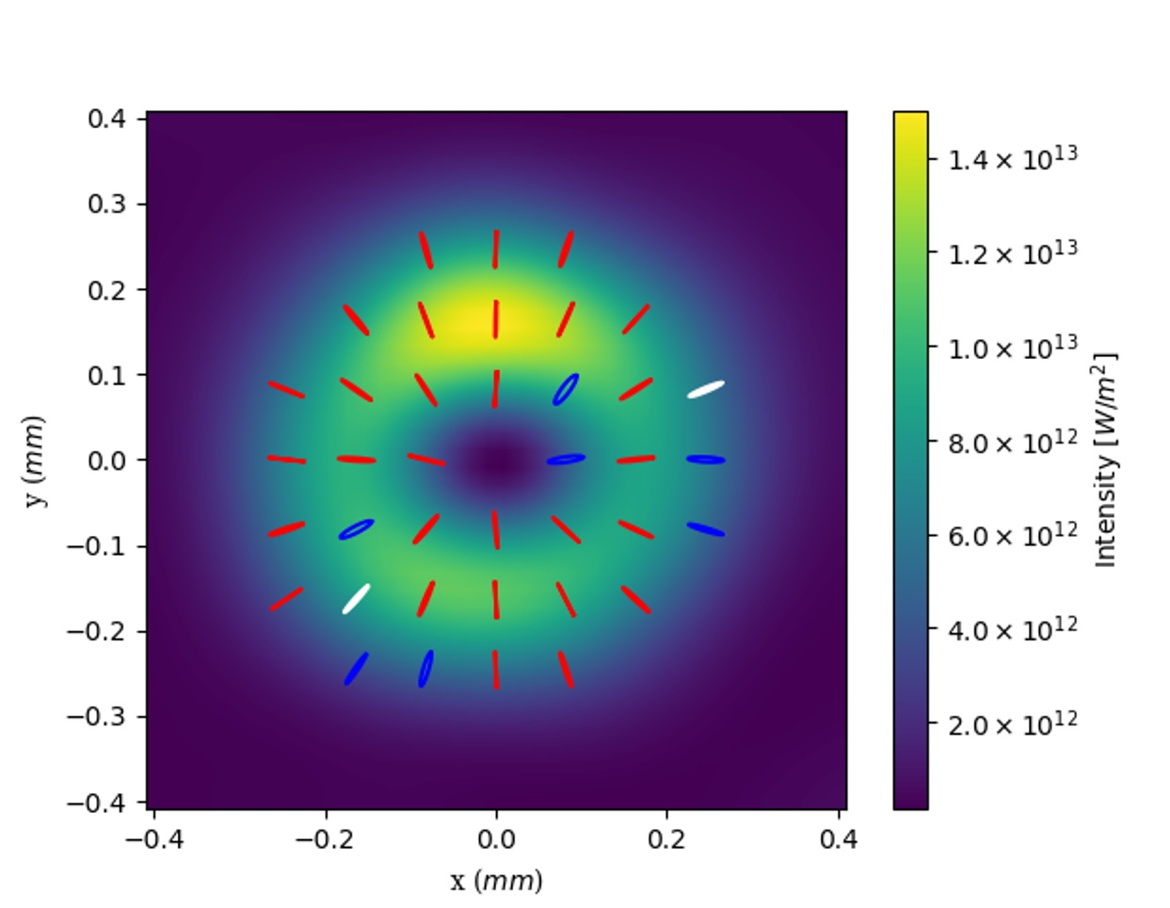
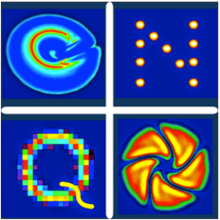




Afterburner configurations to control polarisation of FEL output
Jenny Morgan
University of Strathclyde
Computational
Nonlinear and
Quantum
Optics

Slide 2
Overview
What are Poincaré beams?
Transverse mode generation in a FEL
Poincaré beam generation in a FEL
Results
Other polarisation variation

Slide 3
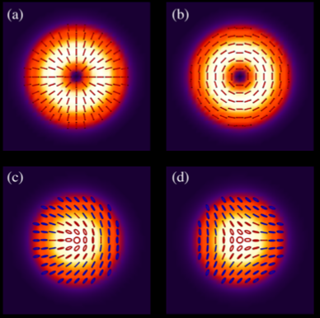
Transverse Polarisation
Poincaré beams – polarisation which varies transversely across the beam.
Cylindrical
Vector
Full Poincaré beams

Slide 4
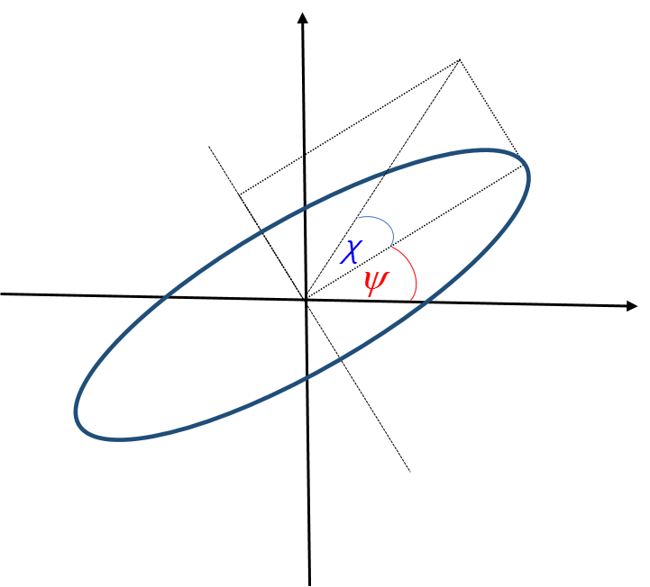

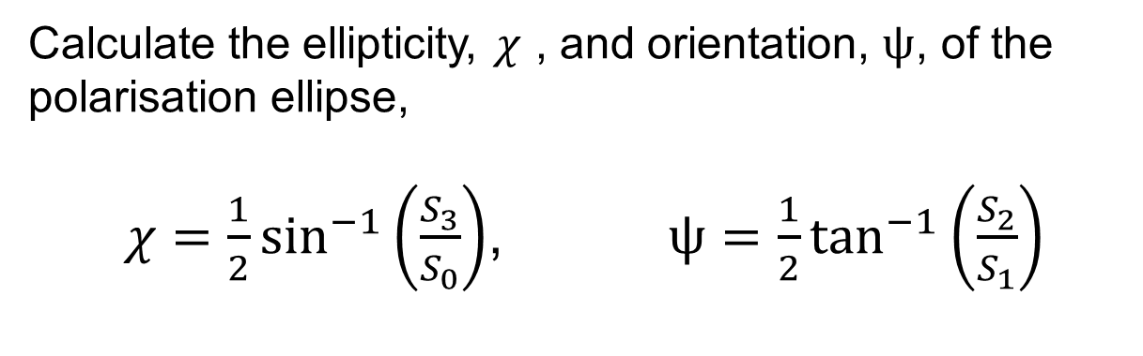
Mapping Polarisation
Mapping Polarisation
From the Stokes Vectors,
$S_{0}=|E_{x}|^{2}+|E_{y}|^{2}$ , $S_{1}=|E_{x}|^{2}−|E_{y}|^{2}$
${ S}_{2}=Re\left(E_{x}^{∗}E_{y}\right) , S_{3}=Im(E_{x}^{∗}E_{y})$
Calculate the ellipticity, $χ$ , and orientation, $ψ$, of the polarisation ellipse,
$χ=\frac{1}{2}\sin^{−1}\left(\frac{S_{3}}{S_{0}}\right)$, $ψ=\frac{1}{2}\tan^{−1}\left(\frac{S_{2}}{S_{1}}\right)$
Figure: Polarisation ellipse

Slide 5
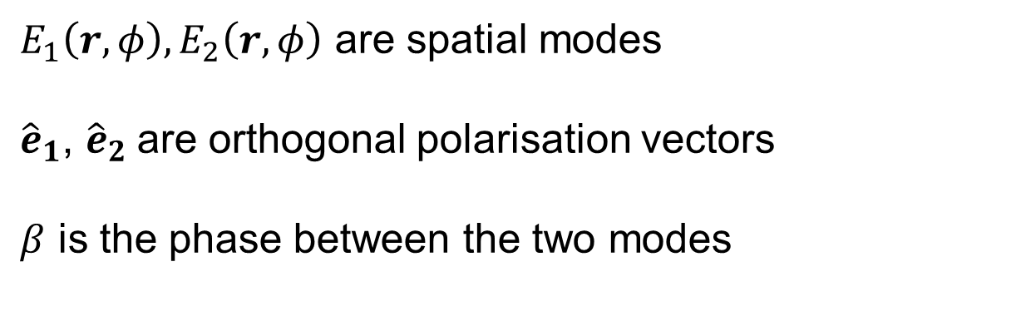
Transverse Polarisation
Poincaré Beams:
$$E(r,φ)=E_{1}(r,φ){\hat{e}}_{1}+e^{iβ}E_{2}(r,φ){\hat{e}}_{2}$$
$E_{1}\left(r,φ\right), E_{2}\left(r,φ\right)$ are spatial modes
${\hat{e}}_{1}$, ${\hat{e}}_{2}$are orthogonal polarisation vectors
$β$ is the phase between the two modes

Slide 6
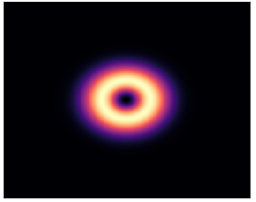
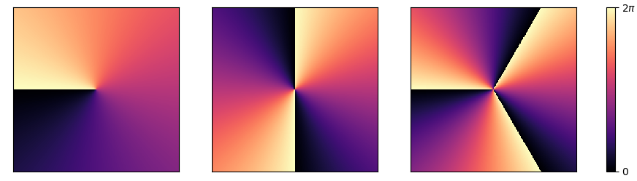
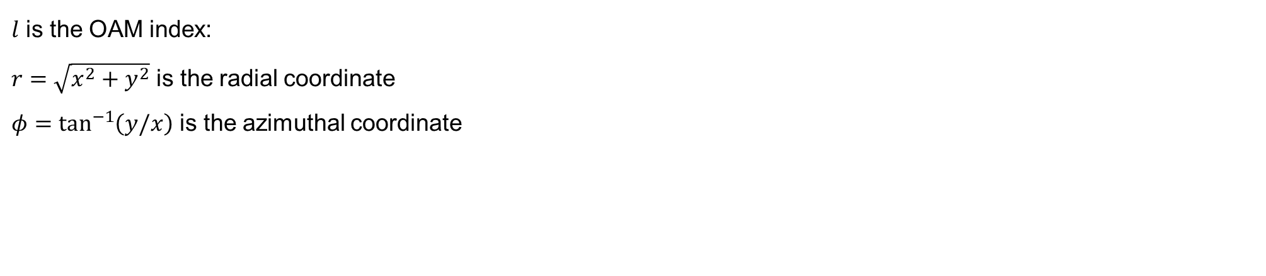


Laguerre-Gaussian beams
Laguerre-Gaussian Beams
Laguerre-Gaussian modes make up a complete orthonormal basis set:
$l$ is the OAM index:
$r=\sqrt{x^{2}+y^{2}}$ is the radial coordinate
$φ=\tan^{−1}\left(y/x\right)$ is the azimuthal coordinate
Figure: Intensity profile of the $l=1$ mode
Figure: Transverse phase distributions due of different Laguerre -Gaussian modes: $l=1,2,3$ respectively.
[1] Alison M. Yao and Miles J. Padgett, "Orbital angular momentum: origins, behavior and applications," Adv. Opt. Photon. 3, 161-204 (2011)

Slide 7

Combining Laguerre-Gaussian beams
Laguerre-Gaussian Beams
Single right or left hand polarisation: Scalar combination of spin and angular momentum:
$$E=LG_{0}^{1}{\hat{e}}_{L}$$
$$E=(LG_{0}^{3}+LG_{0}^{−3}){\hat{e}}_{L}$$

Slide 8


Combining Laguerre-Gaussian beams
Laguerre-Gaussian Beams
$$E=LG_{p}^{l_{L}}{\hat{e}}_{L}+e^{iβ}LG_{p}^{l_{R}}{\hat{e}}_{R}$$
Vector combination of spin and OAM:
Cylindrical vector beams $l_{L}$=-$l_{R}$
$l_{L}$=1
Full Poincaré Beams $l_{L}≠$-$l_{R}$

Slide 9

Hermit Gaussian Modes
Laguerre-Gaussian Beams
Using linear polarisation cylindrical vector beams can be expressed in terms of Hermite-Gaussian modes.
$$E={HG}_{mn}{\hat{e}}_{x}+{HG}_{mn}{\hat{e}}_{y}$$
[1] Qiwen Zhan, “Cylindrical vector beams: from mathematical concepts to applications," Advances in Optics and Photonics. 1.1, 161-1-57 (2009)

Slide 10
Generation methods
Laguerre-Gaussian Beams
Techniques for generating Poincaré beams include:
  interferometric techniques
  q-plates
  liquid crystal spatial light modulators.
These use external conversion optics which superimpose orthogonally polarized transverse modes.
This limits the wavelength and power of the Poincaré beams generated through these methods.
No optics method currently exists at X-rays.
We want to generate bight generating bright, tunable, coherent Poincaré beams with wavelengths as short as X-rays.
Solution: Use a FEL.

Slide 11

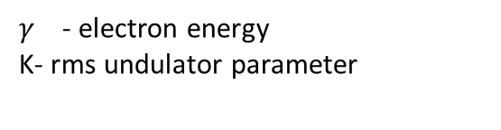
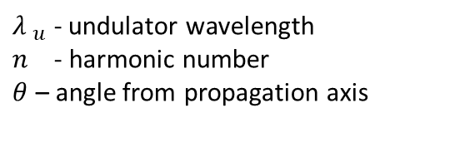
Free Electron Lasers, FELs
Tuneable wavelength
High-Brightness
Short wavelength : (down to a few Armstrong)
Short pulse durations : (few femto-seconds. )
Resonant wavelength:
$${λ }_{n}=\frac{{λ }_{u}}{2nγ^{2}}(1+K^{2}+θ^{2}γ^{2})$$
Figure : Electrons exchange energy with the radiation field causing them to bunch together and emit coherently[1].
${λ }_{u}$ - undulator wavelength
$n$ - harmonic number
$θ$ – angle from propagation axis
$γ$ - electron energy
K- rms undulator parameter
[1] Brian WJ McNeil and Neil R Thompson. X-ray free-electron lasers. Nature photonics, 4(12):814, 2010.

Slide 12
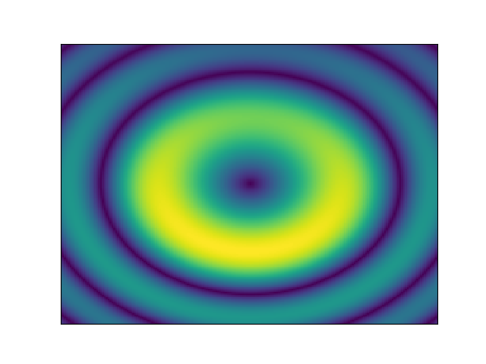
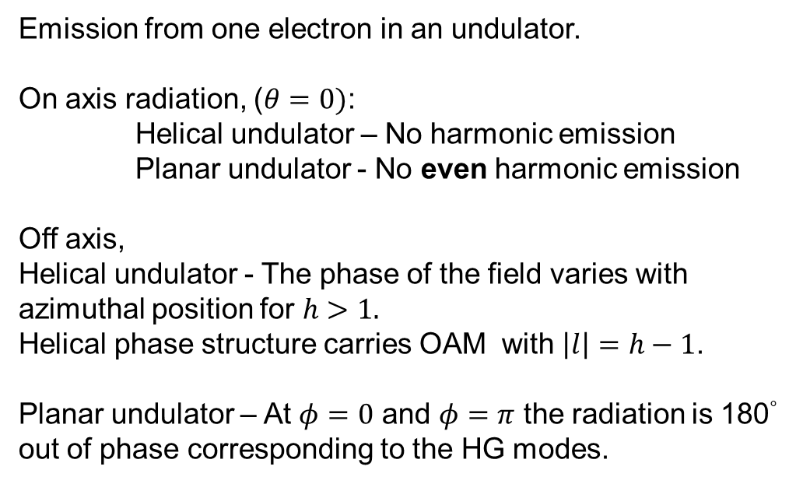
Transverse modes from harmonic emission
Emission from one electron in an undulator.
On axis radiation, ($θ=0)$:
Helical undulator – No harmonic emission
Planar undulator - No even harmonic emission
Off axis,
Helical undulator - The phase of the field varies with azimuthal position for $h>1.$
Helical phase structure carries OAM with $\left|l\right|=h−1$.
Planar undulator – At $φ=0$ and $φ=π$ the radiation is 180° out of phase corresponding to the HG modes.
For a Gaussian electrons beam: The angular emission is determined by the beams finite electron beam directions.
Bunching in the e-beam determines the spectrum radiated.
Shigemi Sasaki and Ian McNulty. Proposal for generating brilliant x-ray beams carrying orbital angular momentum. Phys. Rev. Lett., 100(12):124801, 2008.

Slide 13
Higher order modes carry OAM
Helical undulator – LG modes.
Planar undulator – HG modes.
Can access the higher order modes through an afterburner set up:
Electrons bunched at the second harmonic of the undulator, $λ_{b}=λ_{r}$/h, radiate with higher order transverse modes.
Hemsing, E. (2020). Coherent photons with angular momentum in a helical afterburner. Physical Review Accelerators and Beams, 23(2), 020703

Slide 14
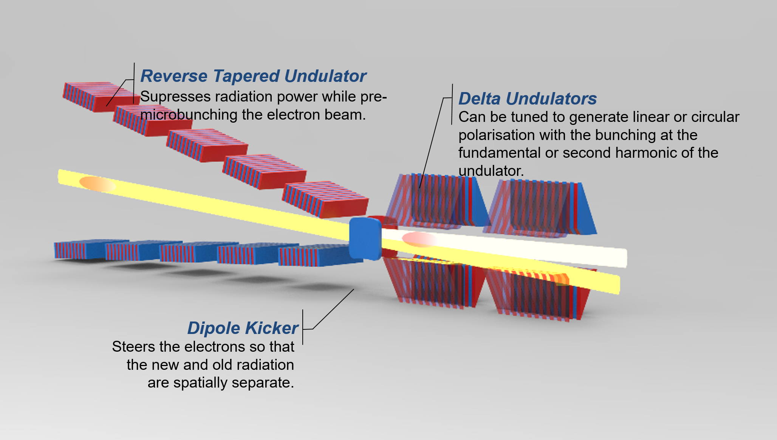
Schematic of set up

Slide 15

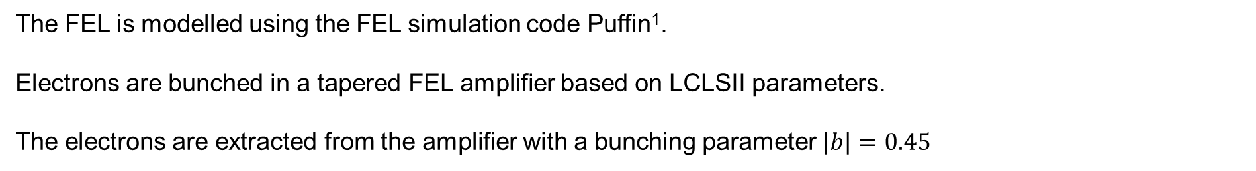
Schematic of set up
The FEL is modelled using the FEL simulation code Puffin¹.
Electrons are bunched in a tapered FEL amplifier based on LCLSII parameters.
The electrons are extracted from the amplifier with a bunching parameter $\left|b\right|=0.45$
[1] Campbell, L.T. and McNeil, B.W.J., Phys. Plasmas. 19, 093119 (2012)

Slide 16
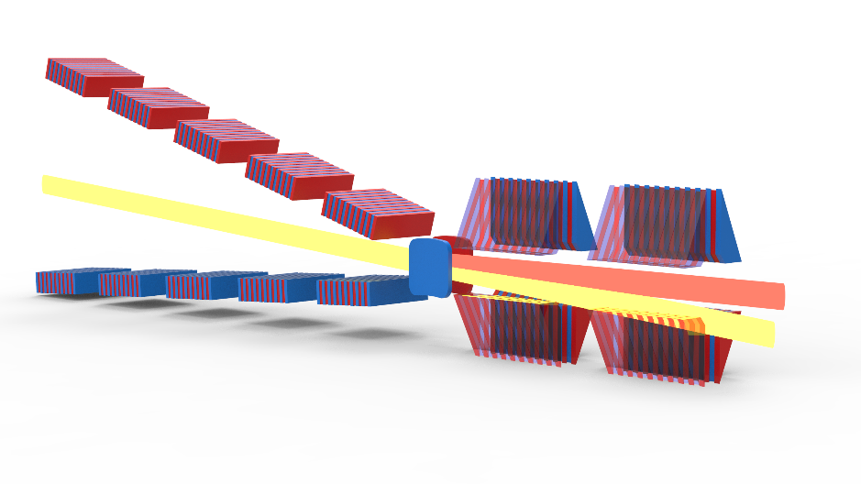
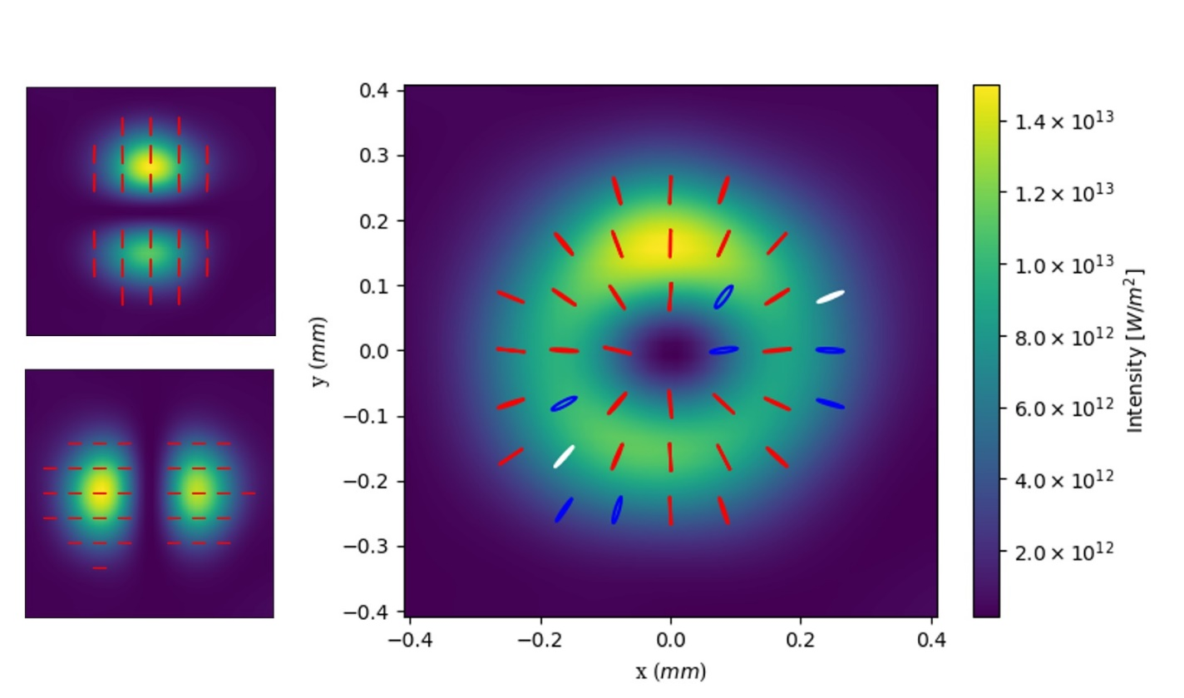




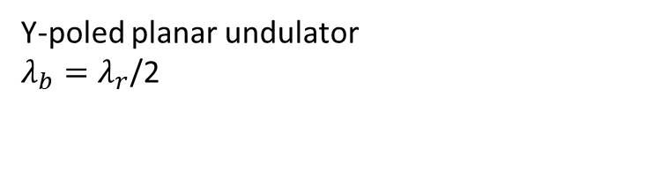

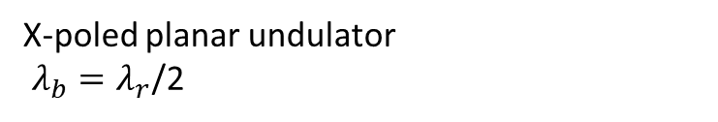

Results
Combination of second harmonic radiation from two planar undulators produces a Radial Vector beam.
X-poled planar undulator
$λ_{b}=λ_{r}$/2
Y-poled planar undulator
$λ_{b}=λ_{r}$/2
$$+$$
$$=$$
$${HG}_{01}{\hat{e}}_{y}$$
$${HG}_{10}{\hat{e}}_{x}$$
$$E={HG}_{10}{\hat{e}}_{x}+{HG}_{10}{\hat{e}}_{y}$$

Slide 17
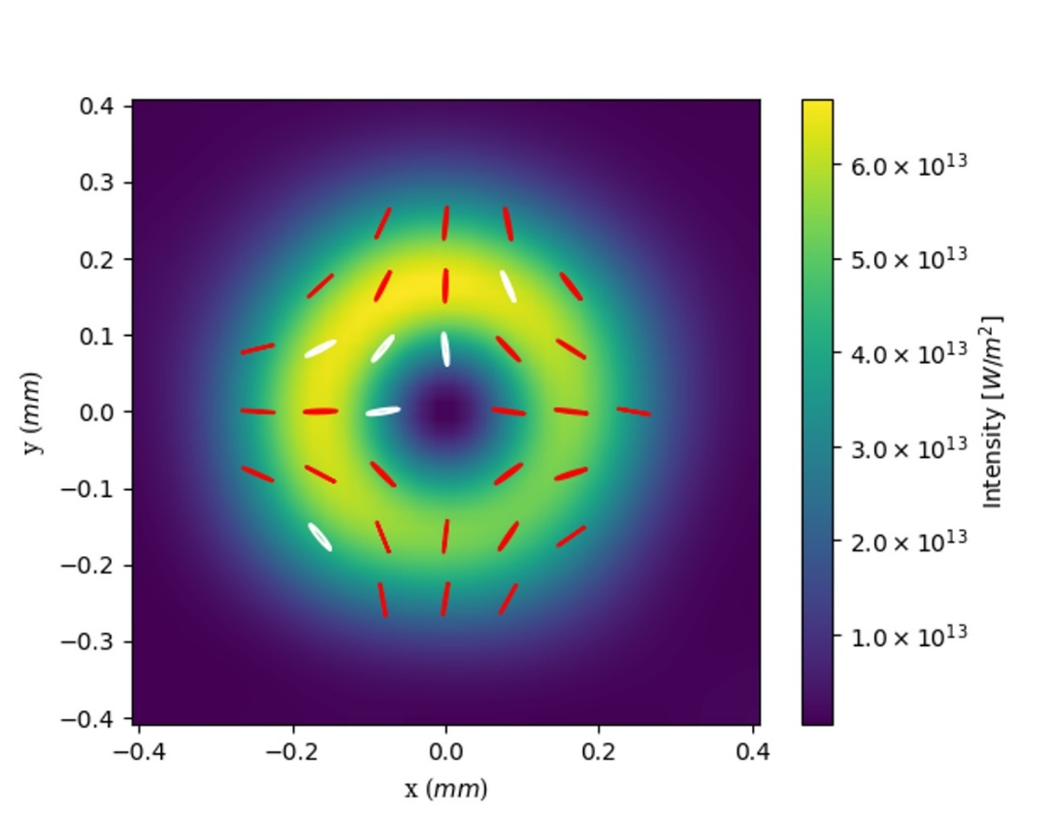
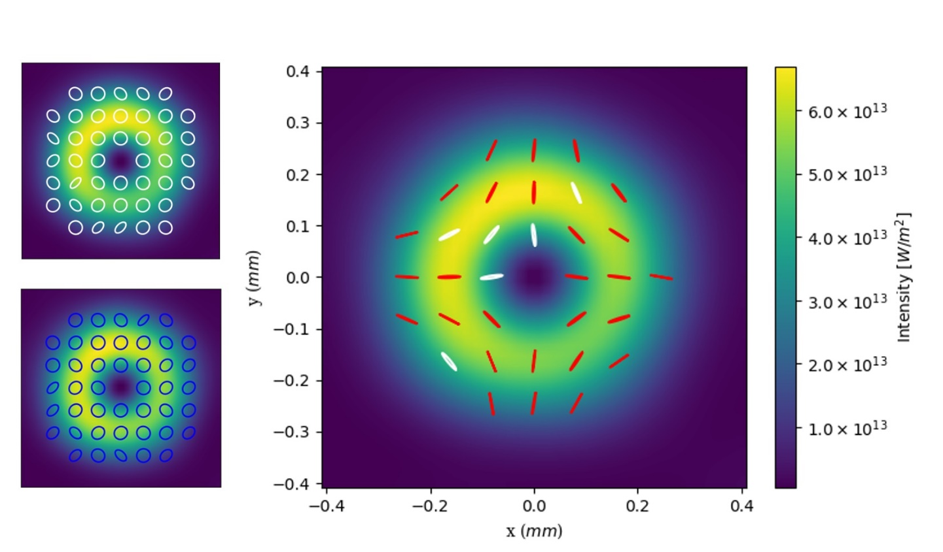

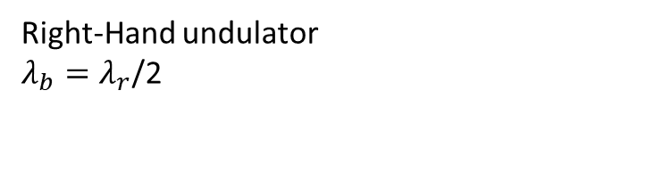

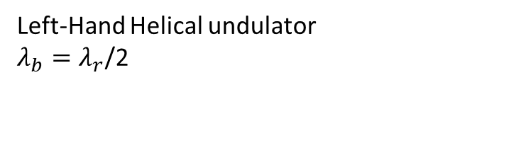



Results
Combination of second harmonic radiation from two helical undulators
Left-Hand Helical undulator
$λ_{b}=λ_{r}$/2
Right-Hand undulator
$λ_{b}=λ_{r}$/2
$$+$$
$$=$$
$$E=LG_{0}^{1}{\hat{e}}_{L}+LG_{0}^{−1}{\hat{e}}_{R}$$
$$LG_{0}^{−1}{\hat{e}}_{R}$$
$$LG_{0}^{1}{\hat{e}}_{L}$$

Slide 18
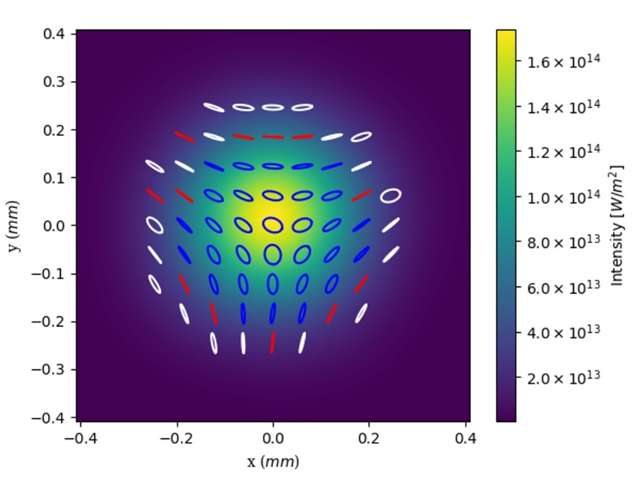




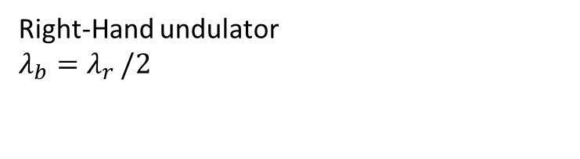
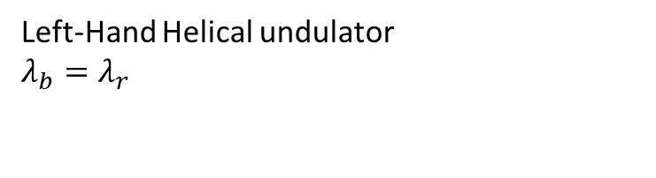
Results
Left-Hand Helical undulator
$$λ_{b}=λ_{r}$$
Right-Hand undulator
$$λ_{b}=λ_{r }/2$$
$$+$$
$$=$$
$$E=LG_{0}^{1}{\hat{e}}_{L}+LG_{0}^{0}{\hat{e}}_{R}$$
$$LG_{0}^{0}{\hat{e}}_{R}$$
$$LG_{0}^{1}{\hat{e}}_{L}$$

Slide 19



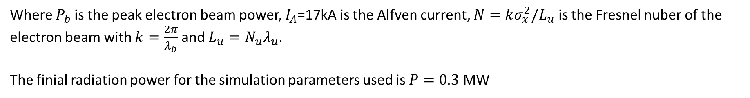
Results
The finial power is,
Where $P_{b}$is the peak electron beam power, $I_{A}$=17kA is the Alfven current, $N=kσ_{x}^{2}/L_{u}$ is the Fresnel nuber of the electron beam with $k=\frac{2π}{λ_{b}}$ and $L_{u}=N_{u}λ_{u}$.
The finial radiation power for the simulation parameters used is $P=0.3$ MW

Slide 20
Future work
We have demonstrated three polarisation distributions by varying the polarisation and resonance of the afterburner undulators.
Other factors which will change the polarisation distribution includes,
Phase between the two transverse modes
Power ratio between the two transverse modes
Detuning the resonance of one undulator to push radiation further off axis
Radiating at even higher harmonics of a helical undulator.

Slide 21
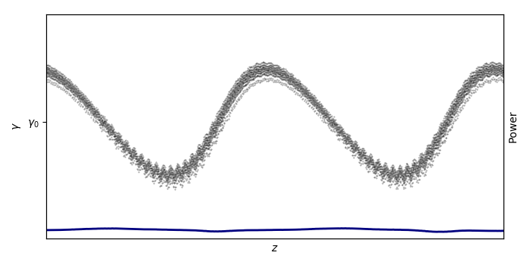
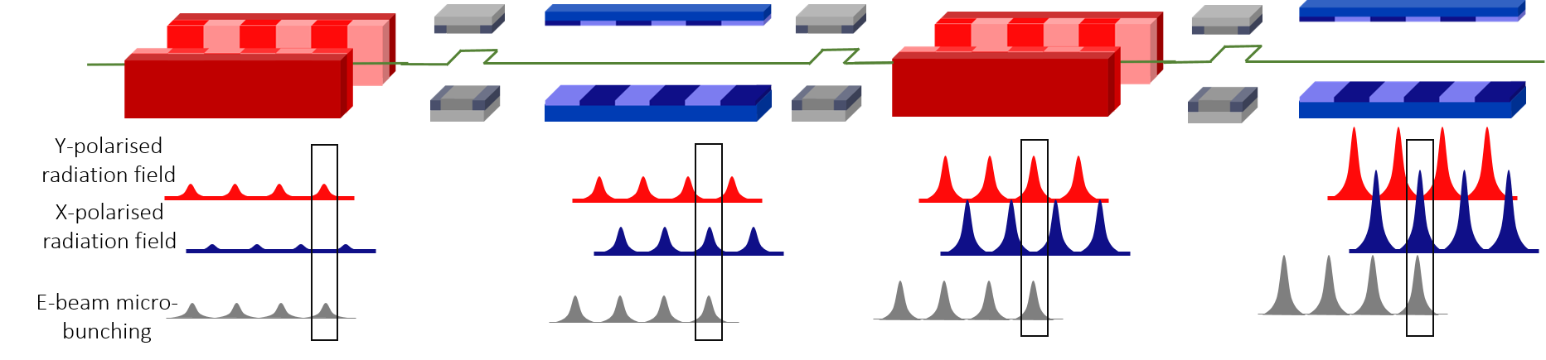
Pulses with alternating polarisation
A train of pulse can be generated through mode locking where the polarisation of each pulse alternates.
An energy modulated beam only experiences bunching at the energy minima – creating a micro bunching comb
In each undulator, those regions of the electron beam with modulated micro-bunching emit coherently.
Chicanes delay the electron beam between undulator modules so that those sections of high micro-bunching overlap with the appropriately polarised pulse.
Energy modulation creates a microbunching comb
D Dunning et al, PRL 110, 104801 (2013)

Slide 22
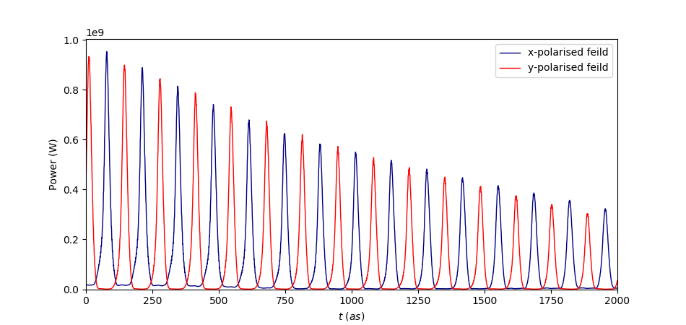
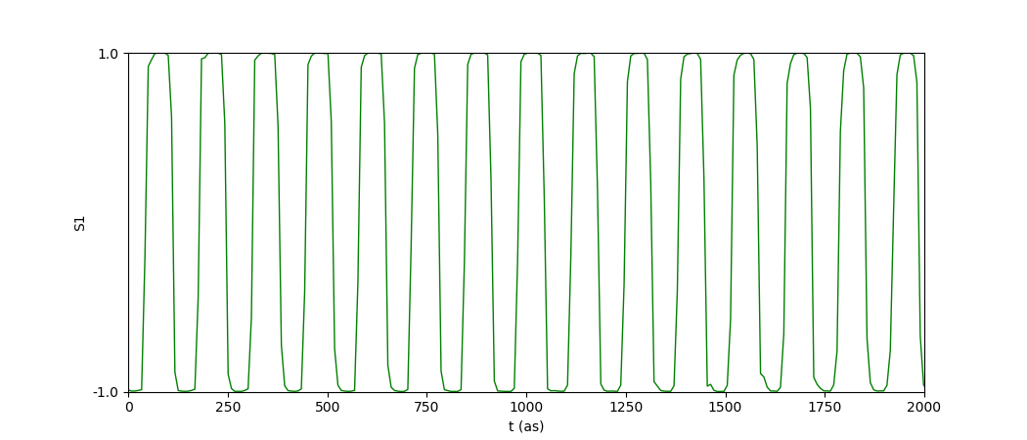
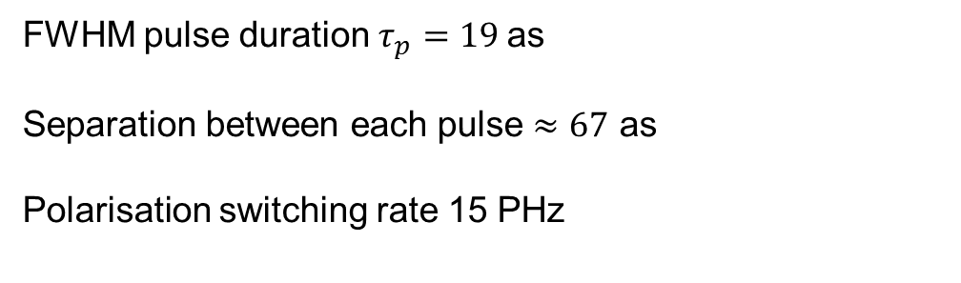

Pulses with alternating polarisation
FWHM pulse duration $τ_{p}=19$as
Separation between each pulse $≈67$ as
Polarisation switching rate 15 PHz
$S_{1}=|E_{x}|^{2}−|E_{y}|^{2}$
Switching rate might be improved by moving to yet shorter wavelengths.
Further opportunities : alternating wavelengths
alternating Transverse modes

Slide 23
Thank you
Recent publication of this work is available,
Morgan, J., Hemsing, E., McNeil, B., & Yao, A. M. (2020). Free electron laser generation of X-ray Poincaré beams. New Journal of Physics.
Thank you to my collaborators: Erik Hemsing, Brian McNeil and Alison Yao

