Slide 1
Layout and optimization of the linac rf system
WP4 progress meeting, 08 October 2020
M. Diomede (INFN-LNF)
On behalf of the CompactLight-XLS project

Slide 2
Tuning of the structure
Used the concepts shown in [1] and [2]
[1] Shi et al., “Tuning of CLIC accelerating structure prototypes at CERN.” No. CERN-ATS-2010-210. 2010.
[2] Alesini, D., et al. "Tuning procedure for traveling wave structures and its application to the C-Band cavities for SPARC photo injector energy upgrade." Journal of Instrumentation 8.10 (2013): P10010.

Slide 3
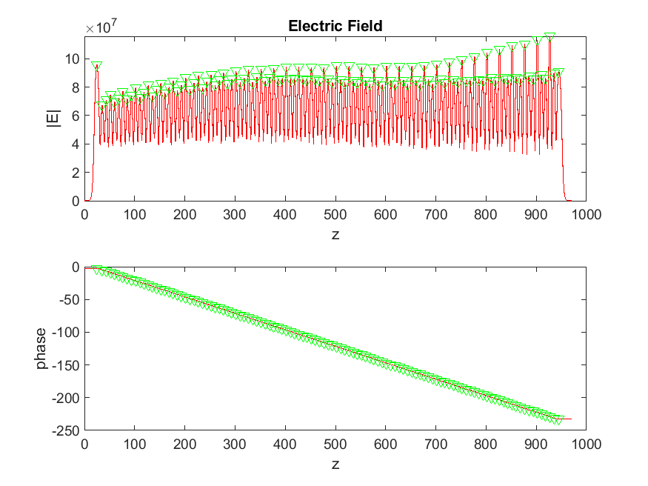
Original structure

Slide 4
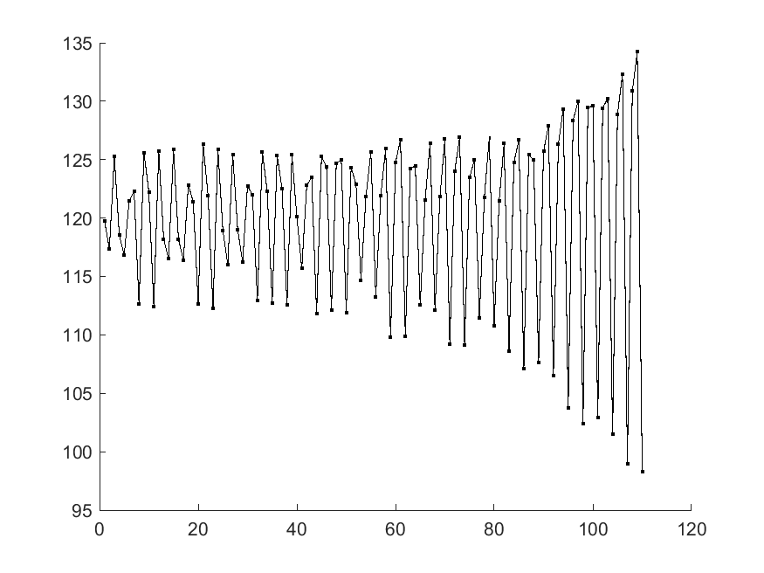
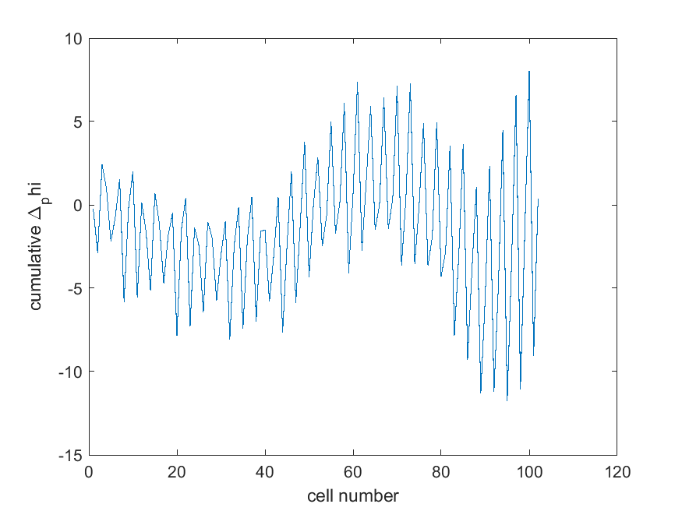
Original structure

Slide 5
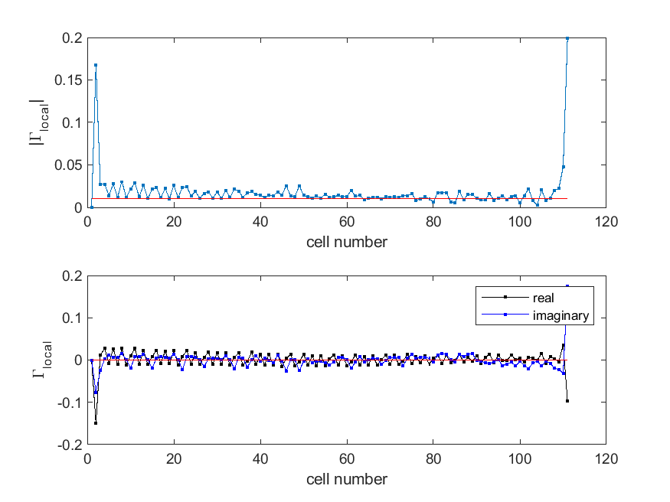
Original structure

Slide 6
(Partially) tuned structure

Slide 7
(Partially) tuned structure

Slide 8
(Partially) tuned structure
 | S11 [dB] | S22 [dB]
Before | -25 | -14
After | -29 | -41

Slide 9
Effect of mechanical errors on RF performance
2 options
Give the structure as it is to VDL for thermo-mechanical simulations
Do it once the tuning procedure is complete (might take a while)

