Slide 1
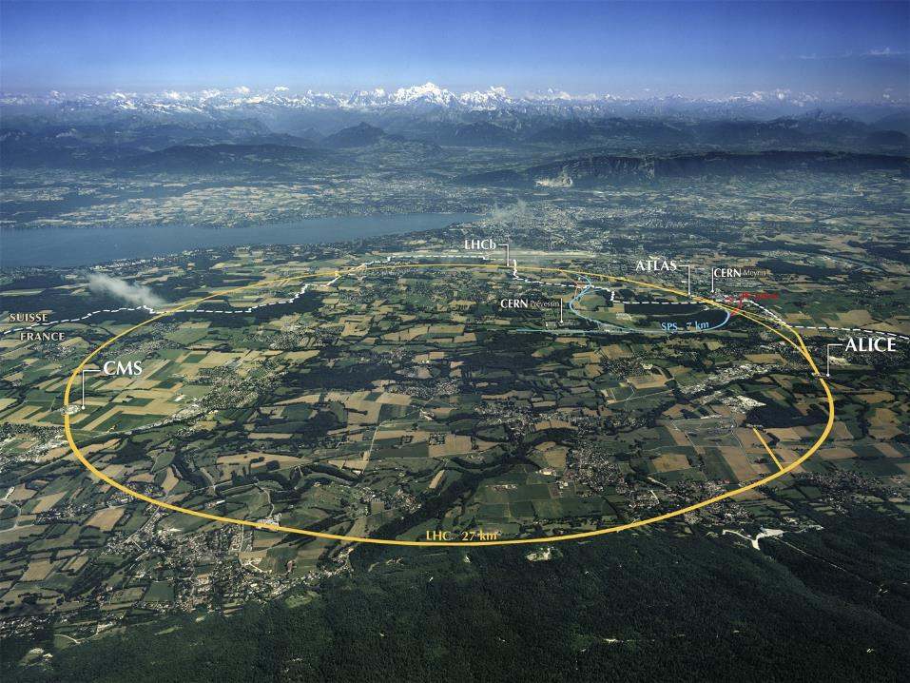
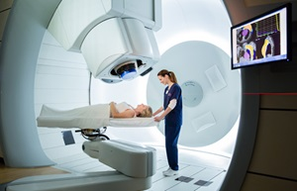
The CERN Next Ion Medical Machine Study: towards a new generation of accelerators for cancer therapy
Maurizio Vretenar for the NIMMS Collaboration
ATS&KT Seminar
19 October 2020

Slide 2
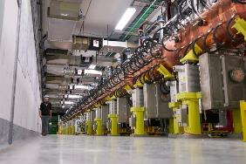
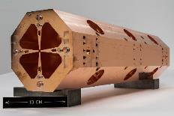
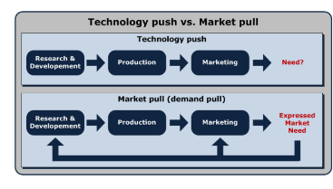
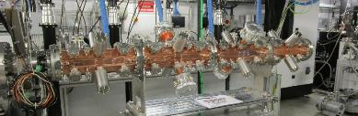
CERN Knowledge Transfer for Medical Applications
EXAMPLE: Linac4
Huge portfolio of CERN technologies with potential impact on society, some with related commercial interest;
But: CERN technologies as such (optimized for particle physics) have little or no direct interest;
An additional R&D step is needed, to adapt CERN technologies to what is required by society and by the market.
Developed for particle physics, no societal or commercial interest as such
The Next Ion Medical Machine Study (NIMMS) is a CERN-based initiative, aimed at leveraging on CERN technologies developed for HEP for a new generation of accelerators for cancer therapy with ion beams
The CERN high-frequency RFQ
Developed using Linac4 technology, for medical and societal applications (2 years, 1.5 MCHF shared between CERN and industrial partner)
Challenges:
Promote the development within a wide collaboration;
In close contact with the final users, to privilege “market pull” against “technology push”;
Combining competences and expertise from many different CERN and non-CERN groups and teams
Wider Goal: highlight the social benefit of technologies developed for HEP
Notes:
Before showing what we do, I need to convince you of why we need to do it

Slide 3
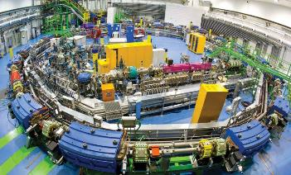
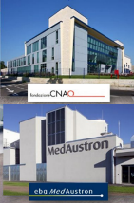
From PIMMS to NIMMS
1996/2000: CERN hosts PIMMS (Proton-Ion Medical Machine Study), a collaborative study (CERN, TERA Foundation, MedAUSTRON, Onkologie 2000) for the design of a cancer therapy synchrotron. The study has been the foundation for the construction of the CNAO and MedAustron particle therapy centres.
In parallel, GSI develops a similar technology and treats the first patients. This experience goes in the construction of the HIT and MIT therapy centres
Successful technology, but developing slowly because of:
high treatment costs linked to cost and size of the facility
slow acceptance by the medical community
20 years later, and with the experience gained with LHC construction, it is time to explore new technologies to extend to a wider fraction of society the benefits of cancer therapy with particle beams.
June 2017 CERN Council Strategy document on KT for Medical Applications:
A collaborative design study coordinated by CERN would contribute to the development of a new generation of compact and cost-effective light-ion medical accelerators. A new initiative of this type would leverage existing and upcoming CERN technologies and the Laboratory’s expertise in the fields of radiofrequency systems, advanced magnet design, superconducting materials, and beam optics.
NIMMS = Next Ion Medical Machine Study
To be developed at CERN in collaboration with the existing ion therapy centres and with similar programmes in the Member States.

Slide 4
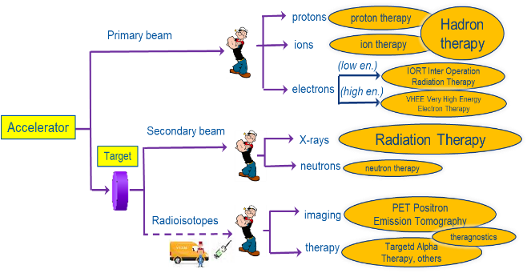
Particle accelerators: a formidable tool for medicine
Particle beams (primary and secondary) precisely deliver large amounts of energy to small volumes, penetrate in depth (different from lasers) and interact with cells, molecules, and atoms (electrons and nuclei).
Particles beams can activate the nuclei generating radiation that can destroy cancerous cells or can be detected from outside
Accelerators are the way to realise the old dream of a bloodless surgery and imaging: penetrate into the human body to treat diseases and to observe internal organs without using surgical tools.
Operating facilities
≈ 75
12
>300
0
≈ 14’000
7
≈ 1’500
0
Cancer treatment
Imaging
New cancer treatments
Nuclear medicine:
application of radioactive substances in the diagnosis and treatment of disease
Radiation therapy:
therapy using ionizing radiation, generally as part of cancer treatment to control or kill malignant cells
≈ 16’000 particle accelerators operating for medicine worldwide, in cancer therapy and imaging
M. Vretenar | NIMMS
Notes:
One step back

Slide 5
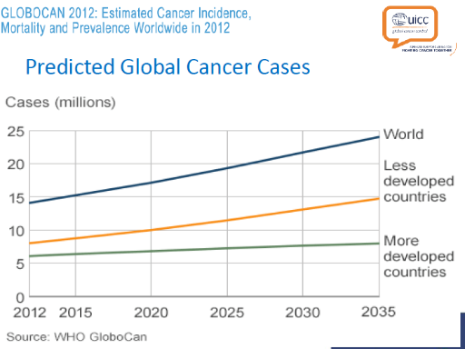

Fighting against Cancer
Cancer and Covid
193,000 deaths reported in Europe for Covid19 (at 7.10.20).
About 1,900,000 deaths of cancer every year in Europe.
→ Factor 10 !
Cancer is the second leading cause of death globally, and was responsible for 8.8 million deaths in 2015. Globally, nearly 1 in 6 deaths is due to cancer (WHO).
Increase of cancer cases due to:
Increasing age of population
Aggressive environmental and living conditions in developing countries.
The standard protocol for treatment of most cancers is based on:
Surgery
Radiotherapy (mainly X-rays)
Chemiotherapy
(Immunotherapy)
EU Mission on Cancer
Cancer research has been declared as one of the 5 specific mission areas of the next EU research and innovation framework programme, Horizon Europe (2021-27): conquering cancer, mission possible
New trend: personalised medicine based on combination of different high-technology treatments.

Slide 6
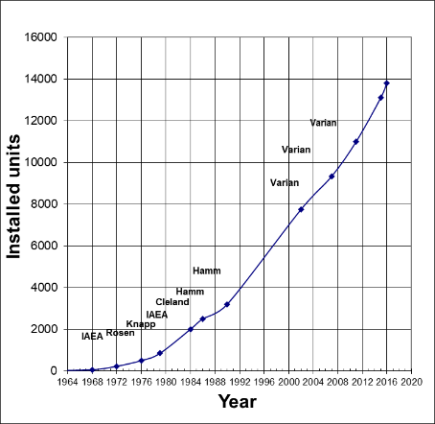
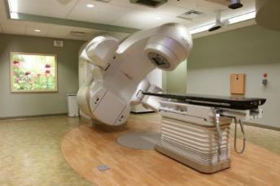
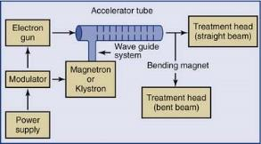
X-ray radiation therapy
New cancer patients per year:
Increasing from 12.5M in 2008 to 27M in 2030.
Over 60% treated with Radiation Therapy.
Courtesy of R. Hamm
The most successful particle accelerator in the world.
More than 15,000 operating units worldwide, at a cost of about 1-5 M€/unit.
Constant improvement (collimation, 3D conformal treatment, intensity modulation, combined imaging and therapy)

Slide 7
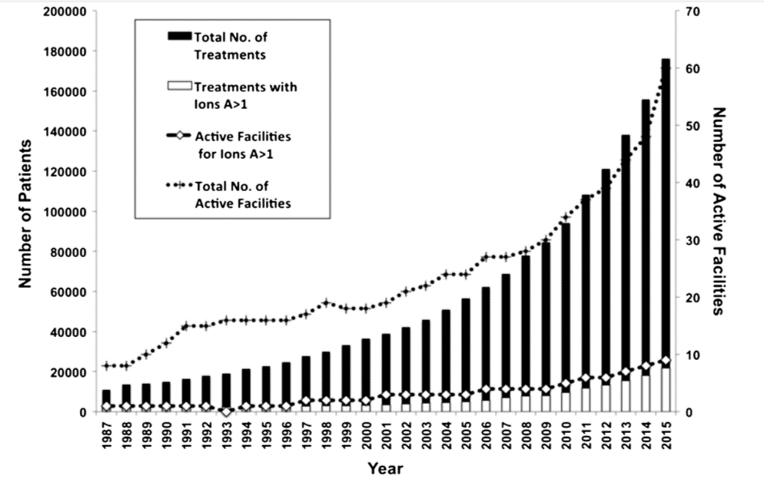
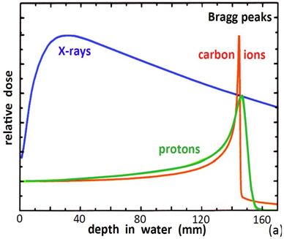
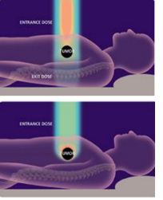
Hadron therapy (protons or ions)
The beauty of the Bragg peak
First experimental treatment: 1954, Berkeley.
First hospital-based proton treatment facility: 1993, Loma Linda, US.
First treatment facility with carbon ions: 1994, HIMAC, Japan.
Treatments in Europe at physics facilities from end of ‘90s.
First dedicated European facility for protons and carbon ions: 2009, Heidelberg.
From 2006, commercial proton therapy cyclotrons appear on the market (but Siemens gets out of proton/carbon synchrotrons market in 2011).
Nowadays 3 competing vendors for cyclotrons, one for synchrotrons (all protons).
Different from X-rays or electrons, protons (and ions) deposit their energy at a given depth inside the tissues, minimising dose to the organs close to the tumour, sparing nearby organs.
Required energy for full-body penetration: 230 MeV protons, 450 MeV/u C-ions.
Hadron therapy remains a niche in cancer therapy:
22,000 patients/year (2018) treated with particle beams against 25,000,000 patients/year with conventional RT.
Notes:
Why?

Slide 8
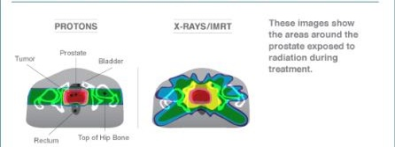
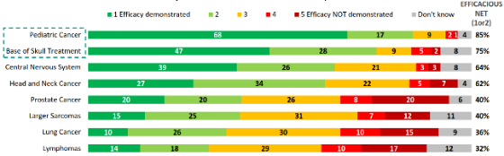
Particle therapy: a growing niche but not a panacea
Factors limiting growth
X-ray Radiation Therapy is improving: thanks to a wide market and a strong industry basis, RT is becoming increasingly precise and effective. FLASH therapy could give it another boost.
Cost: a commercial single-room proton therapy system has a price from 30 M€, to be compared with 2-3 M€ of a X-ray radiotherapy system. An ion therapy centre has a cost of 150-200 M€.
Lack of clinical data: the effect of protons and ions is not as known as that of X-rays, optimisation of treatment is still ongoing. Biological tests are needed to compare the loss of energy (Bragg peak) to the effect on the cells – not necessarily linear.
Quality of life appreciation: protons and ions are superior in sparing the surrounding tissues, improving quality of life after treatment. But while survival rates are easy to measure and compare, quality of life is only recently becoming a “measurable” parameter.
Centralisation of medicine: the high cost of particle treatment calls for large centralised units that have difficulties in attracting patients from other hospitals.
Proton therapy is mainly recommended for:
Some specific tumours close to critical organs
Pediatric tumours (less risk of recurrency)
Source: IBA, state of proton therapy market entering 2017

Slide 9
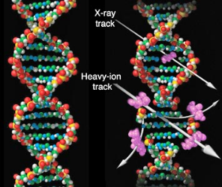
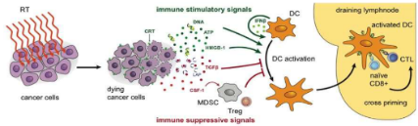
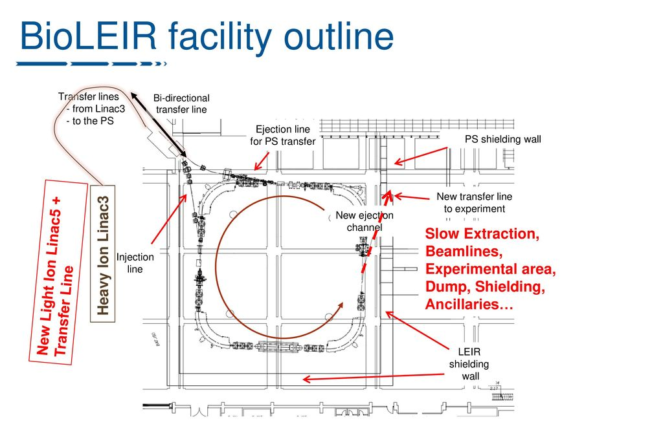
Therapy with heavier ions (Carbon and others)
Ions (e.g. Carbon) are different from X-rays or protons!
Heavy ions are more effective than protons or X-rays in attacking cancer:
The higher energy deposition (and ionisation) per length generates a large number of double-strand DNA breakings that are not reparable by the cell itself.
The different damage mechanism makes them effective on hypoxic radioresistant tumours (while protons or X-rays act via generation of Reactive Oxygen Species) – 1 to 3% of all RT cases.
Are more precise, with lower straggling and scattering.
Recent studies show that ion therapy combined with immunotherapy may be successful in treating diffused cancers and metastasis.
So far, 2/3 of cases at the mixed facilities like CNAO are treated with carbon.
The development of ion therapy needs to be supported by tests with other ions (He, O, etc.) and by a strong experimental effort covering:
  Pre-clinical radiobiology;
  Medical physics;
  Animal studies;
  Clinical trials on patients.
programme of the former BioLEIR study

Slide 10
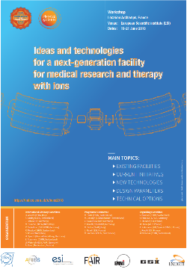
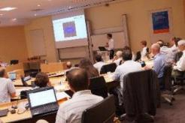
A strategy for CERN
Proton therapy is now commercial, 4 companies offer turnkey treatment facilities (3 SC cyclotrons, one conventional synchrotron), and in competition with conventional radiation therapy (X-rays).
Heavy ion therapy (mainly carbon) is still in an early phase (13 facilities worldwide, 4 in Europe) in spite of its several advantages but its diffusion is limited mainly by:
  Size and cost of the accelerator;
  Lack of experimental data.
Specifications from the scientific community
(Archamps Workshop, June 2018)
Accelerator
Lower cost, compared to present (~120 M€);
Higher beam intensities than present (10¹⁰ ppp);
Reduced footprint, to about 1’000 m²;
Lower running costs.
Delivery
Fast dose delivery (possibly with 3D feedback);
Equipped with a rotating gantry;
Using multiple ions;
With range calibration and diagnostics online.
Opportunity for a strong impact on the medical field with an R&D programme based on critical accelerator technologies for a next generation ion therapy and research facility, smaller, possibly less expensive and more performant than the present reference design.

Slide 11
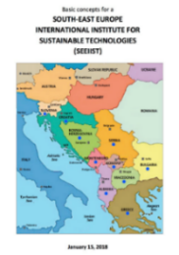

NIMMS Origins and Goals
SEEIIST as strategic partner and reference user
Next Ion Medical Machine Study
Started from an impulse by U. Amaldi in 2016-17
Structured after the Archamps Workshop in 2018
International collaborations started in 2018
CERN funding approved by KT-MA in 2019 until 2022
Submitted two proposals for H2020 EU support in 2020
The SEEIIST (South East Europe International Institute for Sustainable Technologies) is a new international partnership aiming at the construction of a new Research Infrastructure for cancer research and therapy in South East Europe (8 member countries and 2 observers).
SEEIIST has received a preliminary funding from the EC to develop the facility design, in collaboration with CERN.
Goals are to develop a new advanced design and to build international cooperation and scientific capacity in a region that will join EU but is less develop and still divided after the wars, in the line of “science for peace”.
Promoted by S. Damjanovic, Minister of Science of Montenegro, and H. Schopper, former Director General of CERN.
Strong support by the EC and by Switzerland.
In line with CERN mission, build on CERN expertise to develop a portfolio of technologies that can be used in a next generation facility, more than developing a unique design (NIMMS as a «toolbox»)
Approved in June 2019 with a budget of 250’000 CHF/yr for 2020 and 2021 from the CERN KT Medical Applications, as “seed money” to launch collaborations and joint initiatives.
This presentation will report on the first 1.5 years of NIMMS

Slide 12
The NIMMS Collaboration
Large number of international partners collaborating with NIMMS (a collaboration MoU is planned):
SEEIIST E. Benedetto, M. Sapinski, S. Damjanovic, P. Grübling
TERA Foundation U. Amaldi, P. Riboni, N. Alharbi
GSI P. Foka
INFN G. Bisoffi, L. Rossi
CIEMAT J. Navarro, C. Oliver, D. Perez
Cockcroft Institute H. Owen
CNAO S. Rossi, M. Pullia
Imperial College K. Long, R. Taylor
MedAustron P. Urschütz
U. Melbourne S. Sheehy, X. Zhang
Interest in joining the collaboration expressed by other partners:
Indian Institutions
Baltic Institutions
Input from medical community via the ENLIGHT Network (managed by M. Dosanjh with M. Ristova and P. Georgieva)
Input from ion therapy scientific community via M. Durante (GSI) and his International Biophysics Collaboration.
CERN contributors, who have in different ways contributed to the study:
M. Vretenar, A. Lombardi, V. Bencini, D. Gibellieri, A. Grudiev, H. Pommerenke, S. Ramberger, M. Khalvati, E. Oponowicz, D. Tommasini, D. Perini, M. Karpinen, etc.

Slide 13
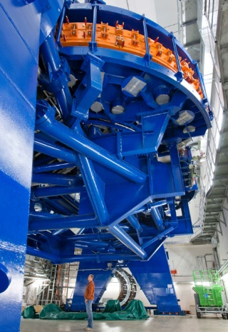
NIMMS Workpackages – inside the toolbox
 | Workpackage | Objectives
1 | Superconducting magnets | Comparison of magnet technologies (CCT, costheta) and cables (NbTi, HTS). Design of prototype magnets (gantry and synchrotron) for the selected option.
2 | High-frequency hadron linacs | End-to-end beam dynamics design, study of 180-degree bend, design of medium-beta accelerating structures (5-20 MeV/u), RF optimisation.
3 | Gantries | Advanced design and comparison of 2 gantry options (optics and mechanical structure): Rotational Toroidal
Superconductivity, the main avenue to accelerator miniaturisation.
Long-standing CERN expertise, needs high fields, pulsed operation, strong curvature
The “full-linac”, a different approach for fast 3D scanning of tumours
The gantry, a strategic component merging traditional CERN competences: magnets, beam optics, mechanics.
4 | Synchrotron design | Design of Superconducting synchrotron and of a backup normal conducting version with advanced features: multi-turn injection for 10¹⁰ particles per pulse, fast and slow extraction, multiple ion operation, new upgraded linac injector.
Design of synchrotrons, key element of most ion therapy systems, is a core competence of CERN.
Main challenge for ion acceleration is the
magnetic rigidity (Bρ) at treatment energy:
  2.27 Tm for protons (220 MeV)
  6.63 Tm for carbon ions (430 MeV/u)
  → factor 2.9
Gantry=rotating beam line sending the beam to precise positions on the patient
HIT carbon ion gantry (RT magnets):
L=25 m, F = 13 m, 600 tons
Notes:
Ions lose more energy per unit length – need higher energy at entrance point to go to inner organs

Slide 14
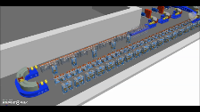
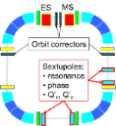
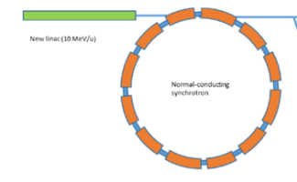
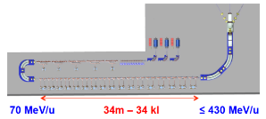
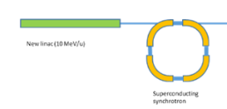
Three alternative accelerator designs
Improved synchrotron (warm)
Equipped with several innovative features: multi-turn injection for higher beam intensity, new injector at higher gradient and energy, multiple extraction schemes, multi-ion.
Circumference ~ 75 m
Improved synchrotron (superconducting)
Equipped with the same innovative features as warm, but additionally 90⁰ superconducting magnets.
Circumference ~ 27 m
Linear accelerator
Linear sequence of accelerating cells, high pulse frequency.
Length ~ 53 m
Other options considered as less interesting because of cost and/or required R&D: RC synchrotron, FFAG, SC cyclotron, PWFA

Slide 15
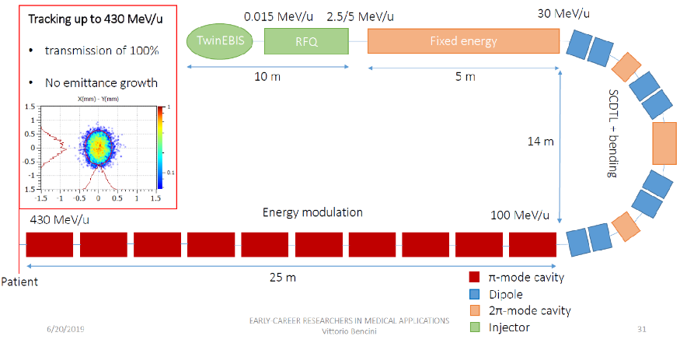
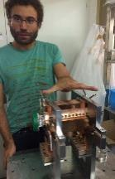
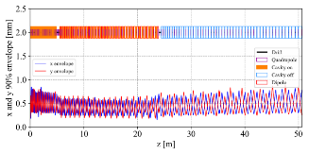
Accelerator option #1: the linac
A. Lombardi, V. Bencini, D. Gibellieri, F. Wenander, BE/ABP
A. Grudiev, H. Pommerenke, S. Ramberger, M. Khalvati, BE/RF J. Navarro, C. Oliver, D. Perez, CIEMAT
High repetition frequency (360 Hz) with pulse-to-pulse energy modulation allow fast and accurate dose delivery to the tumour
Parameter | Value
Frequency | 750 MHz/3 GHz
Species | ¹²C⁶⁺
Final energy | 100-430 MeV/u
Repetition rate | 200 (400) Hz
Pulse length | 5 μs
Acceleration of fully stripped Carbon with 750MHz/3GHz structures
Starts from a TERA basic design (CABOTO)
Innovative «folded» version to save space
Particle tracking completed
Prototype EBIS source under commissioning
RFQ designed
Agreement with CIEMAT for construction of pre-injector in collaboration with Spanish industry

Slide 16
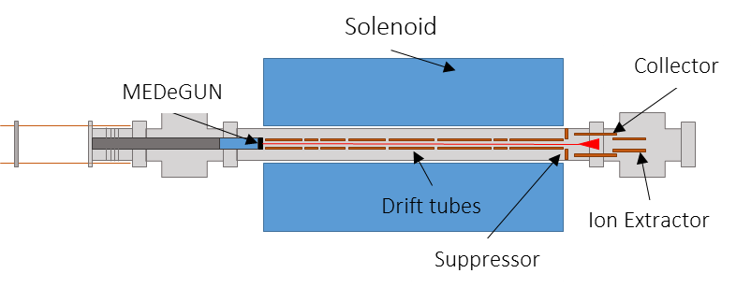

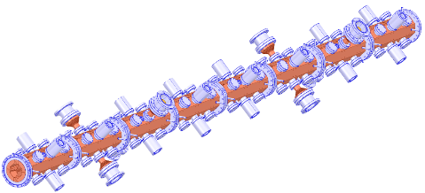
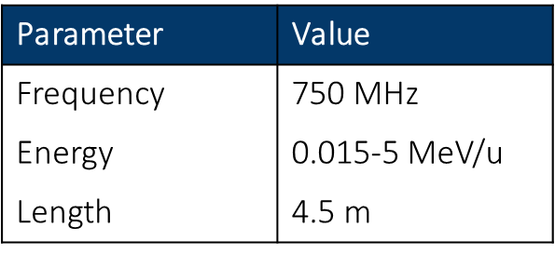
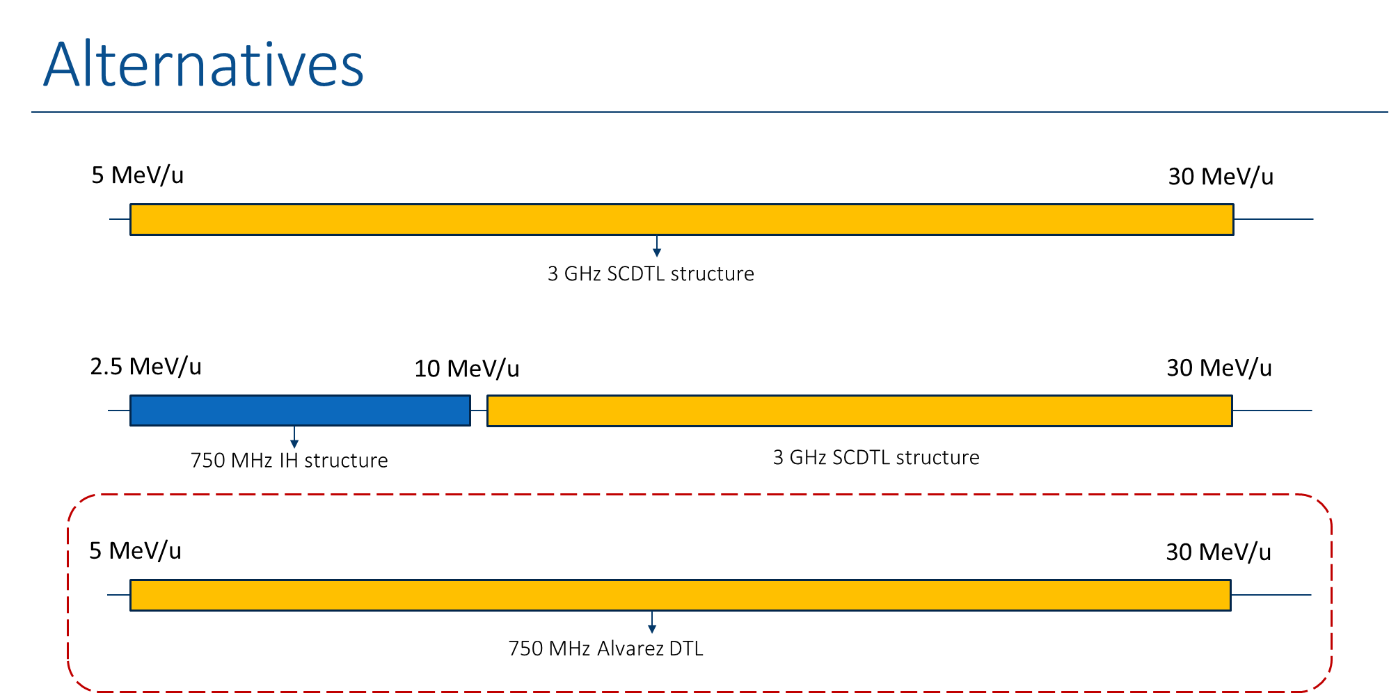
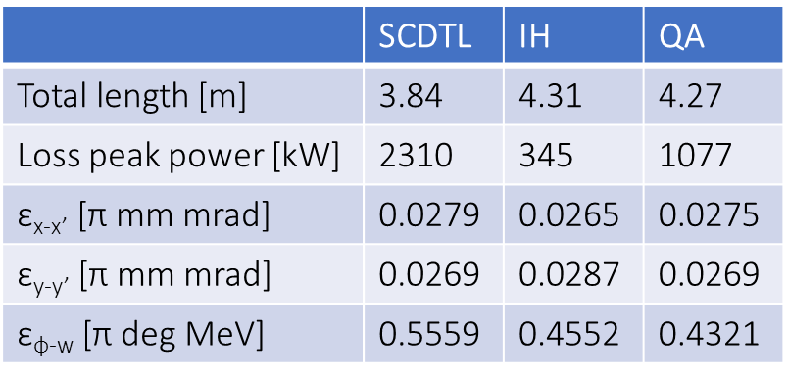
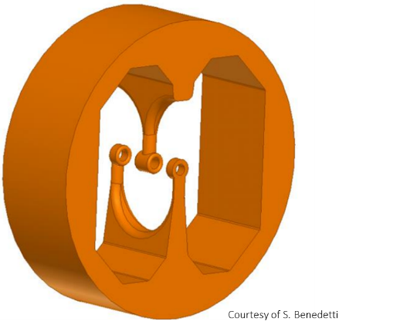
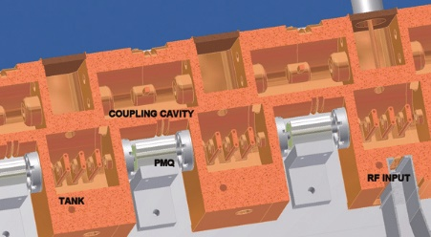
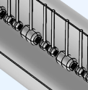
Linac key components: source, RFQ, acc. structures
2019 Commissioning of MEDeGUN
Radio Frequency Quadrupole designed
trapezoidal vanes with sinusoidal step
Stable reproducible operation above nominal current
Energy decreased to the lower theoretical limit
Minimized losses (<1.5 mA)
Calculation of expected ion current
Comparison of alternatives for the fixed energy section 5-10 MeV/u
Interdigital-H
Side-Coupled DTL
QuasiAlvarez
Courtesy S. Benedetti
Courtesy L. Picardi
Courtesy M. Khalvati

Slide 17
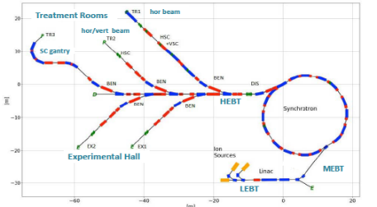
Accelerator option #2: the advanced RT synchrotron
E. Benedetto, M. Sapinski, TERA/SEEIIST
U. Amaldi, TERA
A. Avdic, A. Ibrahimovic, U. Sarajevo
X. Zhang, U. Melbourne
M. Vretenar, CERN
Starting point: the PIMMS design
Improvements:
Higher beam intensity for faster treatment (2x10¹⁰, 20 times higher)
Multiple energy extraction (multiple flat-tops)
Additional fast extraction for FLASH operation
Redesigned linac at higher frequency, for lower cost and parallel isotope production
Multiple particles: p, He, C, O
Optimised layout of beam transport, for both research and therapy

Slide 18
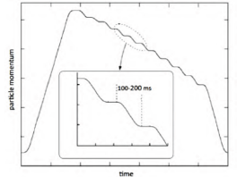
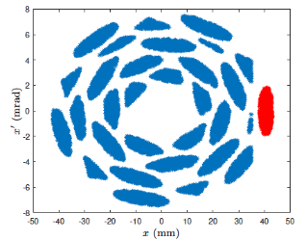
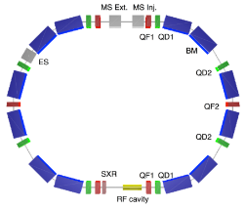
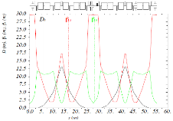
Advanced synchrotron design, key elements
Multiple flat-top operation (from HIMAC, Japan)
Optimisation of multi-turn injection: phase space after 30 turns
(A. Avdic, U. Sarajevo)
Two alternative concepts for a new 7 MeV injector linac at higher frequency
(q/m = 1/3)
Alternative lattice based on Double Bend Achromat cells, with dispersion-free drift sections and only 12 dipoles and 14 quadrupoles (16 dipoles and 24 quadrupoles in PIMMS)
(X. Zhang, U. Melbourne)

Slide 19
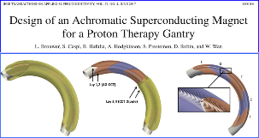
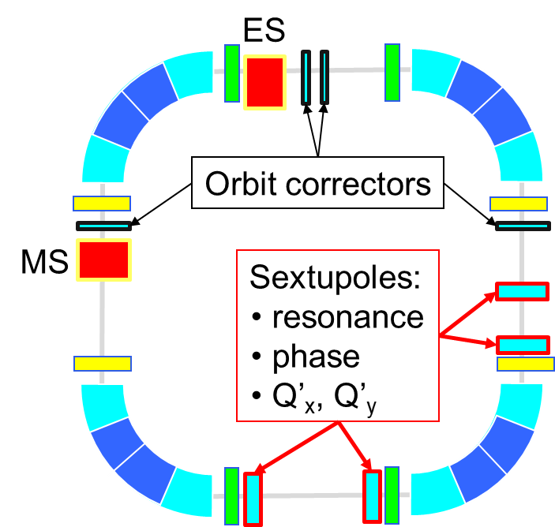

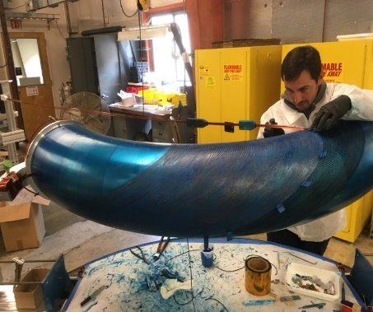
Accelerator option #3: superconducting synchrotron
Advantages:
Smaller dimensions
Lower construction and operation cost
Reduced power consumption
Circumference | 27 m
Injection energy | 7 MeV/u
Extraction energy | 100 → 430 MeV/u
Straight section 1 | 3 m
Straight section 2 | 3.6 m
AG-CCT Max. bending field | 3.5 T
AG-CCT Bending radius | 1.89 m
AG-CCT Magnetic bending angle | 90°
Need: 3 – 4 T magnets ramped at 1 T/s
Magnet options to be explored:
Conventional Nb-Ti
Canted Cosine Theta
High Temperature Superc.
A superconducting C-ring at the same scale of CNAO and MedAustron
TERA synchrotron Design: CCT magnets 3.5T
Aperture 60 mm
Total circumference 27 m
Canted Cosine Theta magnets
Proposed by TERA, based on the LBNL experience in the design and prototyping of a proton gantry magnet
Layered construction, can include quadrupole layers

Slide 20
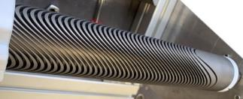



SC magnets for synchrotrons and gantries
High Energy Physics is promoting a wide international effort in the development of conductors, designs and technologies for SC magnets.
NIMMS aims at profiting of this R&D effort for compact synchrotron and gantry magnets.
Some of the challenges are common, other are specific for medical accelerator magnets: ramping field, curved shape, quadrupole integration, use of cryocoolers.
Magnet Parameters for HITRI+ and IFAST
Parameter | Synchrotron magnet | Prototype Magnet
Bρ (Tm) | 6.6 | 6.6
B₀ dipole (T) | 3.0 | 4-5
Coil apert. (mm) | 70-90 | 60 (90)
Curvature radius (m) | 2.2 | 2.2 , ∞
Ramp Rate (T/s) | 1 | 0.15-1
Field Quality (10⁻⁴) | 1-2 | 10-20
Deflecting angle | 90° | 0 - 45°
Alternating-Gradient | yes (triplet) | N/A
Quad gradient (T/m) | 40 | 40
B_{quad} peak (T) | 1.54- 1.98 | 1.2
B_{peak} coil (T) | 4.6 - 5 | 5.6-7
Operating current (kA) | < 6 | < 5
Type of Superconductor | NbTi (Nb₃Sn) | NbTi (curved), HTS (straight)
Operating temperature (K) | 5 (8) | 5 (20)
A few ideas
Solution for curved and straight CCT coils combining dipole and quadrupole in the same winding - Courtesy G. Kirby and J. van Nugteren, CERN
2 proposals submitted to H2020 calls with Workpackages dedicated to SC magnets for medical accelerators – covering 2021/25
HITRIplus – Integrating Activity for Ion Therapy
  WP8 on Magnet Design: overview and assessment of various conductors (LTS, HTS, various types of cables) and magnet layouts (costheta, CCT, racetracks – spit coils or flare ends – etc…). Design construction and test of 1 demontrator 500 mm long (either LTS or HTS)
I.FAST – General innovation programme for accelerator R&D
  WP8 on Innovative Superconducting Magnets: General consensus to go toward CCT, different conductors. Development of a HTS cable suitable for low losses - large size - fast cycling - synchrotrons (led by GSI)
Both WPs coordinated by L. Rossi (INFN, former CERN)
Participants: CEA, CERN, CIEMAT, INFN, PSI, UU, Wigner, SEEIIST, GSI + BNG, Sigmaphi, Elytt (industrial)
Curved cos-theta dipole with H-split yoke with assembly clamps - Courtesy Mikko Karppinen, CERN

Slide 21





The compact SC synchrotron
E. Benedetto, M. Sapinski, TERA/SEEIIST
P. Foka, GSI
D. Kaprinis, Kaprinis Architects
M. Vretenar, CERN
Alternative lattice with 60⁰ magnets
Compact faciliy with 2 rooms
A compact single-room ion therapy facility in about 1,000 m²
Comparable in size with proton therapy systems – here the single-room proton facility ProteusOne, from IBA)

Slide 22




Comparing the three options for SEEIIST
RT synchrotron:
accelerator 1,200 m², facility 6,500 m²
estimated cost (acc. only): 42 M€
SC synchrotron:
accelerator 600 m², facility 5,500 m²
estimated cost (acc. only): 31 M€
Full linac:
accelerator 600 m², facility 5,500 m²
estimated cost (acc. only): 31 M€
SC synchrotron or linac allow 50% reduction in accelerator dimensions, 15% in overall facility dimensions, and 20% reduction in cost.
This study recommends to SEEIIST the adoption as baseline configuration of a warm-magnet synchrotron with novel features. Development of superconducting magnets and adequate superconducting synchrotron designs should continue as an advanced alternative option. The superconducting alternative with its potentially lower cost and smaller dimensions might become the baseline in case preparation for construction of SEEIIST would take more time than foreseen and in case of success of the superconducting magnet development. Additionally, the superconducting option might more easily become a standard commercial design for a next generation of ion therapy facilities beyond SEEIIST.
Linac option discarded by SEEIIST because requires R&D, is not evolutive, and needs specific medical licensing.

Slide 23

Layout of the complete SEEIIST-type facility
All team, with P. Foka, GSI and D. Kaprinis, Kaprinis Architects
Access for therapy
The synchrotron can be replaced by an SC version if R&D successful
Research and Therapy Facility
(50% daily beam time for research, 50% for therapy)
Equipment room and access to synchrotron
Total 6,600 m²
Target for isotope production
Access for animal testing
Reconfigurable experimental room
Access to experimental room and linac

Slide 24




Linac for production of medical radioisotopes
M. Vretenar, CERN
P. Foka, GSI
A. Marmaras, U. Thessaloniki
G. Bisoffi, INFN/CERN
The SEEIIST facility will have a new injector linear accelerator (linac) designed for higher energy (10 MeV/u), with lower cost, higher efficiency and higher intensity.
With a minor additional investment, the linac could have 2 modes of operation: for injection in the synchrotron, and for sending the beam to a target for production of medical radioisotopes.
An example: Targeted Alpha Therapy
Alpha-emitting therapeutic isotopes: charged atomic nuclei emitting α particles (2 protons+2 neutrons), produced by bombardment of nuclei with an α beam.
Attached to antibodies and injected to the patient: accumulate in cancer tissues and selectively deliver their dose.
Advanced experimentation going on in several medical centres, very promising for solid or diffused cancers (leukaemia). Potential to become a powerful and selective tool for personalised cancer treatment.
If the radioisotope is also a gamma or beta emitter, can be coupled to diagnostics tools to optimise the dose (theragnostics)
to synchrotron
to radioisotope production target

Slide 25



The gantry collaboration
CERN, CNAO, MedAustron, INFN
Coordinated by M. Cirilli, CERN and S. Rossi, CNAO
CNAO (Pavia, Italy) and MedAustron (W. Neustadt, Austria) have 3 treatment rooms but no gantry (too large and expensive).
CNAO plans to install a gantry within the next 10 years, MedAustron has a similar plan for the longer term.
They have both asked CERN to collaborate in the design of a superconducting gantry that would satisfy their requirements.
The same design could be adopted by SEEIIST.
CNAO
Term of comparison is the SC gantry built by Toshiba for HIMAC (Japan):
15 m long, 6 m radius, 300 tons
Two alternative designs are being considered.
A specially appointed Review Committee will select in early 2021the priority design for the collaboration
MedAustron

Slide 26






Gantry option 1
U. Amaldi, N. Al Harbi, P. Riboni (TERA)
L. Gentini, M. Karppinen, D. Perini, D. Tommasini (CERN)
E. Benedetto (TERA/SEEIIST)
M. Pullia (CNAO)
Basic idea from TERA: 5T 90⁰ CCT magnets, light structure attached to a wall, rotating by only 180⁰
A CERN team is developing a more conservative version, compatible with the CNAO schedule, based on 3T cos-theta magnets at maximum 45⁰
radius 6.5 m
Ongoing development of analysis tools and magnet design for curved cos-theta magnets
Application for KT-MA support of small demonstrator magnet
gear and motor
Small aperture (40mm)
Scanning magnets downstream
Optics completed:
Bending sections inside 2 cryostats: 45⁰ , 135⁰ with SC quads between dipoles (achromaticity)
Warm quadrupoles between cryostats
Source Axis Distance 2.5 m – challenge for the scanning magnets

Slide 27



Gantry option 2: GaToRoid
L. Bottura, E. Felcini, J. van Nugteren, G. de Rijk, G. Kirby, B. Dutoit, CERN
CERN development (L. Bottura, 2017)
Novel concept of a fixed toroidal gantry to deliver the dose from a number of discrete directions covering the full 360⁰ range
Studied in 2 versions, for protons and for ions
Reference parameters for ion version
Internal diameter | 3.7 m
External diameter | 12.8 m
Number of treatment directions | 20
Length (w/o vector magnet) | 10 m
Peak field on coils | 6 T
Torus mass | 270 t
Ongoing:
Linear beam optics study
Analysis and design of vector magnet
Construction of a proton demonstrator coil
Single particles with different energies converge at the isocentre
The requirements for the ion version are currently being revised to come to a more competitive set of parameters
Demonstrator of a coil for the proton version: first winding test in stainless steel tape on 3D-printed spacers

Slide 28
NIMMS Future Goals and Timeline
User | CNAO-MedAustron | SEEIIST | Future compact facilities
Time frame for completion | 2025-30 | 2025-30 | 2030-35
WP1 - Superconducting magnets
WP2 – High-energy linac
WP3 – Gantry design
WP4 – Synchrotron design
Superconducting magnet plan – courtesy L. Rossi

Slide 29



SEEIIST plans and schedule
SEEIIST has just submitted its application to enter into the ESFRI Roadmap of future Research Infrastructure of European relevance.
Based on 200 pages of technical documents prepared with an important contribution from NIMMS
Masterplan for construction in 9 years

Slide 30
NIMMS Impact on Ion Therapy Accelerator Research
Service Contract for SEEIIST support, 0.5 M€ to CERN
(total budget 1.3 M€ for support to SEEIIST)
2019/2021
development RT synchrotron design
design Quasi-Alvarez option for bent linac
design SC gantry optics
design transfer lines for therapy and experiment
facility integration
comparison of 3 accelerator designs
SEEIIST, TERA, CERN, GSI, SAE
with SEEIIST
HITRI+, submitted to H2020, 1.2 M€ for accelerator studies
(total budget 5 M€ for all ion therapy, support to SEEIIST)
2021-2024
synchrotron injection and extraction
synchrotron beam optics and operational modes
SC synchrotron lattice
injector linac design
gantry integration
engineering design of SC magnets
small SC magnet demonstrator
SEEIIST, CERN, CNAO, MedA, INFN, CEA, CIEMAT, PSI, UU, Wigner
NIMMS
Gantry collaboration for new SC gantry design
2019/…
Design and prototyping of a novel SC ion gantry
CERN, CNAO, MedA, INFN, TERA
IFAST, submitted to H2020, 1.41 M€ for accelerator studies
(total budget 10 M€ for accelerator Research & Innovation)
2021-2025
Improvement of slow extraction spill quality (with FAIR)
Engineering design of curvet CCT magnet
Engineering design of HTS CCT magnet
Construction of curved CCT magnet demonstrator
Construction of HTS magnet demonstrator
Development of ReBCO HTS nuclotron cable (with FAIR)
GSI, BI, BT, CERN, HIT, CERN, CEA, INFN, CIEMAT, Wigner, UU, PSI, Scanditronix, Elytt, SigmaPhi
Bent-linac pre-injector collaboration
2021/…
Engineering design and construction by Spanish industry
CERN, CIEMAT
Starting from a CERN investment of 500 k€ for 2019/21, NIMMS has launched collaborations that have collected funding for ~4 M€ (factor 8 leverage factor)
Synchrotron design collaboration
2020/…
U. Melbourne, Cockcroft I.

Slide 31


Some conclusions - NIMMS and accelerator applications
The next years will be critical for the future of particle physics and of basic research in general.
We need to show the impact on society of our technologies by investing on applications of accelerators and in general of particle physics.
There is a wealth of applications of accelerators waiting to be developed not only in medicine, but also in environment, energy, security, industry,…
Basic Research
Innovation
Economic growth
Government resources
NIMMS
The virtuous circle of scientific innovation
Our community needs to address seriously this issue. For medicine, is the limited “seed-funding” KT-MA scheme the right tool to address it at CERN?
We need wide programs like NIMMS, to federate initiatives, provide coherence, ensure connection with final users, launch new initiatives, offer coordination, support and (some) funding.
Recognition as a strategic direction for our community.
The right way to communicate future projects:
In the «Code of the Universe» exhibition on CERN and FCC 10 out of the 38 panels quote applications, to medicine (3) and more general (7).
2017 EuCARD2 Report on Accelerator Applications:
http://apae.ific.uv.es/apae/wp-content/uploads/2015/04/EuCARD_Applications-of-Accelerators-2017.pdf

Slide 32

the MedAUSTRON hall
Thank you for your attention

