Slide 1

BBQ peak finding
D. Alves, L. Grech
BE-BI

Slide 2
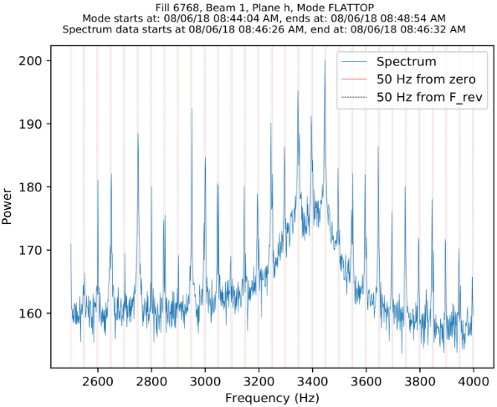
The curse of the 50Hz

Slide 3
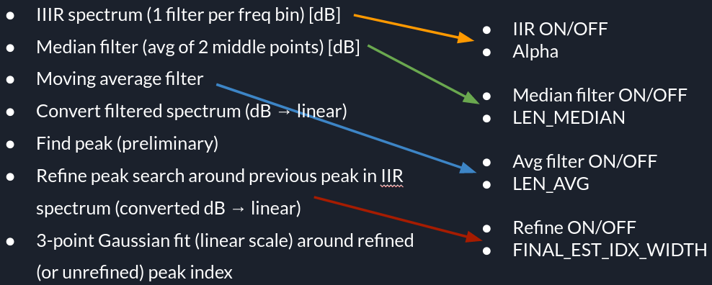
BBQ – present algorithm

Slide 4
BBQ Settings
Use-case FAST
Use-case FB
IIR OFF
Med filter OFF
Mov avg OFF
Refined peak search DONE despite begin configured as DISABLED – width = 2 samples
3 pt Gaussian fit ON
IIR ON → α = 0.5
Med filter ON → LEN = 5 samples
Mov avg ON → LEN = 5 samples
Refined peak search DONE despite begin configured as DISABLED – width = 1 sample
3 pt Gaussian fit ON

Slide 5
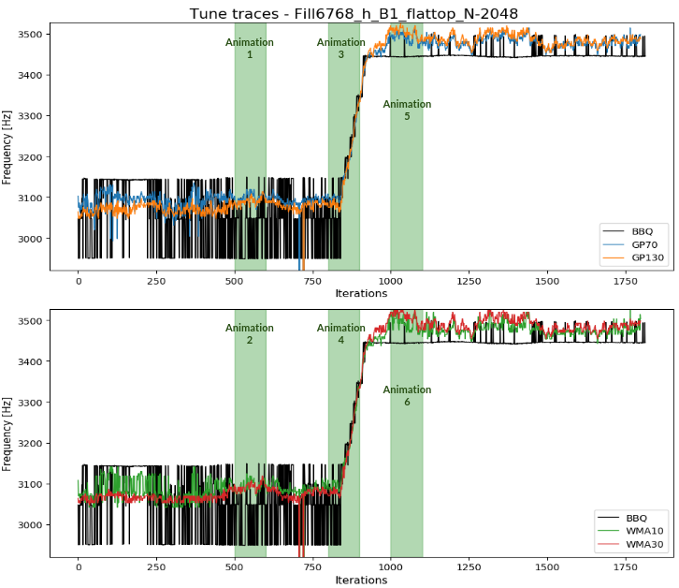
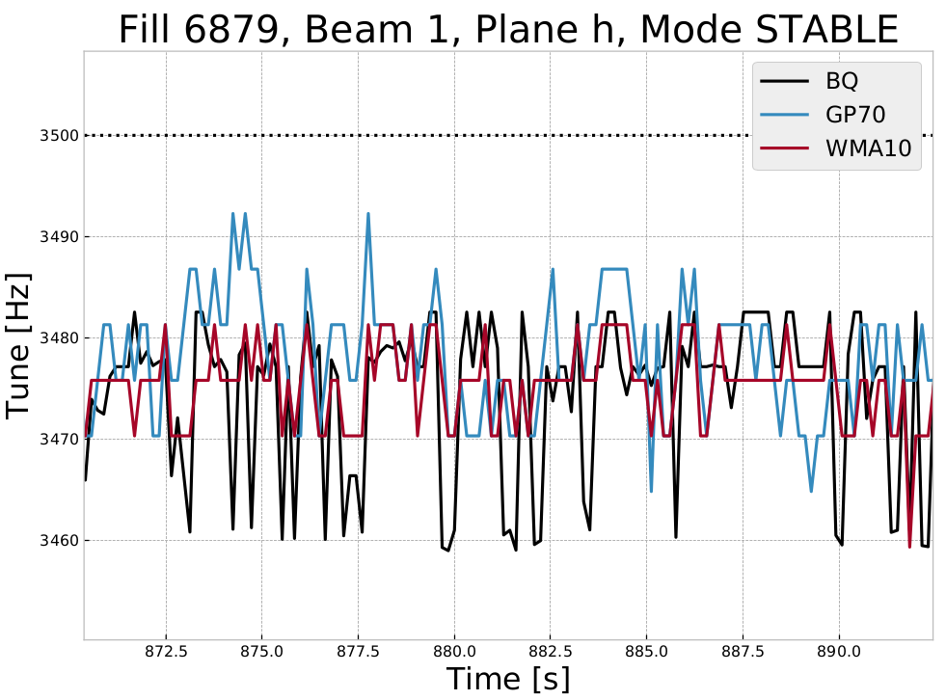
Use-case FAST
Use-case FB

Slide 6
The curse of the 50Hz
Present peak finder algorithm attempts to estimate tune from spectrum polluted with 50Hz harmonic content
  It neither completely rejects or makes use of this knowledge
  Often the tune estimate jumps from 50Hz line to 50Hz line

Slide 7
BBQ peak finding – a different approach
  Frequencies of 50Hz harmonic content are fairly deterministic
  Drop spectral points corresponding to 50Hz noise harmonics
  End up with a spectrum with periodic gaps
  Fit the data with gaps
    Need methods that can cope with unevenly sampled data
  Estimate tune (peak finding)

Slide 8
BBQ peak finding – a different approach
Polynomial fit
Weighted moving average
Gaussian processes
L. Grech et al, “An alternative processing algorithm for the tune measurement system in the LHC”, IBIC’20

Slide 9
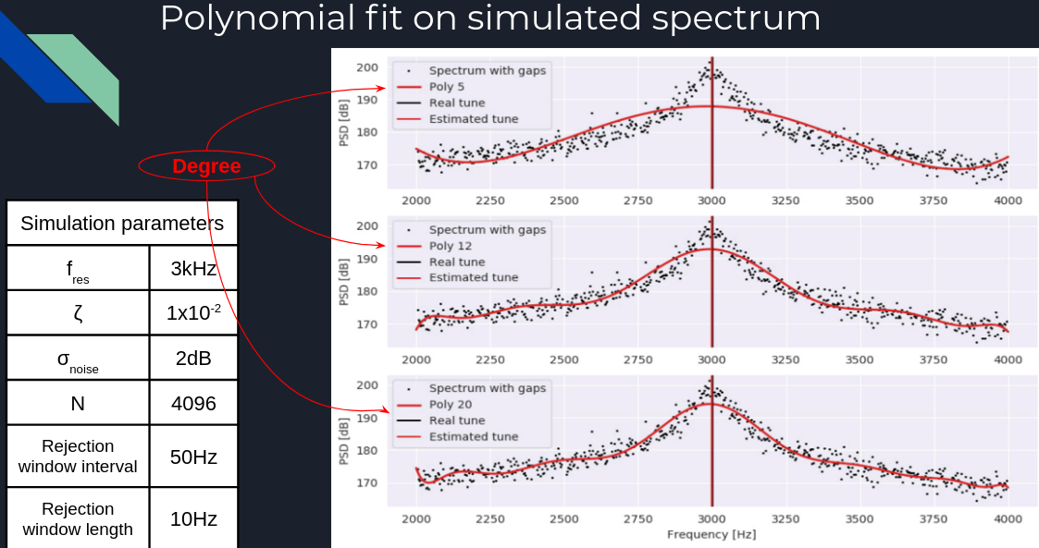
Polynominal fit

Slide 10
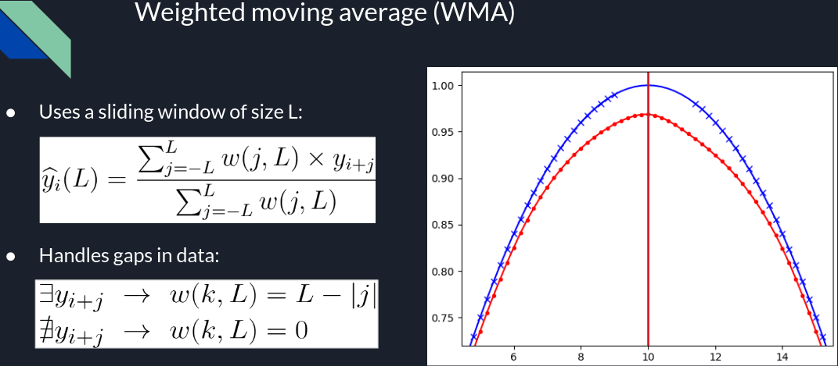
Weighted Moving Average – 1/2

Slide 11
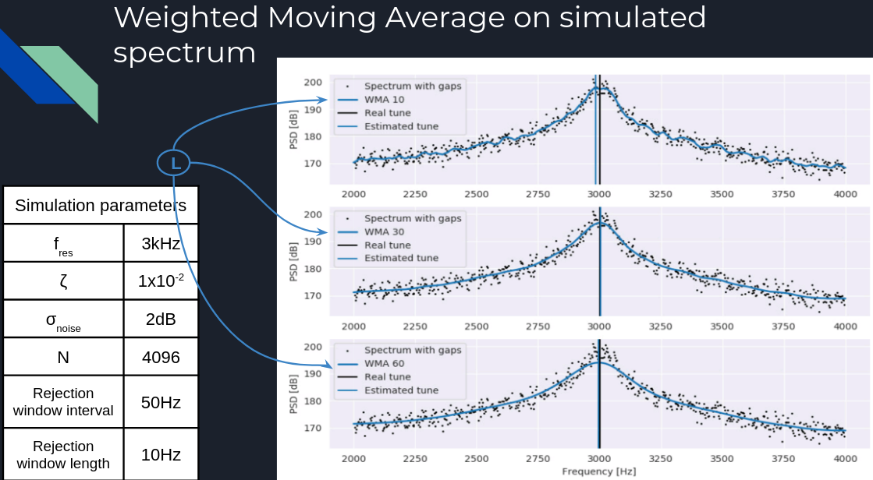
Weighted Moving Average – 2/2

Slide 12
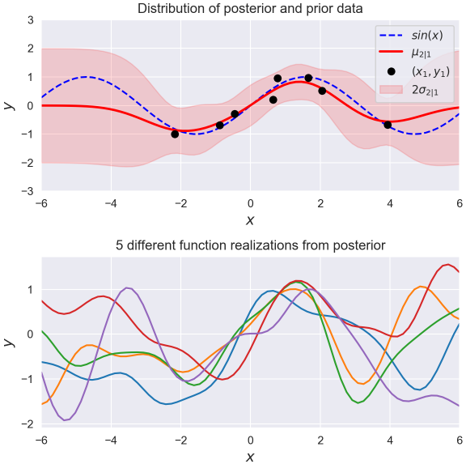
Gaussian processes – 1/2
Observed data (x₁,y₁) – black pts
P(x₁,y₁)~N(μ₁=m₁(x), Σ₁=k(x,x))
Predict y₂ at unobserved pts x₂
P(y₂|x₁,y₁,y₂) ~N(μ_{2|1}=m_{2|1}(x), Σ_{2|1}=k(x,x))
As both distributions are jointly normal, it is possible to relate both parametrisations
https://peterroelants.github.io/posts/gaussian-process-tutorial/

Slide 13
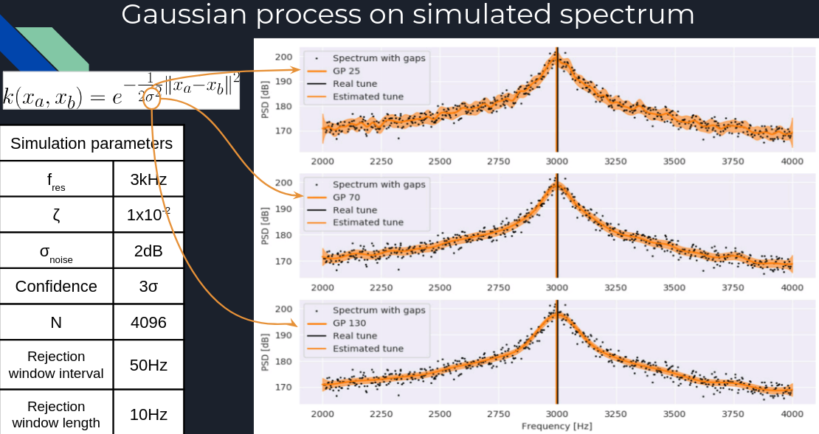
Gaussian processes – 2/2

Slide 14
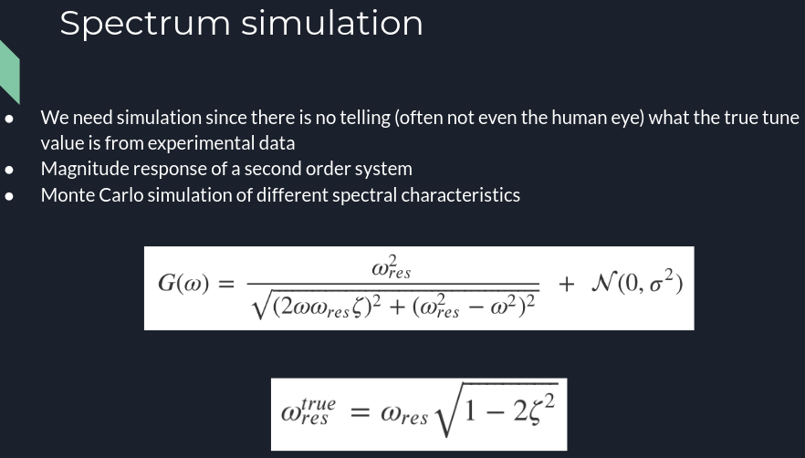

Slide 15
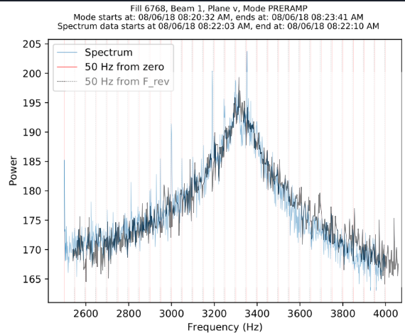
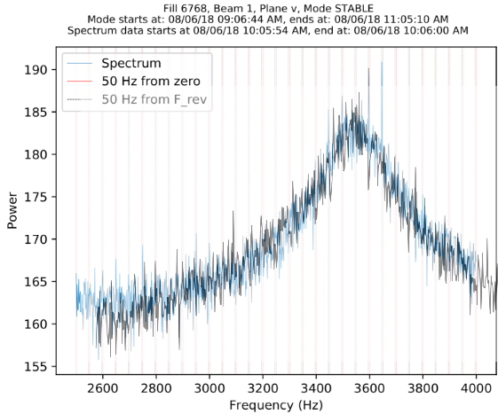
Generated spectrum can be fairly realistic

Slide 16
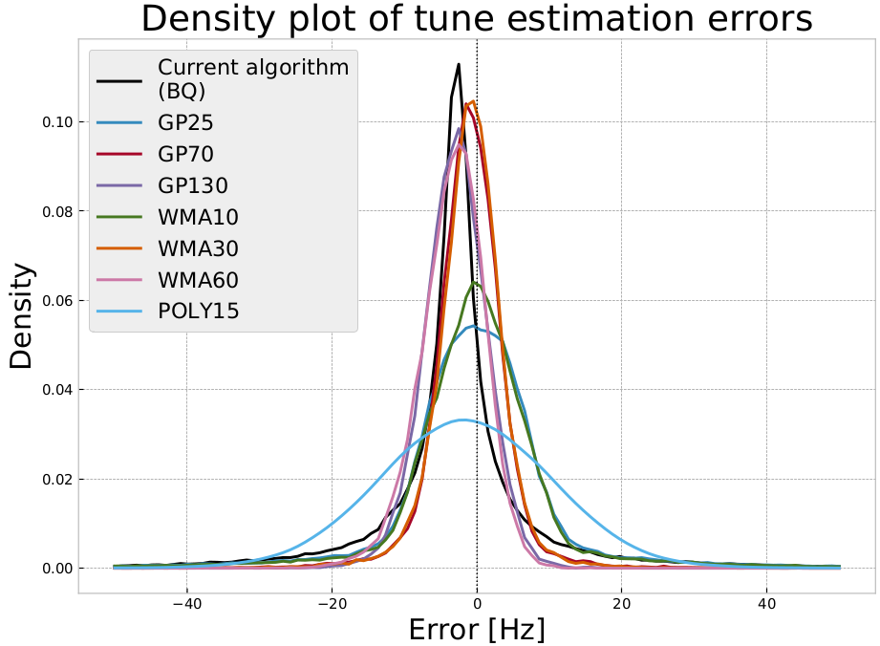
Performance comparison of algorithms with simulated spectra
Needs to be cross-checked and re-done!

Slide 17
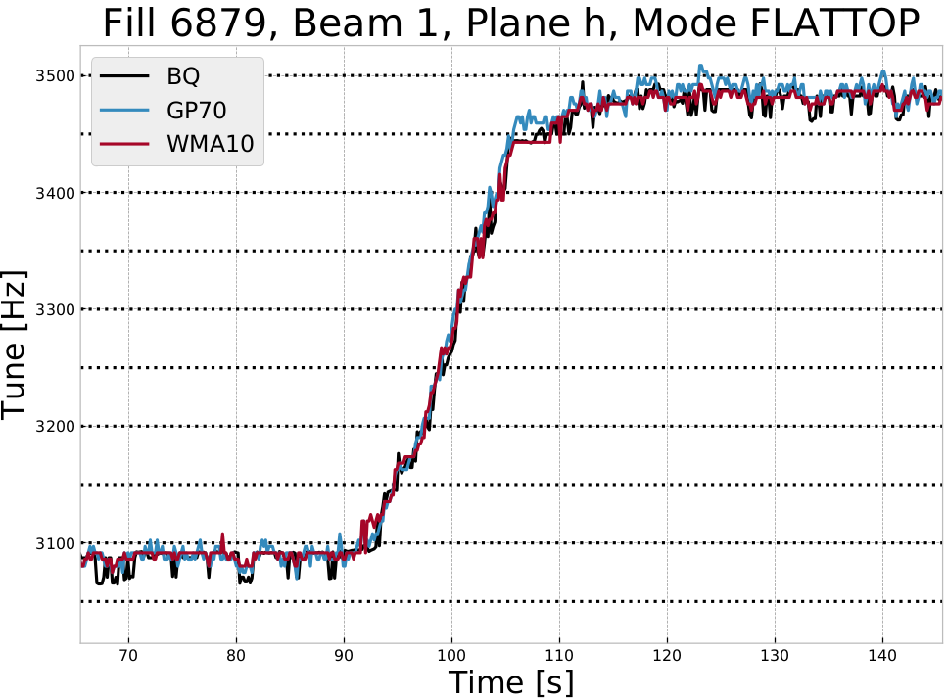
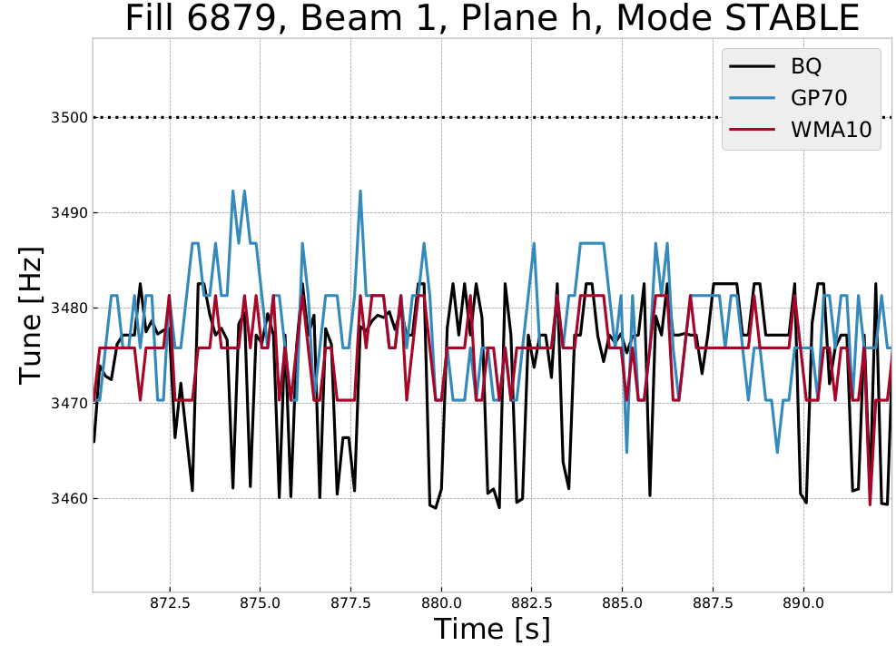
Real data

