Slide 1
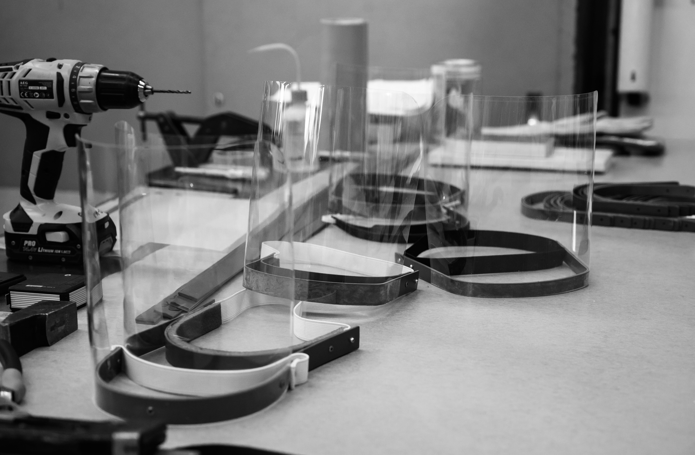
Update on COVID-19 measures
James Purvis
8 October 2020

Slide 2
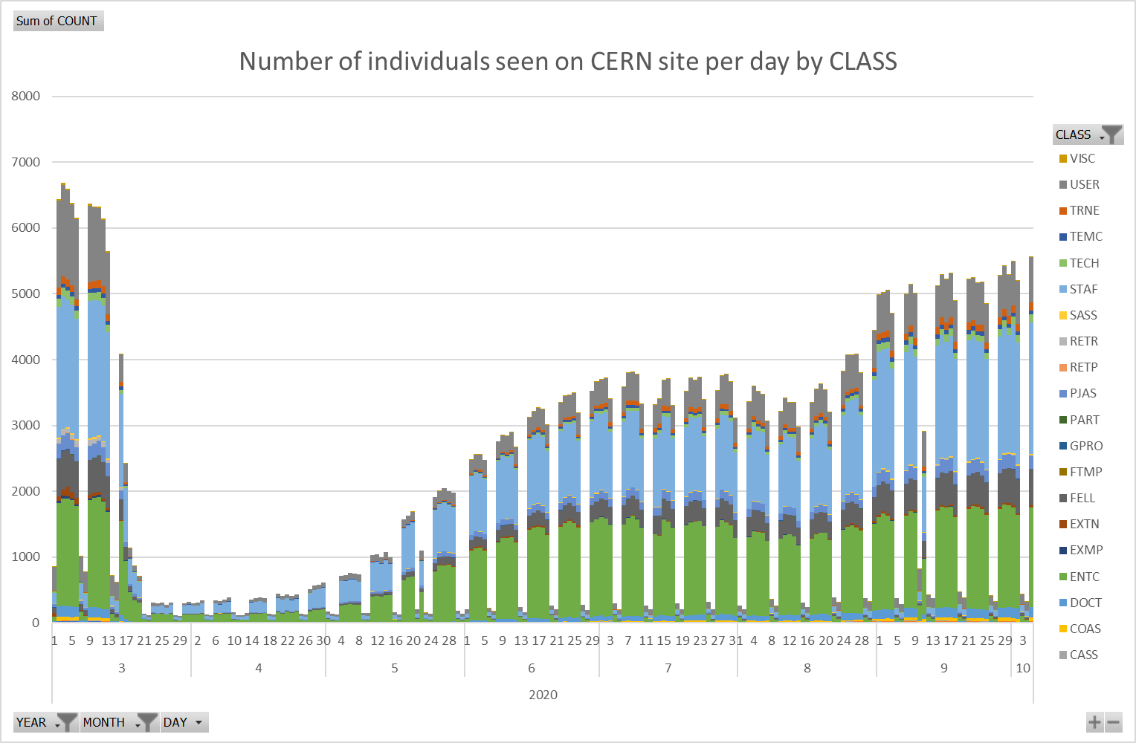
CERN’s Handling of COVID
CERN has demonstrated itself to be ‘exemplary’ in terms of flexibility and responsiveness
Crises management mechanisms
Rapidly introducing flexible arrangements with
Telework, Special Paid Leave, and MPA support
Implementation of safety measures (at times stricter than the host states’ measures)
Very gradual return to site (more cautious than others)
Liaising with host states, medical authorities, other organisations, Member States, and Staff Association
Numerous support channels & regular updates of information
Highly effective contact tracing & follow-up
Advice often sought as ‘reference’ organization
Significant infrastructure support
(IT, Gate E, Host-state attestations etc.)

Slide 3
Safety first: CERN & Host States
CERN COVID-19 instructions (since 5 May 2020)
Training required to be granted site access
Minimum distance 2 m (Switzerland 1.5 m, France 1 m)
Surgical masks T1 (Switzerland: since 6 July masks in public transport, 28 July shops,
31 July restaurants; France since 31 August: masks ‘grand public’, T1 for high risk category)
Additional hygiene measures (enhanced cleaning, distribution of hand sanitizers etc.)
PPE in restricted spaces (face shields, goggles, gloves, etc.)
CERN manages the breaking of chain of infections via Medical Service
(very restrictive; crucial support for national sanitary authorities)
CERN manages the quarantine for returnees from high risk countries
Example: Return from high risk countries
 | List of High Risk Countries/Areas | Quarantine
Switzerland | ~ 60 | 10 days
France | ~ 160 | 7 days or negative RT-PCR test
CERN | French + Swiss list | 10 days no access to CERN (+ quarantine for MPE – if applicable in country of residence)
”
Taking account of the CERN Safety Policy, that foresees that CERN strives to adopt the highest standards in matters of Safety, as well the fact that the CERN site straddles the French-Swiss border and the need for a consistent set of measures on the entire site.

Slide 4
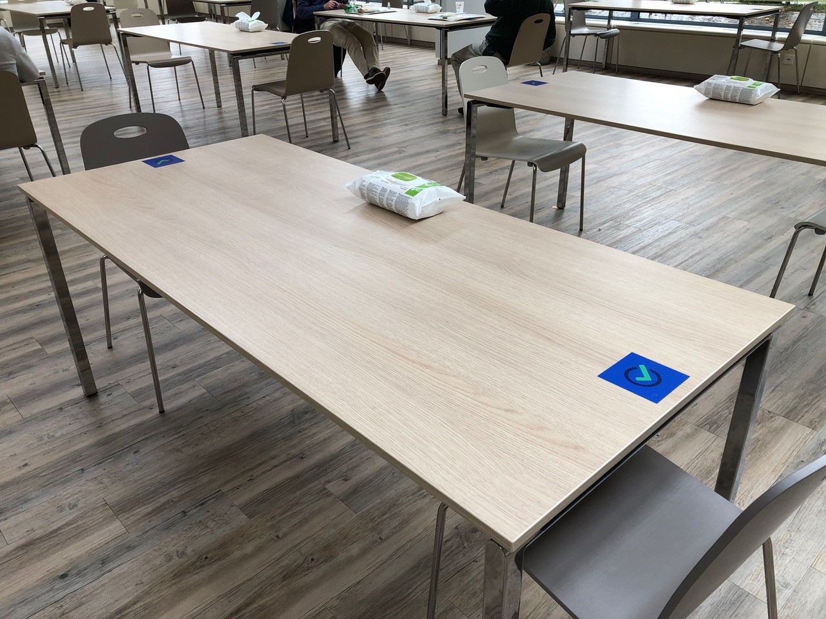

CERN Restaurants
Ensuring respect of
2 m distance
1300 meals/day
Ensure capacity for eating, but not ‘alternative meeting space’
Please avoid rush hours by taking profit of the full warm meals service period 11.00 - 14.30*
*as of 12th October

Slide 5
COVID-19 at CERN
CERN Medical Service Hotline put in place on 8 March
There has been no onsite transmission of coronavirus on the CERN site
Medical Service took care of all COVID-19 cases
(confirmed and suspected):
Assessing health state of caller / family member versus medical protocol
Advise to contact the family doctor if COVID suspected
If no family doctor, Medical Service takes care of the follow-up
Regular contact with all – confirmed and suspected COVID cases (highly appreciated)
Keeping contact with hospital
370 persons with symptoms to-date:
54 tested positive (incl 11 contractors)
236 tested negative (incl 31 contractors)
11 suspect cases
69 suspected cases unable to be tested during confinement
Of the 370 persons in isolation:
231 MPEs
96 MPAs
43 Contractors
CASE REPORTED TO
MEDICAL SERVICE
CLINICAL
ASSESSMENT
INFECTION
SUSPECTED
CLOSE CONTACTS
TRACED WITH DEPARTMENT
MEDICAL SERVICE GIVES GREEN LIGHT TO RE-INSTATE ACCESS
ALL CASES (SUSPECTED & CONTACTS) FOLLOWED REGULARLY BY
MEDICAL SERVICE
  14 day isolation
  Test prescribed
  CERN access revoked
  Names of close contacts provided
  Contacts asked to self-isolate
  Site access revoked for
  14 days
  Site access reinstated

Slide 6
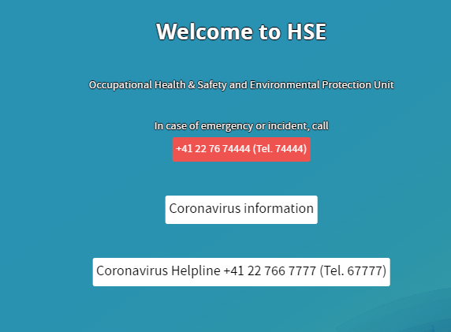

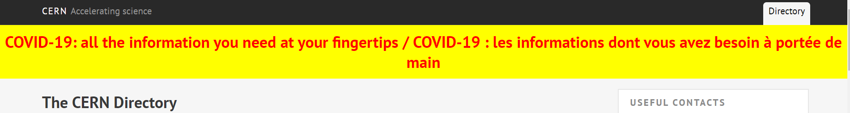
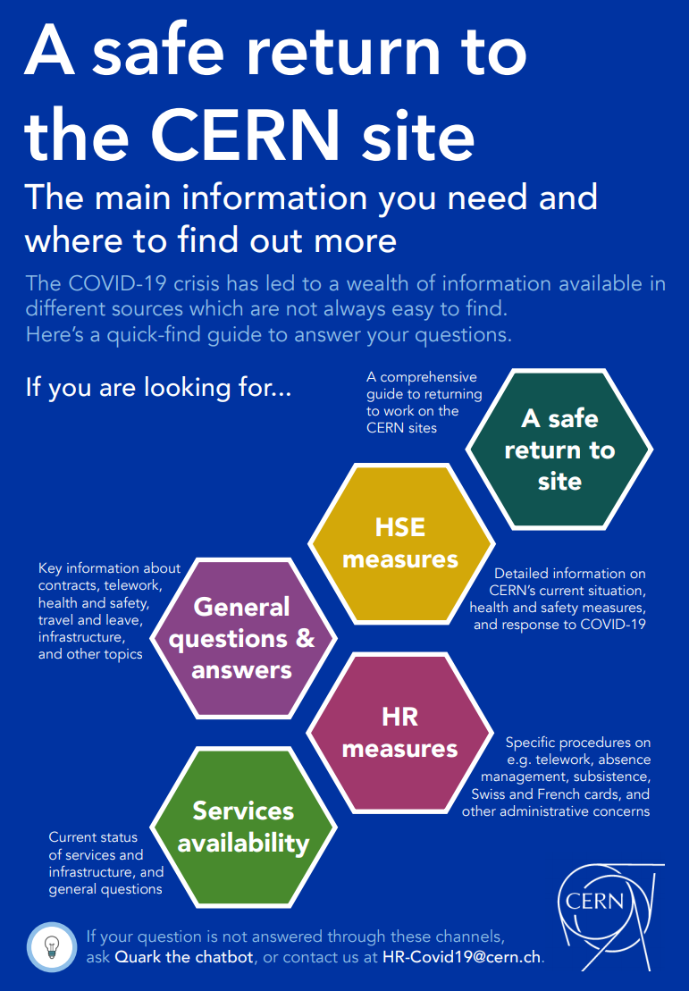
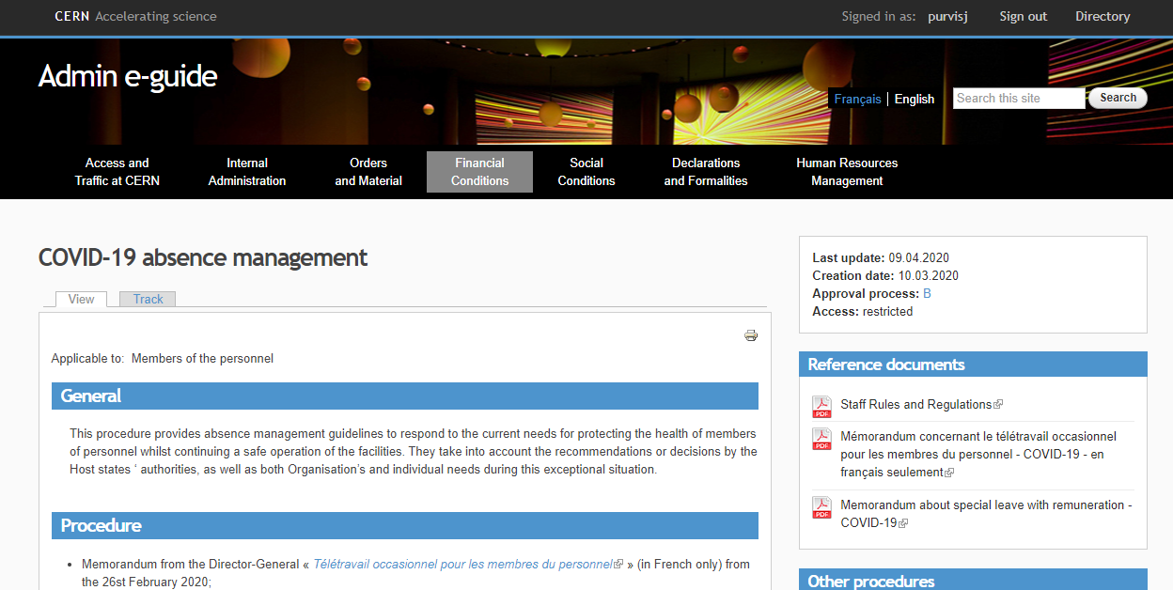
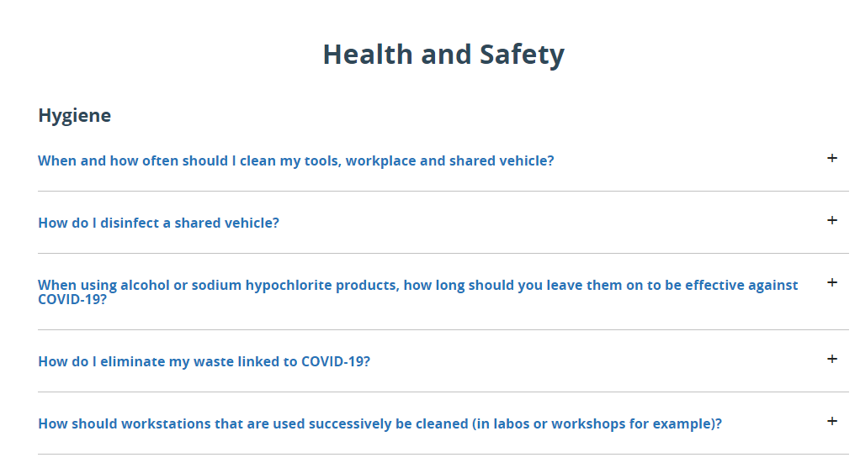

Where can I find the information?
DEDICATED COVID-19 PAGES
CERN DIRECTORY
hse.cern
ADMIN E-GUIDE
FAQ
INTERACTIVE FLYER
SERVICES AVAILABLE

Slide 7
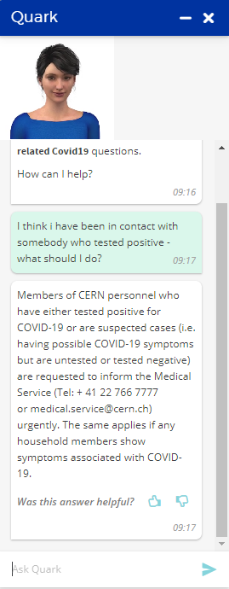
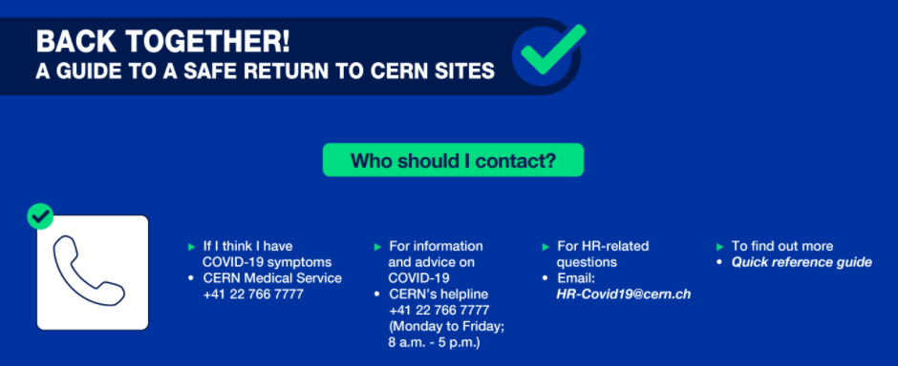
I have a question – who can I ask?
Numerous dedicated services
200+
support follow-up
SERVICE DESK
In addition to
your hierarchy, and
GAO, DAO, DSO, HRA, etc.
5884 calls (40/day)
5000+ tickets
MEDICAL HELPLINE
HR HELPLINE
“QUARK” CHATBOT
COVID
WEB PAGES
1100+ questions
20 000+
views

Slide 8

Travel & Quarantine
Overarching Principles
Ensure health & safety for all
  Facilitate situations where travel is absolutely required for professional or personal reasons whilst
  Limiting non-essential travel for the benefit of all of us
Align with practices of both host-states (which evolve quickly and are not identical)
New measures as of today: Access to CERN sites not allowed for 10* days after arrival from a country/area on at least one of the lists (Switzerland or France) of high-risk countries and areas for COVID-19 infection
More information :
https://hse.cern/content/medical-and-travel-quarantine-covid-19
https://cds.cern.ch/record/2712801/files/AbsenceManagement-Table.pdf
Discuss with your supervisor or institute ahead of time so that you are aware of what applies to you and how to manage your return to the CERN site.
*some exceptions, e.g. urgent onsite interventions

Slide 9
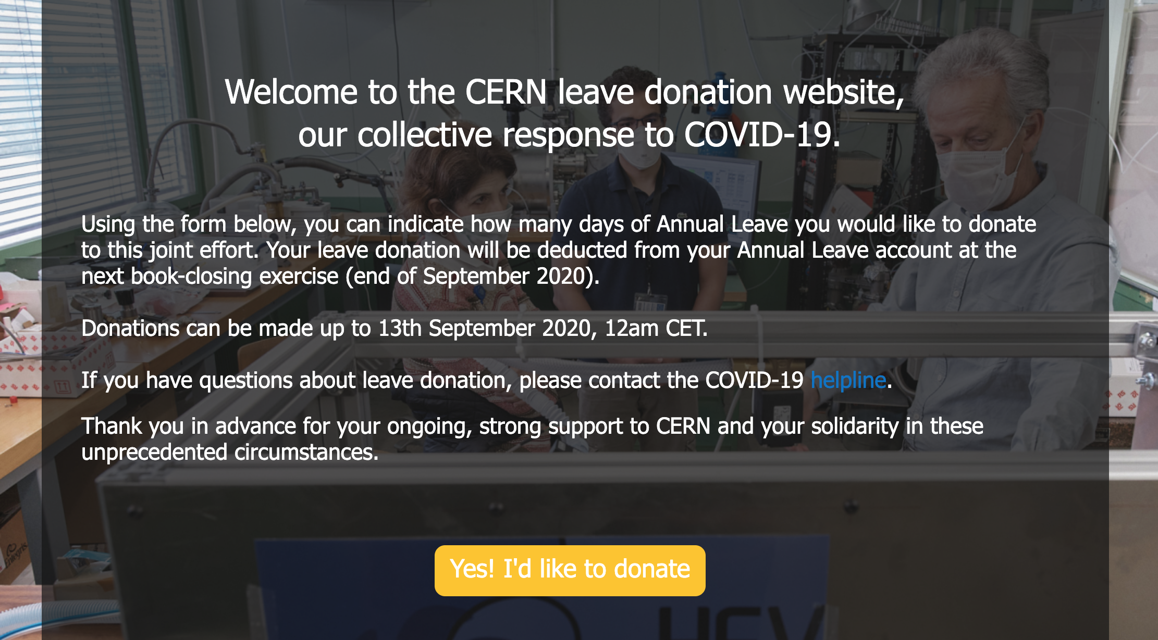
Leave donation
Leave is key to take care of ourselves and return to work refreshed
26 May: Director-General appeal
  Collective sense of solidarity and generosity by encouraging CERN employees to donate some of their leave days (Staff and Fellows)
Monetary equivalent to contribute to
  Work of the CERN against COVID-19 taskforce
  Other COVID-19-related expenses the Laboratory has to face
Remarkable response!
  First week: total of 547 days
  Closure - by 31 September:
  1077 days donated

Slide 10
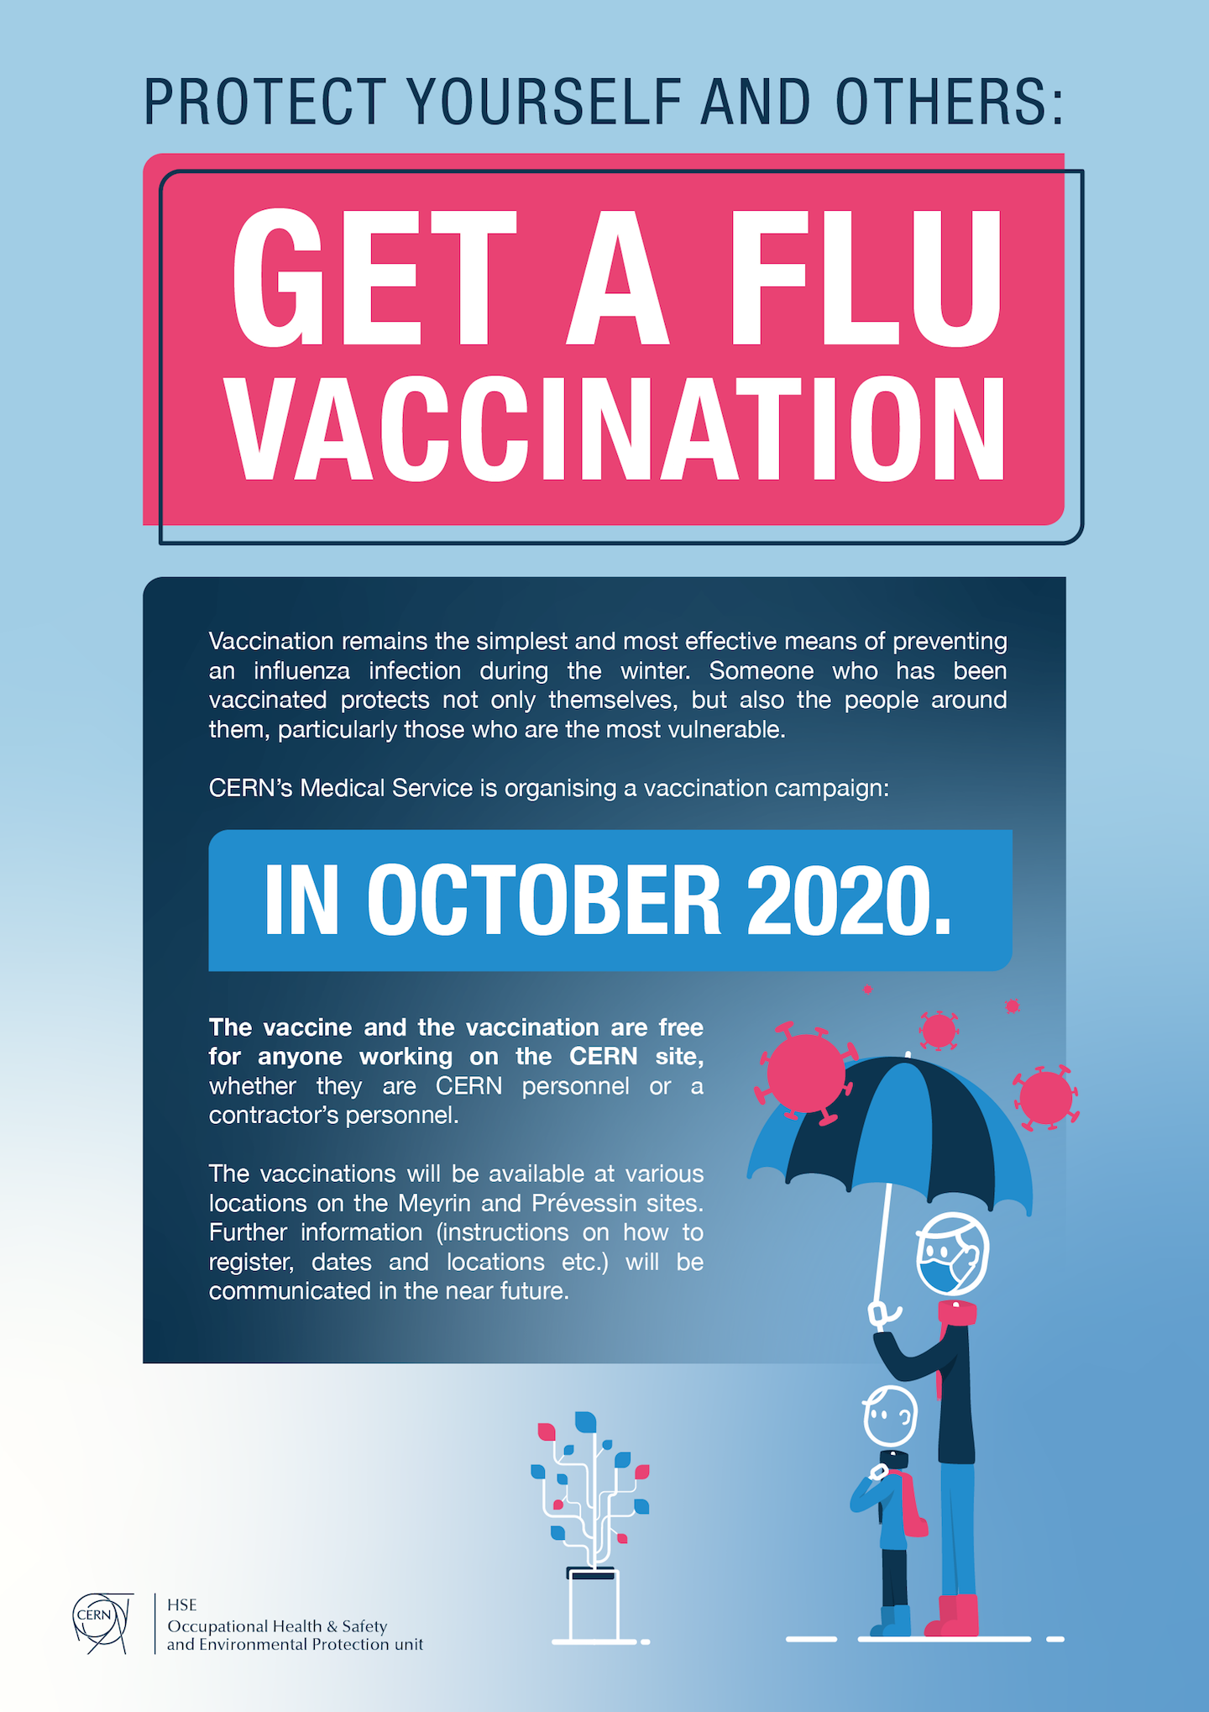
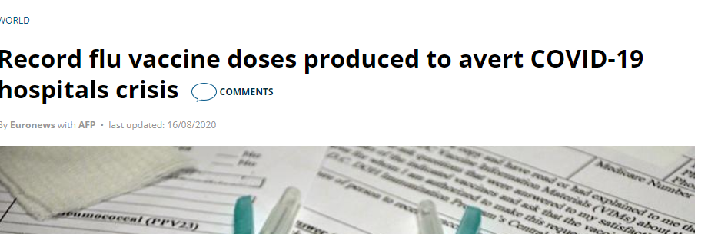
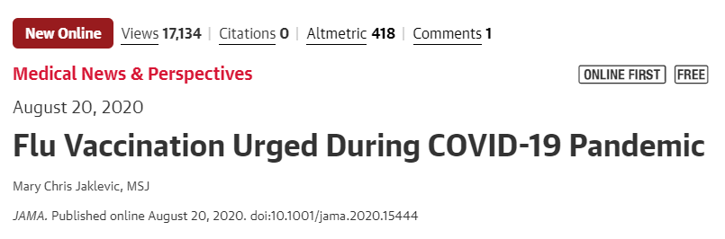
Flu vaccination
HSE ordered 5000 units of flu vaccinations
Vaccination campaign 15 October - 13 November
5 different points for vaccination –
50 vaccinations/point/day
In addition, special vaccination campaigns on
ATLAS and CMS sites (2 days each)
Online booking available soon

Slide 11

The Future…
Highest priority: protect the health of CERN’s personnel and everyone on site by taking measures that are effective and proportionate to the risk
whilst allowing the continued, safe operation of the facilities and keeping CERN up and running as long as possible.
The management is closely monitoring the evolution in the Host States and meet frequently to adapt & update the measures and plan accordingly.
Thank you for your support & collaboration

Slide 13
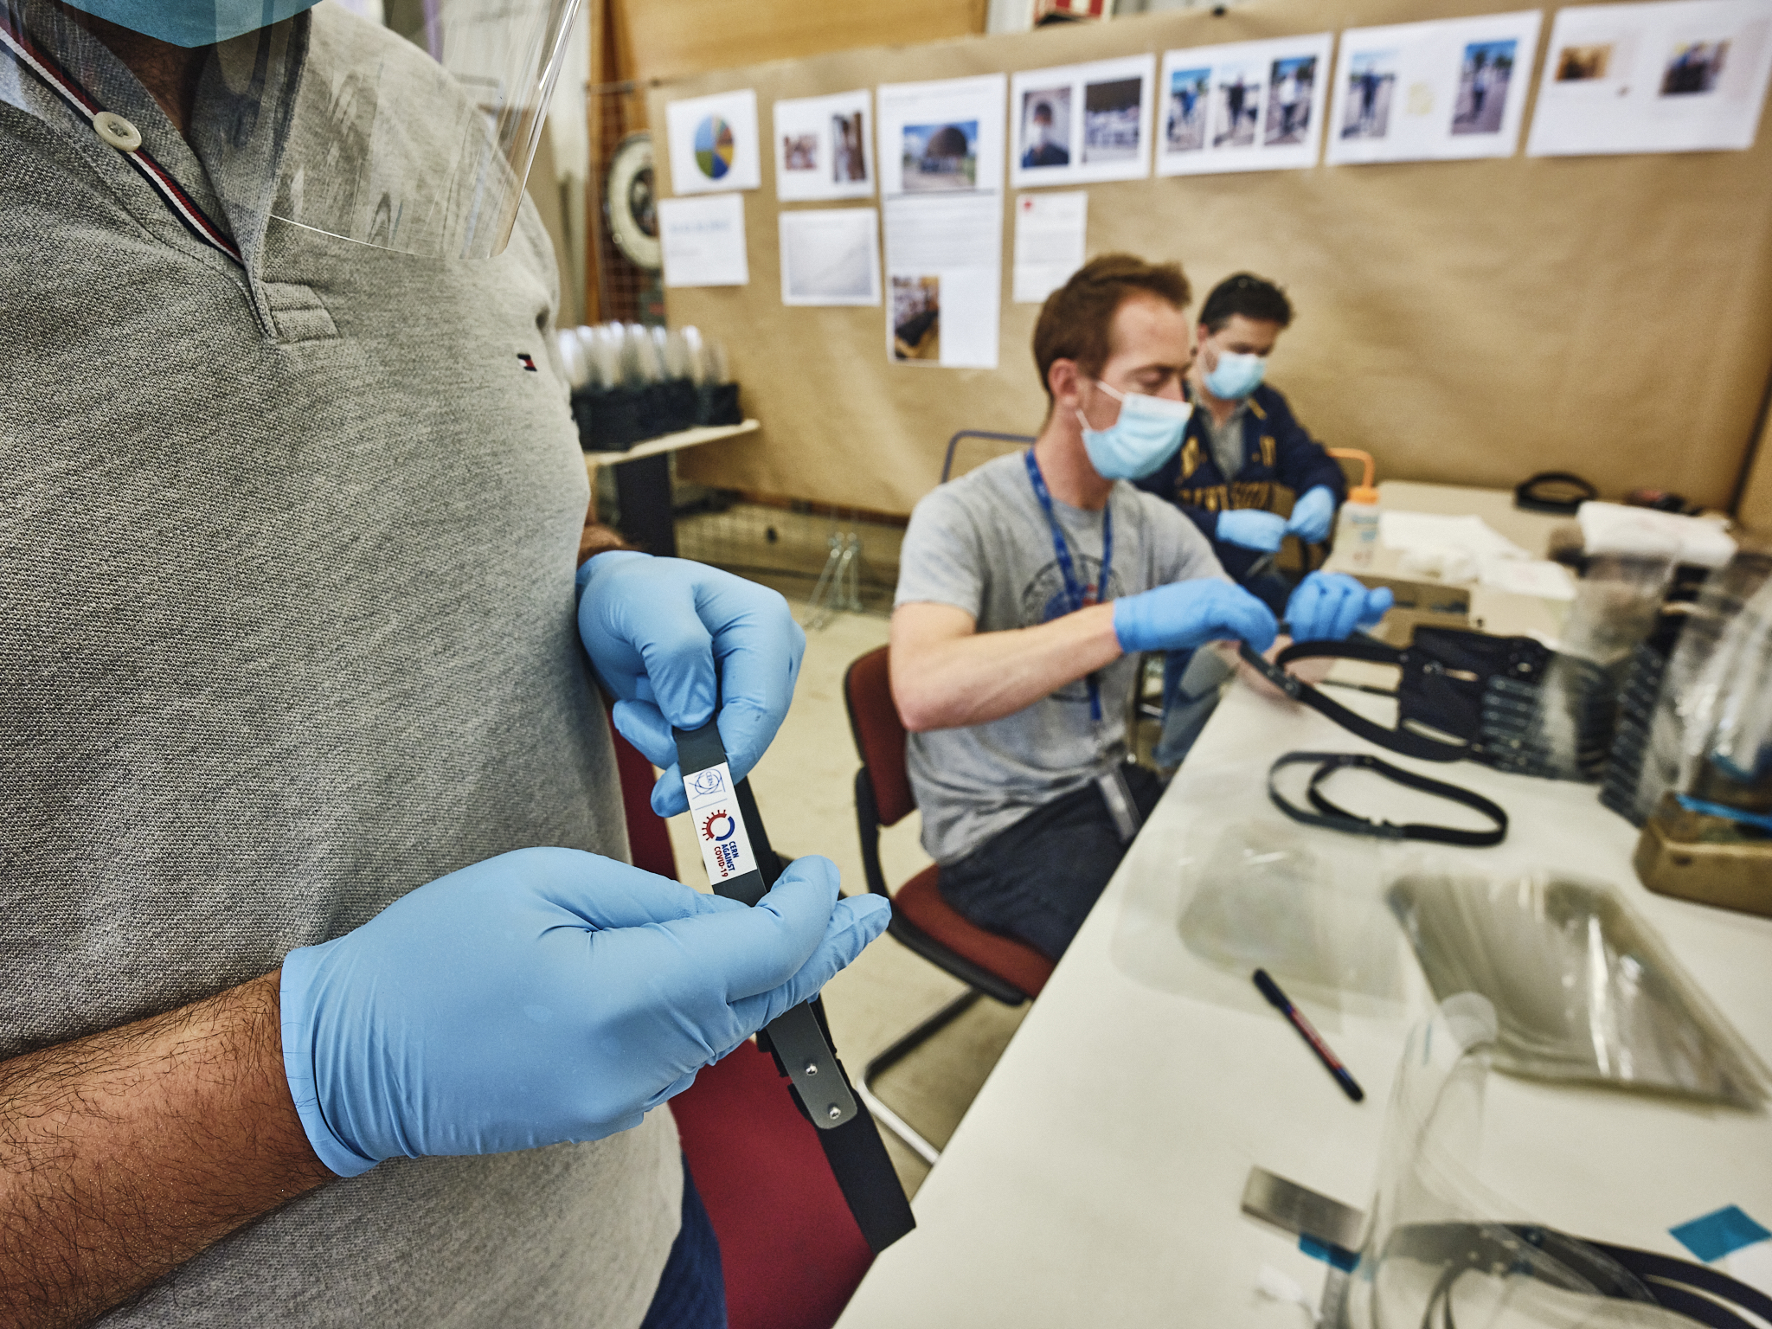


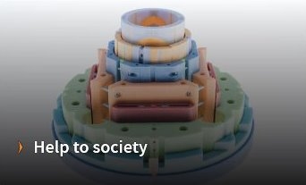
Fight against COVID
Over 15,000 face shields & certification
Ongoing work on sterilisation , gels etc.
Computing support
Prototype HEV ventilator
  Development of innovative, low-cost, easy and fast to build;
  particularly suitable for developing countries, WHO review
ACTION AREAS
https://againstcovid19.cern/

