Slide 1
Preparations for installation of SND detector
- ECRs in preparation -
Pablo Santos Díaz, Richard Jacobsson
CERN Geneva / 30-09-2020
TREX meeting (link)
EDMS 2422718 v.1

Slide 2
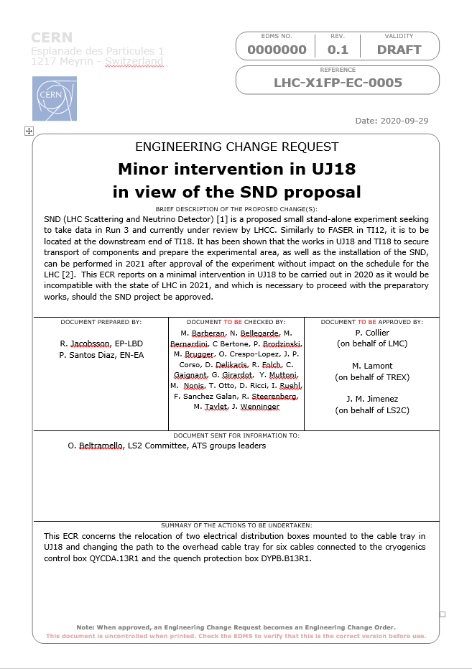
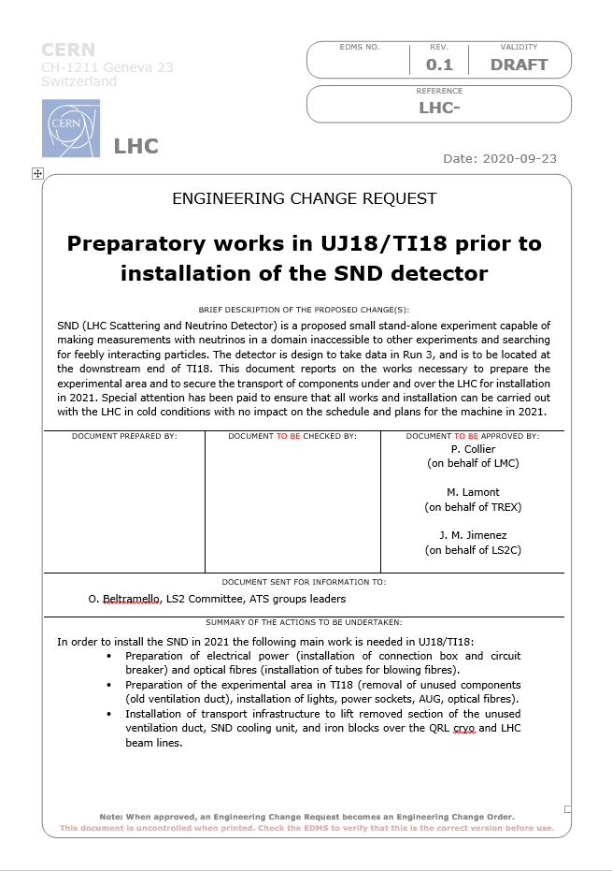

Slide 3
Outline
Introduction
Experimental area preparation in 2021
Essential works in 2020
Conclusions

Slide 4
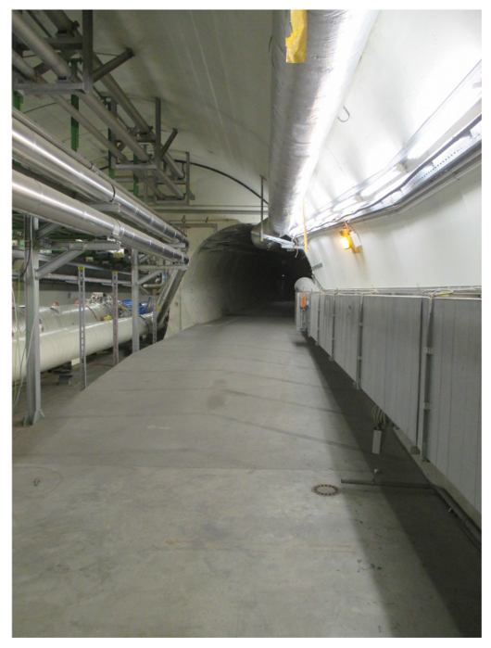
Integration
Particular effort has been placed on services integration studies to guarantee a cost efficient conceptual design of the SND detector and evaluate the feasibility of its installation inside the TI18 cavern.
Study seeking for approval in September 2020.
Several iterations with the CERN groups performed:
  EN-SMM, HSE-OHS, HSE-RP, EN-HE, EN-EL-EIC, EN-EL-FC, IT-CS-DO, EN-CV, IT-CS-CS, EN-STI-BMI, EN-EA-AS, BE-OP-LHC, TE-CRG-OP, TE-CRG-CI, EN-SMB, TE-MPE-EP & EN-ACE-OSS.
Subjects evaluated:
  Cooling & ventilation.
  Powering & lighting.
  Signals, readout and networking.
  Survey.
  Transport.
  Safety.
  Radiation protection.
  Radiation protection to electronics.
TI18 entrance

Slide 5
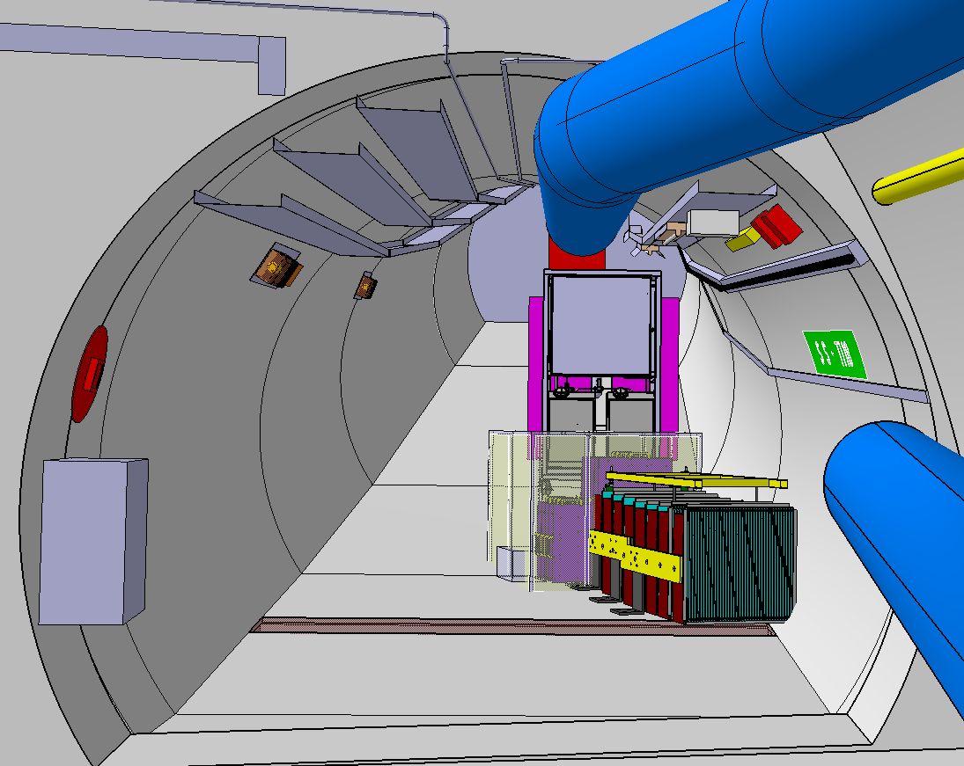
TI18 SND integration
Smoke detection
He pipe
Lighting
Cable trays
AUG
Racks
Cooling system
Ventilation duct
Electrical box
Insulated room
SND
SND 3D model provided by A. Di Crescendo & A. Crupano

Slide 6
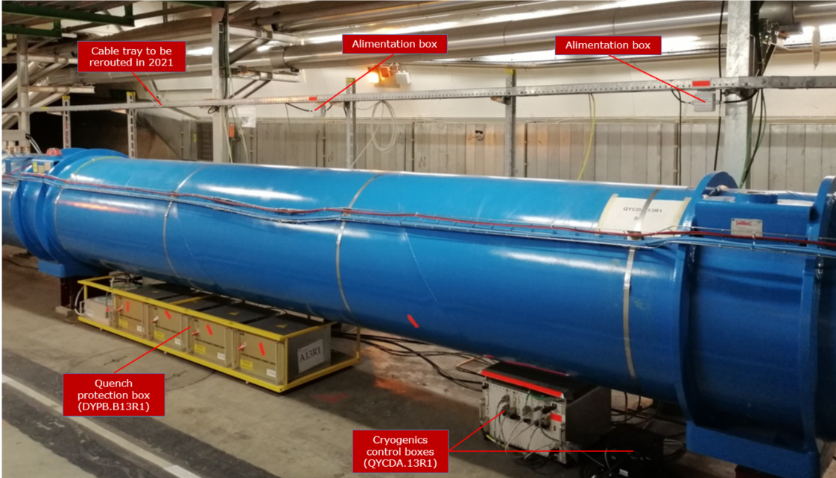
Activities to prepare the experimental area
(2020)
Inside UJ18:
  Relocation of two electrical distribution boxes on the cable tray in UJ18 and rerouting of the cables (cryostat pressure and temperature monitoring) connected to the cryogenics control box QYCDA.13R1 and quench protection box DYPB.B13R1.
  Attach the signal cables of the cryogenics control box, currently laying on the floor, to the cryostat to free the passage for transport of equipment.

Slide 7
Activities to prepare the experimental area
(2021)
Inside UJ18:
  Raising a section of the cable tray (EN-EA-AS), involving also relocating electrical distribution boxes and rerouting cables.
  Installation of the QRL protection, including drilling fixations in the floor (EN-HE-PO).
    Floor scans to be made to avoid drilling on any service integrated in the concrete floor.
  Displacement of a light (EN-EL-EWS) to make space for the installation of a rail and manual hoist (EN-HE-PO) above the LHC machine.
  Displace current electrical distribution box above footbridge (EN-EL-EWS).
  Connect and route a power cable for the SND from the distribution box within UJ18 to a connection box to be installed in TI18 (EN-EL-EWS).
  Pull cables for AUG and lights in TI18 (EN-EL-EWS).
Inside TI18:
  Removal of the unused ventilation duct within TI18 (EN-CV).
  Installation of a closed circuit cooling system (EN-CV).
  Installation of an electrical distribution box for the experiment together with normal lighting, emergency lighting, power sockets and AUGs (EN-EL-EWS).
  Installation of racks for detector electronics (EN-EL-AS).
From TI18 to ATLAS site surface:
  Installation of optical fibre tubes from RE18 to TI18 (EN-EL-FC).
  Pulling of optical fibres (EN-EL-FC).

Slide 8
2. Experimental area preparation in 2021

Slide 9
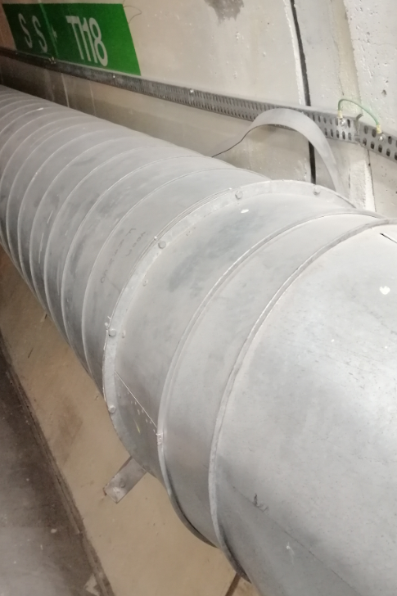
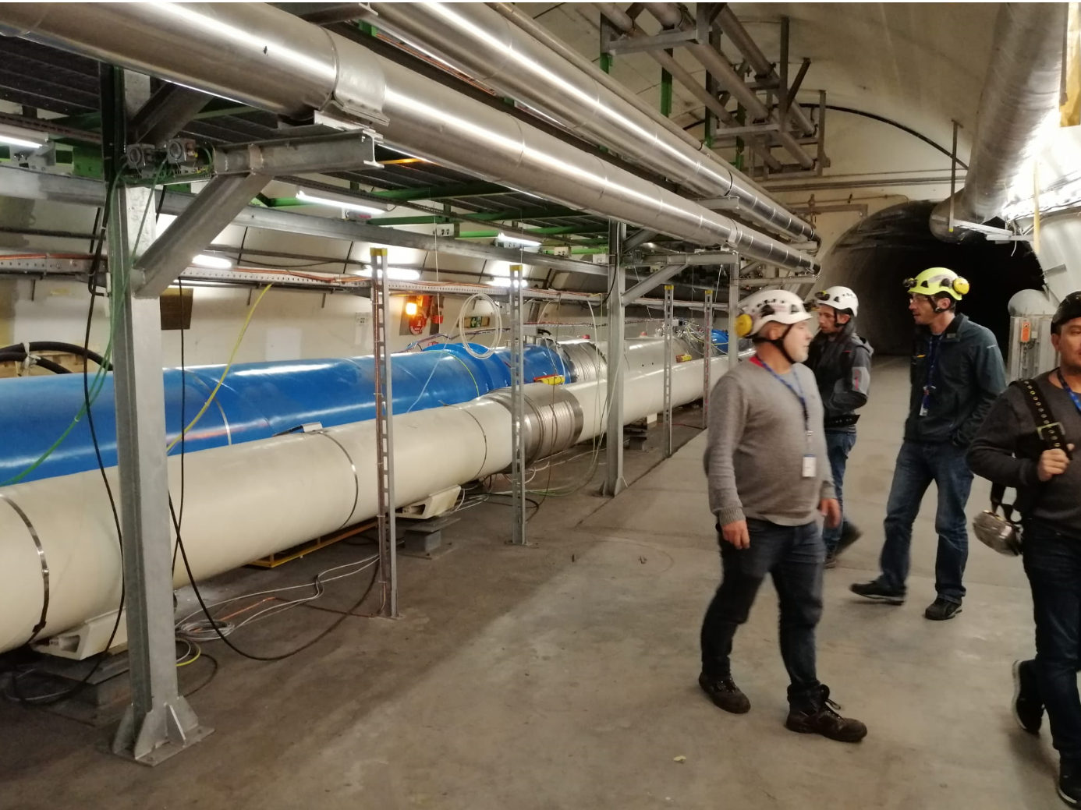
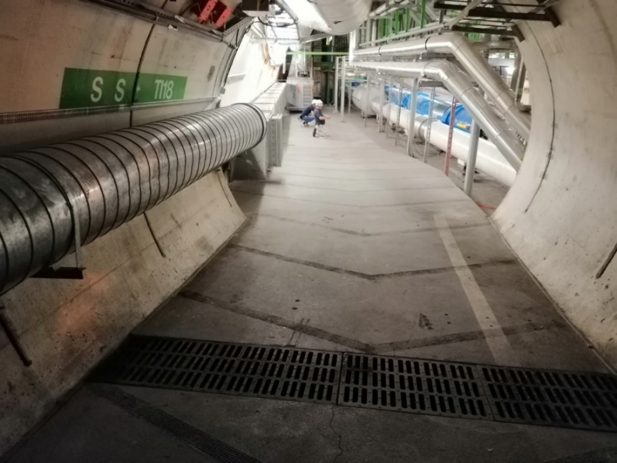
Ventilation
20m ventilation duct to be removed to avoid interferences with the SND.
  Cable tray layout will be modified!
Side duct is made of three bolted pipes and a connection piece, therefore,
cutting and duct spread is not expected.
Duct to be
removed
Pilar to be
removed
Cable tray
to be raised

Slide 10
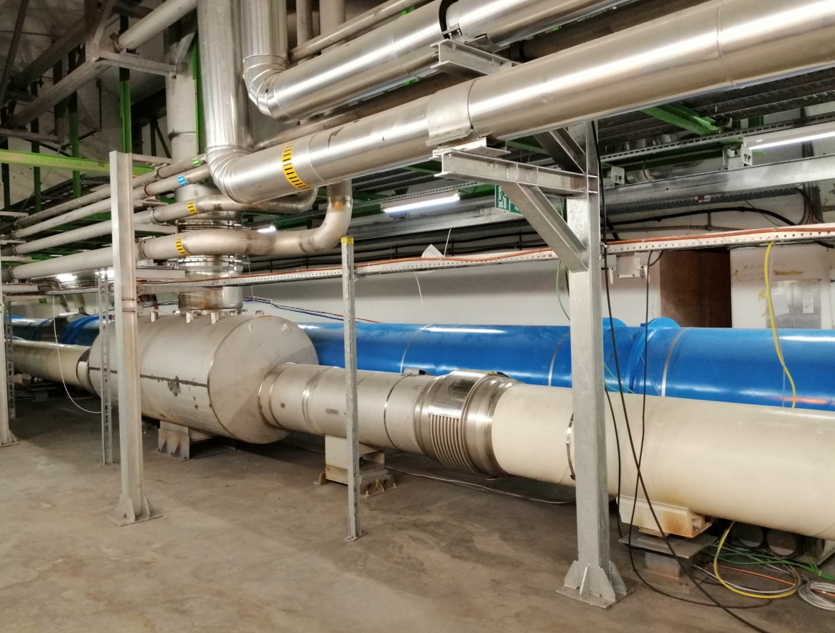
Transport
A manual hoist (250kg capacity) to pass components above the LHC is required.
  QRL protection foreseen.
Small parts can be passed bellow the LHC machine with a simple low trolley.
  Free passage is about 80cm wide and 37cm high.
Free passage

Slide 11
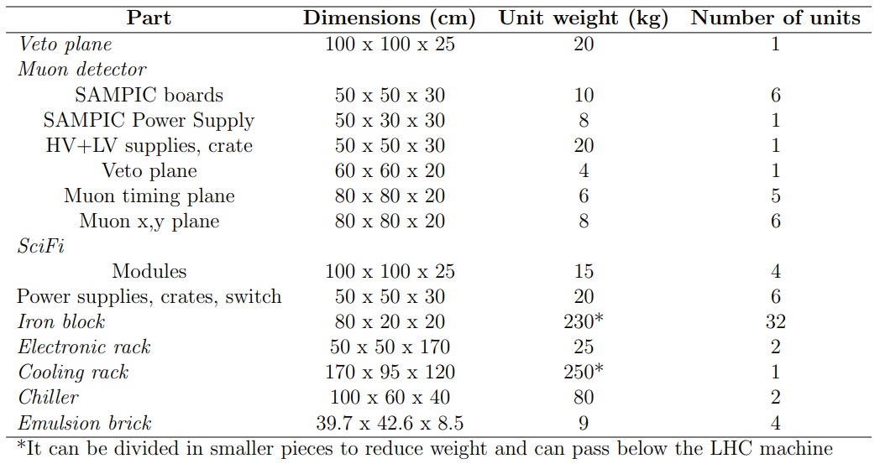
Main items to be passed to TI18 cavern
The most restricitve item that need to pass over the LHC machine are the chillers.

Slide 12
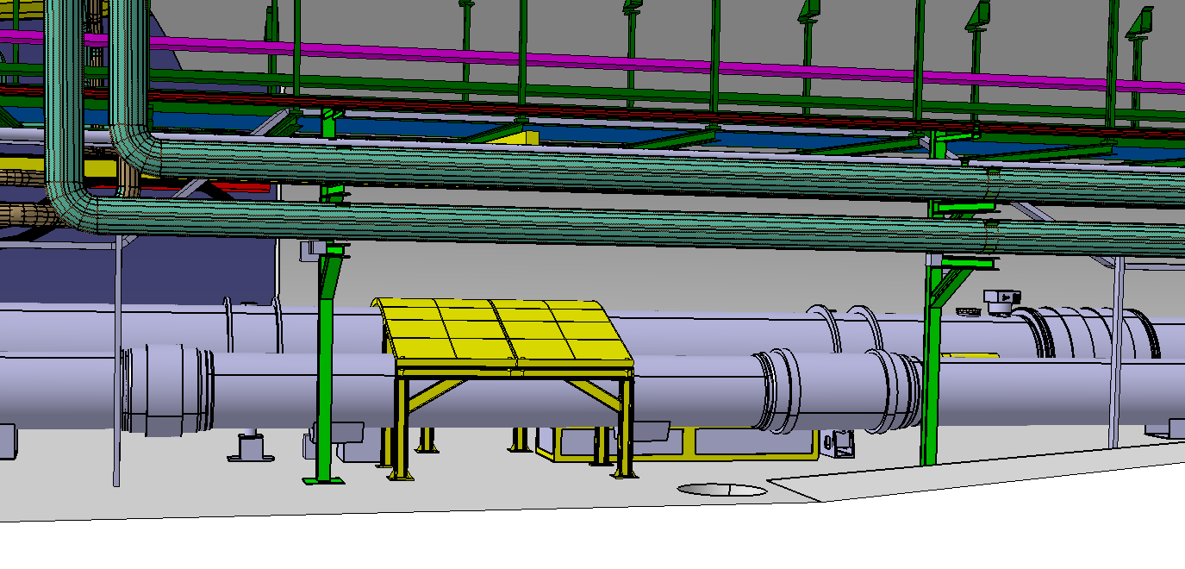
Cable tray raising within UJ18
Electrical boxes to be relocated and cables rerouted.
  Cable length sufficient for the new cable path.
Manual hoist reservation space (200x100mm)
Electric box
Electric box
Raised cable tray
ATLAS
LHC machine
QRL
TI18 slope
Quench protection box to be lightly displaced
Below
Below
2m QRL protection

Slide 13
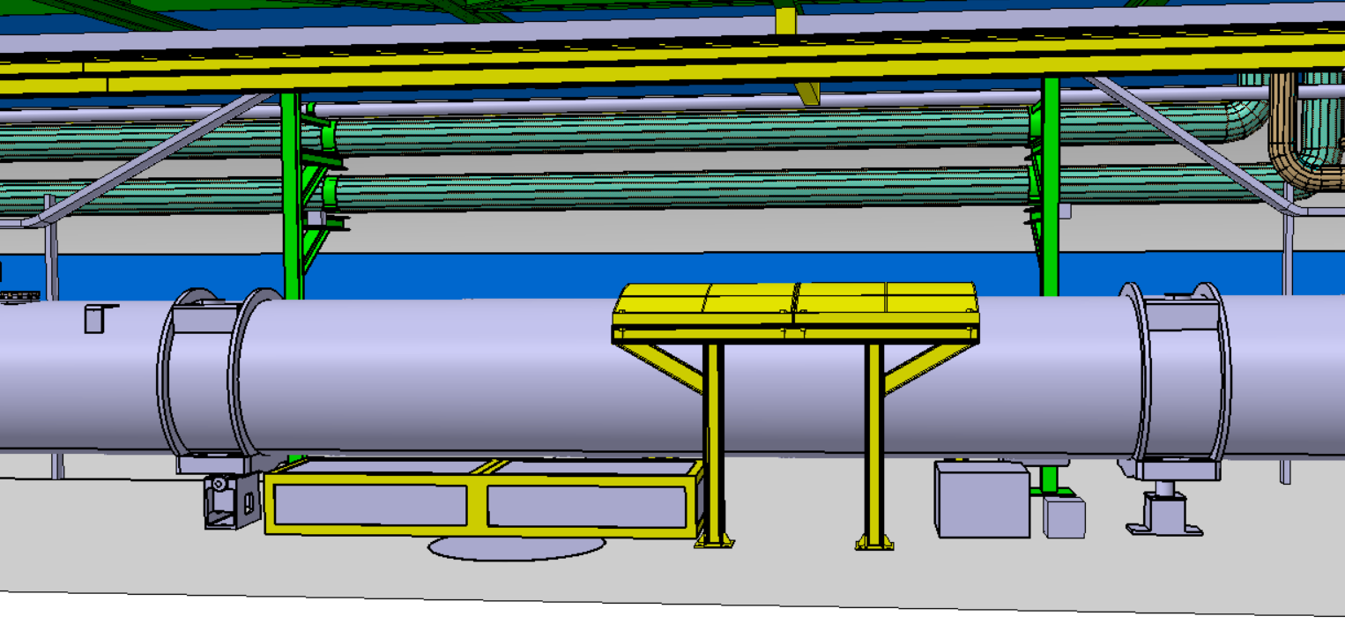
Hoist and QRL protection integration
QRL protection designed for 2t while 250kg are required for the SND detector.
  Support design slightly modified to free rack access.
Manual hoist reservation space (200x100mm)
Raised cable tray
ATLAS
LHC machine
Quench protection box slightly displaced
2m QRL protection proposed slightly modified design
Electronic rack for cryogenics

Slide 14
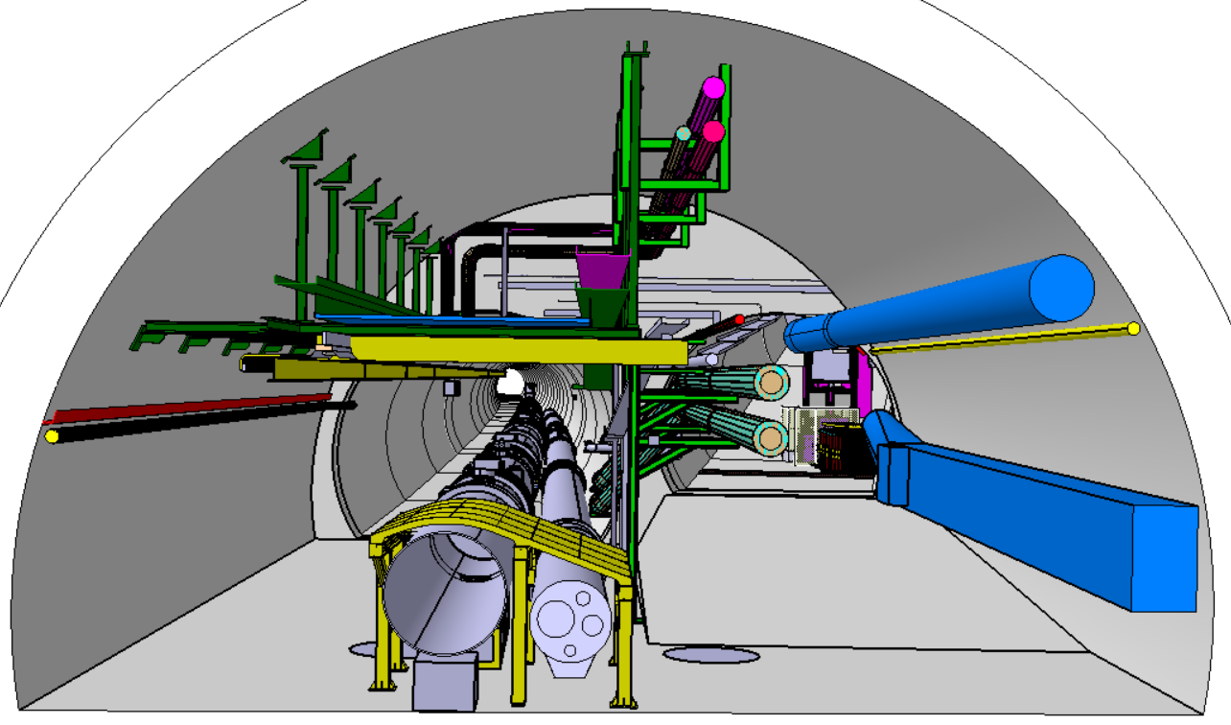
Transverse section cut
Structure can withstand a 250kg load (verifications to be done)
SND
Cable tray to be locally rerouted
Space reservation for the hoist’s profile

Slide 15
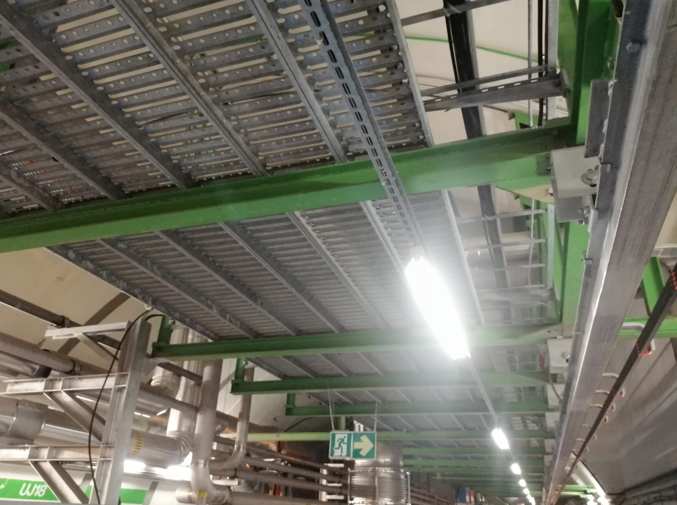
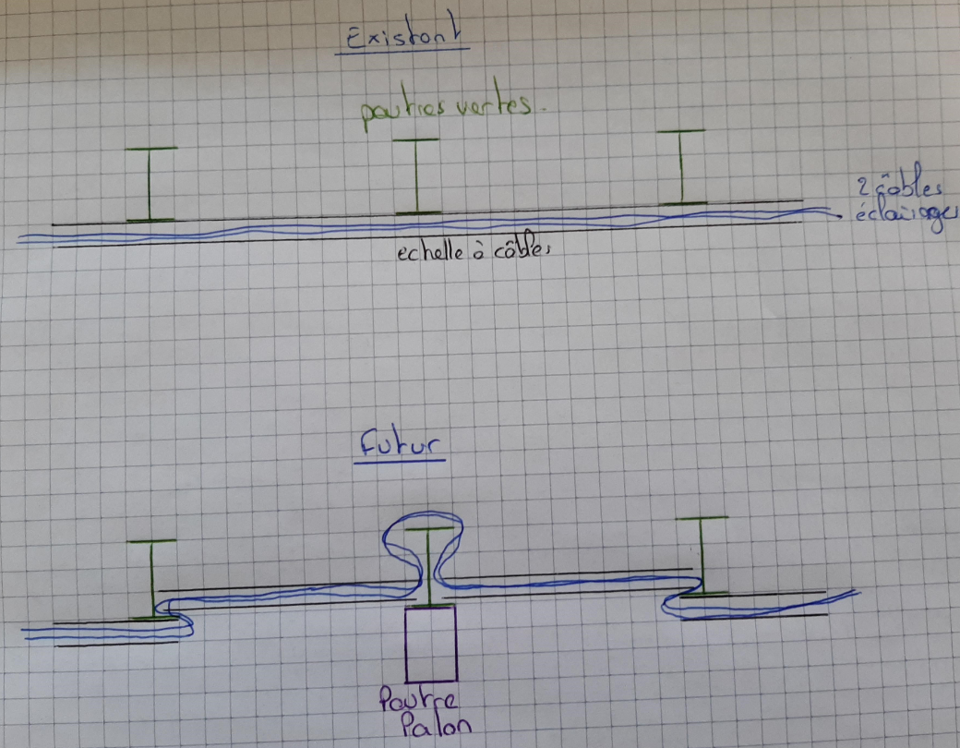
Integration cable tray – beam hoist
Cable tray to be locally rerouted
Omega configuration.
Courtesy of Y. Maurer
Light
Beam where the hoist will be attached

Slide 16
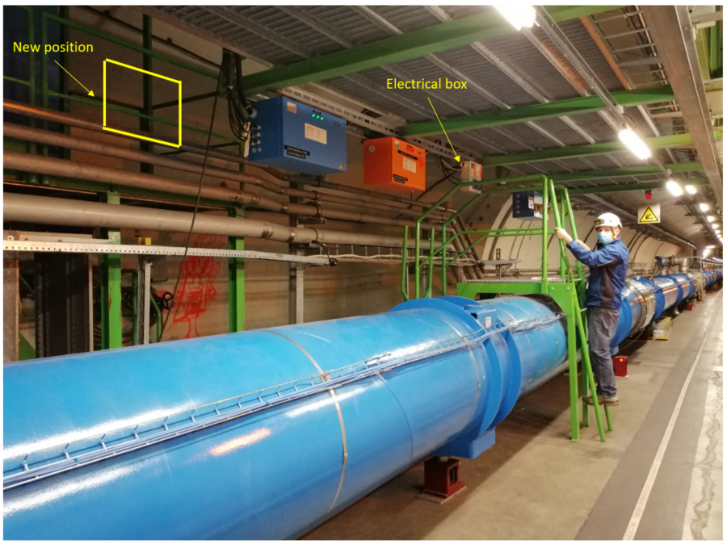
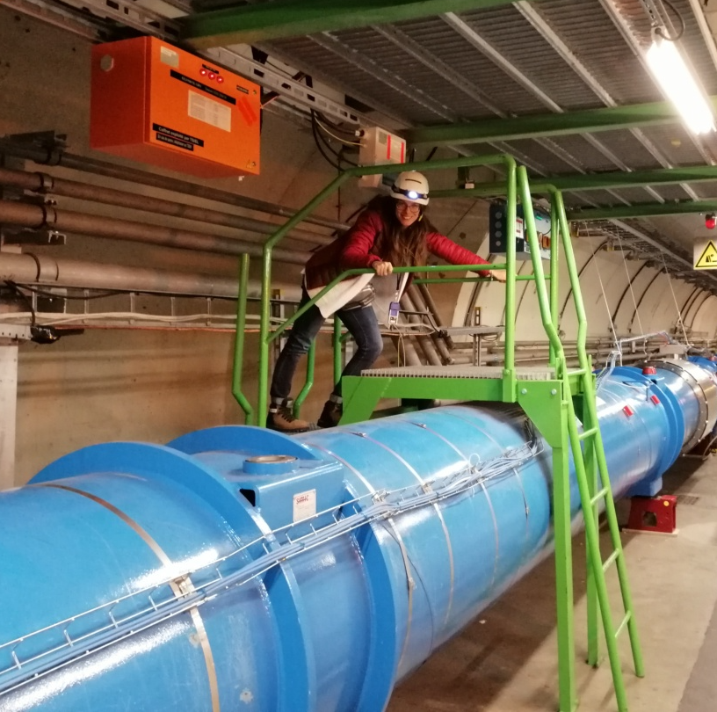
Relocation of distribution box
An electrical distribution box is on the foot bridge passage, so, it has to be displaced for safety reasons and easy access to TI18.

Slide 17
Powering & lighting
Electrical box for distribution.
x2 AUG (arret d’urgence general) required.
Permanent lighting.
  x3 normal lamps.
  x2 anti-panic lighting.
x2 sockets of 220V.
Maximum power to be installed: 11kW.
  Detailed list of power per component
  under development.
Cable trays in place
Lighting
Anti-panic lighting
AUG
Electrical box

Slide 18
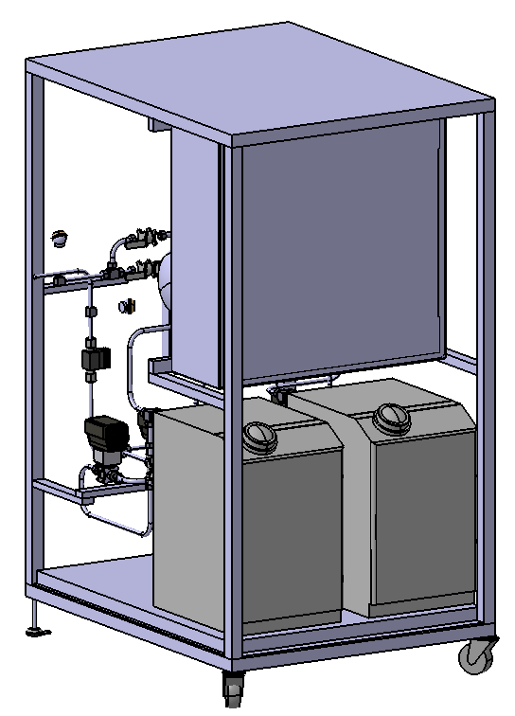
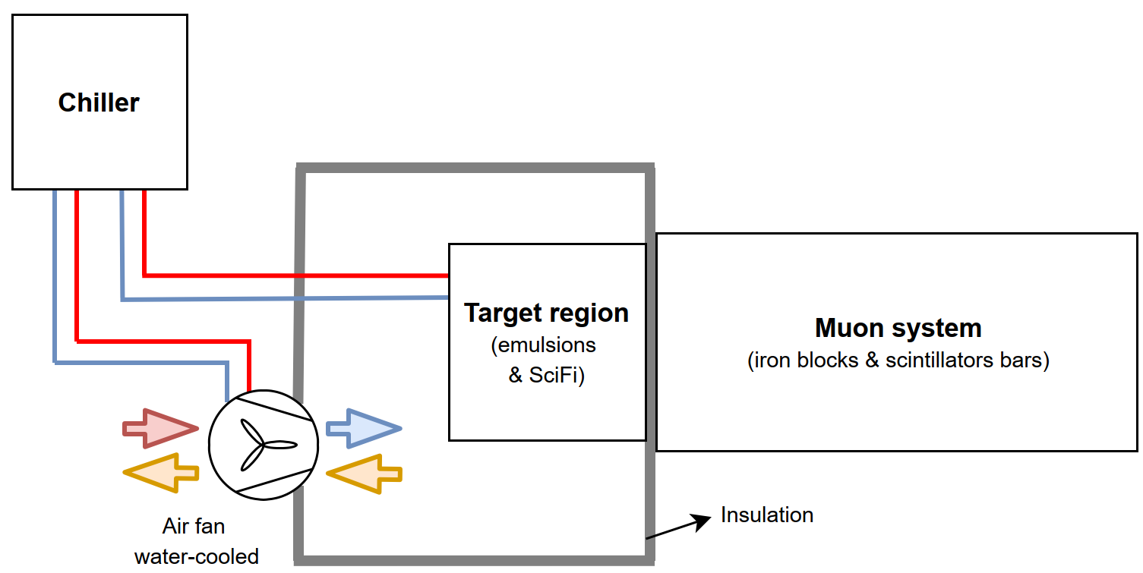
Cooling
Cooling required for the SciFi electronics and for keeping the emulsions at 15deg.
  Two chillers to cool down the water.
  An insulated room.
  Air fan which takes air from the tunnel and is cool down by the chillers.
The preliminary water-cooling capacity expected is 2.5kW.
  SciFi: 1kW.
  Emulsions: ∆T≈5deg.
Detailed study to be performed for the complete design.
Preliminary
cooling P&D
Chiller
FASER cooling rack (for illustration)
- new design to be done for SND

Slide 19
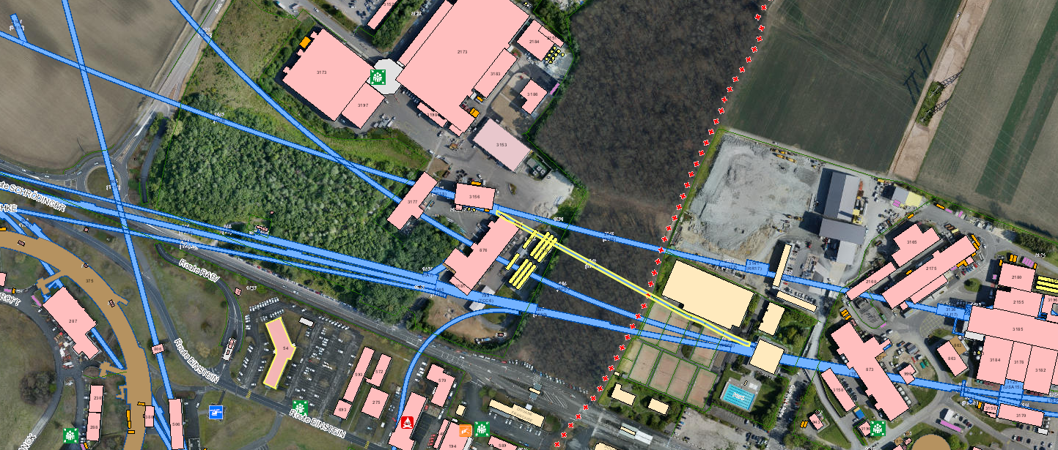
Signals, readout and networking
Set of 12 optical fibers.
x2 units of 19’’ in the nearby rack for the fiber connection modules are required.
Ethernet connection.
  1/10Gbit/s for the SciFi.
A rack on surface to host the server for data acquisition.
  Integration and location under discussion with ATLAS PO.
Two 19' racks close to the detector for the fibre optics connection modules,
NIM crates and power supply for the detector components.
RE18
(SX1/SR1)
ATLAS
SND
(TI18)
Blowing tube to be installed
Blowing tube already in place
Preliminary optical fiber layout due to HL-LHC upgrade during LS3

Slide 20
3. Essential works in 2020

Slide 21
Cable rerouting and electrical boxes relocation
x6 cables are to be rerouted and x2 electrical supply boxes to be relocated due
to pressure and temperature monitoring of the cryogenics system while the machine is cold.

Slide 22
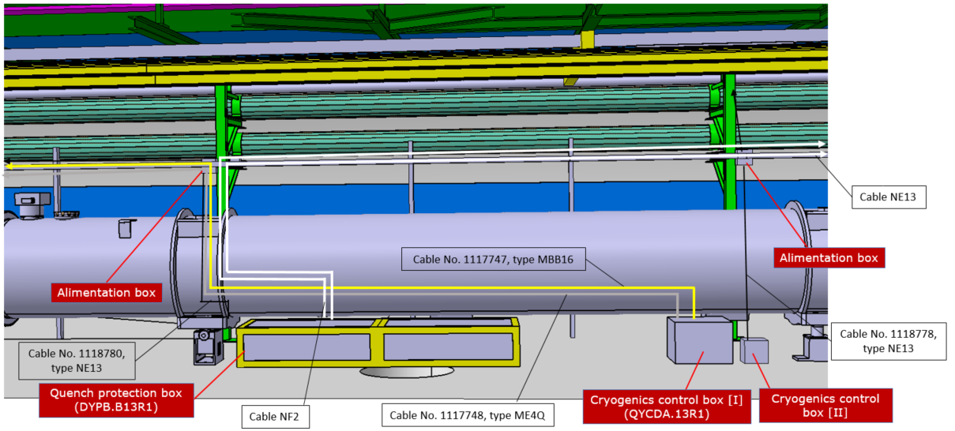
New configuration after the works
Activity foreseen for the last week of October.

Slide 23
Free future equipment passage
Attach of two cables to the cryostat which are connected to the cryogenic control boxes to free the future passage for the SND components.
Free passage
Cables to be attached
to the cryostat

Slide 24
4. Conclusions

Slide 25
Conclusions
Very productive and effective discussions with the CERN groups concluded that the SND integration and installation of the required infrastructure are feasible.
ECR on minor intervention in 2020 in circulation, and ECR on complete set of preparatory works in preparation for circulation.
CERN groups are aware and waiting for the approval to launch the design phase and include the activities in their planning.
Seeking and waiting for approval to launch design, manufacturing and installation phase.
  Windows identified in 2021 for experimental area preparation and detector installation.

Slide 26
THANKS YOU FOR YOUR ATTENTION!
&
Many thanks for your big contribution!
The CERN groups: EN-SMM, HSE-OHS, HSE-RP, EN-HE, EN-EL-EIC, EN-EL-FC, IT-CS-DO, EN-CV, IT-CS-CS, EN-STI-BMI, EN-EA-AS, BE-OP-LHC, TE-CRG-OP, TE-CRG-CI, EN-SMB, TE-MPE-EP & EN-ACE-OSS.
SND detector colleagues: G. De Lellis, A. Di Crescendo, G. Haefeli, C. Betancourt & A. Crupano.

Slide 27
Back-up slides

Slide 28
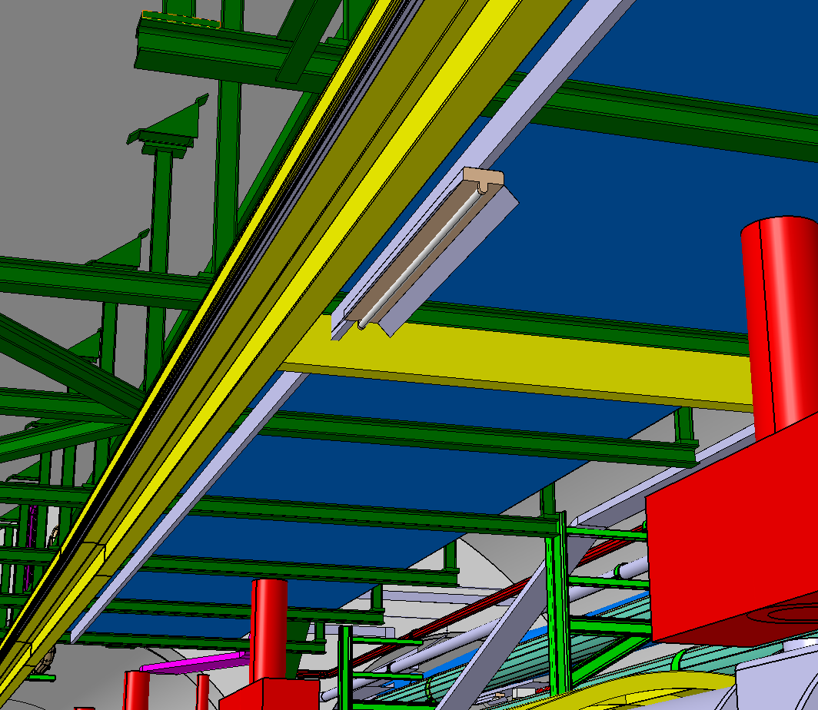
Integration cable tray – beam hoist 3D
Omega configuration.
Courtesy of Y. Maurer
Light
Beam hoist
Cable tray to be locally rerouted

Slide 29
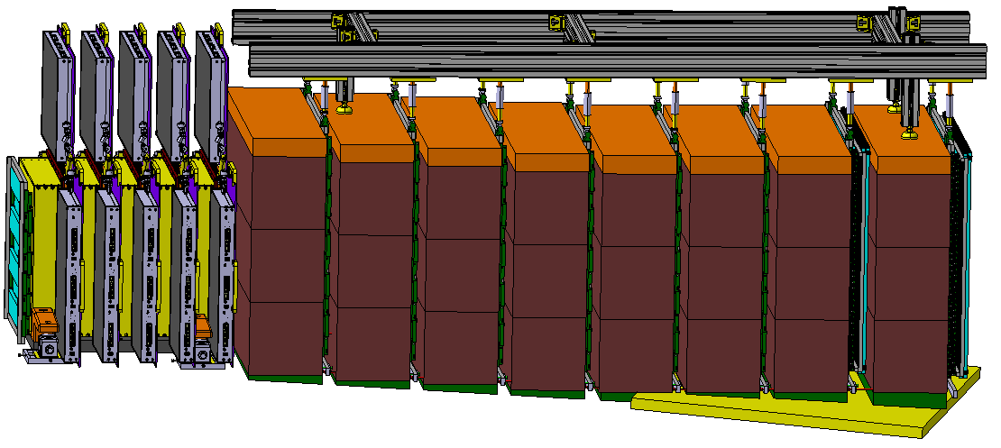
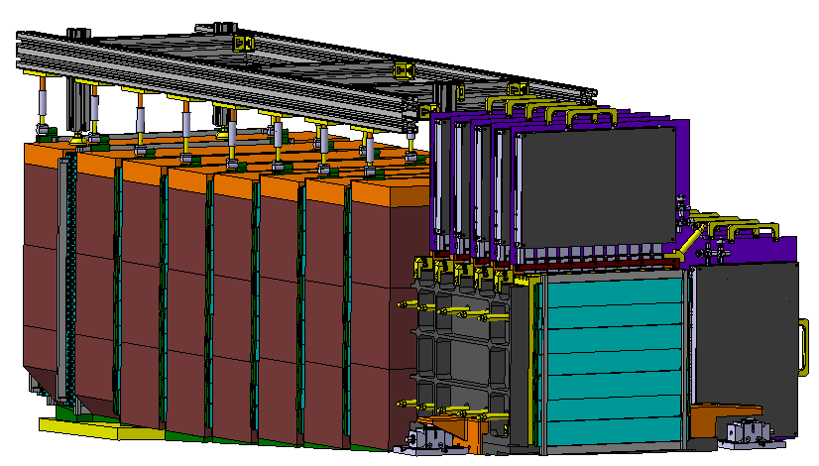
SND detector
Courtesy of A. Di Crescendo & A. Crupano

Slide 30
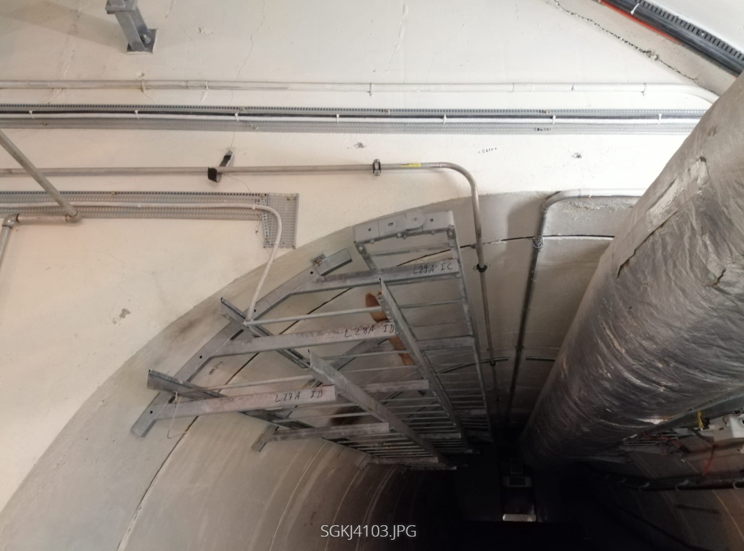
He pipe [I]
He pipe

Slide 31
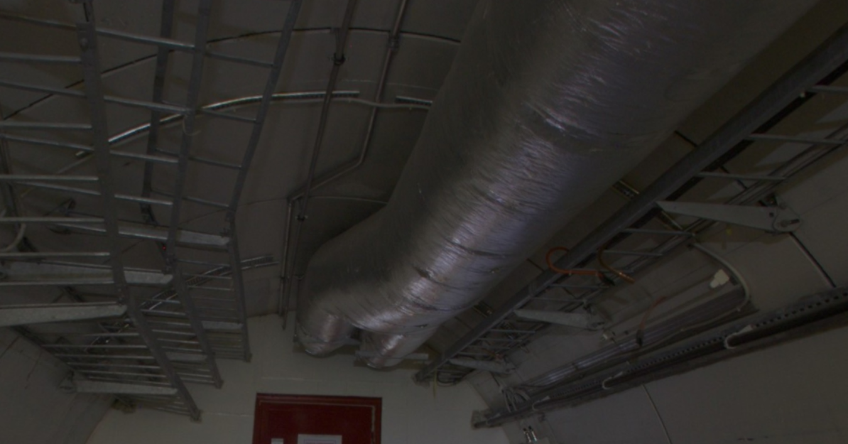
He pipe [II]
He pipe

Slide 32
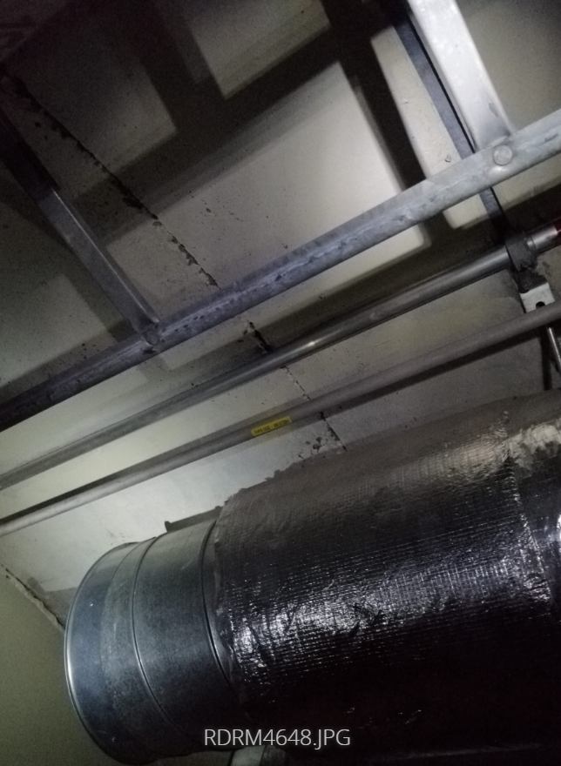
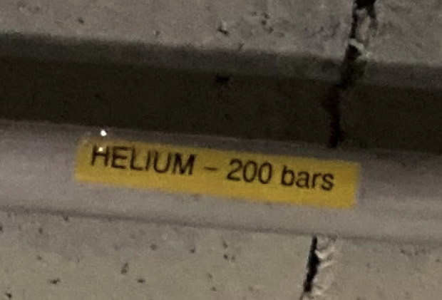
He pipe [III]
He pipe

Slide 33
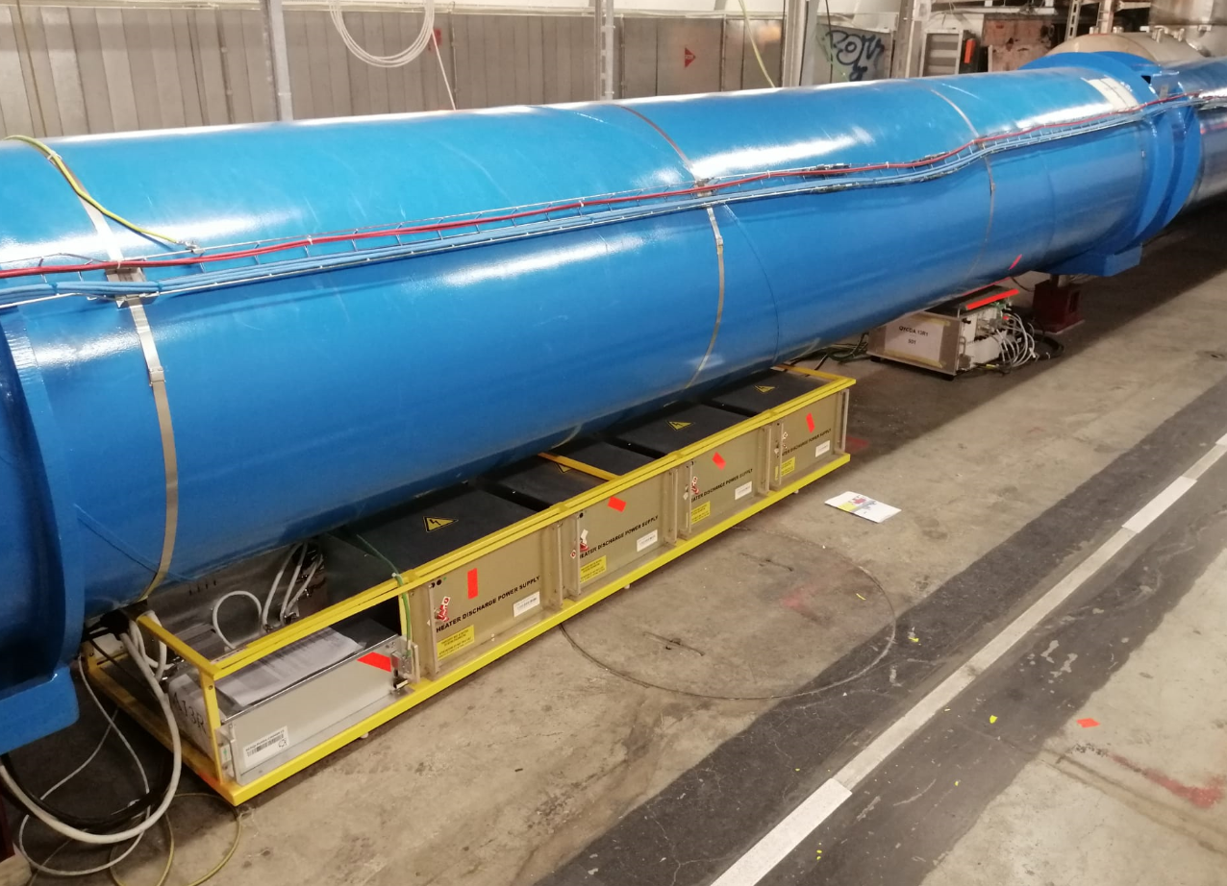
Quench protection box integration

Slide 34
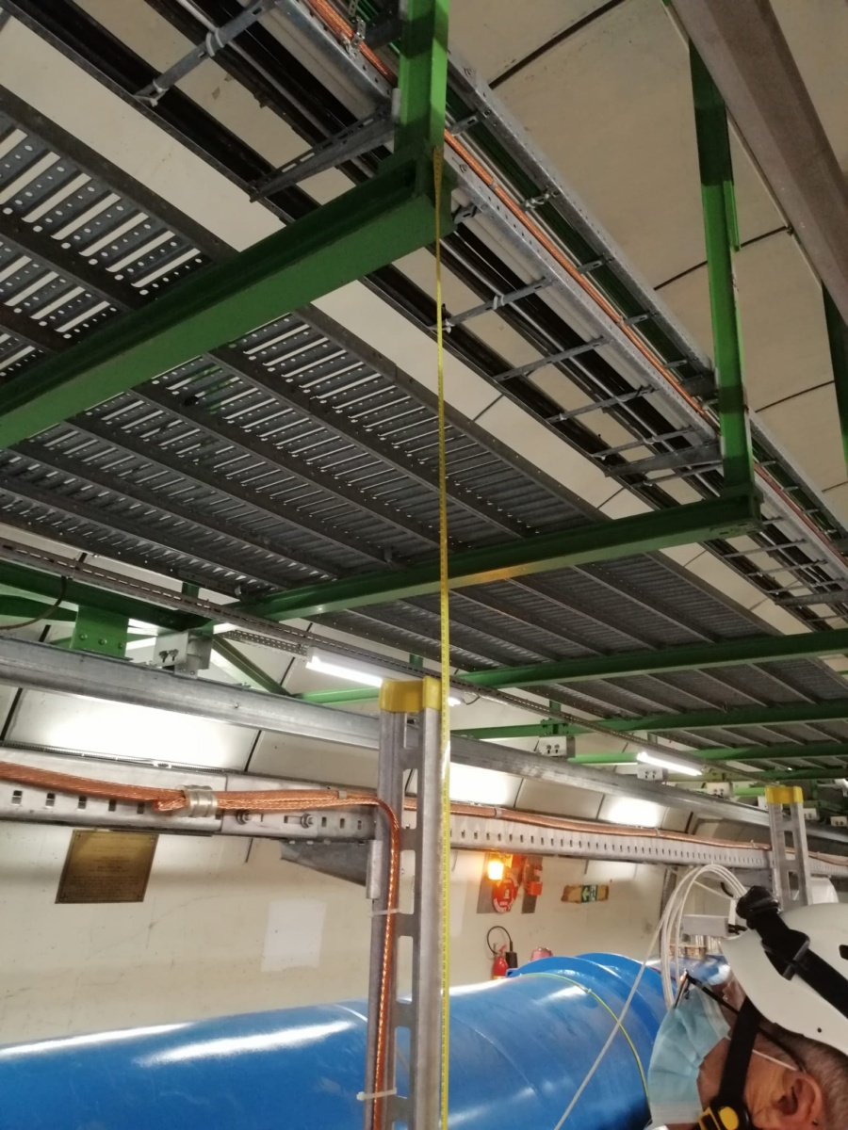
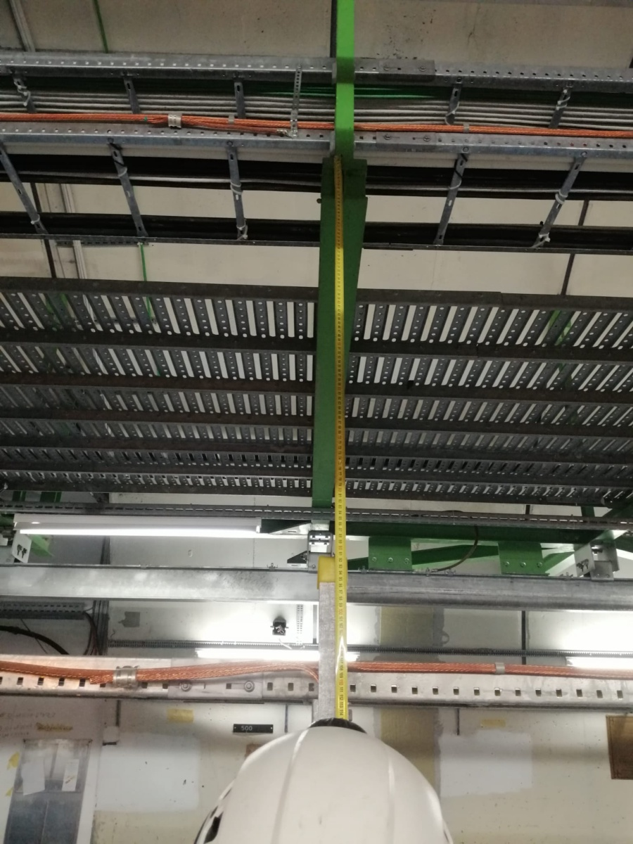
Position of the hoist

Slide 35
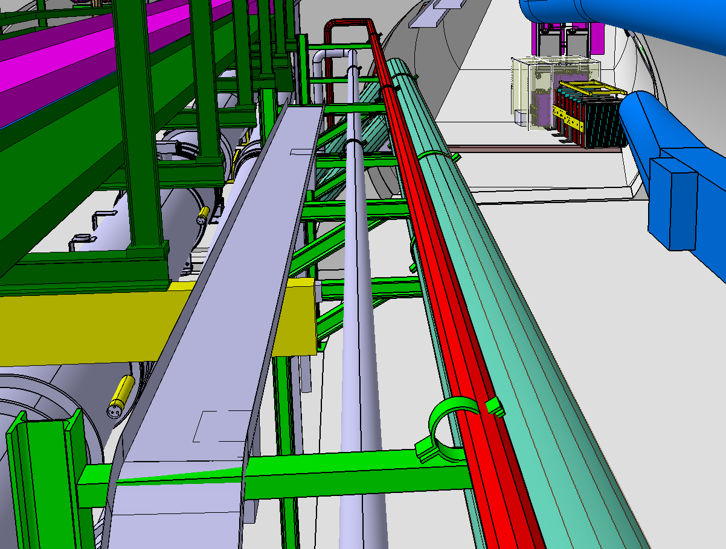
Cable tray new routing
Raised cable tray
Manual hoist reservation space (200x100mm)

Slide 36
Radiation protection to electronics
The measured radiation values during 2018 are almost an order of magnitude
larger than the limits which EN-STI-BMI considers to declare an area as radiation safe
for pure commercial electronics systems.
However, it is to be noted that the limits consider distributed systems,
whereas for a single unit system, they can be regarded as clearly pessimistic.
The prospects are that commercial electronics in TI18 are expected to operate in
radiation safe conditions, however, a more detailed study of the environment is required
for validation.
Courtesy of R. Garcia Alia

Slide 37
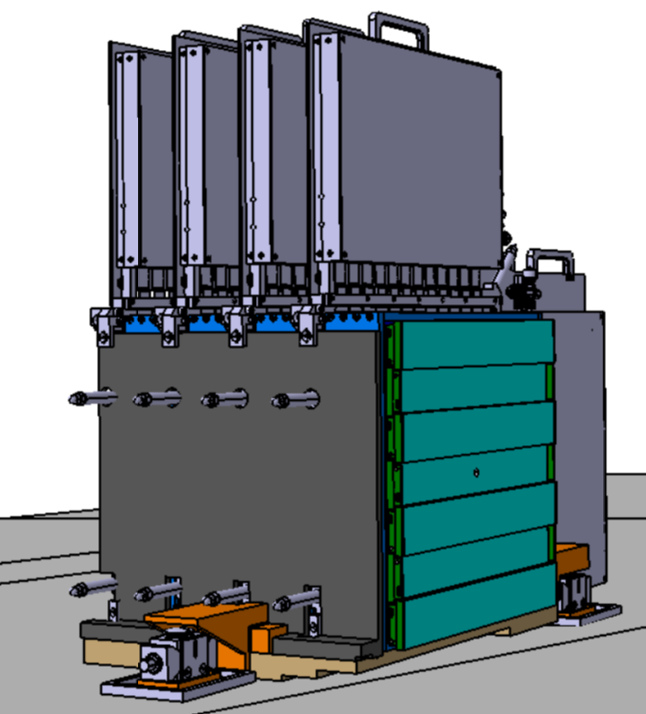
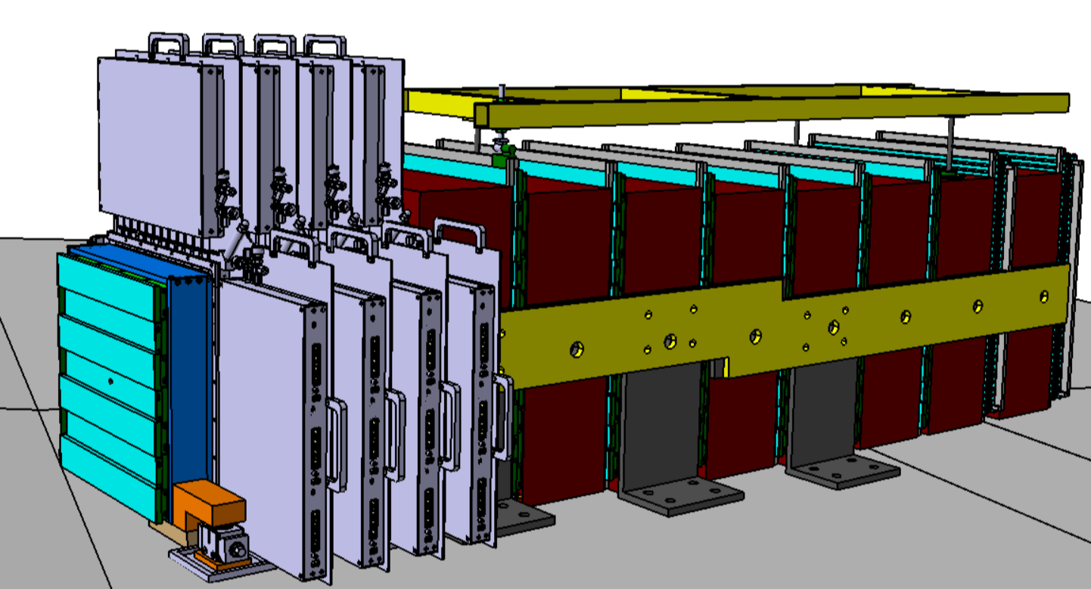
Survey
The positional link of the experiment with the LHC machine is feasible.
Survey fiducials are being integrated in the detector design.
Alignment system and strategy in work.
WP5
Target region – platform design
Alignment design of the full detector

