Slide 1
Data Analysis Section report
Daniel, Till, Ivan, Vasso, Łukasz, Massimo,
Kuba, Faustin, Mario and Dan

Slide 2
Update on DAS activities (since March)
Introduction
LHC experiments distributed analysis
Other projects/activities
  EnviroGRIDS (Hydrology)
  PARTNER (Hadrotherapy)
  CERN TH
  New projects

Slide 3
Main lines
Starting point:
  Existing (developed in IT) products (like Ganga) and services/tools (DAST and HammerCloud)
  Excellent collaboration with the experiments
  Building on IT main-stream technologies/services
    E.g. PanDA migration, integration with the different monitoring technologies, etc…
Present phase and directions:
  Extend this in two directions:
    Face needs connected to data taking (more users, etc…)
    Reuse tool and know how outside the original scope
      For example, HammerCloud for CMS
    Be open to new technologies
  Catalyser role in the experiments and in IT
    Tier3 (coordinator role)
    User Support (new approach)
DAS specific feature:
  We host some non-LHC activities
    Foster commonality also across these projects

Slide 4
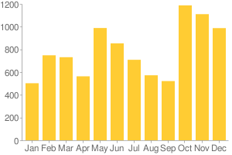
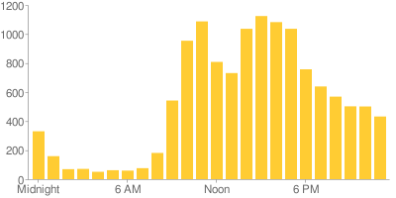
User Support in ATLAS
Running for more than a year: shift system covering around 15-hour per day with shifters working from their home institutes (Europe and North America)
News:
  Coordination of the ATLAS Distributed Analysis Support Team (DAST) shifters
    Main activity was arguing for and now receiving a doubling of the shifter effort (shifted are manned by experiment people)
  Instant Messaging technology evaluation:
    Evaluating alternatives to Skype (scaling issues with 100+ participants and “long” history)
      Consulted with UDS about Jabber support.
      Evaluating jabber using a UIO (Oslo) server for the DAST and ADC operations shifters
      Plan to meet with CMS about overlapping requirements / potential for common solution
    Expect meeting organised by Denise
  Led the Tier 3 Support Working Group
    Consulted with clouds and sites to develop a model for Tier 3 support.
    Developed Tier 3 support in HammerCloud for stress and functional testing
Issues per month
Issues vs time (UTC)

Slide 5
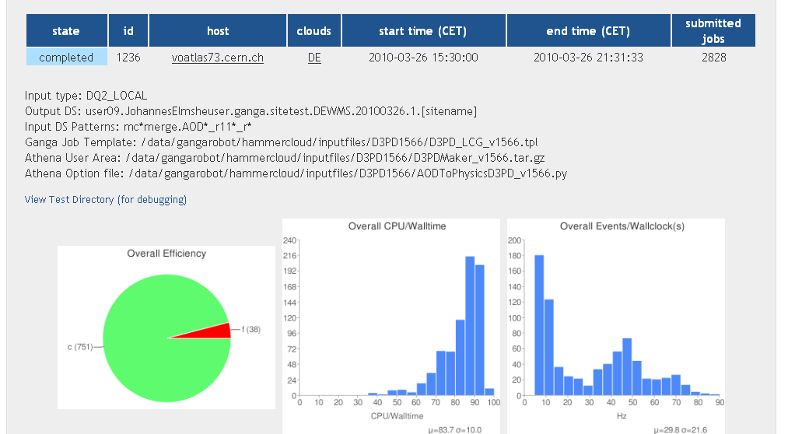
HammerCloud | ATLAS
Continuous operations of HammerCloud (stress tests of the distributed analysis facilities)
  Sites do schedule tests for testing,
  troubleshooting, etc...
  CERN “Tier2” now running (DAS+VOS)
Added functional testing feature to
replace the ATLAS GangaRobot service
  “Few” jobs to all sites continually.
  Summary page showing all sites and their efficiency.
Many new features to improve Web UI
performance:
  Server-side pre-computation of the test performance metrics to improve page loading time.
  AJAX used more frequently in the UI
Added support for testing Tier 3 sites
Deploying new release on an SLC5 VO box:
  voatlas49.cern.ch/atlas (will become hammercloud.cern.ch/atlas)
  Old GangaRobot and HammerCloud running on gangarobot.cern.ch will be switched off
SW Infrastructure:
  Opened a savannah project to track issues: savannah.cern.ch/projects/hammercloud

Slide 6
HammerCloud | CMS
Delivered a prototype CMS instance of HammerCloud and presented it in the April CMS Computing meeting
  CMS plugin required: (a) Ganga-CMS plugin which provides a basic wrapper around the CRAB client, (b) a HammerCloud plugin to interact with the CMS data service, manage the CRAB jobs, and collect and plot relevant metrics.
  Prototype is running on an lxvm box with very limited disk, so is quite limited in the testing scale
Feedback was positive and were encouraged to deploy onto a VO box for scale testing.
Current activities:
  Opened a dialog with CMSSW storage/grid testing experts to make HC an effective tool for them.
    We are integrating their grid test jobs into HC|CMS.
    Discussion about useful metrics from CMSSW and CRAB.
  Deploying on a new SLC5 VO box.

Slide 7
Ganga summary
Since March 22nd:
  750 users (60%Atlas, 30%LHCb, 10%others)
  37 releases -> 4 public releases + 3 hotfix releases + 30 development releases
  Bugtracker statistics:
  - 126 savannah tickets followed up (65 closed)
  - 45 issues in Core, 64 in Atlas, 17 in LHCb
      NB: after the DAST prefiltering (or equivalent)
  Plots: http://gangamon.cern.ch/django/usage?f_d_month=3&f_d_day=22&f_d_year=2010&t_d_month=0&t_d_day=0&t_d_year=0&e=-#tab_content_3

Slide 8
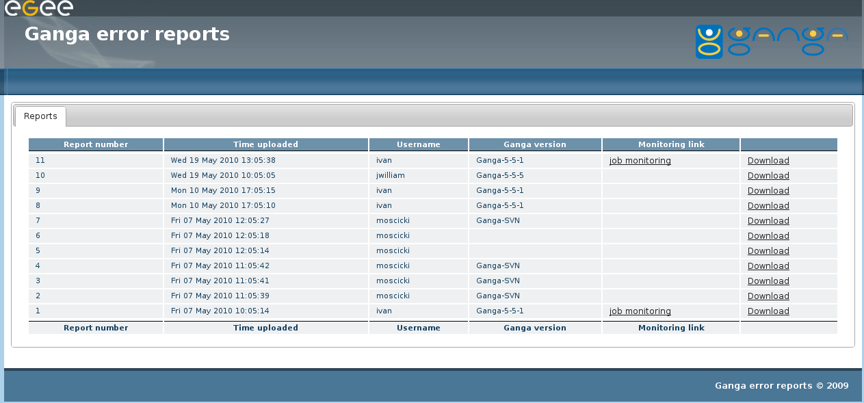
User Support with Ganga
Prototype of error reporting tool and service in place as of release 5.5.5
  “One-click” tool to capture session details and share them with others (notably User Support)
We are collecting initial experience
Interest from CMS, ongoing discussions on possible synergies

Slide 9
Ganga and Monitoring
Ganga UI - ATLAS/CMS Task Monitoring Dashboard
  Common web application, modelled on existing CMS task monitoring + Ganga requirements
  Prototype in progress
    Subset ATLAS jobs visible (and all CMS ones)
  “By-product” of the EnviroGRIDS effort
Other MSG related activities
  Job peek
    As LSF bpeek: on-demand access to stdout/stderr for running jobs
    Summer student shared with MND section
    Starting point: existing prototypes
    “Required” by ATLAS
    Interest from CMS: to be followed up in Q3/4
  Job instrumentation
    Ganga jobs (OK). Next step instrument the PanDA pilots

Slide 10
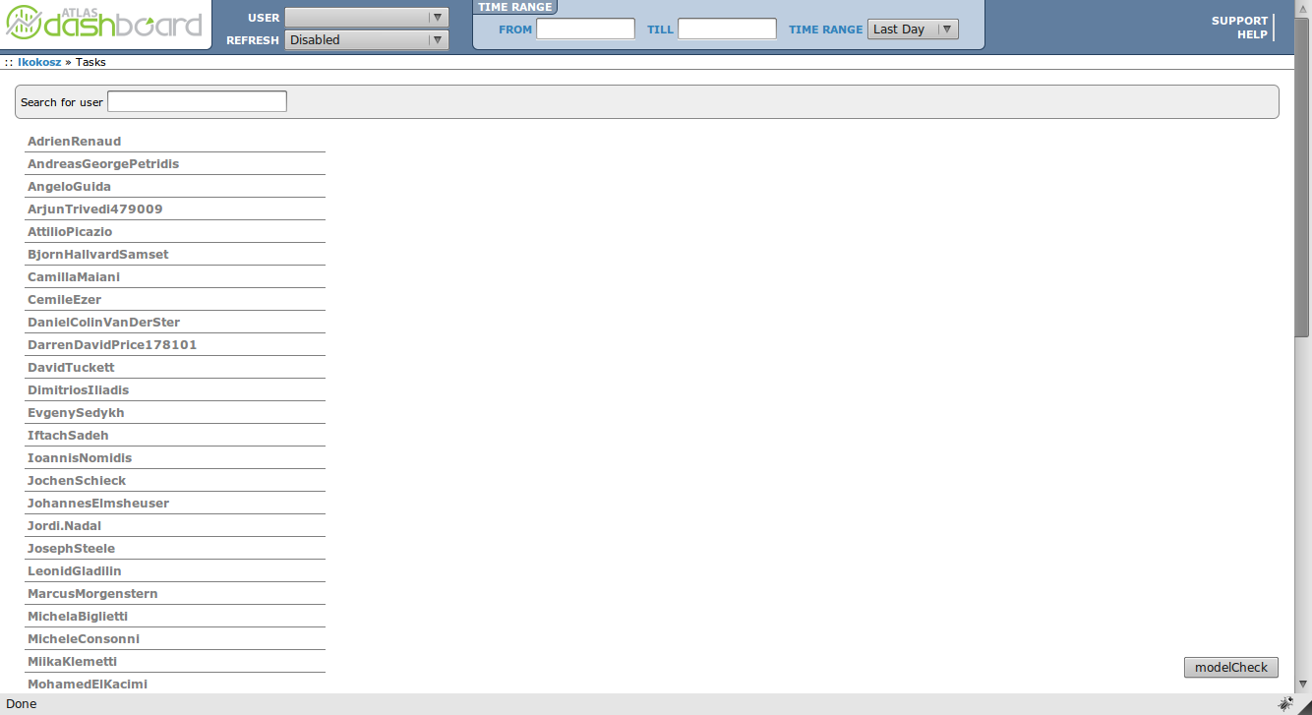
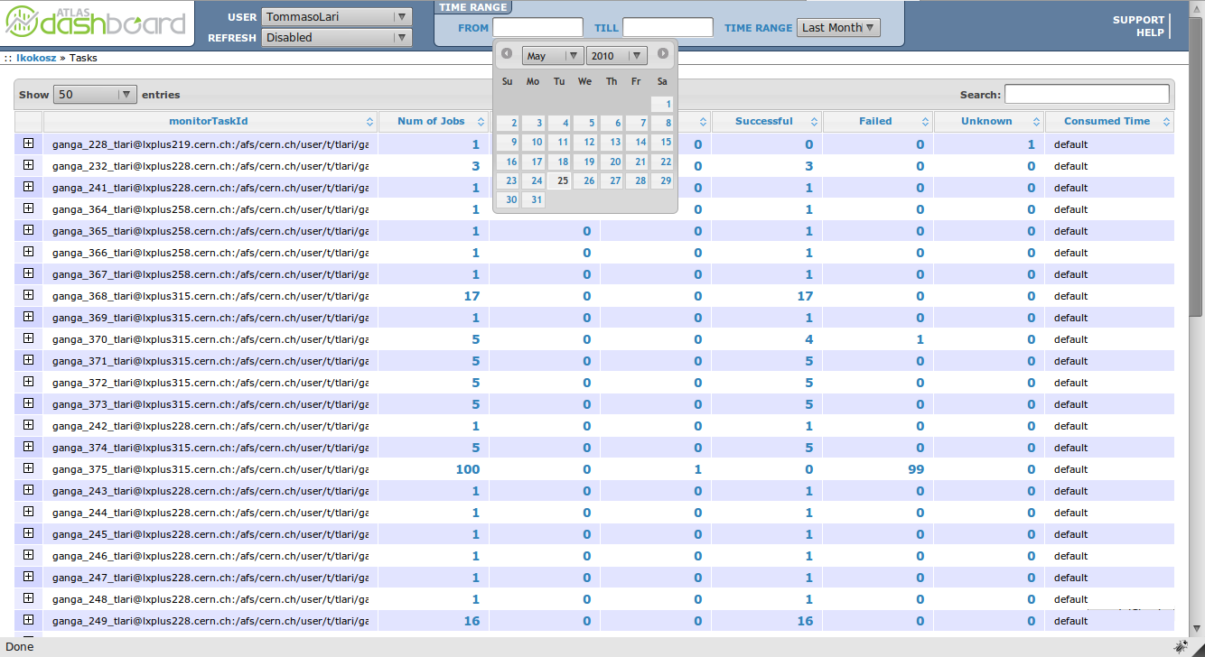
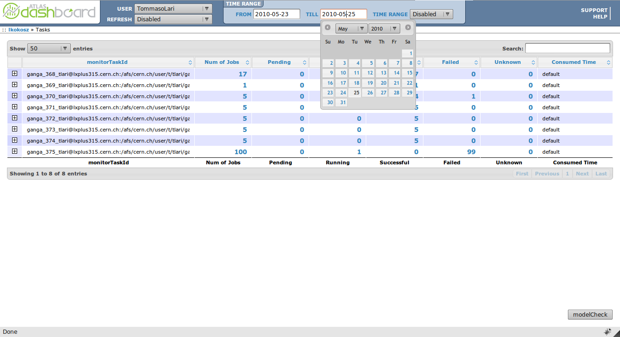
Task monitoring (EnviroGRIDS effort)
Generic (all Ganga applications)
Integrated with MSG services
To be usable on side-by-side with other dashboard applications (CMS and ATLAS)
Basis of a Ganga GUI

Slide 11
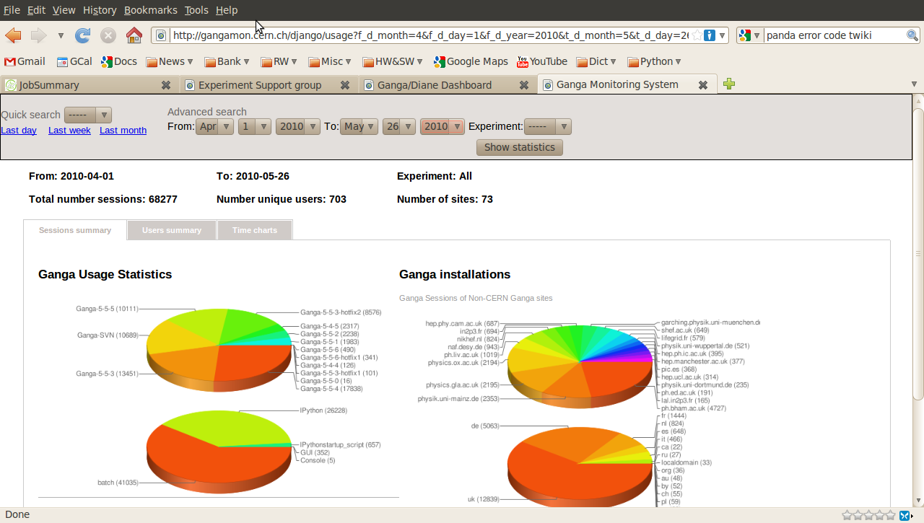
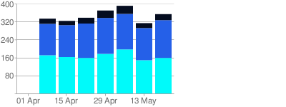
Monitoring Ganga
For many years we monitor Ganga usage ultimately to improve user support
  VO%Site%User%GangaVersion etc...
  Time evolution (all above quantities)
New version being put in place
Unique users per week

Slide 12
Tier3s
Next place to do analysis?
  Direct contribution in ATLAS
    Initiated by us
    Lot of contributions from the section (and group)
    Contacts with CMS (mainly in the US)
  Participating in more general events (with CMS): OSG all-hand meeting
  First-hand experience in (hot) technologies:
    Data management:Lustre/GPFS/xroot/CVMFS
    Data analysis: PROOF
    + virtualisation + more user support + site support (community building)
    All this (combined with the HammerCloud) allow “in-vivo” measurements/comparisons of data management technologies with real applications
Checkpoint in April
    https://twiki.cern.ch/twiki/bin/view/Atlas/AtlasTier3
End of the ATLAS working groups: early June

Slide 13
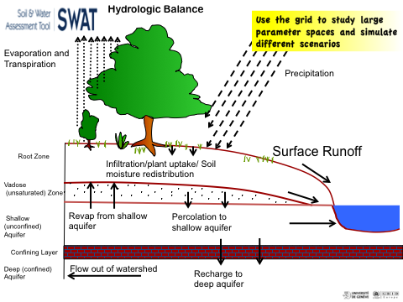
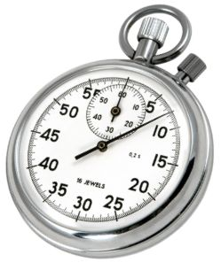
EnviroGRIDS
Main task: gridify SWAT (Soil and Water Assessment Tool).
SWAT is a river basin, or watershed, scale model: Impact of land management practices on water, sediment and agricultural chemical yields in large complex watersheds with varying soils, land use and management conditions over long periods of time
Port to the Grid + parallel execution
  Ganga
    Isolation layer
  DIANE:
    Automatic error recovery and low latency
Sub-basin based parallelization
  Great benefit, still to be fully demonstrated (on small basins, normal SWAT run: 249.s, model split run: 72.5s (hence dominated by Grid scheduling etc...)
Parameter sweeping:
  Immediate benefit. On relatively small tests: original model: 2835 s on can go down by a factor of 10 (splitting time!) and the actual execution accounts for << 1 min
Notes:
Key application, main tool
13

Slide 14
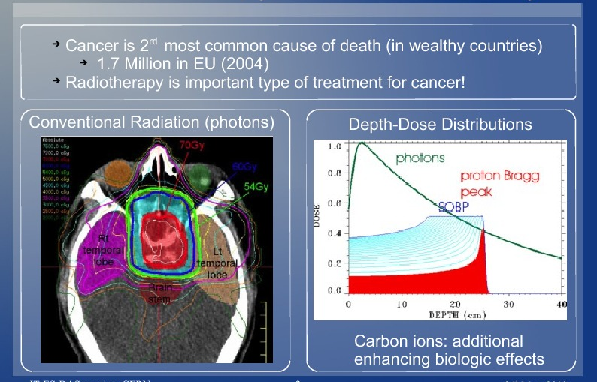
Hadrotherapy (Cancer treatment)

Slide 15

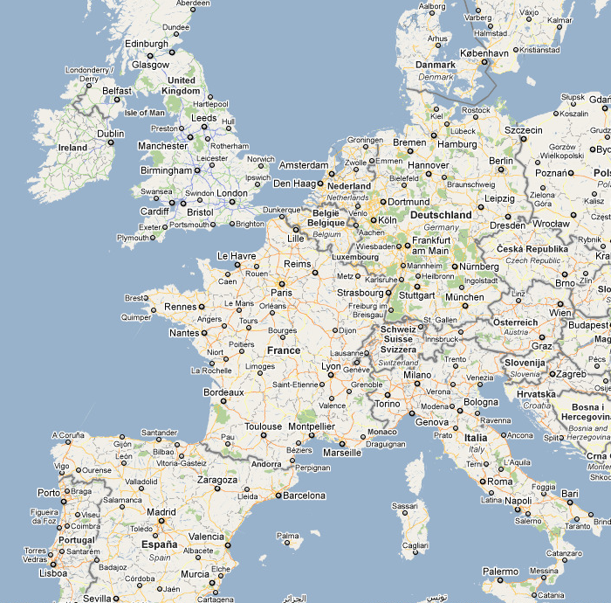
PARTNER
Users, Data
distributed across Europe
from multiple disciplines
Connect hadron-therapy centres in Europe
Share data for clinical treatment and research
with specific terminologes
with different ethical and legal requirements
ICT
...and requirements:
HIT
(Heidelberg)
MedAustron
(Wiener Neustadt)
resource discovery and matching
ETOILE
(Lyon)
secure data access
data integration
CNAO
(Pavia)
  Syntactic and semantic interoperability
Notes:
Efficacy needs to be proven
One of the few treatment centres alone cannot accumulate sufficient amount of data in short time...
Therefore
Bridge the “geographical Gap” between centres distributed across Europe
BUT:
No software platform connecting people, information and research across the hadron therapy community in Europe.
No standards and best practises
15

Slide 16
PARTNER recent activities
Review of medical databases
Grid technology review
  Semantic Web technologies for data integration
  Grid data access, security and Grid services
  Review of data protection requirements ... in progress
Storyline for
  Scientific use case: rare-tumor database
  Clinical use case: patient referral ... in progress
Contacts with data owners
  ECRIC – cancer registry ... sample dataset expected soon
  Hospitals (Oxford, Cambridge, Valencia) … to learn about data flow and security requirements

Slide 17
“CERN TH”
Lattice QCD (2008/9) running on TeraGrid
  Hand over to Lousiana State Univ.
  Grid/SuperComputers “interoperability”
Data management solution for CERN/TH users
  using xrootd proxy service enables to efficiently stream large files (10-20GB) to and from Castor at CERN
  Clients are run in several supercomputing sites in Europe
    Users are happy, report being prepared
    Ongoing discussion with DSS on the follow-up and further support
“New” communities
  2 pilot users from CERN TH
  Example of Ganga provided to one user (C++ application)
  Second user on hold (clarify real requirement)
  Less than 10 hours spent (in a month), including initial meetings. Report on our twiki to decide what to do next

Slide 18
Future possibilities
Gridimob
  FP7 project on mobility (road traffic). 10 partners (50% SME)
  Submitted on April 13th
  Very competitive call
    Hope to get 1 FTE (Fellow)

